Slide 1
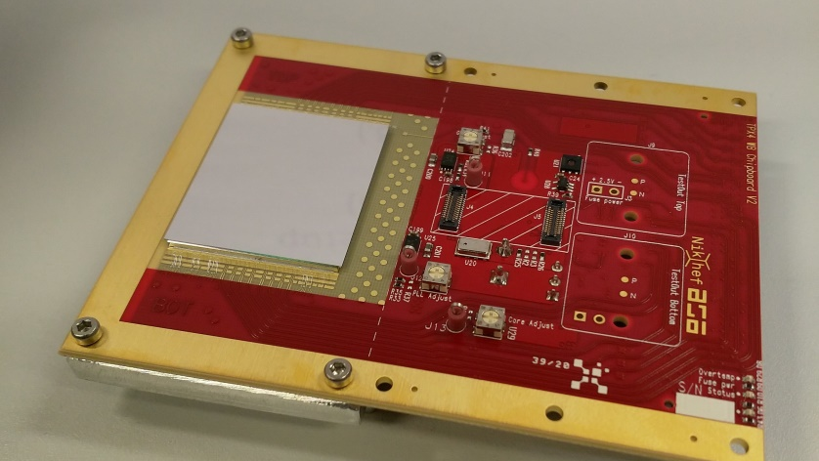
Faster, smaller, more and better.
Future pixel detectors for particle tracking
Martin Fransen
Detector R&D group, Nikhef

Slide 2

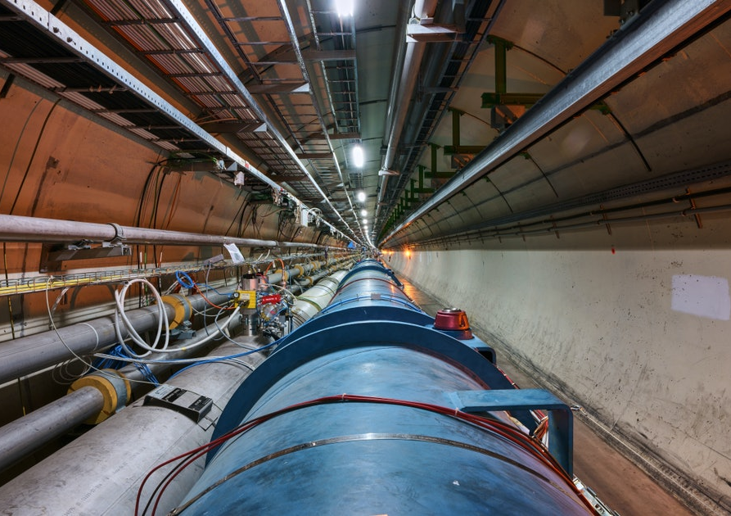
The LHC at CERN
Swiss/French border near Geneva.
Accelerating and colliding atomic nuclei (protons, lead ions).
Testing theories by detecting ‘debris’ from particle collisions.
Do ‘things’ happen
  with the energies we expect,
  with the particles we expect,
  as often as we expect,
  in the ratios we expect, and
  do we observe things that we don’t expect?
LHC 27 km circumference

Slide 3
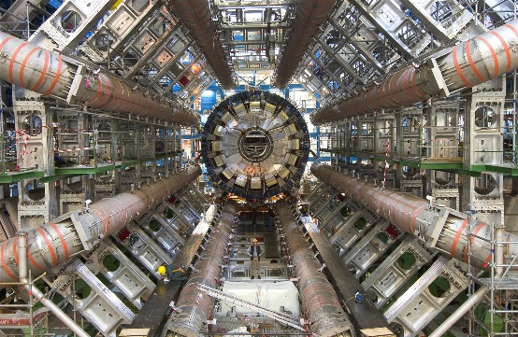
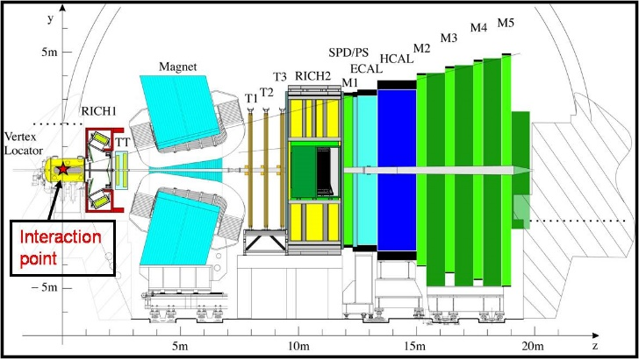

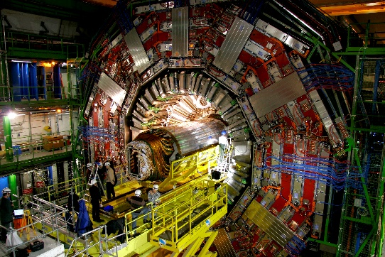
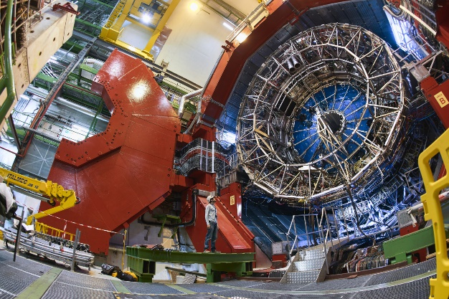
Detectors at the LHC
ATLAS
LHCb
CMS
ALICE

Slide 4
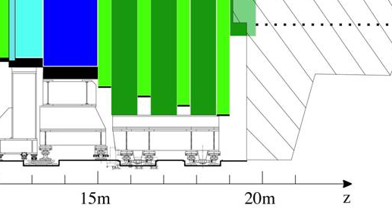



Detectors at the LHC
ATLAS
LHCb
CMS
ALICE

Slide 5
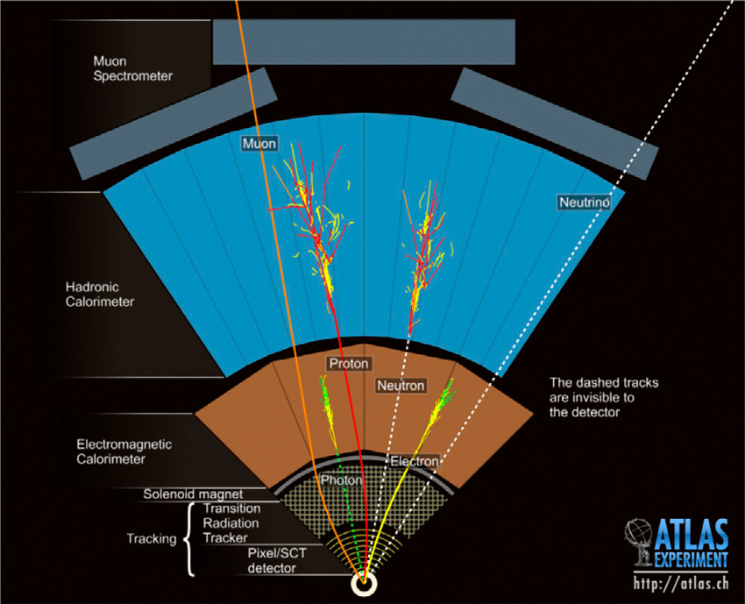
Detectors at the LHC
Enclosing a collision point, 10 to 20 m wide, 20 to 45 m long.
Mostly cylinder like, in layers that each perform a specific measurement.
Every 25 ns two bunches of particles collide. → 40 million ‘frames’ per second.

Slide 6
Detectors at the LHC
Particle tracking:
Find the origin of particles.
Minimise scattering and ‘Showering’.
Energy/momentum:
Calorimeter (absorbing all energy)
Muon spectrometer (deflection)
Identify particles by:
Direction of deflection (polarity)
Momentum, velocity, energy

Slide 7
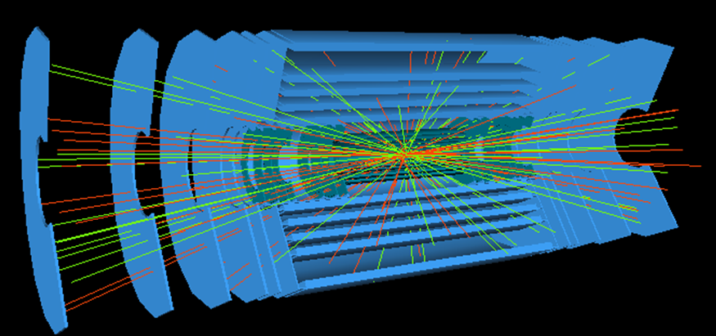
Particle tracking
Inner layers of detectors at the LHC
Silicon sensors register the spot where a charged particle went through.
Track reconstruction: connecting the dots…

Slide 8
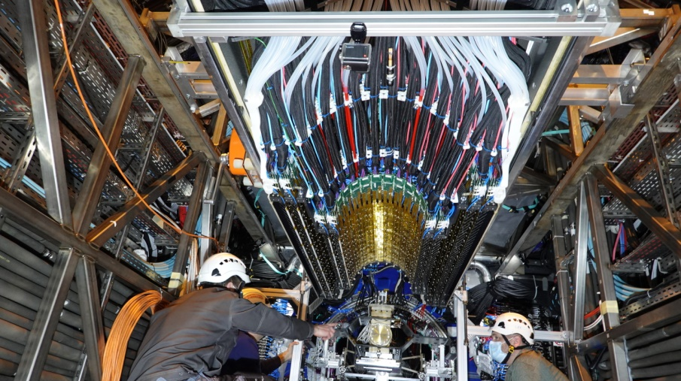
New 13 billion pixel tracker ALICE
(Yes, that is sort of a 13000 Mpix camera doing 40 million fps)
https://home.cern/news/news/experiments/ls2-report-upgraded-inner-tracking-system-joins-alice-detector

Slide 9
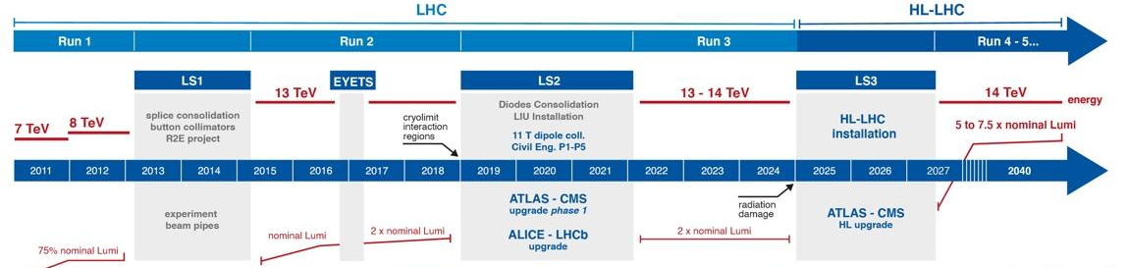
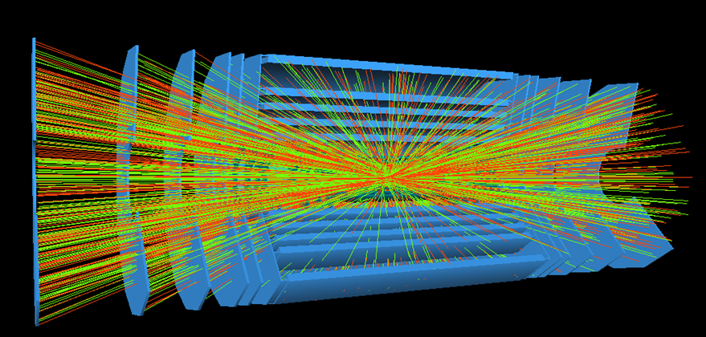
LHC timeline: Higher event rates
Need more data for better precision and to improve sensitivity for rare phenomena
https://hilumilhc.web.cern.ch/sites/default/files/HL-LHC_Janvier2022.pdf

Slide 10
Timing for track reconstruction
Current developments put a lot of effort in time measurement.
Need to know down to about 20 ps when something happened

Slide 11
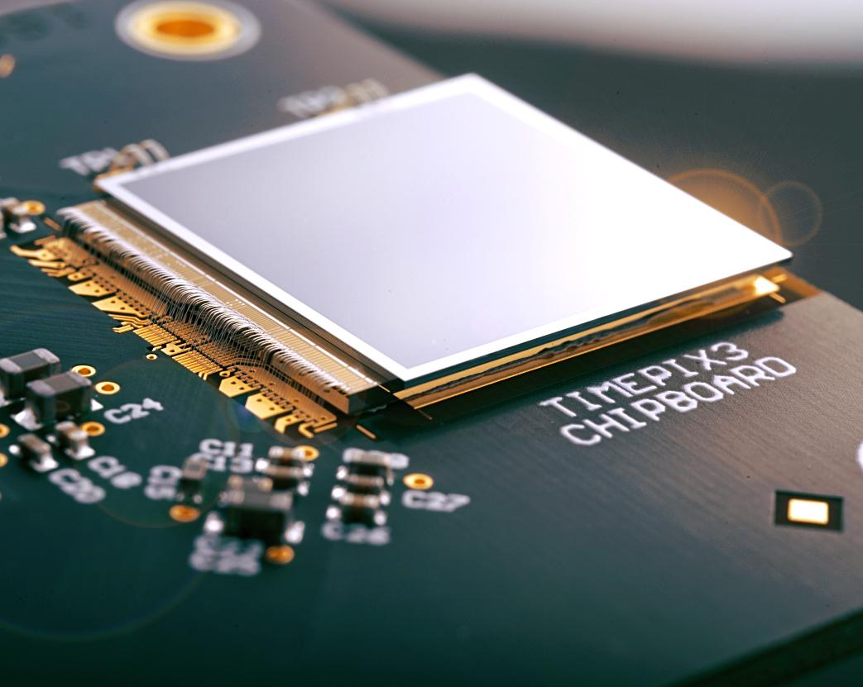
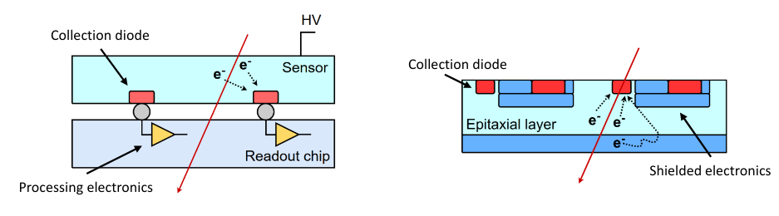
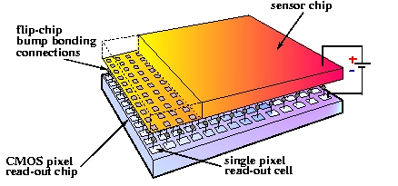
Pixel chips for particle tracking
Chip with (smart) pixels to read out sensor.
  Hybrid
    Flexible: ‘independent’ development of readout ASIC and sensor
    Bulky and expensive
  Monolithic
    Light/thin, cheap (or least expensive)
    Less flexible in sensor and readout ASIC development
Sketch of cross section
hybrid
monolithic

Slide 12
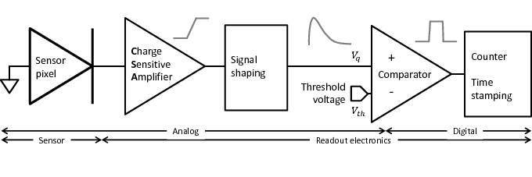
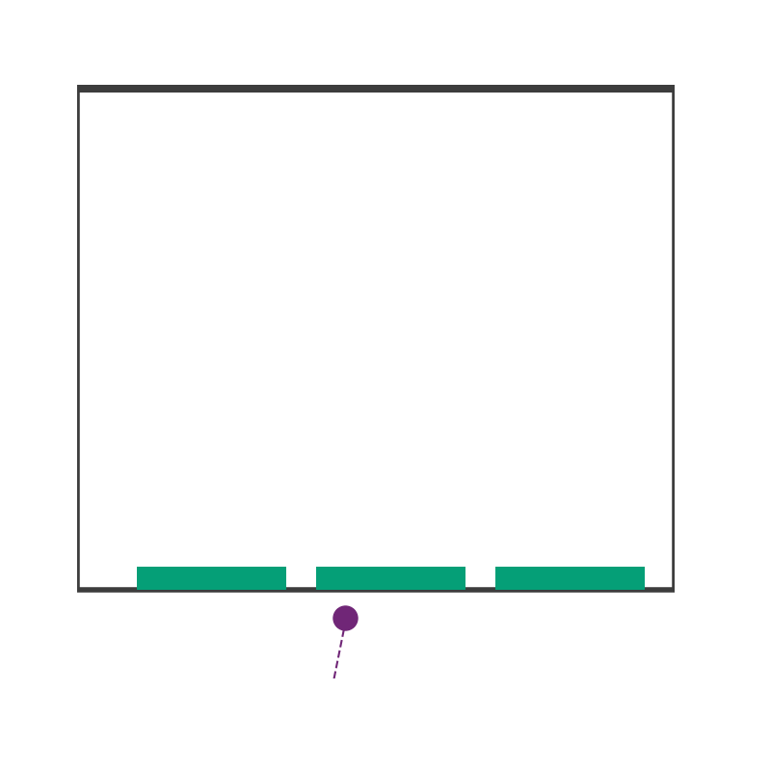
The signal starts in the sensor
Charge liberation by ionising particle.
Particle energy loss statistical process.
→ Variations in liberated charge.
Animations courtesy of Robbert Geertsema

Slide 13
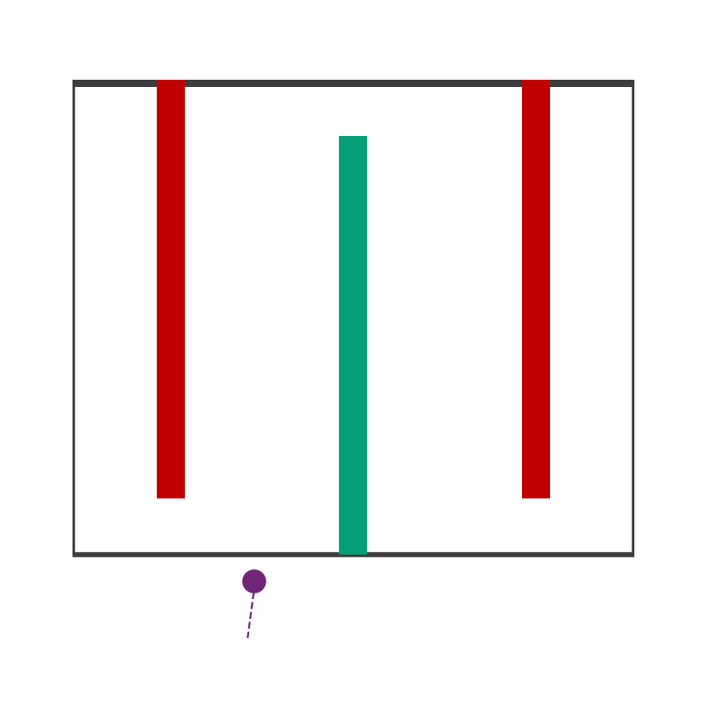
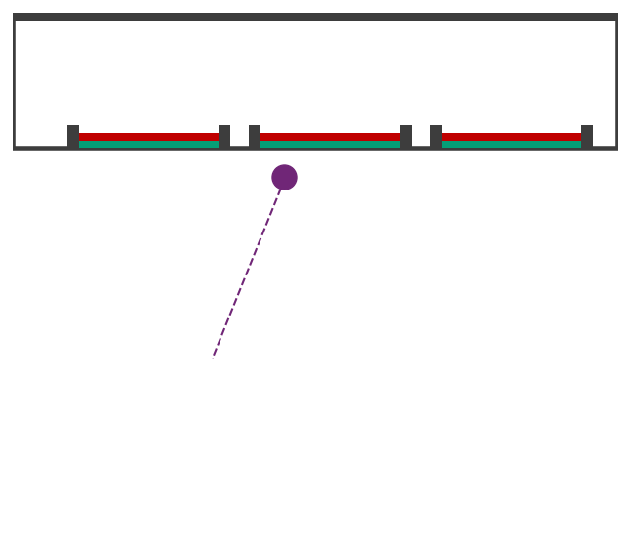
Improving signals from a sensor
Conventional planar.
Low gain avalanche.
Thin sensor for fast readout
Gain to amplify signal
3D sensor.
Short drift distance for fast readout
Signal strength proportional to sensor thickness
Animations courtesy of Robbert Geertsema

Slide 14
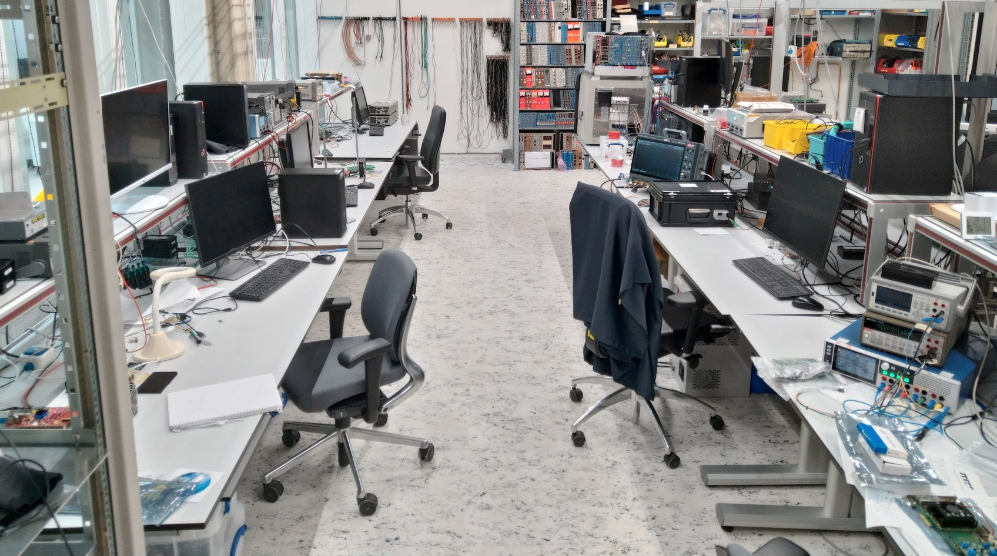
Set-ups @ R&D group for timing and efficiency
Faraday cage and 90Sr β source
55Fe γ source
Electronic pulse generators, powering, ‘chip tuning’

Slide 15
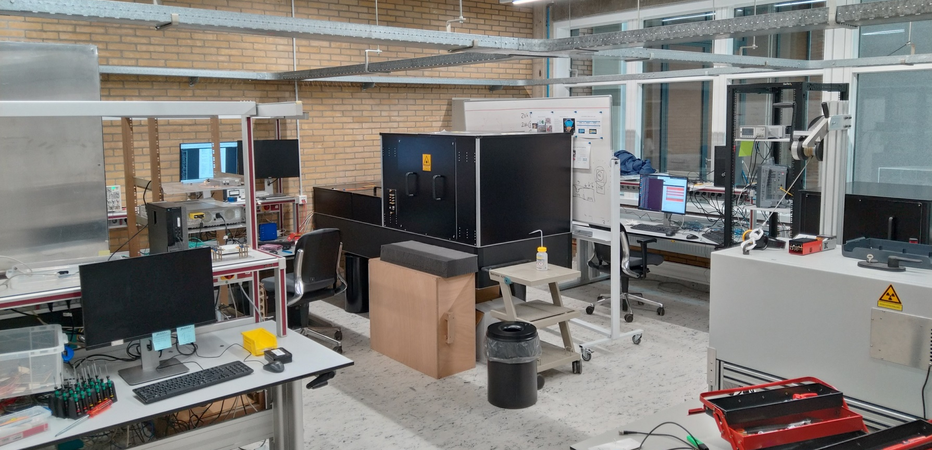
Set-ups @ R&D group for timing and efficiency
Generic pulsed lasers
fs two photon absorption laser
Ps pulsed laser
X-ray set-up

Slide 16
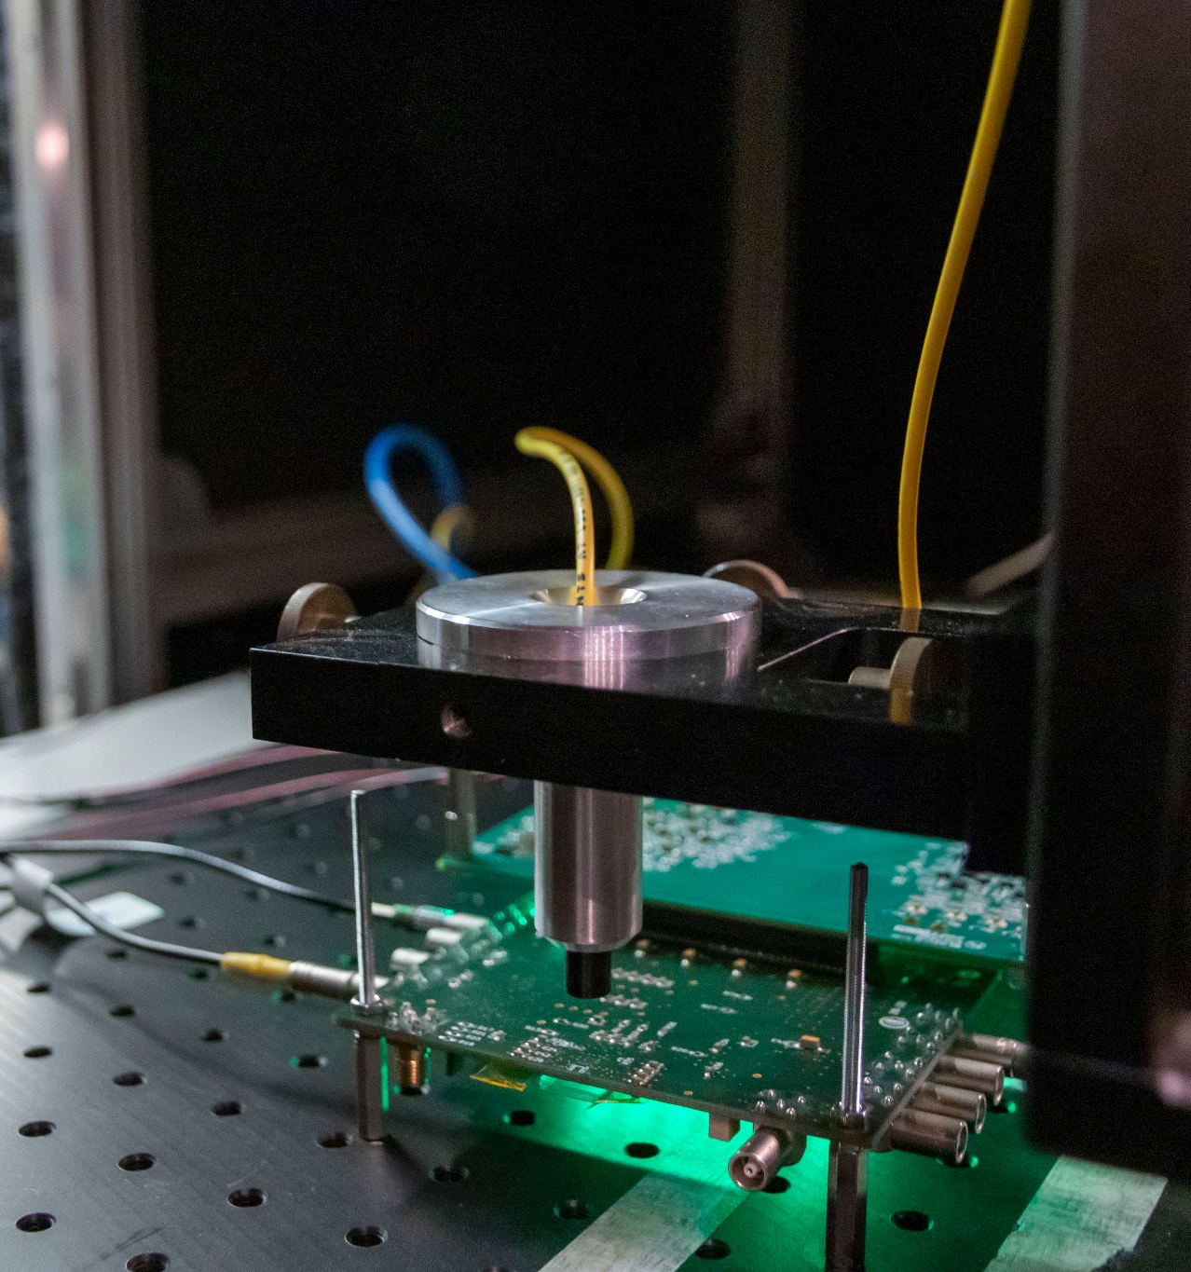
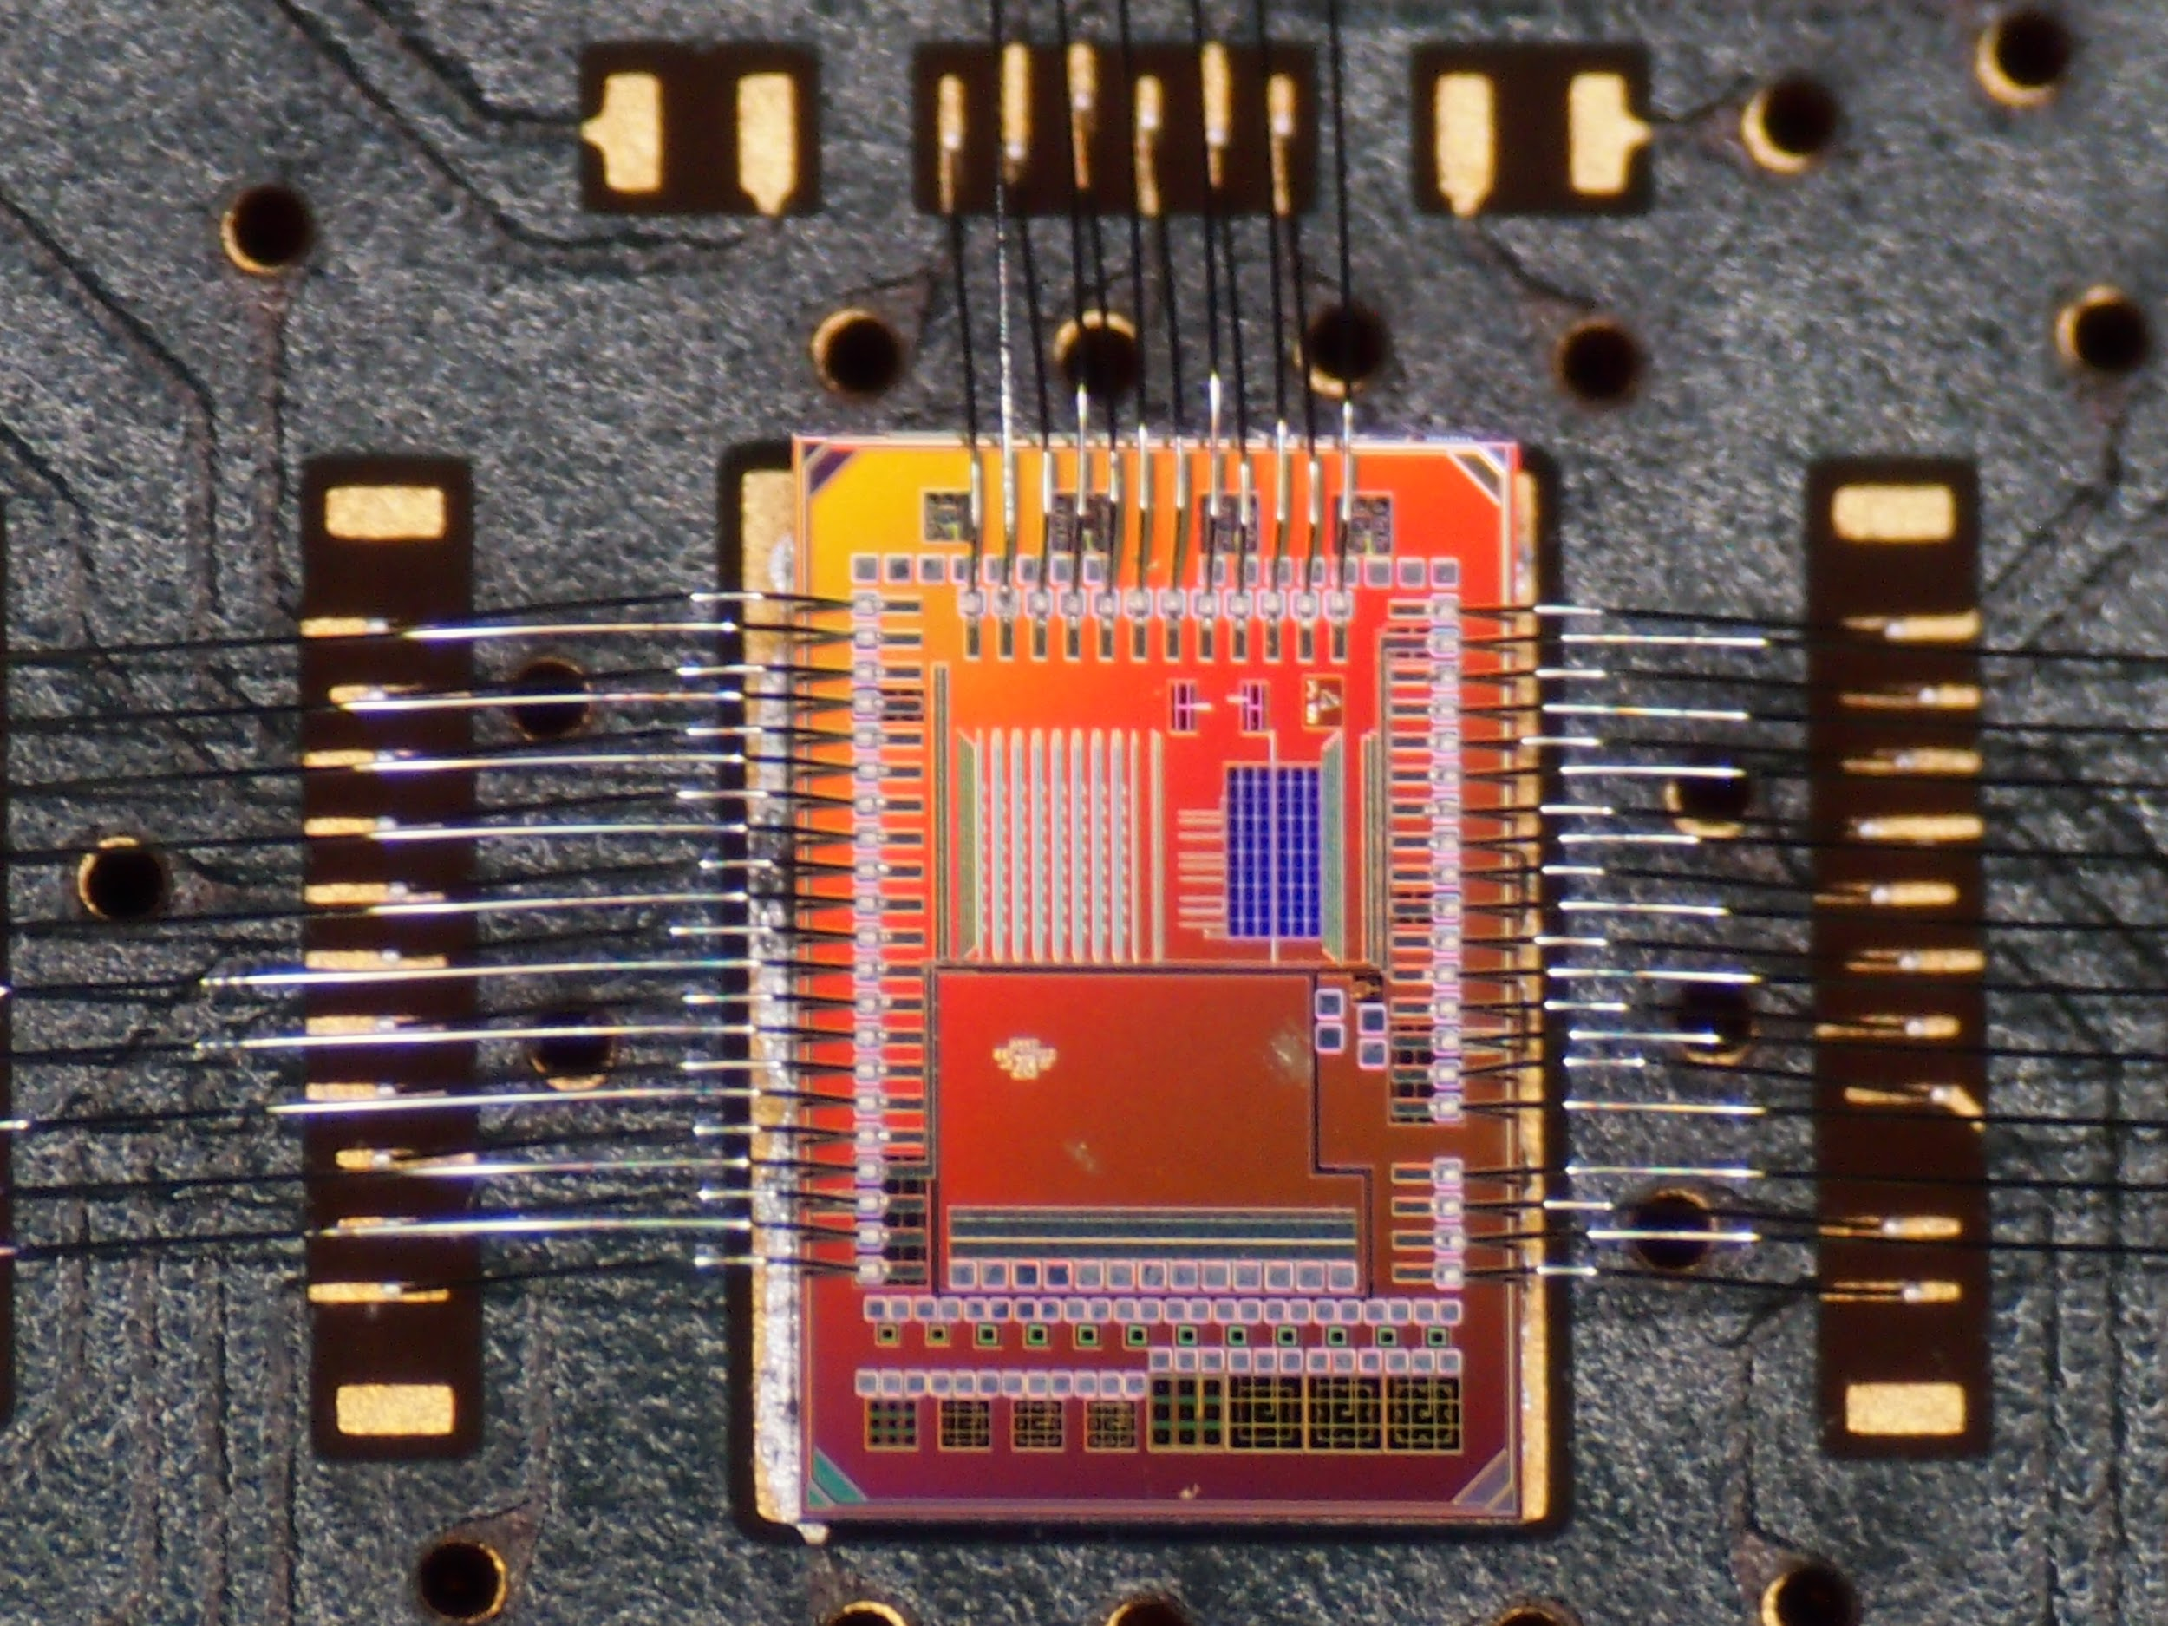
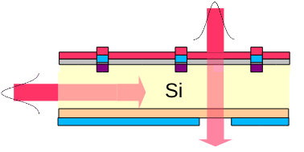
Testing with laser pulses at Nikhef I
Creating a signal in the sensor using a laser
Allows for sub pixel precision sensitivity scans
Infrared 1060nm = 1.17 eV
Penetrates deep into sensor
1 photon = 1 eh pair

Slide 17
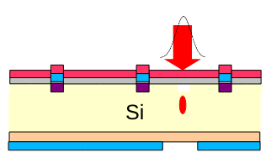
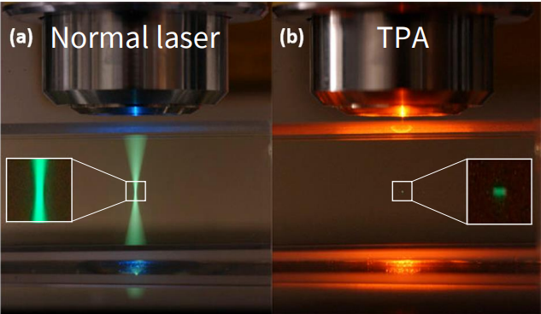
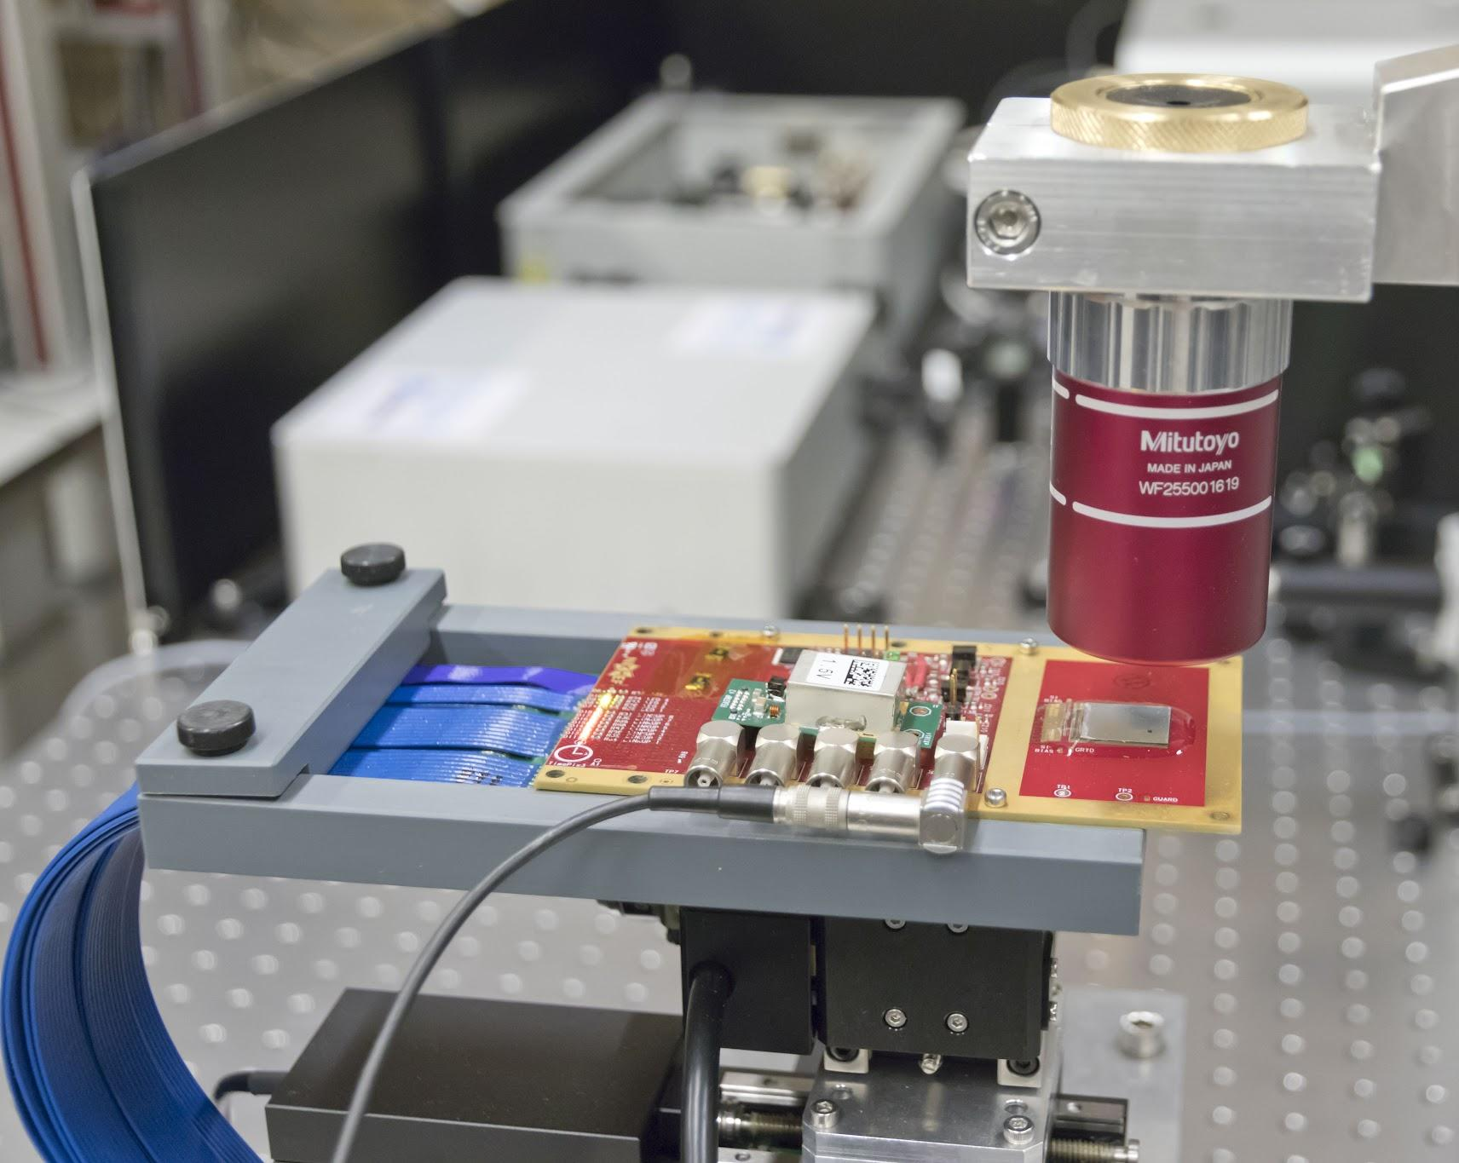
Testing with laser pulses at Nikhef II
3D scanning. Resolution: about 1 µm X,Y, few µm in Z.
1550 nm = 0.8 eV: smaller than silicon band gap!
→ 2 photons = 1 electron-hole pair
380 fs – 5.5 nJ – 1 µm wide spot
fast – powerful – precise
Picture by Marco Kraan

