Slide 1
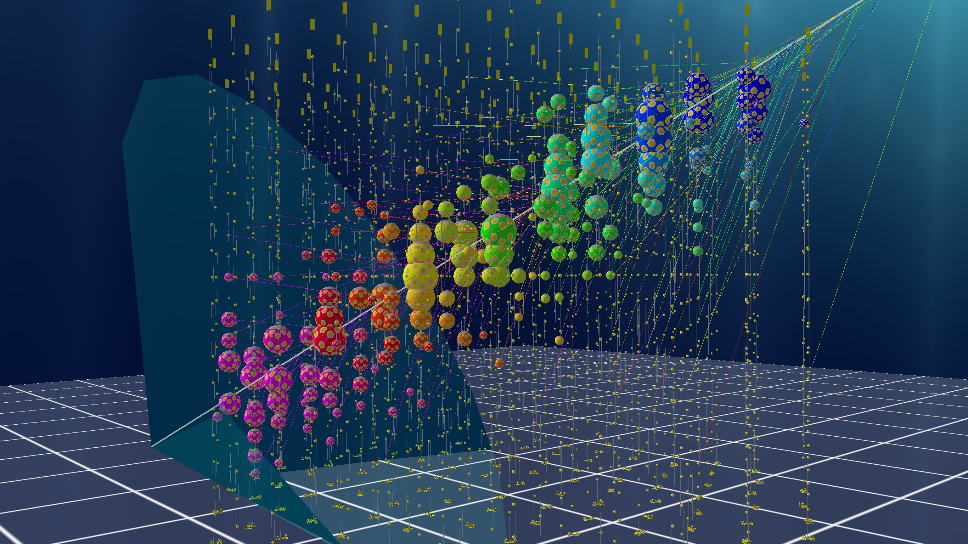
KM3NeT
The Cubic Kilometre Neutrino Telescope
Anna Hurhina
[7]

Slide 2
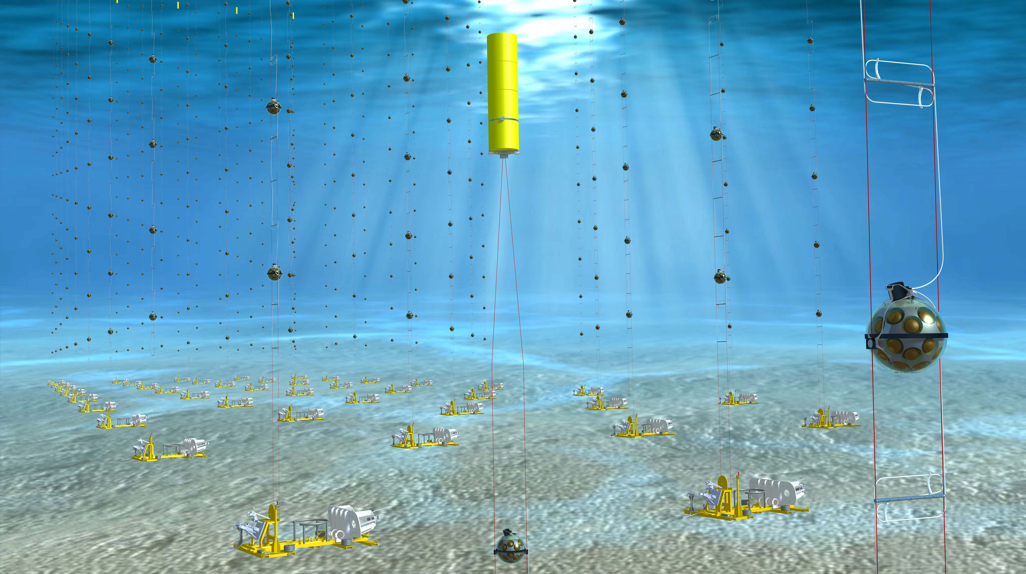
Introduction
Cubic Kilometre Neutrino Telescope:
Water Chereknov detector.
Detects products of neutrino – water interactions.
At the bottom of the Mediterranean Sea.
Several km³ of instrumented volume.
[7]

Slide 3
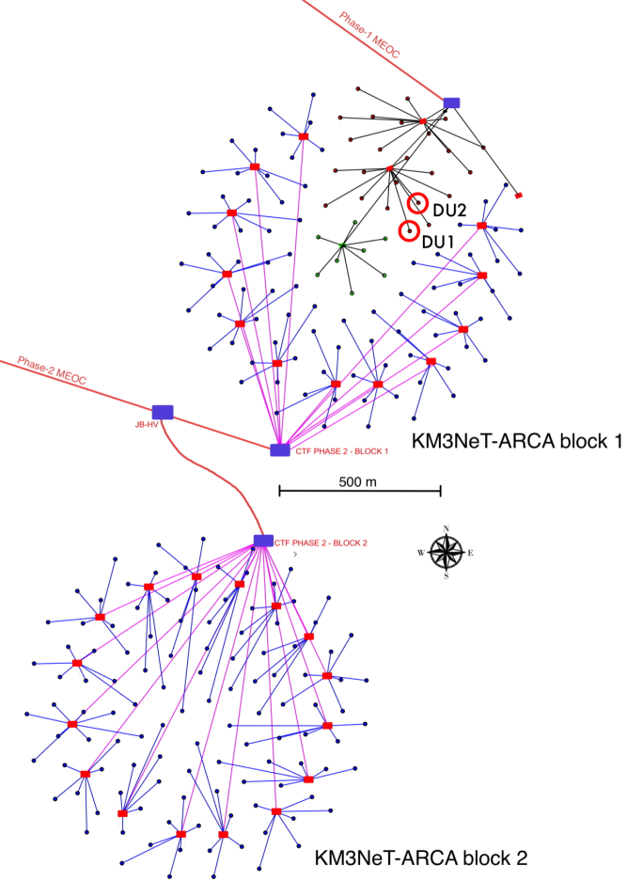
ARCA
Astroparticle Research with Cosmics in the Abyss:
Study high-energy neutrino sources in the Universe.
2 building blocks.
At 3500 m depth, 100 km offshore Italy.
Horizontal spacing 95 m.
TeV neutrino energies.
[1]
[1] [2]
[1]

Slide 4
ORCA
Oscillation Research with Cosmics in the Abyss:
Study of neutrino flavour oscillations and the neutrinos mass hierarchy.
At 2450 m depth, 40 km offshore France.
1 building block.
Horizontal spacing 20 m.
GeV neutrino energies.
[1]
[1] [2]
[1]

Slide 5
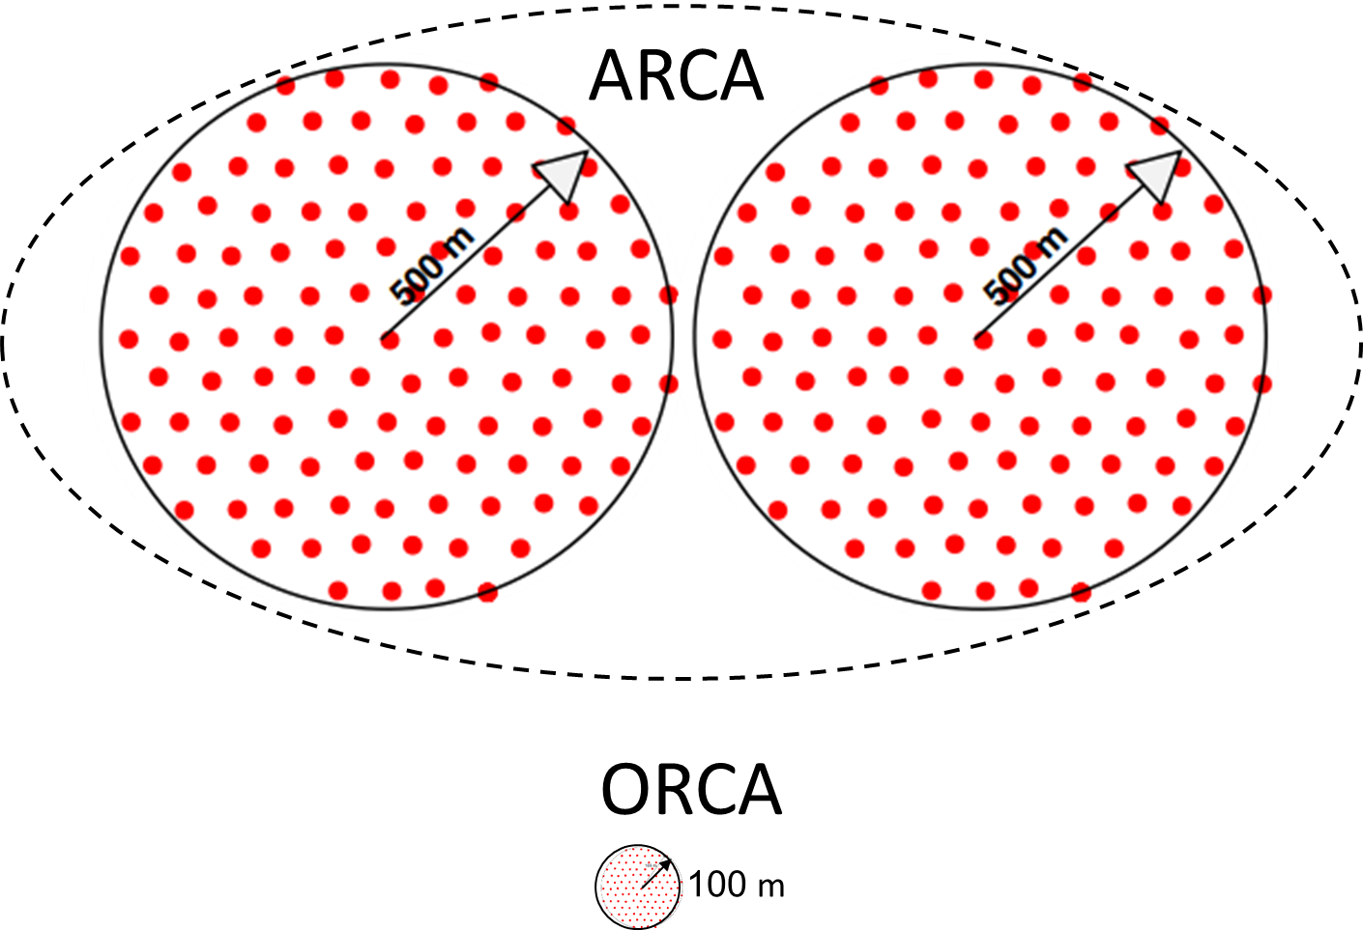
[7]

Slide 6
Detection String
Each block has 115 strings.
Each string has 18 digital optical modules (DOMs).
ARCA: spread out configuration; height: 700 m with DOMs vertical spacing 36 m.
ORCA: dense configuration; height: 200 m with DOMs vertical spacing 9 m.
Cables for power and data transmission.
Float at the top.
Calibration equipment in the base.
[1] [2]
[7]

Slide 7
[7]
[7]

Slide 8
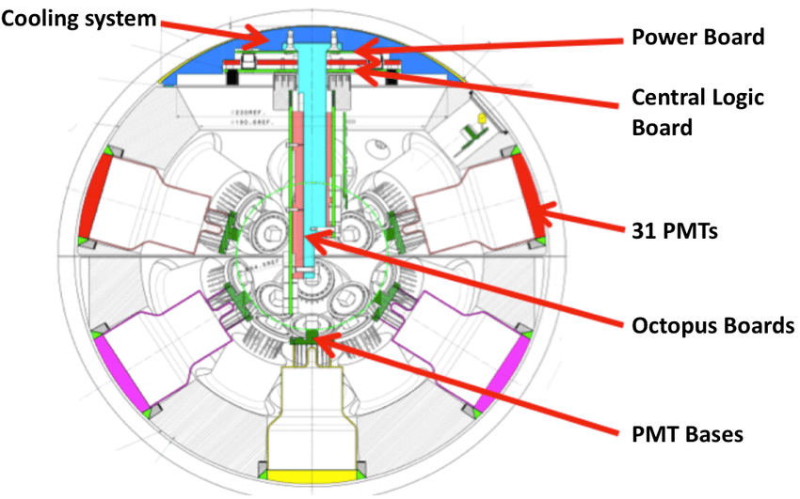
The DOM
44 cm in diameter.
Pressure-resistant glass sphere.
31 PMTs.
Optical gel to fill all cavities.
Calibration sensors: LED nano beacon, compass, tilt-meter and acoustic sensor.
[7]
[1] [2] [5]
[8]

Slide 9
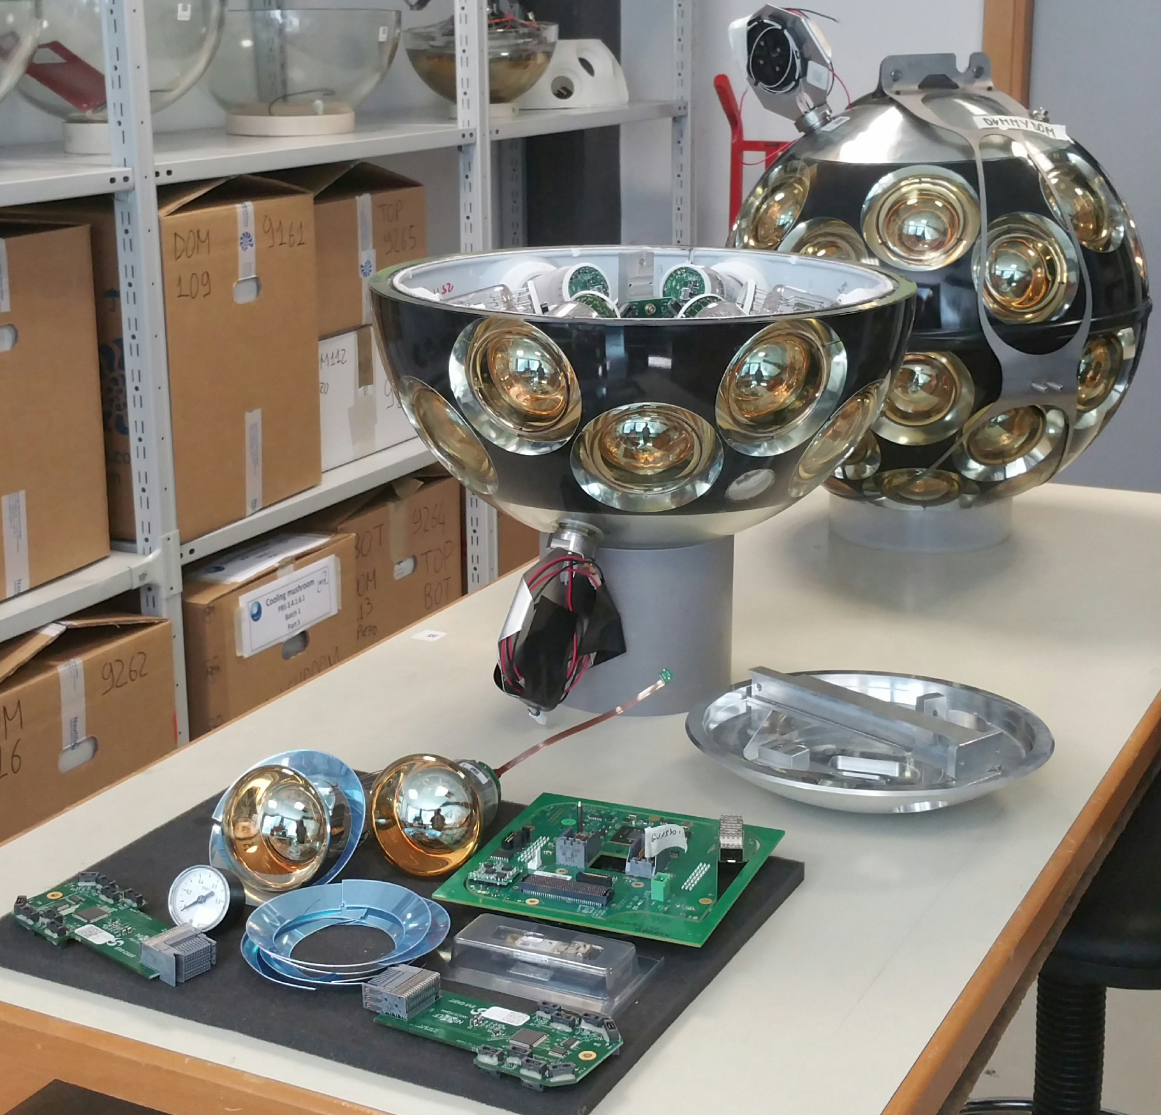
[7]
[7]
[7]

Slide 10
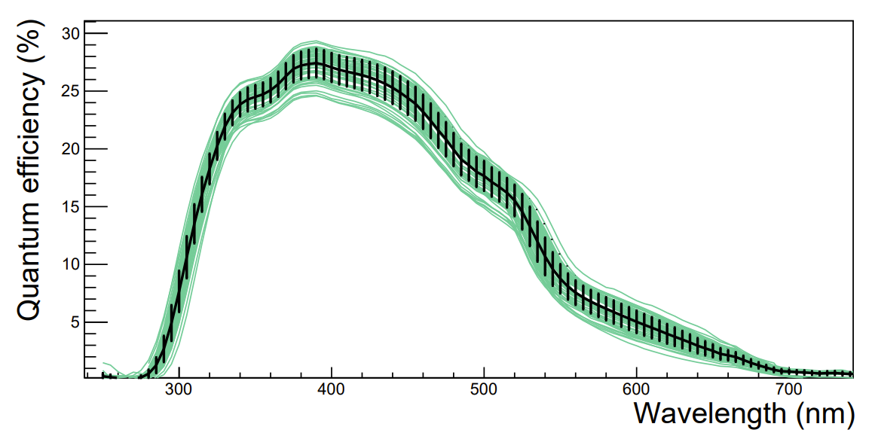
PMT Characteristics
Minimum gain 10⁶.
Photocathode diameter 72 mm + reflector ring.
Length 122 mm.
Small dark count rate.
High quantum efficiency.
Time resolution <5 ns.
Individual HV base with integrated amplification and tuneable signal discrimination.
[5]
[1] [3] [4]
[3]

Slide 11
Interactions
Charged current events:
$ν_{e}+N →e+X$ EM + hadronic shower
$ν_{μ}+N →μ+X$ Muon track + hadronic shower
$ν_{τ}+N →τ+X$ Hadronic shower + 2nd decay signature
$τ→ν_{τ}{\overline{ν}}_{μ}μ$ / $τ→ν_{τ}{\overline{ν}}_{e}e$ / $τ→ν_{τ}$+ hadrons
Neutral current:
$ν+N →ν+X$ Hadronic shower
Scattering:
${\overline{ν}}_{e}+e→{\overline{ν}}_{e}+e$ EM shower
[2]
[2]

Slide 12
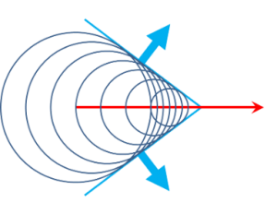
Cherenkov Radiation
Emission angle of Cherenkov radiation:
$$\cos\left(θ\right)= \frac{1}{nβ}$$
β is the ratio of particle speed over the speed of light in vacuum.
Frequency spectrum of Cherenkov radiation given by Frank-Tamm equation:
$$\frac{d^{2}E}{dxdω}= \frac{q^{2}μ\left(ω\right)ω}{4π}\left(1−\frac{1}{β^{2}n^{2}(ω)}\right)$$
Amount of energy E emitted from Cherenkov radiation, per unit length travelled x and per frequency ω. μ(ω) is permeability and n(ω) is frequency dependent index of refraction.
[6]

Slide 13
Event
Measurement: time of arrival and TOT.
Each PMT – individual time-to-digital converter.
Each measurement: 6 B from PMT + position and orientation from calibration equipment.
Information sent to shore: 1B for PMT address, 4B for time and 1B for TOT.
[1]
[7]

Slide 14
Track
Good direction measurment, not good energy measurement.
Cascade
Good energy measurment, bad direction measurement.
[7]

Slide 15
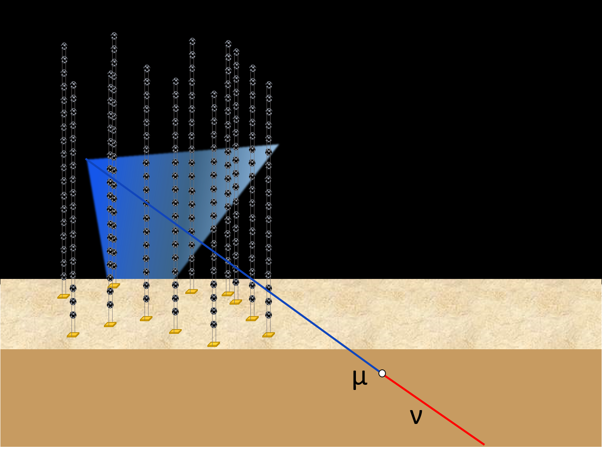
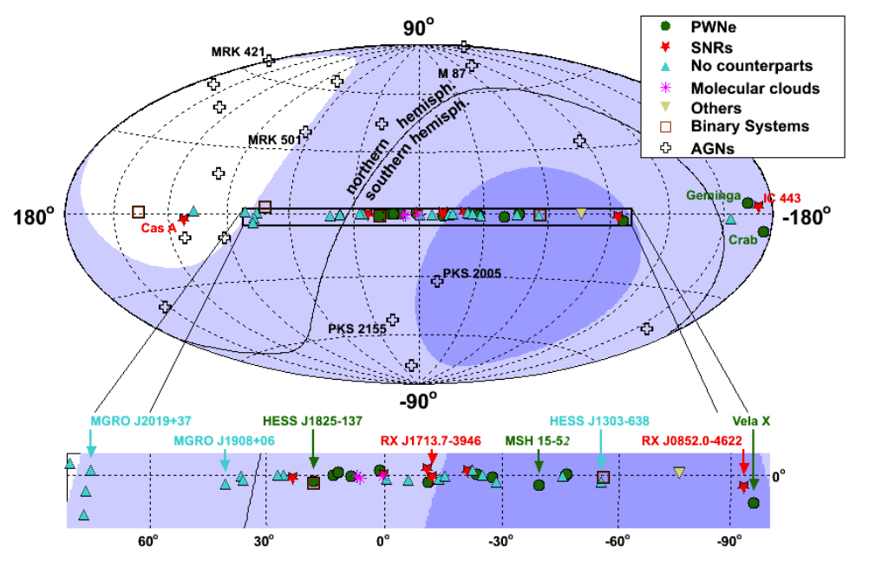
Background
⁴⁰K β-decay.
Bioluminescence.
Atmospheric muons and neutrinos.
[1] [2]
[7]
[2]

Slide 16
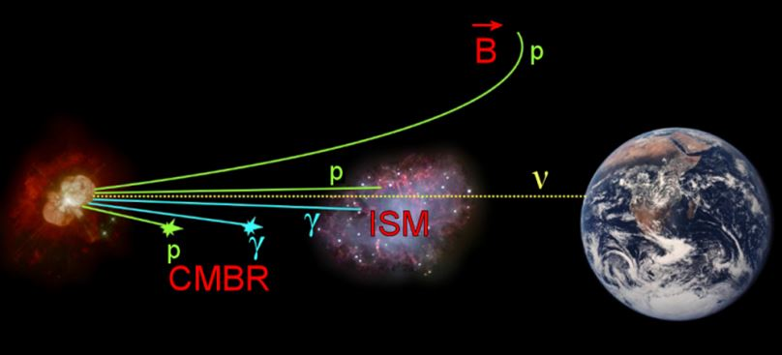
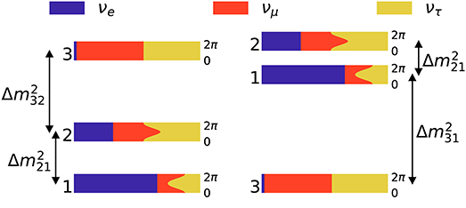
The Science
Point-like neutrino sources.
Diffuse galactic neutrino flux.
Multi-messenger astronomy.
[1] [2]
Neutrino flavour states oscillations.
Order of neutrino mass states.
[1] [2]

Slide 17
Exotic Science
SUSY Neutralinos (neutrinos flux)
Magnetic monopoles (Cherenkov radiation)
Nuclearites – strange quark stable matter from cosmic rays (black-body radiation)
Violation of Lorentz Invariance (unexpected interference in neutrino oscillation patters)
[1] [2]

Slide 18
References
[1] Adrian-Martinez, S., Ageron, M., Aharonian, F., Aiello, S., Albert, A., Ameli, F., Anassontzis, E., Andre, M., Androulakis, G., Anghinolfi, M. and Anton, G., 2016. Letter of intent for KM3NeT 2.0. Journal of Physics G: Nuclear and Particle Physics, 43(8), p.084001.
[2] KM3NeT collaboration. Conceptual design report. 2008. https://www.km3net.org/wp-content/uploads/2015/07/CDR-KM3NeT.pdf.
[3] Aiello, S., Akrame, S.E., Ameli, F., Anassontzis, E.G., Andre, M., Androulakis, G., Anghinolfi, M., Anton, G., Ardid, M., Aublin, J. and Avgitas, T., 2018. Characterisation of the Hamamatsu photomultipliers for the KM3NeT Neutrino Telescope. Journal of Instrumentation, 13(05), p.P05035.
[4] Simonelli, A., Mollo, C.M., Migliozzi, P. and KM3NeT collaboration, 2023, February. Characterisation of an improved 3” Hamamatsu photomultiplier for the KM3NeT Neutrino Telescope. In Journal of Physics: Conference Series (Vol. 2429, No. 1, p. 012031). IOP Publishing.
[5] KM3NeT Collaboration, 2022. The KM3NeT multi-PMT optical module. arXiv preprint arXiv:2203.10048.
[6] Fülöp, L. and Biró, T., 1992. Cherenkov radiation spectrum. International journal of theoretical physics, 31, pp.61-74.
[7] Credits KM3NeT (as per their official copyright policy for their media files)
[8] Biagi, S., 2015. The data acquisition system of the KM3NeT detector. PoS (ICRC2015), 1172.

Slide 19
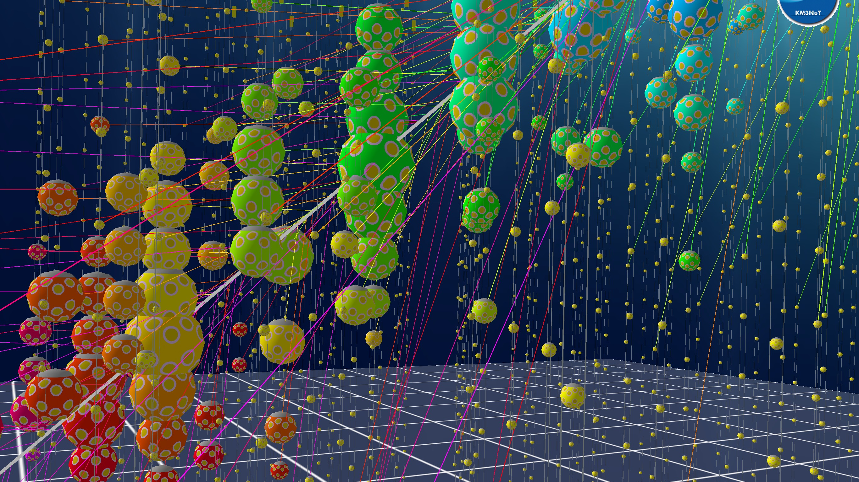
Thank you for attention!

