Slide 1
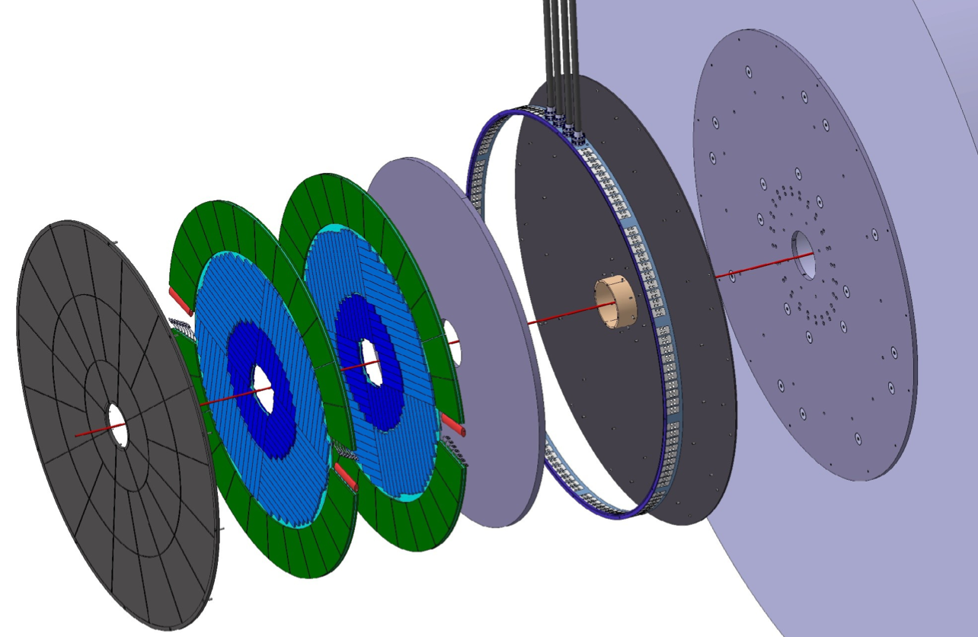
The ATLAS High-Granularity Timing Detector
for ATLAS Phase-II Upgrade
Jay Lyu
Particle Detection Presentation
20th March 2024

Slide 2
Motivation
ATLAS: General-purpose detector in LHC
High-Luminosity LHC (HL-LHC):
Will start operation in 2026
More collisions to study new phenomena
Greater precision
Integrated luminosity increases by a factor of 10
But: Large increase of pileup interaction!
To mitigate pileup effects: High-Granularity Timing Detector (HGTD) —> distinguish collisions occurring close in space but well-separated in time.
Notes:
The most difficult challenge of this program is the the large increase of the pileup interaction.

Slide 3
Overview
In the forward region, between the Inner Tracker and the End Cap of Calorimeter
Covers from |η| = 2.4 to |η| = 4
Complement the capabilities of ITk
Improve the performances in forward region of ATLAS, e.g. jets and leptons reconstruction
Region very important for the study of the vector boson fusion
Aim at average $σ_{t}$ ~ 30ps per track at the start, 50ps per track at the end
As counting detector for luminosity measurements
Notes:
It provides an average target time resolution of 30 ps per minimum-ionising particle in the forward region, although at the end of HL-LHC operation, increase to 50ps.

Slide 4
Detector Design
Small Elements

Slide 5
Detector Design
Key components: Hybrid module!
Two main parts:
the sensor - Low-Gain Avalanche Detector (LGAD)
the electronics - Application-Specific Integrated Circuit (ASIC)
Notes:
2 dedicated read-out chips called ASIC

Slide 6
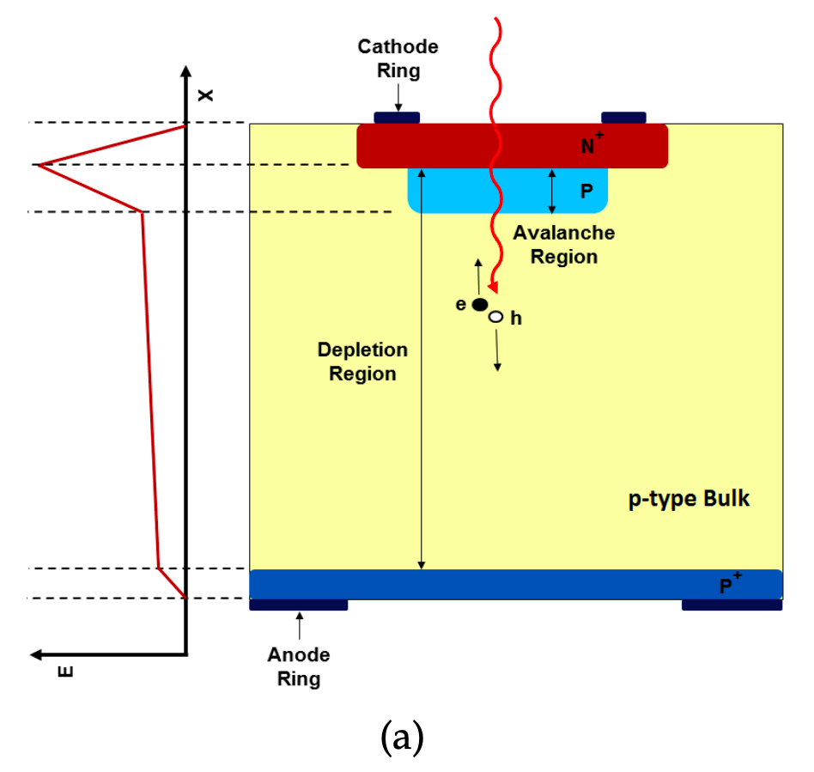
Detector Design - LGAD
Pixel (pad) size of 1.3 × 1.3 mm²
Key ingredient to get excellent time resolution: larger current further created by holes
n-on-p silicon hybrid pixel detectors with an internal gain ~10 to 50
An extra highly-doped p-layer (Boron B)!
Low noise amplification to improve the S/N
CERN-LHCC-2020-007; ATLAS-TDR-031, Geneva, 2020
Notes:
These LGAD sensors, or say the active detector elements, are made of silicon pixels in order to cope with the thickness constraints and the high radiation level. Needs to be replaced.
The detection is based on electro-hole pair production.
When electrons reach the amplification region, new e+e- pairs are created. The new holes drift towards the p+ region and generate a large current. This charge amplification is referred as the internal gain of the LGAD (about 10 to 50).
After amplification the height of the signal is proportional to the gain. And this current is larger than in a standard diode. So this is the key for the time resolution of energy deposited by Minimum Ionised Particles.

Slide 7
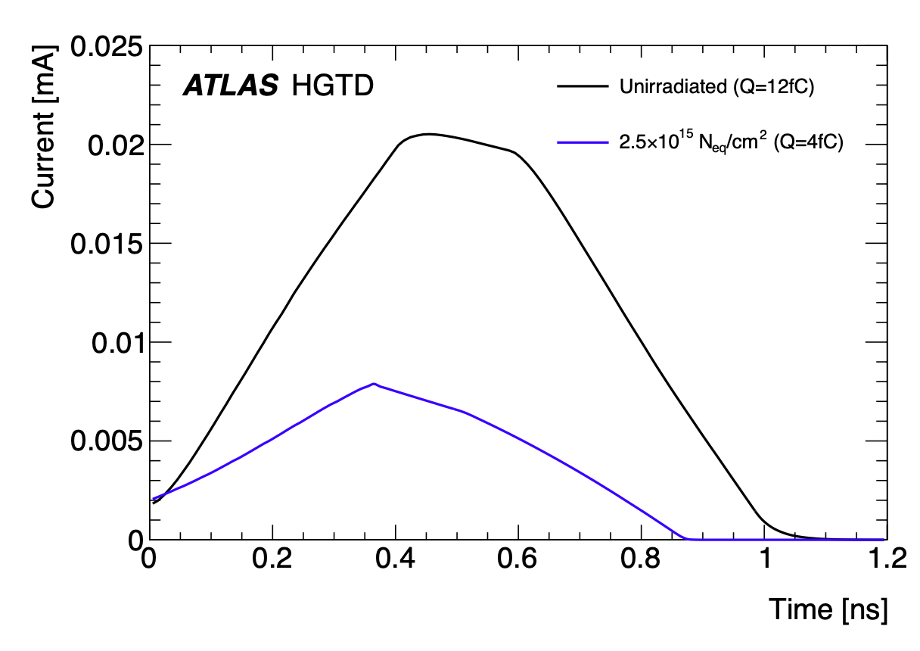
Detector Design - LGAD
LGAD signal
Key aspect: rise time $r_{rise}$:
convolution of signal duration and amplifier rise time
Large gain: $r_{rise}$~50ps, signal duration ~1ns
Smaller rise time if thinner & larger gain
If irradiation neutron fluence increases —> smaller charge and current, shorter signal duration
CERN-LHCC-2020-007; ATLAS-TDR-031, Geneva, 2020
Notes:
A key aspect is rise time. The LGAD rise time is the convolution of signal duration and amplifier rise time. For large gain, the rise time is about 500 ps and the signal duration is approximately 1 ns. It’s smaller for thinner pads and larger gain. When the irradiation neutron fluence increases, the charge is smaller and the rise time and the signal duration are shorter.

Slide 8
Detector Design - ALTIROC
Customised read-out ASIC chip: ALTIROC
Dedicated front-end electronics
The LGAD sensors will be read out by the ALTIROC
Excellent time resolution and radiation hard
In each module:
two ASICs Bump-bonded to sensor
—> 450 pads, 225 channels + common digital electronics in each ASIC
Notes:
Customised for this experiment it is called ALTIROC, to meet the requirements of time resolution and radiation hardness. It’s a dedicated front-end electronics. In each module, one LGAD sensor is bump-bonded to two dedicated read-out ASICs.

Slide 9
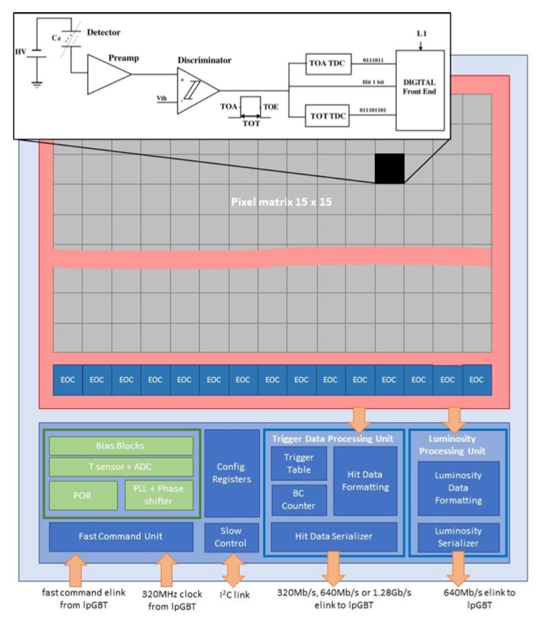
The two TDC provide digital hit data: time of arrival (TOA) and time over threshold (TOT)
Significantly reduced number of channel + an optimised front-end block
CERN-LHCC-2020-007; ATLAS-TDR-031, Geneva, 2020
Notes:
Compared to other ASICs for pixel detectors, the ALTIROC had significantly reduced number of channel, and a quite different Front End block optimised for time measurement

Slide 10
Detector Design - ALTIROC - Time resolution
$$σ_{t}^{2}=σ_{Landau}^{2}+σ_{clock}^{2}+σ_{elec}^{2}$$
where $σ_{elec}^{2}=σ_{TW}^{2}+σ_{Jitter}^{2}+σ_{TDC}^{2}$
$σ_{Landau}^{2}$ ~ 25ps
Landau fluctuations in the deposit energy of the traverse particles
Non-uniform
Caused by rare knock-on electrons
Greater for thinner sensor
Notes:
Causedby the rare occurrence of knock-on electrons which have enough energy to become ionising particles.
The fluctuation around the maximum of energy distribution becomes greater as the sensor becomes thinner.

Slide 11
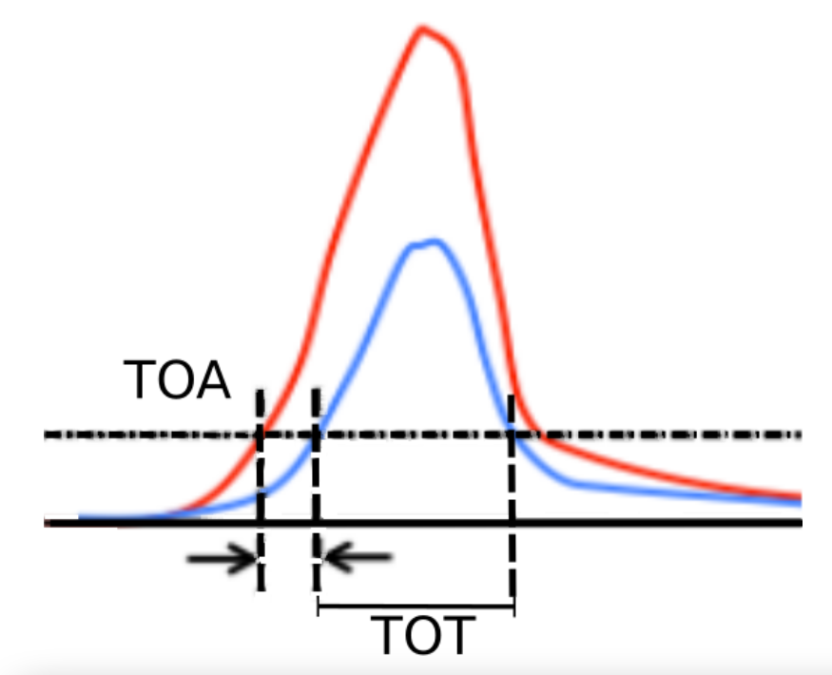
Detector Design - ALTIROC - Time resolution
$$σ_{t}^{2}=σ_{Landau}^{2}+σ_{clock}^{2}+σ_{elec}^{2}$$
where $σ_{elec}^{2}=σ_{TW}^{2}+σ_{Jitter}^{2}+σ_{TDC}^{2}$
$σ_{Landau}^{2}$
$σ_{Elec}^{2}$
Time-walk $σ_{TW}^{2}=[\frac{V_{th}}{S/{t_{rise}}}]_{RMS}$ < 10ps
Can be addressed by applying a correction based on the fact that the variations in TOA are related to the TOT
Notes:
Time-walk variation is due to the differences in the amplitude of the signals. So the time of preamplifier signal crosses the threshold depends on the pulse height. The lower the height, the later the signal crosses the threshold, consequently the later the pixel detects the hit. If two simultaneous hits have large difference in the pulse height, they will be assigned to different clock cycles and not the same trigger signal.

Slide 12
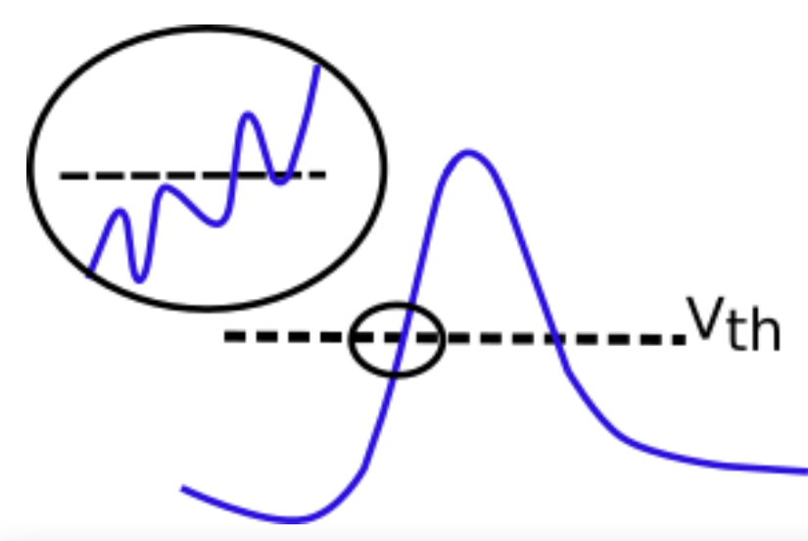
Detector Design - ALTIROC - Time resolution
$$σ_{t}^{2}=σ_{Landau}^{2}+σ_{clock}^{2}+σ_{elec}^{2}$$
where $σ_{elec}^{2}=σ_{TW}^{2}+σ_{Jitter}^{2}+σ_{TDC}^{2}$
$σ_{Landau}^{2}$
$σ_{Elec}^{2}$
Jitter $σ_{Jitter}^{2}=\frac{N}{dV/dt}$ from 25ps to 85ps after irradiation
due to the noise in signal, decreases with gain
Notes:
Jitter variation is due to the noise in the signal, from 25ps to 85ps after irradiation. It’sthe most critical aspect is the design of the analog front-end electronics

Slide 13
Detector Design - ALTIROC - Time resolution
$$σ_{t}^{2}=σ_{Landau}^{2}+σ_{clock}^{2}+σ_{elec}^{2}$$
where $σ_{elec}^{2}=σ_{TW}^{2}+σ_{Jitter}^{2}+σ_{TDC}^{2}$
$σ_{Landau}^{2}$
$σ_{Elec}^{2}$
Time to Digital converter $σ_{TDC}^{2}$ < 10ps

Slide 14
Detector Design - ALTIROC - Time resolution
$$σ_{t}^{2}=σ_{Landau}^{2}+σ_{clock}^{2}+σ_{elec}^{2}$$
where $σ_{elec}^{2}=σ_{TW}^{2}+σ_{Jitter}^{2}+σ_{TDC}^{2}$
$σ_{Landau}^{2}$
$σ_{Elec}^{2}$
$σ_{Clock}^{2}$ < 15ps after calibration
non-deterministic jitter contribution
Goal: total time resolution per track = ${σ_{t}}/{\sqrt{N_{hits}}}$ < 30 ps
Notes:
total time resolution per track combined with number of hits per track

Slide 15
Detector Design
Assembly

Slide 16
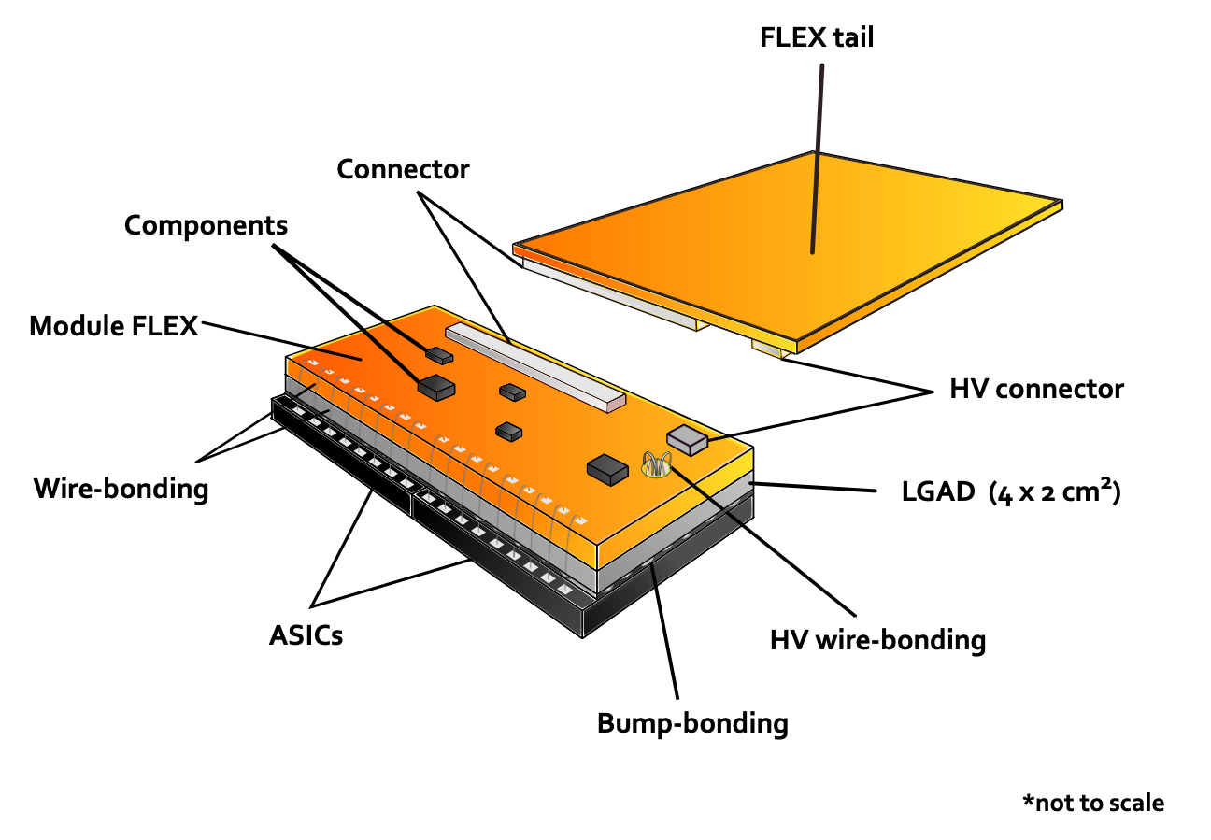
Detector Design - Module Assembly
CERN-LHCC-2020-007; ATLAS-TDR-031, Geneva, 2020
Notes:
All connections between the ASICs and peripheral electronics are routed through flex cable

Slide 17
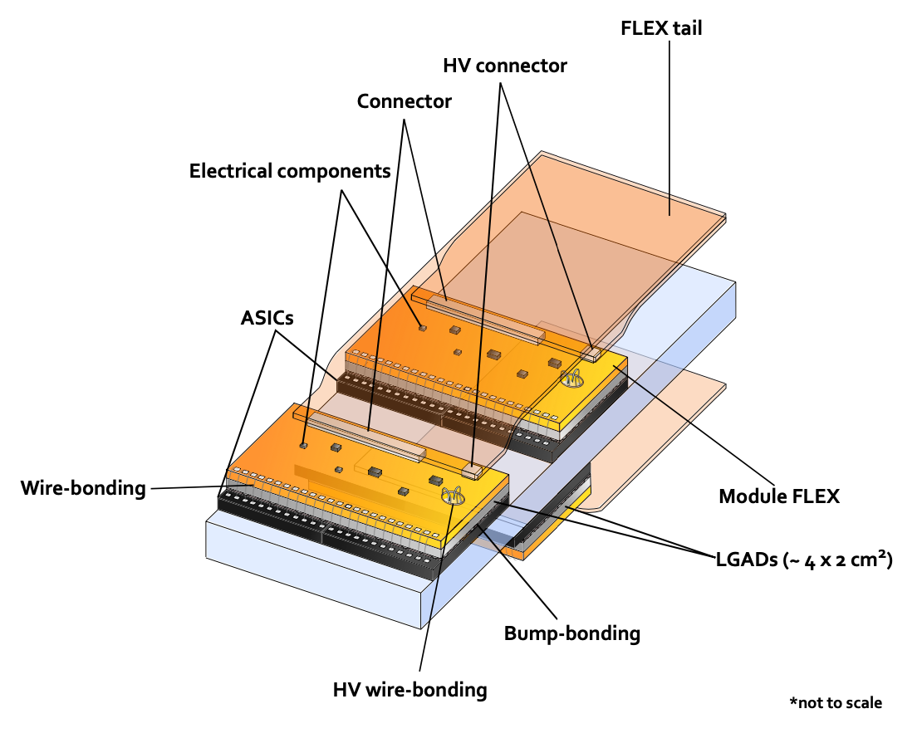
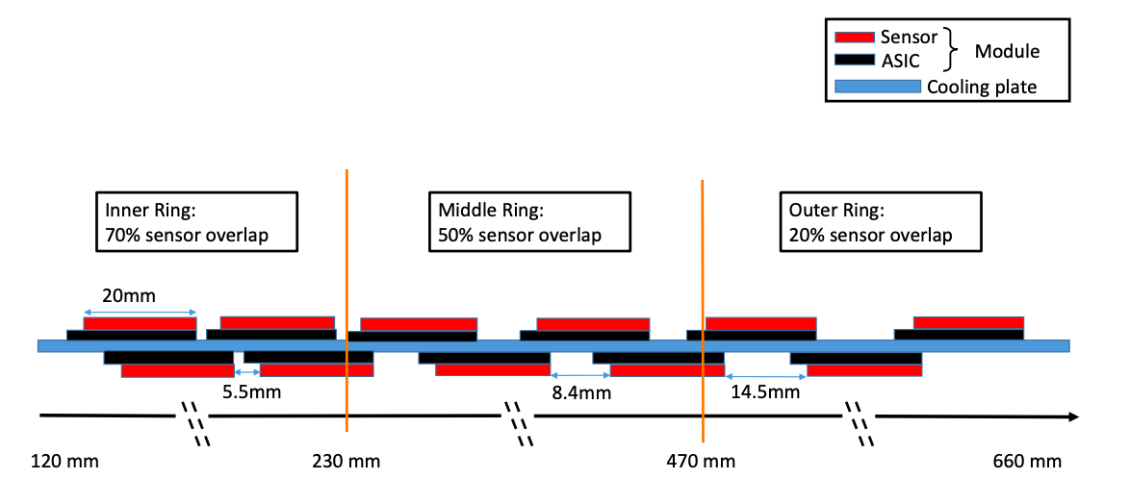
Detector Design - Module Assembly
Glue on each sides
CERN-LHCC-2020-007; ATLAS-TDR-031, Geneva, 2020
Notes:
Modules overlap of 80% at radius <320mm and and 20% for larger radius region.

Slide 18
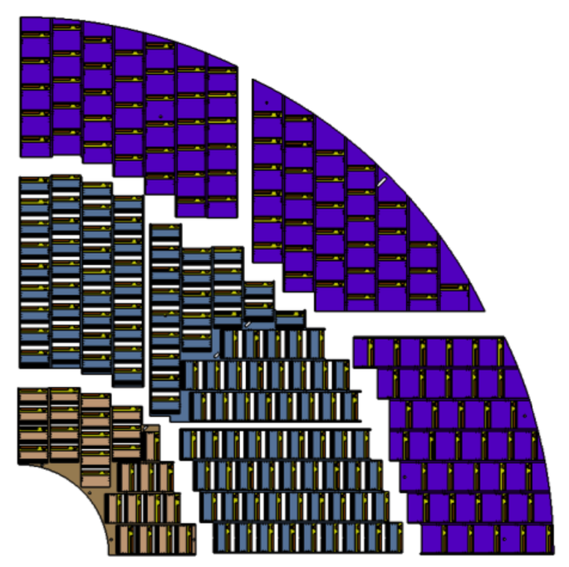
Detector Design - Module Assembly
Mounted on the CO2 cooling disks
Inserted in the pre-define window
Modules align along x or y direction
Each active double-layer plate: three rings, radius from 120mm to 640mm
Average 2.6, 2.4 and 2.0 hits per track (in to out)
Beyond r > 640 mm are the peripheral electronics
CERN-LHCC-2020-007; ATLAS-TDR-031, Geneva, 2020
Notes:
Average 2.6, 2.4 and 2.0 hits per track respectively, from small to large

Slide 19
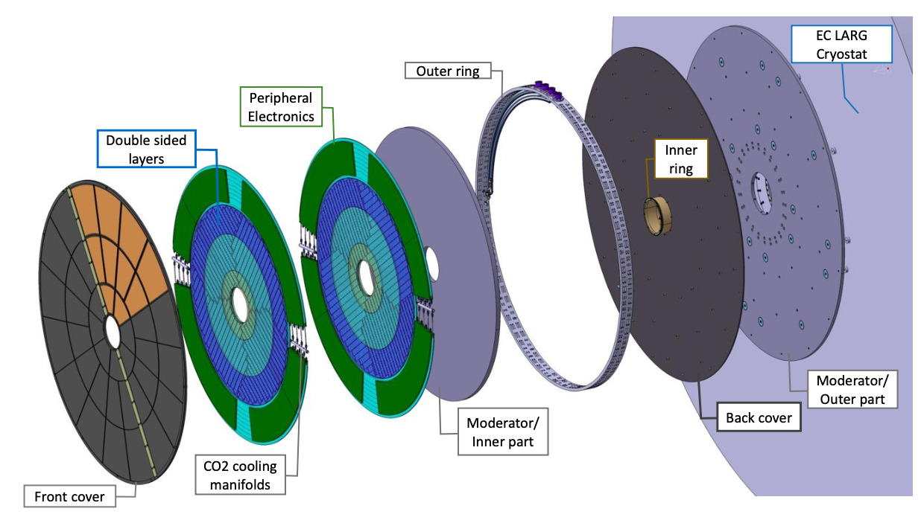
Detector Design - Layout
CERN-LHCC-2020-007; ATLAS-TDR-031, Geneva, 2020
Notes:
Hermetic vessel (front and rear covers, inner and outer rings)
Total thickness of 125mm including two moderators.

Slide 20
Basic Conditions
Each module requires operating bias voltage in a range up to 750 V
Power consumption constrained by CO2 cooling power
—> operating temperate -35°C
Outside the HGTD vessel: >14°C
Grounding and shielding similar to ITk requirements
Notes:
Operation conditions
But the external face outside of the HGTD vessel is kept to be at least 14°C to avoid condensation.
The grounding and shielding of HGTD follows similar requirements as for ITk.

Slide 21
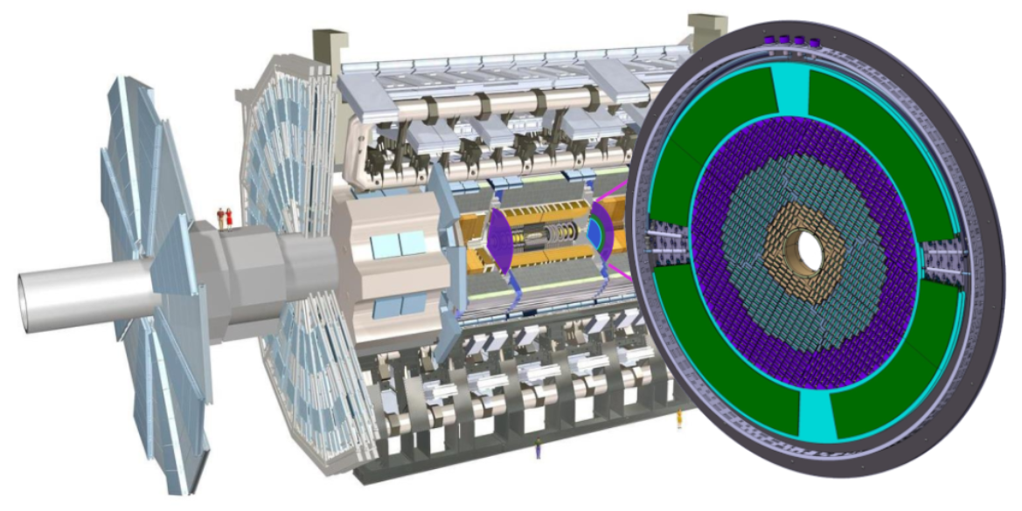
Detector Design - Layout
CERN-LHCC-2020-007; ATLAS-TDR-031, Geneva, 2020
Notes:
3.5m from interaction point.

Slide 22
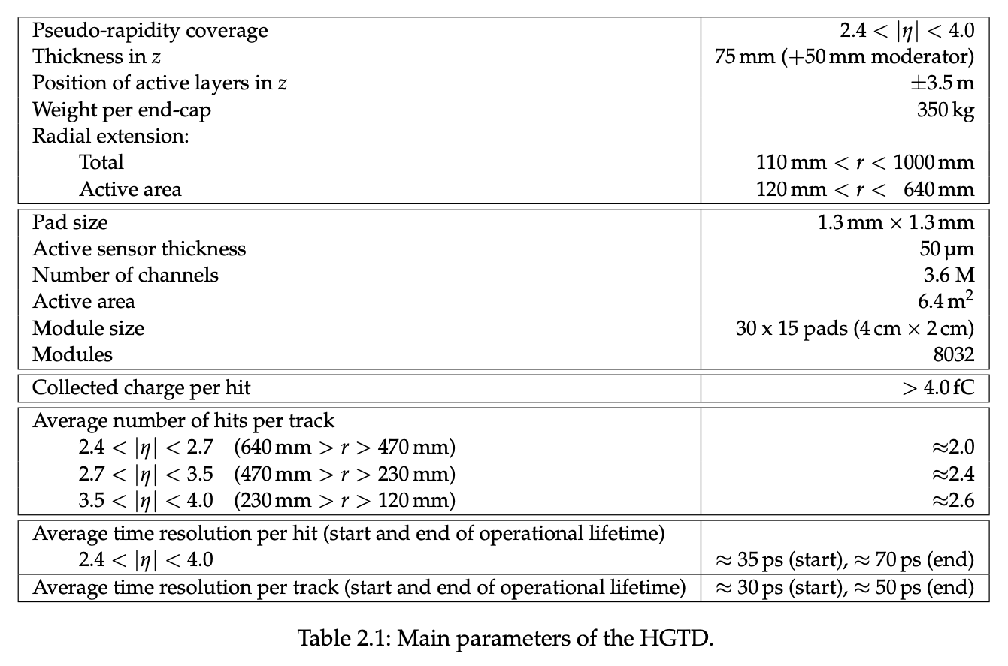
Summary
CERN-LHCC-2020-007; ATLAS-TDR-031, Geneva, 2020
Notes:
The timing information provided by LGAD will be used to mitigate the effects of the pile-up interactions in the forward region, and more complex studies could show further impact of this detector.

Slide 23
References
CERN, “High-Luminosity LHC | CERN,” Home.cern, Nov. 28, 2019. https://home.cern/science/accelerators/high-luminosity-lhc
“About,” ATLAS Experiment at CERN. https://atlas.cern/about
ATLAS Collaboration, Technical Design Report: A High-Granularity Timing De- tector for the ATLAS Phase-II Upgrade, CERN-LHCC-2020-007 ; ATLAS-TDR-031, Geneva, 2020, https://cds.cern.ch/record/2719855/files/ATLAS- TDR- 031.pdf.
“HGTD | ATLAS IJCLab.” https://atlas.ijclab.in2p3.fr/detector/high-granularity-timing-device/.
M. P. Casado, “A High-Granularity Timing Detector for the ATLAS Phase-II upgrade,” Nuclear Instruments and Methods in Physics Research Section A: Accelerators, Spectrometers, Detectors and Associated Equipment, vol. 1032, pp. 166628–166628, Jun. 2022, doi: https://doi.org/10.1016/j.nima.2022.166628.
C. Allaire, “A High-Granularity Timing Detector in ATLAS: Performance at the HL-LHC,” Nuclear Instruments and Methods in Physics Research Section A: Accelerators, Spectrometers, Detectors and Associated Equipment, vol. 924, pp. 355–359, Apr. 2019, doi: https://doi.org/10.1016/j.nima.2018.05.028.
N. Seguin-Moreau et al., “ALTIROC1, a 25 pico-second time resolution ASIC for the ATLAS High Granularity Timing Detector (HGTD),” HAL (Le Centre pour la Communication Scientifique Directe), Mar. 2020, doi: https://doi.org/10.22323/1.370.0042.
S. Sacerdoti, “The ATLAS High-Granularity Timing Detector,” CERN Document Server, 2018. https://cds.cern.ch/record/231853. ‌

Slide 24
Get some real tastes!

Slide 25
Performance
Electron beams at DESY
Bias voltage 230V —> MIP charge deposit of 20fC
Achieved $σ_{t}=37.6±0.7ps$
Time difference between the sensor and a timing reference (Quartz+SiPM)
Subtracting Landau contribution —> 39ps of the remaining time resolution
CERN-LHCC-2020-007; ATLAS-TDR-031, Geneva, 2020
Notes:
test results of the time resolution.
A version of ALTIROC was exposed to electron beams at DESY in 2019. The LGAD were operated with a bias voltage of 230V, resulting in a minimum ionising particle (MIP) charge deposit of 20fC. The time resolution of this device was measured to be 37.6±0.7 ps.
distribution of TOA as a function of the TOT. The black dots are mean value of the TOA distribution for a given TOT bin extracted from a Gaussian. The red line is a fit of average TOA as a function of TOT.
Another picture shows the time difference between our sensor and a timing reference (Quartz+SiPM) before and after the time walk correction together with Gaussian fit in the left figure.
Subtracting Landau contribution we have 39ps of the remaining time resolution.

