Slide 1
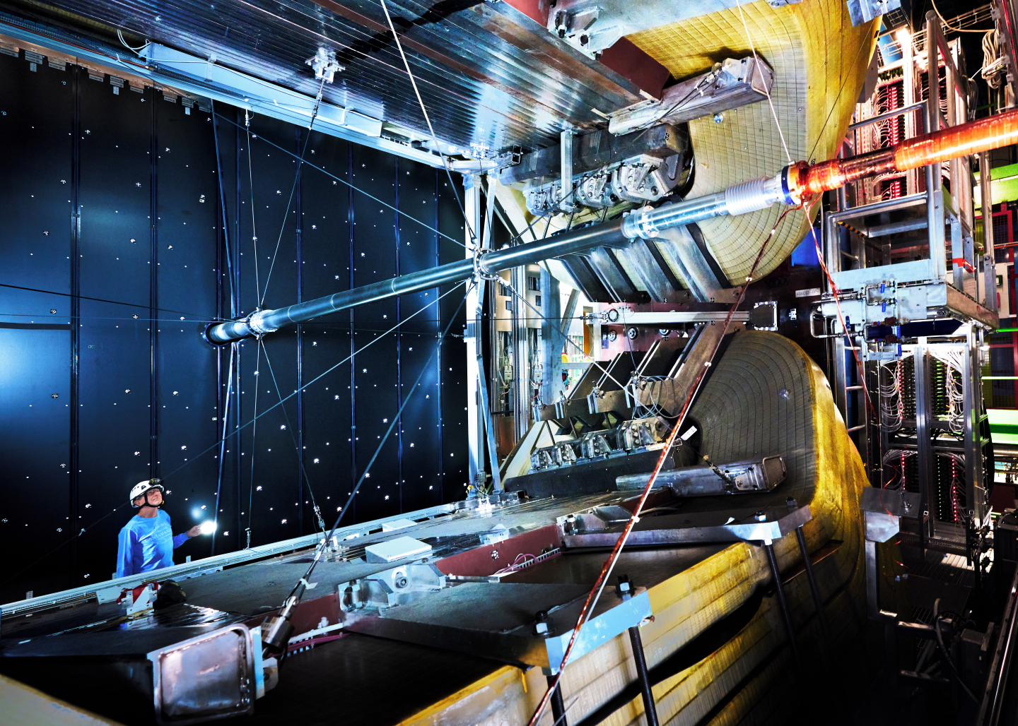
CERN. (2024). LHCB. CERN. https://www.home.cern/science/experiments/lhcb
CERN. (2024). LHCB. CERN. https://www.home.cern/science/experiments/lhcb

Slide 2
LHCbeauty
CP violation and rare decays of b and c
Indirect evidence
Particle identification
${10}^{12}$ $b\overline{b}$ pairs per year
Ring-imaging Cherenkov detector
The latest from lhcb. CERN Document Server. (2009, October 1). https://cds.cern.ch/record/1209907
RICH

Slide 3
YouTube. (2018, October 31). How does Cerenkov Radiation Work?. YouTube. https://www.youtube.com/watch?v=Yjx0BSXa0Ks
Idaho National Laboratory. (2023, August 9). Advanced test reactor. Idaho National Laboratory. https://inl.gov/advanced-test-reactor/

Slide 4
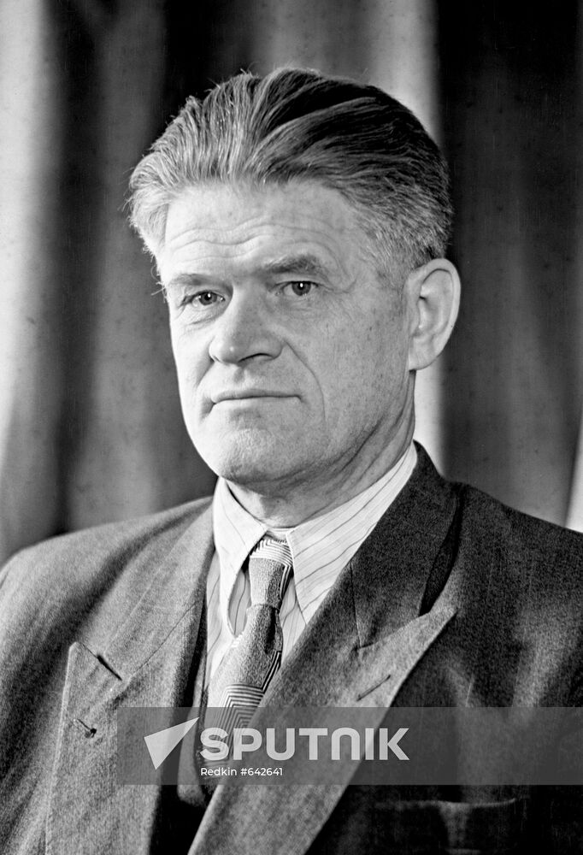
Cherenkov Radiation
Characteristic number: Cherenkov angle
Main resolution to be measured: Cherenkov angle resolution
Refractive index $n$, particle speed $v_{p}$
$$\cos{θ_{C}=\frac{1}{nβ}}$$
$$β=\frac{v_{p}}{c}$$
Pavel Cherenkov’s 110th anniversary of birth. Sputnik Mediabank. (2023, November). https://sputnikmediabank.com/selection/list_1007417/

Slide 5
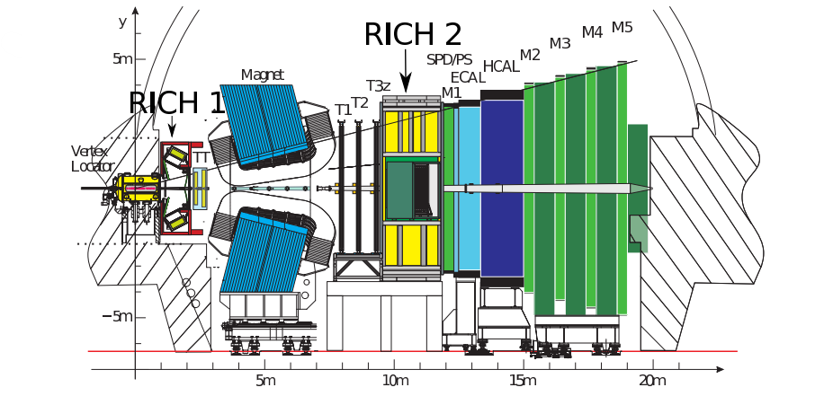
LHCb sideview
15-100 GeV,
Acceptance:
15-120-100 mrad
2-40 GeV,
Acceptance:
25-300-250 mrad
The LHCb RICH Collaboration., Adinolfi, M., Aglieri Rinella, G. et al. Performance of the LHCb RICH detector at the LHC. Eur. Phys. J. C 73, 2431 (2013). https://doi.org/10.1140/epjc/s10052-013-2431-9

Slide 6
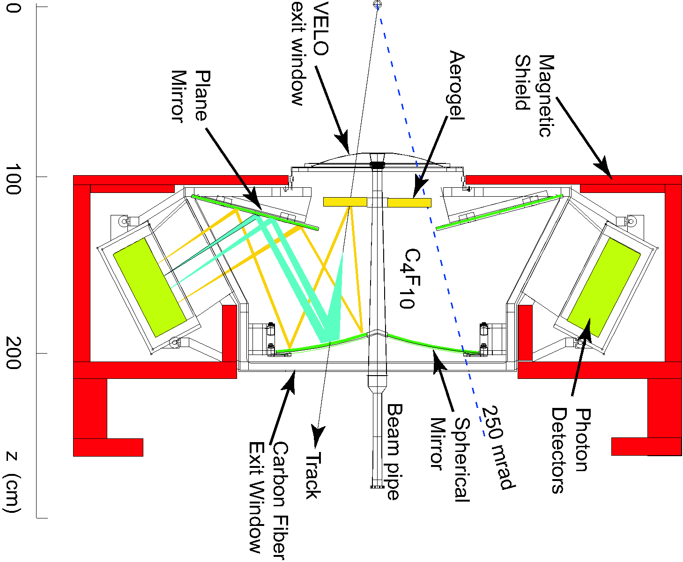
RICH1
Optical system
Mirrors
Support structure
Radiators
Gas enclosure
Photon detectors
Magnetic shielding
LHCb Collaboration. (2022). Pictures, figures, and plots. LHCB Collaboration. https://twiki.cern.ch/twiki/bin/viewauth/LHCb/RICHPicturesAndFigures

Slide 7
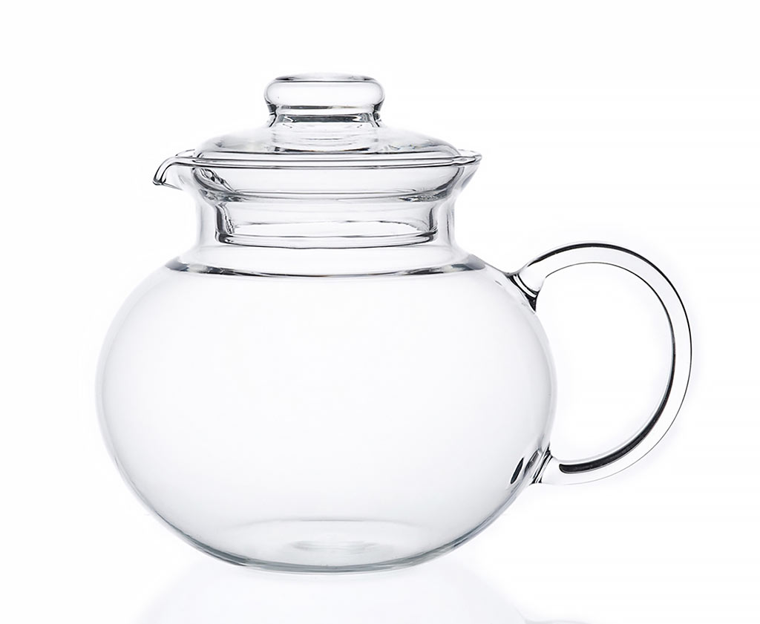
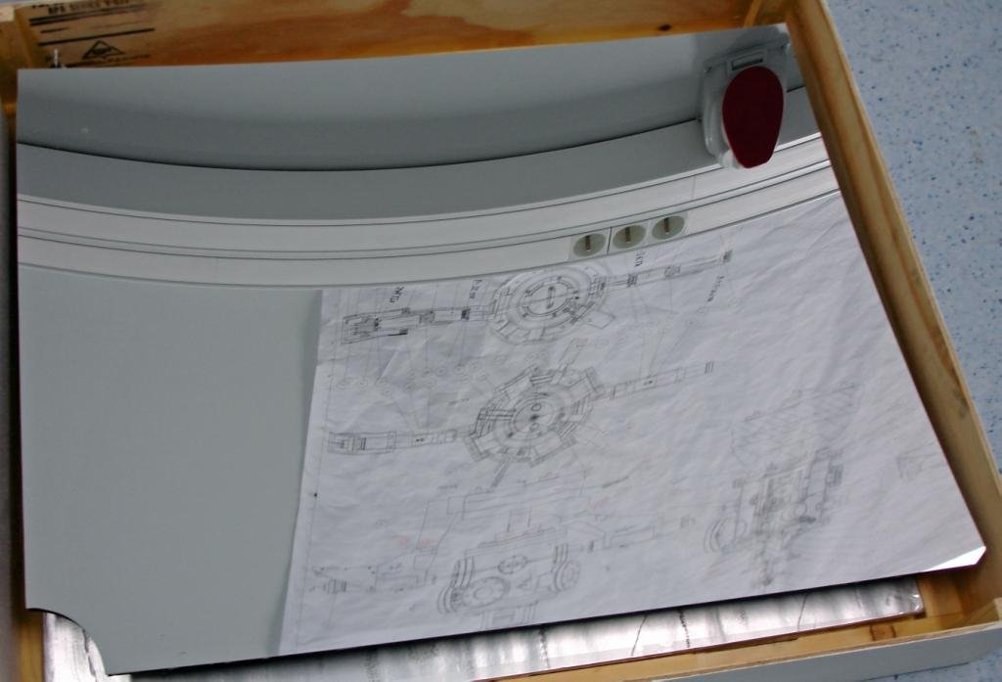
Optical System: RICH1
Primary spherical mirror CFRP
Secondary flat mirror Simax glass
90% reflectivity
Vertical halves for magnetic shielding
SIMAX GLASS
CARBON-FIBRE REINFORCED POLYMER
LHCb Collaboration. (2022). Pictures, figures, and plots. LHCB Collaboration. https://twiki.cern.ch/twiki/bin/viewauth/LHCb/RICHPicturesAndFigures
Simax Glass teapot 1L. " Simax Glass Teapot 1l. (n.d.). https://muller-nv.be/en/simax-glass-teapot-1l/

Slide 8
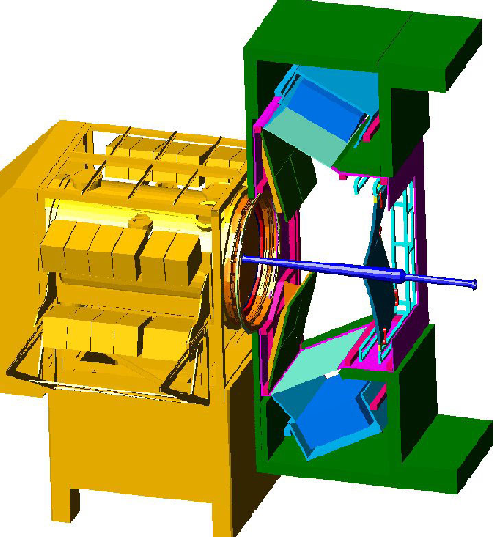
Design Constraints: RICH1
Material budget
CFRP, systems outside acceptance
8% $X_{0}$
Beampipe
Low angle acceptance
Magnetic shielding
Heavy!
The characteristic amount of matter traversed is called the radiation length X₀, measured in g·cm⁻²
LHCb Collaboration. (2022). Pictures, figures, and plots. LHCB Collaboration. https://twiki.cern.ch/twiki/bin/viewauth/LHCb/RICHPicturesAndFigures

Slide 9
RICH2
Optical system
Mirrors
Support structure
Radiators
Gas enclosure
Photon detectors
Magnetic shielding
LHCb Collaboration. (2022). Pictures, figures, and plots. LHCB Collaboration. https://twiki.cern.ch/twiki/bin/viewauth/LHCb/RICHPicturesAndFigures

Slide 10
Optical System: RICH2
Simax glass only
15% $X_{0}$
Greatest challenge: stability
Horizontal halves
SIMAX GLASS
Simax Glass teapot 1L. " Simax Glass Teapot 1l. (n.d.). https://muller-nv.be/en/simax-glass-teapot-1l/

Slide 11
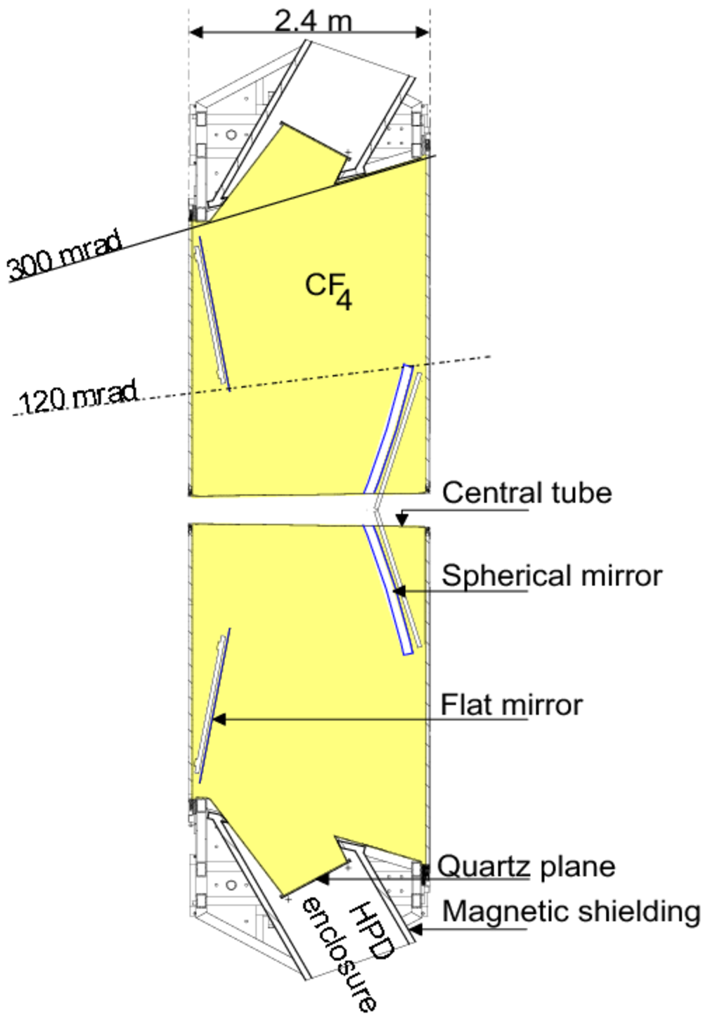
Design Constraints: RICH2
Supporting structures outside acceptance
Iron shielding
Lower limit of acceptance
15 mrad
Beampipe clearance 45 mm
LHCb Collaboration. (2022). Pictures, figures, and plots. LHCB Collaboration. https://twiki.cern.ch/twiki/bin/viewauth/LHCb/RICHPicturesAndFigures

Slide 12
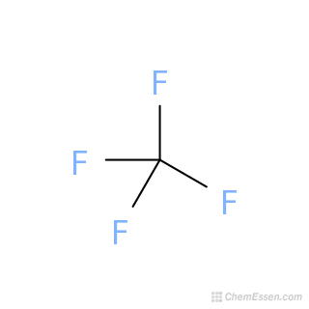
Gas Radiators
$$C_{4}F_{10}$$
Fluorocarbon gases
Room temperature & pressure
Low dispersion
Refractive indices (0C, 101.3 Pa, 400nm) are 1.0014 ($C_{4}F_{10}$) and 1.0005 ($CF_{4}$)
K?
$$CF_{4}$$
Wikimedia Foundation. (2023, October 31). Perfluorobutane. Wikipedia. https://en.wikipedia.org/wiki/Perfluorobutane
Carbon tetrafluoride SDF/mol file - CF4 - over 100 million chemical compounds: CCDDS. Mol. (n.d.). https://www.molinstincts.com/sdf-mol-file/CARBON-TETRAFLUORIDE-sdf-CT1001636577.html

Slide 13
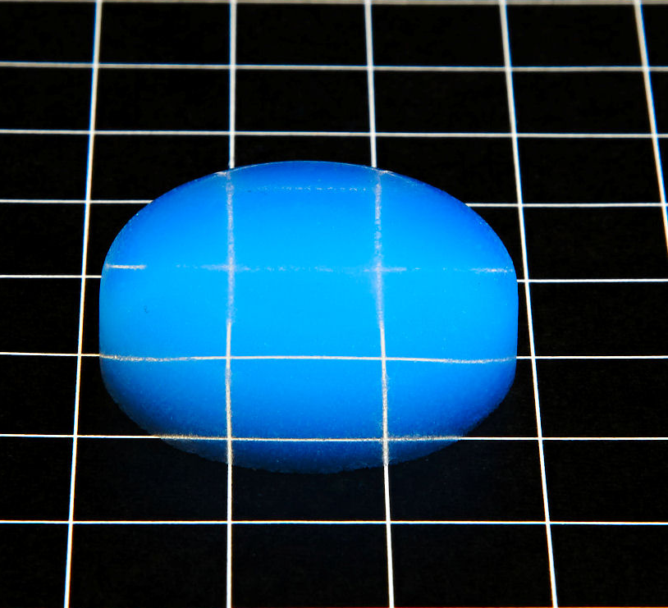
Aerogel
RICH1
50 mm thick wall
Refractive index 1.03
High quality & clear
Classic SilicaTM disc. BuyAerogel.com. (n.d.). http://www.buyaerogel.com/product/classic-silica-disc/
LHCb Collaboration. (2022). Pictures, figures, and plots. LHCB Collaboration. https://twiki.cern.ch/twiki/bin/viewauth/LHCb/RICHPicturesAndFigures

Slide 14
Cherenkov angle versus particle momentum in RICH radiators
$$\cos{θ_{C}=\frac{1}{nβ}}$$
https://twiki.cern.ch/twiki/pub/LHCb/RICHPicturesAndFigures/radiators.png
$$β=\frac{v_{p}}{c}$$

Slide 15
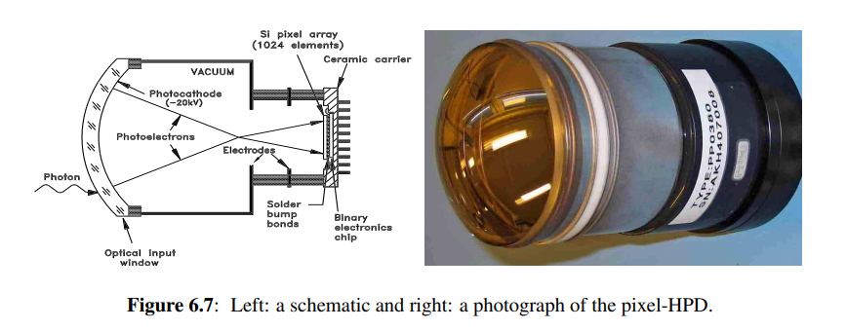
Photon Detectors
Pixel Hybrid Photon Detectors (HPDs)
Photoelectron acceleration
5000 electron-hole pairs
75 mm diameter tubes,1024 pixels
196 tubes in RICH1, 288 in RICH2
Multi Anode Photomultipliers (MaPMTs)
Improved resolution
LHCb Collaboration. (2022). Pictures, figures, and plots. LHCB Collaboration. https://twiki.cern.ch/twiki/bin/viewauth/LHCb/RICHPicturesAndFigures
The LHCb Collaboration et al 2008 JINST 3 S08005DOI 10.1088/1748-0221/3/08/S08005

Slide 16
Cherenkov angle resolution for reconstructed photons detected by RICH1 (left) and RICH2 (right) using early Run 3 Data Gaussian fit = good performance
how often a particular Δθ Cherenkov is observed
standard deviation of the Δθ_Cherenkov distribution
difference between the measured Cherenkov angle and the expected Cherenkov angle
LHCb collaboration. (2023). RICH Performance Plots - Cherenkov Angle Resolutions for RICH 1 and RICH 2. Geneva; CERN.

Slide 17
A Day in RICH
Coordinate information
Vertex locator
Cherenkov photons generated
Photon detectors
Impact points recorded
Cherenkov angle
Midway assumption
Emission point error
LHCb Collaboration. (2022). Pictures, figures, and plots. LHCB Collaboration. https://twiki.cern.ch/twiki/bin/viewauth/LHCb/RICHPicturesAndFigures

Slide 18
Reconstructed Cherenkov angle as a function of track momentum in the $C_{4}F_{10}$ radiator
Isolated rings
Distinct bands based on mass
2% of all tracks
The LHCb RICH Collaboration., Adinolfi, M., Aglieri Rinella, G. et al. Performance of the LHCb RICH detector at the LHC. Eur. Phys. J. C 73, 2431 (2013). https://doi.org/10.1140/epjc/s10052-013-2431-9

Slide 19
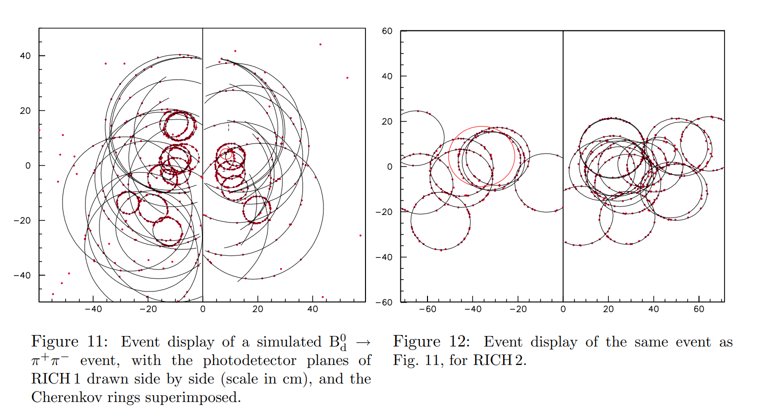
The LHCb Collaboration. (2000a). LHCb RICH Technical Design Report. Geneva; CERN.

Slide 20
Before & after RICH…
Invariant mass distribution for B decays, before RICH information (left) and after (right). Decay modes are eliminated by particle identification.
The LHCb RICH Collaboration., Adinolfi, M., Aglieri Rinella, G. et al. Performance of the LHCb RICH detector at the LHC. Eur. Phys. J. C 73, 2431 (2013). https://doi.org/10.1140/epjc/s10052-013-2431-9

Slide 21
We need RICH because
Identification of charged hadrons (even muons!)
Distinguish the final states
Bonus: efficient flavour tagging & trigger

Slide 22
Future?
Better precision!
More data!
RICH with timing!
(next big thing…)
Alessio, F. (2020). The LHCb Upgrades for Run3 and Run4. CERN.

Slide 23
Thank you!
Questions?
LHCb Collaboration. (2022). Pictures, figures, and plots. LHCB Collaboration. https://twiki.cern.ch/twiki/bin/viewauth/LHCb/RICHPicturesAndFigures

Slide 24
Sources
Alessio, F. (2020). The LHCb Upgrades for Run3 and Run4. CERN.
Carbon tetrafluoride SDF/mol file - CF4 - over 100 million chemical compounds: CCDDS. Mol. (n.d.). https://www.molinstincts.com/sdf-mol-file/CARBON-TETRAFLUORIDE-sdf-CT1001636577.html
CERN. (2024). LHCB. CERN. https://www.home.cern/science/experiments/lhcb
Classic SilicaTM disc. BuyAerogel.com. (n.d.). http://www.buyaerogel.com/product/classic-silica-disc/
High-luminosity LHC. CERN. (n.d.). https://home.cern/science/accelerators/high-luminosity-lhc
Idaho National Laboratory. (2023, August 9). Advanced test reactor. Idaho National Laboratory. https://inl.gov/advanced-test-reactor/
The latest from lhcb. CERN Document Server. (2009, October 1). https://cds.cern.ch/record/1209907
The LHCb Collaboration. (2000a). LHCb RICH Technical Design Report. Geneva; CERN.
The LHCb RICH Collaboration., Adinolfi, M., Aglieri Rinella, G. et al. Performance of the LHCb RICH detector at the LHC. Eur. Phys. J. C 73, 2431 (2013). https://doi.org/10.1140/epjc/s10052-013-2431-9
The LHCb Collaboration et al 2008 JINST 3 S08005DOI 10.1088/1748-0221/3/08/S08005
LHCb Collaboration. (2022). Pictures, figures, and plots. LHCB Collaboration. https://twiki.cern.ch/twiki/bin/viewauth/LHCb/RICHPicturesAndFigures
Palutan, M. (2021). LHCb Upgrade II. INFN.
Pavel Cherenkov’s 110th anniversary of birth. Sputnik Mediabank. (2023, November). https://sputnikmediabank.com/selection/list_1007417/
Simax Glass teapot 1L. " Simax Glass Teapot 1l. (n.d.). https://muller-nv.be/en/simax-glass-teapot-1l/
Wikimedia Foundation. (2023, October 31). Perfluorobutane. Wikipedia. https://en.wikipedia.org/wiki/Perfluorobutane
YouTube. (2018, October 31). How does Cerenkov Radiation Work?. YouTube. https://www.youtube.com/watch?v=Yjx0BSXa0Ks

