Slide 1
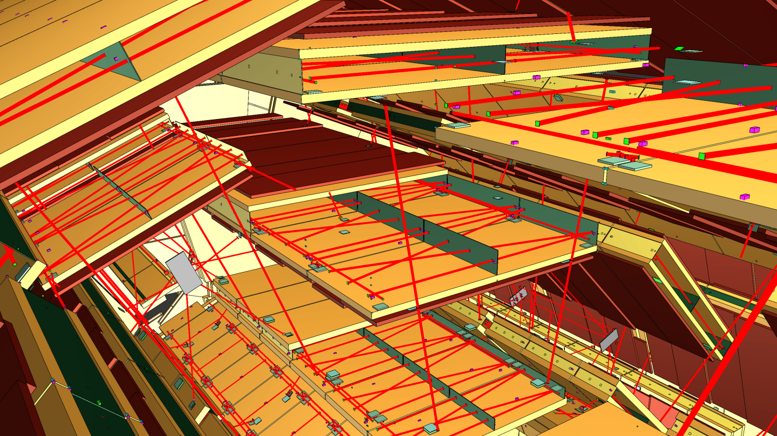
ATLAS Muon Spectrometer
Aditi Sharma

Slide 2
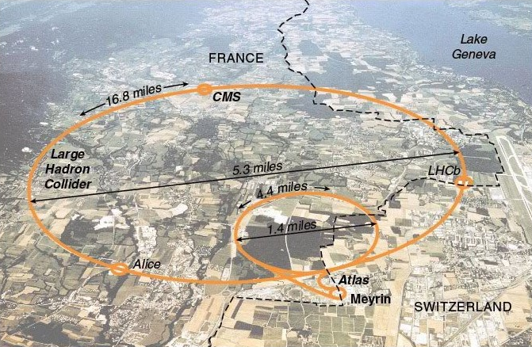
ATLAS – A Toroidal LHC ApparatuS
Largest General-Purpose Detector at LHC
One of the two LHC experiments involved in the discovery of the Higgs boson in July 2012
ATLAS measures:
masses;
channels of production, decay and mean lifetimes;
interaction mechanisms and coupling constants for electroweak and strong interactions.

Slide 3
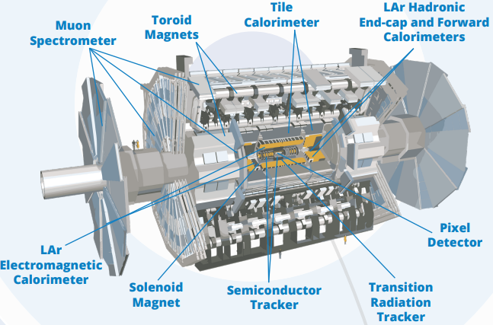
ATLAS Structure
General Purpose
designed in layers of different types of detectors.
Concentric cylinders around the interaction point where the proton beams from the LHC collide.
MS consists of three parts:
1. Magnetic field
2. A set of Track chambers measuring
3. A set of Triggering chambers with accurate time-resolution.

Slide 4
Why do we care to measure Muons?
because
Muons are the only (charged primary) collision products traversing the calorimeters. → Clean signature of muonic final states.
Many interesting physical processes can only be observed if one or more muons are detected (H → ZZ∗ → µµ, A → µµ, Z_0 → µµ. )
The total energy of particles in an event could not be measured if the muons were ignored.
Notes:
Contrary to electrons muons do not significantly lose energy by emission of synchrotron radiation.

Slide 5
ATLAS Muon Spectrometer

Slide 6
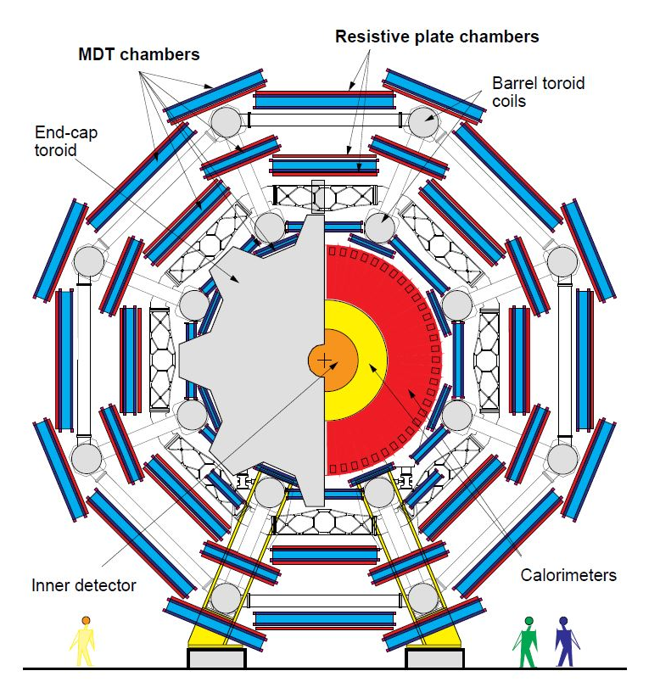
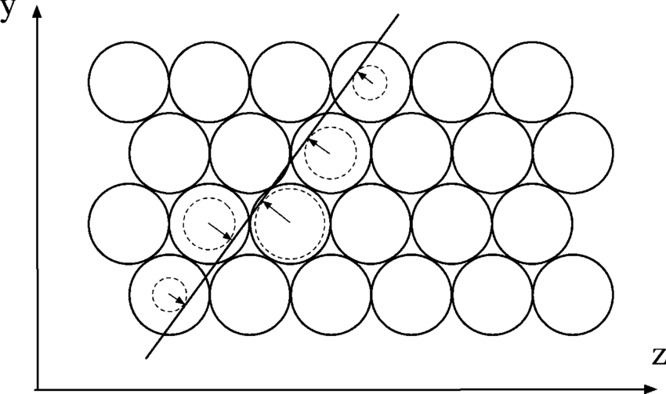
Precision Detectors
Use: To determine the position of a muon,
Accuracy: less than a 10th of a millimetre!
How? Monitored Drift Tube (MDTs) detectors are
3 cm wide aluminium tubes filled with a gas mixture. Argon and C02
Muons pass through the tubes, ionize the gas.
Electrons drift to a wire at the center of the tube == signal!!!
Over 380,000 aluminium tubes are stacked up in several layers in order to precisely trace the trajectory of each muon.
https://www.youtube.com/watch?v=A8L2RtvEKok

Slide 7
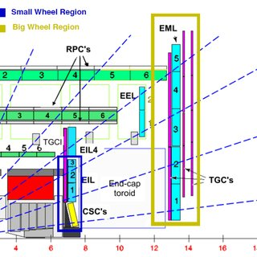
Fast-Response Detectors
Qickly select interesting collision
They make this decision within 2.5 μs (400,000th of a second!!).
The Resistive Plate Chambers (RPCs) surround the central region of ATLAS
pairs of parallel plastic plates at an electric potential difference, separated by a gas volume.
Thin Gap Chambers (TGCs) are at the ends of ATLAS
parallel 30 μm wires in a gas mixture.
Both chambers detect muons when they ionise the gas mixture and generate a signal.
Micromegas and Small-Strip Thin-Gap Chambers (sTGCs) two additional detector technologies specially designed for high-intensity LHC collisions.
These detectors can track muons in high-density areas on either side of the experiment close to the LHC beam pipe, both quickly and with high precision.
The combined data gives a rough measurement of a muon’s momentum, allowing ATLAS to choose whether to keep or discard a collision event.

Slide 8
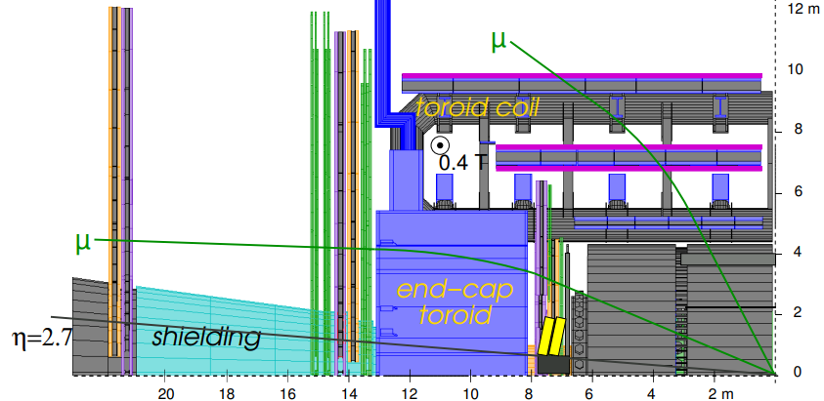
How is Muon Momentum Studied
As for other charged particles, muon momenta are determined from their deflection in a magnetic field (recall tracking and vertexing lecture)
1. What is providing the deflection?
2. How does the bending of muon trajectory help us determine it’s momentum
3. Why do we even care to find the muon’s momentum?

Slide 9
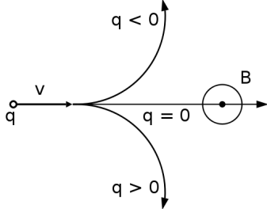
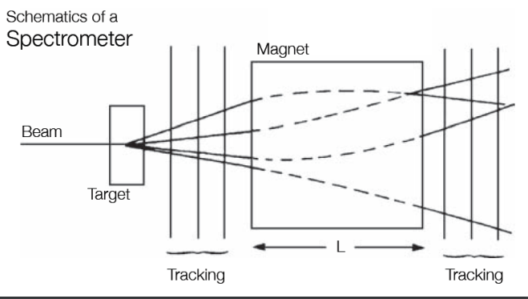
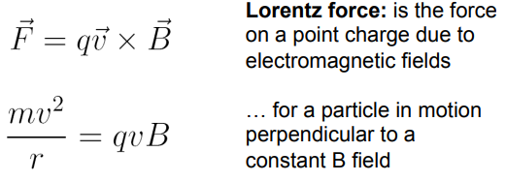
Momentum Measurement
1. Deflection from Toroidal Magnetic Field (non uniform, 2-6 Tm)
2. Think of Charge and Magenetic field (and which very famous formula connects them)
3 We want to measure the momentum of the muon such that we can reconstruct its path back to where it originated from (interaction point)

Slide 10
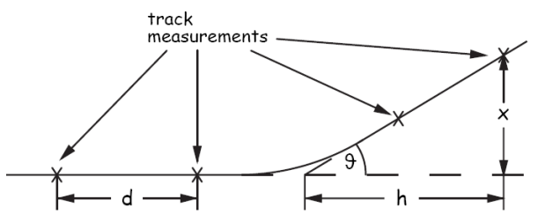
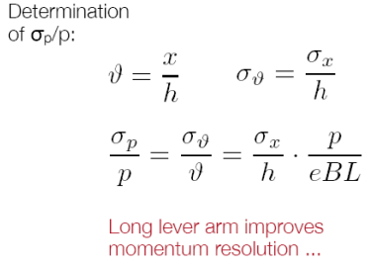
Momentum Resolution
Ability of a Particle Detector to accurately measure the momentum of a charged particle through it
Mathematically:
Recall, the magnetic field due to the torroid is not uniform
Notes:
escribes how well the detector can determine the true momentum of a particle based on the signals it produces.

Slide 11
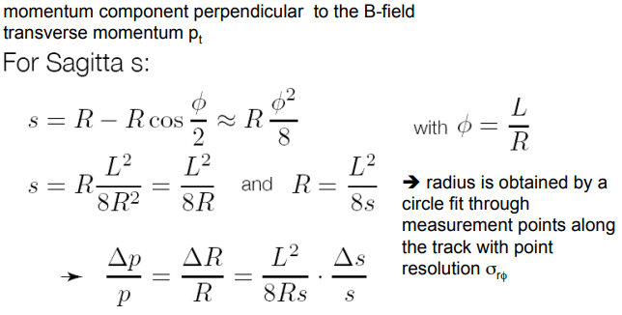
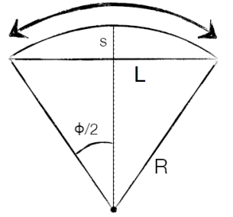
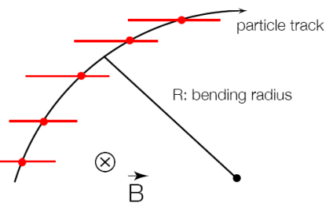
Momentum Resolution MDT
Recall tracking and vertexing lecture
Momentum resolution scales with sagitta resolution

Slide 12
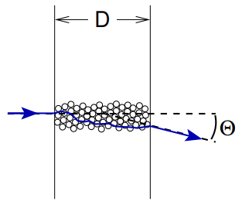
Multiple Scattering
However, one more thing to keep in mind when considering momentum resolution in MS
Muons can “interact” with the Detector Material –> Multiple Scattering
additional uncertainty in momentum measurement
Mathematically:
Here X0 is radiation length of the material
mean length (in cm) to reduce the energy of an electron by the factor 1/e.
Notes:
Multiple scattering of the muons on the nuclei of the detector material leads to an additional uncertainty in momentum measurement

Slide 13
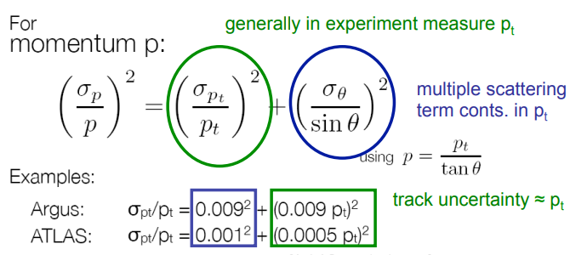
Overall Momentum Resolution
A good momentum resolution can be achieved by
Large path length L
Large Magnetic field B
Good Sagitta measurement

Slide 14
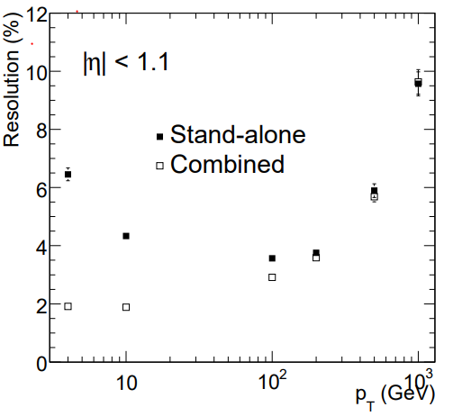
Need for MS
Combining the measurements of the inner detector and muon spectrometer gives us a better momentum resolution
pT < 100 GeV Significant improvement of the resolution by the inner detector.
pT > 100 GeV Momentum resolution dominated by the muon spectrometer.
Muon spectrometer crucial for good momentum resolution at large pT!!

Slide 15
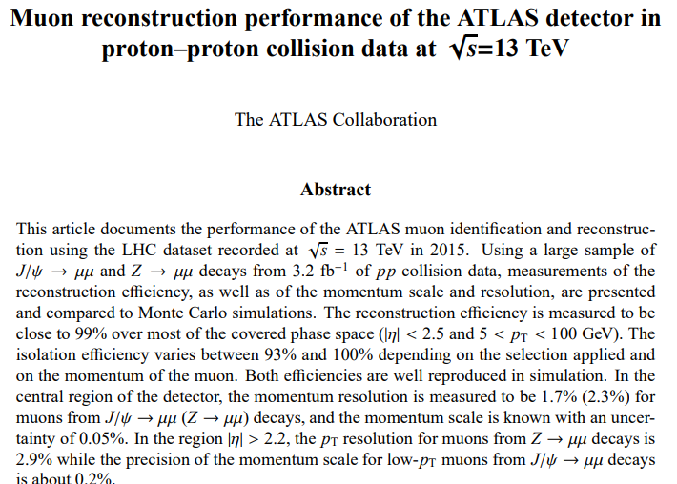
Back to ATLAS –LHC Run 2
Momentum Resolution: 2.3% - 2.9% (at endcaps)
using the LHC dataset recorded at √ s = 13 TeV in 2015
Efficiency: ϵ=Ndetected​​/Ngenerated​
99% over most of the covered phase space (|η| < 2.5 and 5 < pT < 100 GeV). The isolation efficiency varies between 93% and 100% depending on the selection applied and on the momentum of the muon.

Slide 16
Recent Study (2018)

Slide 17
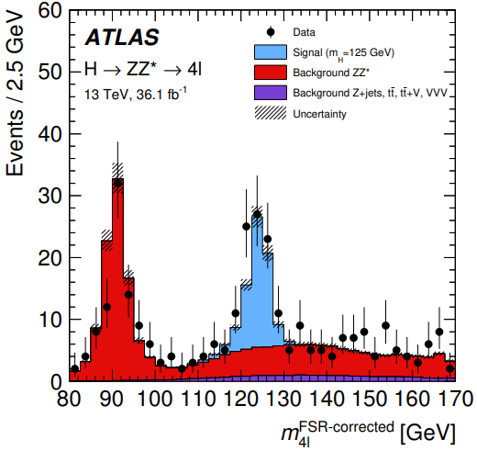
Event Selection
Only events with a four-lepton invariant mass in the range 115−130 GeV are used in the extraction of the signal.
“The acceptance of the fiducial selection is 42% for a SM Higgs boson with mH = 125 GeV. The ratio of the number of events passing the detector-level event selection to those passing the particle-level selection is 53%. Due to resolution effects, about 2% of the events which pass the detector-level selection fail the particle-level selection.”
How many Higgs Boson are lost?

Slide 18
Conclusions
Fiducial cross section is in agreement with SM prediction (yay)
Fiducial cross section is also extended to the total phase space which includes all Standard Model Higgs boson decays
Extracted cross-section distributions are used to constrain anomalous Higgs boson interactions with Standard Model particle
Notes:
- fiducial cross section: cross section of a specific process measured in a restricted region of phase space.
- This region is defined by certain kinematic criteria designed to select events that closely resemble the process being studied.
- often used to compare experimental measurements with theoretical predictions.
- By defining a fiducial region that closely corresponds to the final state of interest, experimentalists can isolate the signal from background processes and focus on the specific physics process they wish to study.
- in the case of Higgs boson production 4l decay channel, the fiducial region might be defined by requirements on the momenta, energies, and angles of the four leptons (ℓℓ) in the final state.
- The fiducial cross section would then represent the rate at which Higgs bosons are produced in this specific final state, as measured experimentally.
- Overall, the fiducial cross section is a useful quantity for comparing experimental measurements with theoretical predictions and testing the validity of the underlying physics models.

