Slide 1
E-field compensation with QuadFocus
Wouter Bos
Meeting 21 november 2016

Slide 2
Overview
QuadFocus
Grid scan
Mapping the Grid
Mapping beams

Slide 3
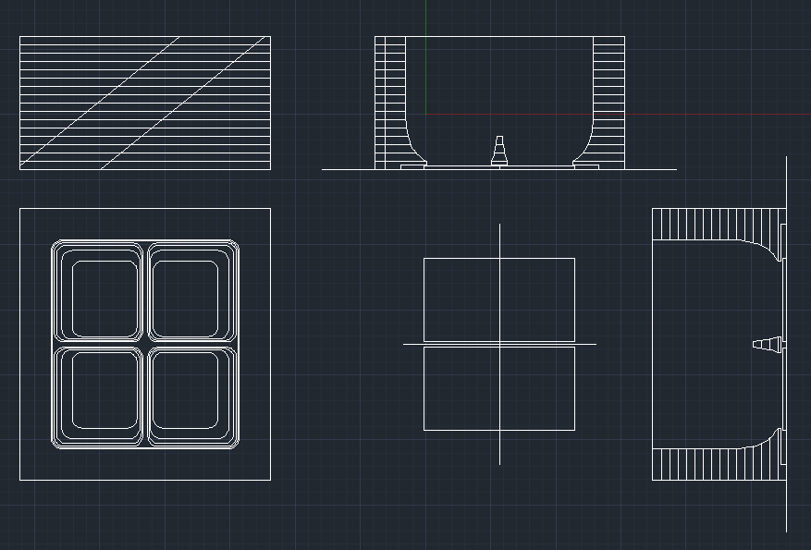
QuadFocus
4 timepix-1 chips
Upper part homogeneous E-field
Lower part has central PCBs for controlled focused E-field
(Design picture)

Slide 4
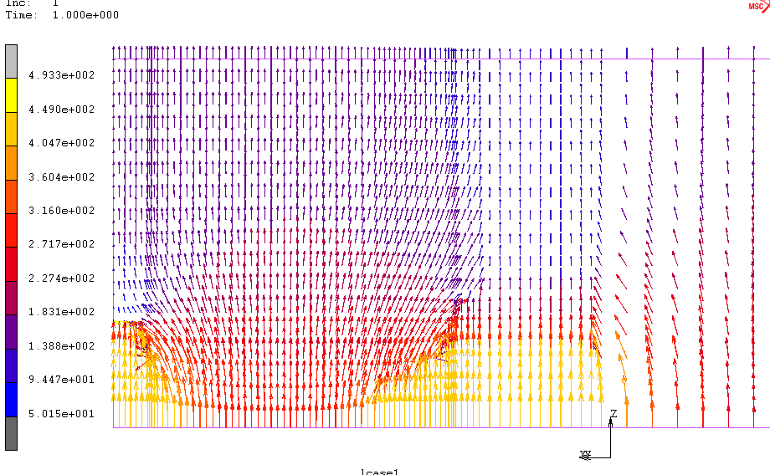
QuadFocus
3D simulation
Upper part homogeneous E-field
Lower part controlled focused E-field
3D-field schematic

Slide 5
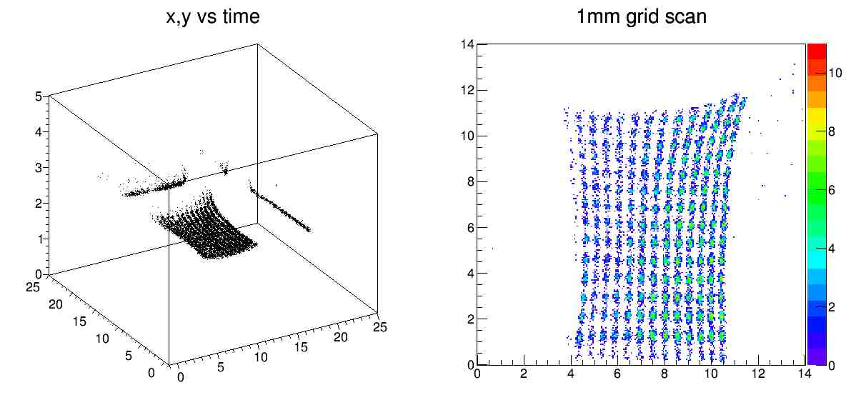
E-field deformations
Single chip electron depositions in 1[mm] grid
Height drift due to longer path
No dead spot between chips

Slide 6
BiCubic interpolation
Cubic interpolation in 2 dimensions
2 functions: F(x,y)->x’ and G(x,y)->y’
4 1D base functions 4 of the 16 2D base functions
Weighted addition of 16 base functions gives smooth surface
Datapoints and smoothness provide conditions

Slide 7
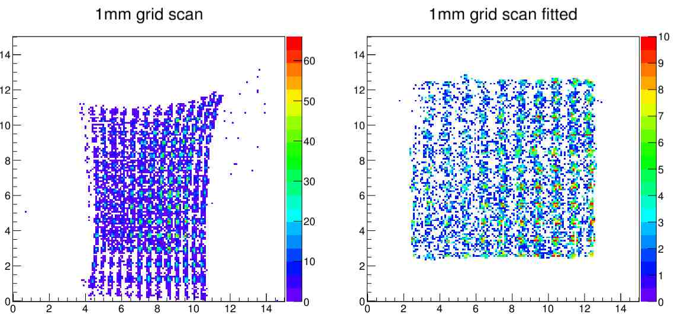
E-field deformations
1mm grid scan
Transforming deformed grid gives uniform grid
Improvement for spots near the edge
Original Grid Transformed Grid

Slide 8
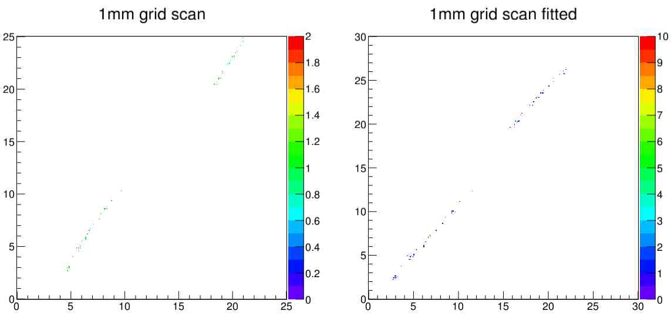
E-field deformations
Tracks on multiple chips are straightened
Resulting angle 45 degrees as expected
Needs distance between chips
Original Track Transformed Track

Slide 9
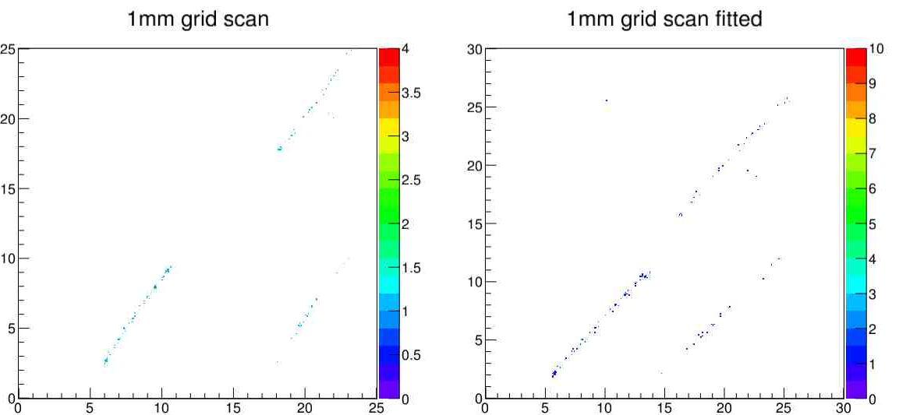
E-field deformations
Tracks on multiple chips are straightened
Resulting angle 45 degrees as expected
Needs distance between chips
Original Track Transformed Track

Slide 10
E-field compensation with QuadFocus
Wouter Bos
Meeting 21 november 2016

