Slide 1








Pixel TPC dEdx performance
Yevgen Bilevych, Klaus Desch, Sander van Doesburg, Harry van der Graaf, Fred Hartjes, Jochen Kaminski, Peter Kluit, Naomi van der Kolk,
Cornelis Ligtenberg,
Gerhard Raven, and
Jan Timmermans
LCTPC DESY meeting March 2024

Slide 2
DESY testbeam Module Analysis
Performance of dEdx
B=0 T
B=1 T
Preliminary
B=0 T has a large Landau tail
B=1 T smaller Landau tail and a more gaussian distribution
An electron crossing 8 chips in the module has about 1000 TX3 hits

Slide 3
DESY testbeam Module Analysis
Hits per chip scan vs grid voltage
Current understanding
B=0 T has a large Landau tail due to UV photons that are produced
The HV scan shows the extra hits that are produced
B=1 T has a reduced Landau tail due to the B field (electrons curl up)
This has large impact on the performance of dEdx: the smaller the fluctuations the better!
B=0 T
Thesis Kees Ligtenberg

Slide 4
DESY testbeam Module Analysis
Analysis of dEdx performance
Combine chips to form 1 m long track with 60 % coverage for electrons
Method 1) reject large clusters and then runs dEdx @ 90% (gives nr of selected hits)
Method 2) fit the slope of the scaled minimum distance (d) distribution with an exponential function (after scaling down the N(d) distribution):
N(d) scaled = N scale (d) N observed (d)
N(d) scaled is then fitted fr each track with N₀ exp(-slope d)
Calculate the “dEdx” variable (method 1 = nr of selected hits; method 2 = slope) for electrons and MIP (== 70% of hits)
Resolution is σ (dEdx) / dEdx (for σ we use the rms)
Scale corrected MIP resolution: scales up the resolution by
factor = dEdx(MIP))/dEdx(e)/0.7 = method 1(2) 1.10 (1.18)

Slide 5
DESY testbeam Module Analysis
Distance distribution
Single chip
Quad module
Calculate minimum distance between the hits.
The slope of the distribution is related to the number of primary clusters /cm
B=0 T
Preliminary
Thesis Kees Ligtenberg

Slide 6
DESY testbeam Module Analysis
Performance of dEdx
Method 2: Fit slope of the distance distribution
From 10 clusters onwards an exponential distribution is followed.
Below 10 the distribution will be down-weighted (by 1/weight). The weights are:
Weights B=0 = { 35.0467 , 12.1497 , 4.52914 , 2.76311 , 1.99386 , 1.59795 , 1.3656 , 1.21409 , 1.11898 , 1.04385 };
Weights B=1 = { 18.0291 , 5.92609 , 1.82486 , 1.26074 , 1.08588 , 1.014 , 0.986373 , 0.967029 , 0.959339 , 0.9649 };
Note the difference in weights in the B=0 and 1 T data sets. This is related to the fluctutations
B=0 T
Preliminary

Slide 7
DESY testbeam Module Analysis
dEdx performance method 1
MIP scale corrected resolution
5.3%
[electron has 3.6%]
1 m track 60% and coverage
Preliminary

Slide 8
DESY testbeam Module Analysis
dEdx performance method 2
MIP scale corrected resolution
4.2%
[electron has 2.9%]
1 m track 60% and coverage
Preliminary

Slide 9
DESY testbeam Module Analysis
Performance of dEdx
The dEdx resolution for MIPs (70% of the electron dE/dx) from data by combining tracks to form a 1 m long track with realistic coverage ~60% coverage (corrected for the e-MIP scale).
Preliminary
Method | B=0 Resolution (%) | B= 1 T Resolution (%)
(1) dEdx 90 tail | 7.7 | 5.3
(2) Fit slope | 6.8 | 4.2
The “dEdx 90 tail” method is truncation at 90% where large clusters are identified and removed (tail reduced)
For the “Fit slope” method (2) an exponential distribution (with the slope and amplitude as free parameters) is fitted to the distance between the hits

Slide 10
DESY testbeam Module Analysis
dEdx Performance extrapolated to ILD detector
Test beam B = 1 T
p=5,6 GeV/c
Method 2 fit slope of the distance distribution
MIP scale corrected resolution 4.2%
electron resolution 2.9%
1 m track 60% and coverage
ILD detector
rInner = 329 rOuter = 1770 mm
MIP resolution = 3.6% at θ=π/2
electron resolution = 2.5%
Assume Pixel TPC performance at B = 1 T at p = 5,6 GeV/c

Slide 11
DESY testbeam Module Analysis
ILD dEdx performance
Contacted Ullrich Einhaus for dEdx studies in ILD
Extracted the ILC soft parametrisations for energy loss based on G4 and full simulation of the ILC TPC with T2K gas
Link generated in 2020 with ILC soft v02-02 and v02-02-01

Slide 12
DESY testbeam Module Analysis
dEdx performance
zoom on Low momenta

Slide 13
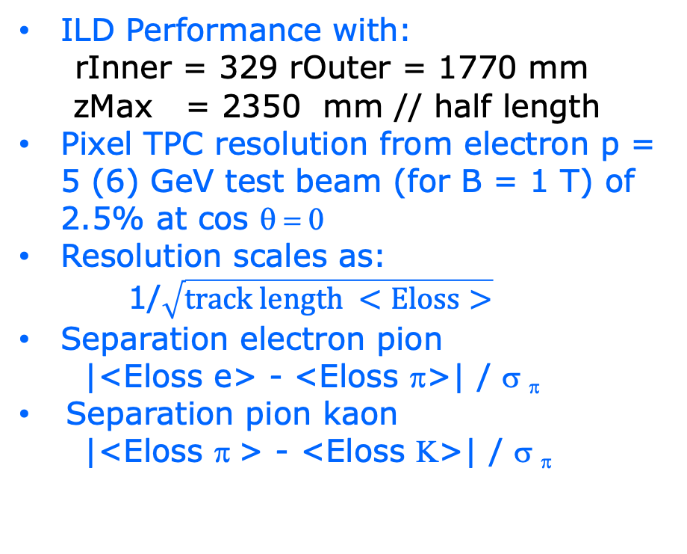
DESY testbeam Module Analysis
Pixel TPC dEdx performance
ILD Performance with:
rInner = 329 rOuter = 1770 mm
zMax = 2350 mm // half length
Pixel TPC resolution from electron p = 5 (6) GeV test beam (for B = 1 T) of 2.5% at cos θ = 0
Resolution scales as:
1/$\sqrt{track length <Eloss>}$
Separation electron pion
|<Eloss e> - <Eloss π>| / σ _{π}
Separation pion kaon
|<Eloss π > - <Eloss Κ>| / σ _{π}
ILD Pixel TPC

Slide 14
DESY testbeam Module Analysis
Pixel TPC dEdx performance
Separation pion kaon
|<Eloss π > - <Eloss Κ>| / σ _{π}
Separation pion kaon for different cos(theta) values due to the track length dependence
For cos(theta)=0 till 0.95 the separation lies between the black and red curves. Only above 0.95-0.975 the separation drops till the blue curve.
Excellent performance over very large polar angle range
ILD Pixel TPC

Slide 15
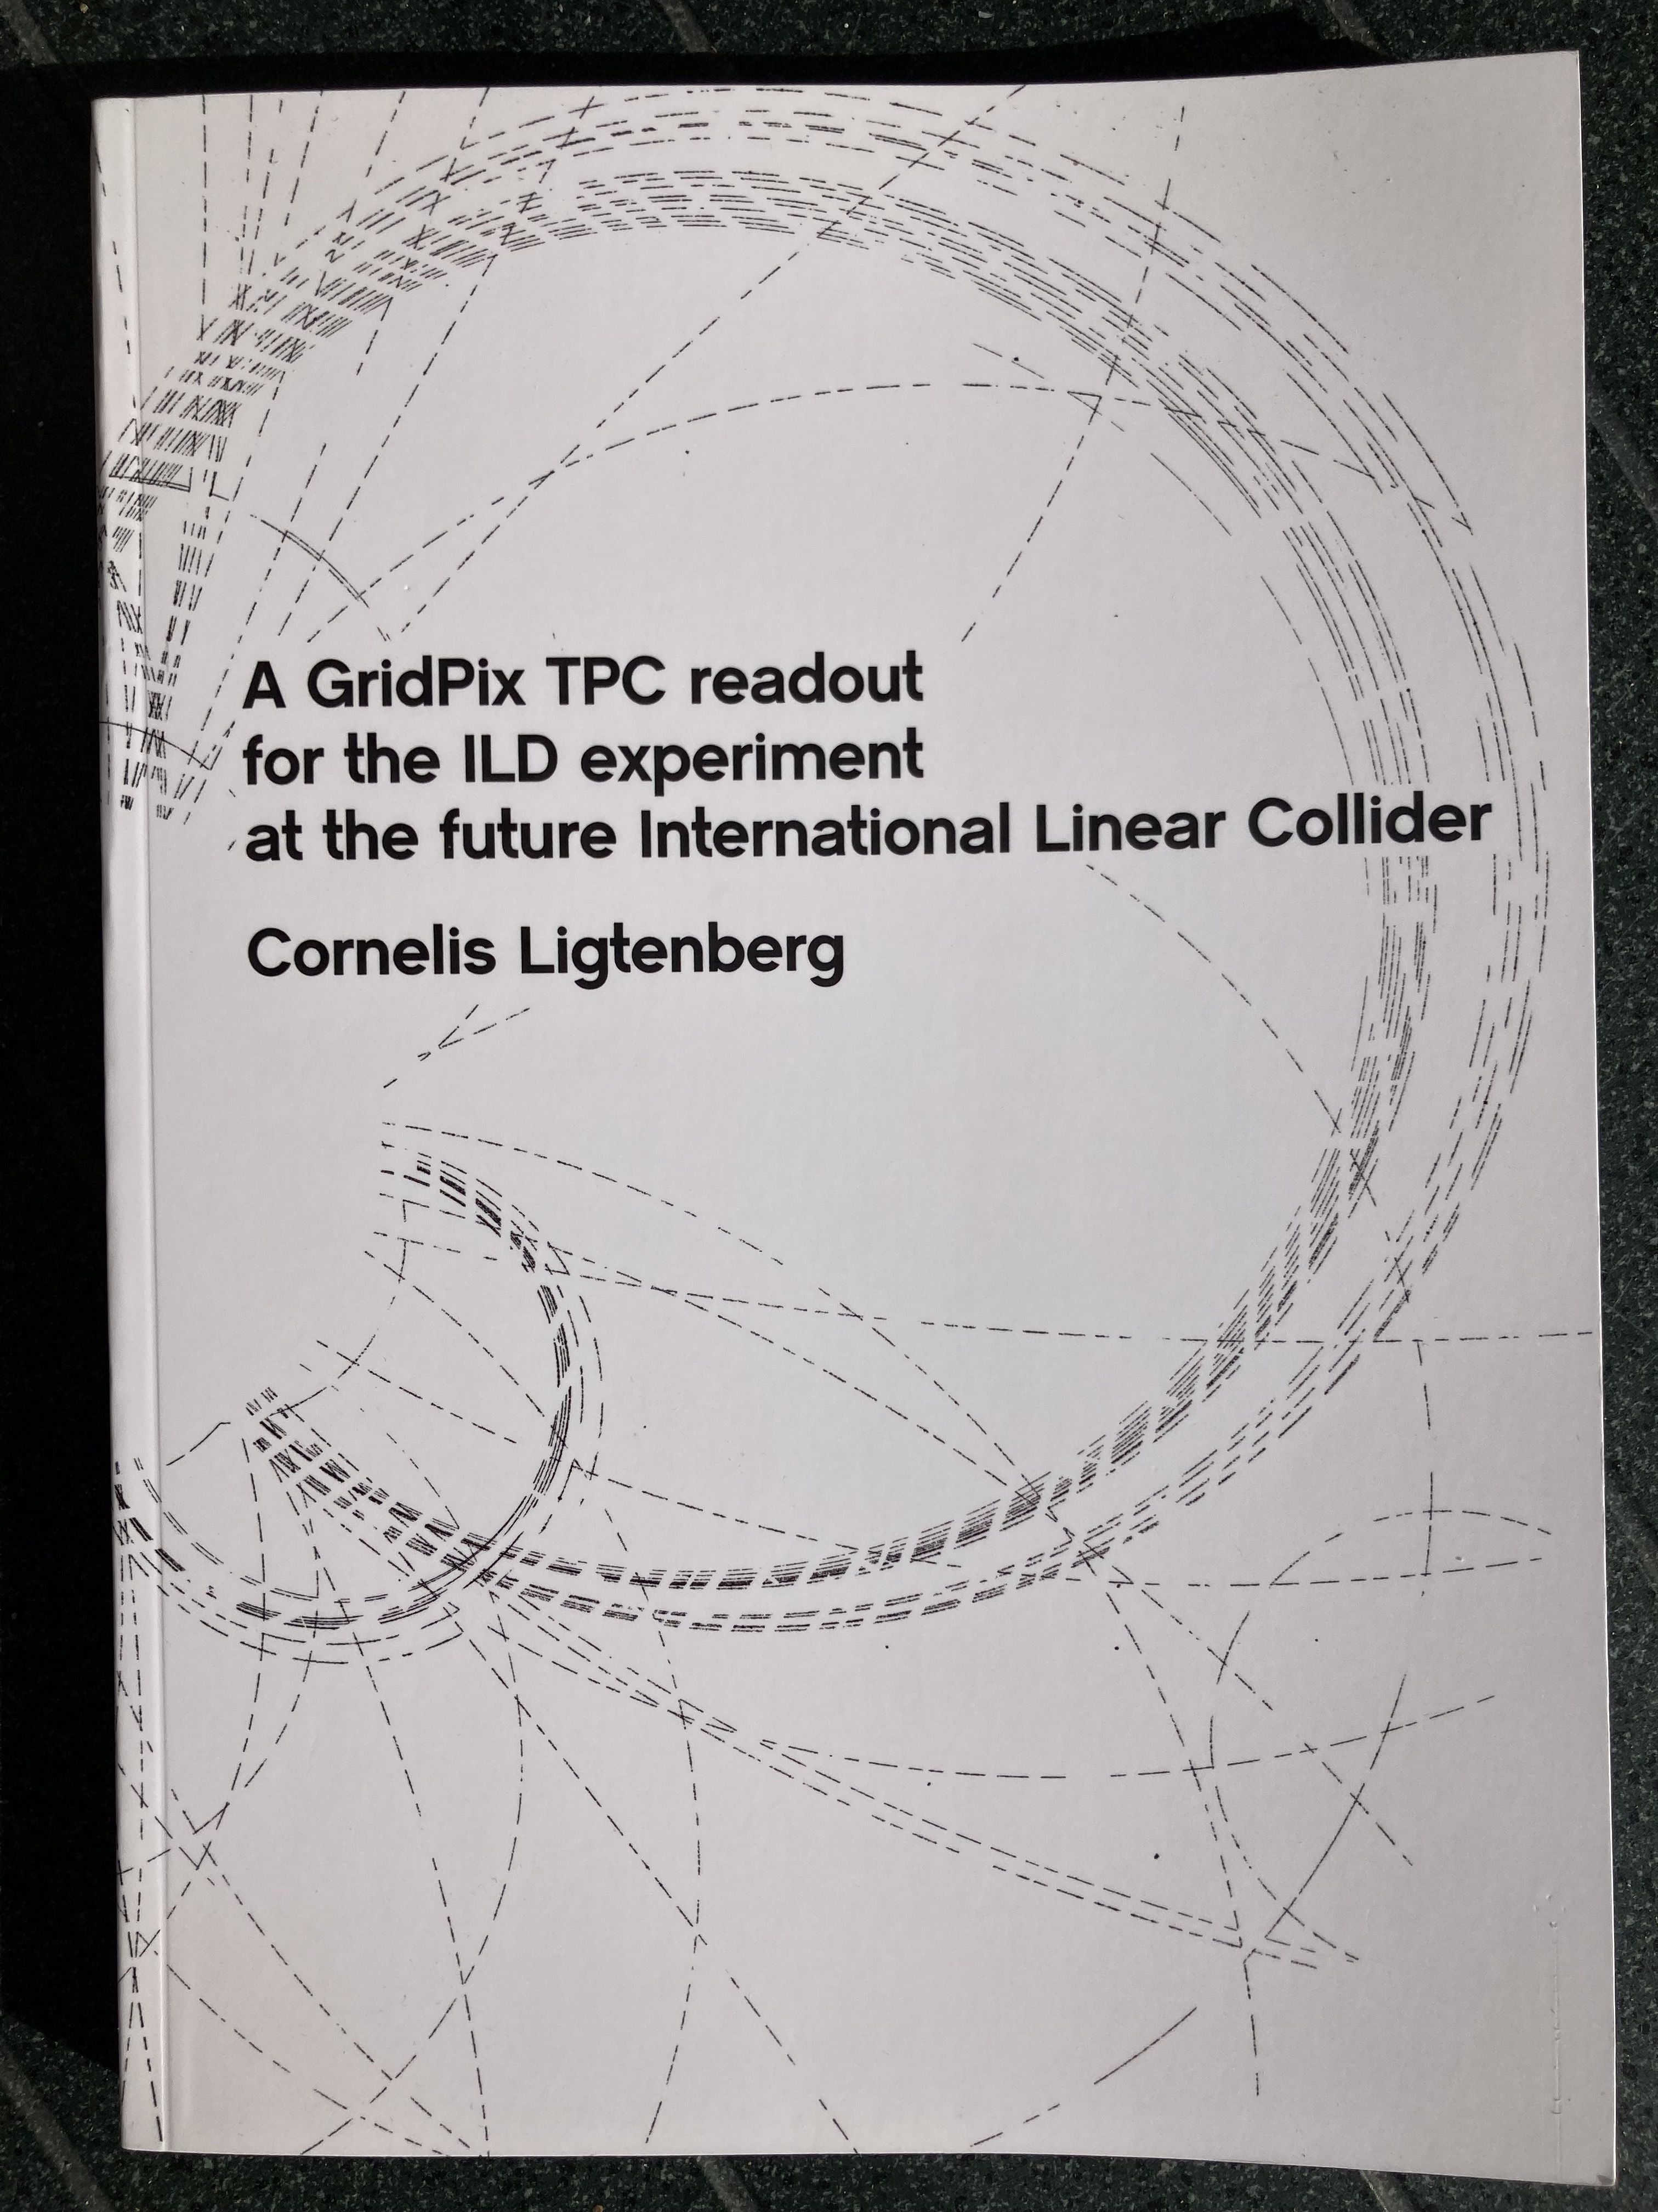
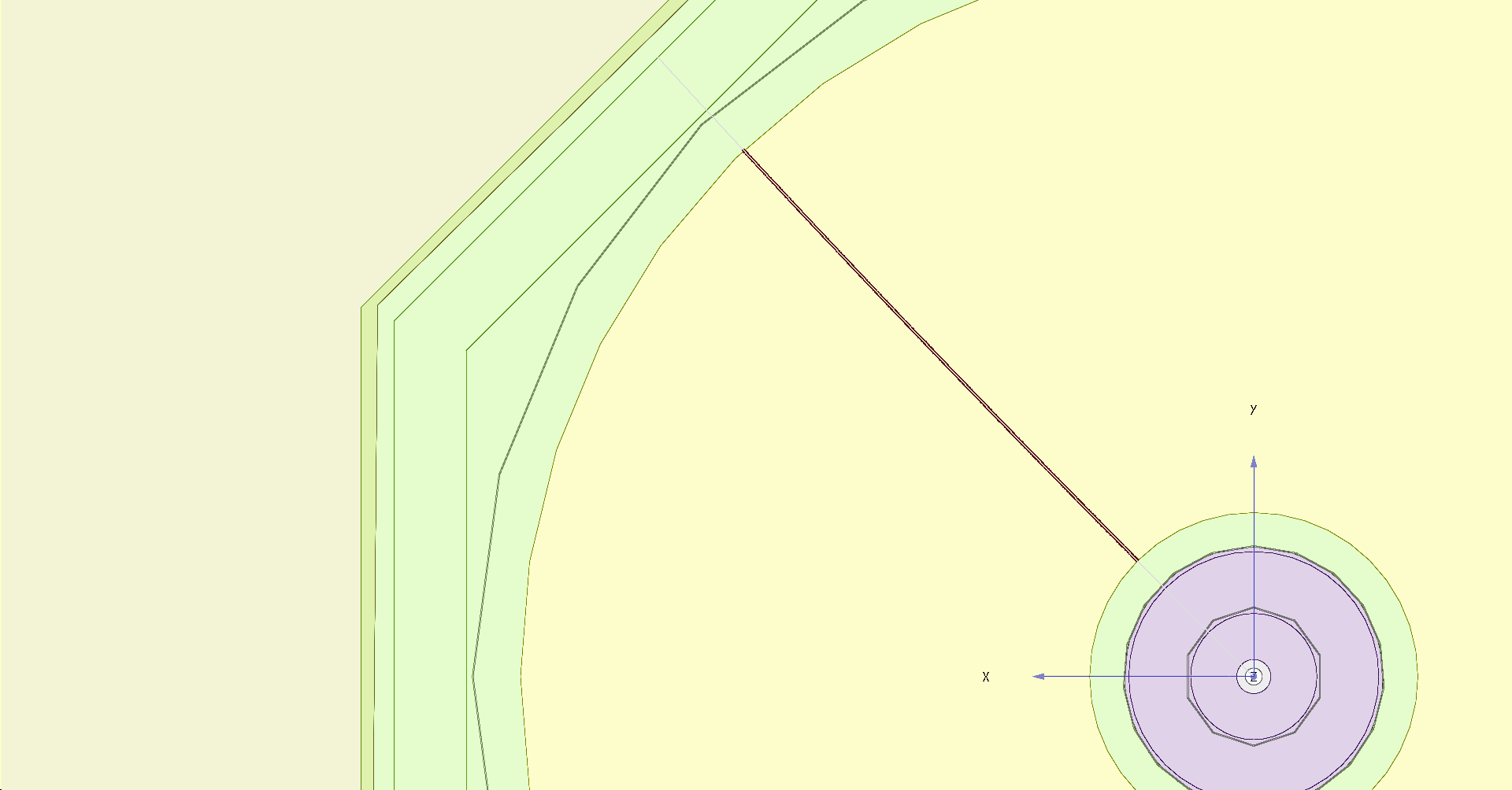
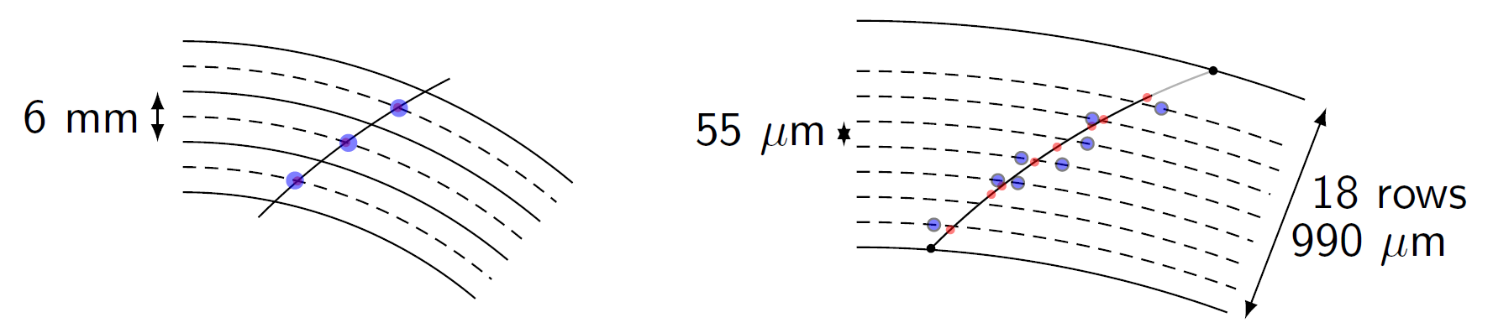
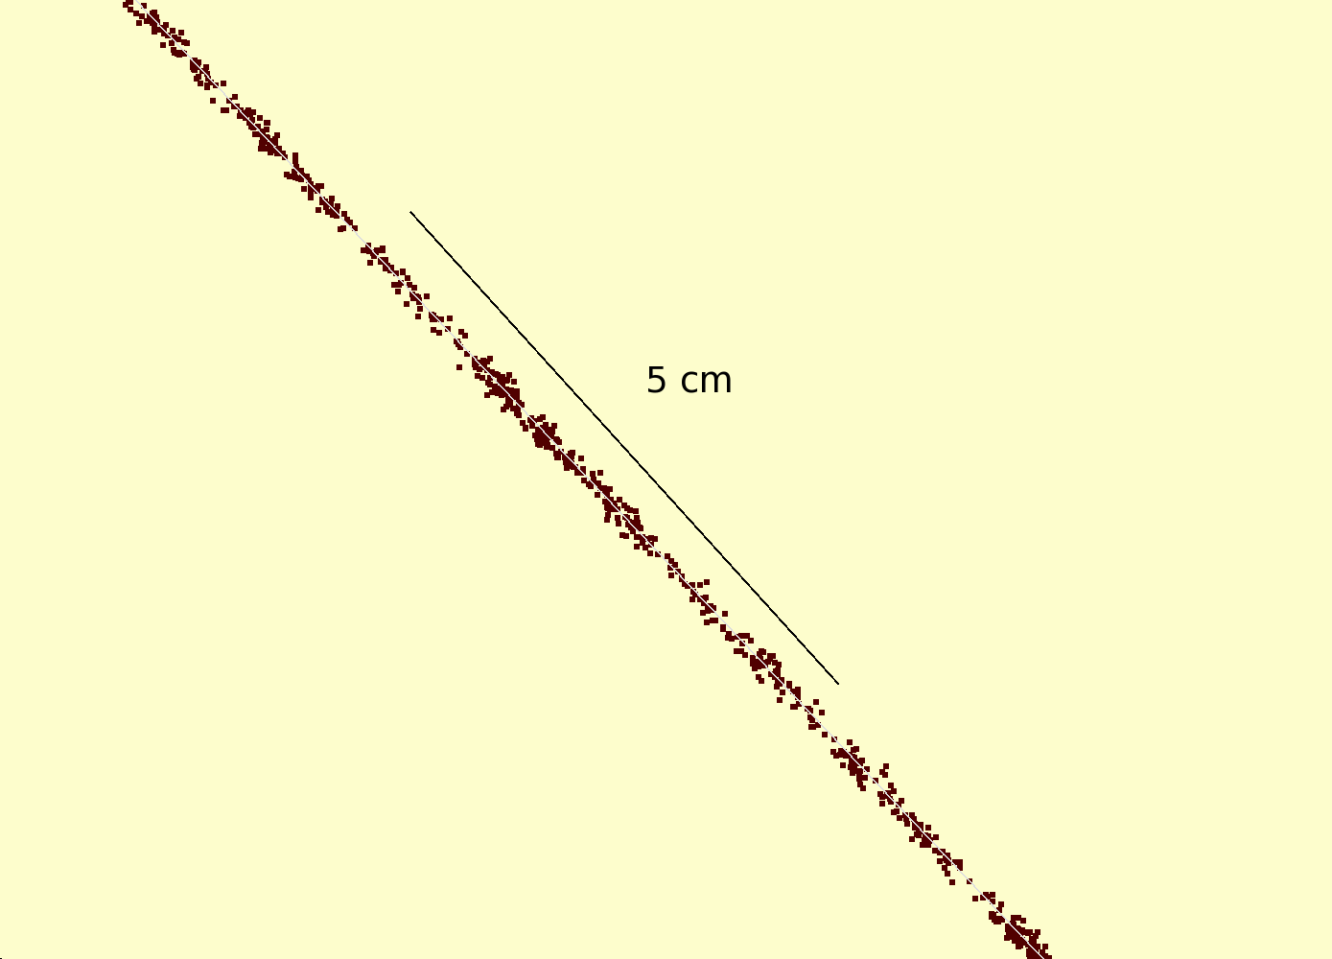
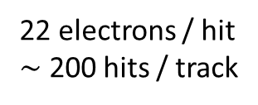
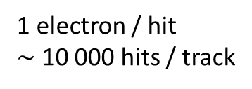
Simulation of ILD TPC with pixel readout
To study the performance of a large pixelized TPC, the pixel readout was implemented in the full ILD DD4HEP (Geant4) simulation
Changed the existing TPC pad readout to a pixel readout
Adapted Kalman filter track reconstruction to pixels
details: PhD thesis Kees Ligtenberg
pixels
pads
50 GeV muon track with
pixel readout

Slide 16
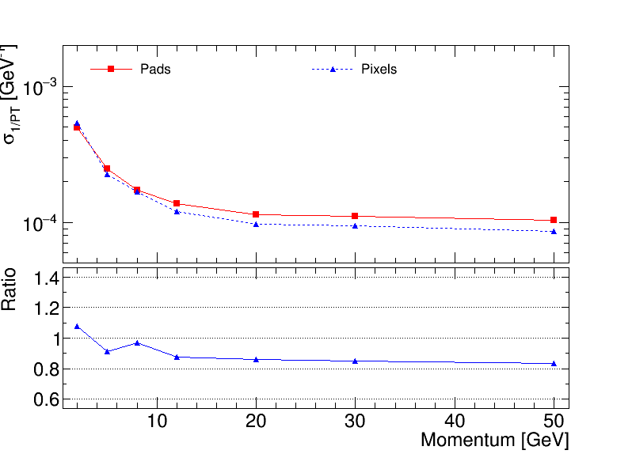
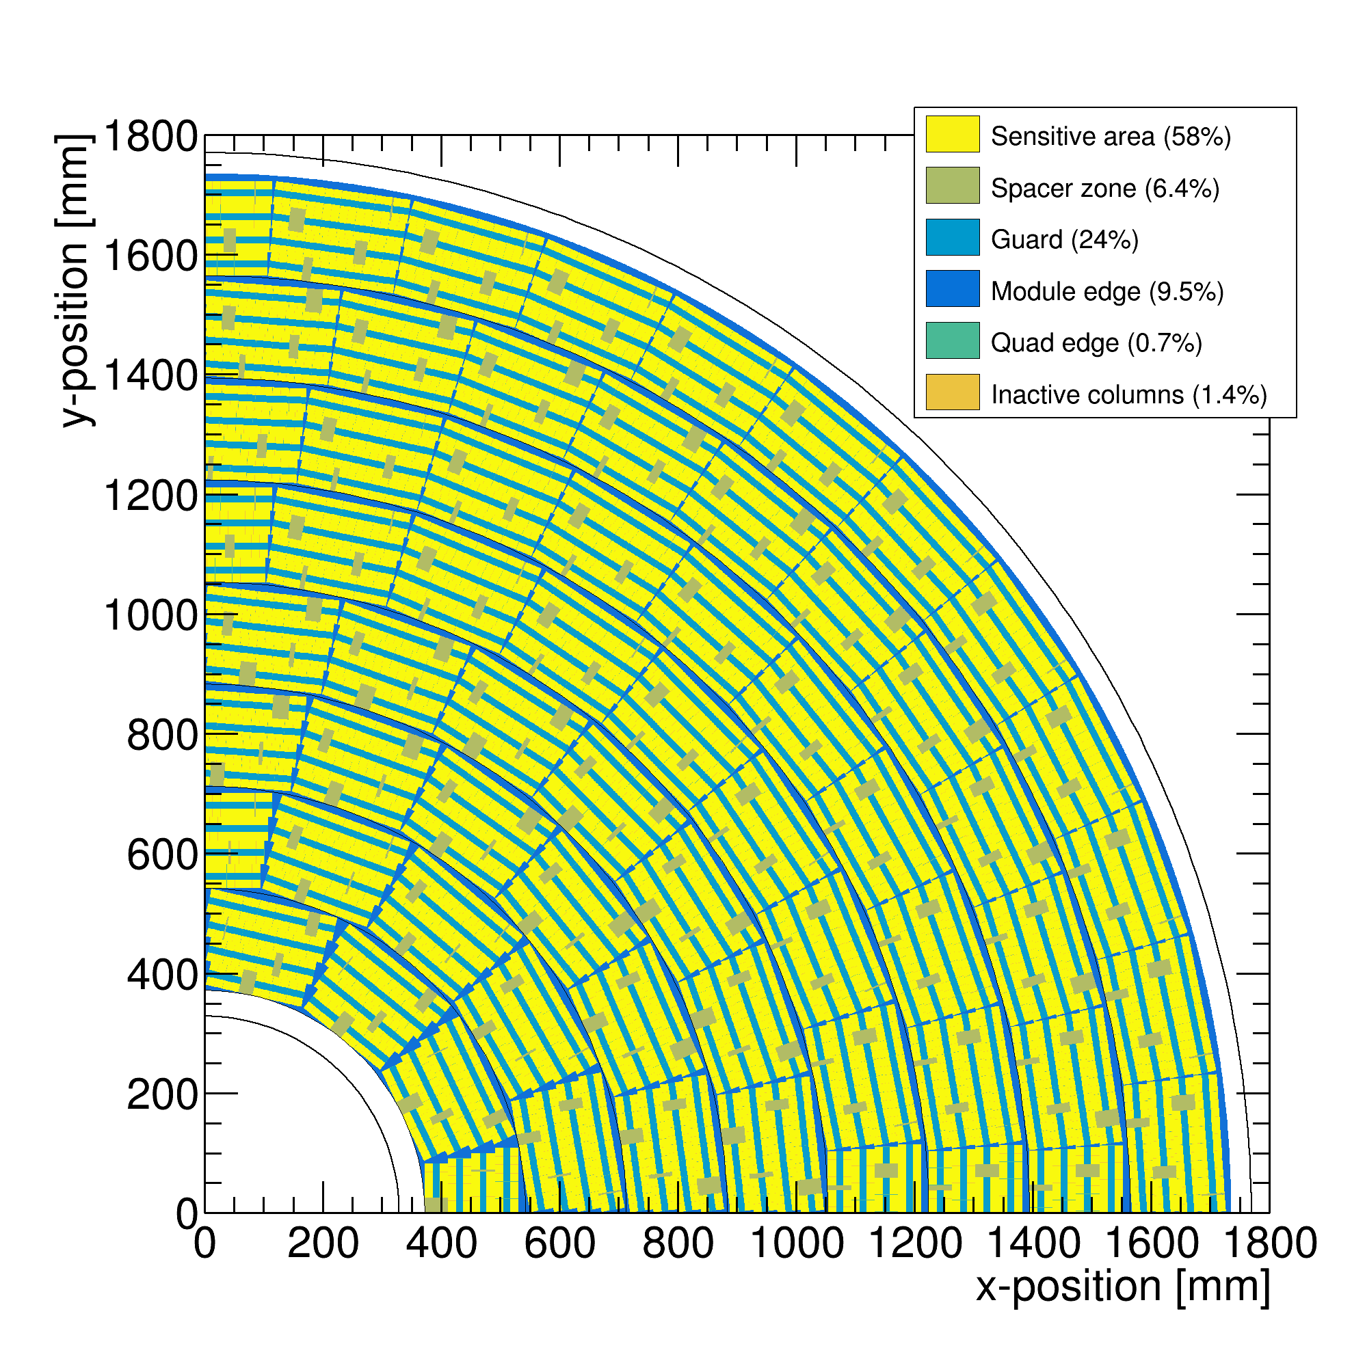
Performance of a GridPix TPC at ILC
From full simulation the momentum resolution can be determined
Momentum resolution is about 15% better for the pixels with realistic coverage (with the quads arranged in modules coverage 59%) and deltas.

Slide 17
Performance of a GridPix TPC
Further integration of the Pixel TPC in the ILD software
A thought by Frank Gaede about combining pixels into pads:
one could easily project the pixels into pads - of similar/same size as in the current ILD simulation
but rather than simply adding up the charge, you can compute the true center-of-gravity based position and charge of the virtual pad
in a second step you combine neighbouring pads to a cluster and compute the position (in r-phi, z) of the cluster and create a SimHit from this
both operations should be linear in time (i.e. one loop over pixels/pads)
This procedure should preserve all the point resolution information of the pixels but allow you to run standard Clupatra as for the pad based TPC reconstruction

Slide 18
Pixel TPC: Track fitting at the edge
In case of the a realistic geometry with detector edges, Kees Ligtenberg observed a worsened momentum resolution and momentum biases. This was traced down to be caused by biases in the residuals at the edge of the detector
The conclusion was that the track fit should be updated to take into account the (small) biases in the residuals at the detector edge(s)
Recently, a master student (computational physics) at the UvA, Peter Voerman, has written a track fit that corrects the biases in one pass: “Track fitting at the edge”.
The technique can also be applied to fit hits from other gaseous or non-gaseous detectors:
  a centre of gravity technique is used (with measured charges over multiple strips near the edge)
  in case of silicon detector hits near the boundaries of the sensitive volume

Slide 19
Pixel TPC: Track fitting at the edge
Peter Voerman

Slide 20
Pixel TPC: Track fitting at the edge
Peter Voerman

Slide 21
Pixel TPC dEdx performance
dE/dx resolution for an electron with p=5,6 GeV/c of 1 m track length with 60% coverage is measured to be 3.5% (at B = 1 Tesla)
The extrapolated resolution for the ILD detector is 2.5%
This allows for particle identification and separation of Kaons from pions up to momenta of 45 GeV with more than 5σ for cos(θ) from 0 to 0.95.
A test beam @ FermiLab with a quad in a TPC is planned (2024, US Grant EIC)
  an EIC R&D program for CO2 cooling is funded (2023) (Yale, Stony Brook, Purdue, Bonn, Nikhef)
  Focus is particle identification and tracking at the Electron-Ion-Collider
A pixel TPC has become a realistic viable option for experiments
  High precision tracking like ILD@ILC in the transverse and longitudinal planes, dE/dx by electron and cluster counting, excellent two track resolution, digital readout that can deal with high rates

Slide 22
Operation of a Pixel TPC at CEPC or FCC-ee

Slide 23
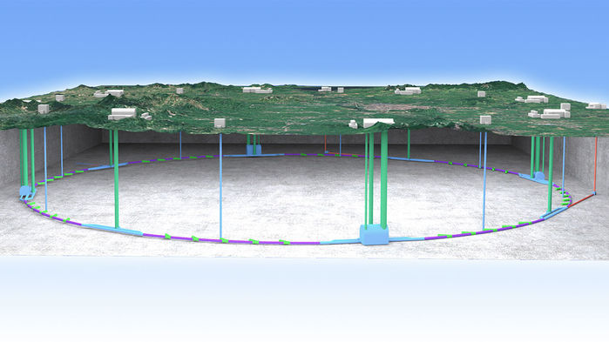
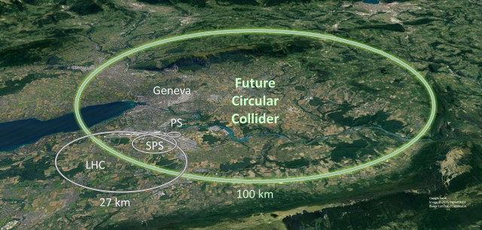
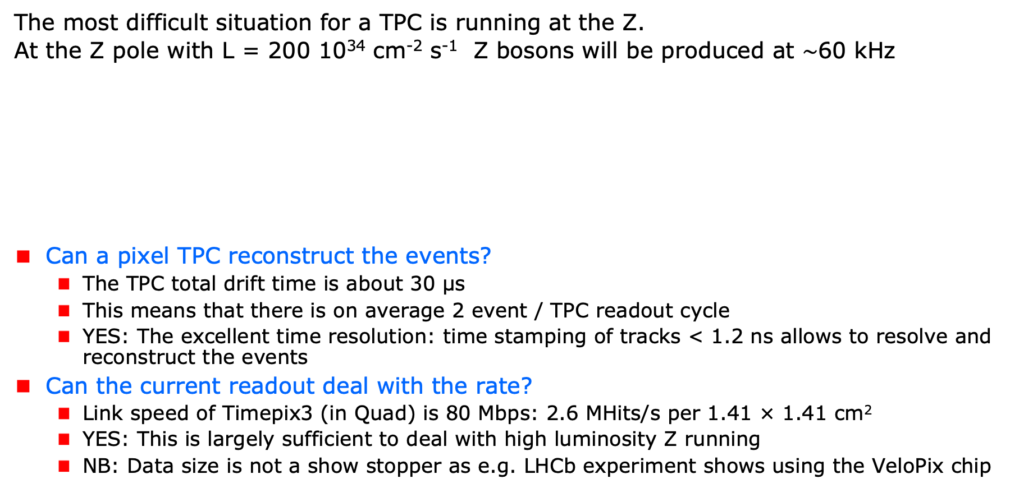
A Pixel TPC at CEPC or FCC-ee
The most difficult situation for a TPC is running at the Z.
At the Z pole with L = 200 10³⁴ cm⁻² s⁻¹ Z bosons will be produced at $\sim$60 kHz
Can a pixel TPC reconstruct the events?
  The TPC total drift time is about 30 μs
  This means that there is on average 2 event / TPC readout cycle
  YES: The excellent time resolution: time stamping of tracks < 1.2 ns allows to resolve and reconstruct the events
Can the current readout deal with the rate?
  Link speed of Timepix3 (in Quad) is 80 Mbps: 2.6 MHits/s per 1.41 × 1.41 cm²
  YES: This is largely sufficient to deal with high luminosity Z running
  NB: Data size is not a show stopper as e.g. LHCb experiment shows using the VeloPix chip
Picture IHEP

Slide 24
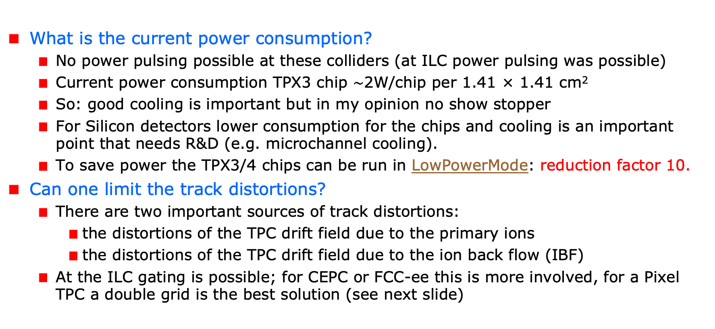
A Pixel TPC at CEPC or FCC-ee
What is the current power consumption?
  No power pulsing possible at these colliders (at ILC power pulsing was possible)
  Current power consumption TPX3 chip $\sim$2W/chip per 1.41 × 1.41 cm²
  So: good cooling is important but in my opinion no show stopper
  For Silicon detectors lower consumption for the chips and cooling is an important point that needs R&D (e.g. microchannel cooling).
  To save power the TPX3/4 chips can be run in LowPowerMode: reduction factor 10.
Can one limit the track distortions?
  There are two important sources of track distortions:
    the distortions of the TPC drift field due to the primary ions
    the distortions of the TPC drift field due to the ion back flow (IBF)
  At the ILC gating is possible; for CEPC or FCC-ee this is more involved, for a Pixel TPC a double grid is the best solution (see next slide)

Slide 25
A Pixel TPC at CEPC or FCC-ee
Is it possible to reduce the IBF for a pixel TPC?
  IDEA: by making chip with a double grid structure (see next slide)
  This idea was already realized as a TWINGRID NIMA 610 (2009) 644-648
  For GEMs for the ALICE TPC this was also the way – several GEMs on top of each other to reduce IBF
  For the Pixel the IBF can be easily modelled and with a hole size of 25 μm an IBF of 3 10⁻⁴ can be achieved and the value for IBF*Gain (2000) would be 0.6.
  YES: the IBF can be reduced to 0.6 but this needs R&D
  In the new detector lab in Bonn it is possible to make and study this device
What would be the size of the TPC distortions?
  Tera-Z studies by Daniel Jeans and Keisuke Fuji show that for FCC-ee or CEPC this means: distortions from Z decays up to < O(100) μm
  Beam strahlung gives (now) a factor 200 more background. Detector optimization and shielding is important for TPC and Silicon detectors to reduce pair background.
  It was argued that in an ILD like detector the distortions can be mapped out using the VTX-SIT/SET detectors.

Slide 26
Reducing the Ion back flow in a Pixel TPC
The Ion back flow can be reduced by adding a second grid to the device.
It is important that the holes of the grids are aligned. The Ion back flow is a function of the geometry and electric fields. Detailed simulations – validated by data - have been presented in LCTPC WP #326.
With a hole size of 25 μm an IBF of 3 10⁻⁴ can be achieved and the value for IBF*Gain (2000) would be 0.6.
Ion backflow | Hole 30 μm | Hole 25 μm | Hole 20 μm
Top grid | 2.2% | 1.2% | 0.7%
GridPix | 5.5% | 2.8% | 1.7%
Total | 12 10⁻⁴ | 3 10⁻⁴ | 1 10⁻⁴
transparancy | 100% | 99.4% | 91.7%

Slide 27
Fitting out TPC distortions in ILD
It is possible to map out distortions using e.g. muons from Z decays
  E.g. by fitting the 3D space charge distribution as a function of time as was done by ALEPH and more recently by ALICE. Using this distribution the hits positions are corrected and the TPC track refitted.
However, ILD allows for more elaborate procedures. One can use the track predictions based of the silicon trackers SIT and SET to correct on a track-by-track level the TPC track.
  One can use as a constraint that the extrapolated positions and angles agree with the measured in the SIT and SET.
  Practically, one can e.g. correct the TPC track parameters
The ultimate way is a fitting technique similar to what is developed in ATLAS. In the ATLAS track fit the common systematics is fitted out for sets of Muon hits. For ILD the fit would fit free parameters in the distortion model, while using as a constraint the SIT and SET postion and direction measurements.
  The simplest case is a model where the strength (amplitude) and radial dependence would be scaled and a model is used for the 3D extrapolations.

Slide 28
Conclusions: Pixel TPC at a circular collider
YES: a pixel TPC can reconstruct the Z events in one readout cycle
YES: the current readout of the Timepix3 chip can deal with the rate
The current power consumption is 1W/cm². By running the TPX chips in low power mode this can be reduced by a factor of 10. Still good cooling is important no show stopper; but needs extensive R&D.
Track distortions in the TPC drift volume are a concern at high lumi Z running:
  Track distortions from Z decays in TPC are O(100) μm
  It is possible to reduce the IBF for a pixel TPC by making a device with a double grid
  A double grid needs dedicated R&D that can be performed in the new lab in Bonn
The Z physics program at FCC-ee or CEPC with an ILD-like detector with a Pixel TPC (with double grid structures) sliced between two silicon trackers (VTX-SIT and SET) can be fully exploited. The reduction of beamstrahlung needs more study.
A pixel TPC can perfectly run at WW, ZH or tt energies where track distortions are several orders of magnitude smaller

