Slide 1








Status Pixel TPC
R&D
Yevgen Bilevych, Klaus Desch, Sander van Doesburg, Harry van der Graaf, Fred Hartjes, Jochen Kaminski, Peter Kluit, Naomi van der Kolk,
Cornelis Ligtenberg,
Gerhard Raven, and
Jan Timmermans
ILD meeting 15 January 2024

Slide 2
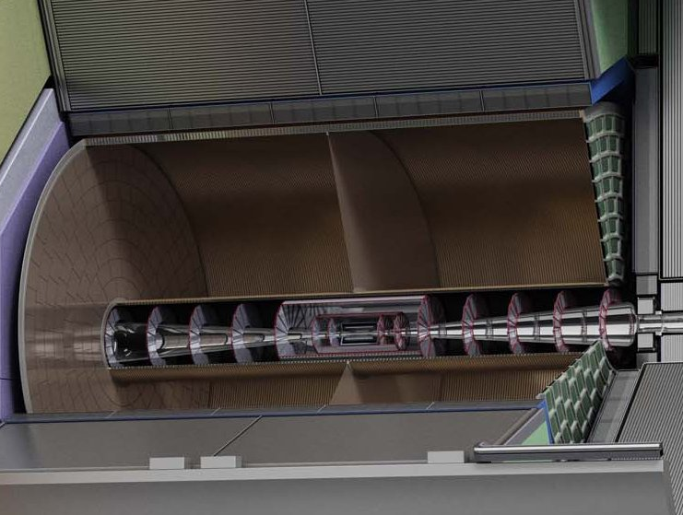



Pixel TPC
(Octopuce)
(TimePix1) TPX3 chip Quad Module TPC plane
(2007-14) 2017 2018 2019

Slide 3
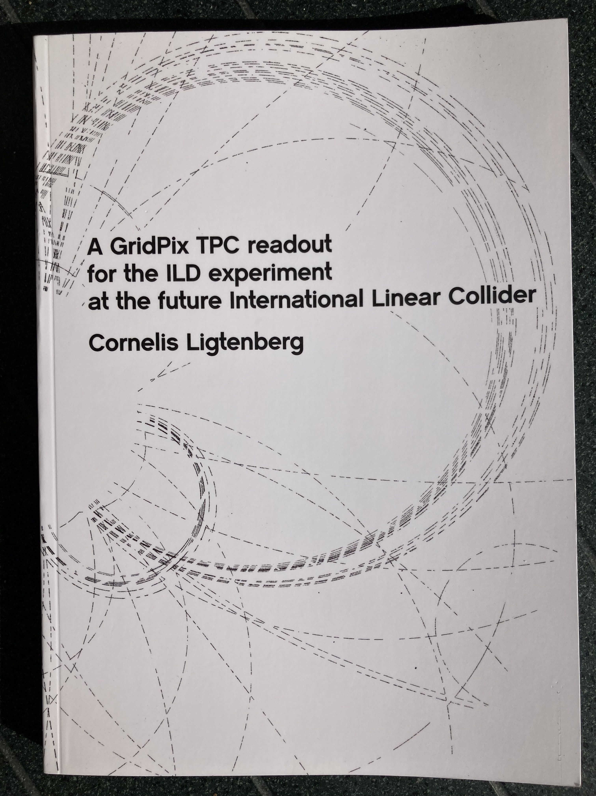
Pixel TPC
Material budget is
  0.01 X₀ TPC gas
  0.01 X₀ inner cylinder
  0.03 X₀ outer cylinder
  < 0.25 X₀ endplates (incl readout)
Note the very low budget in the barrel region. Material budget can be respected by different technologies like GEM, MicroMegas and Pixels
TPC is sliced between silicon detectors VTX, SIT and SET
pixel readout is a serious option for the TPC readout plane @ ILC/FFC-ee/CLIC/CEPC colliders
https://www.nikhef.nl/pub/services/biblio/theses_pdf/thesis_C_Ligtenberg.pdf

Slide 4
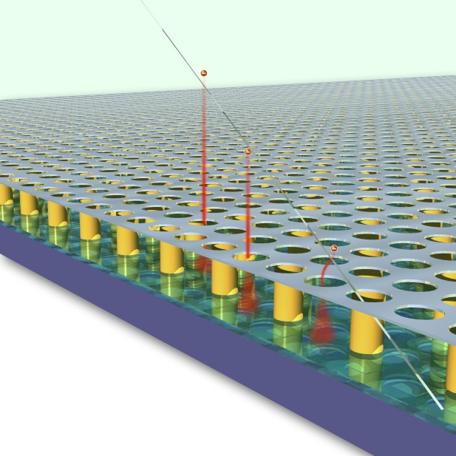
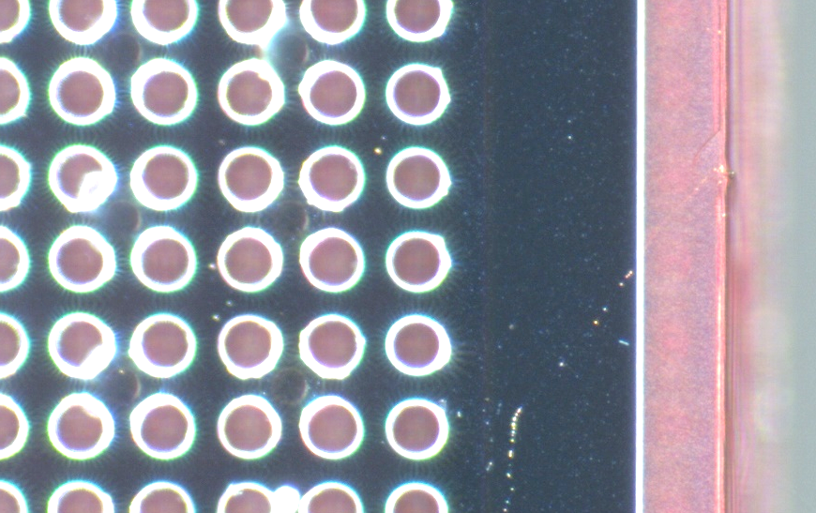
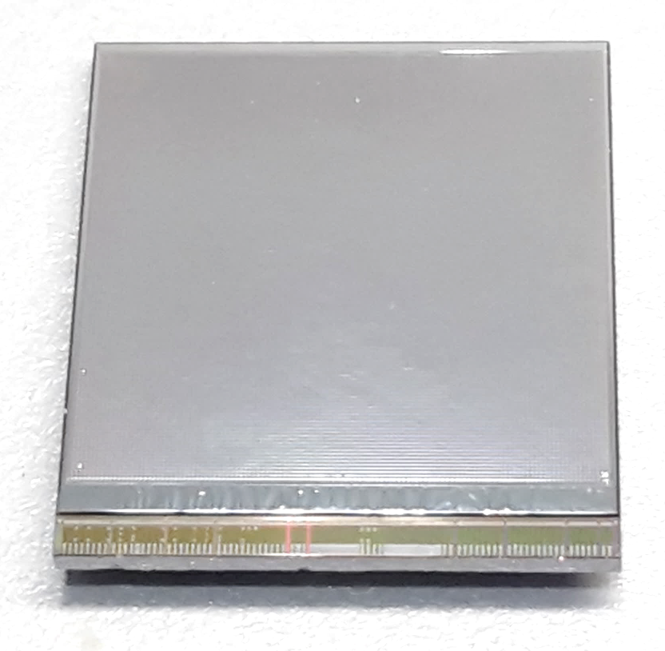
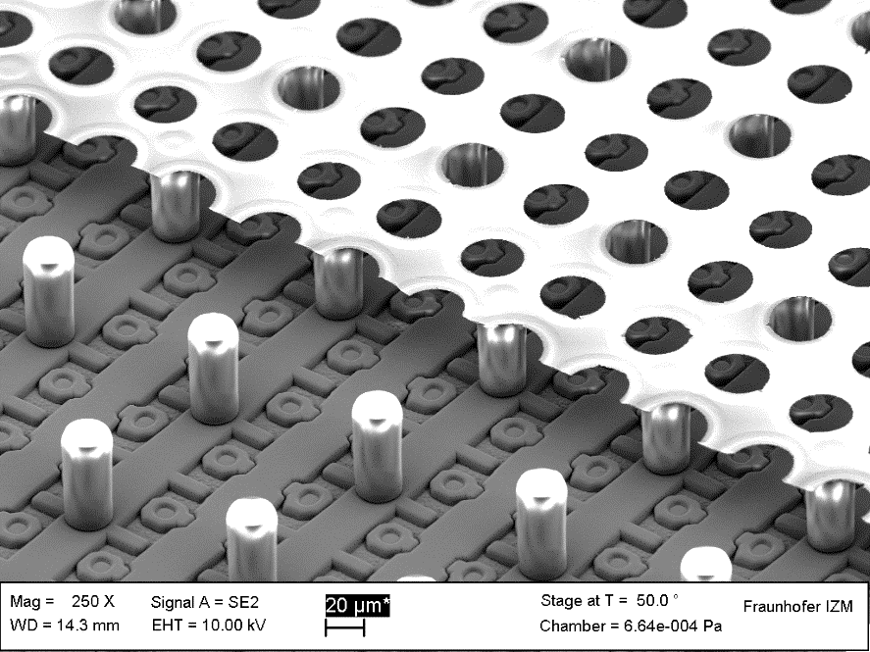
GridPix technology
Pixel chip with integrated Grid (Micromegas-like)
InGrid post-processed @ IZM
Grid set at negative voltage (300 – 600 V) to provide gas amplification
Very small pixel size (55 µm)
detecting individual electrons
dyke
55 µm
Aluminium grid (1 µm thick)
35 µm wide holes, 55 µm pitch
Supported by SU8 pillars 50 µm high
Grid surrounded by SU8 dyke (150 µm wide solid strip) for mechanical and HV stability
50 µm

Slide 5
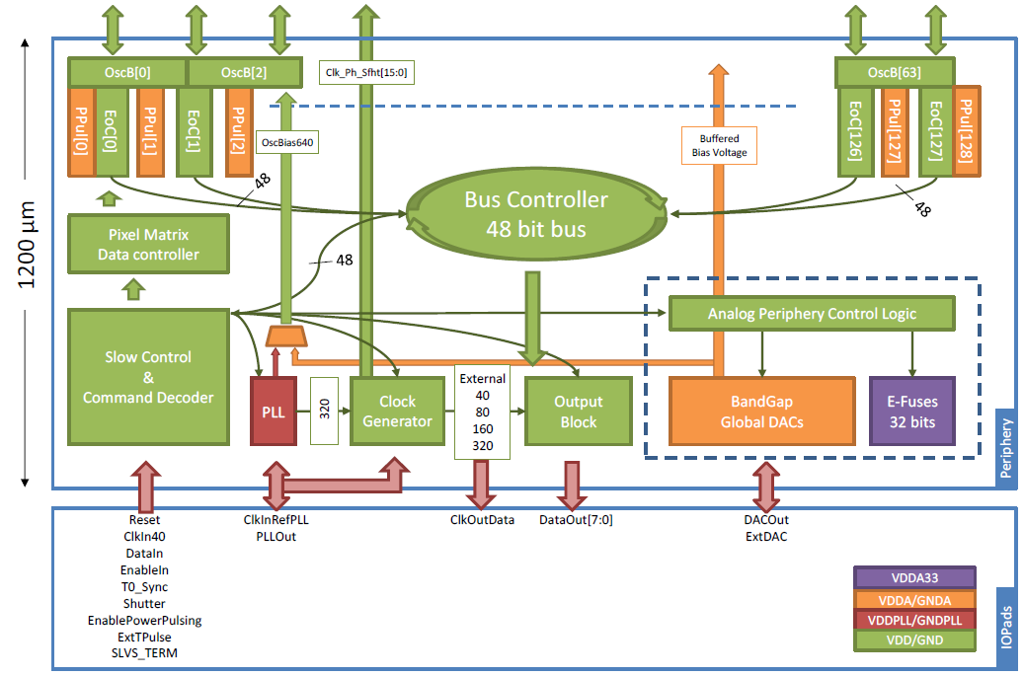
Pixel chip: TimePix3
256 x 256 pixels
55 x 55 µm pitch
14.1 x 14.1 mm sensitive area
TDC with 640 MHz clock (1.56 ns)
Used in the data driven mode
  Each hit consists of the pixel address and time stamp of arrival time (ToA)
  Time over threshold (ToT) is added to register the signal amplitude
  compensation for time walk
  Trigger (for t₀) added to the data stream as an additional time stamp
Power consumption
  ~1 A @ 2 V (2W) depending on hit rate
  good cooling is important
Sensitive area
14.1 mm
2+3 mm

Slide 6
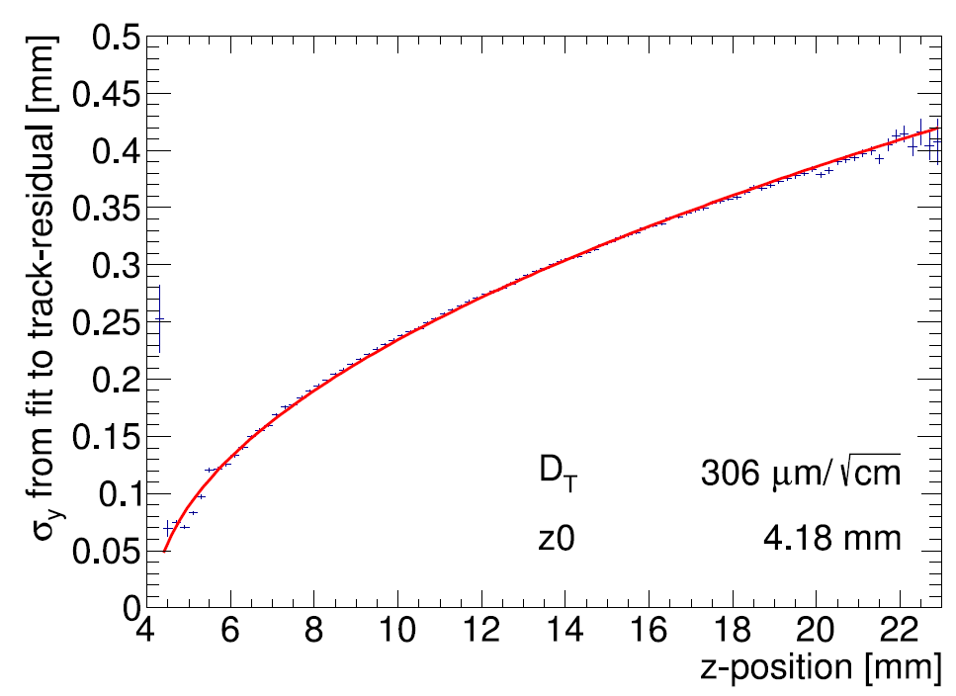
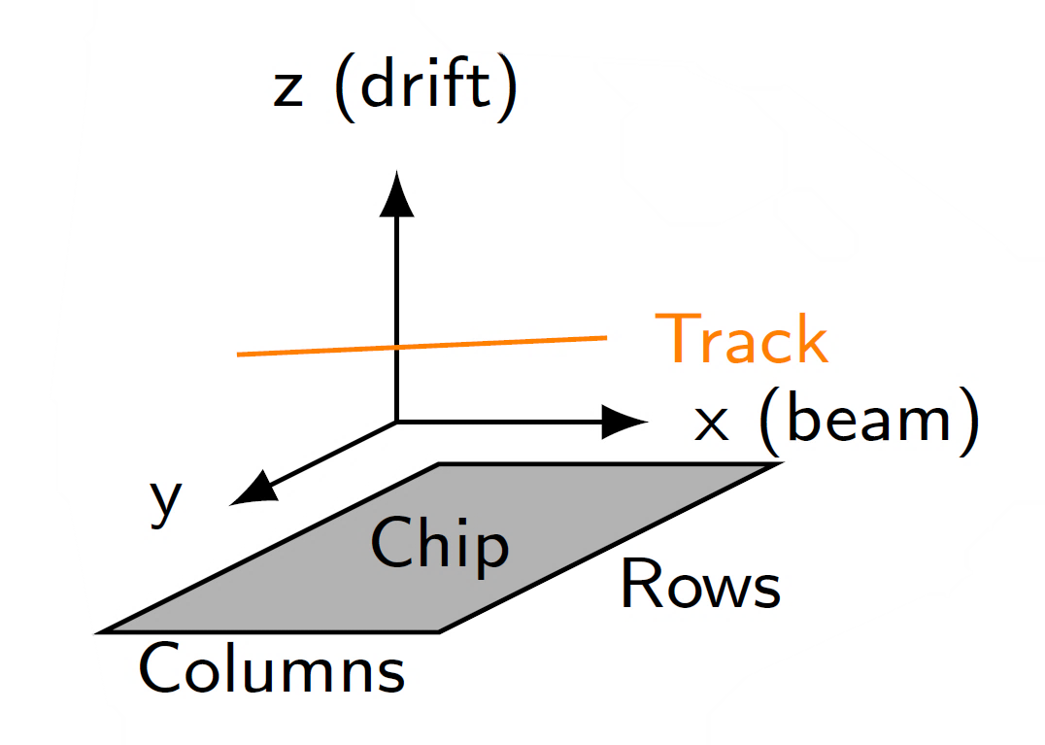
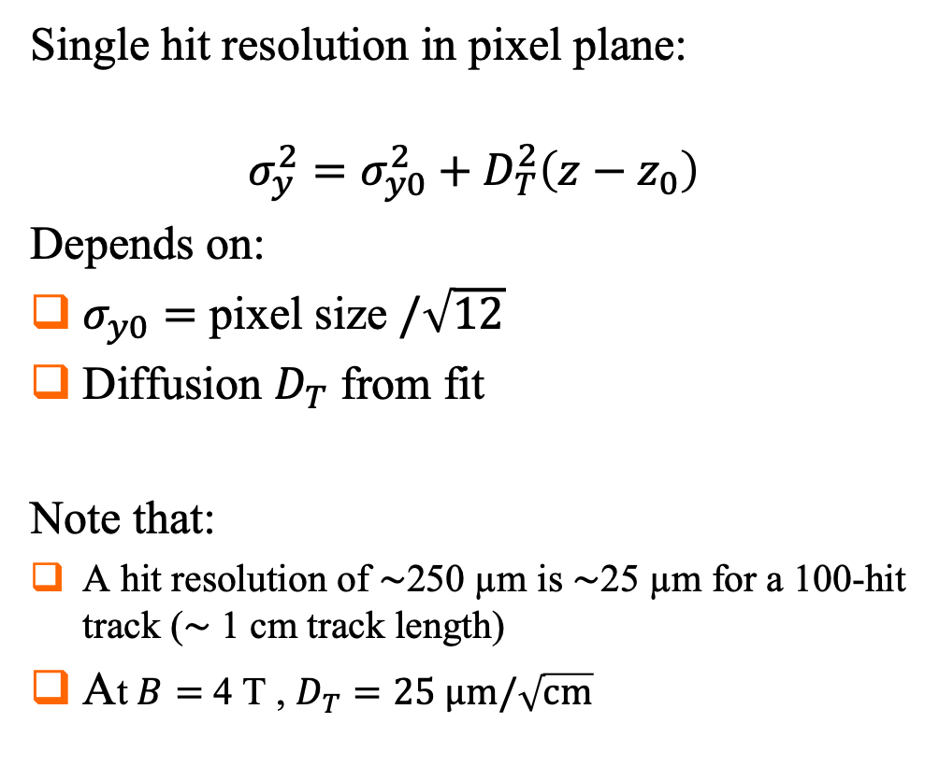
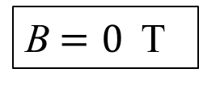
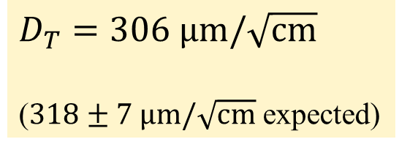
Single hit resolution in transverse direction
Results from Bonn-Elsa testbeam in 2017
https://doi.org/10.1016/j.nima.2018.08.012
B$=0$ T
Single hit resolution in pixel plane:
$$σ_{y}^{2}=σ_{y0}^{2}+D_{T}^{2}\left(z−z_{0}\right)$$
Depends on:
$σ_{y0}=$ pixel size $/\sqrt{12}$
Diffusion $D_{T}$ from fit
Note that:
A hit resolution of $\sim$250 µm is $\sim$25 µm for a 100-hit track ($\sim$ 1 cm track length)
At $B=$ 4 T , $D_{T}=25 \text{μm}/\sqrt{\text{cm}}$
T2K gas
$D_{T}=306 \text{μm}/\sqrt{\text{cm}}$
($318±7 \text{μm}/\sqrt{\text{cm}}$ expected)

Slide 7
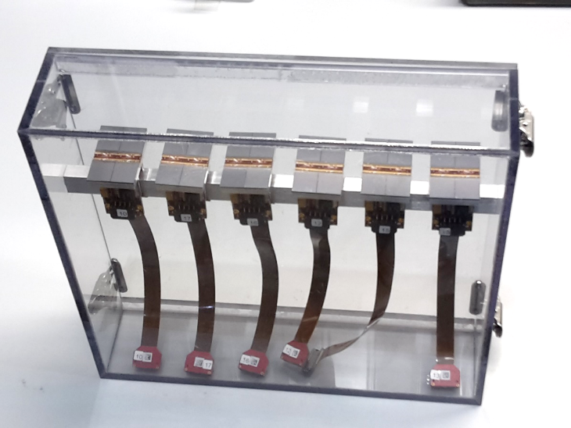
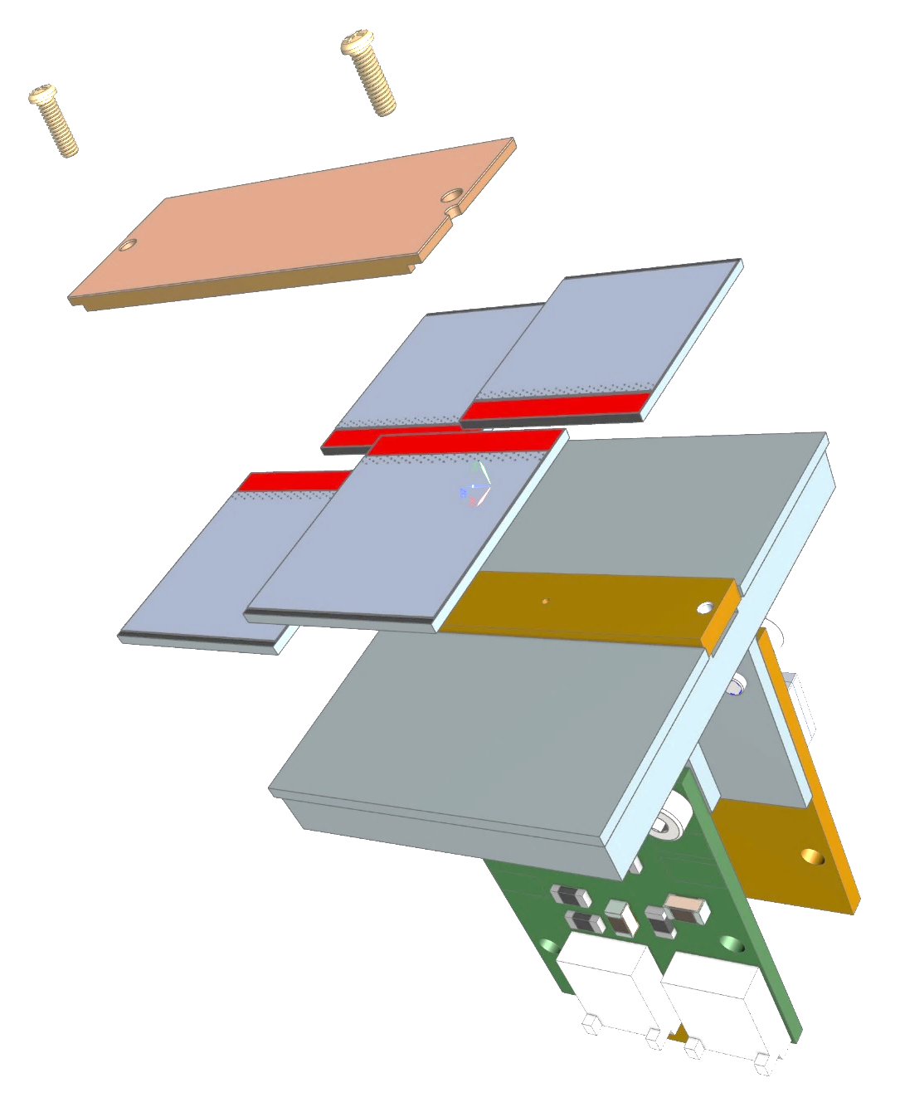
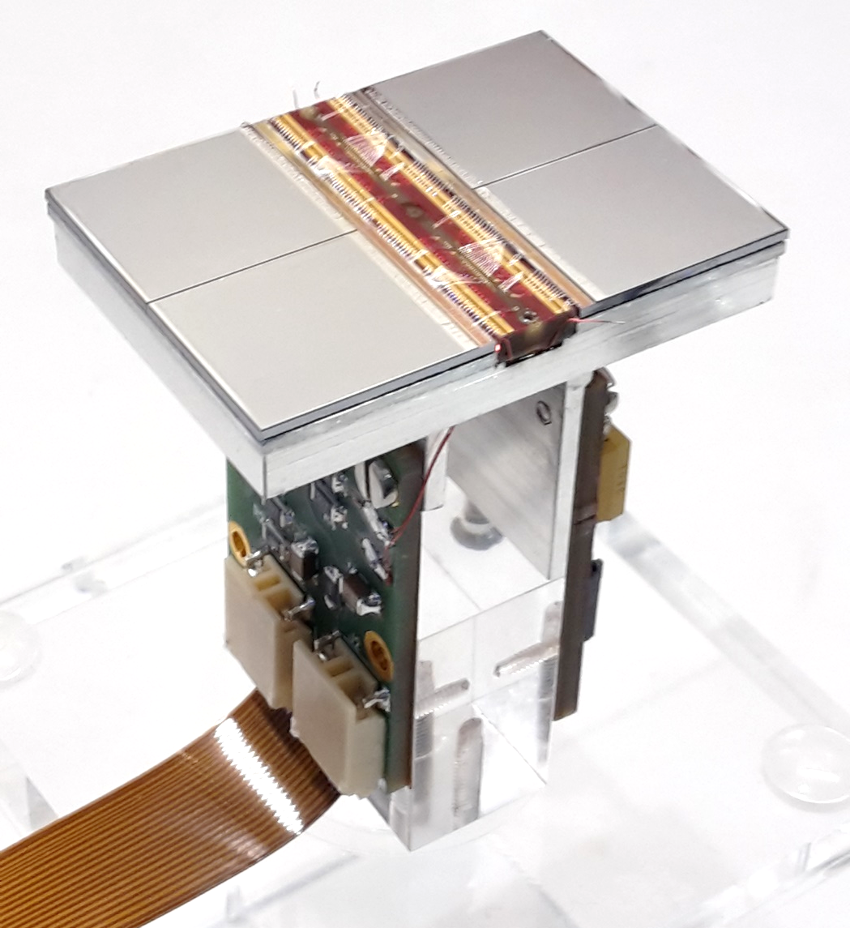
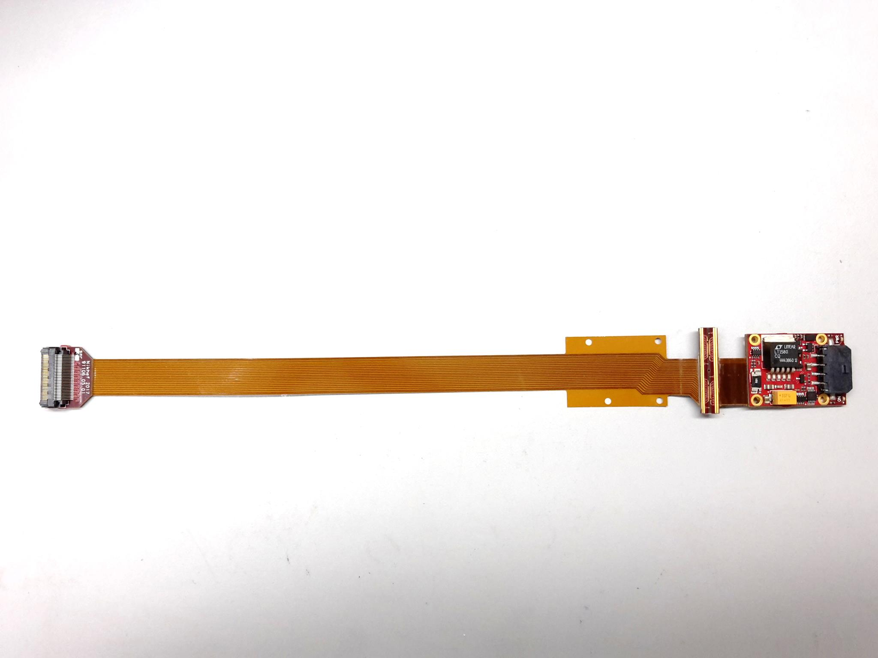
QUAD design and realization
Four-TimePix3 chips
All services (signal IO, LV power) are located under the detection surface
The area for connections was squeezed to the minimum
Very high precision 10 μm mounting of the chips and guard
QUAD has a sensitive area of 68.9%
DAQ by SPIDR
39.6 x 28.38 mm
series of QUADs
Guard
TPX3
TPX3
TPX3
TPX3
COld
CArrier

Slide 8
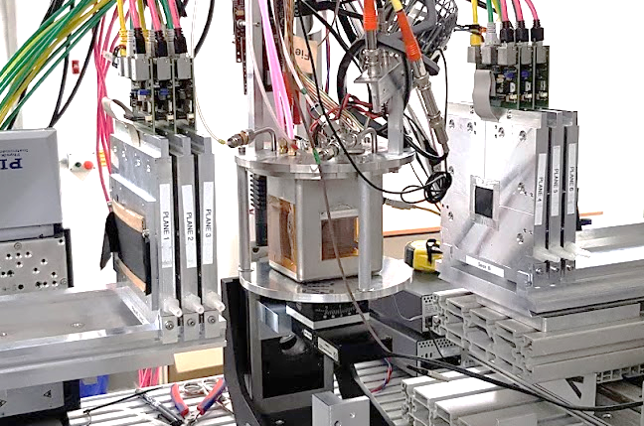
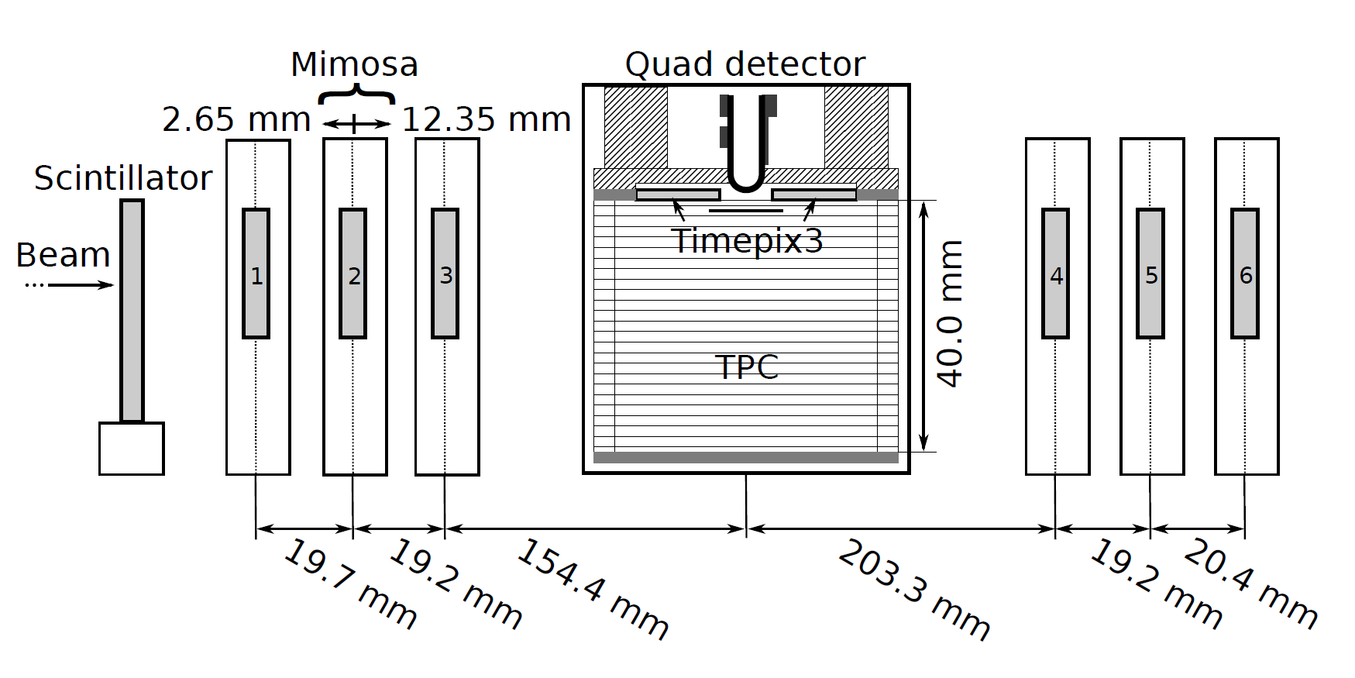

QUAD test beam in Bonn (October 2018)
ELSA: 2.5 GeV electrons
Tracks referenced by Mimosa telescope
QUAD sandwiched between Mimosa planes
  Largely improved track definition
  6 planes with 18.4 μm × 18.4 μm sized pixels
Gas: Ar/CF₄/iC₄H₁₀ 95/3/2 (T2K)
E_{d} = 400 V/cm, V_{grid} = -330 V
Typical beam height above the chip: ~1 cm
Published NIMA https://doi.org/10.1016/j.nima.2019.163331
@Bonn
Field cage

Slide 9
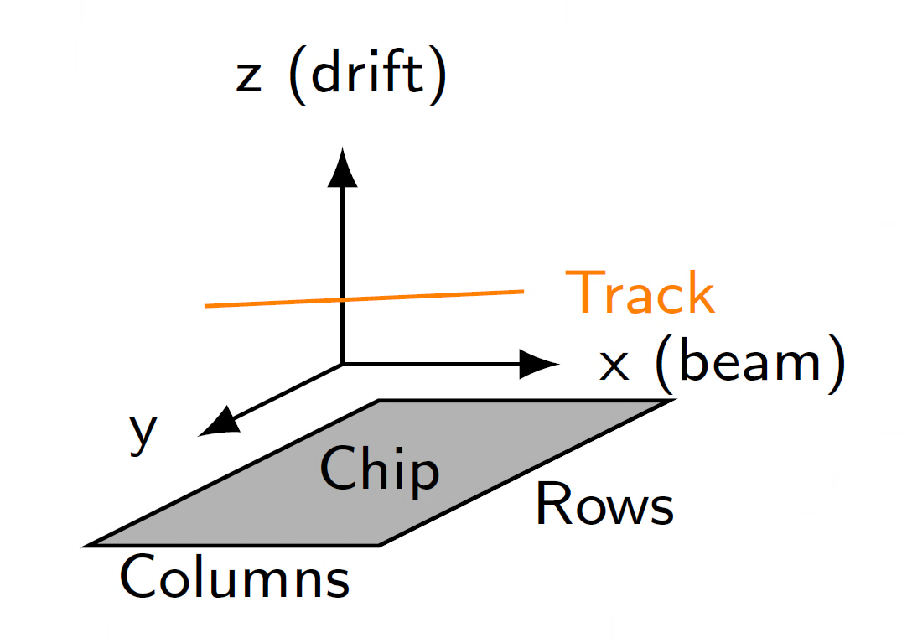
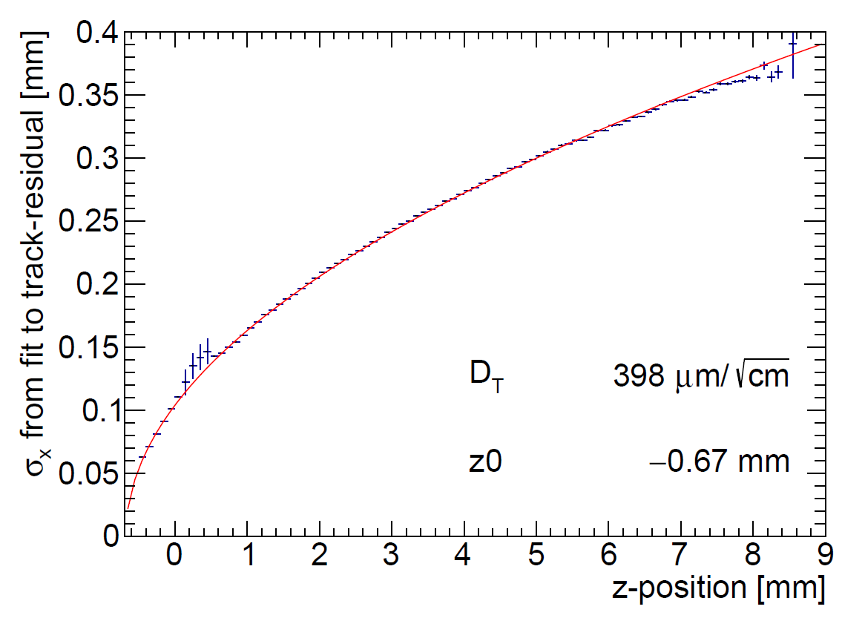
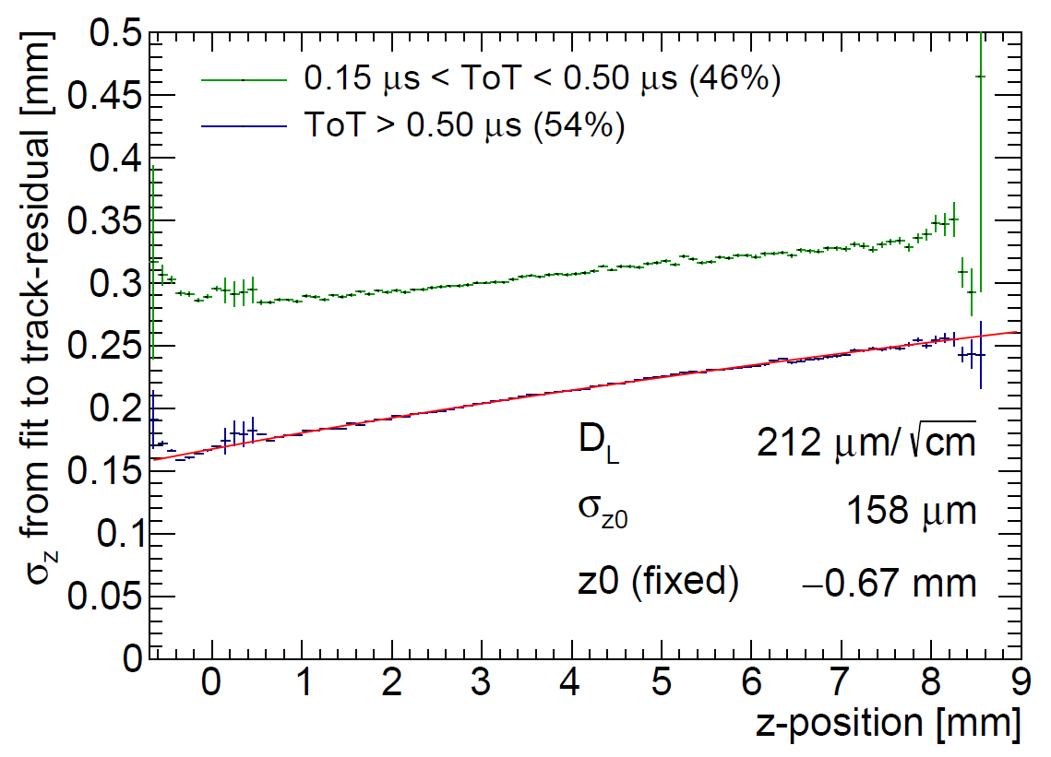
QUAD single hit resolution
Transverse
Longitudinal
D_{T} = 398 μm/√cm
D_{L} = 212 μm/√cm
The D_{T} value is rather high due to an error in the gas mixing (too low CF4)

Slide 10
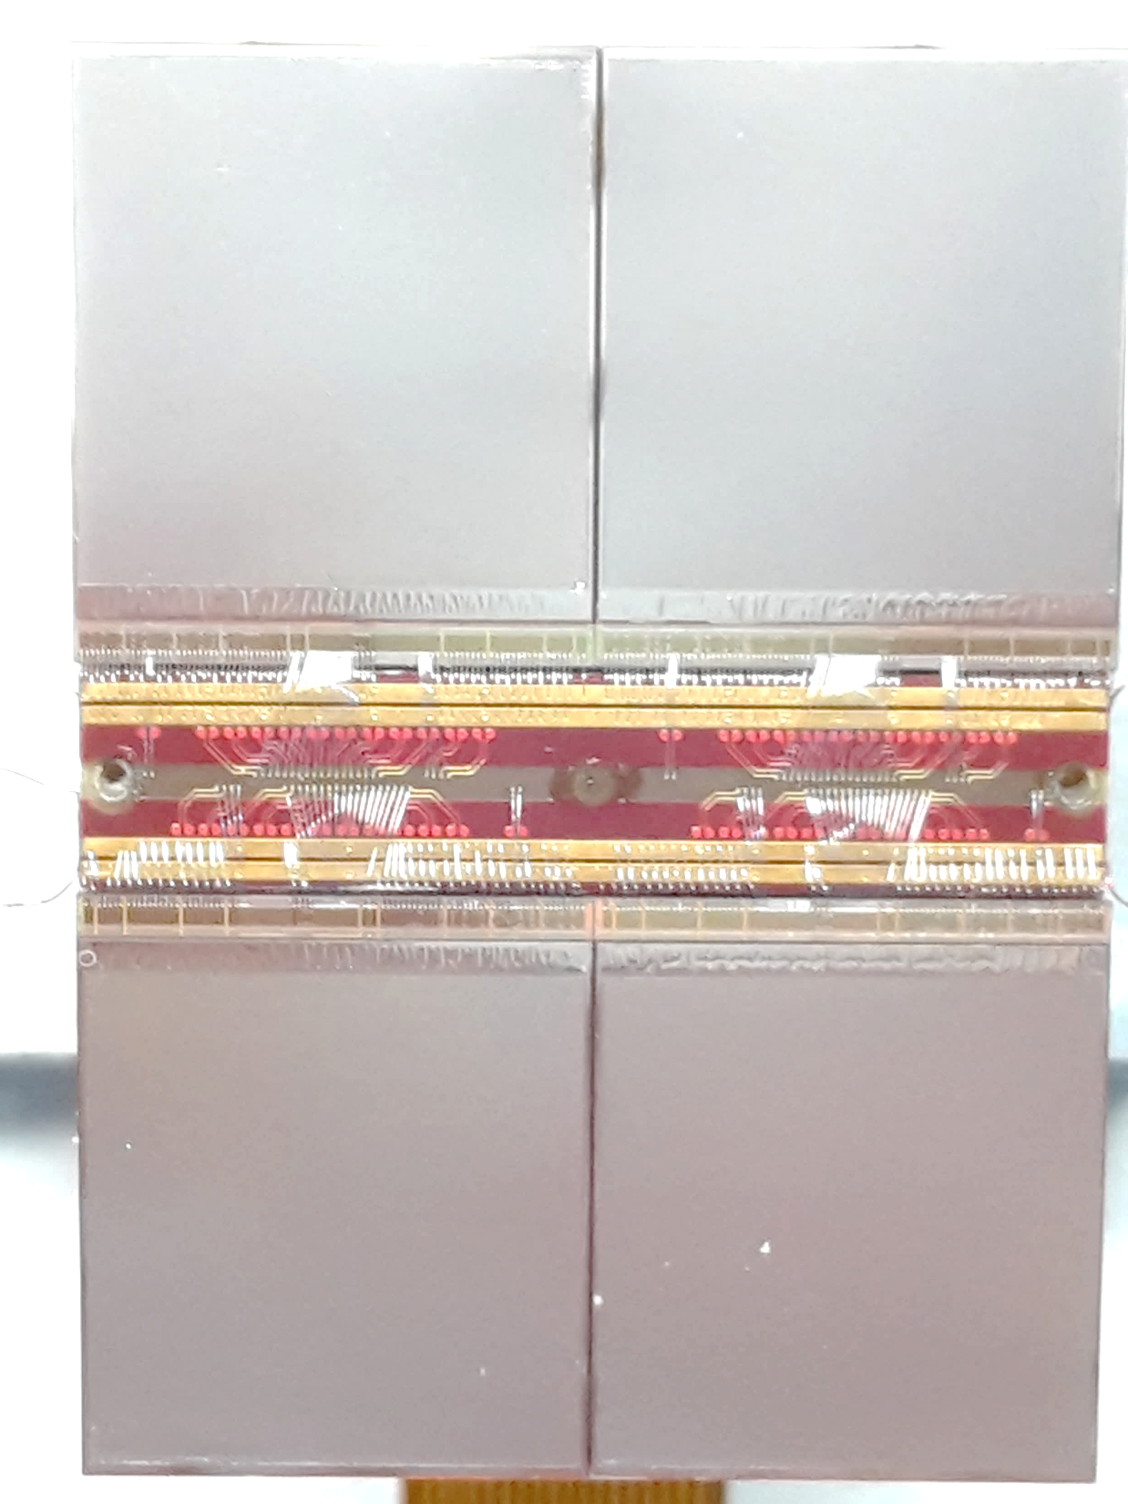
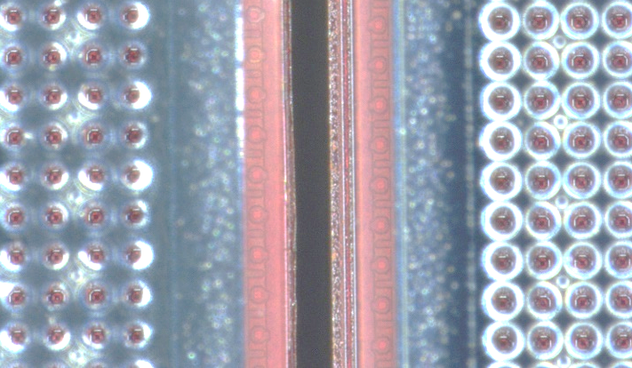
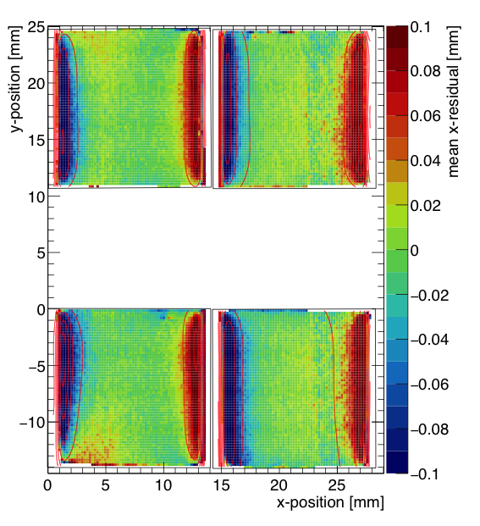
QUAD edge deformations (XY)
Small deformations due to
  Dead zone between chips
  Grounded region between chips
Are corrected by:
  fitted correction function
  adding proper guard wire electrode
Grounded region

Slide 11
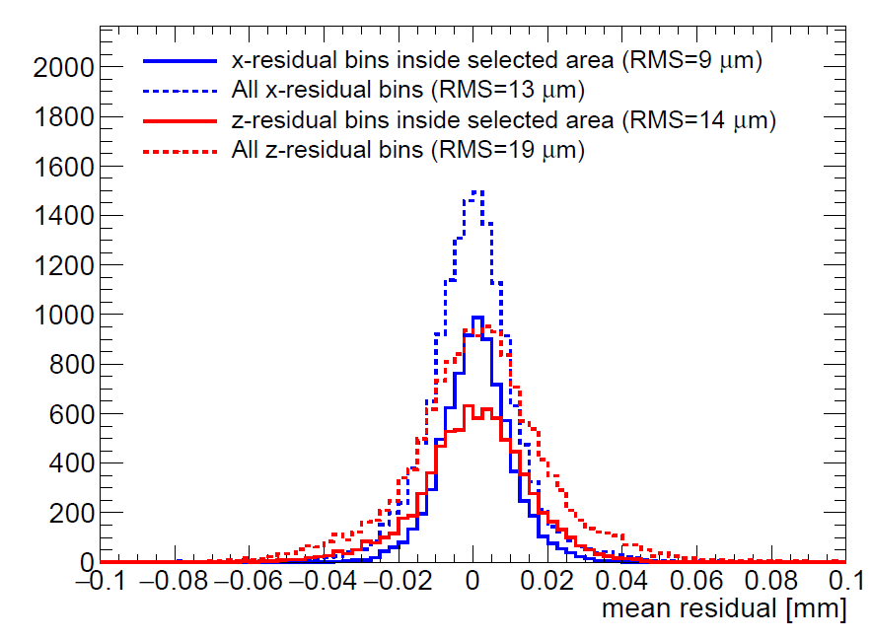
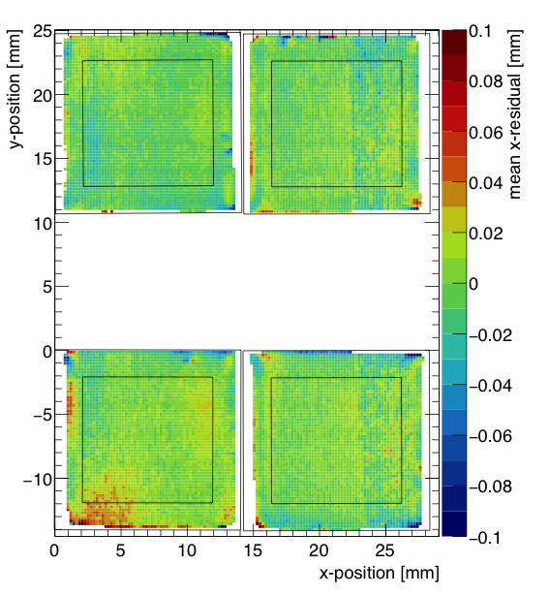
QUAD deformations in transverse plane (XY)
After applying fitted edge corrections
RMS of the mean residuals are 13 μm over the whole QUAD
XY

Slide 12
QUAD as a building block
8-QUAD module (2x4 quads) with field cage
in red guard wires

Slide 13
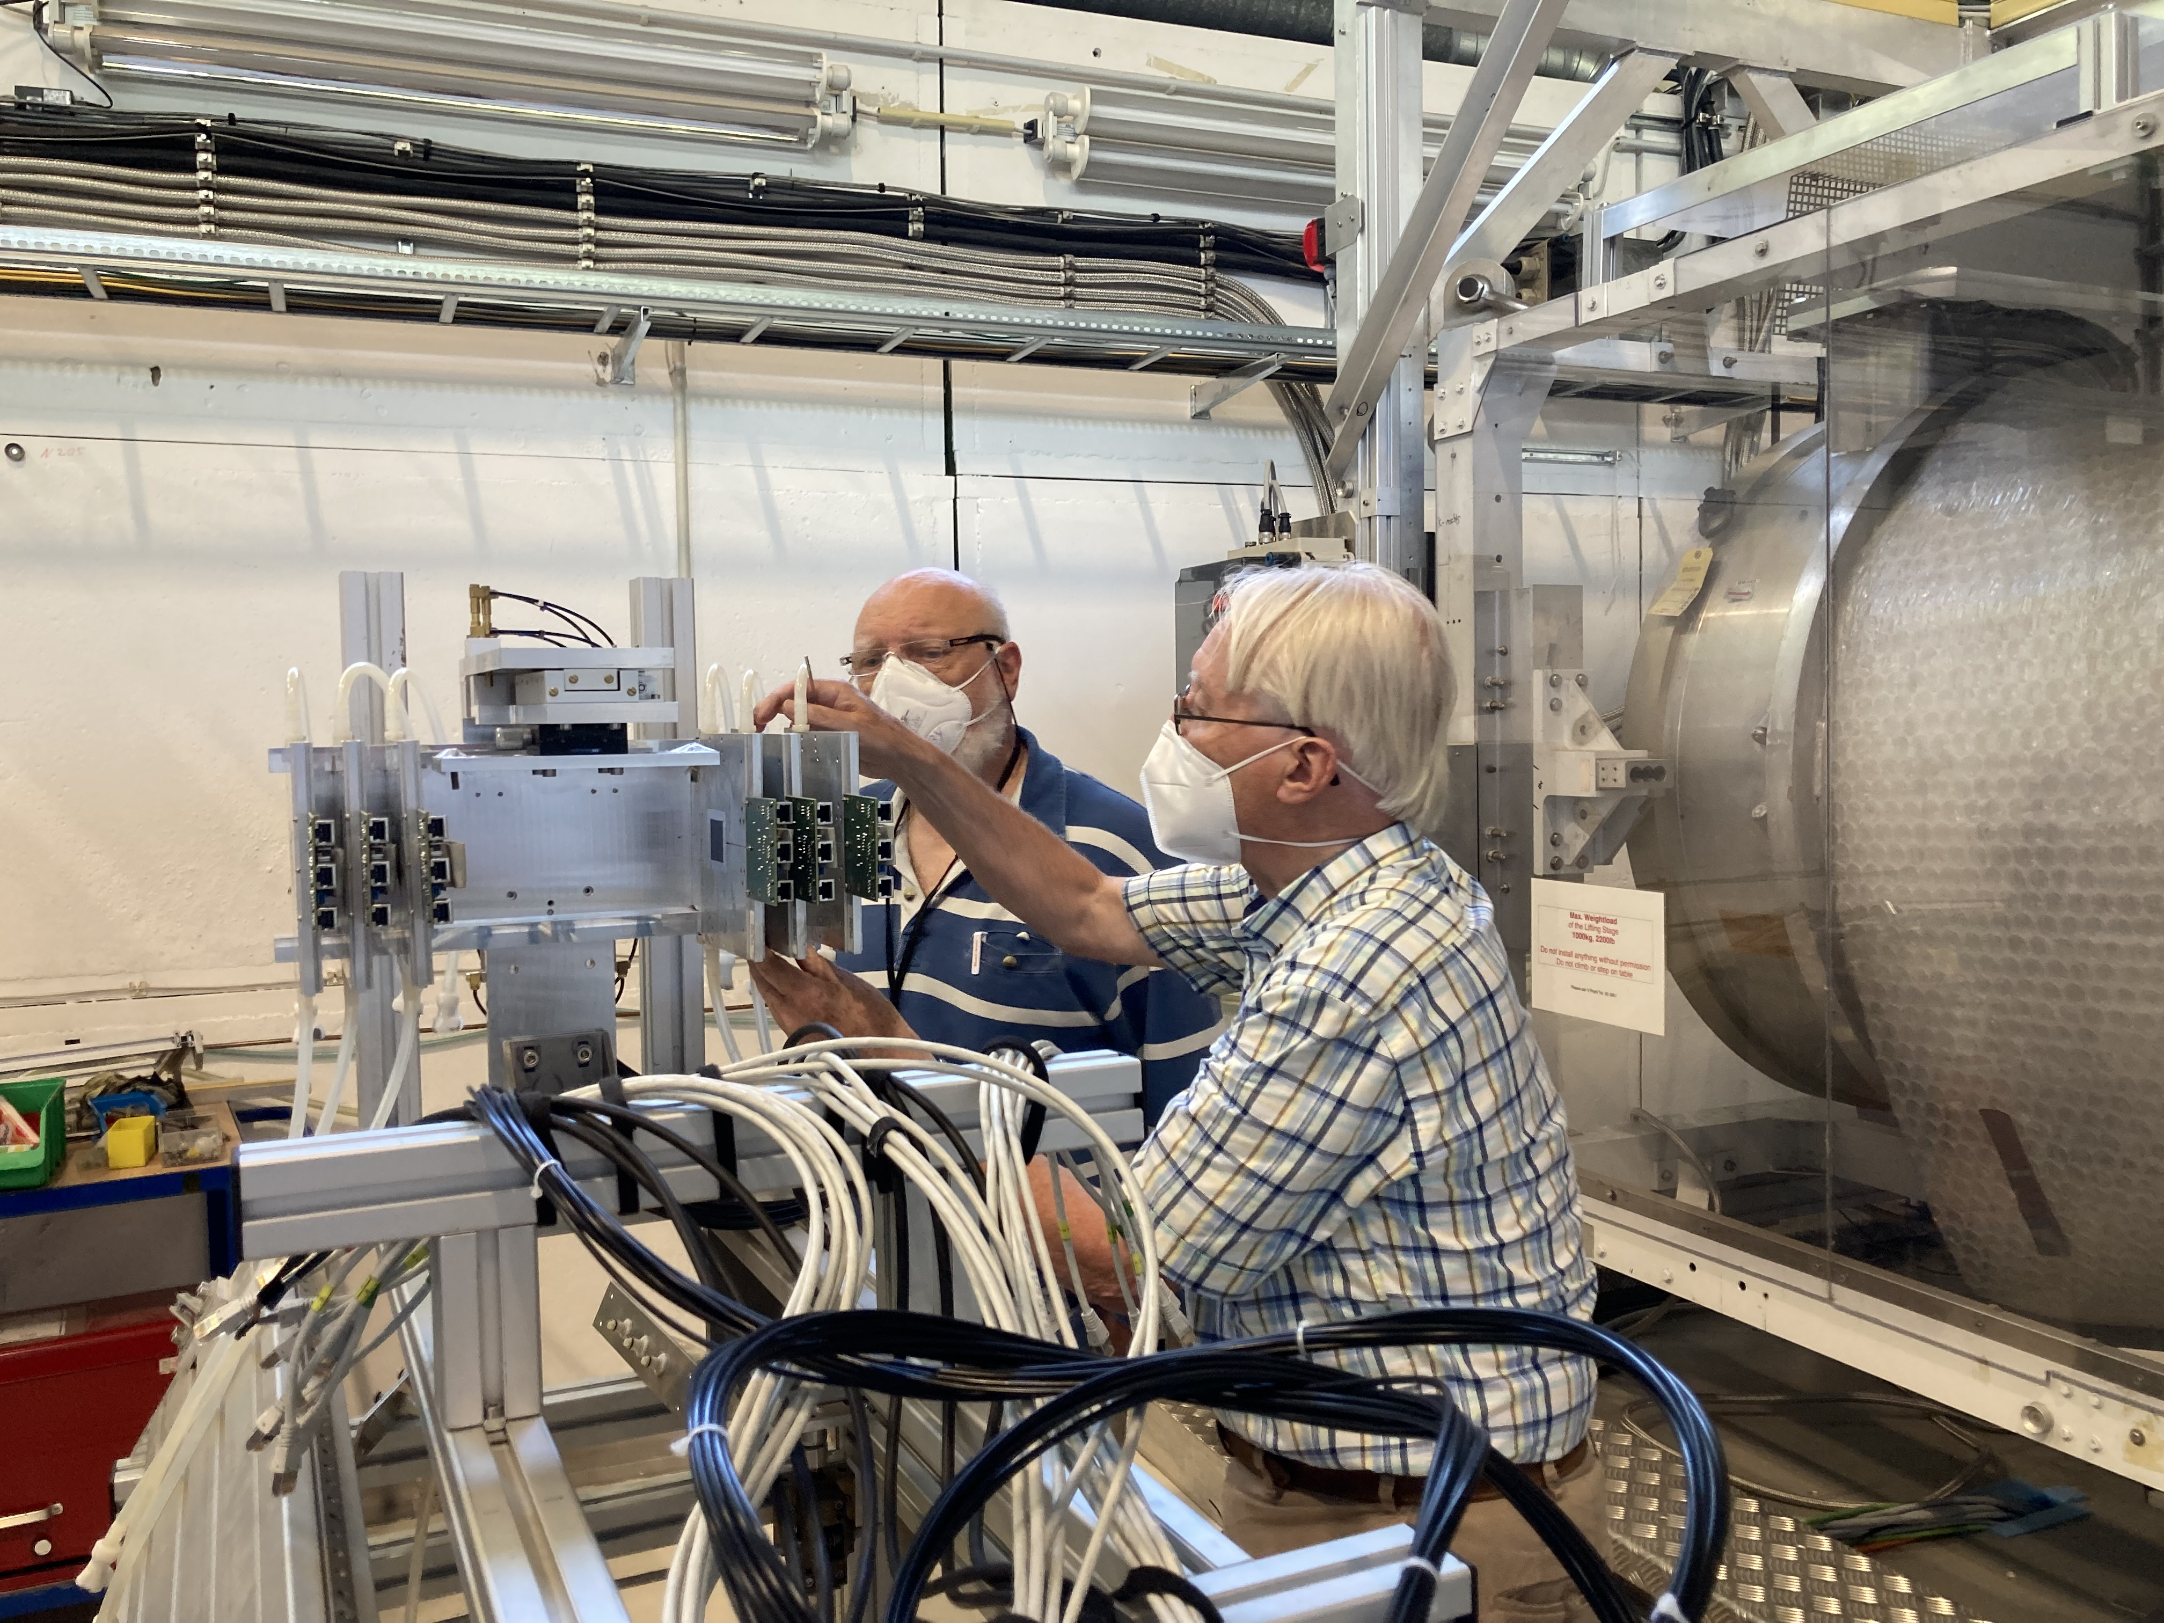
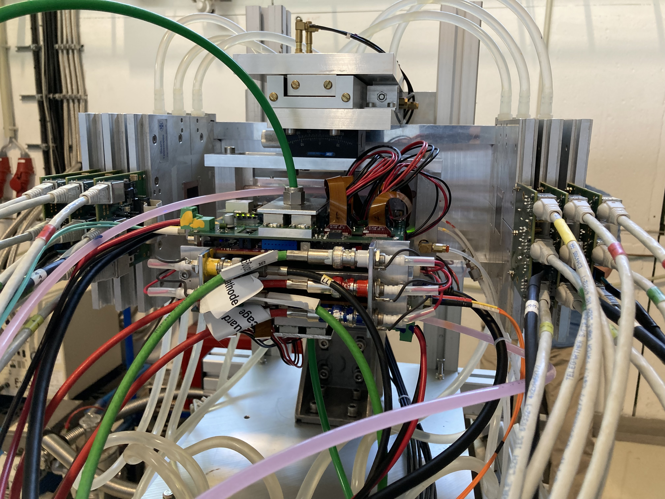
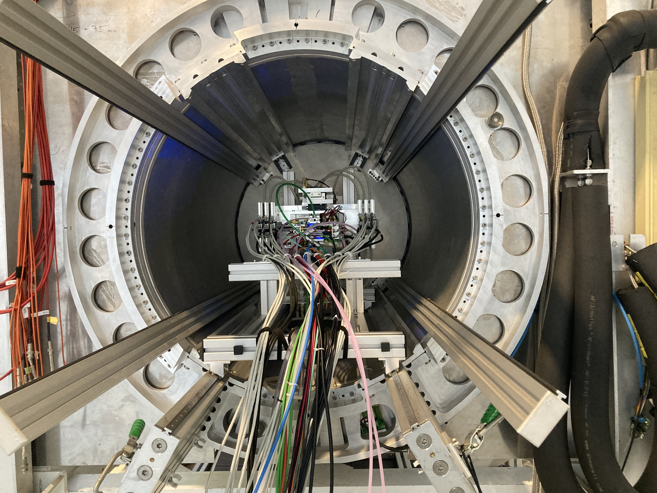
DESY testbeam June 2021
Mounting the 8 quad module between the silicon planes
sliding it into the 1 T PCMAG solenoid

Slide 14
DESY testbeam June 2021

Slide 15
DESY testbeam Module Analysis
Event display with module and telescope
TPX3 track 1130 hits
χ²_{xy} = 677.5/1128
χ²_{z} = 775.9/1069
Asymmetric tail outlier removal applied 1071 hits in z kept.
TPX3 track hits
Telescope track hits (off track green)
Preliminary
x global
x local
z global
y local
z global
y global
z local drift
y local

Slide 16
DESY testbeam Module Analysis
Run 6916 B=0 T p =6 GeV
Preliminary
8-quad module Tracking precision:
position 9 μm (xy) 13 μm (z)
angle 0.19 mrad (dx/dy) 0.25 (dz/dy) mrad
module tracklength = 157.96 mm
Note that in a B field because of the reduced diffusion the tracking precision will improve substantially
964 selected tracks
Impressive 1009 hits / track

Slide 17
DESY testbeam Module Analysis
Run 6916-6918 B=0 T p=6 GeV
Three runs at different drift distances
Preliminary

Slide 18
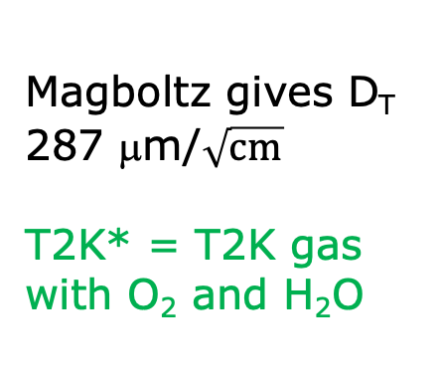
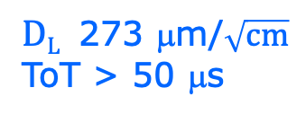

DESY testbeam Module Analysis
Run 6916-6918 B=0 T p=6 GeV
Fitted resolution
$$σxy,z2=σ2xy0,z0+D2xy,z \left(z−z0\right)$$
σ² _{xy0}= σ²_{pixel} + σ²_{xy tele} σ²_{pixel}= 55²/12 μm²
σ_{xy tele}=35 μm
$DT$ 287 μm/$\sqrt{cm}$
$DL$ 273 μm/$\sqrt{cm}$
ToT > 50 μs
Preliminary
Magboltz gives D_{T} 287 μm/$\sqrt{cm}$
T2K* = T2K gas with O₂ and H₂O
B=0 T
T2K*
E_{d}=280 V/cm

Slide 19
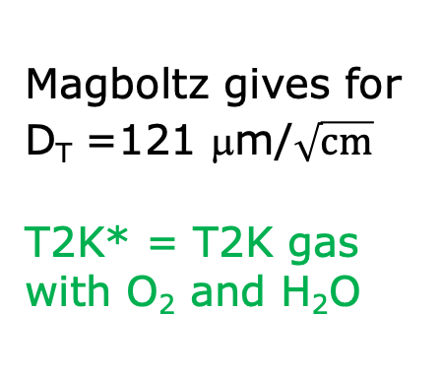
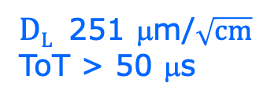

DESY testbeam Module Analysis
Run 6983-6990 B=1 T p=5 and 6 GeV
Fitted resolution
$$σxy,z2=σ2xy0,z0+D2xy,z \left(z−z0\right)$$
σ² _{xy0}= σ²_{pixel} + σ²_{xy tele} σ²_{pixel}= 55²/12 μm²
σ_{xy tele}=42 μm
$DT$ 120 μm/$\sqrt{cm}$
$DL$ 251 μm/$\sqrt{cm}$
ToT > 50 μs
Preliminary
Magboltz gives for D_{T} =121 μm/$\sqrt{cm}$
T2K* = T2K gas with O₂ and H₂O
B=1 T
T2K*
E_{d}=280 V/cm

Slide 20
DESY testbeam Module Analysis
Runs 6909, 6916-17, 6934-35 B=0 T p =6 & 5 GeV
Mean residuals in the module plane with acceptance cuts
B=0 T
situation
There are clear deformations in xy for the chips in the 4 corners.
The field around chip 11 (no grid HV) is affected.
The Efield defined by the field cage is in these areas not homogenous enough
Preliminary
xy
Vertical white bands guards
z

Slide 21
DESY testbeam Module Analysis
Runs 6981-6988 B=1 T p=5 GeV
Mean residuals in the module plane with acceptance cuts
B=1 T
situation
There are clear deformations in xy for the chips in the 4 corners.
The field around chip 11 (no grid HV) is affected.
The Efield defined by the field cage is in these areas not homogenous enough
Preliminary
xy
Vertical white bands guards
z

Slide 22
DESY testbeam Module Analysis
Runs 6909, 6916-17, 6934-35 B=0 T p =6 & 5 GeV
Distribution of mean residuals in the plane
Method row
See back up slide for the two methods that group the module plane
xy
z
method | rms (stat) xy | bins xy | rms (stat) z | bins z
row | 11 (5) μm | 896 | 15 (5) μm | 891
column | 13 (5) μm | 895 | 13 (5) μm | 892
Preliminary
Method column
We did not include the 4 corner chips and (11), 14, 8, 13 and 19.
These are affected by the field cage and the short in chip 11.

Slide 23
DESY testbeam Module Analysis
Runs 6983-6988 B=1T p=5 GeV
Distribution of mean residuals in the plane
Method row
B=1 T situation
xy
z
method | rms (stat) xy | bins xy | rms (stat) z | bins z
row | 13 (2) μm | 896 | 19 (5) μm | 896
column | 11 (2) μm | 880 | 20 (5) μm | 880
Preliminary
Method column
We did not include the 4 corner chips and (11), 14, 8, 13 and 19.
These are affected by the field cage and the short in chip 11.

Slide 24
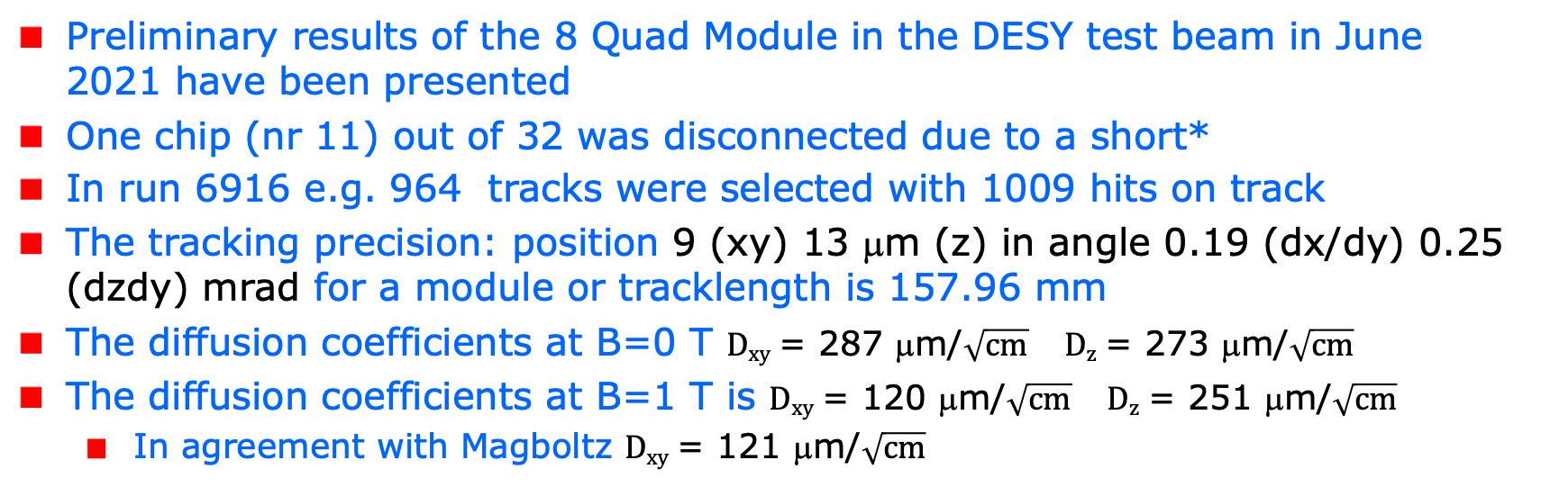
Conclusions on module performance
Resolution and precision
Preliminary results of the 8 Quad Module in the DESY test beam in June 2021 have been presented
One chip (nr 11) out of 32 was disconnected due to a short*
In run 6916 e.g. 964 tracks were selected with 1009 hits on track
The tracking precision: position 9 (xy) 13 μm (z) in angle 0.19 (dx/dy) 0.25 (dzdy) mrad for a module or tracklength is 157.96 mm
The diffusion coefficients at B=0 T $Dxy$ = 287 μm/$\sqrt{cm}$ $Dz$ = 273 μm/$\sqrt{cm}$
The diffusion coefficients at B=1 T is $Dxy$ = 120 μm/$\sqrt{cm}$ $Dz$ = 251 μm/$\sqrt{cm}$
  In agreement with Magboltz $Dxy$ = 121 μm/$\sqrt{cm}$
*the chip was successfully repaired in 2023 Bonn see backup slide

Slide 25
Conclusions on module performance
Resolution and precision
Results for the module showed that:
  the HV of the guard wires was well tuned
  B=0 T rms residuals in the module plane xy 13 μm and z 15 μm
  The results are compatible with (very) high stats quad measurement
  B= 1 T rms residuals in the plane xy 13 μm and z 20 μm;
High tracking precision is demonstrated with small systematics
  deformations xy stay below 13 μm
Writing a NIM paper (including more results)

Slide 26
DESY testbeam Module Analysis
Analysis topics discussed in the following:
  Measured efficiency at a high hit rates
  Study and characterization of bursts i.e. large numbers of hits due to highly energizing particles (e.g. delta’s)
  Extraction of the resolution as a function of the incident angle using circles (helixes)

Slide 27
DESY testbeam Module Analysis
Efficiency at high hit rates
The efficiency of the device to detect a hit in a high (low) rate environment is measured comparing the mean time over threshold for low and high rate runs at B fields of 0 and 1T.
A succesfull approach – see next slides - is based on hits associated to TPX3 tracks using the two central rows of six chips. The mean ToT was calculated for ToT values between 0.15 and 1.4 μs to remove the tail.
The change in ToT in low and high rate runs is then related to a (maximum) the efficiency change.

Slide 28
DESY testbeam Module Analysis
Efficiency at high hit rates for B=0T
run | ToT 1 | ToT 2 | triggers | time | Hits 1 | Hits 2 | trigger | Rate 1 | Rate 2
 | μs | μs | nr | (s) |  |  | Hz | Hits/s | Hits/s
6916 | 0.6280 | 0.6527 | 16837 | 23221 | 6.252e+06 | 1.312e+07 | 0.72 | 269 | 565
6909 | 0.6220 | 0.6482 | 89250 | 134254 | 2.226e+07 | 5.040e+07 | 0.66
6934 |  | 0.6510 | 73414 | 2413 |  | 2.046e+07 | 30.4 |  | 8479
6935 | 0.6204 |  | 73902 | 2414 | 6.948e+06 |  | 30.6 | 2878
Tot 1 (2) = mean ToT for mcol =1 (2) (each 6 chips) stat errors are neglible
Hits 1 (2) are raw hits with ToT> 0.15 μs
Runs 6916 and 6909 are consistent within 1%
Relative change wrt 6916 in mean ToT -1.2% (mcol=1) -0.3% (mcol=2)
up to 8.5 kHz for 6 chips or 1.4 kHz per chip.
The black numbers could go in the paper

Slide 29
DESY testbeam Module Analysis
Efficiency at high hit rates for B=1T
run | ToT 1 | ToT 2 | triggers | time | Hits 1 | Hits 2 | trigger | Rate 1 | Rate 2
 | μs | μs | nr | (s) |  |  | Hz | Hits/s | Hits/s
6969 | 0.6499 | 0.6658 | 7947 | 13816 | 1.929e+06 | 2.164e+06 | 0.57 | 139 | 156
6983 | 0.6568 | 0.6775 | 67968 | 2825 | 1.162e+07 | 1.409e+07 | 24.1 | 4110 | 4986
6985 |  | 0.6783 | 102488 | 4373 |  | 2.925e+07
6988 | 0.6653 |  | 95785 | 4251 | 6.148e+06
Runs 6985 and 6988 are consistent with 6983 within 0.5%
Relative change wrt 6983 in mean ToT +1% (mcol=1) +1.7% (mcol=2)
up to 5 kHz for 6 chips or 1.2 kHz per chip.
The black numbers could go in the paper

Slide 30
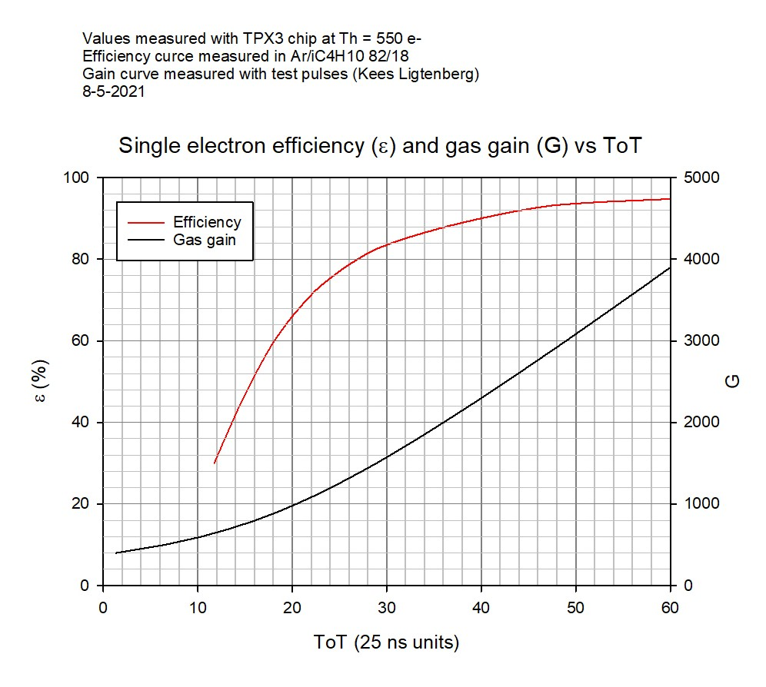
DESY testbeam Module Analysis
Efficiency at a high hit rates
The relative change in mean ToT is related to the relative change in the efficiency ε - at the working point around 0.6 μs - as:
  See efficiency vs ToT curve δε/ε ~ 0.5 δToT/ToT
This means that the efficiency δε/ε is stable at the level of +1.7% (B=1T) and -1.2% (B=0T) for hit rates up to 1.2 kHz per chip.
Conclusion
It is demonstrated that running at hit rates up 1.2 kHz gives at most a reduction of 0.6% in the relative efficiency.

Slide 31
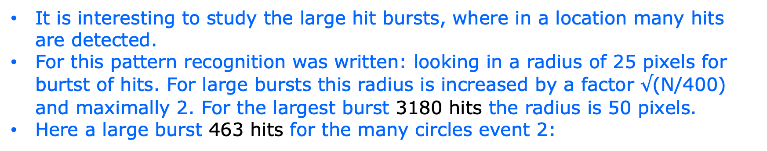
DESY testbeam Module Analysis
Large hit bursts
It is interesting to study the large hit bursts, where in a location many hits are detected.
For this pattern recognition was written: looking in a radius of 25 pixels for burtst of hits. For large bursts this radius is increased by a factor $√$(N/400) and maximally 2. For the largest burst 3180 hits the radius is 50 pixels.
Here a large burst 463 hits for the many circles event 2:

Slide 32
DESY testbeam Module Analysis
Large hit bursts
Event 42 with a burst of 1066 hits

Slide 33
DESY testbeam Module Analysis
Large hit bursts
For B=1 T p= 6GeV run 6969 ~ 8000 triggers (events)
rms d0 rms t
B=1 T
The largest burst has 3180 hits
100 or 50 ns

Slide 34
DESY testbeam Module Analysis
Large hit bursts
For B=0 T p= 6 GeV run 6916 ~ 20k triggers (events)
rms d0 rms t
B=0 T
100 or 50 ns
Much reduced time tails wrt B=1 T

Slide 35
DESY testbeam Module Analysis
Large hit bursts run 6969
radius90: radius in which 90% of hits are found
Average Hit density in a burst is 3180 hits /3.14*50*50 pixels = 0.4 per pixel.
Max hit density is 1, because after one hit the pixel is dead for 475 ns.
B = 1 T

Slide 36
DESY testbeam Module Analysis
Large hit bursts run 6916
radius90: radius in which 90% of hits are found
Conclusion
- B=0 and 1 T radius
distribution similar
- More often hits > 400
in B =1 T
B = 0 T

Slide 37
DESY testbeam Module Analysis
Large hit bursts run 6969
time90 time in which 90% of hits are found
Time varies
goes from 0-200 nsec
(0 μm to 12 mm)
At low multiplicities shorter “tracks”
Diffusion peak time90<20 ns
B = 1 T

Slide 38
DESY testbeam Module Analysis
Large hit bursts run 6916
time90 time in which 90% of hits are found
Conclusion
Much more tail in B=1 T time distribution (previous slide)
B = 0 T

Slide 39
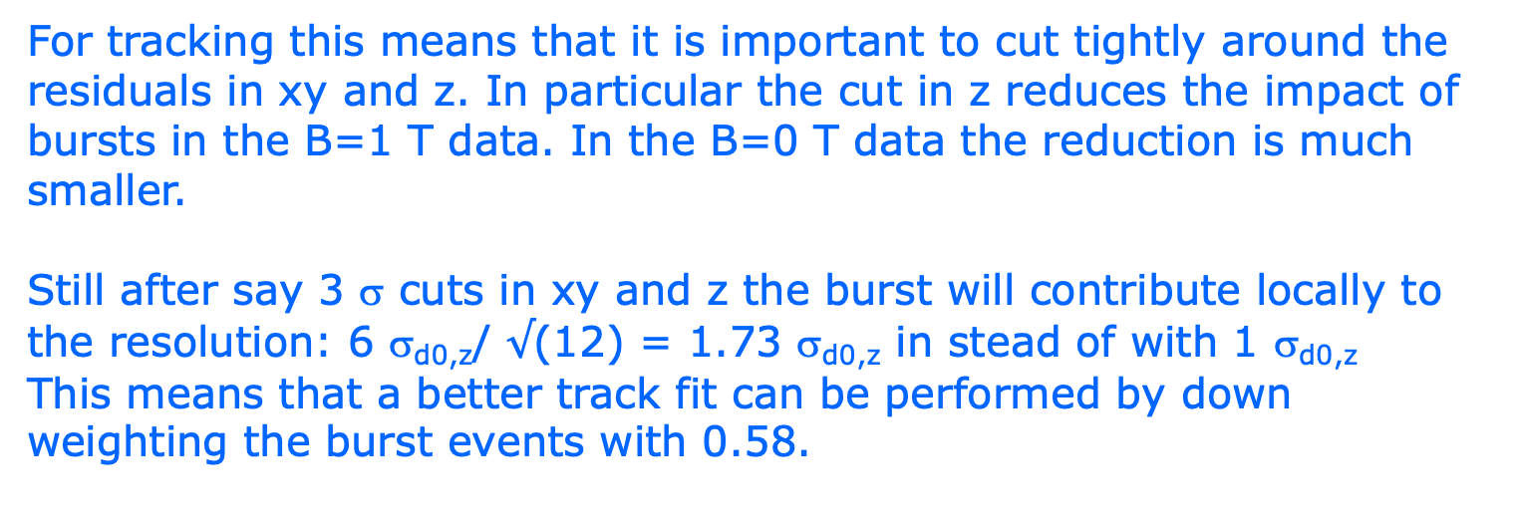
DESY testbeam Module Analysis
Track fitting and large hit bursts
For tracking this means that it is important to cut tightly around the residuals in xy and z. In particular the cut in z reduces the impact of bursts in the B=1 T data. In the B=0 T data the reduction is much smaller.
Still after say 3 σ cuts in xy and z the burst will contribute locally to the resolution: 6 σ_{d0,z}/ $√$(12) = 1.73 σ_{d0,z} in stead of with 1 σ_{d0,z}
This means that a better track fit can be performed by down weighting the burst events with 0.58.

Slide 40
DESY testbeam Module Analysis
Does a Pixel TPC have a hit resolution independent of the incident angle of the track?
In order to study this topic we use circular tracks (curlers).
We took data with small incident angles plus min 10 degrees; in a circle one will have 360 degrees incident angles.
To get a (part of a) circle the one needs a B field. Not that the electrons from the beam go “straight” and we need to look for lower momentum electrons in the event.
Here we analysed the B=1 data for run 6969 p = 6 GeV beam.
a Hough transform for a circle was coded; also a straight line hough transform was used to reject high momentum tracks.

Slide 41
DESY testbeam Module Analysis
Circle finding
The center should lie in the plane
Pattern finding can get disturbed by large hit bursts and “straight” line beam particles
The solutions in red are selected
Events 14 and 41
R = 1024 pixels
p = 8.45 MeV/c
R = 121 pixels
p = 1 MeV/c
R = 25 pixels
p = 206 keV/c

Slide 42
DESY testbeam Module Analysis
Circle finding
For the events 14 and 41. Calculate phi around the circle (phi = 0 is pointing opposite the local y axis = right to left in the event display).The drift time (z) can be fitted vs phi. It has a linear dependence (for a helix). The residuals in z are calculated after the fit.
phi hit on circle

Slide 43
DESY testbeam Module Analysis
Event selection for circles
Radius > 50 pixels with at least 20 selected hits
Reject circles with a better SL line fit by applying cuts on the χ² and number of hits for the circle and line hypothesis.
Resolution σ _{xy} = 4 pixels and σ _{z} = 1 mm
Track χ²_{xy}/dof < 5 χ²_{z}/dof < 5
Phi range (phi max – phi min) > 1 rad
phi> 8 π/32 and phi < 2 π − 8 π/32
Remove hits near edge of chip (15 pixels columns and rows)
Residual cuts at 2.5 σ (xy and z)
Down weighting of large clusters (counting hits N in bins Rφ 1 pixels)
where w = 1/ (N(bin-1)+N(bin)+N(bin+1))

Slide 44
DESY testbeam Module Analysis
Selected circles plots

Slide 45
DESY testbeam Module Analysis
Selected circles plots weighted
phi hit on circle

Slide 46
DESY testbeam Module Analysis
Selected circles plots resolution xy
There is a dependency of the resolution of phi and the radius
Small radii correlated to large phi range
phi hit on circle

Slide 47
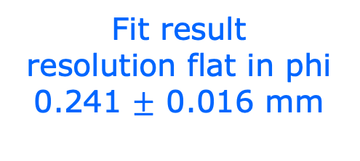
DESY testbeam Module Analysis
Selected circles plots resolution xy
fit: a + b cos φ
Taking out these dependencies
Fit result
resolution flat in phi
0.241 $±$ 0.016 mm
phi hit on circle

Slide 48
DESY testbeam Module Analysis
Does a Pixel TPC have a hit resolution independent of the incident angle of the track?
Using circles in the 1 T data set, it can be concluded that the Pixel TPC single electron resolution is – as expected - independent of the incident track angle within an uncertainty of 16 μm.

Slide 49
DESY testbeam Module Analysis
Conclusions
  Measured efficiency at a high hit rates
  It is demonstrated that running at hit rates up 1.2 kHz gives at most a reduction of 0.6% in the relative efficiency.
  Study and characterization of bursts
  The time distribution in the B=1 T data is most sensitive to reject burts. In the track fit an improvement can be obtained by identifying and downweighting burst.
  The Pixel TPC single electron resolution is independent of incident track angle within an uncertainty of 16 μm.

Slide 50
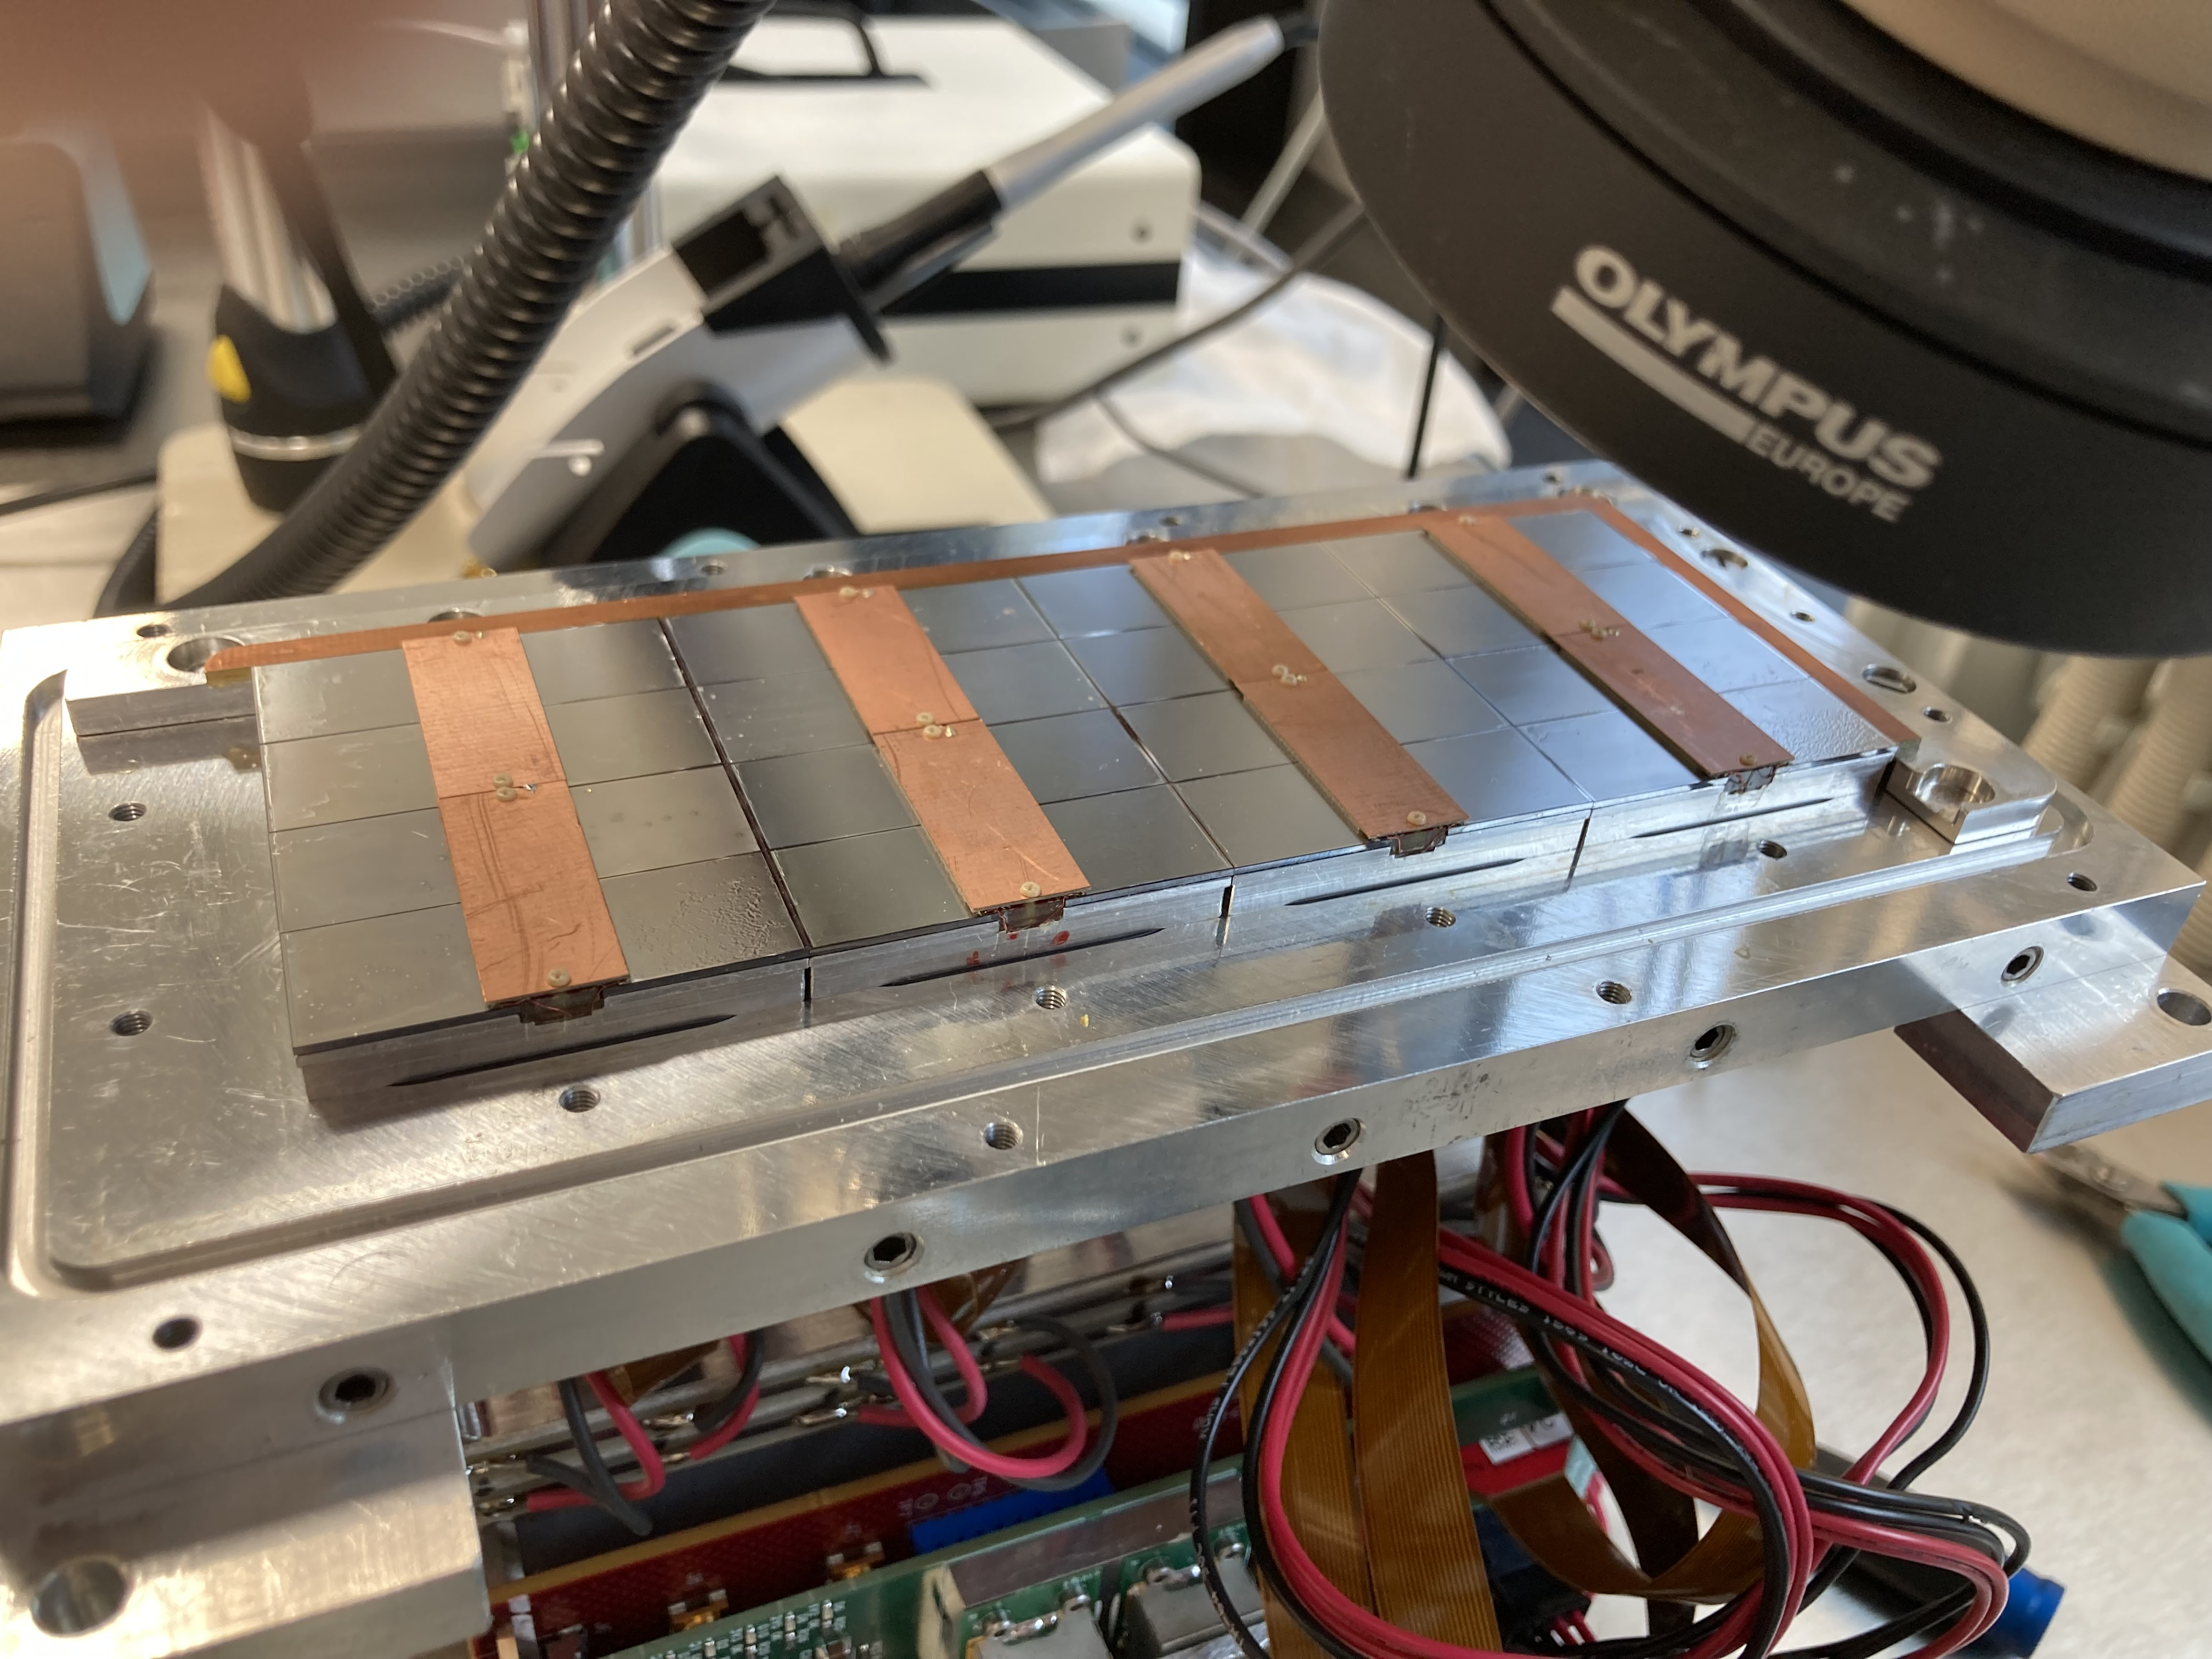
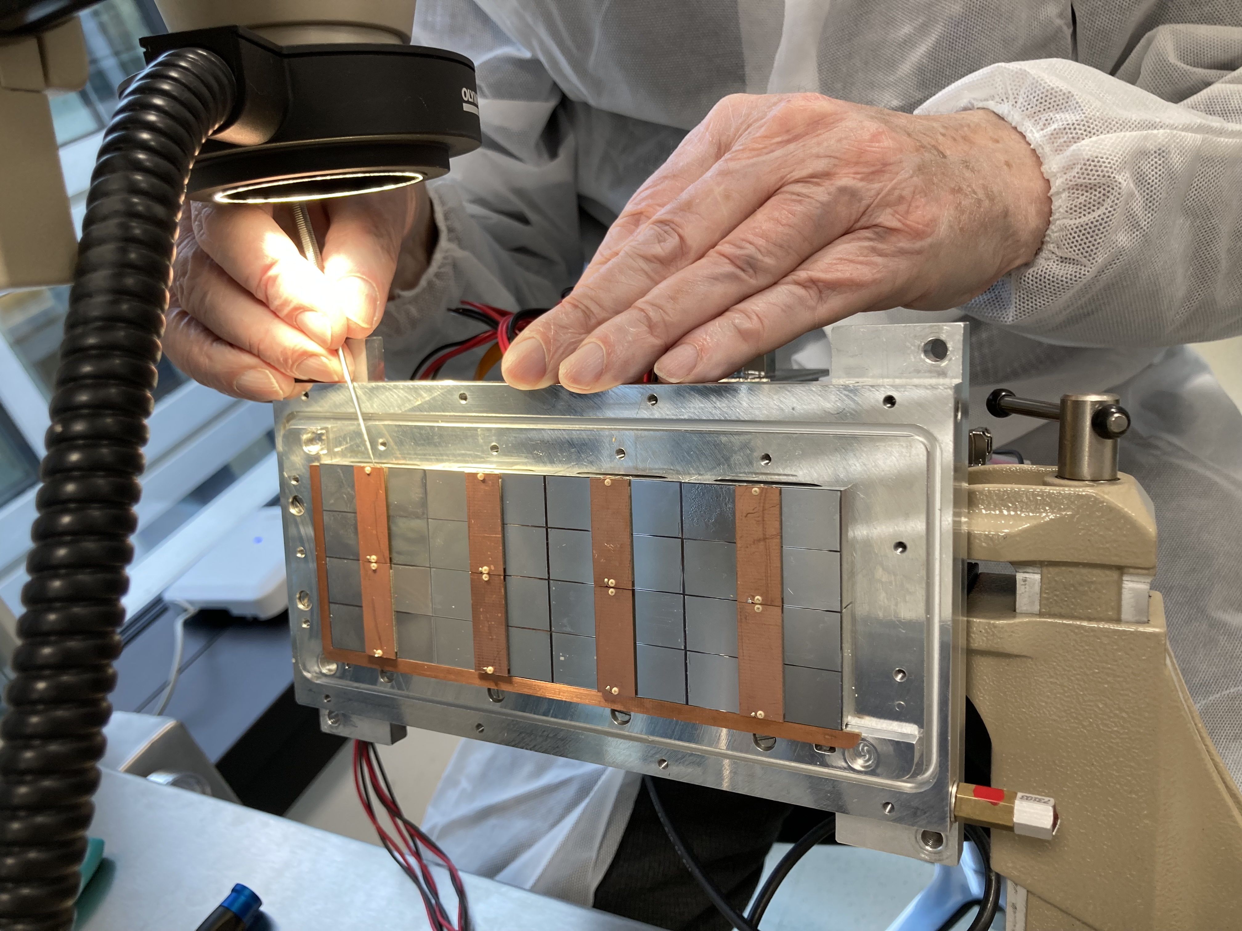
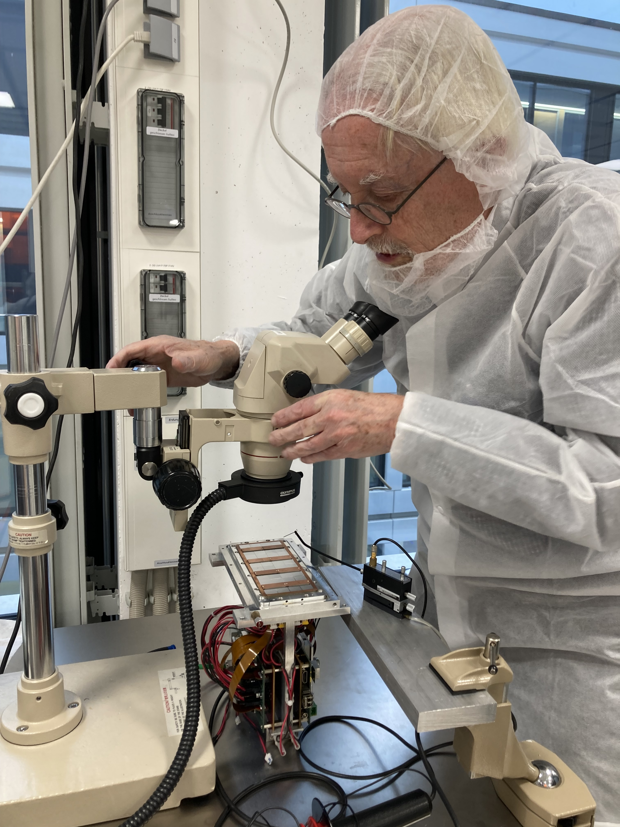
Pictures of repair work in Bonn
Backup
The short in chip 11 was succesully repaired by Fred Hartjes

Slide 51
DESY testbeam Module Analysis
Runs 6909, 6916-17, 6934-35 B=0 T p =6,5 GeV
Mean residuals (module) row (module) column
Regrouping the module plane to increase stats
Granularity 8x8 pixels
acceptance cut
entries > 1500
xy
xy
Backup
Preliminary
column 256 pixels
z
column 4x256 pixels
row 4x256 pixels
For the column plot the 4 chip rows are kept separately (that is why there are white bands)
For the row plot the data is projected keeping 4 bins in local y (one follows the track)
z
row 256 pixel

