Slide 1
Topical Lectures – Rare Decays
N. Tuning

Slide 2
“Leerdoelen”
Knowledge of historical insights
Introduction to Wilson coefficients
Explain the latest results / tensions
C₉
Z’
P₅’

Slide 3

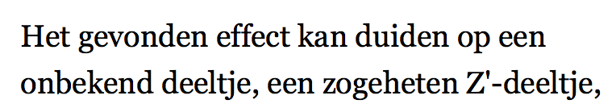
Volkskrant, 23 maart 2015

Slide 4
Plan
Introduction
  My motivation for flavour physics
  History of indirect measurements
  HQET: Wilson coefficients
Rare Decays
  B_{s}⁰→μμ
  B⁰→K*μμ
  Present tensions in (rare) B decays

Slide 5
Rare Decays - Outline:
9h30 - 10h15 Lecture 1: Introduction
10h30 - 11h15 Lecture 2: Effective couplings
11h30 - 12h15 Lecture 3: B_{s}→μμ
Lunch
13h45 - 14h30 Lecture 4: B⁰→K*μμ
15h00 - 16h30 Discussion Session

Slide 6
Road to discovery: Wilson coefficients
Theory
(What are Wilson coefficients?)
Measurements
(sensitive to Wilson coefficients)
Fit
(i.e. determine Wilson coefficients)
Interpretation
(which models correspond to theses Wilson coefficients?)

Slide 7
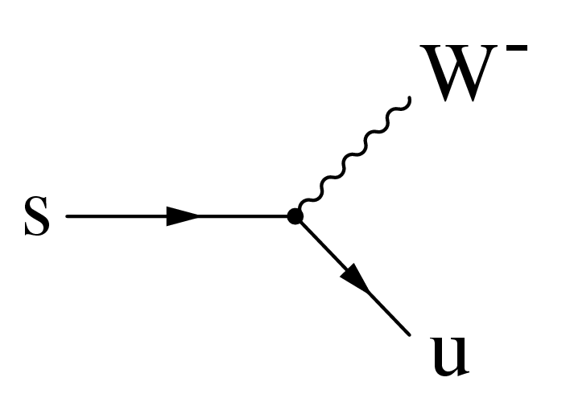
Jargon
CP violation: neutrinos
CP violation
CP violation: hadrons
B physics
Flavour Physics
Kaon physics
Rare Decays
charm physics

Slide 8
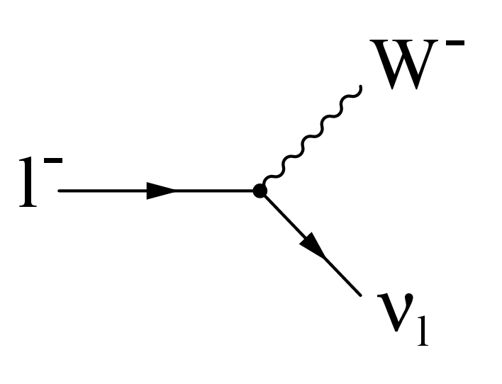
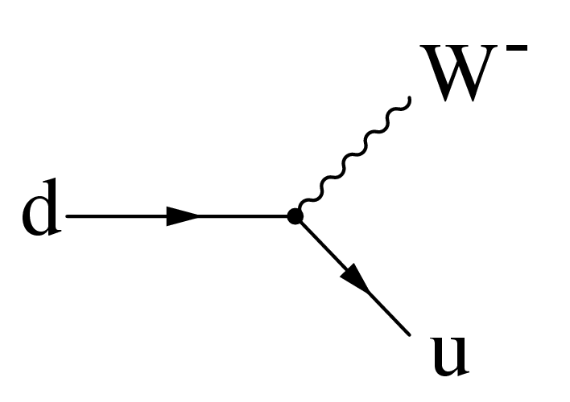
Introduction: it’s all about the charged current
“CP violation” is about the weak interactions,
In particular, the charged current interactions:
The interesting stuff happens in the interaction with quarks
Therefore, people also refer to this field as “flavour physics”

Slide 9
Flavour physics – Current Experiments
LHCb
K, D
B_{s}⁰
B⁰, B^{+/-}
top
tau
ATLAS/CMS
Belle II
Sketch adopted from Marie-Hélène
Schune ECFA2013, 1 Oct 2013

Slide 10
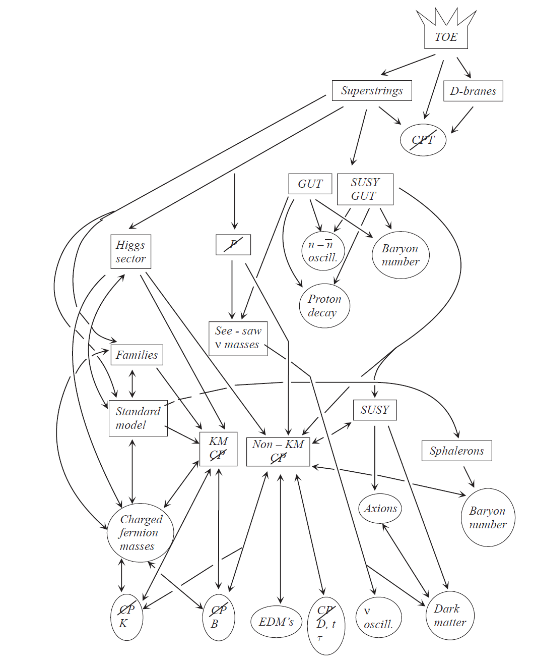
Grand picture….
These lectures
Main motivation
Universe

Slide 11
Motivation 1: New Physics in loop diagrams?
Precision measurements
Find deviations from the Standard Model
Sensitive to heavy particles in loop diagrams
“Box” diagram: ΔB=2
“Penguin” diagram: ΔB=1
s
b
s
b
b
μ
s
μ

Slide 12
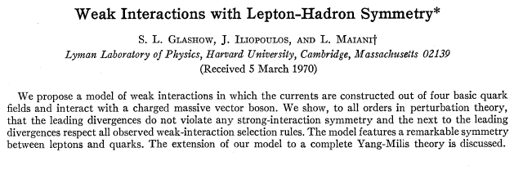
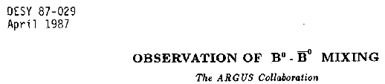


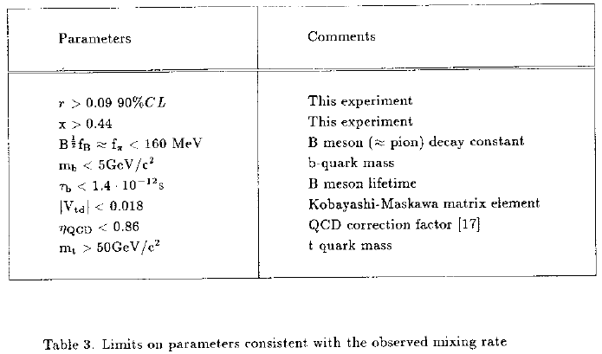
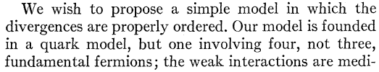
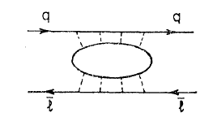
Motivation 1: New Physics in loop diagrams?
K⁰ →μμ pointed to the charm quark:
B⁰ mixing pointed to heavy top quark:
GIM, Phys.Rev.D2,1285,1970
ARGUS Coll, Phys.Lett.B192:245,1987
…
…
…
d
s
b
d
μ
d
b
μ

Slide 13
Motivation 2: at the heart of the SM

Slide 14
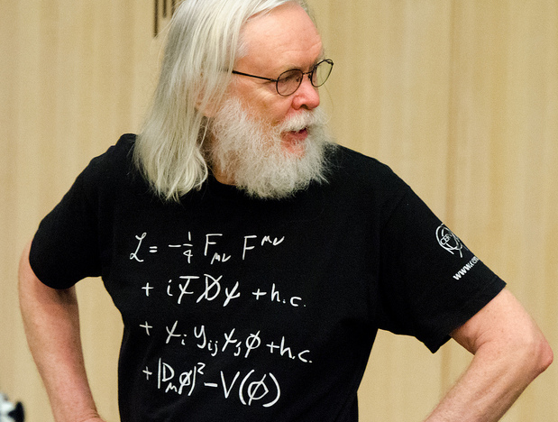
Prof.dr. J. Ellis
Origin of
CKM matrix

Slide 15






Motivation 2: at the heart of the SM
Charged current:
flavour diagonal
Yukawa couplings:
mix between generations

Slide 16




Motivation 2: at the heart of the SM
Charged current:
flavour diagonal
Yukawa couplings:
mix between generations
Diagonalize Yukawa matrix:
Off diagonal in CC Mass terms

Slide 17
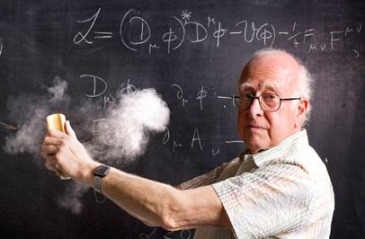
Motivation 2: at the heart of the SM
Flavour physics closely connected to Higgs??

Slide 18
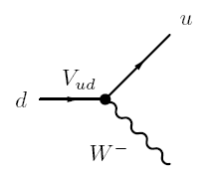


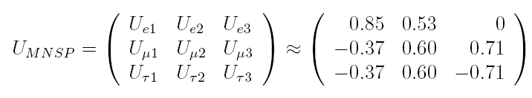
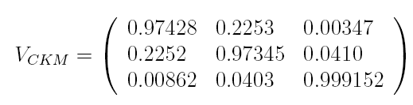
Motivation 3: CKM magnitude mysterious
CKM matrix:
Coupling strength of charged current
Completely different hierarchy !
vs
flavour
mass
flavour
mass

Slide 19
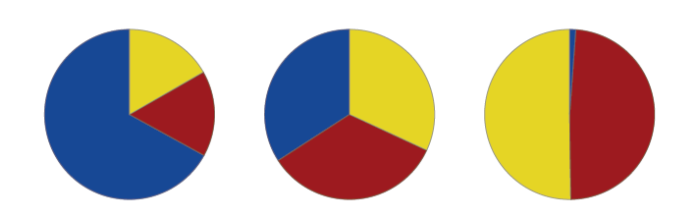
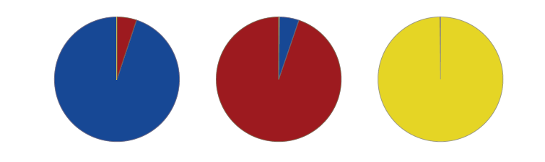
Motivation 3: CKM magnitude mysterious
CKM matrix:
Coupling strength of charged current
Completely different hierarchy !
vs
flavour
mass
flavour
mass
ν₁
ν₂
ν₃
d
s
b
ν_{e}
d'
PhD thesis R. de Adelhart Toorop

Slide 20
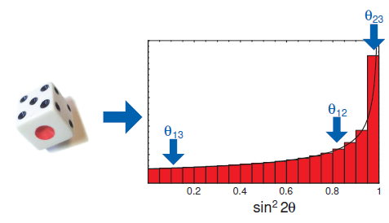

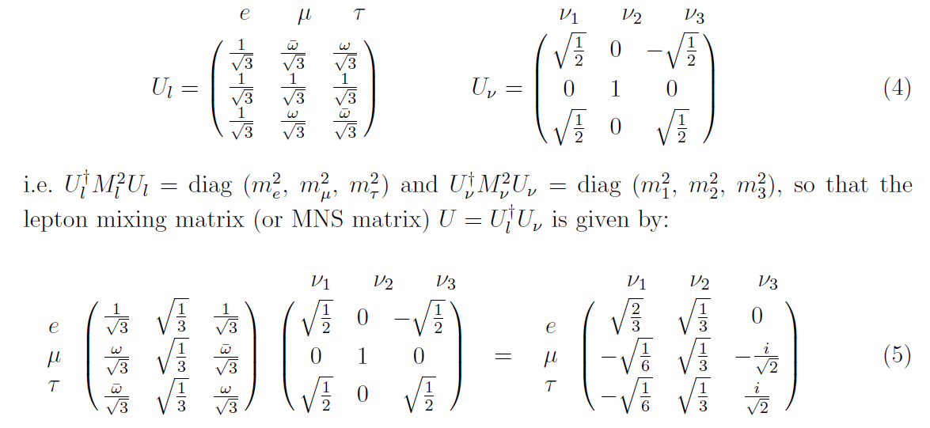
Intermezzo: what does the size tell us?
H.Murayama, 6 Jan 2014, arXiv:1401.0966
Neutrino mixing due to ´anarchy´:
`quite typical of the ones obtained by randomly drawing a mixing matrix from an unbiased distribution of unitary 3x3 matrices´
Harrison, Perkins, Scott, Phys.Lett. B530 (2002) 167, hep-ph/0202074
Neutrino mixing due to underlying symmetry:

Slide 21
Motivation 4: EWSB / Antimatter / Cosmology
Electro-weak symmetry breaking
  CKM matrix is related to Yukawa couplings
  The Yukawa couplings arose when particles acquired mass
Antimatter – matter asymmetry
  CP violation only known mechanism to distinguish
  Warning: CP violation ≠ Baryon number
Cosmology
  Aspects above determined our faith

Slide 22
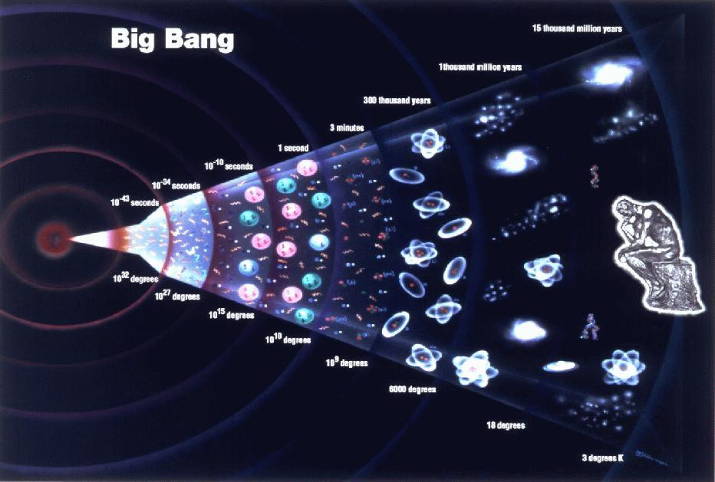
Recap:
CP-violation (or flavour physics) is about charged current interactions
Interesting because:
  Beyond Standard Model: measurements are sensitive to new particles
  Standard Model: in the heart of quark interactions
  Mysterious: magnitude CKM elements
  Cosmology: related to matter – anti-matter asymetry
b
s
s
b
Matter Dominates !

Slide 23
Personal impression:
People think it is a complicated part of the Standard Model Why?
Non-intuitive concepts?
  Imaginary phase in transition amplitude, T ~ e^{iφ}
  Different bases to express quark states, d’=0.97 d + 0.22 s + 0.003 b
  Oscillations (mixing) of mesons: |K⁰> ↔ |K⁰>
Complicated calculations?
Many decay modes? “Beetopaipaigamma…”
  PDG reports 347 decay modes of the B⁰-meson:
    Γ₁ l⁺ ν_{l} anything ( 10.33 ± 0.28 ) × 10⁻²
    Γ₃₄₇ ν ν γ <4.7 × 10⁻⁵ CL=90%
  And for one decay there are often more than one decay amplitudes…

Slide 24
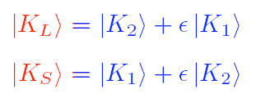
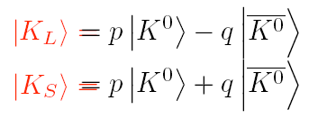
What is a kaon?
Different notation: confusing!
K₁, K₂, K_{L}, K_{S}, K₊, K₋, K⁰
Flavour eigenstate K⁰: well-defined quarks
Mass-, lifetime eigenstate K_{S}, K_{L}: well defined mass
CP eigenstate K₁, K₂: well-defined CP eigenvalue
Similar for B, but then B_{L} = K_{S} and B_{H} = K_{L}
Total confusion??

Slide 25
Break

Slide 26
Rare Decays - Outline:
9h30 - 10h15 Lecture 1: Introduction
10h30 - 11h15 Lecture 2: Effective couplings
11h30 - 12h15 Lecture 3: B_{s}→μμ
Lunch
13h45 - 14h30 Lecture 4: B⁰→K*μμ
15h00 - 16h30 Discussion Session

Slide 27
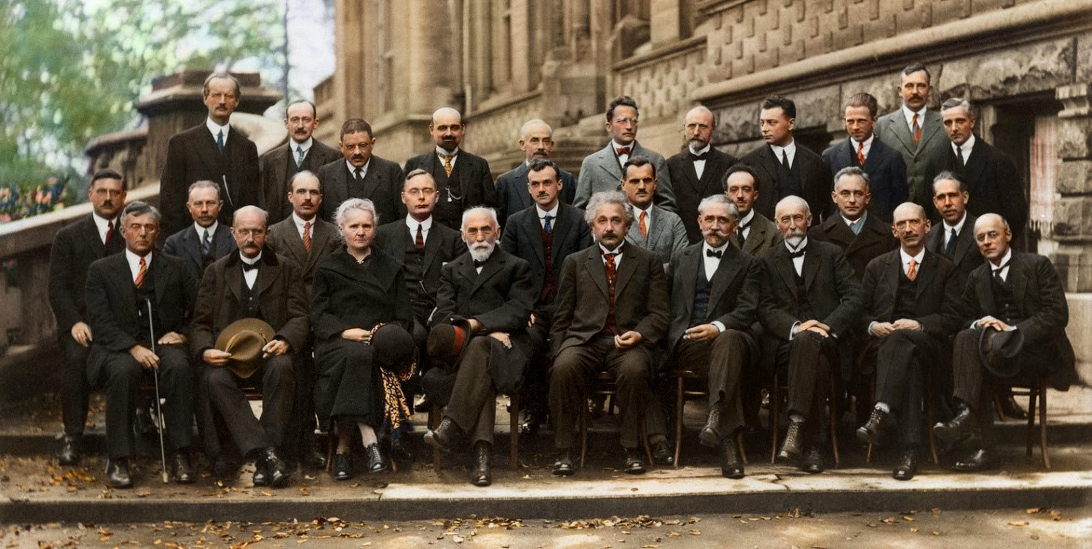
Historical perspective

Slide 28
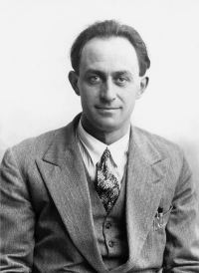
Historical perspective: W
Radioactive decay was “discovery” of weak interaction?

Slide 29
Historical perspective: W
Radioactive decay was “discovery” of weak interaction?
Direct
Indirect
E.Fermi, Z.Phys. 88 (1934) 161
UA1 Coll., Phys.Lett. B122 (1983) 103

Slide 30
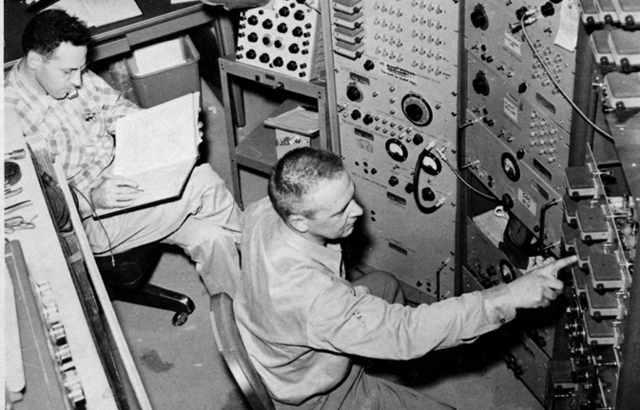
Historical perspective: ν
Radioactive decay was “discovery” of neutrino?
Direct
Indirect
E.Fermi, Z.Phys. 88 (1934) 161
Cowan, Reines, et al., Science 124 (1956) 103-104

Slide 31
Historical perspective: charm
Kaon decay was “discovery” of charm quark?
Direct
Indirect
GIM, Phys.Rev. D2 (1970) 1285
B.Richter et al, Phys.Rev.Lett. 33 (1974) 1406

Slide 32
Historical perspective: charm
d
s
cosθ_{c}
sinθ_{c}
u
W
W
ν_{μ}
μ⁺
μ⁻
Niels Tuning (32)
There was however one major exception which Cabibbo could not describe: K⁰ → μ⁺ μ⁻
  Observed rate much lower than expected from Cabibbos rate
  correlations (expected rate ~ g⁸sin²θ_{c}cos²θ_{c})
Notes:
32

Slide 33
Historical perspective: charm: GIM-mechanism
Solution to K⁰ decay problem in 1970 by Glashow, Iliopoulos and Maiani → postulate existence of 4th quark
  Two ‘up-type’ quarks decay into rotated ‘down-type’ states
  Appealing symmetry between generations
u
c
W⁺
W⁺
d’=cos(θ_{c})d+sin(θ_{c})s
s’=-sin(θ_{c})d+cos(θ_{c})s
Niels Tuning (33)
Notes:
33

Slide 34
Historical perspective: charm: GIM-mechanism
Phys.Rev.D2,1285,1970
…
…
…

Slide 35
Historical perspective: charm: GIM-mechanism
d
s
d
s
cosθ_{c}
+sinθ_{c}
-sinθ_{c}
cosθ_{c}
u
c
ν_{μ}
ν_{μ}
μ⁺
μ⁻
μ⁺
μ⁻
Niels Tuning (35)
How does it solve the K⁰ → μ⁺μ⁻ problem?
  Second decay amplitude added that is almost identical to original one, but has relative minus sign → Almost fully destructive interference
  Cancellation not perfect because u, c mass different
Notes:
35

Slide 36
Historical perspective: bottom
CP violation was “discovery” of 3rd generation?
Direct
Indirect
Cronin and Fitch, Phys.Rev.Lett. 13 (1964) 138
L.Lederman et al., Phys.Rev.Lett. 39 (1977) 252

Slide 37
Historical perspective: top
Bottom mixing was “discovery” of top quark?
Direct
Indirect
ARGUS, Phys.Lett. B192 (1987) 245
CDF Coll., Phys.Rev.Lett. 74 (1995) 2626

Slide 38
Historical perspective: Z
Neutral current interaction was “discovery” of Z?
Direct
Indirect
Gargamelle Coll., Phys.Lett. B46 (1973) 138
UA1 Coll., Phys.Lett. B126 (1983) 398

Slide 39
Historical perspective: Higgs
Precision measurements at LEP were “discovery” of Higgs?
Direct
Indirect
LEP, Phys.Rept. 427 (2006) 257
ATLAS Coll., Phys.Lett. B716 (2012) 1

Slide 40
Historical perspective
Historical record of indirect discoveries:
Particle | Indirect |  |  | Direct
ν | β decay |  | 1932 | Reactor ν-CC | Cowan, Reines | 1956
W | β decay |  | 1932 | W→eν | UA1, UA2 | 1983
c | K⁰→μμ | GIM | 1970 | J/ψ | Richter, Ting | 1974
b | CPV K⁰→ππ | CKM, 3rd gen | 1964/72 | Υ | Ledermann | 1977
Z | ν-NC | Gargamelle | 1973 | Z→ e⁺e⁻ | UA1 | 1983
t | B mixing | ARGUS | 1987 | t→ Wb | D0, CDF | 1995
H | e⁺e⁻ | EW fit, LEP | 2000 | H→ 4μ/γγ | CMS, ATLAS | 2012
? | What’s next ? |  | ? |  |  | ?

Slide 41
Historical perspective
Historical record of indirect discoveries:
Particle | Indirect |  |  | Direct
ν | β decay |  | 1932 | Reactor ν-CC | Cowan, Reines | 1956
W | β decay |  | 1932 | W→eν | UA1, UA2 | 1983
c | K⁰→μμ | GIM | 1970 | J/ψ | Richter, Ting | 1974
b | CPV K⁰→ππ | CKM, 3rd gen | 1964/72 | Υ | Ledermann | 1977
Z | ν-NC | Gargamelle | 1973 | Z→ e⁺e⁻ | UA1 | 1983
t | B mixing | ARGUS | 1987 | t→ Wb | D0, CDF | 1995
H | e⁺e⁻ | EW fit, LEP | 2000 | H→ 4μ/γγ | CMS, ATLAS | 2012
Z’ | pp→B X | LHCb | 2019 | pp→Z’→Y | FCC | 2038

Slide 42
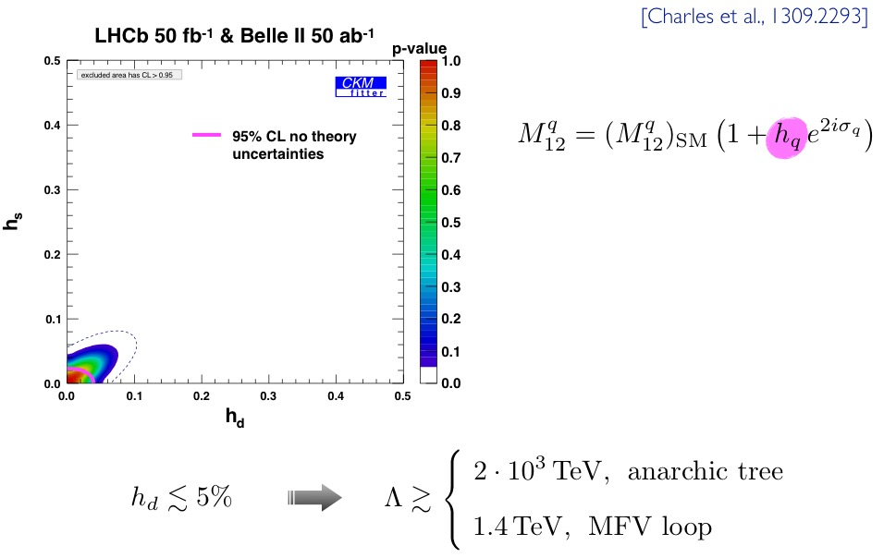
Heavy Flavour = Precision search for NP
Depending on your model, sensitive to multi-TeV scales, eg:
h_{q} parametrizes magnitude
of NP in B_{q} mixing
From Uli Haisch, 31 Aug 2016

Slide 43
Heavy Flavour = Precision search for NP
Depending on your model, sensitive to multi-TeV scales, eg:
μ_{B→μμ} is ratio BR^{exp}/BRSM
From Uli Haisch, 31 Aug 2016

Slide 46
Rare Decays

Slide 47
Effective couplings
Historical example:
Both are correct, depending on the energy scale you consider

Slide 48
Effective couplings
Historical example
Analog: Flavour-changing neutral current

Slide 49
Ingredients to B-decay calculations

Slide 50
Example: B⁺→ τ⁺ν
Example: leptonic
Factorization:
Strong interaction collected in matrix element
From: Robert Fleischer, Flavour Physics and CP Violation, arXiv:0802.2882

Slide 51
Example: B⁺→ τ⁺ν
Example: leptonic
Factorization:
From: Robert Fleischer, Flavour Physics and CP Violation, arXiv:0802.2882

Slide 52
Example: B⁺→ τ⁺ν
Example: leptonic
Factorization:
B meson is pseudo-scalar
From: Robert Fleischer, Flavour Physics and CP Violation, arXiv:0802.2882

Slide 53
Example: B⁰→ D⁺μ⁺ν
Example: semi-leptonic
Factorization:
Strong interaction collected in matrix element
From: Robert Fleischer, Flavour Physics and CP Violation, arXiv:0802.2882

Slide 54
Example: B⁰→ D⁺μ⁺ν
Example: semi-leptonic
Factorization:
From: Robert Fleischer, Flavour Physics and CP Violation, arXiv:0802.2882

Slide 55
Example: B⁰→ D⁺μ⁺ν
Form-factors:
D
D
μν
μ
ν
“zero-recoil”
From: Robert Fleischer, Flavour Physics and CP Violation, arXiv:0802.2882

Slide 56
Example: B⁰→ D⁺μ⁺ν
Form-factors:
From: Robert Fleischer, Flavour Physics and CP Violation, arXiv:0802.2882

Slide 57
Effective Hamiltonian – Operator Product Expansion
Hadronic decays, typically factorization does not hold any longer
Separate calculable short distance effects, from non-perturbative long-distance effects
C_{i}: calculable Wilson coeffients
To be compared to experiment

Slide 58
Effective couplings
Hadronic decays, typically factorization does not hold any longer
Separate calculable short distance effects, from non-perturbative long-distance effects

Slide 59
Effective couplings: b→sqq
Hadronic decays, typically factorization does not hold any longer
Separate calculable short distance effects, from non-perturbative long-distance effects

Slide 60
Effective couplings: b→sll
Hadronic decays, typically factorization does not hold any longer
Separate calculable short distance effects, from non-perturbative long-distance effects

Slide 61
Operators for b→sll FCNC
Remember C₇, C₉, C₁₀:

Slide 62
Operators for b→sll FCNC
Yet another graph:
“Genuine” b→sll
b→sγ
b→s cc

Slide 63
Effective couplings
Effective coupling can be of various “kinds”
  Vector coupling
  Axial coupling
  Left-handed coupling (V-A)
  Right-handed (to quarks)
  …

Slide 64
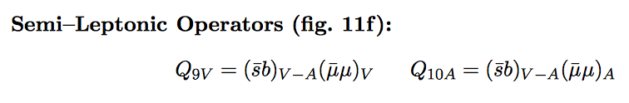
Effective couplings
Effective coupling can be of various “kinds”
  Vector coupling: C₉
  Axial coupling: C₁₀
  Left-handed coupling (V-A): C₉-C₁₀
  Right-handed (to quarks): C₉’, C₁₀’, …
  …
See e.g. Buras & Fleischer, hep-ph/9704376
From Buras & Fleischer, hep-ph/9704376
“the true picture of a decaying hadron is more correctly described by the local operators”

Slide 65
Measuring the Wilson coefficients
Rare B-decays to probe Wilson coefficients:

Slide 66
Measuring the Wilson coefficients
Rare B-decays to probe Wilson coefficients:

Slide 67
Road to discovery: Wilson coefficients
Theory
(What are Wilson coefficients?)
Measurements
(sensitive to Wilson coefficients)
Fit
(i.e. determine Wilson coefficients)
Interpretation
(which models correspond to theses Wilson coefficients?)

Slide 68
b→s μμ
Flavour changing neutral current: FCNC
In SM only at higher order:

Slide 69
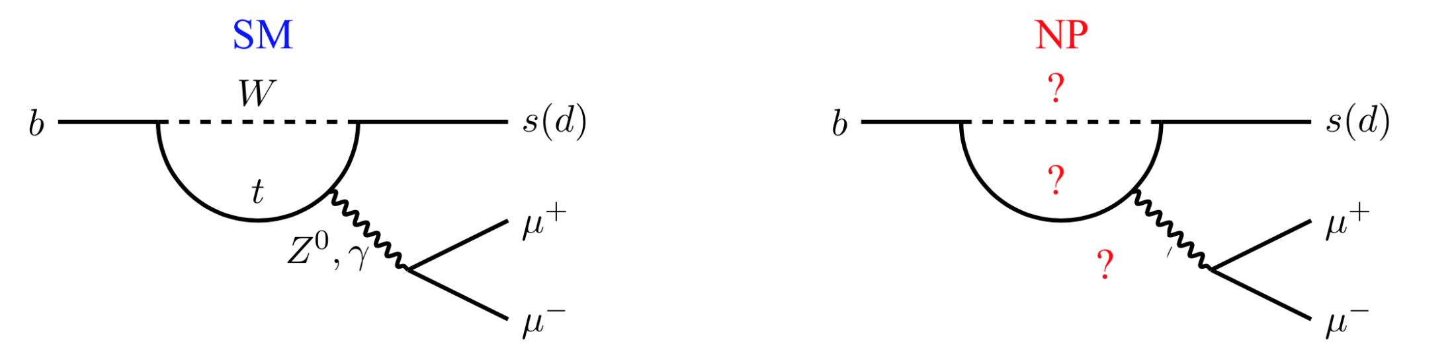
b→s μμ
Flavour changing neutral current: FCNC
In SM only at higher order:

Slide 70
Specific decays
B^{0,+}_{(s)}/Λ_{b}
K^{0,+(*)}/φ/Λ
b
Specific decays:
  B→μμ
  B→Kμμ
B⁰_{(s)}
d(s)

Slide 71
Break

Slide 72
Rare Decays - Outline:
9h30 - 10h15 Lecture 1: Introduction
10h30 - 11h15 Lecture 2: Effective couplings
11h30 - 12h15 Lecture 3: B_{s}→μμ
Lunch
13h45 - 14h30 Lecture 4: B⁰→K*μμ
15h00 - 16h30 Discussion Session

Slide 73
B_{s}⁰→μμ

Slide 74
B_{s}⁰→μμ
Small BR…
FCNC: b→s transition only allowed at higher order
  GIM cancellation!
Weak interaction: helicity suppressed
  Sensitive to new physics: (pseudo)scalar operators
spin
μ⁻
μ⁺
Lefthanded: OK
Lefthanded: not OK

Slide 75
B_{s}⁰→μμ
Historical endeavour!

Slide 76
B_{s}⁰→μμ
Historical endeavour!

Slide 77
B_{s}⁰→μμ
Historical endeavour
Sensitive to SUSY
+
+
2
+
+…

Slide 78
B_{s}⁰→μμ
Historical endeavour
Sensitive to SUSY
In terms of OPE:
From: PhD Thesis, Siim Tolk, Apr 2016

Slide 79
B_{s}⁰→μμ: Observation
Challenge: huge amount of events with two muons!
  Background: BR(B → Xμ⁺) = 10⁻¹
  Signal: BR(B_{s}⁰→μ⁺μ⁻) < 10⁻⁸
10¹² B produced; probability of μμ decay 10⁻⁹; eff ~5%
  Expect ~50 events
Thesis S.Oggero (2013)
Signal 1 : 10⁷ Background

Slide 80
B_{s}⁰→μμ: Observation
Good luck…
m(μμ) [GeV]

Slide 81
B_{s}⁰→μμ: Observation

Slide 82
B_{s}⁰→μμ: Observation

Slide 83
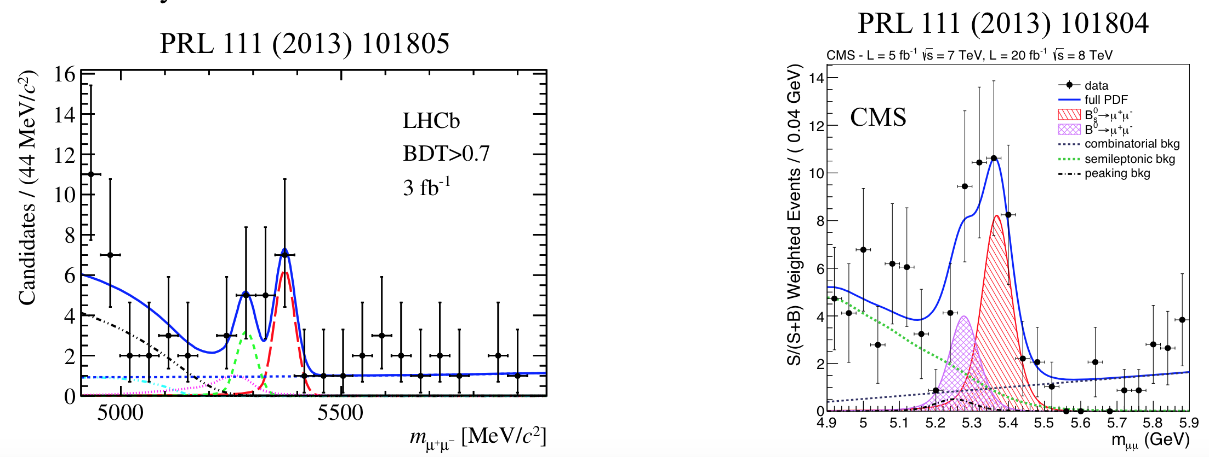
B_{s}⁰→μμ: Observation
LHCb CMS

Slide 84
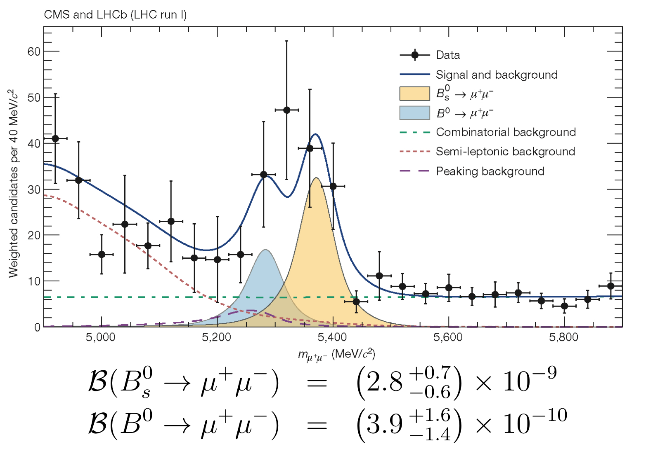
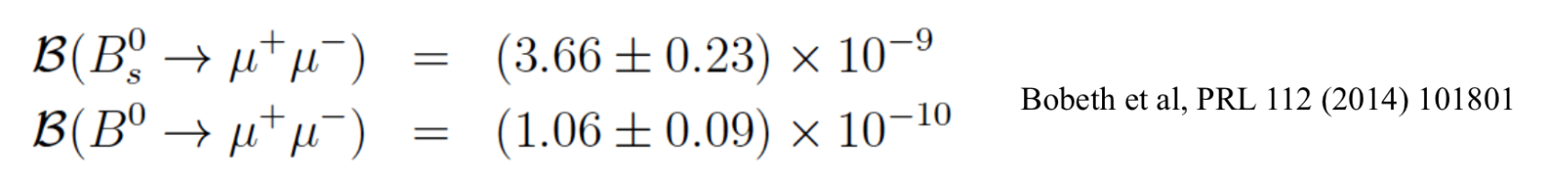
B_{s}⁰→μμ: Observation
Nature 522, 68–72 (04 June 2015)
3 fb⁻¹ 2.3σ
SM:

Slide 85
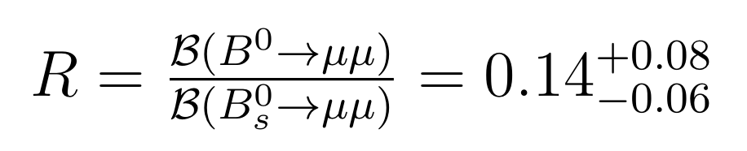
B_{s}⁰→μμ: Ratio B⁰ / B_{s}⁰
BR(B⁰ → μμ): a little high?
  First evidence at 3.0σ
  2.3σ above SM prediction:
    R_{SM} = 0.030 ± 0.003
    R_{exp} = 0.140 ^{+0.080}_{-0.060}
ATLAS, EPJ C76 (2016) 513
LHCb & CMS, Nature 522, 68–72 (2015)

Slide 86
B_{s}⁰→μμ: 2016 ?!
Mick unblinded last week…
Run-I : 3 fb⁻¹, √s=7,8 TeV
Run-II: 1.4 fb⁻¹ , √s=13 TeV (Rel. stat: 13/8 * 1.4/3 = 0.75 )
  0.6 fb-1 extra on tape...
Expect 1.75x more events + analysis improvement
  ~ x2 sensitivity
  5σ x √2 > 7σ

Slide 87
B_{s}⁰→μμ: Aspects relating theory/experiment
Relative production rate of B_{s}⁰
Correct BR for B_{s}⁰ lifetime difference
Effective lifetime

Slide 88
1) Relative production rate
From N(B_{s}⁰→μμ) to BR(B_{s}⁰→μμ)
But N is the product of production and decay …

Slide 89
1) Relative production rate
Reverse the argument!
From which processes do we know relative BR’s ?

Slide 90
1) Relative production rate
Dominant systematic uncertainty for BR(B_{s}⁰→ µµ)
Relies on theoretical knowledge of ratio of BRs:
  Semileptonic: Г(B_{s}⁰ → µX) = Г(B → µX)
Mind the cross feeds….

Slide 91
1) Relative production rate
Dominant systematic uncertainty for BR(B_{s}⁰→ µµ)
Relies on theoretical knowledge of ratio of BRs:
  Semileptonic: Г(B_{s}⁰ → µX) = Г(B → µX)
  Hadronic:
Bailey et al, PRD.85(2012)114502
Fleischer, Serra, NT, PRD82 (2010) 034038
Mind the form factor ratio….

Slide 92
1) Relative production rate
Dominant systematic uncertainty for BR(B_{s}⁰→ µµ)
Relies on theoretical knowledge of ratio of BRs:
  Semileptonic: Г(B_{s}⁰ → µX) = Г(B → µX)
  Hadronic:
  B→J/ψX:
Bailey et al, PRD.85(2012)114502
Fleischer, Serra, NT, PRD82 (2010) 034038
Liu, Wang, Xie, PRD89 (2014) 094010
Mind factorisation and penguins?!

Slide 93
1) Relative production rate
Dominant systematic uncertainty for BR(B_{s}⁰→ µµ)
Relies on theoretical knowledge of ratio of BRs:
  Semileptonic: Г(B_{s}⁰ → µX) = Г(B → µX)
  Hadronic:
  B→J/ψX:
Bailey et al, PRD.85(2012)114502
Fleischer, Serra, NT, PRD82 (2010) 034038
Liu, Wang, Xie, PRD89 (2014) 094010

Slide 94
1) Relative production rate
Dominant systematic uncertainty for BR(B_{s}⁰→ µµ)
Measurements
 | Normalization | Dependence
LHCb | Semileptonic Phys. Rev. D 85 (2012) 032008 B→Dh Phys. Rev. Lett. 107 (2011) 211801 LHCb-CONF-2013-011 | B→Dh JHEP 04 (2013) 001
CDF | Semileptonic Phys. Rev. D 77, 072003 (2008). | B→J/ψX Public Note 10795
ATLAS | B→J/ψX | B→J/ψX Phys.Rev.Lett. 115 (2015) 262001
Mind kinematic dependence…

Slide 95
2) Correct for lifetime difference
Branching fraction at t=0 different from all (time-integrated) decays
CP-even
CP-odd
B_{s,H}: CP-odd: long-living
B_{s,L}: CP-even: short-living

Slide 96
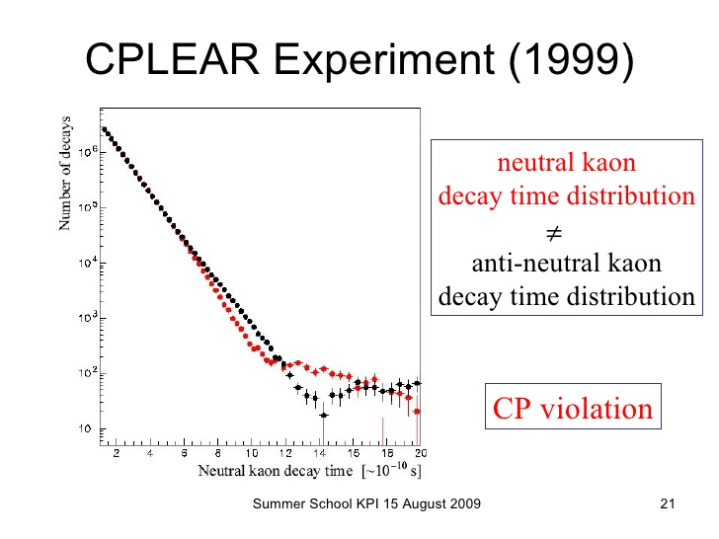
2) Correct for lifetime difference
CPLEAR
B_{s,H}: CP-odd: long-living
B_{s,L}: CP-even: short-living
K_{L}: CP-odd: long-living
K_{S}: CP-even: short-living

Slide 97
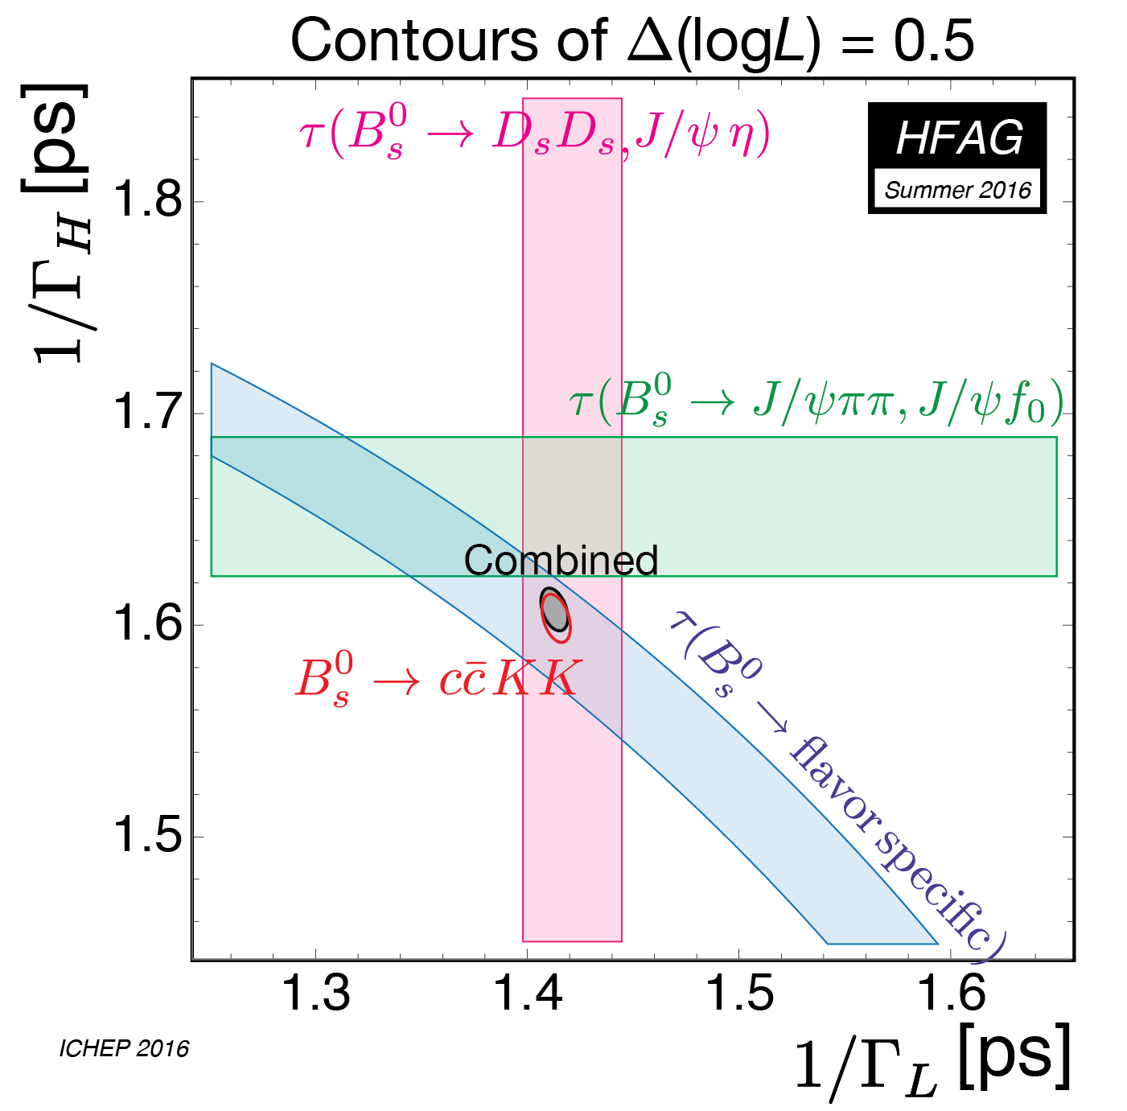
2) Correct for lifetime difference
Branching fraction at t=0 different from all (time-integrated) decays
De Bruyn, Fleischer, NT, et al. Phys.Rev. D86 (2012) 014027

Slide 98
2) Correct for lifetime difference
B_{s}⁰→μμ: P(seudo) and S(calar) amplitude
SM: P-amplitude dominates, selecting CP-odd (= B_{s}⁰_{H})
De Bruyn, Fleischer, NT, et al. Phys. Rev. Lett. 109, 041801 (2012)

Slide 99
BR(B_{s}⁰→μμ)
BR(t=0)
Time integrated:
 | BR x 10⁹
Fleischer (Nikhef) | 3.5 | 0.2 | PRL 109 (2012) 041801 | arXiv:1204.1737
Buras, Fleischer, Knegjens | 3.56 | 0.18 | JHEP 1307 (2013) 77 | arXiv:1303.3820
Bobeth, Gorbahn et al | 3.65 | 0.23 | PRL 112 (2014) 101801 | arXiv:1311.0903

Slide 100
BR(B_{s}⁰→μμ)
Courtesy Lectures Robert Fleischer
Time integrated:
 | BR x 10⁹
Fleischer (Nikhef) | 3.5 | 0.2 | PRL 109 (2012) 041801 | arXiv:1204.1737
Buras, Fleischer, Knegjens | 3.56 | 0.18 | JHEP 1307 (2013) 77 | arXiv:1303.3820
Bobeth, Gorbahn et al | 3.65 | 0.23 | PRL 112 (2014) 101801 | arXiv:1311.0903

Slide 101
3) “effective lifetime”
Effective lifetime: ~”single exponential fit to double exponential decay time”
Different CP admixture affects effective lifetime
  possibly not affecting the BR, when |S| and A_{ΔΓ} compensate…
Could be due to scalar amplitude |S| from NP
Same BR, different lifetime!
SM
De Bruyn, Fleischer, NT, et al. Phys. Rev. Lett. 109, 041801 (2012)

Slide 102
Break

Slide 103
Rare Decays - Outline:
9h30 - 10h15 Lecture 1: Introduction
10h30 - 11h15 Lecture 2: Effective couplings
11h30 - 12h15 Lecture 3: B_{s}→μμ
Lunch
13h45 - 14h30 Lecture 4: B⁰→K*μμ
15h00 - 16h30 Discussion Session

Slide 104
b→s μμ
Flavour changing neutral current: FCNC
In SM only at higher order:

Slide 105
B⁰→K*μμ
Diagrams:

Slide 106
B⁰→K*μμ
Decay rate
Observables
Wilson coefficients

Slide 107
B⁰→K*μμ
Decay rate
Observables
Wilson coefficients

Slide 108
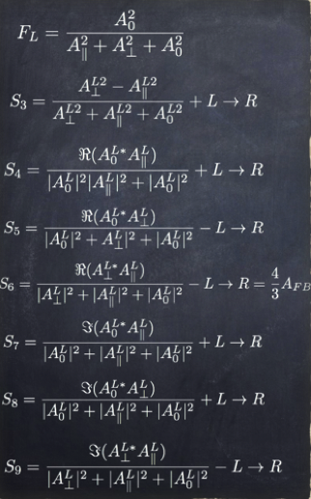
B⁰→K*μμ
Decay rate
Observables
Wilson coefficients

Slide 109
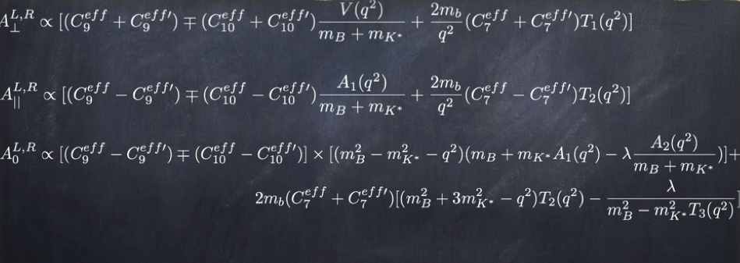
B⁰→K*μμ
Decay rate
Observables
Wilson coefficients

Slide 110
b→s μμ
B→Kμμ spectrum
q²=m_{μμ}²
“large-recoil”
“small-recoil”
Sketch from J. Martin Camalich

Slide 111
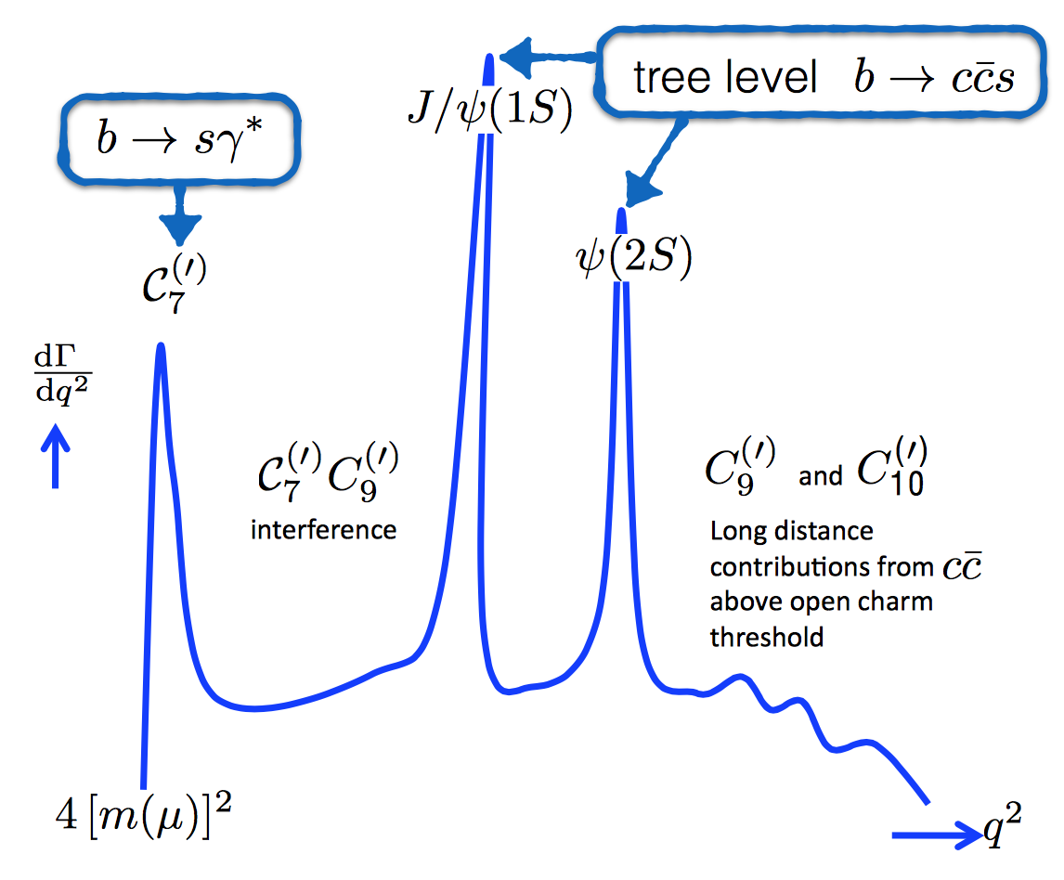
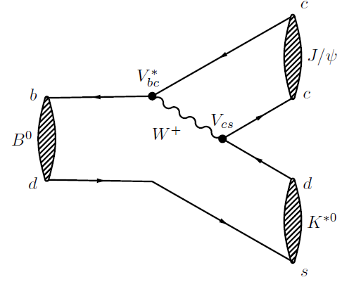
b→s μμ
B→Kμμ or B→K(J/Ψ→)μμ ?
  If m(μμ)=3.1 GeV, we hit the J/Ψ …
Sketch from Christian Linn

Slide 112
B⁰→K*μμ
Event selection:

Slide 113
B⁰→K*μμ
Event selection:

Slide 114
b→s μμ
Observables:
Decay rates
Angular distributions
Ratio of branching fractions

Slide 115
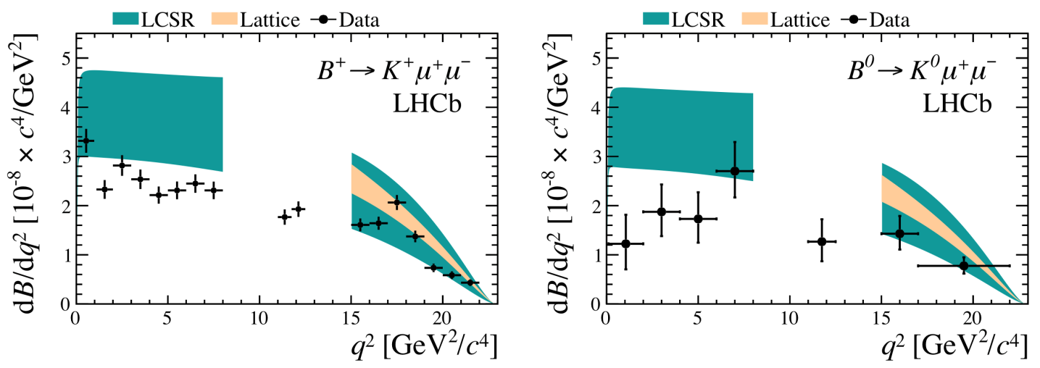
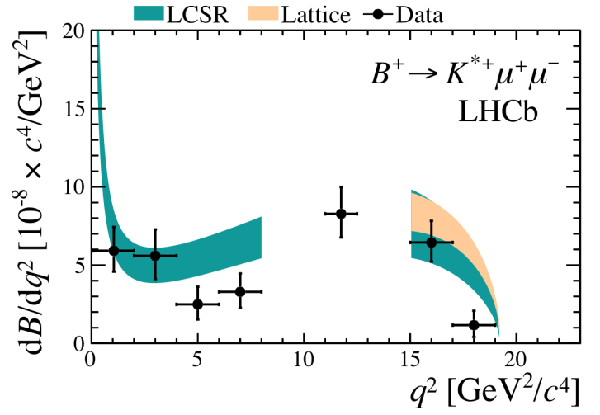
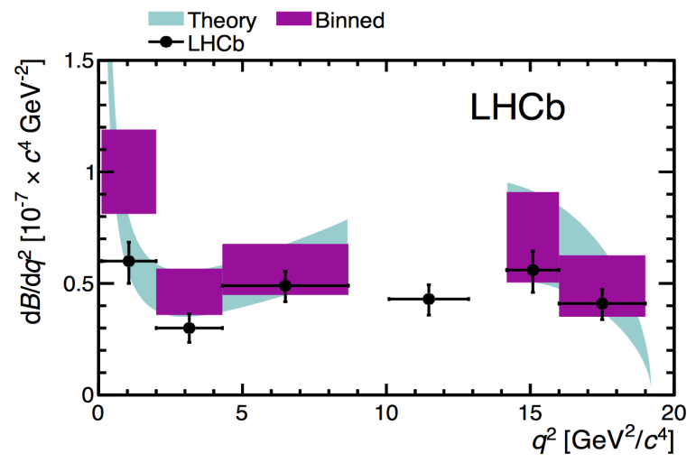
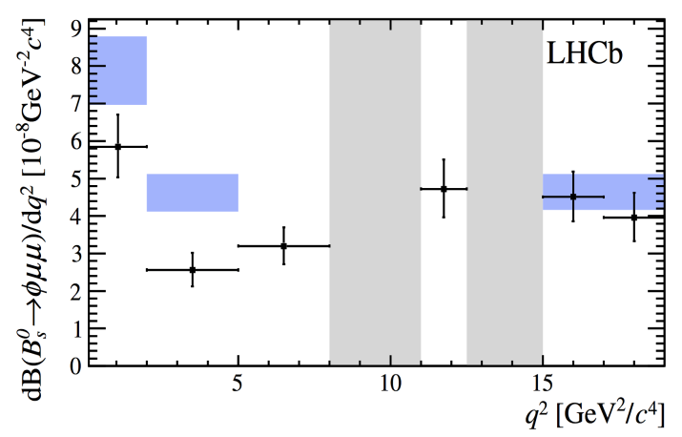
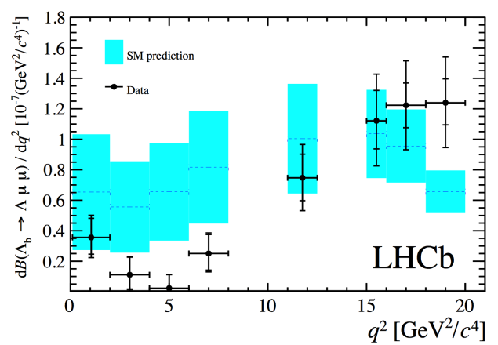
1) b→s μμ: Decay rates
3 fb⁻¹, arXiv:1403.8044
B⁺→K⁺μμ
B⁰→K⁰μμ
B⁰→K*⁺μμ
1 fb⁻¹, arXiv:1304.6325
3 fb⁻¹, LHCB-2015-023
3 fb⁻¹, arXiv:1503.07138
B⁰→K*⁰μμ
B_{s}⁰→φμμ
Λ_{b}⁰→Λμμ
Lower BRs consistent with modified C₉, it seems

Slide 116
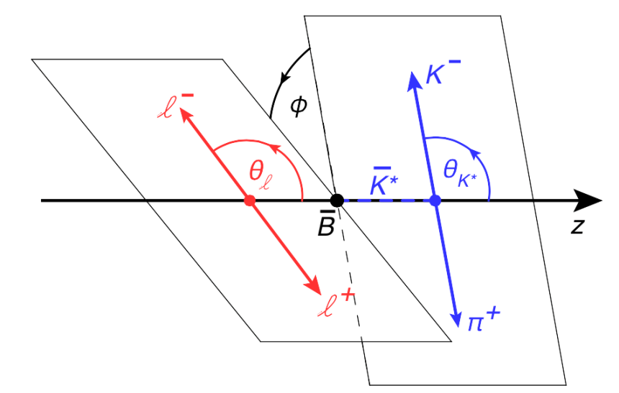
2) Angular analysis B⁰→K*μμ

Slide 117
2) Angular analysis B⁰→K*μμ

Slide 118
2) Angular analysis B⁰→K*μμ
3 fb⁻¹, LHCb arXiv:1512.04442

Slide 119
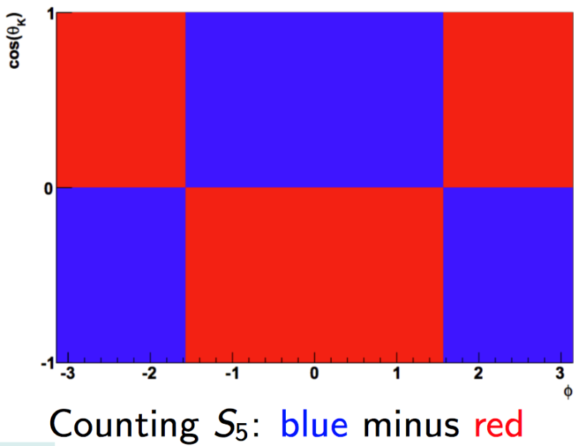
2) Angular analysis B⁰→K*μμ
Such a mix of events can hardly cause an artificial experimental asymmetry…

Slide 120
2) Angular analysis B⁰→K*μμ
Such a mix of events can hardly cause an artificial experimental asymmetry…

Slide 121
2) Angular analysis B⁰→K*μμ
Such a mix of events can hardly cause an artificial experimental asymmetry…
2.9σ in each bin

Slide 122
B⁰→K*μμ
Many observable, many measurements…

Slide 123
B⁰→K*μμ
Many observable, many measurements
No wonder there is some deviation somewhere?!
Fit

Slide 124
Road to discovery: Wilson coefficients
Theory
(What are Wilson coefficients?)
Measurements
(of Wilson coefficients)
Fit
(i.e. determine Wilson coefficients)
Interpretation
(which models correspond to theses Wilson coefficients?)

Slide 125
Fit to b→sμμ
Agreement of various measurements:
Altmannshofer & Straub, arXiv:1503.06199

Slide 126
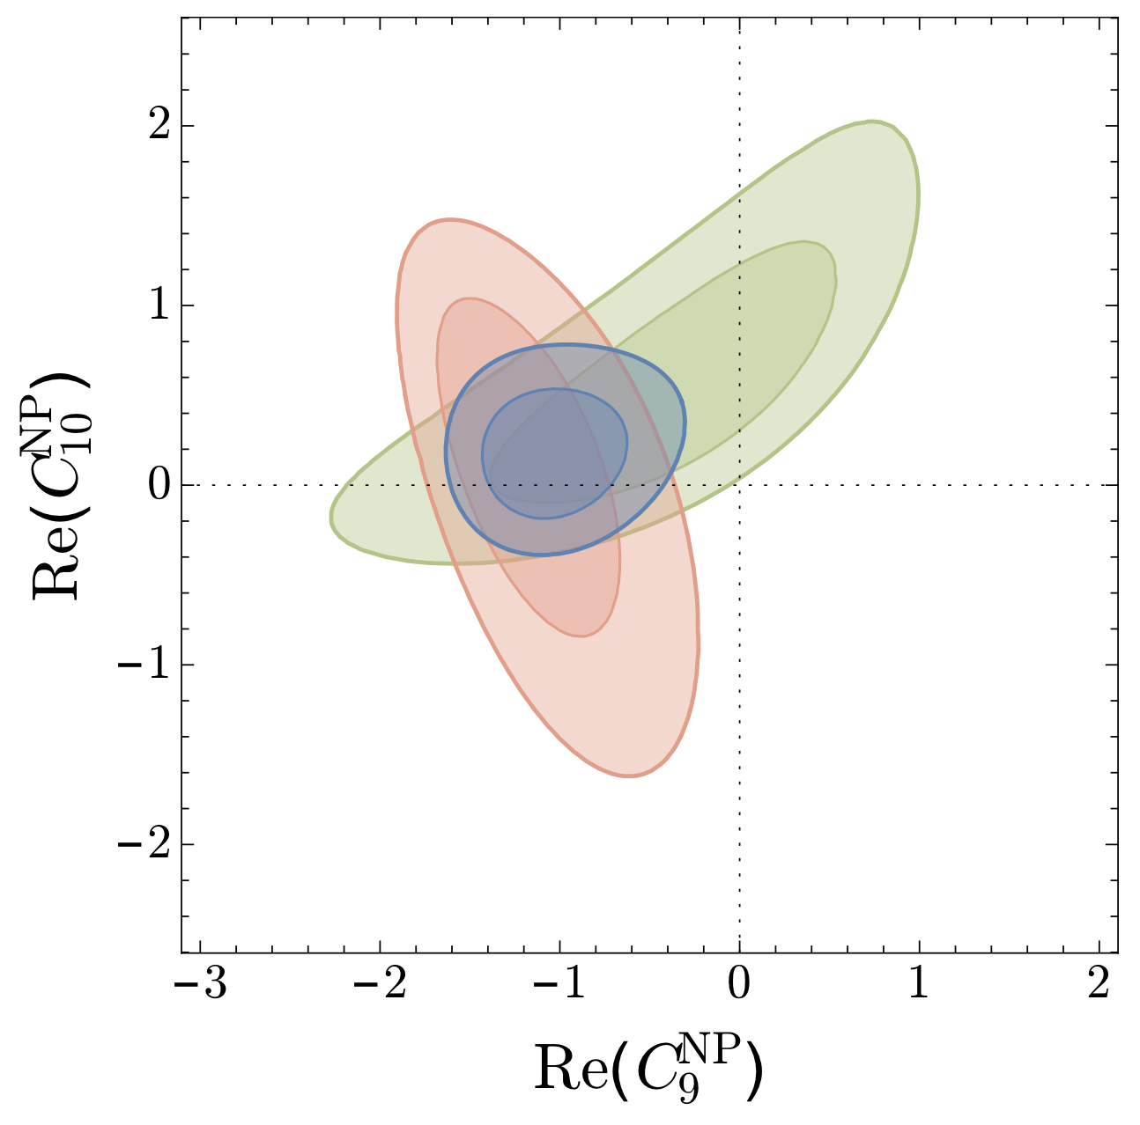
Fit to b→sμμ
C₉
C₉^{NP} deviates from 0 by >4σ
Caveat: debate on non-pertirbative charm-loop effects
LHCb-PAPER-2015-051
Altmannshofer & Straub, arXiv:1503.06199
Descotes-Genon, Matias, Virto, arXiv:1510.04239
SM
Only BR info
Only angular info
Pull_{SM} p-val +ee
SM (χ²/ndof=117/88) 2.1% 0.9%
C₉^{NP}=-1.07 : 3.7σ 11.3% 4.3σ
C₉^{NP}=-C₁₀^{NP}=-0.5: 3.1σ 7.1% 3.9σ
Pull_{SM} p-val
SM (χ²/ndof=110/96) 16%
C₉^{NP}=-1.11 : 4.5σ 62%
C₉^{NP}=-C₁₀^{NP}=-0.7: 4.1σ 55%

Slide 127
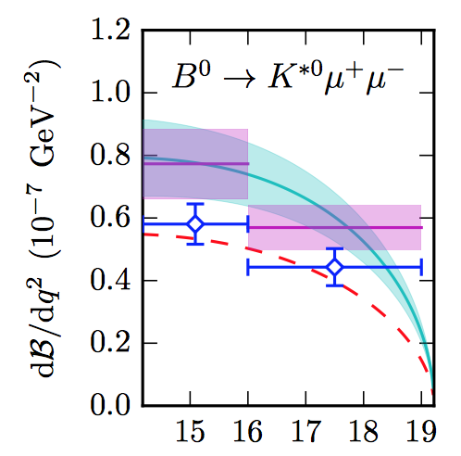
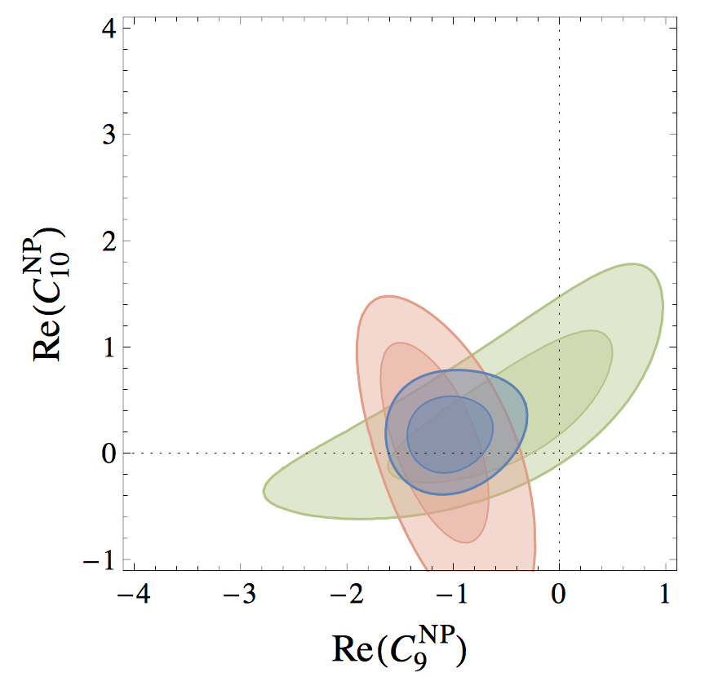
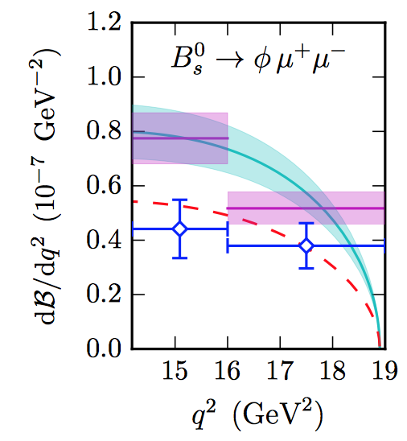
BR(b→sμμ) vs P5’ in B⁰→K*μμ
Horgan et al, arXiv:1310.3887
^{Altmannshofer & Straub,} ^{arXiv:1411.3161}
Only BR info
C₉^{NP}=-1.0
Only angular info
SM
Low BR points in same direction as angular observables

Slide 128
Fit to b→sμμ
Fit could be better if SM is not imposed…:
V:
V+A:
V-A:
Altmannshofer & Straub, arXiv:1503.06199

Slide 129
Fit to b→sμμ
Fit could be better if SM is not imposed…:
V:
V+A:
V-A:
Descotes, Virto, Matias, arXiv:1510.04239

Slide 130
Fit to b→sμμ
Fit could be better if SM is not imposed…:
Leave 2 coefficients free in fit:
Descotes, Virto, Matias, arXiv:1510.04239

Slide 131
Fit to b→sμμ
Fit could be better if SM is not imposed…:
Leave 6 coefficients free in fit:
Descotes, Virto, Matias, arXiv:1510.04239

Slide 132
Fit to b→sμμ
Fit could be better if SM is not imposed…:
Virto, CKM2016

Slide 133

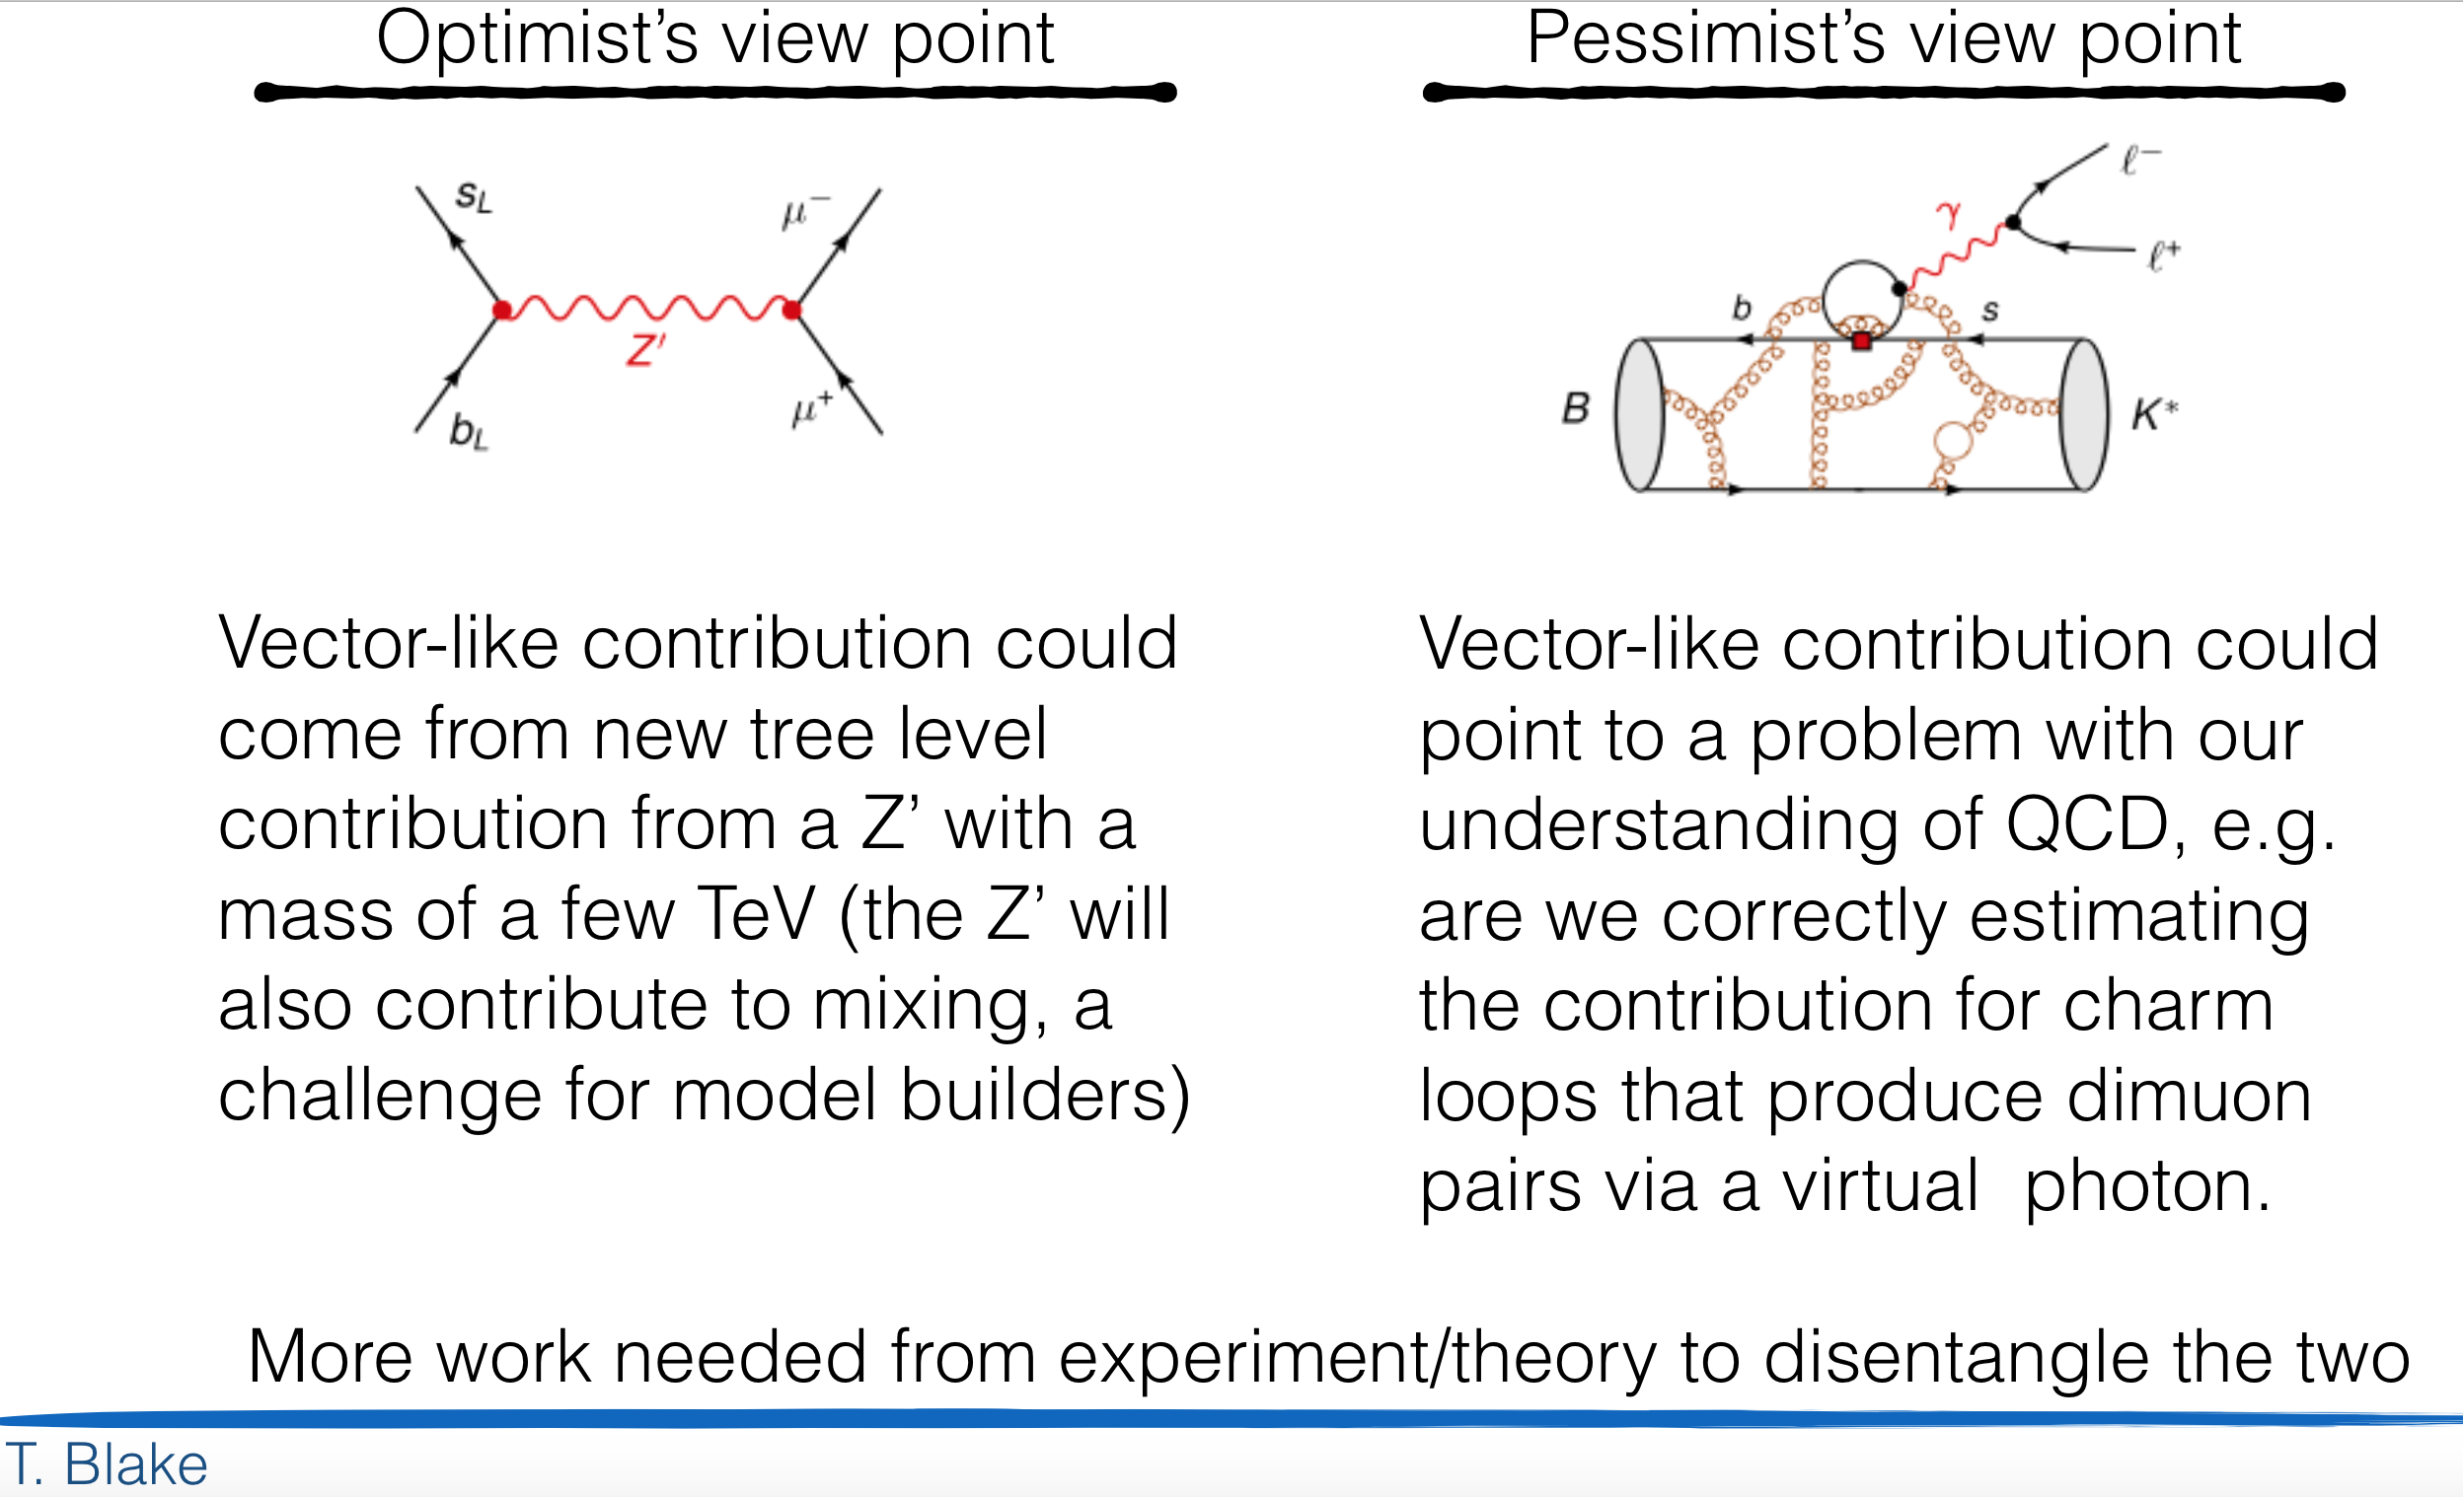
Interpretation? (Both affect the vector coupling, C₉ …)
Slide from Tom Blake

Slide 134

3) b→ sll : Ratio of branching fractions
FCNC: EW penguin
2.6 σ
LHCb, PRL113 (2014) 151601

Slide 135
b→ sll : FCNC anomalies!?
FCNC: EW penguin
Curious tensions:
  Lepton flavour universality
  Decay rates
  Angular distributions, P₅’
or
3.1 σ
2.6 σ
3.4 σ
LHCb, PRL113 (2014) 151601
LHCb, JHEP 1509 (2015) 179
LHCb, JHEP 1602 (2016) 104

Slide 136
b→ sll : P5’ and LFNU ?
Belle: CKM workshop 2 weeks ago
Wehle, CKM2016

Slide 137

b→ sll : P5’ and LFNU ?
Belle: CKM workshop 2 weeks ago
Agreement with LHCb
Wehle, CKM2016

Slide 138

b→ sll : P5’ and LFNU ?
Belle: CKM workshop 2 weeks ago
e – μ difference …?!
Wehle, CKM2016

Slide 139
Lepton Flavour Non-Universality
More?

Slide 140
Lepton-Flavour Non-Universality ?
Surprises possible in tree-level decays?
B→ D*lν
  Measure ratio τ/μ :
  SM: R(D*)=0.252±0.003
Fajfer, Kamenik, Nisandzic PRD 85, 094025 (2012)

Slide 141
Lepton-Flavour Non-Universality ?
Spot the differences …

Slide 142
Lepton-Flavour Non-Universality ?
Missing mass
E_{μ}
Result:
Energy of muon in B rest frame

Slide 143

Lepton-Flavour Non-Universality
Surprises possible in tree-level decays?
There is more than “roadmap” channels with loops
B→ D*lν
  Measure ratio τ/μ :
  SM: R(D*)=0.252±0.003
  R(D) and R(D*) combined: 4.0σ
?
Fajfer, Kamenik, Nisandzic PRD 85, 094025 (2012)
LHCb
Standard Model
3.0σ
Average
4.0σ

Slide 144



More Measurements
“Interesting” recent measurements at LHCb:
R(D*) and R(D): Lepton universality B→D⁽*⁾τυ / B→D⁽*⁾μυ
R_{K}: Lepton universality B→Kee / B→Kμμ
P₅’: Angular observable B⁰→K*μμ
Г(b→ s μμ) Decay rates of B_{(s)}→K(φ)μμ
B_{s}⁰→μμ
V_{ub}
Other interesting measurements and constraints:
BR(B⁰→ μμ): high?
V_{ub}: incl vs excl: different?
g-2 high?
Diboson resonance high?
H→τμ high?
ε’/ε x10 high?
B-mixing
τ→μμμ
μ→eγ
g-2
Diboson
Diphoton
h→μτ
LHCb/CMS Nature 522, 68 (2015)
LHCb arXiv:1504.01568
BNL E821 PDG
ATLAS arXiv:1506.00962
CMS PAS-HIG-14-005

Slide 145
Other puzzles involving LFNU ?
W→ τυ/W→ μν:
  2.6 σ
g-2
  2.2 – 2.7 σ
Proton radius puzzle
  7 σ
LEP EW WG, arXiv:1302.3415
BNL, hep-ex/0602035
Pohl et al, arXiv:1301.0905

Slide 146

Tensions…?
3.6 σ
3.1 σ
Flavour Changing
Neutral Current
(FCNC)
R_{K}
Γ,P₅’
R(D*)
arXiv:1506.08777
3.4 σ
LHCb-PAPER-051
2.6 σ
arXiv:1406.6482
Lepton Non-
Universality
(LFNU)
arXiv:1506.08614
2.3 σ
3.9 σ
146

Slide 147
End
Thank you

Slide 148

WETEN WAAR HET IN DE WETENSCHAP OM DRAAIT
… ZEER INDRUKWEKKEND, COLLEGA …
MAAR WERKT
HET OOK IN
THEORIE ?
http://www.foksuk.nl/

Slide 149
Road to discovery: Wilson coefficients
Theory
(What are Wilson coefficients?)
Measurements
(of Wilson coefficients)
Fit
(i.e. determine Wilson coefficients)
Interpretation
(which models correspond to theses Wilson coefficients?)

Slide 150
Theory: 1) Leptoquarks
arXiv:1511.01900
Example: “Bauer/Neubert” model
  Leptoquark m_{Δ} ~ 1 TeV
  g-2
  R(D*)
  R_{K}
  b→c : tree level, b→s : loop level
Predictions:
  1σ effects on BR(Z→µµ)
  B-mixing affected
  (BR(h→τµ)~10⁻⁷)

Slide 151
Theory: 2) heavy Z’
arXiv:1506.01705
Example: “Isidori” model
  New Z’ boson
  Relatively simple model
  Describes all (most?) data
  Extra SU(2)_{L} symmetry, coupling to 3rd gen
Predictions:
  C^{NP}₁₀=-C^{NP}₉
  τ,μ difference universal: R(D)=R(D*)=R(Λ_{c})=… ~ 30%
  e, μ difference: ~1-2%
  B-mixing: 10% deviations from SM
  τ→μμμ not far from present bound
  No coupling to bosons, so cannot explain diboson excess…
  Z’→tt,bb,ττ not very easy in ATLAS, most stringent constraint from m(Z’→ττ)>300 GeV, ruling out most minimal version of this model!

Slide 153
Interpretations
 | Authors | Model | Input | Predictions/ Result | arXiv
☑ | Descotes-Genon, Matias, Virto | Model independent | b→ sll, b→ sγ | C₉^{NP}=-1 C^{NP}₁₀=-C^{NP}₉ | 1307.5683 1510.04239
☑ | Altmannshofer, Straub | Model independent | b→ sll, b→ sγ | C₉^{NP}=-1 C^{NP}₁₀=-C^{NP}₉ | 1411.3161 1503.06199
☐ | Glashow, Guadagnoli, Lane | Z' | B⁰→K*µµ, R_{K}, B_{s}⁰→µµ | LFNU → LFV | 1411.0565 1507.01412
☐ | Bhattacharya, Datta, London, Shivashankara | Z’, W’ | R_{K}, R(D*) | R(D)=R(D*) | 1412.7164
☐ | Crivellin, Hofer, Matias, Nierste, Pokorski, Rosiek | Z’ | B→K*µµ, R_{K} (τ→3µ, µ→eγ, g-2, B-mix) | 1) C^{NP}₁₀=0 2) C^{NP}₁₀=-C^{NP}₉ Limits on B→(K)µe. (h→µν 1503.03477) | 1504.07928
☐ | Celis, Fuentes-Martin, Jung, Serodio | Z‘ | B⁰→K*µµ, R_{K} | R_{K}=R_{K*} | 1505.03079
☑ | Greljo, Isidori, Marzocca | Z’,W’ | B⁰→K*µµ, R_{K}, R(D*), τ→3µ, B-mix, B→Xν | R(D)=R(D*), Dµν/Deν ~ 1-2% | 1506.01705
☐ | Buras, Butazzo, Knegjens De Fazio | Z’ SU(3)_{L} | ε’/ε, K_{L}→μμ, B_{s}⁰→µµ | K→πνν, B⁰→K*µµ m_{Z’}~3 TeV | 1507.08672 1512.02869
☐ | Hiller, Schmaltz | Leptoquark | R_{K,} b→ sµµ |  | 1408.1627
☐ | Bečirević, Fajfer, Košnik | Leptoquark (scalar, or vector) | BR(B→Kµµ), B_{s}⁰→µµ | C₉’=-C₁₀’, R_{K}=0.88 | 1503.09024 1511.06024
☐ | Freytsis, Ligeti, Ruderman | Leptoquark (scalar/vector) | R(D*),B⁺→τυ | B⁺/B⁻ CPV, D→πνν~10⁻⁵ | 1506.08896
☑ | Bauer, Neubert | Leptoquark (scalar) | R_{K}, R(D*), g-2 (B-mix, τ→µγ, D→µµ) | BR(Z→µµ), B-mix | 1511.01900
Shown

Slide 154
New physics?
More involved Standard Model calculation?
Statistical fluctuations?
Or first hints for new particles??
  Leptoquark ?
  Couples to quark ánd leptons
  Explaining many open questions
    g-2, B→Kμμ, B→D*μν, diphoton
  Z’ ?
  New symmetry, new boson (force)
  Explaining many open questions
    B→Kμμ, B→D*μν

Slide 156
Backups

Slide 157
Strange
New field within LHCb
Dedicated triggers
Rich program:
  K_{S}⁰→ μμ
    BR < 5.8 x 10⁻⁹ @ 90% CL
    Software trigger, 23 fb⁻¹: 2 x 10⁻¹⁰
  K_{S}⁰→ π⁰μμ
    Hardware trigger bottleneck → upgrade!
  K_{S}⁰→ μμμμ
    No experimental constraint to date
  K_{S}⁰→ π⁺π⁻ee
    5σ observation possible in Run-II
  K⁺→ π⁺π⁻π⁺
    10⁶ events observed in Run-I
    software trigger in upgrade: 2x 10¹⁰ /fb⁻¹
  Σ⁺→ pμμ
    Check HyperCP (E871) events
LHCb-CONF-2016-012
LHCb-CONF-2016-013

Slide 158

Strange
New field within LHCb
Dedicated triggers
Rich program:
  K_{S}⁰→ μμ
    BR < 5.8 x 10⁻⁹ @ 90% CL
    Software trigger, 23 fb⁻¹: 2 x 10⁻¹⁰
  K_{S}⁰→ π⁰μμ
    Hardware trigger bottleneck → upgrade!
  K_{S}⁰→ μμμμ
    No experimental constraint to date
  K_{S}⁰→ π⁺π⁻ee
    5σ observation possible in Run-II
  K⁺→ π⁺π⁻π⁺
    10⁶ events observed in Run-I
    software trigger in upgrade: 2x 10¹⁰ /fb⁻¹
  Σ⁺→ pμμ
    Check HyperCP (E871) events
    LHCb:
      Fit at m=214.3 MeV: 1.6±1.9 evts
HyperCP Coll.
HyperCP, PRL 94 (2005) 021801
LHCb-CONF-2016-013

Slide 159

Searches
Dark photons, Majorana, light scalars
Light scalars
  A→μμ
Majorana neutrino’s
  B⁺→ π⁻μ⁺μ⁺
Dark photons
  D*⁰→D⁰γ, A→μμ
Haisch et al., PRD93 (2016) 055047
Atre et al., JHEP 0905 (2009) 030
Ph.Ilten et al PRL 116 (2016) 251803

Slide 160
Common misunderstandings
CP violation ≠ Baryon number violation
Meson mixing ≠ CP violation
Mixing phase φ_{s} ≠ Mixing phase φ_{s}
CP violation in Kaon system ≠ CPV in decay K_{L}→ππ
K_{S}⁰ ≠ CP eigenstate

Slide 161
LHCb = more than heavy flavour
Resolve b and c jets
Discovery of
pentaquark P(4450)
Impressive sin²θ_{w}
Improve proton pdf’s

