Slide 1
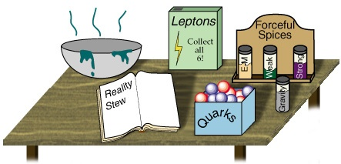


CP Violation in the Standard Model
Topical Lectures
Nikhef
Dec 14, 2016
Marcel Merk
Part 1: Discrete Symmetries
Part 2: The origin of CP Violation in the Standard Model
Part 3: Flavour mixing with B decays
Part 4: Observing CP violation in B decays

Slide 2

Before we saw how CP violation can be embedded in the CKM sector of the SM.
Next we investigate how we can observe CP violation and measure the relevant parameters in the CKM description.
Although CP violation was first observed with Kaons I will focus on B mesons.
Again, questions are
welcome.

Slide 3


Back to serious business…
A) Mixing in the neutral B decay system

Slide 4
Dynamics of Neutral B (or K) mesons…
Time evolution of B⁰ and B⁰ can be described by an effective Hamiltonian:
No mixing, no decay…
No mixing, but with decays…
(i.e.: H is not Hermitian!)
With decays included, probability of observing
either B⁰ or B⁰ must go down as time goes by:

Slide 5
As can be easily seen…. – skip
Since the particles decay:

Slide 6
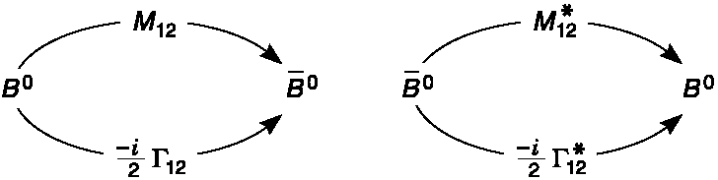
Describing Mixing…
Time evolution of B⁰ and B⁰ can be described by an effective Hamiltonian:
Where to put the mixing term?
Now with mixing – but what is the
difference between M₁₂ and Γ₁₂?
M₁₂ describes B⁰ ↔ B⁰ via off-shell states, e.g. the weak box diagram (“dispersive”)
Γ₁₂ describes B⁰↔f↔B⁰ via on-shell states, eg. f=π⁺π⁻, (“absorptive”)
For details, look up “Wigner-Weisskopf” approximation…
Notes:
Any 2x2 matrix can be decomposed in a sum of two Hermitian matrices.

Slide 7
Solving the Schrödinger Equation
Solution:
(α and β are initial conditions):
Eigenvectors:
Δm and ΔΓ follow from the Hamiltonian:
From the eigenvalue calculation:
Notes:
The physical particles are the eigenstates of the Hamiltonian. Solve the eigenvalues lambda by putting det (H11-lambda*I) = 0
This you can not see here. You just have to sit down and *do* it.

Slide 8
B Oscillation Amplitudes
For an initially produced B⁰ or a B⁰ it then follows: using:
with
For B⁰, expect:
ΔΓ ~ 0,
|q/p|=1
`
Notes:
These formula’s just follow from substitution. No magic. Note that in the last step g_ gets a 90 degree phase !

Slide 9

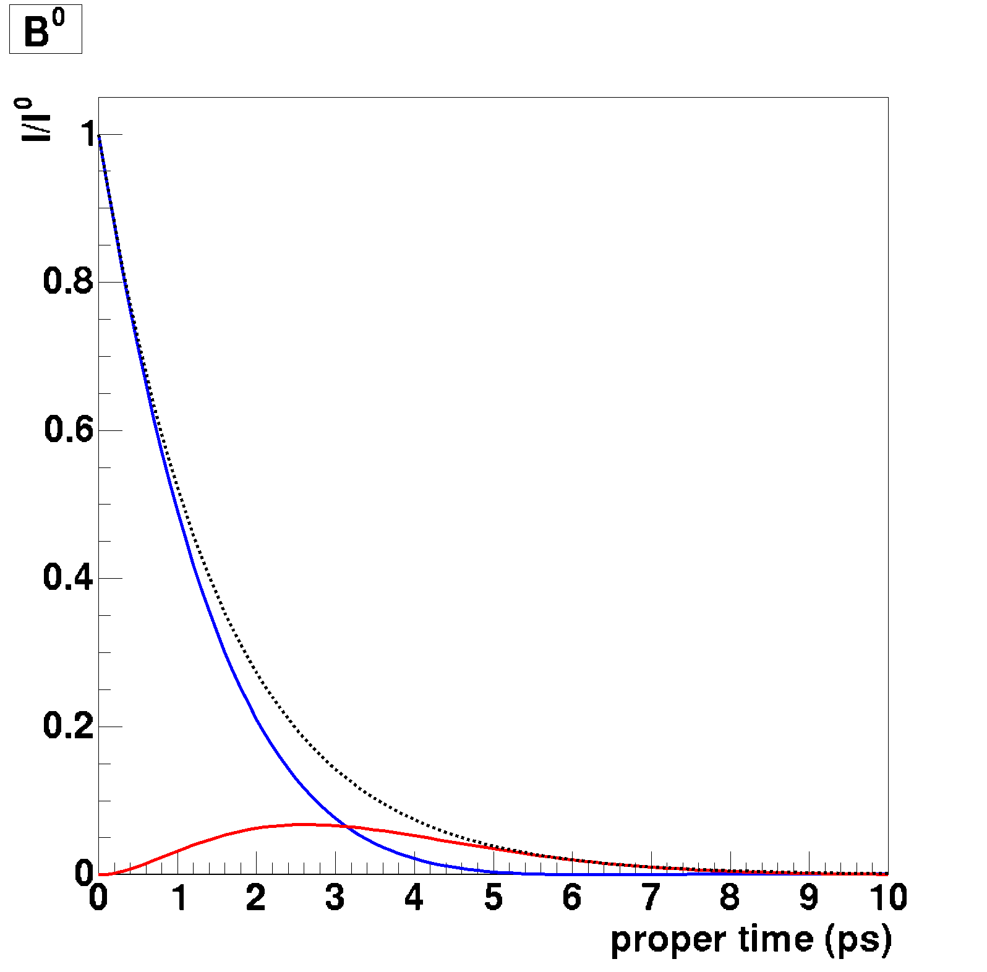
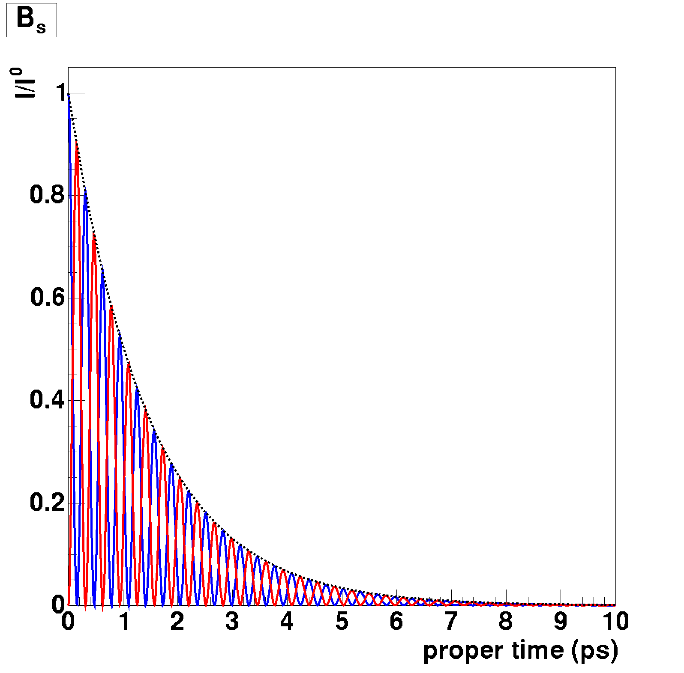
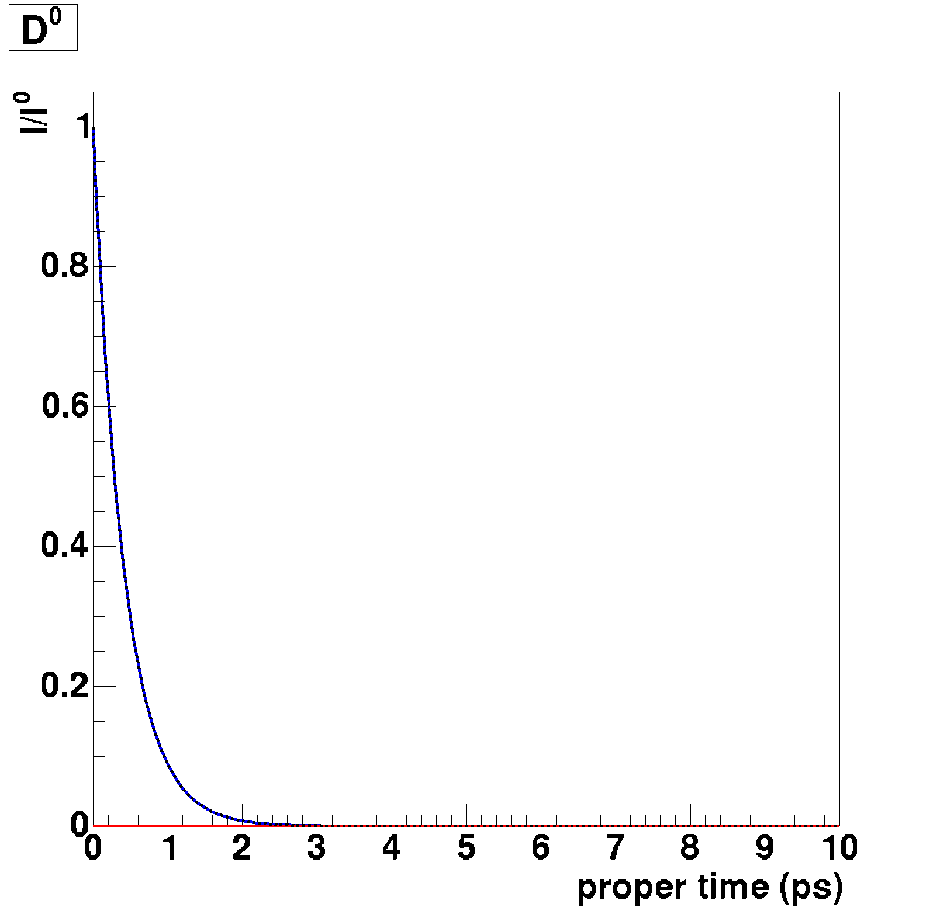
Measuring B Oscillations
For B⁰, expect:
ΔΓ ~ 0, |q/p|=1
Examples:
B⁰→B⁰
B⁰→B⁰
Decay probability
Proper Time →
Notes:
Probability is square of the amplitude! Use cos^2 (dmt/2) = 0.5 * (1 + cos(dmt))

Slide 10
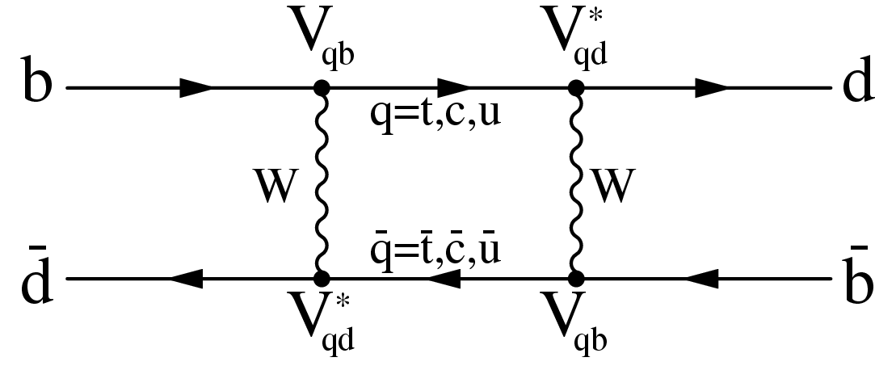
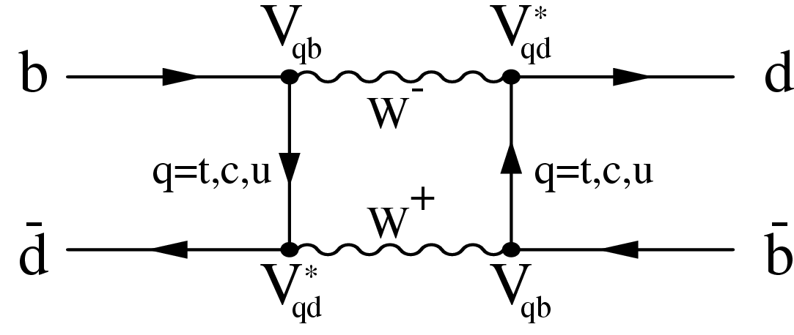
Computing Δm_{d}: Mixing Diagrams
GIM(i.e. V_{CKM} unitarity):
if u,c,t same mass,
everything cancels!
Detailed calculation:
Dominated by top quark mass:
Notes:
GIM: Due to triangle relation: VubVud* + VcdVcb* + VtdVtb*=0.
Highly non-trivial calculation of Delta M. Eta_B is a QCD factor~0.55. The decay constant f_B ~ 175 MeV , the bag factor B_B~1.3

Slide 11
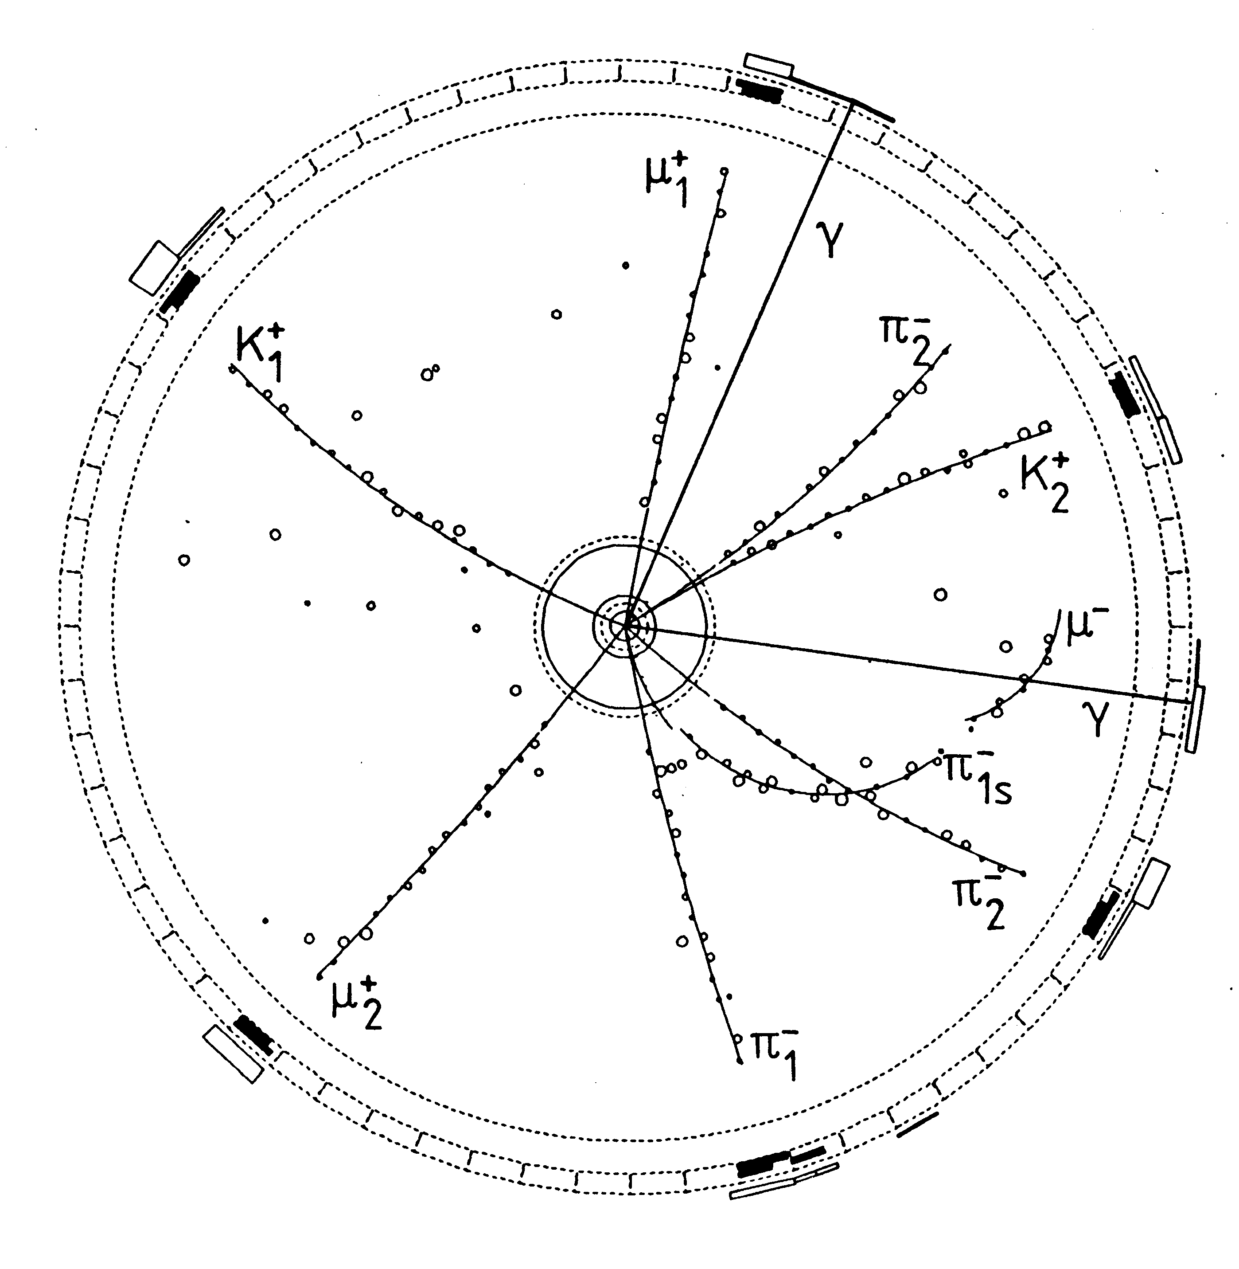
B⁰B⁰ Mixing: ARGUS, 1987
Produce an bb bound state, ϒ(4S),
in e⁺e⁻ collisions:
e⁺e⁻ → ϒ(4S) → B⁰B⁰
and then observe:
Integrated luminosity 1983-87: 103 pb⁻¹
~17% of B⁰ and B⁰ mesons
oscillate before they decay
→Δm ~ 0.5/ps, τ_{B} ~ 1.5 ps
First hint of a really large m_{top}!
Notes:
B1 and B2 decay both into a positive lepton. The hinted top mass is ~160 GeV

Slide 12
Exercise
Given the reconstructed tracks
and their particle ID, how many
ways can you determine the
flavour of B₁?
And of B₂?
B₁: 3
Charge of muon
Charge of slow pion
Charge of Kaon
B₂: 2
Charge of the muon
Charge of the Kaon
Notes:
B1: 3: The charge of the muon, the charge of the slow pion, the charge of the Kaon
B2: 2: The charge of the muon and the charge of the Kaon

Slide 13
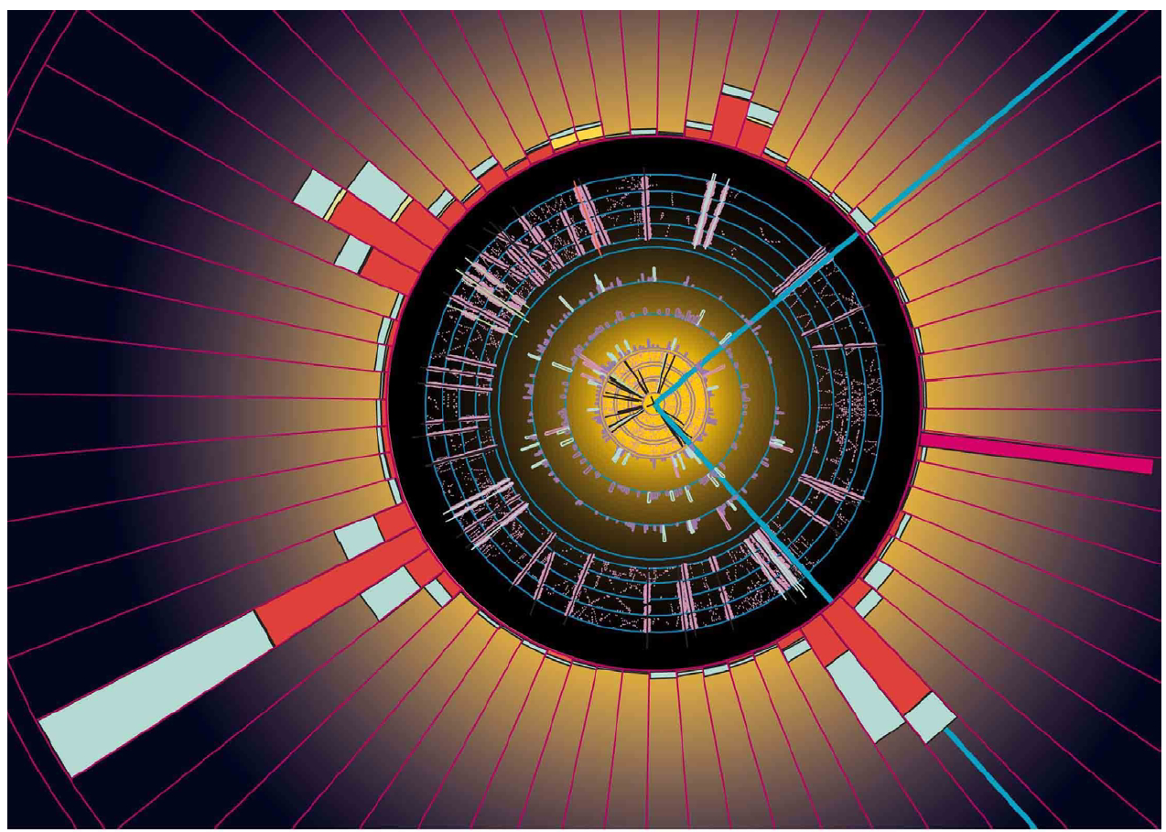
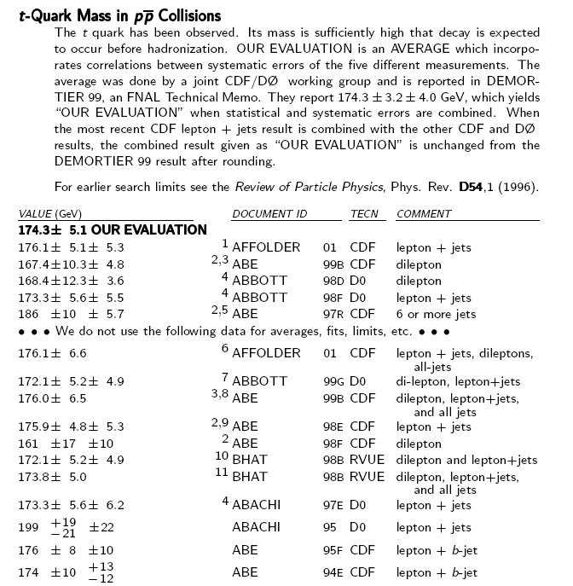
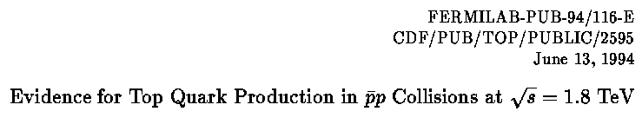
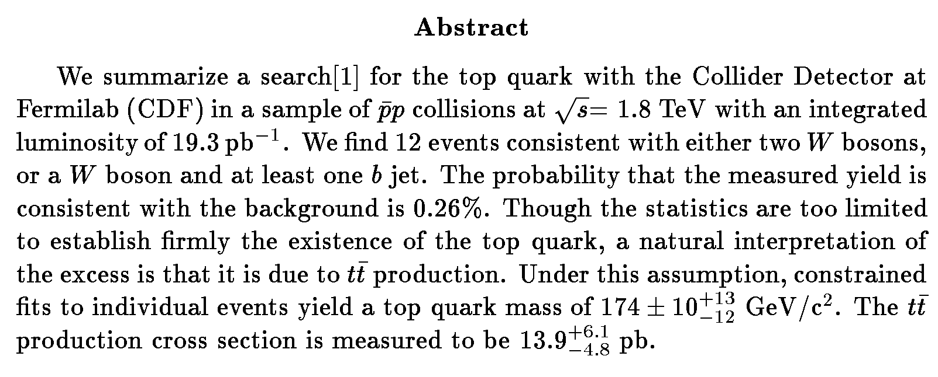
Discovery of the Top Quark: CDF & D0, 1994/5
m _{t} ~174 GeV

Slide 14
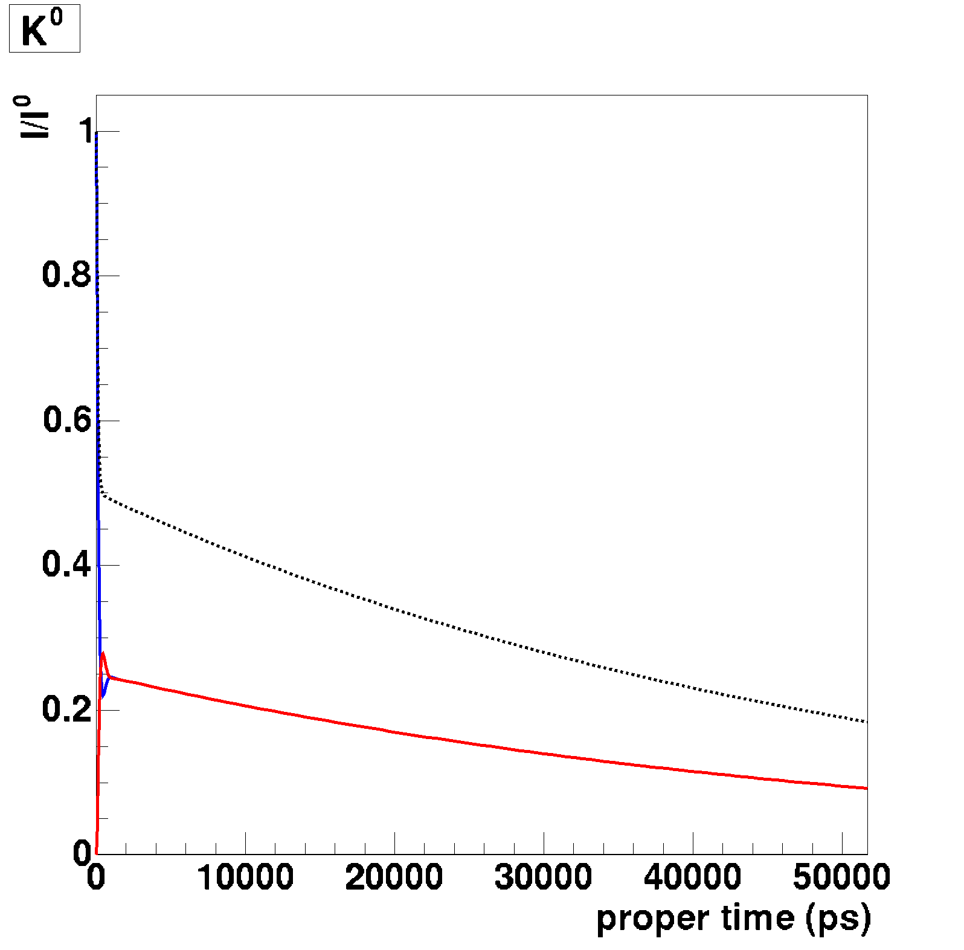
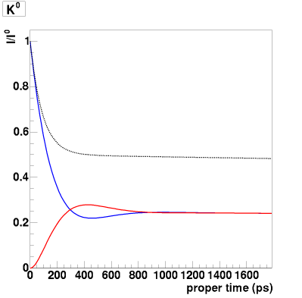
Summary of Neutral Meson Mixing
Blue line:
given a P⁰, at t=0,
the probability of
finding a P⁰ at t.
Red Line:
given a P⁰, at t=0,
the probability of
finding a P⁰ at t.
B⁰ meson
B_{s} meson
Q: Why does the B_{s} oscillate so much faster than the B⁰?
Q: why does the D⁰ meson
oscillate very slowly?
Q: do you expect any other (neutral) mesons/baryons to mix?
K⁰ meson
(Vts/Vtd)
D⁰ meson
(Box diagram: beauty mass << top mass)
(Top decays too fast)
Notes:
A1: Ratio is |V_ts/V_td|^2 ~ 25
A2: Draw Feynman diagram: mediator b or s quark -> m_b, m_s and corresponding CKM elements
A3: No, top decays too fast Pi0 too

Slide 15
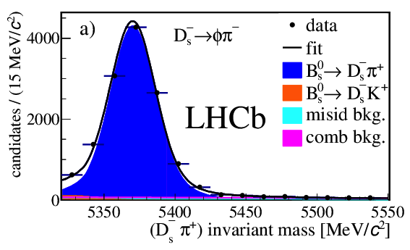
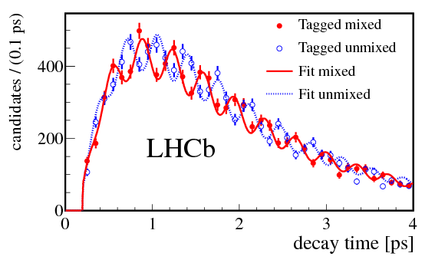
LHCb Performance: B_{d/s} Mixing
Trigger, background suppression, decay time reconstruction, flavour tagging: it works!
B⁰ – B⁰ mixing
B_{s}⁰ – B_{s}⁰ mixing
B⁰→D⁻ π⁺
B_{s}⁰→D_{s}⁻ π⁺
Phys.Lett.B719 (2013) 318
New.J.Phys.15 (2013) 053021

Slide 16

B) CP violation in neutral B decays

Slide 17
CP violation in Mixing?
?
B-factories:
Coherent B-B !
t=0
t
gV_{cb}*
gV_{cb}

Slide 18
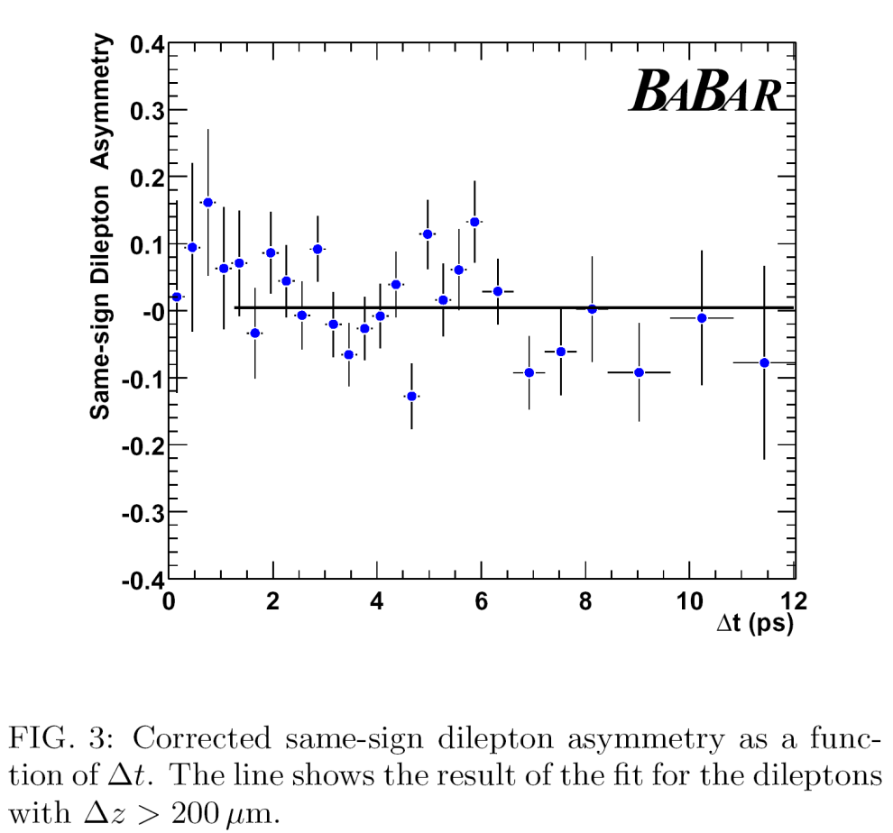
CP Violation in B⁰ Mixing
Look for a like-sign lepton
asymmetry with inclusive dilepton events:
As expected, no
asymmetry is observed…
(requires lifetime differences)
Acp = (0.5±1.2(stat) ±1.4(syst) )%
|q/p| = 0.998 ±0.006(stat)±0.007(syst)
➔ No CP Violation in Mixing. Revisit with LHCb: even higher precision.

Slide 19
B Decay Rates
Look at a particular decay of a B into a final state f and calculate the decay rate:
We had already from solving Schrodinger’s equation
With:
Introduce notation:

Slide 20
Master Formula for B decay
Writing it out gives the master equation for B decays valid for all neutral B decays:
With:

Slide 21

Master Formula for B decay
Often they are also written in an alternative form:
(Only for final state f)
With:
Notes:
This is just writing out simple quantum mechanics. The physics of the Feynman diagrams is hidden in the parameter lambda.

Slide 22
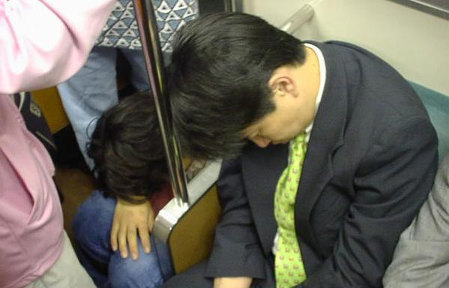

Slide 23


Slide 24


Slide 25


Slide 26


Slide 27

Observing CP Violation
It’s all about imaginary numbers…

Slide 28
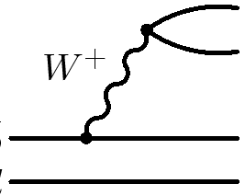
CP Observables
Reflecting a quark process involving W bosons in the CP mirror induces a CP-violating phase shift in the transition amplitude
CP
φ
A single phase can not lead
to an observable effect…
Need a bit more!

Slide 29
Observing CP violation
CP-violating asymmetries can be observed from interference of two amplitudes with relative CP-violating phases
  But additional requirements exist to observe a CP asymmetry!
Example: process B→f via two amplitudes a₁ + a₂ = A.
weak phase diff. φ ≠ 0, no CP-invariant phase diff.
B→f
B→f
|A|=|A| → No observable CP asymmetry

Slide 30
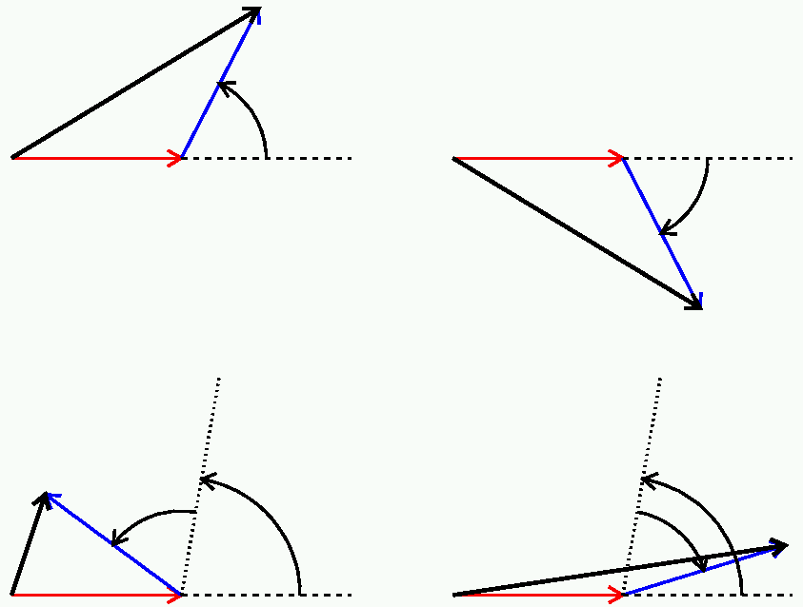
Observing CP violation
CP-violating asymmetries can be observed from interference of two amplitudes with relative CP-violating phases
  But additional requirements exist to observe a CP asymmetry!
Example: process B→f via two amplitudes a₁ + a₂ = A.
weak phase diff. φ ≠ 0, no CP-invariant phase diff.
B→f
B→f
A=a₁+a₂
A=a₁+a₂
A
a₂
+φ
a₁
a₁
-φ
A
a₂
|A|=|A| → No observable CP asymmetry

Slide 31
Observing CP violation
Example: process B→f via two amplitudes a₁ + a₂ = A.
weak phase diff. φ ≠ 0, CP-invariant phase diff. δ ≠ 0
B→f
B→f

Slide 32
Observing CP violation
Example: process B→f via two amplitudes a₁ + a₂ = A.
weak phase diff. φ ≠ 0, CP-invariant phase diff. δ ≠ 0
Interference between two decay amplitudes gives decay time independent observable
  CP violated if BF(B → f) ≠ BF(B → f)
  CP-invariant phases provided by mixing or strong interaction.
  Strong phases usually unknown → this can complicate things…
B→f
B→f
A=a₁+a₂
A=a₁+a₂
+φ
δ
δ
A
-φ
a₂
A
a₂
a₁
a₁
|A|≠|A| → Need also CP-invariant phase
for observable CP violation

Slide 33
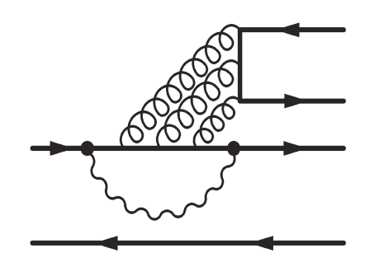
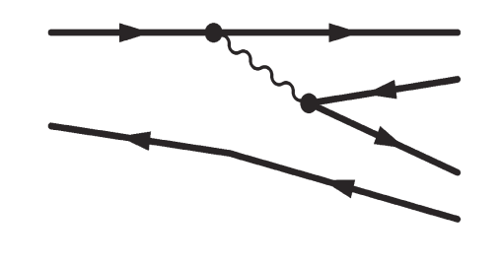
Classification of CP violation
CP violating phase is imbedded in the λ parameter:
Three types of CP violation (always two amplitudes!):
  CP violation in mixing (“indirect” CP violation):
  CP violation in decay (“direct” CP violation):
  CP violation in the interference:

Slide 34
Classification of CP violation
CP violating phase is imbedded in the λ parameter:
Three types of CP violation (always two amplitudes!):
  CP violation in mixing (“indirect” CP violation):
  CP violation in decay (“direct” CP violation):
  CP violation in the interference:
Note that in the SM all these effects
are caused by a single complex
parameter in the CKM matrix!

Slide 36
Special case (i): B decay into CP eigenstates
Consider final states that are CP eigenstates:
B
f_{CP}
B
An example is the decay:
Assume no CP in mixing and no CP in decay
In this case we have:
To observe CP just fill in the Master equation and require:

Slide 37
Master Formula for B decay (recap)
with

Slide 38
Combining Mixing and Decay
t=0
t
Amplitude
CP
For neutral B mesons, g₋ has
a 90º phase difference wrt. g₊

Slide 39
Interfering Amplitudes
t=0
t
Amplitude

Slide 40
Interfering Amplitudes
t=0
t
Amplitude
im
re
40

Slide 41
Interfering Amplitudes
t=0
t
Amplitude
Δmt/2=0
Δmt/2=π/4
Δmt/2=π/2
Δmt/2=3π/4
➔Time Dependent CP Asymmetry!!!
Notes:
Note that the observable is the length of the red vector. CP violation is 0 at Dmt=0, Dmt=pi. CP violation is maximal at Dmt=pi/2 and 3pi/2

Slide 42
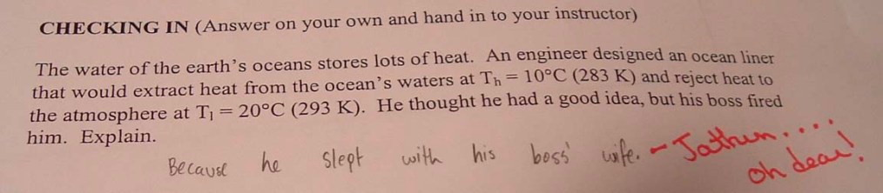
EXERCISE
The decay rate is obtained by taking the absolute square of the amplitude.
To get the result, show that:

Slide 43
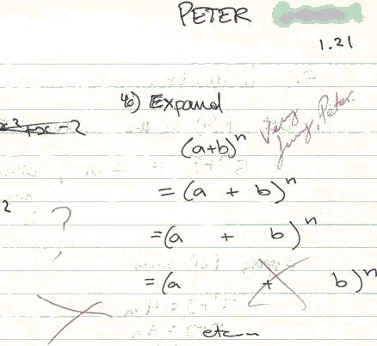
Let’s expand a bit further…

Slide 44
Decays to CP Eigenstates
t=0
t
Amplitude
Decay rate (prob.) is square of amplitude:

Slide 45
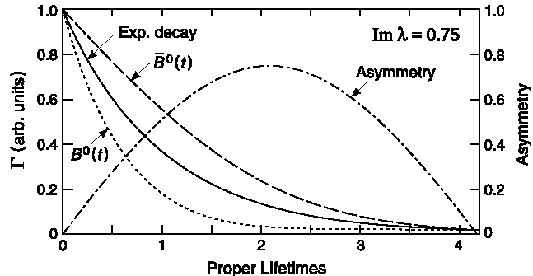
Time dependent CP asymmetries for B→f_{CP}
Finally we get:
Probe of “direct CP violation”
since it requires
Sensitive to the phase
of λ even without direct
CP Violation
Notes:
A maximum in the Asymmetry is predicted at Dm*t = x*t/tau = pi/2 => t/tau = pi/2*1/x = 1.57 * 1/0.776 = 2.0 => OK

Slide 46
Exactly as expected from Master Equation…
with
Putting ΔΓ=0 immediately yields the just derived result

Slide 47
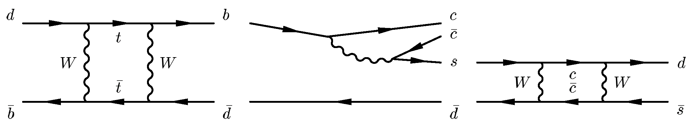
B-factories: Golden Decay Mode: B⁰ → J/ψK⁰_{S}
b
c
J/ψ
c
B⁰
s
d
d
K⁰
b
c
J/ψ
c
B⁰
s
b
d
K⁰
d
d
b
d
Notes:
The physics of the actual decay is hidden in the parameter lambda. Let us investigate the golden decay mode J/psi Ks.

Slide 48
B-factories: Golden Decay Mode: B⁰ → J/ψK⁰_{S}
b
c
J/ψ
c
B⁰
s
d
d
K⁰
b
c
J/ψ
c
B⁰
s
b
d
K⁰
d
d
b
d
Notes:
The reason why for kaons we have (p/q)_K instead of (q/p)_B with B’s is that we go in reverse direction: from flavour to CP state.

Slide 49
B-factories: Golden Decay Mode: B⁰ → J/ψK⁰_{S}
b
c
J/ψ
c
B⁰
s
d
d
K⁰
b
c
J/ψ
c
B⁰
s
b
d
K⁰
d
d
b
d
d
s
s
d
Notes:
|Vcs Vcd|^2 mc^2 = (1*lambda)^2 mc^2 vs. |Vts Vtd|^2 mt^2 = (lambda^2*lambda^3)^2 mt^2 → suppressed by lambda^8, enhanced by (mt/mc)^2 << 1

Slide 50
B-factories: Golden Decay Mode: B⁰ → J/ψK⁰_{S}
b
c
J/ψ
c
B⁰
s
d
d
K⁰
b
c
J/ψ
c
B⁰
s
b
d
K⁰
d
d
b
d
d
s
s
d
Notes:
|Vcs Vcd|^2 mc^2 = (1*lambda)^2 mc^2 vs. |Vts Vtd|^2 mt^2 = (lambda^2*lambda^3)^2 mt^2 → suppressed by lambda^8, enhanced by (mt/mc)^2 << 1

Slide 51
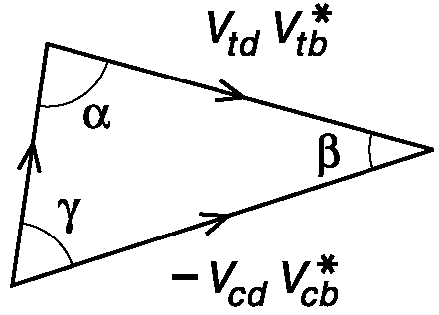
B-factries: Golden Decay Mode: B⁰ → J/ψK⁰_{S}
  η_{CP} = +1
    B⁰  J/ψ K⁰_{L}
  η_{CP} = -1
    B⁰  J/ψ K⁰_{S}
    B⁰  ψ(2s) K⁰_{S}
    B⁰  χ_{c1} K⁰_{S}
K⁰_{S}
Time-dependent CP asymmetry:
Notes:
|Vcs Vcd|^2 mc^2 = (1*lambda)^2 mc^2 vs. |Vts Vtd|^2 mt^2 = (lambda^2*lambda^3)^2 mt^2 → suppressed by lambda^8, enhanced by (mt/mc)^2 << 1

Slide 52
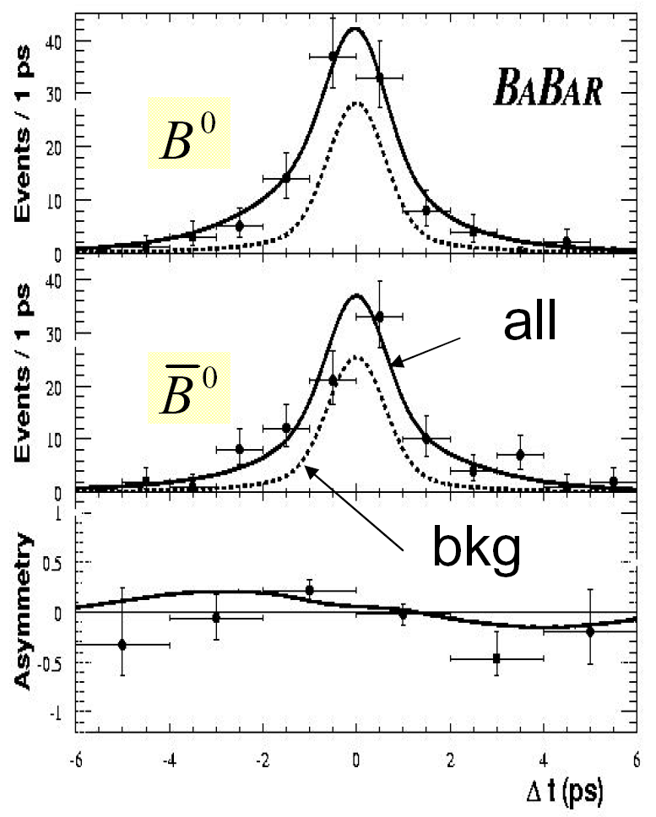

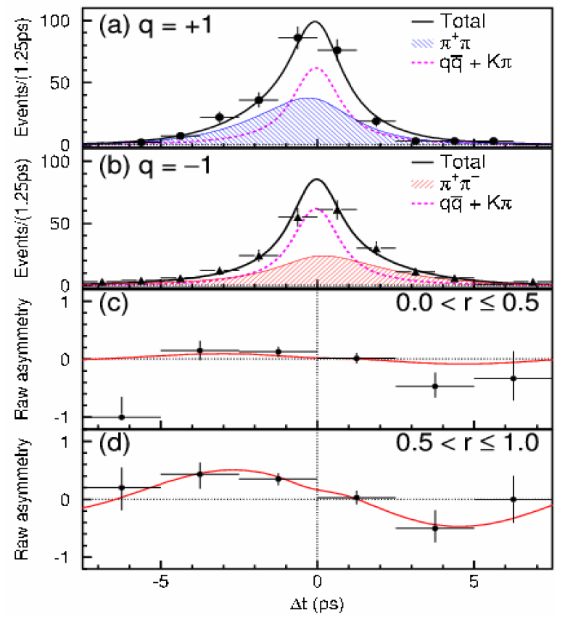
Babar and Belle
BaBar: 113 fb⁻¹
Belle: 140 fb⁻¹

Slide 53
Special case (ii): B-decay to non-CP eigenstates
B_{s}
f
B_{s}
f
vs
B_{s}
B_{s}
`

Slide 54
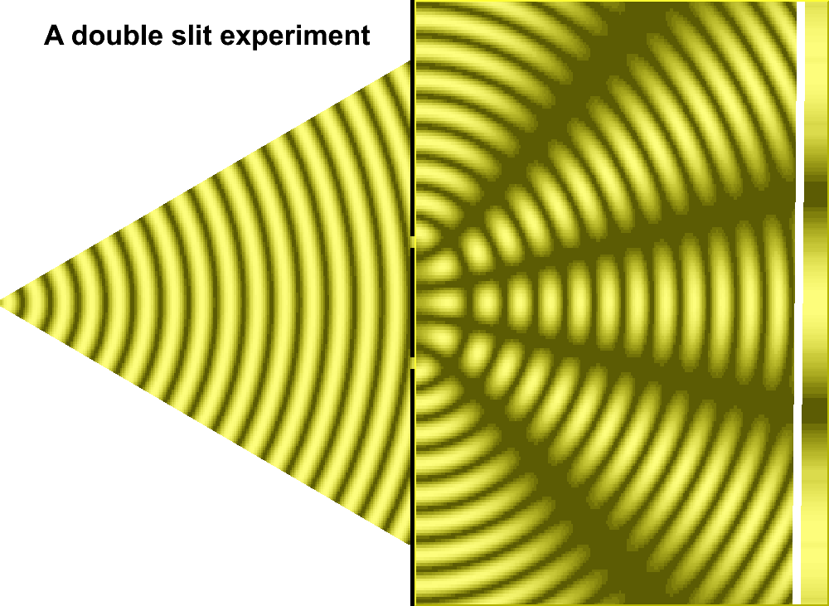
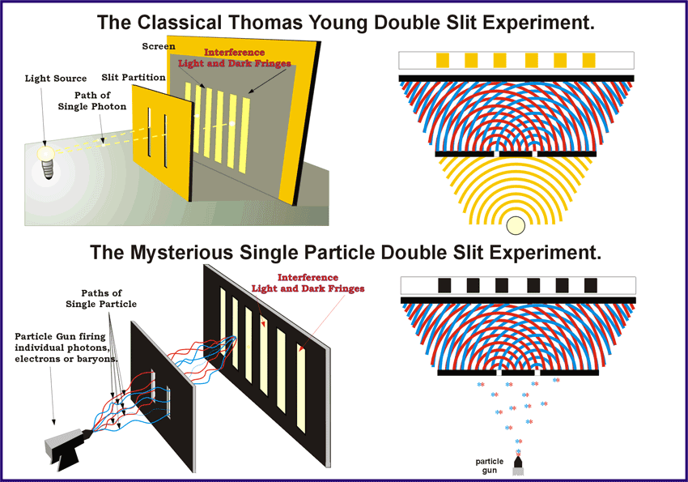
CP Violation
Remember the classical double slit experiment of Young and Feynman’s quantum equivalent…

Slide 55
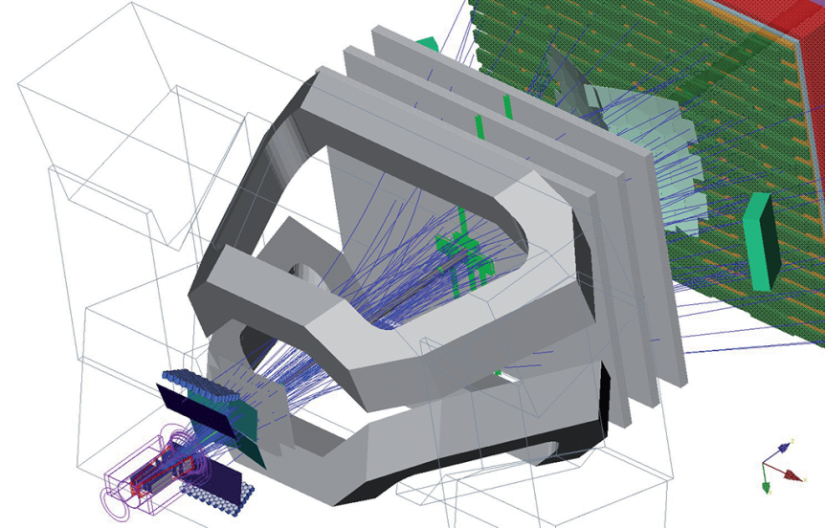
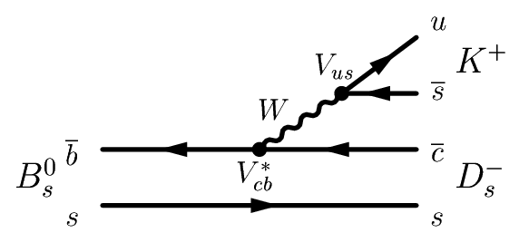
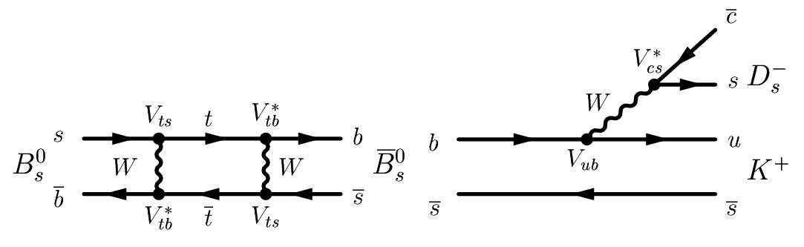
A Quantum Interference B-experiment
pp at LHCb:
100 kHz bb
Measure decay time
“slit A”:
D_{s}⁻
B_{s}
Decay time
Κ⁺
“slit B”:

Slide 56
CP Violation: matter – antimatter asymmetry
An interference pattern:
D_{s}⁻
B_{s}
Decay time
Κ⁺
→ Decay time

Slide 57
CP Violation: matter – antimatter asymmetry
An interference pattern:
Matter
D_{s}⁻
B_{s}
Decay time
Κ⁺
CP-mirror:
Antimatter
D_{s}⁺
B_{s}
Decay time
Κ⁻
→ Decay time
Observation of CP Violation is a consequence of quantum interference!!

Slide 58

Double Slit: Particle-Wave Duality
The decaying particle’s point of view….

Slide 59
Next Lecture
Measurements of CP Violation with B-mesons.

