Slide 1
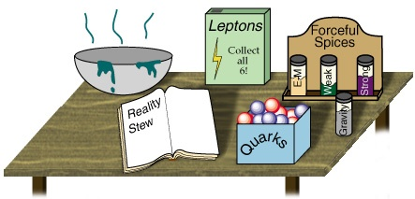


CP Violation in the Standard Model
Topical Lectures
Nikhef
Dec 14, 2016
Marcel Merk
Part 1: Discrete Symmetries
Part 2: The origin of CP Violation in the Standard Model
Part 3: Flavour mixing with B decays
Part 4: Observing CP violation in B decays

Slide 2
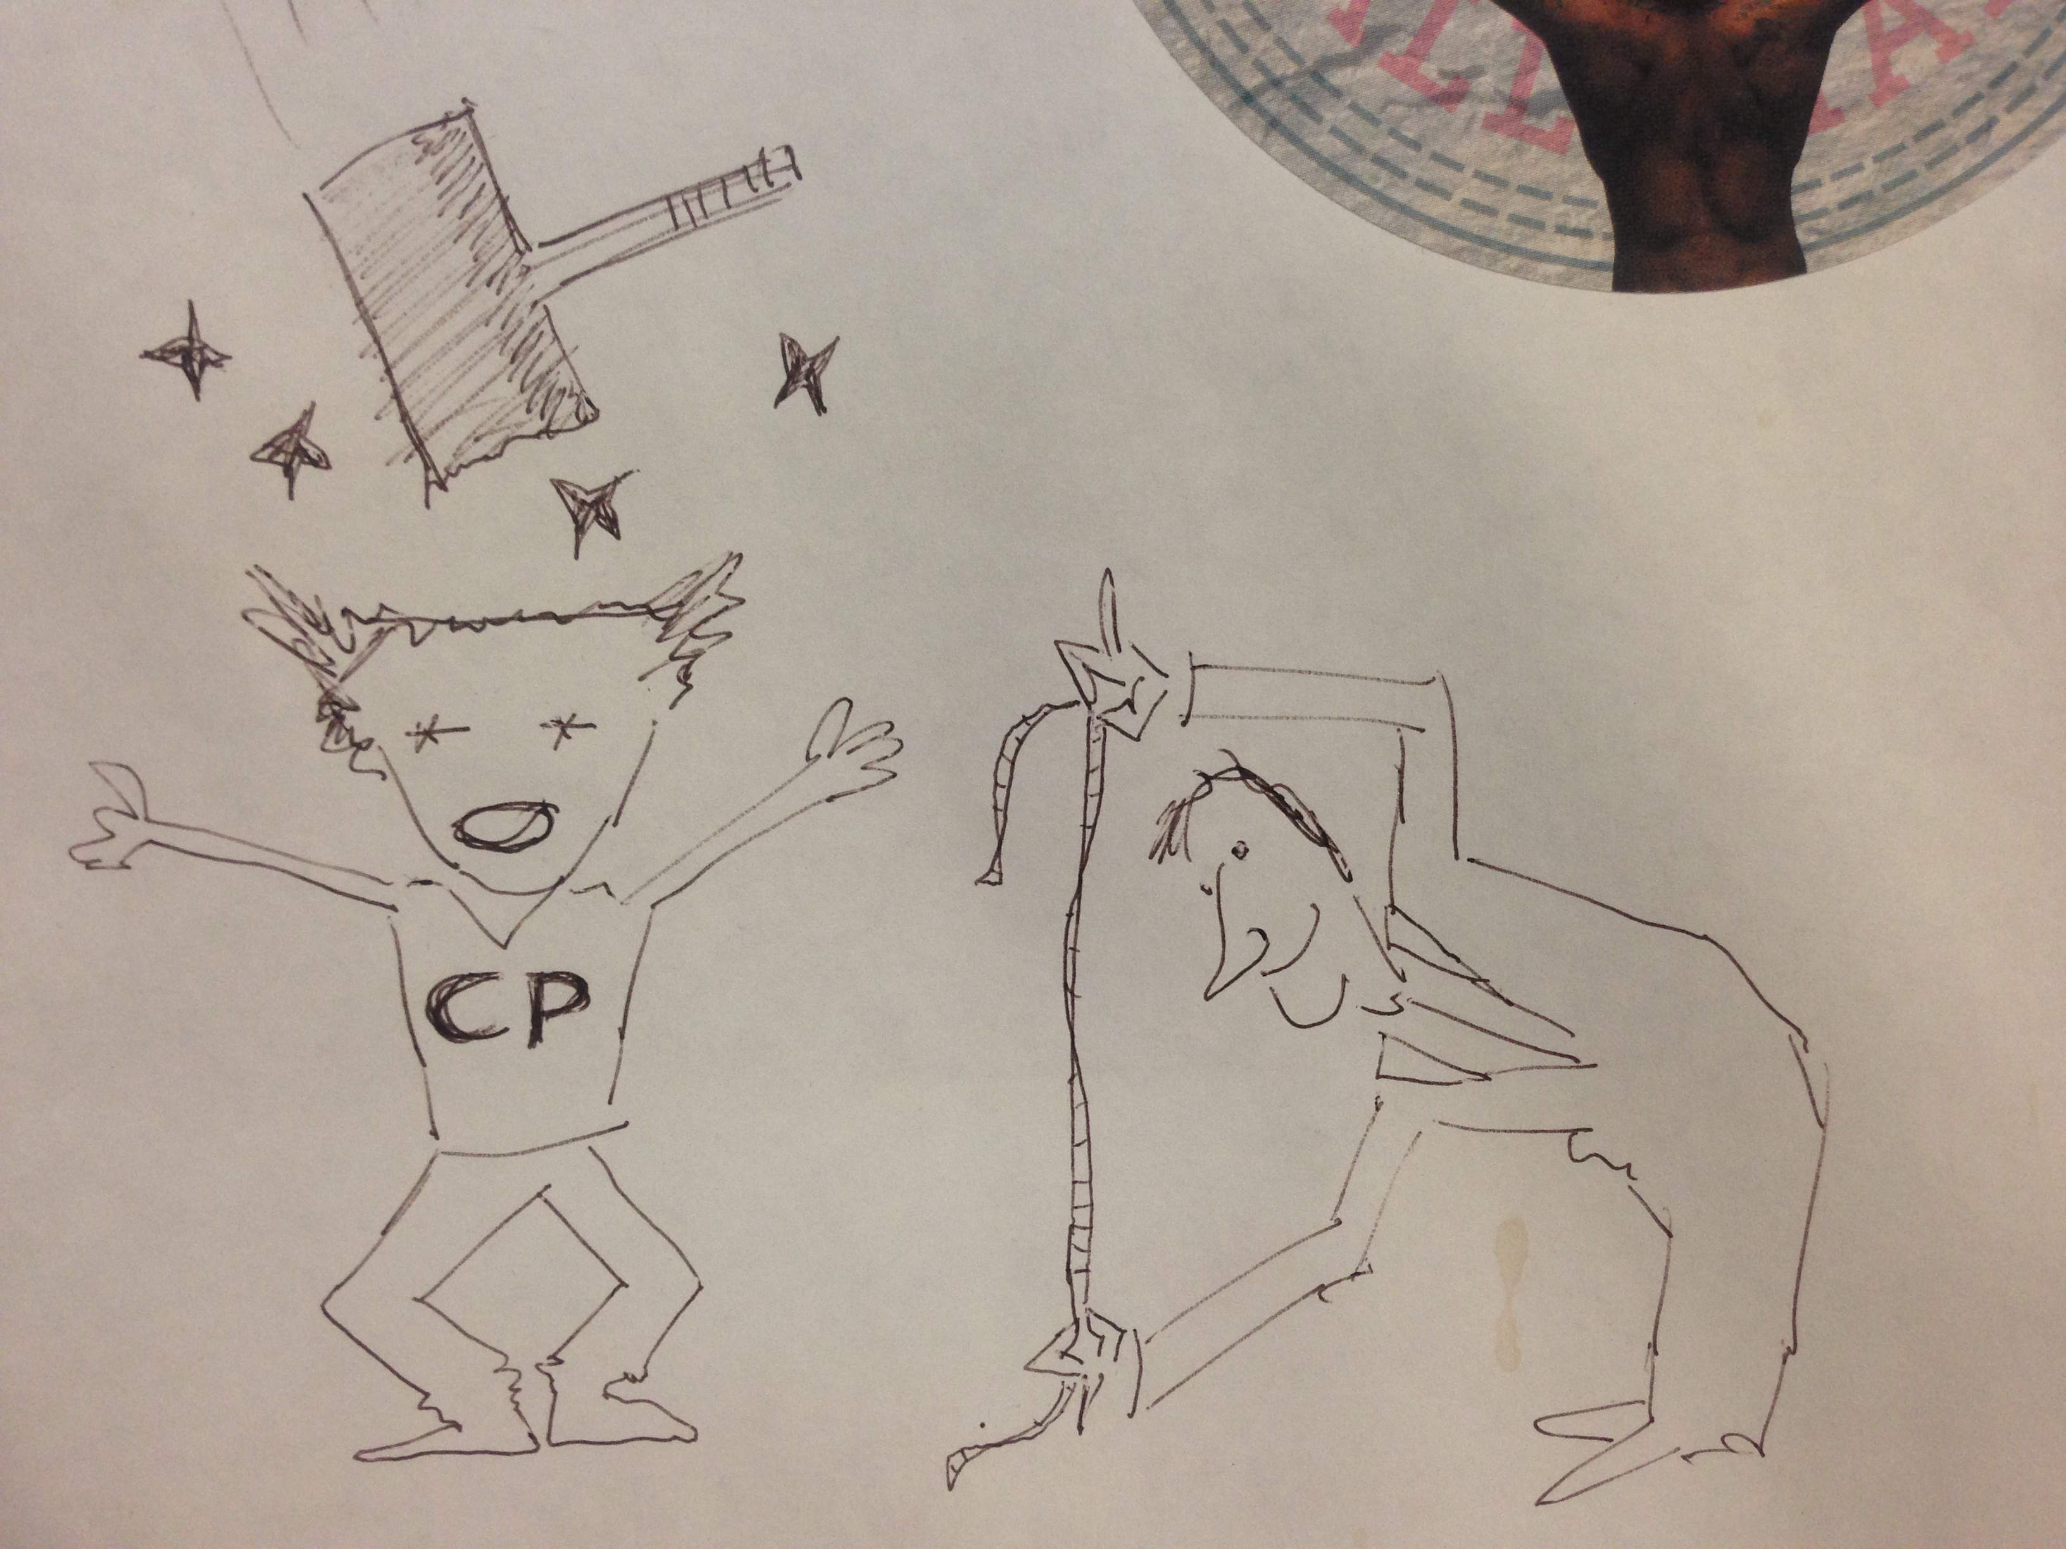
“Measurement of CP Violation”
Erwin Agasi, 1999

Slide 3
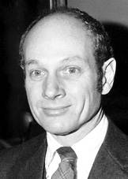
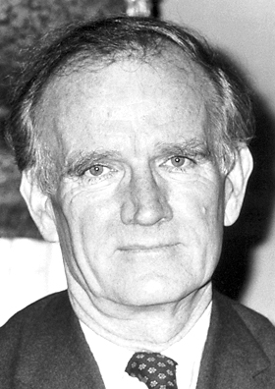
Discovery of CP violation!
Nobelprize 1980
1964
But K_{L} →π⁺ π⁻ also occurs!
K_{s}: Short-lived ~CP even:
K₁⁰ → π⁺ π⁻
K_{L}: Long-lived ~CP odd:
K₂⁰ →π⁺ π⁻ π⁰
James Cronin
Val Fitch
The physical particle K_{L} is not K₂⁰ , a pure eigenstate of CP ➔ CP Violation!

Slide 4
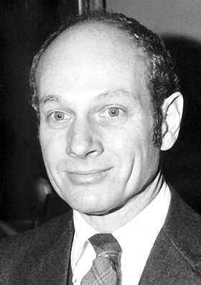

Remember the three types of CP Violation
Charge Parity Violation:
  1964 (CCFT): Discovered in neutral Kaon beam “indirect CP violation”
    Also called: CPV in mixing
    Prob(K⁰→K⁰) ≠ Prob (K⁰→K⁰)
    |ε|= (2.228 ± 0.011 ) x 10⁻³ (PDG 2014)
  1999 (NA48 & KTeV): Seen in Kaon decays “direct CP violation”
    Also called: CPV in decay
    Decay rates Γ(K⁰→π⁺π⁻) ≠ Γ(K⁰→π⁺π⁻)
    Re(ε’/ε) = (1.65 ± 0.26) x 10⁻³ (PDG 2014)
  2001 (Belle & Babar): Observed in B mesons decays “CP violation in interference”
    Also called: mixing induced CPV
    sin 2β = 0.682 ± 0.019 (PDG 2014)
James Watson Cronin
Val Logsdon Fitch
➔ Nobel prize 1980

Slide 5
Searching CP Violation in B-mesons
Comparing B Production facilities
 | Aleph,Delphi, L3, Opal | BaBar & Belle | D₀ & CDF | LHCb
 | LEP-I | PEP-II/KEKB | Tevatron | LHC
Mode | e⁺e⁻ | e⁺e⁻ | pp | pp
Start datataking | 1989—1995 | 1999 | 2002 | 2010
√s (GeV) | 91 = M_{Z} | 10.4 = M_{ϒ(4S)} | 2000 | <14000
σ_{bb}/σ_{qq} | 1/5 | 1/4 | 1/1000 | 1/160
N_{qq}/s (Hz) | 2.5 | 40 | 20k | 13M
N_{bb}/s (Hz) | 0.5 | 10 | 20 | 100K
<B flight distance> (μm) | 1000 | 260 | 450 | 10000
Notes:
30 nb vs 4 nb, 10**33 vs. 10**31

Slide 6
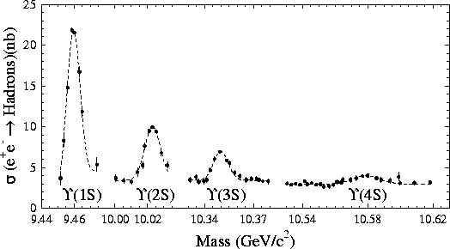
B Meson Production: the “easy” way…
Electron-Positron collider: e⁺e⁻ → ϒ(4s) → B⁰ B⁰
  Only 4S resonance can produce B meson pair
  Low B⁰ production cross-section: ~1 nb
  Clean environment, coherent B⁰B⁰ production
CESR
CLEO
BB threshold
B⁰B⁰ threshold

Slide 7
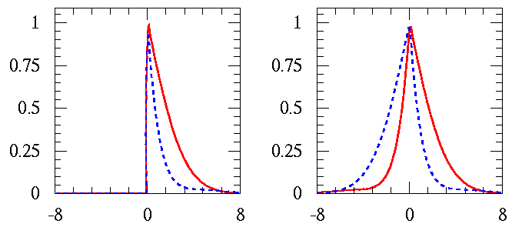
ϒ(4S): Coherent B⁰B⁰ production
B⁰B⁰ system produced by ϒ(4S) decay
evolves coherently until one of them
decays (EPR!)
  Instead of tagging the flavour at production,
  the B mesons have opposite flavour at the time
  the first B meson decays, so one tags the flavour
  of the other B decay at Δt=0:
  Half of the time CP B decays first (Δt<0)
Time integrated CP asymmetry is 0:
Coherent production requires time dependent analysis
But it also improves the flavour tagging performance!
Incoherent
At t_{cp}=0
B⁰
B⁰
t(ps)
Coherent
t→Δt = t_{CP} – t_{OtherB}
At Δt=0
B⁰
B⁰
Δt(ps)
Notes:
Upsilon(4S) = J^PC = 1^-- . (L-1) wave. Under Charge the wave function gets a minus sign:

Slide 8
A Symmetric Collider @ ϒ(4S) won’t work…
CP asymmetry is a time-dependent process
  A_{CP} ∝ Δt between two B decays, Δt ~ ps
  In reality one measures decay distance between two B decays
In symmetric energy e⁺e⁻ collider, where ϒ(4S) produced at rest, daughter B’s travel ~ 20μm
  Too small a distance to discern with today’s detector technology
e⁺
B_{tag}
B_{CP}
5.3 GeV
5.3 GeV
Σl ≈ 40 μm

Slide 9
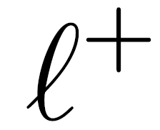
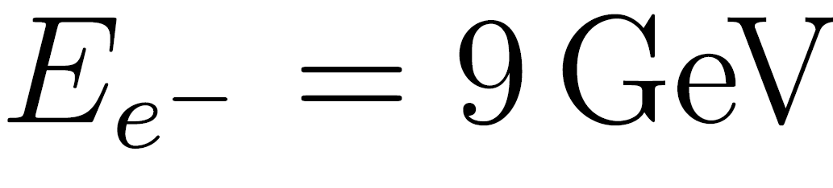
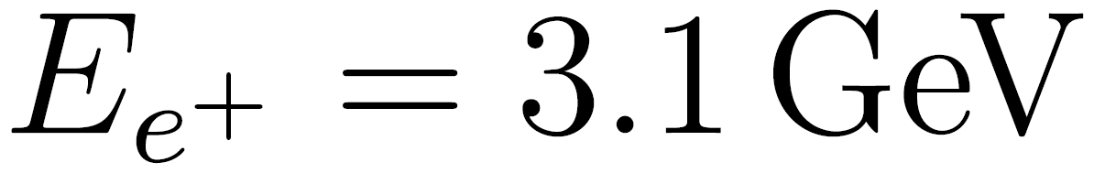
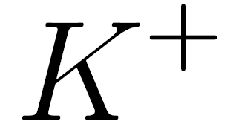
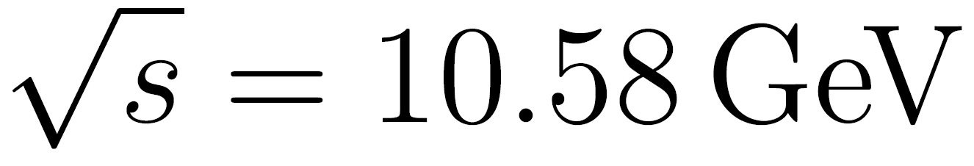

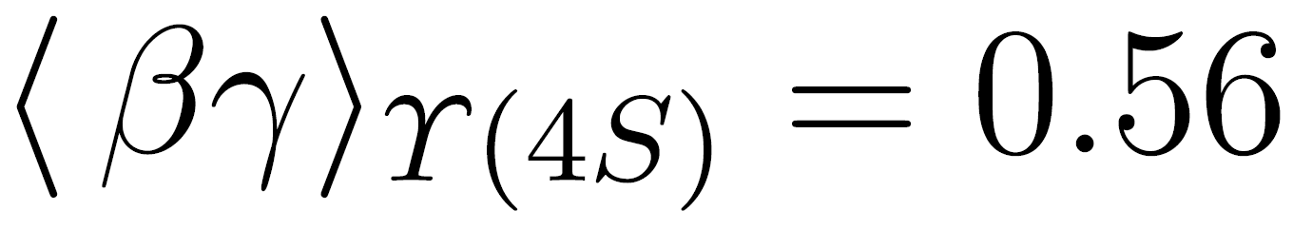
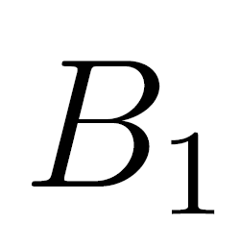
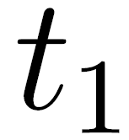

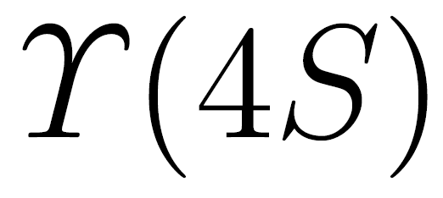
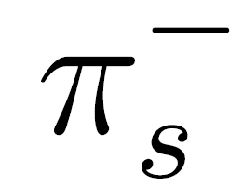
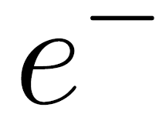
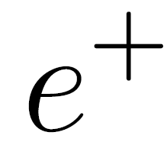
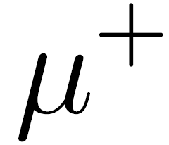
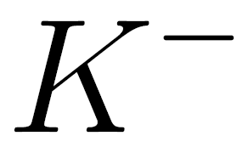
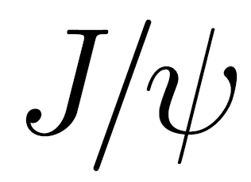
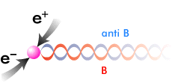
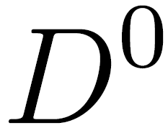

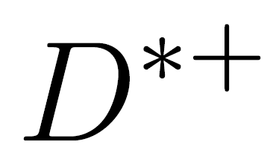
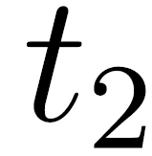
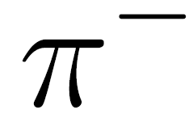

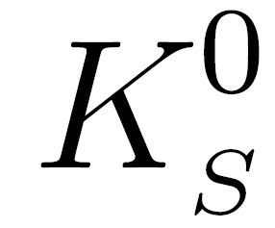
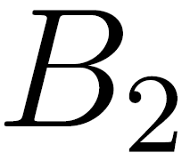
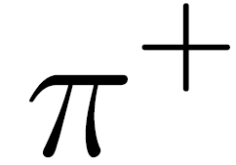
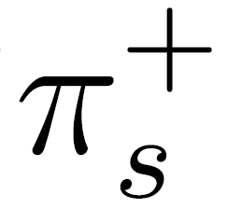

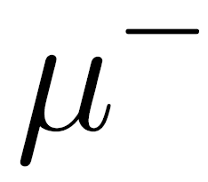
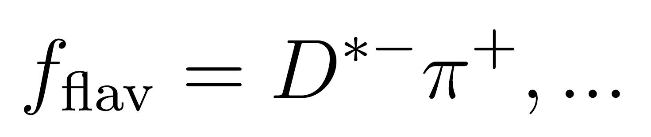
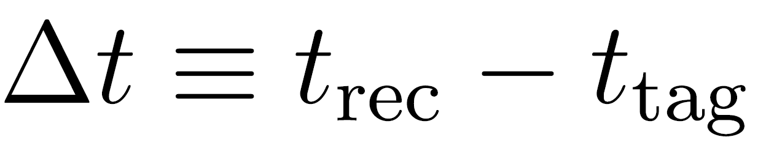

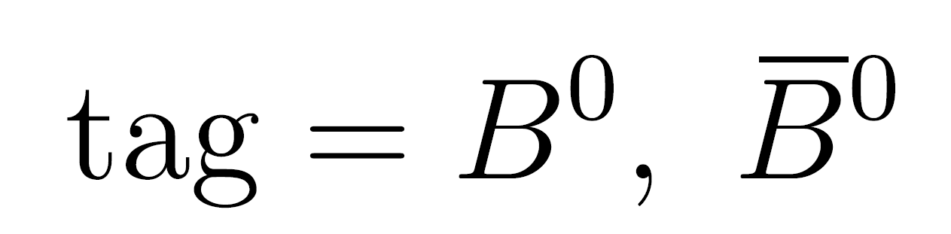
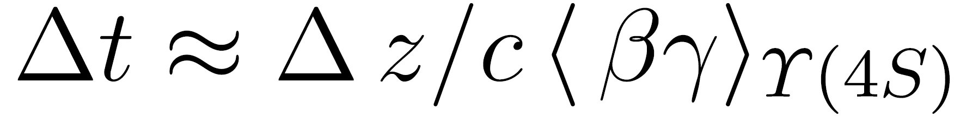
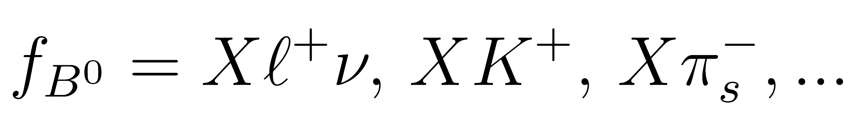

Coherent Time Evolution at the ϒ(4S)
PEP-2 (SLAC)
B-Flavor Tagging
Exclusive
B Meson Reconstruction
Vertexing &
Time Difference
Determination

Slide 10
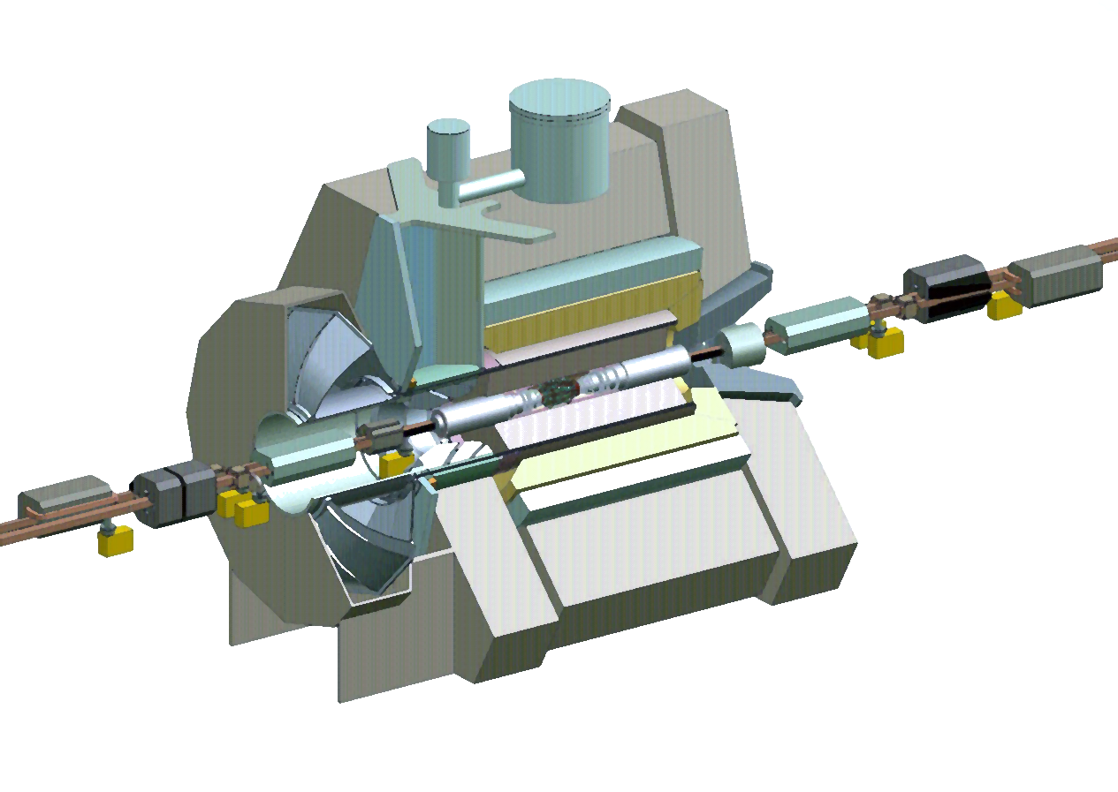
The BaBar Detector
Superconducting Coil (1.5T)
Silicon Vertex
Tracker (SVT)[5 layers]
e⁺ (3 GeV)
e⁻ (9 GeV)
Drift Chamber
[40 stereo lyrs](DCH)
CsI(Tl) Calorimeter (EMC)
[6580 crystals].
Instrumented Flux Return (IFR)
[Iron interleaved with RPCs].
Cherenkov Detector (DIRC)
[144 quartz bars, 11000 PMTs]

Slide 11
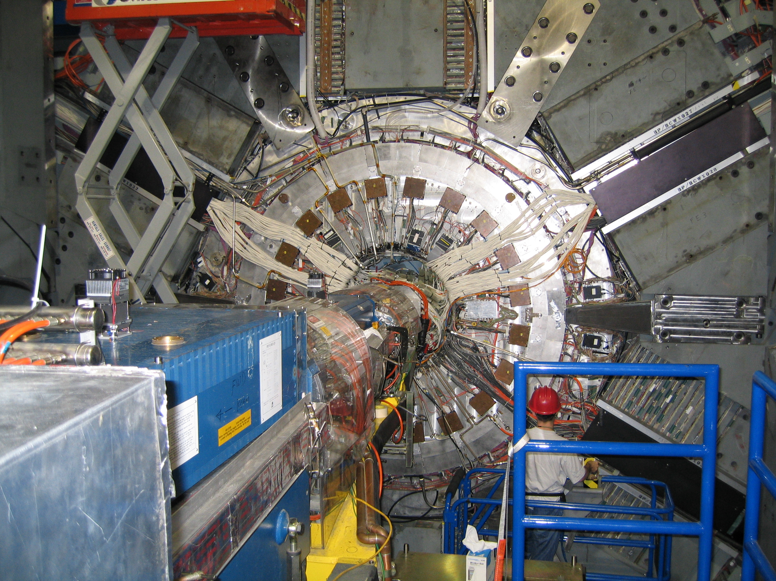
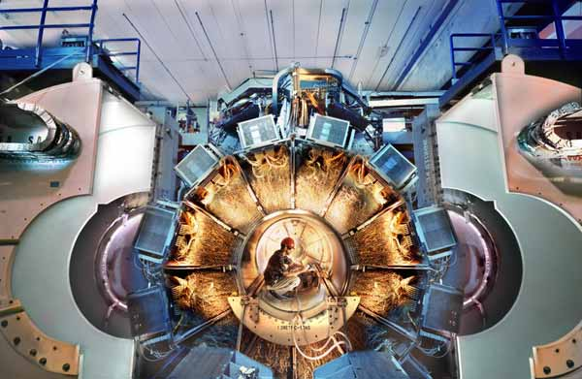
The BaBar Detector

Slide 12
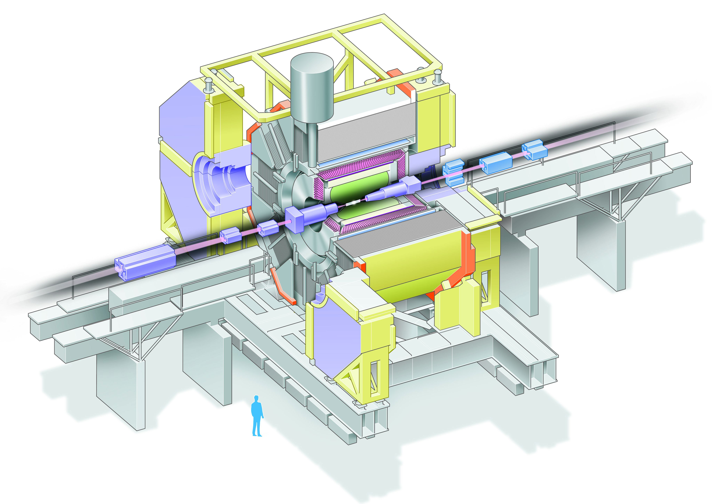
The Belle Detector
Aerogel Cherenkov cnt.
n=1.015~1.030
SC solenoid
1.5T
3.5GeV e⁺
CsI(Tl) 16X₀
TOF counter
8GeV e⁻
Tracking + dE/dx
small cell + He/C₂H₅
μ / K_{L} detection
14/15 lyr. RPC+Fe
Si vtx. det.
3 lyr. DSSD

Slide 13
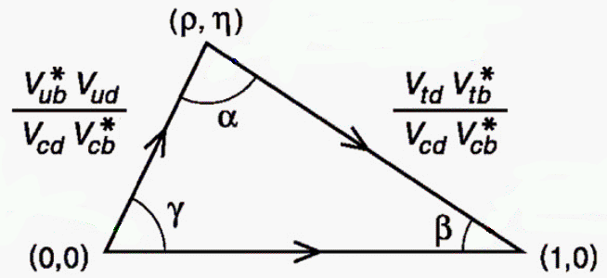
B-factory Measurements
Determining the angle β

Slide 14
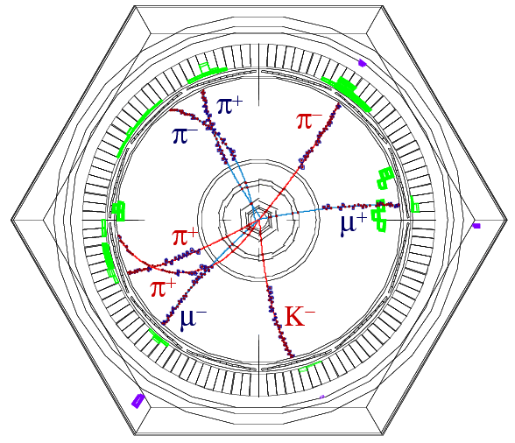
Example of a Fully Reconstructed Event
‘’fish eye’’
view
B⁰ → D*⁺ π⁻_{fast}
  → D⁰π⁺_{soft}
  →K⁻π⁺
fast
EPR!
B⁰(Δt)
→ψ(2S) K_{s}
  → μ⁺μ⁻ → π⁺π⁻
soft
At Δt=0 (i.e. when the D*π decay happened), the ‘CP’ B was/would have been a B⁰
In general, use charges of identified
  leptons,
  kaons,
  soft pions
from the “the rest of the event” to tag B flavour

Slide 15
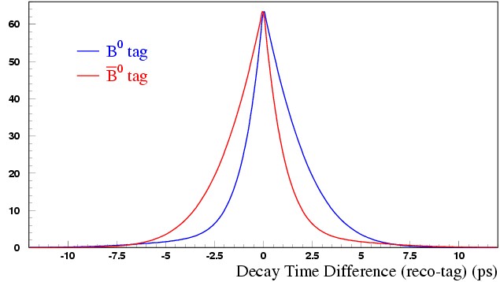
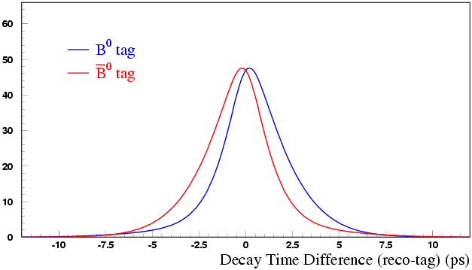
Δt Spectrum of CP events
perfect
flavour tagging & time resolution
realistic
mis-tagging & finite time resolution
CP PDF: |λ|=1 → C_{f}=0
Mistag fractions w
And
Resolution function R
Mixing PDF: |λ|=0 → S_{f}=0 and C_{f}=1
measured from
fully reco’d flavour
sample, B⁰ -> D^{(*)+} p⁻, …
Notes:
CP |lambda|=1: Cf=0 Mixing |lambda|=0 Cf=1

Slide 16
“Golden channel” B→J/ψK_{S}
Babar: sin2β = 0.657 ± 0.036 (stat) ± 0.012 (syst)
Belle: sin2β = 0.670 ± 0.029 (stat) ± 0.013 (syst)

Slide 17

Babar & Belle
Babar:
Belle:

Slide 18
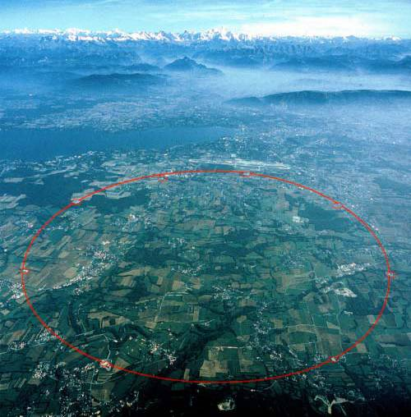
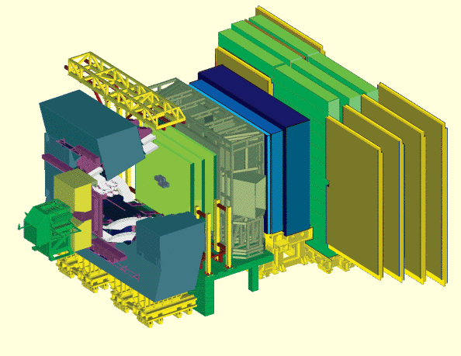
LHCb @ LHC
CERN
LHCb
ATLAS
CMS
ALICE

Slide 19
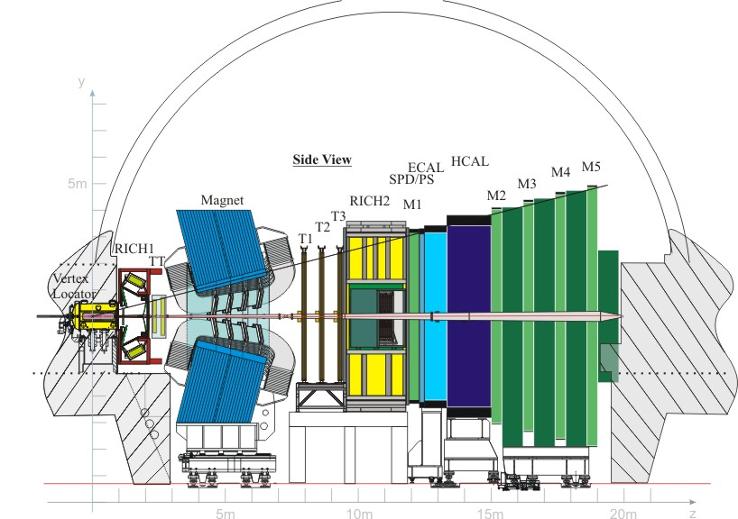
B Physics @ LHCb
B_{s}→D_{s}⁻ K⁺
K⁺
Background Suppression
Flavour tagging
Decay time measurement
Vertex and momenta reconstruction
Particle identification (π, К, μ, е, γ)
Trigger for online reconstruction
LHCb event rate: ~30 MHz
1 in 160 is a b-b event
10¹² b-b events per year

Slide 20
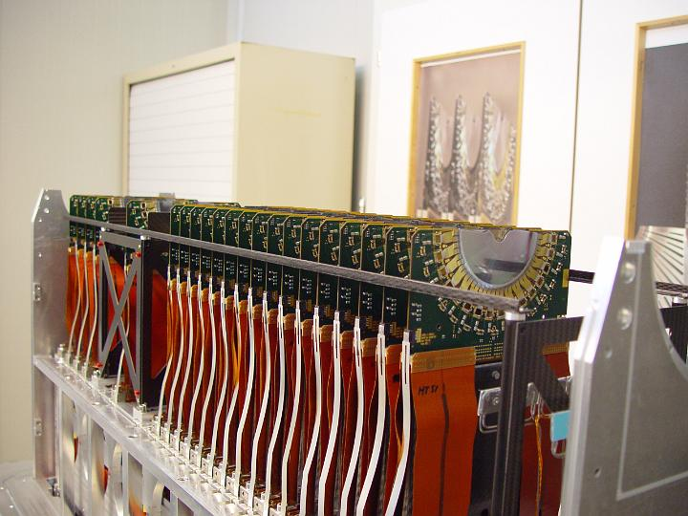
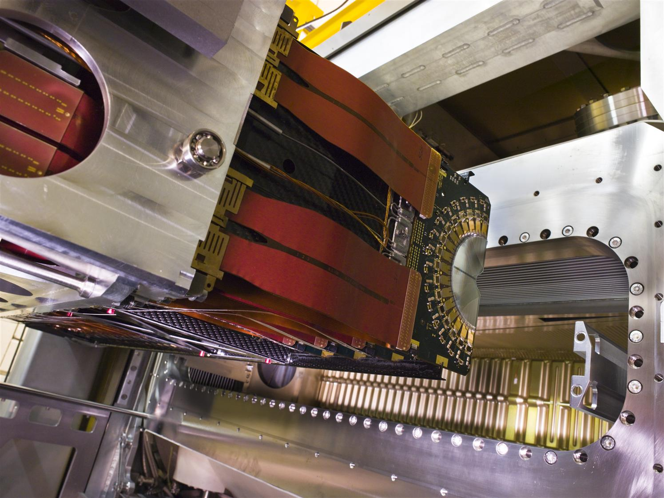
Vertex Topology
Vertex Locator

Slide 21

Vertex Topology
Vertex Locator
Example: Bs → Ds K
144 μm
σ(τ) ~40 fs
47 μm
K⁺
B_{s}
K⁺
D_{s}
K⁻
Primary vertex
π⁻
d
440 μm
Decay time resolution = 40 fs
Notes:
Lifetime B ~ 1.5 ps

Slide 22
Vertex Topology
Vertex Locator

Slide 23



Momentum and Mass Reconstruction
Trigger Tracker
Magnet
Outer Tracker

Slide 24
Momentum and Mass Reconstruction
Trigger Tracker
Magnet
Outer Tracker
Example: Bs → Ds K
Bs→ Ds K
Bs →Ds π
π⁺, K⁺
B_{s}
K⁺
D_{s}
K⁻
π⁻
Primary vertex
b^{t}

Slide 25
Momentum and Mass Reconstruction
Trigger Tracker
Magnet
Outer Tracker

Slide 26



Particle Identification: π, K, μ, γ, e
RICH
Calorimeter
Muon

Slide 27

Particle Identification: π, K, μ, γ, e
RICH
Calorimeter
Muon
sheiss
Example Bs → Ds K
π⁺,K⁺
B_{s}
K⁺
K→K : 97.29 ± 0.06%
π→K : 5.15 ± 0.02%
D_{s}
K⁻
π⁻
Primary vertex
b^{t}

Slide 28
Particle Identification: π, K, μ, γ, e
RICH
Calorimeter
Muon

Slide 29


The LHCb Detector?
LHCb
29

Slide 30
The LHCb Detector!
30

Slide 31

The LHCb Detector
23 sep 2010 19:49:24
Run 79646 Event 143858637
23 sep 2010 19:49:24
Run 79646 Event 143858637
31

Slide 32


The LHCb Detector
23 sep 2010 19:49:24
Run 79646 Event 143858637
23 sep 2010 19:49:24
Run 79646 Event 143858637
32

Slide 33
Measuring B_{s} B_{s} Oscillations
π⁺
B_{s}
Measurement of Bs oscillations:
K⁺
D_{s}
K⁻
Primary vertex
π⁻
b^{t}
B_{s}→D_{s}– π⁺
;
B_{s}→D_{s}⁺ π–
Experimental Situation:
Ideal measurement (no dilutions)
B_{s}→D_{s}– π⁺ (2 fb⁻¹)

Slide 34
Measuring B_{s} B_{s} Oscillations
π⁺
B_{s}
Measurement of Bs oscillations:
K⁺
D_{s}
K⁻
Primary vertex
π⁻
b^{t}
B_{s}→D_{s}– π⁺
;
B_{s}→D_{s}⁺ π–
Experimental Situation:
Ideal measurement (no dilutions)
+ Realistic flavour tagging dilution
B_{s}→D_{s}– π⁺ (2 fb⁻¹)

Slide 35
Measuring B_{s} B_{s} Oscillations
π⁺
B_{s}
Measurement of Bs oscillations:
K⁺
D_{s}
K⁻
Primary vertex
π⁻
b^{t}
B_{s}→D_{s}– π⁺
;
B_{s}→D_{s}⁺ π–
Experimental Situation:
Ideal measurement (no dilutions)
+ Realistic flavour tagging dilution
+ Realistic decay time resolution
B_{s}→D_{s}– π⁺ (2 fb⁻¹)

Slide 36
Measuring B_{s} B_{s} Oscillations
π⁺
B_{s}
Measurement of Bs oscillations:
K⁺
D_{s}
K⁻
Primary vertex
π⁻
b^{t}
B_{s}→D_{s}– π⁺
;
B_{s}→D_{s}⁺ π–
Experimental Situation:
Ideal measurement (no dilutions)
+ Realistic flavour tagging dilution
+ Realistic decay time resolution
+ Background events
B_{s}→D_{s}– π⁺ (2 fb⁻¹)

Slide 37
Measuring B_{s} B_{s} Oscillations
π⁺
B_{s}
Measurement of Bs oscillations:
K⁺
D_{s}
K⁻
Primary vertex
π⁻
b^{t}
B_{s}→D_{s}– π⁺
;
B_{s}→D_{s}⁺ π–
Experimental Situation:
Ideal measurement (no dilutions)
+ Realistic flavour tagging dilution
+ Realistic decay time resolution
+ Background events
+ Trigger and selection acceptance
B_{s}→D_{s}– π⁺ (2 fb⁻¹)
Two equally important aims for the experiment:
Limit the dilutions: good resolution, tagging etc.
Precise knowledge of dilutions

Slide 38


LHCb Performance: B_{d/s} Mixing
Trigger, background suppression, decay time reconstruction, flavour tagging: it works!
B⁰ – B⁰ mixing
B_{s}⁰ – B_{s}⁰ mixing
B⁰→D⁻ π⁺
B_{s}⁰→D_{s}⁻ π⁺
Phys.Lett.B719 (2013) 318
New.J.Phys.15 (2013) 053021

Slide 39



B-meson Mixing and Decay
Use mixing and decay of B-mesons (B_{d} or B_{s}) to study complex part of CKM:
Mixing
Decay
b
d
d
s
d
b
μ
μ
Search for new particles in loop diagrams:
“Box”
“Penguin”

Slide 40




Flavour Physics: Trees, Penguins, and Boxes
Many processes available to test the Standard Model:
All must result in a consistent CKM picture.
A deviation can be due to a virtual contribution of a massive particle.
Many NP models can be tested using different decays:
SuSY and non-Susy
Z-prime, W-prime bosons
Charged Higgs
Leptoquarks
Lepton Flavor Violation
Extra dimensions
…

Slide 41
Probing new CP-violation with B mesons
Look for interference of CKM with BSM amplitudes:
  “Indirect” or “Mixing”: SM Prediction: No CP violation a la kaons
    K⬅➔K = ε ≠ 0 but B⬅➔B = 0
  “Direct”: Compare measurement of angle γ “with trees” vs γ “with loops”
    Many decay modes with tree and loop diagrams are available
  “Mixing Induced”: SM Prediction: B_{s} box diagram phase φ_{s} = -2β_{s} ≈ 0
    New Physics “in the box”?
d
s
b
d
μ
d
b
μ

Slide 42
Feynman: “Remember the double slit experiment”
Feynman:
“Remember the double slit experiment”
LHCb is a completely analogous interference experiment using B-mesons.
B→f
J/ψ
B_{s}
ϕ
B→B→f
Notes:
Consider the analogy of the classical Young experiment in which waves travels through two slits in a screen to make an interference pattern on a screen which depends on the phase difference along the paths. In Feynman example he demonstrates that the same is through for quantum waves of individual electrons. In B decays we have a similar situation where two amplitudes with a different phase contribute to a decay.

Slide 43
Feynman: “Remember the double slit experiment”
Feynman:
“Remember the double slit experiment”
LHCb is a completely analogous interference experiment using B-mesons.
B_{s}→J/ψ φ
B_{s}→J/ψ φ
SM
J/ψ
B_{s}
ϕ
(Hypothetical
curves)
NP
Look for interference of SM with NP
Notes:
Consider the analogy of the classical Young experiment in which waves travels through two slits in a screen to make an interference pattern on a screen which depends on the phase difference along the paths. In Feynman example he demonstrates that the same is through for quantum waves of individual electrons. In B decays we have a similar situation where two amplitudes with a different phase contribute to a decay.

Slide 44
Outline
CP Violation Measurements:
  a) CP Violation in B-mixing: a_{sl}^{d} and a_{sl}^{s}
  b) Direct CP Violation: CKM angle γ
  c) Time dependent CP violation: CKM angles φ_{d} , φ_{s} and γ
  i) Mixing phases φ_{d} , φ_{s}
  ii) γ from loop diagrams
  iii) γ from tree diagrams
➔

Slide 45

CP Violation in Mixing
Interference of the dispersive and absorptive amplitudes
  Similar to measurement ε in kaon physics
Hamiltonian:
|π⁺π⁻>
Eigenstates:
Observable:
Lenz, Nierste JHEP.06 (2007) 072
In the Standard Model φ₁₂ ≈ 0.2° for B_{s}
B_{d,s}: measure with flavor specific decays: B_{d,s}→D_{(s)}⁺ μ– ν and C.C.
Notes:
Absorptive (G12) and dispersive (M12)
B→f and B-bar → f-bar.
B-bar to f: produced B-bar oscillated and decayed
B to f-bar: produced B oscillated and decayed

Slide 46
B_{d} vs B_{s}
B_{d}→D⁺μ– ν
B_{s}→D_{s}⁺μ– ν
(B_{d}) : must measure time-dependent
(B_{s}) : washout of fast oscillation factor and production asymmetry
Δm_{d} = 0.5 ps⁻¹
Δm_{s} = 17.7 ps⁻¹
Notes:
The charge of the lepton determines B or B-bar. Method requires no tagging.

Slide 47

Semileptonic charge asymmetry with B_{s}: a_{sl}^{s}
B_{s}→D_{s}⁺μ– ν
1 fb⁻¹
D_{s}⁻→K⁻K⁺π⁻
D⁻→K⁻K⁺π⁻
Correct for detection asymmetry:
M(KKπ) MeV
LHCb:
arXiv: 1605.09768
Standard Model:
Lenz, Nierste JHEP.06 (2007) 072
Notes:
Use D* decays for efficience determinations

Slide 48
Semileptonic charge asymmetry with B_{d}: a_{sl}^{d}
B_{d}→D⁺μ– ν
3 fb⁻¹
Time dependent analysis:
Decay time reconstruction with missing neutrino
Background modelling
Magnet up/down combined
t [ps]
LHCb:
PRL 114 (2015) 041601
Standard Model:
Lenz, Nierste JHEP.06 (2007) 072

Slide 49

Semileptonic charge asymmetry with B_{d}: a_{sl}^{d}
B_{d}→D⁺μ– ν
3 fb⁻¹
Time dependent analysis:
Decay time reconstruction with missing neutrino
Background modelling
a_{sl}^{s} vs a_{sl}^{d}
Magnet up/down combined
t [ps]
LHCb:
PRL 114 (2015) 041601
a_{sl}^{s} [%]
Standard Model:
Lenz, Nierste JHEP.06 (2007) 072
a_{sl}^{d} [%]

Slide 50


Semileptonic charge asymmetry with B_{d}: a_{sl}^{d}
B_{d}→D⁺μ– ν
3 fb⁻¹
Time dependent analysis:
Decay time reconstruction with missing neutrino
Background modelling
a_{sl}^{s} vs a_{sl}^{d}
Magnet up/down combined
t [ps]
LHCb:
PRL 114 (2015) 041601
a_{sl}^{s} [%]
Standard Model:
Lenz, Nierste JHEP.06 (2007) 072
a_{sl}^{d} [%]

Slide 51
Outline
CP Violation Measurements:
  a) CP Violation in B-mixing: a_{sl}^{d} and a_{sl}^{s}
  ◆ Unlike kaons, no large CPV, in agreement with SM.
  b) Direct CP Violation: CKM angle γ
  c) Time dependent CP violation: CKM angles φ_{d} , φ_{s} and γ
  i) Mixing phases φ_{d} , φ_{s}
  ii) γ from loop diagrams
  iii) γ from tree diagrams
➔

Slide 52
Outline
CP Violation Measurements:
  a) CP Violation in B-mixing: a_{sl}^{d} and a_{sl}^{s}
  ◆ Unlike kaons, no large CPV, in agreement with SM.
  b) Direct CP Violation: CKM angle γ
  c) Time dependent CP violation: CKM angles φ_{d} , φ_{s} and γ
  i) Mixing phases φ_{d} , φ_{s}
  ii) γ from loop diagrams
  iii) γ from tree diagrams
➔

Slide 53

Penguins
John Ellis after losing a game of darts…

Slide 54
Direct CP Violation with B_{(s)}→ Kπ (“charmless”)
+
γ
Interference of trees and penguins
  New physics can contribute to penguin loop
Sensitive to V_{ub} phase: CKM angle γ
Measure the untagged CP asymmetry for B⁰ and B_{s} decays:
(The correction factor is O(1%),
measured from data)
Instrumental
asymmetry
Mixing dilution times
production asymmetry
Notes:
The instrumental asymmetry is controlled using charm decays and magnet polarity reversion. The production asymmetry is measured using B->J/psi K* times the mixing dilutions using world averages.

Slide 55

Direct CP Violation with B_{(s)}→ Kπ (“charmless”)
+
γ
B⁰ → K π
PRL 110.221601
A_{CP} = -0.080 ± 0.007 ± 0.003
Most precise measurement
of CP violation in a hadronic
Machine.
B⁰ → K⁺ π⁻
B⁰ → K⁻ π⁺
B_{s} → π K
PRL 110.221601
A_{CP} = 0.27 ± 0.04 ± 0.01
B_{s}⁰ → K⁺ π⁻
B_{s}⁰ → K⁻ π⁺
First observation of a
CP asymmetry in B_{s} decays
Notes:
Direct CP Violation

Slide 56
Direct CP Violation with B→DK (“charmed”)
γ
+
Interference of trees and trees
  Interfere decays b→c with b→u to final states common to D⁰ and D⁰
Sensitive to V_{ub} phase: CKM angle γ :
Many decays available.
Atwood, Dunietz, Soni:
Phys Rev Lett 78, 3257 (1997)
Phys Rev D 63, 036005 (2001)
b→c favoured
Cabibbo supp.
ADS method:
Use common flavour state f_{D}=(K⁺ π –) Note: decay D⁰→K⁺π– is double Cabibbo suppressed
Large interference
D⁰K–
B–
f_{D}K–
D⁰K–
b→u suppressed
Cabibbo allowed.
Notes:
Direct CP Violation

Slide 57
Direct CP Violation with B→DK/π (“charmed”)
Observe ADS mode B⁻→[π⁻K⁺]_{D} K⁻ and B⁻→[π⁻K⁺]_{D} π⁻
PLB 712 (212) 203
arXiv:1203.3662
LHCb: 1.0 fb⁻¹
B⁻→[π⁻K⁺]_{D} K⁻
B⁺→[π⁺K⁻]_{D} K⁺
B⁻→[π⁻K⁺]_{D} π⁻
B⁺→[π⁺K⁻]_{D} π⁺
A_{ADS(K)} = -0.403 ± 0.056 ± 0.011
A_{ADS(π)} = 0.100 ± 0.031 ± 0.009
First observation of CP violation in single B→Dh mode.
Notes:
Production asymmetry and detection effects are below the 1% level each and included in the systematic error.
A_CP+ (GLW) gives a 4.5 sigma asymmetry. In total 5.8 sigma CP violation observed.

Slide 58

γ from B→D K and B→D π
More methods/modes available: GLW, ADS, GGSZ, GLS…:
  B⁺→Dh⁺ with D→ hh ; GLW/ADS method (2011 data): Phys.Lett.B712(212)203
  B⁺→Dh⁺ with D→Κπππ ; ADS method (2011 data) : Phys.Lett.B723(2013)44
  B⁺→DK⁺ with D→K_{s}⁰hh ; GGSZ method (2011+2012 data) : arXiv:1408.2748
  B⁺→DK⁺ with D→K_{s}⁰Kπ ; GLS method (2011+2012 data) : Phys.Lett B 733 (2014) 36
  B⁰→D⁰K^{*0} with D→hh ; GLW/ADS (2011+2012 data) : arXiv:1407.8136
Most precise γ determination:
LHCb-CONF-2016-001
Notes:
GLW = Gronau, London, Wyler ADS=Atwood Dunietz, Soni, GGSZ=Giri, Grossman, Soffer, Zupan, GLW= (Dalitz analyses)

Slide 59
Outline
CP Violation Measurements:
  a) CP Violation in B-mixing: a_{sl}^{d} and a_{sl}^{s}
  ◆ Unlike kaons, no large CPV, in agreement with SM.
  b) Direct CP Violation: CKM angle γ
  ◆ Large CP violation in many decays, consistent with CKM.
  c) Time dependent CP violation: CKM angles φ_{d} , φ_{s} and γ
  i) Mixing phases φ_{d} , φ_{s}
  ii) γ from loop diagrams
  iii) γ from tree diagrams
➔

Slide 60
Outline
CP Violation Measurements:
  a) CP Violation in B-mixing: a_{sl}^{d} and a_{sl}^{s}
  ◆ Unlike kaons, no large CPV, in agreement with SM.
  b) Direct CP Violation: CKM angle γ
  ◆ Large CP violation in many decays, consistent with CKM.
  c) Time dependent CP violation: CKM angles φ_{d} , φ_{s} and γ
  i) Mixing phases φ_{d} , φ_{s}
  ii) γ from loop diagrams
  iii) γ from tree diagrams
➔

Slide 61
Outline
CP Violation Measurements:
  a) CP Violation in B-mixing: a_{sl}^{d} and a_{sl}^{s}
  ◆ Unlike kaons, no large CPV, in agreement with SM.
  b) Direct CP Violation: CKM angle γ
  ◆ Large CP violation in many decays, consistent with CKM.
  c) Time dependent CP violation: CKM angles φ_{d} , φ_{s} and γ
  i) Mixing phases φ_{d} , φ_{s}
  ii) γ from loop diagrams
  iii) γ from tree diagrams
➔

Slide 62
Time Dependent CP Violation: Eigenstates f_{CP}
B
f_{CP}
B_{s}
f_{CP}
φ_{q}
B
B_{s}
Extraction of and require flavour tagging: knowing the flavour of the B-meson at production
Measure φ_{d} ( ) and φ_{s} ( )
Notes:
A^mix = Im(lambda), A^DG = Re(lambda), A^dir = (1-|lambda|^2 / (1+|lambda|^2)

Slide 63


(B_{d}-meson) φ_{d} : B-factory golden mode: B⁰→J/ψ K_{s}
B-factories:
• Coherent production,
clean flavour tag
BaBar: Phys.Rev.D79 (2009) 072009
Belle: PRL 108 (2012) 171802
Babar:
Belle:
LHCb:
PRL. 115 (2015) 031601
(Not so golden mode for LHCb:
K_{s} decays often outside Velo)
( CKM Mixing Phase: φ_{d} = 2β )

Slide 64
(B_{s}-meson) φ_{s} : LHCb golden mode: B_{s}→J/ψ φ
Two decay amplitudes to the same CP eigenstate final state.
via mixing B_{s}→B_{s}→J/ψ ϕ:
direct: B_{s}→J/ψ ϕ:
( CKM Mixing Phase:
φ_{s} = -2β_{s}≈ 0 )
:
+
β_{s}
:
Technical Complication:
B_{s} is a pseudoscalar (s=0) while J/ψ and ϕ are vector particles (s=1)
  − Final state is superposition of CP even (L=0 and L=2) CP odd (L=1)
  − Requires angular analysis to disentangle
Alternative analysis in pure CP odd eigenstate B_{s}→J/ψ π⁺π⁻

Slide 65
(B_{s}-meson) φ_{s} : LHCb golden mode: B_{s}→J/ψ φ
Requires combined decay time and angular analysis to statistically disentangle the CP even and CP odd amplitudes…
Mass spectrum
CP even
CP odd
Decay time spectrum

Slide 66

(B_{s}-meson) φ_{s} : LHCb golden mode: B_{s}→J/ψ φ
B_{s}→J/ψ φ(K⁺K⁻)
B_{s}→J/ψ π⁺π⁻
LHCb:
φ_{s} = -0.010 +- 0.039 [rad]
PRL 114 (2015) 041801
Standard Model:
φ_{s} = -2β_{s} = -0.0376 +- 0.0008 [rad]
CKMFitter
Consistent.
2011 + 2012
data: 3 fb⁻¹

Slide 67

(B_{s}-meson) φ_{s} : LHCb golden mode: B_{s}→J/ψ φ
B_{s}→J/ψ φ(K⁺K⁻)
B_{s}→J/ψ π⁺π⁻
LHCb:
φ_{s} = -0.010 +- 0.039 [rad]
PRL 114 (2015) 041801
Standard Model:
φ_{s} = -2β_{s} = -0.0376 +- 0.0008 [rad]
CKMFitter
Consistent.
2011 + 2012
data: 3 fb⁻¹

Slide 68
LHCb Outlook for Mixing Phase φ_{s}

Slide 69
Outline
CP Violation Measurements:
  a) CP Violation in B-mixing: a_{sl}^{d} and a_{sl}^{s}
  ◆ Unlike kaons, no large CPV, in agreement with SM.
  b) Direct CP Violation: CKM angle γ
  ◆ Large CP violation in many decays, consistent with CKM.
  c) Time dependent CP violation: CKM angles φ_{d} , φ_{s} and γ
  i) Mixing phases φ_{d} , φ_{s}
  ii) γ from loop diagrams
  iii) γ from tree diagrams
➔

Slide 70
Outline
CP Violation Measurements:
  a) CP Violation in B-mixing: a_{sl}^{d} and a_{sl}^{s}
  ◆ Unlike kaons, no large CPV, in agreement with SM.
  b) Direct CP Violation: CKM angle γ
  ◆ Large CP violation in many decays, consistent with CKM.
  c) Time dependent CP violation: CKM angles φ_{d} , φ_{s} and γ
  i) Mixing phases φ_{d} , φ_{s}
  ii) γ from loop diagrams
  iii) γ from tree diagrams
➔

Slide 71
Time Dependent CP Violation: γ with loops
B
f_{CP}
B_{s}
f_{CP}
B
B_{s}
Extraction of and require flavour tagging: knowing the flavour of the B-meson at production
Measure “γ with penguins” together with mixing phases φ_{d,s}

Slide 72
(4) Charmless B_{(s)} decays B→π⁺π⁻ and B_{s}→K⁺K⁻
+
+
β_{(s)}
γ
Fleisher: Phys.Lett.B459 (1999) 306, Eur.Phys.J.C52 (2007) 267
Fleischer, Knegjens: Eur.Phys.J.C71:1532 (2011)
A measurement of “γ with loops”
Sensitivity to new physics enters via the penguin loop
Combined analysis of B→KK, B→ππ with B→Kπ
  Make use of U-spin flavour symmetry to extract common hadronic factors

Slide 73
(4) Charmless B_{(s)} decays B→π⁺π⁻ and B_{s}→K⁺K⁻
B→ππ
3 fb⁻¹
2011 +
2012 data
First measurement of decay time dependent CP violation in B_{s} (3.3σ)
B_{s}→KK

Slide 74
Outline
CP Violation Measurements:
  a) CP Violation in B-mixing: a_{sl}^{d} and a_{sl}^{s}
  ◆ Unlike kaons, no large CPV, in agreement with SM.
  b) Direct CP Violation: CKM angle γ
  ◆ Large CP violation in many decays, consistent with CKM.
  c) Time dependent CP violation: CKM angles φ_{d} , φ_{s} and γ
  i) Mixing phases φ_{d} , φ_{s}
  ii) γ from loop diagrams
  iii) γ from tree diagrams
➔

Slide 75
Outline
CP Violation Measurements:
  a) CP Violation in B-mixing: a_{sl}^{d} and a_{sl}^{s}
  ◆ Unlike kaons, no large CPV, in agreement with SM.
  b) Direct CP Violation: CKM angle γ
  ◆ Large CP violation in many decays, consistent with CKM.
  c) Time dependent CP violation: CKM angles φ_{d} , φ_{s} and γ
  i) Mixing phases φ_{d} , φ_{s}
  ii) γ from loop diagrams
  iii) γ from tree diagrams
➔

Slide 76
Time Dependent CP Violation: γ with trees
B_{s}
f
B_{s}
f
vs
B_{s}
B_{s}
Determine weak phase γ and strong phase δ.
Extraction of and require flavour tagging.
Significant sensitivity in untagged variable .

Slide 77
(5) Charmed B_{s} decays: B_{s}→D_{s}K
Two decay amplitudes to the same final state:
via mixing B_{s}→B_{s}→D_{s}⁻K⁺:
direct: B_{s}→D_{s}⁻K⁺:
γ
β_{s}
:
+
:
Golden mode for a time dependent measurement of “γ with trees”
  Hadronic uncertainties small
Sensitivity to new physics enters via the mixing loop: known to be very small.
Combined analysis of B→D_{s}K with B_{s}→D_{s}π:
  For B_{s}→D_{s}π only decay amplitude 2) is possible (no CP violation)
  Use B_{s}→D_{s}π decay as a calibration process for B_{s} mixing

Slide 78
(5) Charmed B_{s} decays: B_{s}→D_{s}K
B_{s}→D_{s}π
Tagging Power:
εD² = 5.1%
B_{s} mixing:
Δm_{s} = 17.768 ± 0.023
± 0.006 ps⁻¹
B_{s}→D_{s}π
Second “First measurement” of decay time dependent CP violation in B_{s} (3.6σ)
B_{s}→D_{s}K
B_{s}→D_{s}K: CP Violation

Slide 79

Lennaert checking things…
B_{s}→D_{s}π
Tagging Power:
εD² = 5.1%
B_{s} mixing:
Δm_{s} = 17.768 ± 0.023
± 0.006 ps⁻¹
B_{s}→D_{s}π
Second “First measurement” of decay time dependent CP violation in B_{s} (3.6σ)
B_{s}→D_{s}K
B_{s}→D_{s}K: CP Violation

Slide 80

“γ from trees” vs. “γ from loops”
γ from trees:
Time integrated: B→DK + B→Dπ
Time dependent: B_{s}→D_{s}K
γ from loops:
B_{d/s}→hh

Slide 81


Penguins & Trees
“Penguins”
“Trees”
?

Slide 82
Outline
CP Violation Measurements:
  a) CP Violation in B-mixing: a_{sl}^{d} and a_{sl}^{s}
  ◆ Unlike kaons, no large CPV, in agreement with SM.
  b) Direct CP Violation: CKM angle γ
  ◆ Large CP violation in many decays, consistent with CKM.
  c) Time dependent CP violation: CKM angles φ_{d} , φ_{s} and γ
  i) Mixing phases φ_{d} , φ_{s}
  ii) γ from loop diagrams
  iii) γ from tree diagrams
  ◆ Mixing phase is large CPV for B_{d}, no CPV for B_{s}
  ◆ γ from trees and γ from loops so-far consistent

Slide 83

Precision of angle γ

Slide 84
Precision of angle γ

Slide 85
2) B-B Mixing and CP Violation
Phase space for NP
Charles et. al., 1309.2293
“now”
Currently:
After Upgrade (50 fb⁻¹):

Slide 86
2) B-B Mixing and CP Violation
“now”
LHCb 50 fb⁻¹ & Belle 50 ab⁻¹
Charles et. al., 1309.2293
CP Violation measurements:
Many channels (e.g. “trees”, “boxes” en “penguins”) and CKM tests
Measurements statistically limited

Slide 87



Mass
CP-Violation

Slide 88



Electroweak Baryogenesis?
Three Sacharov Conditions:
✔ Baryon Number Violation
✔ C and CP Violation
✔ Thermal non-equilibrium
1st order
‘t Hooft, PRL
37 (1976) 8
V
Axial Anomaly:
f
f
tunnel
f
Quantum anomaly
φ
Weak Interaction
Higgs Phase Transition
All three components present in EW phase transition.
But, in Standard Model:
Higgs mass too heavy: 125 GeV instead of M < 70 GeV: 2nd order phase transition instead of 1st order.
CP violation not sufficient: need new, massive, particles.
➔ Search for new particles or force carriers!
Notes:
‘t Hooft shows that for internal fermion loop

Slide 89

Electroweak Baryogenesis?
Three Sacharov Conditions:
✔ Baryon Number Violation
✔ C and CP Violation
✔ Thermal non-equilibrium
✖
✖
2nd order
(SM)
‘t Hooft, PRL
37 (1976) 8
V
Axial Anomaly:
f
f
f
Quantum anomaly
φ
Weak Interaction
Higgs Phase Transition
All three components present in EW phase transition.
But, in Standard Model:
Higgs mass too heavy: 125 GeV instead of M < 70 GeV: 2nd order phase transition instead of 1st order.
CP violation not sufficient: need new, massive, particles.
➔ Search for new particles or force carriers!

Slide 90

Alternative Explanation for Big Bang…

