Slide 1
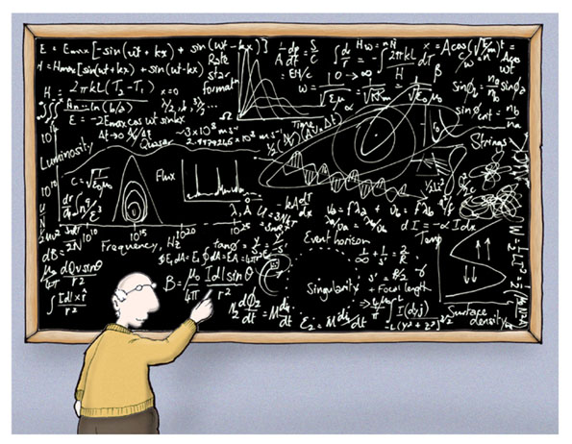
Flavour Physics
Welcome to the Topical Lectures on
Dec 14, Marcel Merk:
- “CP Violation”
Dec 15, Niels Tuning:
- “Rare B-decays”
Dec 16, Jordy de Vries:
-“Electric Dipole Moments”
Nikhef, Dec 14 – 16, 2016

Slide 2
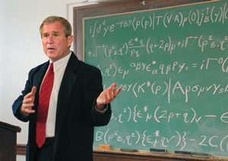
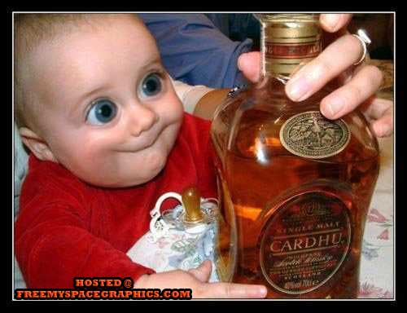
Daily Agenda
9h30 – 10h15: Lecture 1
10h30 – 11h15: Lecture 2
11h30 – 12h15: Lecture 3
13h45 – 14h30: Lecture 4
15h00 – 16h30: Discussion Session
First…
Then Friday afternoon…

Slide 3
Flavor Physics
Puzzles in Flavor Physics:
Why do we have three generations?
What describes the particle masses hierarchy?
What describes the hierarchy of the weak flavor couplings?
Can we see quantum effects of physics beyond SM?
Does flavor diagonal CP violation exist: Electric dipole Moments?
Why is there no CP violation in the strong interaction?
How did the matter – antimatter asymmetry arise?

Slide 4
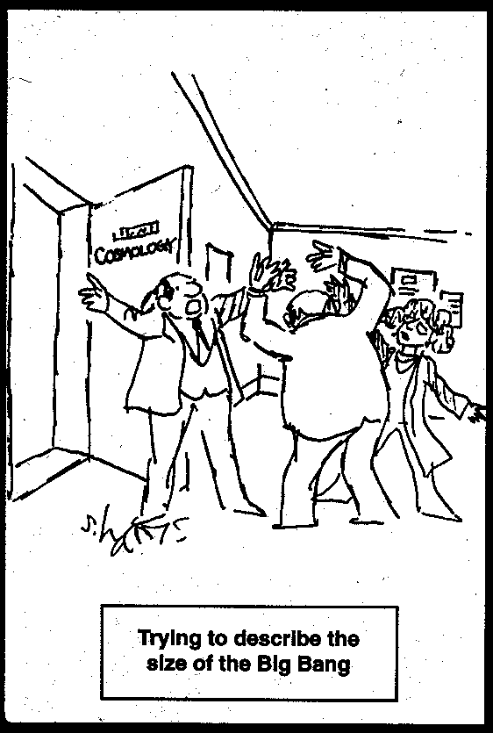
Lecturers will do their best to explain…

Slide 5
… and discuss interesting questions

Slide 6
OK, let’s stop the nonsense and start…

