Slide 1
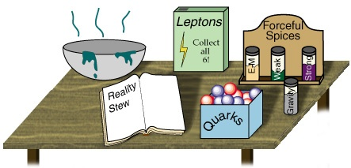


CP Violation in the Standard Model
Topical Lectures
Nikhef
Dec 14, 2016
Marcel Merk
Part 1: Discrete Symmetries
Part 2: The origin of CP Violation in the Standard Model
Part 3: Flavour mixing with B decays
Part 4: Observing CP violation in B decays

Slide 2
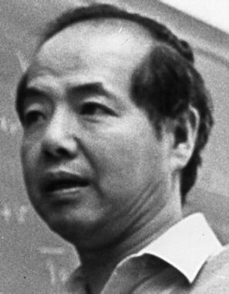
Introduction: Symmetry and non-Observables
T.D.Lee:
“The root to all symmetry principles lies in the assumption that it is impossible to observe certain basic quantities; the non-observables”
There are four main types of symmetry:
Permutation symmetry:
Bose-Einstein and Fermi-Dirac Statistics
Continuous space-time symmetries:
translation, rotation, acceleration,…
Discrete symmetries:
space inversion, time inversion, charge inversion
Unitary symmetries: gauge invariances:
U₁(charge), SU₂(isospin), SU₃(color),..
If a quantity is fundamentally non-observable it is related to an exact symmetry
If a quantity could in principle be observed by an improved measurement;
the symmetry is said to be broken
Noether Theorem:
symmetry
conservation law
Notes:
Relation between symmetries and non-observables: mention each. 1) identity of QM particle 2) absolute position, direction 3) handedness, directionof time, sign of charge 4)internal symmetries: phase of a wave function, rotation in SU(N) (p-n) differenc.e
Space-time symmetry: supersymmetry??

Slide 3
Symmetry and non-observables
Simple Example: Potential energy V between two charged particles:
Absolute position is a non-observable:
The interaction is independent on the choice of the origin 0.
Symmetry:
V is invariant under arbitrary
space translations:
0’
0
Consequently:
Total momentum is conserved:
Notes:
Physical assumption of a non-observable, the implied invariance and the physical consequence of a conservation law

Slide 4
Symmetry and non-observables
Non-observables | Symmetry Transformations | Conservation Laws or Selection Rules
Difference between identical particles | Permutation | B.-E. or F.-D. statistics
Absolute spatial position | Space translation | momentum
Absolute time | Time translation | energy
Absolute spatial direction | Rotation | angular momentum
Absolute velocity | Lorentz transformation | generators of the Lorentz group
Absolute right (or left) |  | parity
Absolute sign of electric charge |  | charge conjugation
Relative phase between states of different charge Q |  | charge
Relative phase between states of different baryon number B |  | baryon number
Relative phase between states of different lepton number L |  | lepton number
Difference between different co- herent mixture of p and n states |  | isospin

Slide 5
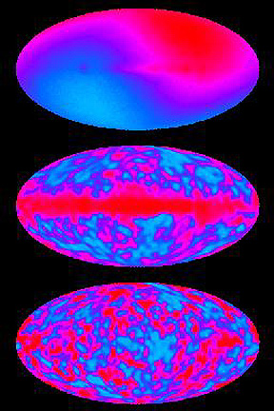
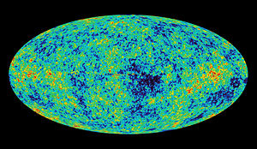
Puzzling thought… (to me, at least)
COBE:
Can we use the “dipole asymmetry” in cosmic microwave background to define an absolute Lorentz frame in the universe?
  If so, what does it imply for Lorentz invariance?
WMAP:
Notes:
Is this special lorentzframe the same in which the universe is “the least Lorentz contracted”?

Slide 6
C, P, T Symmetries
Parity, P: unobs.: (absolute handedness)
  Reflects a system through the origin.
  Converts right-handed to left-handed.
    x → −x , p → -p, but L = x × p → L
Charge Conjugation, C: unobs.: (absolute charge)
  Turns internal charges to opposite sign.
    e ⁺ → e⁻ , K ⁻ → K ⁺
Time Reversal, T: unobs.: (direction of time)
  Changes direction of motion of particles
    t → −t
CPT Theorem
  Generally valid in quantum field theory.
  All interactions are invariant under combined C, P and T
  A particle is an antiparticle travelling backward in time
  Implies e.g. particle and anti-particle have equal masses and lifetimes
+
−

Slide 7
Parity
The parity operation performs a reflection of the space coordinates at the origin:
If we apply the parity operation to a wave function ψ, we get another wave function ψ’ with:
which means that P is a unitary operation.
If P ψ = a ψ, then ψ is an eigenstate of parity, with eigenvalue a. For example:
The combination ψ = cos x + sin x is not an eigenstate of P
Spin-statistics theorem:
bosons ψ(1,2) → +ψ(2,1) symmetric
fermions ψ(1,2) → –ψ(2,1) antisymmetric
Notes:
Unitarity operator: <Ux|Uy> = <x|y>
What does spin-statistics have to do with this? Y5s to two B mesons at symmetrical positions

Slide 8
Parity
One can apply the parity operation to physical quantities:
  Mass m P m = m scalar
  Force F P F(x) = F(-x) = -F(x) (F=dp/dt) vector
  Acceleration a P a(x) = a(-x) = -a(x) (a=d²xdt²) vector
It follows that Newton’s law is invariant under the parity operation
There are also vectors that do not change sign under parity. They are usually derived from the cross product of two other vectors, e.g. the magnetic field:
These are called axial vectors.
Finally, there are also scalar quantities which do change sign under the parity operation. They are usually an inner product of a vector and a axial vector, e.g. the electric dipole moment (σ is the spin): . These are the pseudoscalars.
Notes:
F=dp/dt, since p changes sign, F changes sign. a = d2x/dt2 changes sign.
Axial vectors: L,S (r x p). Sigma=axial vector, E=vector => d = pseudoscalar.

Slide 9
Charge conjugation
Charge conjugation C changes the charge (and all other internal quantum numbers). Applied to the Lorentz force
it gives:
which shows that this law is invariant under the C operation.
Generally charge conjugation inverts the charge and the magnetic moment of a particle leaving other quantities (mass, spin, etc.) unchanged.
Only neutral states can be eigenstates, e.g.
Evidently, with and so C is unitary, too.
Notes:
Magnetic moment = sigma . B . Electric moment would also change (it it exists).

Slide 10

C and P operators
In Dirac theory particles are represented by Dirac spinors:
Antimatter!
+1/2, -1/2 helicity solutions for the particle
+1/2, -1/2 helicity solutions for the antiparticle
Implementation of the P and C conjugation operators in Dirac Theory is
(See H&M section
5.4 and 5.6)
However: In general C and P are only defined up to phase, e.g.:
Note:
quantum numbers associated with discrete operations C and P are multiplicative in contrast to quantum numbers associated by continuous symmetries
Notes:
0. gamma0 is 1,-1, since particle and antiparticle have opposite parity
1. Only the square of a wave function has physical meaning, so a phase rotation is allowed. So, P**2=1 is not required, only |P**2|=1
2. The difference in behaviour has its root in the fact that the additive quantum numbers are the eigenvalues of the generators of some continuous transformations, while parity and C-parity are the eigenvalues of (discrete) transformations themselves.

Slide 11
Time reversal
Time reversal is analogous to the parity operation, except that the time coordinate is affected, not the space coordinate
Again the macroscopic laws of physics are unchanged under the operation of time reversal (although some people find it hard to imagine the time inverse of a broken mirror…), the law
remains invariant since t appears quadratically.
Other vectors, like momentum and velocity, change sign under time reversal. So do the magnetic field and spin, which are due to the motion of charge.

Slide 12
Time reversal: antiunitary
Wigner found that T operator is antiunitary:
This leaves the physical content of a system unchanged, since:
Anti-unitary operators may be interpreted as the product of a unitary operator by an operator which complex-conjugates.
As a consequence, T is anti-linear:
Consider time reversal of the free Schrodinger equation:
Complex conjugation is required to stay invariant under time reversal
Notes:
Initial and final states are interchanged.

Slide 13
C-,P-,T-, Symmetry
The basic question of Charge, Parity and Time symmetry can be addressed as follows:
Suppose we are watching some physical event. Can we determine unambiguously whether:
  we are watching the event where all charges have been reversed or not?
  we are watching this event in a mirror or not?
    Macroscopic asymmetries are considered to be accidents on life’s evolution rather then a fundamental asymmetry of the laws of physics.
  we are watching the event in a film running backwards in time or not?
    The arrow of time is due to thermodynamics: i.e. the realization of a macroscopic final state is statistically more probably than the initial state.
    It is not assigned to a time-reversal asymmetry in the laws of physics.
Classical Theory (Newton mechanics, Maxwell Electrodynamics) are invariant under C,P,T operations, i.e. they conserve C,P,T symmetry
Notes:
Macroscopic: human body, left handed molecules etc.
Second law of thermodynamics

Slide 14
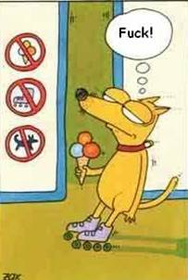
CPT Violation…

Slide 15

Macroscopic time reversal (T.D. Lee)
At each crossing: 50% - 50% choice to go left or right
After many decisions: invert the velocity of the final state and return
Do we end up with the initial state?
Notes:
But the microscopic laws of physics for each decision (50%-50% choice) are time inversion invariant.

Slide 16
Macroscopic time reversal (T.D. Lee)
Very unlikely!
At each crossing: 50% - 50% choice to go left or right
After many decisions: invert the velocity of the final state and return
Do we end up with the initial state?
Notes:
But the microscopic laws of physics for each decision (50%-50% choice) are time inversion invariant.

Slide 17
Parity Violation
Before 1956 physicists were convinced that the laws of nature
were left-right symmetric. Strange?
A “gedanken” experiment:
Consider two perfectly mirror symmetric cars:
Gas pedal
Gas pedal
driver
driver
“L” and “R” are fully symmetric,
Each nut, bolt, molecule etc.
However the engine is a black box
“L”
“R”
Person “L” gets in, starts, ….. 60 km/h
Person “R” gets in, starts, ….. What happens?
What happens in case the ignition mechanism uses, say, Co⁶⁰ β decay?
Notes:
In everyday world left and right are clearly different. People are not symmetric: e.g. our hearts are on the left side.
These differences are attributed either to accidental or initial conditions, but not related to fundamental physics laws.
Parity violation was first suggested theoretically by Lee and Yang in 1956 in connection with the theta-tau puzzle.
Parity violation was discovered experimentally in 1957 in beta decay by Wu et al and in pi and mu decays: Garwin et al and Telegdi et al.

Slide 18
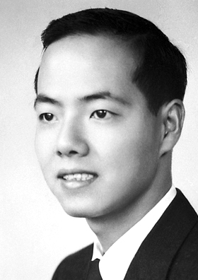
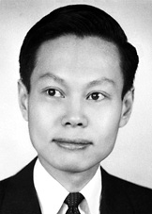
Parity Violation
Before 1956 physicists were convinced that the laws of nature
were left-right symmetric. Strange?
A “gedanken” experiment:
Consider two perfectly mirror symmetric cars:
Gas pedal
T.D. Lee
C.N. Yang
Gas pedal
driver
driver
“L” and “R” are fully symmetric,
Each nut, bolt, molecule etc.
However the engine is a black box
“L”
“R”
Person “L” gets in, starts, ….. 60 km/h
Person “R” gets in, starts, ….. What happens?
What happens in case the ignition mechanism uses, say, Co⁶⁰ β decay?
Notes:
In everyday world left and right are clearly different. People are not symmetric: e.g. our hearts are on the left side.
These differences are attributed either to accidental or initial conditions, but not related to fundamental physics laws.
Parity violation was first suggested theoretically by Lee and Yang in 1956 in connection with the theta-tau puzzle.
Parity violation was discovered experimentally in 1957 in beta decay by Wu et al and in pi and mu decays: Garwin et al and Telegdi et al.

Slide 19
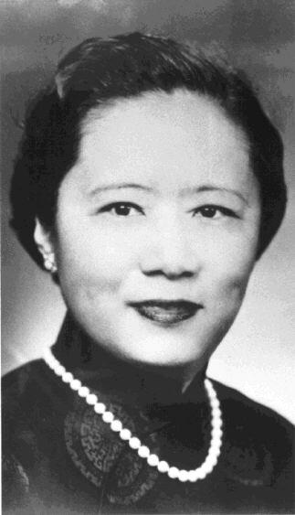
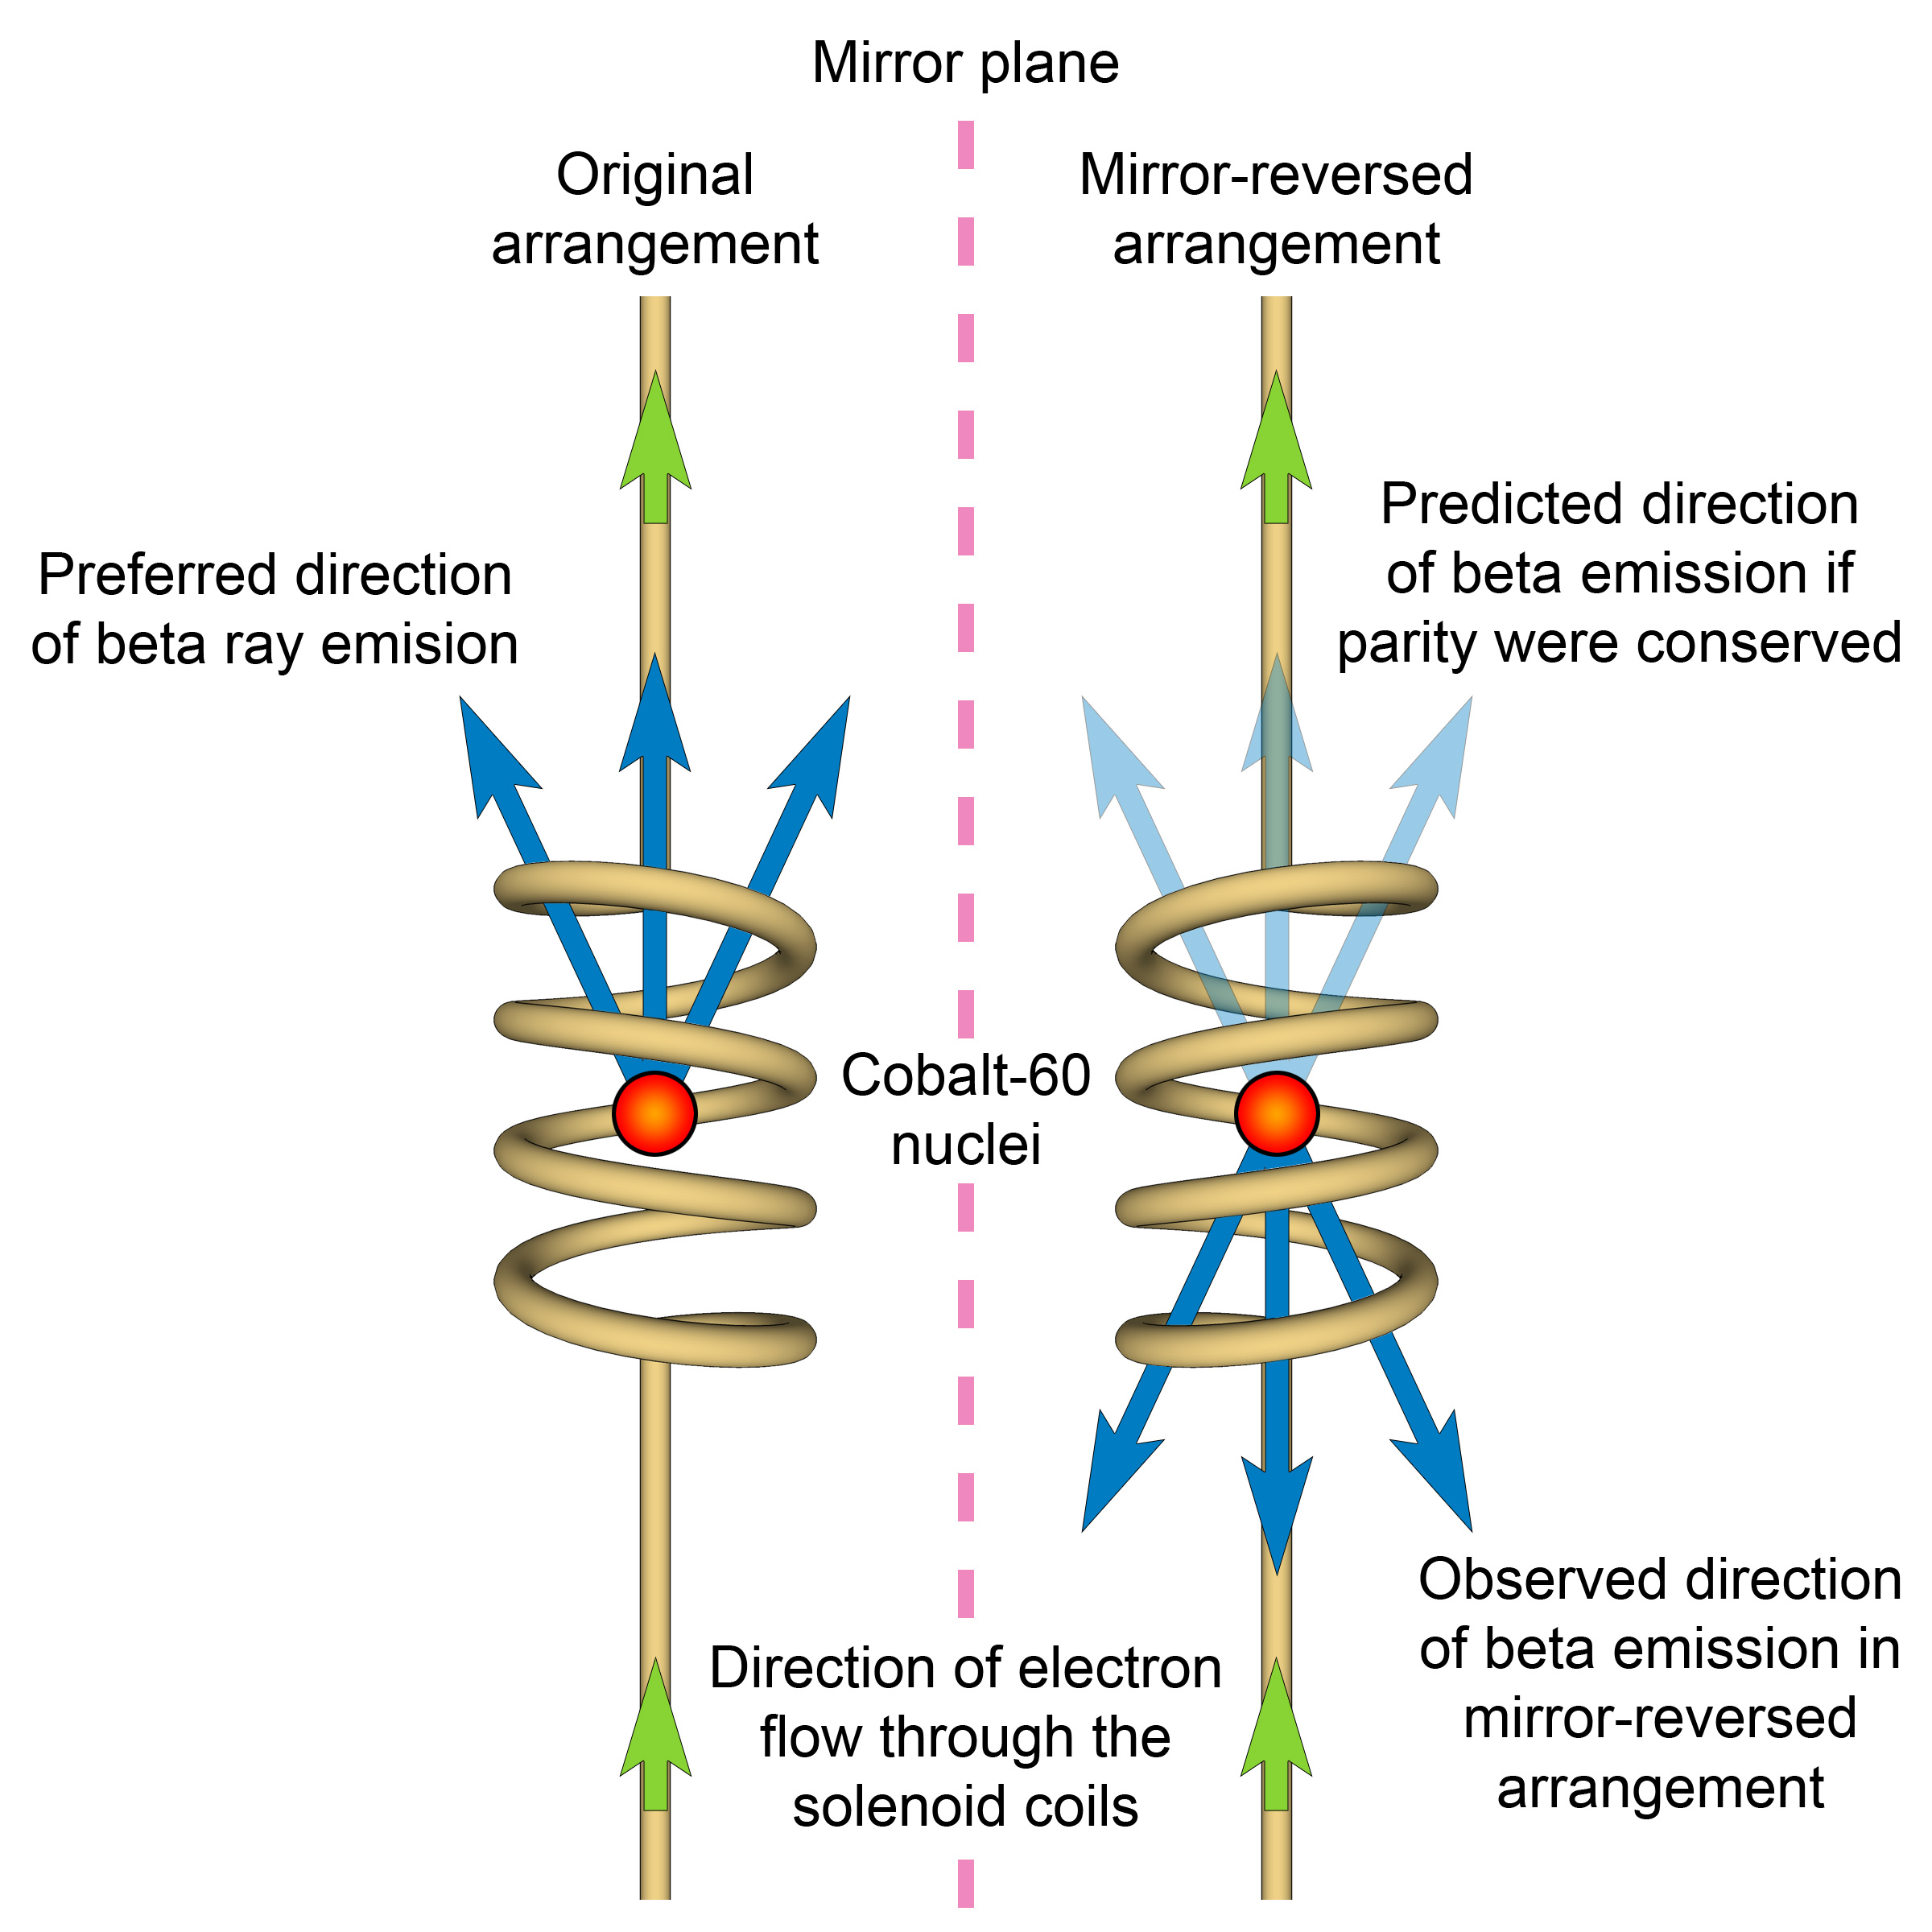
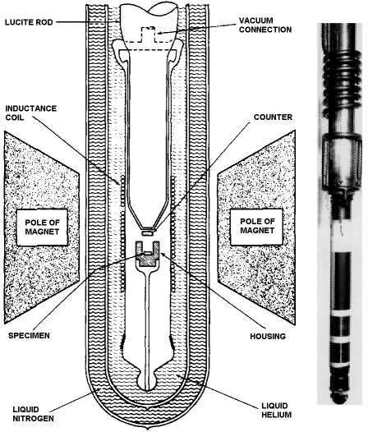
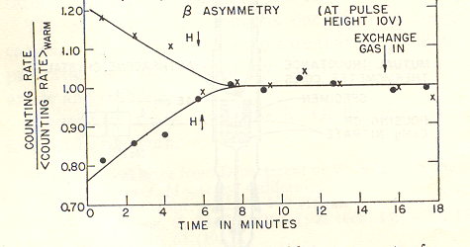
Discovery of Parity Violation!
1956
C.S. Wu
e⁻
θ
Parity
transformation
θ
→
→
J
J
Magnetic
field
⁶⁰Co
⁶⁰Co
Symmetric?
e⁻
B
→
More electrons emitted opposite the J direction
Not random → Parity violation!
Notes:
60Co -> 60Ni* + e- + v. 60Co has J=5, 60Ni has J=4, so J=1. Temperature 0.01 K, the nuclei are aligned in the magnetic field. Measure the electron intensity along the polarization. Spin of the electron must be in the direction of the B field.
The essence is that a pseudoscalar (changes sign under Parity) variable has a non-zero expectation value!

Slide 20
Weak Force breaks C and P, is CP really OK ?
Weak Interaction breaks both C and P symmetry maximally!
Despite the maximal violation of C and P symmetry, the combined operation, CP, seemed exactly conserved…
But, in 1964, Christensen, Cronin, Fitch and Turlay observed CP violation in decays of Neutral Kaons!
C
e⁺_{R}
e⁻_{R}
W⁺
W⁻
ν_{L}
ν_{L}
e⁺_{L}
e⁻_{L}
P
W⁺
W⁻
ν_{R}
ν_{R}

Slide 21
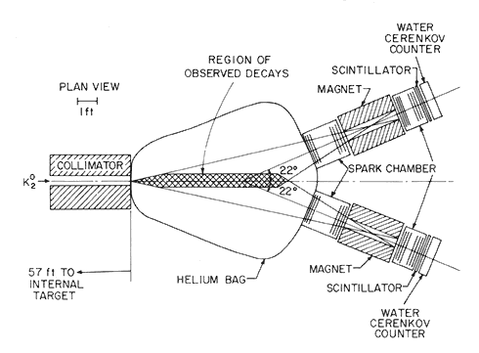
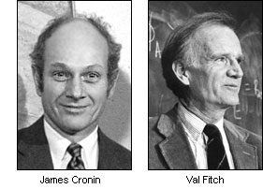
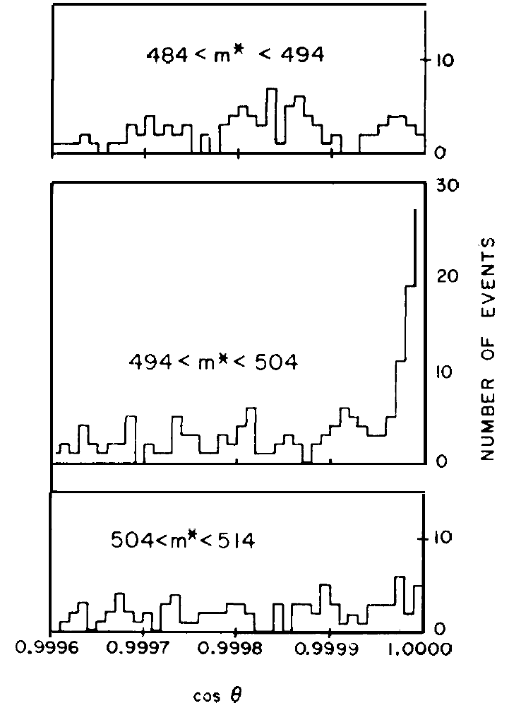
Discovery of CP-Violation!
K_{s}: Short-lived CP even:
K₁⁰ → π⁺ π⁻
K_{L}: Long-lived CP odd:
K₂⁰ →π⁺ π⁻ π⁰
Create a pure K_{L} (CP=-1) beam: (Cronin & Fitch in 1964)
Easy: just “wait” until the K_{s} component has decayed…
If CP conserved, should not see the decay K_{L}→ 2 pions
James Cronin
K₂→π⁺π⁻
Effect is tiny:
about 2/1000
Val Fitch
θ
Main background: K_{L}->π+π-π⁰
… and for this experiment they got the Nobel price in 1980…
Notes:
Kl-> pi+pi-pi0

Slide 22

Discovery of CP-Violation!
K_{s}: Short-lived CP even:
K₁⁰ → π⁺ π⁻
K_{L}: Long-lived CP odd:
K₂⁰ →π⁺ π⁻ π⁰
Create a pure K_{L} (CP=-1) beam: (Cronin & Fitch in 1964)
Easy: just “wait” until the K_{s} component has decayed…
If CP conserved, should not see the decay K_{L}→ 2 pions
James Cronin
K₂→π⁺π⁻
Effect is tiny:
about 2/1000
Val Fitch
θ
Main background: K_{L}->π+π-π⁰
… and for this experiment they got the Nobel price in 1980…
Notes:
Kl-> pi+pi-pi0

Slide 23
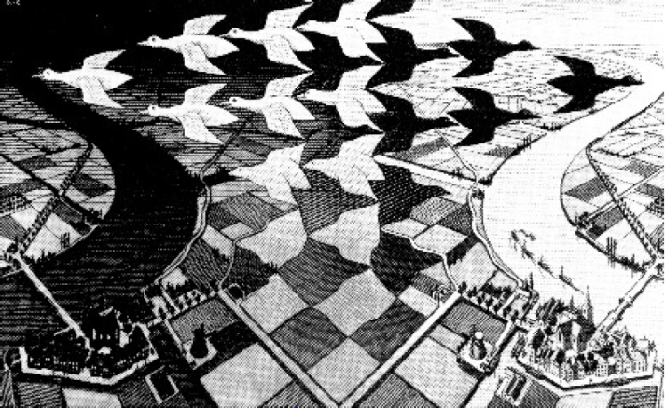
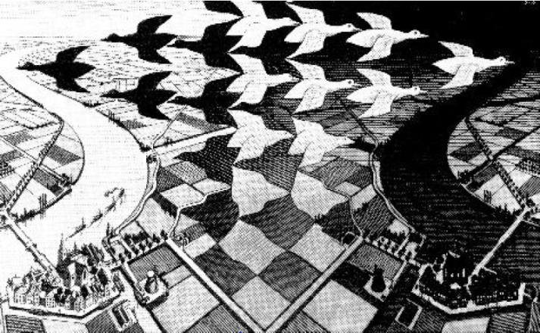
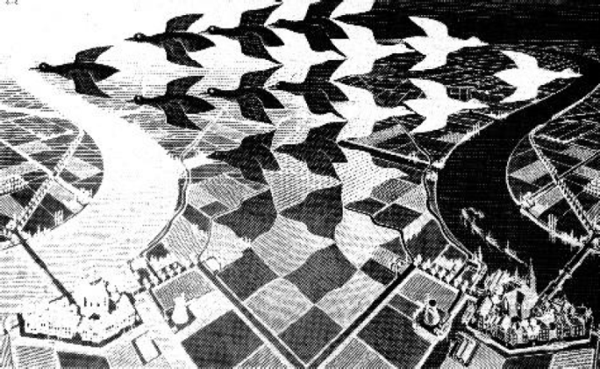
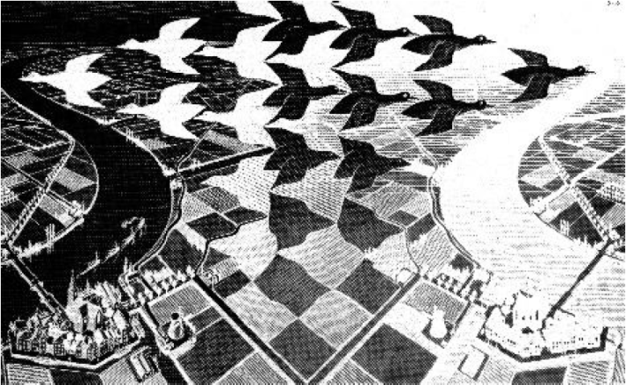
Escher on CP-Violation
C
CP-Violation!
Matter world
C: Color anti-color
CP:
Antimatter world
P: left right

Slide 24
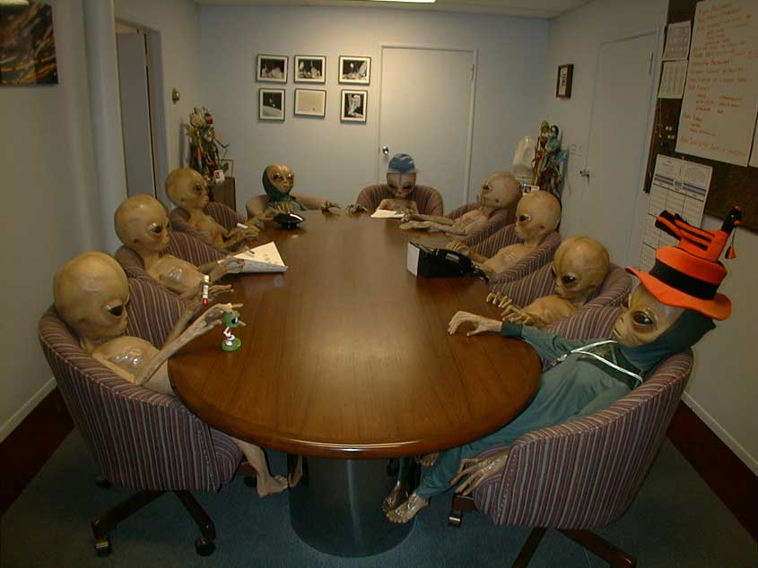
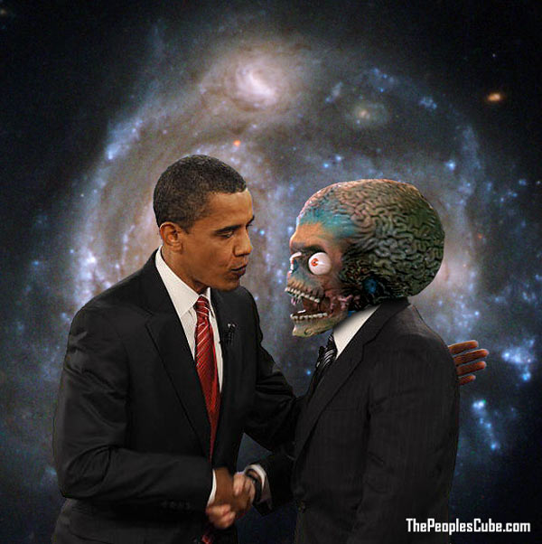
Contact with Aliens !
Are they made of matter or anti-matter?

Slide 25
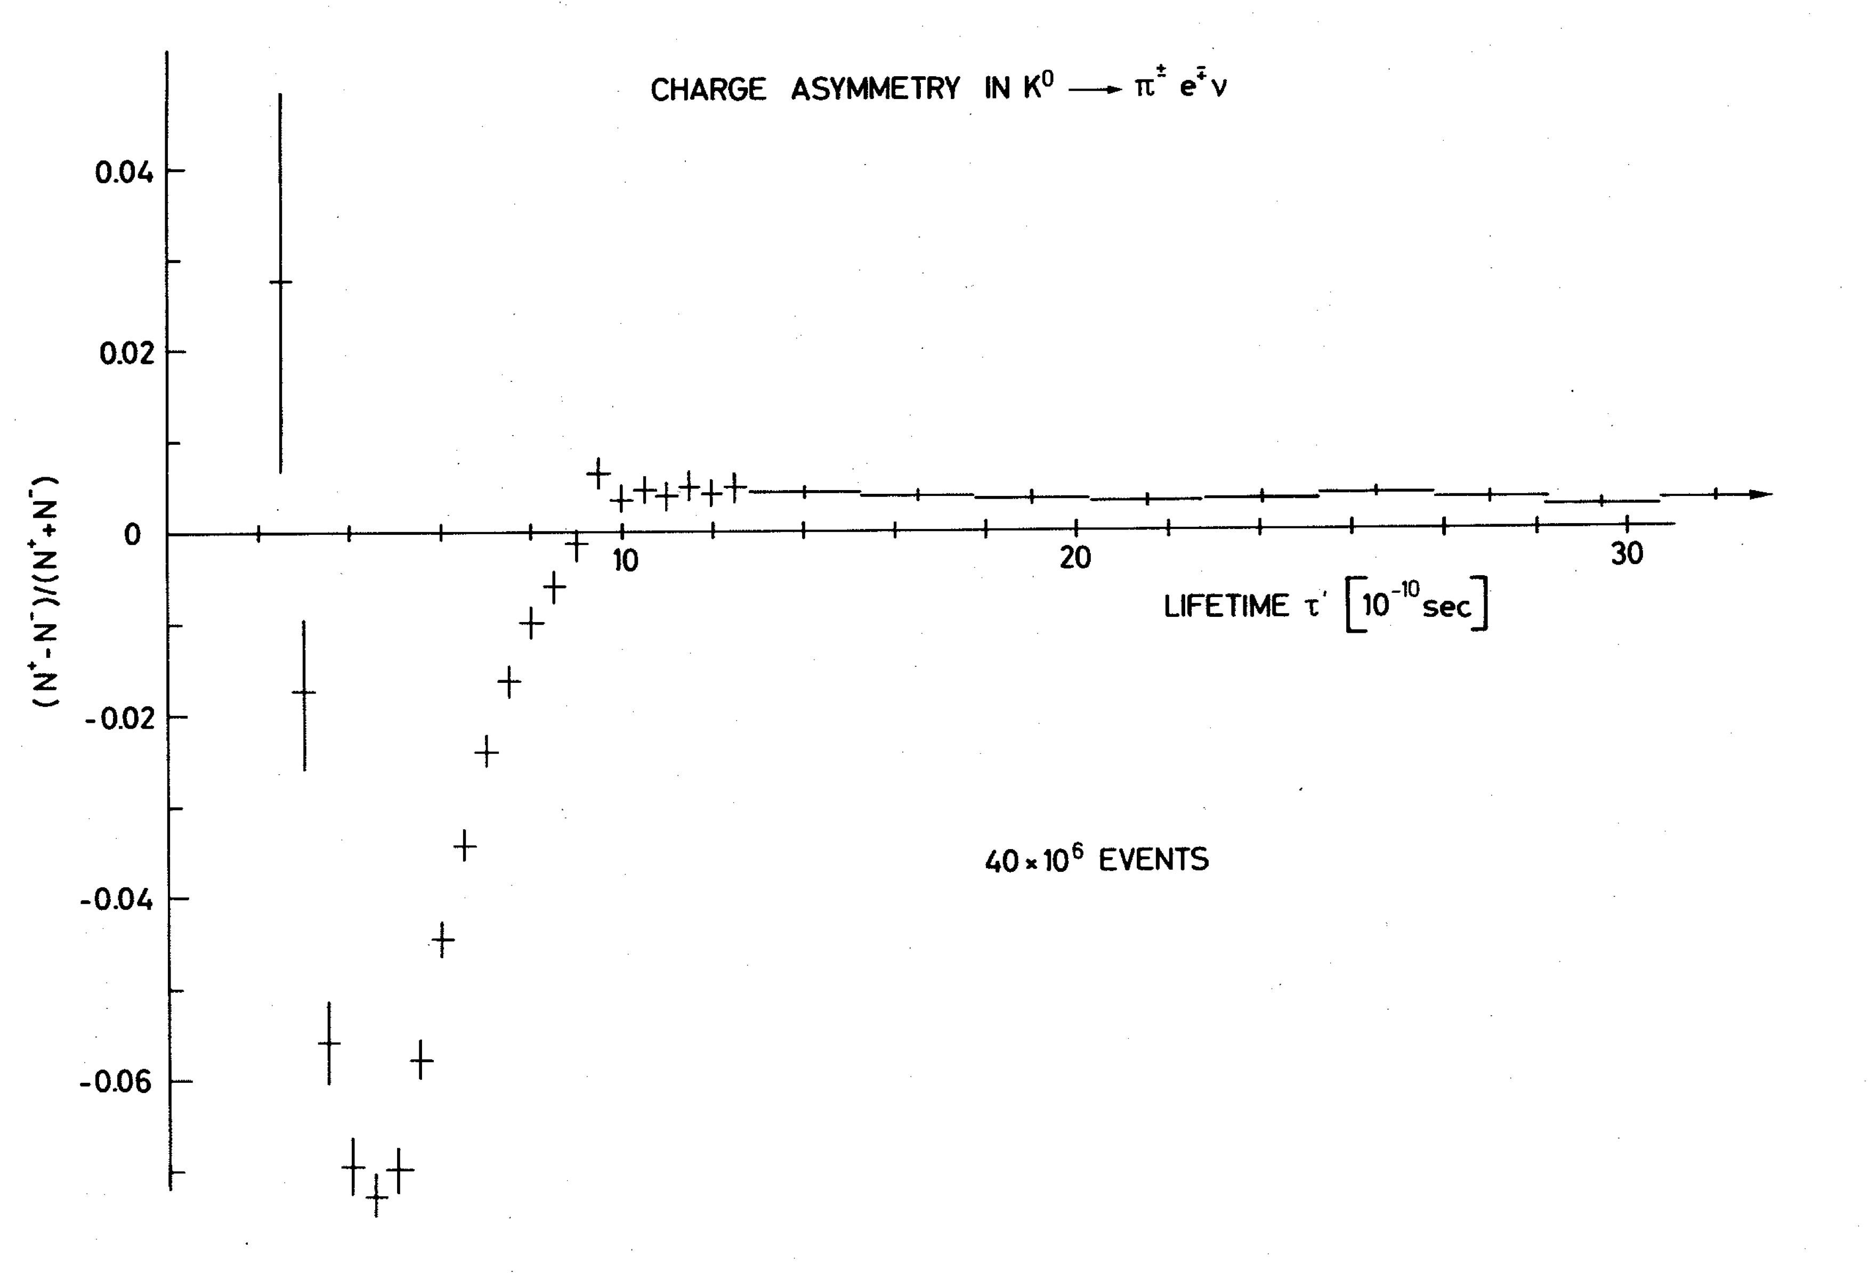
Charge Asymmetry in K⁰
Thesis Vera Luth, CERN 1974

Slide 26
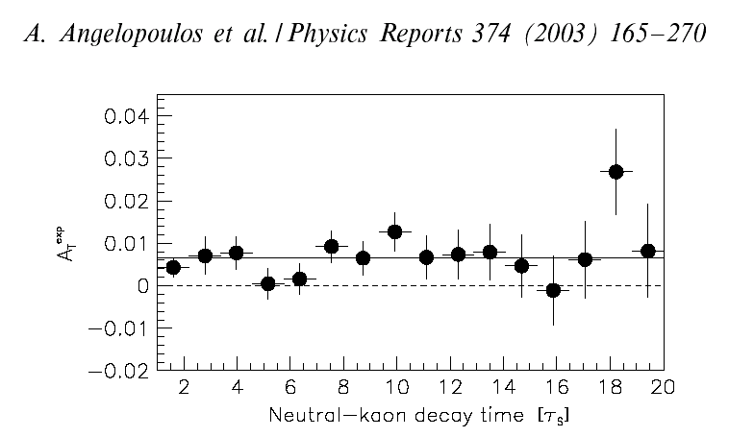
Charge Asymmetry in K⁰
CPLEAR, Phys.Rep. 374(2003) 165-270
Compare the charge of the most abundantly produced electron with that of the electrons in your body:
If equal: anti-matter If opposite: matter

Slide 27
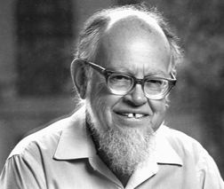
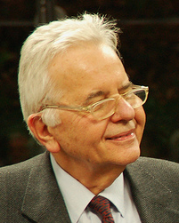
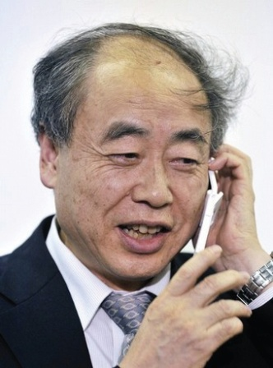
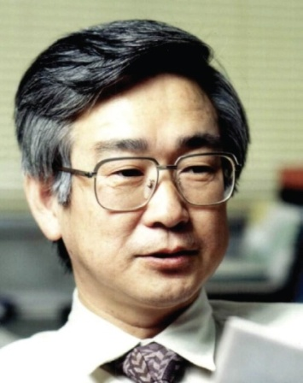
CP Violation: Superweak force or CKM?
1964 : Lincoln Wolfenstein
CP violation caused by superweak force
Only present in ΔS= 2 transitions
K⁰ ←SuperWeak→ K⁰
1972: Cabibbo Kobayashi Maskawa V_{CKM}
coupling
boson
current
u , c , t
9 Coupling constants:
g_{weak} → g ∙ V_{CKM}
Particle →Antiparticle
g_{weak}→g*_{weak}
W
J^{μ+}
g_{weak}
d , s , b
Kobayashi and Maskawa predicted the 3rd quark generation to explain CP-Violation within the Standard Model ➔ Nobel Prize 2008 (shared with Nambu)

Slide 28
Next Lecture
What is the root of CP Violation in the Standard Model?

