Slide 1
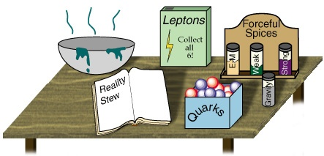


CP Violation in the Standard Model
Topical Lectures
Nikhef
Dec 14, 2016
Marcel Merk
Part 1: Discrete Symmetries
Part 2: The origin of CP Violation in the Standard Model
Part 3: Flavour mixing with B decays
Part 4: Observing CP violation in B decays

Slide 2
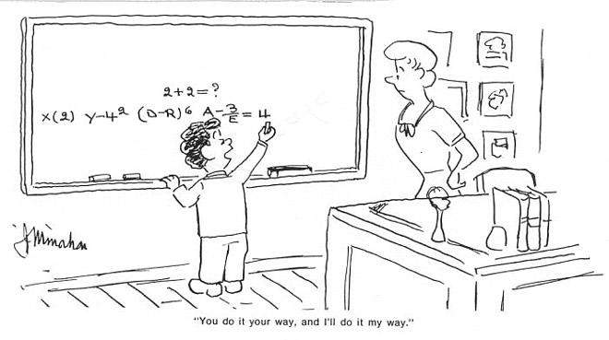
CP in the Standard Model Lagrangian
(The origin of the CKM-matrix)

Slide 3
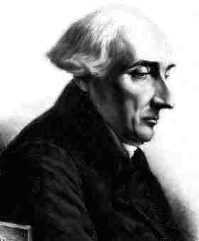
Lagrangian and Hermeticity
Local field theories work with Lagrangian densities:
The fundamental quantity, when discussing symmetries is the Action:
If the action is (is not) invariant under a symmetry operation then the symmetry in question is a good (broken) one
=> Unitarity of the interaction requires the Lagrangian to be Hermitian
Notes:
S = S matrix.

Slide 4
Structure of a Lagrangian
Example:
Consider a spin-1/2 (Dirac) particle (“nucleon”) interacting with a spin-0 (Scalar) object (“meson”)
Nucleon field
Meson potential
Nucleon – meson interaction
Exercise:
What are the symmetries of this theory under C, P, CP ? Can a and b be any complex numbers?
Note: the interaction term contains scalar and pseudoscalar parts
Violates P, conserves C, violates CP
a and b must be real from Hermeticity
Notes:
The interacton is scalar because we couple to a scalar field. We cannot have a “mu” index.
Pseudoscalar (gamma_5) gets minus sign under parity.

Slide 5
Transformation Properties
(Ignoring arbitrary phases)
Transformation properties of Dirac spinor bilinears (interaction terms in Lagrangian):
Notes:
Look at P,C,P for S,P

Slide 6
CP in the Standard Model Lagrangian
(The origin of the CKM-matrix)
L_{SM} contains:
L_{Kinetic} : fermion and gauge fields
L_{Higgs} : the Higgs potential
L_{Yukawa} : the Higgs – fermion interactions
Plan:
Look at symmetry aspects of the Lagrangian
How is CP violation implemented?
→ Several “miracles” happen in symmetry
breaking
Standard Model gauge symmetry:
Note Immediately: The weak part is explicitly parity violating
Outline:
Introduce the fermion fields in the SM
L_{Kinetic} : local gauge invariance : fermions ↔ bosons
L_{Higgs} : spontaneous symmetry breaking
L_{Yukawa} : the origin of fermion masses
V_{CKM} : CP violation
Notes:
Lorentz structure: Dirac gamma mu’s and gamma 5’s etc,: V,A,S,P. Higgs: boson masses

Slide 7
The Standard Model Lagrangian
•
•Introduce the massless fermion fields
•Require local gauge invariance => gives rise to existence of gauge bosons
=> CP Conserving
•
•Introduce Higgs potential with <φ> ≠ 0
•Spontaneous symmetry breaking
The W⁺, W⁻,Z⁰ bosons acquire a mass
=> CP Conserving
•
•Ad hoc interactions between Higgs field & fermions
=> CP violating with a single phase
•
• fermion weak eigenstates:
-- mass matrix is (3x3) non-diagonal
• fermion mass eigenstates:
-- mass matrix is (3x3) diagonal
=> CP-violating
=> CP-conserving!
•
in mass eigenstates: CKM – matrix
=> CP violating with a single phase

Slide 8
Fields: Notation
Q = T₃ + Y
Fermions:
Quarks:
Interaction rep.
Under SU2:
Left handed doublets
Right hander singlets
Y
Left-
handed
SU(3)_{C}
SU(2)_{L}
generation
index
Leptons:
Scalar field:
Note:
Interaction representation: standard model interaction is independent of generation number. Why 3???
Notes:
Stress interaction representation.
In left-right symmetric models and additional SU2(R) symmetry is included. In this case we have Y=B-L (nice).
Note that in the particle physics lectures we have Q=T3 + Y/2. (Different normalization).

Slide 9
Fields: Notation
Q = T₃ + Y
Explicitly:
The left handed quark doublet :
Similarly for the quark singlets:
The left handed leptons:
And similarly the (charged) singlets:
Repeat for three generations.

Slide 10
Intermezzo: Local Gauge Invariance in a single transparancy
Basic principle: The Lagrangian must be invariant under local gauge transformations
Example: massless Dirac Spinors in QED:
“global” U(1) gauge transformation:
“local” U(1) gauge transformation:
Is the Lagrangian invariant?
Then:
Not invariant!
=> Introduce the covariant derivative:
Then it turns out that:
and demand that Α_{μ} transforms as:
is invariant!
Conclusion:
Introduce charged fermion field (electron)
Demand invariance under local gauge transformations (U(1))
The price to pay is that a gauge field A_{μ} must be introduced at the same time (the photon)

Slide 11
:The Kinetic Part
Fermions + gauge bosons + interactions
Procedure: Introduce the Fermion fields and demand that the theory is local gauge invariant under transformations.
Start with the Dirac Lagrangian:
Replace:
Fields:
G_{a}^{μ} : 8 gluons
W_{b}^{μ} : weak bosons: W₁, W₂, W₃
B^{μ} : hypercharge boson
Generators:
L_{a} : Gell-Mann matrices: ½ λ_{a} (3x3) SU(3)_{C}
T_{b} : Pauli Matrices: ½ τ_{b} (2x2) SU(2)_{L}
Y : Hypercharge: U(1)_{Y}
For the remainder we only consider Electroweak: SU(2)_{L} x U(1)_{Y}
Notes:
Replace the derivative with the covariant derivative introducing the force carriers: gluons, weak vector bosons and photon.
The constants g_s, g and g’ are the corresponding coupling constants of the gauge particles.

Slide 12
:The Kinetic Part
Exercise:
Show that this Lagrangian formally violates both P and C
Show that this Lagrangian conserves CP
For example the term with Q_{Li}^{I} becomes:
L_{Kin} = CP conserving
and similarly for all other terms (u_{Ri}^{I},d_{Ri}^{I},L_{Li}^{I},l_{Ri}^{I}).
Writing out only the weak part for the quarks:
u_{L}^{I}
W^{+μ}
g
d_{L}^{I}
Notes:
Writing out the weak part leads to terms that can be illustrated by Feynman diagrams. The interactions are usually written as a current J times a gauge field.
Exercise:
To show this use the defitions of the parity and charge operators. Start by setting q_l = ½ (1+g_5) q, etc. Use also (1-g_5)g_0 = g_0(1+g_5). Show for a few terms that Parity leads to q_l -> q_R. For C it goes similarly using transformation properties under C.
In fact, one can see immediately that, since the lagrangian contains vector terms and axial vector terms, which transform with opposite sign, that it cannot be Parity or charge conserving. Under CP, both the vector and axial currents are odd.

Slide 13
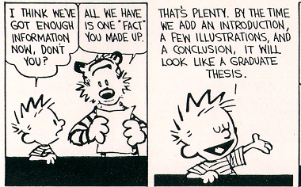

Slide 14
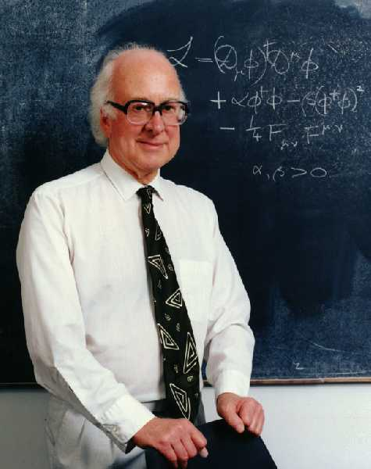
: The Higgs Potential
→Note L_{Higgs} = CP conserving
V(φ)
V(φ)
Symmetry
Broken
Symmetry
φ
φ
~ 246 GeV
Spontaneous Symmetry Breaking: The Higgs field adopts a non-zero vacuum expectation value
Procedure:
Substitute:
And rewrite the Lagrangian (tedious):
.
The W⁺,W⁻,Z⁰ bosons acquire mass
The Higgs boson H appears
(The other 3 Higgs fields are “eaten” by the W, Z bosons)
“The realization of the vacuum breaks the symmetry”
Notes:
The Higgs potential has an asymmetric minimum in one of the 4 degrees of freedom: Re(phi_0). Only this component remains in the final Lagrangian: the Higgs field. The other three components are absorbed in the mass terms of the W+, W-, Z bosons. The photon remains massless.

Slide 15
: The Yukawa Part
Since we have a Higgs field we can add (ad-hoc) interactions between φ and the fermions in a gauge invariant way.
The result is:
doublets
L must be Her-
mitian (unitary)
singlet
With:
(The C-conjugate of φ
To be manifestly invariant under SU(2) )
are arbitrary complex matrices which operate in family space (3x3)
=> Flavour physics!
Notes:
Remember that the Lagrangian is a scalar object (it must respect Lorentz invariance). How can we make scalars with left handed doublets, higgs doublets and right handed singlets?
Y_ij are Yukawa coupling constants, the lefthanded fermion doublet and the higgs doublet together make a scalar to be multiplied by the righthanded fermion scalar.

Slide 16
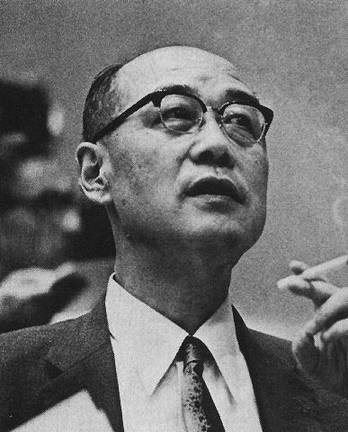
: The Yukawa Part
Writing the first term explicitly:
Question:
In what aspect is this Lagrangian similar to the example of the nucleon-meson potential?
Notes:
Answer: The lagrangian involves scalar and pseudoscalar interactions (since d_l = ½ (1-g_5) d etc.) in a similar way as the nuclean-meson potential.

Slide 17
: The Yukawa Part
Writing the first term explicitly:
For
For the nucleon potential we had an interaction term:
Question:
In what aspect is this Lagrangian similar to the example of the nucleon-meson potential?
Notes:
Answer: The lagrangian involves scalar and pseudoscalar interactions (since d_l = ½ (1-g_5) d etc.) in a similar way as the nuclean-meson potential.

Slide 18
: The Yukawa Part
Exercise (intuitive proof)
Show that:
The hermiticity of the Lagrangian implies that there are terms in pairs of the form:
However a transformation under CP gives:
CP is conserved in L_{Yukawa} only if Y_{ij} = Y_{ij}*
and leaves the coefficients Y_{ij} and Y_{ij}* unchanged
Formally, CP is violated if:
In general L_{Yukawa} is CP violating

Slide 19
: The Yukawa Part
There are 3 Yukawa matrices (in the case of massless neutrino’s):
Each matrix is 3x3 complex:
27 real parameters
27 imaginary parameters (“phases”)
many of the parameters are equivalent, since the physics described by one set of couplings is the same as another
It can be shown that the independent parameters are:
  12 real parameters (9 masses, 3 mixing angles)
  1 imaginary phase
This single phase is the source of all CP violation in the Standard Model
……Revisit later

Slide 20
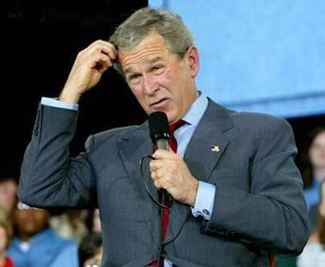
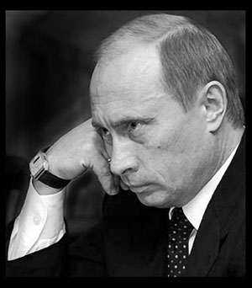

So far, so good…?

Slide 21

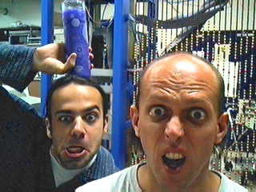
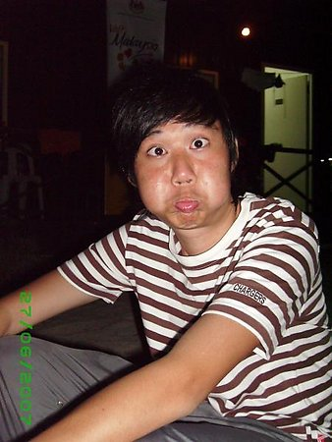
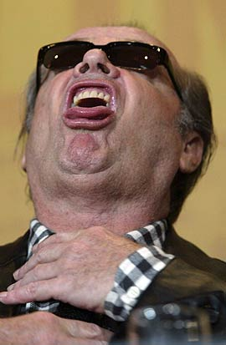
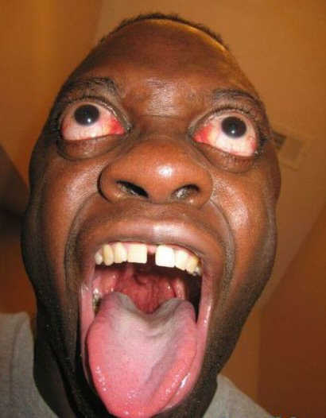
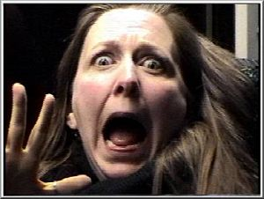
Hope not…

Slide 22
: The Fermion Masses
S.S.B
Start with the Yukawa Lagrangian
v is vacuum expectation value of the Higgs potential
After which the following mass term emerges:
with
L_{Mass} is CP violating in a similar way as L_{Yuk}
Notes:
In the vacuum, the only non-zero component of the Higgs field is phi^0.
The L_mass is CP conserving if the Mass matrices are real.

Slide 23
: The Fermion Masses
S.S.B
Writing in an explicit form:
The matrices M can always be diagonalised by unitary matrices V_{L}^{f} and V_{R}^{f} such that:
Then the real fermion mass eigenstates are given by:
d_{L}^{I} , u_{L}^{I} , l_{L}^{I} are the weak interaction eigenstates
d_{L} , u_{L} , l_{L} are the mass eigenstates (“physical particles”)

Slide 24
: The Fermion Masses
S.S.B
In terms of the mass eigenstates:
= CP Conserving?
In flavour space one can choose:
Weak basis: The gauge currents are diagonal in flavour space, but the flavour mass
matrices are non-diagonal
Mass basis: The fermion masses are diagonal, but some gauge currents (charged weak
interactions) are not diagonal in flavour space
In the weak basis: L_{Yukawa} = CP violating
In the mass basis: L_{Yukawa} → L_{Mass} = CP conserving
=>What happened to the charged current interactions (in L_{Kinetic}) ?
Notes:
Use the fact that: d ½ (1+g_5) m_d ½ (1+g_5) d = m d ½ (1+g5) d.
And similarly: d ½ (1-g_5) m_d ½ (1-g_5) d = m d ½ (1-g5) d.
Sum them up to get: m d d

Slide 25
: The Charged Current
The charged current interaction for quarks in the interaction basis is:
The charged current interaction for quarks in the mass basis is:
The unitary matrix:
With:
is the Cabibbo Kobayashi Maskawa mixing matrix:
Lepton sector: similarly
However, for massless neutrino’s: V_{L}^{ν} = arbitrary. Choose it such that V_{MNS} = 1 => There is no mixing in the lepton sector

Slide 26
Charged Currents
Note that:
The charged current term reads:
Under the CP operator this gives:
(Together with (x,t) → (-x,t))
A comparison shows that CP is conserved only if V_{ij} = V_{ij}*
In general the charged current term is CP violating

Slide 27
Flavour Changing Neutral Currents - skip
To illustrate the SM neutral current take W₃^{μ} and B^{μ} term of the Kinetic Lagrangian:
And consider the Z-boson field:
and
Take further Q_{Li}^{I}=d_{Li}^{I} :
Use to find in general:
In terms of physical fields no non-diagonal contributions occur for the neutral Currents. => GIM mechanism
Standard Model forbids flavour changing neutral currents.

Slide 28
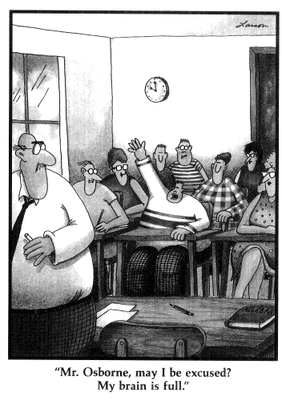
Where were we?

Slide 29
The Standard Model Lagrangian (recap)
•Introduce the massless fermion fields
•Require local gauge invariance => gives rise to existence of gauge bosons
=> CP Conserving
•Introduce Higgs potential with <φ> ≠ 0
•Spontaneous symmetry breaking
The W⁺, W⁻,Z⁰ bosons acquire a mass
=> CP Conserving
•Ad hoc interactions between Higgs field & fermions
=> CP violating with a single phase
• fermion weak eigenstates:
-- mass matrix is (3x3) non-diagonal
• fermion mass eigenstates:
-- mass matrix is (3x3) diagonal
=> CP-violating
=> CP-conserving!
• In mass eigenstates: CKM – matrix
=> CP violating with a single phase

Slide 30
Flavour Changing Quark Interactions
1

Slide 31
Flavour Changing Quark Interactions
3
2
1

Slide 32
Flavour Changing Quark Interactions
3
2
1

Slide 33
Flavour Changing Quark Interactions
3
2
1

Slide 34
Flavour Changing Quark Interactions
3
2
1

Slide 35
Flavour Changing Quark Interactions
3
2
1

Slide 36
Flavour Changing Quark Interactions
3
2
1
Complex coupling constants are the source of CP violating interactions.

Slide 37
Quark field re-phasing
Under a quark phase transformation:
Exercise:
Convince yourself that there are indeed 5 relative quark phases
and a simultaneous rephasing of the CKM matrix:
or
the charged current
is left invariant.
Degrees of freedom in V_{CKM} in 3 N generations
Number of real parameters: 9 + N²
Number of imaginary parameters: 9 + N²
Number of constraints (VV† = 1): -9 - N²
Number of relative quark phases: -5 - (2N-1)
-----------------------
Total degrees of freedom: 4 (N-1)²
Number of Euler angles: 3 N (N-1) / 2
Number of CP phases: 1 (N-1) (N-2) / 2
2 generations:
No CP violation in SM!
This is the reason Kobayashi and Maskawa first suggested a third family of fermions!

Slide 38
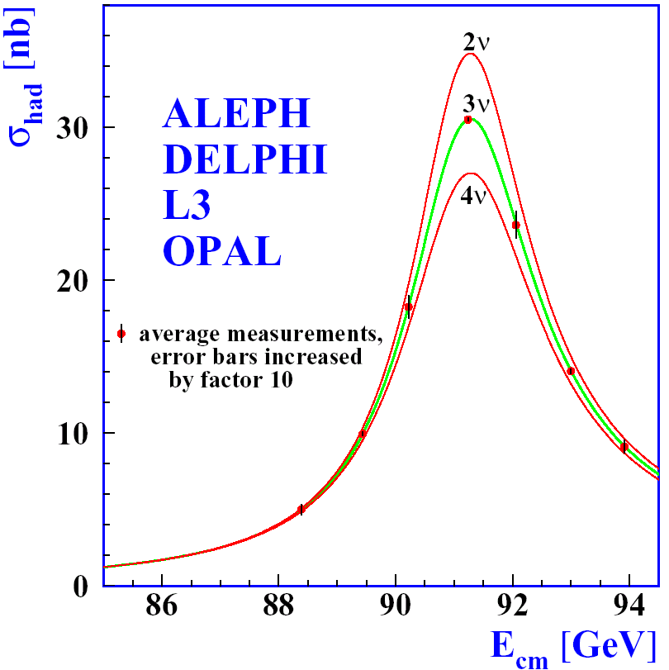
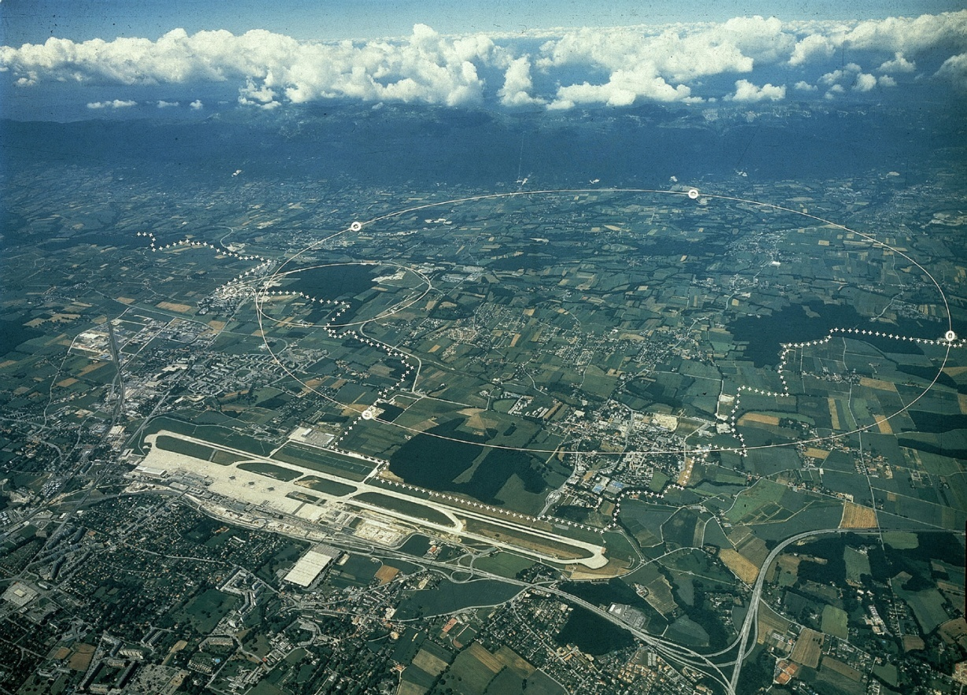
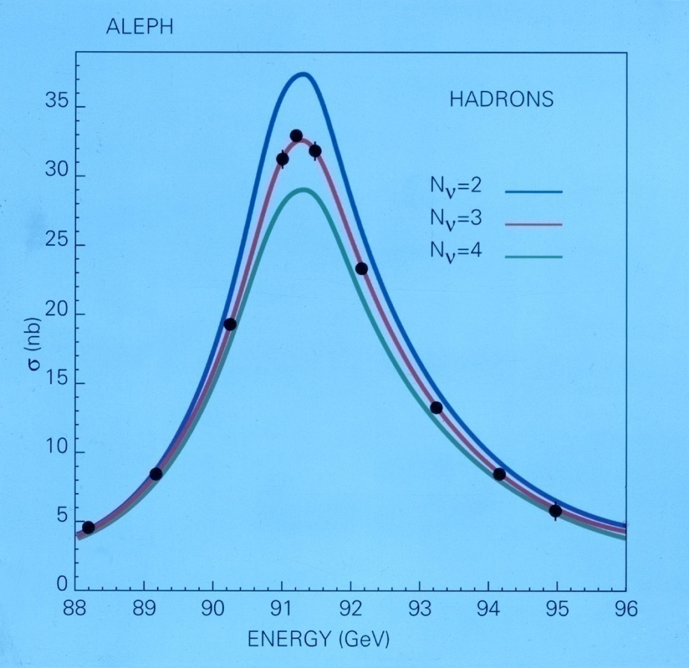
The LEP collider @ CERN
Aleph
L₃
Opal
Delphi
Geneva Airport “Cointrin”
M_{Z}
Maybe the most important result of LEP:
“There are 3 generations of neutrino’s”
Light, left-handed, “active”

Slide 39
The lepton sector (Intermezzo)
N. Cabibbo: Phys.Rev.Lett. 10, 531 (1963)
  2 family flavour mixing in quark sector (GIM mechanism)
M.Kobayashi and T.Maskawa, Prog. Theor. Phys 49, 652 (1973)
  3 family flavour mixing in quark sector
Z.Maki, M.Nakagawa and S.Sakata, Prog. Theor. Phys. 28, 870 (1962)
  2 family flavour mixing in neutrino sector to explain neutrino oscillations!
In case neutrino masses are of the Dirac type, the situation in the lepton sector is very similar as in the quark sector: V_{MNS} ~ V_{CKM}.
  There is one CP violating phase in the lepton MNS matrix
In case neutrino masses are of the Majorana type (a neutrino is its own anti-particle → no freedom to redefine neutrino phases)
  There are 3 CP violating phases in the lepton MNS matrix
    However, the two extra phases are unobservable in neutrino oscillations
  There is even a CP violating phase in case N_{dim} = 2
Notes:
If neutrino’s are their own anti-particles they have no phase freedom. In that case there are only 3 relative phases in the lepton sector (the 3 charged leptons phases) instead of 5 in the quark sector. Therefore 3 phases remain in the MNS matrix.

Slide 40
Lepton mixing and neutrino oscillations
Question:
In the CKM we write by convention the mixing for the down type quarks; in the lepton sector we write it for the (up-type) neutrinos. Is it relevant?
  If yes: why?
  If not, why don’t we measure charged lepton oscillations rather then neutrino oscillations?
μ
ν_{e,}ν_{μ}
e
ν^{Ι}_{μ}
ν^{Ι}_{e}
However, observation of neutrino oscillations is possible due to small neutrino mass differences.

Slide 41
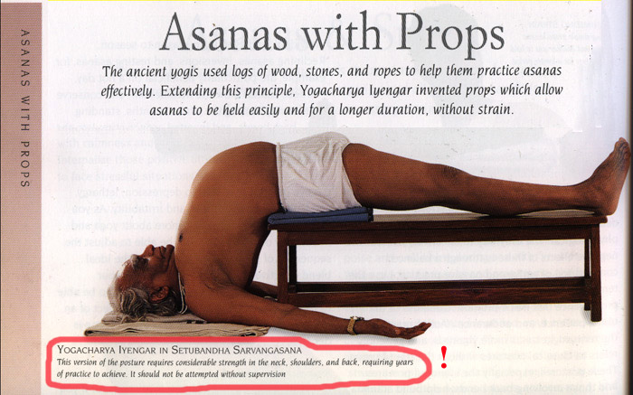
Indian Yoga…

Slide 42

Russian Yoga…

Slide 43
Rephasing Invariants
The standard representation of the CKM matrix is:

Slide 44
Rephasing Invariants
The standard representation of the CKM matrix is:
However, many representations are possible. What are invariants under re-phasing?
Simplest: U_{αi} = |V_{αi}|² is independent of quark re-phasing
Next simplest: Quartets: Q_{αiβj} = V_{αi} V_{βj} V_{αj}* V_{βi}* with α≠β and i≠j
  “Each quark phase appears with and without *”
V†V=1: Unitarity triangle: V_{ud} V_{cd}* + V_{us} V_{cs}* + V_{ub} V_{cb}* = 0
  Multiply the equation by V_{us}* V_{cs} and take the imaginary part:
  Im (V_{us}* V_{cs} V_{ud} V_{cd}*) = - Im (V_{us}* V_{cs} V_{ub} V_{cb}*)
  J = Im Q_{udcs} = - Im Q_{ubcs}
  The imaginary part of each Quartet combination is the same (up to a sign)
  In fact it is equal to 2x the surface of the unitarity triangle
Im[V_{αi} V_{βj} V_{αj}* V_{βi}*] = J ∑ε_{αβγ} ε_{ijk} where J is universal Jarlskog invariant
Amount of CP violation is proportional to J
Notes:
Quartets: since each quark phase appears with and without *, the expression is invariant under rephasing.

Slide 45
The Unitarity Triangle
V_{CKM}† V_{CKM} = 1
The “db” triangle:
unitarity:
Area = ½ |Im Q_{udcb}| = ½ |J|
Under re-phasing:
the unitary angles are invariant
(In fact, rephasing implies a rotation of the whole triangle)

Slide 46
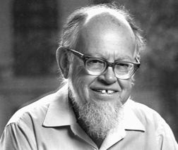
The CKM Matrix V_{CKM}
d s b
u
c
t
Wolfenstein parametrization: V_{CKM}
From unitarity (V_{CKM} V†_{CKM}=1)
CKM has four free parameters:
3 real: λ (≈0.22) , A (≈ 1), ρ
1 imaginary: iη
Particle → Antiparticle: V_{ij} → V_{ij}*
=> 1 CP Violating phase
Notes:
This is the three by three matrix. It represents the strength with which the different quark flavours couple to the W boson.
Lambda=0.225, A=0.81, rho-bar=0.131, eta-bar=0.345

Slide 47
The CKM Matrix V_{CKM}
d s b
u
c
t
Wolfenstein parametrization: V_{CKM}
Notes:
This is the three by three matrix. It represents the strength with which the different quark flavours couple to the W boson.
Lambda=0.225, A=0.81, rho-bar=0.131, eta-bar=0.345

Slide 48
The CKM Matrix V_{CKM}
d s b
u
c
t
Wolfenstein parametrization: V_{CKM}
Notes:
Can the CKM phase have caused the baryo asymmetry in the universe?

Slide 49
CP Violation and quark masses
Note that the massless Lagrangian has a global symmetry for unitary transformations in flavour space.
Let’s now assume two quarks with the same charge are degenerate
in mass, eg.: m_{s} = m_{b}
Redefine: s’ = V_{us} s + V_{ub} b
Now the u quark only couples to s’ and not to b’ : i.e. V₁₃’ = 0
Using unitarity we can show that the CKM matrix can now be written as:
CP conserving
Necessary criteria for CP violation:
Notes:
The massless theory can have an arbitrary number of independent generations. A rotation is generation space leaves the theory invariant.
V’: the first row follows directly. The second and third follow from unitarity

Slide 50
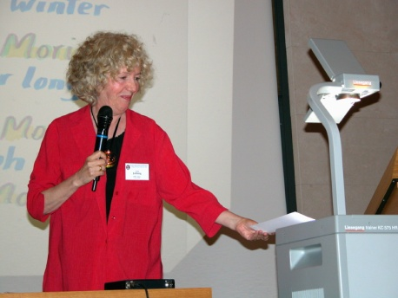
The Amount of CP Violation
Using Standard Parametrization of CKM:
(eg.: J=Im(V_{us} V_{cb} V_{ub}* V_{cs}*) )
(The maximal value J might have = 1/(6√3) ~ 0.1)
However, also required is:
All requirements for CP violation can be summarized by:
Is CP violation maximal? => One has to understand the origin of mass!

Slide 51
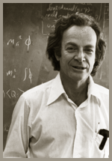
Mass Patterns
Mass spectra (μ = M_{z}, MS-bar scheme)
m_{u} ~ 1 - 3 MeV , m_{c} ~ 0.5 – 0.6 GeV , m_{t} ~ 180 GeV
m_{d} ~ 2 - 5 MeV , m_{s} ~ 35 – 100 MeV , m_{b} ~ 2.9 GeV
Observe:
m_{e} = 0.51 MeV , m_{μ} = 105 MeV , m_{τ} = 1777 MeV
Why are neutrino’s so light? Is it related to the fact that they are the only neutral fermions? See-saw mechanism?
Do you want to be famous?
Do you want to be a king?
Do you want more then the nobel prize?
- Then solve the mass Problem –
R.P. Feynman

Slide 52
In Summary…

Slide 53
Mass vs Weak Eigenstates V_{CKM}:

Slide 54
Mass vs Weak Eigenstates V_{CKM}:
The Higgs interaction and the W interaction do not agree on the quark eigenstates.
  Relation is the CKM matrix V_{CKM},
  Leads to three mixing angles and one free imaginary CP phase in the CKM.
Quark CP violation emerged together with mass.

Slide 55
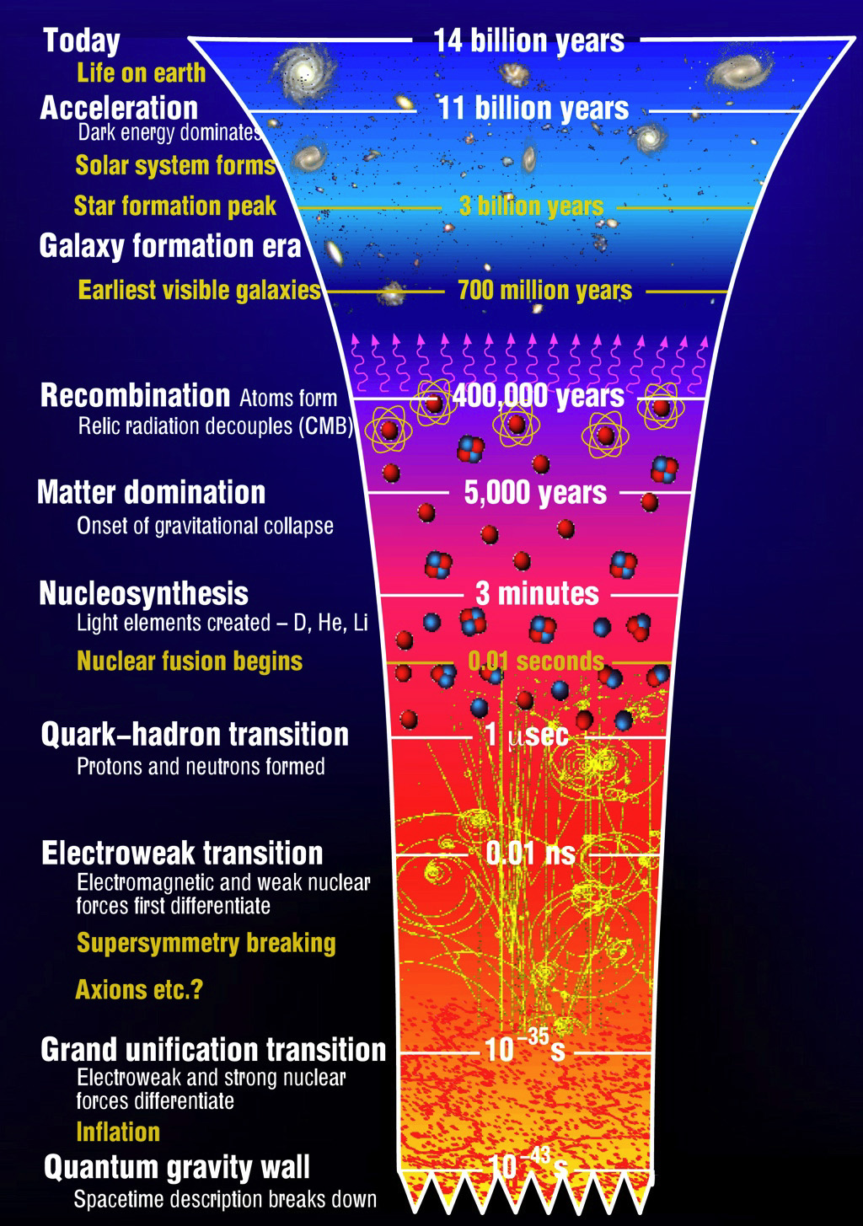
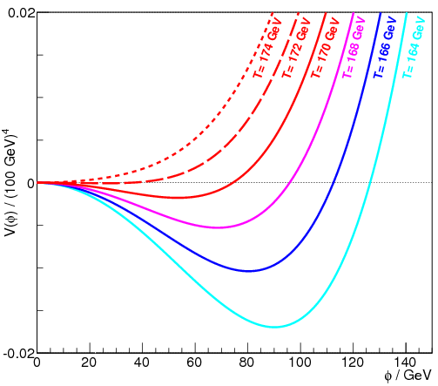
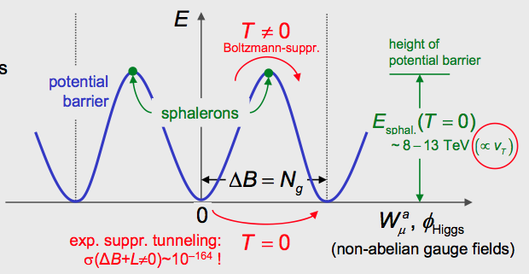
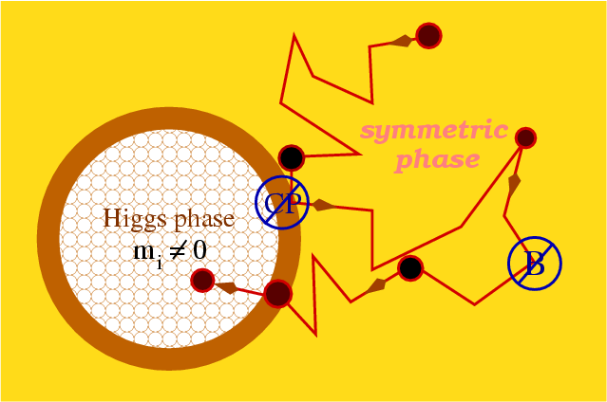
The Baryogenesis Puzzle
symmetric phase
broken phase
expanding bubble (Higgs condensates)
Higgs
?
CPV
Do all matter-antimatter asymmetries originate from Higgs-Yukawa coupling?
B+L viol.
Baryogenesis:
SM not enough.
Requires NP
@ TeV scale.
EW Symmetry Breaking (mass)
Notes:
Can we learn from SU3 and SU2 – different languages. Potential picture in SU3?
What role do Sphalerons play?

Slide 57
Next Lecture
How does CP Violation occur in B-meson decays?

