Slide 1
Enrichment of Calcium in Molten Salt
NNV fall meeting
November, 2024
Wicher van Bree, Nicolo de Groot, Levi Sleegers, Luuk van Summeren (Radboud University), Julia Even, Lisa van der Werff (RU Groningen), Valentina Gonzalez Belmont (TES de Ecatepec)

Slide 2
Intorduntion: periodic table
Atom number= # of protons in element
1
18
1
2
H
2
13
14
15
16
17
He
3
4
5
6
7
8
9
10
Li
Be
B
C
N
O
F
Ne
11
12
13
14
15
16
17
18
Na
Mg
3
4
5
6
7
8
9
10
11
12
Al
Si
P
S
Cl
Ar
19
20
21
22
23
24
25
26
27
28
29
30
31
32
33
34
35
36
K
Ca
Sc
Ti
V
Cr
Mn
Fe
Co
Ni
Cu
Zn
Ga
Ge
As
Se
Br
Kr
37
38
39
40
41
42
43
44
45
46
47
48
49
50
51
52
53
54
Rb
Sr
Y
Zr
Nb
Mo
Tc
Ru
Rh
Pd
Ag
Cd
In
Sn
Sb
Te
I
Xe
55
56
57+
*
72
73
74
75
76
77
78
79
80
81
82
83
84
85
86
Cs
Ba
La
"
Hf
Ta
W
Re
Os
Ir
Pt
Au
Hg
Tl
Pb
Bi
Po
At
Rn
87
88
104
114 115 116 117 118
108 109 110 111
89+
105
106
107
112 113
Fr
Ra
Ac
Rf
Db
Sg
Bh
Hs
Mt
Ds
Rg
Cn
Nh
Fl
Mc
Lv
Ts
Og
*
58
59
60
61
62
63
64
65
66
67
68
69
70
71
Ce
Pr
Nd
Pm
Sm
Eu
Gd
Tb
Dy
Ho
Er
Tm
Yb
Lu
"
90
91
92
93
94
95
96
97
98
99
100
101
102
103
Th
Pa
U
Np
Pu
Am
Cm
Bk
Cf
Es
Fm
Md
No
Lr

Slide 3
Stable calcium isotopes
⁴⁰Ca
96.9%
⁴²Ca
0.647%
⁴³Ca
0.135%
⁴⁴Ca
2.09%
⁴⁶Ca
0.004%
⁴⁸Ca
0.187%
1
18
1
2
H
2
13
14
15
16
17
He
3
4
5
6
7
8
9
10
Li
Be
B
C
N
O
F
Ne
11
12
13
14
15
16
17
18
Na
Mg
3
4
5
6
7
8
9
10
11
12
Al
Si
P
S
Cl
Ar
19
20
21
22
23
24
25
26
27
28
29
30
31
32
33
34
35
36
K
Ca
Sc
Ti
V
Cr
Mn
Fe
Co
Ni
Cu
Zn
Ga
Ge
As
Se
Br
Kr
37
38
39
40
41
42
43
44
45
46
47
48
49
50
51
52
53
54
Rb
Sr
Y
Zr
Nb
Mo
Tc
Ru
Rh
Pd
Ag
Cd
In
Sn
Sb
Te
I
Xe
55
56
57+
*
72
73
74
75
76
77
78
79
80
81
82
83
84
85
86
Cs
Ba
La
"
Hf
Ta
W
Re
Os
Ir
Pt
Au
Hg
Tl
Pb
Bi
Po
At
Rn
87
88
104
114 115 116 117 118
108 109 110 111
89+
105
106
107
112 113
Fr
Ra
Ac
Rf
Db
Sg
Bh
Hs
Mt
Ds
Rg
Cn
Nh
Fl
Mc
Lv
Ts
Og
*
58
59
60
61
62
63
64
65
66
67
68
69
70
71
Ce
Pr
Nd
Pm
Sm
Eu
Gd
Tb
Dy
Ho
Er
Tm
Yb
Lu
"
90
91
92
93
94
95
96
97
98
99
100
101
102
103
Th
Pa
U
Np
Pu
Am
Cm
Bk
Cf
Es
Fm
Md
No
Lr

Slide 4
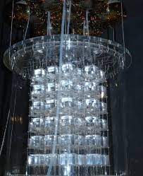
Stable calcium isotopes
⁴⁰Ca
96.9%
⁴²Ca
0.647%
⁴³Ca
0.135%
⁴⁴Ca
2.09%
⁴⁶Ca
0.004%
⁴⁸Ca
0.187%
1
18
1
2
H
2
13
14
15
16
17
He
3
4
Fundamental research:
Sensitize of super heavy elements
Neutrino mass measurement
Dubble beta decay
5
6
7
8
9
10
Li
Be
B
C
N
O
F
Ne
11
12
13
14
15
16
17
18
Candles detector
Na
Mg
3
4
5
6
7
8
9
10
11
12
Al
Si
P
S
Cl
Ar
19
20
21
22
23
24
25
26
27
28
29
30
31
32
33
34
35
36
K
Ca
Sc
Ti
V
Cr
Mn
Fe
Co
Ni
Cu
Zn
Ga
Ge
As
Se
Br
Kr
37
38
39
40
41
42
43
44
45
46
47
48
49
50
51
52
53
54
Rb
Sr
Y
Zr
Nb
Mo
Tc
Ru
Rh
Pd
Ag
Cd
In
Sn
Sb
Te
I
Xe
55
56
57+
*
72
73
74
75
76
77
78
79
80
81
82
83
84
85
86
Cs
Ba
La
"
Hf
Ta
W
Re
Os
Ir
Pt
Au
Hg
Tl
Pb
Bi
Po
At
Rn
87
88
104
114 115 116 117 118
108 109 110 111
89+
105
106
107
112 113
Fr
Ra
Ac
Rf
Db
Sg
Bh
Hs
Mt
Ds
Rg
Cn
Nh
Fl
Mc
Lv
Ts
Og
Synthesized with ⁴⁸Ca
*
58
59
60
61
62
63
64
65
66
67
68
69
70
71
Ce
Pr
Nd
Pm
Sm
Eu
Gd
Tb
Dy
Ho
Er
Tm
Yb
Lu
"
90
91
92
93
94
95
96
97
98
99
100
101
102
103
Th
Pa
U
Np
Pu
Am
Cm
Bk
Cf
Es
Fm
Md
No
Lr

Slide 5
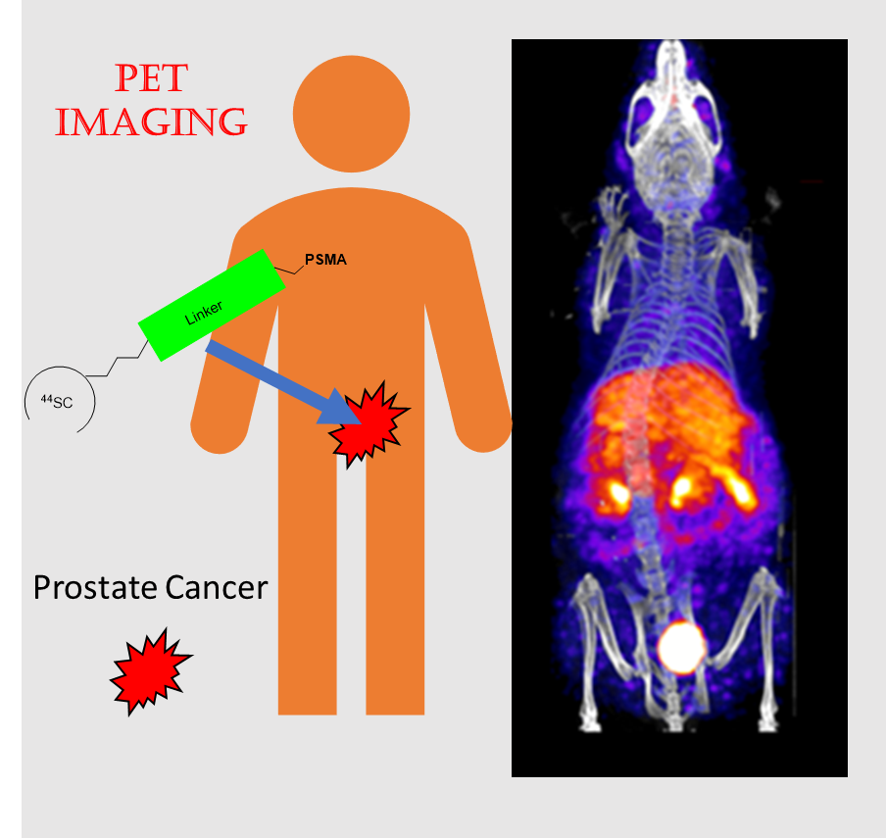
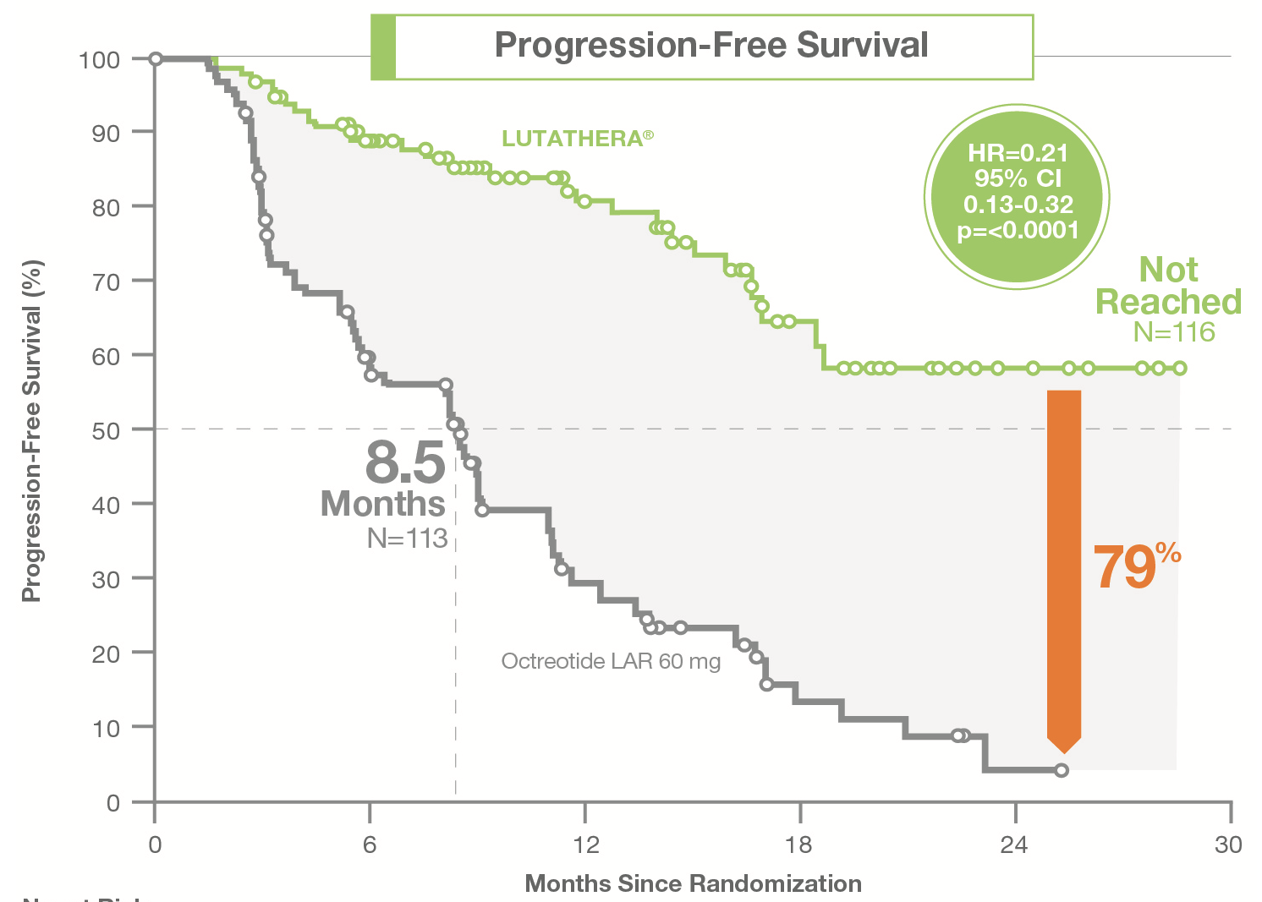
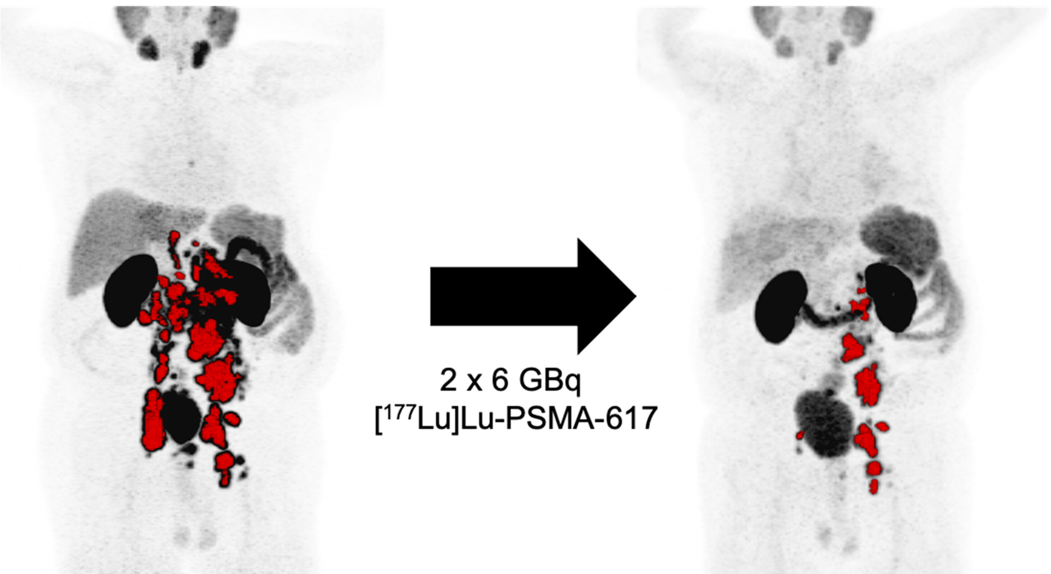
Heavy calcium: medical applications – Scandium 44 & 47
⁴⁰Ca
96.9%
⁴²Ca
0.647%
⁴³Ca
0.135%
⁴⁴Ca
2.09%
⁴⁶Ca
0.004%
⁴⁸Ca
0.187%
PET scan
Radiation therapy

Slide 6
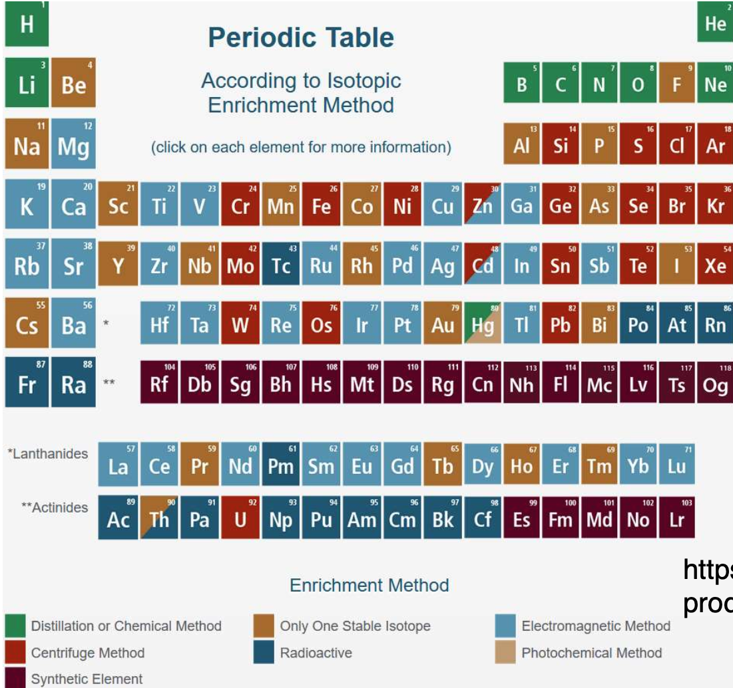
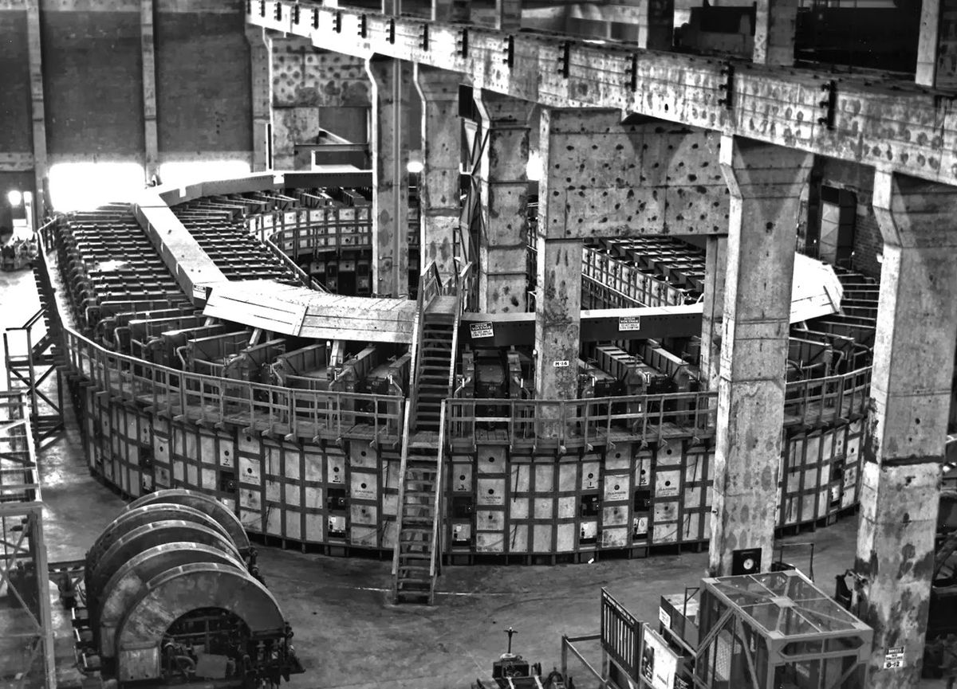
Calcium crisis in europe
Calcium production:
Only with a calutron
Inefficient: 10g ⁴⁸Ca/jaar
Expensive( 1g ⁴⁸Ca = 500k€)
Other elements take priority (¹⁷⁷Lu)

Slide 7
The solution
⁴⁰Ca
96.9%
⁴²Ca
0.647%
⁴³Ca
0.135%
⁴⁴Ca
2.09%
⁴⁶Ca
0.004%
⁴⁸Ca
0.187%
Pre-enrichment of calcium, aim ⁴⁸Ca: 0.2% → 1%
The to calutron for seperation:
⁴⁴Ca for ⁴⁴Sc
⁴⁶Ca for ⁴⁷Sc
⁴⁸Ca for research and ⁴⁷Sc
Reduces cost and increase production
Validatie experiment op Radboud Universiteit (2018)
Demonstrator grant NWO

Slide 8
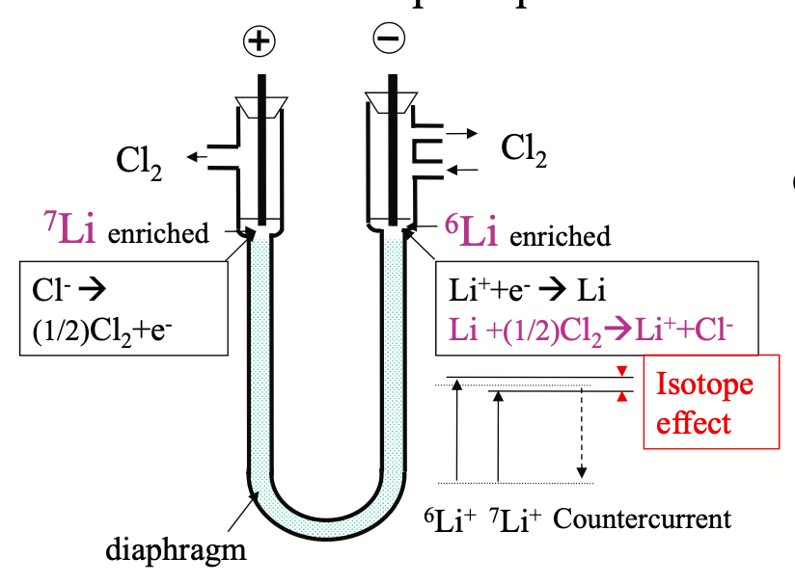
Molten-salt counter current electromigration
anode
cathode
Counter current due to:
Gravity
Capillary action
???
Couter current due to
Gravity
Capillary action
Klemm method
A. Klemm, Z. Naturforsch. 6a, 512 (1951).

Slide 9
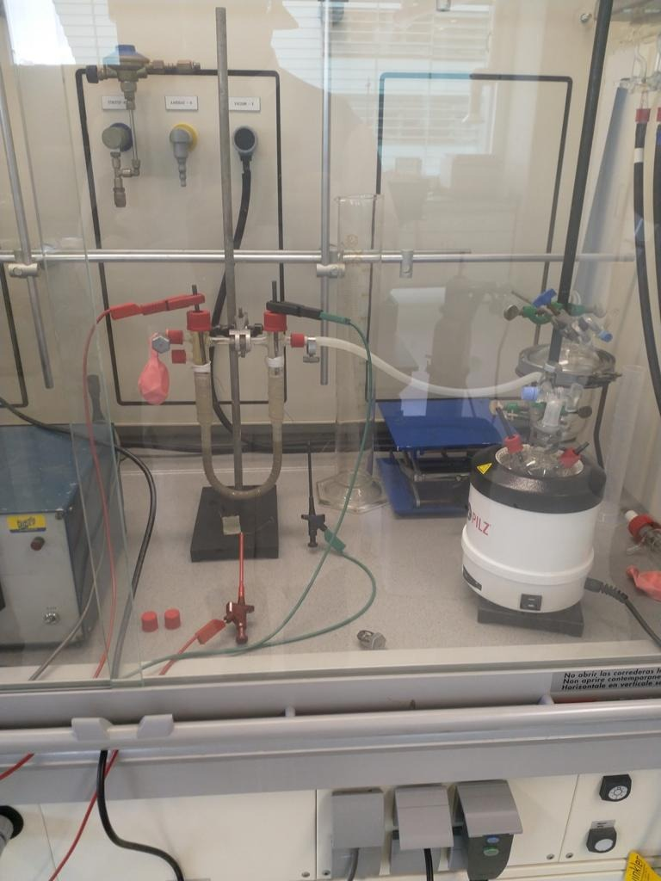
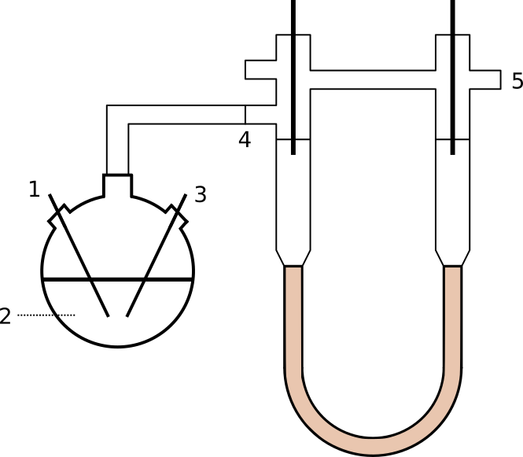
Low-temp CCEM
Ternery salt:
Ca(No₃)₂
KNO₃
NaNO₃
High calcium concentration
Low melting point
cathode
anode
Extra NO₂
NdG, Levi Sleegers
Presented at
NNV subatomic physics (2018)

Slide 10
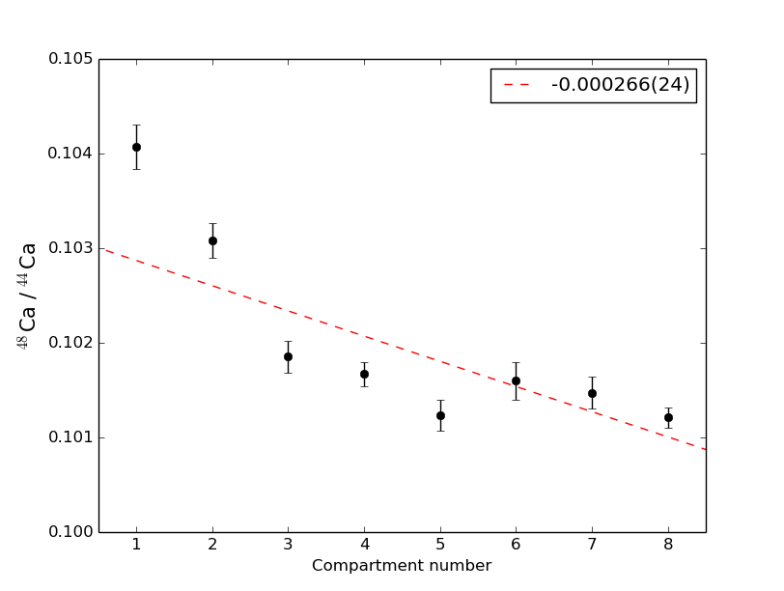
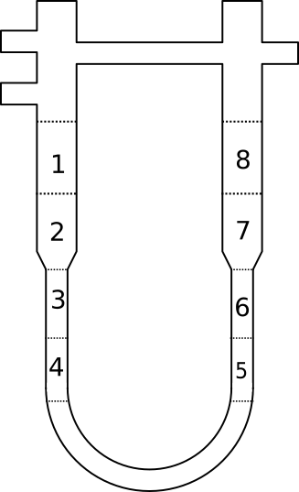
RU EXPERIMENT (2018)
Yara solar zout (calcium/sodium/potassium nitrate, 42% Ca(NO₂)₃, 131ºC
Simple design, easy operation
80V, 8mA, 9 days
4% enrichment
anode
cathode

Slide 11
RU EXPERIMENT (2018)
Electrodes erode
Limited current passing through
Get the NO3 gas to the cathode
Isotope separation
anode
cathode

Slide 12
Chemla Effect
Why don’t the elements separate?
Chemla effect
mobility of different elements
We have: Ca²⁺ and K⁺, Na⁺
At low temperature, there could be a crossing point
Okada, Jour. Mol. Liq.
83 5-22 (1999)

Slide 13
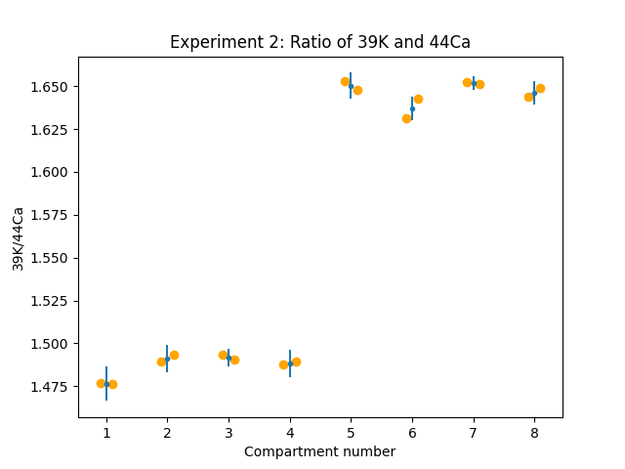
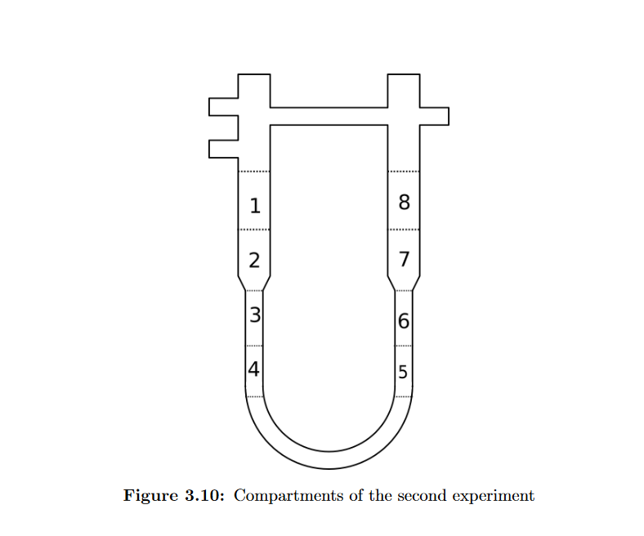
Chemla Effect
Separation between Ca and Na/K.
No separation between K-Na
It will stop the enrichment when salts become unmixed

Slide 14
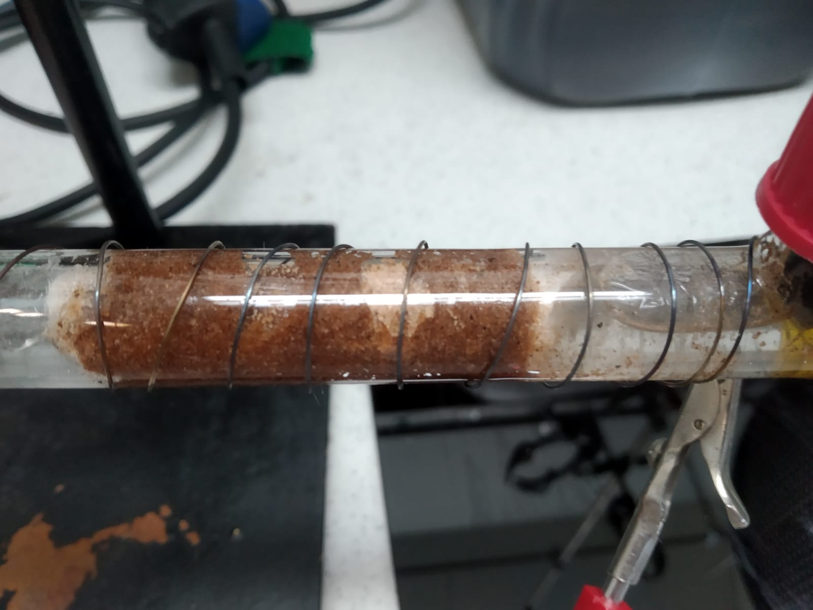
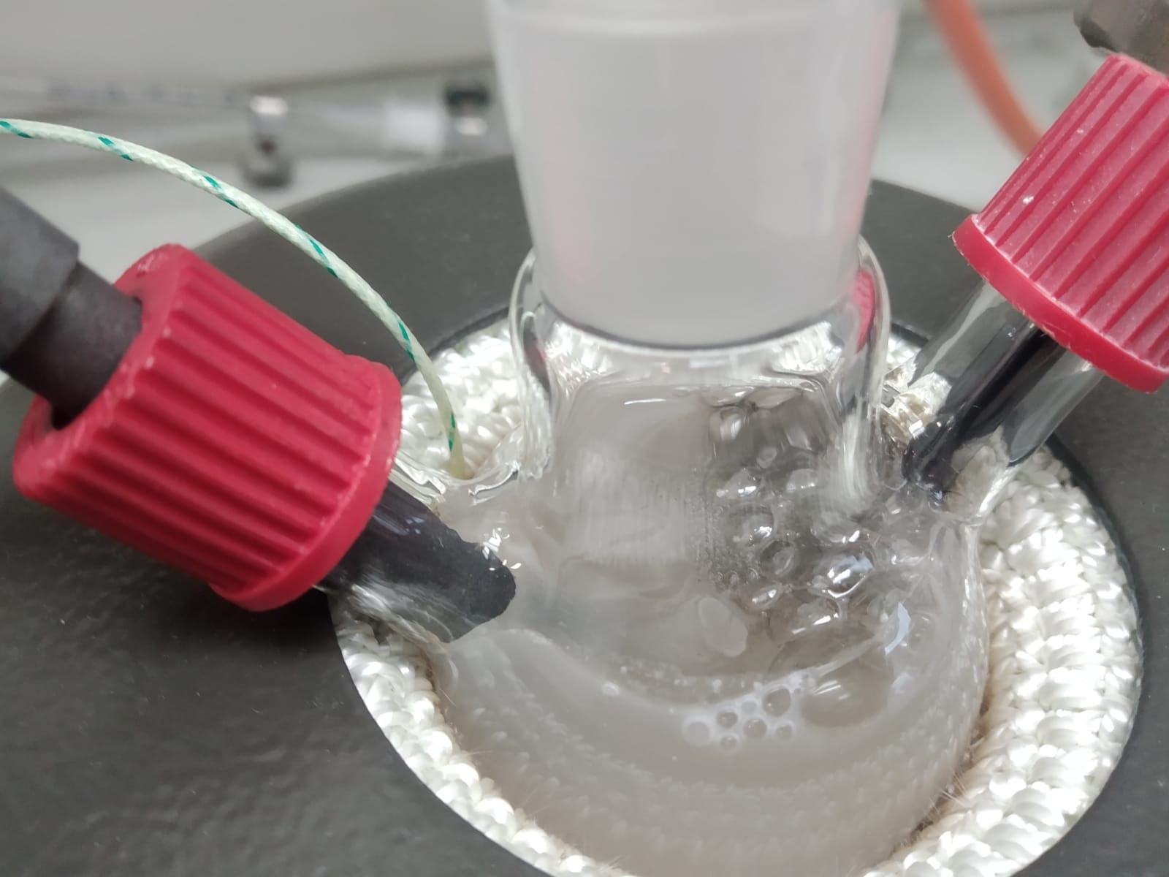
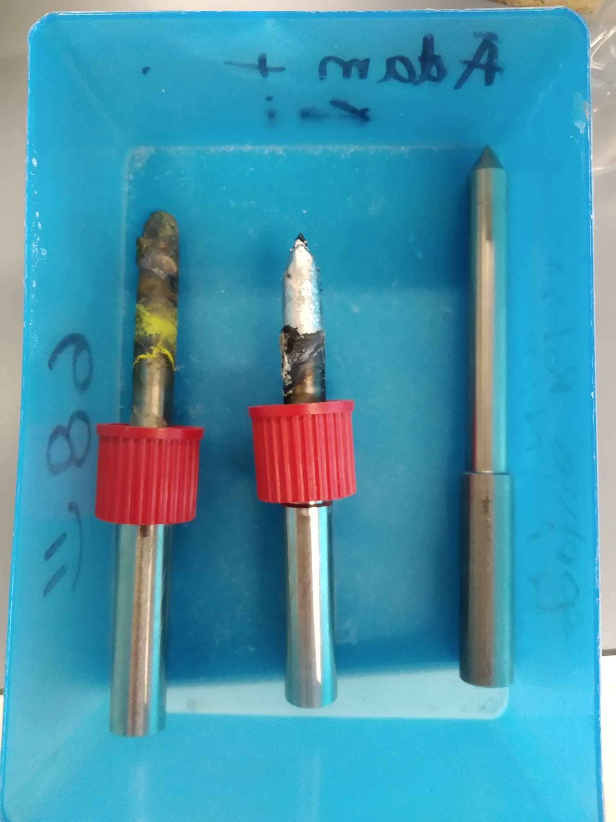
Preperations
Electrode materials
Hastelloy
Titanium
Glassy carbon
Platinum
Filter material
Temperature-current correlation

Slide 15
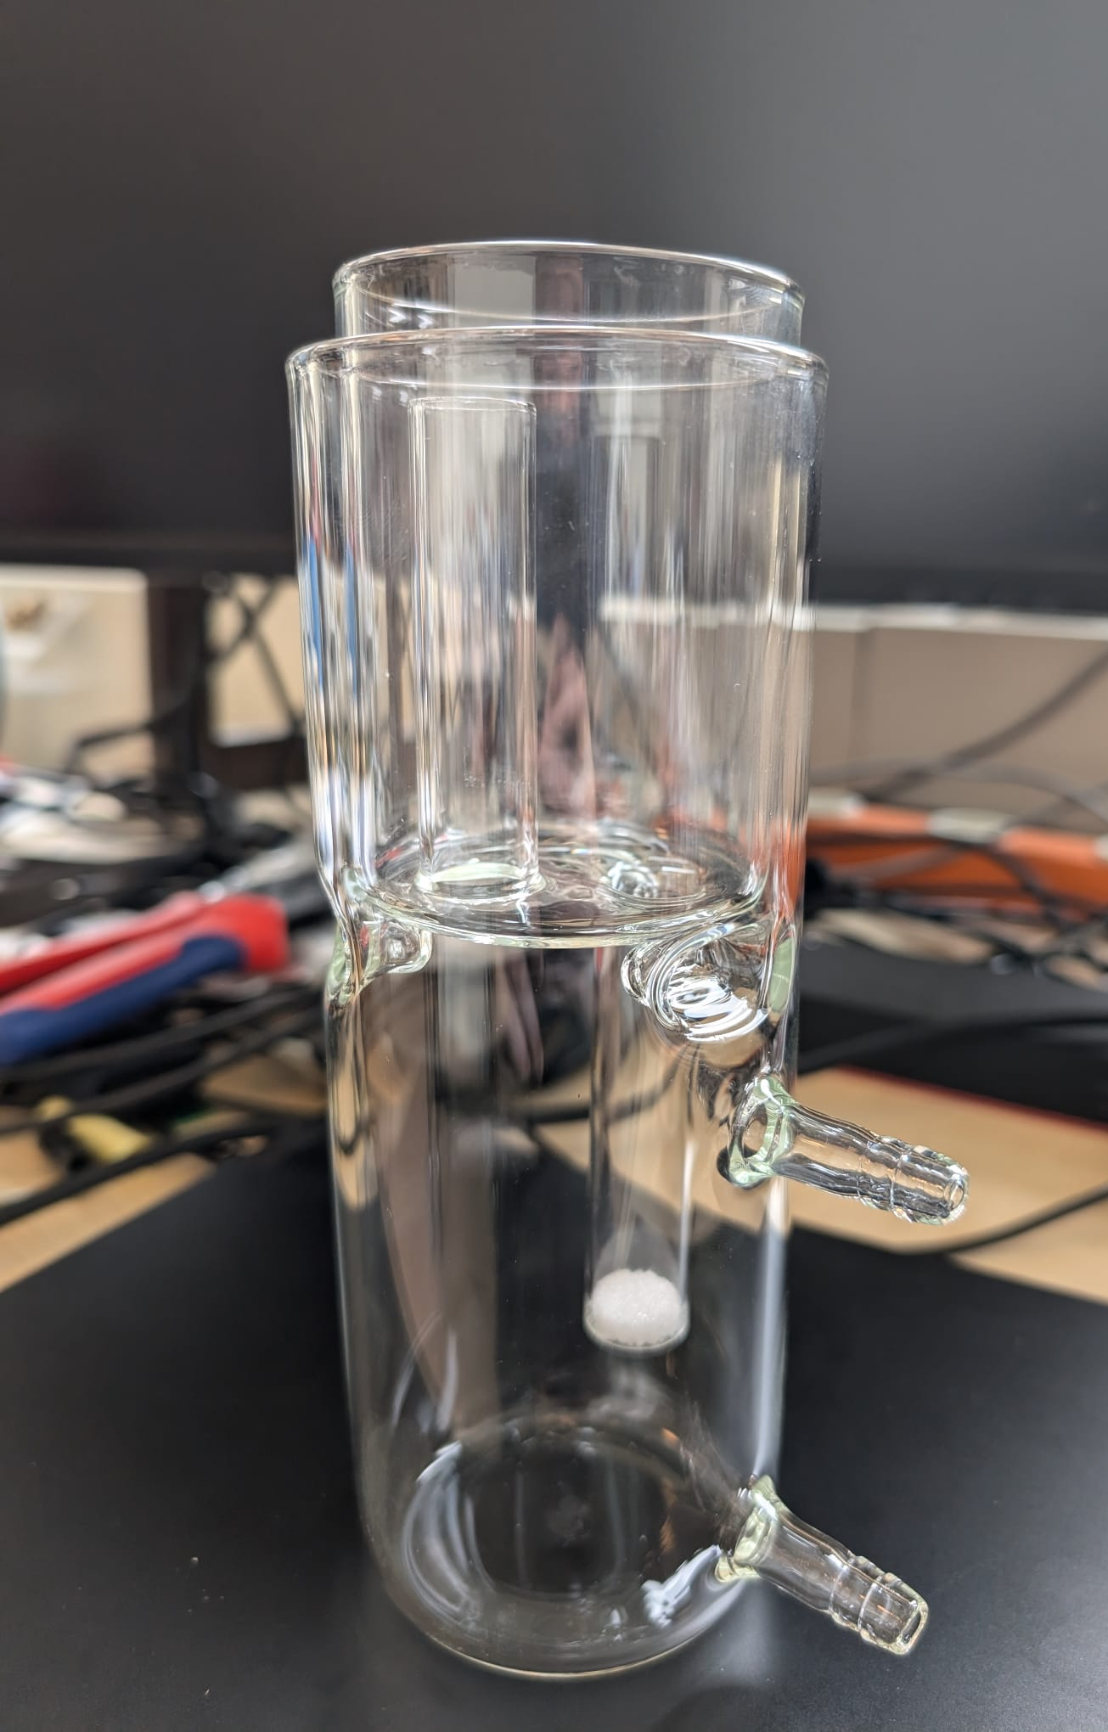
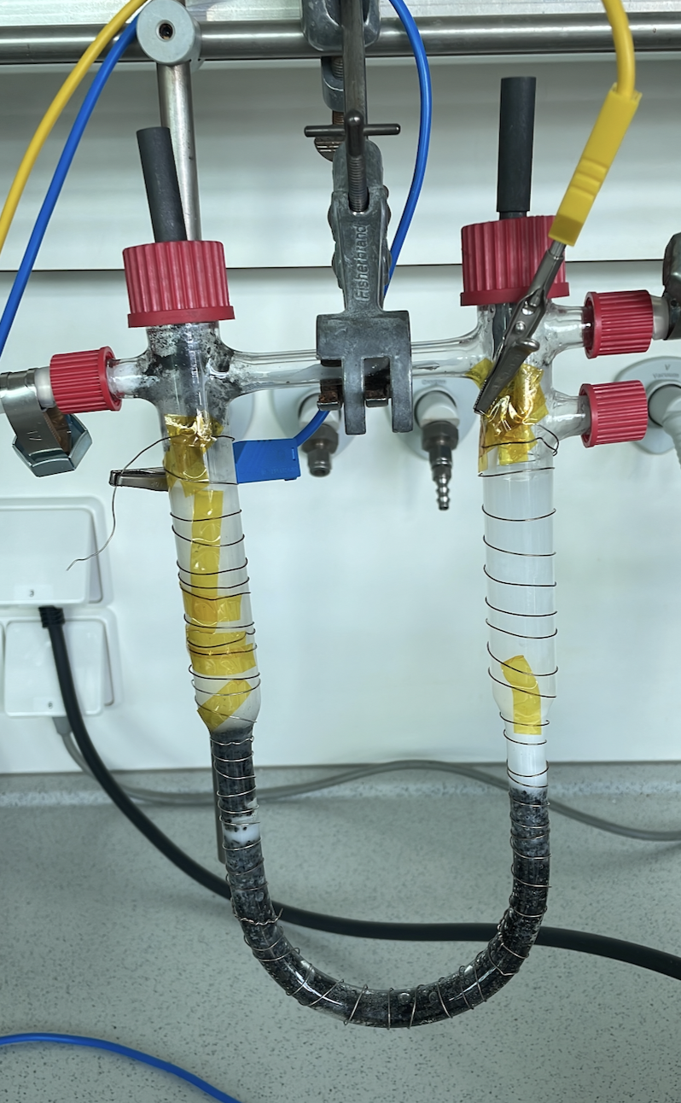
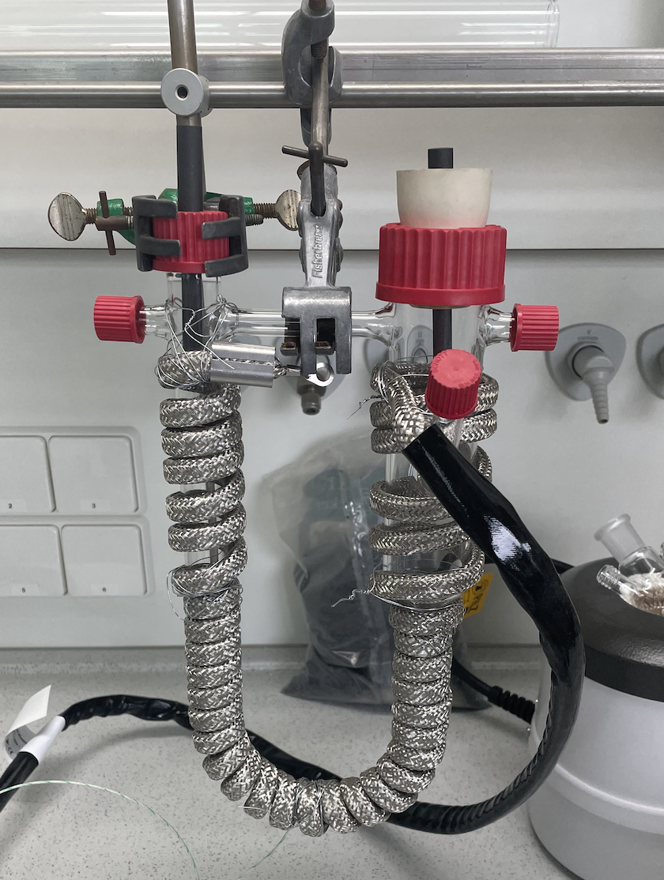
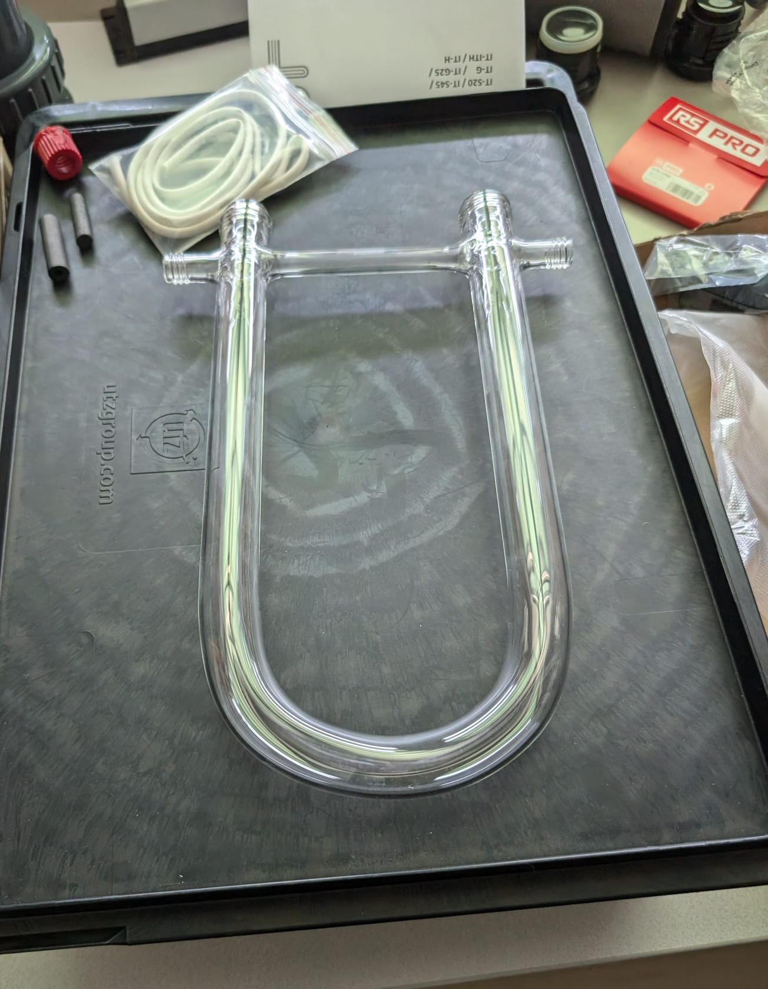
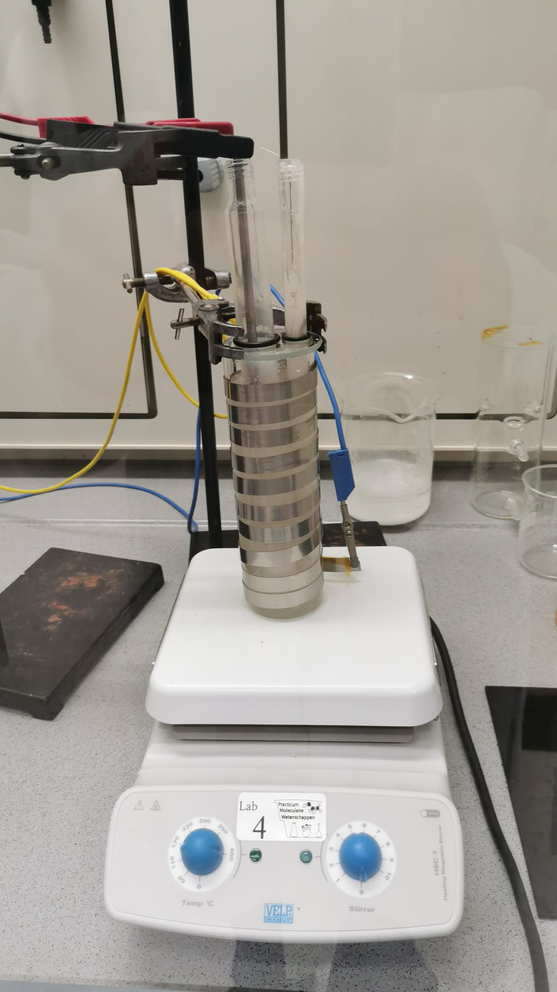
Prototypes
3
2
0
1
4

Slide 16
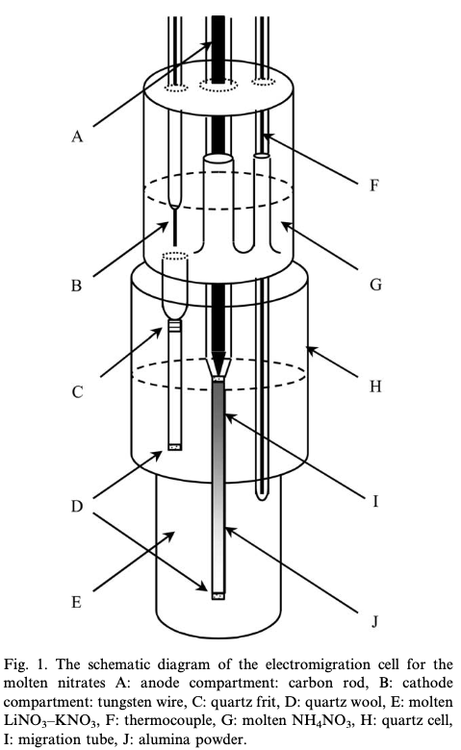
3 reservoir system
New design
3rd reservoir
Cathode reservoir
Donor reservoir
Anode reservoir
Salt with less mobility

Slide 17
Prototype 3
Smaller heating tape
Short filter
Tungsten anode
Temperature gradient
Current unstable (30-600 mA)
Element seperation solved
At least 10% enrichment
3

Slide 18
Testing – Prototype 4
Currently running
Longer filter
More consistent heating
Second copy at Groningen
Aim for more stable running at 200mA or higher

Slide 19
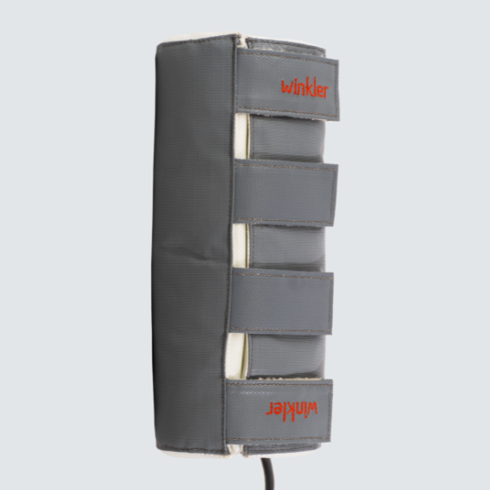
Future plans
10% & 20% enrichment
Temperature control
Optimization
Patent element separation
Rare earth metals

Slide 20
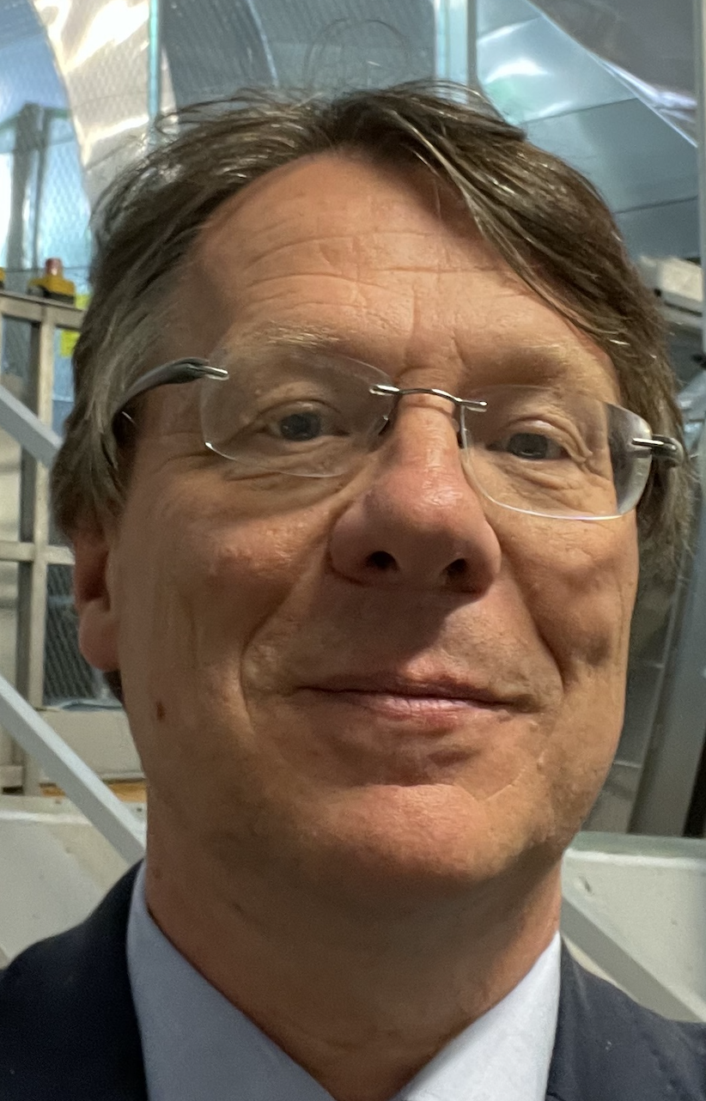
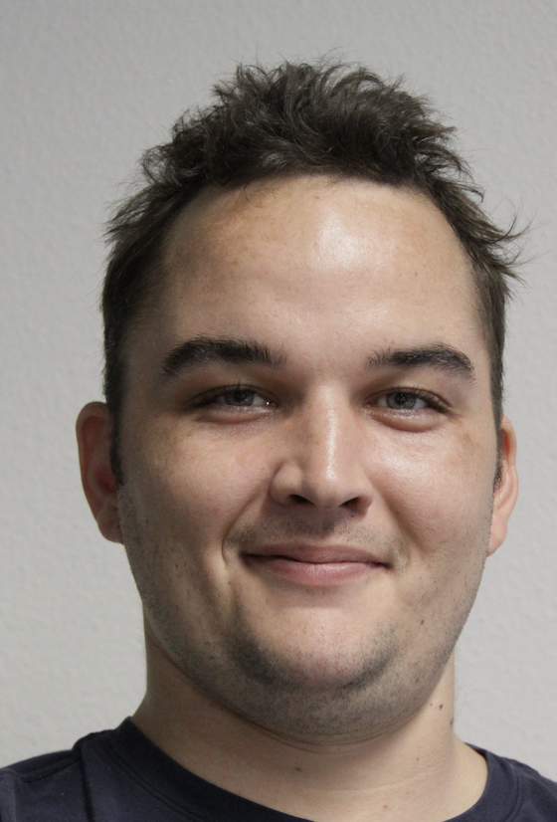
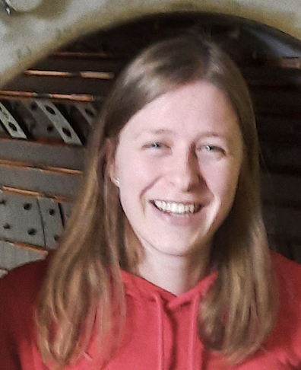
Thanks to the team
RU RUG
Nicolo de Groot Rick van den Bosch Valentina Gonzalez Julia Even
Experimental Physics Engineer Intern Nuclear chemistry
Iris van Veghel Wicher van Bree Luuk van Summeren Lisa van der Werff
KTO Master student Chemistry lab MSc Physics
EINDE

Slide 21
Backup

Slide 22
Barier
The French experiments had currents of ~1A. Our validation experiment had a current of 10mA. We need to scale this up.
We tried two forms of sand as barier material both had their problems. Using Al₂O₃ (60-200μm) made it possible to achieve current of 600mA@100V. Groningen tried pure Al powder. This worked less well. We settle on Al₂O₃, but would move to mesh 80 size (150-200μm)

Slide 23
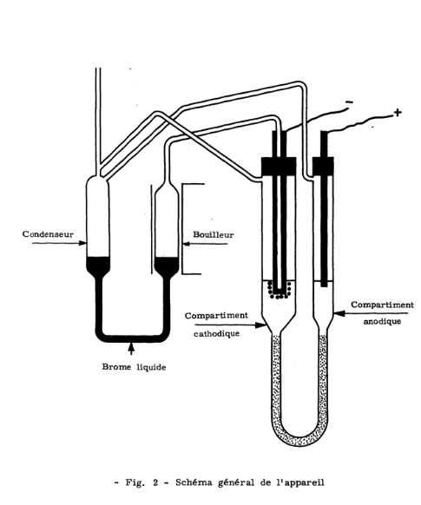
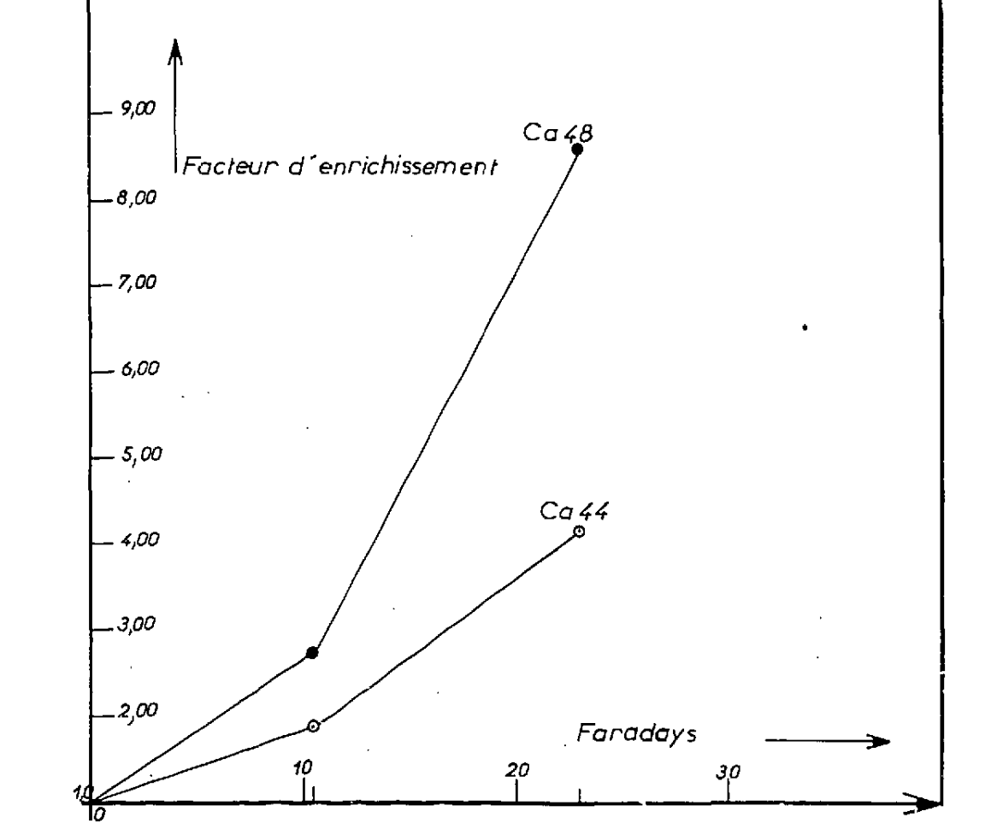
CCEM METHOD
Counter-current electromigration in molten salt
Klemm (1947), Menes (1969). Patent expired.
Maximum enrichment 9x (80V, 2.7A, 3 weeks, 3.3MC)
Menes, CaBr₂, 800ºC
Abandoned:
Corrosive salts
Instable operation
Success with Lithium (1990)

Slide 24
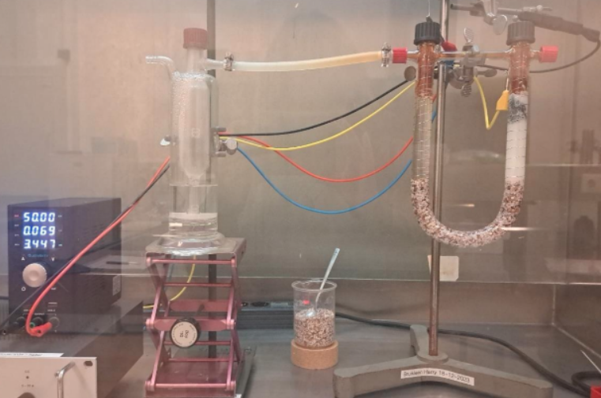
Operational experience - 2
Protoype-3 Groningen:
Using dual electrodes in cathode to improve countercurrent
Works but not perfect
Course filter material
Tried Al powder
Current 100-250mA@70V
Move to Al₂O₃ and 3 reservoirs

Slide 25
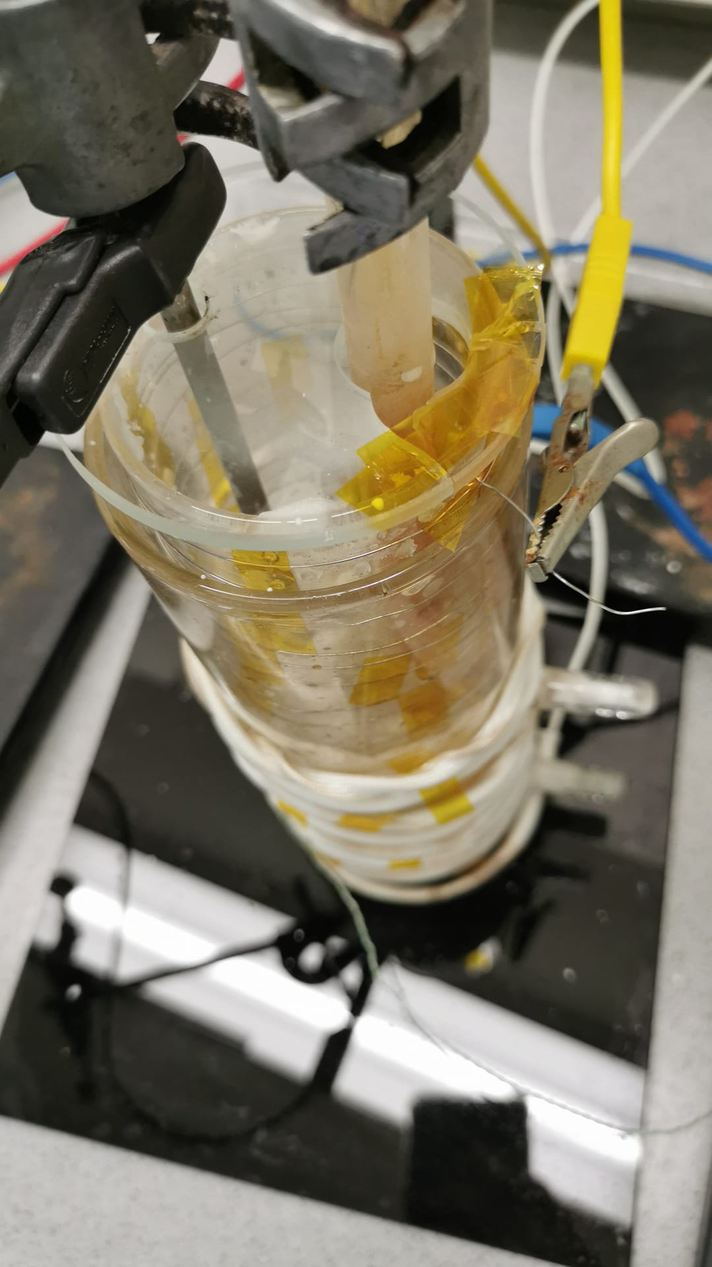
Operational experience
Prototype-2 (Nijmegen):
Several weeks running
NH₄NO₃ solves a lot of problems
Homogenic heating is problematic
Filter too short for large enrichment factor (4cm)
Interruptions:
Top of anode solidifying (increase )
Bubbles (add K/Na to anode)
Clogging of P0 filter?
Current varying (30-600mA)
6 days of running (50% interrupted) 25/9-1/10 5% enrichment ⁴⁸Ca/⁴⁴Ca → ~ 10% ⁴⁸Ca/⁴⁰Ca

Slide 26
PRODUCTION CHAIN RADIOLOGY ISOTOPES
Source material
Enrichment
(calutron, laser, centrifuge)
Irradiate
(cyclotron or nuclear plant)
Separation
(chemical)
Transport
Source material
Enrichment
(calutron, laser, centrifuge)
Irradiate
(cyclotron of nuclear plant)
Separation
(chemical)
Transport
Pre-enrichment (Demonstrator)

Slide 27
Interpretation 2018 RU experiment
Using some assumptions one can calculate the seperation factor (Menes, 68):
$$ε=\frac{\left(v_{1}−v_{2}\right)}{\left(v_{2}\right)}$$
We find: $\frac{x_{1}}{x_{0}}=1+\frac{Q_{e}}{Q_{a}}ϵ$
Putting in the numbers we get $ε=0.07 −0.11$
Order of magnitude higher than literature using CaBr
Start-up effect which will saturate with more Q?
Boost from asymmetric mixture?
Effect from low-current / tight filter?
Lower temperature?

