Slide 1
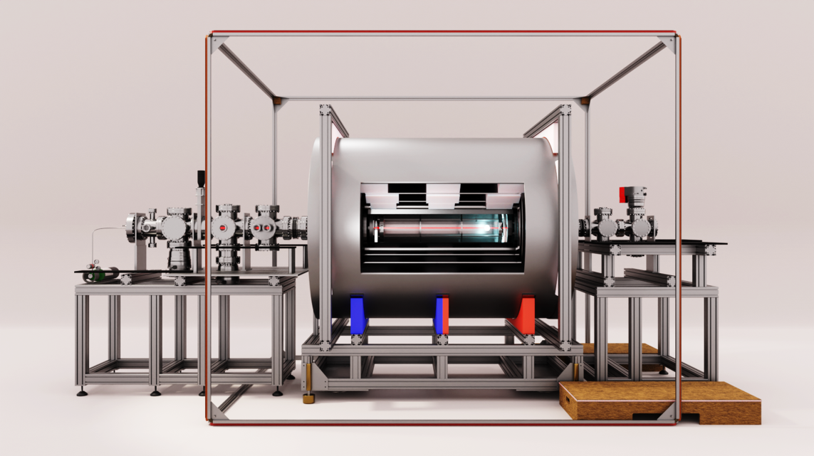


Current state and future prospects of the NL-eEDM experiment
Jelmer Levenga
NNV section for (astro)particle physics fall meeting
8-11-2024
Anno Touwen

Slide 2
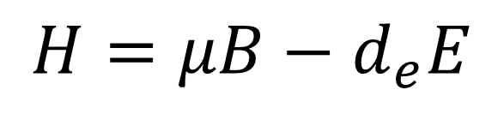

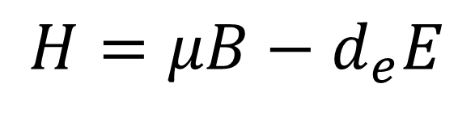
The permanent electron electric dipole moment eEDM
Dipole moments -> linear energy shifts with electric/magnetic fields
$$H=μB+d_{e}E$$
T
P
$$H=μB−d_{e}E$$
$$H=μB−d_{e}E$$
Within molecules enhancement $d_{e}→ D^{P,T}$ ~ ${10}^{6} d_{e}$ for BaF
Measuring the electric dipole moment of the electron in BaF. / The NL-eEDM collaboration. In: The European Physical Journal D, Vol. 72, No. 11, 197, 20.11.2018.

Slide 3

Importance of eEDM
Measure of CP violation
  Neutron, electron, …
Beyond the standard model physics
CP Violation in SM > 10⁻³⁸ ecm
Current best Limits
eEDM limit JILA 4.1×10⁻³⁰ e⋅cm HfF+
eEDM limit ACME II 1.1×10⁻²⁹ e⋅cm ThO
Anno Touwen

Slide 4









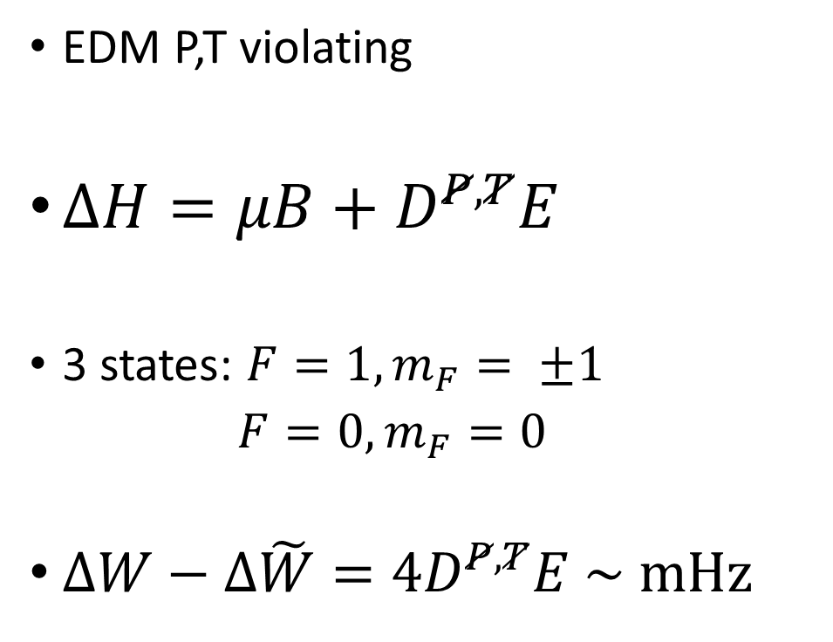














Symmetry breaking
$$D^{P,T}E$$
$$M_{F}=+1$$
$$μB$$
EDM P,T violating
$ΔH=μB+D^{P,T}E$
3 states: $F=1, m_{F}= ±1$
$F=0, m_{F}=0$
$ΔW−Δ\tilde{W}={4D}^{P,T}E \sim mHz$
$$μB$$
$$M_{F}=+1$$
$$D^{P,T}E$$
$$E_{0}$$
$$E_{0}$$
Energy
$$E_{0}$$
$$E_{0}$$
$$M_{F}=0$$
$$M_{F}=0$$
$$D^{P,T}E$$
$$μB$$
$$μB$$
$$M_{F}=−1$$
$$D^{P,T}E$$
$$M_{F}=−1$$
$$μB \sim 100 Hz$$
$$B$$
$$E$$
$$B$$
$$E$$

Slide 5



$B=10 μT$
$B \sim nT$
$$E∼kV/cm$$
Counter-propagating laser beams
Supersonic beam source
Glass tube with electric field plates
Magnetic shield
5 mu-metal layers

Slide 6
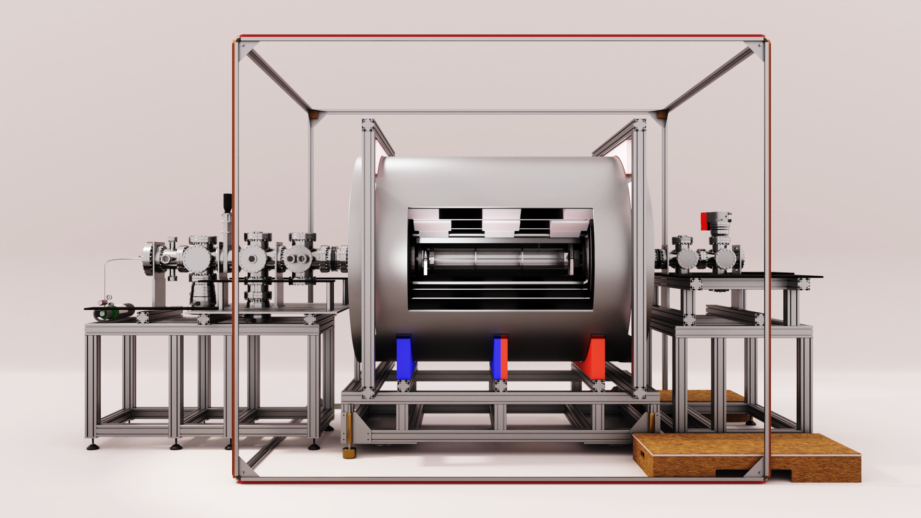


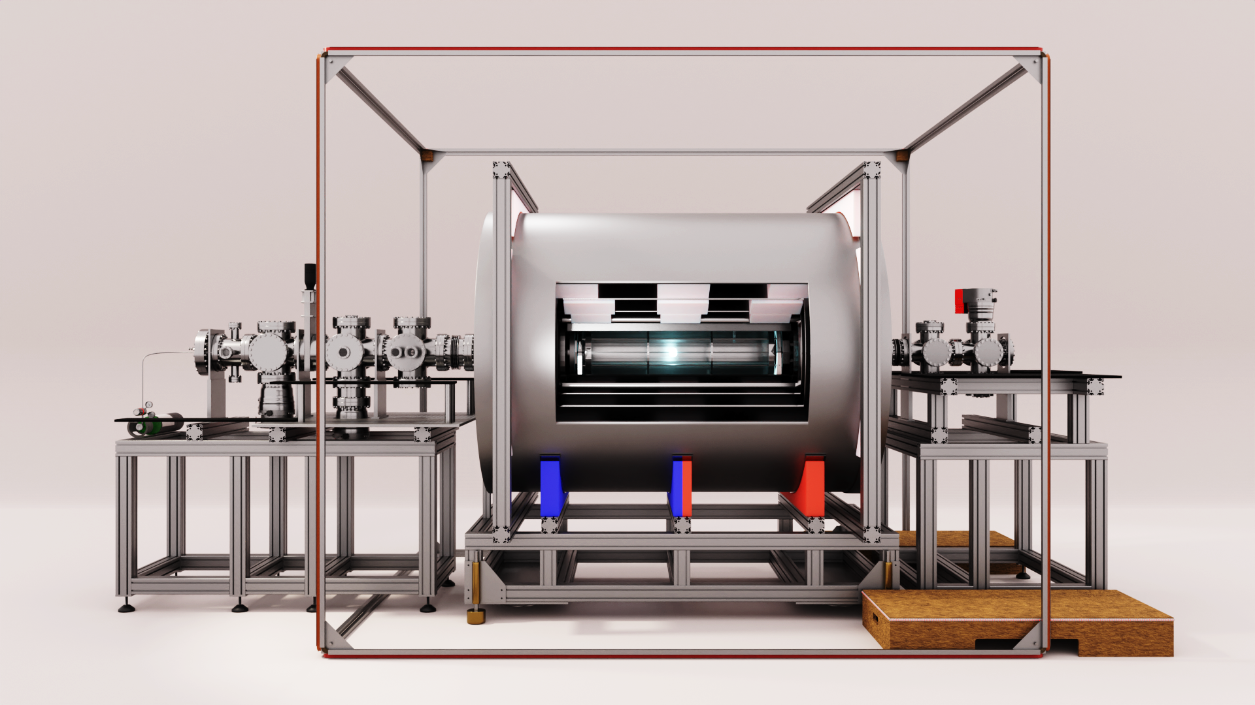

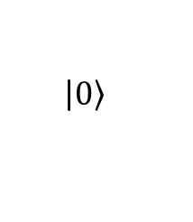

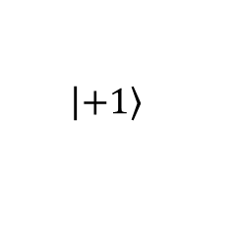
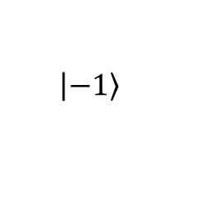


Spin precession
Supersonic source
Pumping
Spin precession
Detection
$$F=1$$
$$\left|\left.−1\right\rangle \right.$$
$$\left|\left.+1\right\rangle \right.$$
$$F=0$$
$$\left|\left.0\right\rangle \right.$$
Precession
$$P_{\left|\left.1\right\rangle \right.}∝\sin^{2}{(θ)}$$
$$θ=\left(μB+D^{P,T}E\right)T/ℏ$$

Slide 7
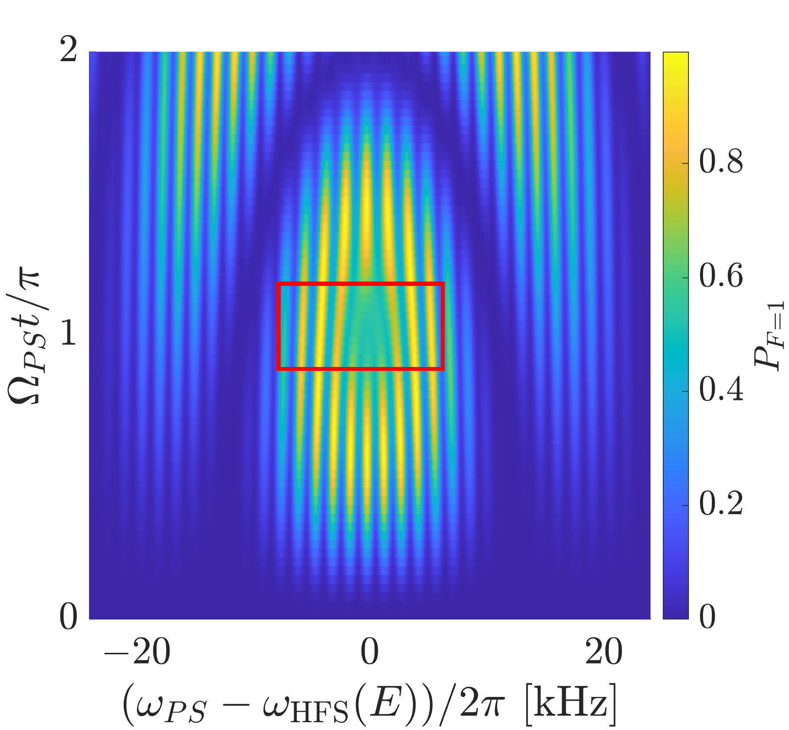

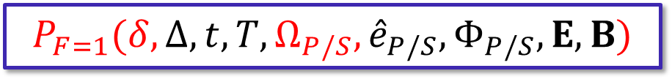
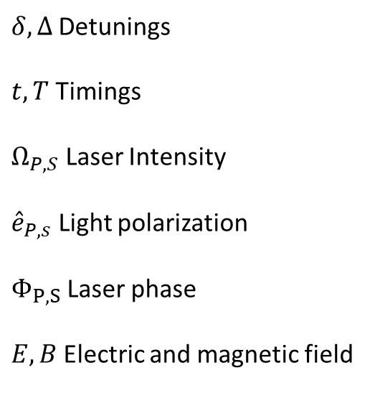


Signal
$$P_{\left|\left.1\right\rangle \right.}∝\sin^{2}{(θ)}$$
$$P_{F=1}(δ, Δ,{t,T, Ω}_{P/S},{\hat{e}}_{P/S},Φ_{P/S},E,B)$$
$δ, Δ$Detunings
$t,T$ Timings
$Ω_{P,S}$ Laser Intensity
${\hat{e}}_{P,s}$ Light polarization
$Φ_{P,S}$Laser phase
$E,B$Electric and magnetic field
Laser intensity
$$detuning δ$$
Boeschoten, A., et al. ‘Spin-Precession Method for Sensitive Electric Dipole Moment Searches’. Phys Rev A L010801.

Slide 8
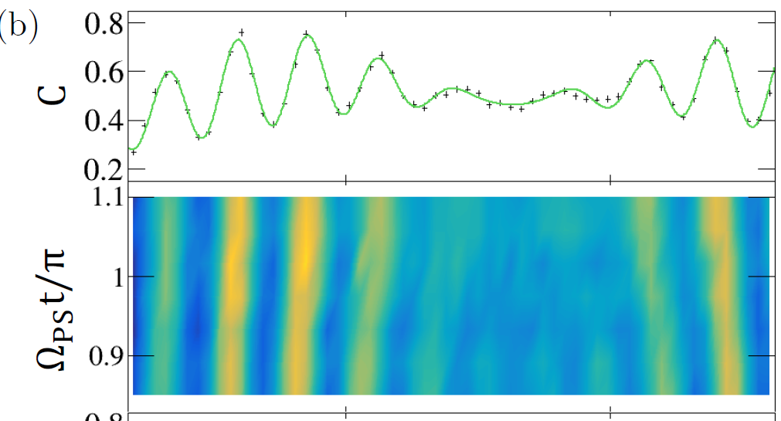
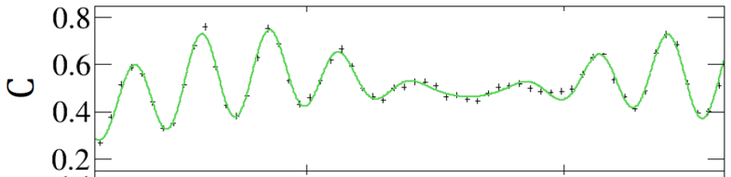
Measurement
Calculated prediction lines up very well
with measurement
Error bars due to counting statistic
Future: More data
Smaller error bars permits identification
of systemic biases
Key requirement for such
precision experiments
Boeschoten, Alexander. ‘Precision Measurements in Diatomic Molecules: A Route to a Permanent Electric Dipole Moment’. PhD Thesis, University of Groningen, 2023.

Slide 9


Disentangling the EDM
$P_{F=1}\left(δ, Δ,t,T,Ω_{P/S},{\hat{e}}_{P/S},Φ_{P/S}, B,E\right)$ $∝\sin^{2}\left(θ\right)$
$θ=2(μB+D^{P,T}E)T$
Systematic change of E distinguishable
Changing E
$$δ/2π [kHz]$$
Changing $θ$
$$δ/2π [kHz]$$

Slide 10
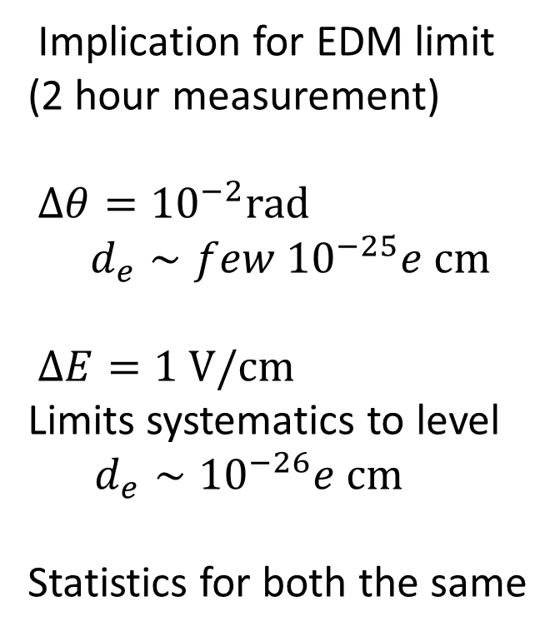

Measured signals
Implication for EDM limit
(2 hour measurement)
$Δθ={10}^{−2}rad$
  $$d_{e}∼few {10}^{−25}e cm$$
$ΔE=1 V/cm$
Limits systematics to level
  $$d_{e}∼{10}^{−26}e cm$$
Statistics for both the same
$$\left(δ+ω_{HFS}\right)/2π [MHz]$$
28

Slide 11
Conclusion status
Completed experimental checkup
Developed signal description for
analysis
systematics
Collected first data
What next?

Slide 12
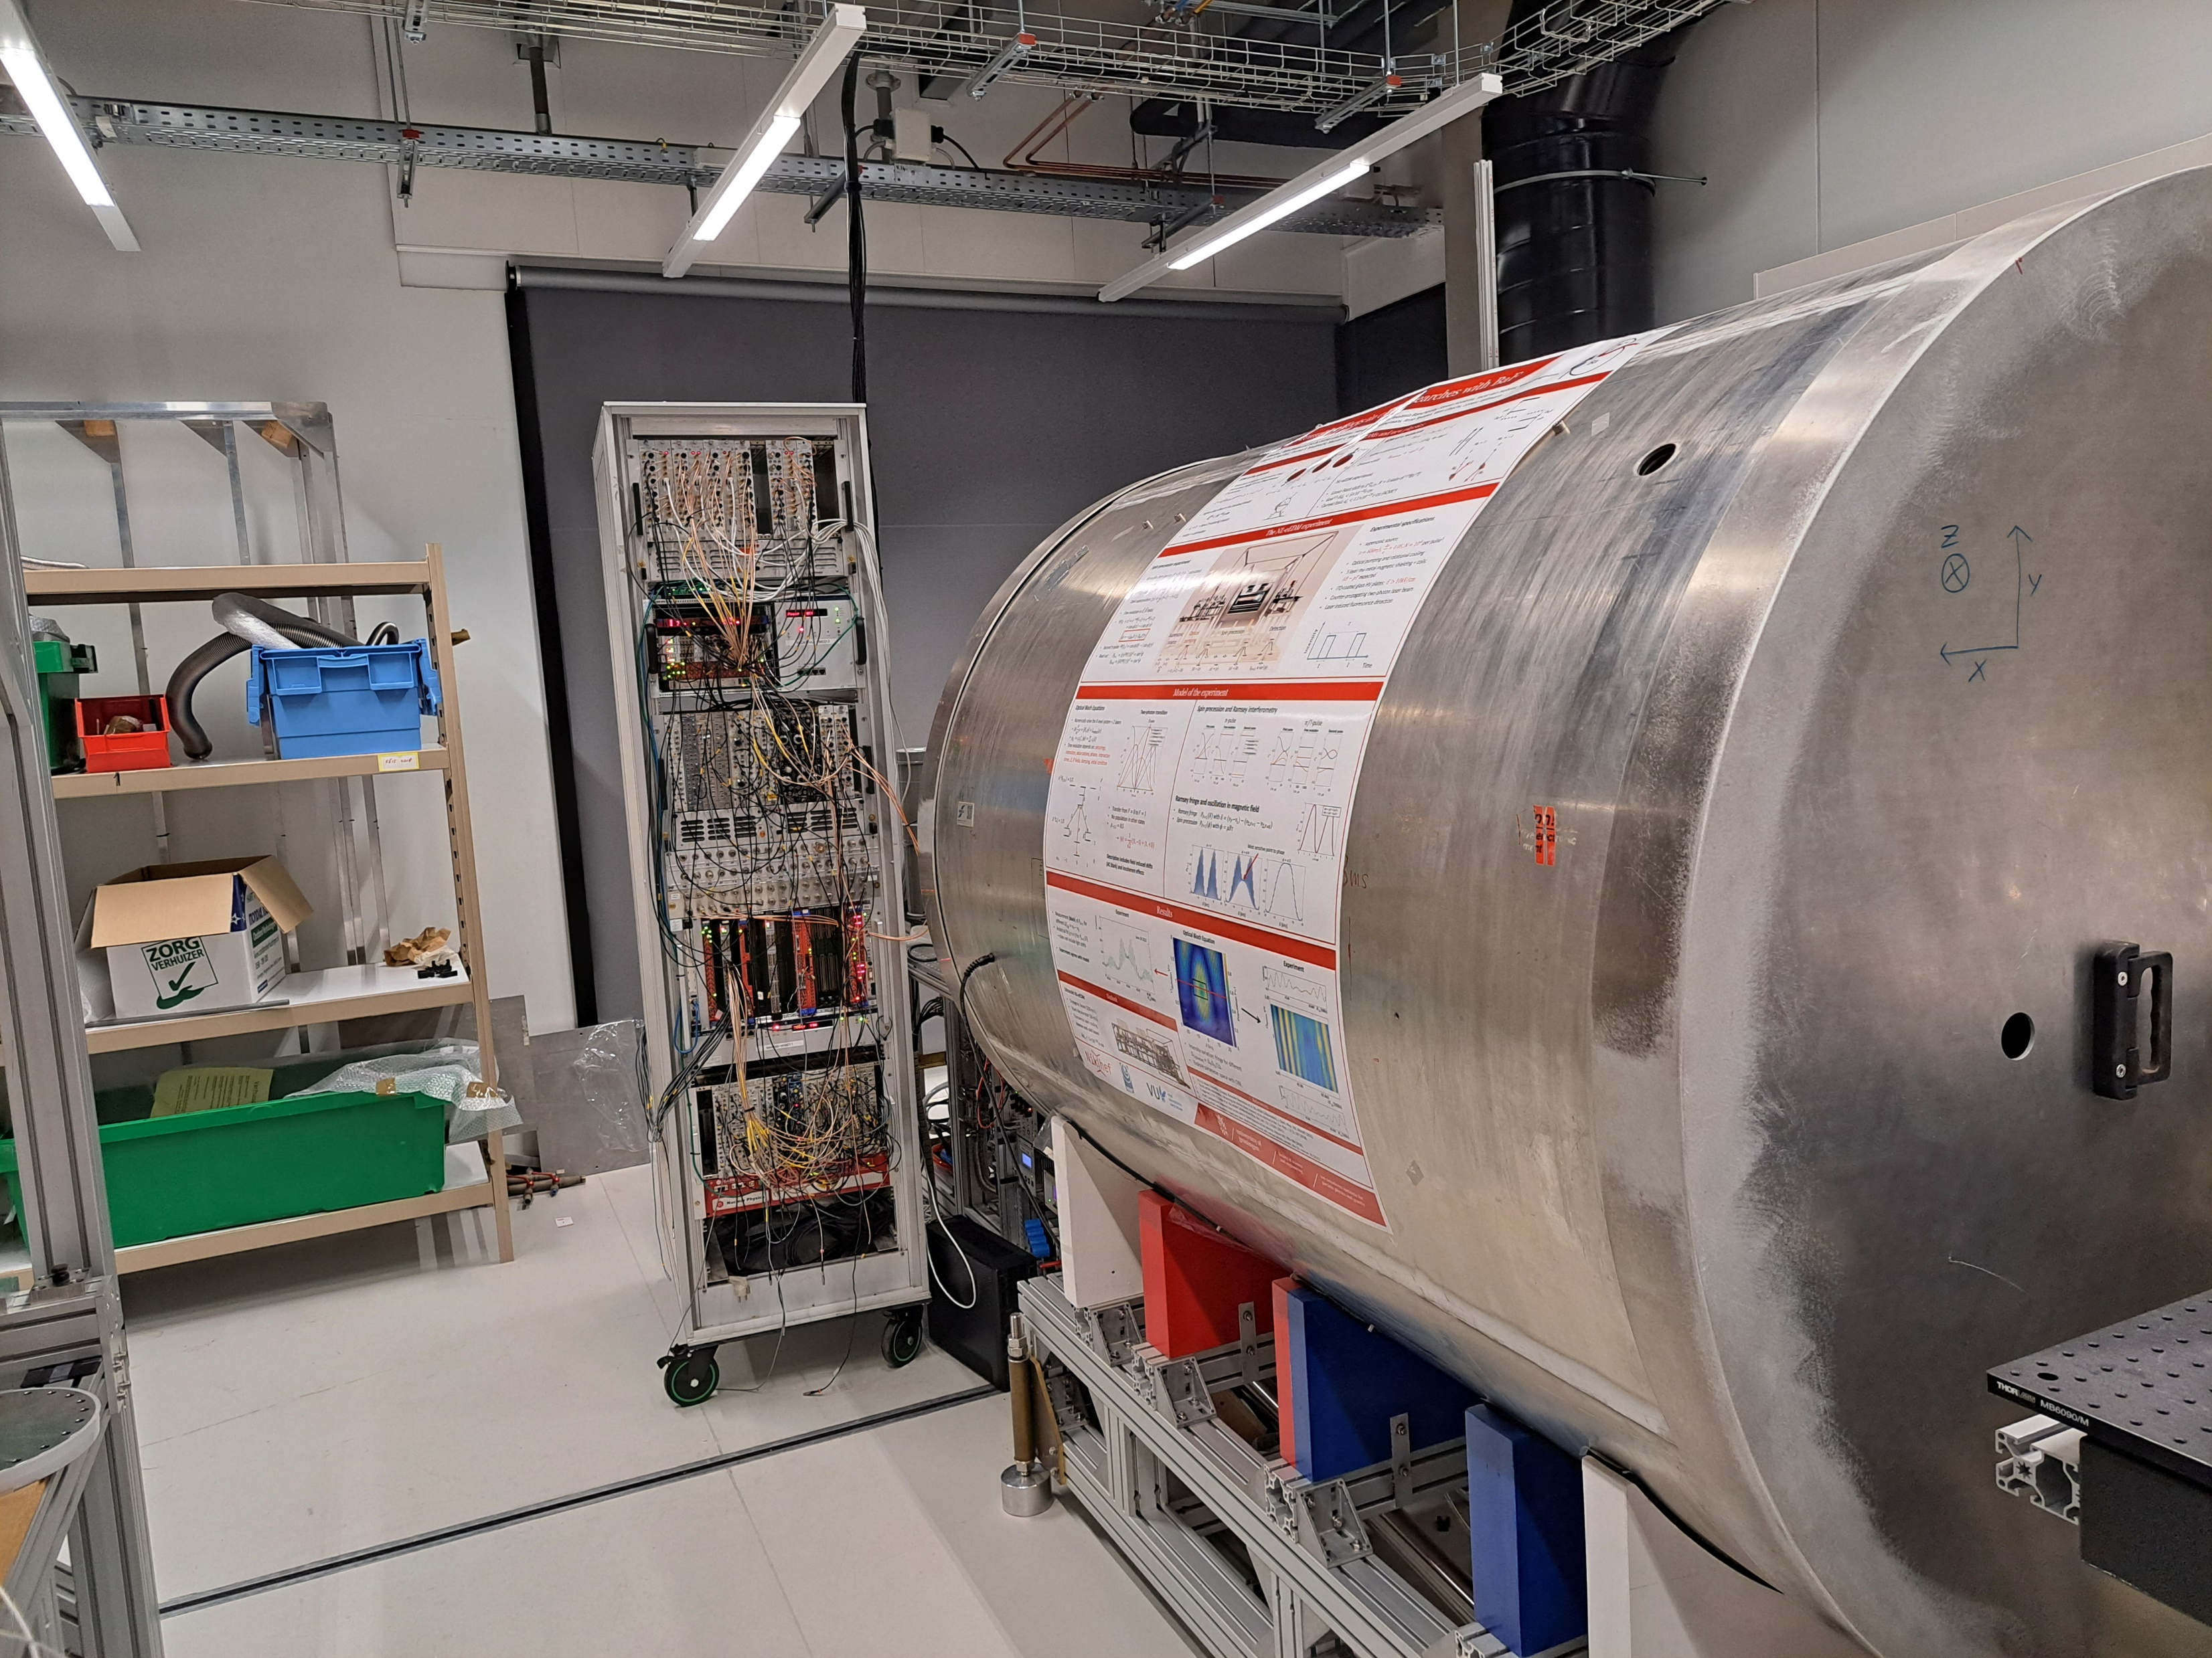
In new lab!

Slide 13
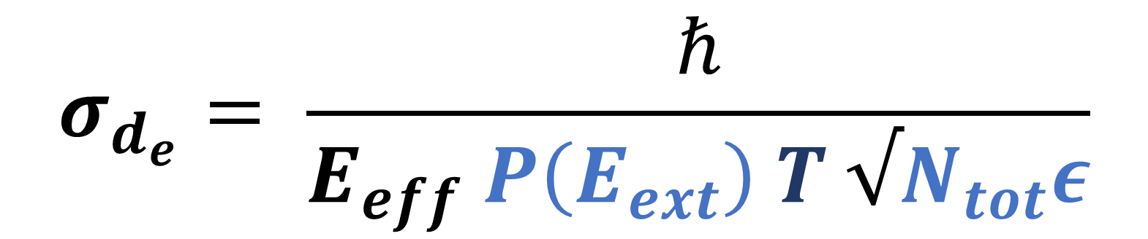
Experimental Sensitivity
$$σ_{d_{e}}= \frac{ℏ}{E_{eff} P\left(E_{ext}\right) T √N_{tot}ε}$$
Molecular parameter:
Enhancement 6.5 GV/cm
Coherence time
Polarization in external field
Total number of measurable particles
Efficiency: Fraction
of measured particles

Slide 14
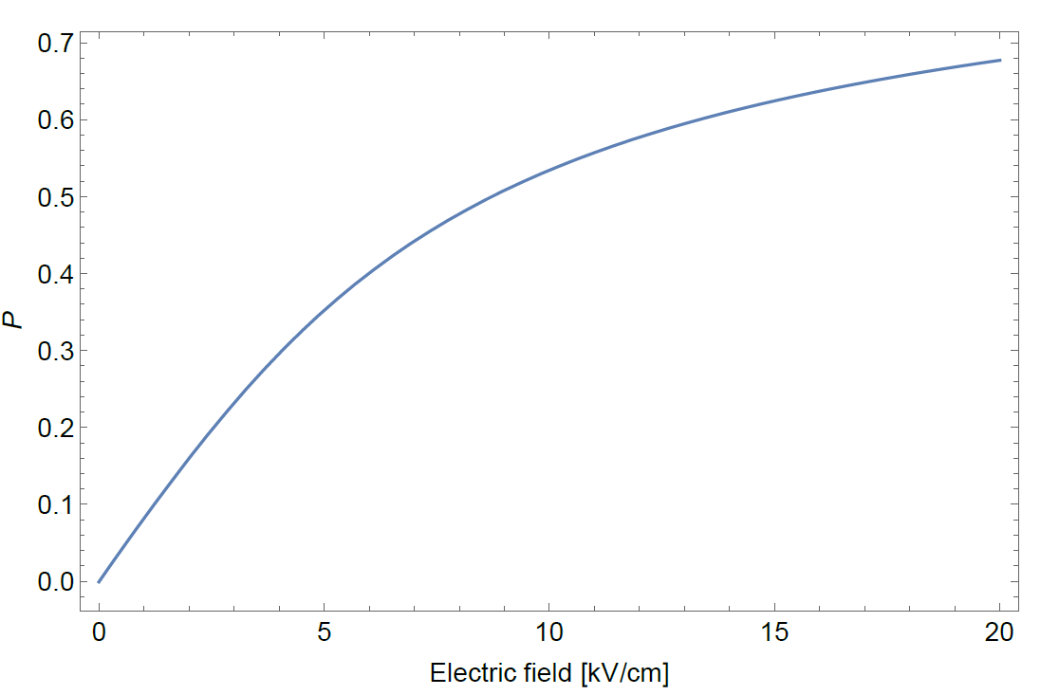
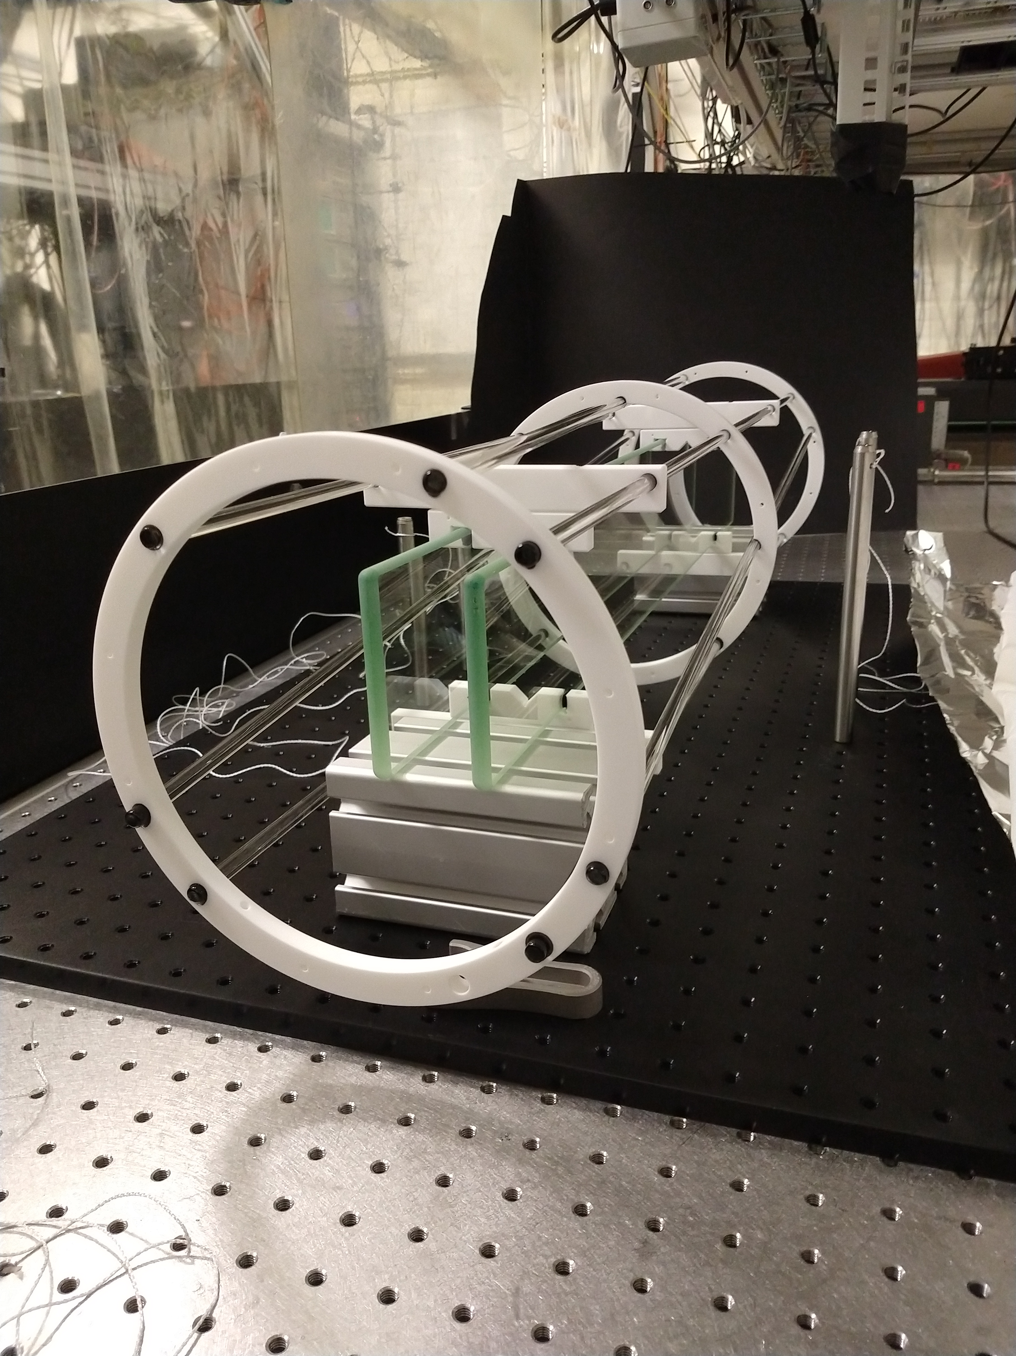
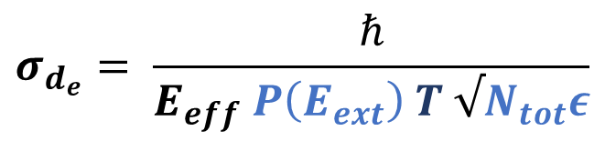
Increasing external electric field strength
Polarization
Polarization as a function
of the external field
factor 3 increased
sensitivity
(E)
$$σ_{d_{e}}= \frac{ℏ}{E_{eff} P\left(E_{ext}\right) T √N_{tot}ε}$$

Slide 15
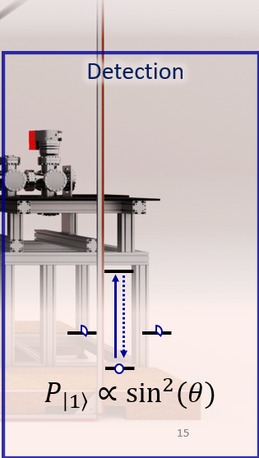
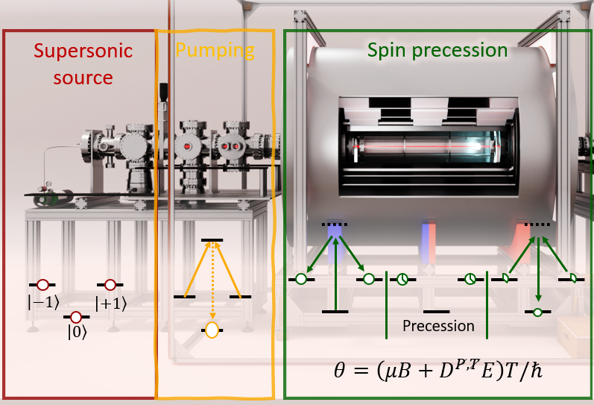

Addressing light collection
Now ${1: 10}^{3}$ molecules seen
PMT 10% Q.E -> Silicon APD’s up to 65% Q.E.
Increase solid angle from ${10}^{−2} of 4 π$
Other optical transitions
$$σ_{d_{e}}= \frac{ℏ}{E_{eff} P\left(E_{ext}\right) T √N_{tot}ε}$$

Slide 16
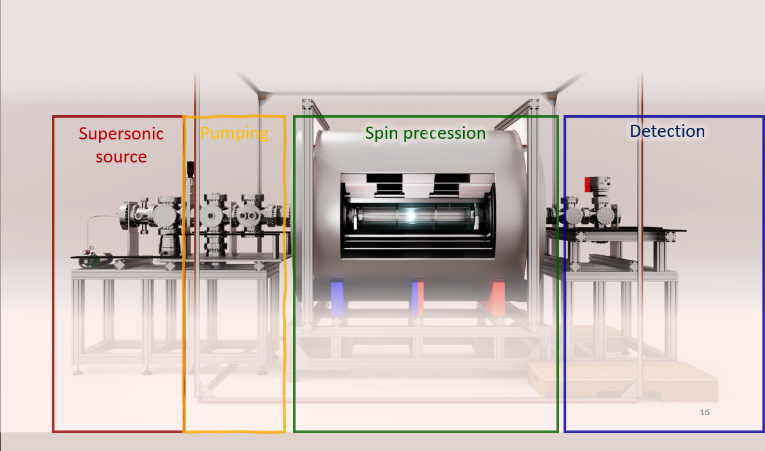
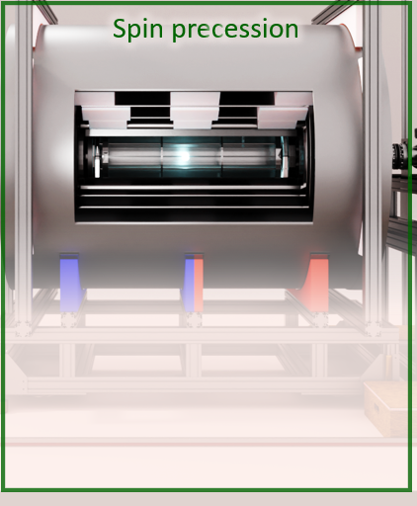
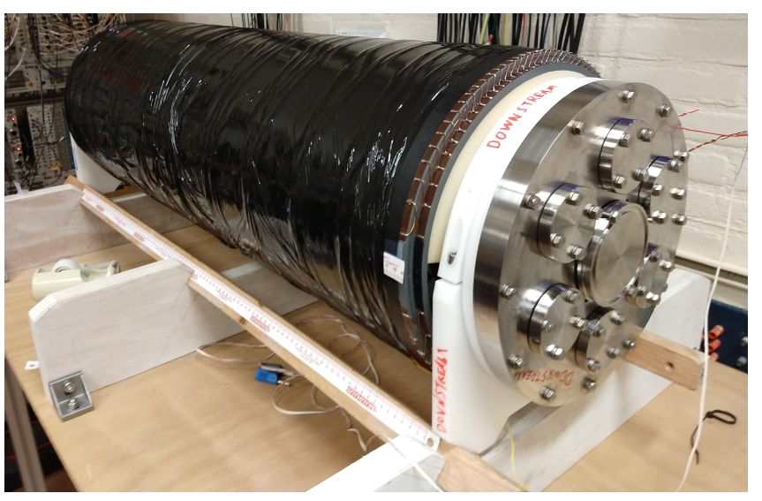
Systematics and the magnetic field
Better magnetic field
control
Cosine coil for biased field
on the order of ~ nT
Magnetic field map < nT

Slide 17
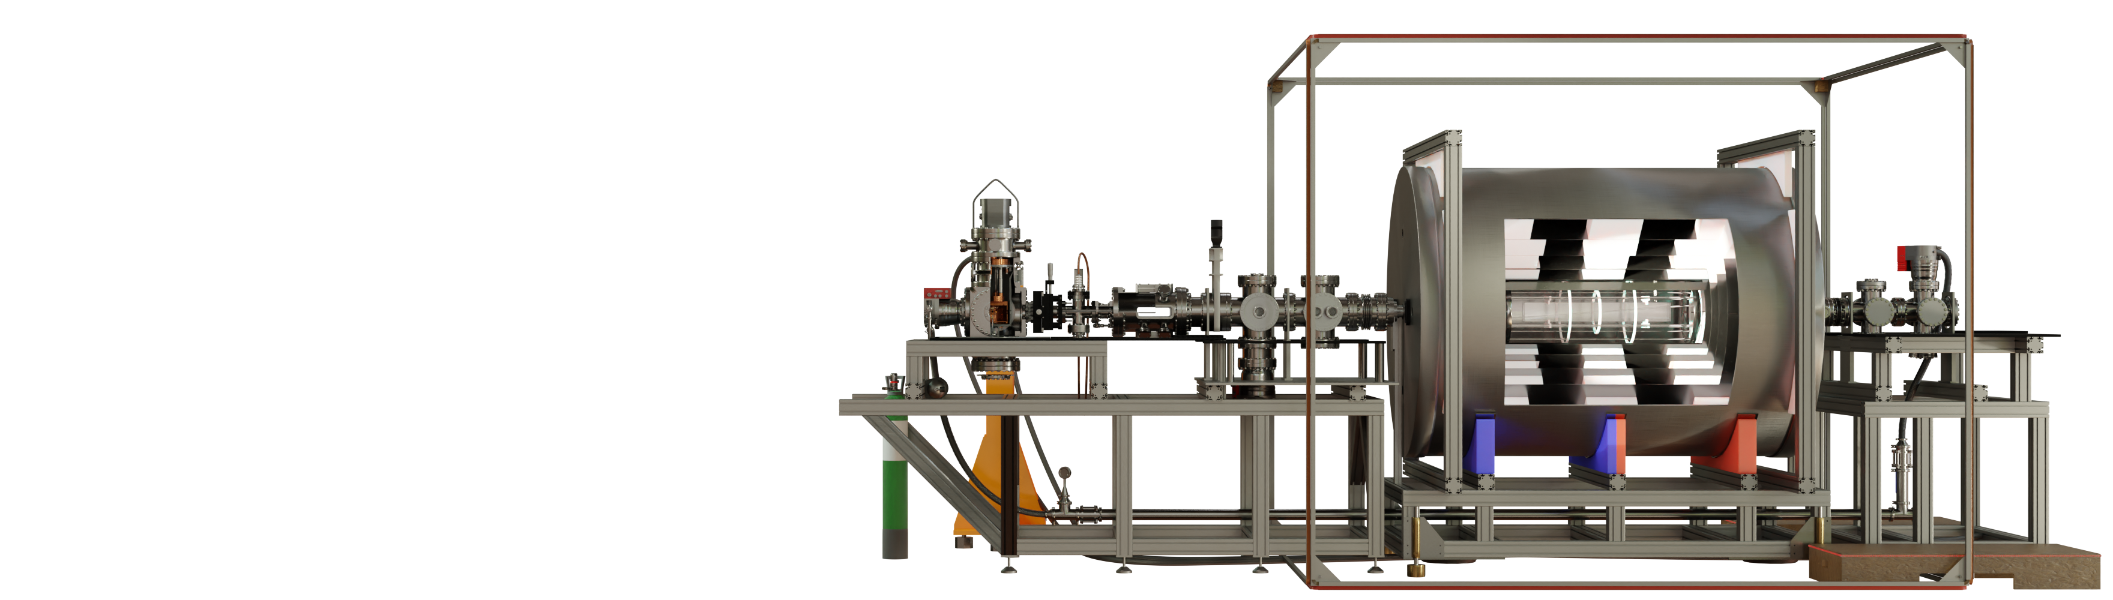
Long term improvements
More, slower molecules
Laser cooled source
Expected ~100x higher flux
Joost van Hofslot at Nikhef Jamboree
$$σ_{d_{e}}= \frac{ℏ}{E_{eff} P\left(E_{ext}\right) T √N_{tot}ε}$$

Slide 18
Conclusion
EDM measurement requires well defined symmetries
NL-eEDM experiment:
  Optically implemented spin precession
  Well understood measurement process
Novel spin-precession methods provides desired information
Improvements in statistics and experimental control provide for order of magnitude improvement

Slide 19
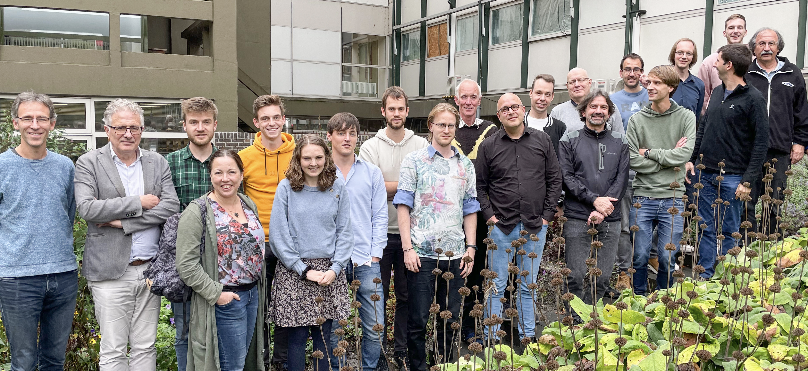
The NL-eEDM team
  Alexander Boeschoten
  Joost van Hofslot
  Virginia Marshall
  Thomas Meijknecht
  Maarten Mooij
  Anno Touwen
  Jelmer Levenga
  Bastiaan Nijman
  Heleen Mulder
  Ties Fikkers
  Nitesh Balasubramanian
  Bart Schellenberg
  Lucas van Slooten
  Pi Haase
  Parul Aggarwal
  Kevin Esajas
  Yanning Yin
  Malika Denis
  Roman Bause
  Anastasia Borschevsky
  Hendrick Bethlem
  Steven Hoekstra
  Steve Jones
  Klaus Jungmann
  Rob Timmermans
  Wim Ubachs
  Lorenz Willmann
  Jordy de Vries
Technical support:
  Leo Huisman
  Oliver Böll
Picture of the team with unfortunately not every current member present

Slide 20
Thank You

Slide 21
Backup Slides

Slide 22
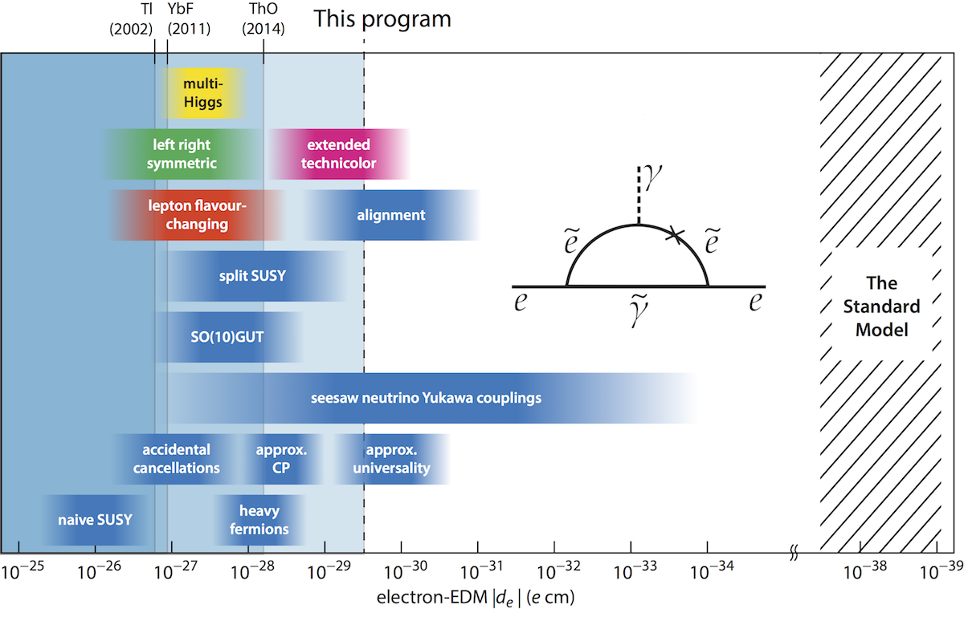
EDM and theory
CP violation
Strongly
Correlated to theory
RUG Van Swinderen Instituut, accessed 16-10-2024 at https://www.rug.nl/research/vsi/newtopics/electron-edm?lang=en.

Slide 23


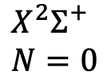


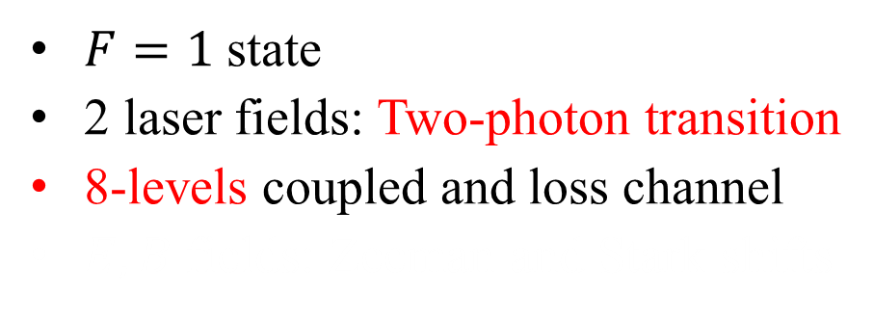






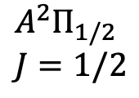


Coupled multi-level system
$$A^{2}Π_{1/2} \\ J=1/2$$
$$F=1$$
$$F=0$$
$$Δ$$
$$Ω_{S}$$
$$Ω_{S}$$
$$Ω_{P}$$
$$F=1$$
$$δ$$
$$X^{2}Σ^{+} \\ N=0$$
$$F=0$$
$F=1$state
2 laser fields: Two-photon transition
8-levels coupled and loss channel
$E, B$fields: Zeeman and Stark shifts
$$m_{F}=−1$$
$$0$$
$$1$$

Slide 24
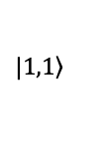


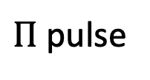
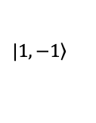
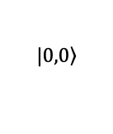

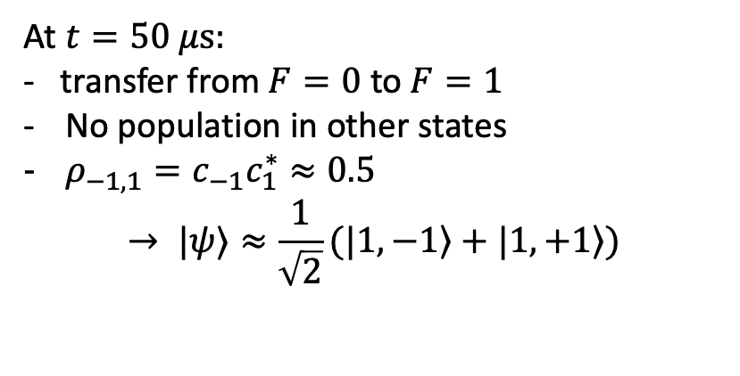
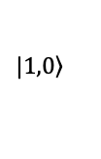
Superposition creation
$$Δ$$
Laser parameters:
  $Δ=−1 GHz$
  $δ=0$
  $I_{P}=I_{S}=40I_{sat}$
$→$ Rabi oscillations
$$δ$$
$$|\left.1,−1\right\rangle$$
$$|\left.1,0\right\rangle$$
$$|\left.1,1\right\rangle$$
$Π$ pulse
$$|\left.0,0\right\rangle$$
At $t=50 μs:$
- transfer from $F=0$ to $F=1$
No population in other states
$ρ_{−1,1}=c_{−1}c_{1}^{∗}≈0.5$
$→ |ψ⟩≈\frac{1}{\sqrt{2}}(|\left.1,−1\right\rangle +|\left.1,+1\right\rangle )$

