Slide 1




TrackHHL: LHCb Track Reconstruction using novel quantum algorithms
Xenofon Chiotopoulos
xenofon.chiotopoulos@maastrichtuniversity.nl
NNV Section for (astro)particle physics fall meeting

Slide 2

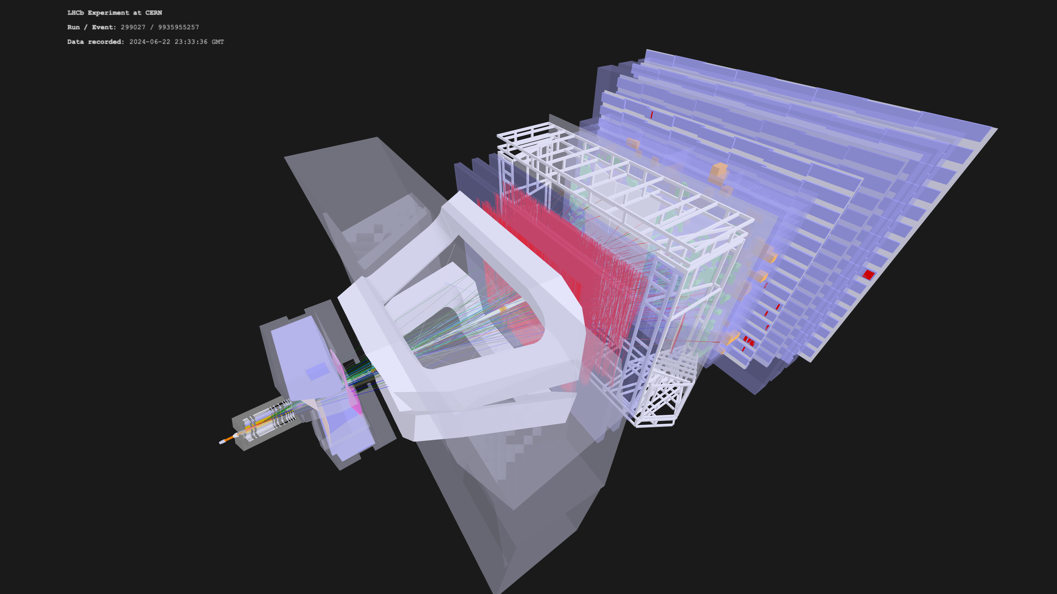
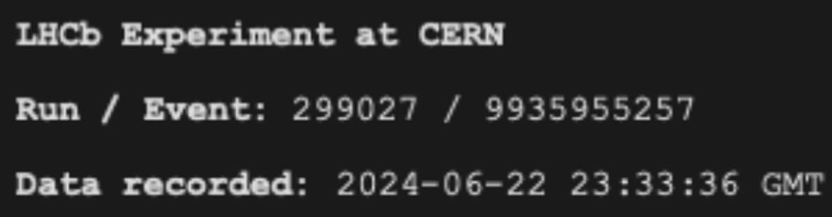




Slide 3
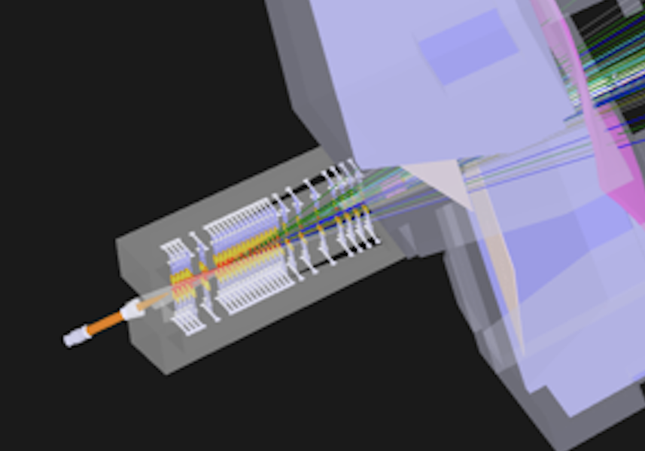

Slide 4
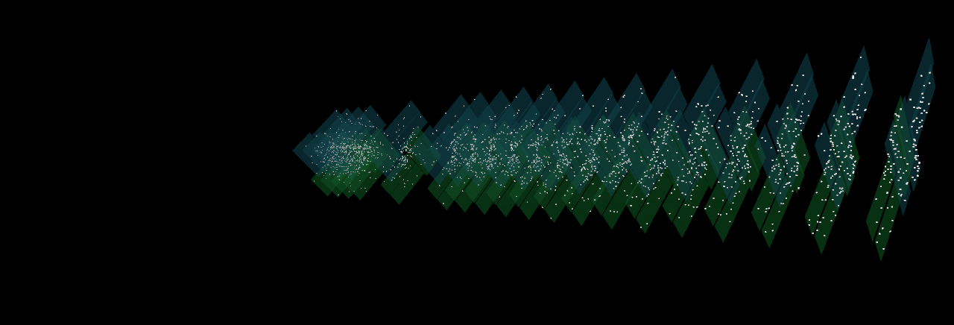
Hits in the VELO
Creator: Davide Nicotra

Slide 5
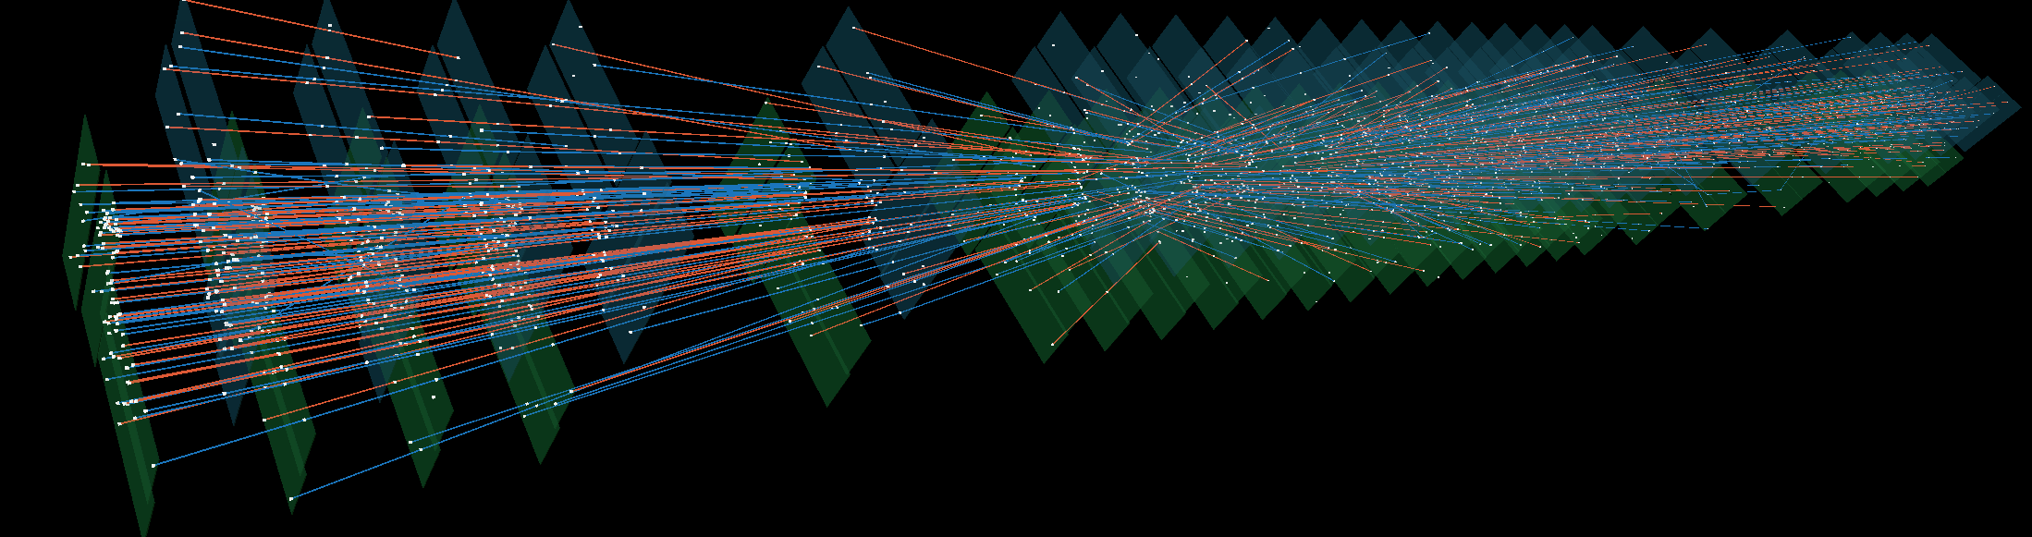
Tracks in the VELO
Particle “tracks”
Creator: Davide Nicotra

Slide 6
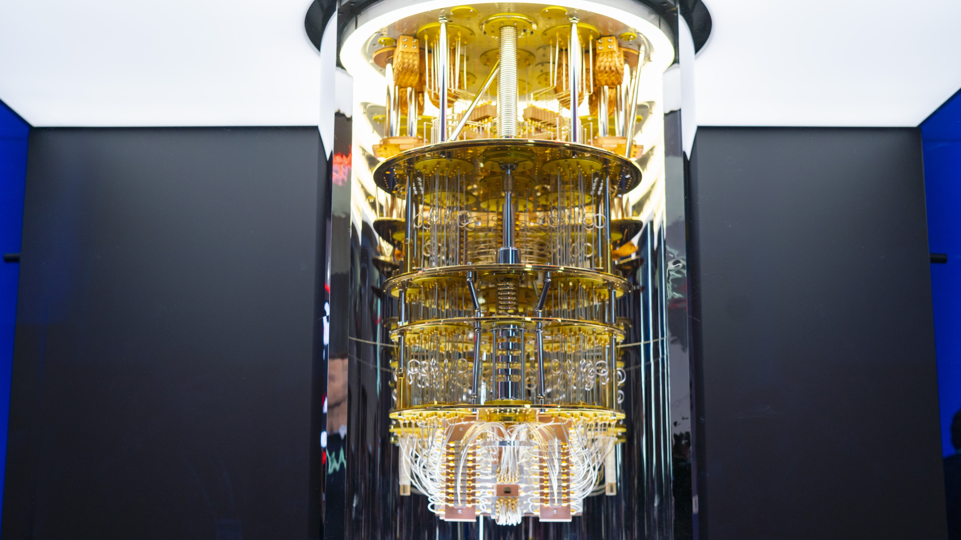
New Quantum Computing algorithm for Track Reconstruction

Slide 7
Translation For Quantum Advantage
[arXiv:2308.00619] [JINST]
Segment [S_{ab}]: combination of hit a and hit b
→ in consecutive layers - for now

Slide 8
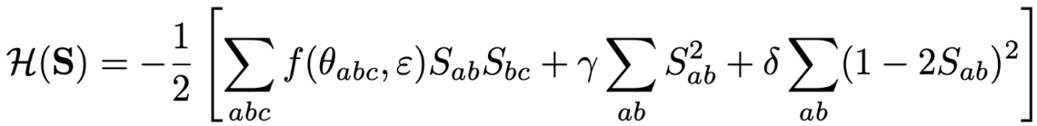
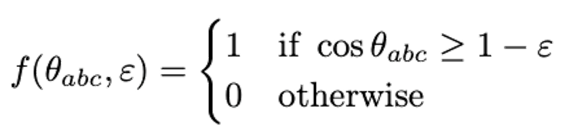
Translation For Quantum Advantage
(a) (b) (c)
(a) Angular term: assigns values for straight doublets
(b) Regularization term: makes the spectrum of A positive
(c) Gap term: ensures gap in the solution spectrum

Slide 9



Translation For Quantum Advantage
$$Relaxation of binary S values allows$$
$$∇_{S}H=0$$
$$−AS+b=0$$
$$AS=b$$

Slide 10

Translation For Quantum Advantage
$$AS=b$$
$$A=$$
$$b=$$

Slide 11
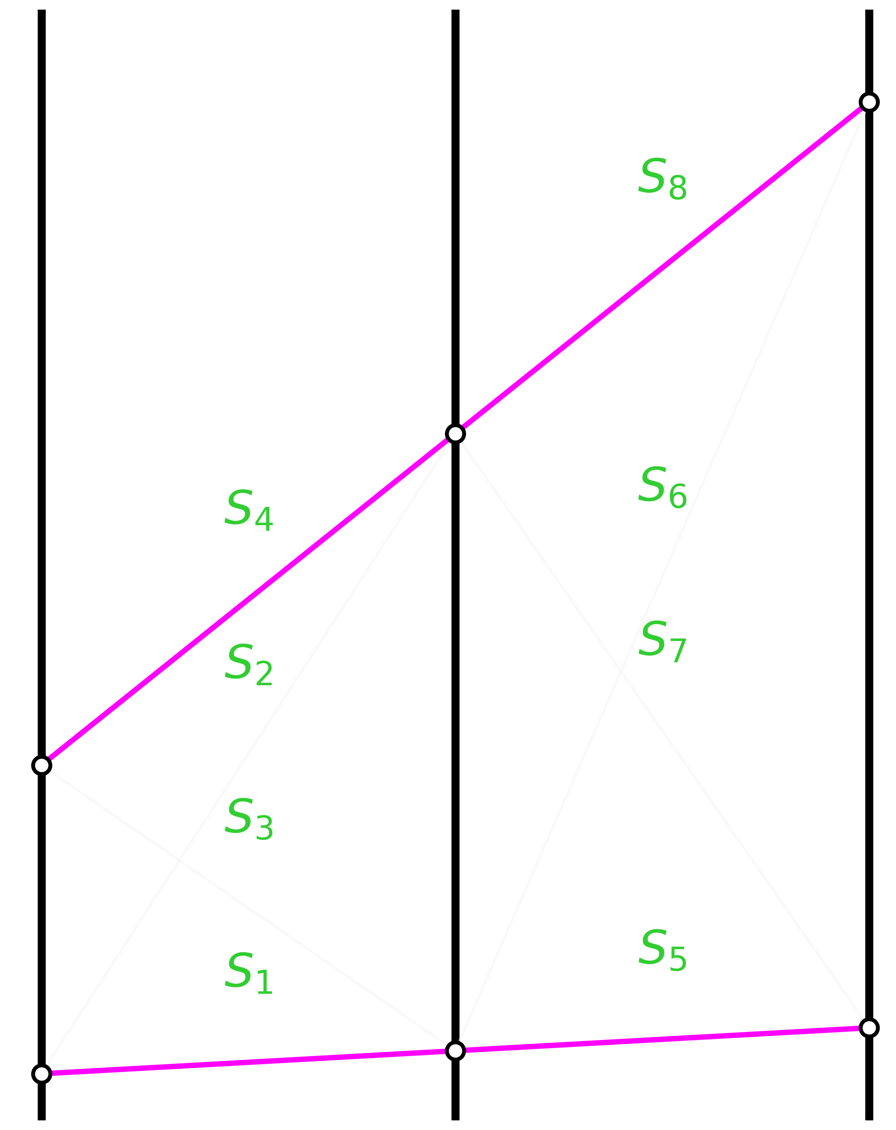
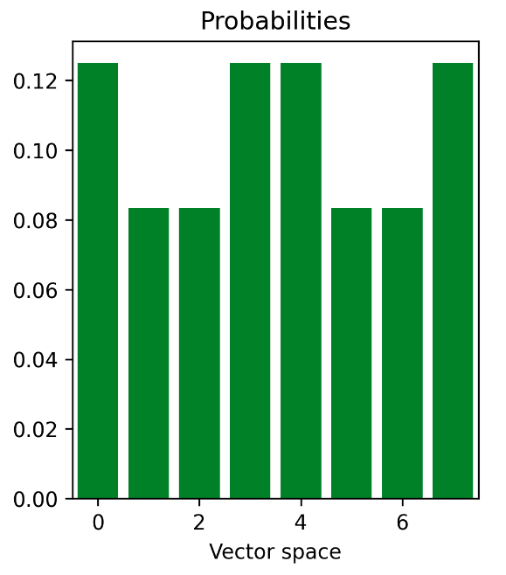








Most Trivial Tracking Scenario
$$S_{1}$$
$$S_{2}$$
$$S_{3}$$
$$S_{4}$$
$$S_{5}$$
$$S_{6}$$
$$S_{7}$$
$$S_{8}$$

Slide 12
Solving it Classically
Particle “tracks”
Creator: Davide Nicotra

Slide 13
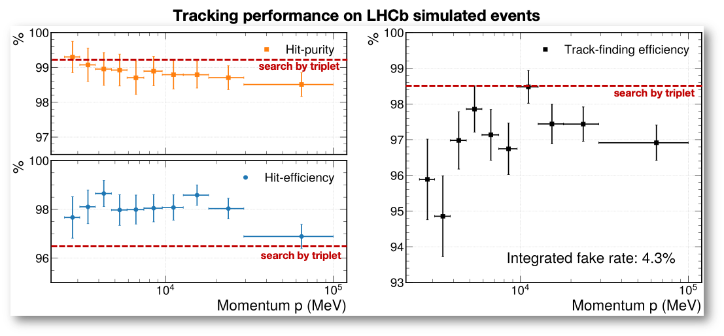




Solving it Classically
$$e_{pure}=\frac{N_{hit}^{correct}}{N_{hit}^{all}}$$
$$e_{eff}=\frac{N_{hit}^{correct}}{N_{hit}^{gen}}$$
$$ε_{track}=\frac{N_{track}^{corr}}{N_{gen}^{acc}}$$
Benchmarked on a Classical Equivalent of the Quantum algorithm [arXiv:2308.00619], [JINST]

Slide 14
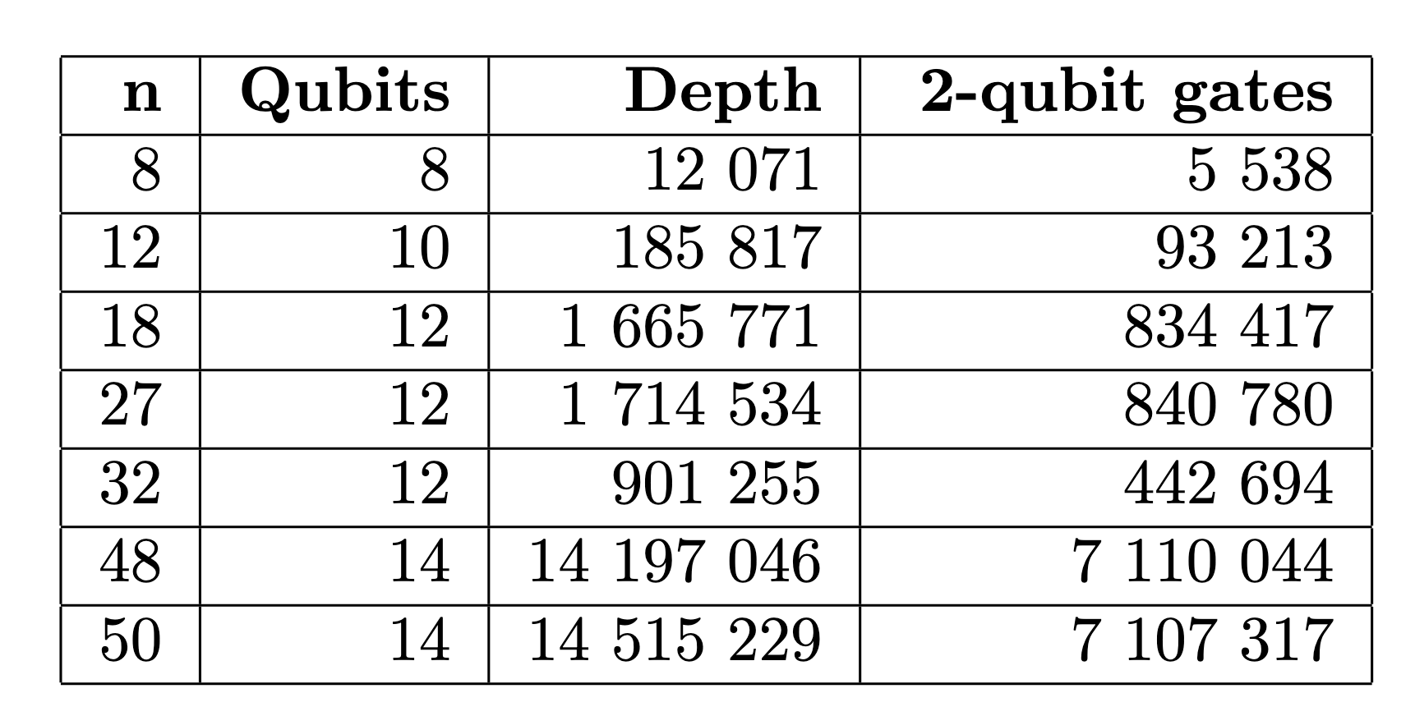
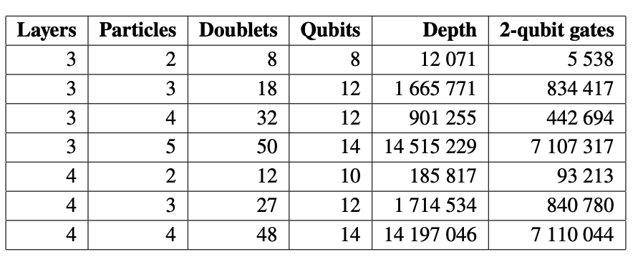


HHL(Harrow–Hassidim–Lloyd) algorithm
$$AS=b$$
Classical Complexity: $𝒪\left(n^{2}\right)$*
HHL Complexity: $𝒪\left(κ^{2}\log{n}\right)$
$n=input matrix size$
$k=condition number$
System size scales with:
$n=p^{2}×Average Hits Per Track$
$p=particles in detector$

Slide 15


HHL(Harrow–Hassidim–Lloyd) algorithm
$$AS=b$$
Classical Complexity: $𝒪(n^{2})$*
HHL Complexity: $𝒪\left(κ^{2}\log{n}\right)$
$n=input matrix size$
$k=condition number$
Current Best IBM:
~3000 gates
System size scales with:
$n=p^{2}×Average Hits Per Track$
$p=particles in detector$

Slide 16
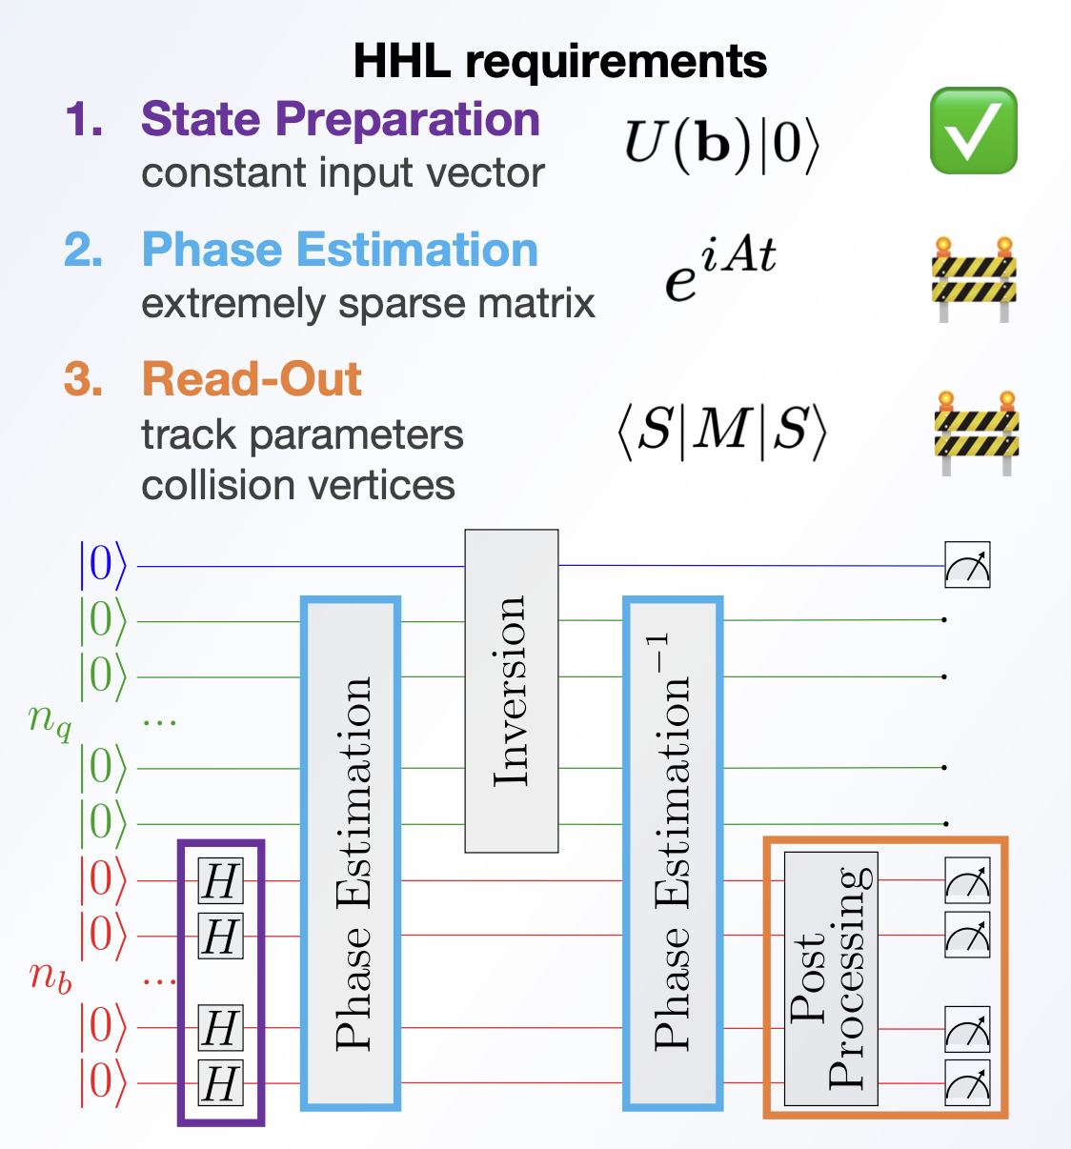
Challenges with HHL

Slide 17


1-Bit Phase Estimation

Slide 18
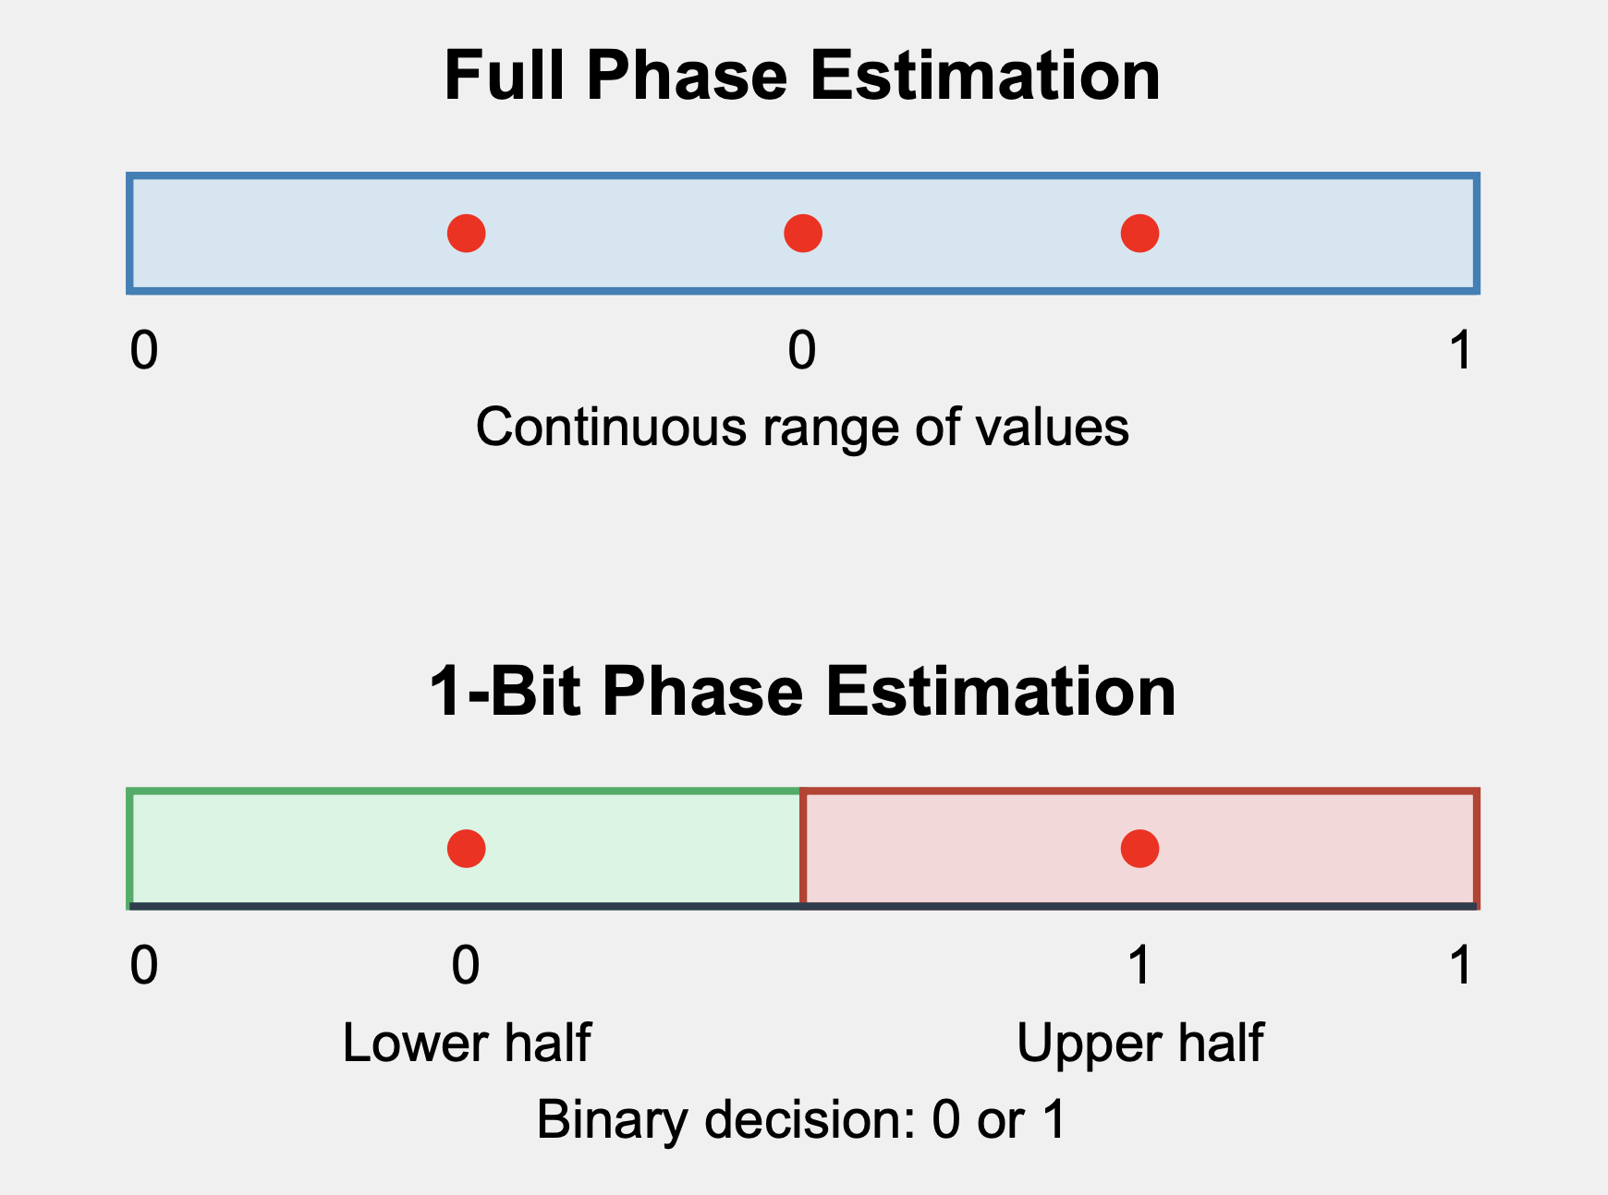


3-Bit Phase Estimation
8 possible phase discretization
1-Bit Phase Estimation
Binary phase discretization

Slide 19
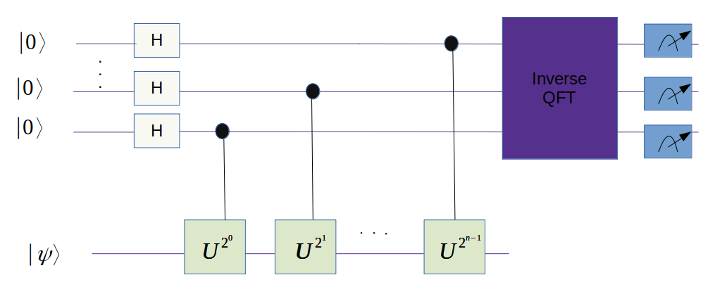
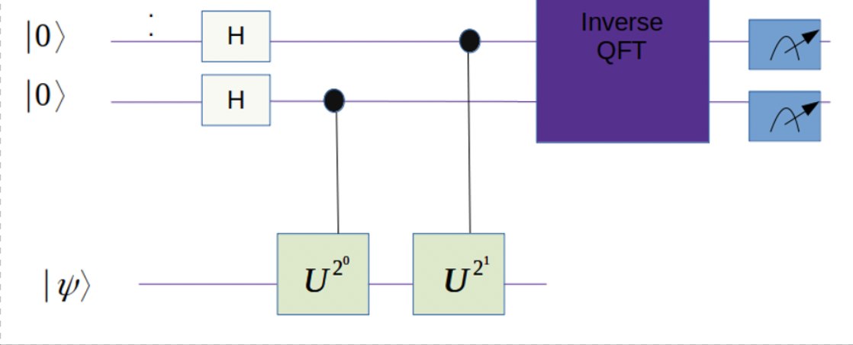



N-Bit QPE
1-Bit QPE

Slide 20
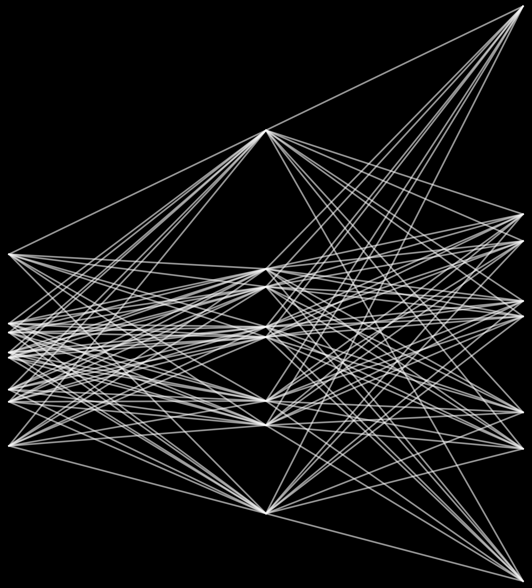
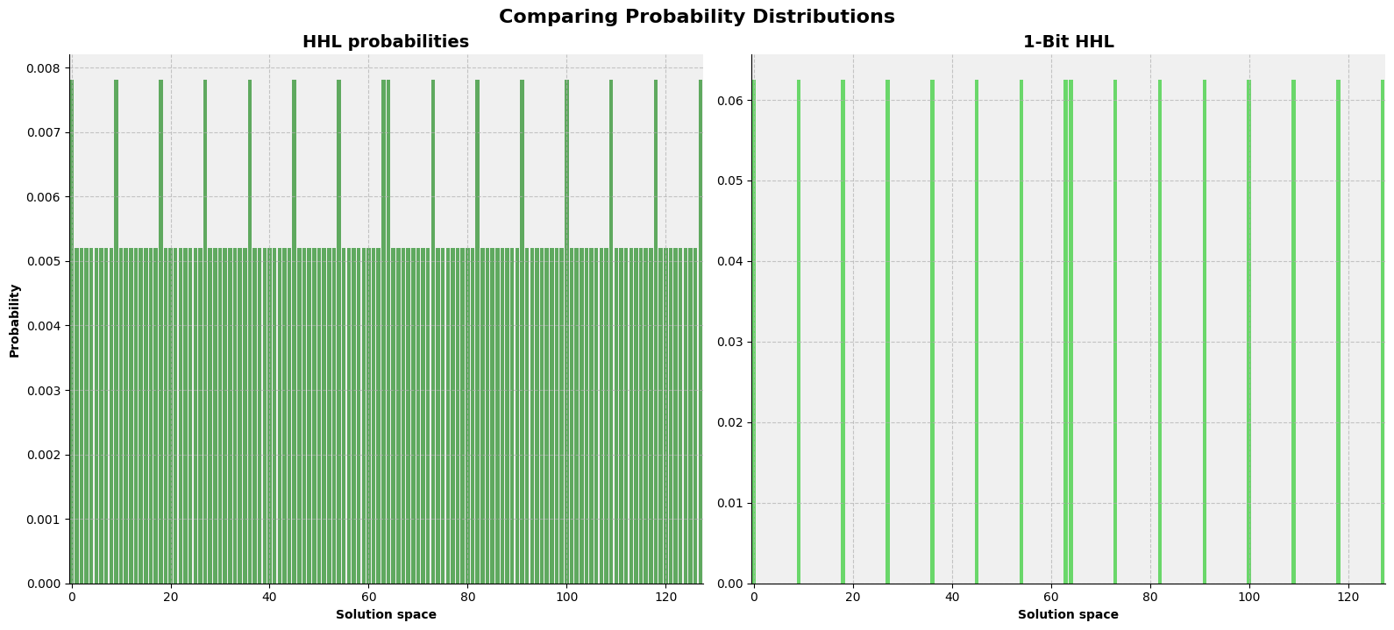
Trying to solve our Phase Estimation Problem

Slide 21
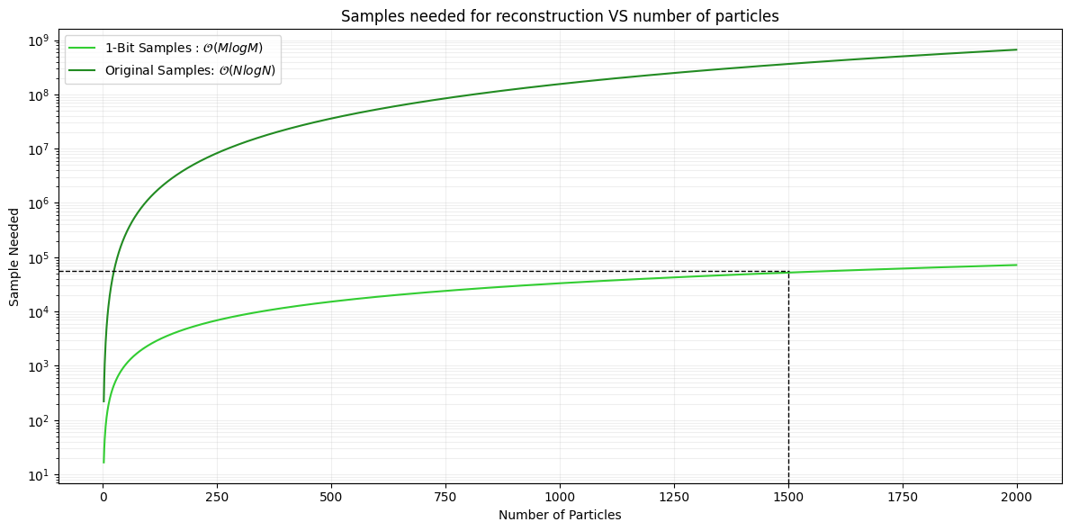
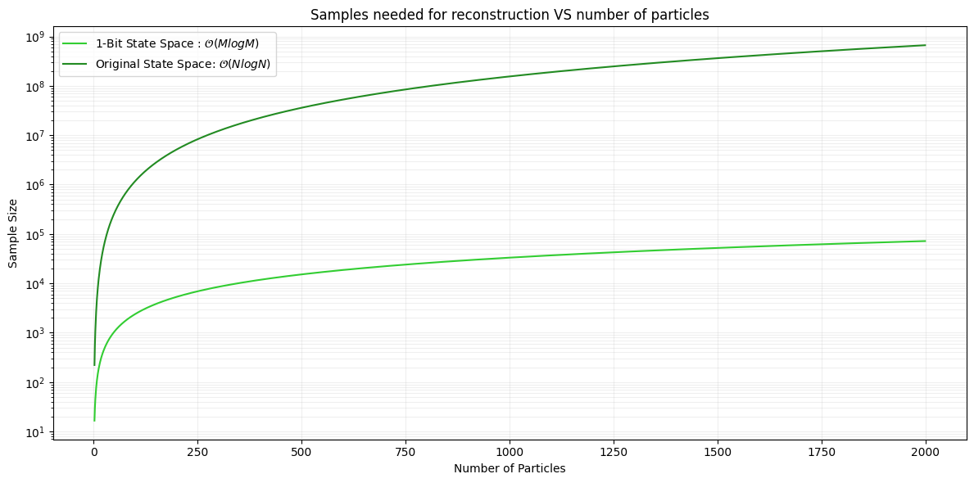



Output Problem
Event with 1500 particles needs ${10}^{4.8}$ samples for 1-Bit
Event with 1500 particles needs ${10}^{8.6}$ samples for HHL
$M=p×Average Hits Per Track$
$N=p^{2}×Average Hits Per Track$

Slide 22
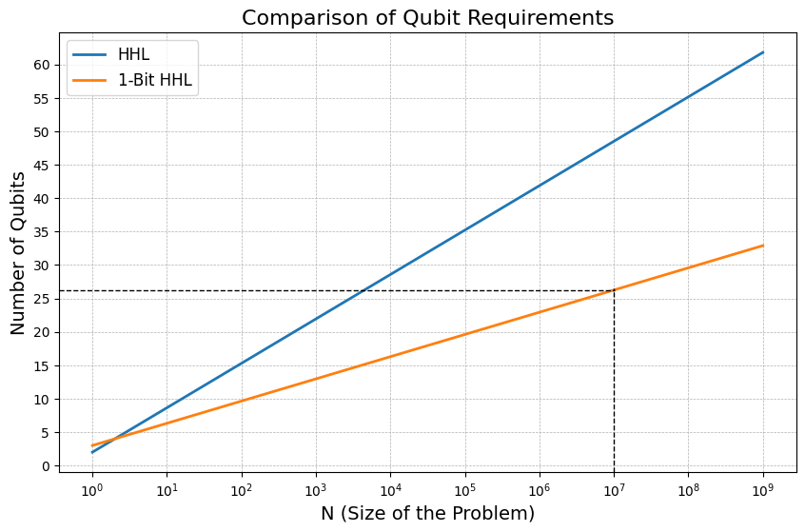

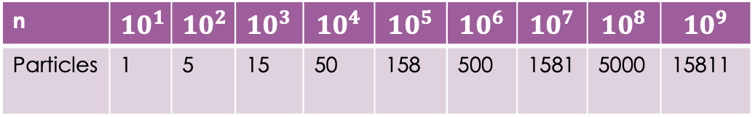
Qubit Reduction
  $2\log_{2}{N}+2$ qubits for HHL
  $\log_{2}{N}+3$ qubits for 1-Bit HHL
n | $${10}^{1}$$ | $${10}^{2}$$ | $${10}^{3}$$ | $${10}^{4}$$ | $${10}^{5}$$ | $${10}^{6}$$ | $${10}^{7}$$ | $${10}^{8}$$ | $${10}^{9}$$
Particles | 1 | 5 | 15 | 50 | 158 | 500 | 1581 | 5000 | 15811
*5 Hits Per Track Assumption

Slide 23
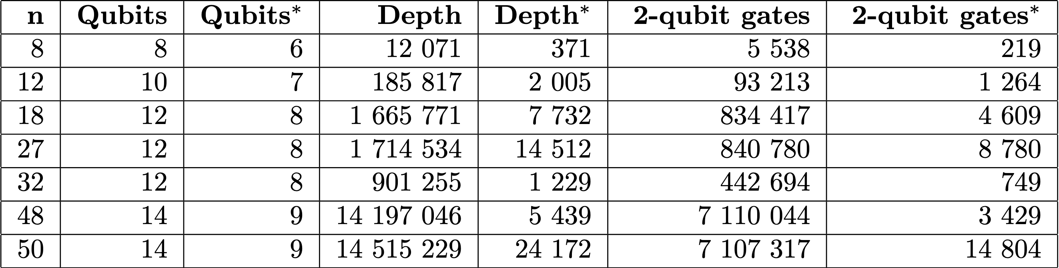
Solving our Phase Estimation Problem
1-Bit Phase Estimation
Achieved through circuit optimization and 1-bit phase estimation
* Represents the 1-Bit Phase estimation results

Slide 24

Largest Simulated Event

Slide 25
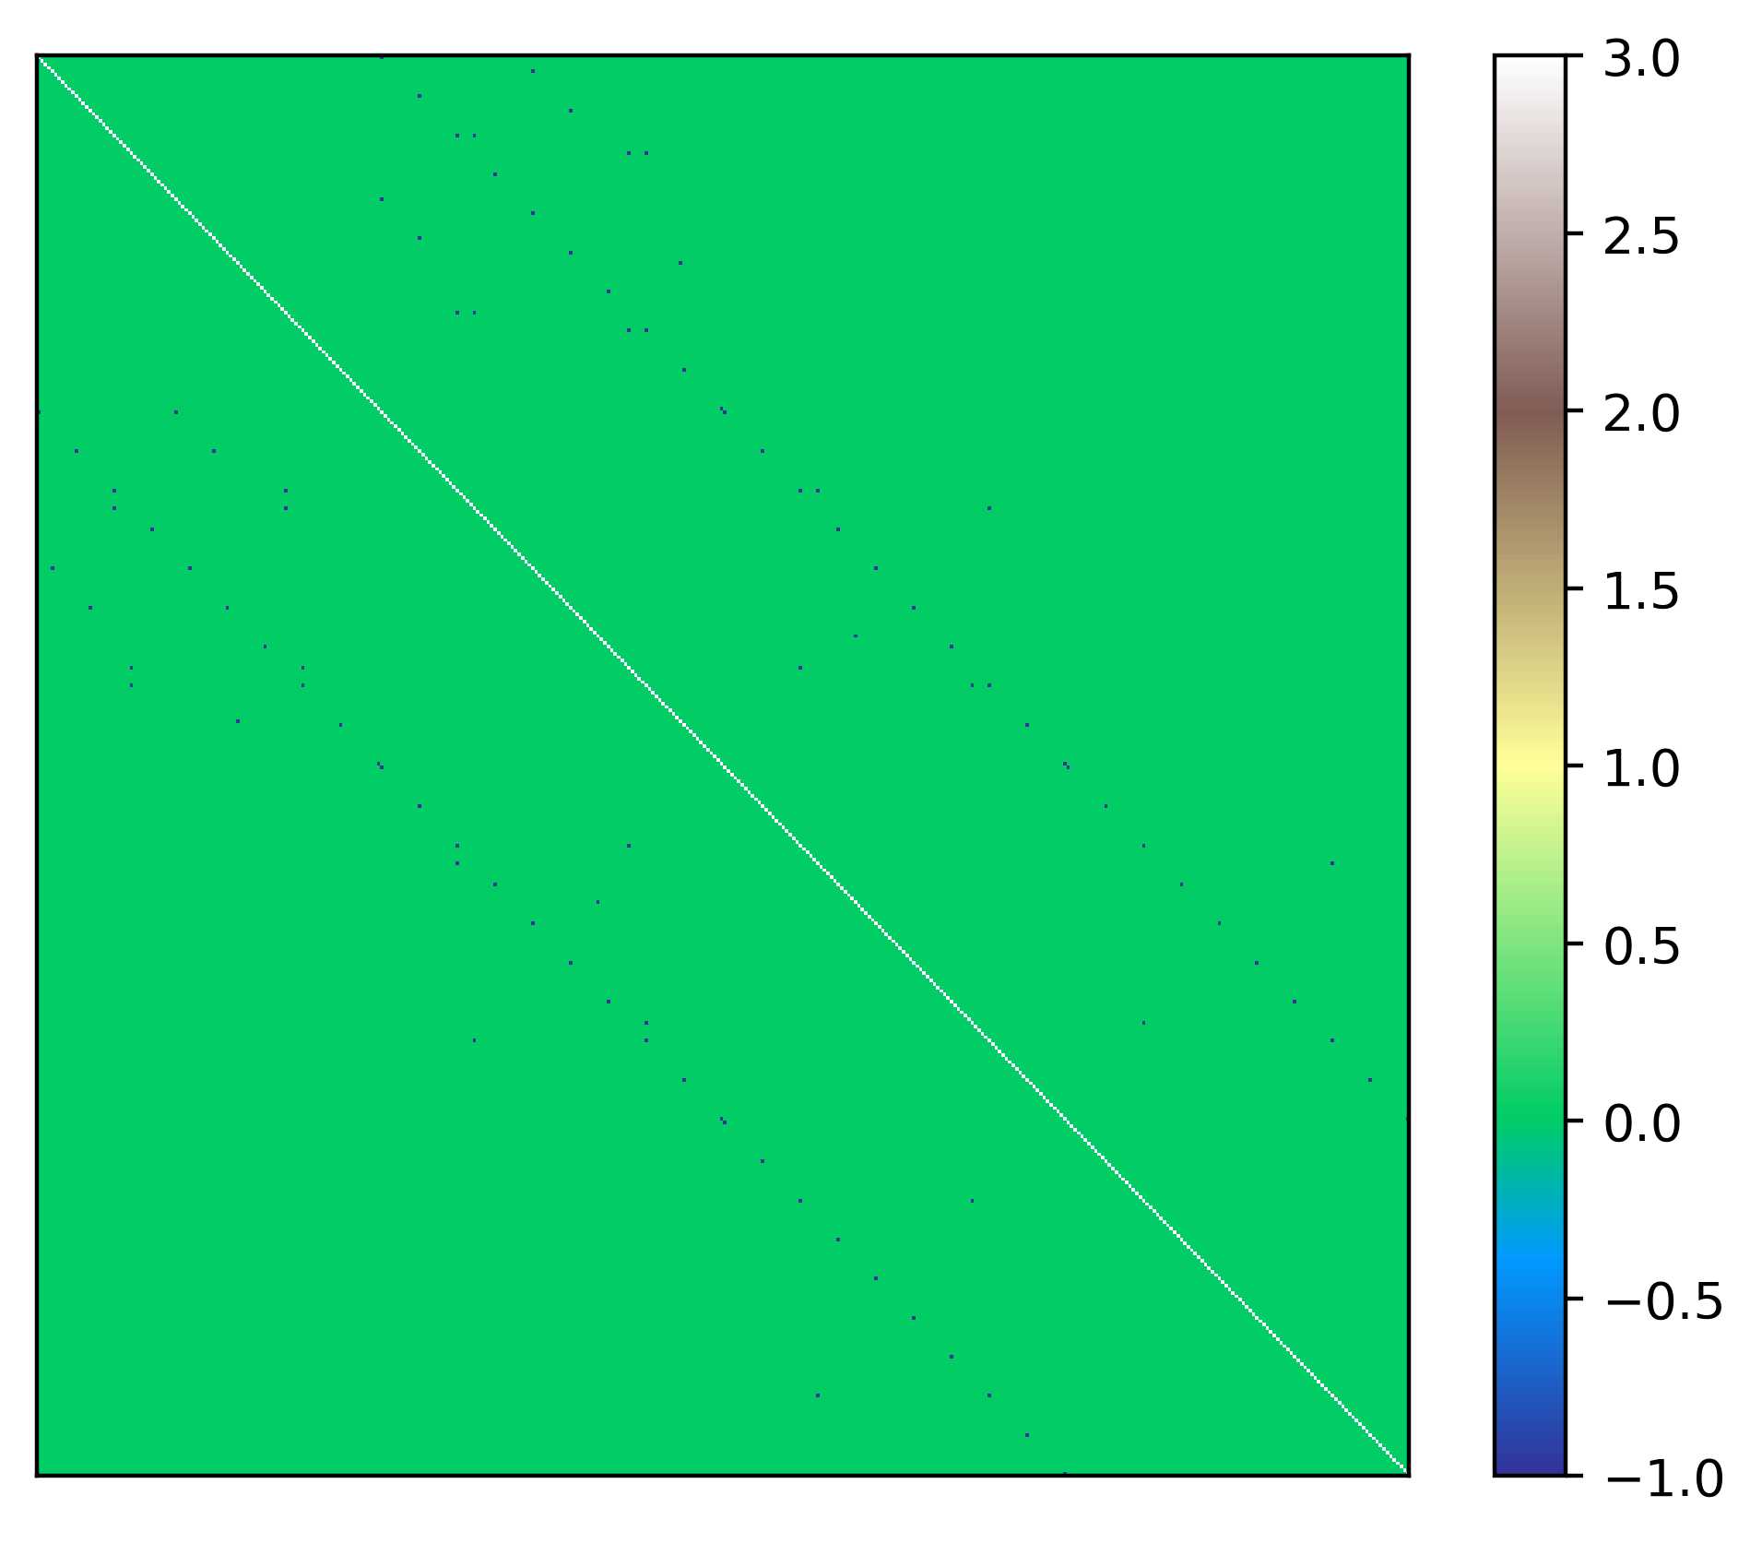
Largest Simulated Event
Matrix

Slide 26
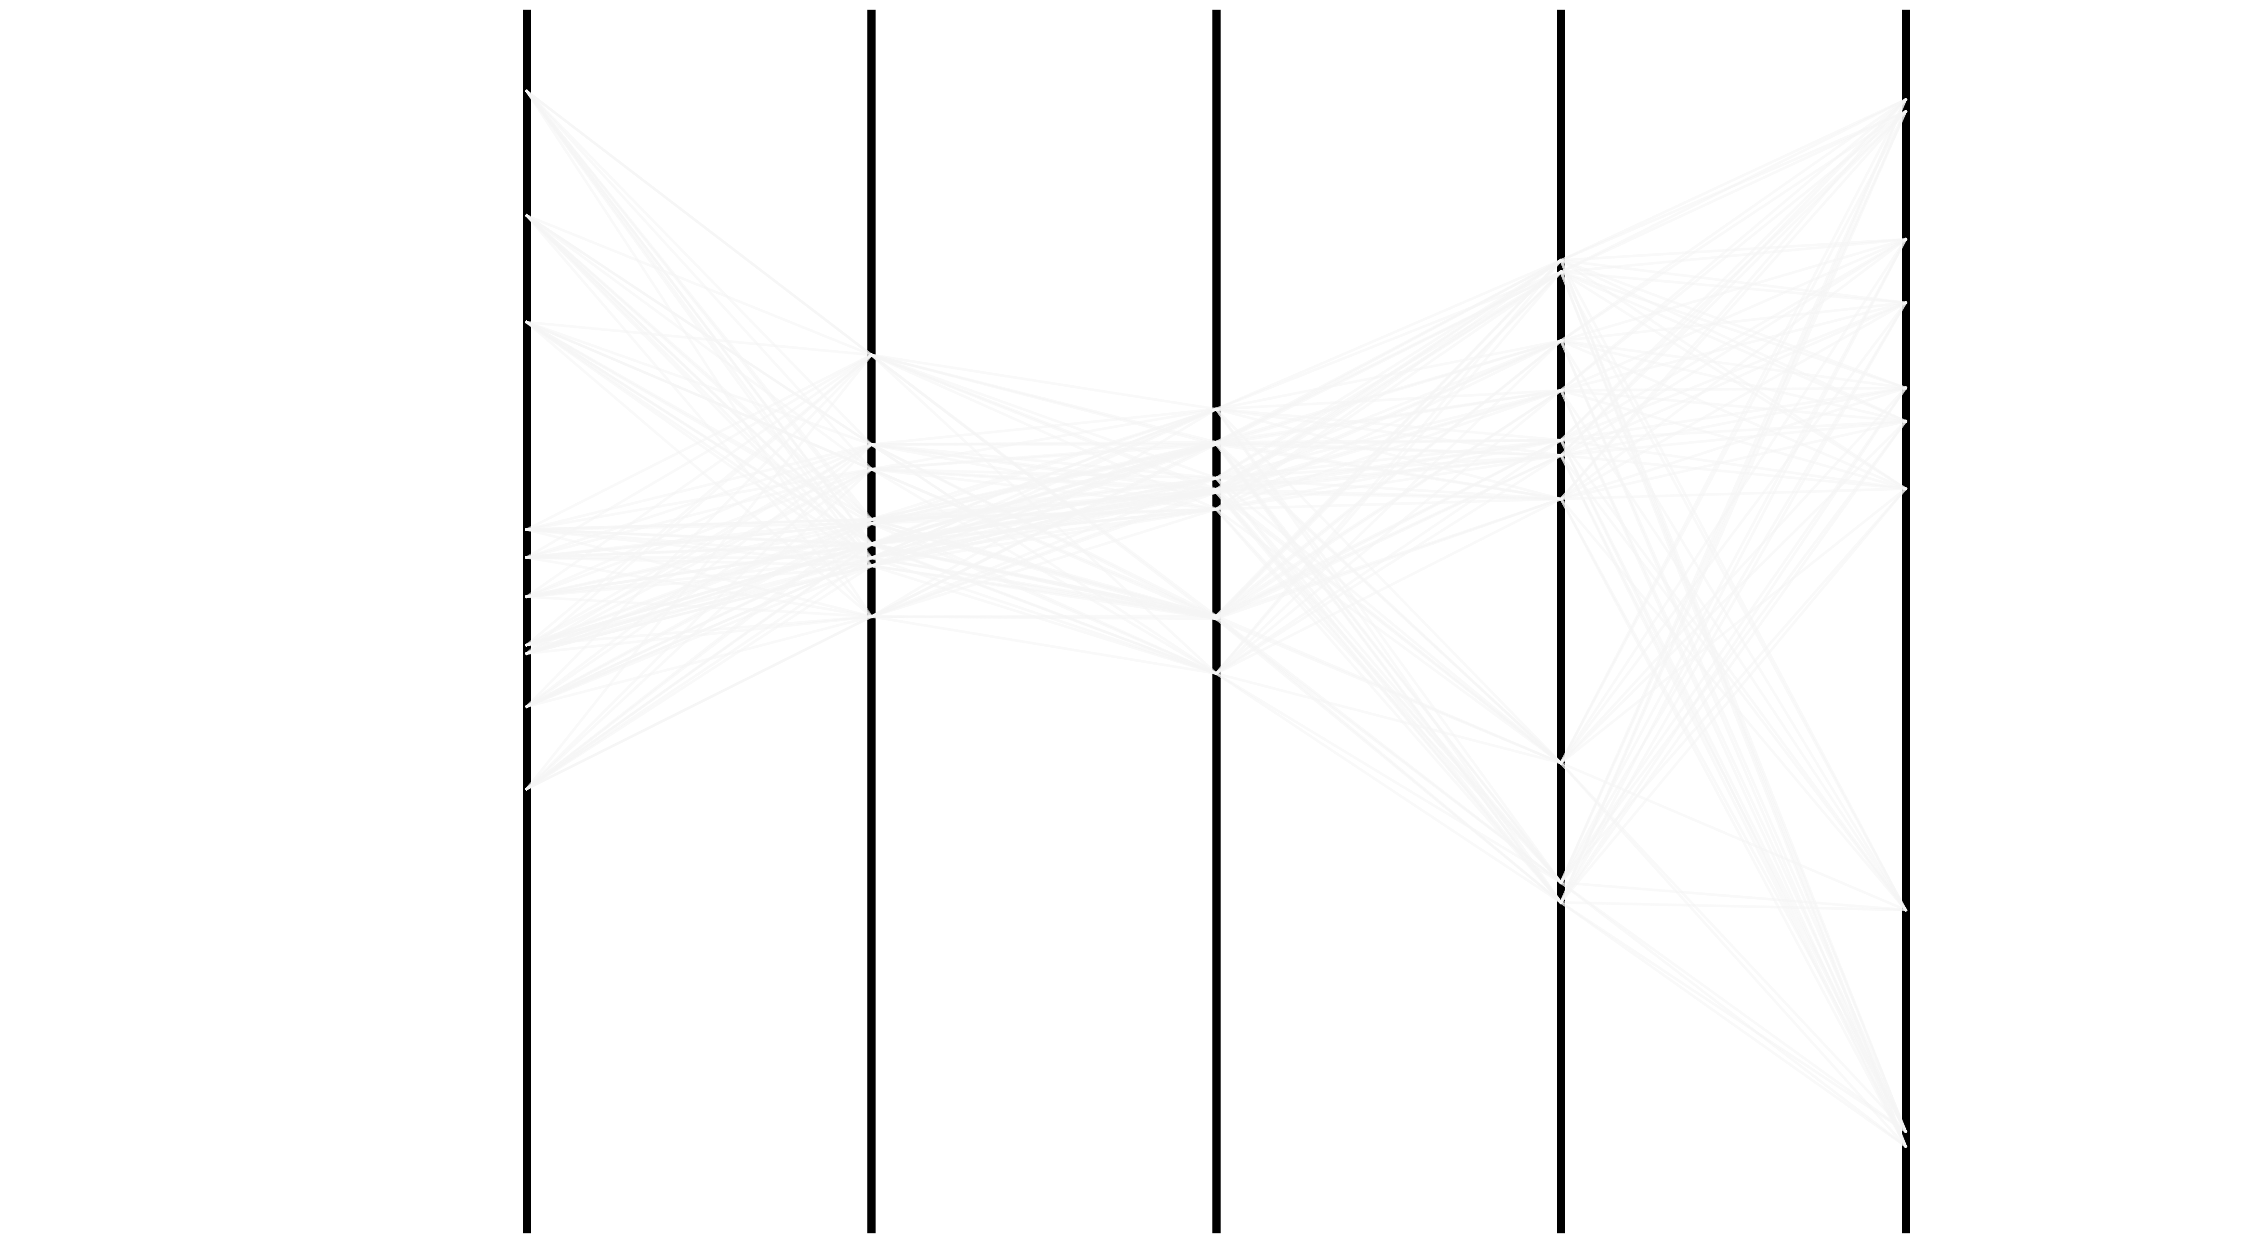

Slide 27


Slide 28
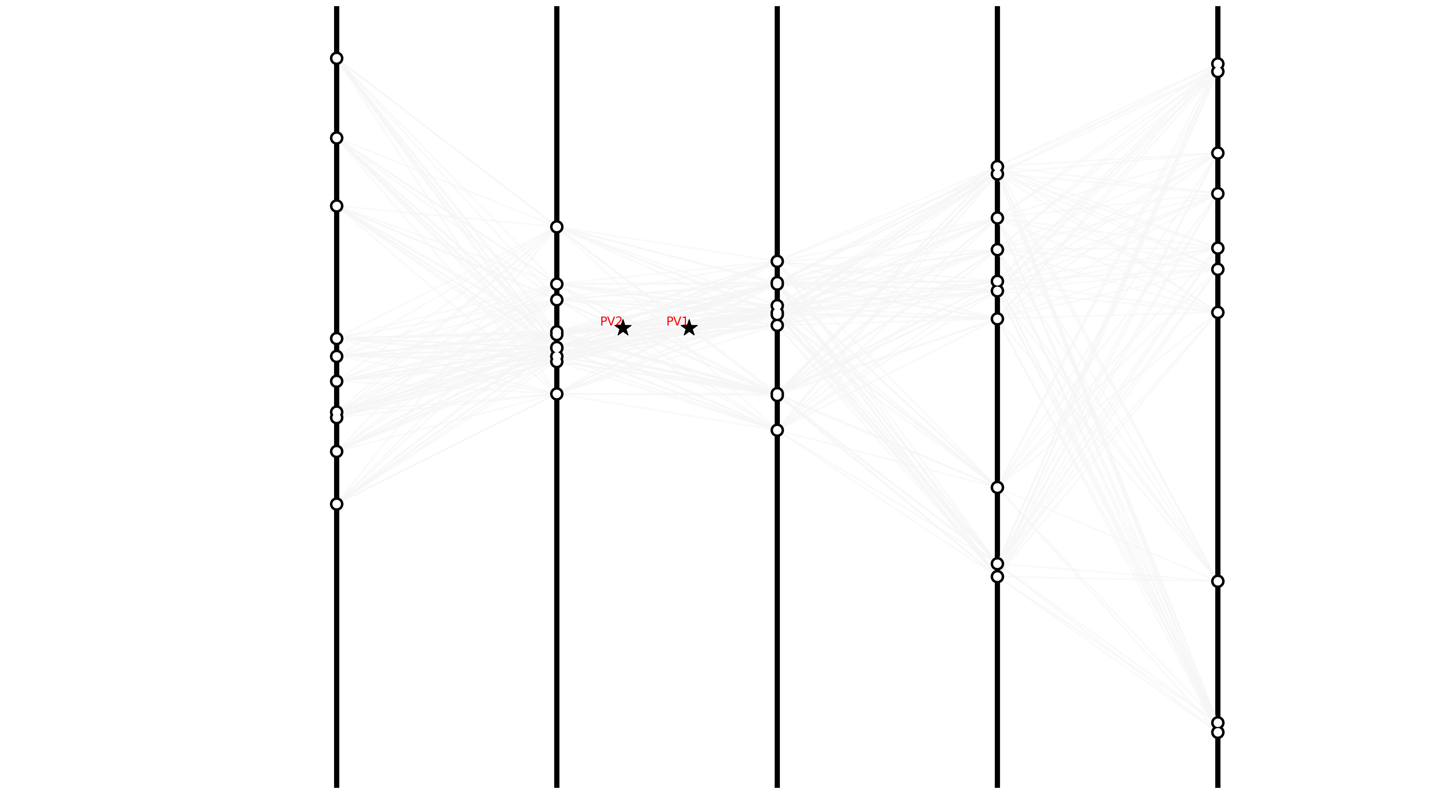

Slide 29
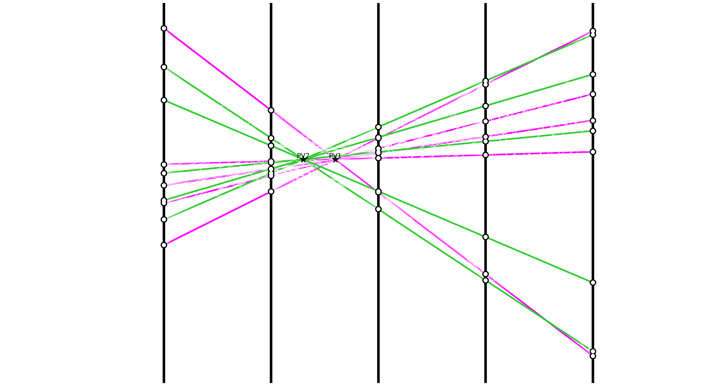

Slide 30


Benefits of 1-Bit HHL
Upto a $×10,000$ reduction in circuit depth
Pre-processing inside quantum circuit, logarithmic reduction in samples needed for reconstruction
Reduction in qubits needed (where N is matrix dimension):
  $2\log_{2}{N}+2$ qubits originally
  $\log_{2}{N}+3$ qubits for 1-Bit HHL

Slide 31
Conclusions
Matrix inversion track solvers have a good performance classically, HHL quantum version also shows good results
Adopting 1-bit phase estimation HHL significantly improves feasibility in qubits, circuit depth and read-out
Future Work
Take advantage of sparsity structures
Encoding geometry information into the Hamiltonian
Benchmarking the Primary Vertex finding on data with PV information

Slide 32
Backup Slides

Slide 33
Further Solving our Read-Out Problem

Slide 34


Time Evolution
$$H|\left.ψ\left(t\right)\right\rangle =iℏ\frac{∂}{∂t}|\left.ψ\left(t\right)\right\rangle$$
Time Evolution Operator
$$\left|\left.ψ\left(t\right)\right\rangle =U\left(t\right)\right|\left.ψ\left(0\right)\right\rangle =e^{−iHt/ℏ}|\left.ψ\left(0\right)\right\rangle$$
Via Trotterization

Slide 35


Suzuki Trotter Decomposition
$H=H_{A}+H_{B} and U\left(t\right) =e^{−iHt/ℏ}$
If $\left[H_{A},H_{B}\right]≠0$ computing $e^{−i(H_{A}+H_{B})t/ℏ}$ is very expensive
So, we use the Suzuki-Trotter decomposition to do time evolution
$e^{−i(H_{A}+H_{B})t/ℏ}≈{(e^{−iH_{A}∆t}e^{−iH_{B}∆t})}^{N}$
where $∆t= t/N$ and as $N→∞$ the approximation becomes exact.

Slide 36
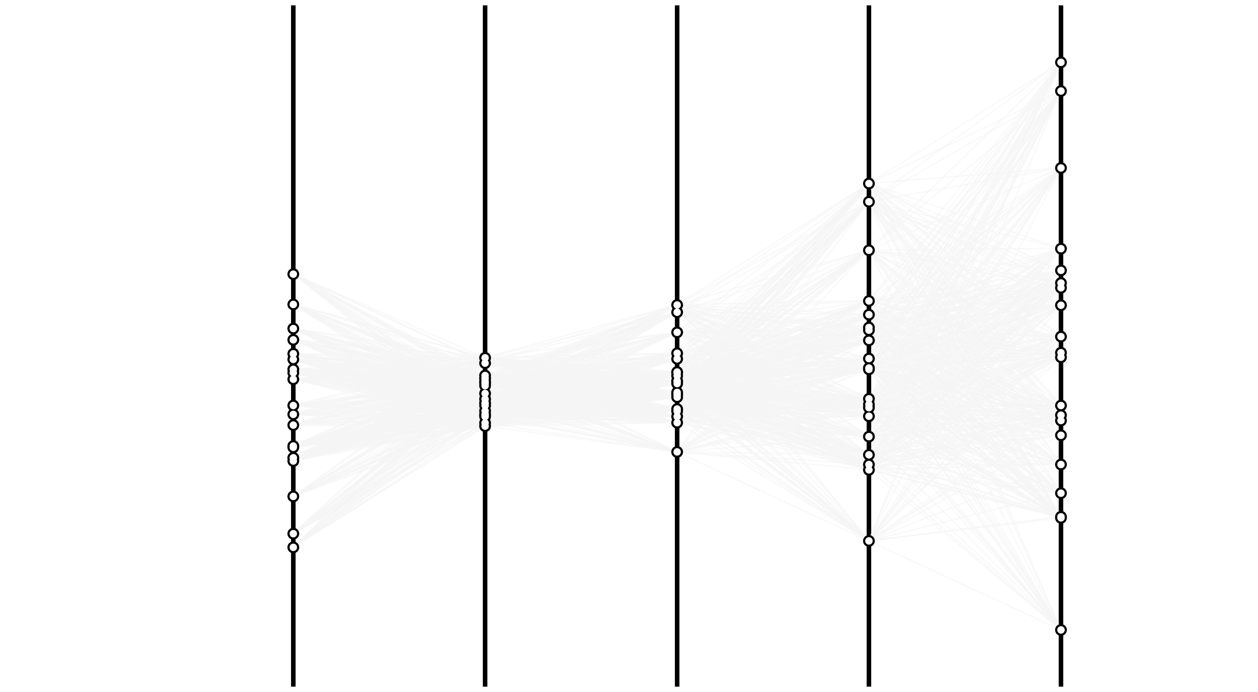

Slide 37
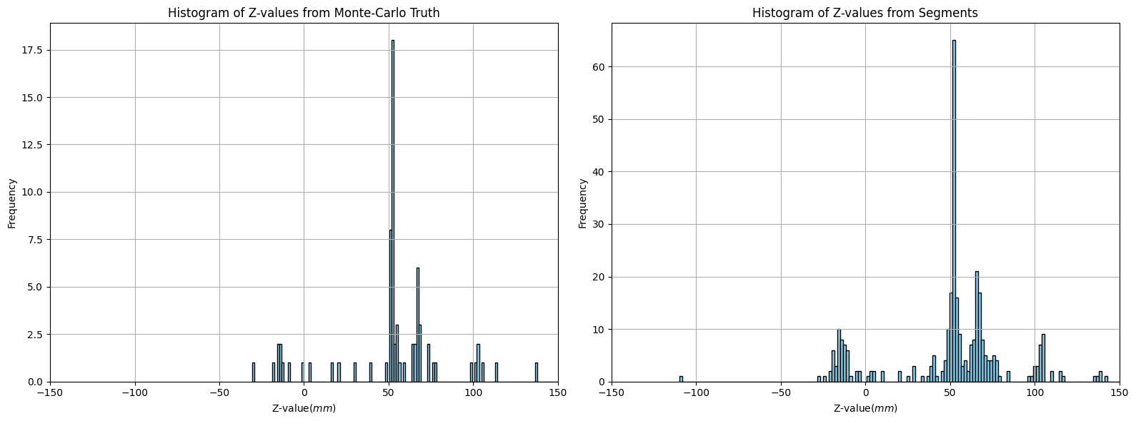
Solving the Readout Problem: Reconstruct the Primary Vertices and re-find all tracks

Slide 38
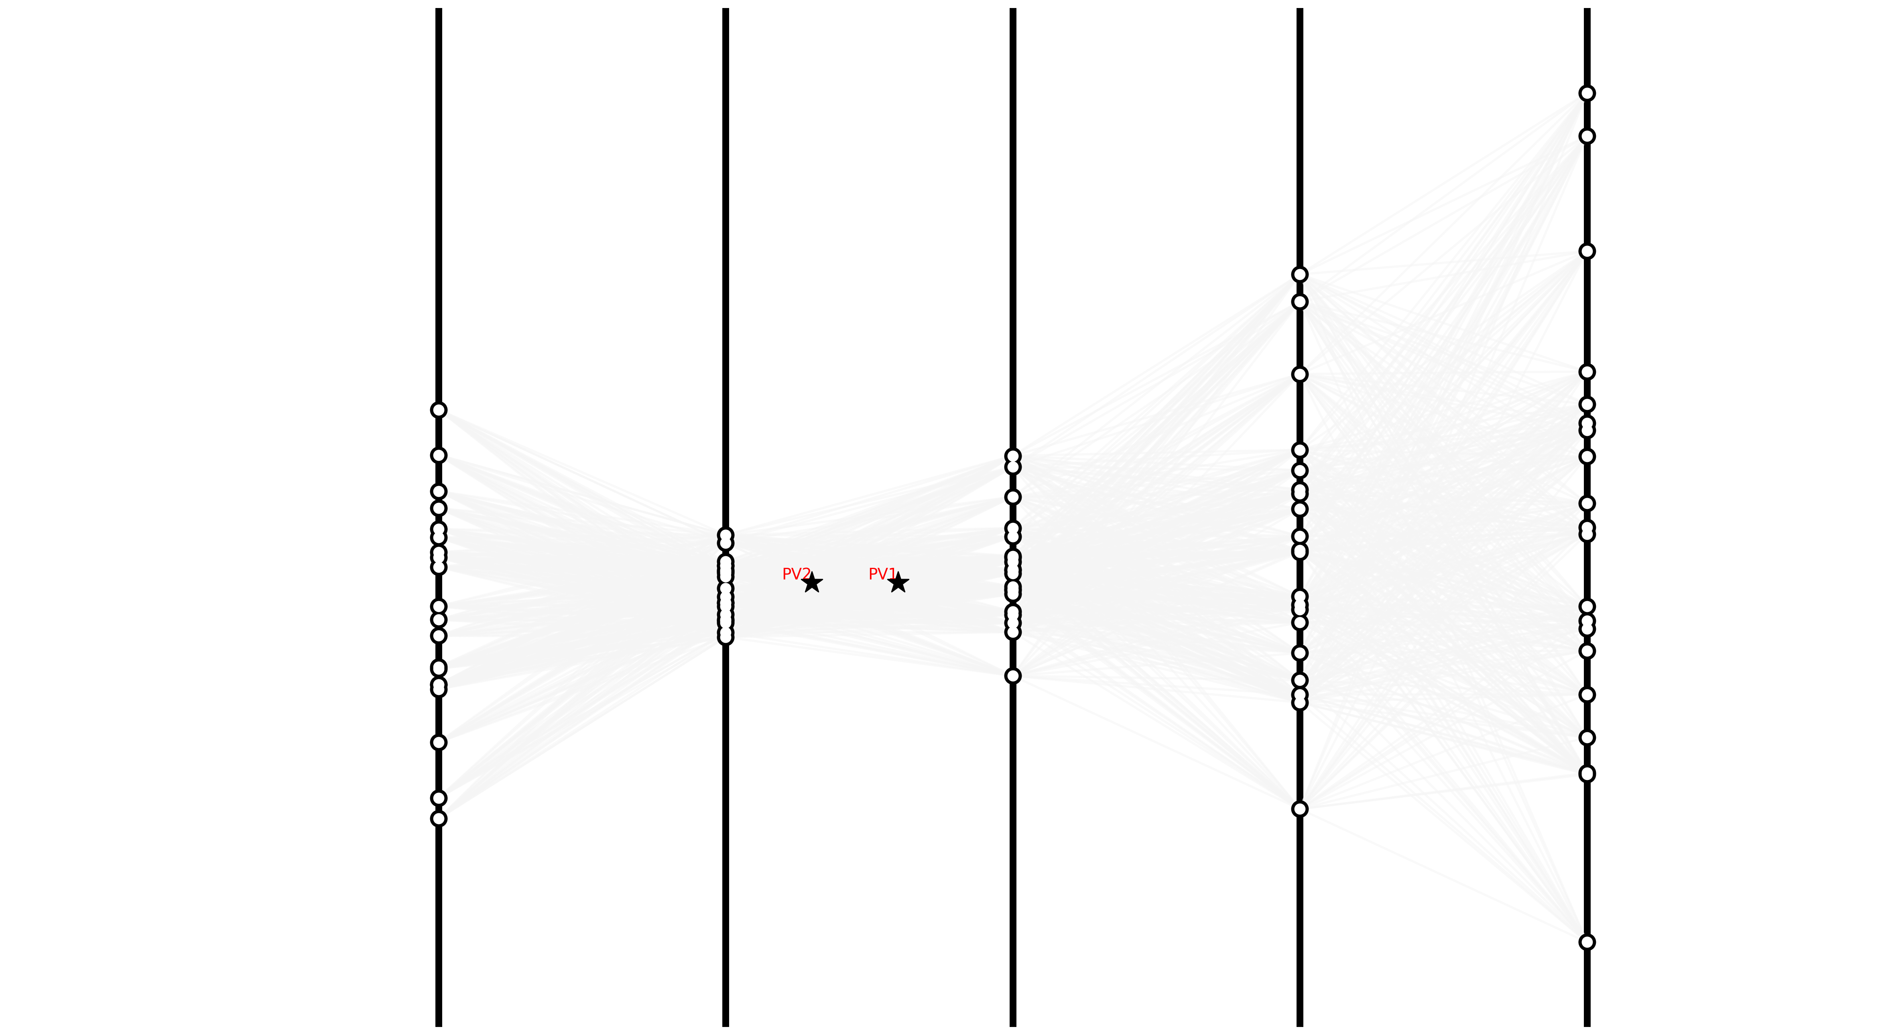

Slide 39
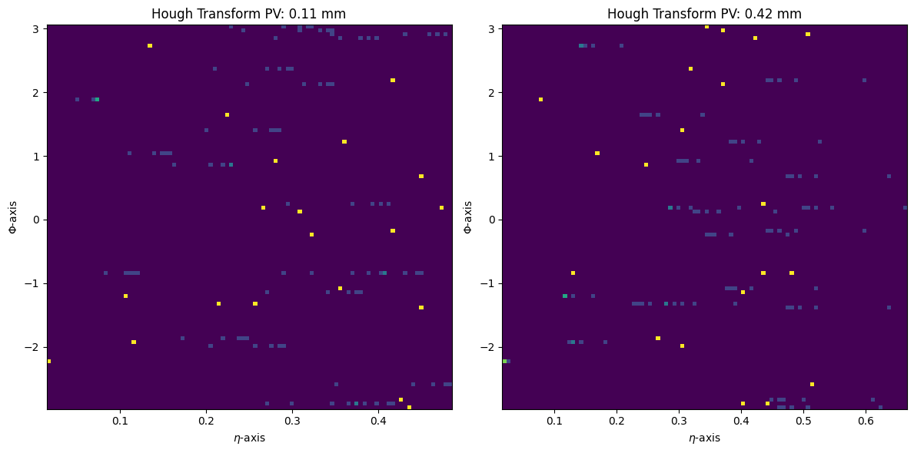
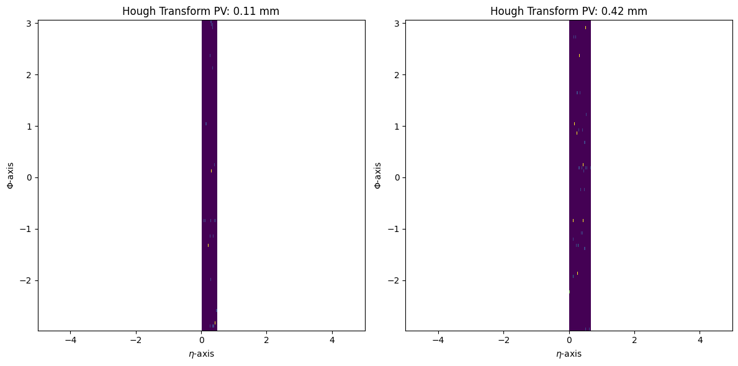

The Hough Transform
$$η≔−\ln\left[\tan{\frac{θ}{2}}\right]$$

