Slide 1
Radio interferometry for AugerPrime RD
By
Anthony Bwembya
Supervisors:
Harm Schoorlemmer
Charles Timmermans

Slide 2
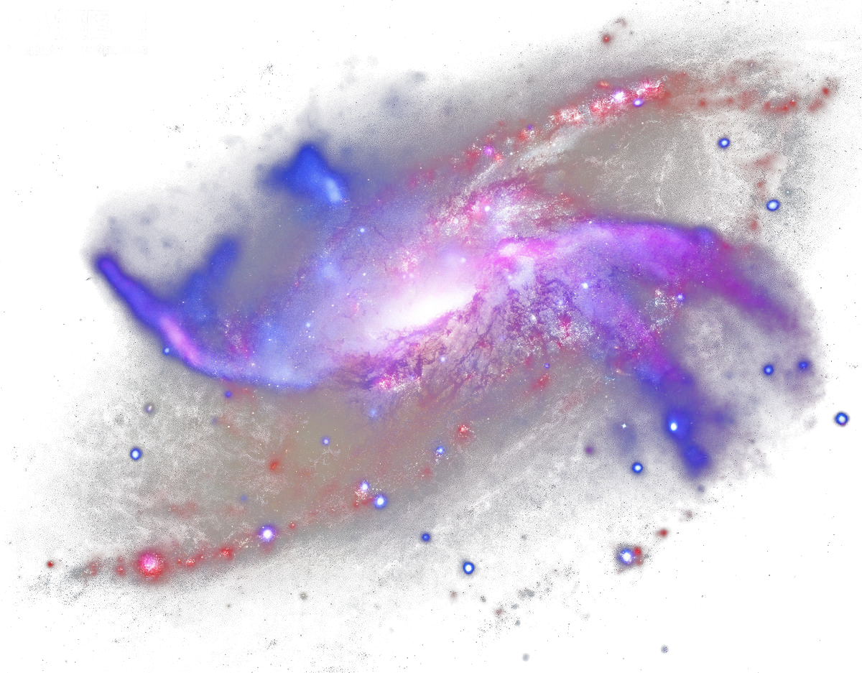
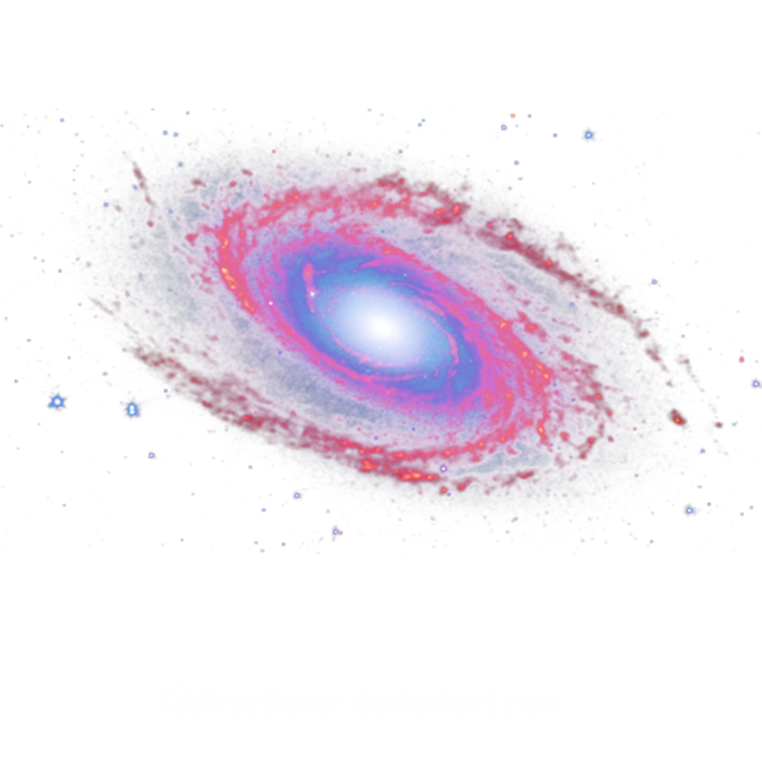
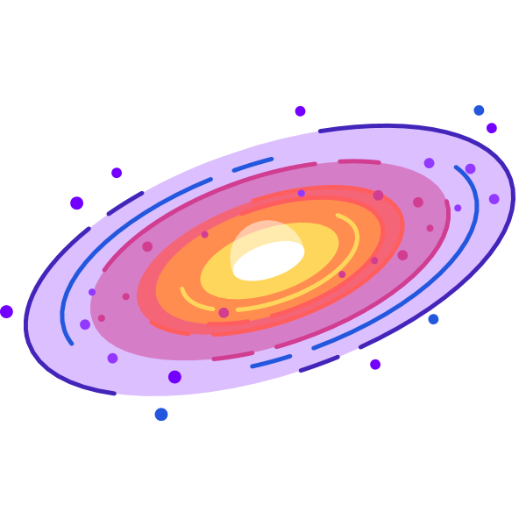
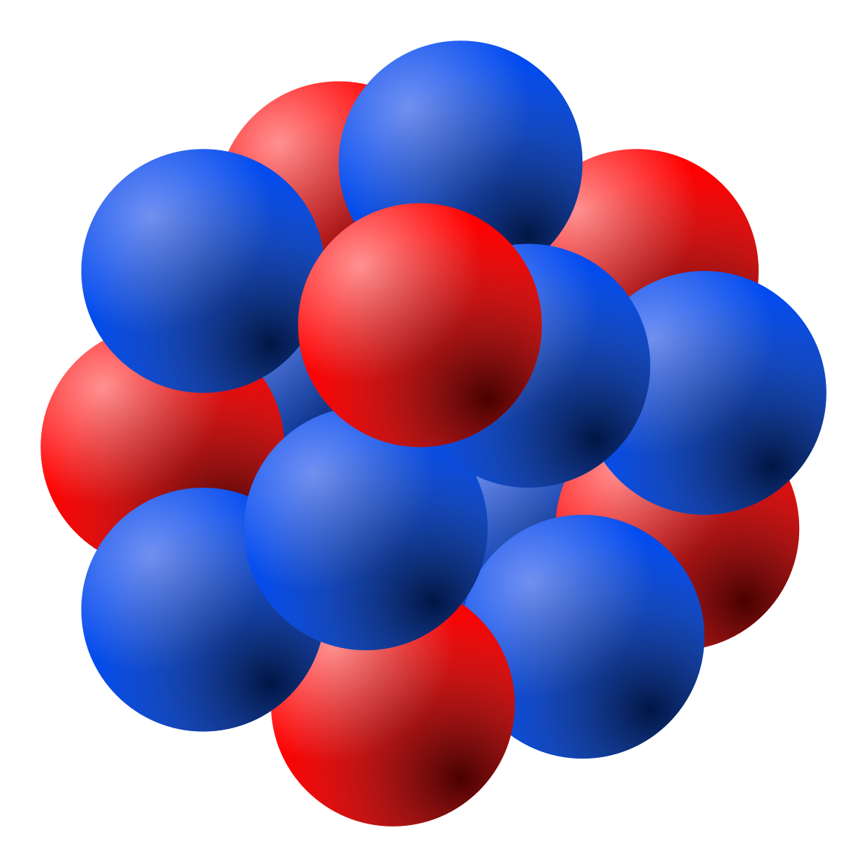
Ultra High Energy Cosmic Rays
Particles have energies > 1 EeV
Less than 1 particle/km²/century for the highest energy particles
The magnetic deflection D of the particles depends on their charge Q and energy E.
Detected through the interaction with the atmosphere via air showers
Protons
Neutrals
Iron

Slide 3
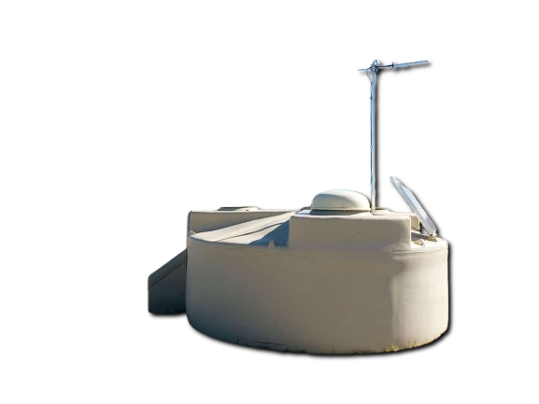
The Pierre Auger Observatory
located in the Argentinian pampas and has been collecting for 20 years.
The observatory covers 3000 km² in area and comprises of 1660 water Cherenkov tanks.
Twenty four fluorescence detectors overlooking the array from four locations.
Currently undergoing an upgrade to AugerPrime
Water Cherrn
https://east-usa.com/world/images/Argentina.jpg

Slide 4
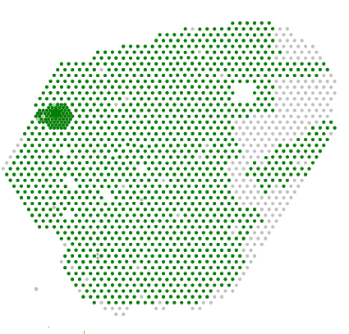
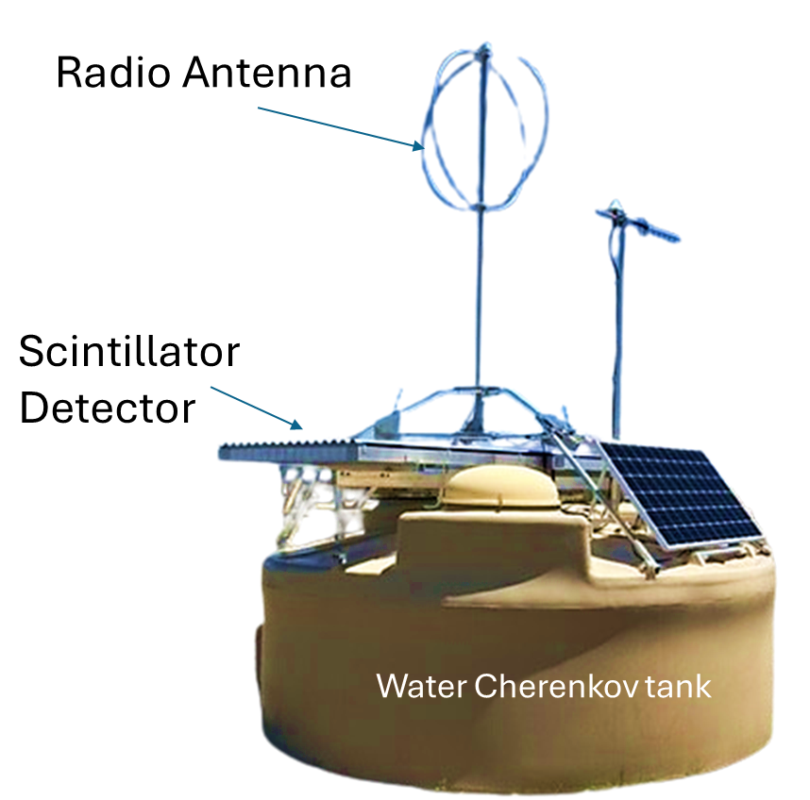
AugerPrime
AugerPrime is set to run for 10 years. New international agreement will be signed this week.
Extra small PMT, scintillator and radio antenna
Dutch contribution to upgrade is the radio which will measure very inclined air showers.
Two polarisations , 30-80 MHz band
1425 Stations Taking Data
UPGRADE
11/05/2024

Slide 5
The primary particle interacts with the atmosphere , creating a cascade of secondary particles.
This cascade is then measured on the ground to derive the primary particle’s energy, mass and arrival direction .
https://opendata.auger.org/display.php

Slide 6
The point in particle cascade with the maximum number of particles is called the “Depth of Shower Maximum” or X_{max}
This depends on the mass of the incoming particle
A radio signal is generated when the particle cascade interact with the Earth’s magnetic field.
Radio emission

Slide 7
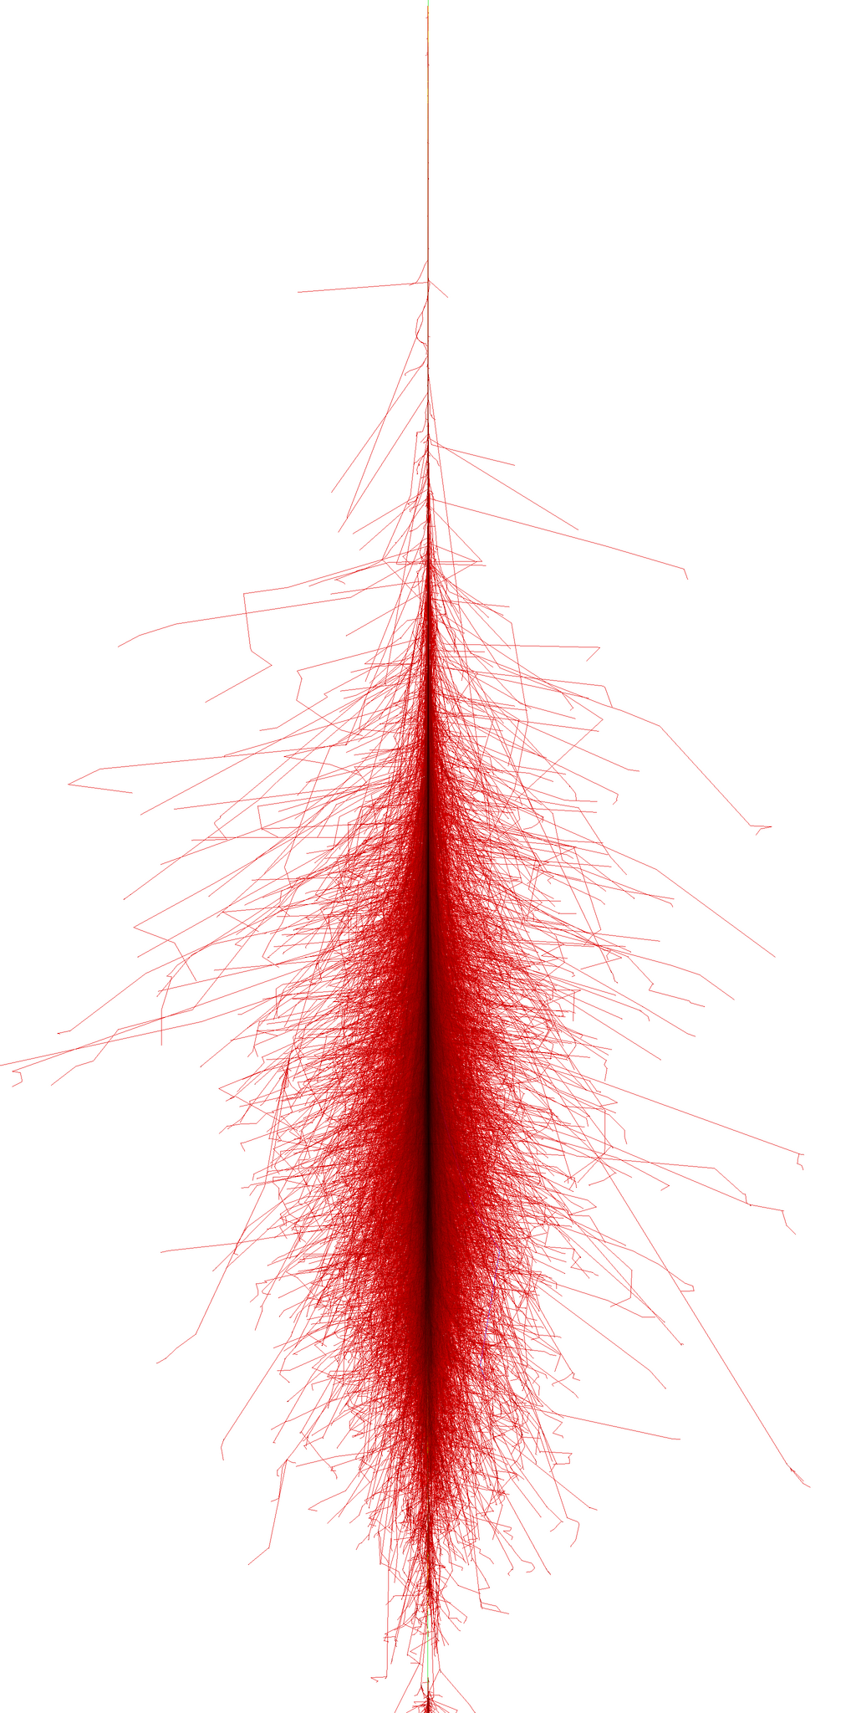
Determining the shower maximum via radio detection
The determination of the shower maximum is done by measuring the area illuminated on the ground or radio footprint.
The depth of the shower maximum determines the radius of the footprint.
Iron
Proton
d
Footprint

Slide 8
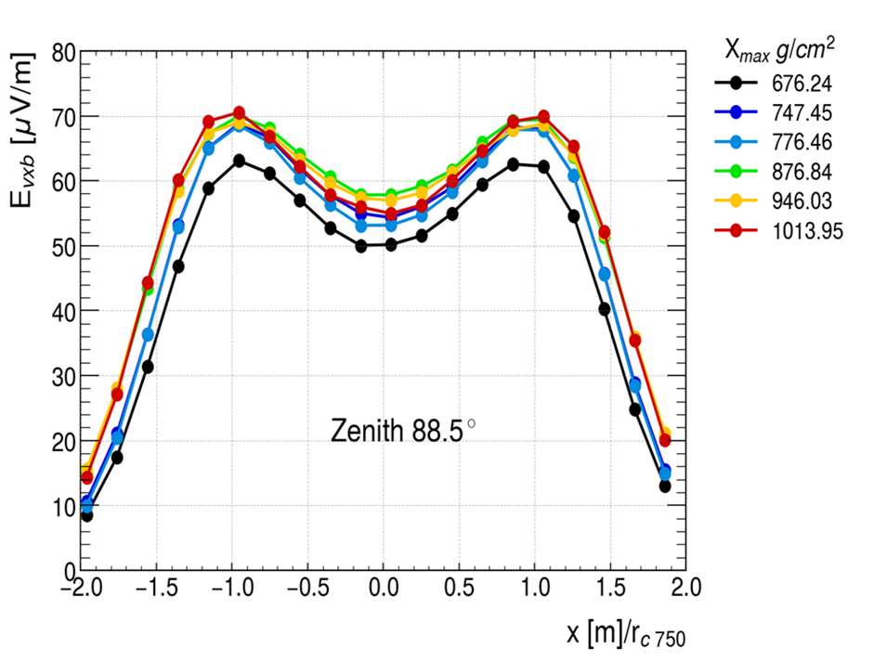
Radio amplitude distribution
For small zenith angles < 60 degrees , strong dependance on the shower maximum .
For showers with zenith angles > 60 degrees, weak/ nontrivial dependance on the shower maximum.
*Simulation:
10,200 m
500 m

Slide 9
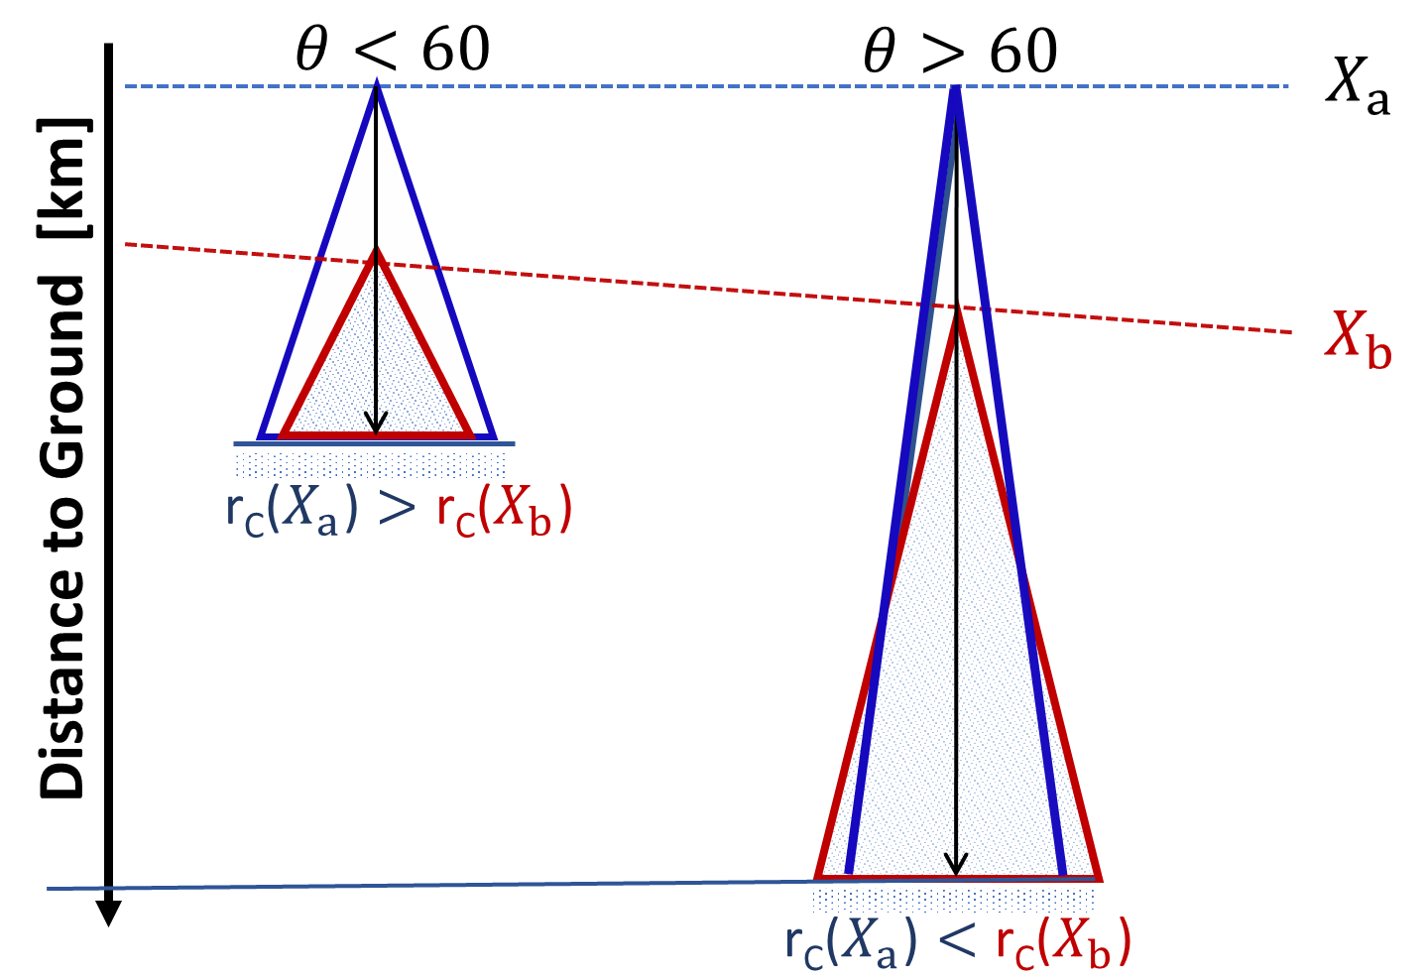
The problem with very inclined showers
Shallow showers are at smaller refractive indices and, thus have narrower beams
Deeper showers are at larger refractive indices and, thus have broader beams.
This results in very inclined deep showers projecting larger areas in the ground than shallow ones.

Slide 10
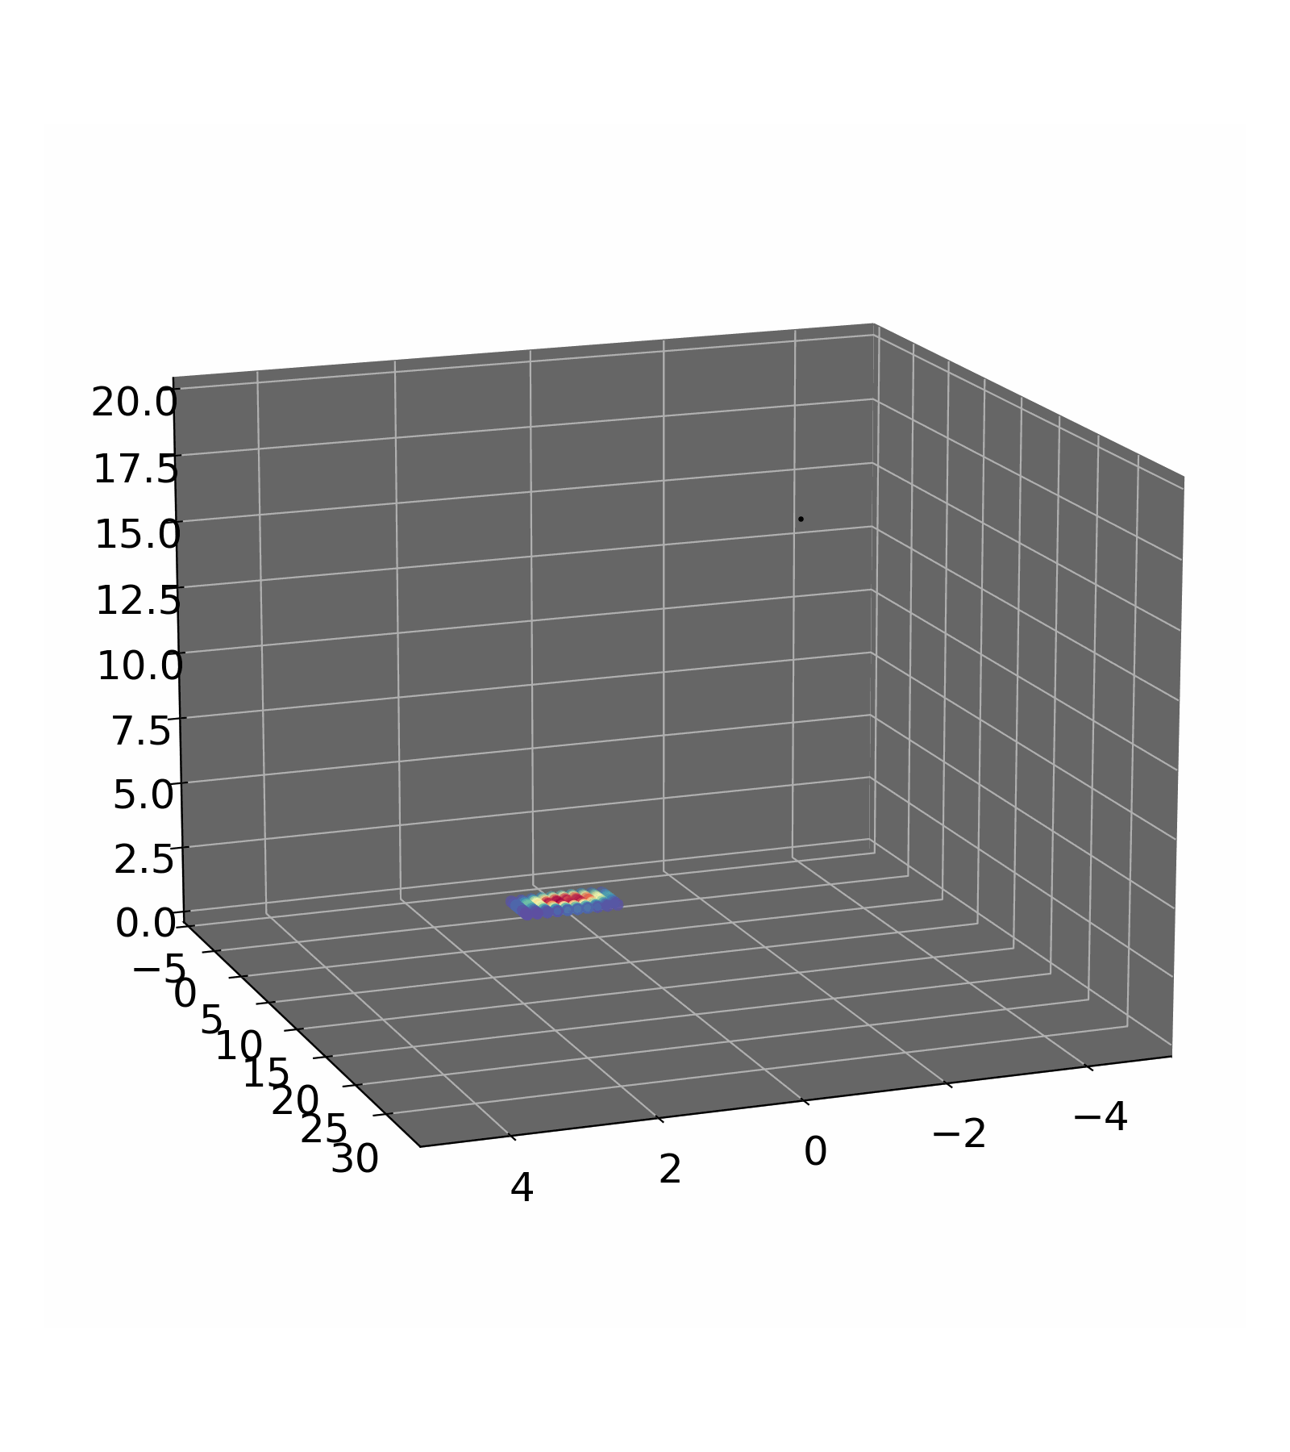
Solution : Radio interferometry
H. Schoorlemmer et al., “Radio Interferometry applied to air showers recorded by the Auger Engineering Radio Array,” ICRC, Jul. 2023, doi: 10.22323/1.444.0380

Slide 11
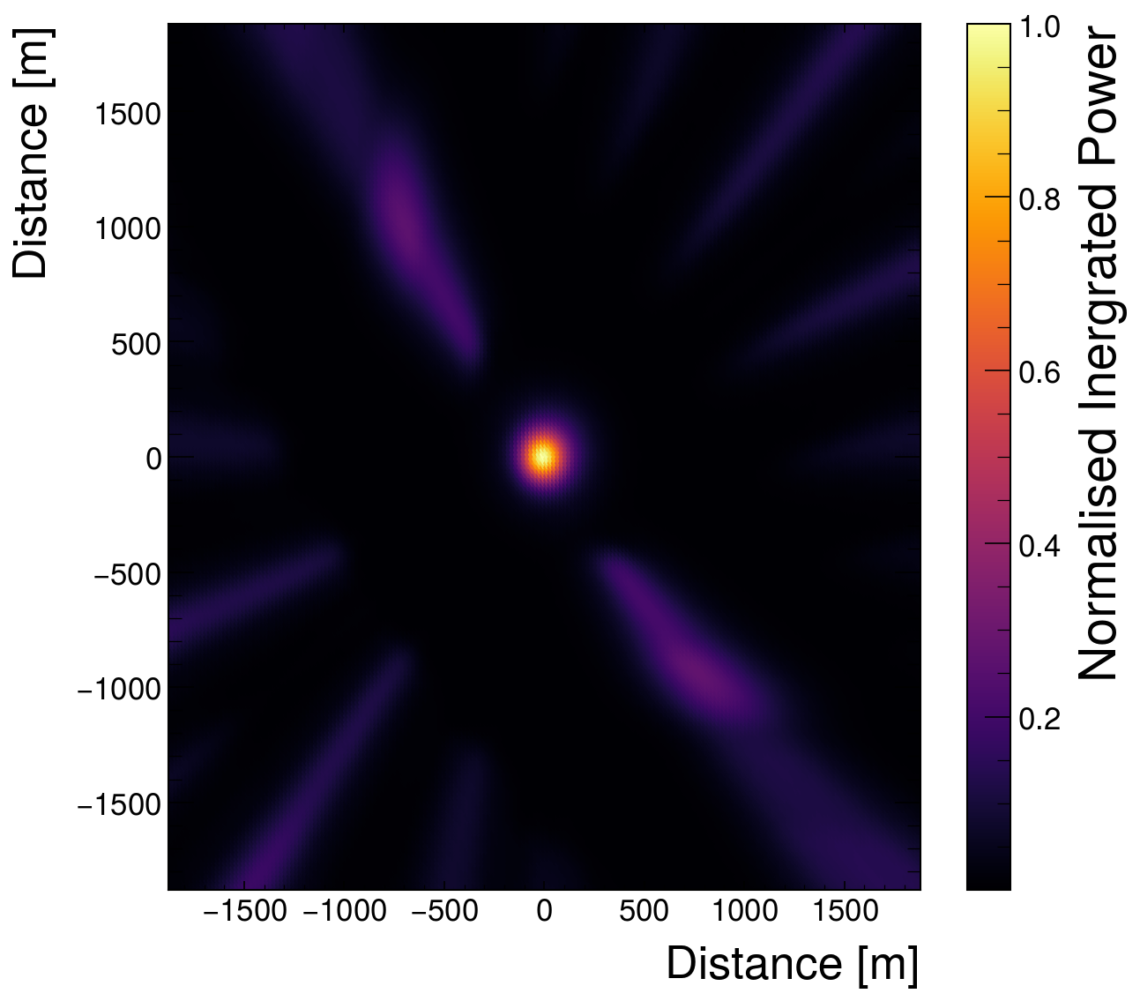
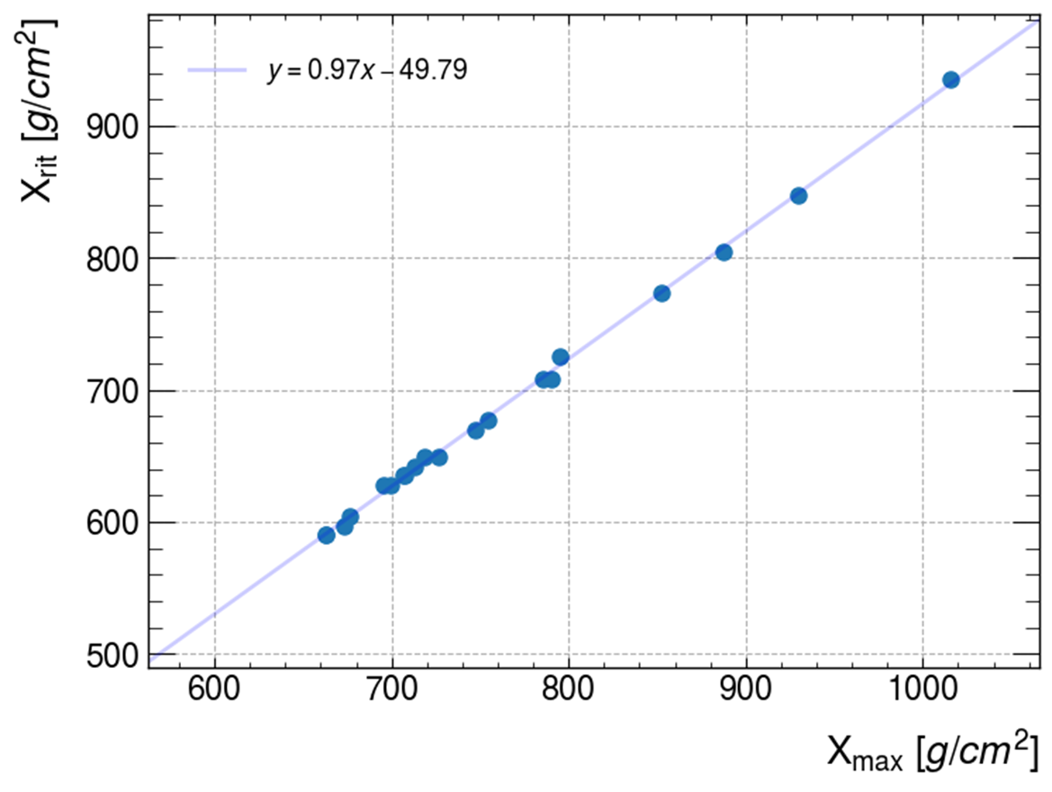
Interferometry for very inclined showers
Using 1EeV ZHAires proton simulations, with an Auger like atmosphere , altitude and triangular grid at 82 degrees.
*Simulation
With interferometry we can determine X_{max} for very inclined air showers with the radio detection technique.
http://aires.fisica.unlp.edu.ar/zhaires/

Slide 12
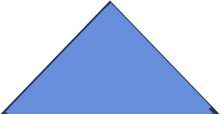
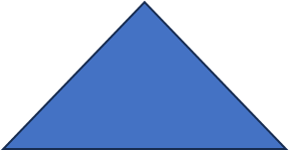
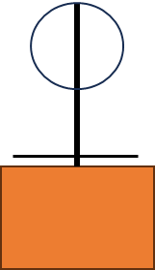
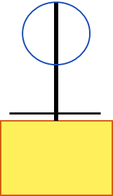
How to implement interferometry at Augerprime
This would require:
Timing precision O(ns)
Station localization of the O(30 cm)
A beacon emitting multiple sine waves can reach O(ns) demonstrated at Auger on a 10 km scale.
We will be using the existing beacon as a proof of principle
Beacon
*A. Aab et al 2016 JINST 11 P01018 :DOI 10.1088/1748-0221/11/01/P01018

Slide 13
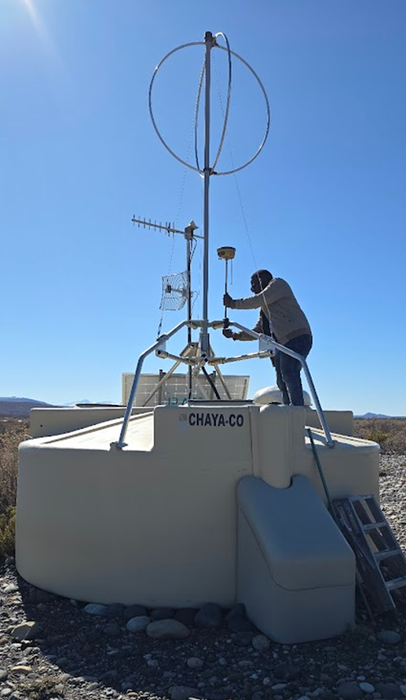
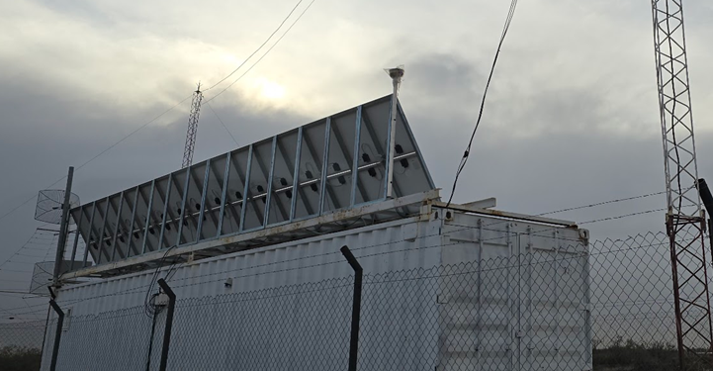
Locating our antennas accurately
Performed a differential GPS survey campaigns on the RD:
Ordinary GPS is accurate to about 5 meters.
Differential GPS can achieve accuracy on the order of a few centimeters.

Slide 14
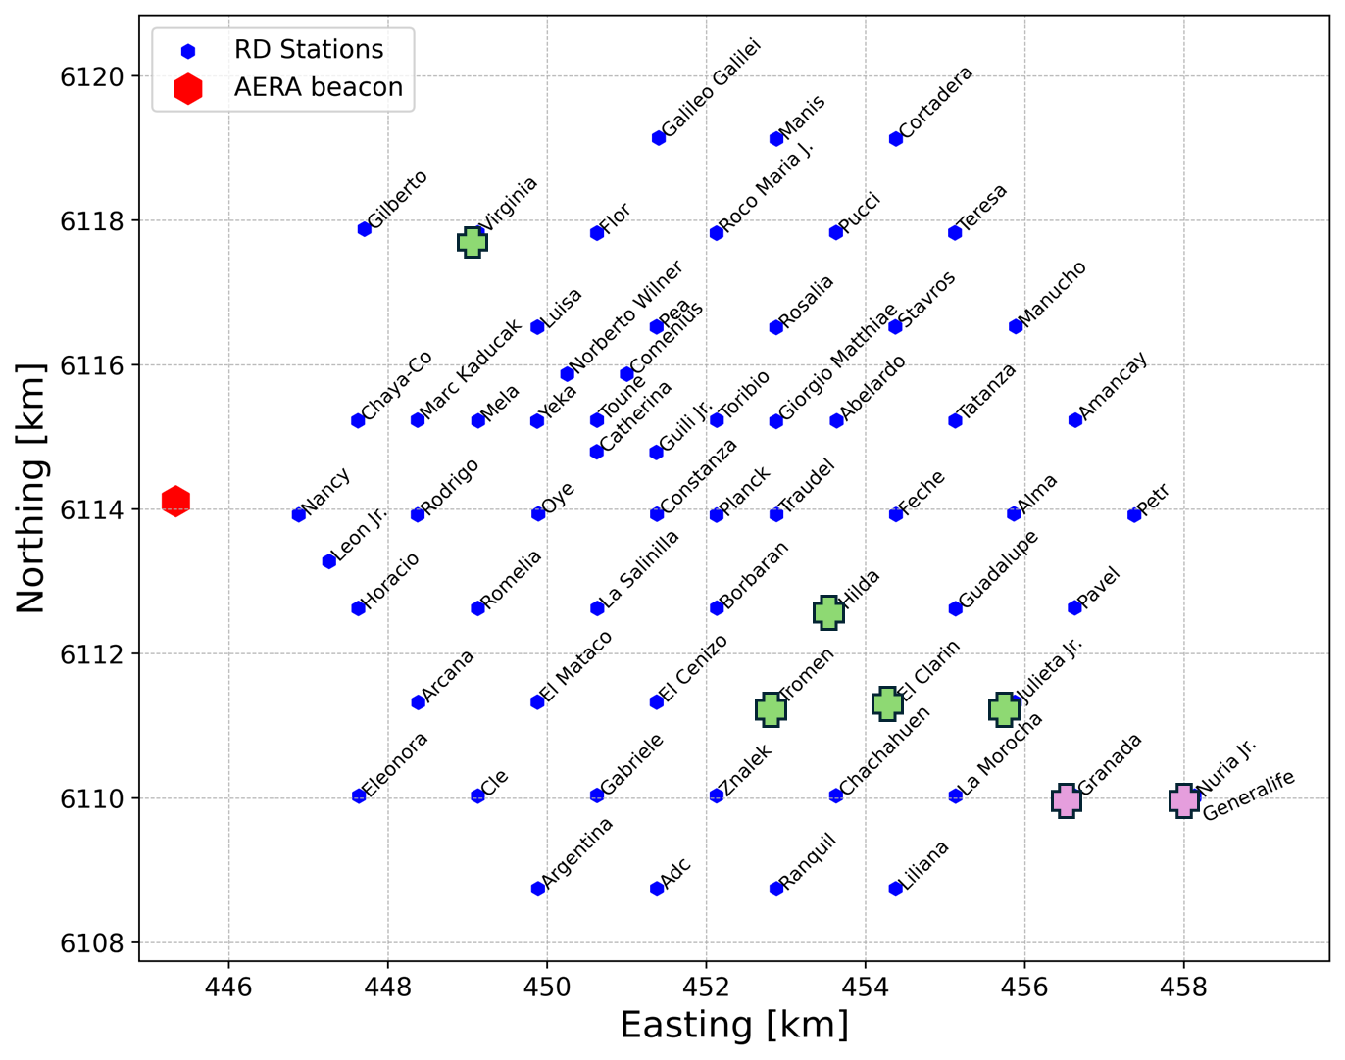
Survey Result
In total 64 stations were surveyed using DGPS, covering an area of ~35km².
All surveyed stations had enough signal from the beacon to reach O(ns).

Slide 15
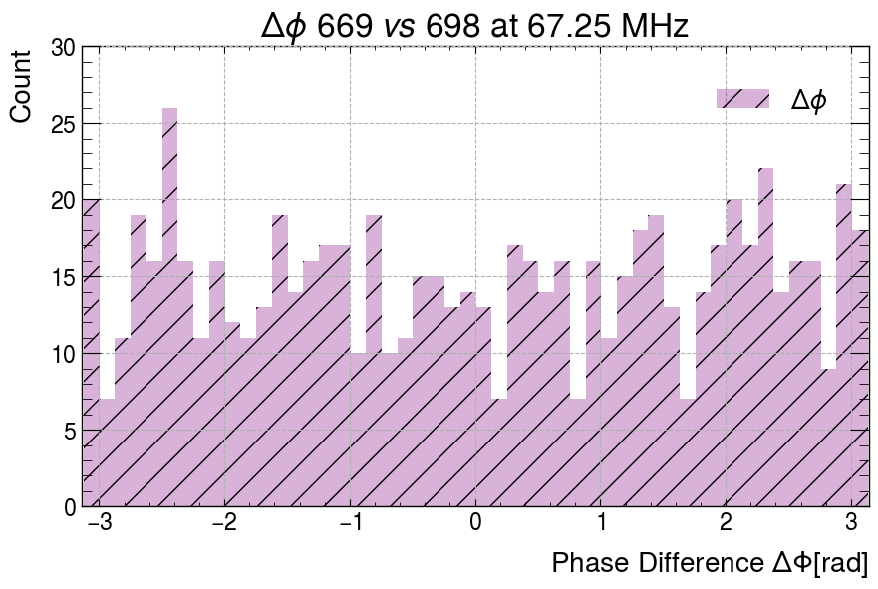
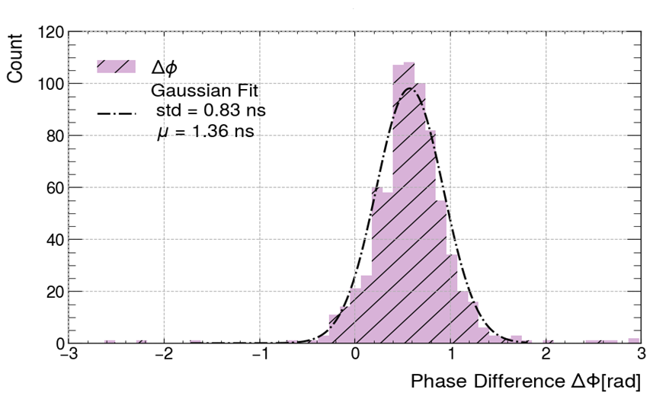
Timing precision of synchronisation
We use a TV signal, dominant in the EW channel of our antennas, as an independent test to assess the precision of our timing correction.
The distribution of phase difference on the TV line gives a standard deviation of 0.83 ns
There might be some broadening in the phase difference distribution due to the TV signal being amplitude-modulated.
Before
After

Slide 16
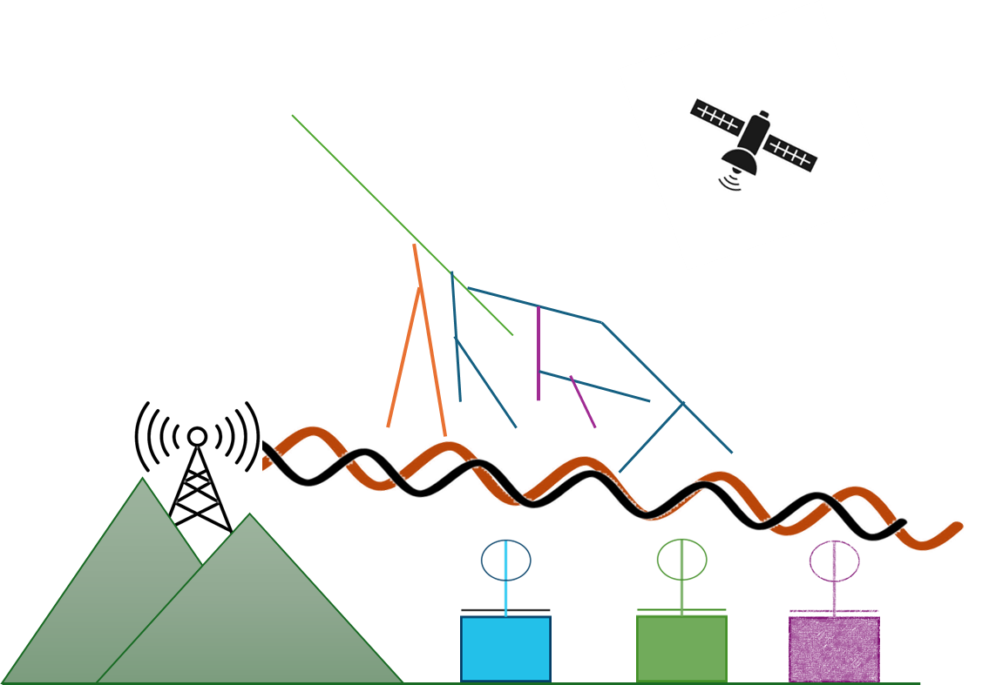
Outlook
Interferometry can determine in the X_{max} of very inclined showers .
Currently have surveyed an area of ~ 35 km² .
Aim to increase the range of the beacon and number of surveyed stations soon.
We can synchronise the RD to a precision of 0.83 ns.
Selection candidate events for interferometry

Slide 17
End

Slide 18
Synchronisation
::Extra::
Time offset

Slide 19
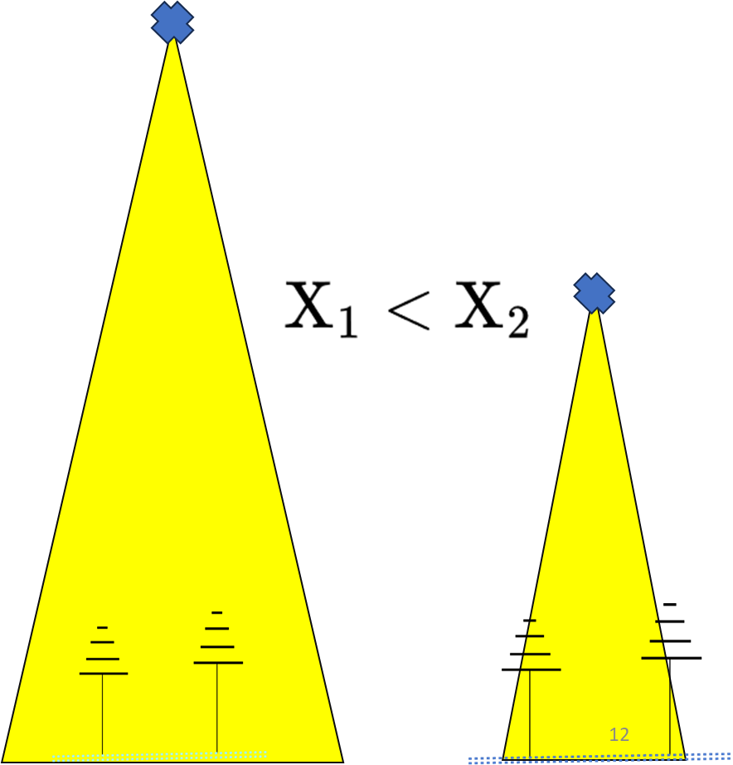
Effects of X_{max} and n on the footprint
::Extra::
The greater the n the wider the opening angle.
The deeper the X_{max} the smaller the area.

Slide 20
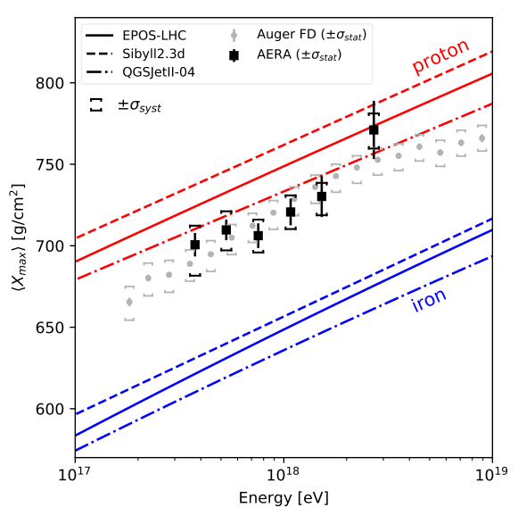
Simulated radio amplitude distribution
::Extra::
Auger Collaboration* , Radio Measurements of the Depth of Air-Shower Maximum at the Pierre Auger Observatory. ‌
r_{c750}=125 m

Slide 21
Locating our antennas accurately
::Extra::
Performed a differential GPS survey campaigns on the RD.

