Slide 1
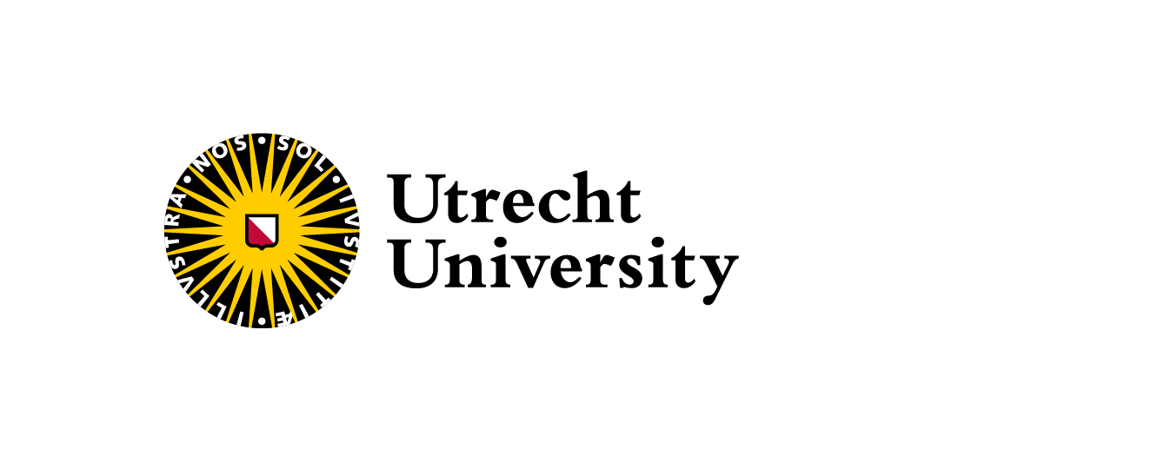
A neural likelihood estimator for fast evidence computation
Luca Negri
Utrecht University
NNV Astroparticles Meeting, 8 Nov. 2024

Slide 2
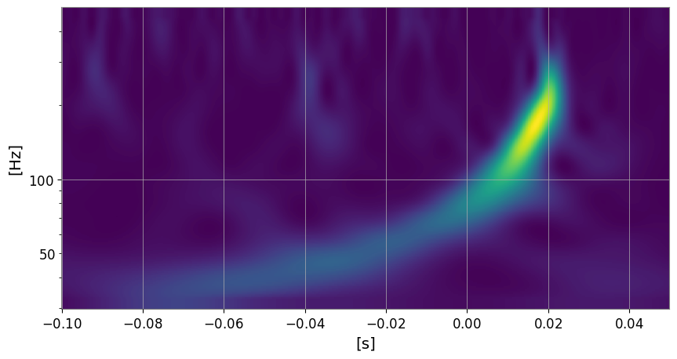
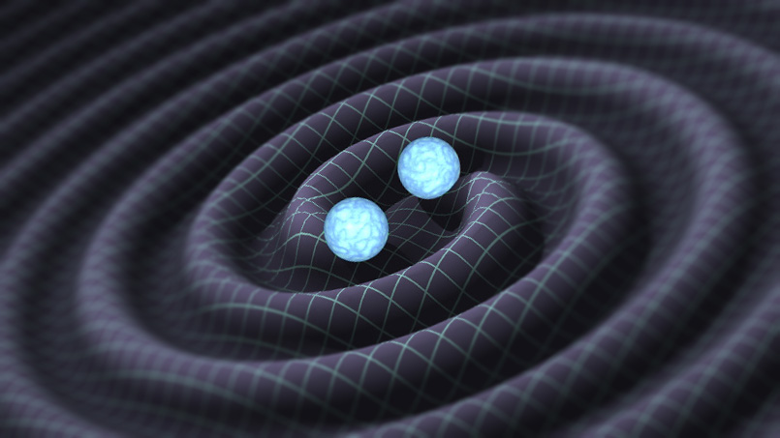
Introduction : Bayes theorem
Given (noisy) data y :
And model 𝜧 that depends on parameters 𝜽 = [m1,m2,Dl, …]:
Credit : Caltech
We can find 𝜽 by using the Bayes theorem:
Likelihood
Prior
Posterior:
what we want!
Evidence
Can be used for model comparison

Slide 3
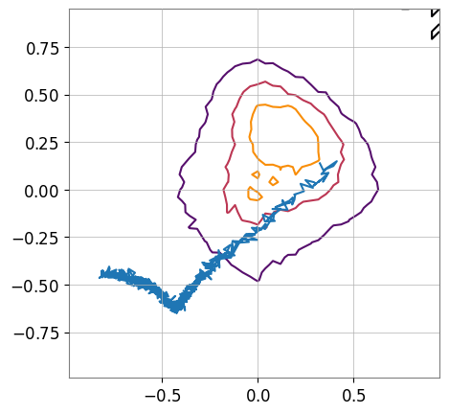
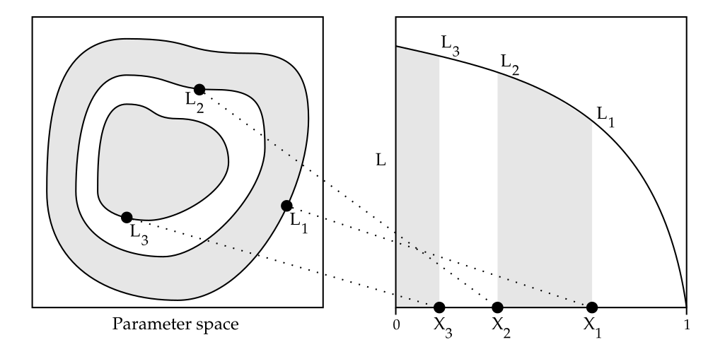
Introduction : Stochastic Samplers
Evaluating posterior samples on a grid is a very bad idea (curse of dimensionality), so instead we use Stochastic Samplers:
Markov Chain Monte Carlo (MCMC):
Gets posterior by skipping evidence calculation 🥲
Very versatile, well understood and tested for a long time (1957)
Nested sampling:
Stochastic integrator that evaluates evidence! 🤩
Harder sampling process, relatively new (2006) but growing fast
Credit : John Skilling

Slide 4
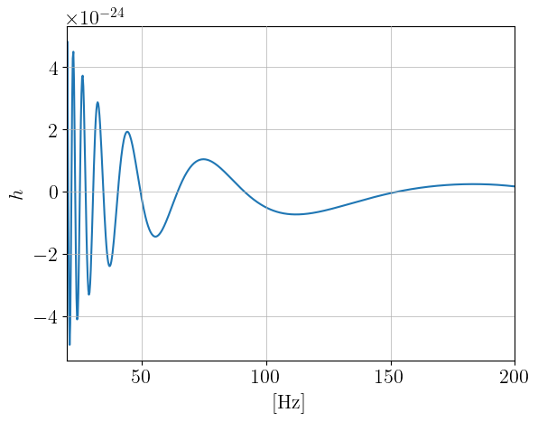
Introduction: GW likelihoods are expensive
We still need to evaluate the posterior for a lot of samples …
Simulate for some 𝜽
Project
Compare
Repeat for 𝜪(10⁶), 𝜪(10⁷) times
Assuming 1s per likelihood, and 3e6 evaluations:
~ 33 days to analyze a single signal …

Slide 5
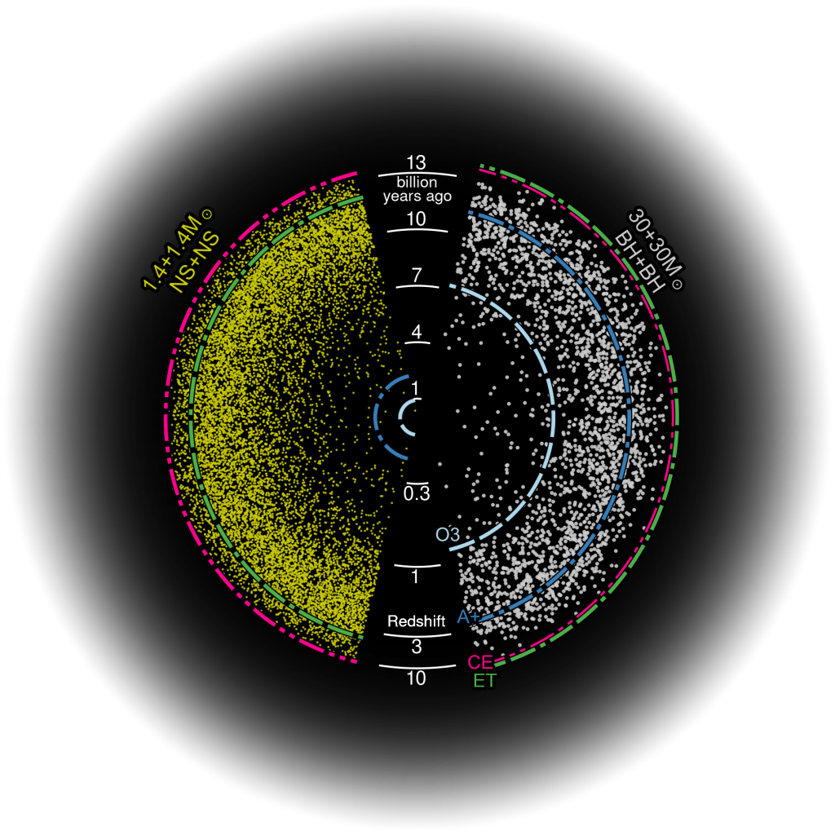
Introduction : It's going to get much worse …
The next gen of interferometers will come with a new set of challenges:
We are not ready to analyze this data!
~1000 times more signals → | ~1000 more problems
Signals will be louder → | Need more accurate modelling
Signals will be longer → | Need longer simulation time
Overlapping signals → | Parameter space harder to explore
Credit : Evan Hall, Salvatore Vitale/ MIT

Slide 6
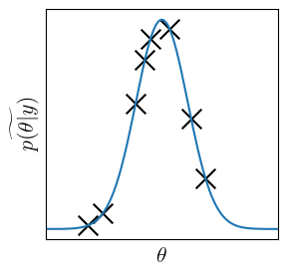
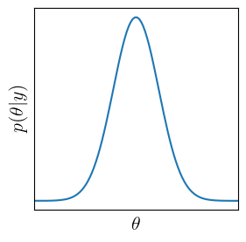
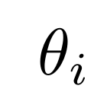
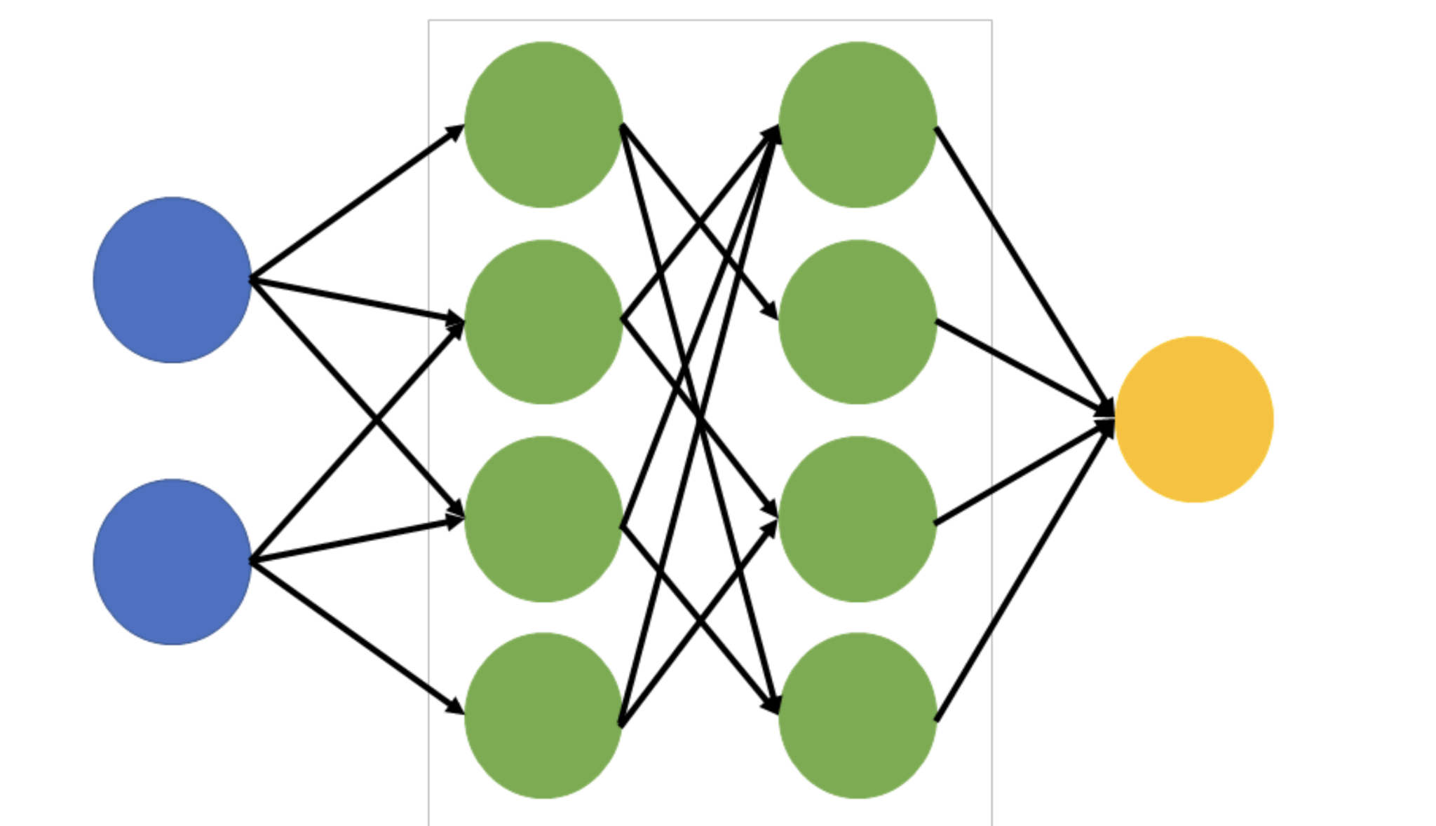
Machine Learning can help! … Right?
Maybe! Many works already dedicated to speeding up calculations with ML:
Neural posterior estimators : Given the data, directly estimate the posterior (Dingo, 2021):
Fastest inference
Expensive training
Not very flexible
No reliable access to evidence
Neural proposals : approximating the posterior to choose smart 𝜽s (Nessai, 2022):
Very flexible
Reduction of likelihood evaluations by ~10
Can get the evidence
𝜽_{N+1}
y

Slide 7
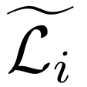
Neural likelihood estimators
Neural likelihood estimators: Train a net to approximate the likelihood (Bambi, 2012):
Speeds up inference
Easily parallelizable with GPUs
Quick access to the gradient of the likelihood
Most flexible! You can use any sampler you want with the neural likelihood. (Nested sampling)
But …
Generating the training set can be expensive
… and you have to train a new one for every new signal
… and still you have to run the sampler afterwards

Slide 8
Introducing FLEX
We are developing a framework that allows calculating Fast Likelihoods for Evidence approXimation (FLEX). How? Well:
Evaluate initial set of likelihoods with parameter sampled from the prior
3. Train the network
4 . Run nested sampling on the FLEX likelihood
Get more interesting samples by approx the posterior
Training set

Slide 9
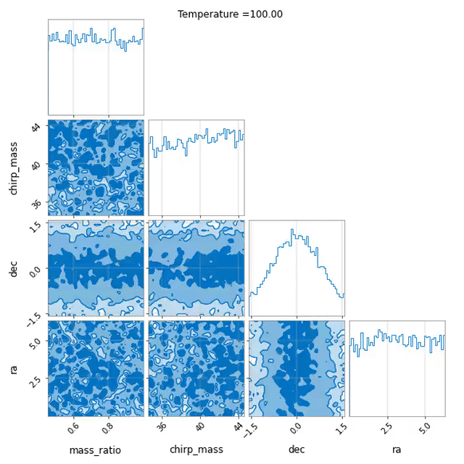
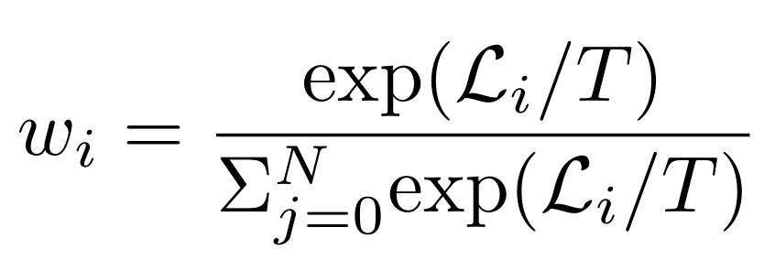
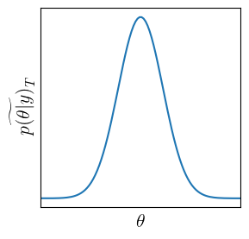
Get training samples, in a smart way
Using weighted Kernel Density Estimation (KDE) allows us to get progressively less-awful approximations of the posterior
Assign weights to each sample with softmax
4. Add new samples to {𝜽_{i} } and repeat with lower T
2. Train a KDE on {𝜽_{i} } with weights {w_{i}}
3. Take K new samples from the KDE
and calculate their likelihood

Slide 10
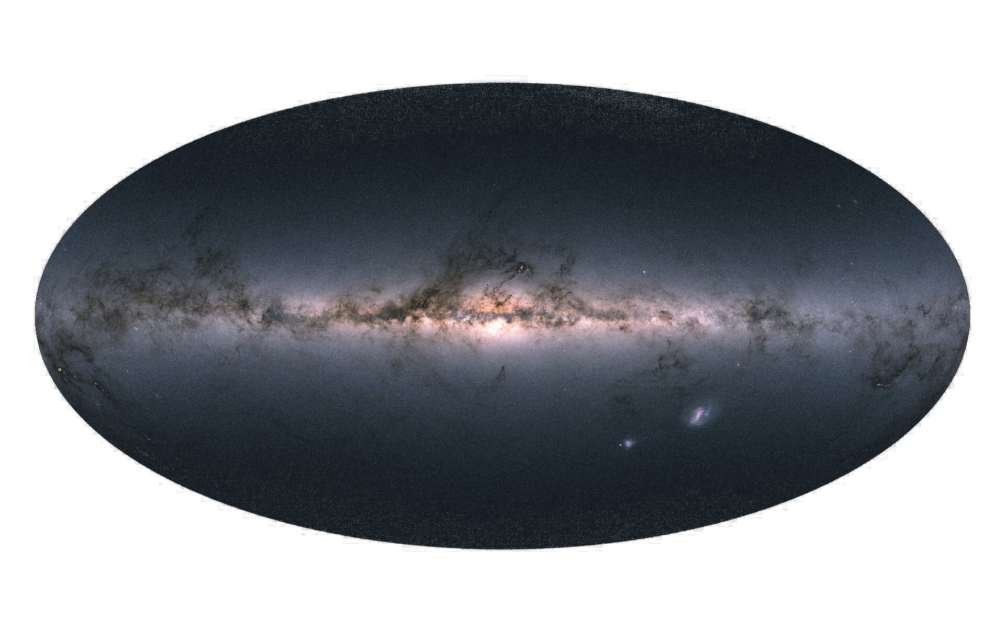
1.2 Reduce computation costs
We can also use data augmentation to reduce training costs
✕
✕
✕
✕
Credit : ESA
Generate one waveform (most expensive part the whole inference process)
Simulate it coming from different sky positions (cheap)

Slide 11
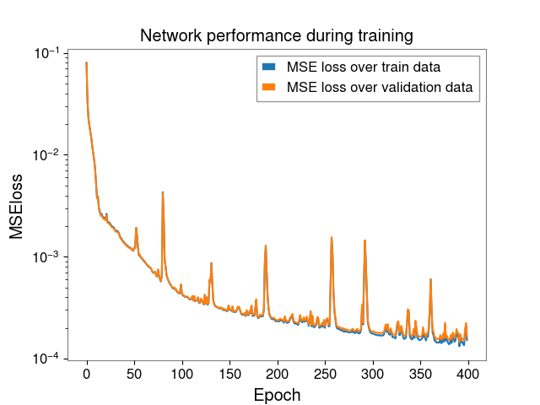
2. Training the network
After preparing the training set, the network can finally learn to approximate the likelihood.
Trained to estimate the log likelihood, but error calculated on e^{log(ℒ)}

Slide 12
3. Inference
Likelihood evaluations timing for a short BBH:
🐌
🏍️🏍️🏍️🏍️🏍️
~13 000s (3 and a half hours) for 3e6 evaluation
~1s (1/3600 of an hour)
for 3e6 evaluation
Best case scenario for vanilla samplers
We are using the Dynesty nested sampler to finally solve the Bayes theorem with the approximate likelihood
Very stable
Very accurate
Already used by the collaboration

Slide 13
Disclaimer
This is a work in progress!
Dynesty, while being amazing, it is not optimized for FLEX
We are not seeing the theoretical 10⁴ speed improvement since there is a lot of overhead time 🐌
This slow and steady approach allows us to ensure the FLEX likelihood is accurate 🎯

Slide 14
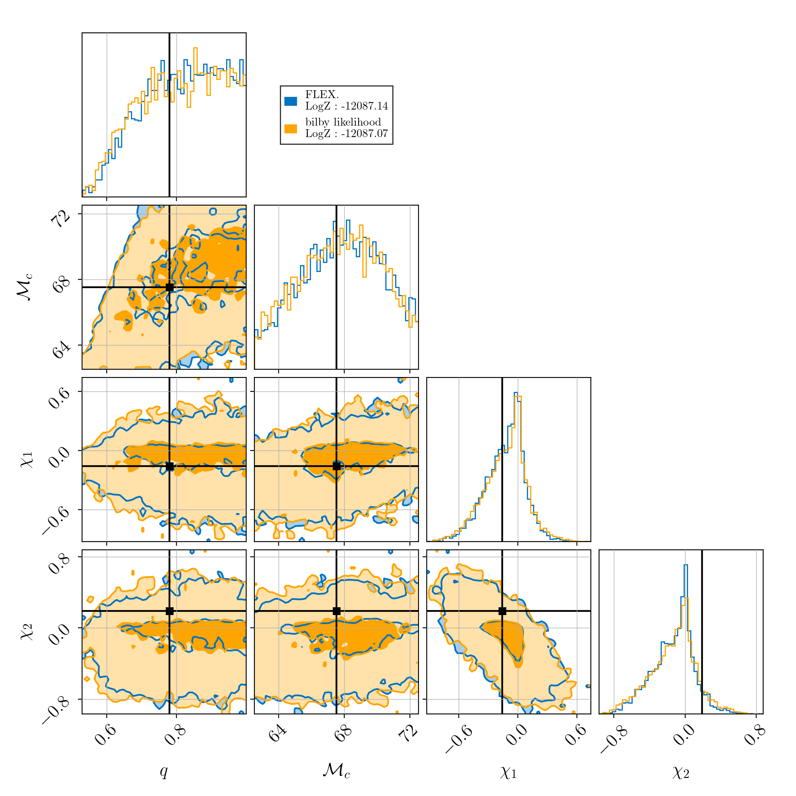
So, is it good?
A lot of test carried out on simulated Binary Black Hole signals injected in the current gen of interferometers
Model | Log Evidence | N Waveforms
Original | -12087.07 | ~ 4e6
FLEX | -12087.14 | ~ 8e4
50 times reduction
🎯
🏍️
(potentially)

Slide 15
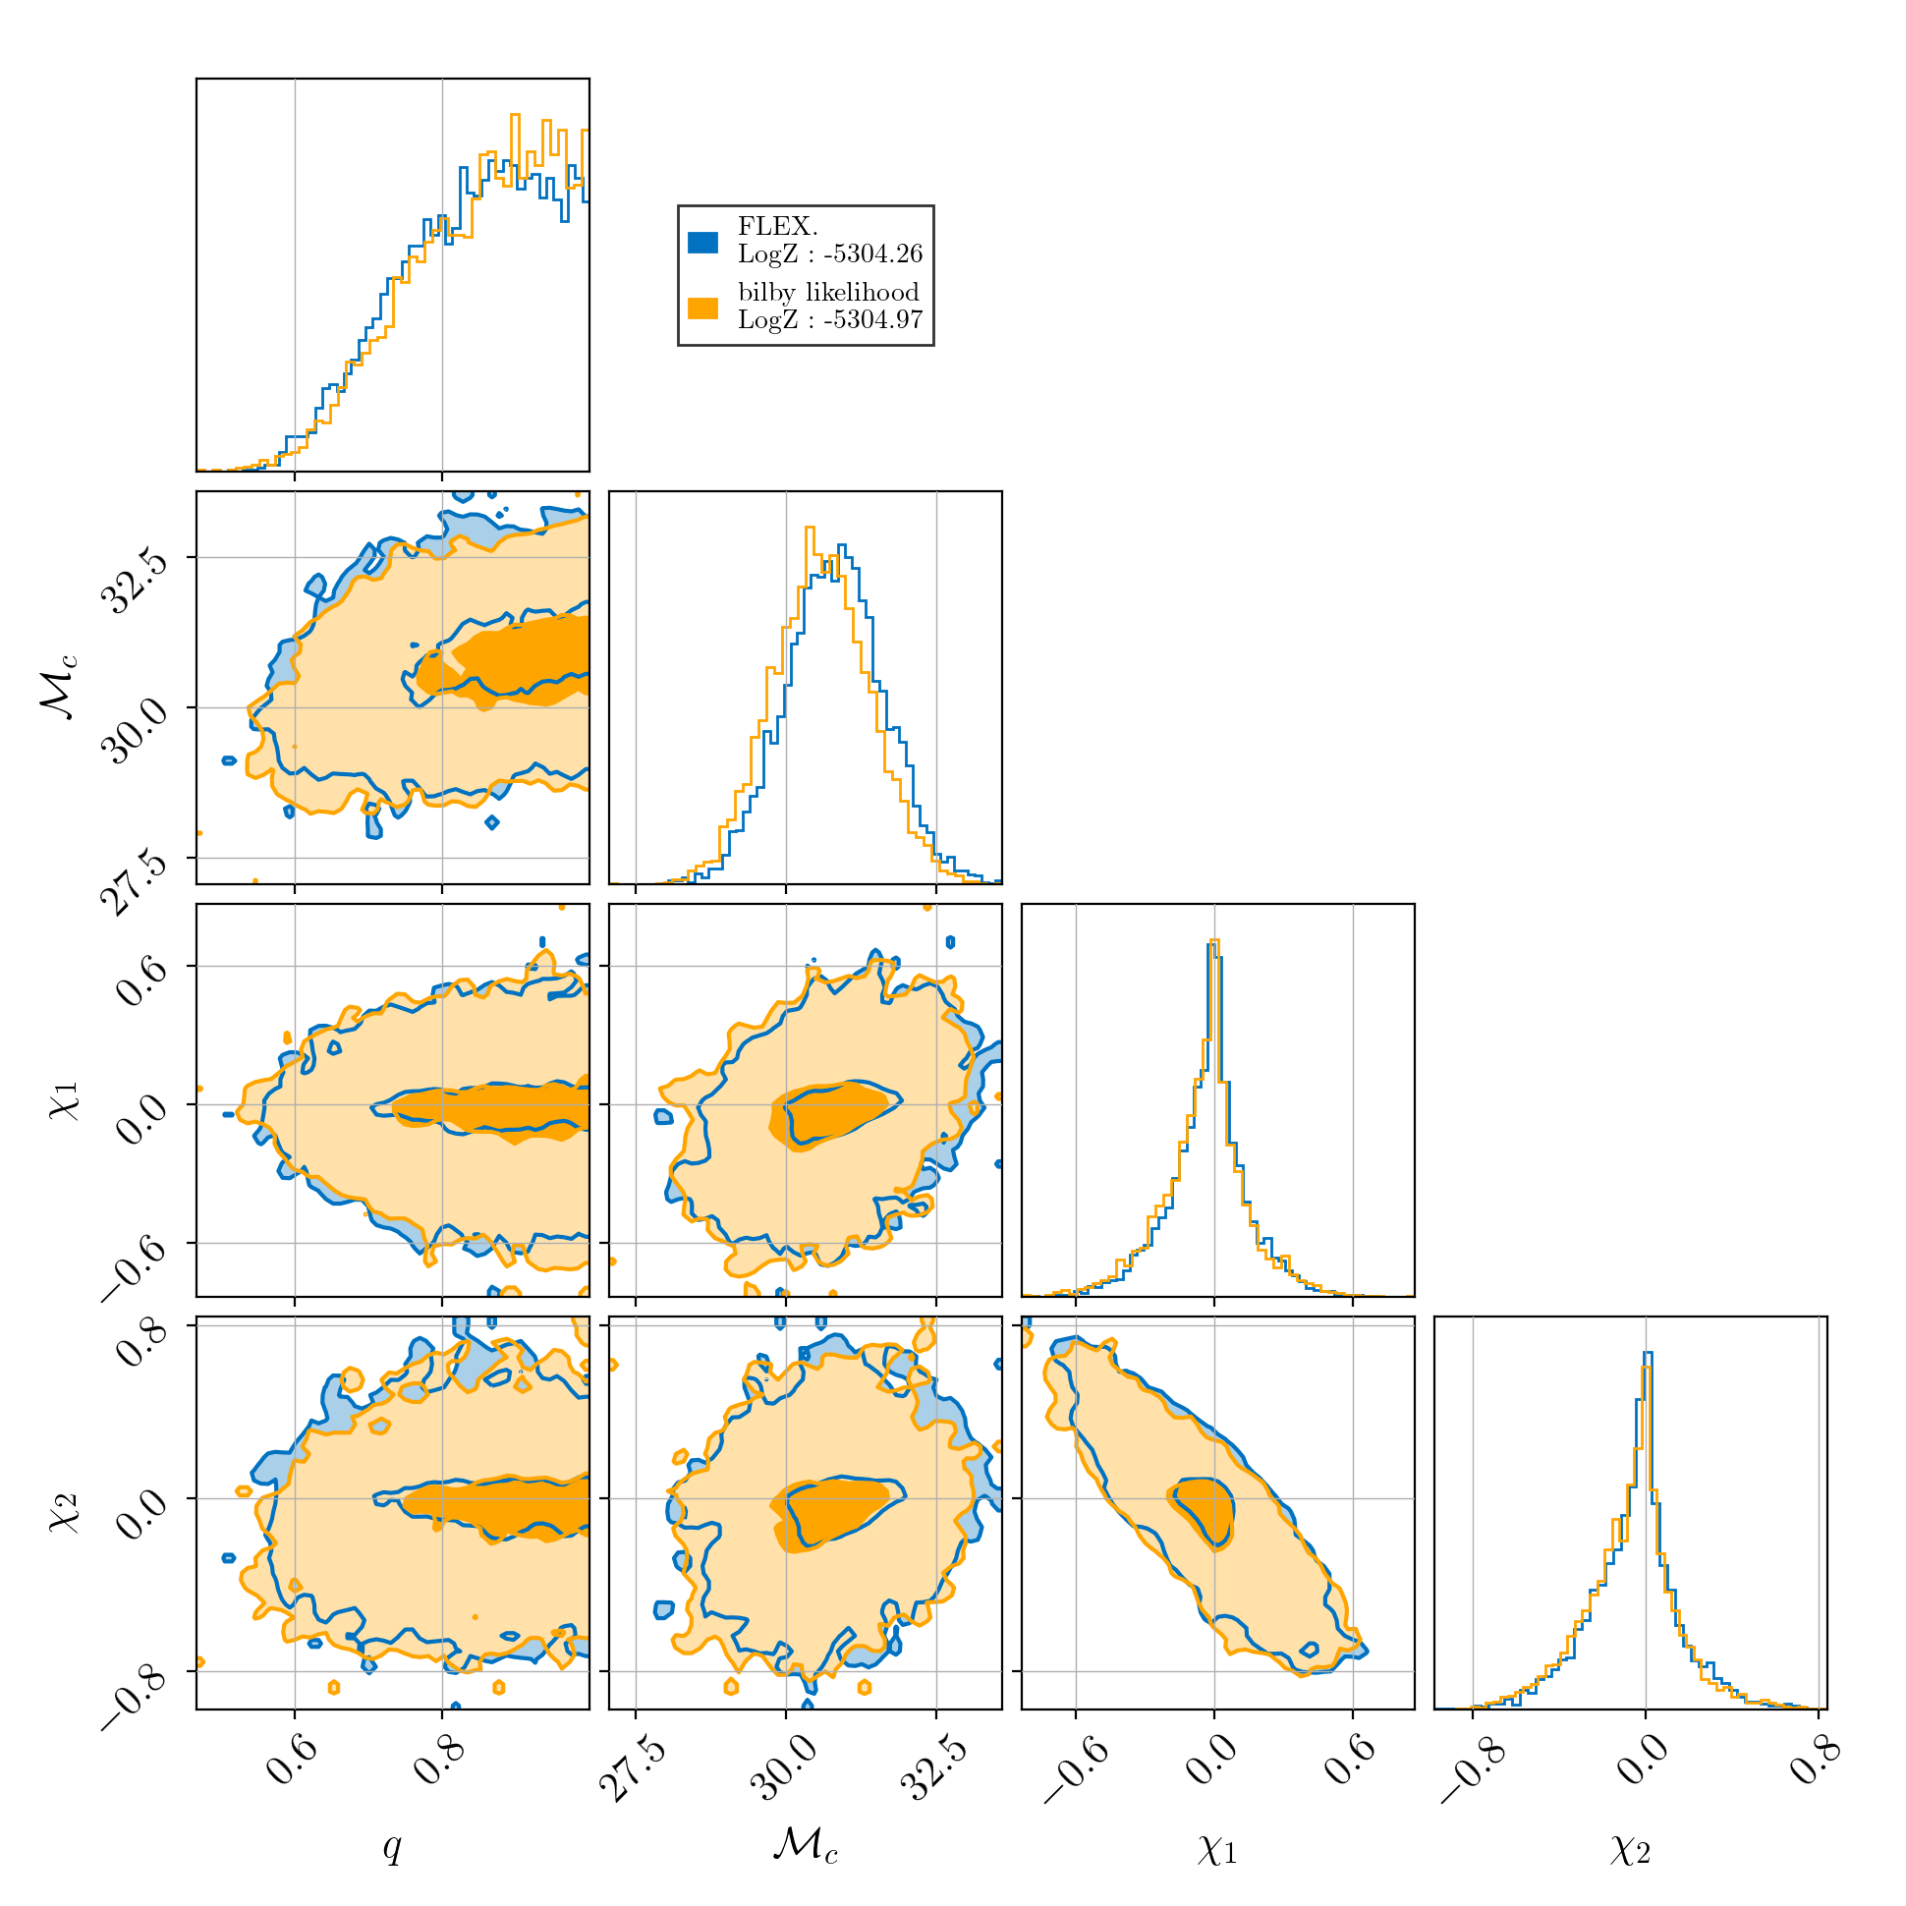
Using it on real data: GW150914
Model | Log Evidence | N Waveforms
Original | -5304.26 | ~ 2e7
FLEX | -5304.97 | ~ 3e5
60 times reduction
Still obtaining decent results!

Slide 16
Conclusions
Neural Likelihood seem to be a viable option for fast parameter estimation and get accurate evidence
Get similar results with ~50 times less waveform evaluations than vanilla runs
But …
Still a lot of work to do
Make algorithm more stable
Test on different kinds of signals (BNSs, next gen)
Modify Dynesty to take advantage of FLEX

Slide 17
Thank you!
:)

