Slide 1
Sexaquarks: Quarks uniting to form Dark Matter at LHCb
Wouter Morren
8 November 2024

Slide 2
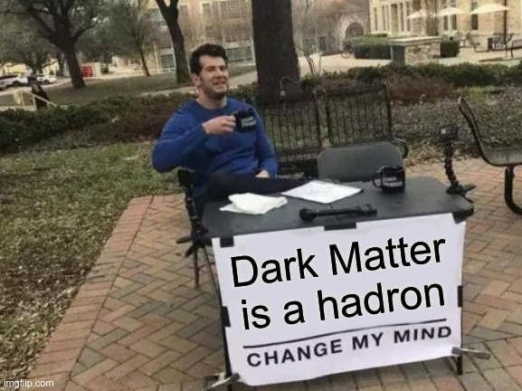
Overview
What!?
How?
Interaction with detector material
Missing momentum
Why not both?
Dark Matter is a baryon

Slide 3
What!?

Slide 4
Sexaquark (S)
Six quarks: uuddss
Strangeness S=-2
SU(3)_{c} x SU(3)_{f} x SU(2)_{s} singlet → deeply bound
Flavourless: in $m_{u}=m_{d}=m_{s}$ limit → no pion cloud → compact
Colourless: rgbrgb
Neutral: $Q=2∗\frac{2}{3}−4∗\frac{1}{3}$
Spinless scalar: $u↑u↓d↑d↓s↑s↓$
Symmetric spatial wavefunction → small charge radius
Stable?

Slide 5
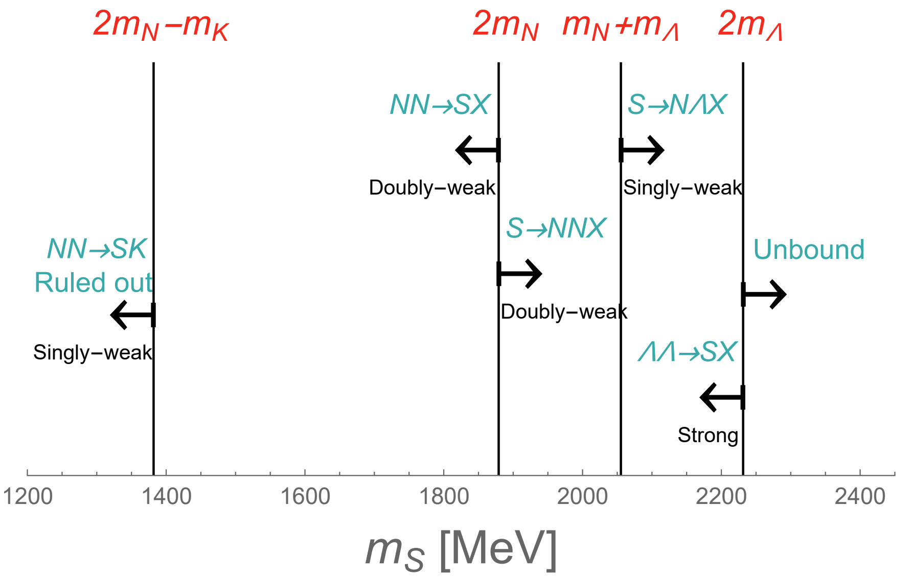
Mass & stability
$1875.1 MeV=m_{D}−m_{e}<m_{S}<m_{D}+m_{e}=1876.1 MeV$ $D→SX$ (S stable)
For $N=p, n$, possible $m_{S}$ are:
Theory predicts 1.2 - 2.23 GeV
Look for:
$$1875.1<m_{S}<2055 MeV$$
Unstable nuclei & neutron stars
Unstable nuclei
Resonance
S cosm. stable
S stable ←
→S unstable

Slide 6
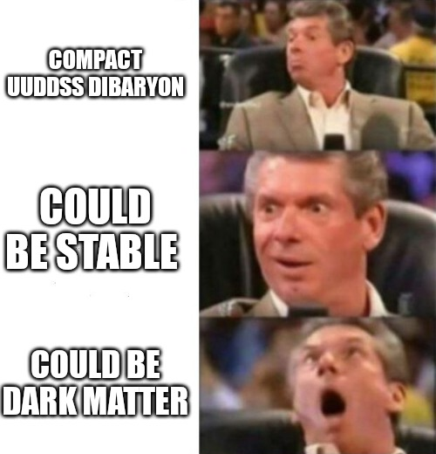
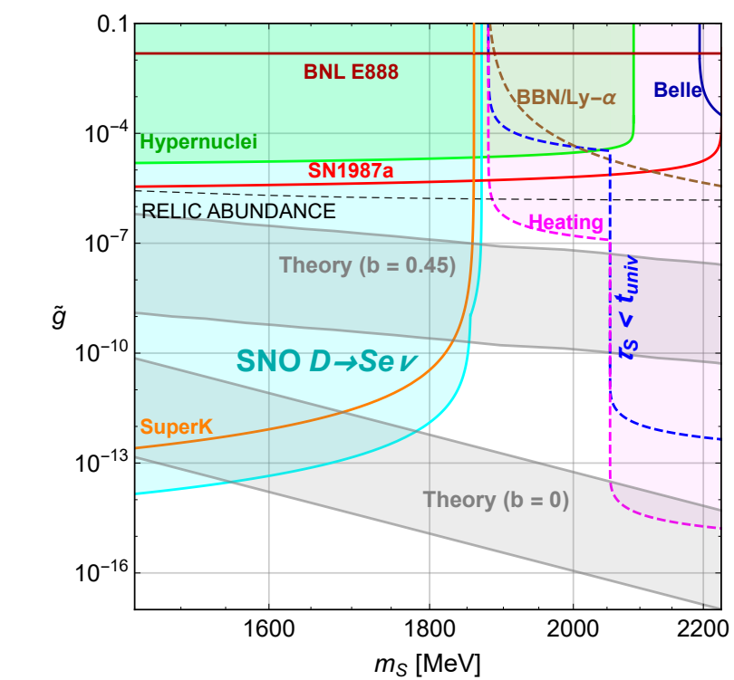
Sexaquark the saviour?
It could:
(Partially) explain DM
Resolve the muon g-2 anomaly (if it still is one)
Mean low mass Neutron stars have S core or layer
Many unknowns (detectability & abundacy):
$m_{s}$
$σ\left(pp→\overline{S}/SX\right)$ production
$σ\left(S\overline{S}→X\right)$ & $σ(\overline{S}/Sb→{\overline{b}}^{′}X)$ annihilation
$σ\left(\overline{S}n\right)$ scattering from polarisation
$r_{S}=λ_{S}+bλ_{m}≈0.2−0.3 fm$ charge radius
$\tilde{g}$ interaction strength to hadrons
$σ\left(DMp\right)<10^{26.2} cm^{2}$ for $m_{s}≈2 GeV$ (scattering) [18 farrar]
if S=DM

Slide 7
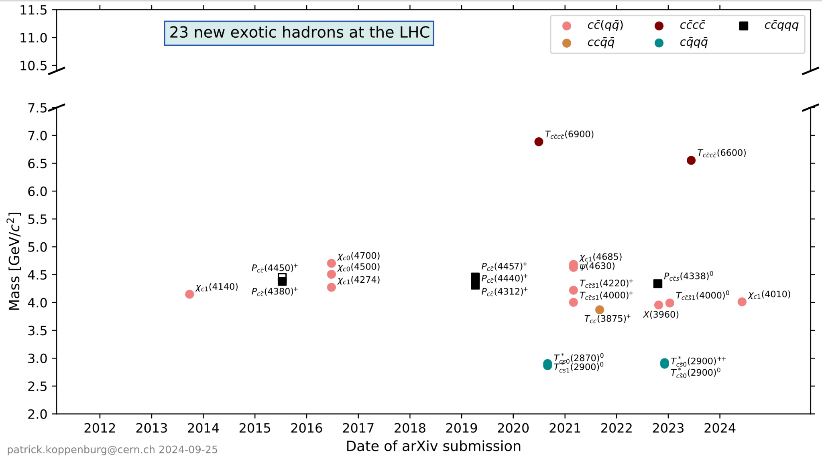
Other exotic hadrons
Sexaquark $∈$:
hexaquark (6-quark state)
hyperons (baryon ≥1s)
Found:
Deuteron: uud udd (spin-1, stable)
D*(2380): uuuddd (spin-3)
${}_{Λ}^{3}H$: uud udd uds
Many exotic tetra- and pentaquarks at LHCb
Not found (yet):
$ΛΛ$ molecule: uds uds

Slide 8
How?

Slide 9
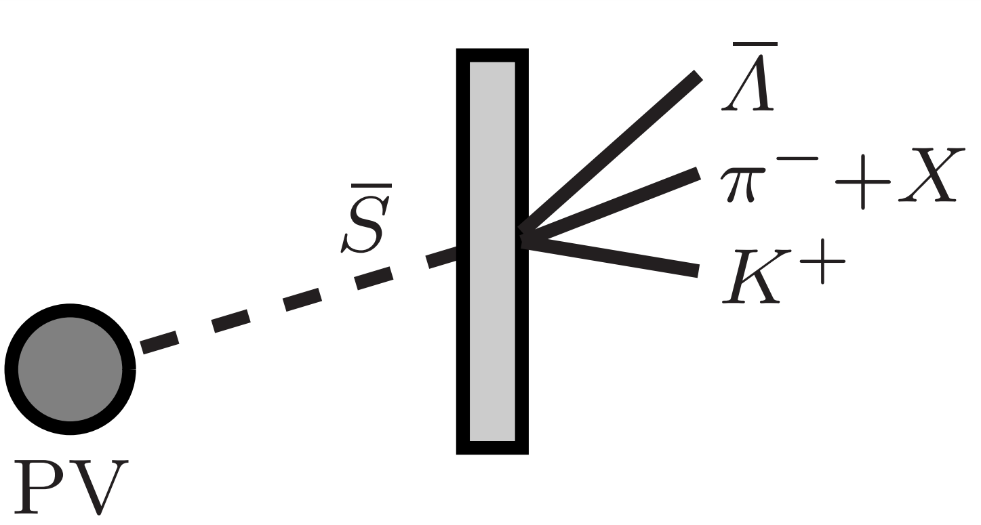
Method 1: Interaction with detector material
Stable → $\overline{S}$ from QGP annihilating in LHCb detector
Trigger on $B=−1$ & $S=+2$
$\overline{S}p→\overline{Λ}K^{+}$ & $\overline{S}n→\overline{Λ}K_{s}^{0}$ ← We are here
$\overline{S}p→{\overline{Ξ}}^{+}X$ & $\overline{S}n→\overline{Ξ}X$
$\overline{S}p→K^{+}K^{+}X$ & $\overline{S}n→K^{+}K^{+}X$
$\overline{S}p→\overline{Λ}\overline{Λ}X$ & $\overline{S}n→\overline{Λ}\overline{Λ}X$
Collect extra particles $X$ from same vertex
Background: $Ξ$ interacting with material
Goal: production + annihilation cross section

Slide 10
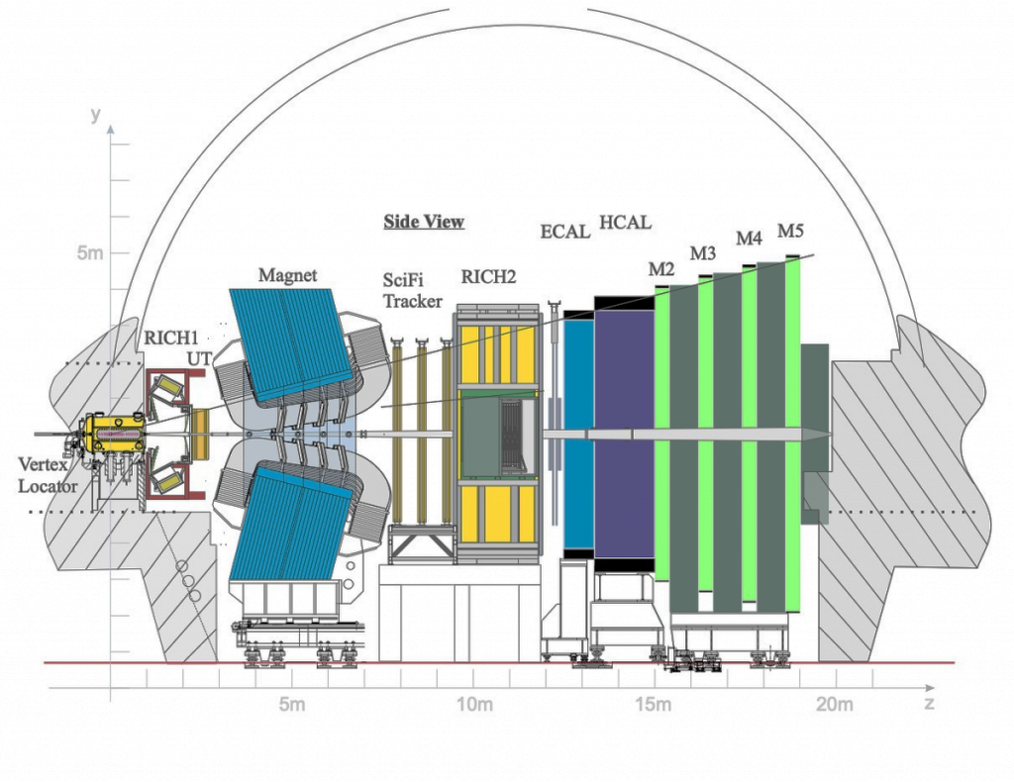
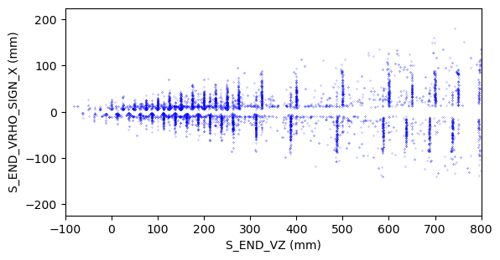
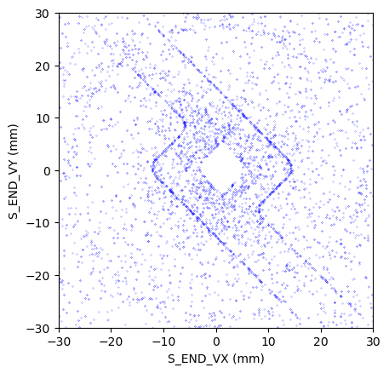
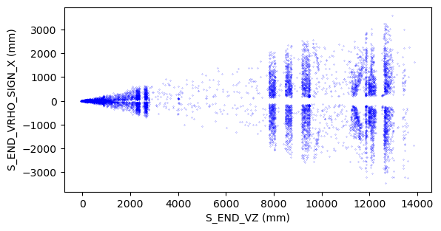
Annihilation vertices
Showing simulated $\overline{S}p$annihilation vertices
Even the vacuum RF box can be used
→ Add material selection
Vertex Locator (VELO) & RF box:

Slide 11
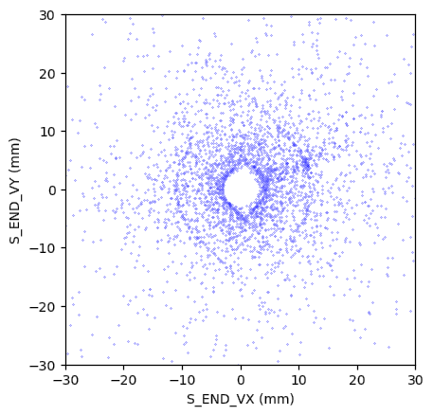
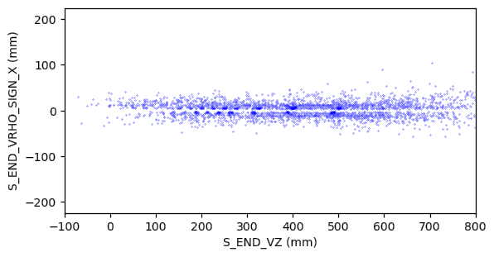
First data
Started taking data with trigger line since late August
Found mass peak $Ω^{+}→\overline{Λ}K^{+}$($\overline{s}\overline{s}\overline{s}→\overline{u}\overline{d}\overline{s}+u\overline{s}$)
Useful for refining cuts
To be continued…

Slide 12
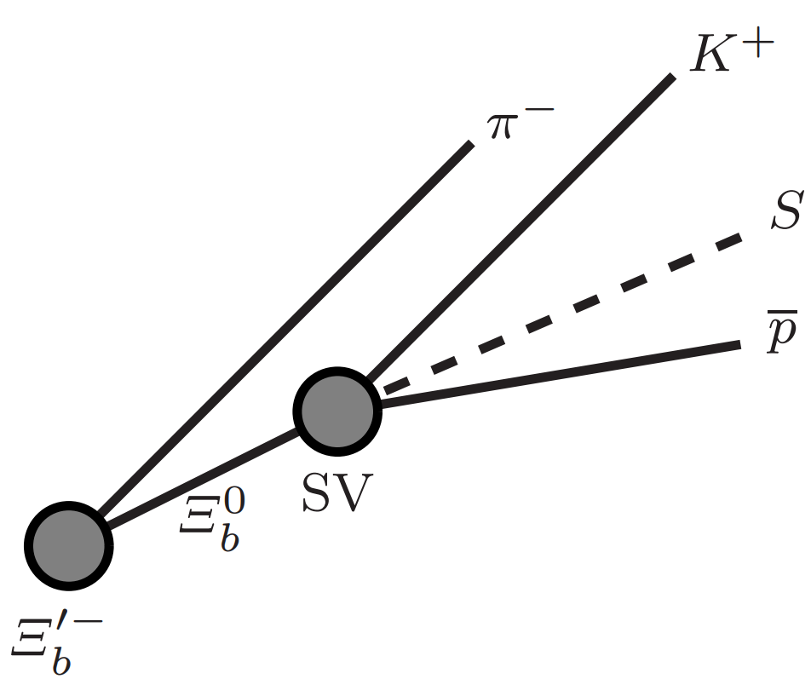
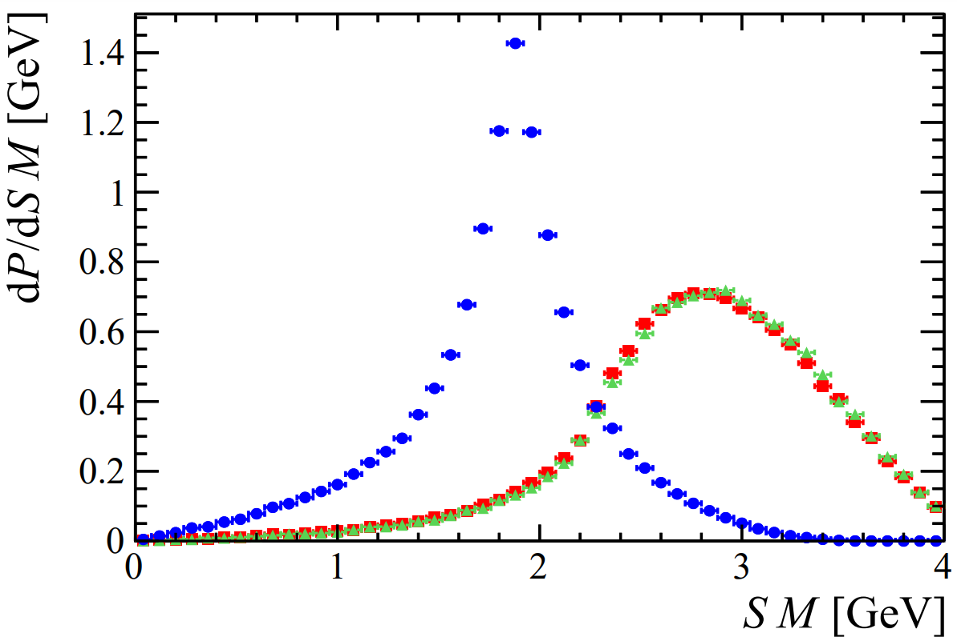
Method 2: Missing momentum
Reconstruct mass of missing particle from all other particles:
$Ξ_{b}^{0}→S\overline{p}K^{+}$, where $Ξ_{b}^{∗−}→Ξ_{b}^{0}π^{−}$ or $Ξ_{b}^{′−}→Ξ_{b}^{0}π^{−}$ ← We are here
$Λ_{b}^{0}→S\overline{p}K^{+}$, where $Σ_{b}^{−}→Λ_{b}^{0}π^{−}$
$B^{+}→S\overline{p}K^{+}$, where $B_{s2}^{∗}\left(5840\right)→B^{+}π^{−}$
Background:
$Ξ_{b}^{0}→ΛΛ\overline{p}K^{+}$
$Ξ_{b}^{0}→Ξ^{0}n\overline{p}K^{+}$
Charge conjugate included
Goal: Rate $Ξ_{b}^{0}→S\overline{p}K^{+}$& $m_{S}$

Slide 13
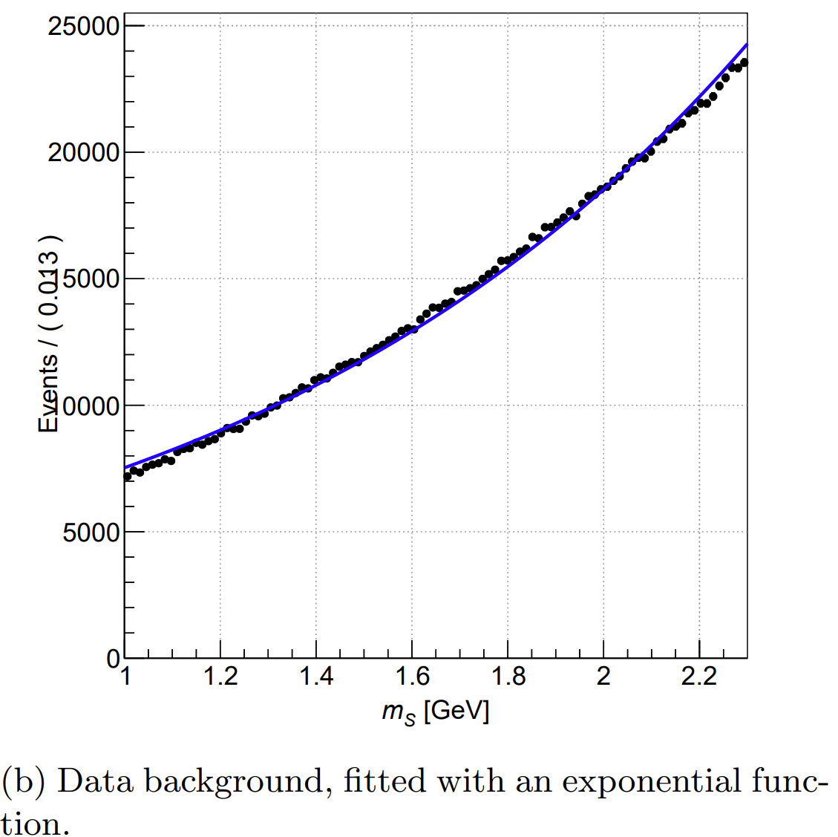
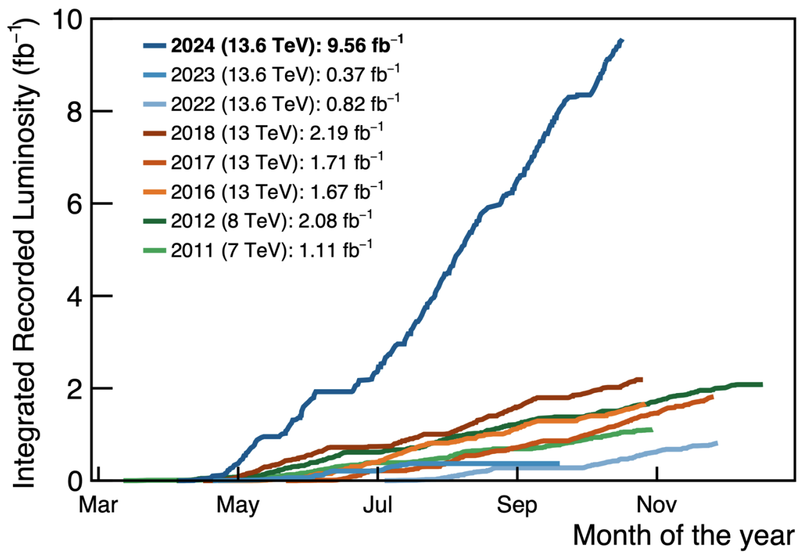
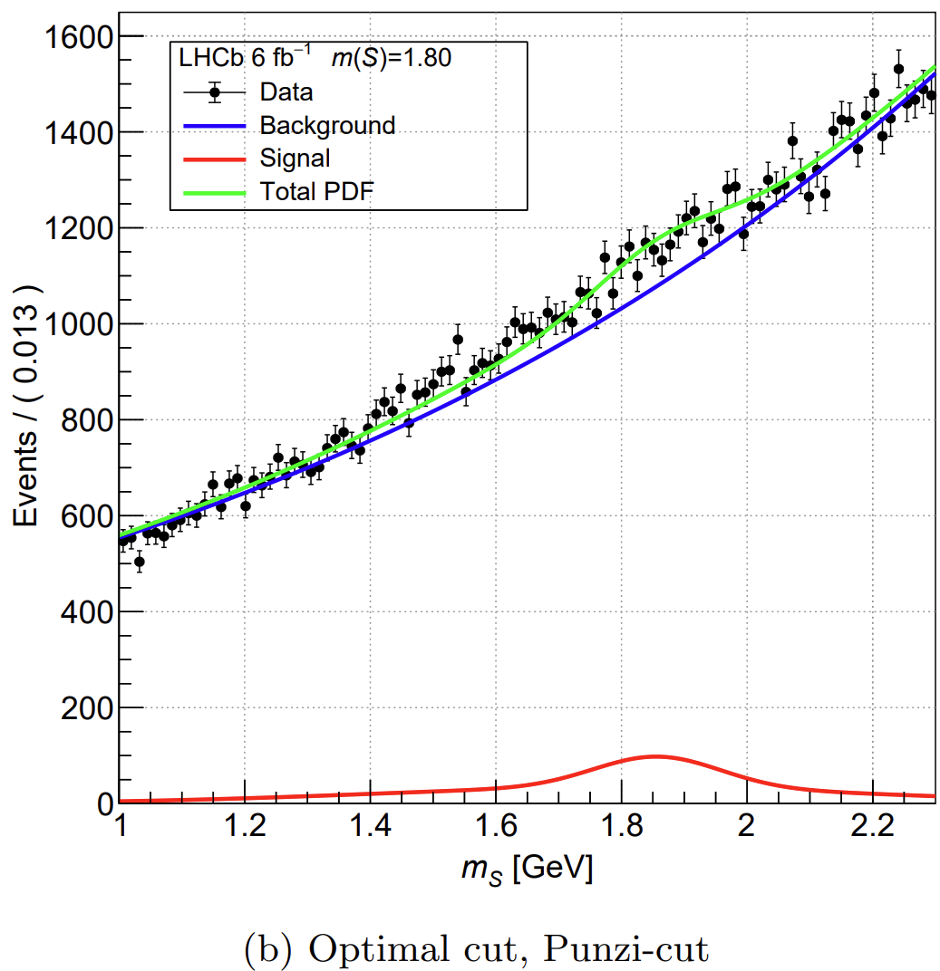
Preliminary results
MSc Alex Doheny (finished):
Mass shape not understood, hard to assess if there is signal
Background source unknown and background search not fruitful yet
Niels Odijk:
Run 3: more data!
Looser selection cuts
Better understand background

Slide 14
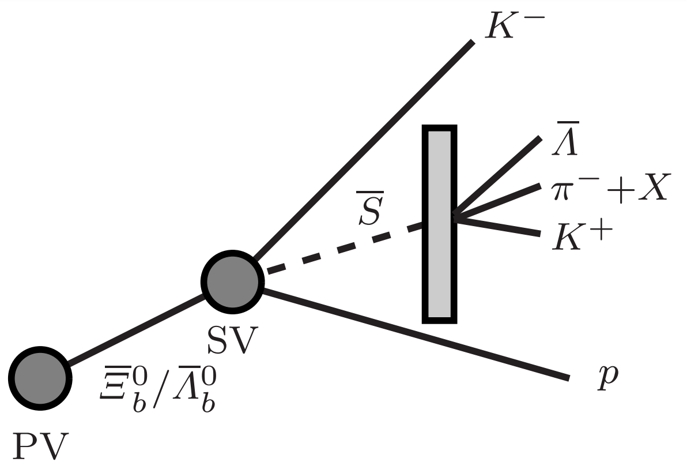
Method 3: Why not both?
Advantages:
No need for $Ξ_{b}^{∗−}$ or $Ξ_{b}^{′−}$ tagging
Clean sample
Goal: cross section of S with matter & $m_{S}$

Slide 15
Summary
To do:
Find S
$m_{S}$
$σ(pp→SX)$
$σ(SN→X)$
DM?
Sexaquarks!
Using detector interactions and missing momentum!

Slide 16
Thanks!
And stay tuned…

Slide 17
References
LHCb. (n.d.). The LHCb Detector. https://lhcb-outreach.web.cern.ch/detector/
Farrar, G. R. (2022, January 4). A Stable Sexaquark: Overview and discovery strategies. arXiv.org. https://arxiv.org/abs/2201.01334
Doheny, A. (2024, August 23). Searching for Sexaquarks in Ξb decays at LHCb.
LHCb Collaboration. (2024, October 22) SP news. https://indico.cern.ch/event/1469865/#32-sp-news
Koppenburg, P. (2024, September 25). New particles discovered at the LHC. https://www.nikhef.nl/~pkoppenb/particles.html
Eckstein, E. (2024, September) Sexaquark analyses. https://codimd.web.cern.ch/AFGQKyIDSiyHH1GNUlxM5w#Sexaquark-analyses
Farrar, G. R., & Wang, Z. (2023, June 5). Constraints on long-lived di-baryons and di-baryonic dark matter. arXiv.org. https://arxiv.org/abs/2306.03123

Slide 18
Back-up slides

Slide 19
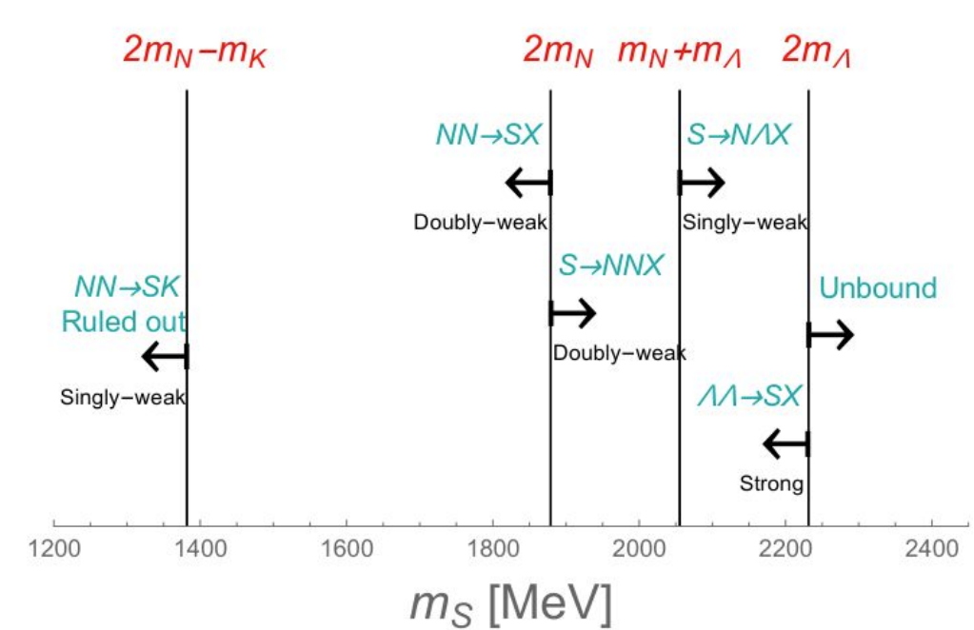
Mass
For $N=p, n$, possible $m_{S}$ are:
$m_{S}>2m_{N}−m_{K}=1382 MeV$, else $NN→SK$ → unstable nuclei & neutron stars
$1382 MeV<m_{S}<2m_{N}$ unlikely, else $NN→SX$ → unstable nuclei (S fully stable)
$1875.1=m_{D}−m_{e}<m_{S}<m_{D}+m_{e}=1876.1 MeV$ (S stable)
$1876=2m_{Λ }<m_{S}<2m_{N}+m_{Λ}=2055 MeV$ →$S→NNX$ possible (S cosm. stable)
${2m}_{N}+m_{Λ}<m_{S}<2m_{Λ}$ → $S→NΛX$ and $ΛΛ→SX$ possible (unstable)
$m_{S}>2m_{Λ}$→ S unbound broad resonance
→ Look for $1875.1<m_{S}<2055 MeV$

