Slide 1




Pixel TPC testbeam results
Circle analysis
Yevgen Bilevych, Klaus Desch, Harry van der Graaf, Fred Hartjes, Jochen Kaminski, Peter Kluit, Naomi van der Kolk,
Cornelis Ligtenberg,
Gerhard Raven, and
Jan Timmermans
8 Quad Module
Lepton Collider 12 February 2024

Slide 2
DESY testbeam Module Analysis
Does a Pixel TPC have a hit resolution independent of the incident angle of the track?
In order to study this topic we use circular tracks (curlers).
We took data with small incident angles plus min 10 degrees; in a circle one will have 2 pi incident angles.
To get a (part of a) circle the one needs a B field. Not that the electrons from the beam go “straight” and we need to look for lower momentum electrons in the event.
Here we took the B=1 data for run 6969 p = 6 GeV beam.
a Hough transform for a circle was coded; also a straight line hough transform was used to reject high momentum tracks.

Slide 3
DESY testbeam Module Analysis
Circle finding
The center should lie in the plane
Pattern finding can get disturbed by large hit bursts and “straight” line beam particles
The solutions in red are selected
Events 14 and 41
R = 1024 pixels
p = 8.45 MeV/c
R = 121 pixels
p = 1 MeV/c
R = 25 pixels
p = 206 keV/c

Slide 4
DESY testbeam Module Analysis
Circle finding
Use circle and line fits to compare hypothesis.
Solutions in red are selected
So blue circles are vetoed red circles are kept
Events 60 and 88
R = 1024 pixels
p = 8.45 MeV/c
R = 121 pixels
p = 1 MeV/c
R = 25 pixels
p = 206 keV/c

Slide 5
DESY testbeam Module Analysis
For the events 14 and 41. Calculate phi around the circle (phi = 0 is pointing opposite the local y axis = right to left in the event display).The drift time (z) can be fitted vs phi. It has a linear dependence (for a helix). The residuals in z are calculated after the fit.
phi hit on circle

Slide 6
DESY testbeam Module Analysis
Event selection for circles
Radius > 50 pixels with at least 20 selected hits
Reject circles with a better SL line fit by applying cuts on the χ² and number of hits for the circle and line hypothesis.
Resolution σ _{xy} = 4 pixels and σ _{z} = 1 mm
Track χ²_{xy}/dof < 5 χ²_{z}/dof < 5
Phi range (phi max – phi min) > 1 rad
phi> 8 π/32 and phi < 2 π − 8 π/32
Remove hits near edge of chip (15 pixels columns and rows)
Residual cuts at 2.5 σ (xy and z)
Down weighting of large clusters (counting hits N in bins Rφ 1 pixels)
where w = 1/ (N(bin-1)+N(bin)+N(bin+1))

Slide 7
DESY testbeam Module Analysis
Selected circles plots

Slide 8
DESY testbeam Module Analysis
Selected circles plots weights
phi hit on circle

Slide 9
DESY testbeam Module Analysis
Selected circles plots residuals (weighted)

Slide 10
DESY testbeam Module Analysis
Selected circles plots resolution xy
There is a dependency of the resolution of phi and the radius
Small radii correlated to large phi range
phi hit on circle

Slide 11
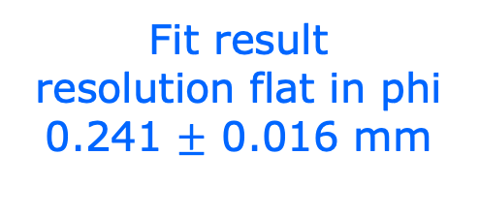
DESY testbeam Module Analysis
Selected circles plots resolution xy
Taking out these dependencies
fit: a + b cos φ
Fit result
resolution flat in phi
0.241 $±$ 0.016 mm
Conclusion Grid pix hit resolution is independent of incident track angle within an uncertainty of 16 μm
phi hit on circle

Slide 12
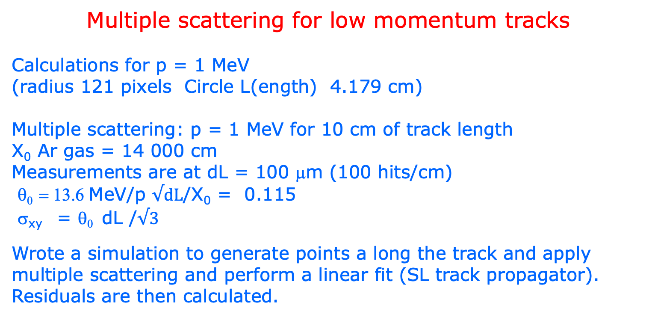
DESY testbeam Module Analysis
Multiple scattering for low momentum tracks
Calculations for p = 1 MeV
(radius 121 pixels Circle L(ength) 4.179 cm)
Multiple scattering: p = 1 MeV for 10 cm of track length
X₀ Ar gas = 14 000 cm
Measurements are at dL = 100 μm (100 hits/cm)
θ₀ = 13.6 MeV/p $√dL$/X₀ = 0.115
σ_{xy} = θ₀ dL /$√3$
Wrote a simulation to generate points a long the track and apply multiple scattering and perform a linear fit (SL track propagator).
Residuals are then calculated.
Backup

Slide 13
DESY testbeam Module Analysis
Multiple scattering for low momentum tracks
rms of the residual distribution is:
σ_{xy} = 1025 μm/ p/p₀ (L/L₀)^{1.5}
p₀ = 1 MeV/c L₀ = 10 cm
The rms depends on the track length.
Note that for the 5 an 6 GeV data the ms
will be less than 1 μm
Only at very low momenta < 100 MeV/c
it becomes relevant
One can do a better fit by allowing ms between
the hits e.g. with the GBL package (not done here).
So for 1 MeV full circle one expects σ_{xy} = 270 μm.
Compatible with observed resolution σ_{xy} = 240 μm.
Backup

Slide 14
DESY testbeam Module Analysis
Backup
p = 200 keV
Note for momenta below 0.5 MeV/c the energy loss start to explode
p = 1 MeV
Code: /Users/peterkluit/Desktop/DESY testbeam/cicle/plotCircle.C
input ntuple: SummaryCircleRun006969_v1.root

