Slide 1
Towards Ultra High Energy Cosmic Ray Composition Estimation using the AugerPrime Radio Detector
Anthony Bwembya
PhD candidate
Radboud university
abwembya@science.ru.nl

Slide 2
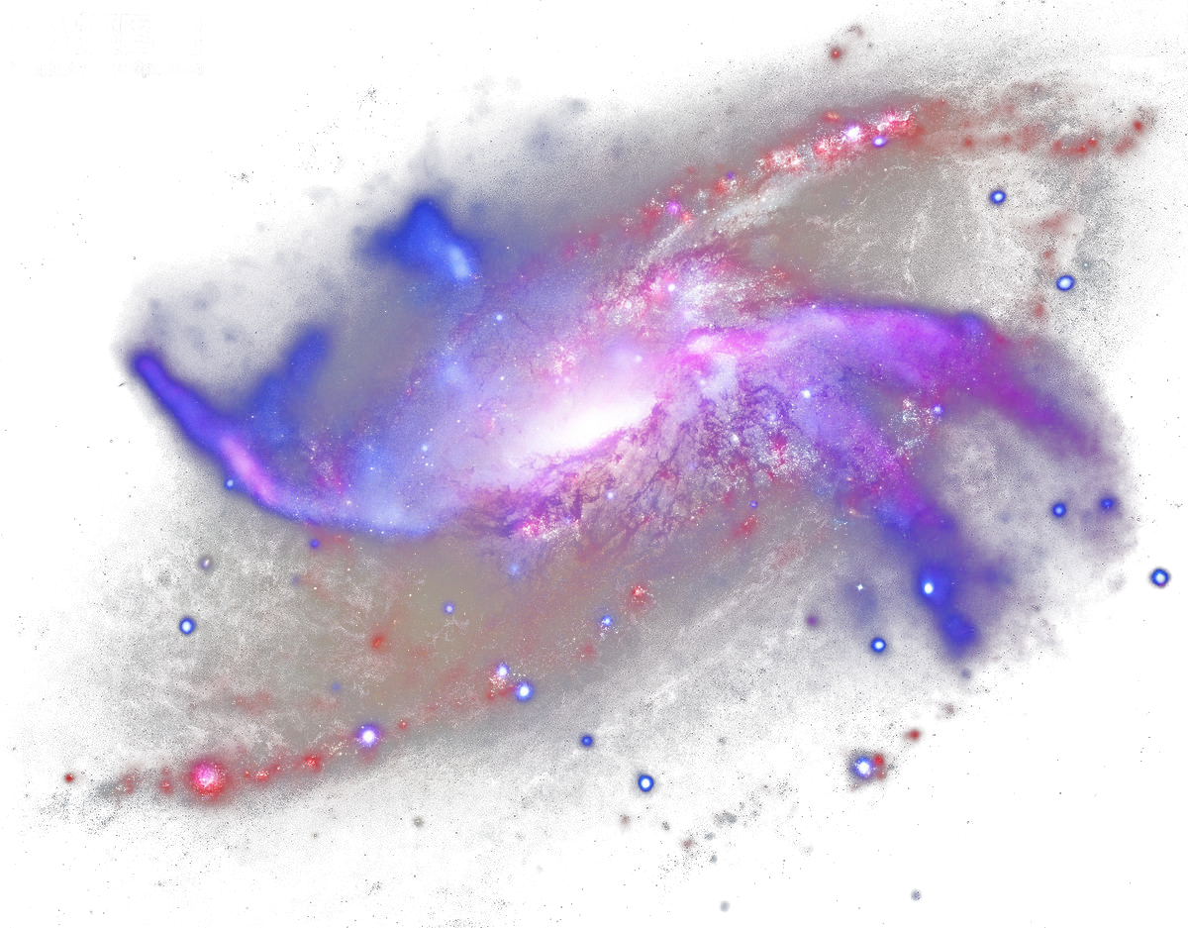
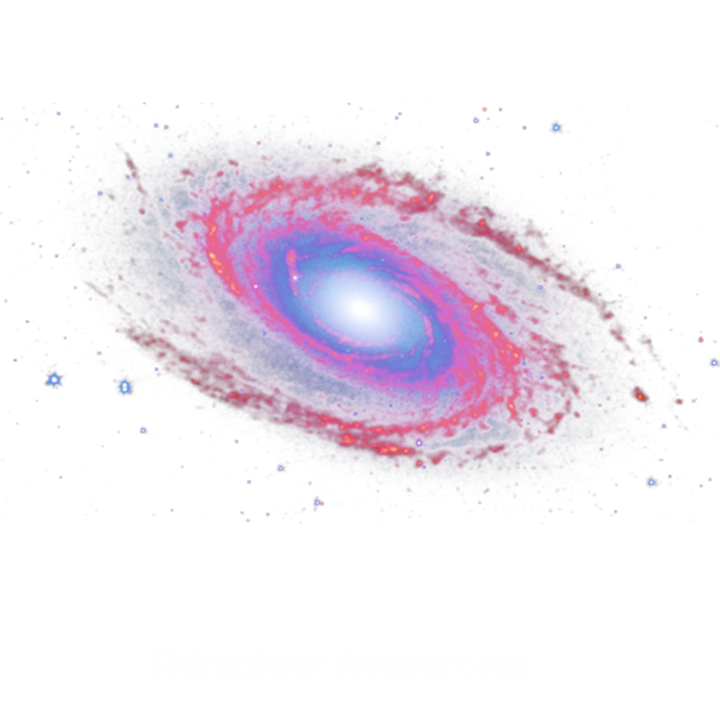
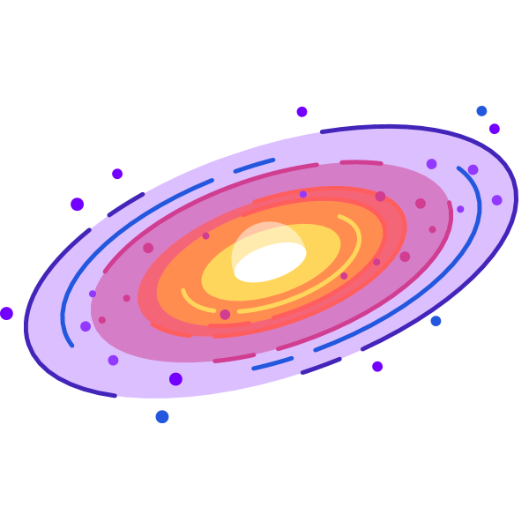
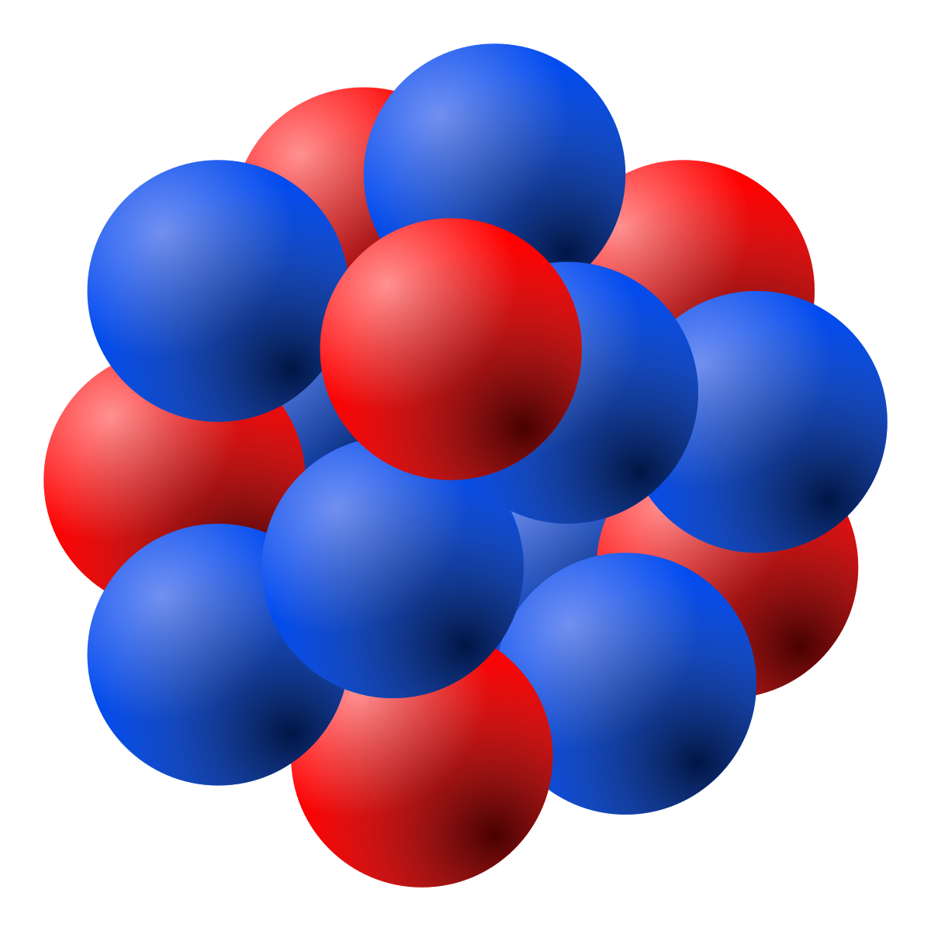
Particles have energies > 1 EeV
The deflection of the particles depends on the charge of the particle and the energy ie.
Protons
Neutrals
Iron

Slide 3
The particle then interacts in the atmosphere and creates a cascade of particles
https://opendata.auger.org/display.php

Slide 4
The point in the particle cascade with the maximum number of particles is called the “Depth of Shower Maximum” or X_{max}
This depends on the mass of the incoming particle
Particle tracks

Slide 5
The point in particle cascade with the maximum number of particles is called the “Depth of Shower Maximum” or X_{max}
This depends on the mass of the incoming particle
A shower is a cascade of particles which generates a radio signal in the Earth’s magnetic field
Radio emission

Slide 6
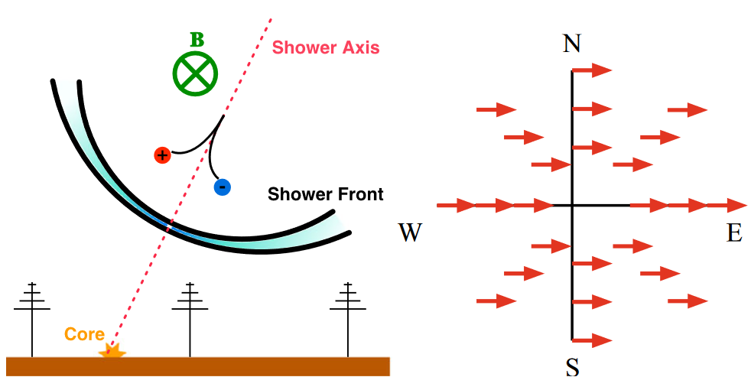
Radio signal generation from air showers:
The majority of the radio emission originates from the deflection of electrons and positrons made in the air shower cascade by the earth’s geomagnetic field.
H. Schoorlemmer, PhD thesis, Radboud Universiteit Nijmegen (2012)

Slide 7
Pierre Auger Observatory:
The observatory covers 3000 km² in area and comprises of 1660 detector stations.
Spaced 1.5 km apart.
It is located in the Argentinian pampas.
Currently undergoing an upgrade to >> AugerPrime

Slide 8
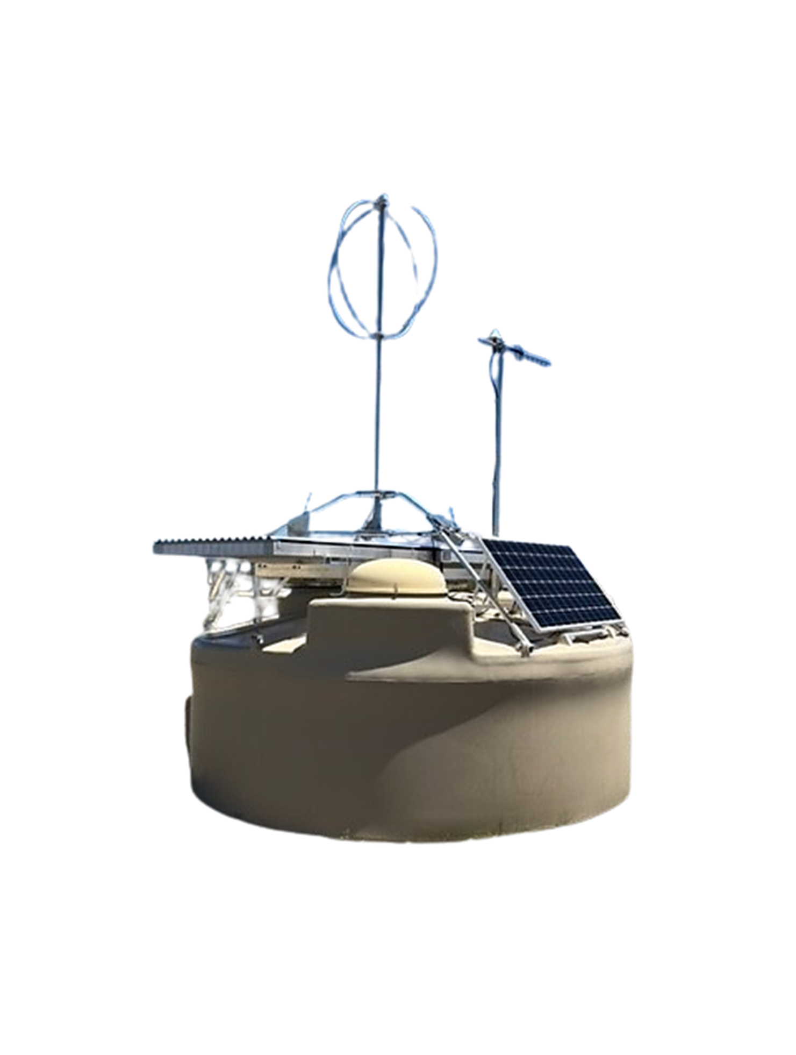
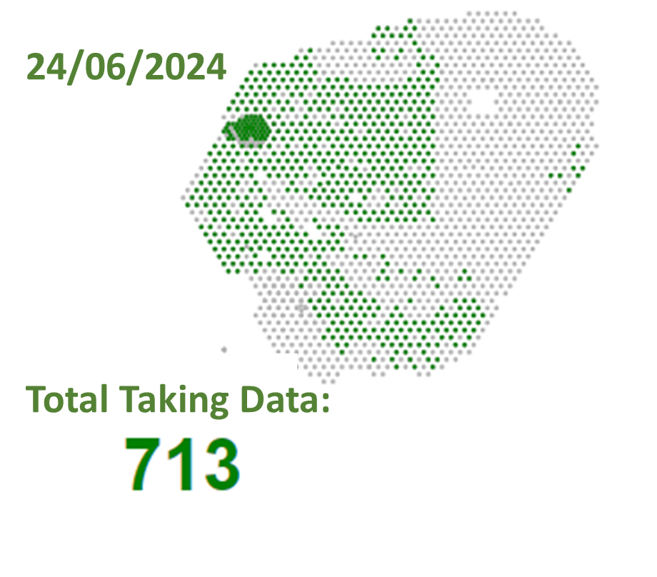
AugerPrime Radio detector upgrade:
Radio Antenna
Scintillator Detector
Water Cherenkov tank

Slide 9
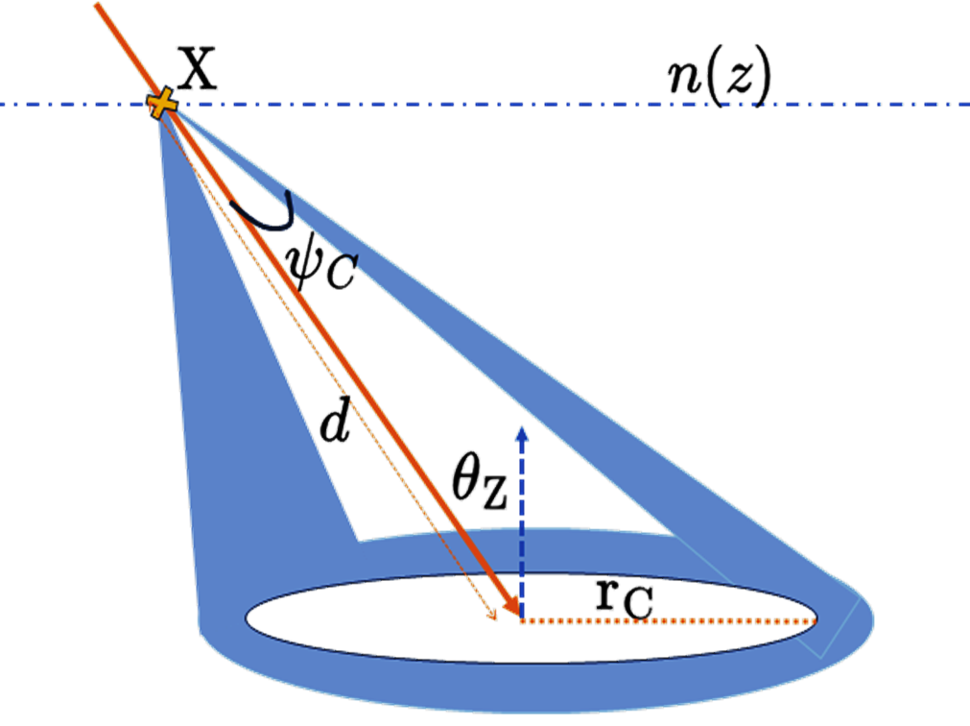
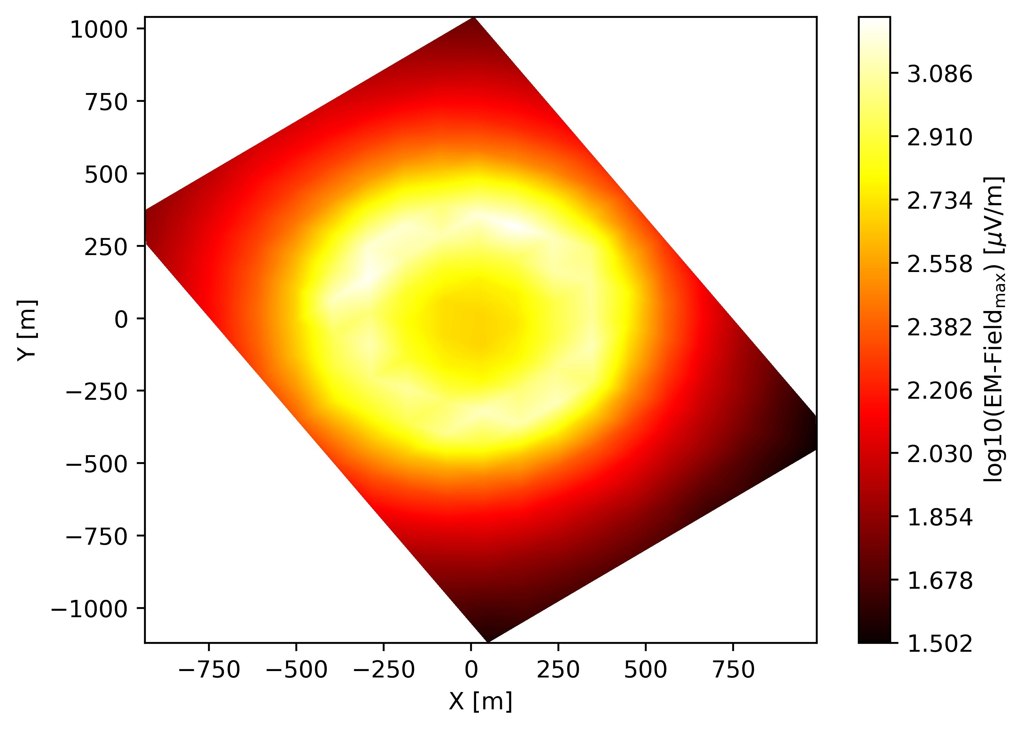
Determining Shower maximum via Radio detection:
Using Radio, traditionally the determination of the shower maximum is done by measuring the area illuminated on the ground or radio footprint.
The depth of the shower maximum determines the radius of the footprint.

Slide 10
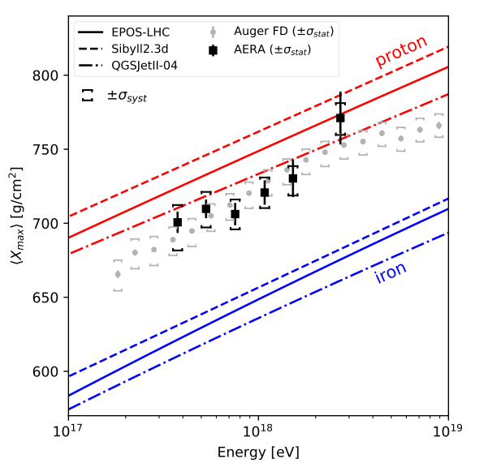
Simulated radio Amplitude distribution:
For showers with a zenith angle < 50 degrees, the amplitude distribution depends on the position of the shower maximum
Auger Collaboration* , Radio Measurements of the Depth of Air-Shower Maximum at the Pierre Auger Observatory. ‌
r_{c750}=125 m

Slide 11
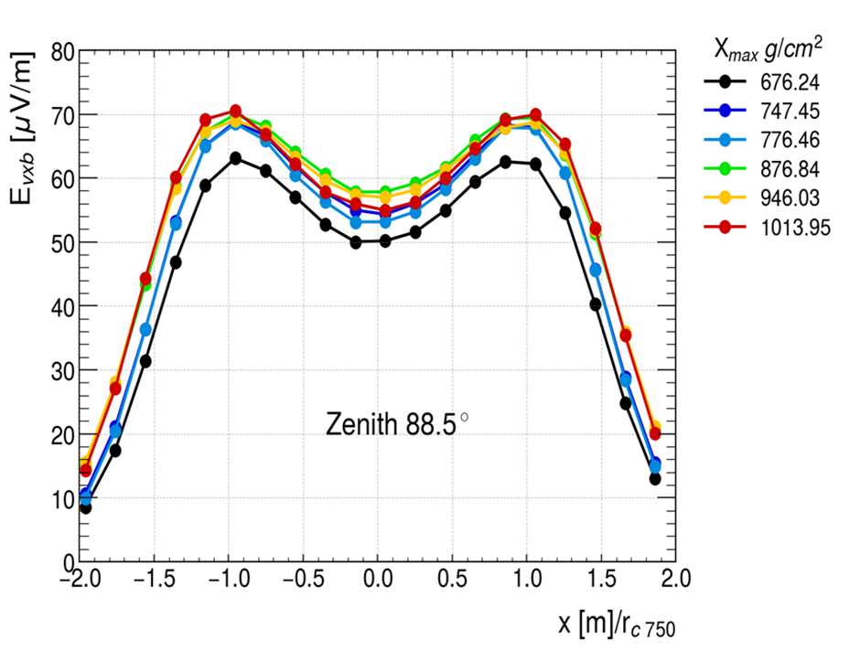
Simulated radio Amplitude distribution:
For showers with a zenith angle < 50 degrees, the amplitude distribution depends on the position of the shower maximum
For showers with zenith angles beyond 70 degrees the shape no longer depends on the position shower maximum.
r_{c750}=2550 m
r_{c750}=125 m

Slide 12
Very inclined showers:
X₁
Shallow showers are at smaller refractive indices and, thus have narrower beams
Deeper showers are at larger refractive indices and, thus have broader beams.
X₂
This results in very inclined deep showers projecting larger areas in the ground than shallow ones.

Slide 13
Radio Interferometry:
H. Schoorlemmer et al., “Radio Interferometry applied to air showers recorded by the Auger Engineering Radio Array,” ICRC, Jul. 2023, doi: 10.22323/1.444.0380

Slide 14
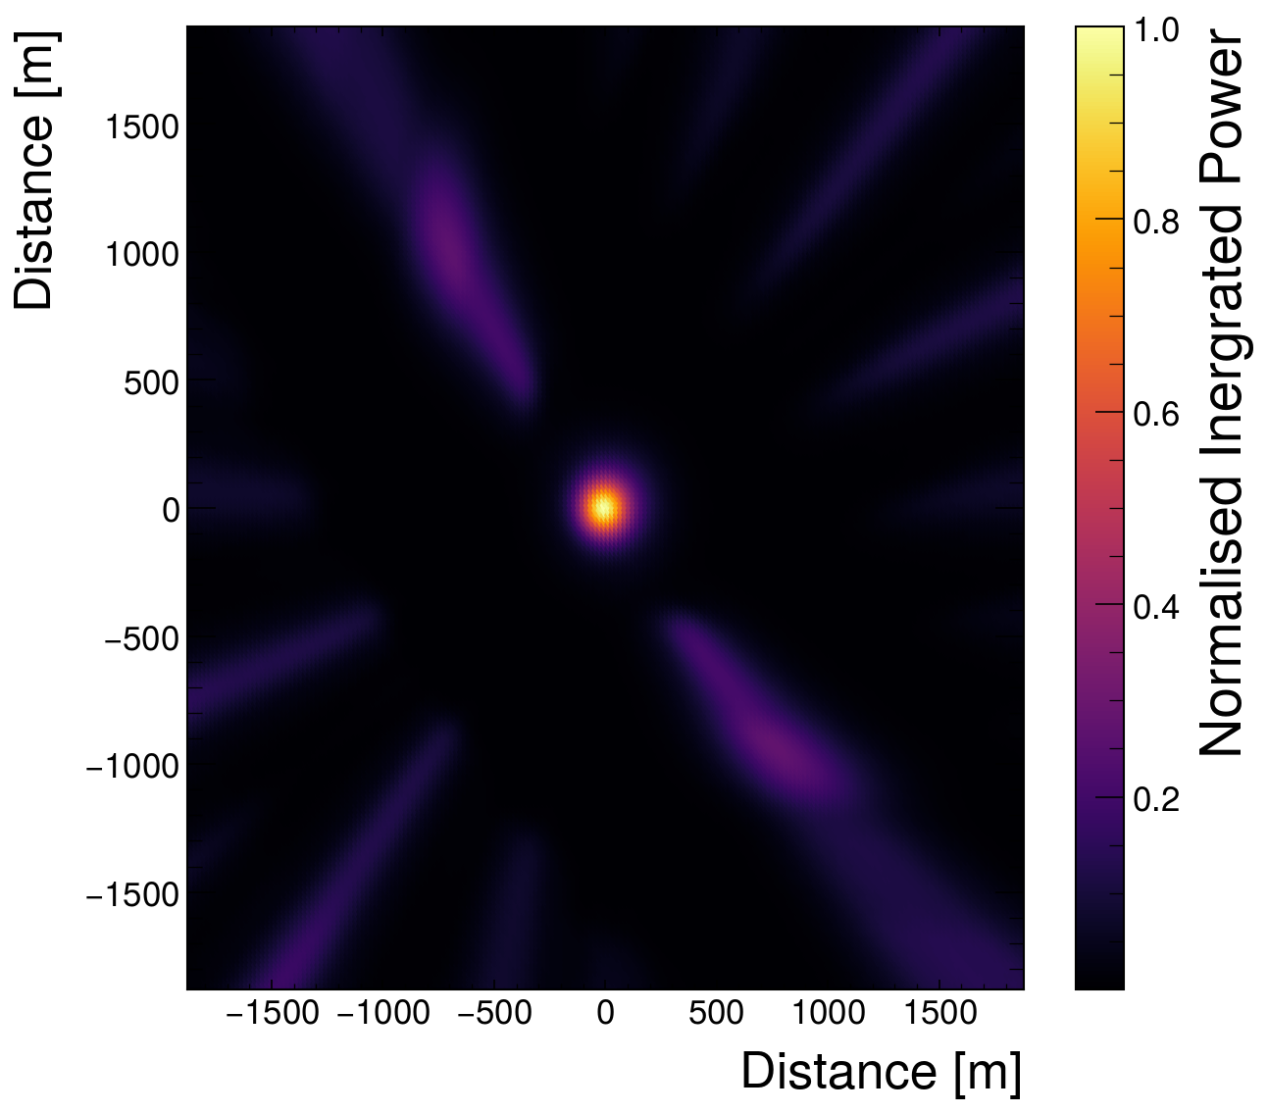
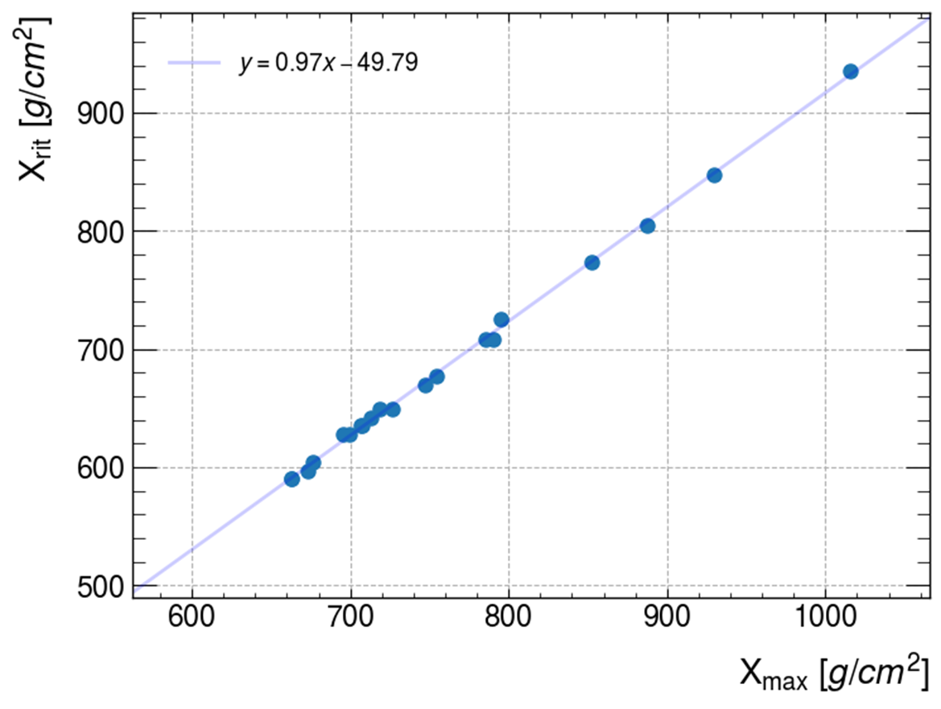
Interferometry for very inclined showers:
*simulation
With interferometry we can determine X_{max} for very inclined air showers with the radio detection technique. This requires excellent timing precision.

Slide 15
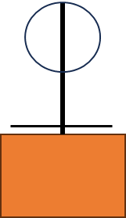
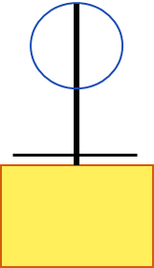
Synchronisation at Auger Prime:
Currently looking at using interferometry at AugerPrime.
This would require:
Timing precision under 5ns
Station Localization of the order 30 cm
The required timing precision can be made possible by using a beacon emitting multiple sine waves.
This was demonstrated in AERA
Precise to 2ns or better*
Beacon
*A. Aab et al 2016 JINST 11 P01018 :DOI 10.1088/1748-0221/11/01/P01018

Slide 16
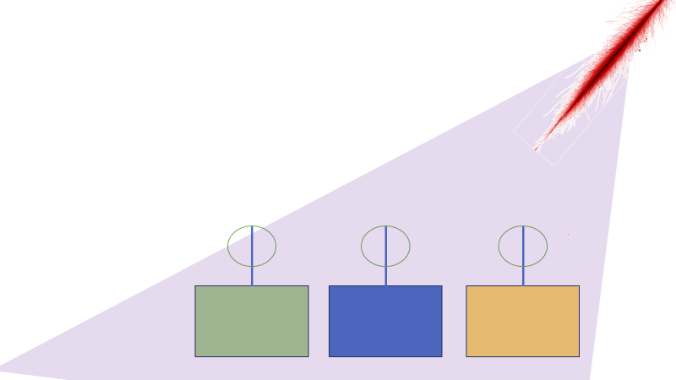
Conclusion/Outlook :
For very inclined showers radio interferometry is an excellent technique to determine the position of X_{max} in the atmosphere with a precision that rivals conventional techniques. This requires excellent time synchronization and station localisation.
Currently studying the feasibility of applying this method within AugerPrime.

Slide 17
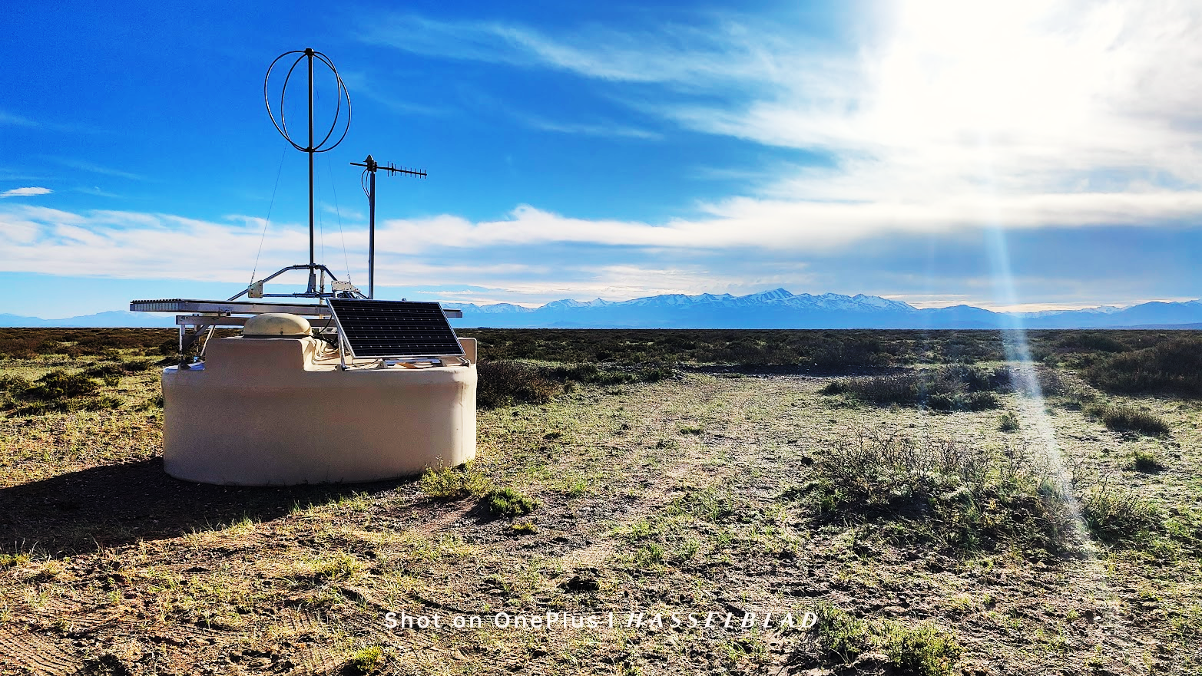
Questions?
abwembya@science.ru.nl

Slide 18
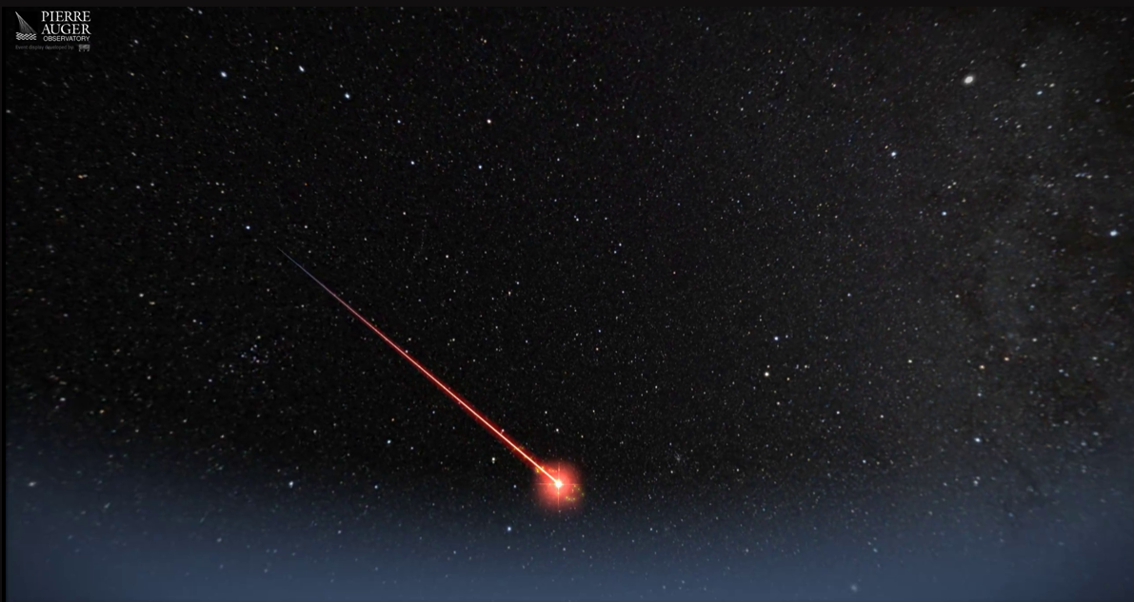
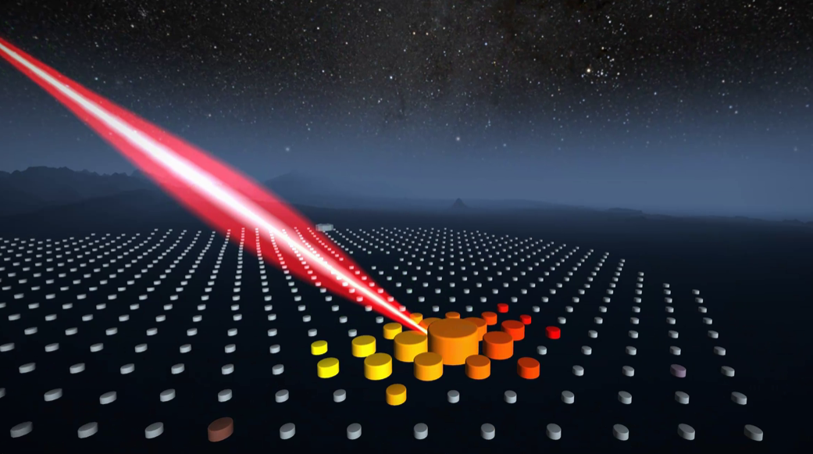
The particle then interacts in the atmosphere and creates a cascade of particles
https://opendata.auger.org/display.php

Slide 19
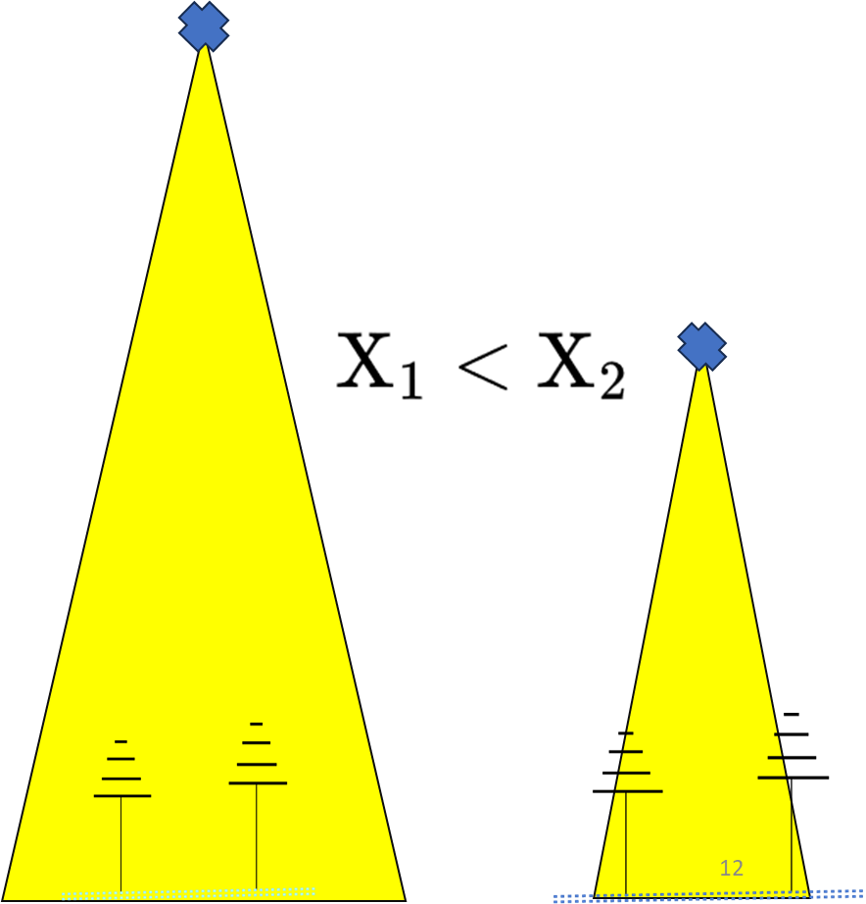
Effects of X_{max} and n on the footprint:
Extras::
The greater the n the wider the opening angle.
The deeper the X_{max} the smaller the area.

Slide 20
Influence of timing jitter on Radio Interferometry:
Extras::
Increased timing uncertainty corresponds to greater uncertainty in determining the shower maximum.
<5ns timing would be ideal for the method to work.

Slide 21
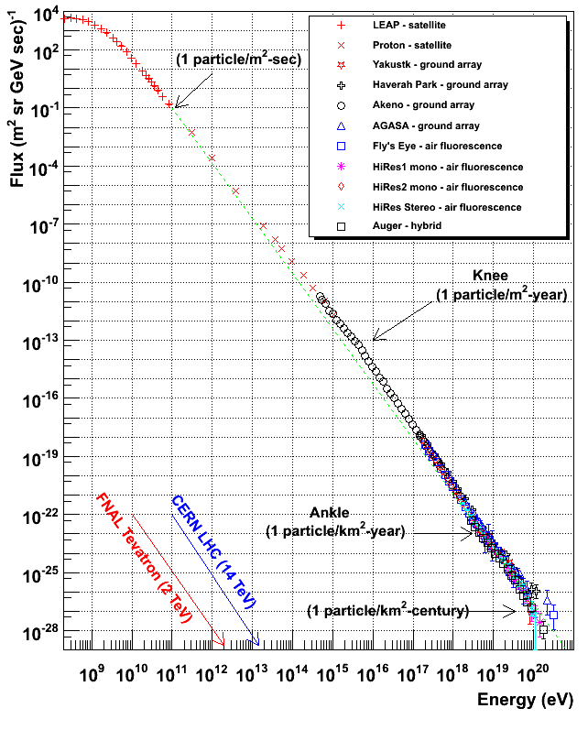
Cosmic ray energy spectrum:
Extras::
For ultra-high-energy cosmic rays, the low flux can be combatted by making large detectors.
https://web.physics.utah.edu/~whanlon/spectrum.html

Slide 22
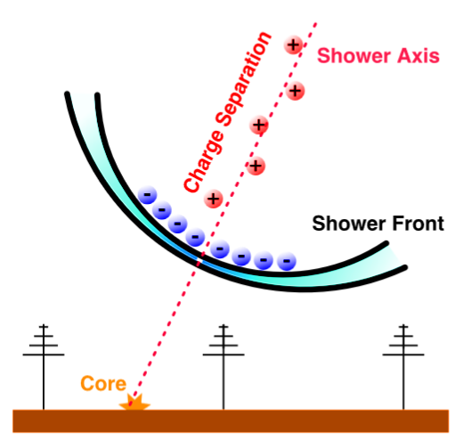
Charge Excess:
Extras::
Second strongest emission in air showers, is a result of the knocked electrons building up at the shower front whilst the heavier positive ions remain behind .

