Slide 1




Pixel TPC testbeam results
Circle analysis
Yevgen Bilevych, Klaus Desch, Harry van der Graaf, Fred Hartjes, Jochen Kaminski, Peter Kluit, Naomi van der Kolk,
Cornelis Ligtenberg,
Gerhard Raven, and
Jan Timmermans
8 Quad Module
Lepton Collider 8 January 2024

Slide 2
DESY testbeam Module Analysis
Circle finding
In order to demonstrate that a GridPix has a hit resolution independent of the incident angle, I thought of using circular tracks.
We took data with small incident angles plus min 10 degrees; in a circle one will have 2 pi incident angles.
To get a (part of a) circle the one needs a B field. Not that the electrons from the beam go “straight” and we need to look for lower momentum electrons in the event.
Here we took the B=1 data for run 6969 p = 6 GeV beam.
I started with coding a Hough transform for a circle; the most difficult part is not the circle fit, but finding the circle(s)

Slide 3
DESY testbeam Module Analysis
Circle finding
The center should lie in the plane
Can make combinations with hits other tracks and “invent” a circular pattern
Pattern finding gets disturbed by large hit bursts
R = 1024 pixels
p = 8.45 MeV/c
R = 121 pixels
p = 1 MeV/c
R = 25 pixels
p = 206 keV/c

Slide 4
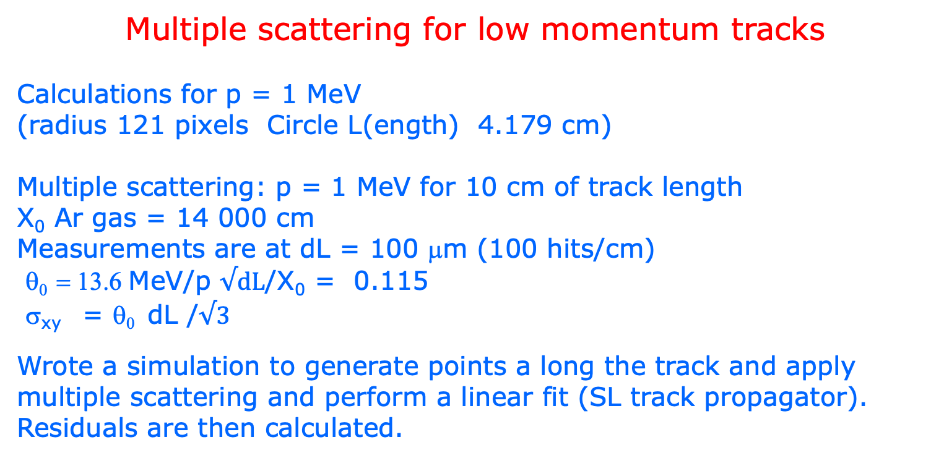
DESY testbeam Module Analysis
Multiple scattering for low momentum tracks
Calculations for p = 1 MeV
(radius 121 pixels Circle L(ength) 4.179 cm)
Multiple scattering: p = 1 MeV for 10 cm of track length
X₀ Ar gas = 14 000 cm
Measurements are at dL = 100 μm (100 hits/cm)
θ₀ = 13.6 MeV/p $√dL$/X₀ = 0.115
σ_{xy} = θ₀ dL /$√3$
Wrote a simulation to generate points a long the track and apply multiple scattering and perform a linear fit (SL track propagator).
Residuals are then calculated.

Slide 5
DESY testbeam Module Analysis
Multiple scattering for low momentum tracks
rms of the residual distribution is:
σ_{xy} = 1025 μm/ p/p₀ (L/L₀)^{1.5}
p₀ = 1 MeV/c L₀ = 10 cm
The rms depends on the track length.
Note that for the 5 an 6 GeV data the ms
will be less than 1 μm
Only at very low momenta < 100 MeV/c
it becomes relevant
One can do a better fit by allowing ms between
the hits e.g. with the GBL package (not done here).

Slide 6
DESY testbeam Module Analysis
p = 200 keV
Note for momenta below 0.5 MeV/c the energy loss start to explode
p = 1 MeV

Slide 7
DESY testbeam Module Analysis
Code: /Users/peterkluit/Desktop/DESY testbeam/cicle/plotCircle.C
input ntuple: SummaryCircleRun006969_v1.root

