Slide 1




Pixel TPC testbeam results
Large hit bursts
Yevgen Bilevych, Klaus Desch, Harry van der Graaf, Fred Hartjes, Jochen Kaminski, Peter Kluit, Naomi van der Kolk,
Cornelis Ligtenberg,
Gerhard Raven, and
Jan Timmermans
8 Quad Module
Lepton Collider 29 January 2024

Slide 2
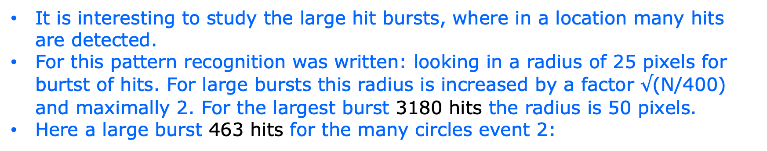
DESY testbeam Module Analysis
Large hit bursts
It is interesting to study the large hit bursts, where in a location many hits are detected.
For this pattern recognition was written: looking in a radius of 25 pixels for burtst of hits. For large bursts this radius is increased by a factor $√$(N/400) and maximally 2. For the largest burst 3180 hits the radius is 50 pixels.
Here a large burst 463 hits for the many circles event 2:

Slide 3
DESY testbeam Module Analysis
Large hit bursts
For event 2 with 463 hits:
Timing cuts 100
and 50 nsec
Variables characterize the burst: nhits, rms xy, rms t with a 200 or 100 nsec cut.

Slide 4
DESY testbeam Module Analysis
Large hit bursts
Event 42 with a burst of 1066 hits

Slide 5
DESY testbeam Module Analysis
Large hit bursts
Event 99 with a burst of 909 hits

Slide 6
DESY testbeam Module Analysis
Large hit bursts
Event 5899 with 3180 hits

Slide 7
DESY testbeam Module Analysis
Large hit bursts
For B=1 T p= 6GeV run 6969 ~ 8000 triggers (events)
rms d0 rms t
The largest burst has 3180 hits
100 or 50 ns

Slide 8
DESY testbeam Module Analysis
Large hit bursts
For B=0 T p= 6 GeV run 69169 ~ 20k triggers (events)
rms d0 rms t
B=0 T
100 or 50 ns
Much reduced tails wrt B=1 T

Slide 9
DESY testbeam Module Analysis
Large hit bursts run 6969
rms d0 with nr of hit cuts
rms d0: slight increase for large bursts
(could be due to R cut)

Slide 10
DESY testbeam Module Analysis
Large hit bursts run 6969
Radius90: radius in which 90% of hits are found
Conclude:
radius90: slight increase for large bursts (max 40) pixels

Slide 11
DESY testbeam Module Analysis
Large hit bursts run 6916
Radius90: radius in which 90% of hits are found
B = 0 T

Slide 12
DESY testbeam Module Analysis
Large hit bursts run 6969
rms time varies
goes from 10-100 nsec
(600 μm to 6 mm)
Average Hit density in a burst is 3180 hits /3.14*50*50 pixels = 0.4 per pixel.
Max hit density is 1, because after one hit the pixel is dead for 475 ns.
rms time with nr of hit cuts

Slide 13
DESY testbeam Module Analysis
Large hit bursts run 6969
time90 time in which 90% of hits are found
time varies
goes from 0-200 nsec
(0 μm to 12 mm)
At low multiplicities shorter “tracks”
Diffusion peak time90<20 ns

Slide 14
DESY testbeam Module Analysis
Large hit bursts run 6916
time90 time in which 90% of hits are found
B = 0 T
Much reduced tails wrt B=1 T

Slide 15
DESY testbeam Module Analysis
Large hit bursts run 6969
Time over Threshold with nr of hit cuts
Mean ToT is a bit higher for high multiplicity burst
Difference mean <ToT> is ~15%

Slide 16
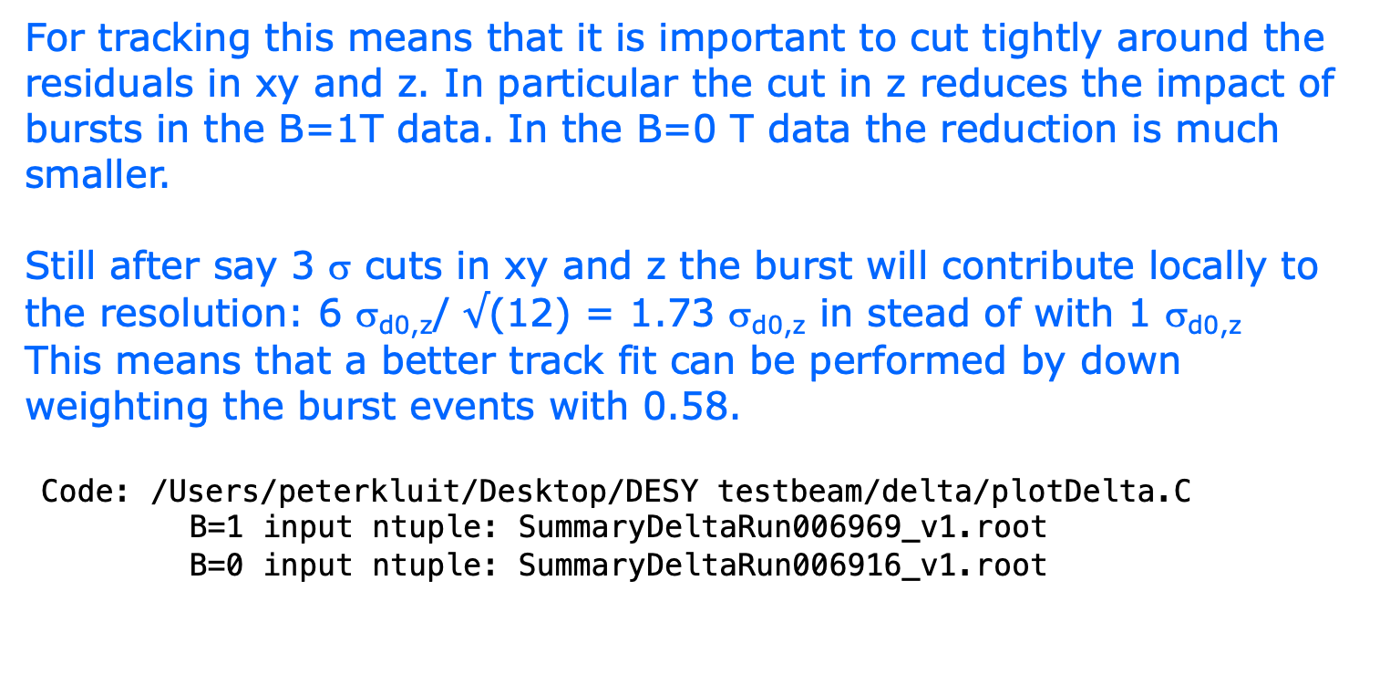
DESY testbeam Module Analysis
Track fitting and large hit bursts
For tracking this means that it is important to cut tightly around the residuals in xy and z. In particular the cut in z reduces the impact of bursts in the B=1T data. In the B=0 T data the reduction is much smaller.
Still after say 3 σ cuts in xy and z the burst will contribute locally to the resolution: 6 σ_{d0,z}/ $√$(12) = 1.73 σ_{d0,z} in stead of with 1 σ_{d0,z}
This means that a better track fit can be performed by down weighting the burst events with 0.58.
Code: /Users/peterkluit/Desktop/DESY testbeam/delta/plotDelta.C
B=1 input ntuple: SummaryDeltaRun006969_v1.root
B=0 input ntuple: SummaryDeltaRun006916_v1.root

