Slide 1
Sensors for fast timing
FASTER project kick-off
Martin van Beuzekom
31 January 2024

Slide 2
Silicon pixel detectors
Fast silicon sensors consist e.g. of p-type silicon bulk with n-type pixel implants
Many effects relevant for good time resolution happen below the surface
Pixels have a non-zero thickness -> ‘voxel’
Typical pixel size 20 – 50 μm
Typical sensor thickness 20 – 300 μm

Slide 3
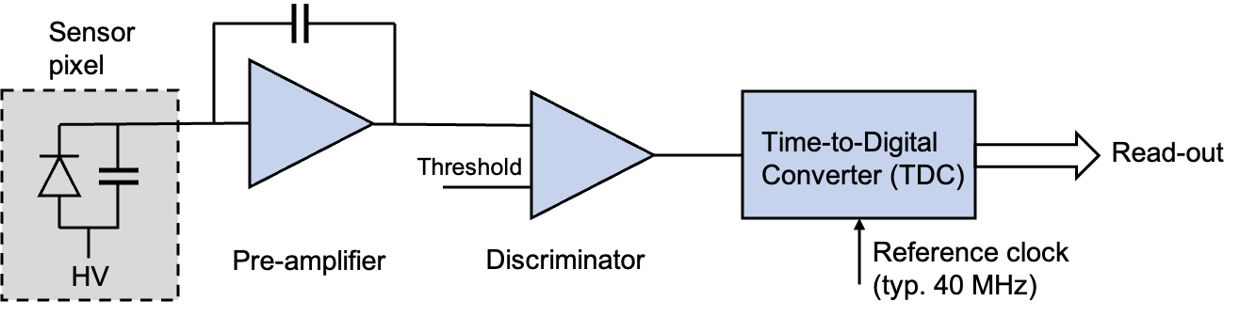
Basic electronic structure of a pixel
Each pixel of a sensor has its own pre-amplifier, discriminator and Time-to-Digital Converter (TDC)
All this electronics has to fit in the available area of a pixel
Most of the power is consumed by the pre-amplifier, clock distribution over chip, and high rate readout
On pixel
On pixel or in periphery

Slide 4
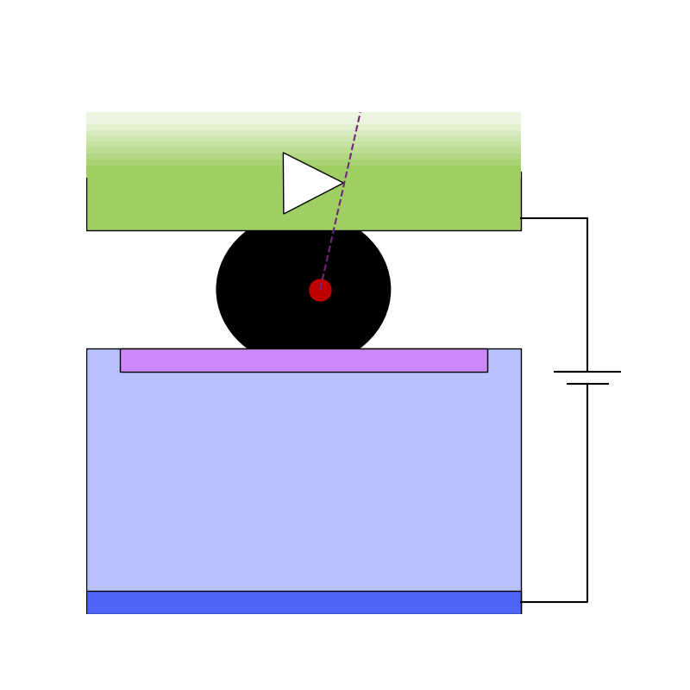
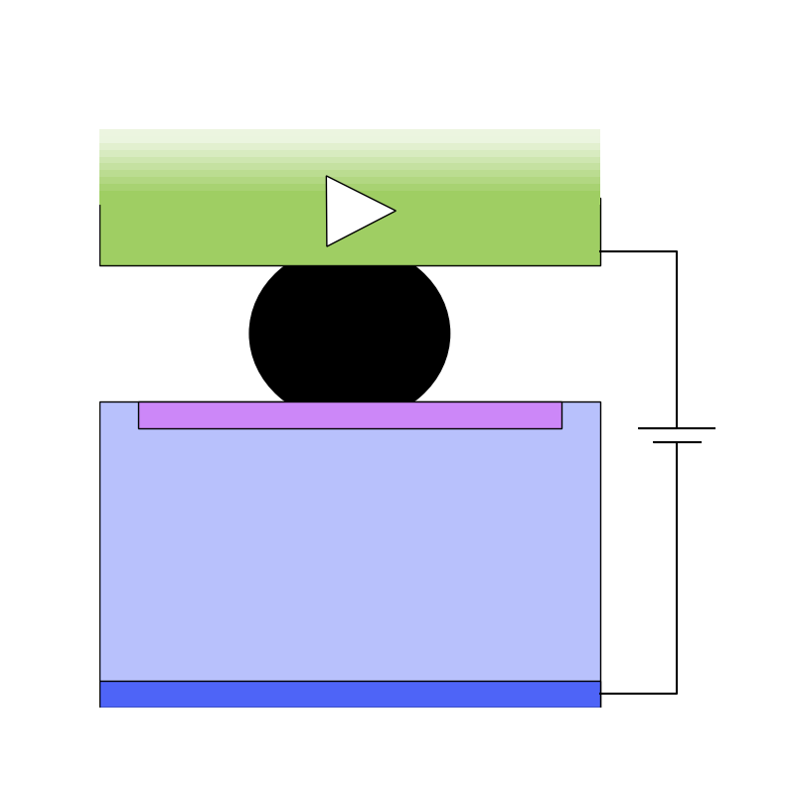
Planar silicon sensor basics
Traditional silicon sensor structure is a p-type bulk with n-type pixel implants
Reverse bias voltage create electric field in the sensor
Passing charged particle creates electron-hole pairs
Electrons and holes drift under influence of electric field
Electronics connected via small (~10 um) solder balls
Single pixel
cross section
10-20 μm
50-300 μm

Slide 5
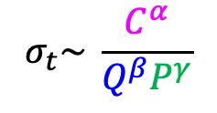
How to get good time resolution (electronics viewpoint)
$$σ_{t}\sim \frac{C^{α}}{Q^{β}P^{γ}}$$
Time resolution
  α,β > γ
Minimise capacitance C
  Small pixel -> can fit less functionality per pixel
  Small electrode -> less uniform fields
Maximise signal Q in shortest possible time (dQ/dt = current)
  Short drift distance (thin), high drift speed (large bias voltage), avalanche gain
Large power P (transistor transconductance, g_{m})
  Last resort, ‘costly’ in terms of material needed to provide power and cooling

Slide 6
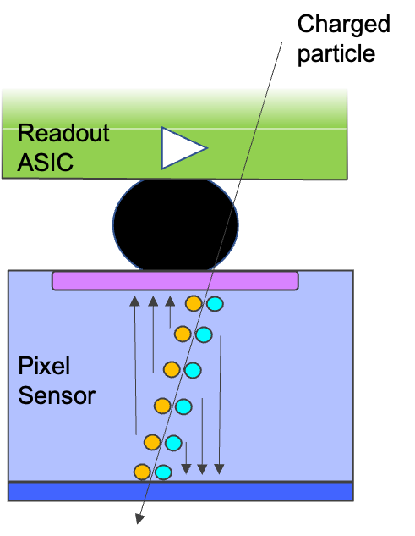
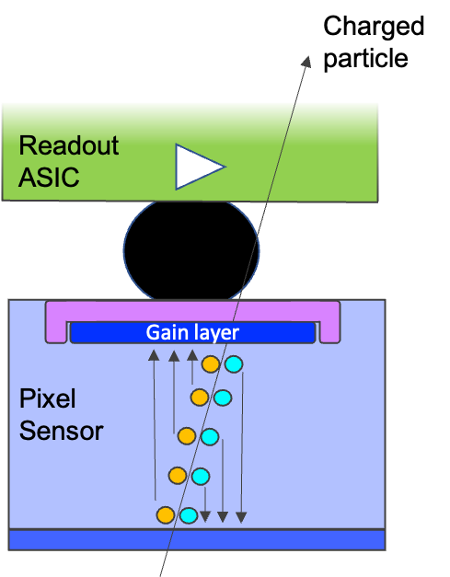
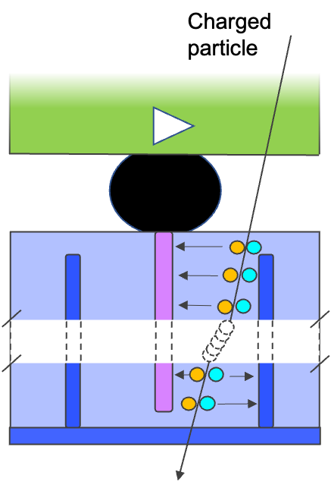
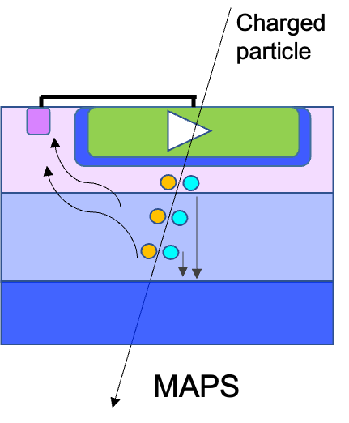
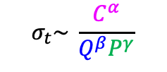
Overview of different sensors
$$σ_{t}\sim \frac{C^{α}}{Q^{β}P^{γ}}$$
Low Gain Avalanche Detector (LGAD)
3D
Planar
Monolithic Active
Pixel Sensor (MAPS)
Small signal if thin
Medium capacitance
Reasonably rad. hard
Large signal (thick)
Rad. Hard (shown 3E16)
High capacitance
More material
Very low capacitance
Low material
Small signal
Extreme rad. hardness
to be proven
Large signal (gain)
Medium capacitance
Modest rad. hard

Slide 7
Overview of different sensors
$$σ_{t}\sim \frac{C^{α}}{Q^{β}P^{γ}}$$
Low Gain Avalanche Detector (LGAD)
3D
Planar
Monolithic Active
Pixel Sensor (MAPS)
WP2.1
WP1.2
WP1.3
WP1.1
Small signal if thin
Medium capacitance
Reasonably rad. hard
Large signal (thick)
Rad. Hard (shown 3E16)
High capacitance
More material
Very low capacitance
Low material
Small signal
Extreme rad. hardness
to be proven
Large signal (gain)
Medium capacitance
Modest rad. hard

Slide 8
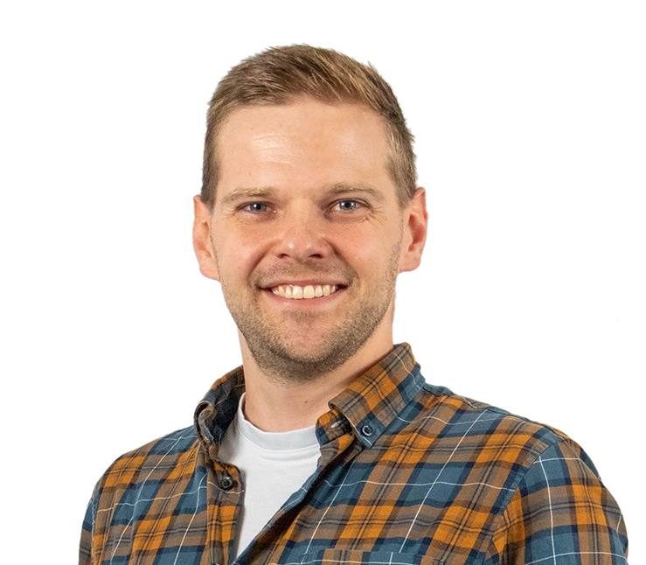
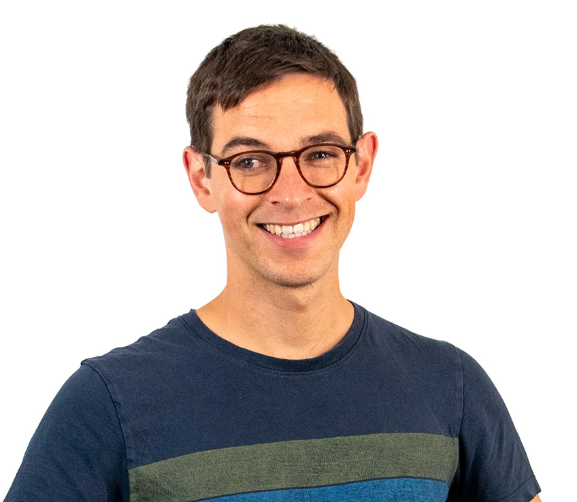


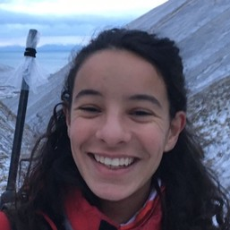
Overview of different sensors
$$σ_{t}\sim \frac{C^{α}}{Q^{β}P^{γ}}$$
Low Gain Avalanche Detector (LGAD)
3D
Planar
Monolithic Active
Pixel Sensor (MAPS)
WP2
Andrej
Daan
WP1.2
WP1.3
WP1.1
Small signal if thin
Medium capacitance
Reasonably rad. hard
Large signal (thick)
Rad. Hard (shown 3E16)
High capacitance
More material
Very low capacitance
Low material
Small signal
Extreme rad. hardness
to be proven
Large signal (gain)
Medium capacitance
Modest rad. hard
Evridiki
Petja
Isis

Slide 9

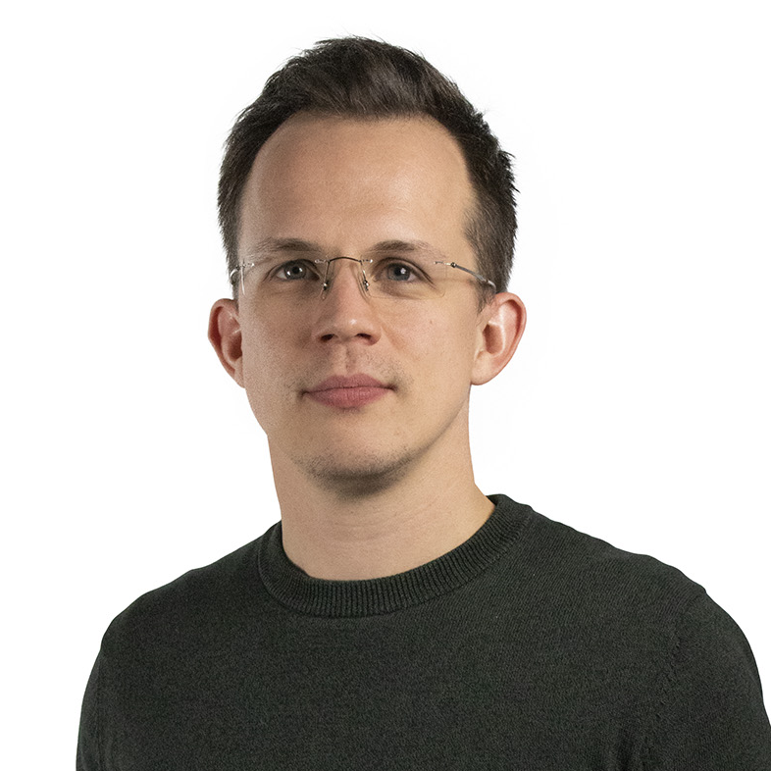
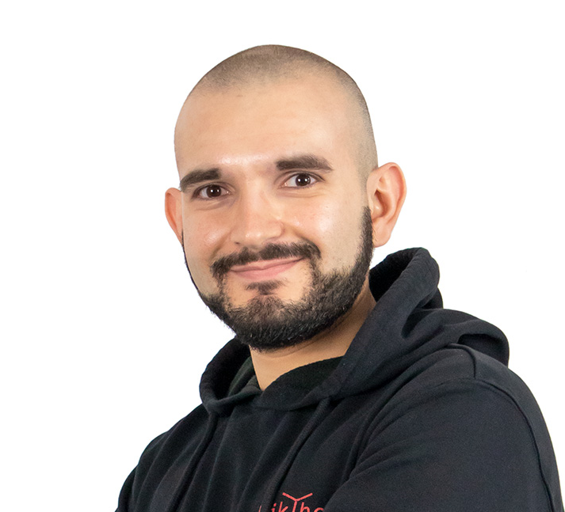


Other PhDs and PostDocs, important for FASTER
(but who are not named in the proposal)
Kevin
Tjip
Mariia
Roberto
Uwe

Slide 10
Sensor developments in FASTER
Why so many sensor different developments?
  At this moment there is no ‘one solution fits all’
  Some things are cheaper/simpler to develop in a hybrid configuration
    E.g. LGADs -> Monolithic detectors with gain
Differences, but also many things in common
  Same/similar tools: Laser, radioactive source, testbeam, (TCAD) simulations
  Same ‘enemies’ and challenges: radiation, high speed, low noise, DAQ, material budget
  -> synergy between monolithic/LGAD/3D developments
Where we distinguish ourselves from many other groups
  Not only ‘single pixel’ measurement, but also larger pixel matrices
  Interplay between sensor and readout ASIC
  Integral / system level approach

Slide 11
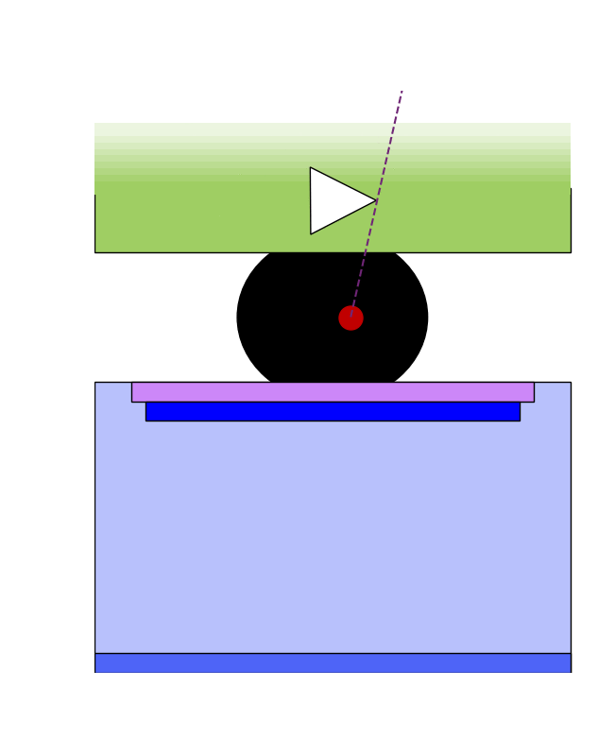
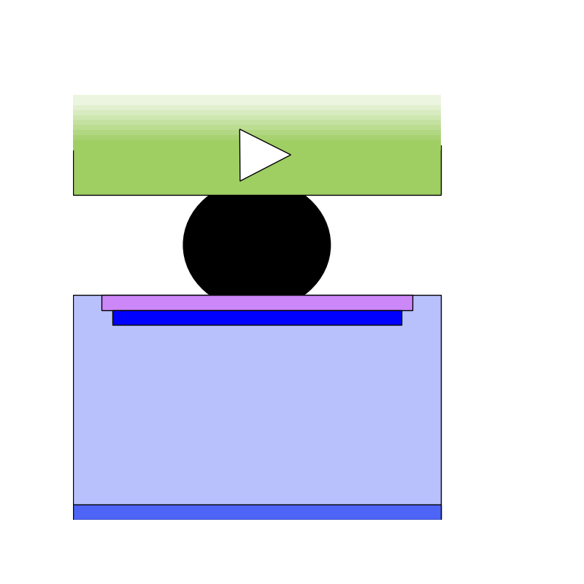
Low Gain Avalanche Detector (LGAD)
WP1.2
Thin highly p-doped layer for locally strong electric field
High field gives energetic electrons that cause
further ionization -> avalanche gain
Gain of order 10
  Low compared to e.g. SPADs
Pixels of 1 mm² show good performance
Suffering from acceptor ‘removal’ (inactivation)
E
Gain layer

Slide 12
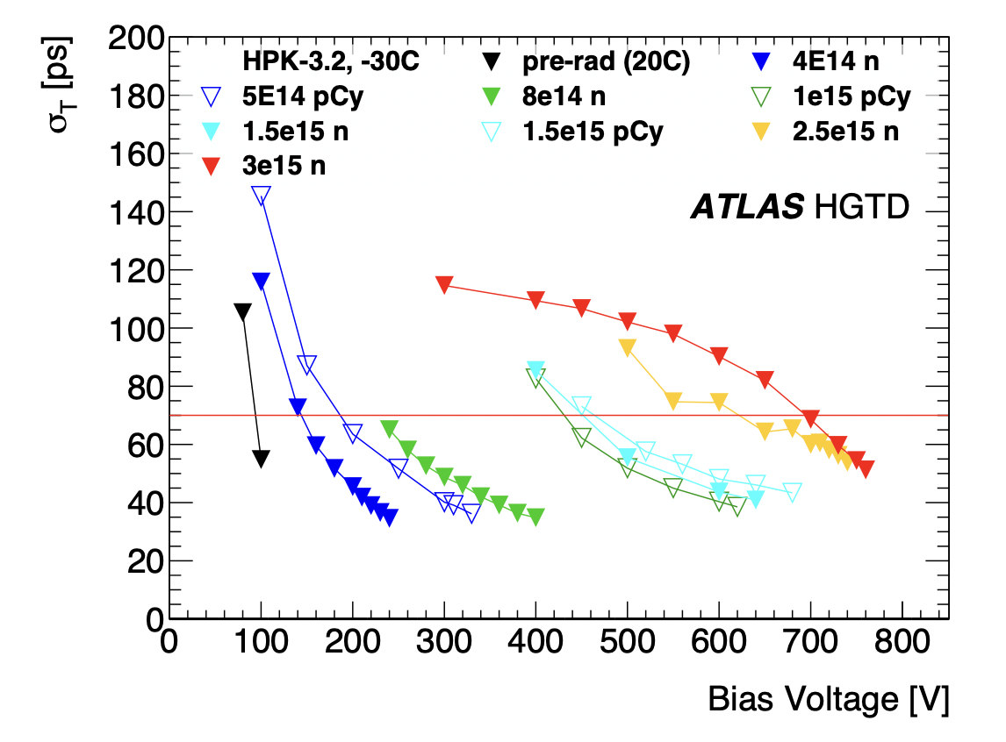
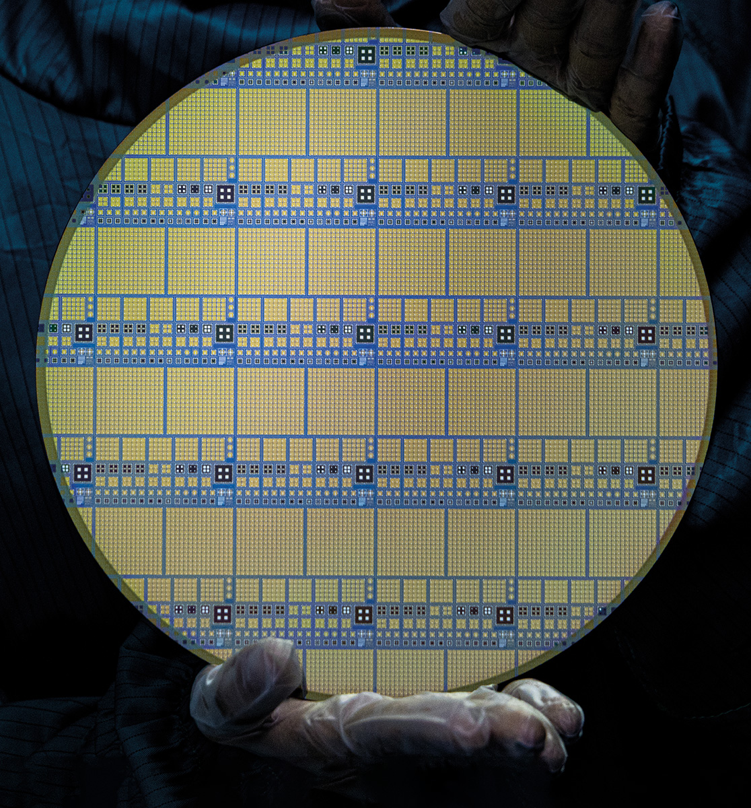
LGAD performance
WP1.2
LGADs are a mature technology that meets the timing requirements of ATLAS/CMS
  ~20 m² of LGADs will be installed in the timing layer upgrades in 2027
The sensors suffer from loss of gain with radiation beyond 2-3x10¹⁵ 1 MeV n_{eq} cm⁻²
  Not radiation hard enough for innermost detector layers, factor 10-20 too low
Another challenge is to reduce pixel size while keeping high efficiency
FASTER
8 inch wafer with ATLAS LGAD

Slide 13
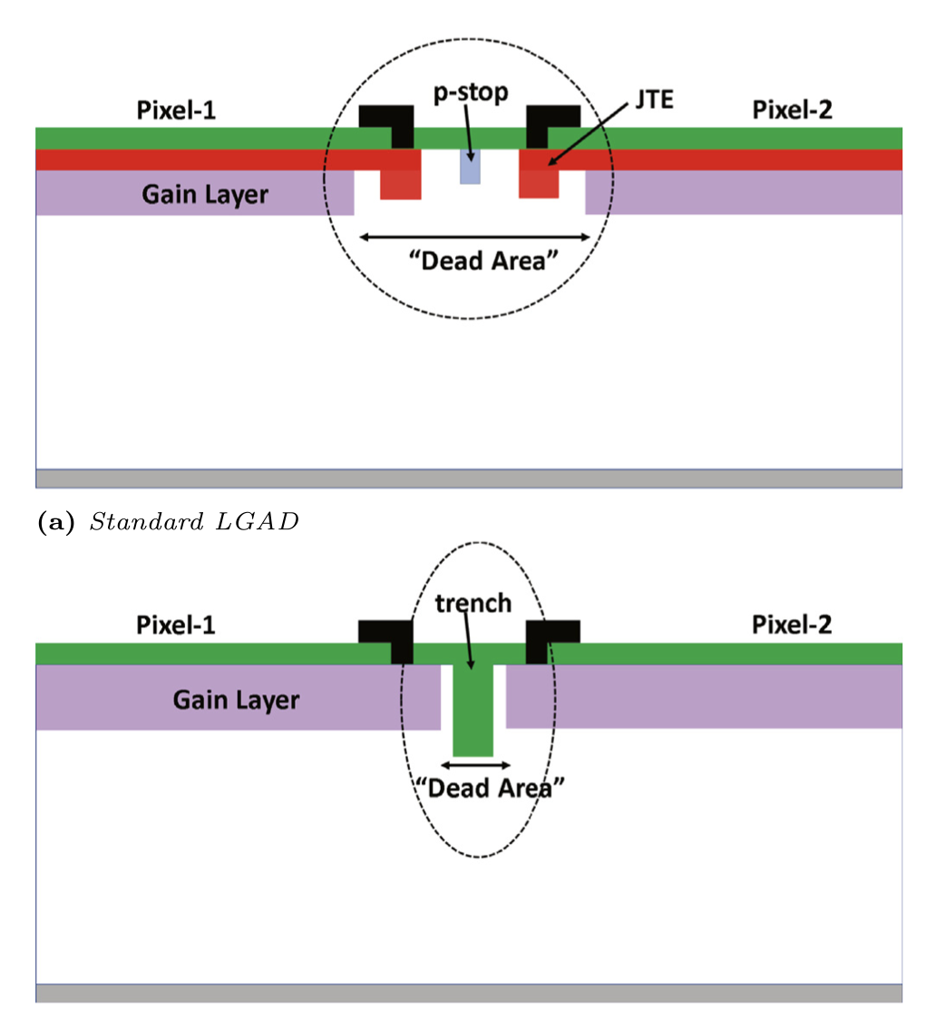
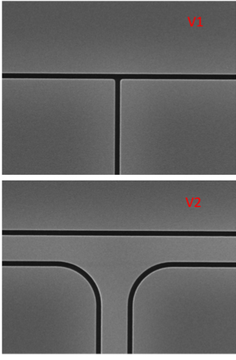
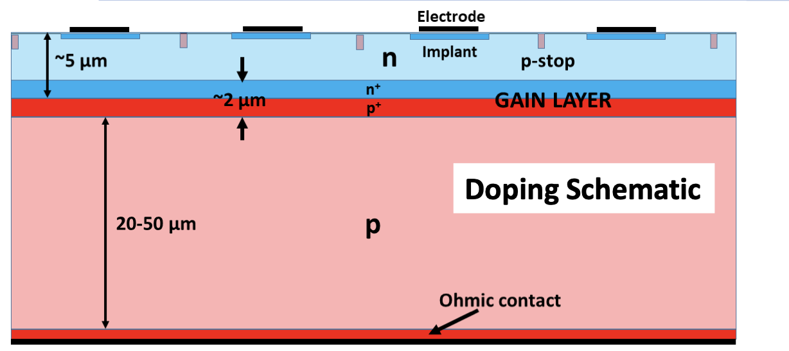
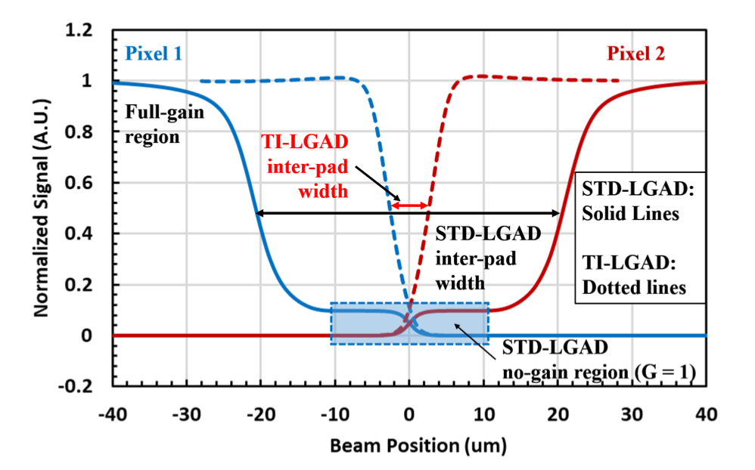
LGAD pixel pitch challenge
WP1.2
Isolation structures (JTE + p-stop) between pixels are large (50-100 um)
No gain region
Replace JTE/p-stop with narrow trench (1-2 um wide)
Yet another variant: Deep Junction LGAD
  Move high field region (junction) away from surface
  Potentially also beneficial for rad. hardness
simulation

Slide 14
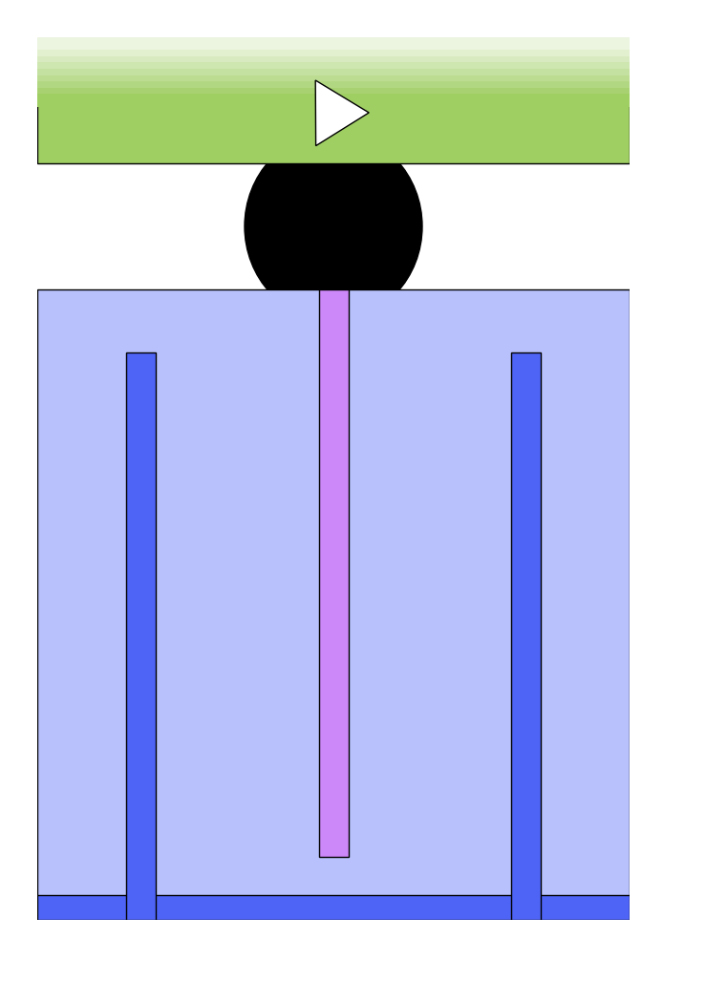
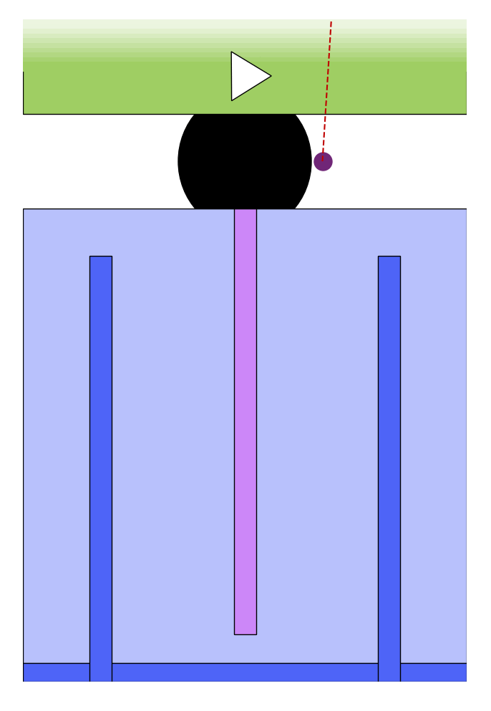
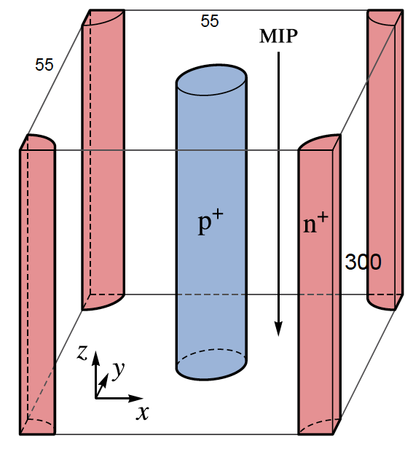
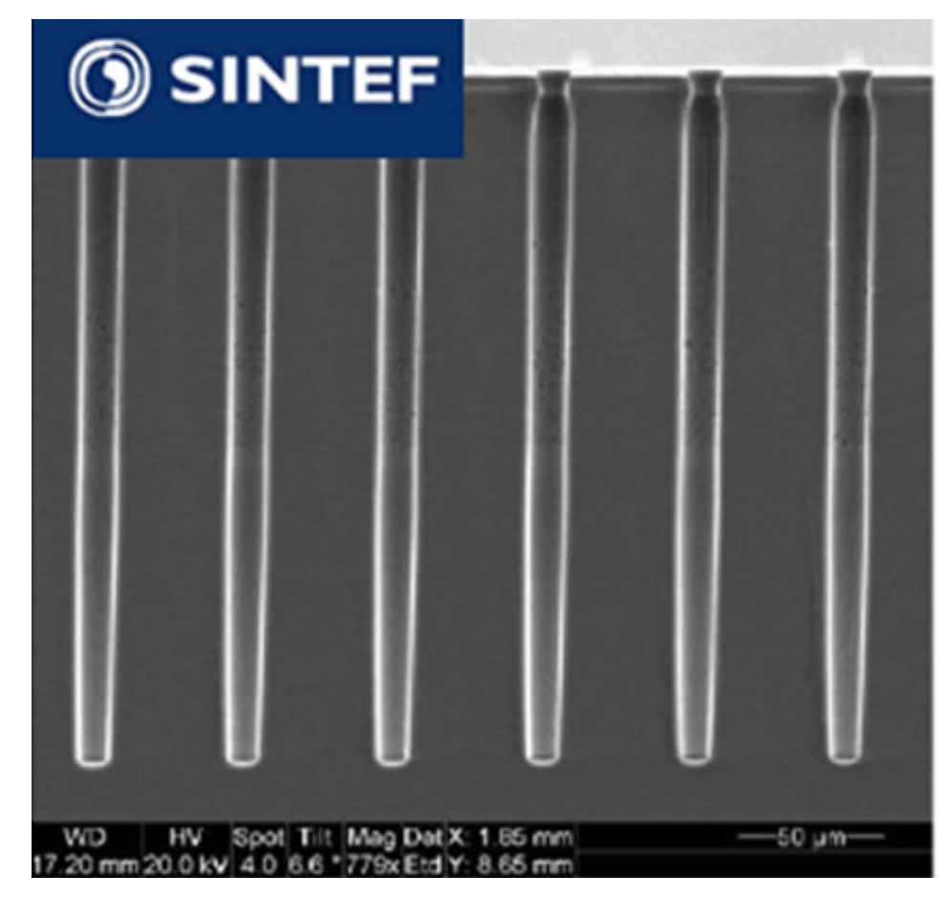
3D sensors
WP1.3
The electrodes of 3D sensors penetrate the silicon bulk
Electron-hole pairs drift perpendicular to track direction
  Track length (= signal magnitude) decoupled from drift distance
O(5) μm holes etched via Deep Reactive Ion Etching (DRIE), then doped
Shown to be radiation hard up to Φ = 3x10¹⁶ 1 MeV n_{eq} / cm²
DRIE etched holes

Slide 15
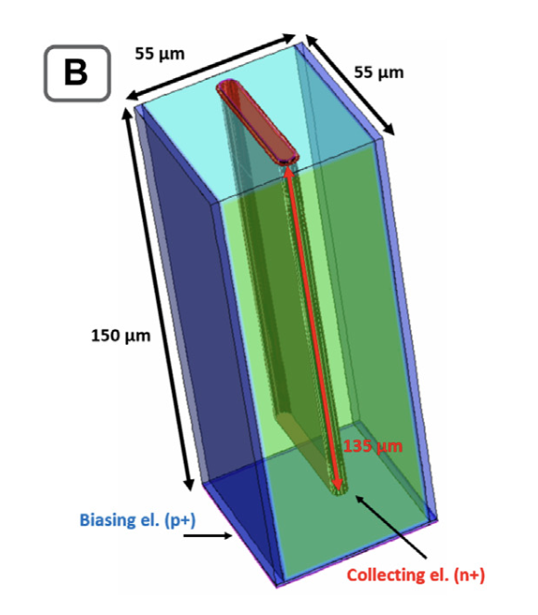
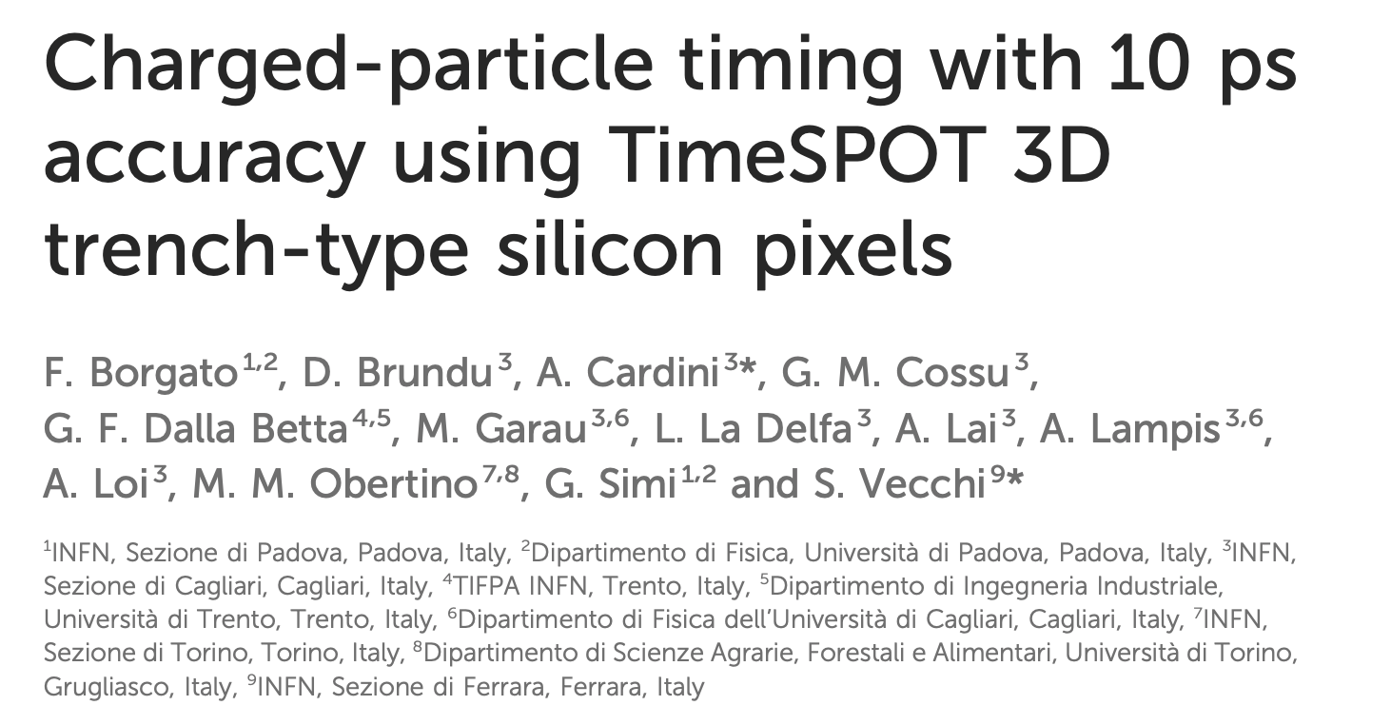
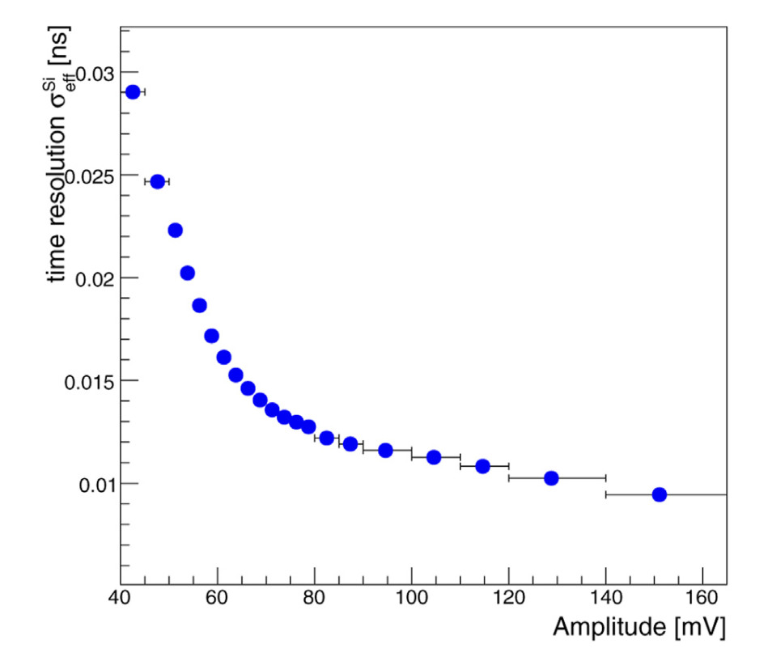
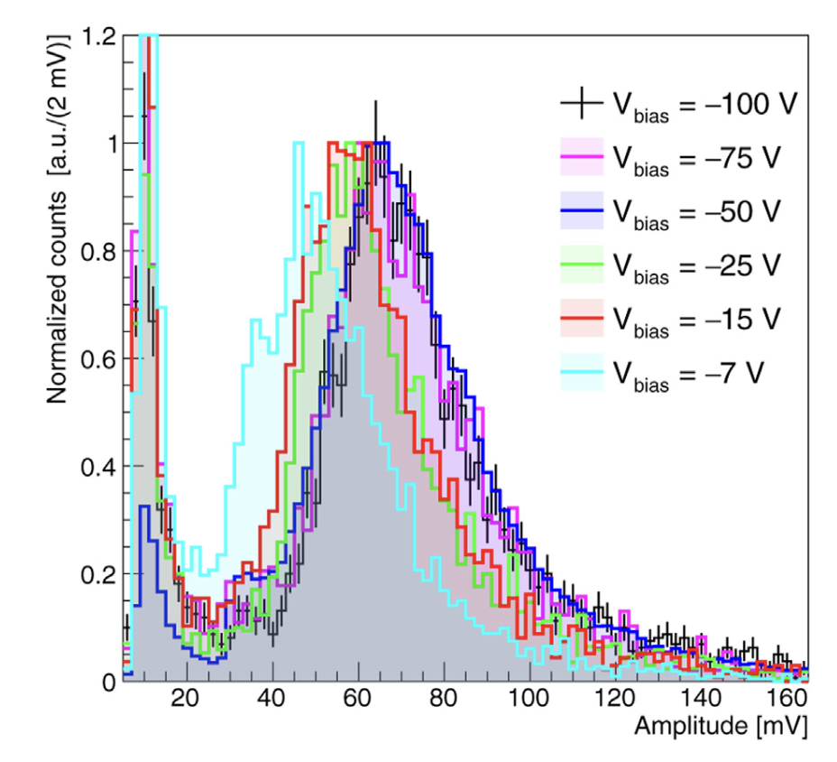
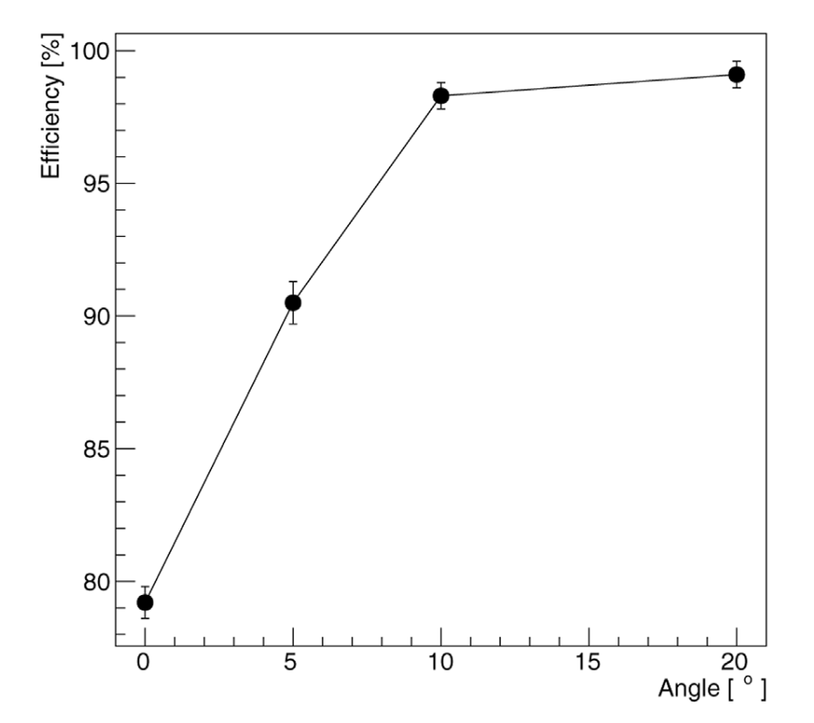
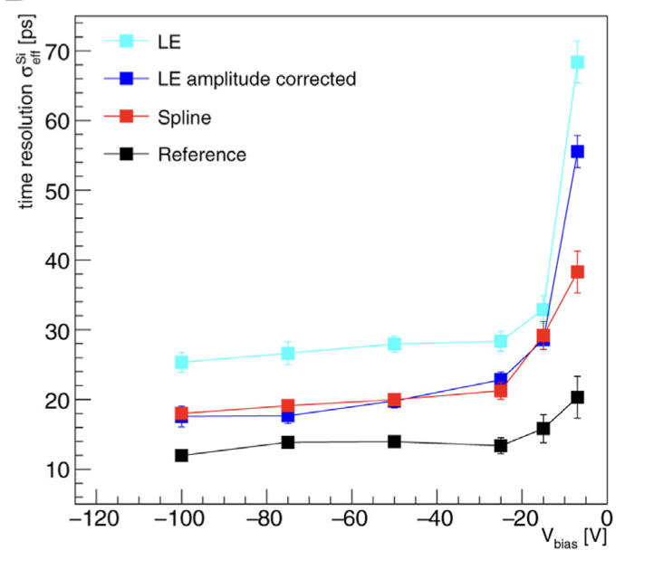
Example 3D sensor results, a critical view
10 ps timing, impressive result, but …
Basically a single pixel measurement
With power hungry discrete electronics
And ‘fancy’ offline analysis methods
And for larger than average signals
Time res. vs amplitude
Amplitude distribution
Efficiency vs. Angle
Power of offline processing
perpendicular

Slide 16
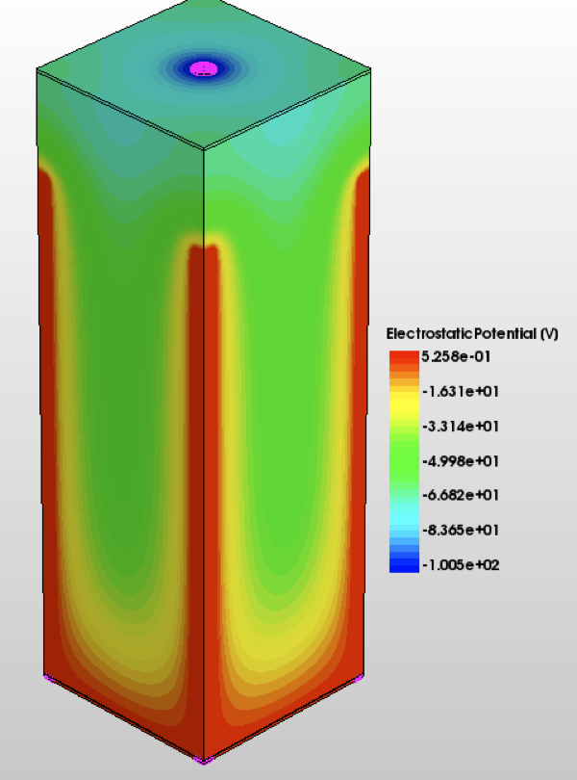
There is still work to be done
WP1.3
55 um
Large signal, only if thick (150 um)
Hence large capacitance ☹
Thus high power electronics
Investigate thinner sensors + avalanche gain
Investigate onset of gain in existing detectors
  With laser and testbeam
TCAD simulations to ‘engineer’ the high electric fields

Slide 17
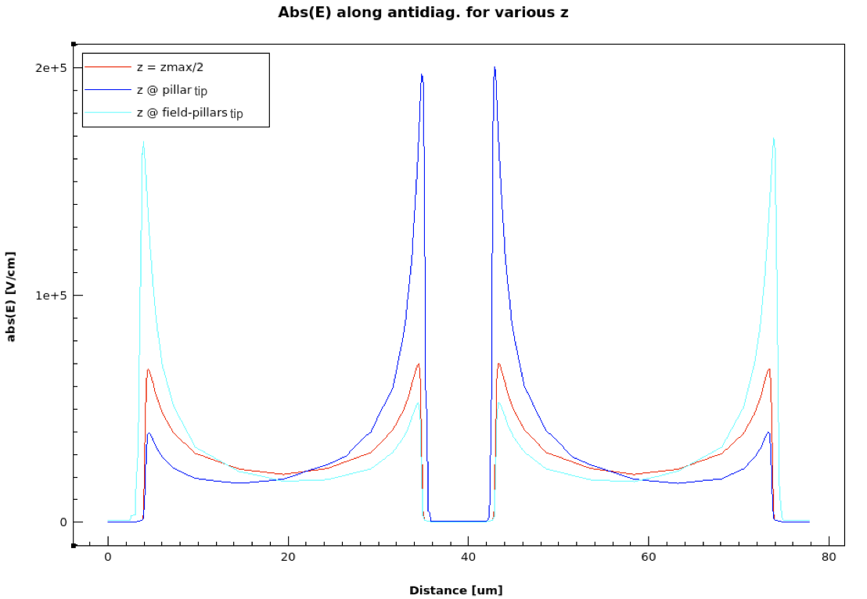
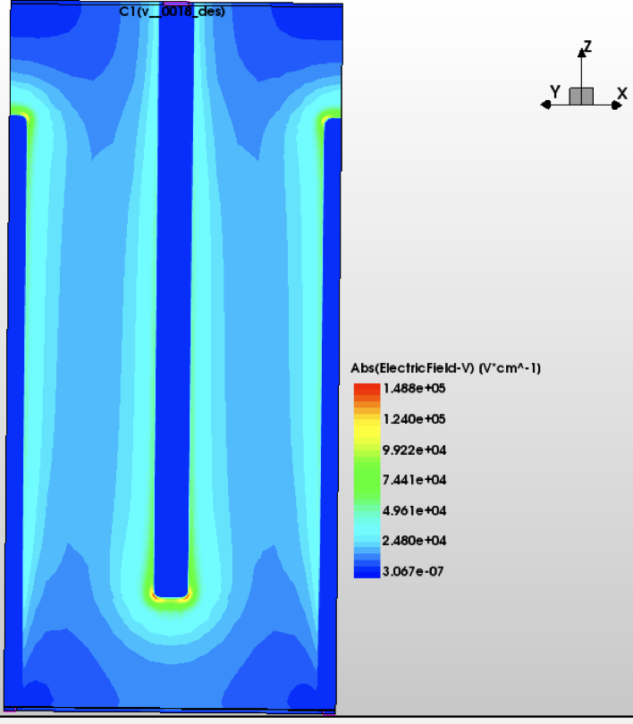
Electric Field
WP1.3
E-field map
Thinner pillars -> high field along entire column
Gain by geometry, not only by doping levels
Reduce the field at the head of the pillar

Slide 18
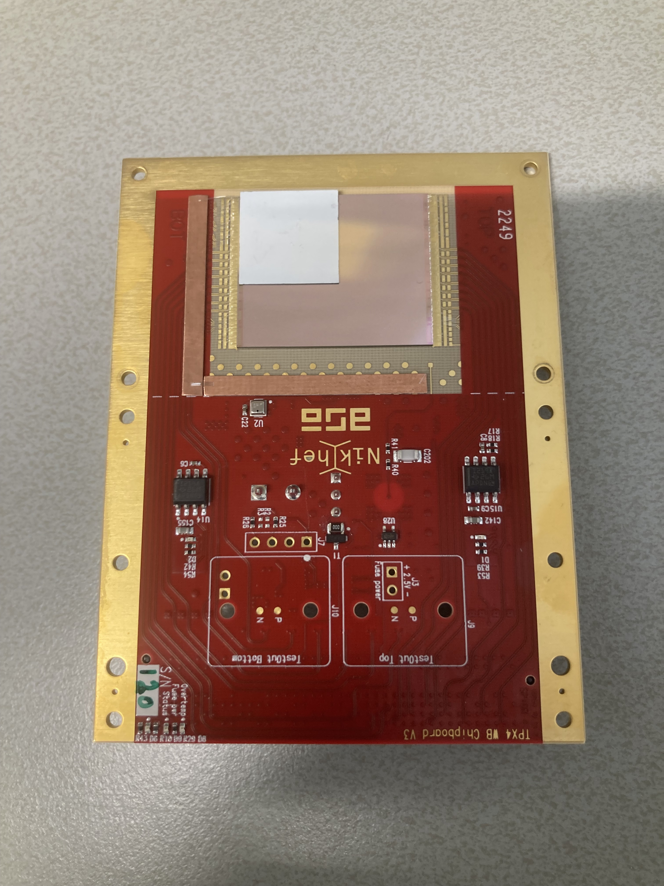
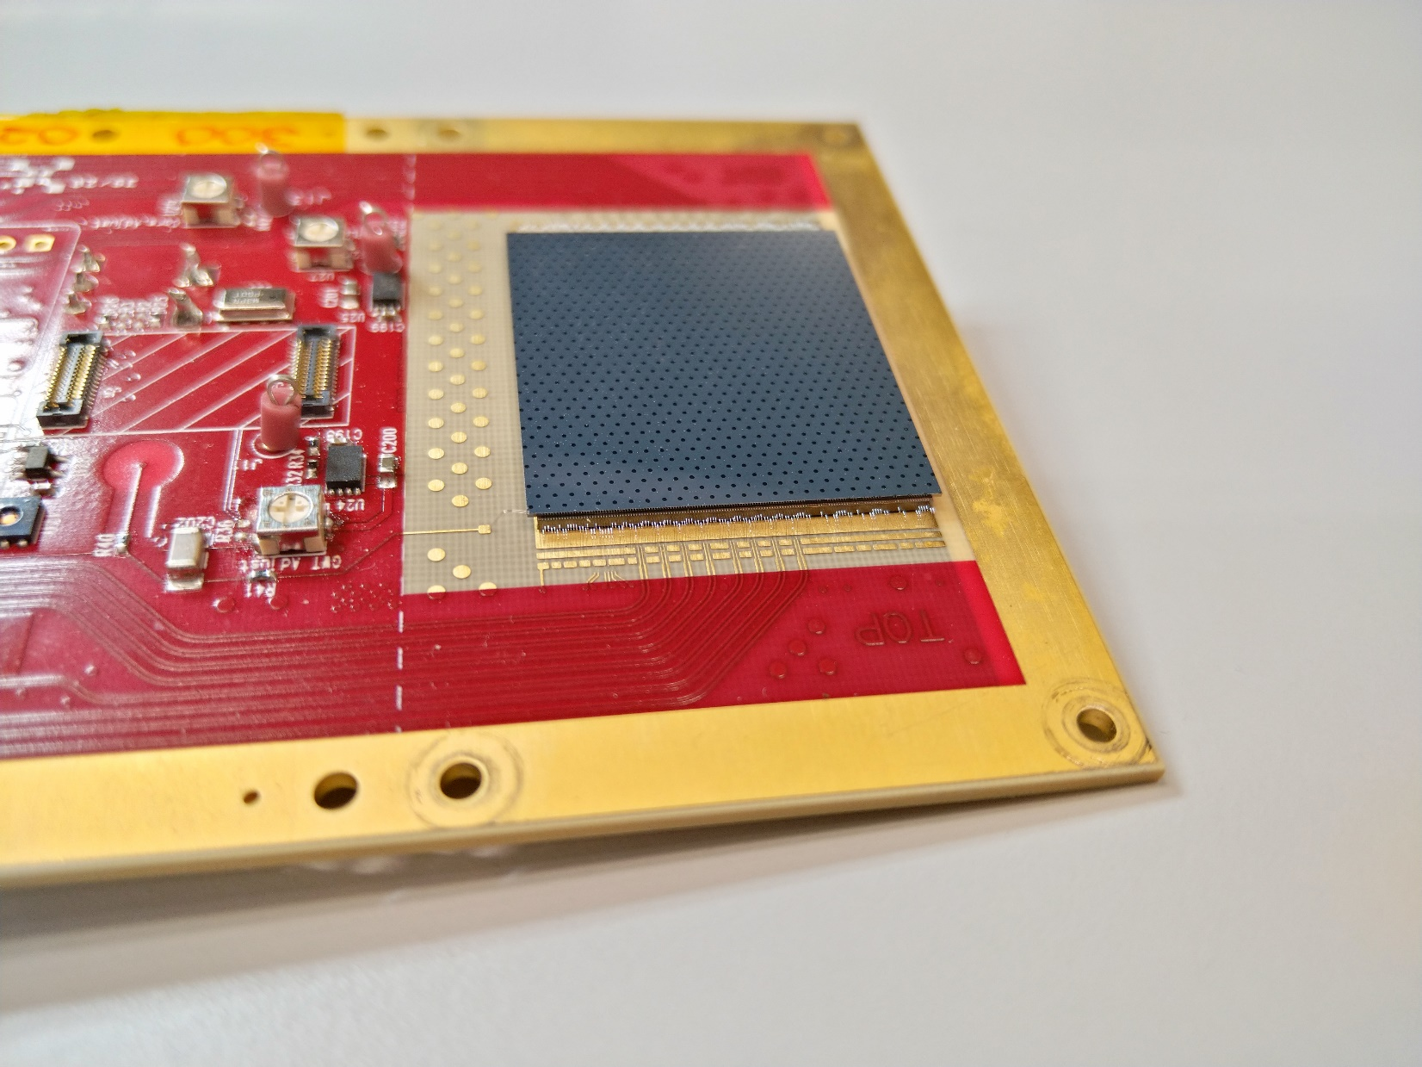
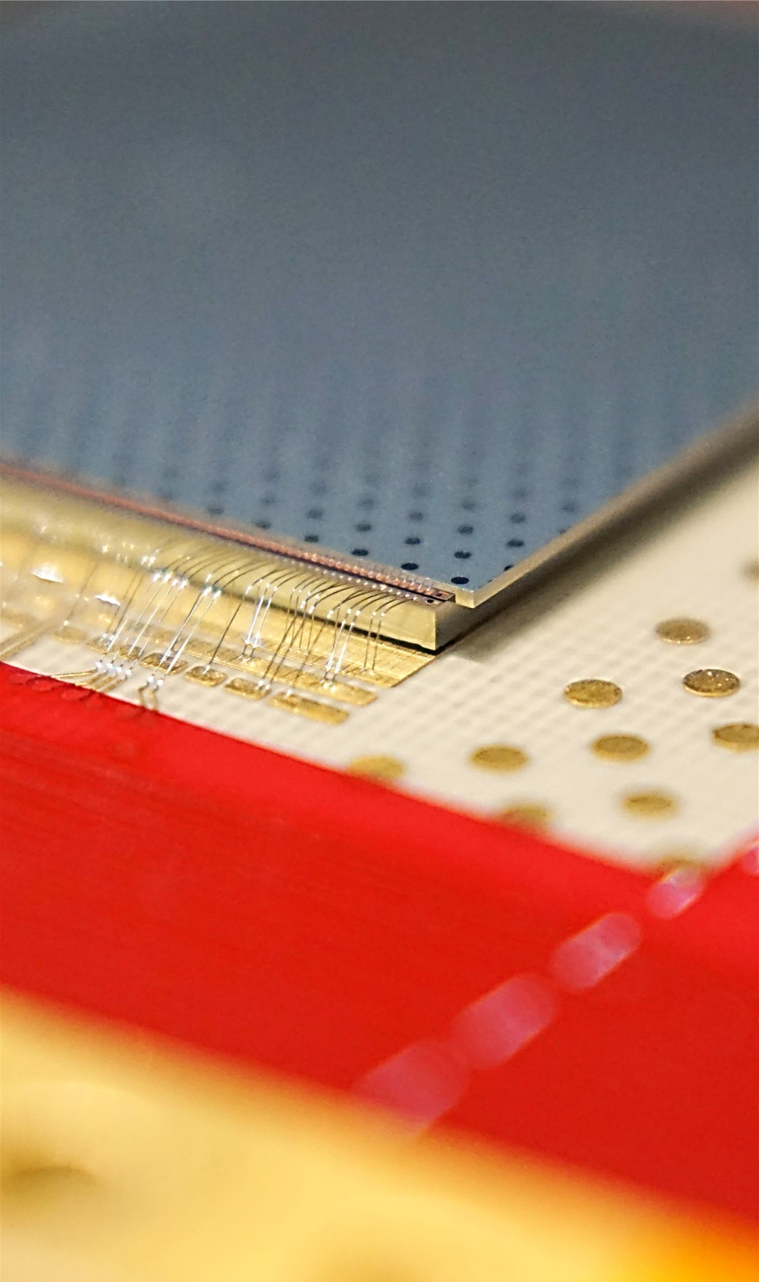
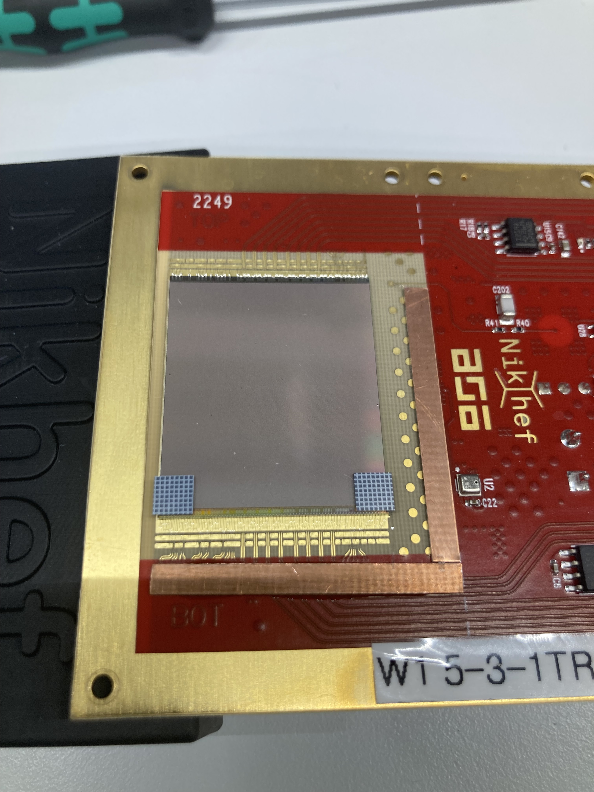
What about the electronics (ASIC), WP2.1
ASIC developments are relatively slow, especially large/complex ASICs
Hence learn all we can from existing ASICs
  Pinpoint the actual limitations
One of the work horse ASICs is Timepix4
  512 x 448 pixels, ~2 x 2.5 cm²
  Should provide ~80 ps resolution for signal of 10 ke-
3D
TI-LGAD
Sensor
Pixel chip
Wire bonds (25 um Al)

Slide 19
Timepix4 pre-amplifier (simulation)
Simulation based on Timepix4 ASIC (65 nm, 2019)
Pre-amplifier only, no TDC!
Timepix4
~60 ps @ 10 ke-
https://doi.org/10.1016/j.nima.2022.167489

Slide 20
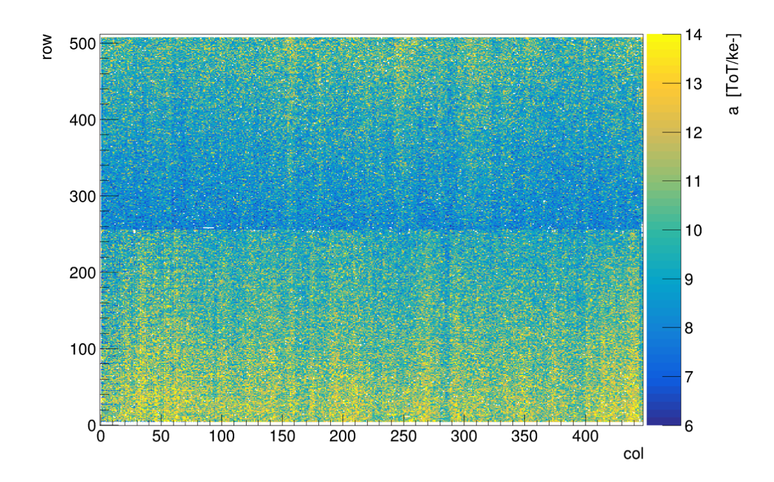
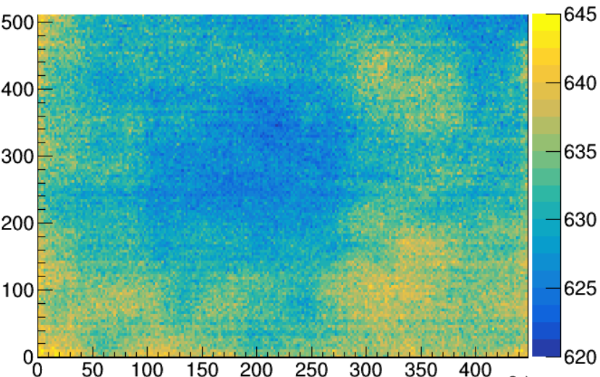
Timepix4 example, pixel to pixel variations
Not all pixel behave in exactly the same way
Making them more equal requires space -> larger pixels
Corrections are mandatory to achieve good time resolution
How to calibrate?
And where to apply the corrections (chip, FPGA, CPU/GPU)?
Charge ‘gain’
Measurement clock frequency
Row
Frequency [MHz]
40 MHz
Col

Slide 21
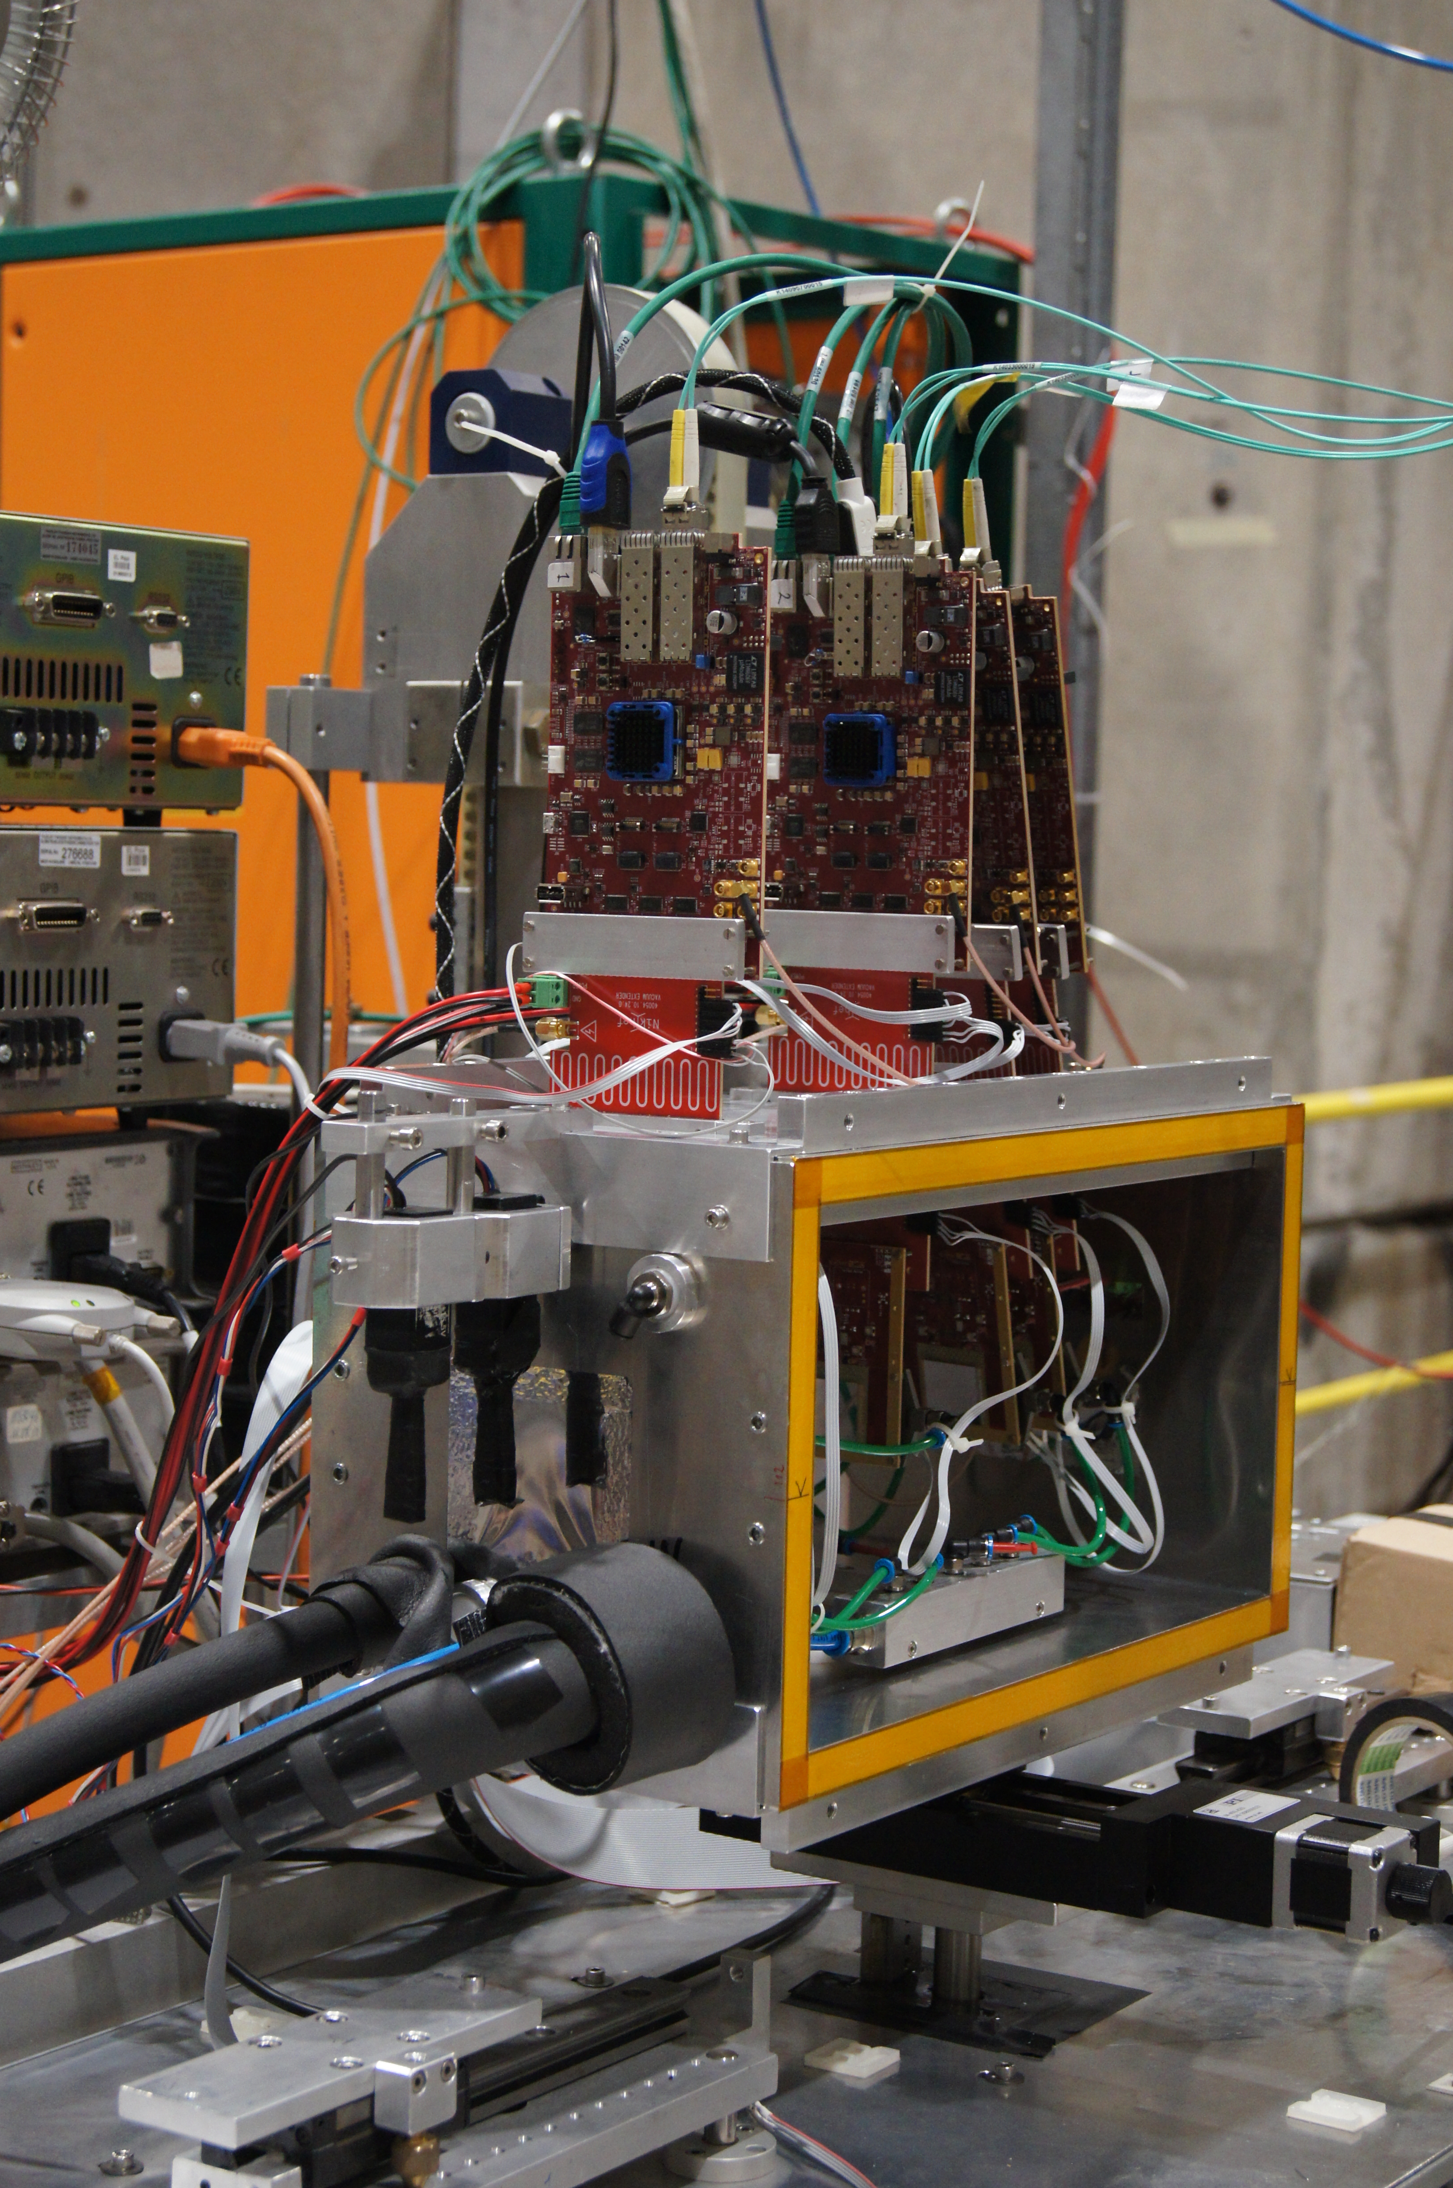
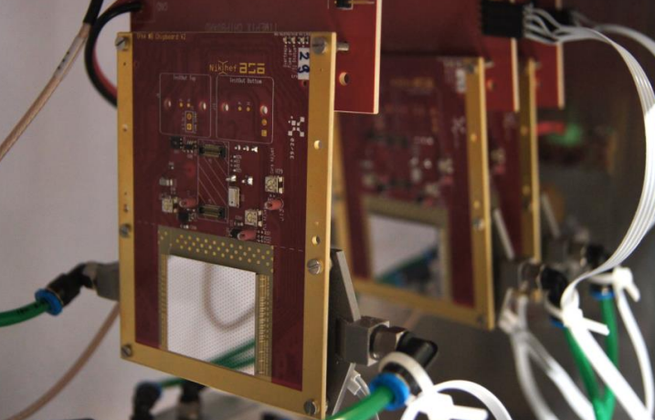
The research just started, so no conclusions!
SPIDR4
scintillators
Detector Box
Timepix4

Slide 23
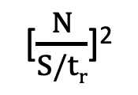
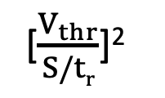
Time resolution
σ²_{t} = σ²_{TimeWalk} + σ²_{jitter} + σ²_{TDC}
[$\frac{V_{thr}}{S/tr}$]²
[$\frac{N}{S/tr}$]²
Bin size of TDC
and reference clock
stability
Need:
Low threshold
Large signal S
Short rise time t_{r}
Need:
High Signal-to-Noise
Short rise time
Limited by area
and power

Slide 24
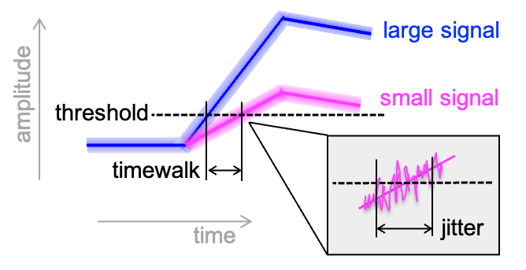
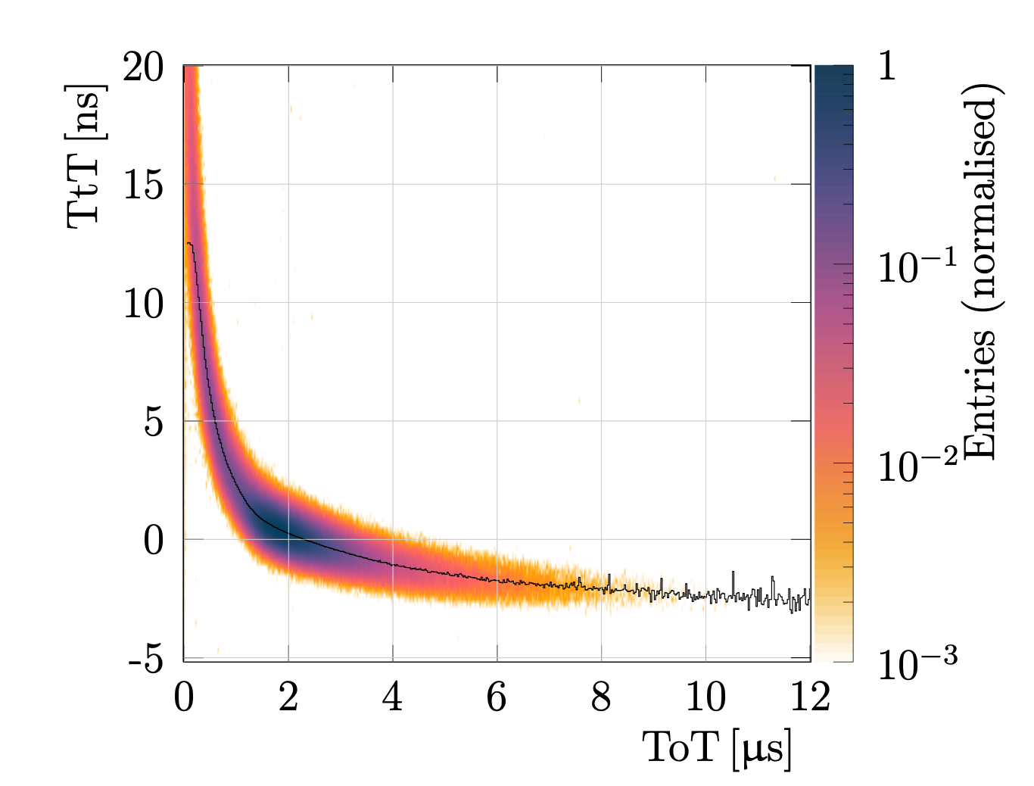
Timewalk and Jitter
Timewalk
Is the dependence of the threshold crossing time on the magnitude of the signal
Can be corrected for by measuring the signal magnitude
Reduces with smaller rise time (higher ‘dV/dt’)
and lower threshold
(for very small signals the timewalk can be larger than the peaking time: discriminator ‘overdrive’)
Timepix4 + 200 μm sensor
Timewalk [ns]
Signal [a.u.]

Slide 25
Timewalk and Jitter
large signal
amplitude
small signal
threshold
timewalk
time
jitter
Jitter
Amplitude fluctuations affecting the exact threshold crossing time
Fluctuations due to
  Thermal noise of the pre-amplifier
    Large signal and/or high gain (power) mitigates this effect
  Local ‘Landau’ fluctuations in the ionization density in the sensor
Can not correct for it offline; only improvement via design

Slide 26

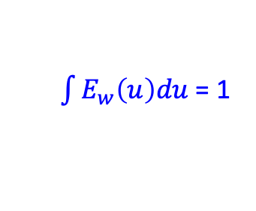

Signal induction
Moving charges induce current in the electrodes
  described by Ramo-Shockley theorem
Weighting field E_{w} describes the coupling between location of the charge and the collecting electrode(s)
E_{w} defined by the geometrical arrangement of electrodes
Note that both the electrons and holes induce current
$$i\left(t\right)=q\vec{v (x,y,z)}∙ \vec{E_{w}(x,y,z)}$$
$$and v=f(Edrift)$$
$\int{E_{w}\left(u\right)du}$ = 1

Slide 27
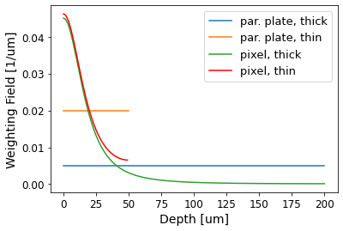
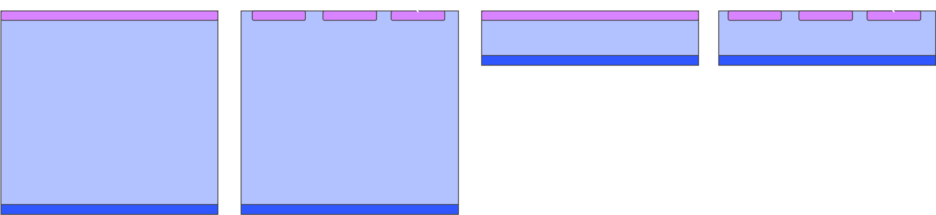


A closer look at the weighting field
Comparing
geometries
Weighting field is uniform for a parallel plate geometry
And typically highly non-uniform for a pixel detector
Collected charge versus time for uniform charge density
No benefit from thick sensor
  Very similar slope
  Larger signal, but late
Par. plate is better for local charge density fluctuations
threshold

