Slide 1
WP4: vacuum and cryogenics overview and readiness

Slide 2
The cryogenic system, overview
LN2 cooling for fast cooldown, superior cooling power, low vibration
Enthalpy (evaporation) 200 kJ/kg
Compare with ~ 1kJ/kgK specific heat nitrogen, ~5 kJ/kgK for helium
Also relevant for ET and future GW interferometers: by evaporating Nitrogen you can take out much more heat at the same flow (so much less vibrations) than with conductive flows.
Currently not considered within ET consortium, but alternative strategies (pulse tube coolers, helium convection) not proven and established yet, and I think LN2 will be necessary to meet ET requirements.
Helium loop for initial cooldown – needed to reach temperatures below 20K but introduces noise (turbulent flow)
Sorption coolers (Ne,H,He) for vibration-free cooling and maintaining low temperatures (LN2 needed to shield from thermal radiation and to cool the sorption cells)

Slide 3
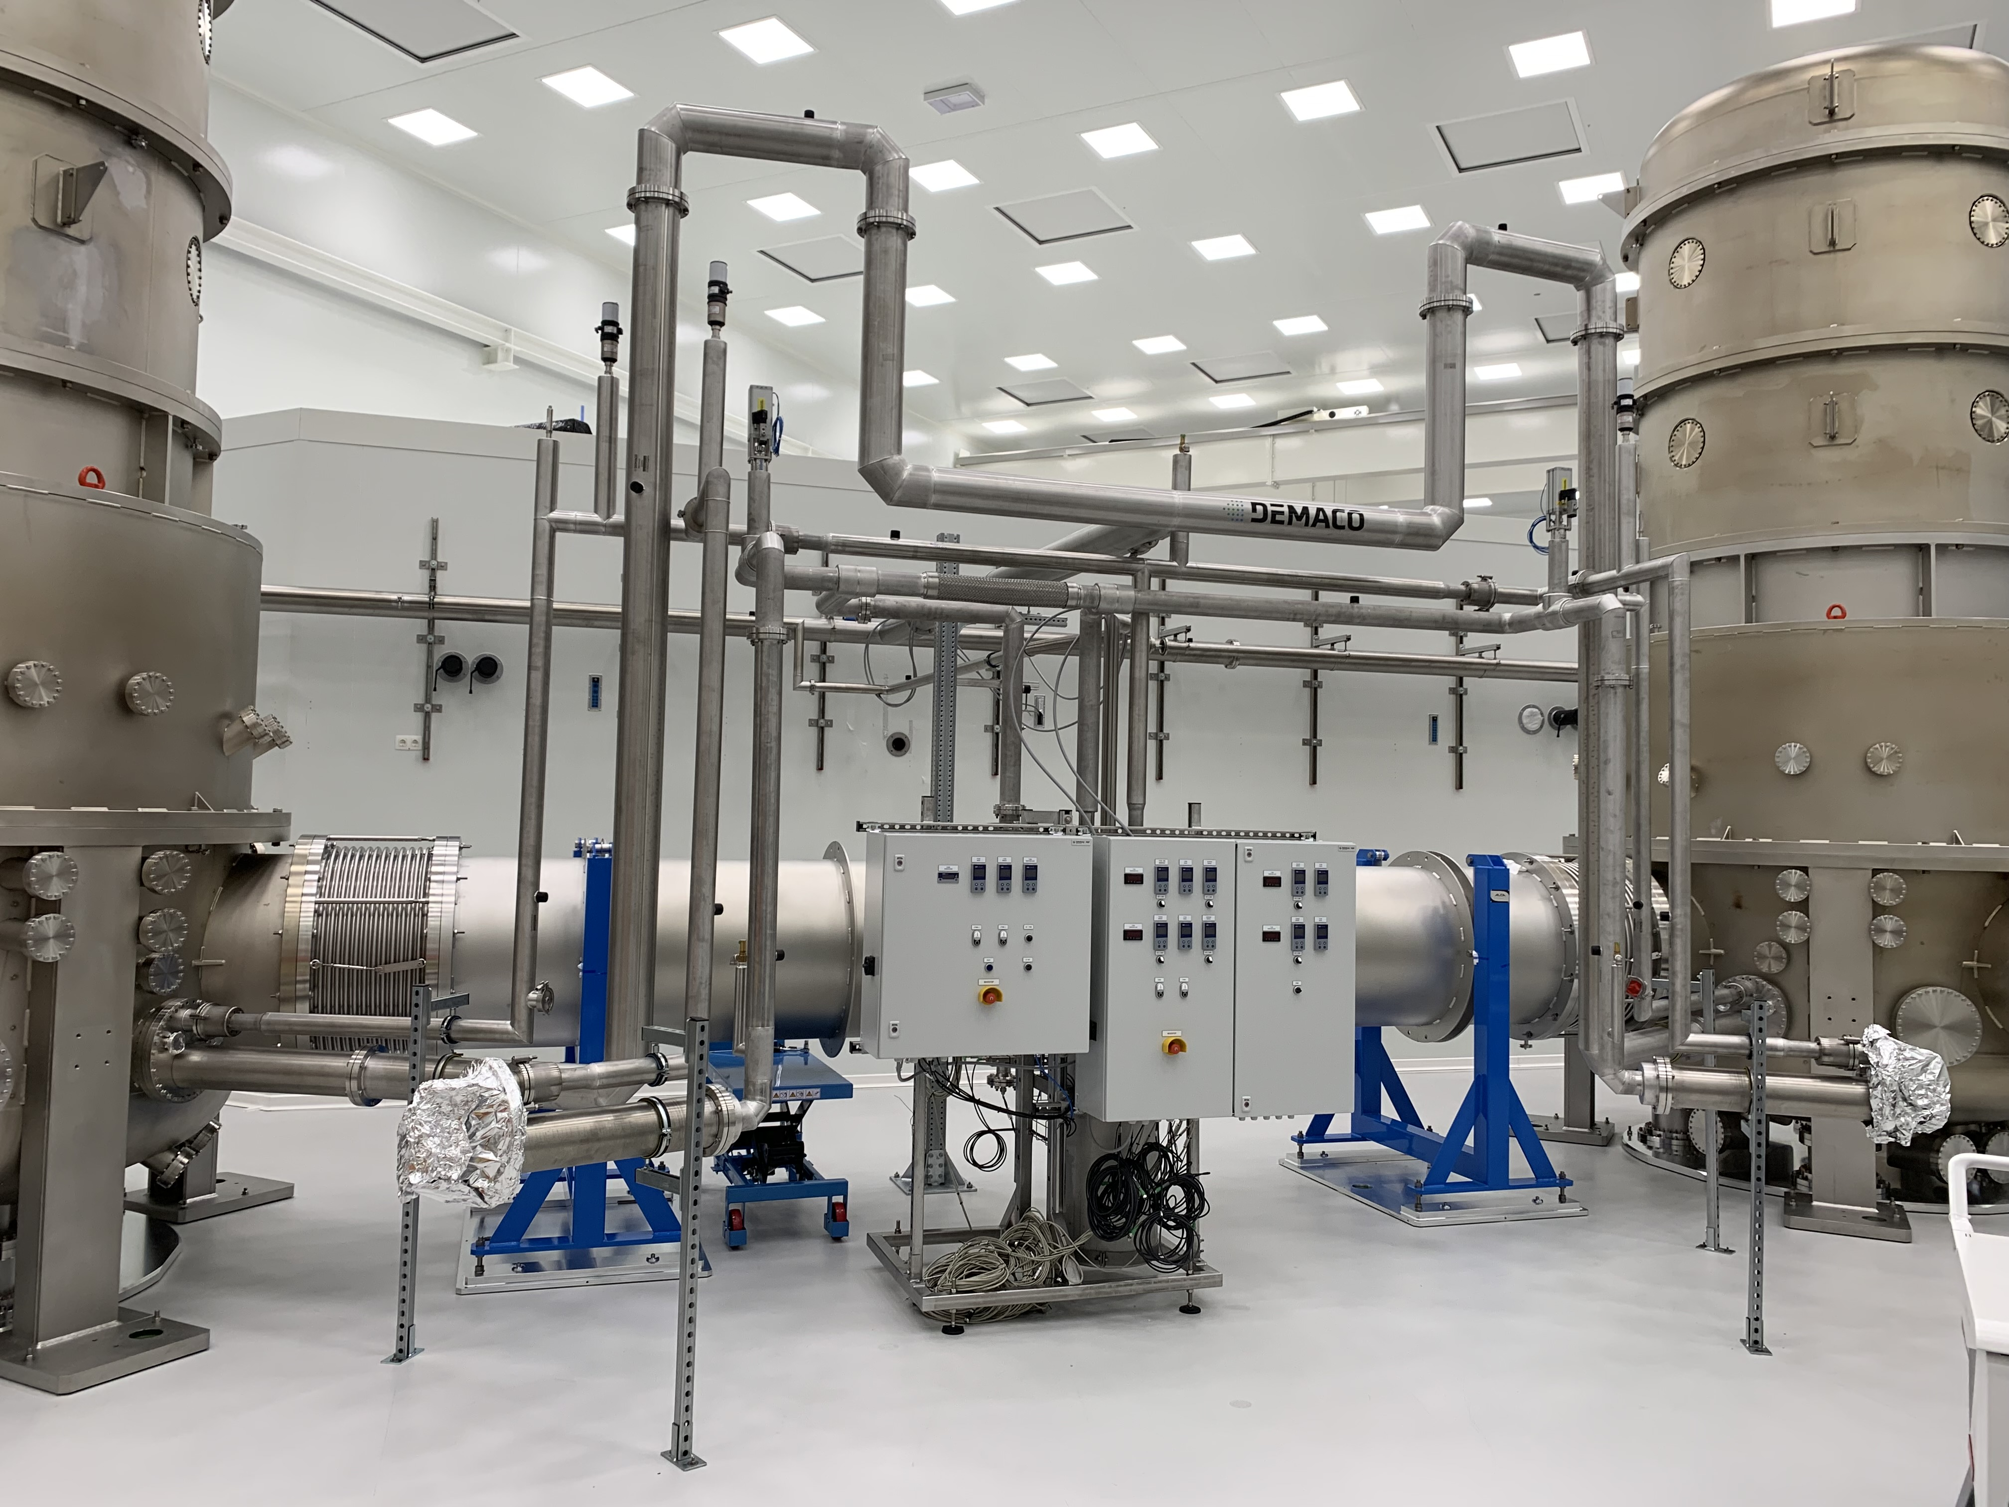
Vacuum and Cryogenics, status hardware
Vacuum towers installed, beam pipes installed, roughing pump lines installed, bellows covered
PLC software designed (vacuum), cabinets for cabling being produced
Vacuum system:
Adapter pieces for the large turbo’s arrive now/coming month
Turbo’s then can be mounted permanently
Cooling water system needs to be installed (planned, Kenny)
Vacuum cabling – needs to be installed Q2 2024 – by ourselves, manpower needed
Modification on roughing system:
Underpressure valve needed on exhaust roughing pump- to prevent backflow through screw pump in case of power failure/mistakes.
Procedure to evacuate slowly: I propose to just partly open the manual all-metal valves between screw pump and towers until pressure is below 50 mbar.
PLC system needs to be installed, Q2 2024. further discussions on PLC system: Thomas Thuemmler KIT (tomorrow, parallel session)
The system in Maastricht, Nov. 2023

Slide 4
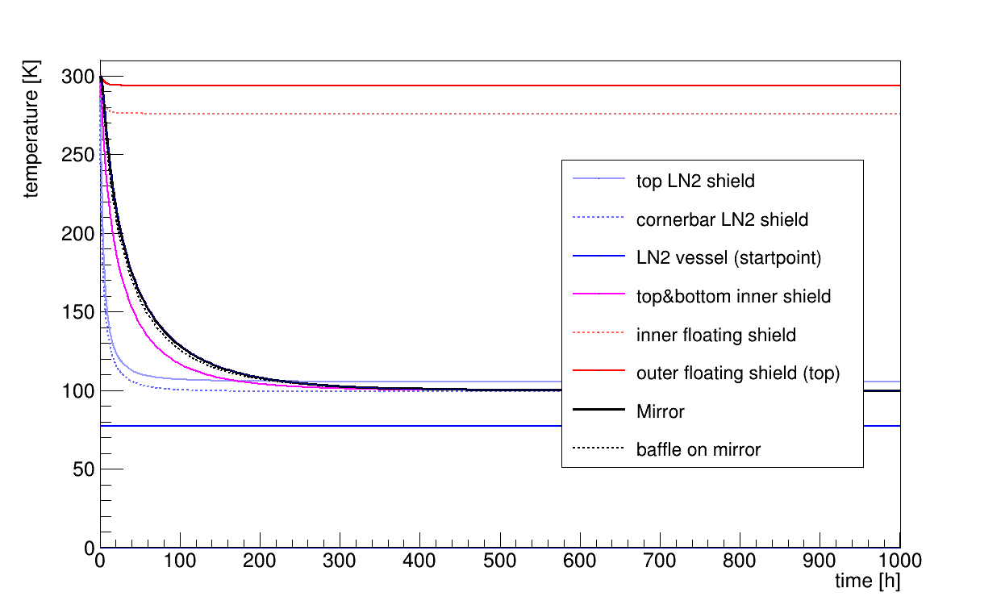
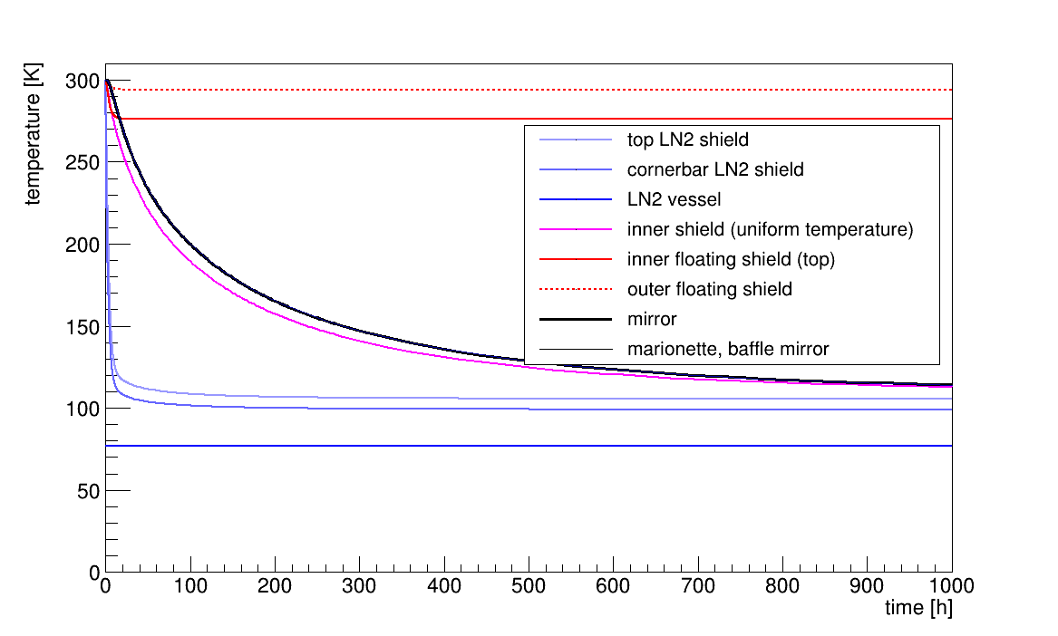
Status hardware, cryogenics system
LN2 system demaco installed and tested
Leaking connections to towers repaired nov 2023
With current system we can cool down to LN2 temperatures, but to operate at continuous flow to limit noise, a phase separator is needed.
LN2 shields, floating shields, inner shields have been produced and delivered
For operation at 123 K, we need to coat some parts of these shields black. For operation at 10K that is not necessary since we will have a powerful cooler on the inner shield.
We need baffles around the mirrors, also for stray light but definitely for cooling the mirrors down
We need baffles inside the pipes of the shields around the beams. (further discussions tomorrow parallel session)
Left: cooling by radiation with the LN2 system. New calculations were necessary since we do not have Al-6063, but Al-6082 for the LN2 shield and vessel, limiting conductivity. Top: cooldown curves when the inside of the 80-K shield and the outside and inside of the 40K-shield are coated black. Bottom: only the baffles are coated black. It takes resp. 4 days or 1 month to reach 123 K for the mirror.

Slide 5
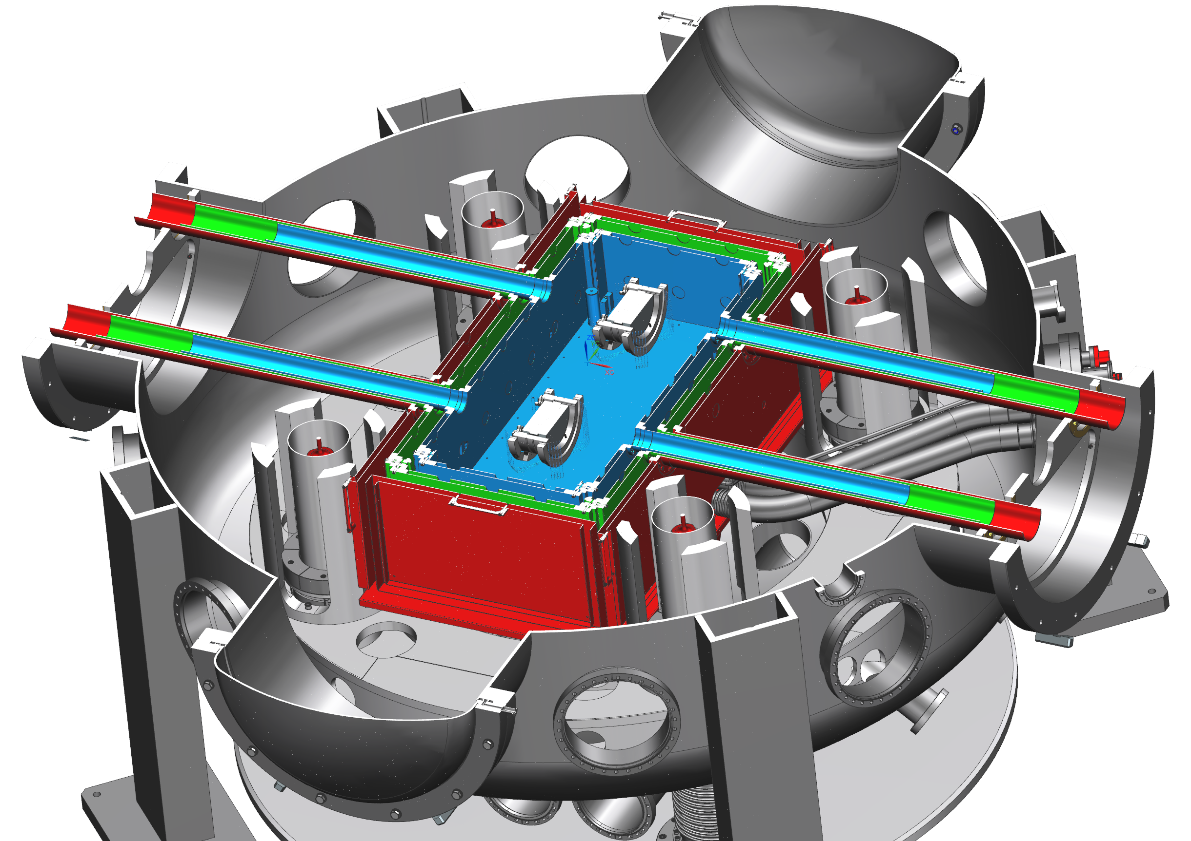
Status hardware, thermal shields - baffles
Baffles needed: around the mirrors (4 per tower), inside the inner shield (4 per tower), LN2 shield (4 per tower) guide tubes and optionally inside the floating shield guide tubes (4 per tower)
Diameters of these thermal shield guide tubes: 80 mm, 100mm, 120 mm. At the ends there is a thread on the inside of the tube so one can screw in a cone or a disk.
For scattered light reduction I would prefer a 45-deg cone maybe with serrated rim, but maybe that is not crucial. If we have good baffles on the safety frame around the mirror, then they may already limit the scattered light 100 percent.
Payload design allows for mounting baffles around mirror

Slide 6
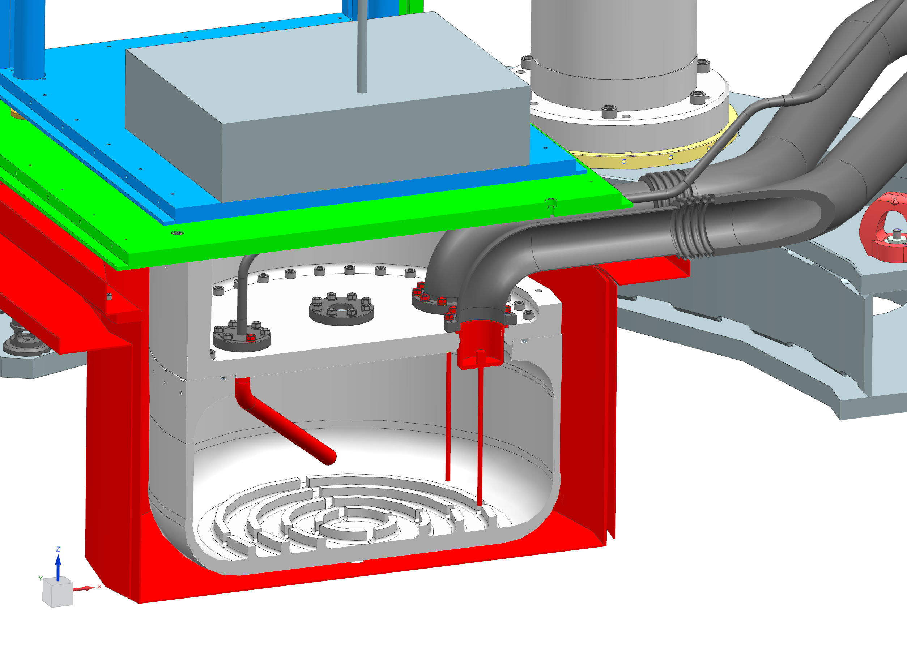
Status hardware, LN2 vessels
Demaco tender: redesign of connection between the LN2 supply system and the vessels cooling the shields/the sorption coolers was needed.
Vessels will be/are being produced at Nikhef
Redesign top part and interface with Demaco by Barcelona (Rafael Garcia, tomorrow)
2 exhaust tubes 63mm diameter; need to go towards a 100-mm diameter single tube.
Connection of SS part to LN2 aluminum vessel – make an interface in Al as part of the top lid
2 new flanges for level sensors
presentations/discussions of redesign tomorrow (Rafael Garcia) parallel session
Vessels/interface with Demaco flange need to be produced to proceed with the cryogenic program; we want to install in Twente Q3 2024.
Being designed. Care for threading of bolts in Al parts, differences in thermal expansion, turbulence, etc
Being machined, ribs in bottom part need space for new level sensors
Support frame for Twente test tower is missing. Either duplicate or produce a cheaper frame with the same interface between vessel, lines and tower.

Slide 7
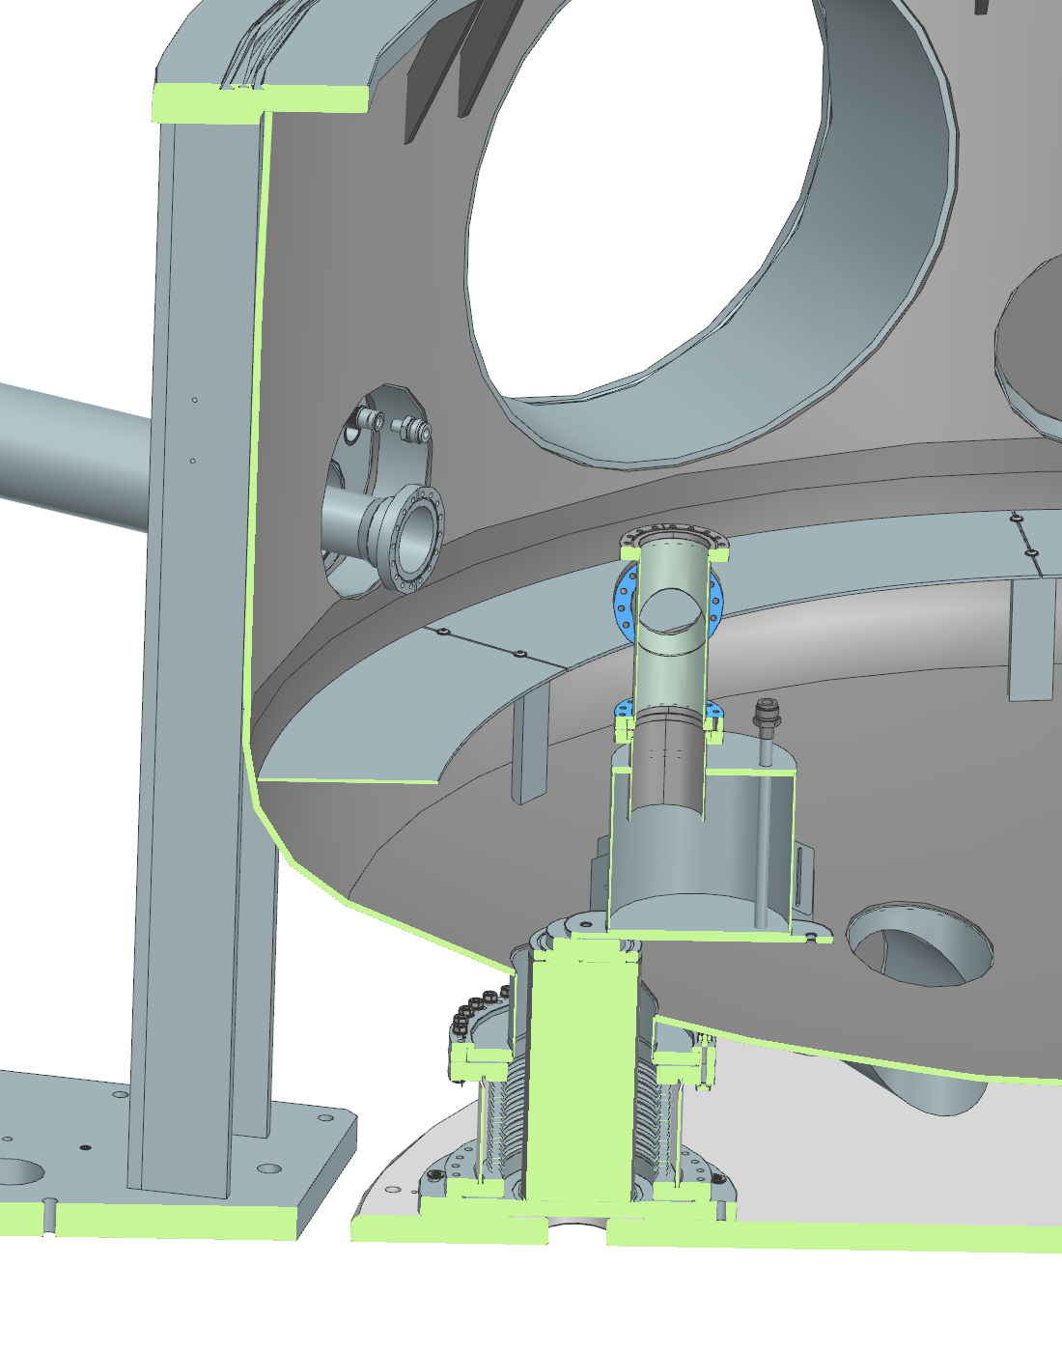
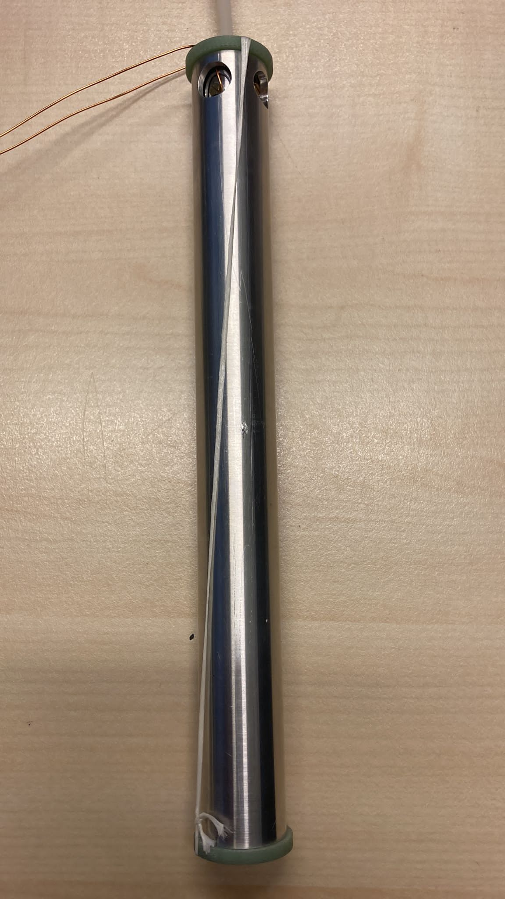
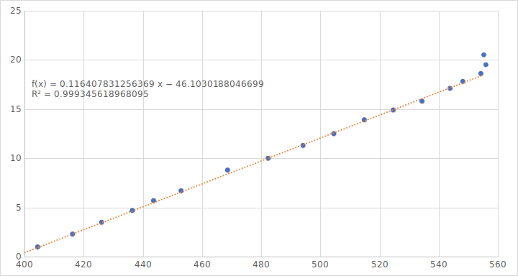
LN2 system, additional hardware needed
Additional requirements on LN2 system:
we need to install a heater (around 20 W) on the 40-K shield to be able to control the temperature around 123K
We need several temperature sensors; I propose pt-100, to install on the shields and parts of the LN2 vessel
We need to design and produce level sensors that fit into the LN2 vessel (test vessel had different dimensions)
Level sensor (Cris Vermeer) as used with the test setup to qualify the Demaco system. A capacitive measurement is made between concentric cylinders (above: calibration of the sensor in an LN2 dewar).

Slide 8
LN2 system, measurements (collaboration-wide help needed)
The LN2 system serves to provide cooling of the thermal shields (cryogenic operation at 10K) and radiative cooling of the mirror (123 K). At 123 K, silicon has no thermal expansion so a thermal noise source disappears.
Vibration-free cooling with LN2: New technique in our field, highly relevant for ET and for other applications where vibration-free cooling is important. (Stefan Hild tomorrow, plenary session).
Operating at 123 K:
Measure cool-down curve, and thermal stability of test mass, characterize the cooling performance
Measure ice build-up
Measure vibrations induced by the LN2 cooling
We want to perform these measurements in Twente this year, if possible (Cris Vermeer, Henk Jan Bulten, parallel and plenary tomorrow)
Vibrations: need a cryogenic, vacuum-compatible accelerometer.
This can be placed inside the inner shield or on top of the floating shield. Help needed. (Accelerometer inside sealed box with He? MEMS accelerometer?)
Alternatively, maybe we can measure angular/displacement noise of the test mass. Then we need an optical lever. Help needed.
Ice build-up: can be measured mechanically
ETpathfinder vacuum/shield design: geared towards low water partial pressures; my aim is to limit ice buildup to 1nm/year (KAGRA 42nm/day)
Ice buildup can be measured with piezo elements. I would like to propose a test surface inside the inner cryogenic shield in vacuum and measure the ice build-up. Can anyone take this up? Help needed.
Optical lever: Test vessel in Twente has the same ports for optical levers as the ETpathfinder towers. We can hang the test mass from the cryogenic shield. With an optical lever we may be able to detect displacements and characterize the noise from the LN2 system.

Slide 9
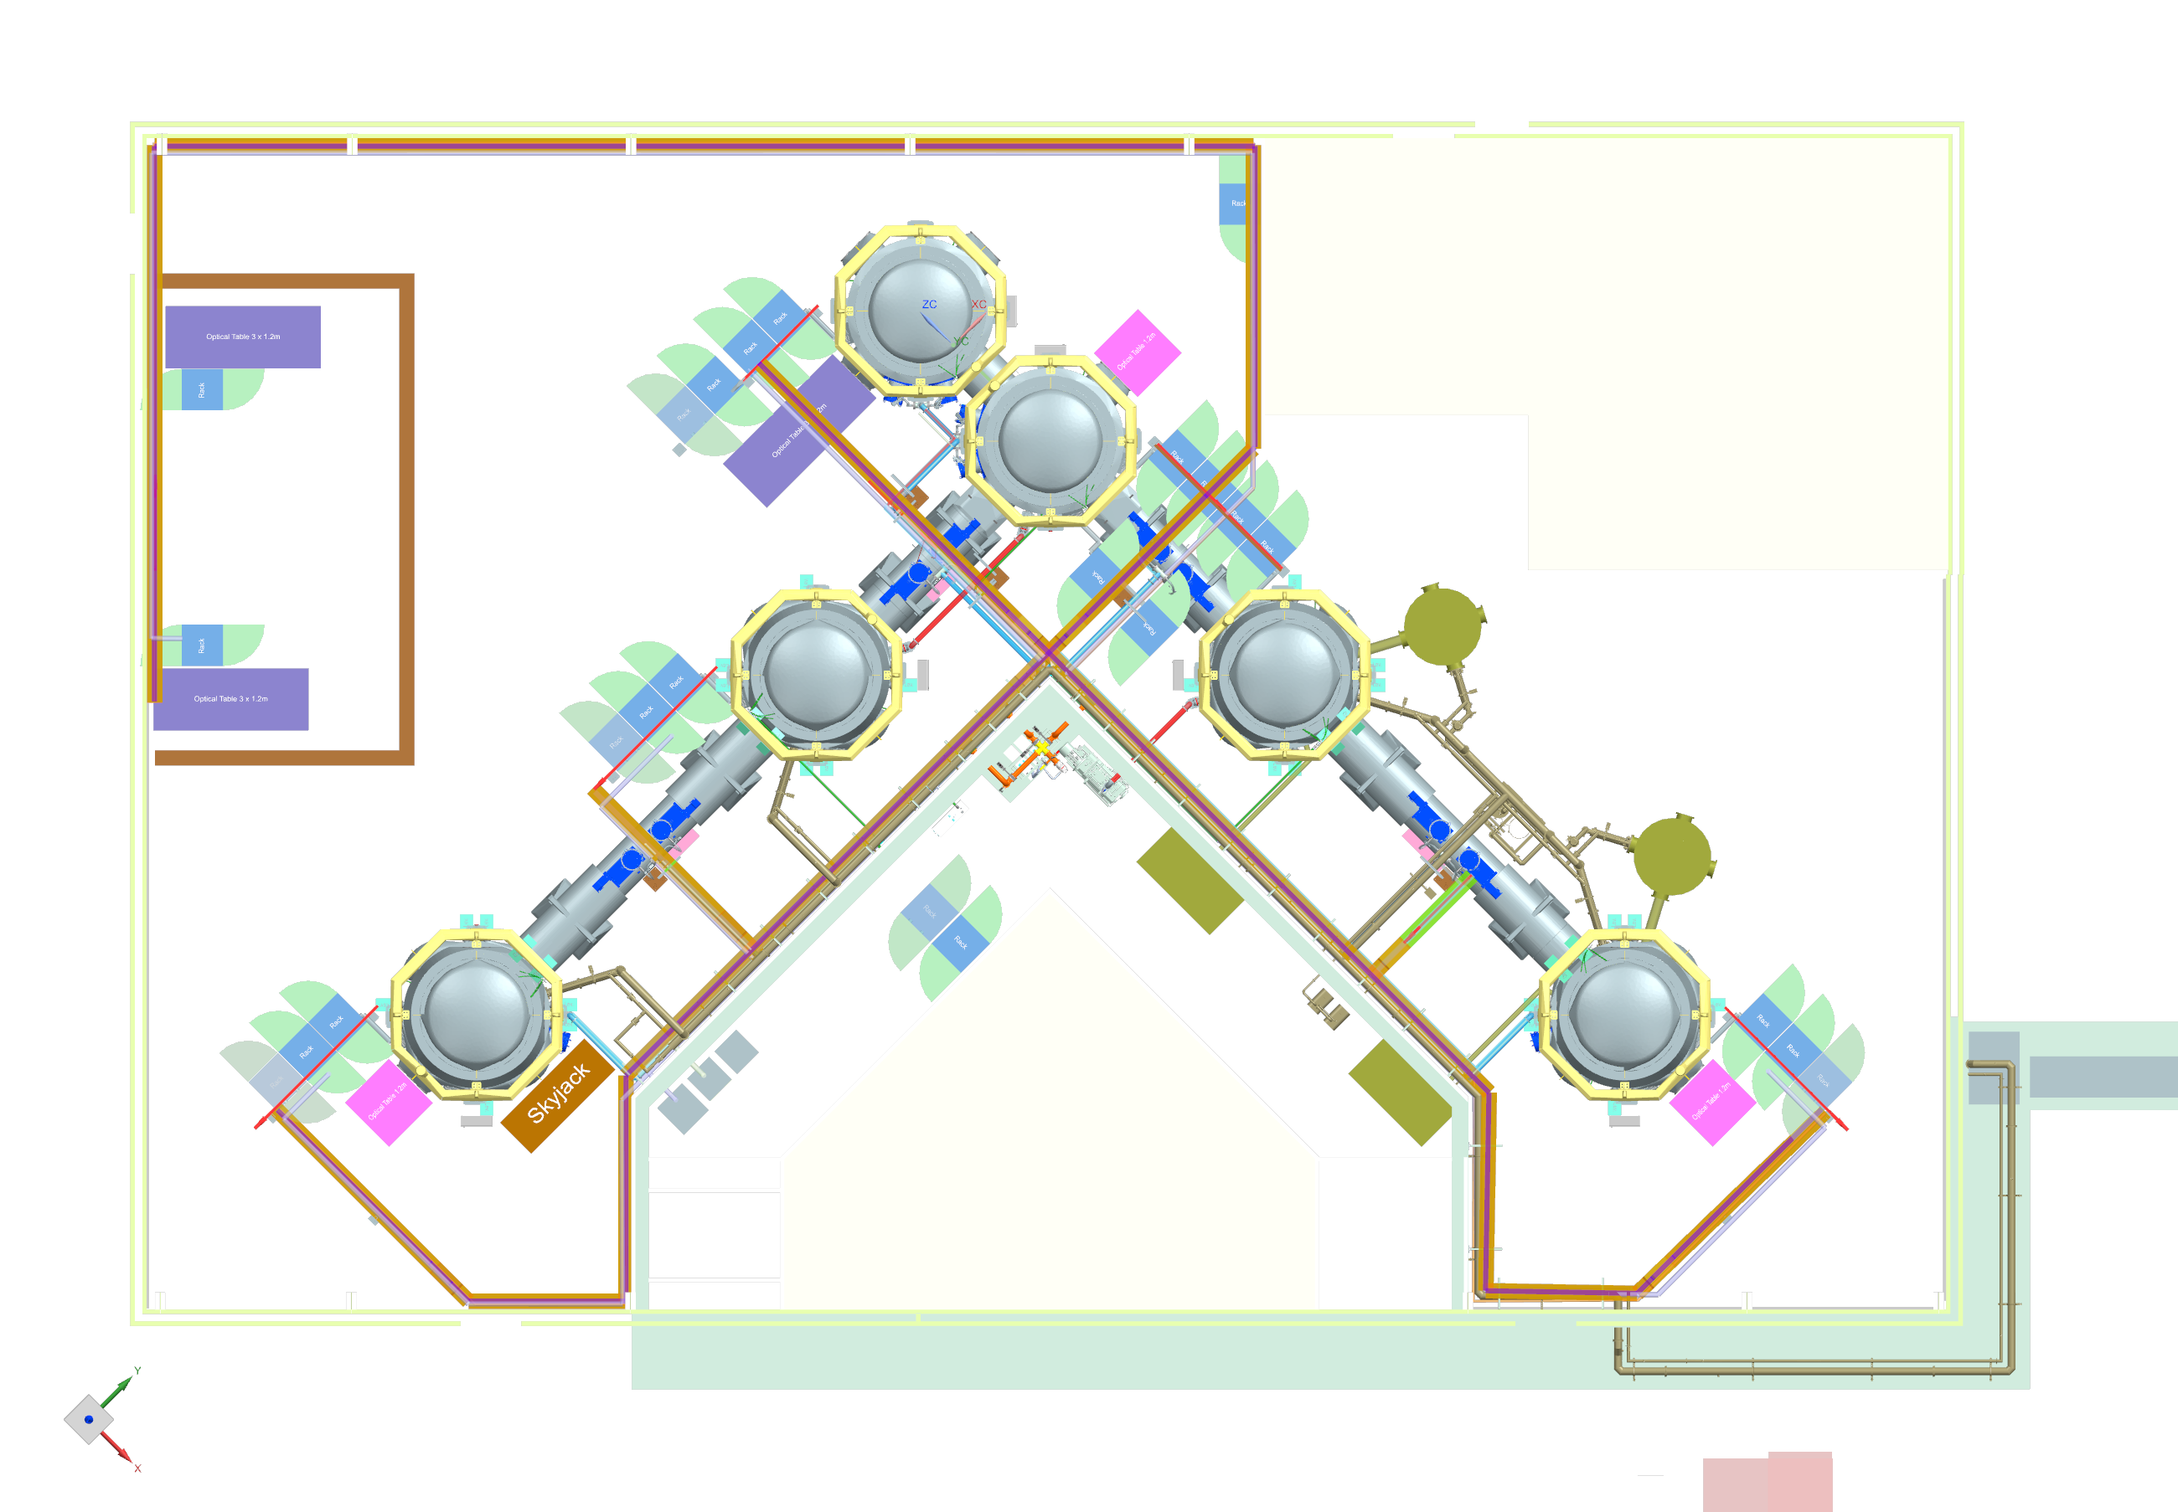
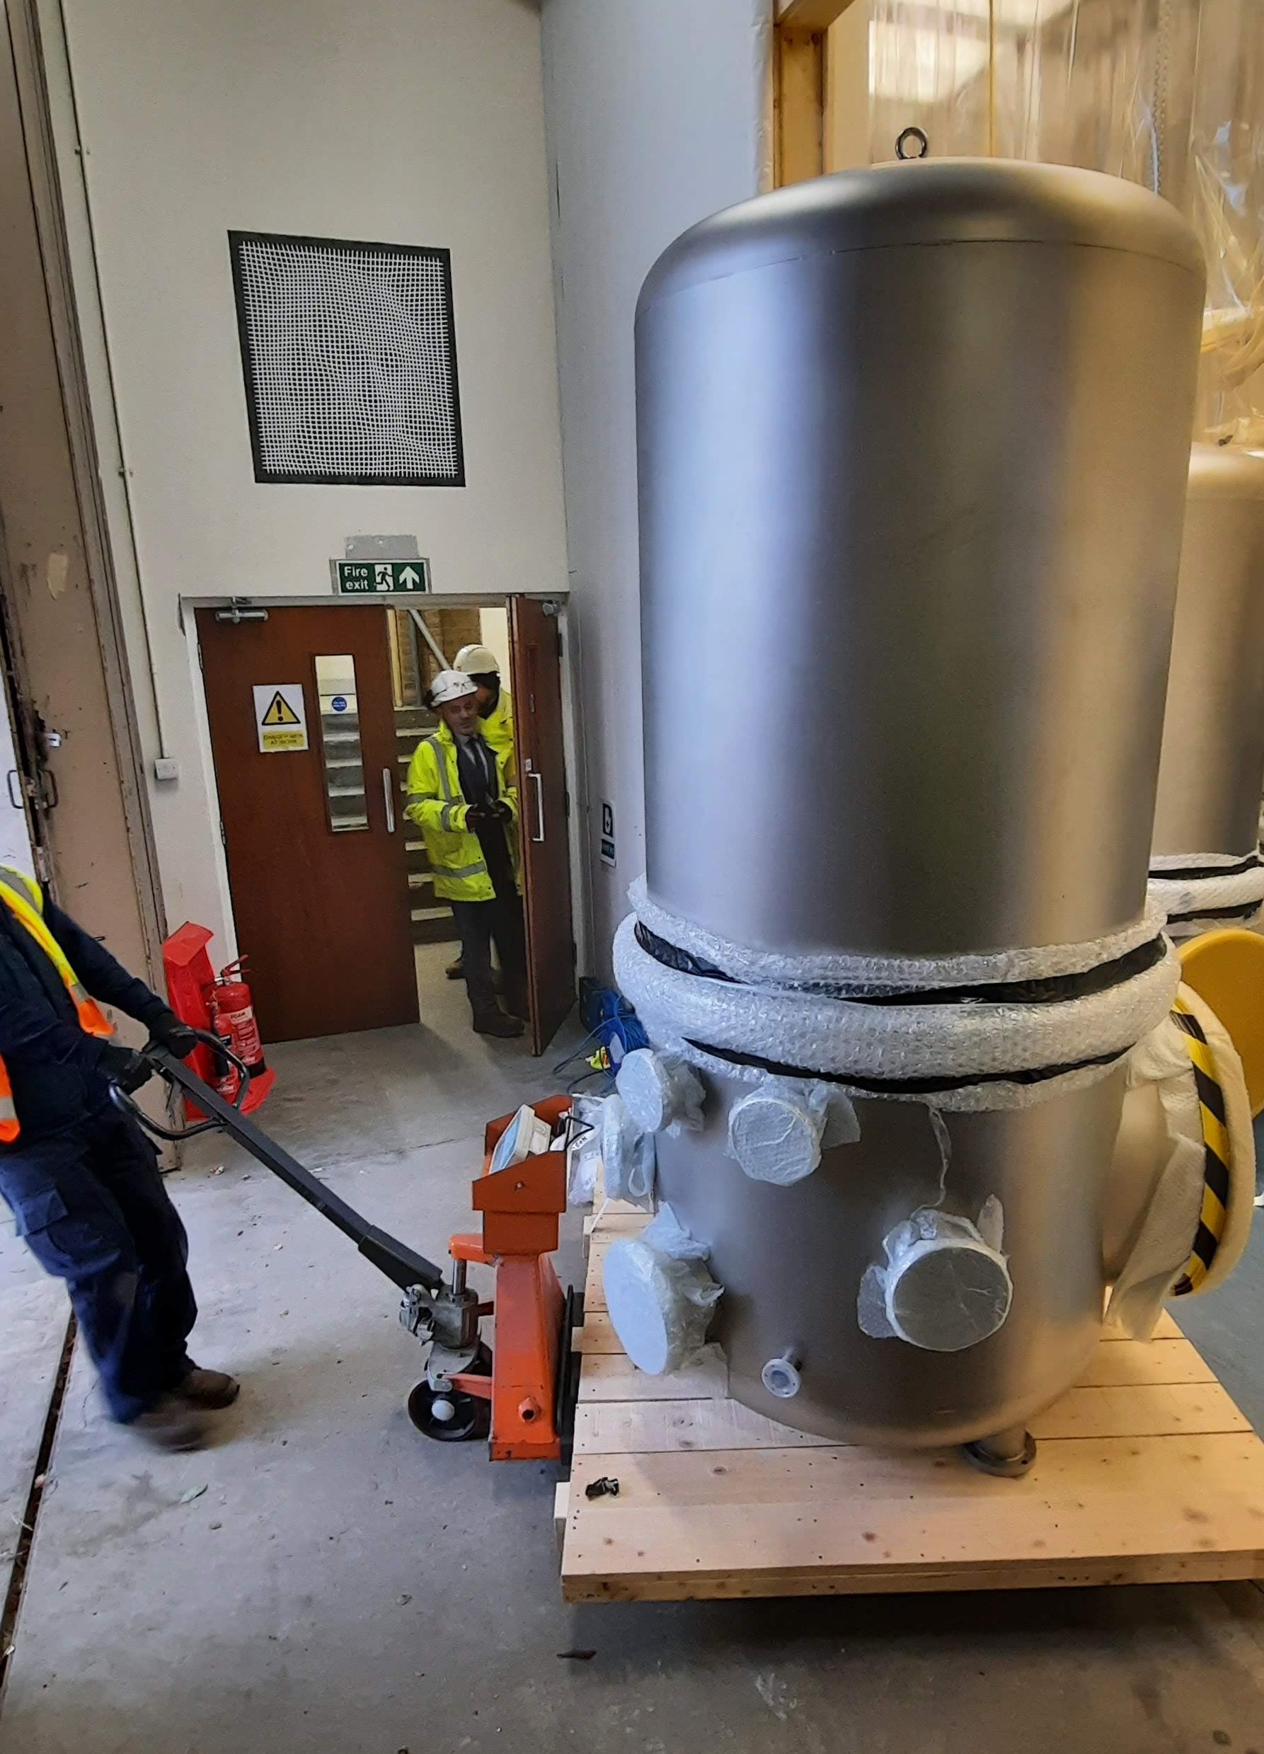
Installations in Maastricht, floorspace cryogenics
Apart from the vacuum system, soon extra vacuum vessels will arrive to host the sorption coolers.
These vessels need not be used in Maastricht in the coming 2 years, but I assume that they need to be installed soon.
Parallel session friday?
He cold loop cryostats
LN2 system (installed)
Sorption-cooler vessels

Slide 10
10 K cryogenic program, workshop presentations
Grant for 3-year program to design, build, and test 10-K vibrational cooling awarded to Demcon, CCool, Utwente
This program is the main topic of the plenary session tomorrow. Parts will be discussed in the parallel session as well.
Project organization: Romaine Kunst (Demcon)
Physics, overview, working principle, planning and realization: Michiel van Limbeek (Utwente)
Sorption cooler design: Arvi Xhahi (UTwente)
Major effort and much progress on the design extra 15K thermal shield, heat platform, (counter-flow) heat exchangers and cryogenic lines – Rafael Garcia (Barcelona)
In the parallel session we will discuss open issues on the design of the cryogenic lines, and on the LN2 vessel and interface with the Demaco system, and try to plan production.
Vibration isolator (JPE) will be discussed in parallel session tomorrow (Luise Kranzhoff, Maastricht)
Furthermore, we will have an update on the E-Test project in the plenary session tomorrow (Anthony Amorosi)

