Slide 1
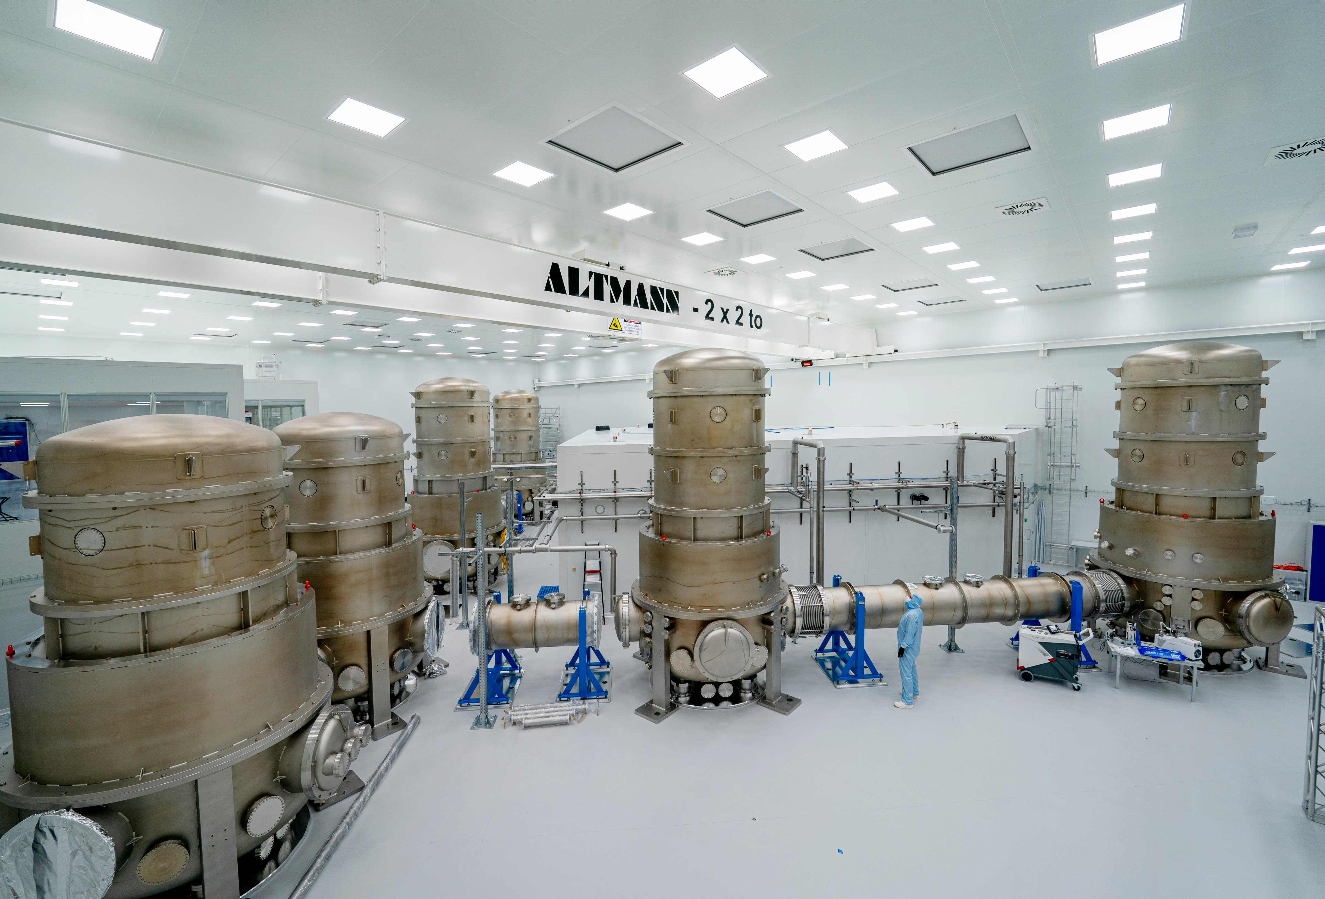
WP3 Infrastructure status and preview
P.Kuijer ETpathfinder workshop 2024-1-31

Slide 2
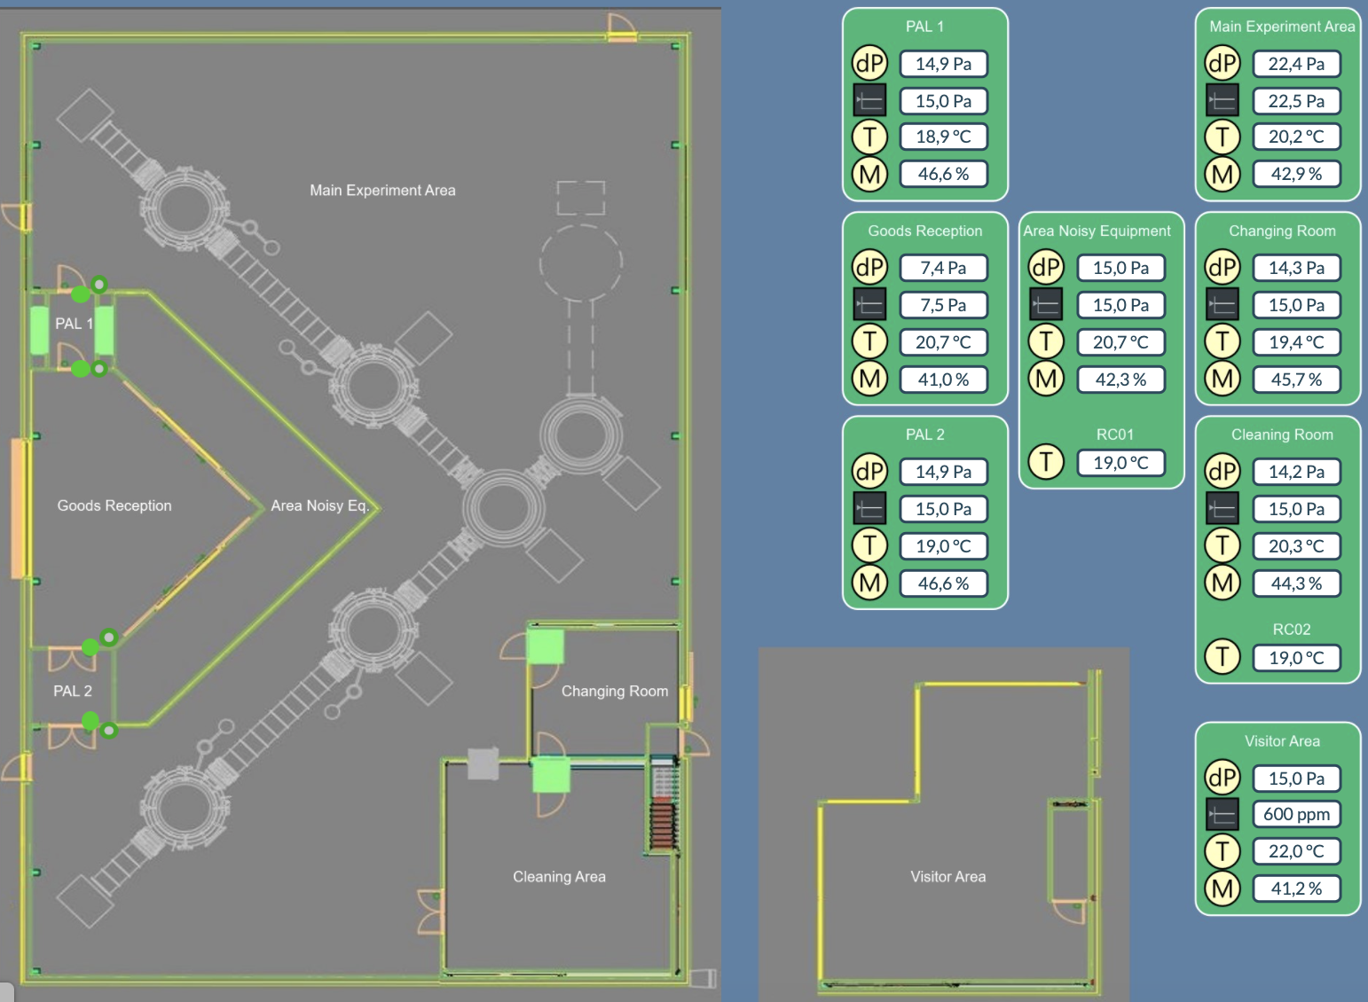
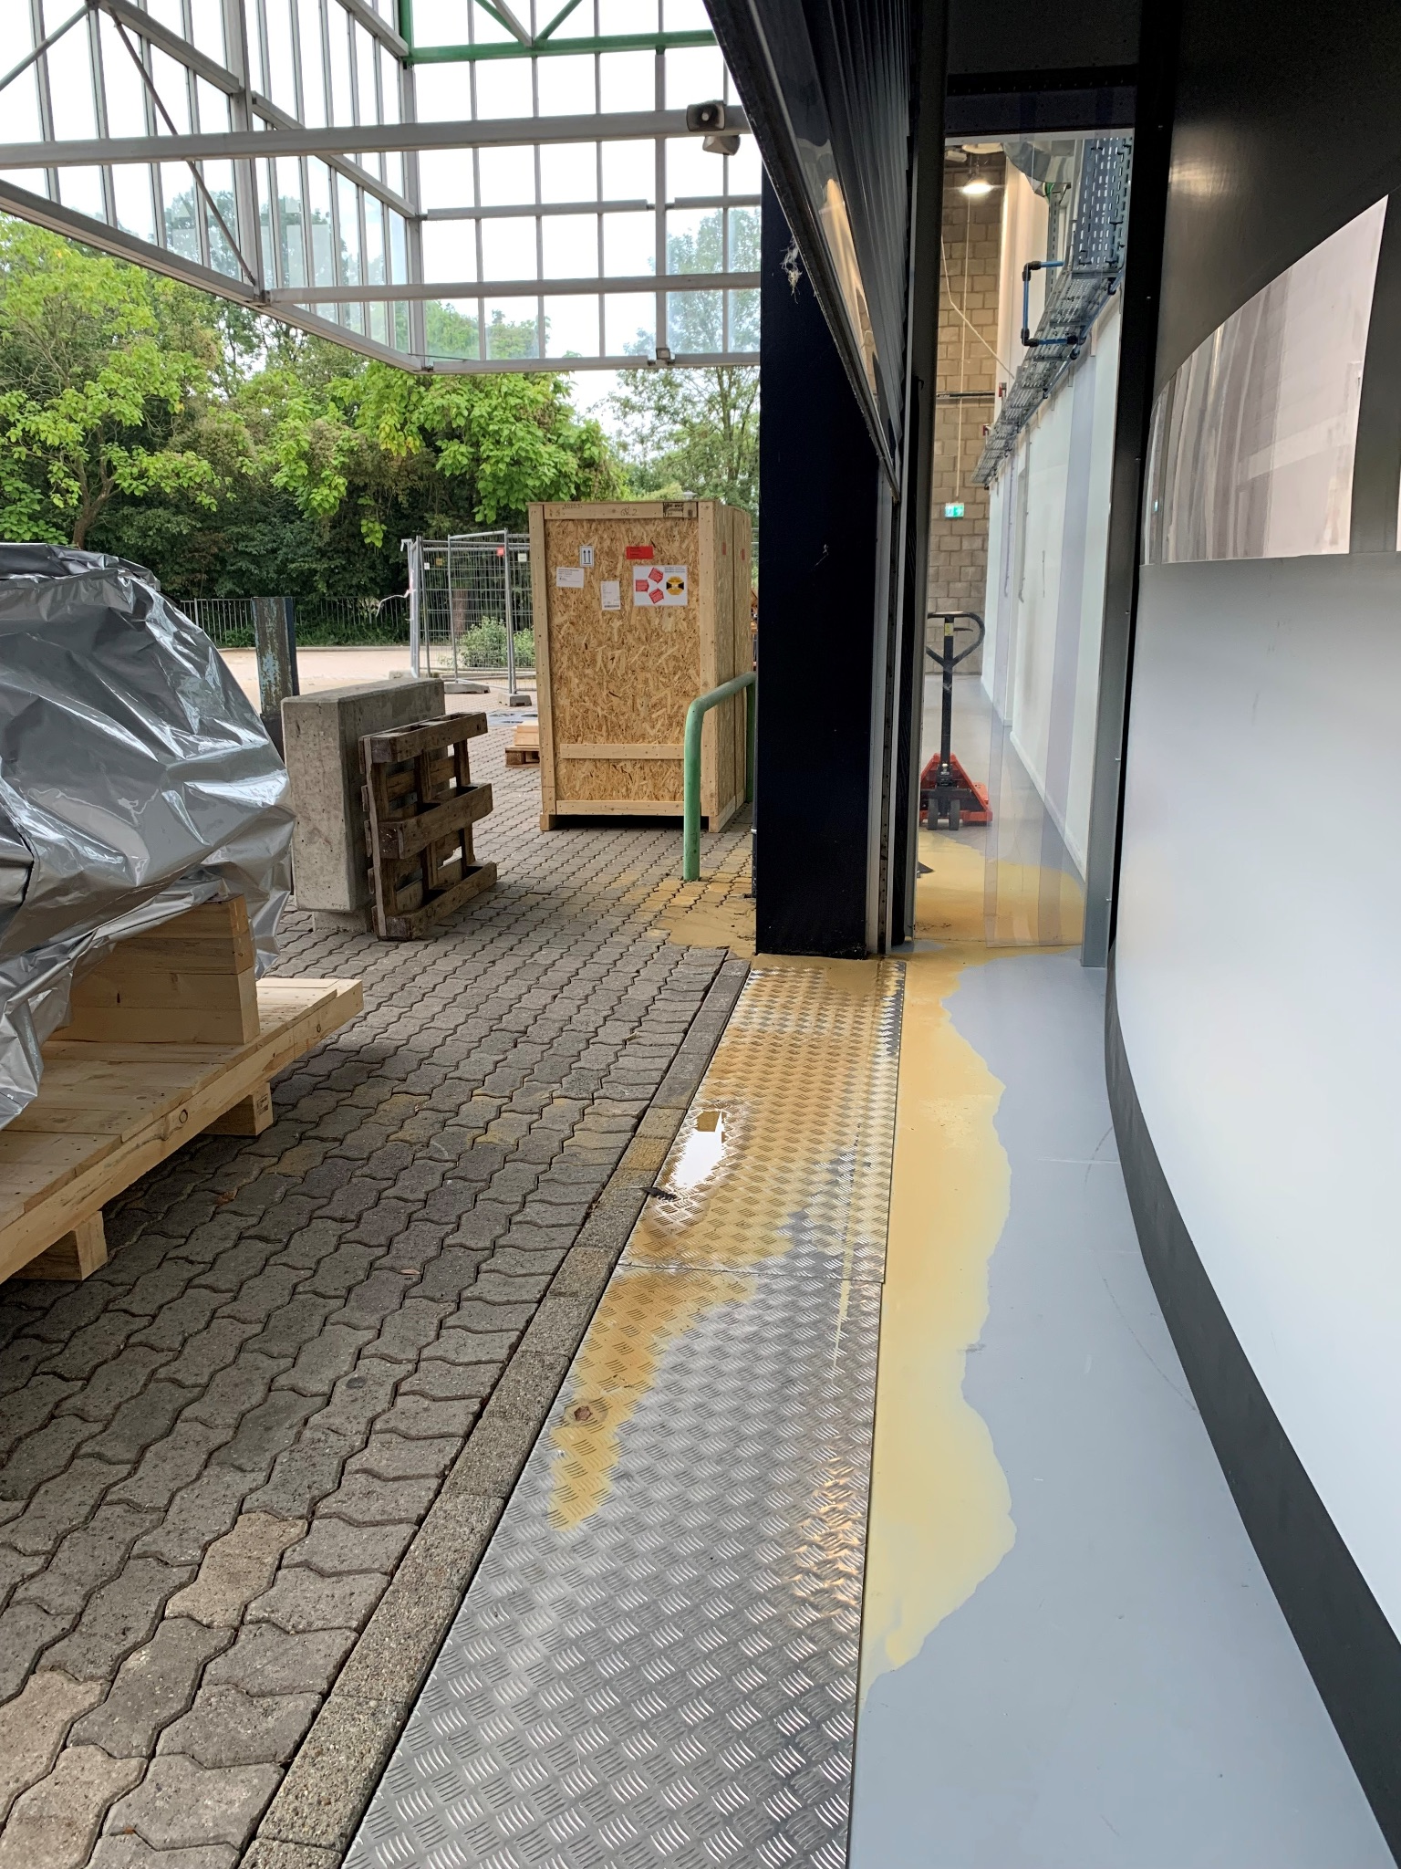
Cleanroom Operation in 2023
The cleanroom continued to perform very well
Extremely hot weather is a challenge for the dehumidifier
System recovers without noticeable effect on the climate
System recovers from power cut without problems
We operate outside tender requirements (Narrower %RH, lower T)
We have a new maintenance contract with Jansen cleanrooms
Data logging is off for software development (and disk space)
Minor problems with leakage of water from the roof
Addressed by UM facilities
Minor problems with sewage overflowing
Addressed by UM facilities
Installed cooling unit for the optics lab in the ETpf corridor
Does not affect the HVAC or available power

Slide 3
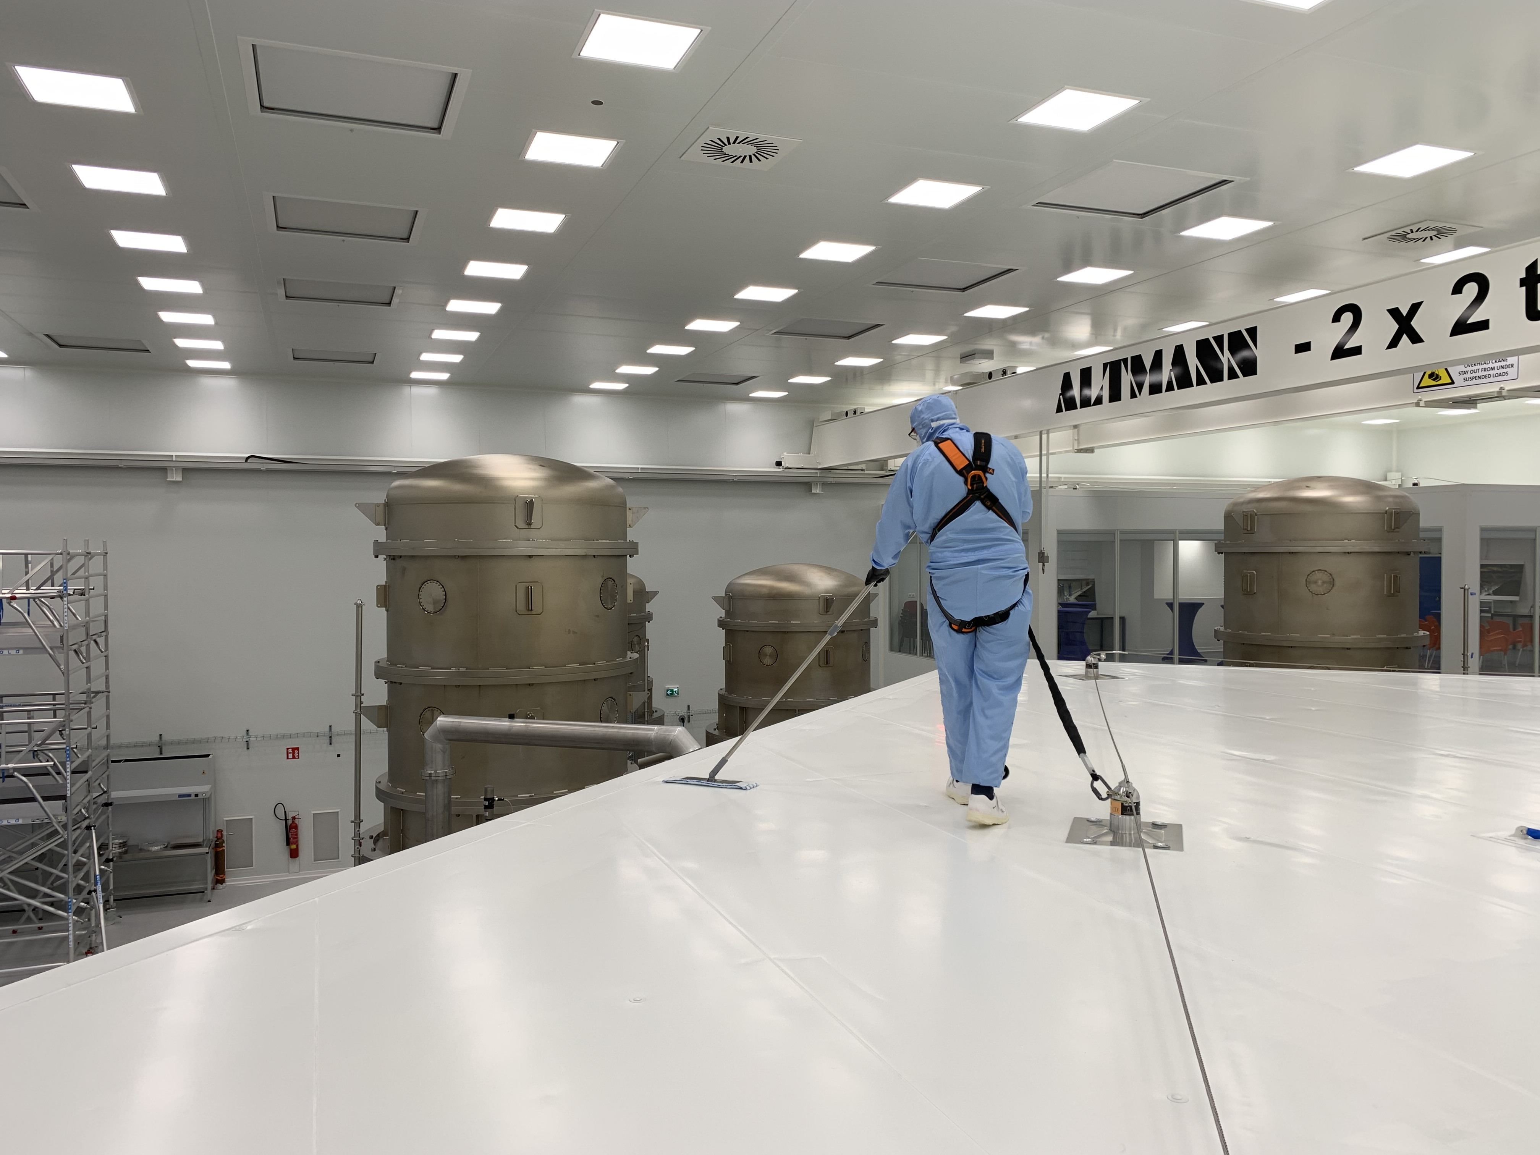
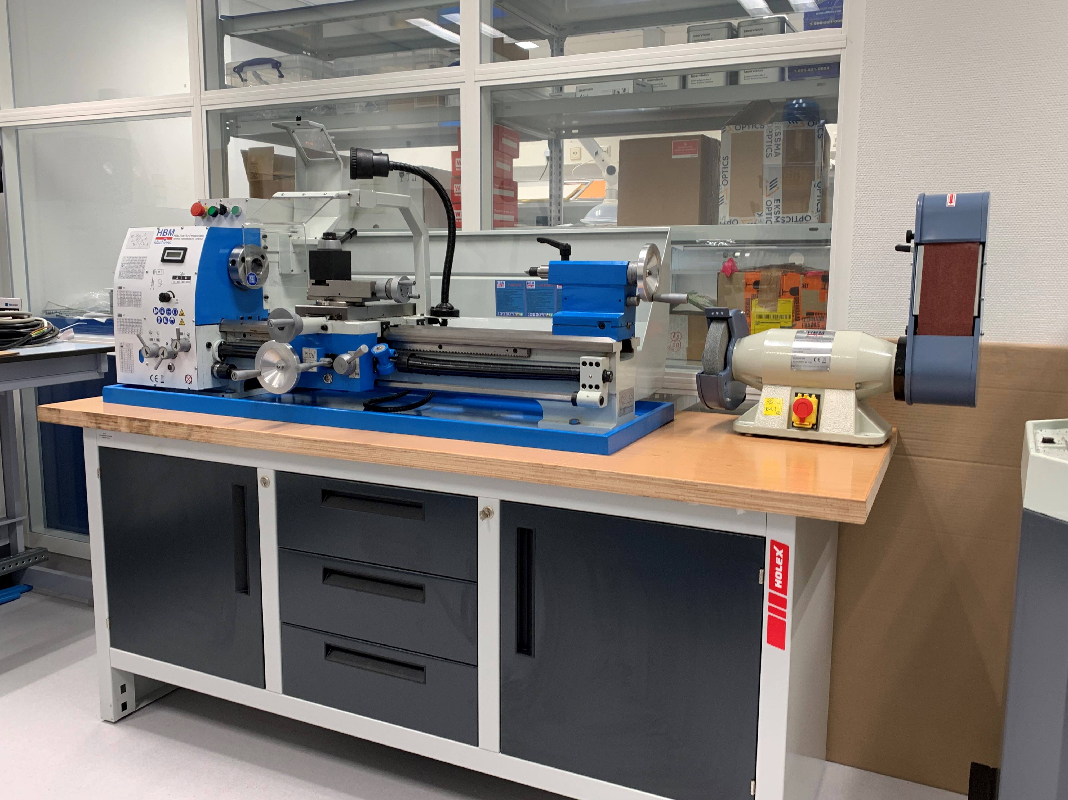
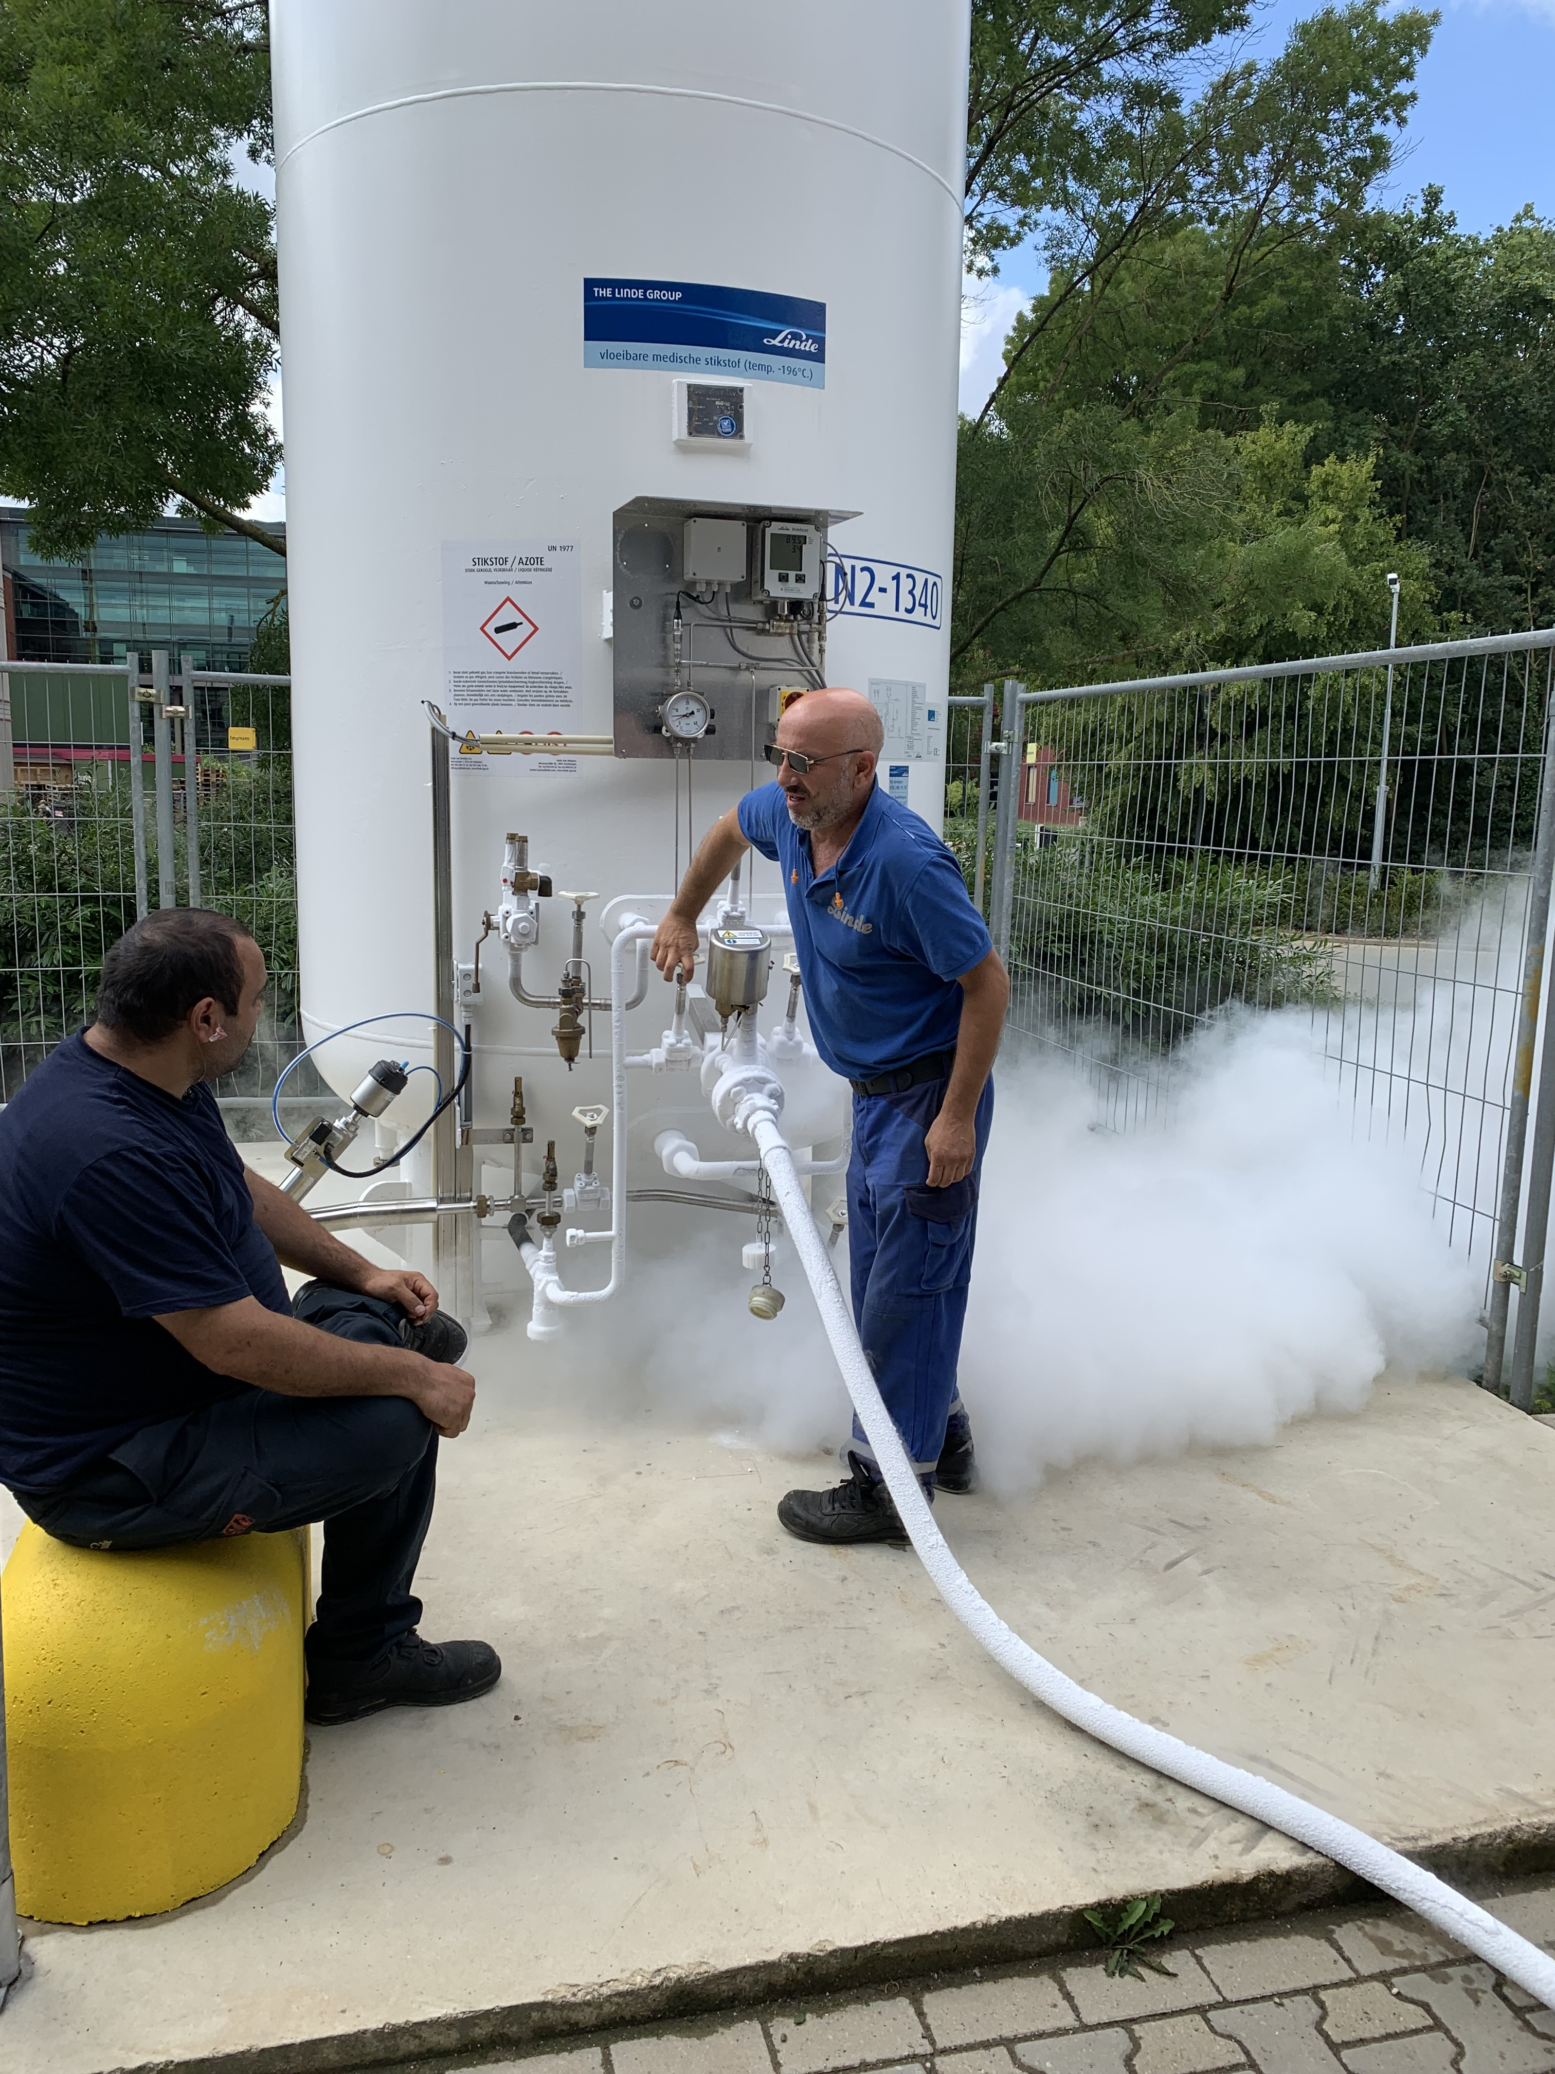
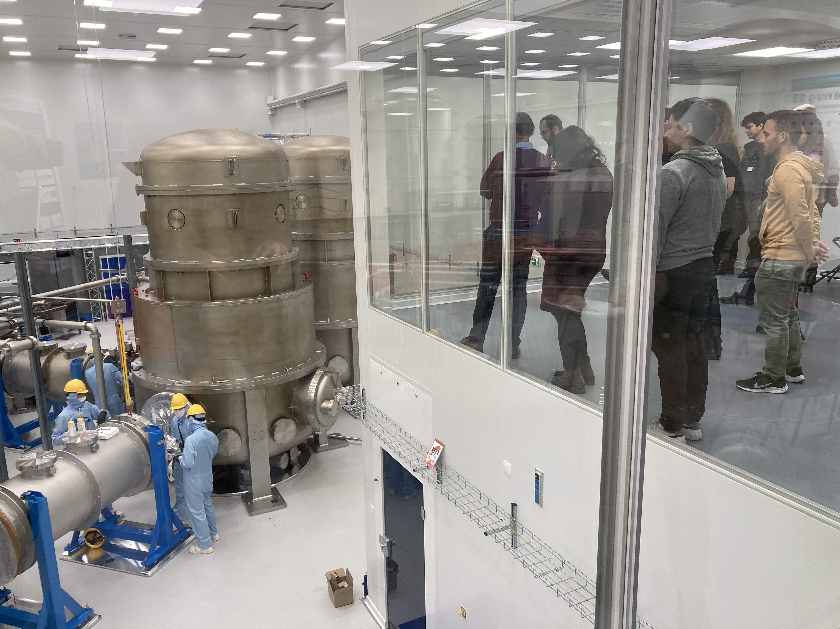
2023
Quite a lot of activities in the cleanroom
Cryo system installation and LN2 tank outside
A lot of progress on the vacuum system
Adding tools to the small workshops
Cleaning campaign was done in January.
Thanks to those who helped!
See specific WP sessions
Visits, public relations
About 150 visits/year
Government
Companies
General public
We now limit visits to stakeholders
check with Tim

Slide 4
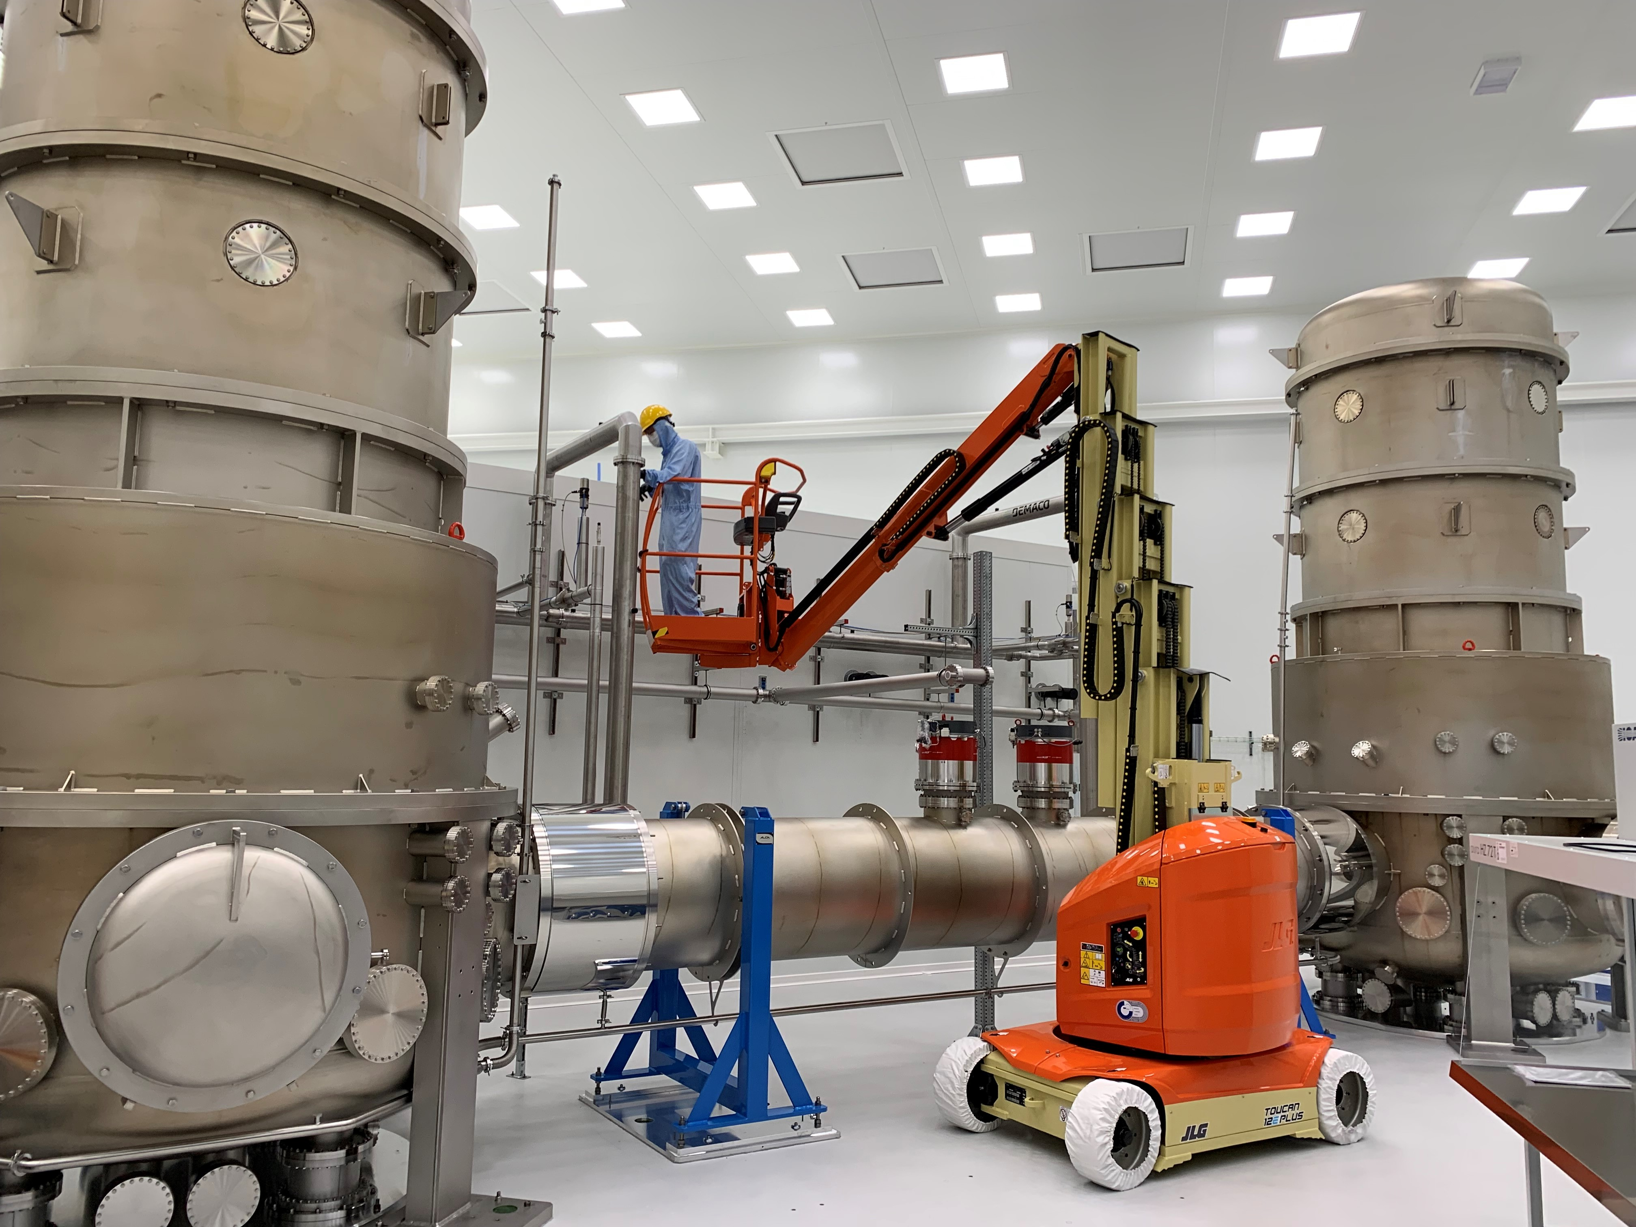
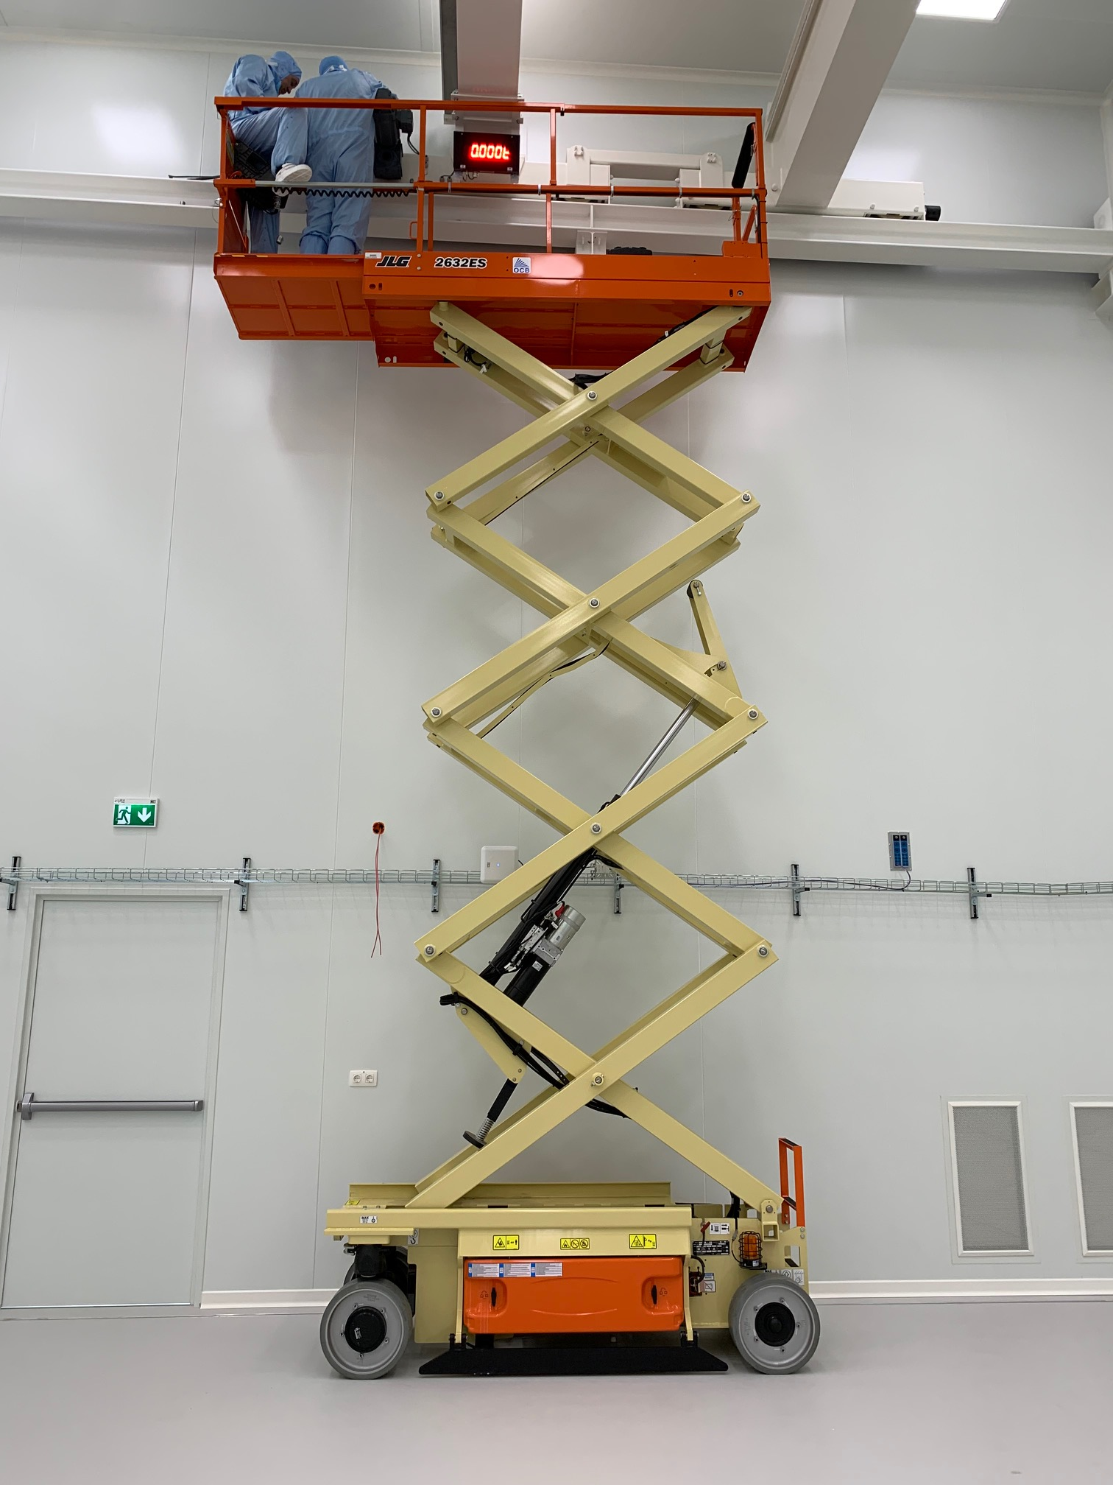
New skyjack
New Toucan 12E
Scissor lift insufficient
Toucan 12E
Up and over reach ~6m
Can still manoeuvre almost everywhere
We have limited the maximum speed for safety
Using “socks” to protect the floor
Trained personnel only! Check with Peter for availability.
Existing scissor lift

Slide 5
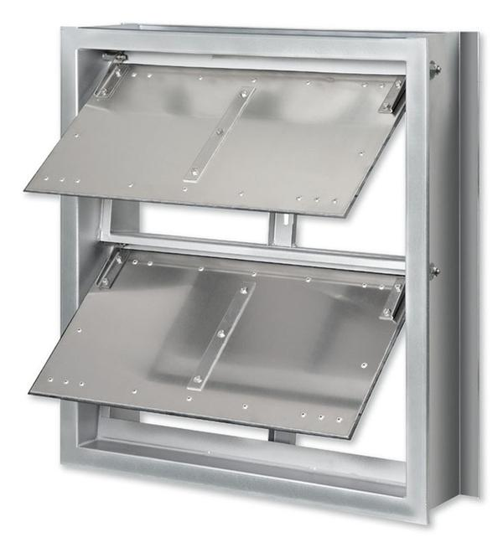
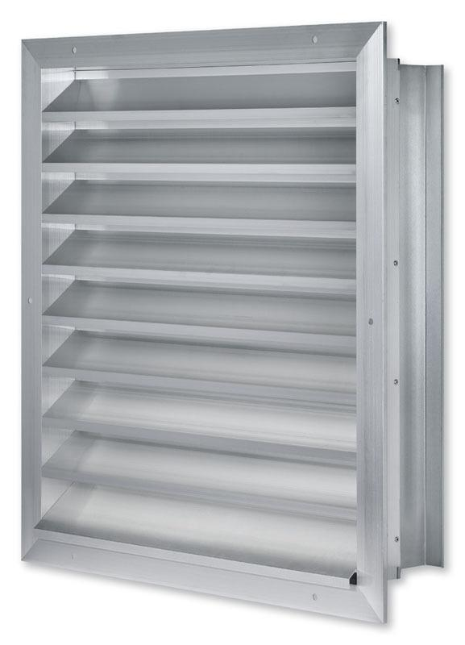
Safety
Safety analysis of vacuum system
Safety of vacuum vessels evaluated
Main issue is the risk of viewports breaking
Under-pressure relief valves in the wall to be installed
37000 m3/h at 50 Pa pressure
Procedures for ensuring viewport quality
Polarised light visual inspections
Procedures for working with the vacuum system
Minimum distance to viewport, …
See the surfdrive for reports
Safety course required for working in the cleanroom
Contact Tim and Dinesh for details
Cleanroom wall
Building wall

Slide 6
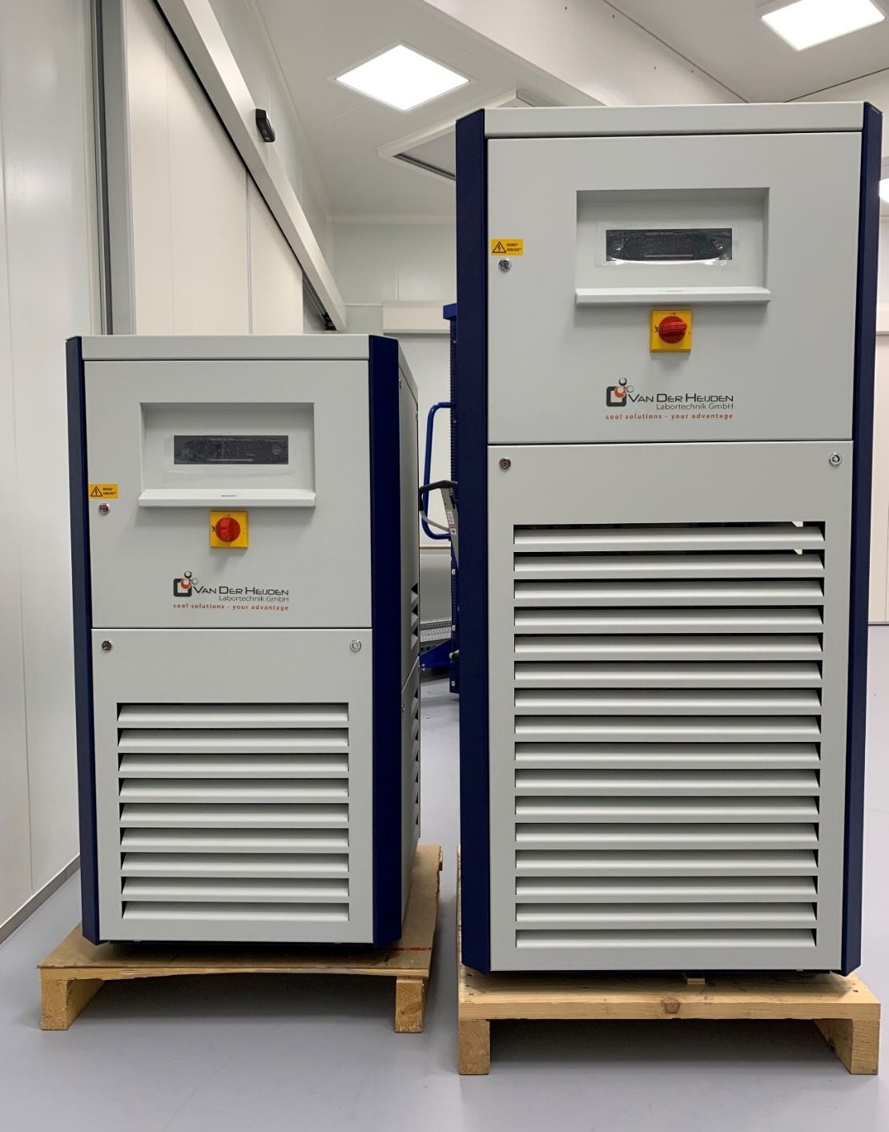
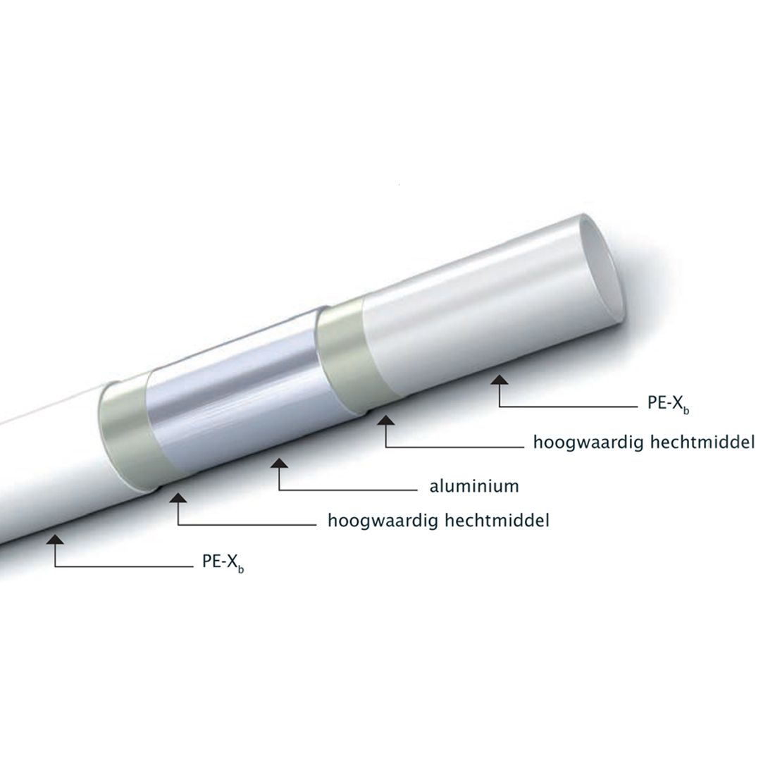
Water
The HVAC has 20kW overcapacity under “standard Dutch weather conditions”
With a lower setpoint and hot summers we get close to the limit
Forepump directly connected to primary cooling circuit
Not critical temperature regulation in noisy area
For now two heat exchangers: 21 kW, 3.2 kW
Racks and pumps in cleanroom
Laser cooling specifications?
Pipes ordered, waiting for delivery
We will install by ourselves using PEX tubes
See installation schedule

Slide 7
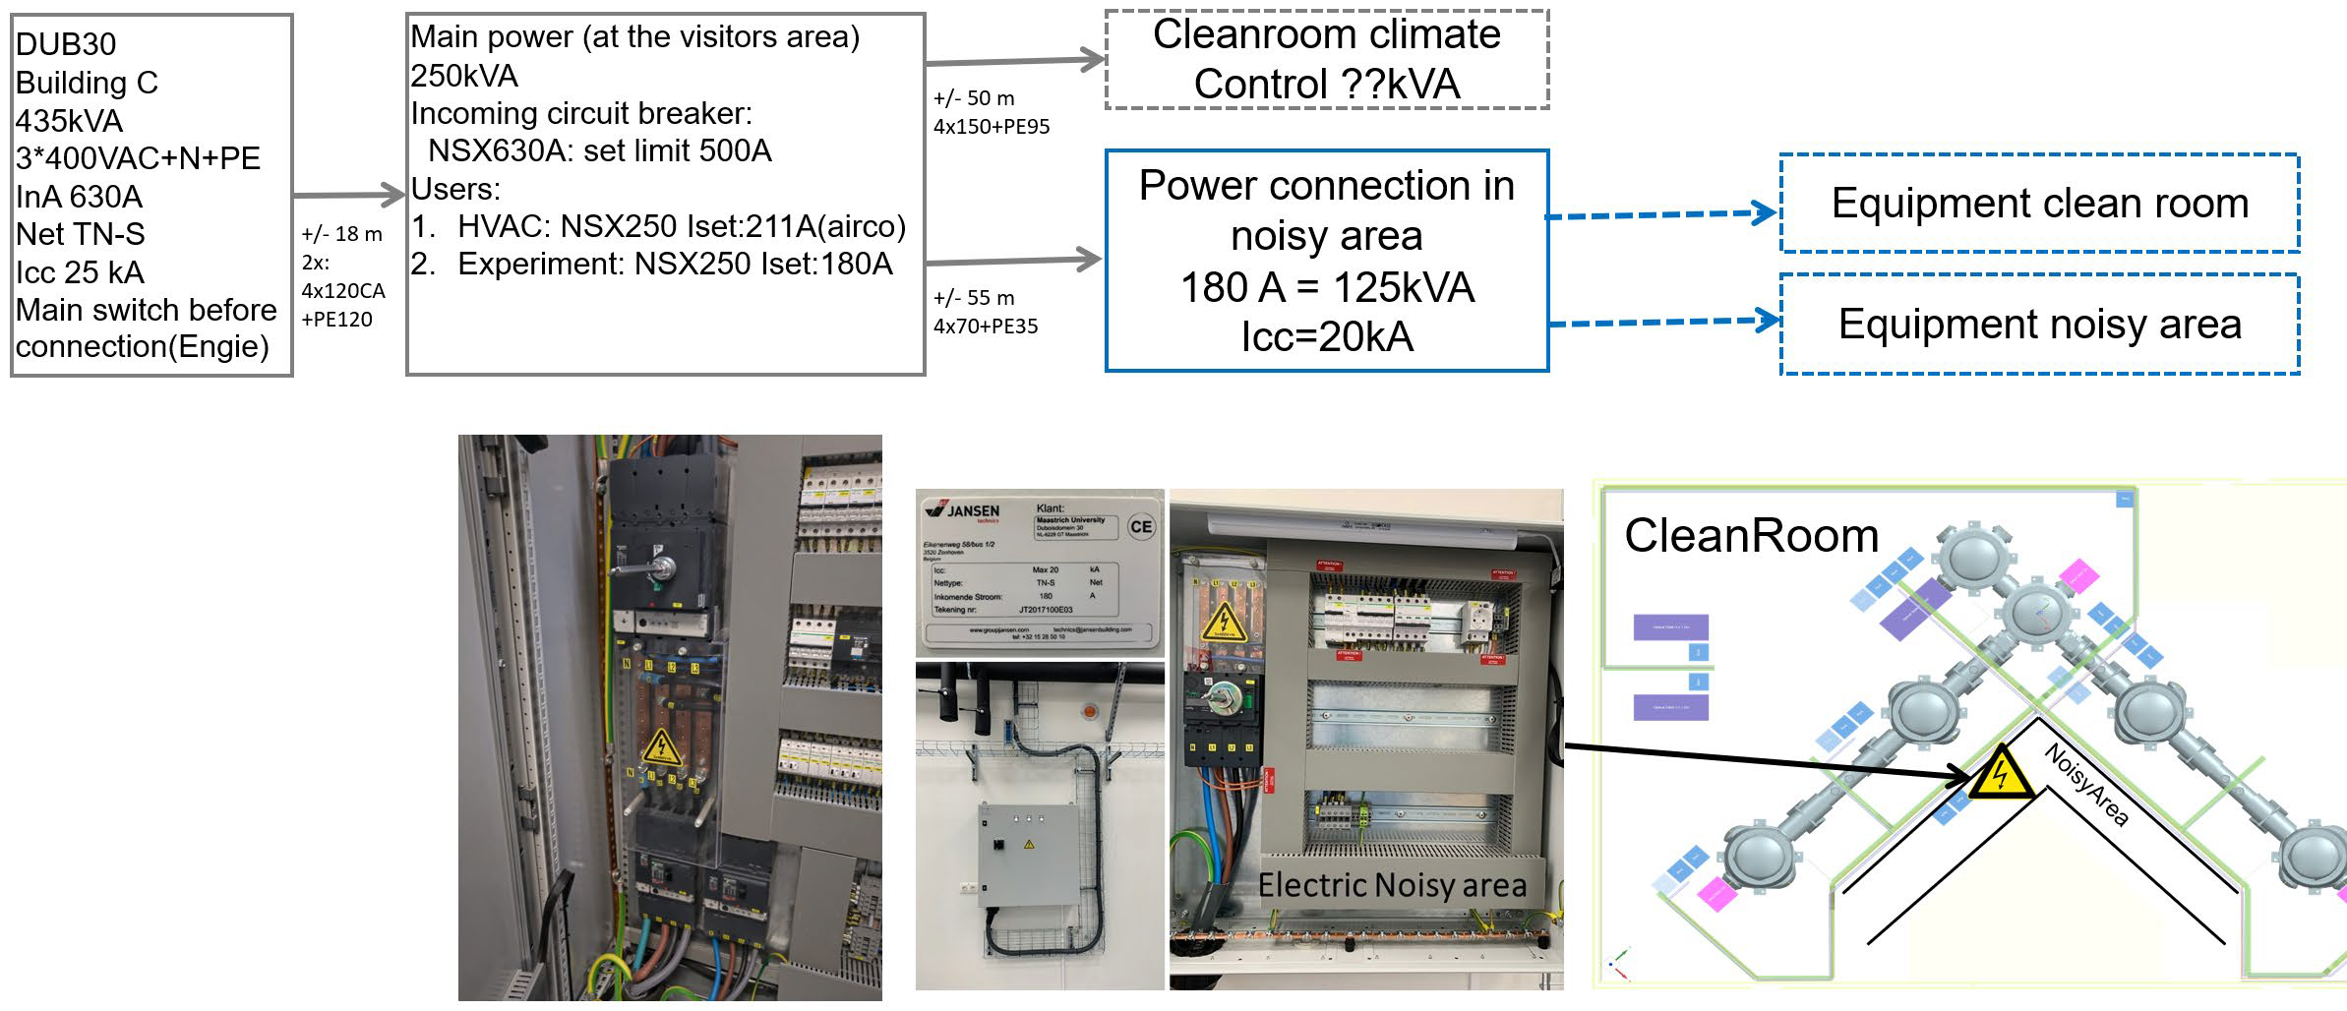
Power distribution
We have wall sockets in cleanroom but not enough for all the equipment
Power will be distributed from the 125 kVA distribution panel in the noisy area
Power rails above each rack and near pumps
Some delay because this is more expensive than anticipated
Work with extension cords for now

Slide 8
LinkedIn message by the Flemish minister of science
LinkedIn message by the Dutch minister of science

Slide 9
Q&A
Suggestions infrastructure?
Suggestions general tools?
Suggestions safety features?

