Slide 1
General overview of ETPf mechanical work for 2023 and 2024
31-01-2024
M. Baars

Slide 2
Contents
1 – What is (almost) finished
2 – What are we currently doing (infrastructure, IM preparations)
3 – What will/should be next (CET internal mechanics)

Slide 3
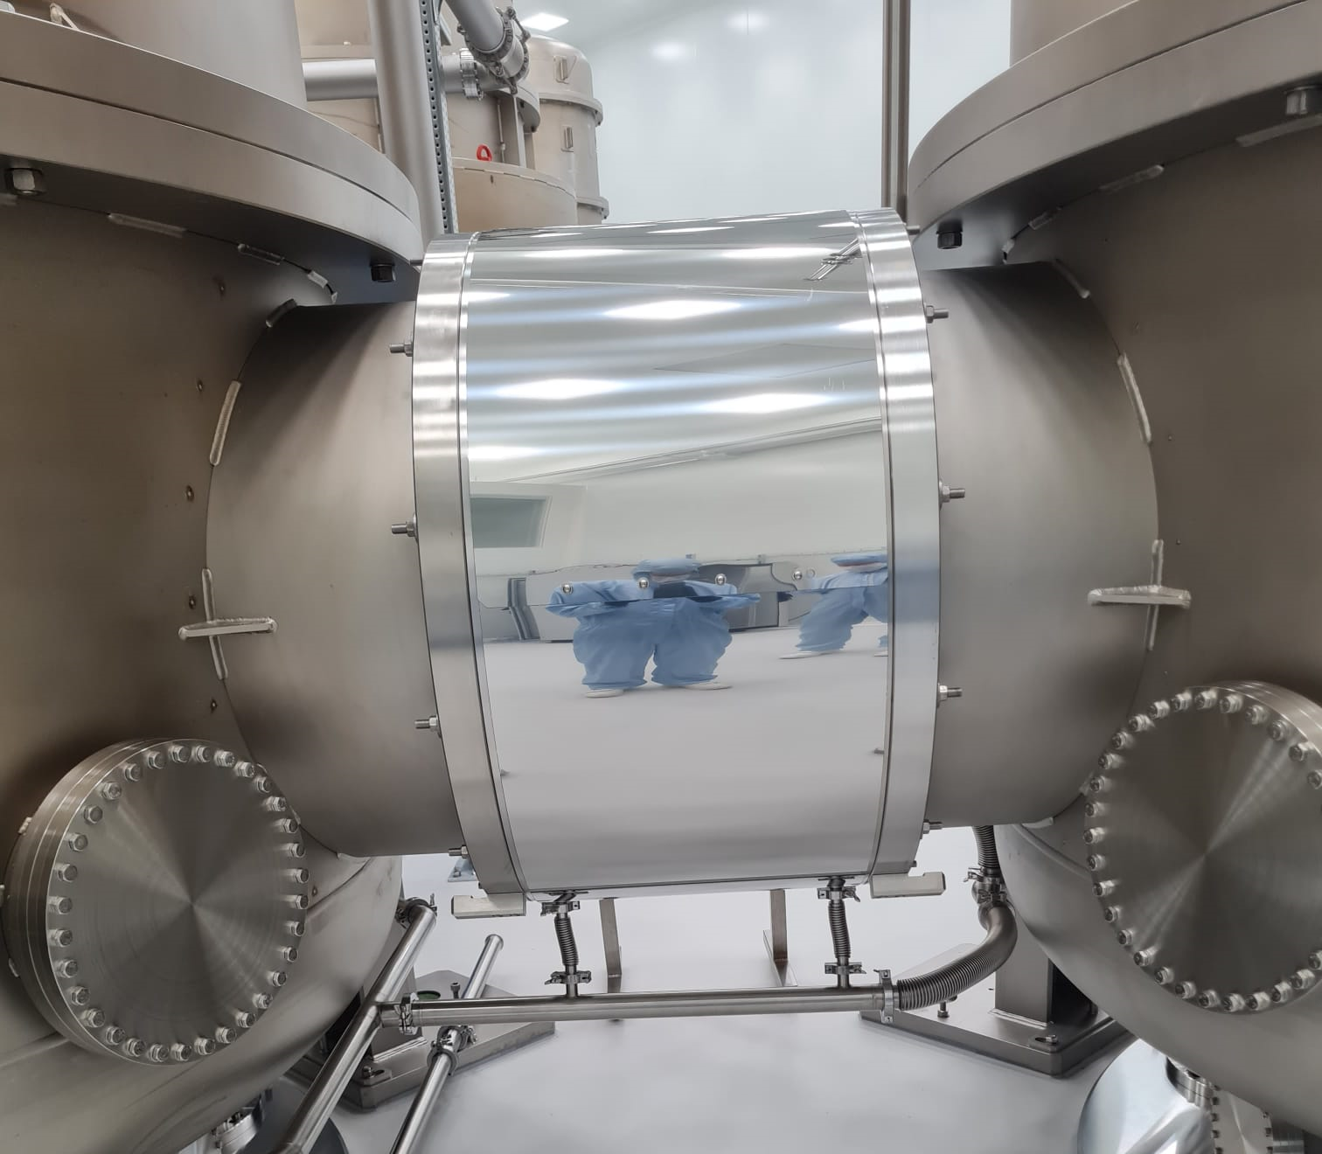
1 – What is (almost) finished
Vacuum vessel (YAY)
Vacuum piping and manifold (almost, pretty critical)
Nominal design of mechanics (with some notable exceptions)
Lots of other small things

Slide 4
2 – What are we currently doing Infrastructure, internal mechanics preparations
GAS filter assembly
GAS tooling
Cable trays and power rails
Turbo water-cooling routing
Cleanroom support structures
In-vacuum cable assemblies
Managing cleanliness (at Nikhef)
Keeping track of a Gazillion parts
Storage solutions (at Nikhef)

Slide 5
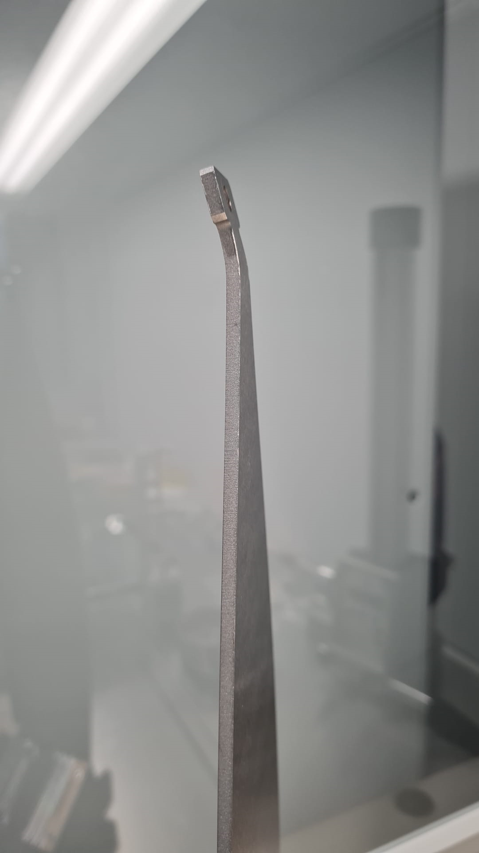
GAS filter assembly
CET F1 and F2 are done (special thanks to Enrico for F1)
CET F0 is fighting back (but nearly done, and special thanks to Enes)
Working methodology
ID assembly document that keeps track of important characteristics
Cleanroom and assembly working methods prove very useful
Tuning steps are now pretty well understood by a small number of people (not named Eric or Alessandro)
2 months for prototype filter, 2 days for CET F1 !!!
“Learning moments”: broken blade, broken harmonic-drive, broken bending jig (5x), bending tooling cold welding (4x), filter parts cold welding (3x), wrong revision parts (4x), parts missing, parts not ordered, parts made wrong by company (2x)

Slide 6
It’s all coming together (CET F2)

Slide 7
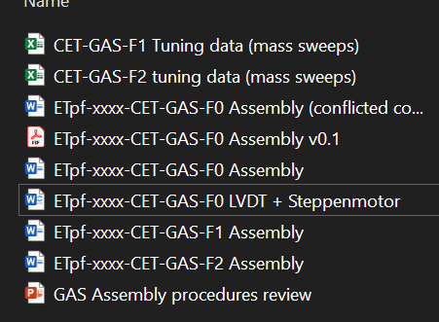
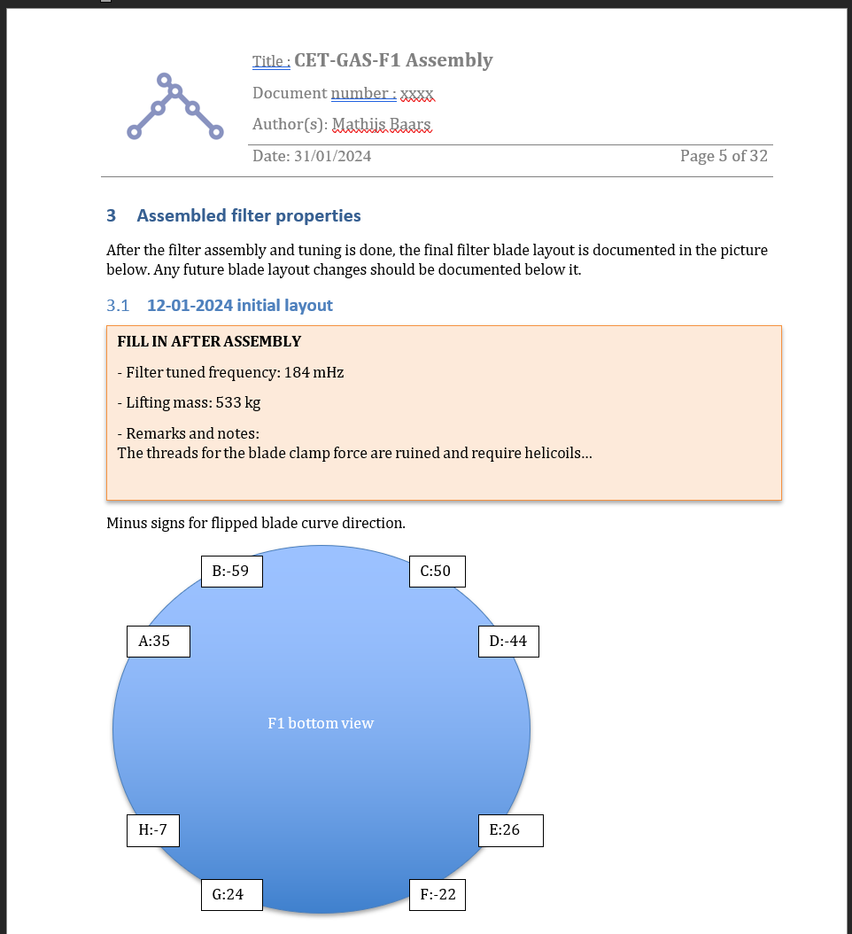
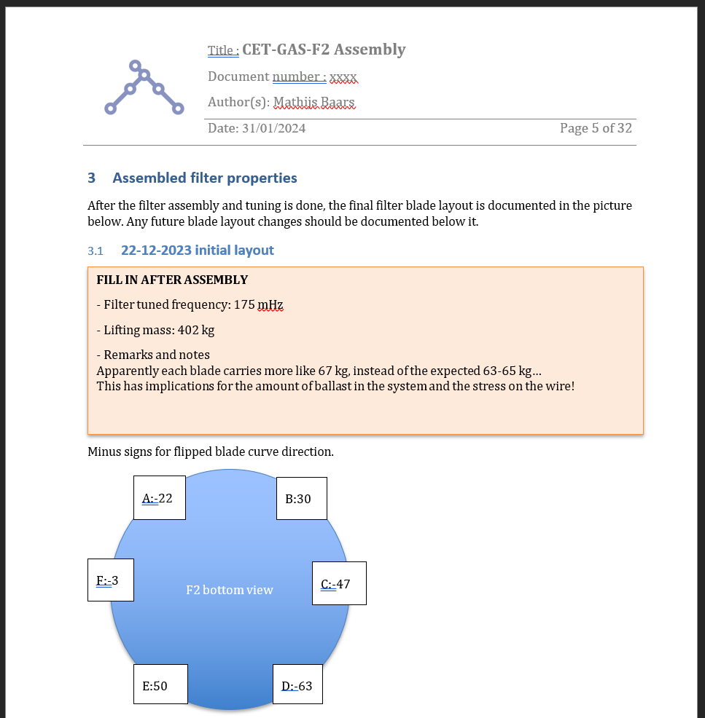

Slide 8
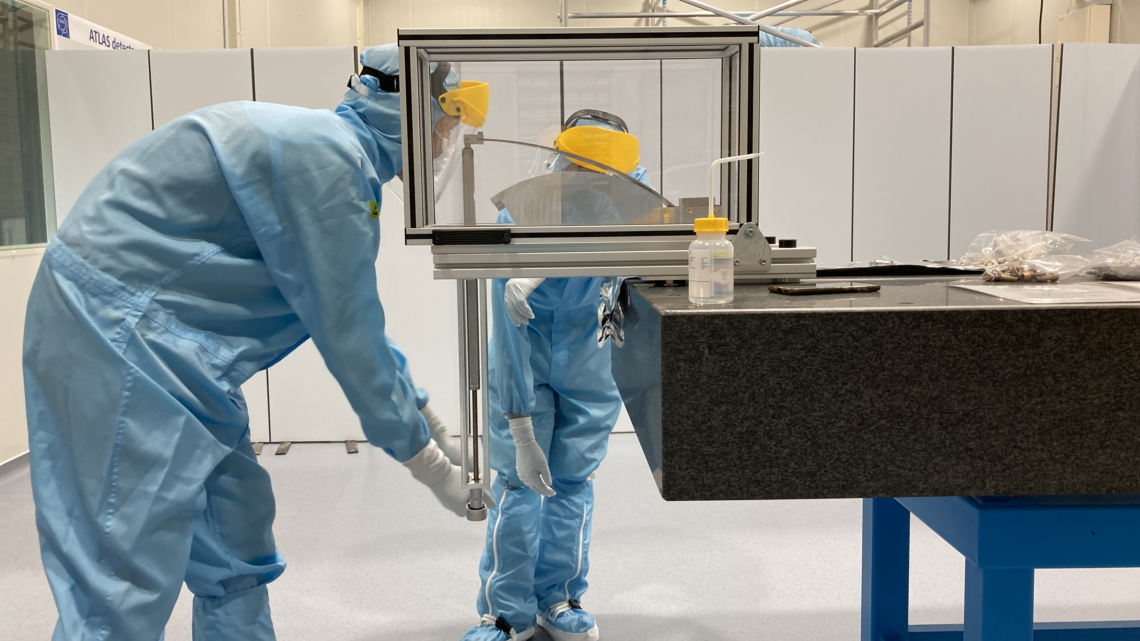
GAS tooling
Nikhef rack (thanks Wim, Pengbo, Kumar!)
LVDT readout capabilities, works great, helps alot
(Soon) driving stepper motors
Blade bending jig (v2, internship: Pim)
Tuning masses (internship: Pim)

Slide 9
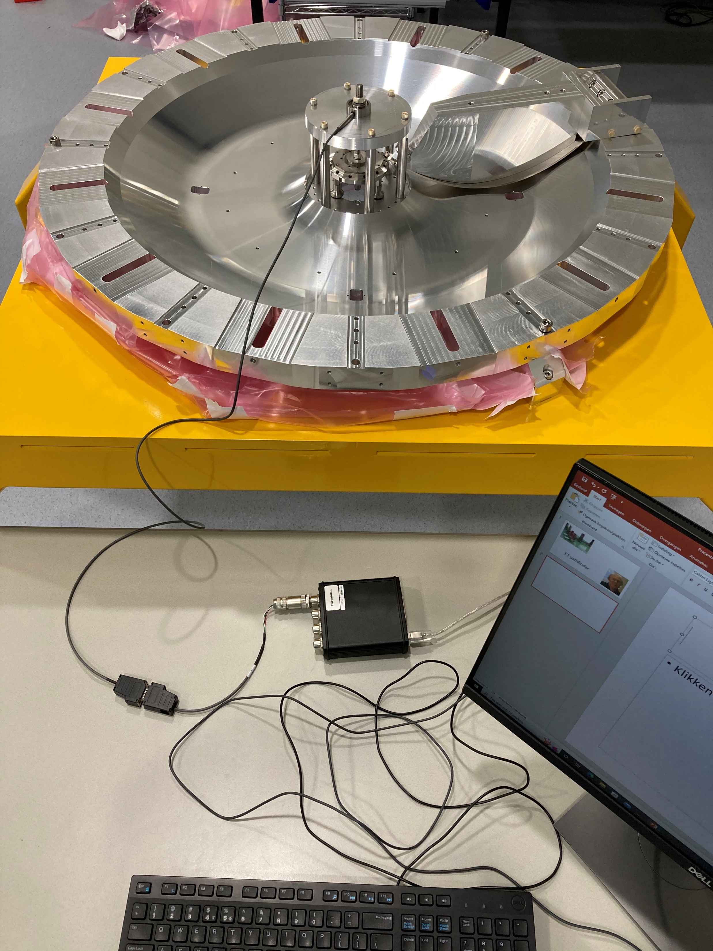
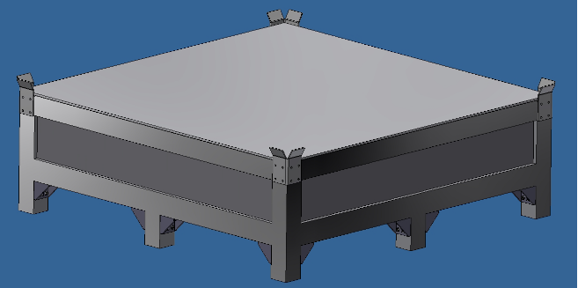
GAS tooling
“Clever” tuning method with loadcell (failed)
Cleanroom compatible shipping boxes (3 pcs.)

Slide 10
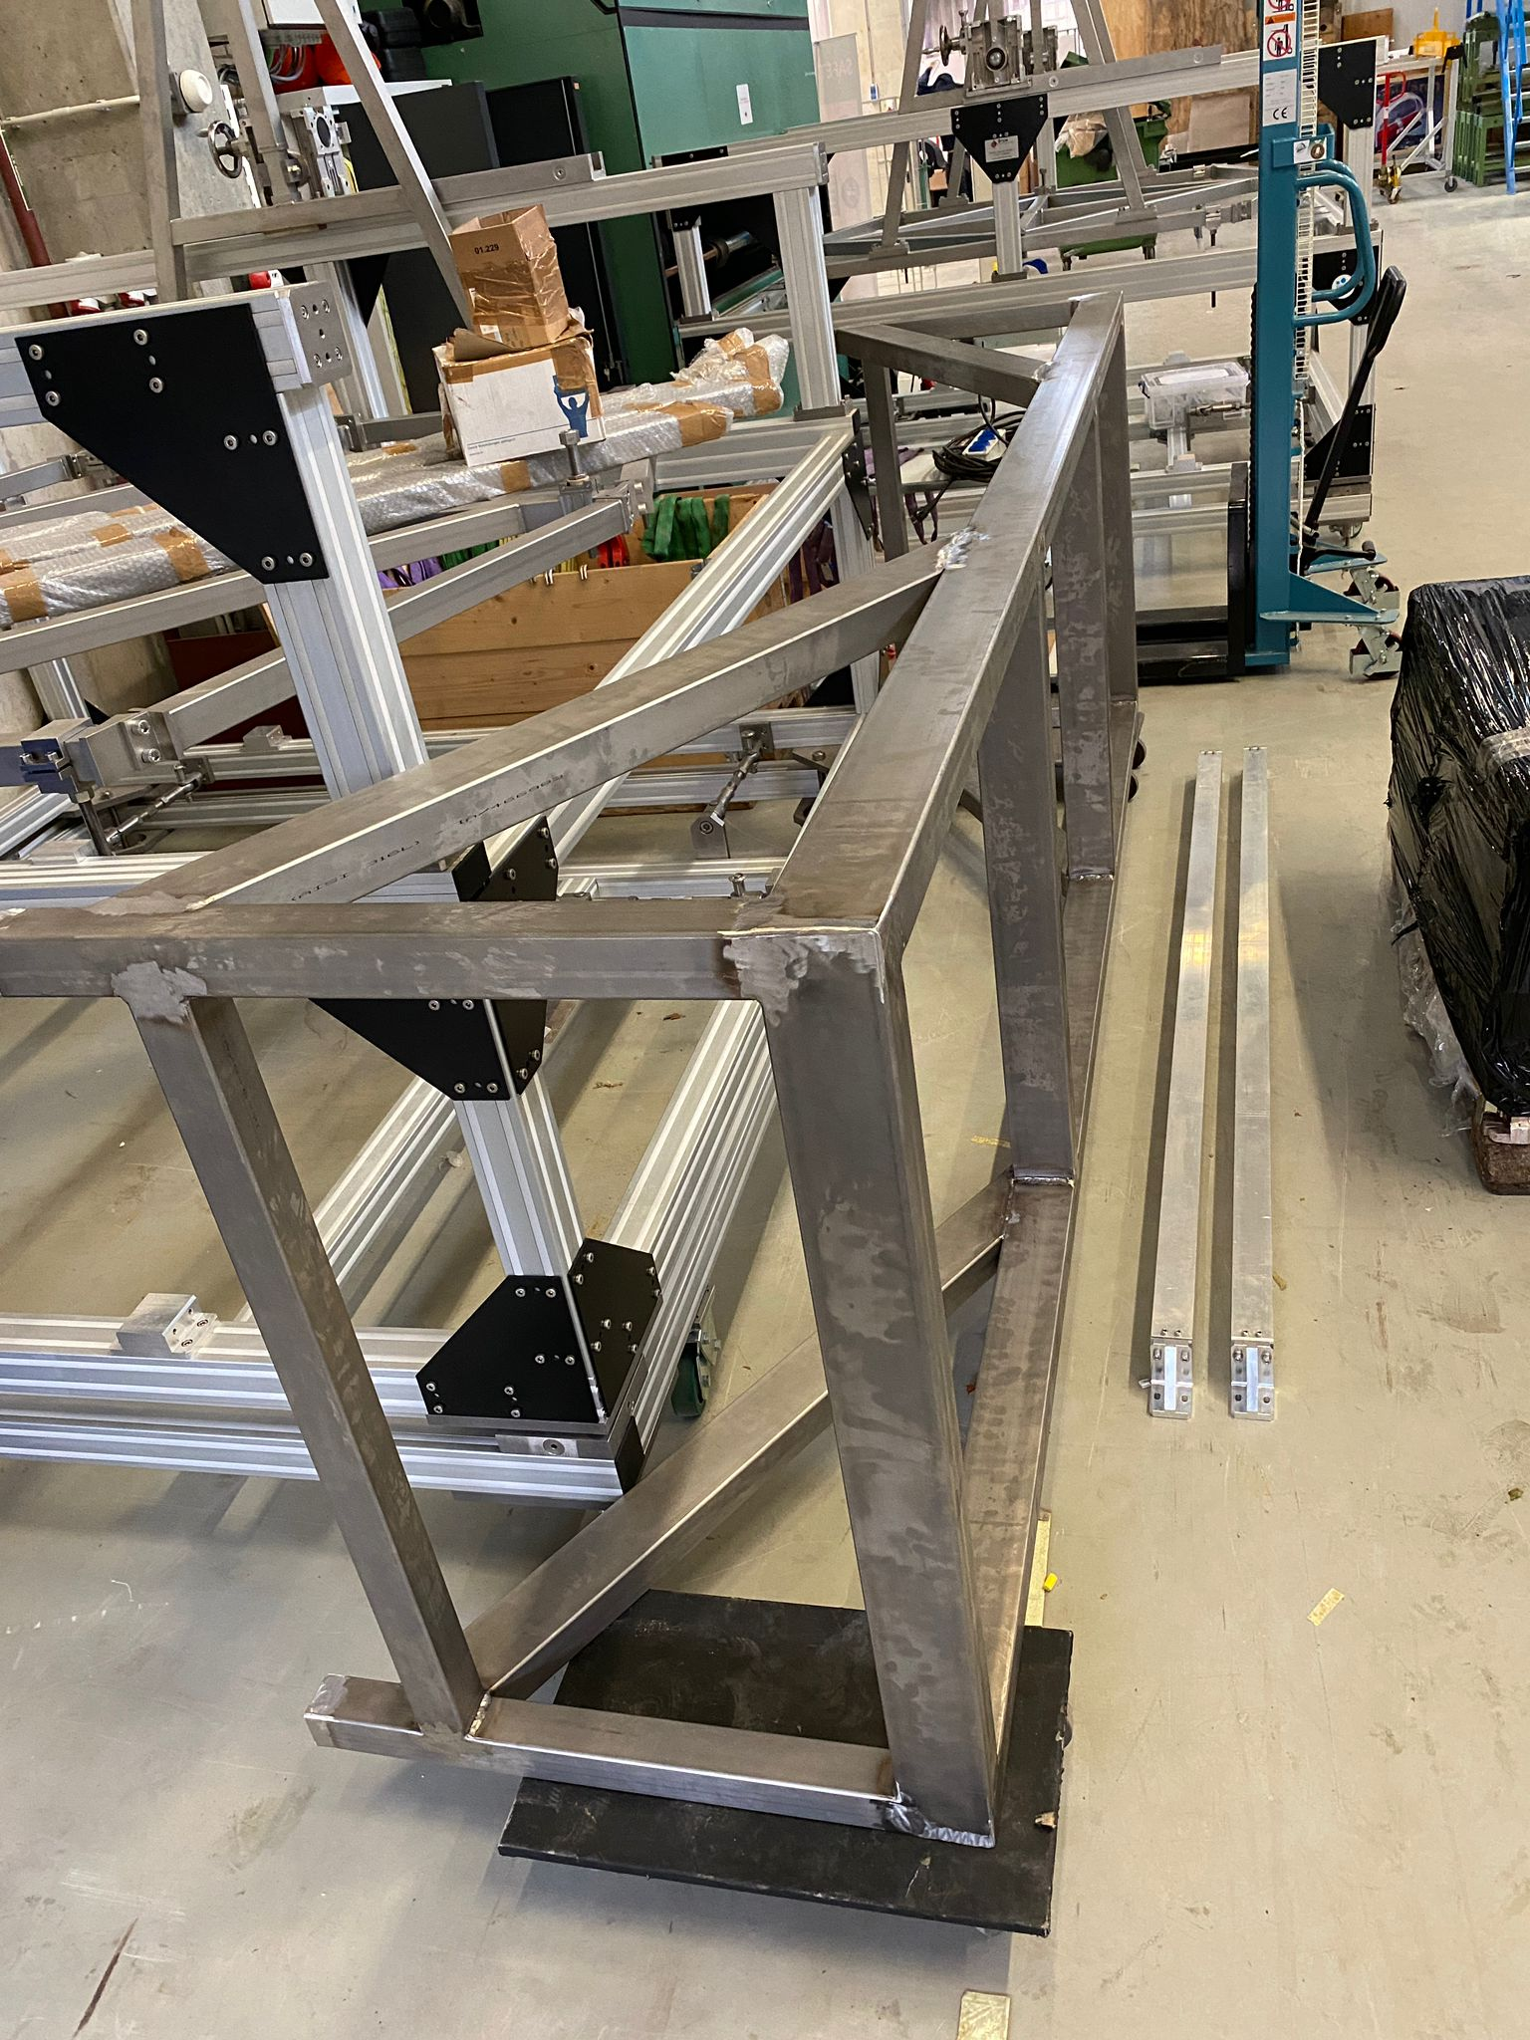
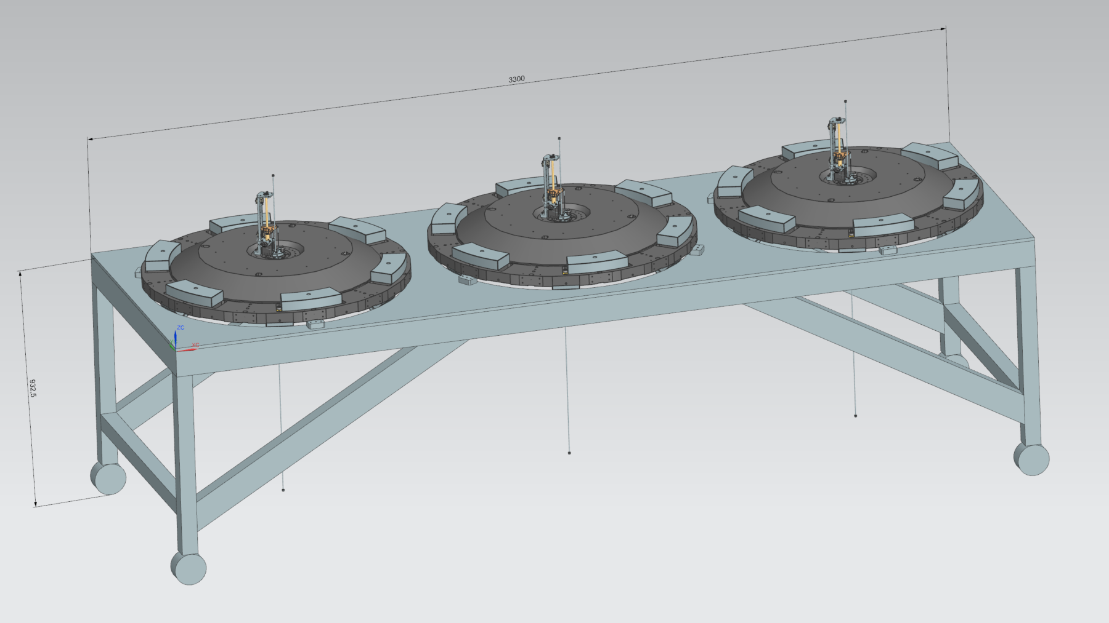
GAS tooling
Multi purpose cleanroom storage bench
Blade pairing excel tool

Slide 11
Cable trays and power rails
Cleanroom but also noisy area
Several levels of closed cable trays at height
Two levels of closed cable trays near floor around the towers
Power rails (tap off points) distributed around cleanroom and noisy area at height
Order is being finalized
We expect this to require a huge amount of manpower to install
To be installed asap after additional support structures are installed (max. 1.5m overhang)
Cleanroom feedthroughs???

Slide 12
Turbo water-cooling routing
Functional design (PI&D)
Rough paths in CAD, but not fully detailed, in particular support
Piping, bends, sensors, connectors, tooling, is all ordered
Rough support plan was made, materials are ordered
To be installed after cable trays (because most flexible system)
Will require some creativity and lots of manpower (but not as much as cable trays)
Cleanroom feedthrough???
Rack and optics water-cooling routing will happen at later stage (not foreseen yet)

Slide 13
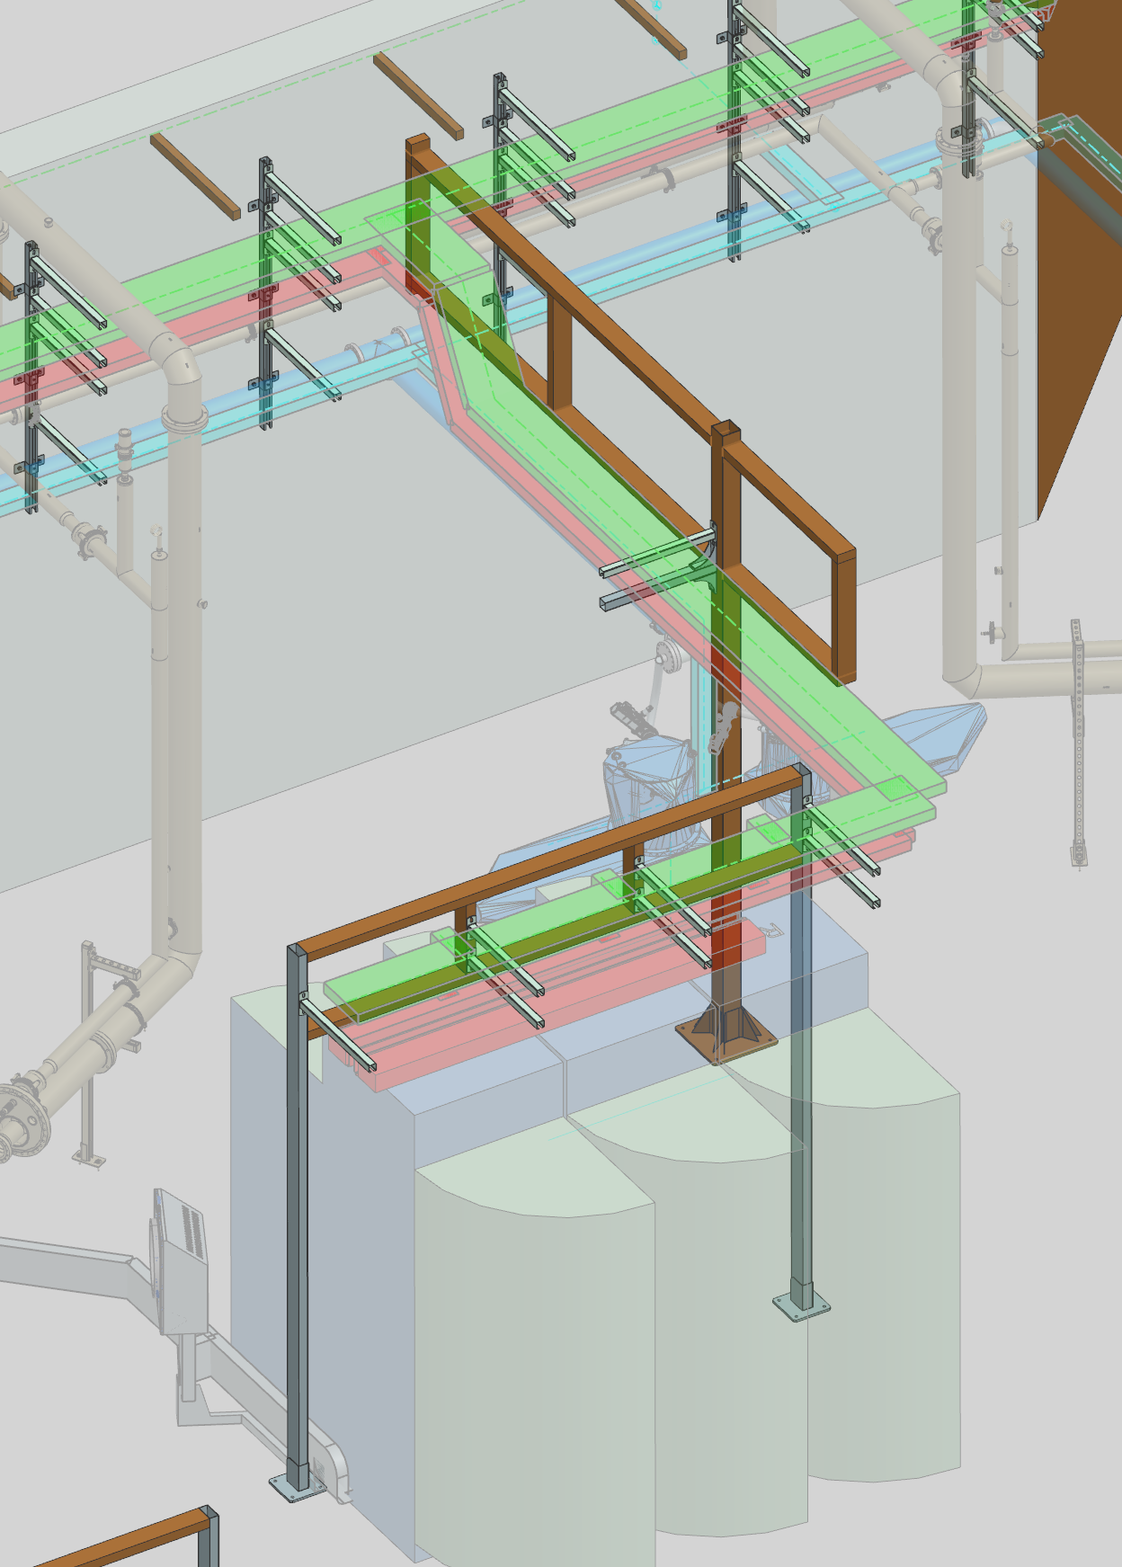
Cleanroom support structures
More elaborate support structures
Mainly for cable trays
But also helps for water-cooling etc.
Design is done, to be cross-checked
Should order asap (somewhat critical)

Slide 14
(to summarize the critical path and short term planning)
March / April?
Turbo adapters + turbo pumps
CET internal mechanics start
(doing this before water-cooling or cable trays is possible, but messy)
Cable trays
Water-cooling
Additional support structures

Slide 15
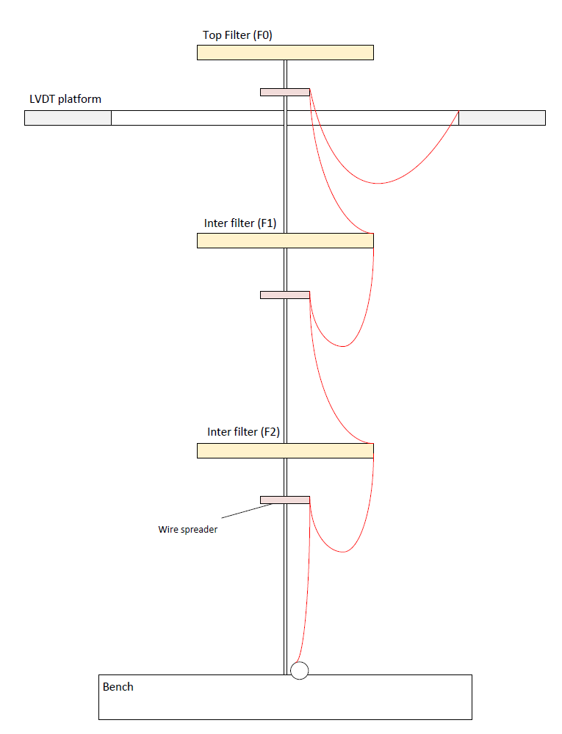
In-vacuum cable assemblies
Detailed cable lengths
Pins, shells, cable labels, etc.
All needed for cable assembly; starting soon
HRTS cable assemblies

Slide 16
Managing cleanliness (at Nikhef)
Manufacturer experiences; we’re keeping a list (RGA results and more)
Lesson from passed year: only select manufacturers that are known to have proper cleaning capabilities. And never organize the cleaning yourself, let the manufacturer do this.
UV light (stains) + particle counter gives good idea of ballpark
Quite a lot of stains
Often from manufacturing (wont come off)
Sometimes from other sources such ass lifting equipment, these can often still be removed
Doing a UV check on finished assemblies is worthwhile

Slide 17
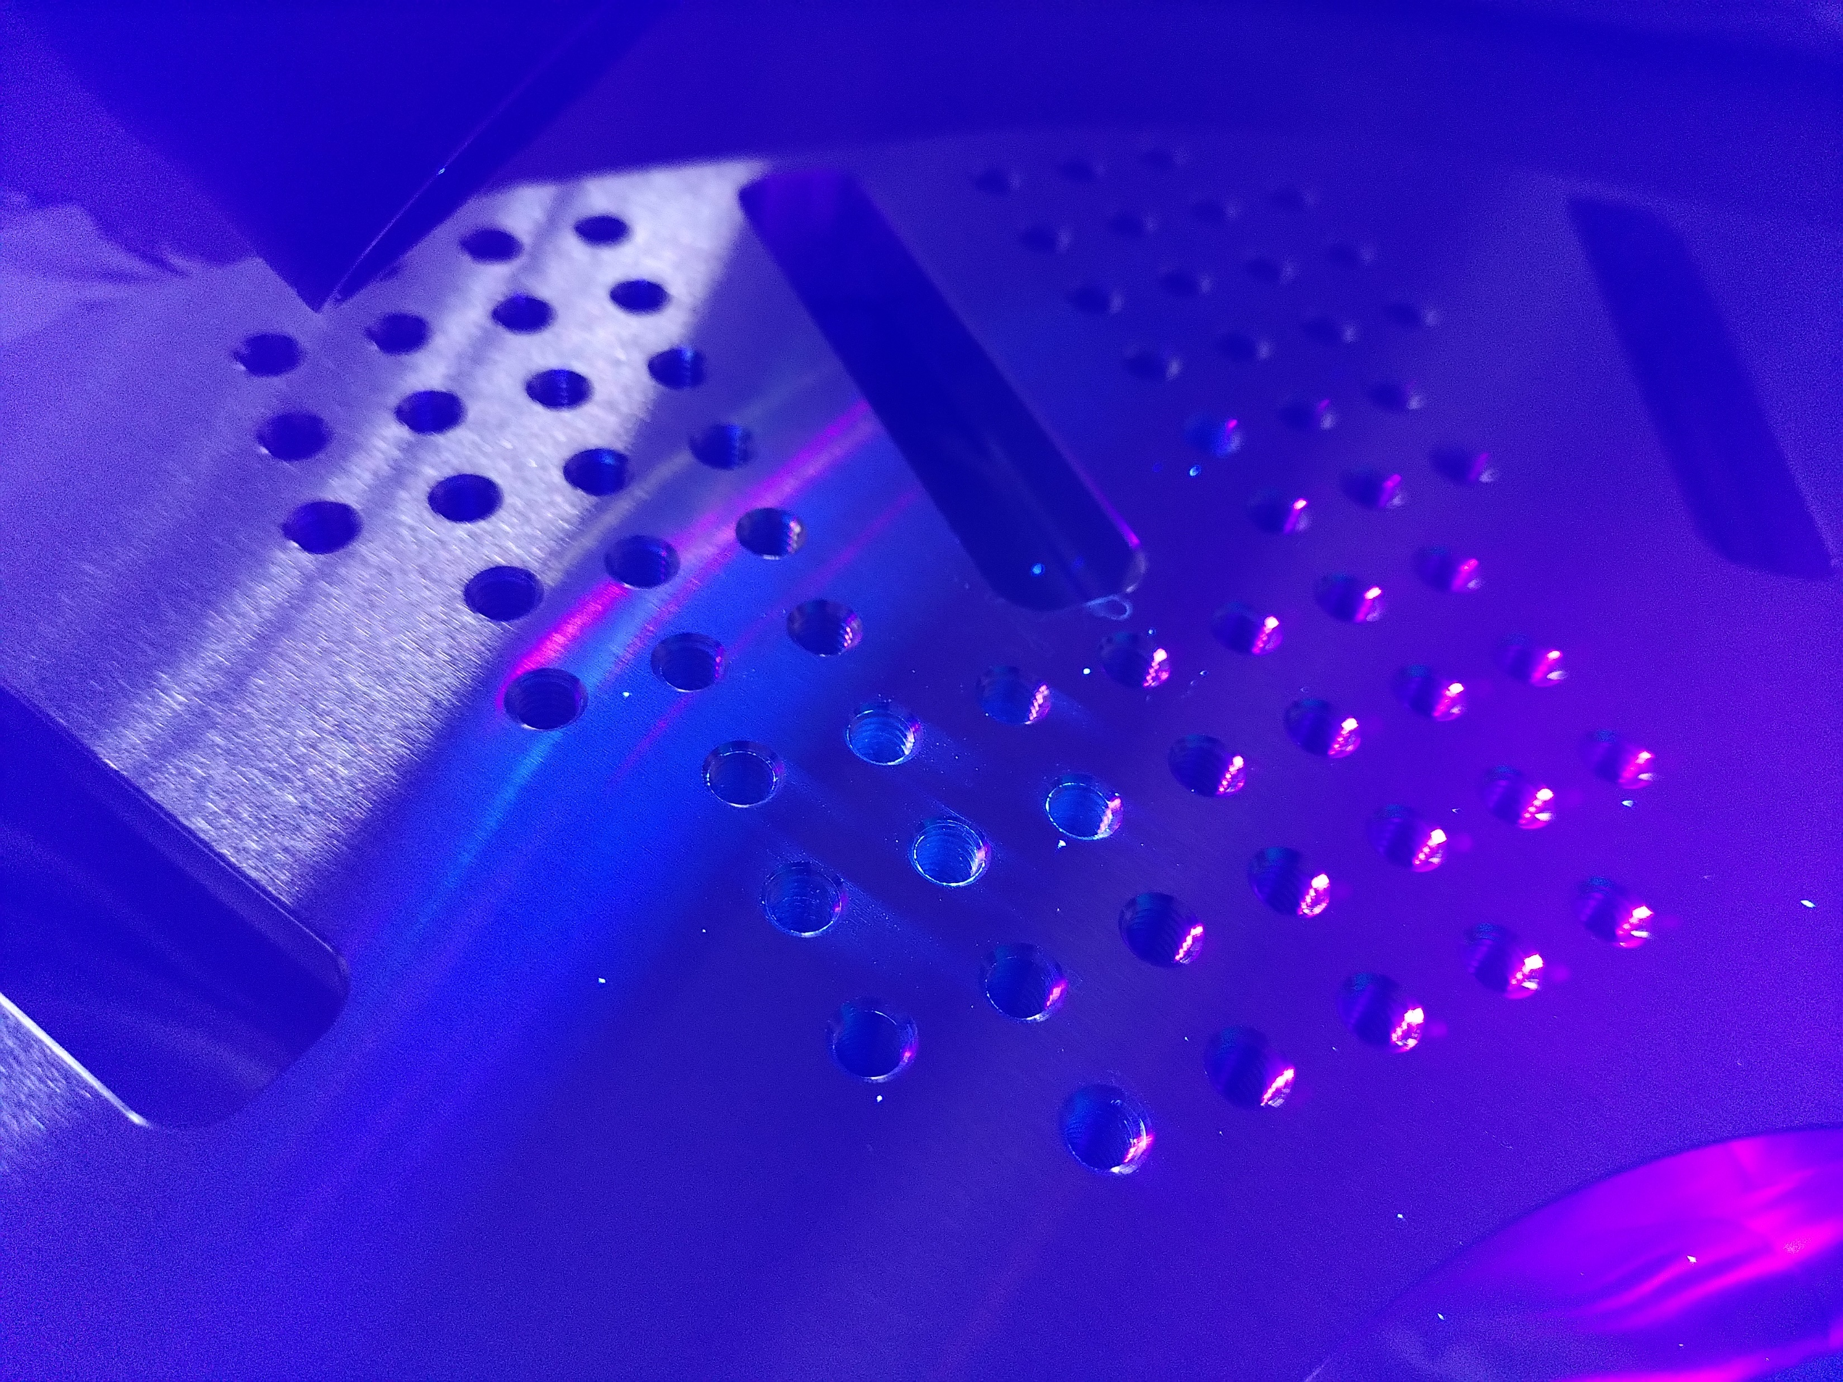

Slide 18
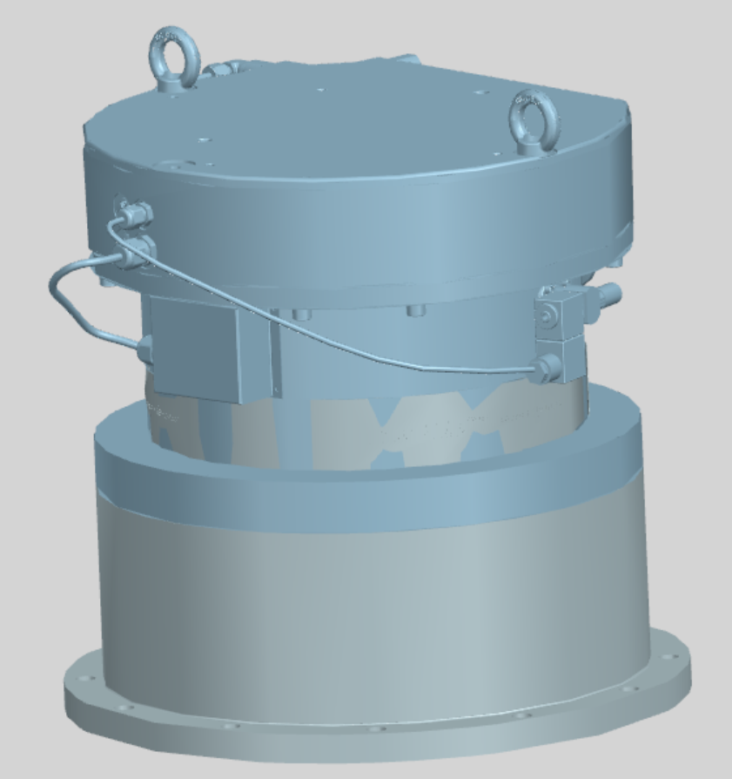
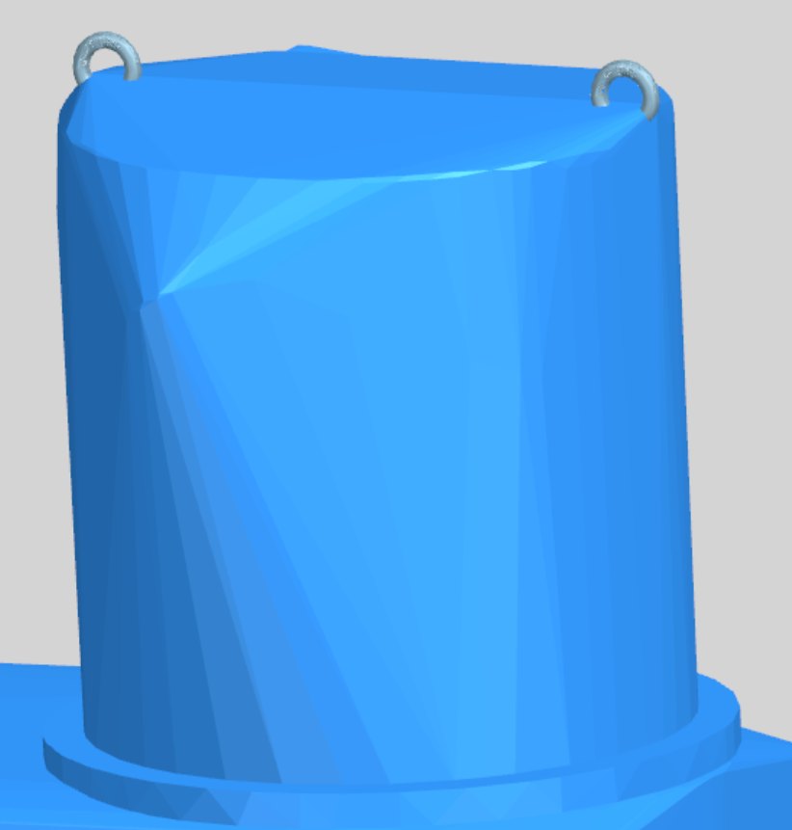
Keeping track of a Gazillion parts
ETPf CAD is somewhat special
Optimized for BOM generation
Optimized for speeeeed
Physical parts management (born ~2 years ago, starts to pay off)
CAD BOM lists of sub-systems compared to ordering data
(Should) contain absolutely all mechanics for ETPf
Easy to see what was ordered and what is still missing
Reasonably complete and up-to date, handy for detailed monitoring
Order management
List of (the larger) orders and their whereabouts and other relevant info
Less strict but handy for the bigger picture

Slide 19
Order management

Slide 20
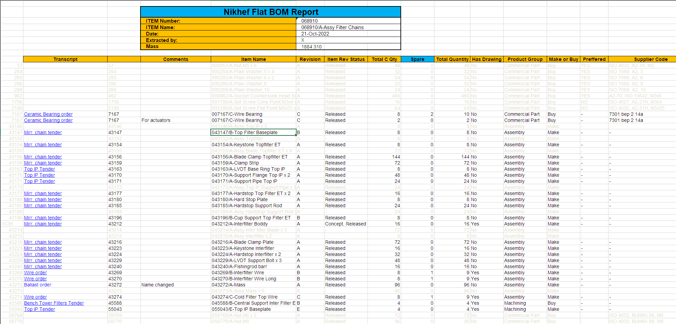
Physical parts management for suspension chains

Slide 21
Storage solutions (at Nikhef)
Parts arrive (by pallet) They are checked for BOM completeness and some samples are taken to check cleanliness. The pallets get a simple ID keep track of what is where for "long-term" storage.
When it is foreseen that a certain set of parts are needed in the short future (months); All required parts should be retrieved (probably with some effort) from the pallets. These parts are stored in numbered (white translucent) RUB boxes. With the outer wrapping still on, somewhere outside the cleanroom. A cabinet containing a number of such boxes will have a list that shows all part numbers and in which box in that cabinet they reside. When (pre-)assembly actually starts; Collect sets of parts that you need from these cabinets and bring them to the changing area where the outer wrapping is removed. With gloves, the single wrapped parts are put in pink translucent RUB boxes that are known to be clean and are always kept in a cleanroom environment. These may then go into the cleanroom to be used or briefly be stored there.

Slide 22
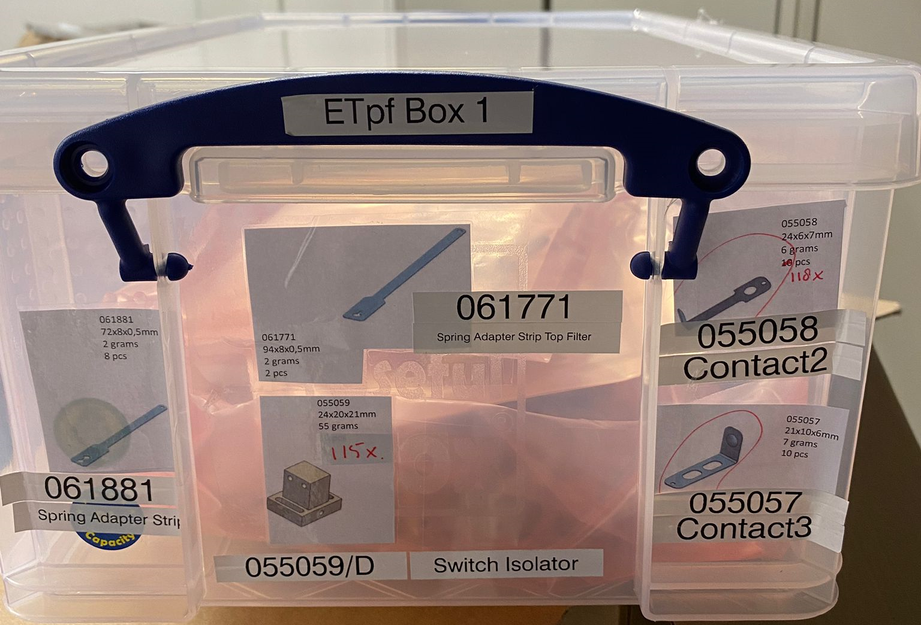
Storage solutions (at Nikhef)
In short:
White boxes = double wrapped, not super clean
Pink boxes = single wrapped, clean, handle with care (generally only in cleanroom)
Keep boxes labeled and in their correct cabinet
Keep sets of boxes indexed with lists

Slide 23
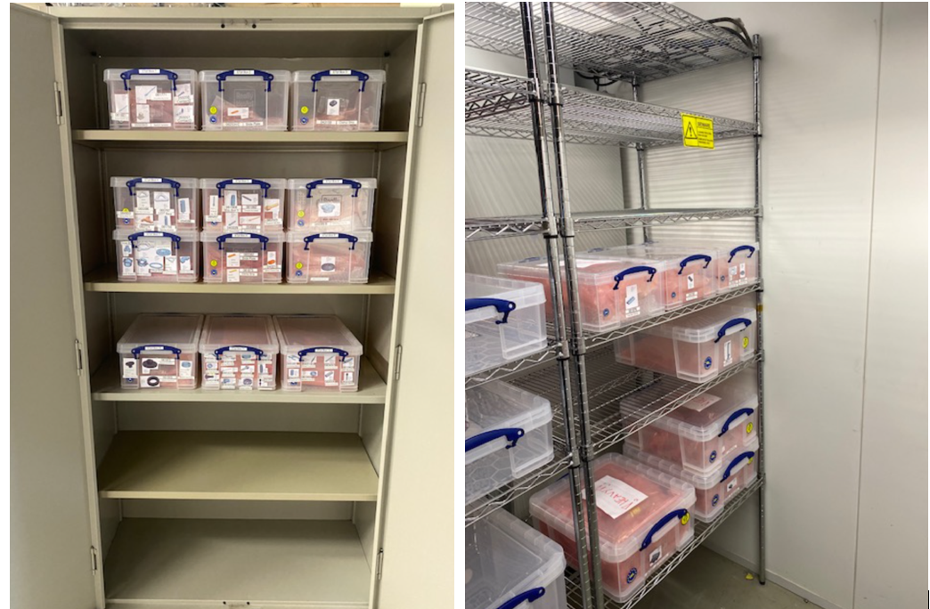
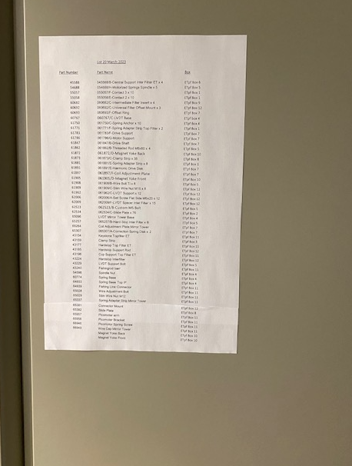

Slide 24
3 – What will/should be next CET internal mechanics
Managing cleanliness (at ETPf)
Storage solutions (at ETPf)
Internal mechanics installation checklist
Documentation
Double IP prototype
Outgassing measurements

Slide 25
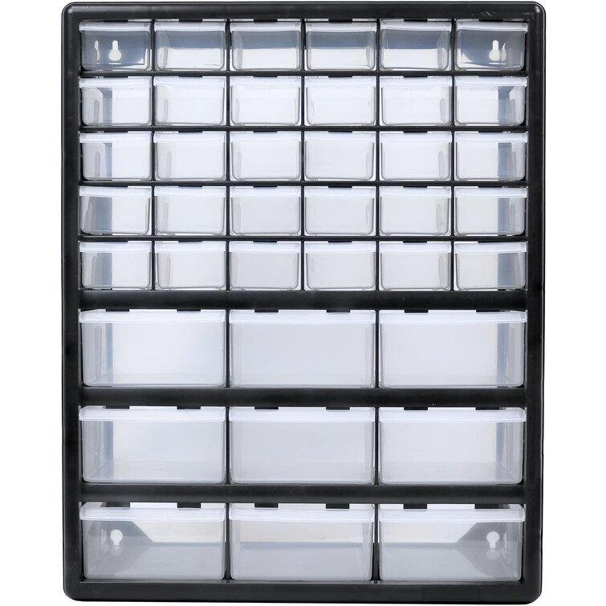
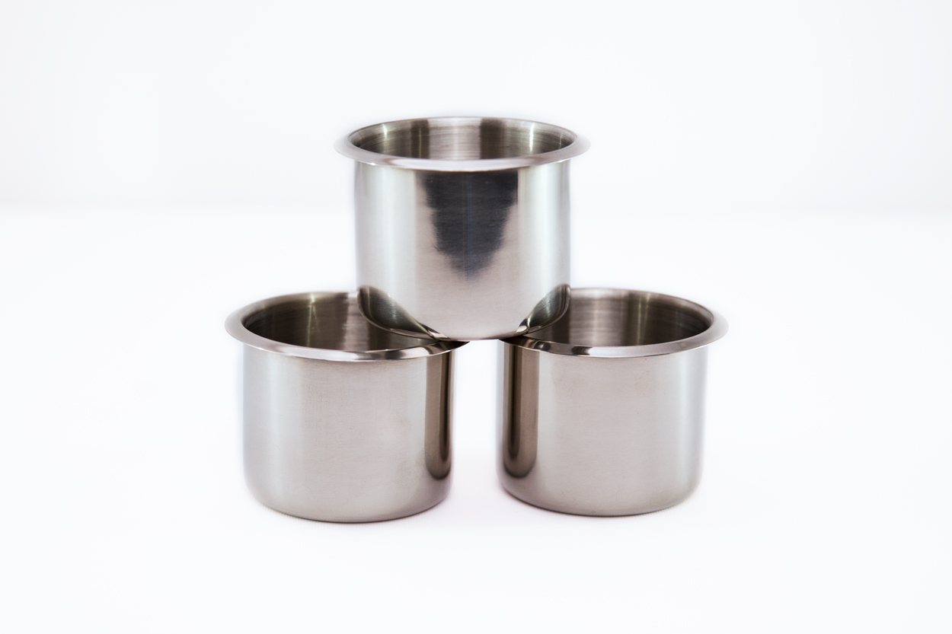
Managing cleanliness (at ETPf)
Pink box / clear box system
Cleaning schedule
Restricting cleanroom access (or parts of the cleanroom) when clean parts are exposed
What was also found to be really nice to have during work on clean assemblies:
(not this one, couldn’t find
the right picture)

Slide 26
Storage solutions (at ETPf)
The Nikhef system works very well
Manpower investment is needed to do this right
Installation will stall if not done properly though (and Peter will likely go crazy)
We should implement Nikhef storage solutions (or something else that works)
Setting this up should happen anytime prior to CET internal mechanics assembly (~March)

Slide 27
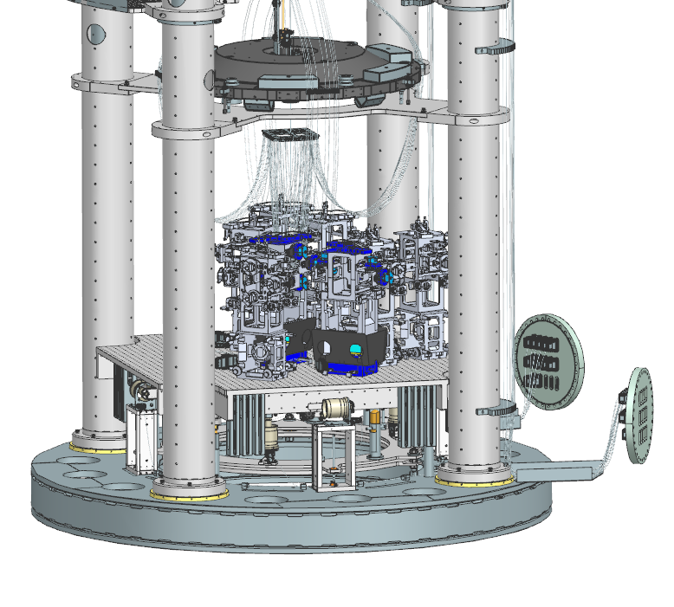
Internal mechanics installation checklist
Red means there are still
open issues
In-vacuum cable assemblies
Tooling
Installation/test plans
HRTS’s
HRTS cable assemblies
(don’t strictly need these yet)
Bench assembly
- LVDT’s
Bench positioning systems

Slide 28
Internal mechanics installation checklist
General tooling
Lifting equipment
Loadcell balancing setup
Large IP assembly
Ballast mass
Flexures mishap
LVDT’s
Correction springs
Tooling
Trillium pods
(strength and cleanliness research for 3d printed ) Wire connectors
GAS filters
LVDT’s
Correction springs
Ballast mass
Cable guides
Standing platforms

Slide 29
Documentation
Critical: assembly and installation plans
The major FMEA’s have been performed (2x IP, GAS)
What more is required to start installation regarding safety?
Way behind on technical design reports
Lots of memo’s and mails, scattered everywhere
Nothing coherent (mistakes have already been made because of this)

Slide 30
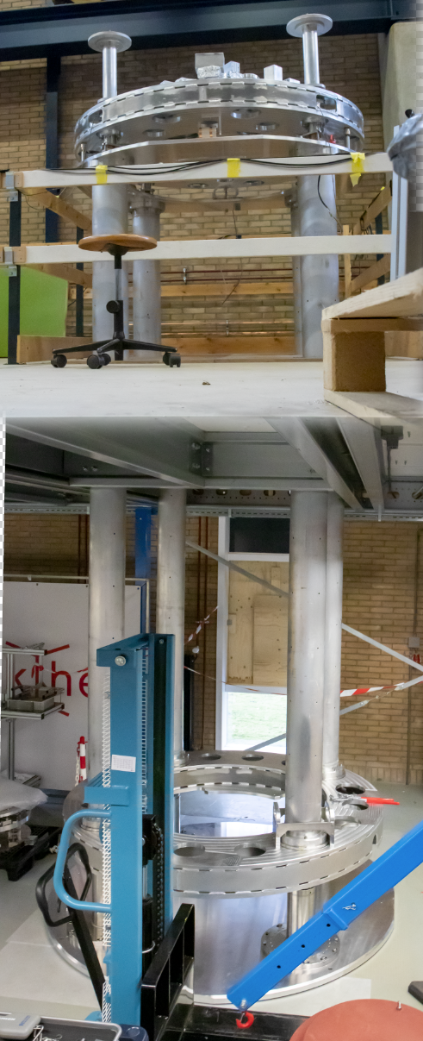
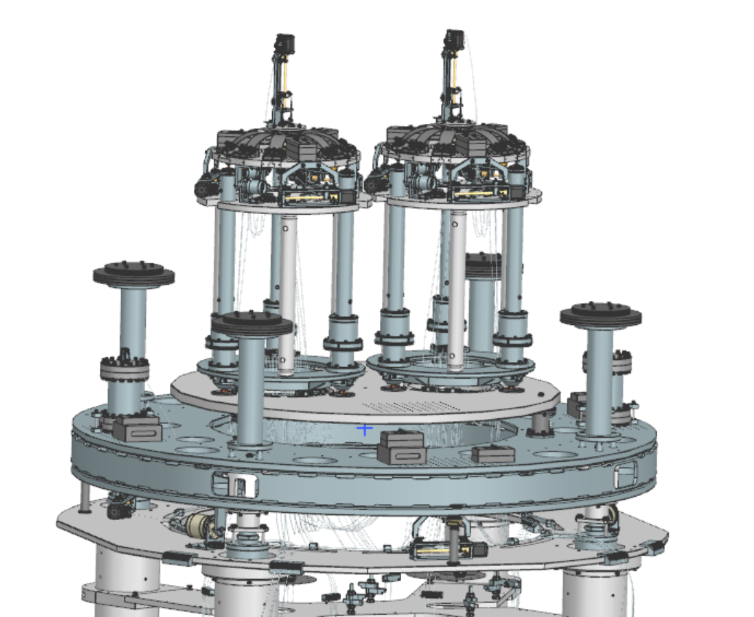
Double IP prototype
Double IP will now actually be built
Clean parts will be used for this
Either we re-clean after the prototype served its purpose, or;
We purchase one new set of small IP’s
In case of the latter, the double IP can be used as a showroom setup
Who wants a cool, rather large, conversational piece?
For the low low price of one set of small IP’s

Slide 31
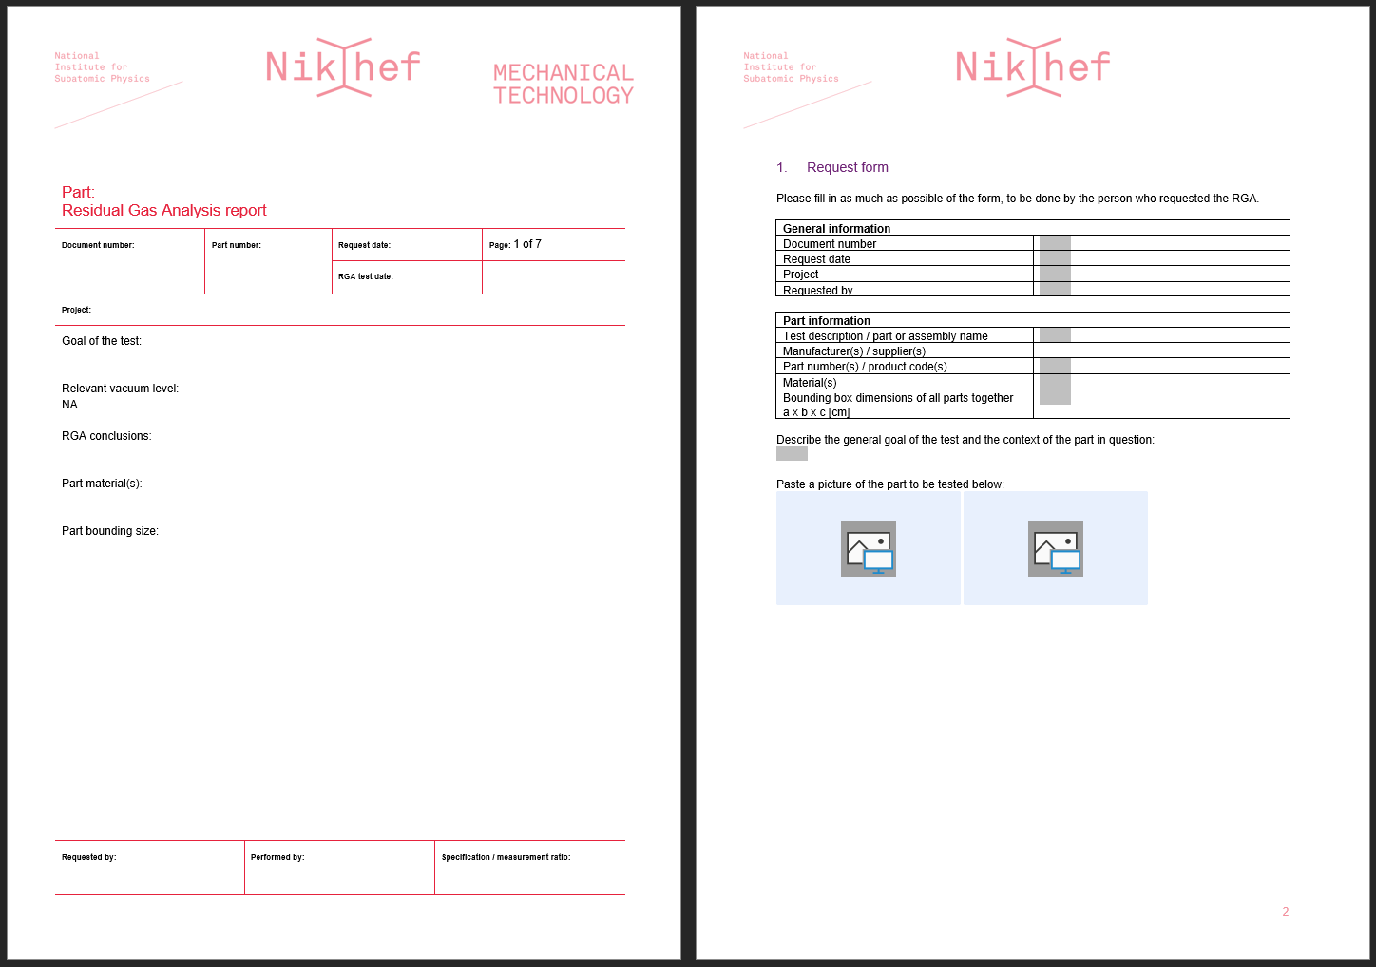
Outgassing measurements
Materials research feeding a outgassing data library
ETPf sub-assemblies -> predict ETPf end pressure
Manufacturer qualification
Developing expertise
RGA request form + report

