Slide 1
ETpathfinder workshop
ET-xxxxxxx
2024-01-31
Towards the commissioning of the Beamsplitter Tower
WP4/WP5 Planning
Kenny Lam for ETpathfinder team

Slide 2
Overview
Where are we now?
How to build a Beam Splitter Tower
Details on order
Some tuning details
Planning

Slide 3
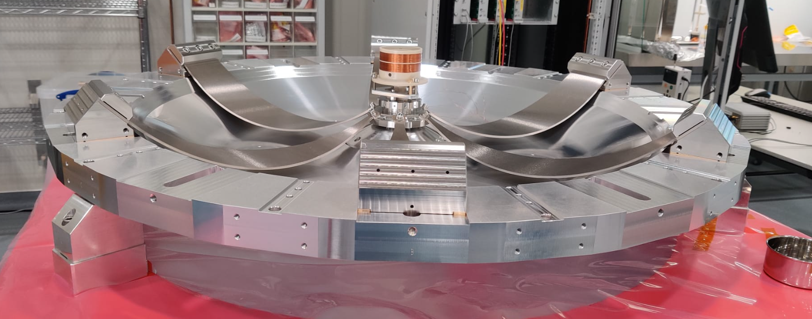
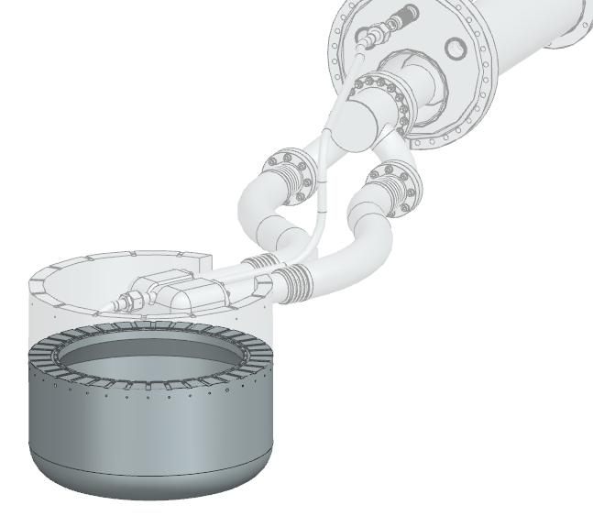
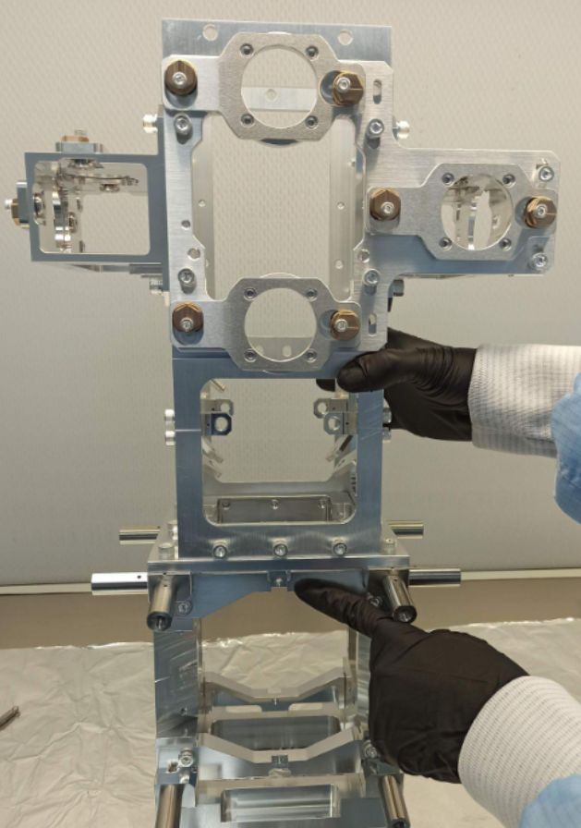
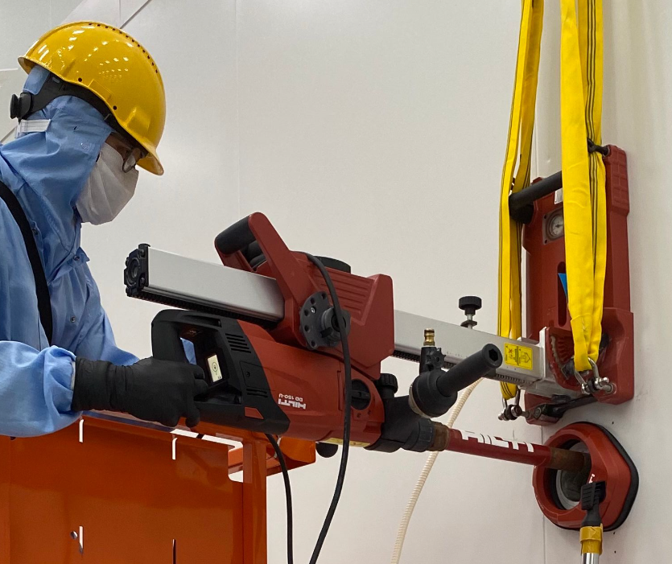
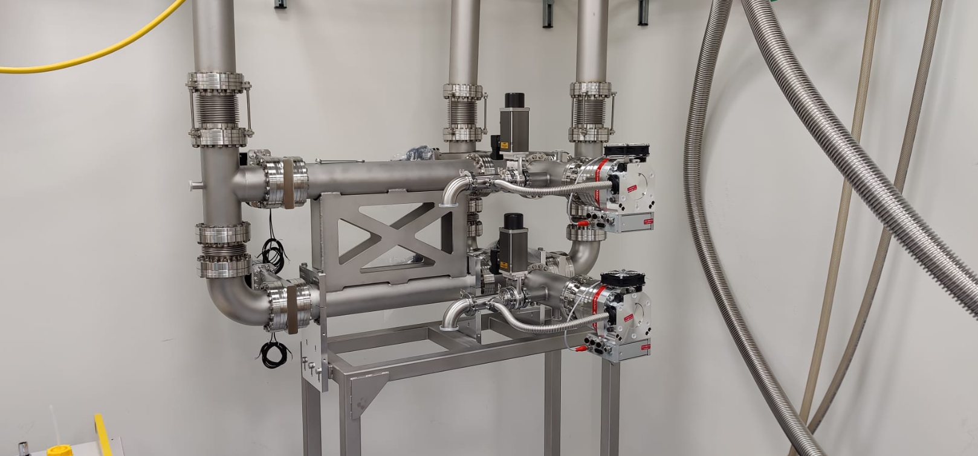
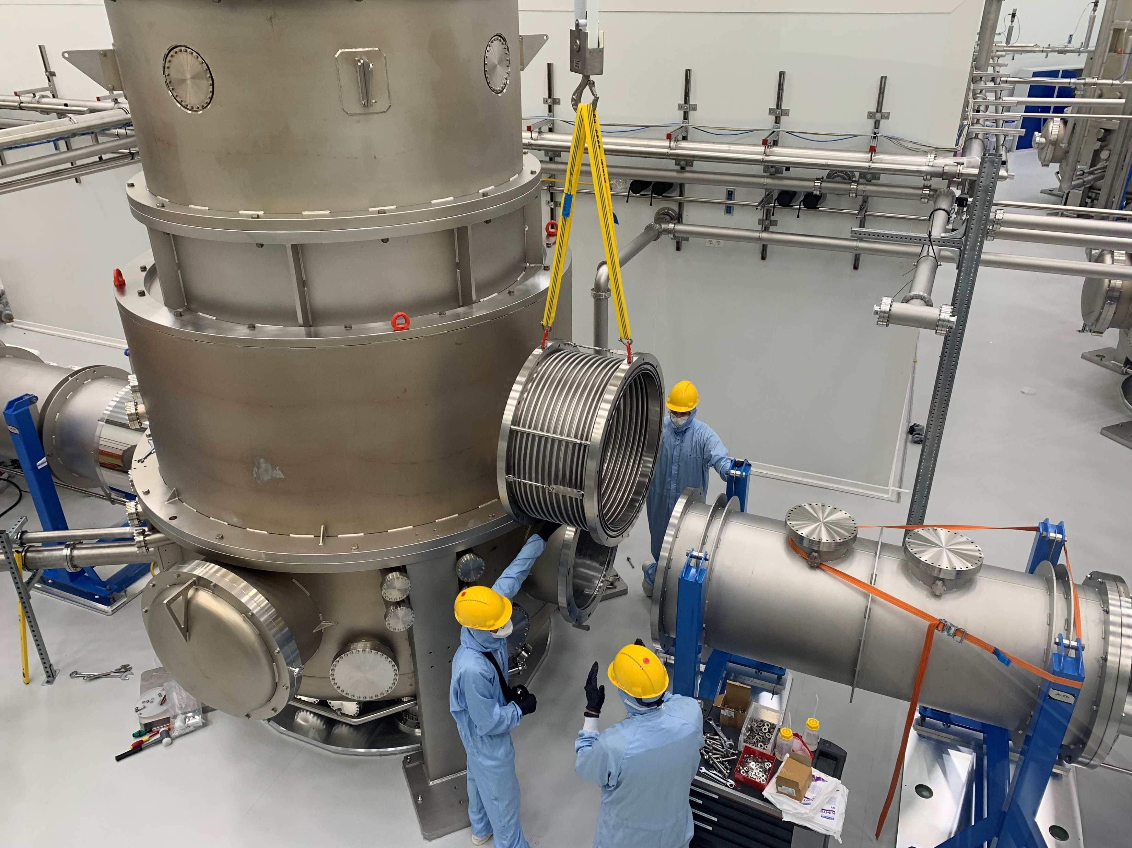
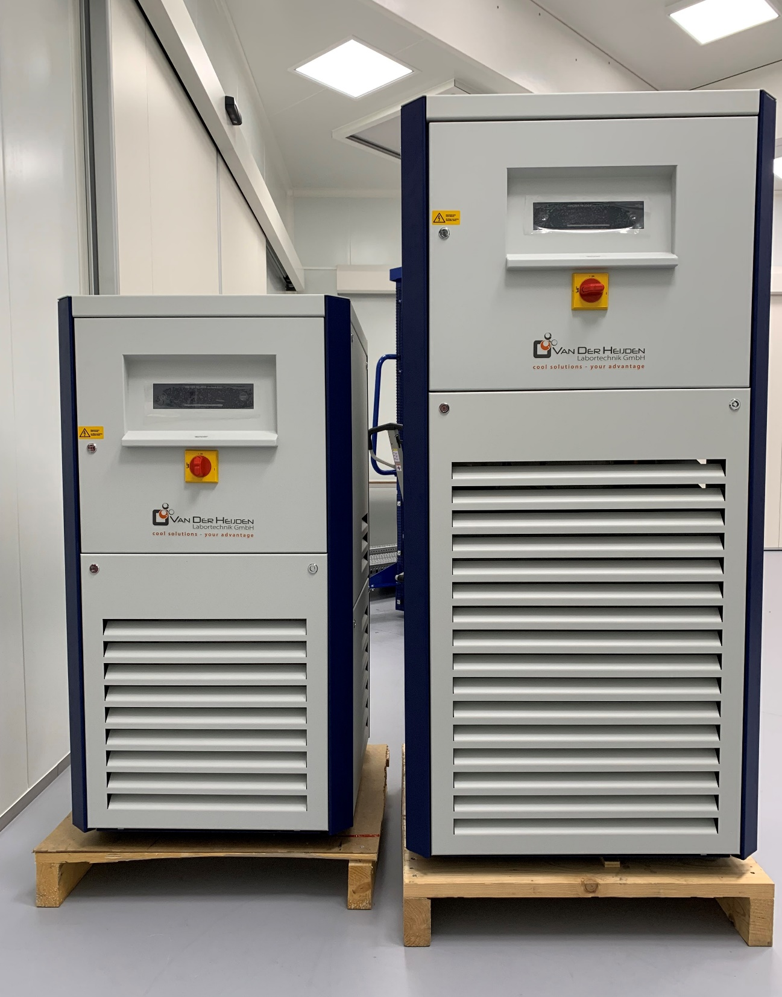
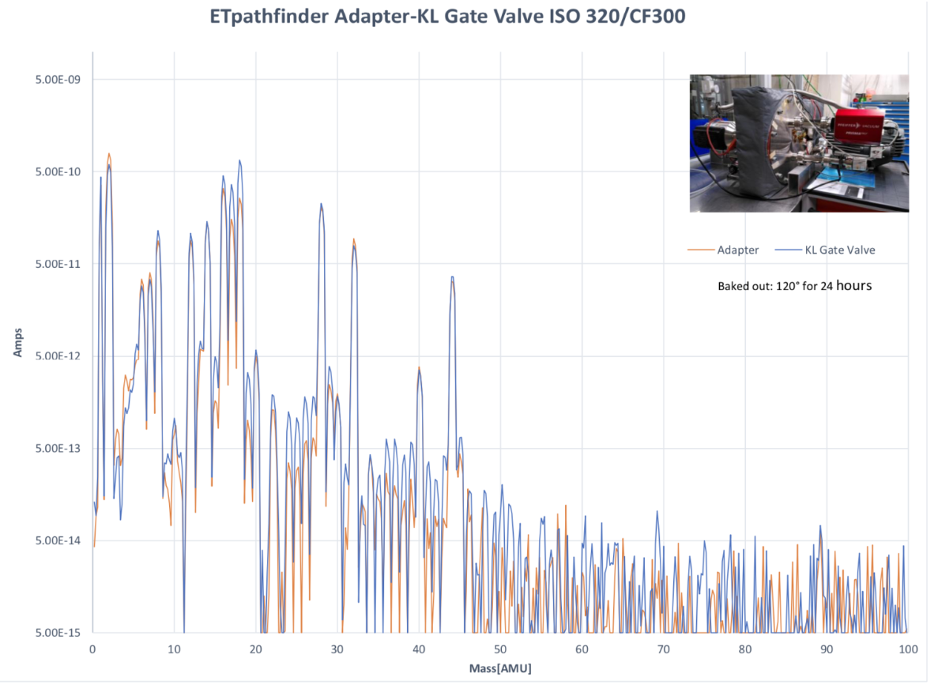
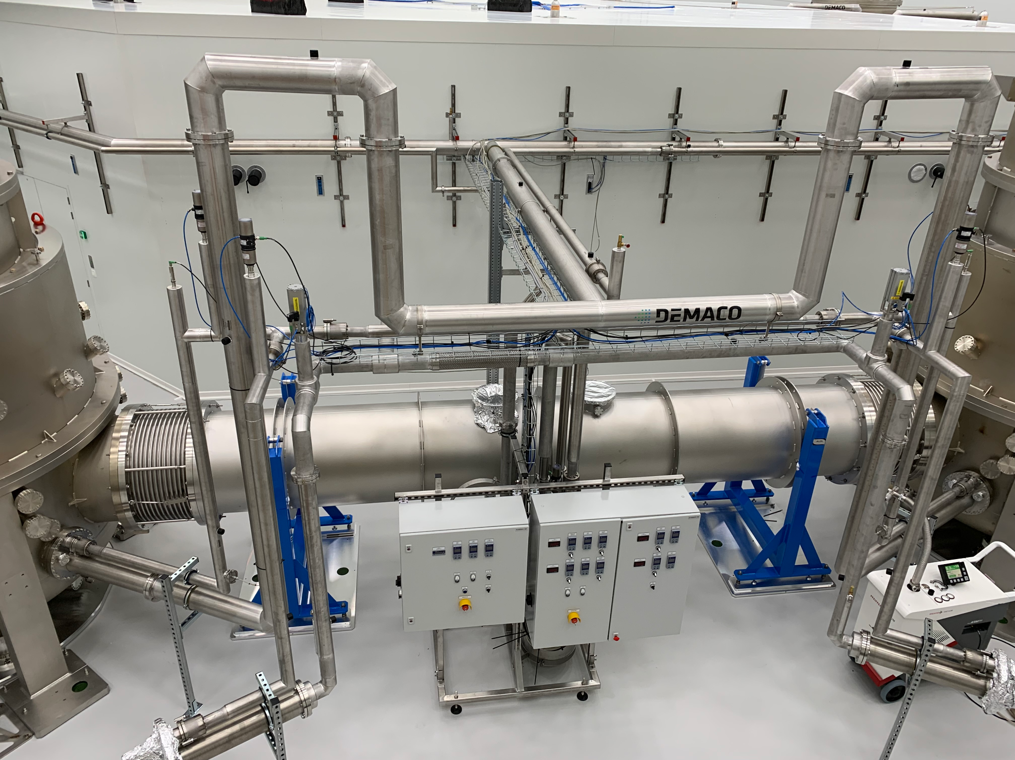
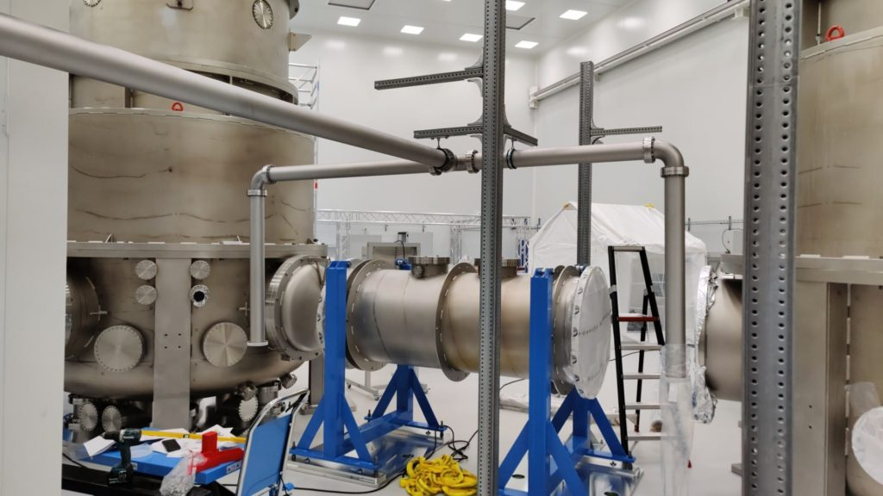
Where are we now?
1st of 6 Bench GAS filters tuned
LN2 Tub production started
Vacuum Manifold installed
Drilling feedthroughs
HRTS Assembly
6 Towers interconnected!
Start of Vacuum Line installation
LN2 supply tank installed
DN300 Gate Valve troubleshooting
Water-Water chillers installed
Completion of LN2 Infrastructure

Slide 4
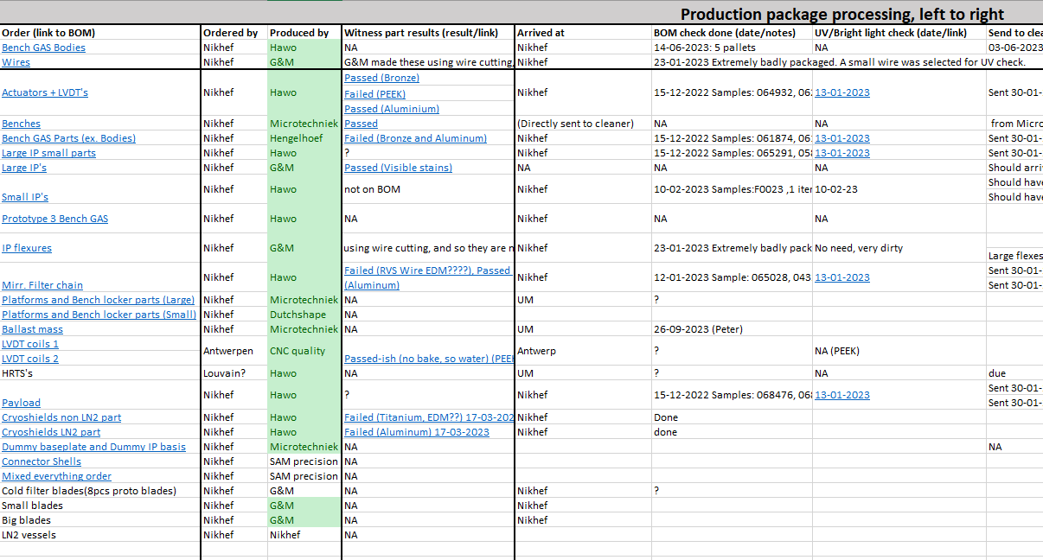
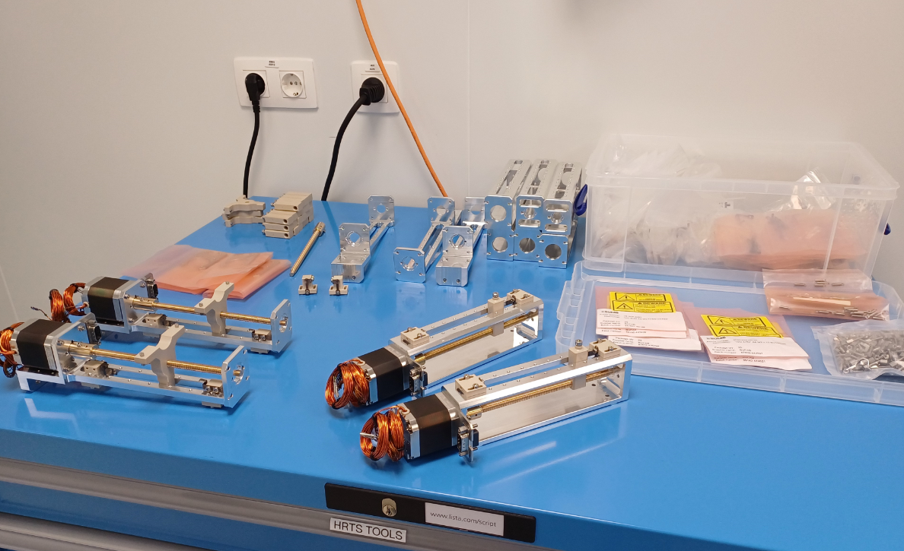
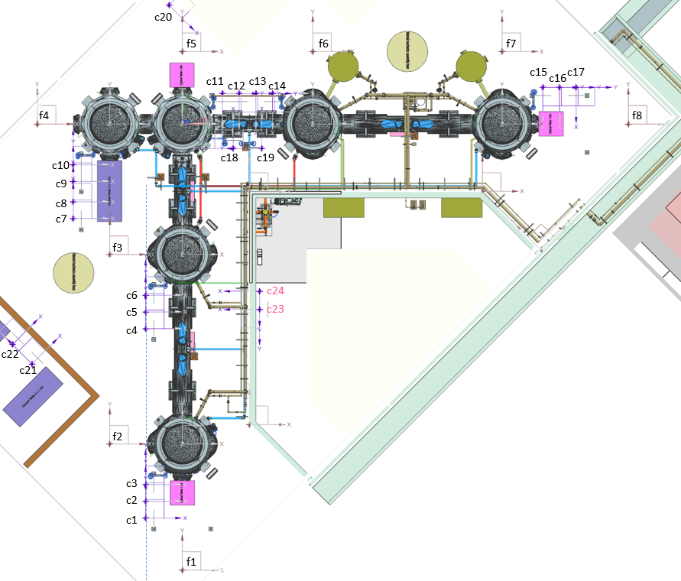
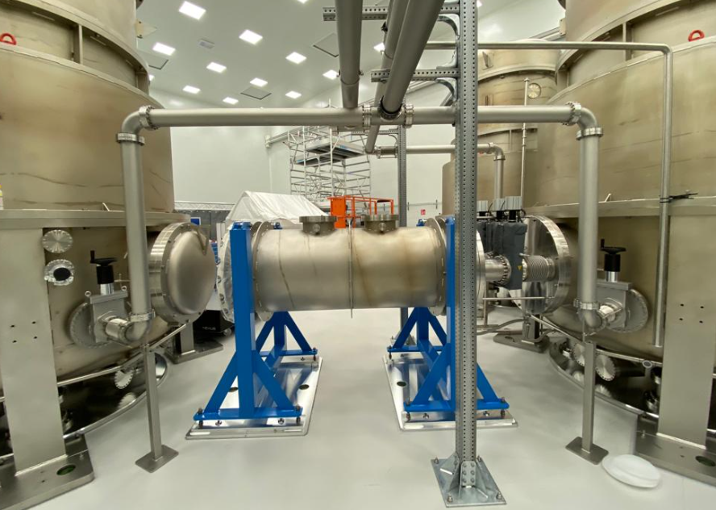
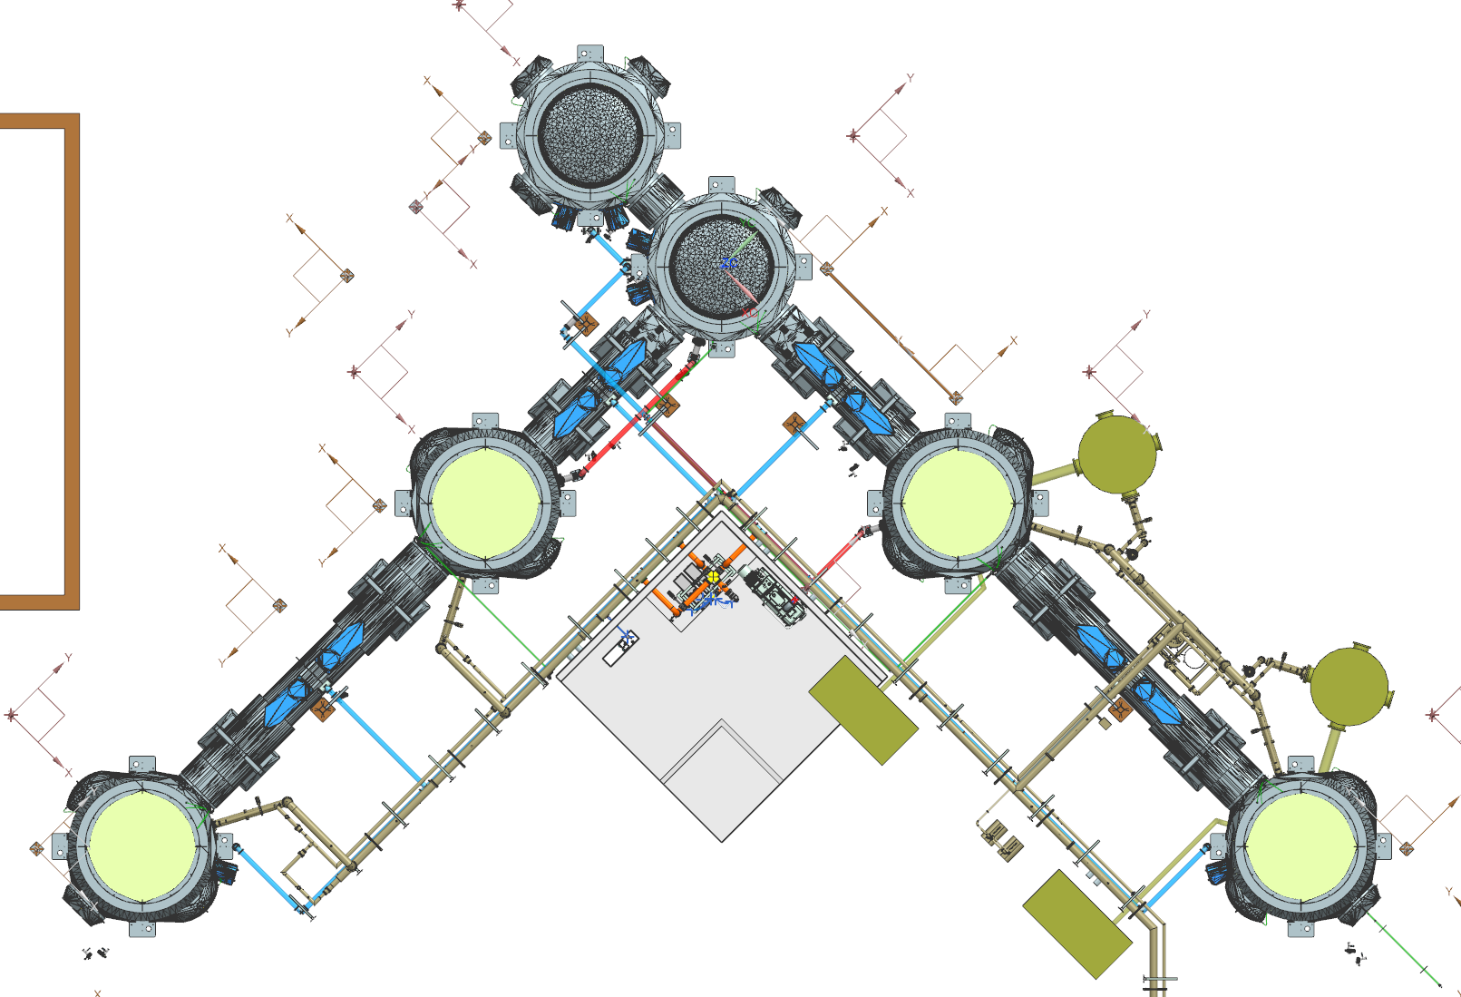
Where are we now?
Almost all parts are delivered and cleaned!
Pre-Isolation Stage parts being cleaned
More orders ongoing, such as water cooling pipes, cables, etc.
First few stepper motor assemblies put together
Anchor holes for various components
Successful evacuation with roughing lines

Slide 5
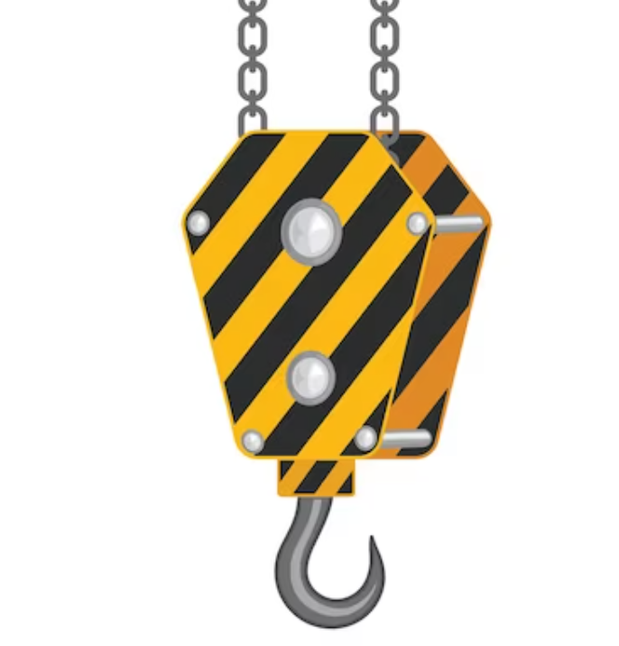
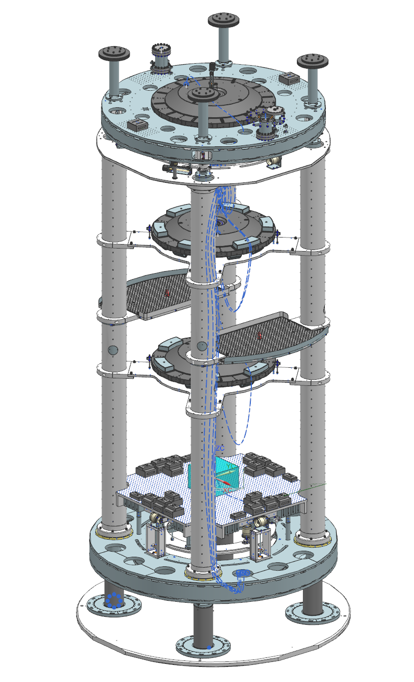
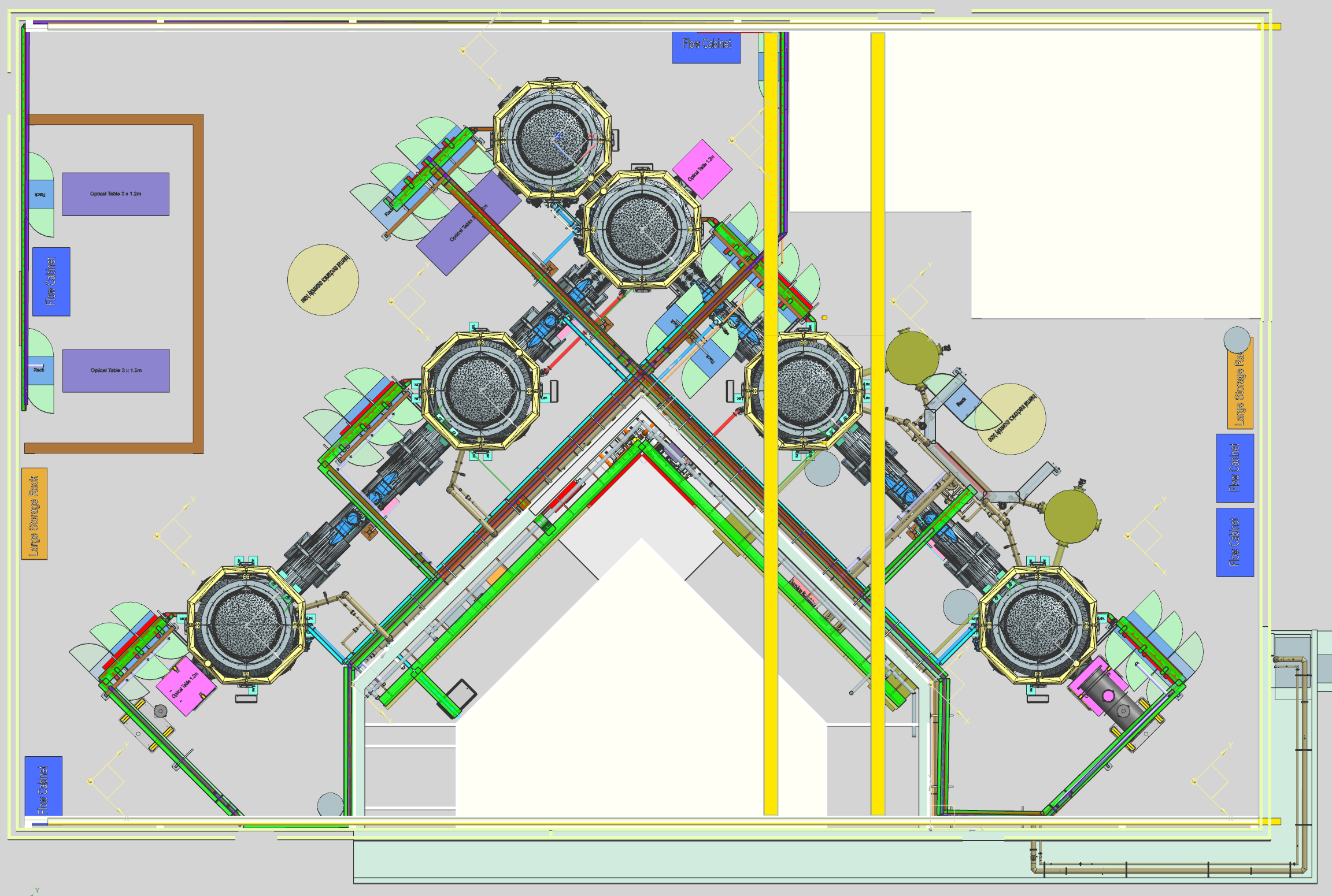
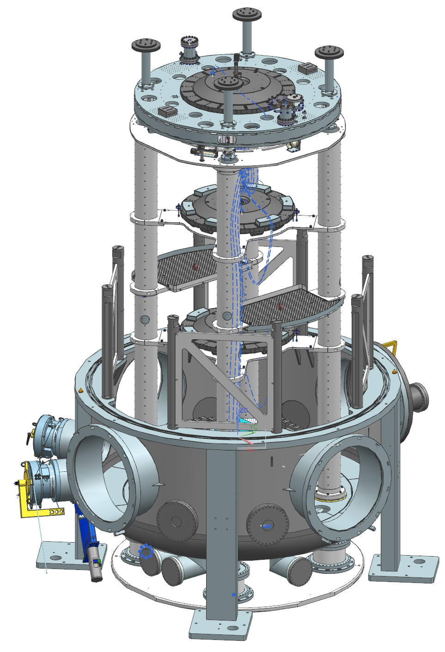
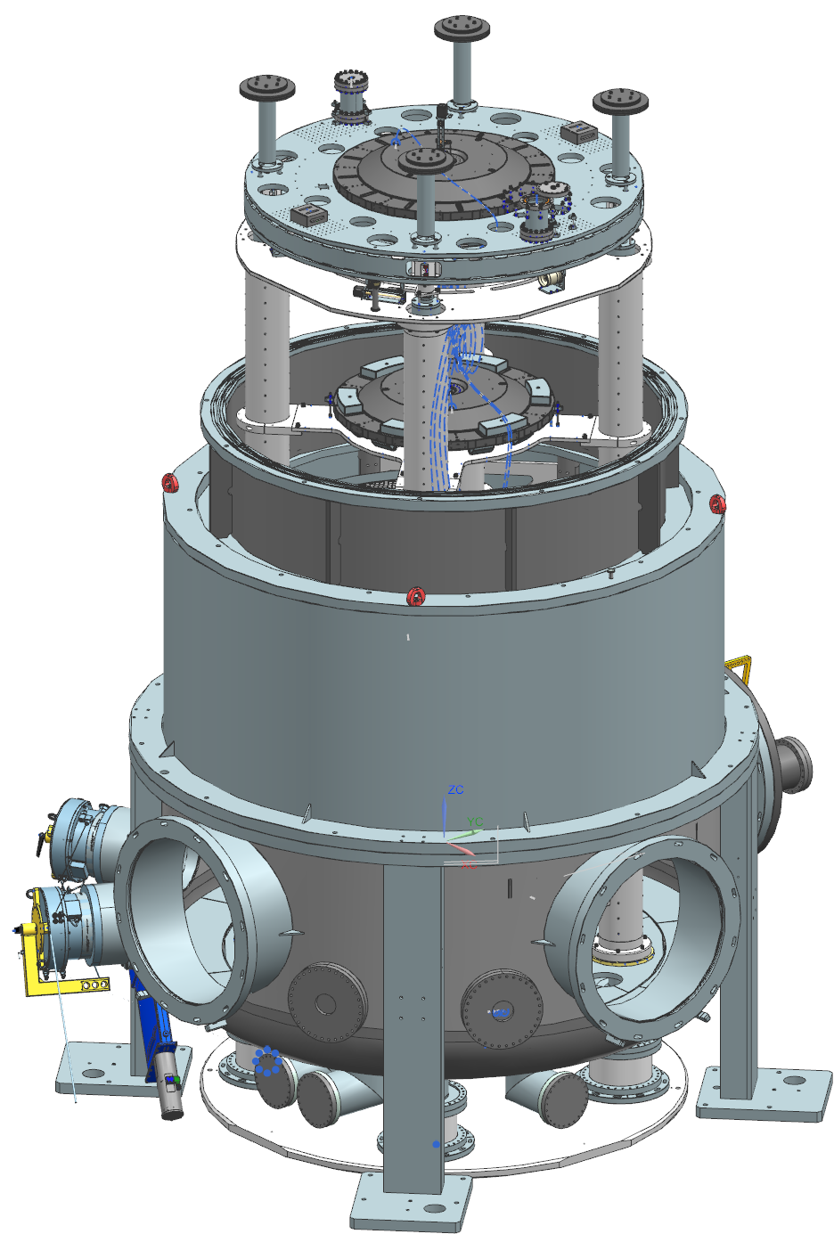
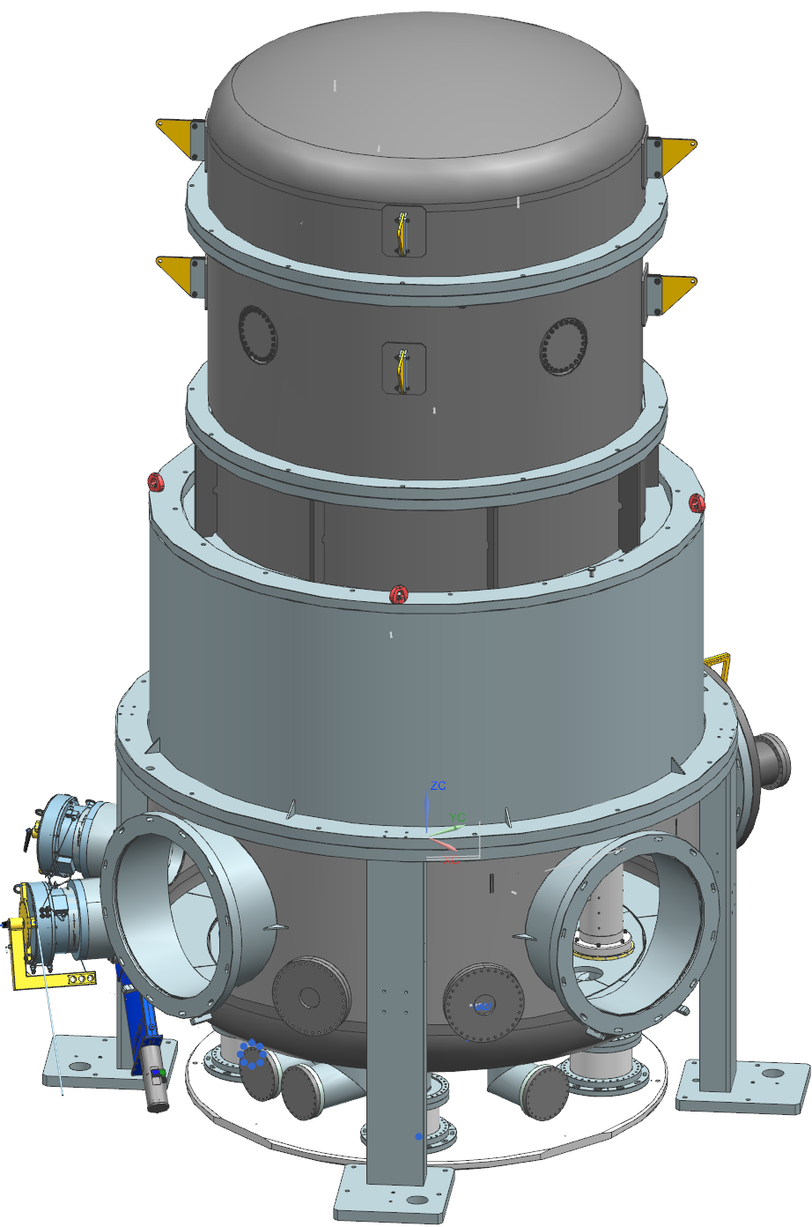
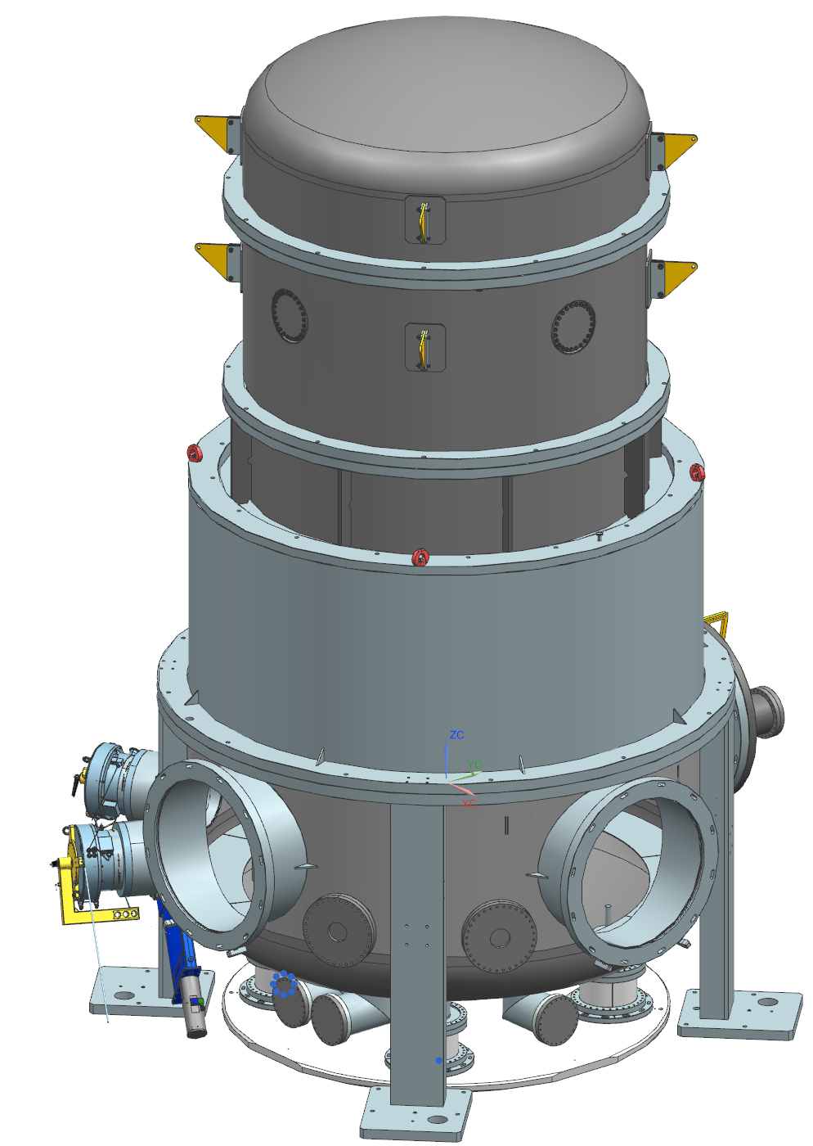
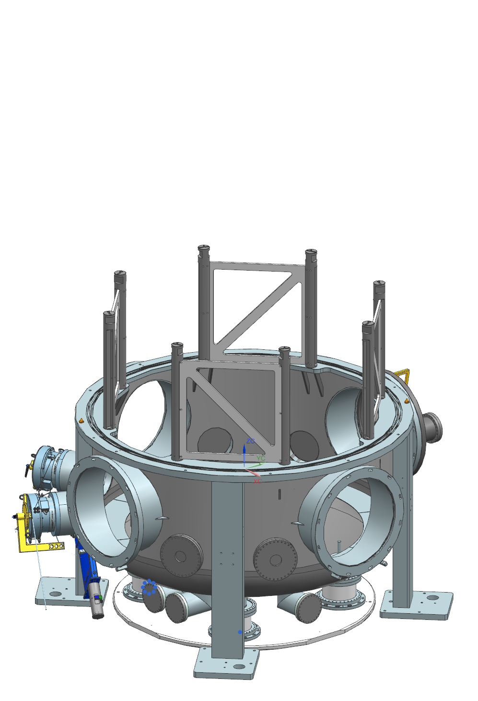
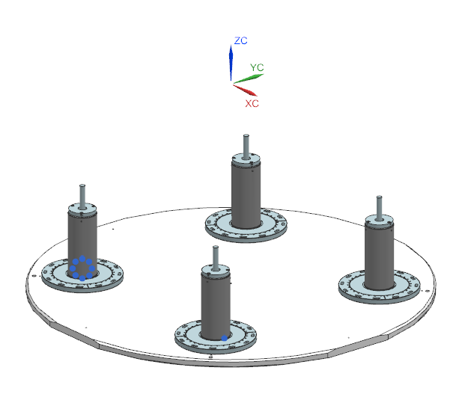
How to build your own Beam Splitter tower
Step 2
Step 4
Step 3
Step 5
Step 1
Build internal mechanics on dummy IP feet
Close tower
BS Path
Hoist the whole internal mechanics assembly into the open vessel
Dismantle vacuum tower up to bottom vessel
Dummy IP feet and baseplate for installation

Slide 6
How to build your own Beam Splitter tower
Build internal mechanics on dummy IP feet
Hoist the whole internal mechanics assembly into the open vessel
Dismantle vacuum tower up to bottom vessel
Dummy IP feet and baseplate for installation

Slide 7
Step 3: Building up the internal mechanics
9. Top GAS filter
6. LVDT
Base Ring
8. Top IP ring and
accessories
10. Routing in-vacuum
cabling
5. IP legs and
supports
7. Safety platforms
and GAS filters
4. Bench and
population
3. Bench Locking
Mechanism
2. Bottom IP Ring
Dummy Baseplate
and IP feet

Slide 8
Step 3.5: Tuning the internal mechanics
Starting state:
All systems are locked to their respective safety frames.
All GAS Filters have been individually tuned beforehand
Equalizing the load between the 4 IP Legs (Done during installation)
Tune Bench CoM and bring to correct working height
Suspend (i.e. unlock) Bench from GAS F2 and tune wire length according to bench working height
Suspend GAS F2 from GAS F1 and tune wire length according to bench working height
Suspend GAS F1 from GAS F0 and tune wire length according to bench working height
F0
F1
F2
Bench height for
tuning reference

Slide 9
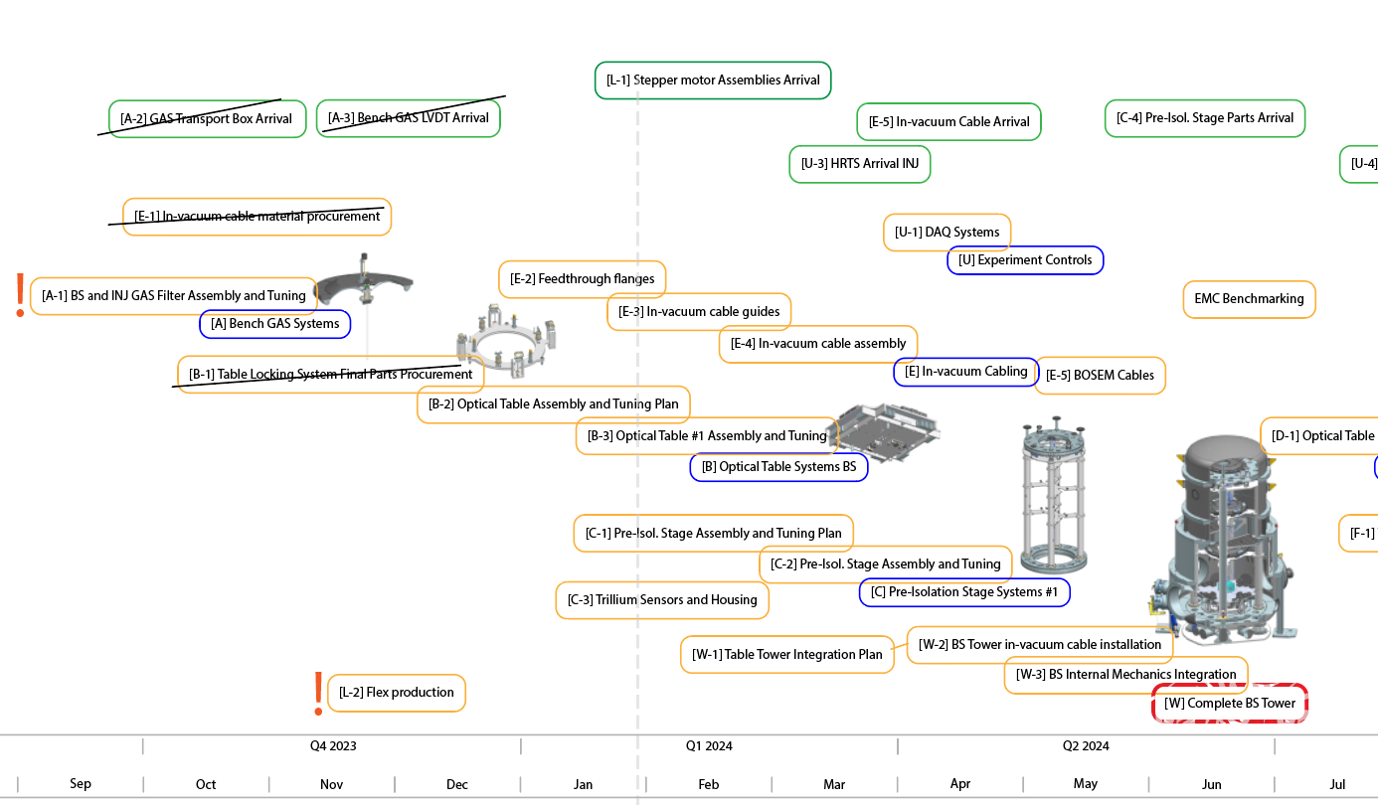
Are the stars aligned?
In addition to the roadmap topics:
Dummy Baseplate and IP Feet
Custom hoisting tool
Optical components
Assembly tooling
Scaffolding sufficient?
Power distribution
(Partial) DAQ?
Control schemes?
Etc.
Etc..
Input appreciated!

Slide 10
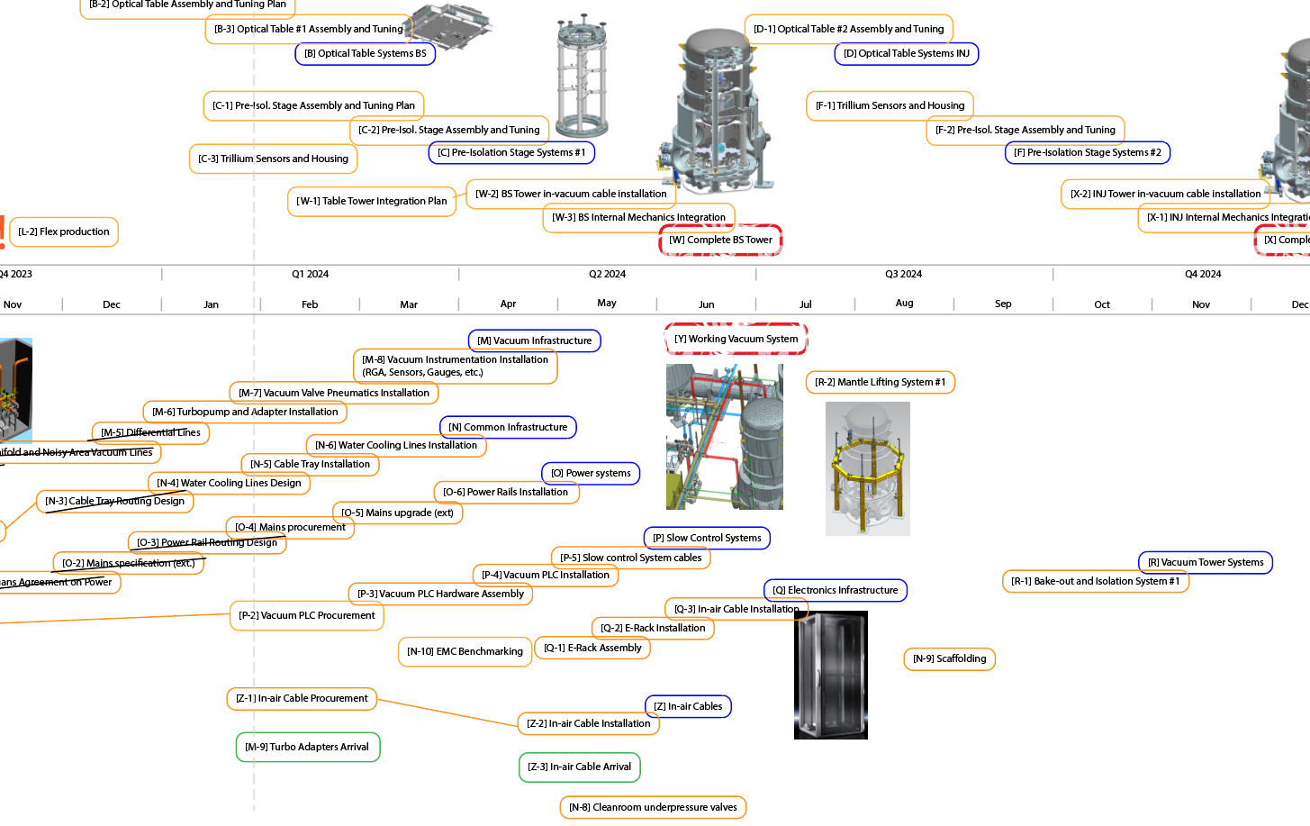
The road ahead
For 2024:
Focus on the commissioning of the first Bench Tower by June/July. Fingers crossed for 2 Bench Towers?
Finish all infrastructure-related topics.

Slide 11
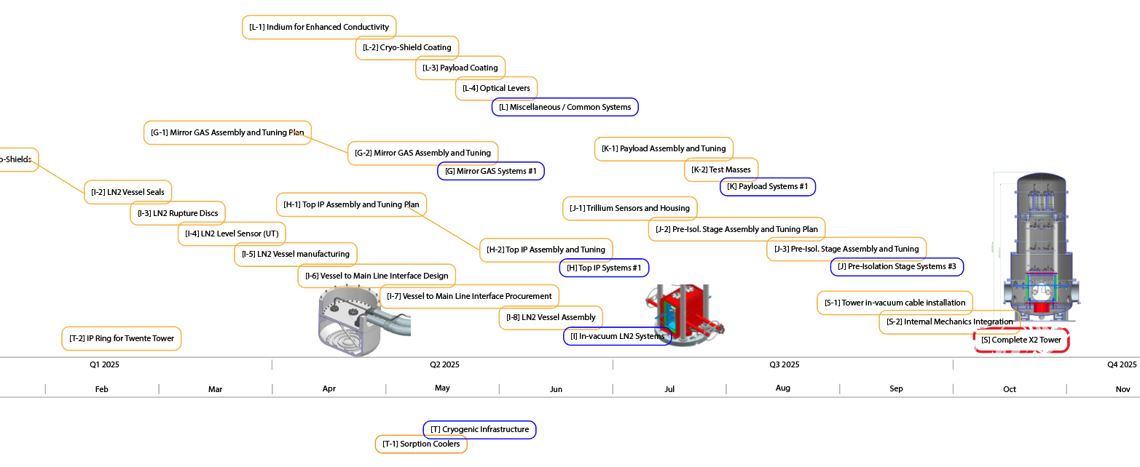
The road ahead
For 2025 and onward:
Mirror tower commissioning focus
Chances to pull some cryogenics work to 2024 with the help from IFAE?

Slide 12
Questions

Slide 13
Open items
LVDTs and Actuators. Timeline?
In-vacuum cables
Populating optical table in or outside tower? When?
HRTS suspensions. When?
Vacuum system
Lifting system
Vacuum controls
Venting system
Baking and isolation
Gate valves cleanliness dispute
Auxiliary systems
Cable trays
Power distribution
Cooling system
Compressed air
Signal cabling: in-air cables, E-racks, patch panels, stress relief
Logistics
Shipping container outside DUB30?
Room for storage inside ETpf cleanroom?
Who
UAntwerp?
UM?
UCLouvain?
UAntwerp?
KIT
Nikhef
Nikhef
Nikhef

Slide 14
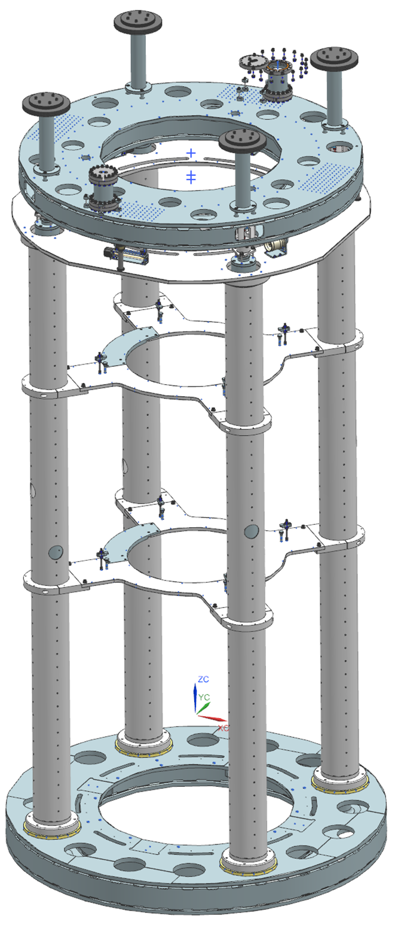
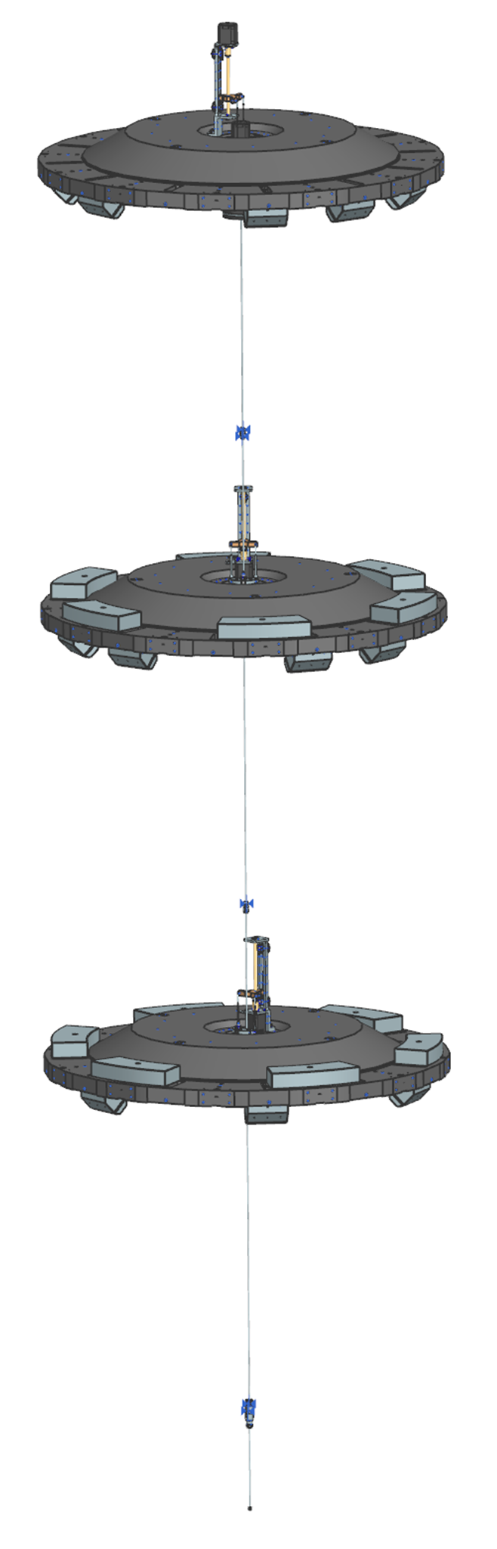
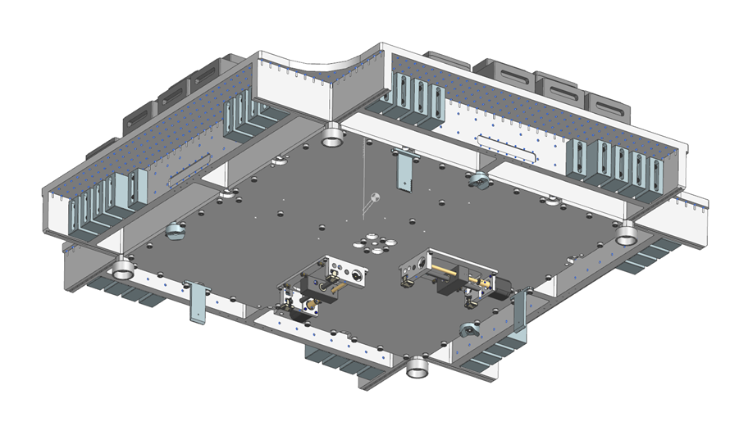
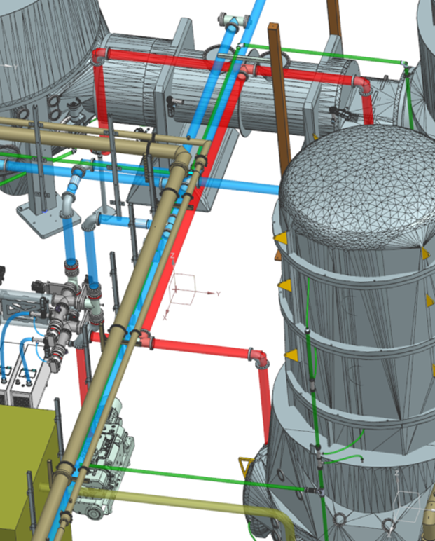
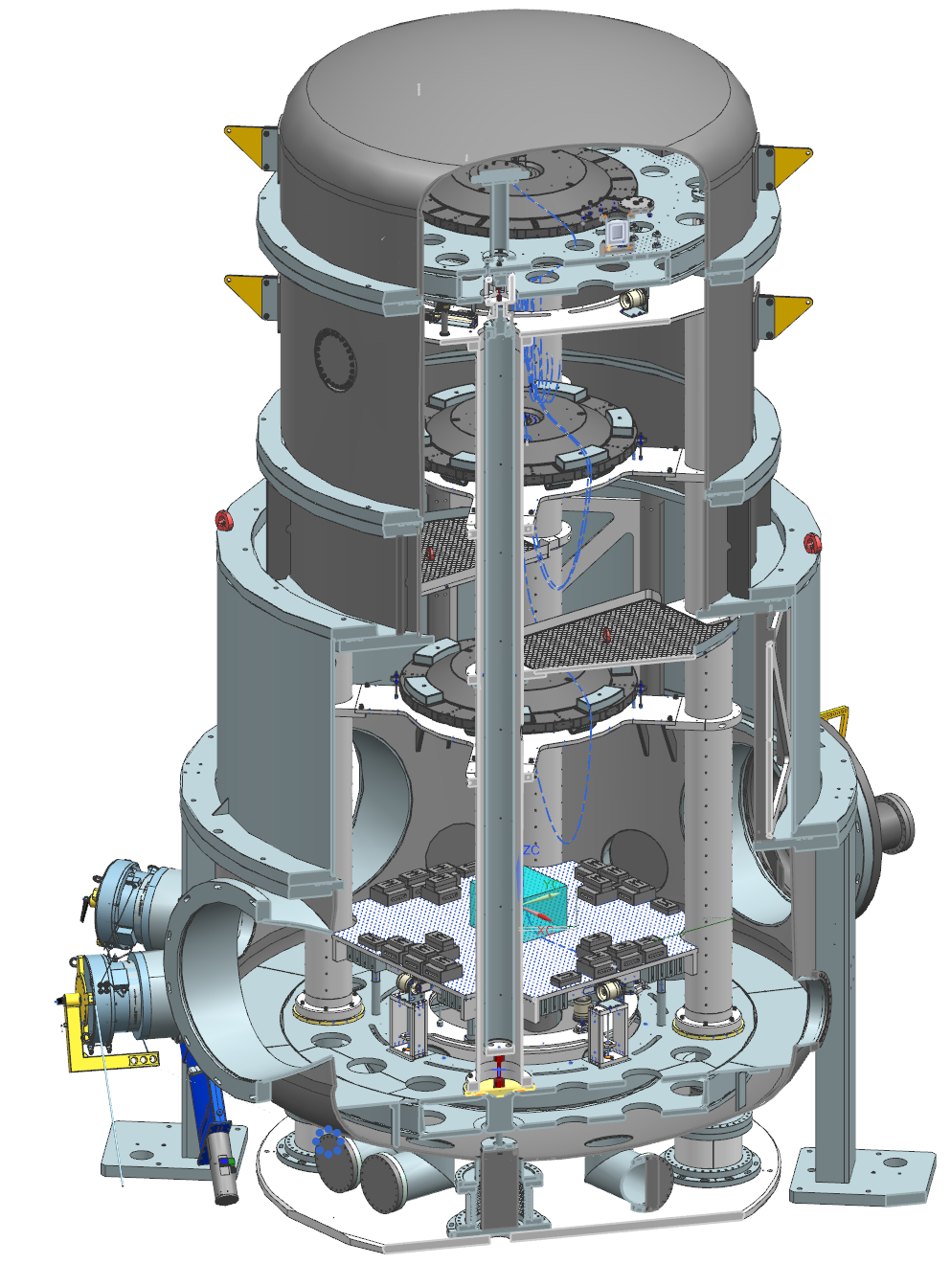
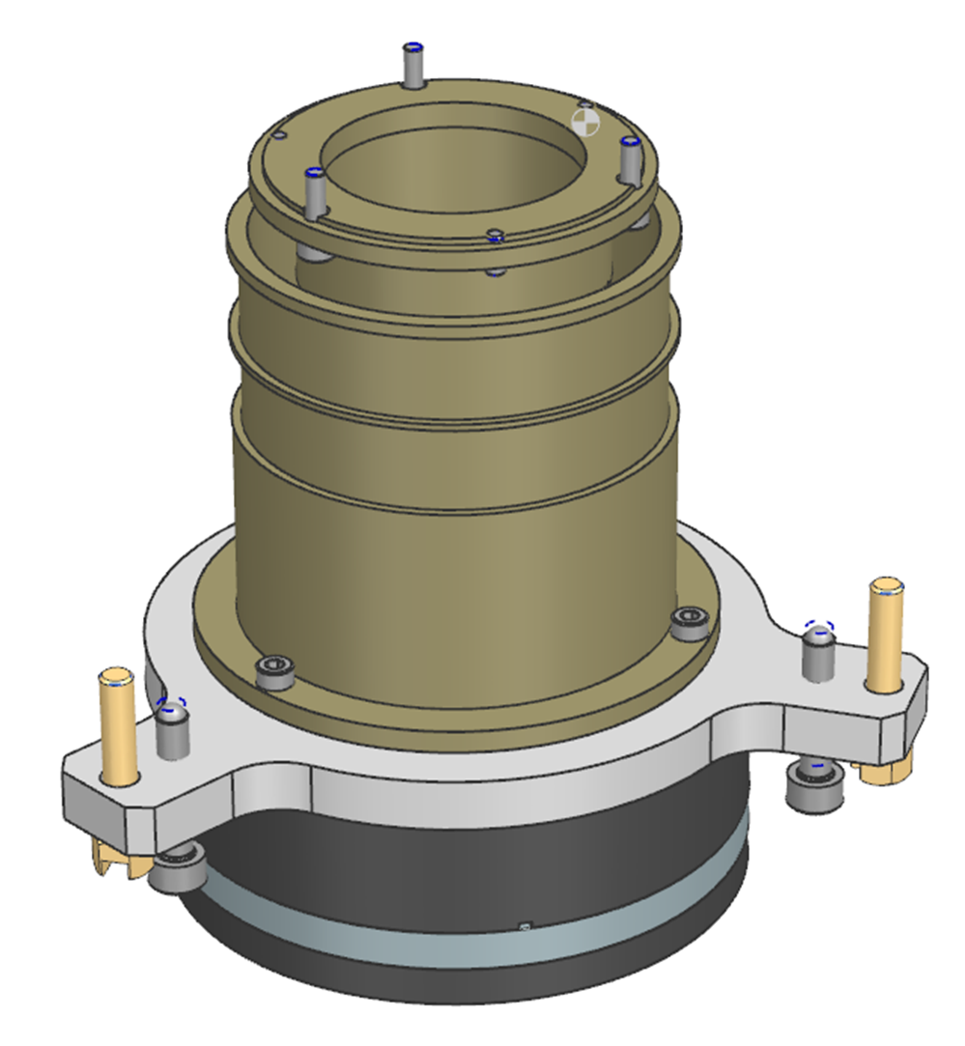
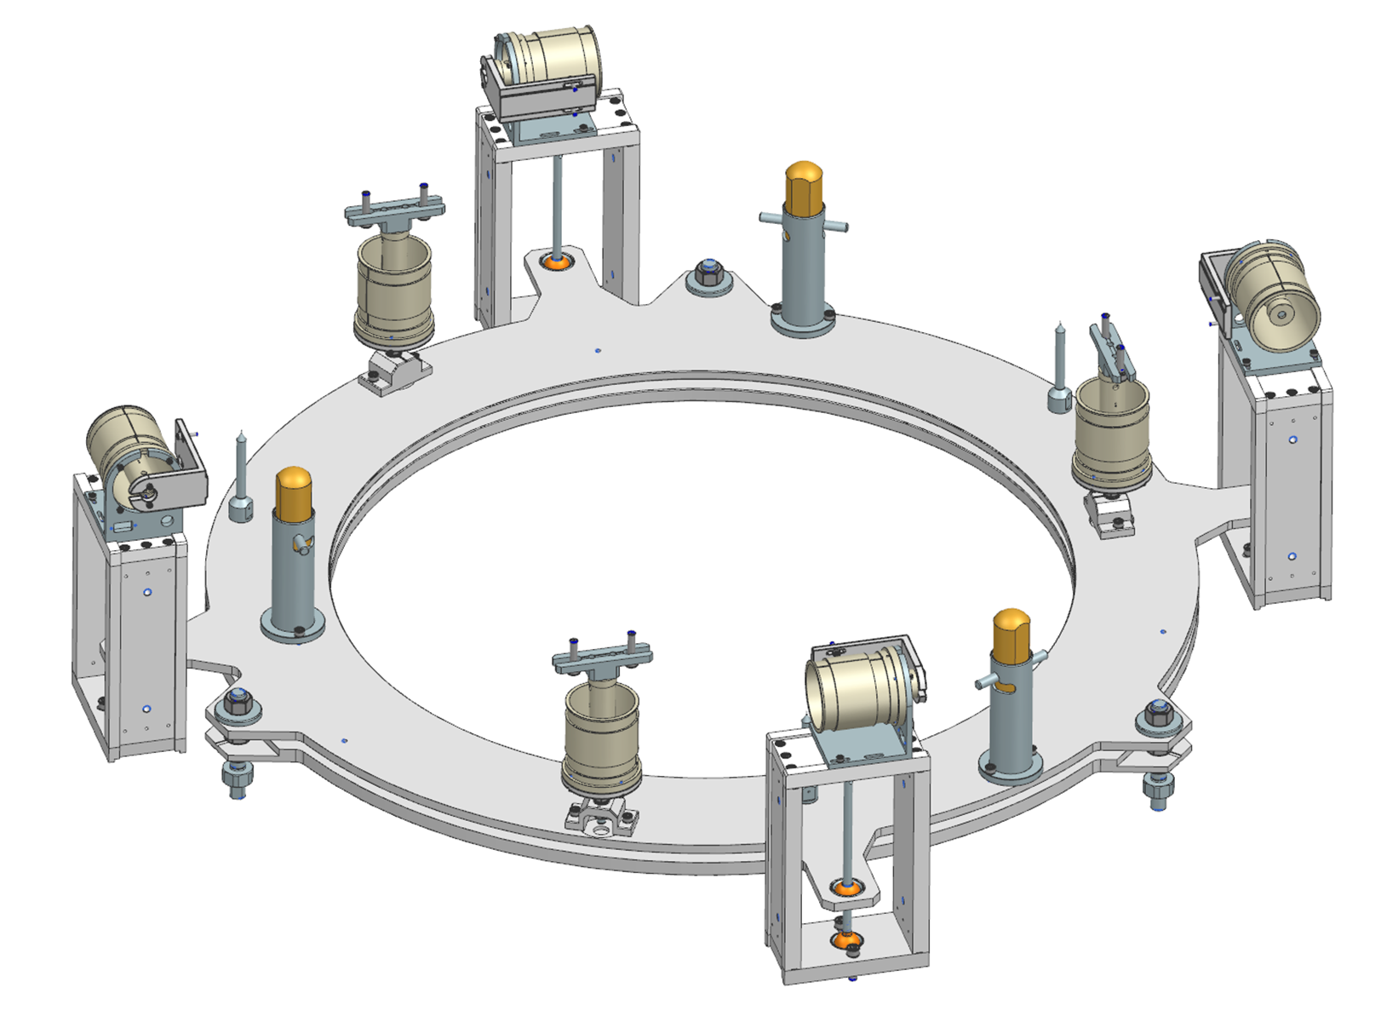
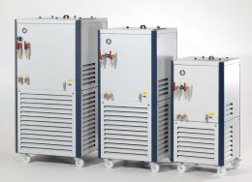
Planning 2023
Clean parts in
In-vacuum cabling in
LN2 SAT
More open items …
LVDTs and actuators in
Water cooling
Vacuum infrastructure
Fasteners in

