Slide 1
LepCol QUAD-Pix Design Concept Type K (O-rings)
A. Korporaal – Nikhef Amsterdam

Slide 2
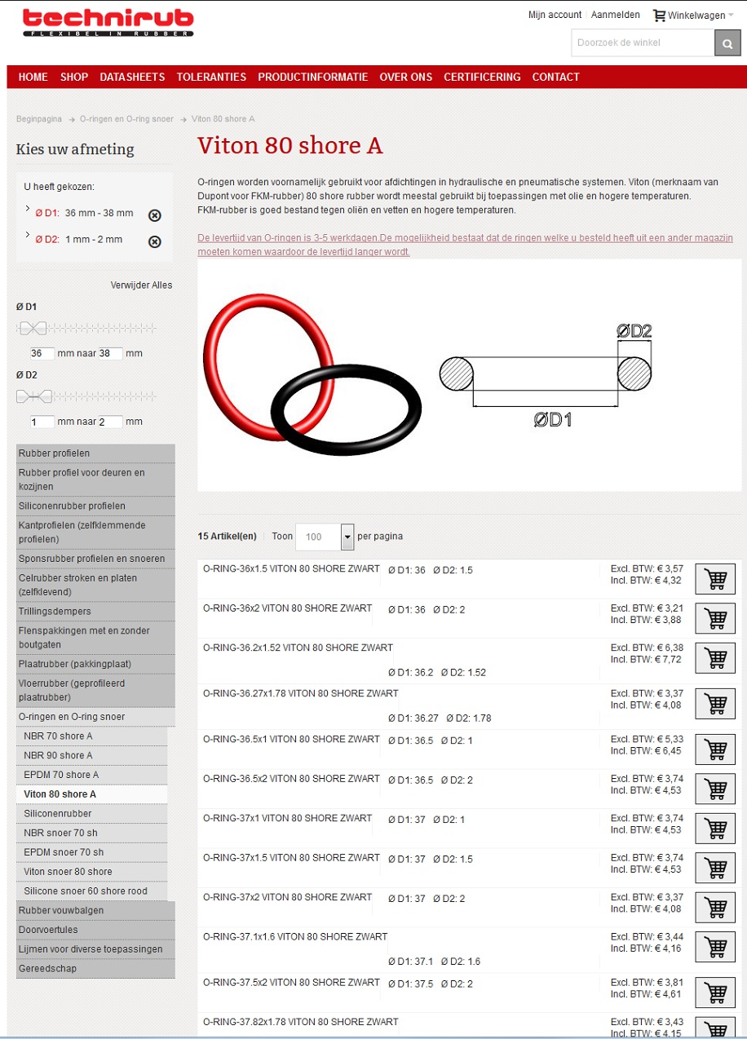
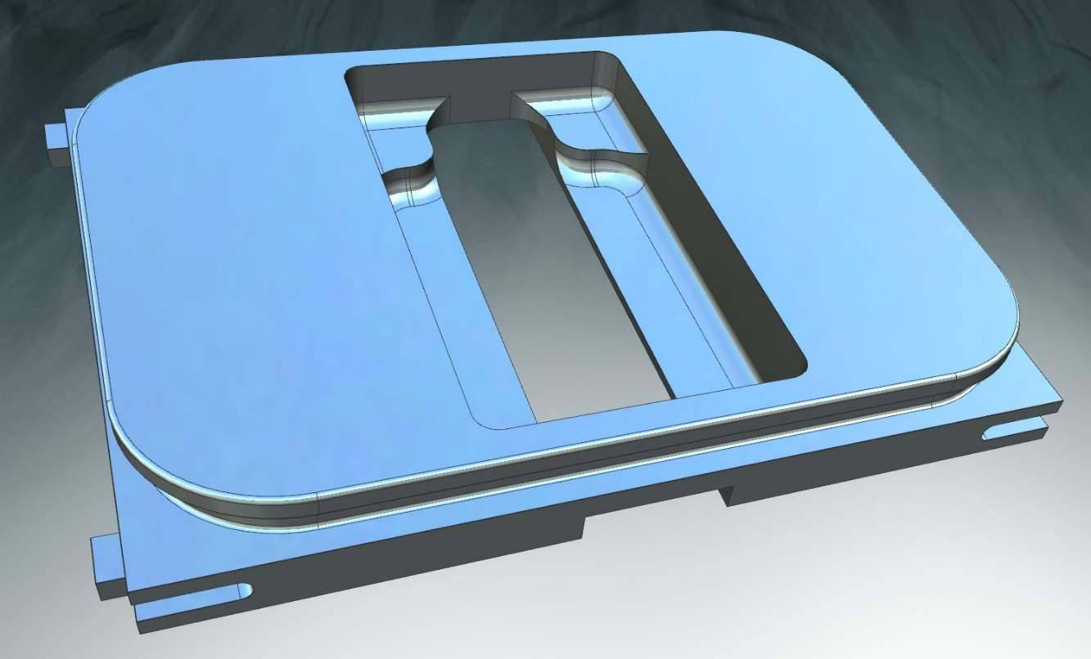
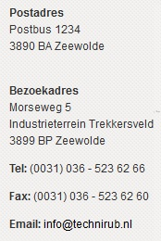
Quad TPX-3 Type K Main Ass’y (007989_A)
Cold carrier Type K (006098)

Slide 3
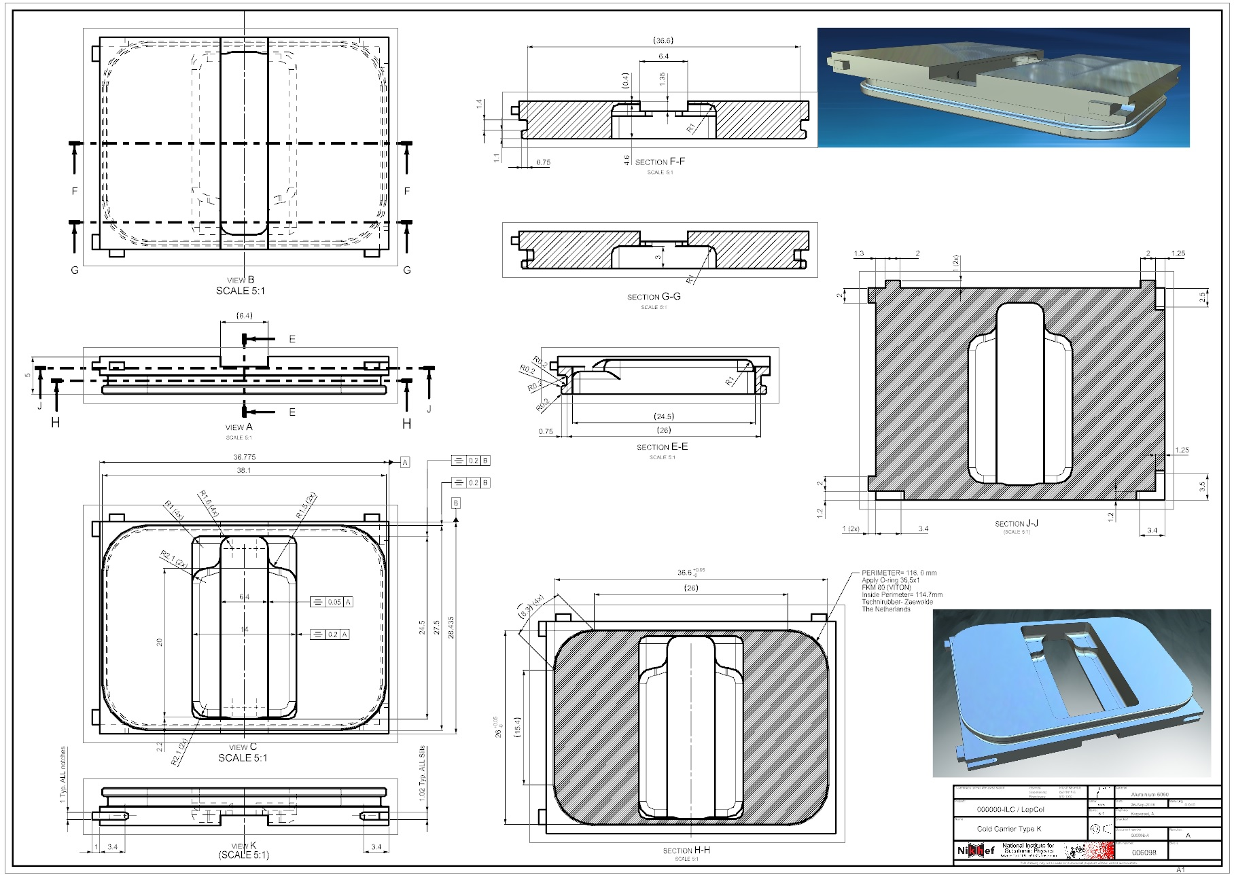
Quad TPX-3 Type K Main Ass’y (007989_A)
Cold carrier Type K (006098)

Slide 4
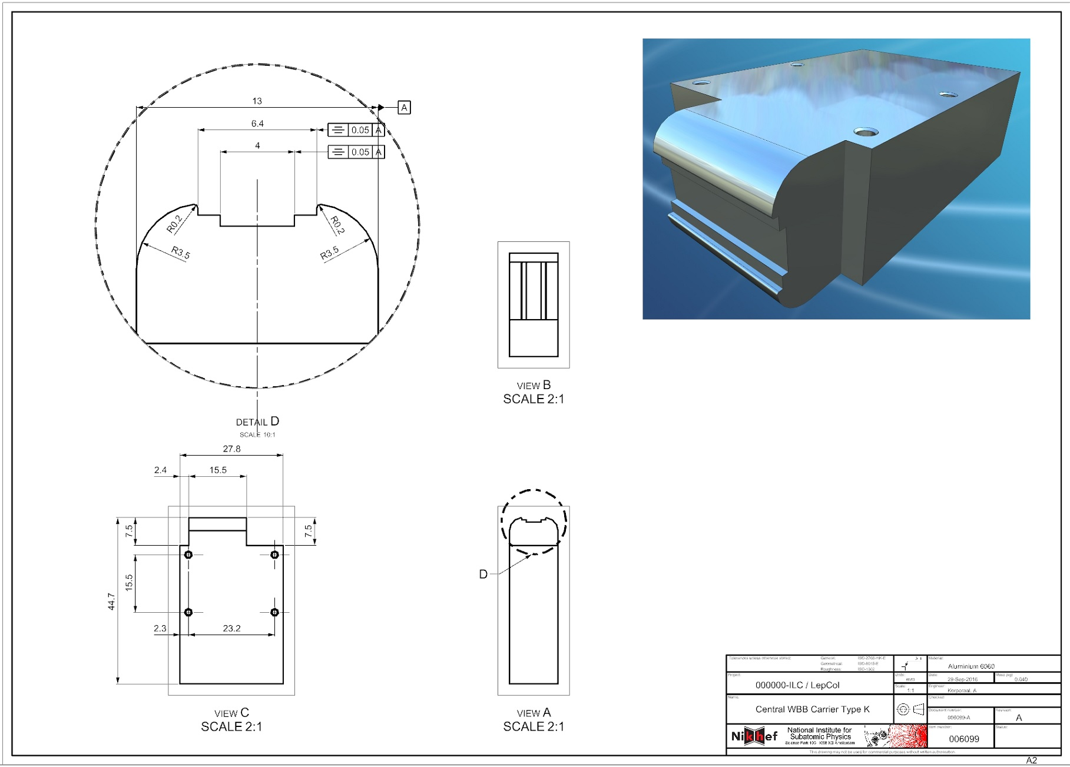
Quad TPX-3 Type K Main Ass’y (007989_A)
Central WBB carrier Type K (006099)

Slide 5
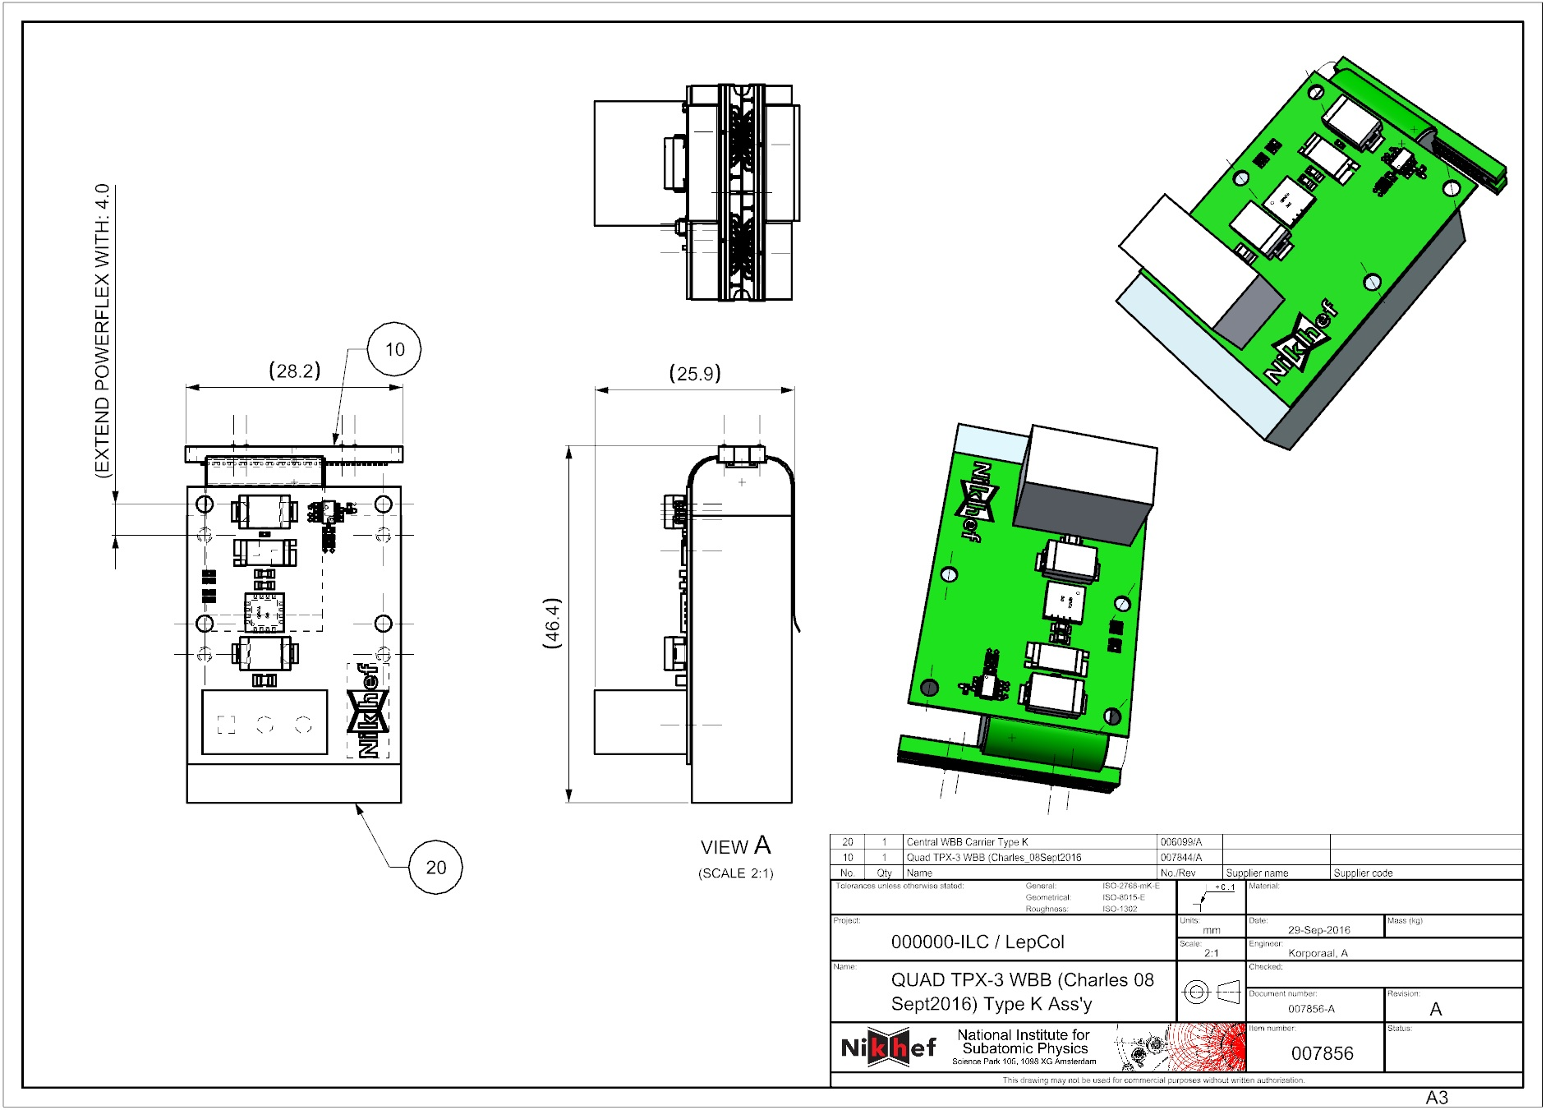
Quad TPX-3 Type K Main Ass’y (007989_A)
QUAD TPX-3 WBB Type K Ass’y (007856)

Slide 6
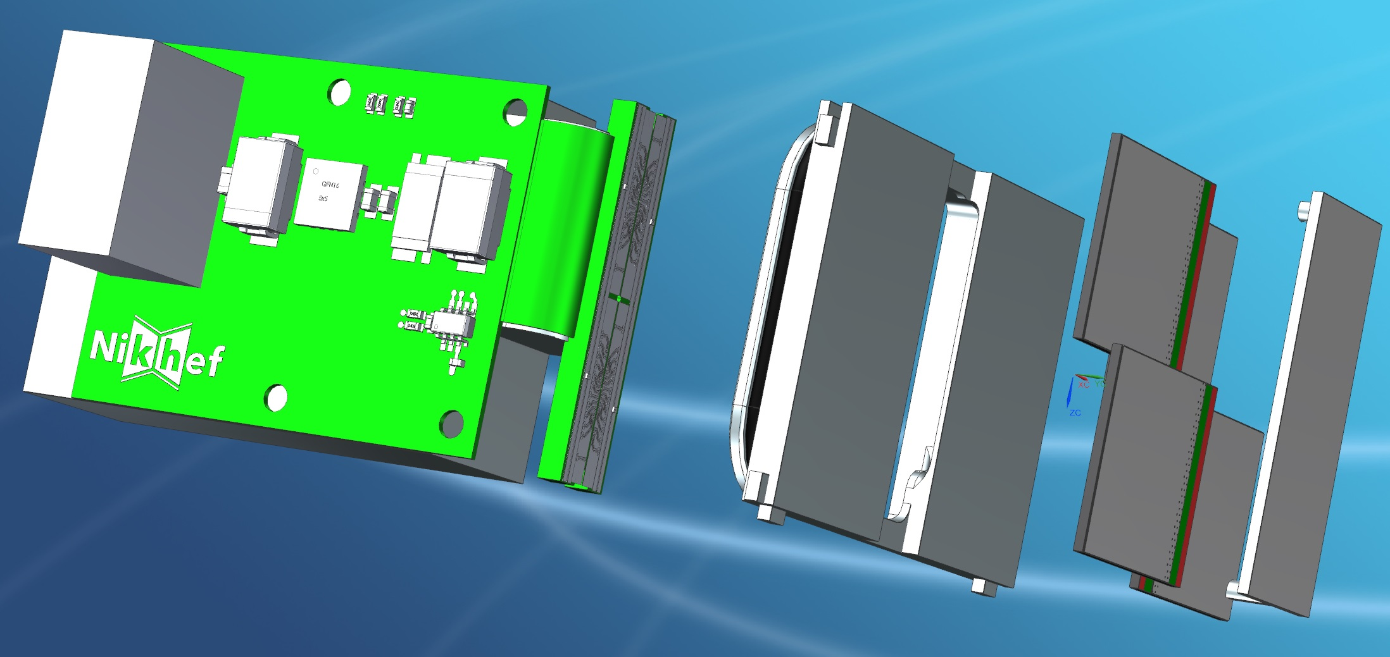
Quad TPX-3 Type K Main Ass’y (007989_A)
QUAD TPX-3 Type K Ass’y (006097)

Slide 7
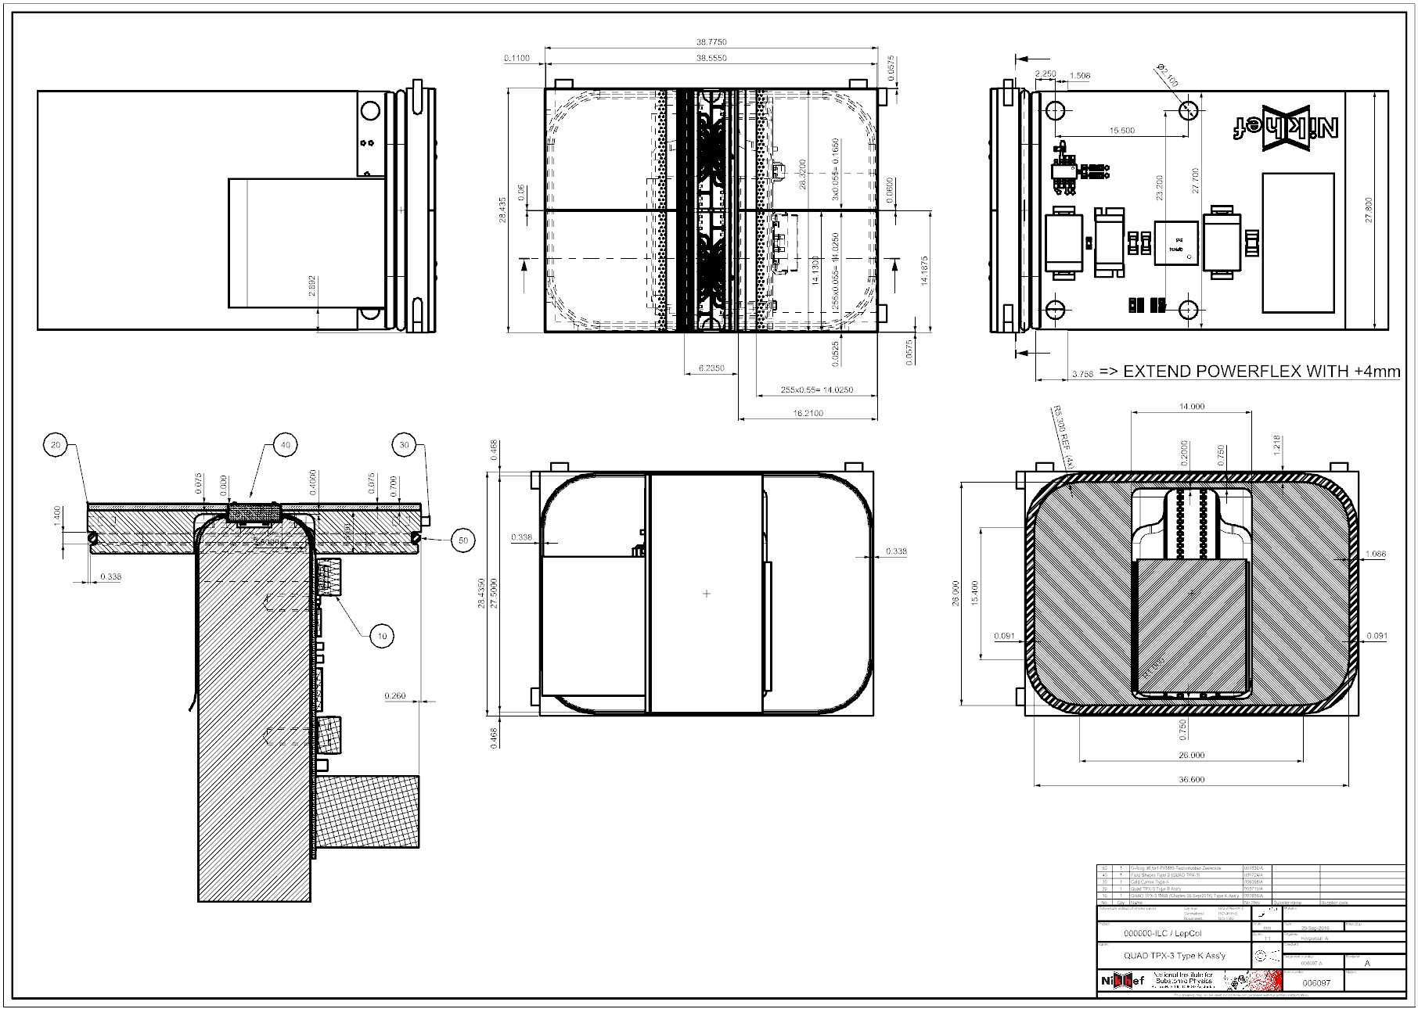
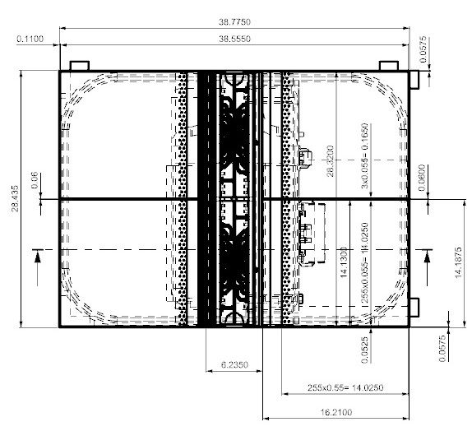
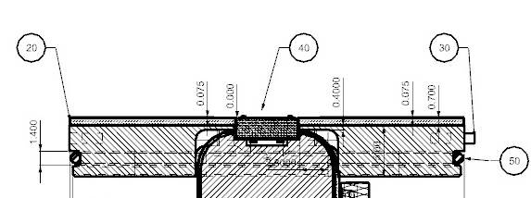
Quad TPX-3 Type K Main Ass’y (007989_A)
QUAD TPX-3 Type K Ass’y (006097)

Slide 8
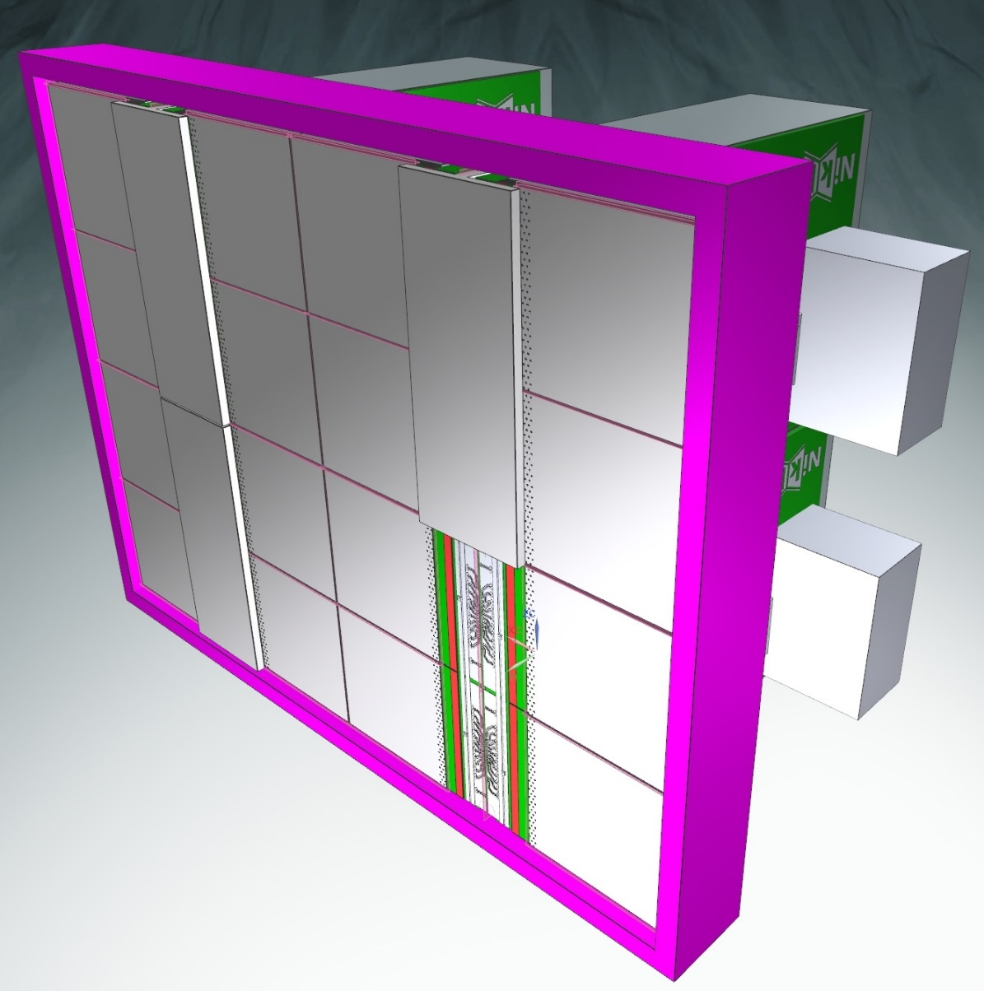
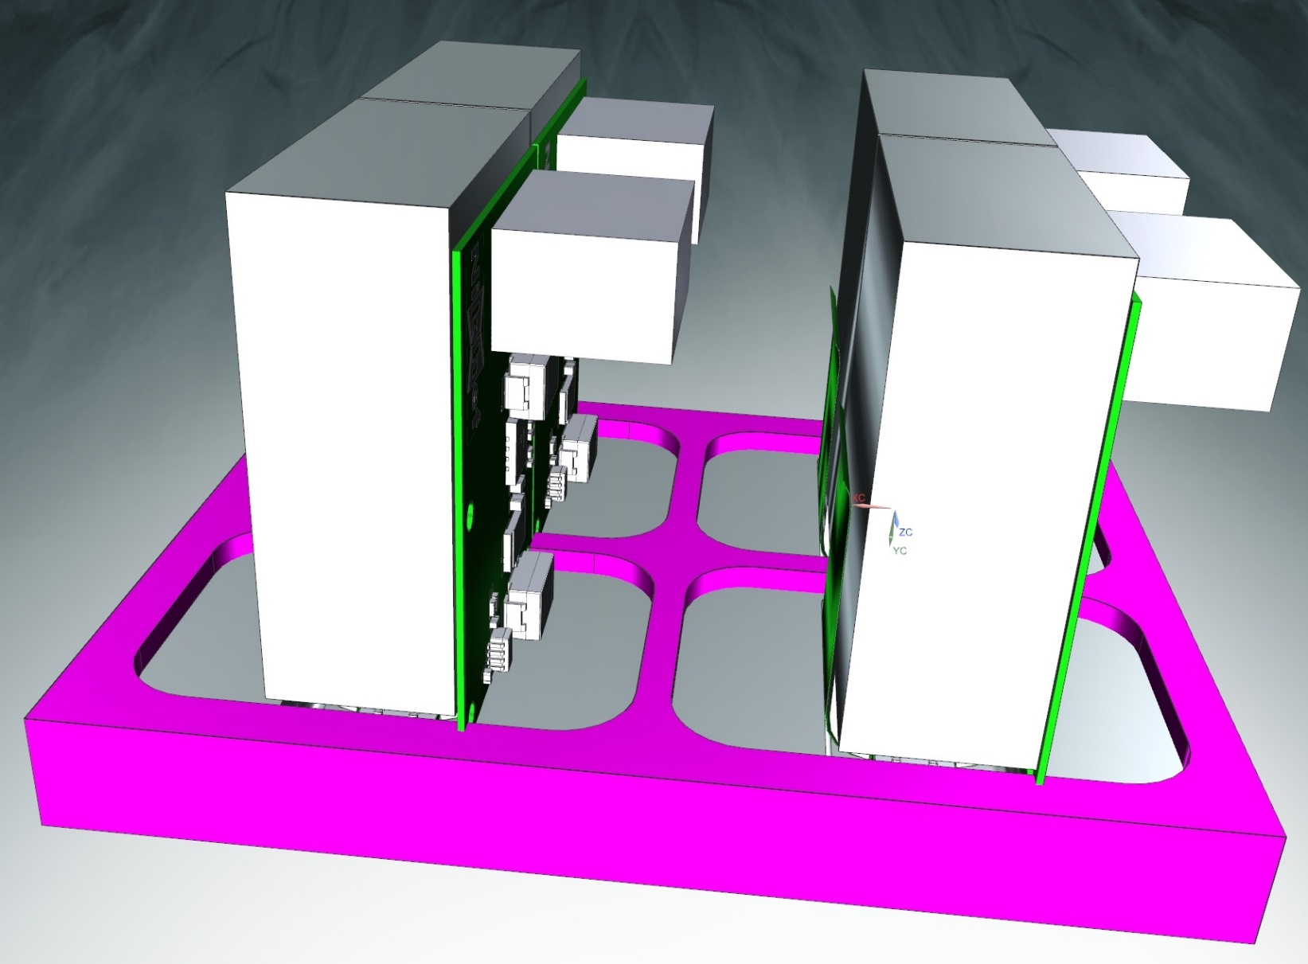
Quad TPX-3 Type K Main Ass’y (007989_A)
2x2 Matrix QUAD TPX-3 Type K Ass’y (007989)

Slide 9
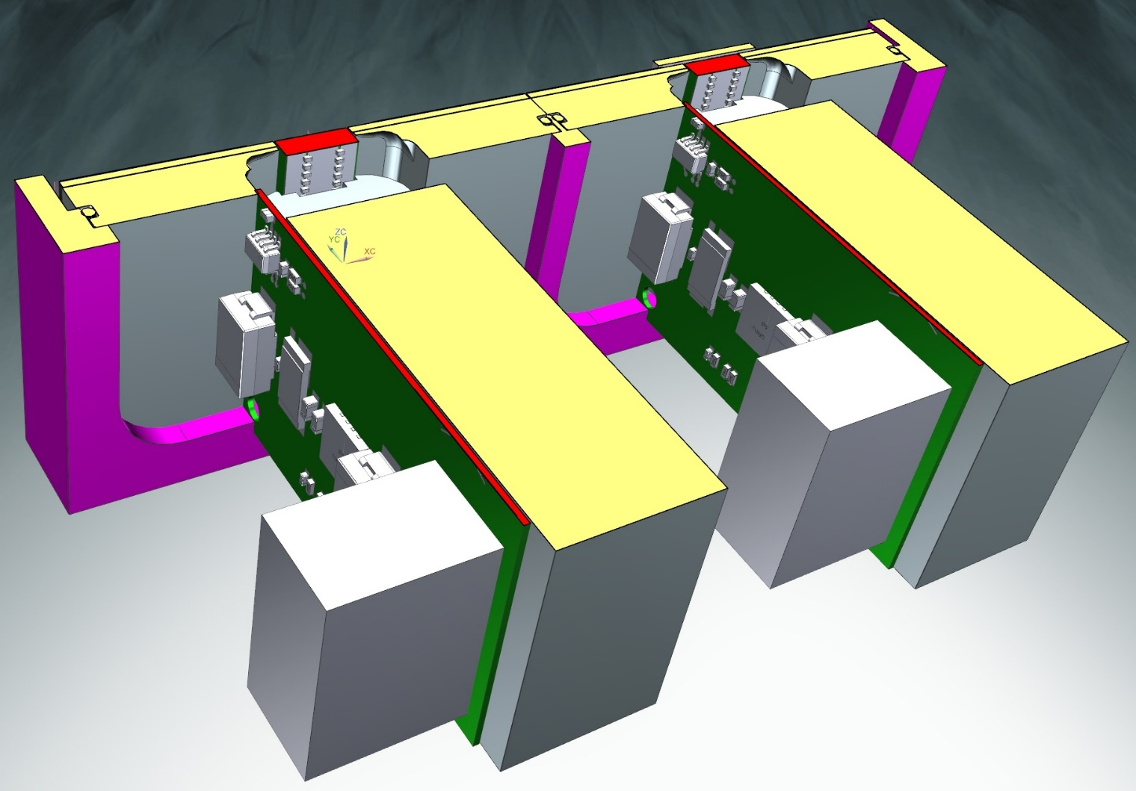
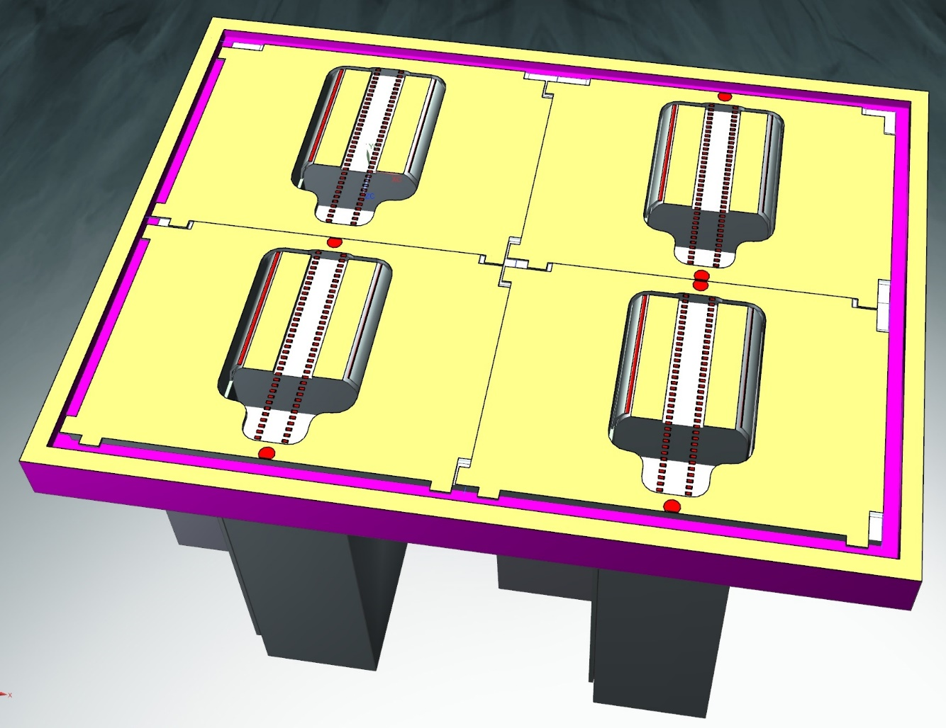
Quad TPX-3 Type K Main Ass’y (007989_A)
2x2 Matrix QUAD TPX-3 Type K Ass’y (007989)

Slide 10
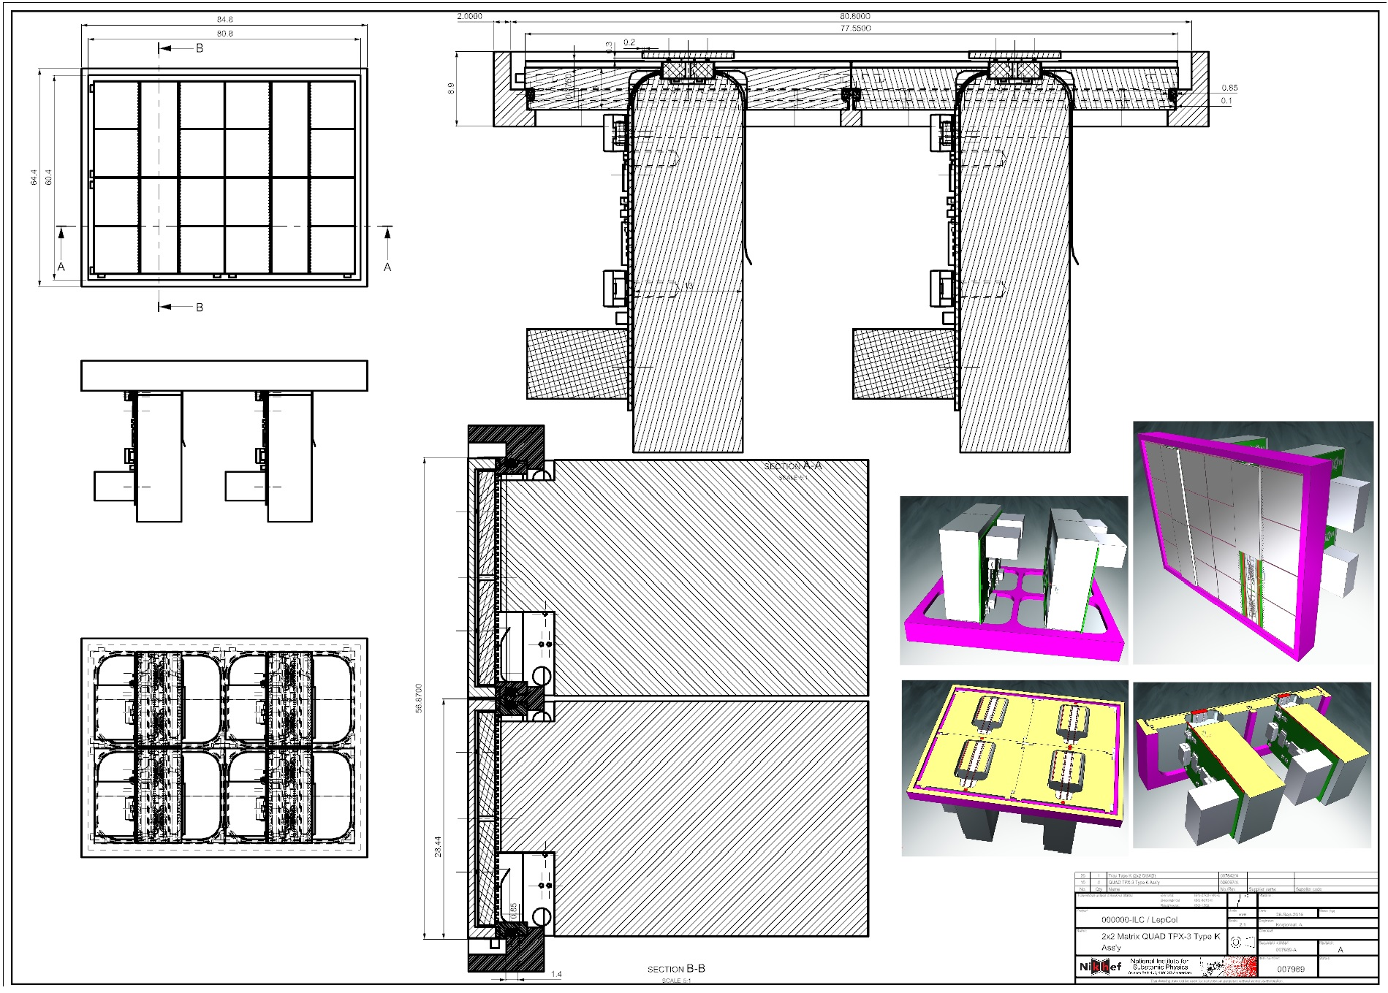
Quad TPX-3 Type K Main Ass’y (007989_A)
QUAD TPX-3 Type K Ass’y (007989)

Slide 11
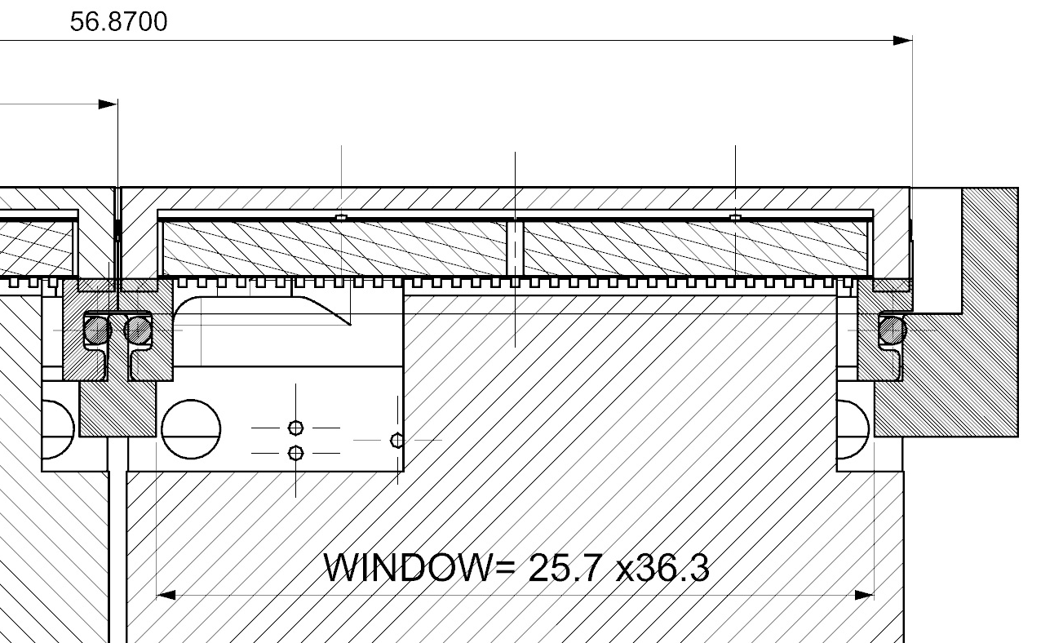
Quad TPX-3 Type K Main Ass’y (007989_A)
QUAD TPX-3 Type K Ass’y (007989)
!

