Slide 1
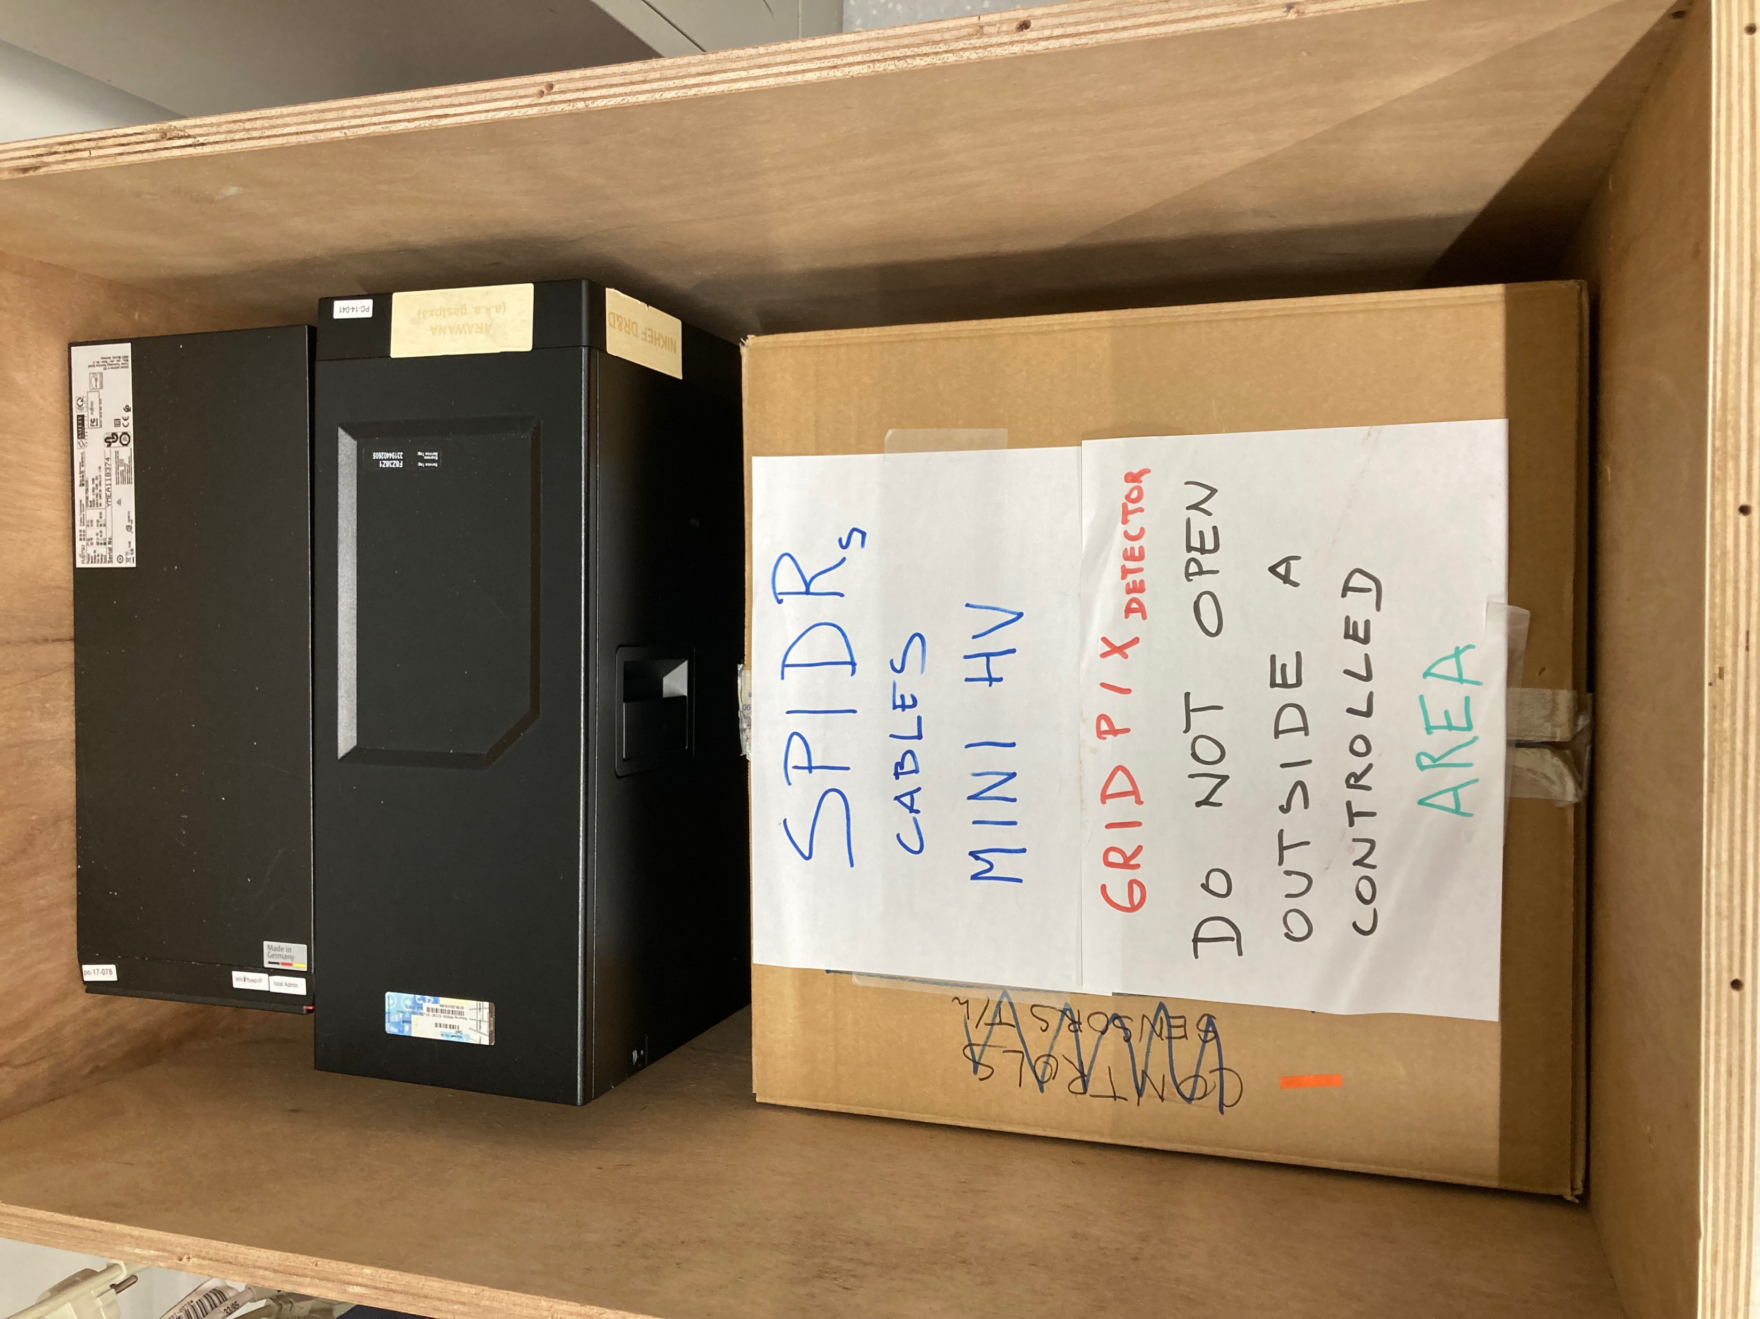
GridPix Detector for EIC
In the end we decide to send the quad detector plus SPIDR to the US for experimental tests (not the 32 chip module). It took a very very long time – up to December 2023 - to get all the US paper work sorted out.
Photograph of what is inside the box

Slide 2
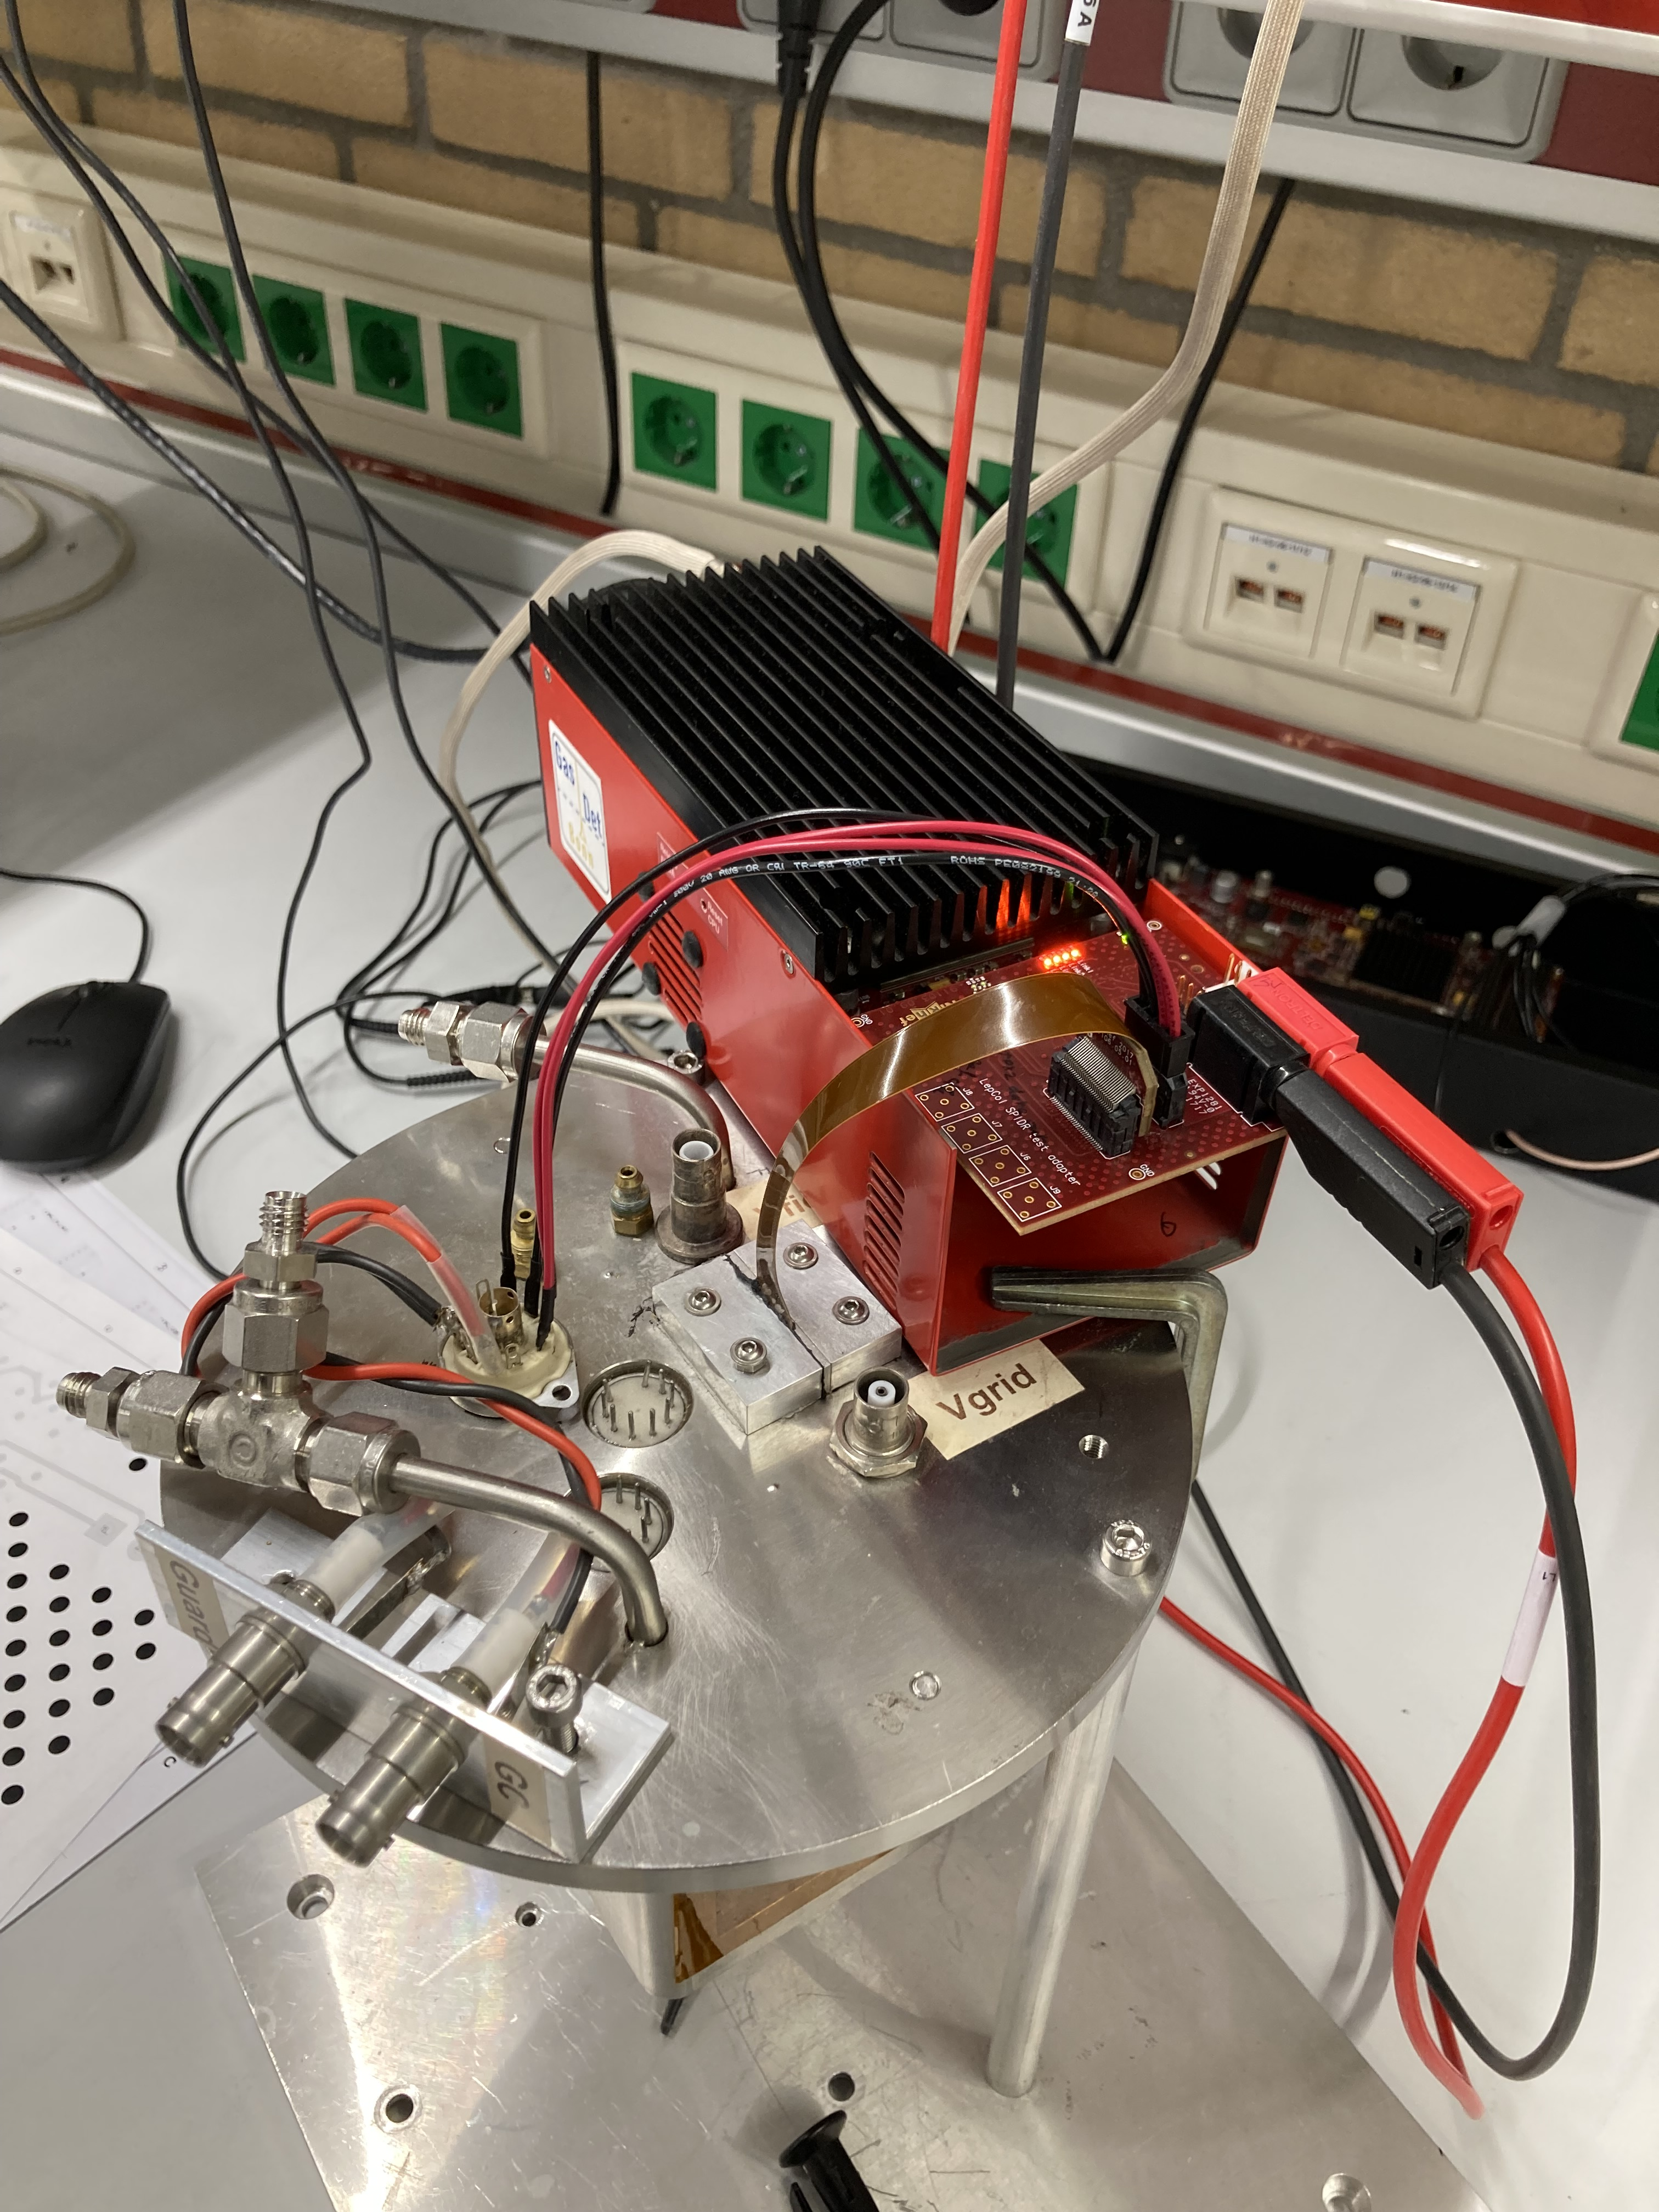
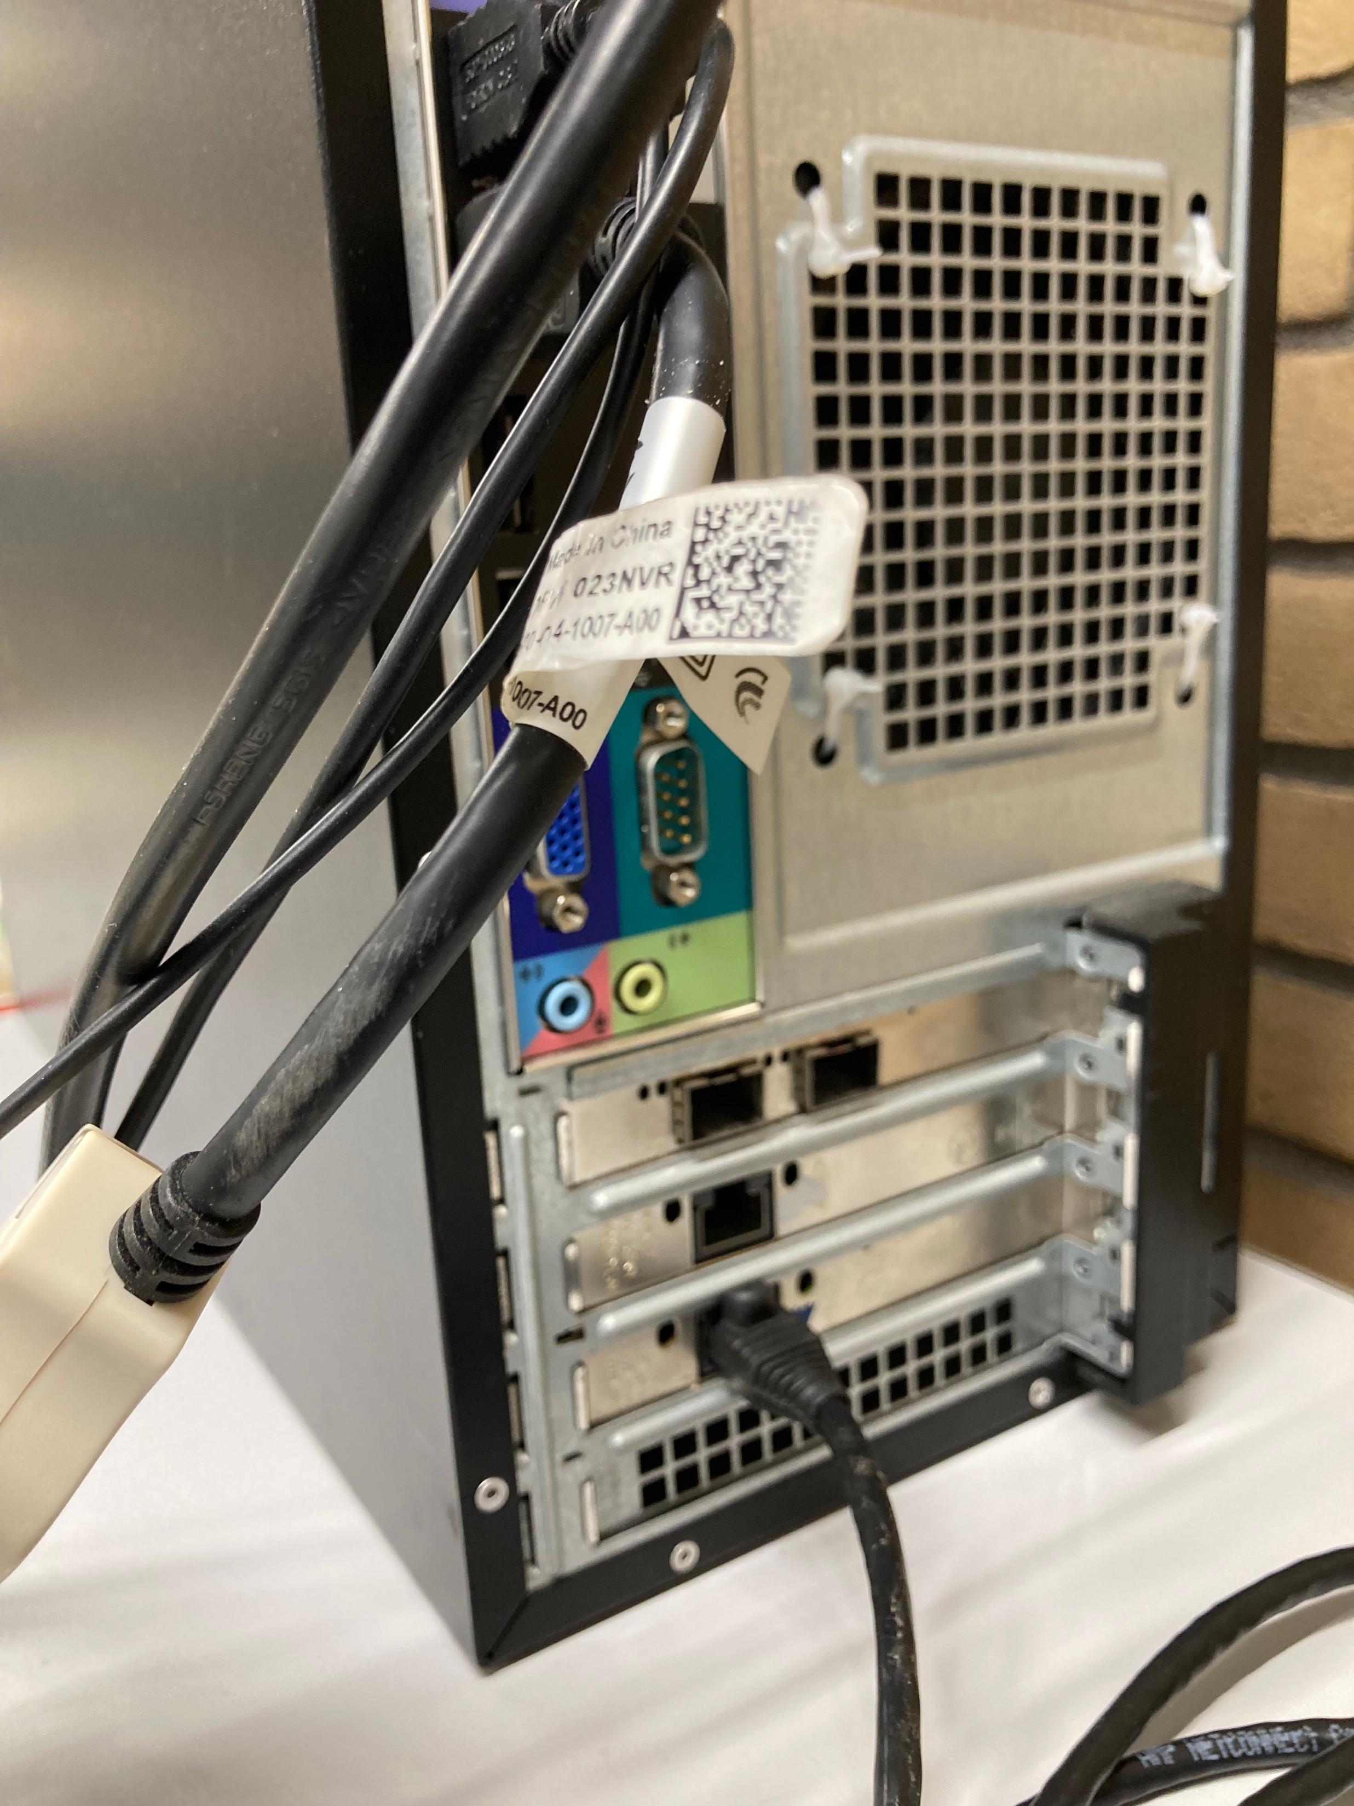
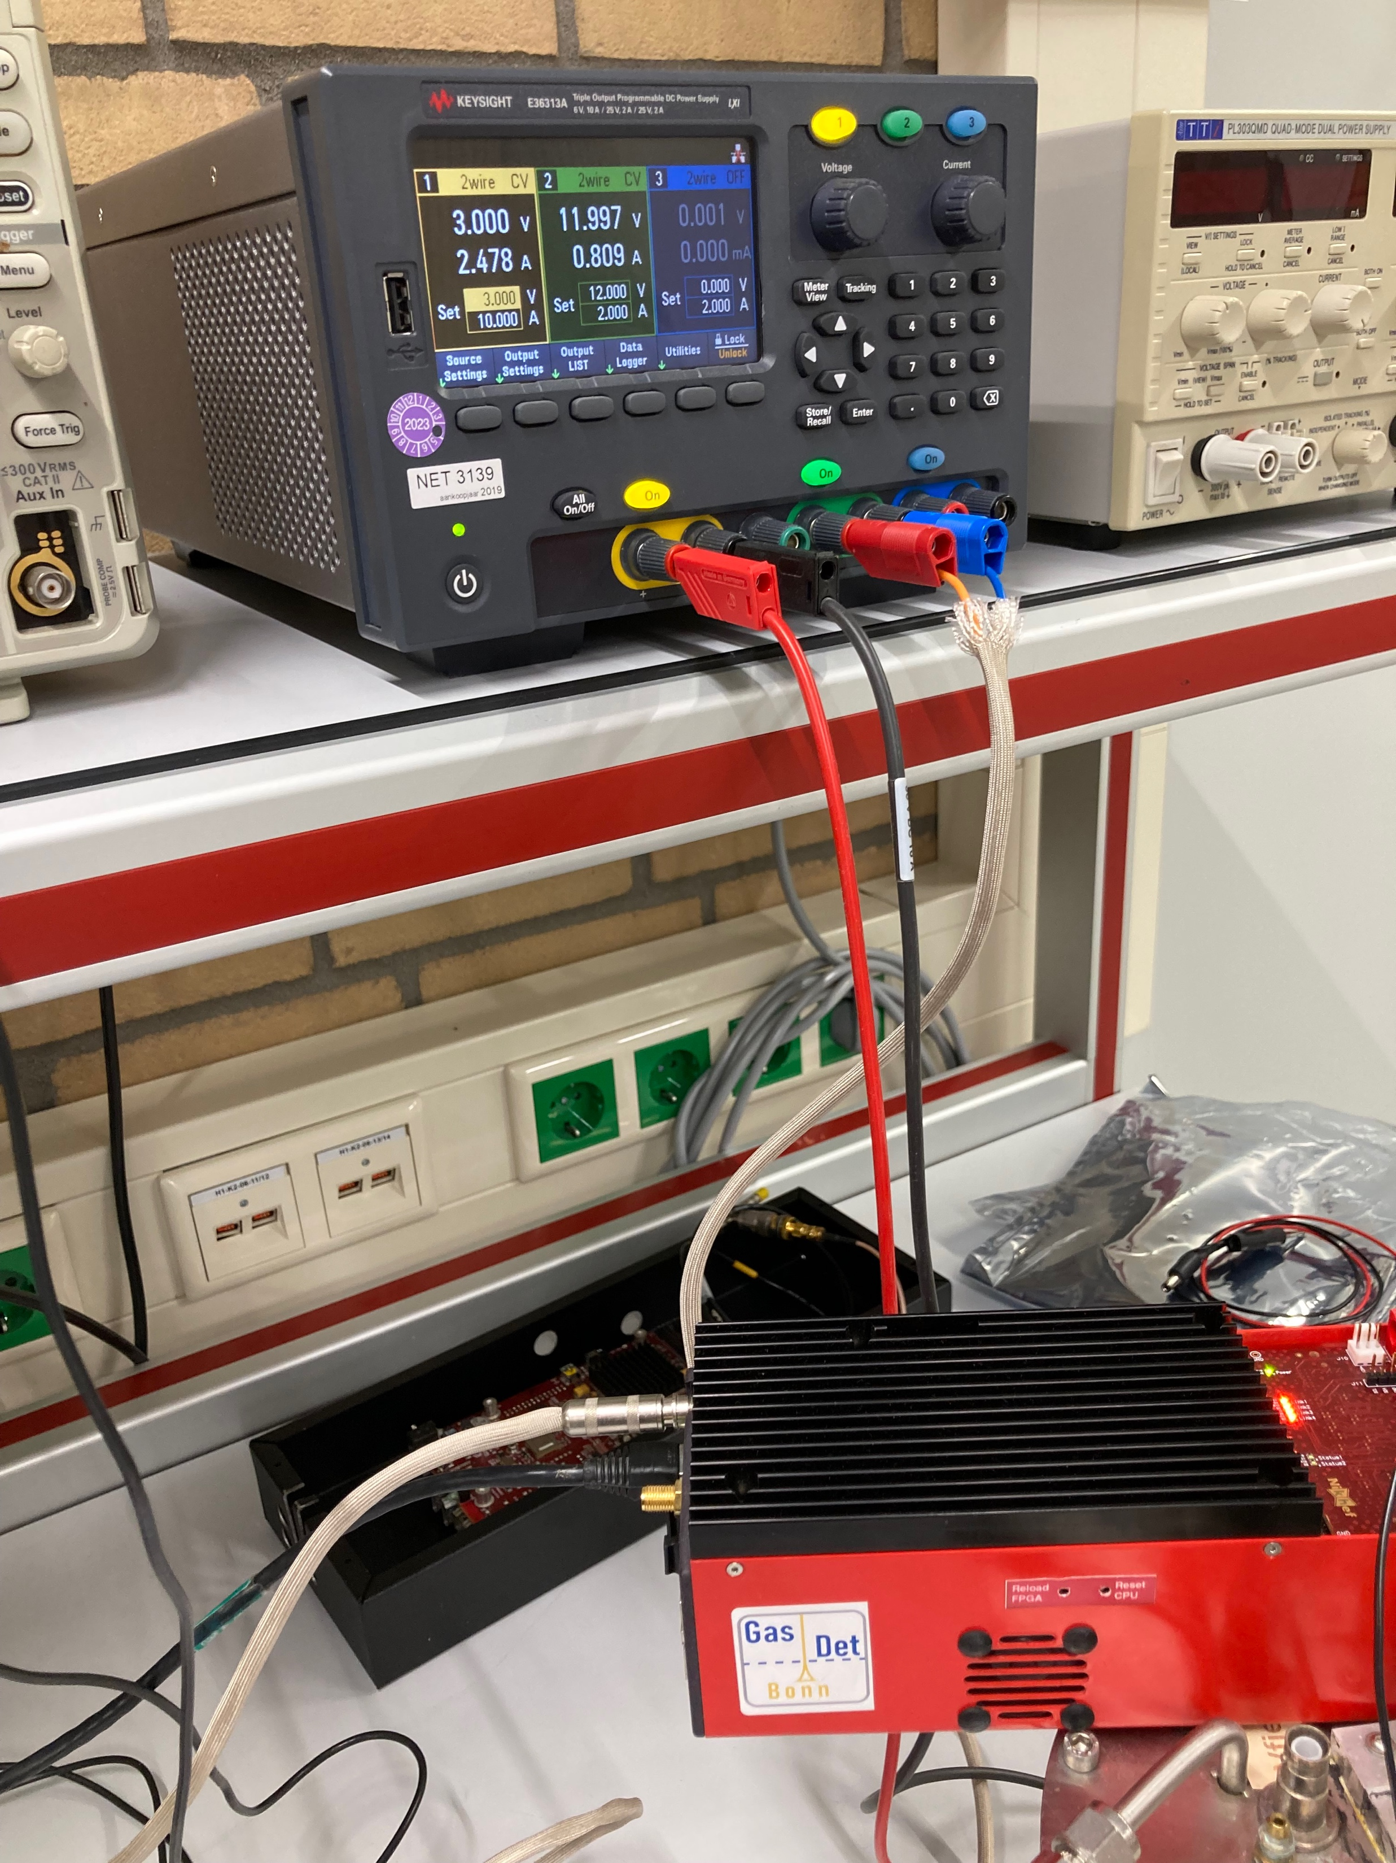
Preparing the quad
Power SPDR with connection to detector (rb)
Arawana back side: one ethernet cable for the data
Power SPDR 12V and 3 V for board

Slide 3
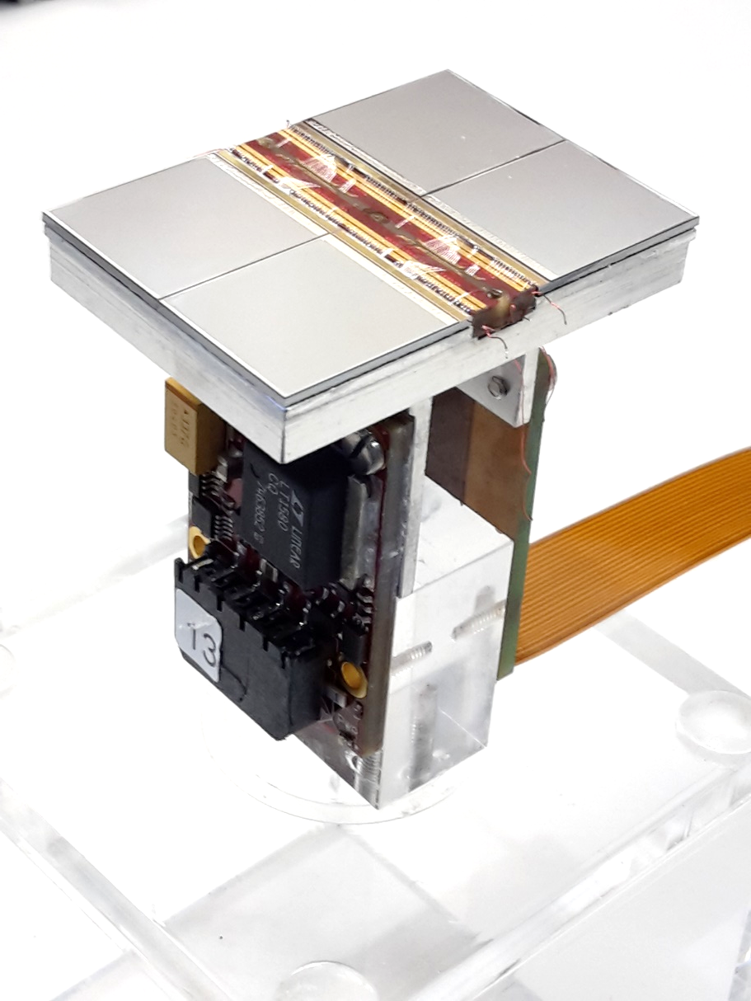
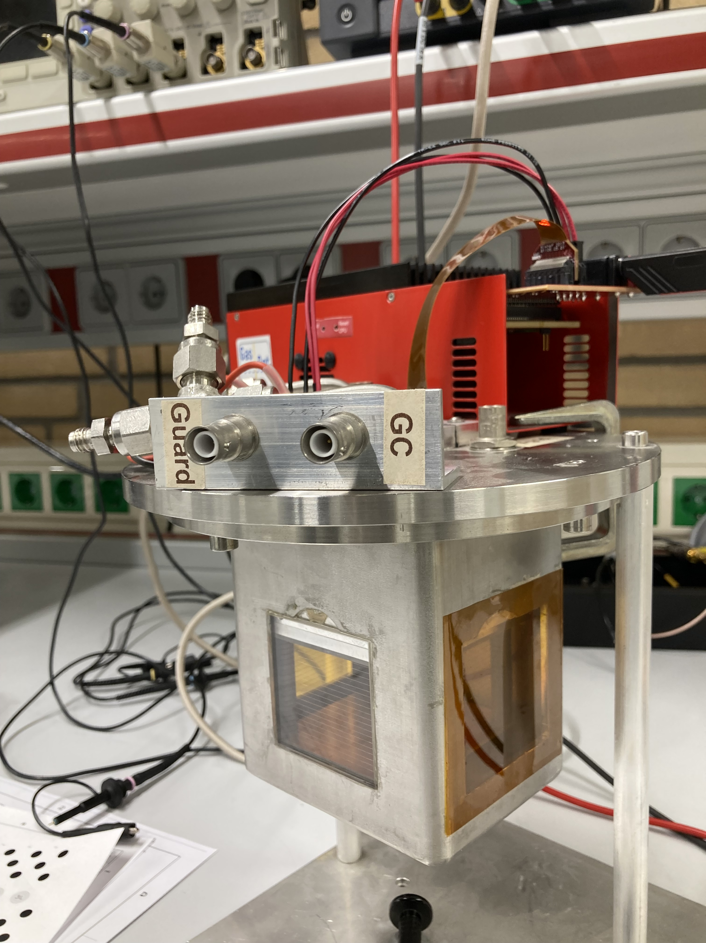
Preparing the quad
Flex to quad
BR c
Gas in/out
HV Grid/Field/Guard
Cooling in/out
Field cage with wires
and quad

Slide 4
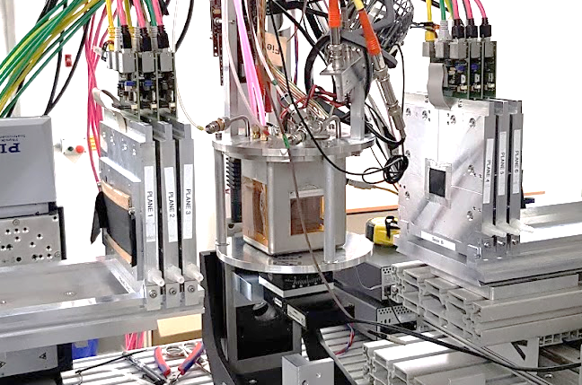
Preparing the quad

Slide 5
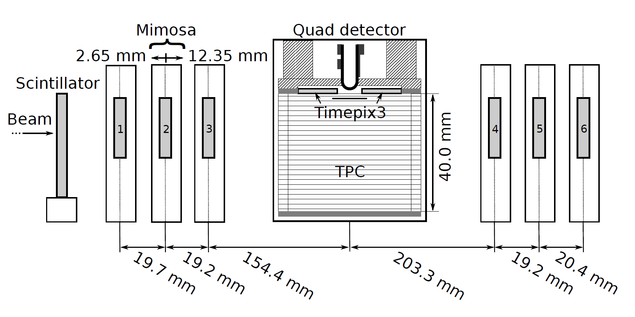

QUAD test beam in Bonn (October 2018)
ELSA: 2.5 GeV electrons
Tracks referenced by Mimosa telescope
QUAD sandwiched between Mimosa planes
  Largely improved track definition
  6 planes with 18.4 μm × 18.4 μm sized pixels
Gas: Ar/CF₄/iC₄H₁₀ 95/3/2 (T2K)
E_{d} = 400 V/cm, V_{grid} = -330 V
Typical beam height above the chip: ~1 cm
Published NIMA https://doi.org/10.1016/j.nima.2019.163331
@Bonn
Field cage

Slide 6
Preparing the trigger
Concerning the trigger signal and the time stamp.
A trigger signal should be provided to the SPDR.
A time stamp packet is injected in the data stream of chip 0.

Slide 7
Running the DAQ for the quad
Starting point is /home/gastpx
A file runQuad.mes gives the instructions/commands
Data files are written to directories per chip
/localstore2/TPX3/DATA/CHIP0/Run*. CHIP1/ CHIP2/ and CHIP3/
Log files are written to
/localstore2/TPX3/DATA/LOGFILES
Currently Noise/Test runs are written to
/localstore2/TPX3/DATA/CHIP*/Run1111

Slide 8
Testing the Chips and SPDR
Commands to test the quad and prepare for data taking
Switch ON power: > spidrtpxpower 192.168.1.10 1
> spidrreset 192.168.1.10
> spidrinfo 192.168.1.10 gives back
SPIDR : COMPACT-V3 for TPX3
Firmware : 220126 14:30 SVN-9999
Software : 20112014
FPGA Temp : 44.172 C
Power Temp : 69.500 C
Humidity : 31 %
Pressure : 1012 mbar
Fan speeds : 0, 0 RPM
Startup opts: 7FFFFFFE (TPX3: power OFF, readout FAST)
Chipboard ID: 42000002 = TPX3-Quad-LC
(NB: subsequent data may be from chipboard, not from SPIDR,
e.g. from TPX3-single, MPX3-quad, TPX3-quad-LC or VPX)
###getAvdd(): Error from SPIDR: ERR_MON_HARDW, SPIDR_ERR_I2C (0x8009)
Power VDD : 1.540 V 2279.0 mA 3506 mW
Bias volts : 24 V
Local Temp : 50.000 C
###getRemoteTemp(): Error from SPIDR: ERR_MON_HARDW, (0x9)
ADC chans : 612 651 630 627
** IMPORTANT Power VDD : 1.540 V (1.5 V)
Local Temp : 50.000 C NEEDS Cooling!!

Slide 9
Testing the Chips and SPDR
Commands to test the quad and prepare for data taking
// get info on device 0 1 2 3
> spidrtpxinfo 192.168.1.10 0
Device 0 ID : 0x1797 (W0023_G09)
LinkStat SPIDR: enabled=01, locked=01
Link speed : 80 Mb/s
GeneralConfig : 00000001 => POLARITY-EMIN, ACQMODE-TOA-TOT, TESTPULSE-DISA, SELECTTP-ANALOG, SELECTTP-INTERNAL
OutBlockConfig: 00009C01 => OUTPORT_MASK=01, CLK-SRC-20-40, 8B10B-ENA, CLK-FAST-OUT-ENA, CLKOUT-SRC-20-40
PllConfig : 0000001E => PLL-ON, PLL-RUN, VCNTRL-PLL, DUAL-EDGE-CLK, PHASESHIFT-DIV-8, PHASESHIFT-NR-1, PLLOUT-CONFIG=0
SlvsConfig : 00000018 => SLVS-TXCURRENT=8, SLVS-TERMINATION=1
PwrPulseConfig: 00000018
DACs:
Ibias_Preamp_ON: 128
Ibias_Preamp_OFF: 8
VPreamp_NCAS: 128
Ibias_Ikrum: 128
Vfbk: 128
Vthreshold_fine: 256
Vthreshold_coarse: 8
Ibias_DiscS1_ON: 128
Ibias_DiscS1_OFF: 8
Ibias_DiscS2_ON: 128
Ibias_DiscS2_OFF: 8
Ibias_PixelDAC: 128
Ibias_TPbufferIn: 128
Ibias_TPbufferOut: 128
Vtp_coarse: 128
Vtp_fine: 256
Ibias_CP_PLL: 128
Pll_Vcntrl: 128

Slide 10
Testing the Chips and SPDR
Commands to test the quad and prepare for data taking
> spidrchipidsReadFuse 192.168.1.10
SPIDR DeviceCount=4
ChipIDs:
1797 0: W0023_G09
179A 1: W0023_J09
17A7 2: W0023_G10
176B 3: W0023_K06
Switch off power: > spidrtpxpower 192.168.1.10 0

Slide 11
Running the DAQ for the quad
The goal of the noise run is to verify the stability of the DAQ and to mask new noisy channels before data taking.
Before performing a run the detector should be switched on
spidrtpxpower 192.168.1.10 1
Cleanup the (noise run) files
rm –f /localstore2/TPX3/DATA/CHIP*/Run1111/*
// run command for 10 secs data (is enough)
// This code is ran /localstore/TPX3/spidr3-software/Telescope/DAQ/Tpx3daq.cpp
Tpx3daq_concentrator -s -r 1111 -i 1 -m -t 10
// ls -lrt /localstore2/TPX3/DATA/LOGFILES
// the file location /localstore2/TPX3/DATA/CHIP*/Run1111/
// the file name are "W - date - time - run - nr.dat"

Slide 12
Noise runs
Ntuple production start a new terminal (cannot mix the setups for ntuple production and A run/ B analysis):
cd /home/gastpx
source init_laser_setup_software.sh
you are in /localstore/TPX3/laser_setup_software
// run the ntuple production
// compile code: make make_tree
// run on all four chips
./make_tree -r 1111 -c 0 -c 1 -c 2 -c 3
//a rootfile is made under /localstore/TPX3/laser_setup_software/run1111.root
root -l run1111.root
// histograms are booked
// and trees triggers/count timestamp hits_chip0/ (123) col row toa tot

Slide 13
Example Data run
Ntuple production start a new terminal (cannot mix the setups for ntuple production and A run/ B analysis):
cd /home/gastpx
source init_laser_setup_software.sh
you are in /localstore/TPX3/laser_setup_software
// Testbeam 2018 // under /localstore2/TPX3/LOGFILES are instructions and Logbook
// Also the data of Run650 is copied /localstore2/TPX3/DATA/CHIP0/Run650 etc up to CHIP3
//
// Note in make_tree that nMaxPackets = 100000000
// one can edit make_tree.cpp end do make make_tree
//
./make_tree -r 650 -c 0 -c 1 -c 2 -c 3
// output with triggers and TPX3 chip data
root -l run650.root

Slide 14
Mask and Trim for Noise runs
C Analyse Ntuple start a new terminal (cannot mix the setups for ntuple production and A run/ B analysis):
cd /home/gastpx
cd /localstore/TPX3/laser_setup_software
root -l
> .L MaskAndTrim.C++
> MaskAndTrim t
> t.LoopM()
edit MaskAndTrim.h to run on both concentrators
name = "/localstore2/TPX3/ROOT/run1111_0.root";
name = "/localstore2/TPX3/ROOT/run1111_1.root";
// this code masks pixels and updates all the 32 W*_trimdacs.txt files
In order to use the new trimdacs: cp -rf W*.txt /localstore/TPX3/localCONFIGS/Module/EIC/.
Then redo A take noise data, B make ntuple, C analyse and mask pixels
NB: for DESY we did not have to update trimdacs anymore.
WORKS FOR MODULE
Code should be updated

Slide 15
Diagnostics from Noise runs
Often one needs several iterations for masking after the equalisation procedure.
It is likely that the current setting of the masks is fine
B) One can see DAQ problems in the running (e.g. time outs etc.)
C) The analysis can show not so apparent problems
  High ToT values indicate a badly running chip
  A high rate 200 hits/ pixel with almost all channels firing
  The most likely cause is that some some dacs were not loaded properly. In the LOGFILE of the run this could be indicated that some problems occurred for this chip.
  HOWEVER it happens that everything looks OK (stored values are OK), but still the dac data is corrupted. SOLUTION: First just rerun again (up to say three times) if not working do a spidr reset and take a new noise run
WORKS FOR MODULE

Slide 16
Diagnostics from Noise runs
Example of noise runs with dac offset of 55 counts
/localstore2/TPX3/DATA/LOGFILES/arawana*EIC55.txt
B) Corresponding ntuples
/localstore2/TPX3/ROOT/EIC/run1111_0_EIC55.root
/localstore2/TPX3/ROOT/EIC/run1111_1_EIC55.root
Logfiles /localstore/TPX3/laser_setup_software/make_conc*55_10s.log
C) Output of the mask and trim
Outputfiles /localstore/TPX3/laser_setup_software/conc*_EIC55.log
** also outputs *last* are there that show some problems that are basically fine
Typically we have 1-20 hits per pixel in a run of 10 seconds.
For a window of 1 μs it means 0.1-20 hits per event. This is a very acceptable noise rate. The noise can be easily removed offline by at ToT cut at 8 counts (time 25 nsec).
WORKS FOR MODULE

Slide 17
Diagnostics from Noise/source run
C) In case the detector is fully on with gas and HV one can take a source and take a noise run for a 10-100 seconds
  One can measure the ToT per chip and this is VERY revealing. It shows the full functioning of the detector
  The mean ToT should be similar for all chips
  see next slides from May 2021
The recipe is simple: take a noise run and make the ntuple and use the tree for making plots of the mean ToT (in units of 25 ns).

Slide 18
New Gas envelop
Old gas box
New gas box
May 2021: https://indico.nikhef.nl/event/3124/
Mean ToT
Concentrator 0 chip nr

Slide 19
New Gas envelop
Old gas box
New gas box
May 2021: https://indico.nikhef.nl/event/3124/
Mean ToT
Concentrator 1 chip nr

Slide 20
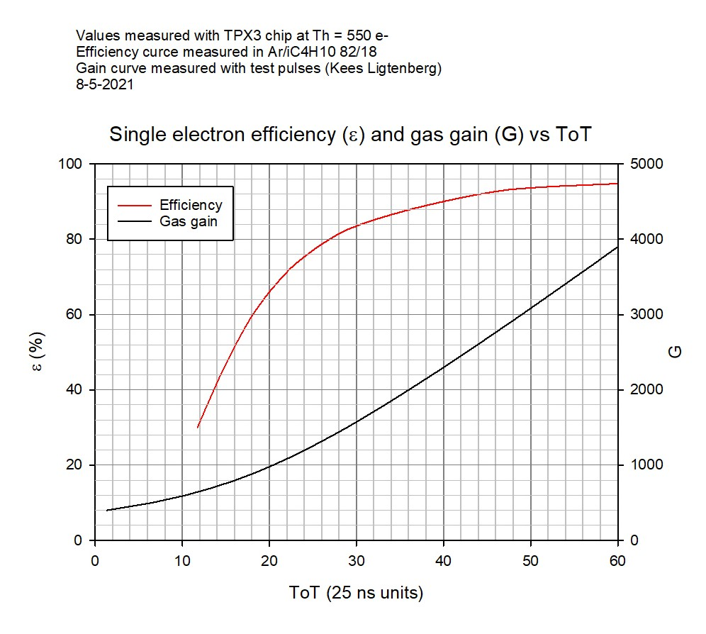
Calibration curve ToT gas gain

