Slide 1


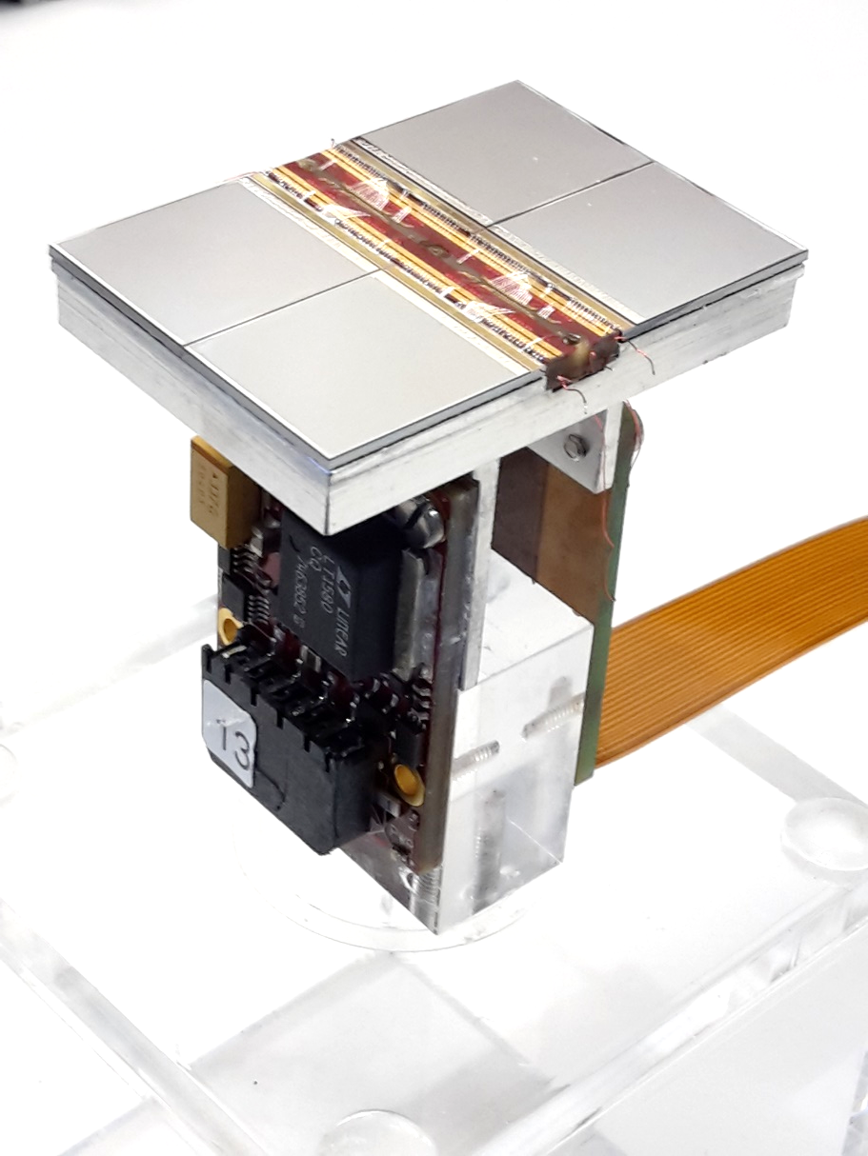





Status Pixel TPC
R&D
Yevgen Bilevych, Klaus Desch, Sander van Doesburg, Harry van der Graaf, Fred Hartjes, Jochen Kaminski, Peter Kluit, Naomi van der Kolk,
Cornelis Ligtenberg,
Gerhard Raven, and
Jan Timmermans
ILD meeting 15 January 2024

Slide 2
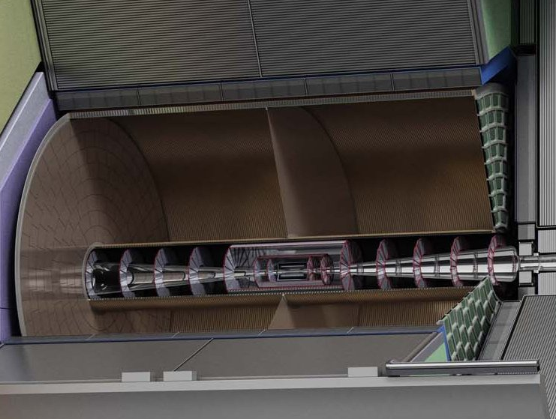
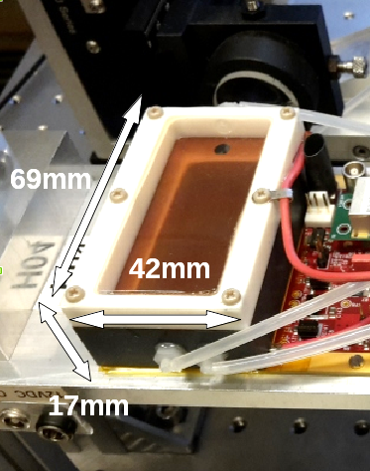
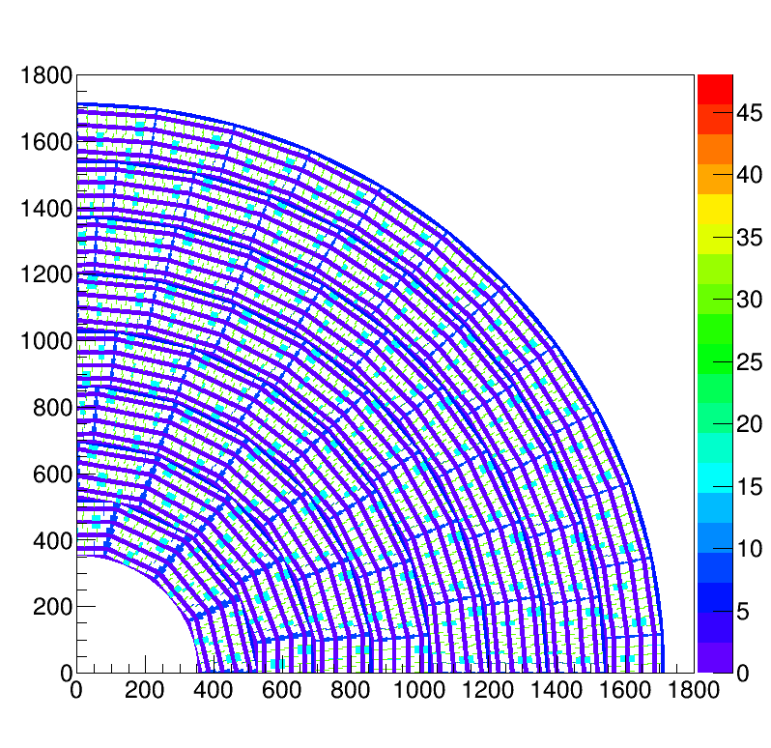
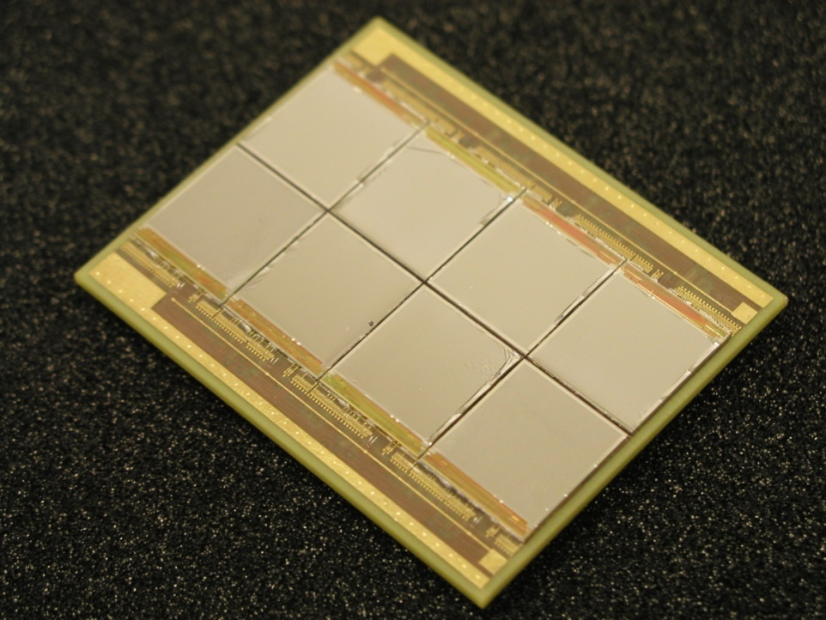
Pixel TPC
(Octopuce)
(TimePix1) TPX3 chip Quad Module TPC plane
(2007-14) 2017 2018 2019

Slide 3
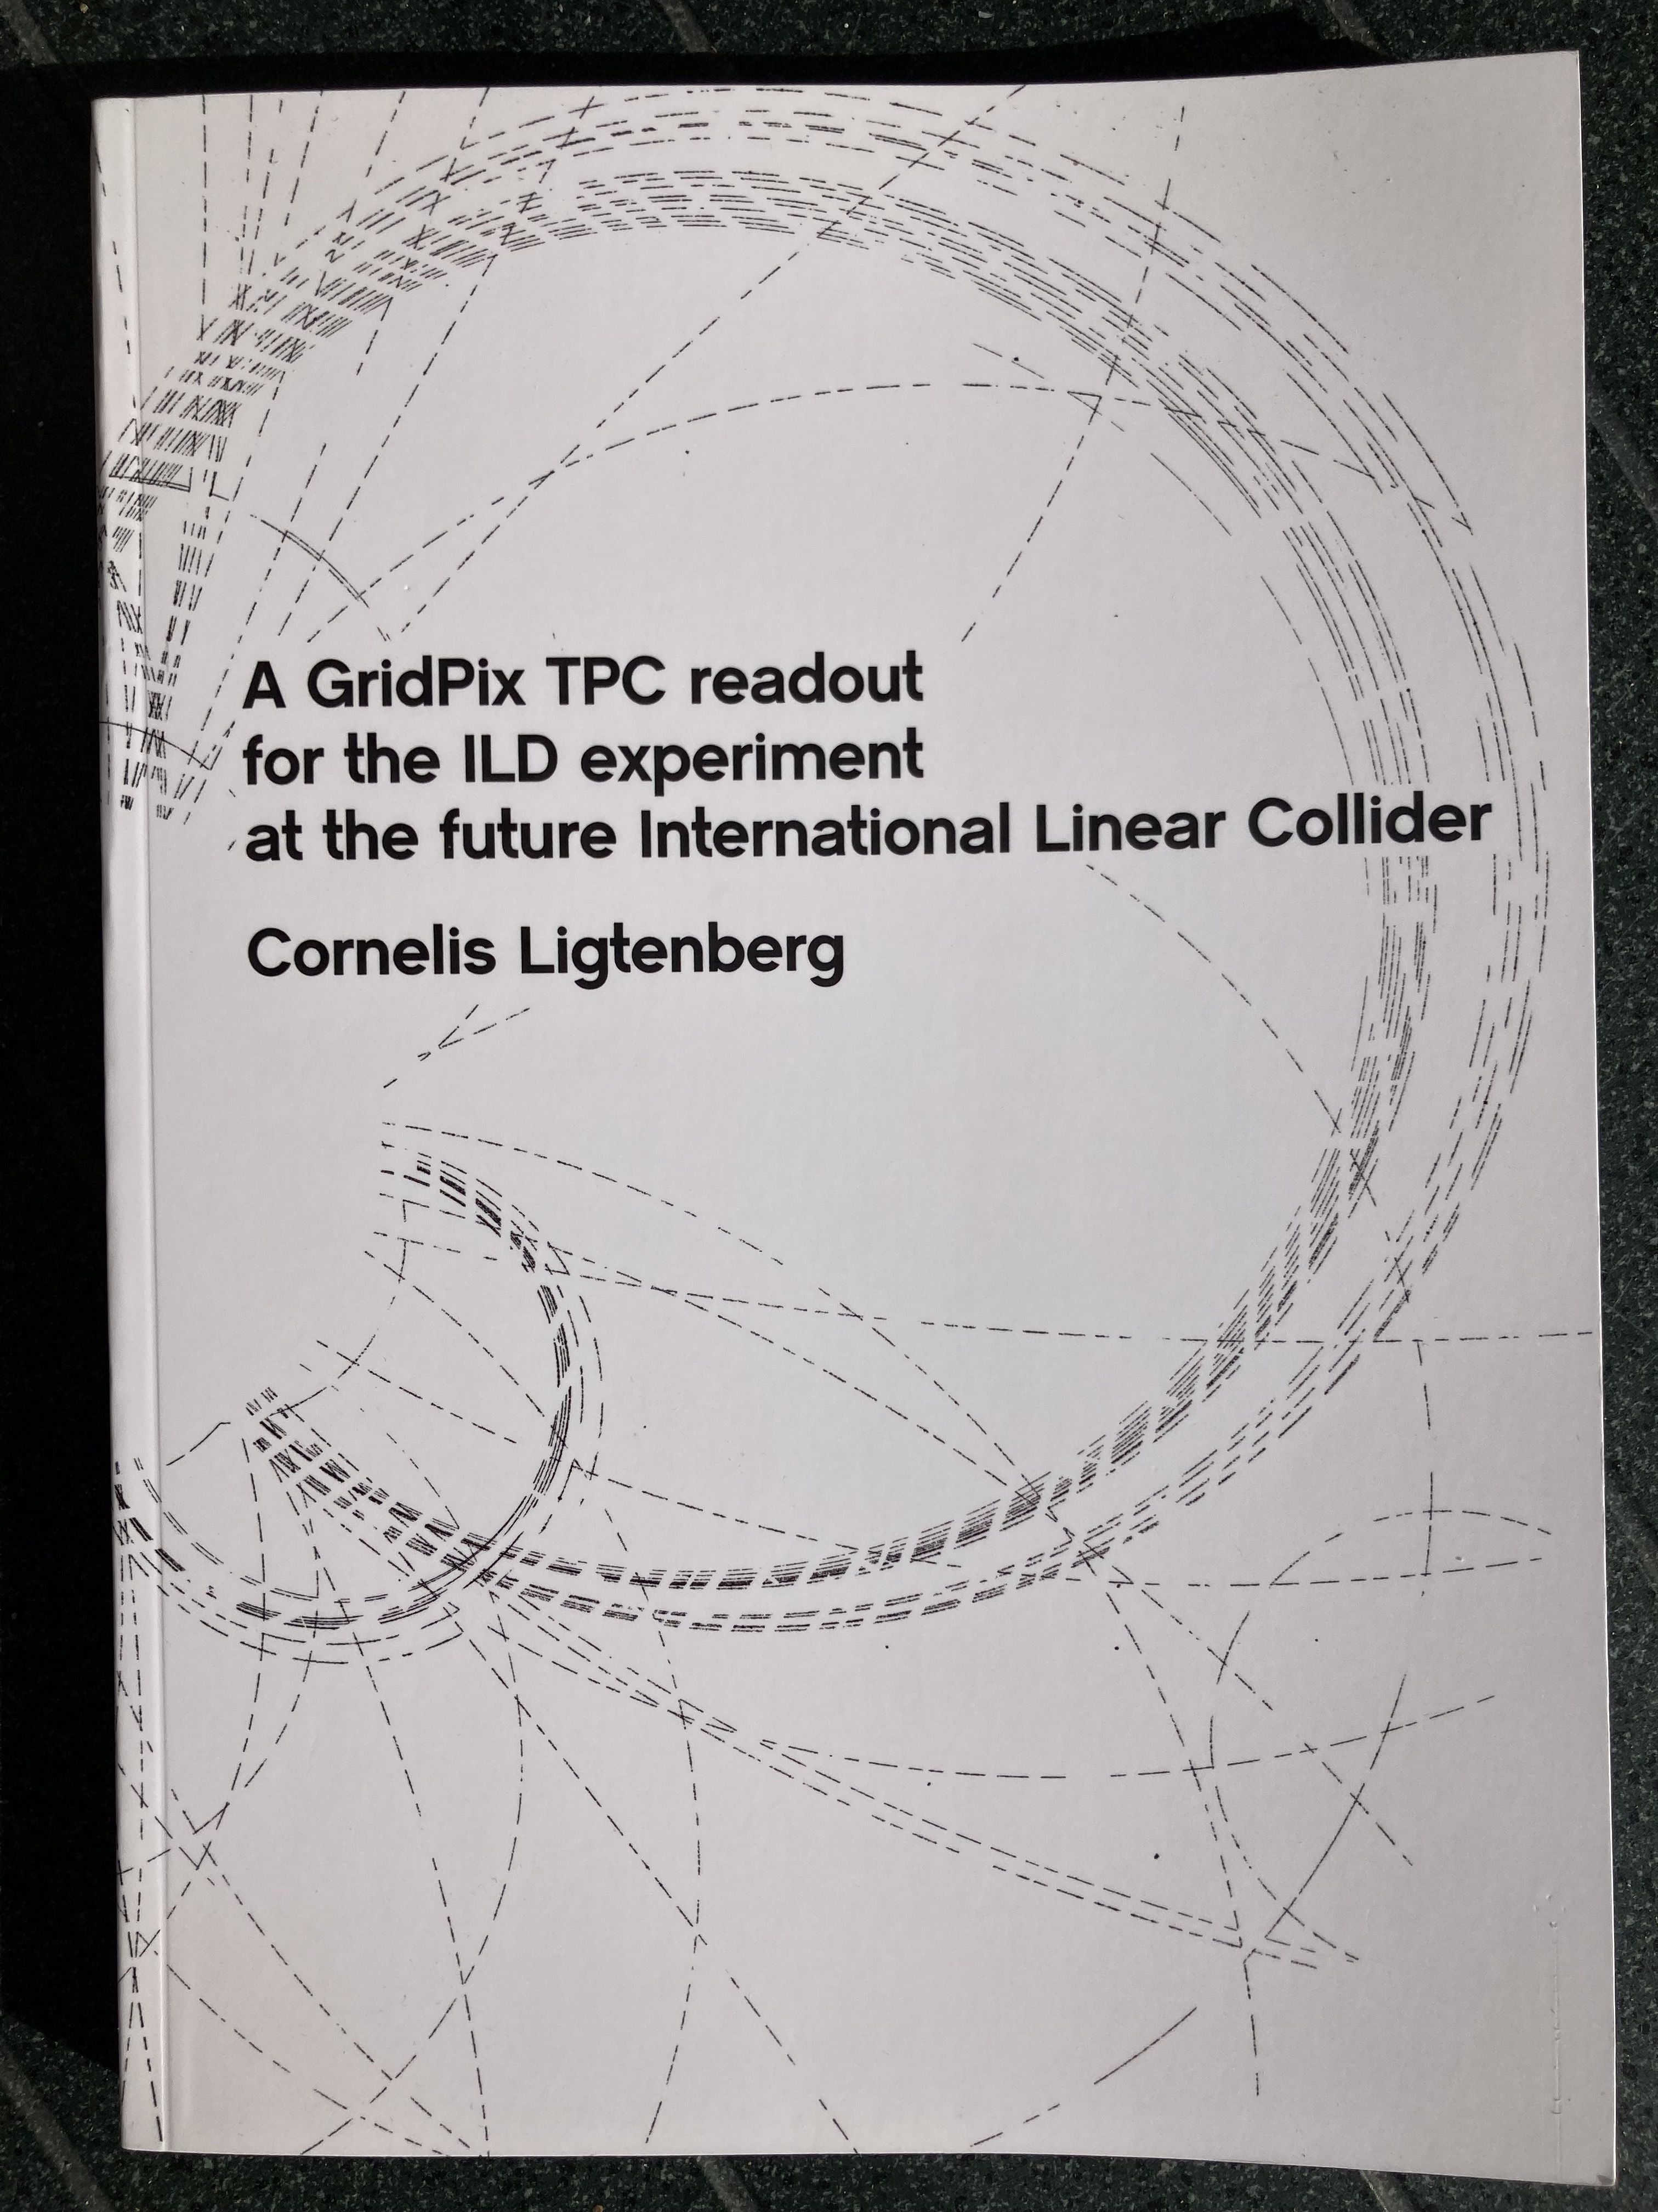
Pixel TPC
Material budget is
  0.01 X₀ TPC gas
  0.01 X₀ inner cylinder
  0.03 X₀ outer cylinder
  < 0.25 X₀ endplates (incl readout)
Note the very low budget in the barrel region. Material budget can be respected by different technologies like GEM, MicroMegas and Pixels
TPC is sliced between silicon detectors VTX, SIT and SET
pixel readout is a serious option for the TPC readout plane @ ILC/FFC-ee/CLIC/CEPC colliders
https://www.nikhef.nl/pub/services/biblio/theses_pdf/thesis_C_Ligtenberg.pdf

Slide 4
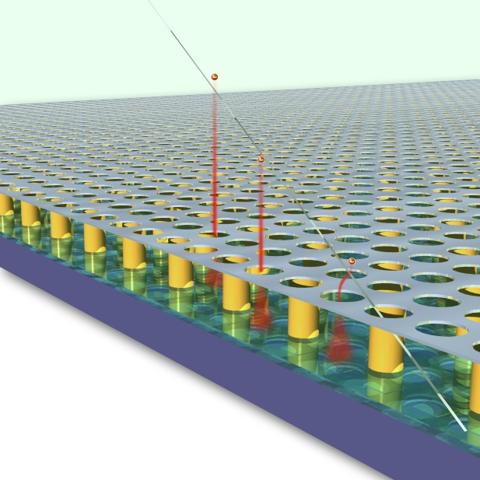
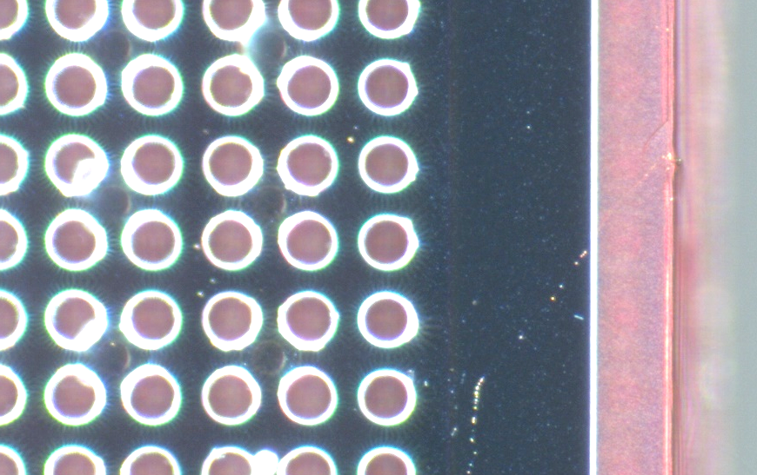
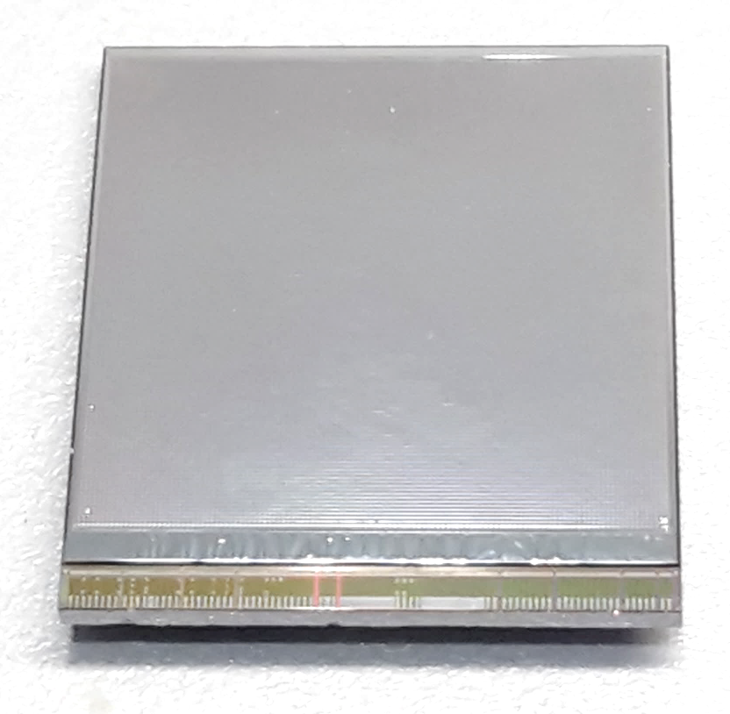
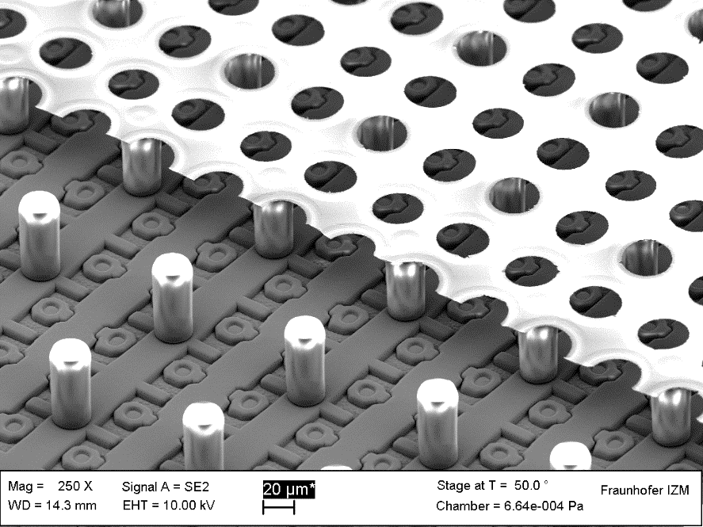
GridPix technology
Pixel chip with integrated Grid (Micromegas-like)
InGrid post-processed @ IZM
Grid set at negative voltage (300 – 600 V) to provide gas amplification
Very small pixel size (55 µm)
detecting individual electrons
dyke
55 µm
Aluminium grid (1 µm thick)
35 µm wide holes, 55 µm pitch
Supported by SU8 pillars 50 µm high
Grid surrounded by SU8 dyke (150 µm wide solid strip) for mechanical and HV stability
50 µm

Slide 5
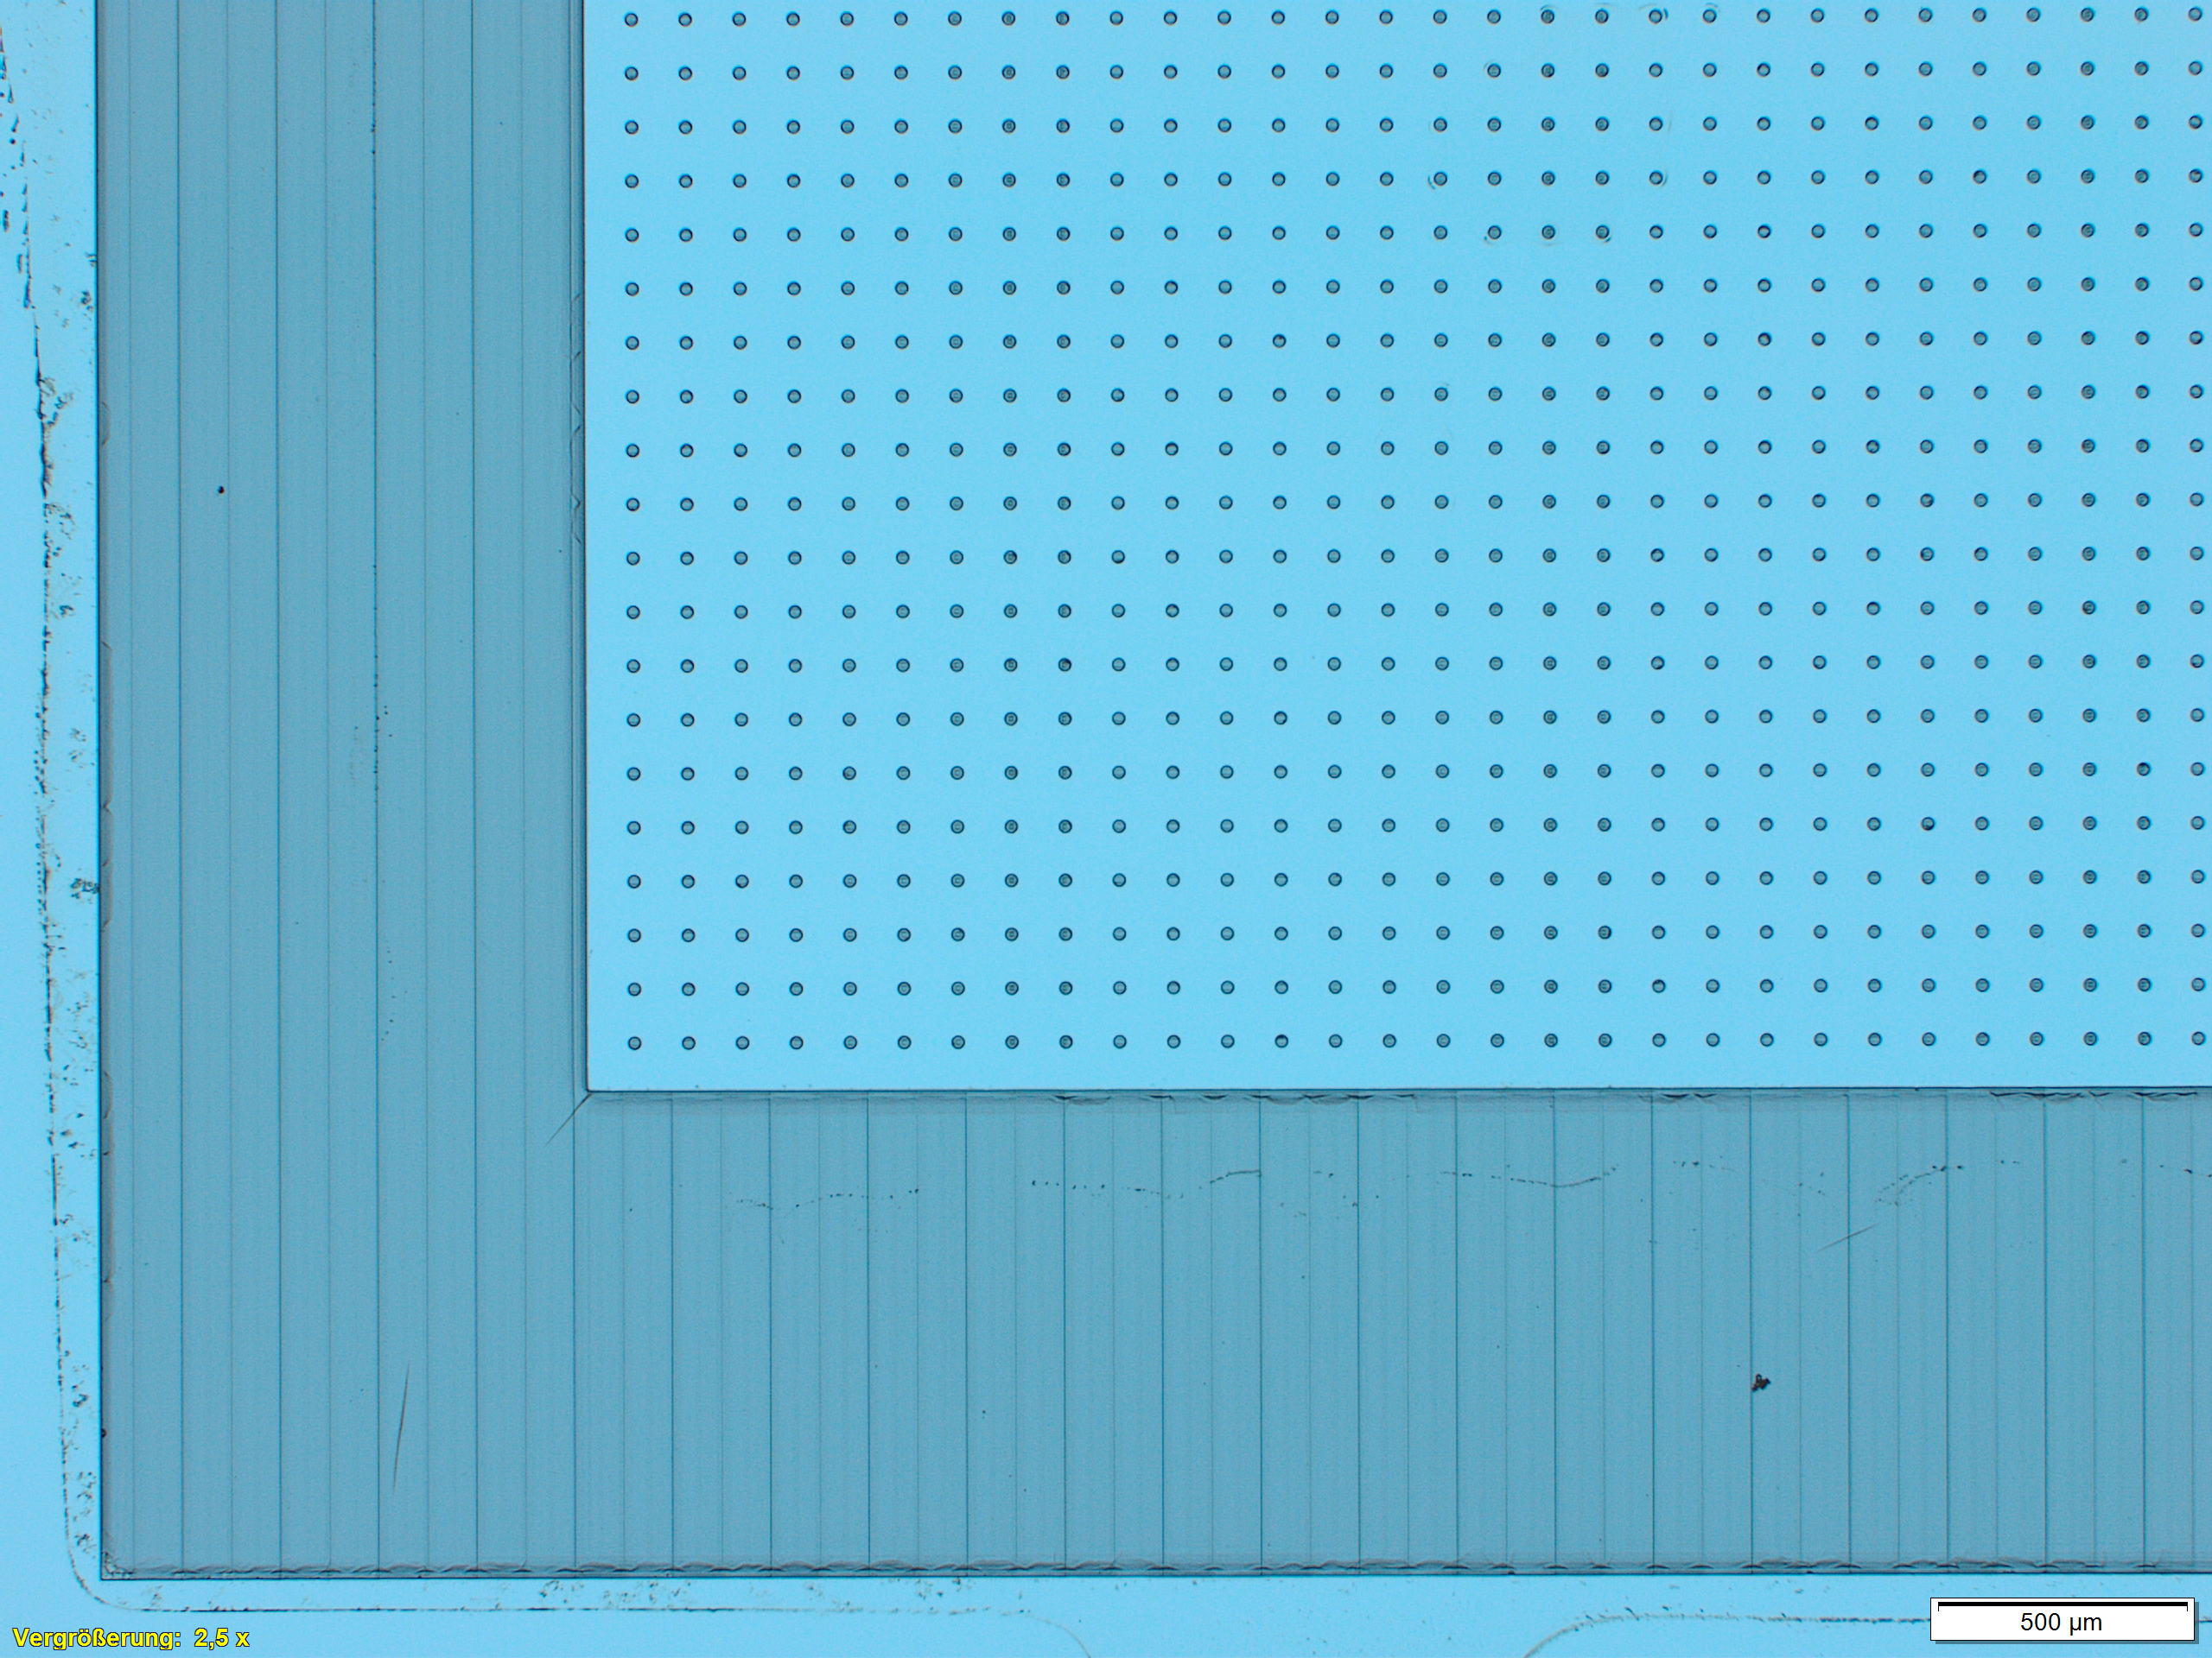
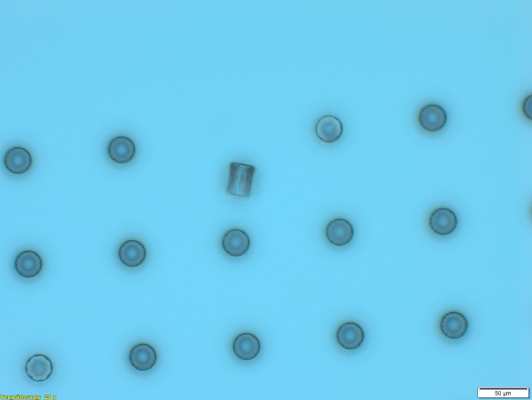
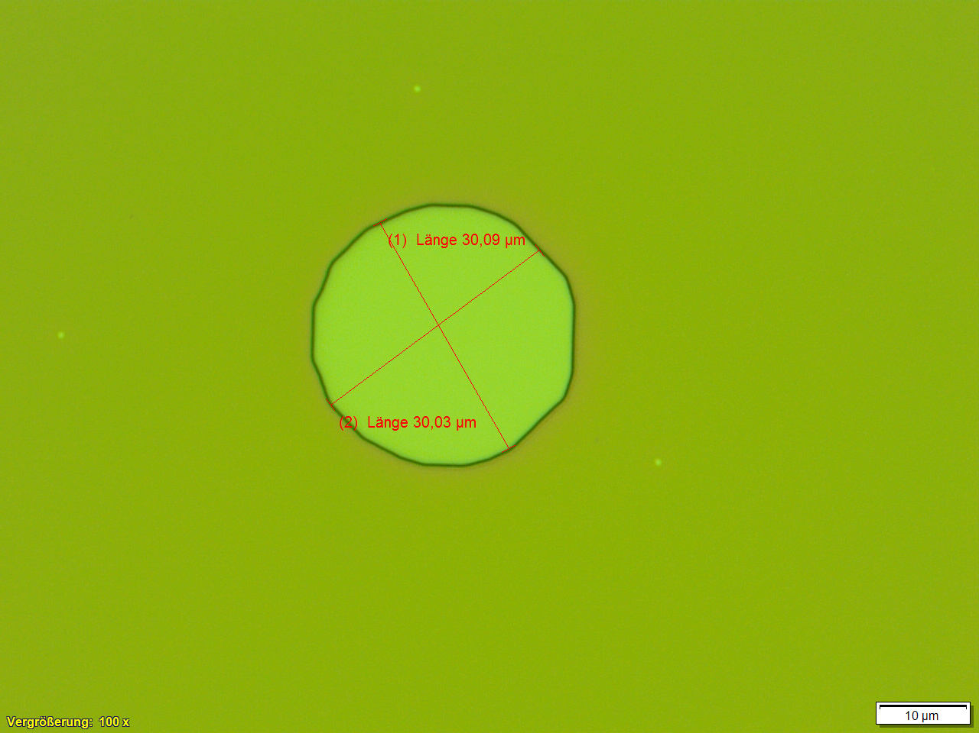
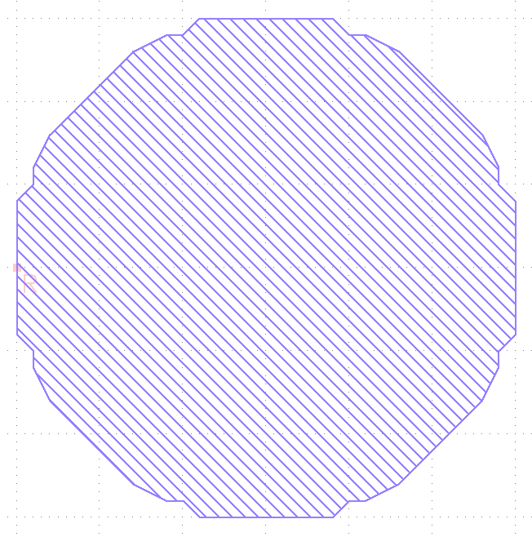
First Steps Towards
“GridPixes made in Bonn (2023)”
First structures made of SU8: 30µm high pillars and dykes
Holes in SU8 layer
Shape caused
by software to
create the mask

Slide 6
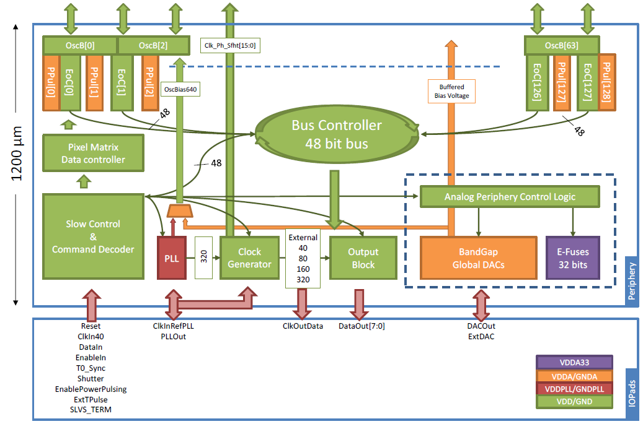
Pixel chip: TimePix3
256 x 256 pixels
55 x 55 µm pitch
14.1 x 14.1 mm sensitive area
TDC with 640 MHz clock (1.56 ns)
Used in the data driven mode
  Each hit consists of the pixel address and time stamp of arrival time (ToA)
  Time over threshold (ToT) is added to register the signal amplitude
  compensation for time walk
  Trigger (for t₀) added to the data stream as an additional time stamp
Power consumption
  ~1 A @ 2 V (2W) depending on hit rate
  good cooling is important
Sensitive area
14.1 mm
2+3 mm

Slide 7
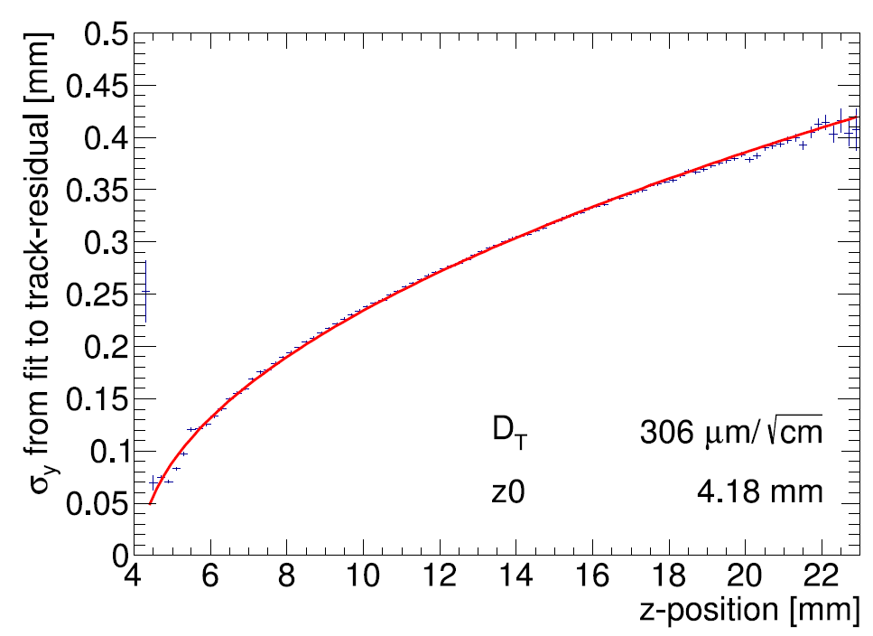
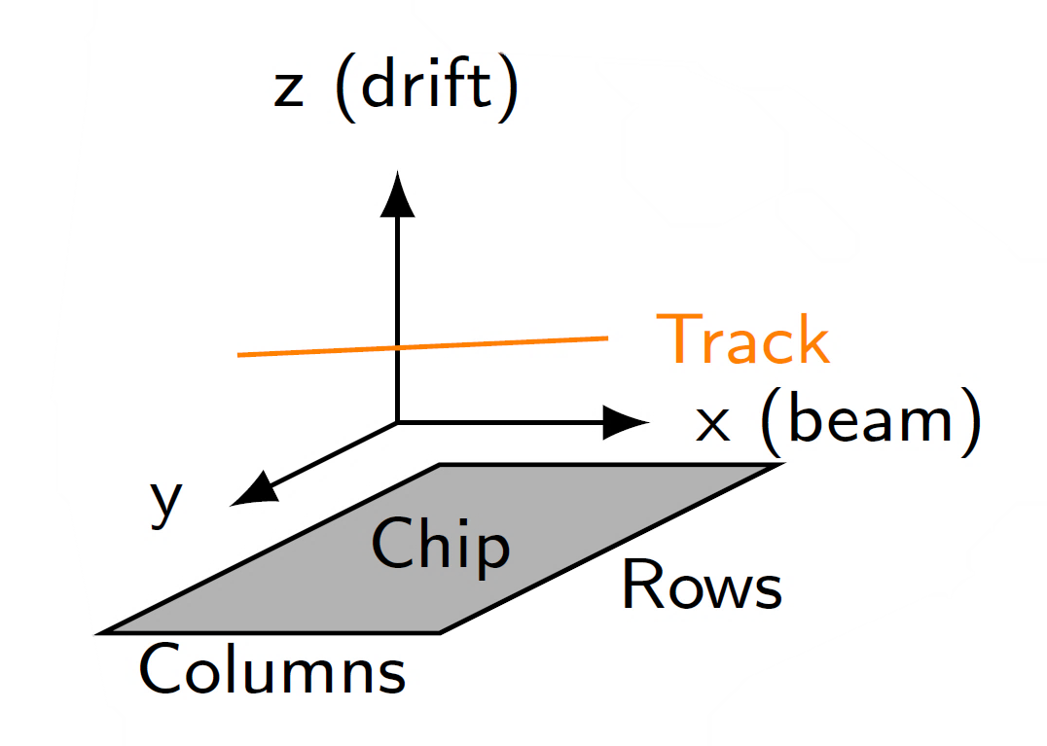
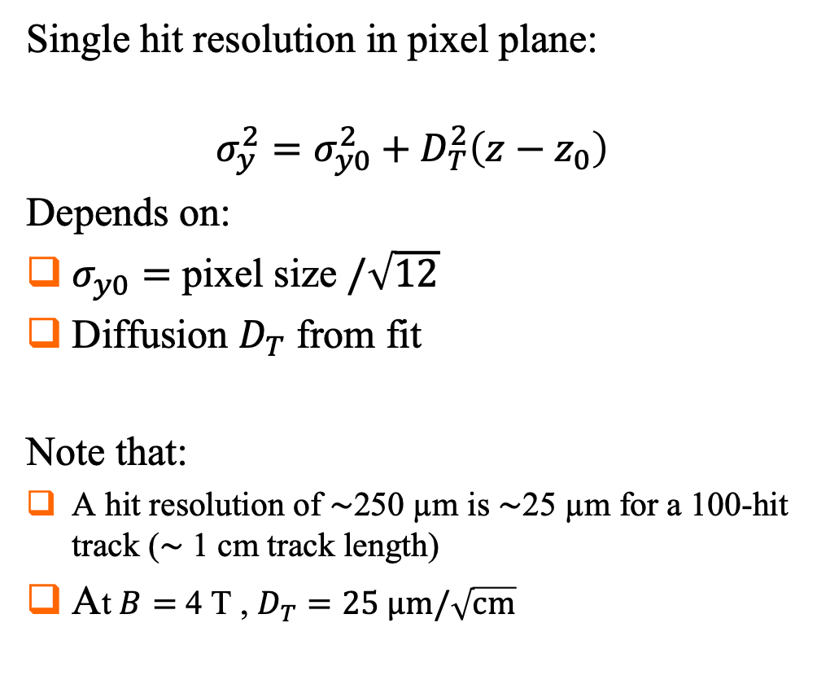
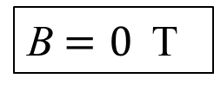
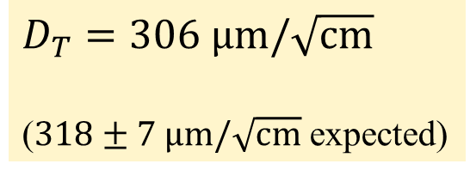
Single hit resolution in transverse direction
Results from Bonn-Elsa testbeam in 2017
https://doi.org/10.1016/j.nima.2018.08.012
B$=0$ T
Single hit resolution in pixel plane:
$$σ_{y}^{2}=σ_{y0}^{2}+D_{T}^{2}\left(z−z_{0}\right)$$
Depends on:
$σ_{y0}=$ pixel size $/\sqrt{12}$
Diffusion $D_{T}$ from fit
Note that:
A hit resolution of $\sim$250 µm is $\sim$25 µm for a 100-hit track ($\sim$ 1 cm track length)
At $B=$ 4 T , $D_{T}=25 \text{μm}/\sqrt{\text{cm}}$
T2K gas
$D_{T}=306 \text{μm}/\sqrt{\text{cm}}$
($318±7 \text{μm}/\sqrt{\text{cm}}$ expected)

Slide 8
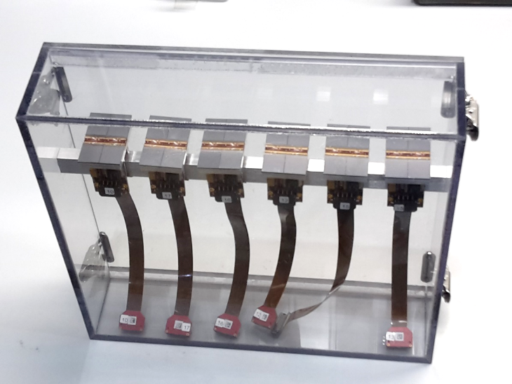
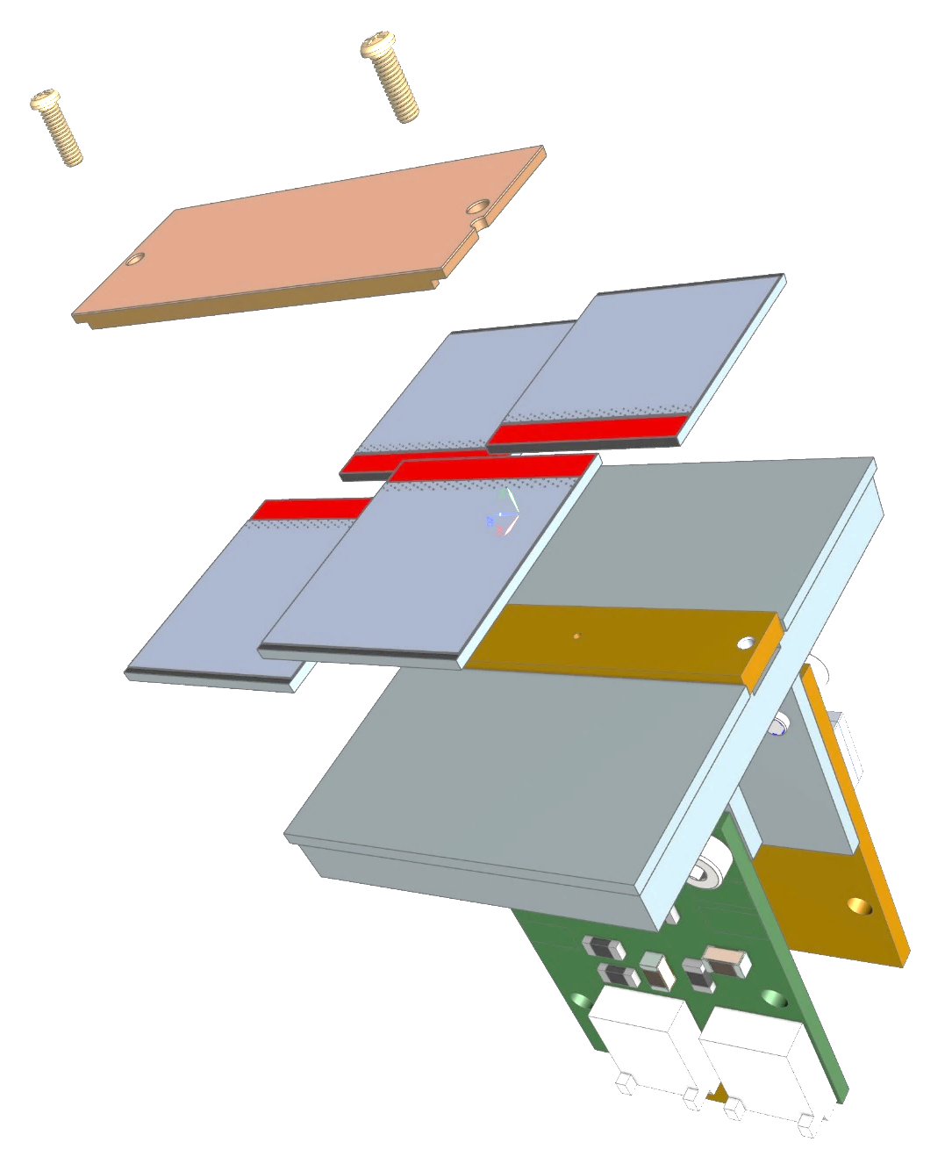
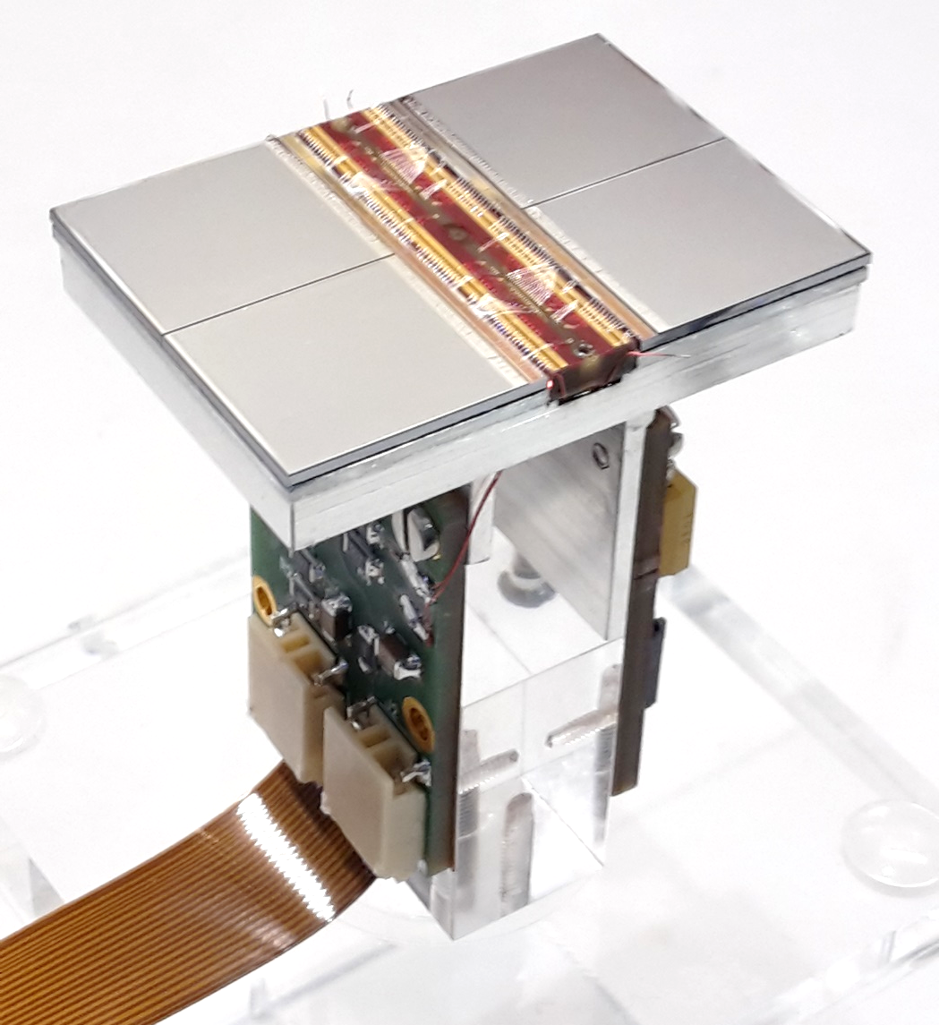
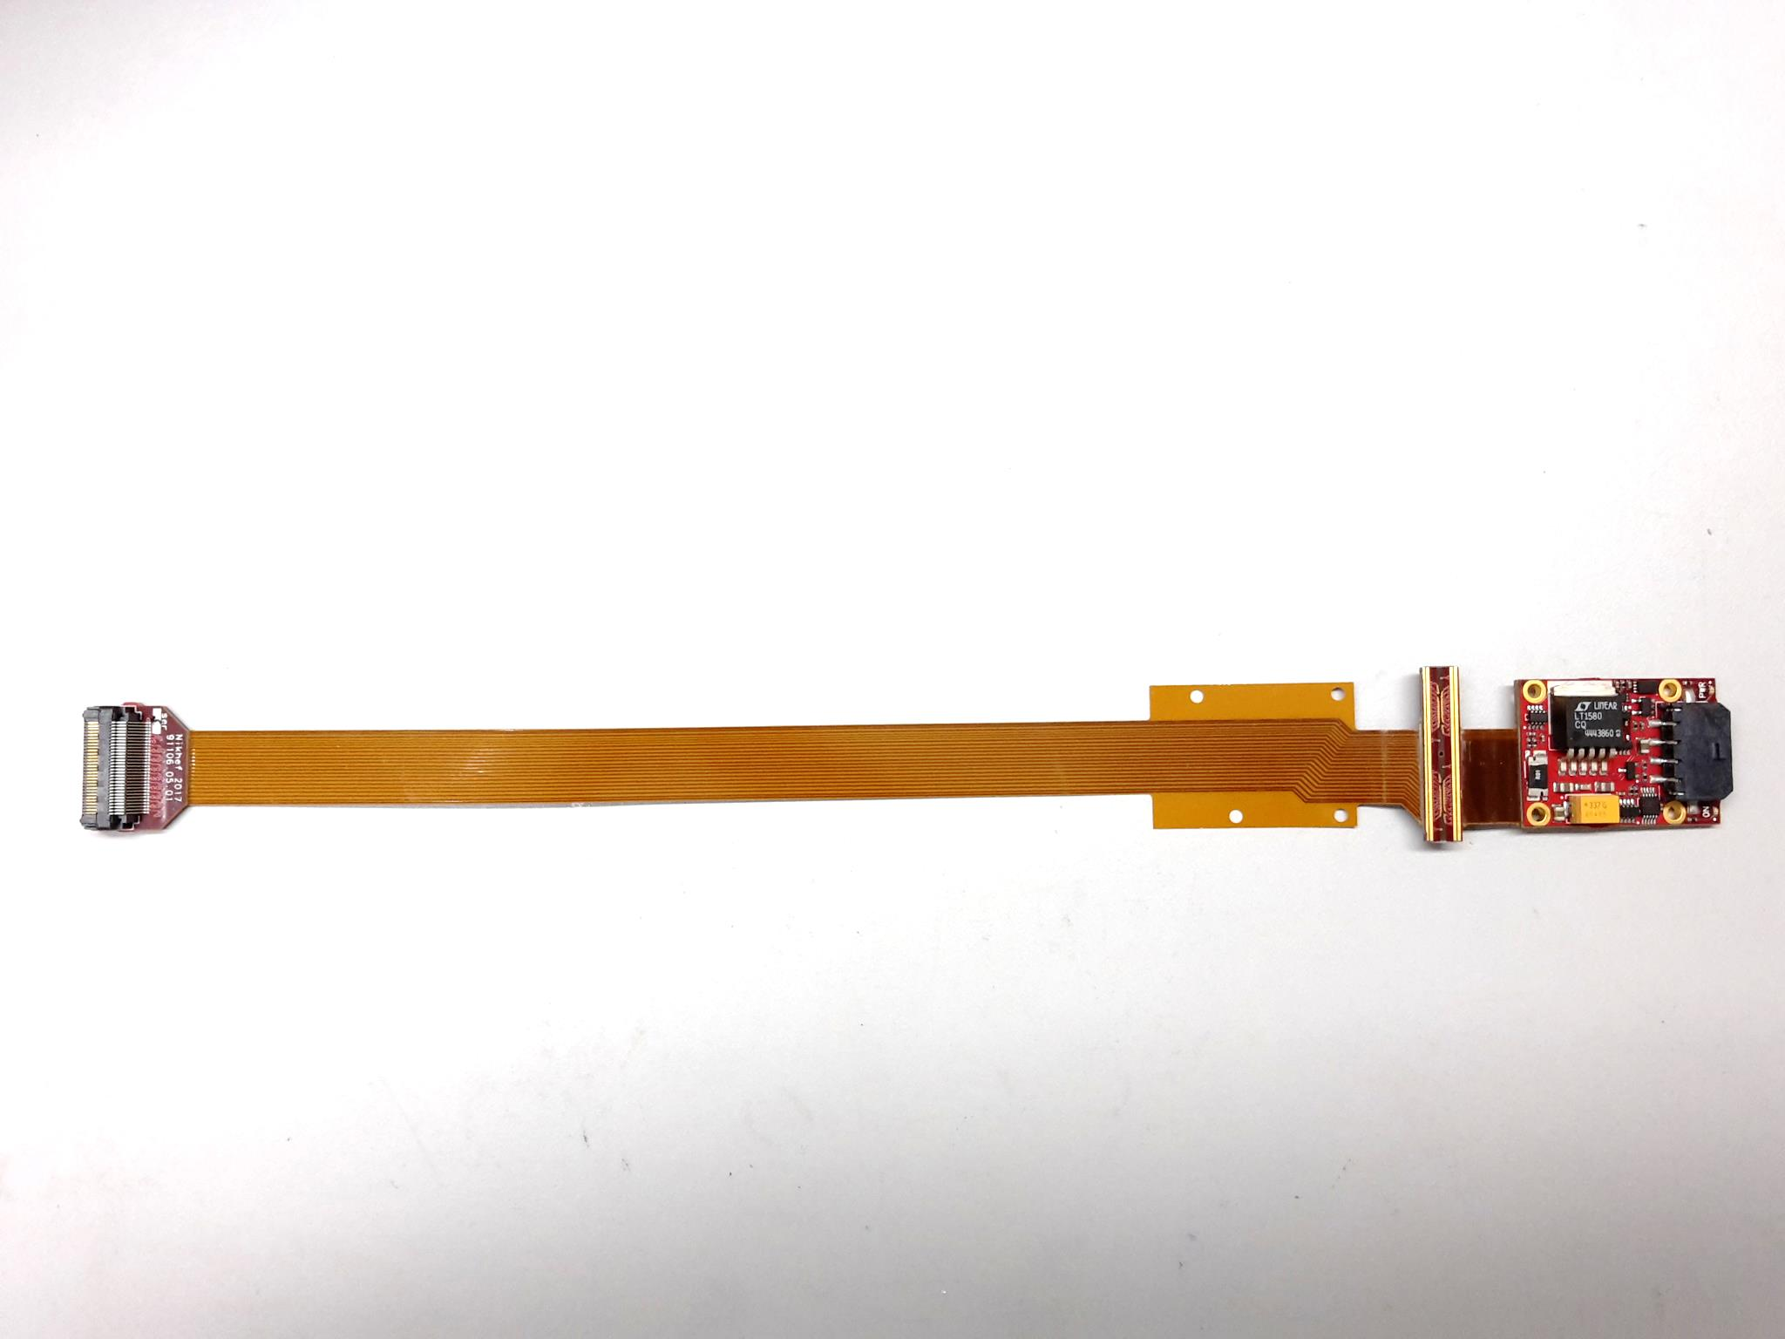
QUAD design and realization
Four-TimePix3 chips
All services (signal IO, LV power) are located under the detection surface
The area for connections was squeezed to the minimum
Very high precision 10 μm mounting of the chips and guard
QUAD has a sensitive area of 68.9%
DAQ by SPIDR
39.6 x 28.38 mm
series of QUADs
Guard
TPX3
TPX3
TPX3
TPX3
COld
CArrier

Slide 9
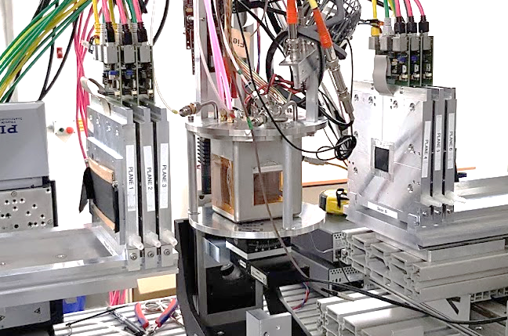
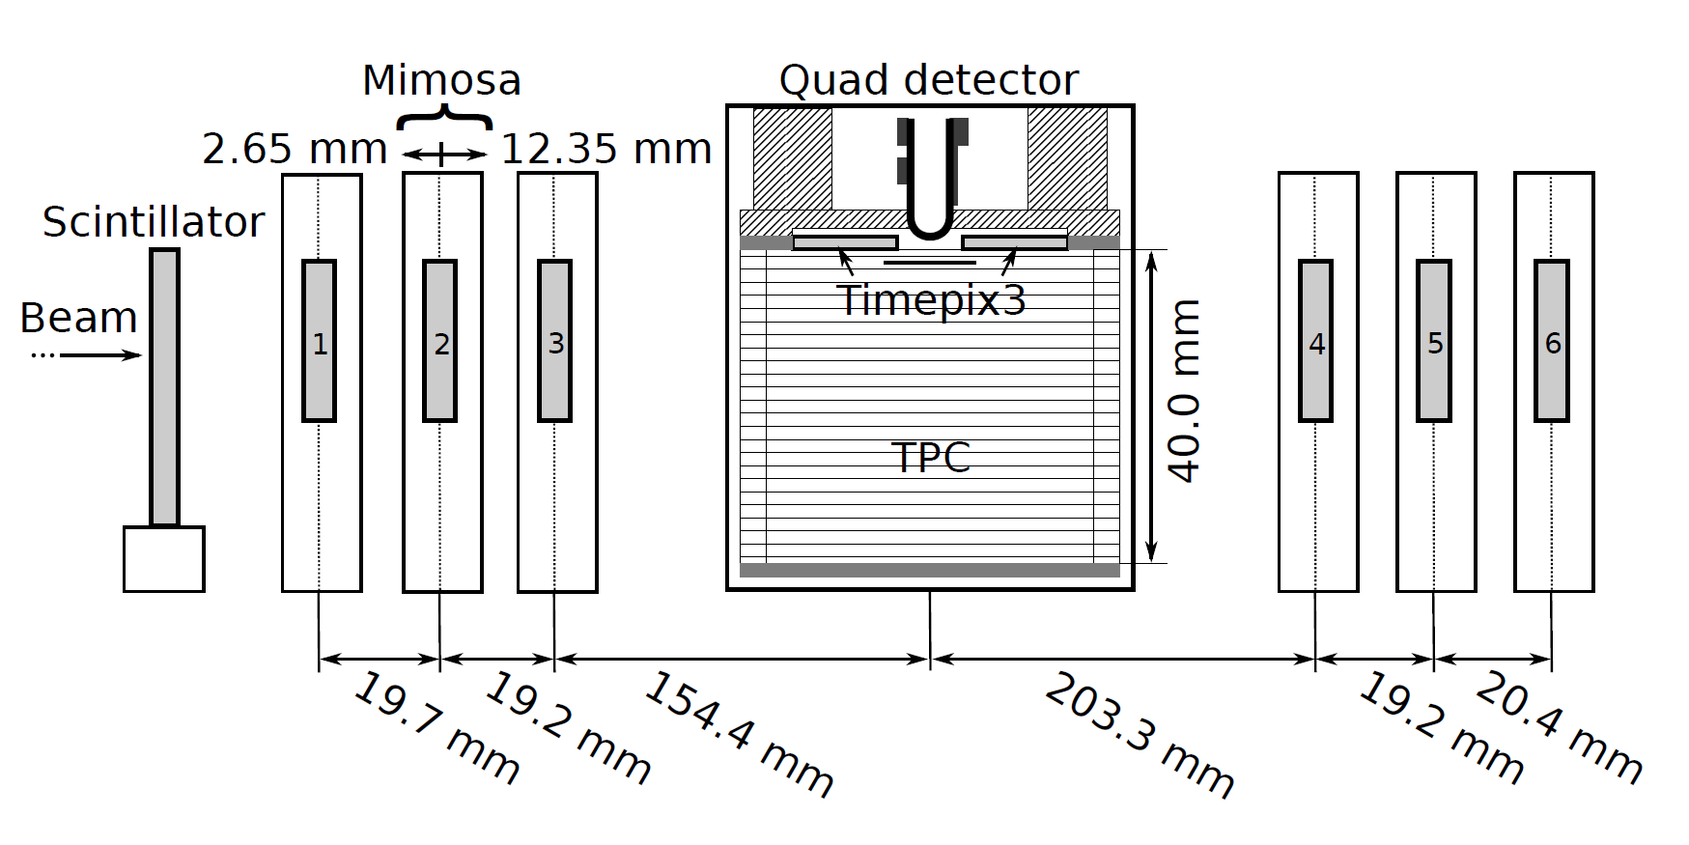

QUAD test beam in Bonn (October 2018)
ELSA: 2.5 GeV electrons
Tracks referenced by Mimosa telescope
QUAD sandwiched between Mimosa planes
  Largely improved track definition
  6 planes with 18.4 μm × 18.4 μm sized pixels
Gas: Ar/CF₄/iC₄H₁₀ 95/3/2 (T2K)
E_{d} = 400 V/cm, V_{grid} = -330 V
Typical beam height above the chip: ~1 cm
Published NIMA https://doi.org/10.1016/j.nima.2019.163331
@Bonn
Field cage

Slide 10
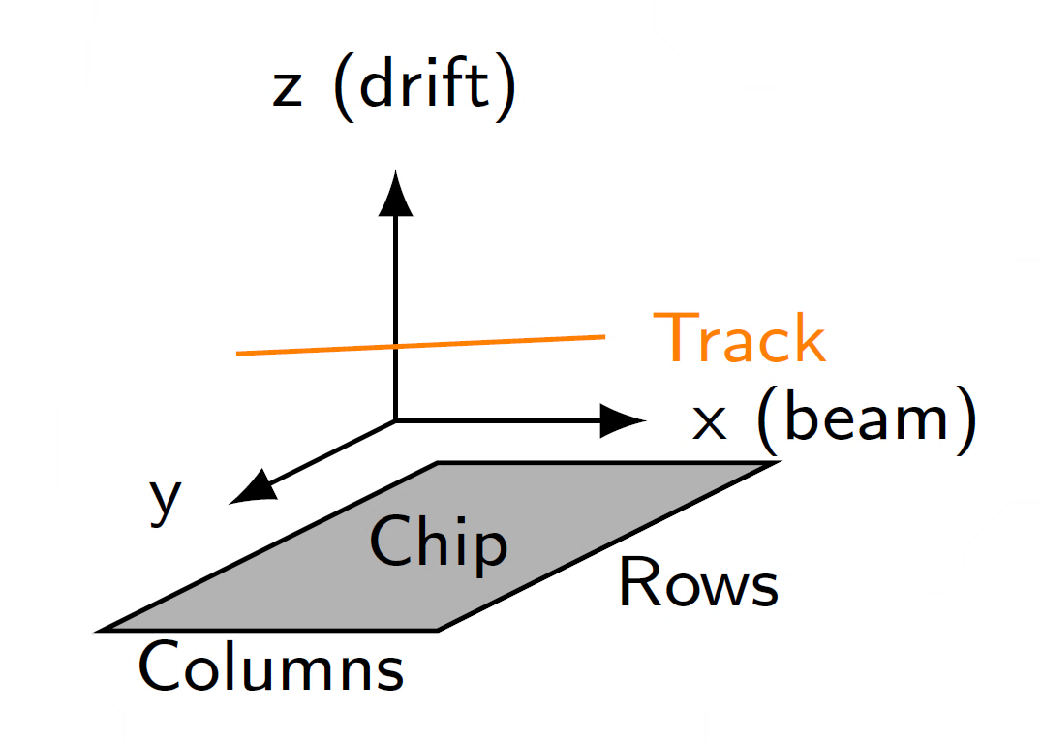
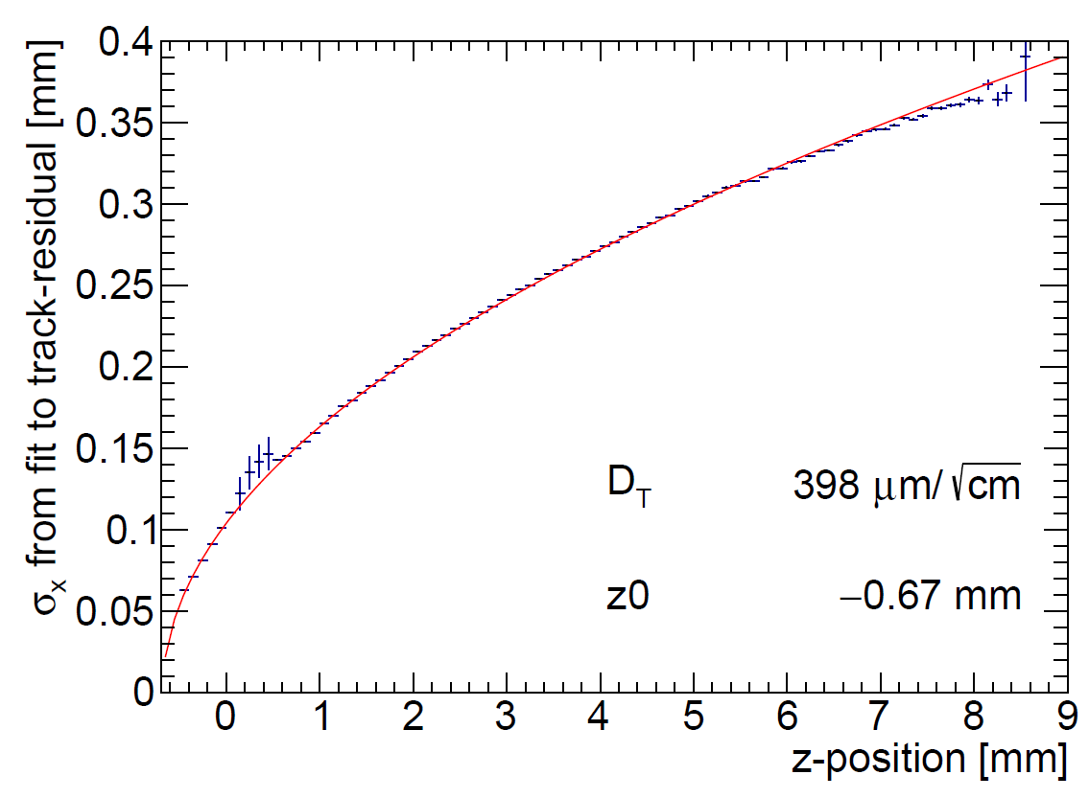
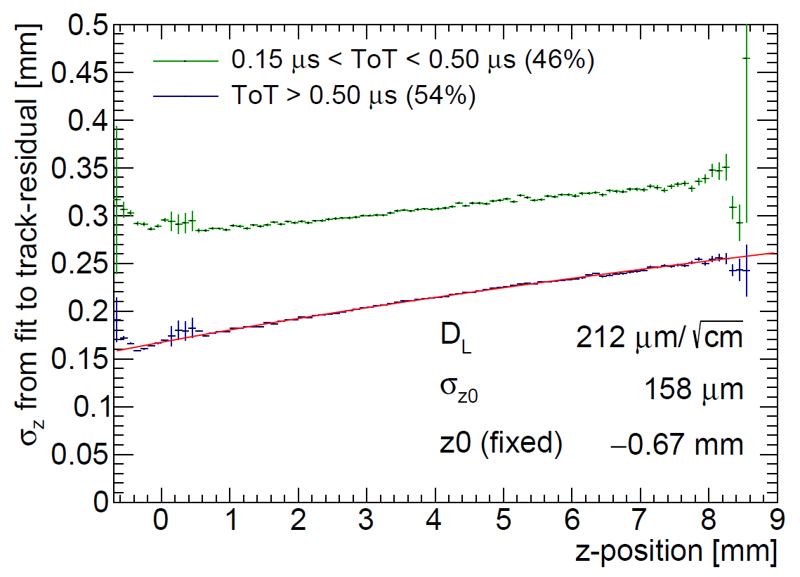
QUAD single hit resolution
Transverse
Longitudinal
D_{T} = 398 μm/√cm
D_{L} = 212 μm/√cm
The D_{T} value is rather high due to an error in the gas mixing (too low CF4)

Slide 11
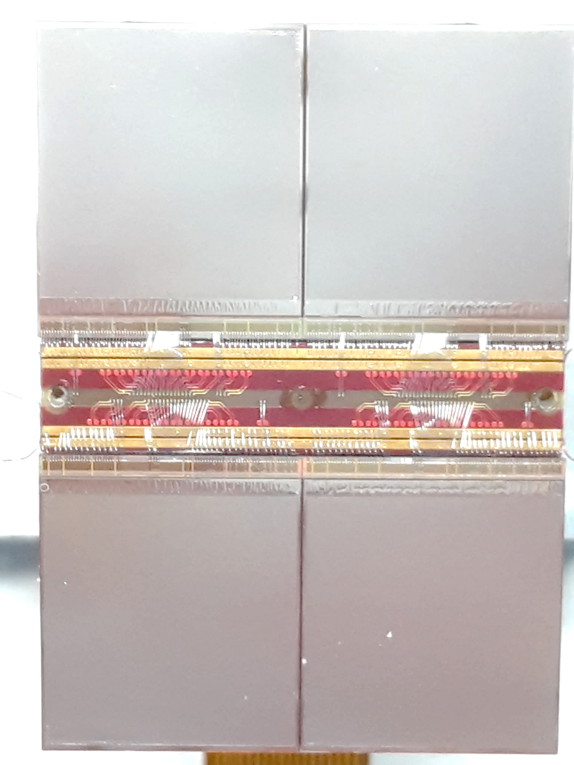
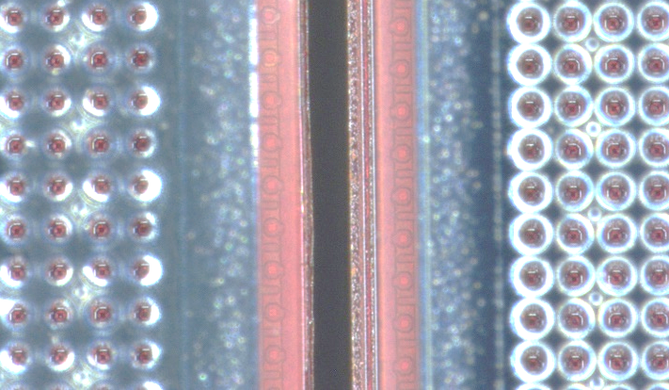
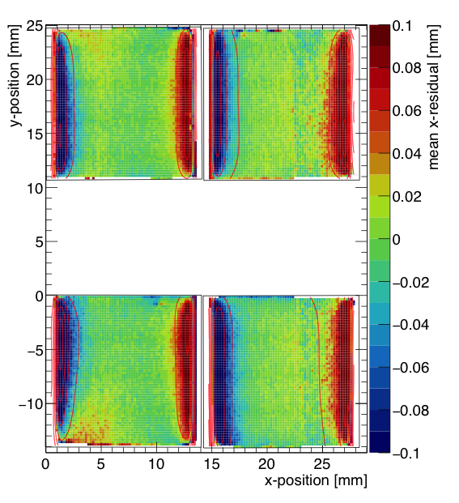
QUAD edge deformations (XY)
Small deformations due to
  Dead zone between chips
  Grounded region between chips
Are corrected by:
  fitted correction function
  adding proper guard wire electrode
Grounded region

Slide 12
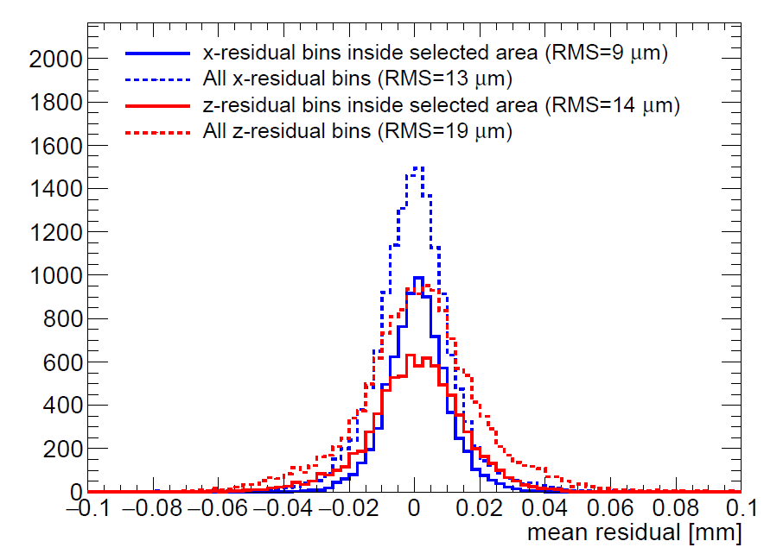
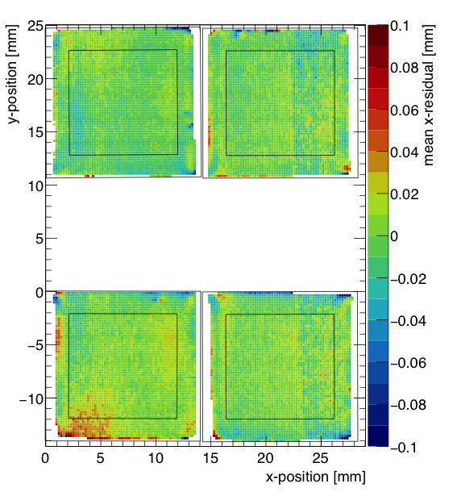
QUAD deformations in transverse plane (XY)
After applying fitted edge corrections
RMS of the mean residuals are 13 μm over the whole QUAD
XY

Slide 13
QUAD as a building block
8-QUAD module (2x4 quads) with field cage
in red guard wires

Slide 14
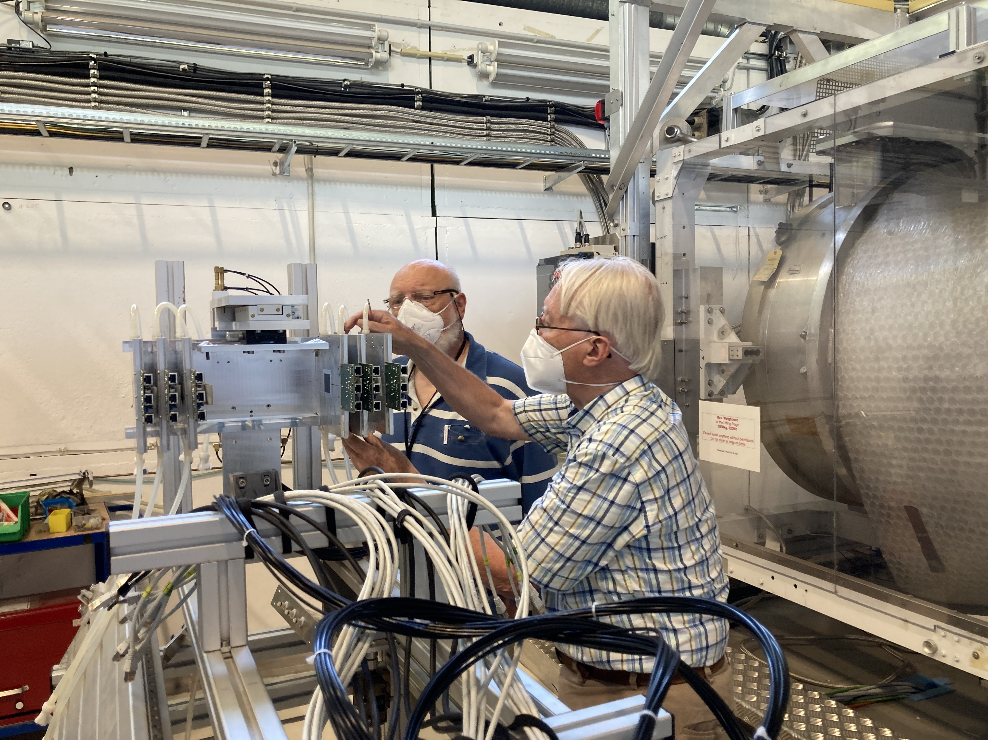
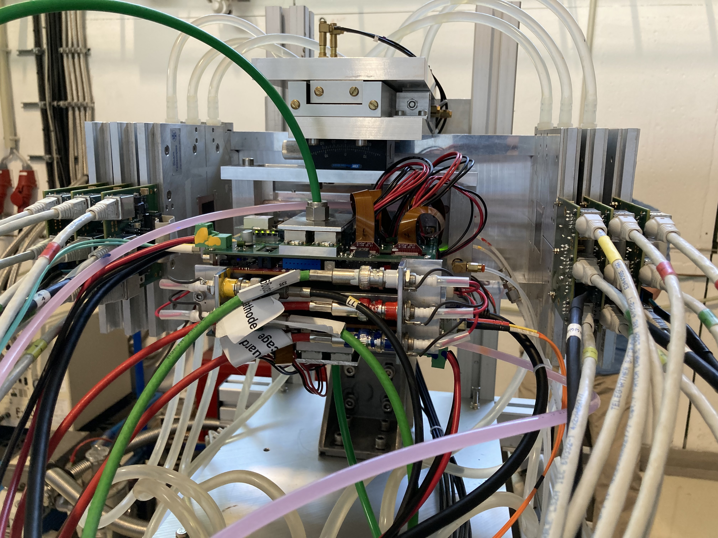
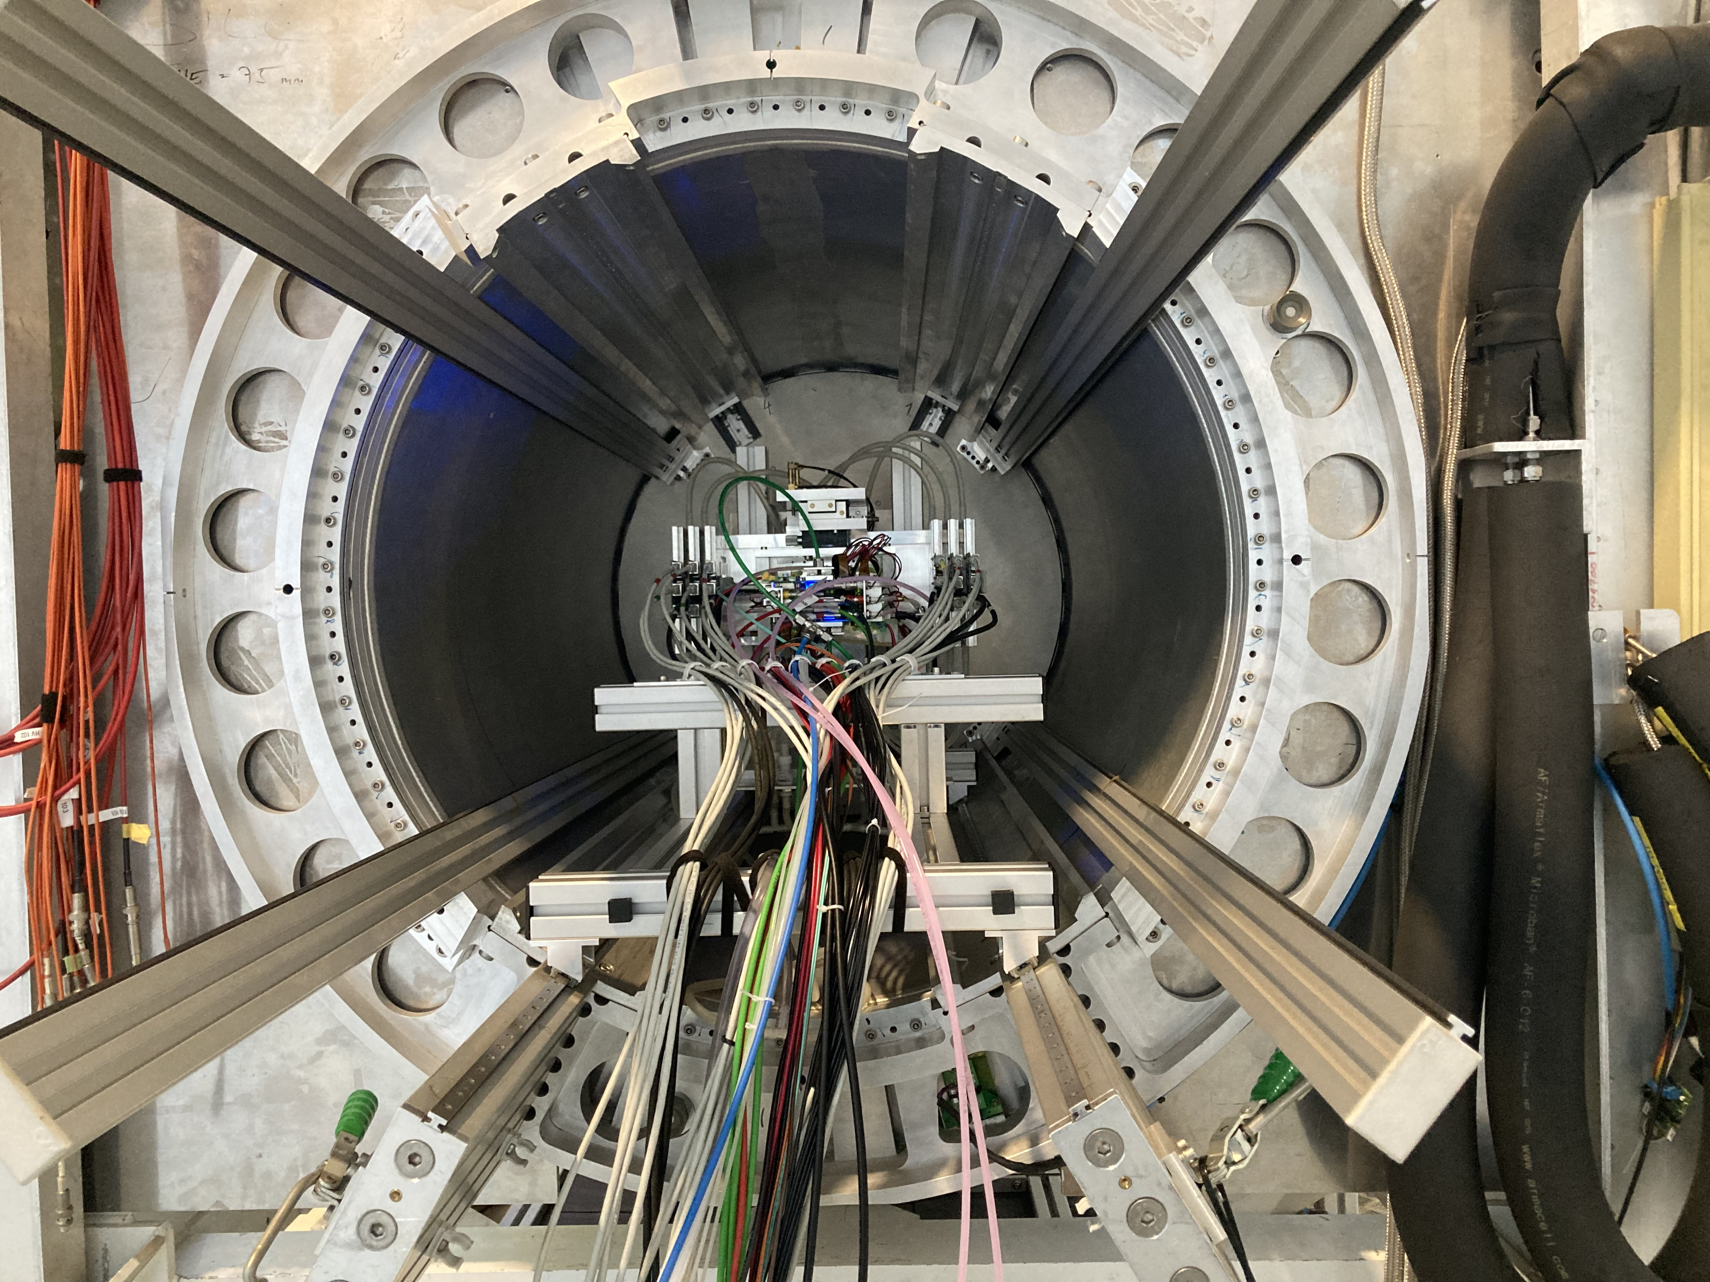
DESY testbeam June 2021
Mounting the 8 quad module between the silicon planes
sliding it into the 1 T PCMAG solenoid

Slide 15
DESY testbeam June 2021

Slide 16
DESY testbeam Module Analysis
Event display with module and telescope
TPX3 track 1130 hits
χ²_{xy} = 677.5/1128
χ²_{z} = 775.9/1069
Asymmetric tail outlier removal applied 1071 hits in z kept.
TPX3 track hits
Telescope track hits (off track green)
Preliminary
x global
x local
z global
y local
z global
y global
z local drift
y local

Slide 17
DESY testbeam Module Analysis
Run 6916 B=0 T p =6 GeV
Preliminary
8-quad module Tracking precision:
position 9 μm (xy) 13 μm (z)
angle 0.19 mrad (dx/dy) 0.25 (dz/dy) mrad
module tracklength = 157.96 mm
Note that in a B field because of the reduced diffusion the tracking precision will improve substantially
964 selected tracks
Impressive 1009 hits / track

Slide 18
DESY testbeam Module Analysis
Run 6916-6918 B=0 T p=6 GeV
Three runs at different drift distances
Preliminary

Slide 19
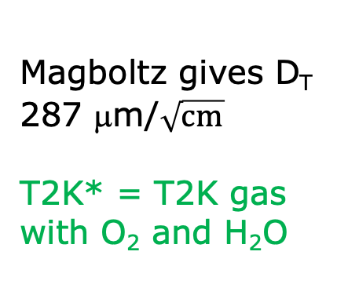
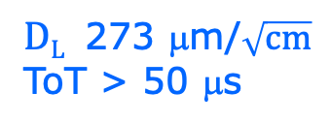

DESY testbeam Module Analysis
Run 6916-6918 B=0 T p=6 GeV
Fitted resolution
$$σxy,z2=σ2xy0,z0+D2xy,z \left(z−z0\right)$$
σ² _{xy0}= σ²_{pixel} + σ²_{xy tele} σ²_{pixel}= 55²/12 μm²
σ_{xy tele}=35 μm
$DT$ 287 μm/$\sqrt{cm}$
$DL$ 273 μm/$\sqrt{cm}$
ToT > 50 μs
Preliminary
Magboltz gives D_{T} 287 μm/$\sqrt{cm}$
T2K* = T2K gas with O₂ and H₂O
B=0 T
T2K*
E_{d}=280 V/cm

Slide 20
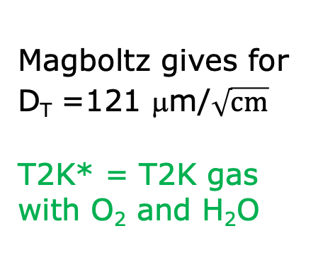
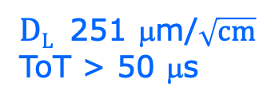

DESY testbeam Module Analysis
Run 6983-6990 B=1 T p=5 and 6 GeV
Fitted resolution
$$σxy,z2=σ2xy0,z0+D2xy,z \left(z−z0\right)$$
σ² _{xy0}= σ²_{pixel} + σ²_{xy tele} σ²_{pixel}= 55²/12 μm²
σ_{xy tele}=42 μm
$DT$ 120 μm/$\sqrt{cm}$
$DL$ 251 μm/$\sqrt{cm}$
ToT > 50 μs
Preliminary
Magboltz gives for D_{T} =121 μm/$\sqrt{cm}$
T2K* = T2K gas with O₂ and H₂O
B=1 T
T2K*
E_{d}=280 V/cm

Slide 21
DESY testbeam Module Analysis
Runs 6909, 6916-17, 6934-35 B=0 T p =6 & 5 GeV
Mean residuals in the module plane with acceptance cuts
B=0 T
situation
There are clear deformations in xy for the chips in the 4 corners.
The field around chip 11 (no grid HV) is affected.
The Efield defined by the field cage is in these areas not homogenous enough
Preliminary
xy
Vertical white bands guards
z

Slide 22
DESY testbeam Module Analysis
Runs 6981-6988 B=1 T p=5 GeV
Mean residuals in the module plane with acceptance cuts
B=1 T
situation
There are clear deformations in xy for the chips in the 4 corners.
The field around chip 11 (no grid HV) is affected.
The Efield defined by the field cage is in these areas not homogenous enough
Preliminary
xy
Vertical white bands guards
z

Slide 23
DESY testbeam Module Analysis
Runs 6909, 6916-17, 6934-35 B=0 T p =6 & 5 GeV
Distribution of mean residuals in the plane
Method row
See back up slide for the two methods that group the module plane
xy
z
method | rms (stat) xy | bins xy | rms (stat) z | bins z
row | 11 (5) μm | 896 | 15 (5) μm | 891
column | 13 (5) μm | 895 | 13 (5) μm | 892
Preliminary
Method column
We did not include the 4 corner chips and (11), 14, 8, 13 and 19.
These are affected by the field cage and the short in chip 11.

Slide 24
DESY testbeam Module Analysis
Runs 6983-6988 B=1T p=5 GeV
Distribution of mean residuals in the plane
Method row
B=1 T situation
xy
z
method | rms (stat) xy | bins xy | rms (stat) z | bins z
row | 13 (2) μm | 896 | 19 (5) μm | 896
column | 11 (2) μm | 880 | 20 (5) μm | 880
Preliminary
Method column
We did not include the 4 corner chips and (11), 14, 8, 13 and 19.
These are affected by the field cage and the short in chip 11.

Slide 25
DESY testbeam Module Analysis
Performance of dEdx
B=0 T
B=1 T
Preliminary
B=0 T has a large Landau tail
B=1 T smaller Landau tail and a more gaussian distribution
An electron crossing 8 chips in the module has about 1000 TX3 hits

Slide 26
DESY testbeam Module Analysis
Performance of dEdx
The dEdx resolution for MIPs (70% of the electron dE/dx) from data by combining tracks to form a 1 m long track with realistic coverage ~60% coverage (corrected for the e-MIP scale).
Method | B=0 Resolution (%) | B= 1 T Resolution (%)
(1) dEdx 90 tail | 7.7 | 5.3
(2) Fit slope | 6.8 | 4.2
Preliminary
The “dEdx 90 tail” method is truncation at 90% where large clusters are identified and removed (tail reduced)
For the “Fit slope” method (2) an exponential distribution (with the slope and amplitude as free parameters) is fitted to the distance between the hits

Slide 27
DESY testbeam Module Analysis
Performance of dEdx fit slope method for B=1T
MIP scale corrected resolution 4.2%
[electron has 2.9%]
1 m track 60% and coverage
Preliminary
ILD detector with
rInner = 329 rOuter = 1770 mm
MIP resolution = 3.6% at θ=π/2
electron resolution = 2.5%

Slide 28
DESY testbeam Module Analysis
Measured efficiency at a high hit rates
Preliminary
In the test beam also data at high hit rates was taken and analysed to study the change of efficiency of the GridPix
This was done by comparing low and high rate runs
It is demonstrated that running at hit rates up 1.2 kHz per chip gives at most a reduction of 0.6% in the relative efficiency.
Other topics for the NIM paper:
  Study and characterization of bursts i.e. large numbers of hits due to highly energizing particles (e.g. delta’s)
  Extraction of the resolution as a function of the incident angle using circles (helixes)

Slide 29
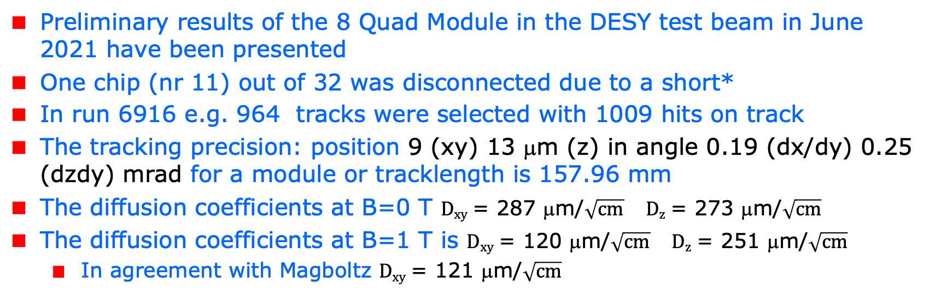
Conclusions on module performance
Preliminary results of the 8 Quad Module in the DESY test beam in June 2021 have been presented
One chip (nr 11) out of 32 was disconnected due to a short*
In run 6916 e.g. 964 tracks were selected with 1009 hits on track
The tracking precision: position 9 (xy) 13 μm (z) in angle 0.19 (dx/dy) 0.25 (dzdy) mrad for a module or tracklength is 157.96 mm
The diffusion coefficients at B=0 T $Dxy$ = 287 μm/$\sqrt{cm}$ $Dz$ = 273 μm/$\sqrt{cm}$
The diffusion coefficients at B=1 T is $Dxy$ = 120 μm/$\sqrt{cm}$ $Dz$ = 251 μm/$\sqrt{cm}$
  In agreement with Magboltz $Dxy$ = 121 μm/$\sqrt{cm}$
*the chip was successfully repaired in 2023 Bonn see backup slide

Slide 30
Conclusions on module performance
Results for the module showed that:
  the HV of the guard wires was well tuned
  B=0 T rms residuals in the module plane xy 13 μm and z 15 μm
  The results are compatible with (very) high stats quad measurement
  B= 1 T rms residuals in the plane xy 13 μm and z 20 μm;
High tracking precision is demonstrated with small systematics
  deformations xy stay below 13 μm
Particle identification dEdx based on the numbers of hits and their distance.
  the “Fit slope” method gives a MIP resolution of 4.2% for a 1 m track with realistic ~60% coverage of the readout plane in a 1 T B field
  this is much better than our single chip dEdx result at B=0 T.

Slide 31
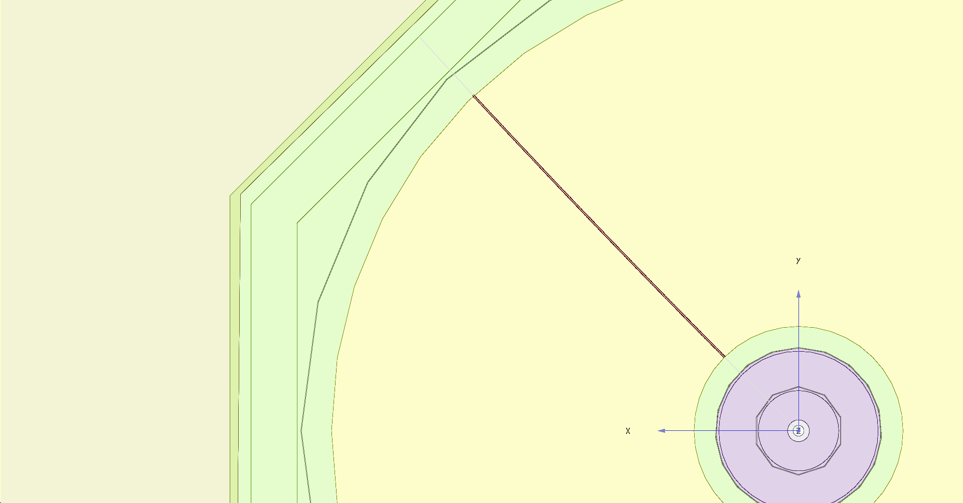
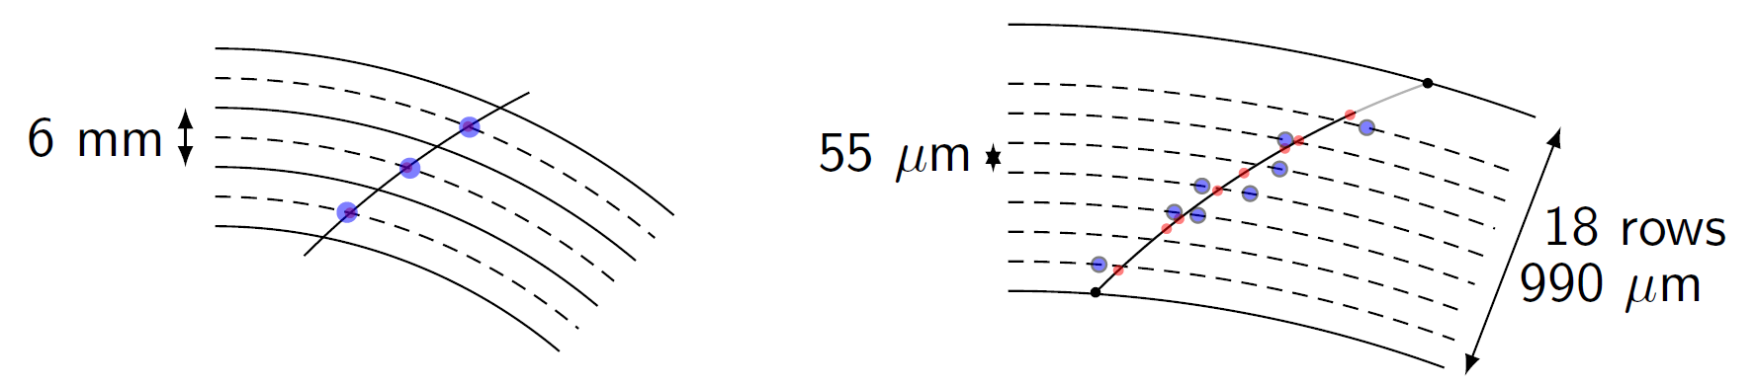
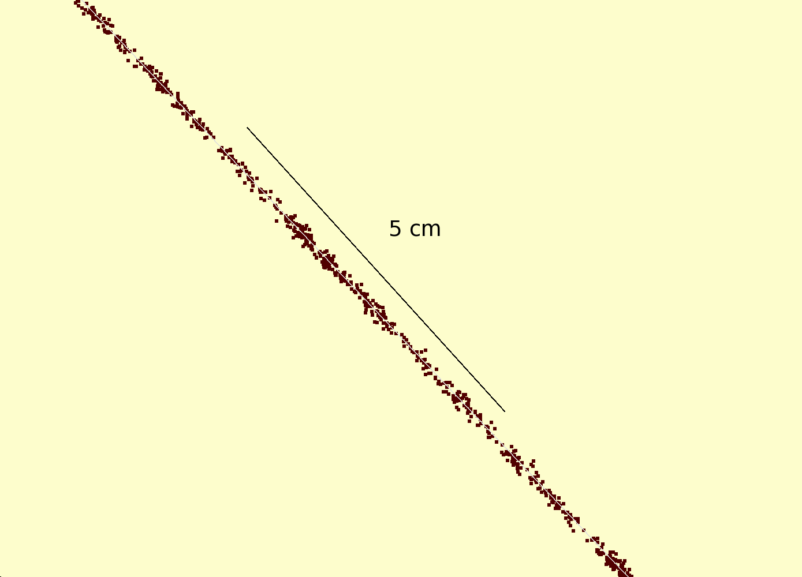
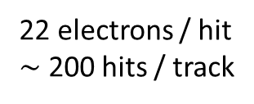
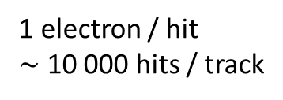
Simulation of ILD TPC with pixel readout
To study the performance of a large pixelized TPC, the pixel readout was implemented in the full ILD DD4HEP (Geant4) simulation
Changed the existing TPC pad readout to a pixel readout
Adapted Kalman filter track reconstruction to pixels
details: PhD thesis Kees Ligtenberg
pixels
pads
50 GeV muon track with
pixel readout

Slide 32
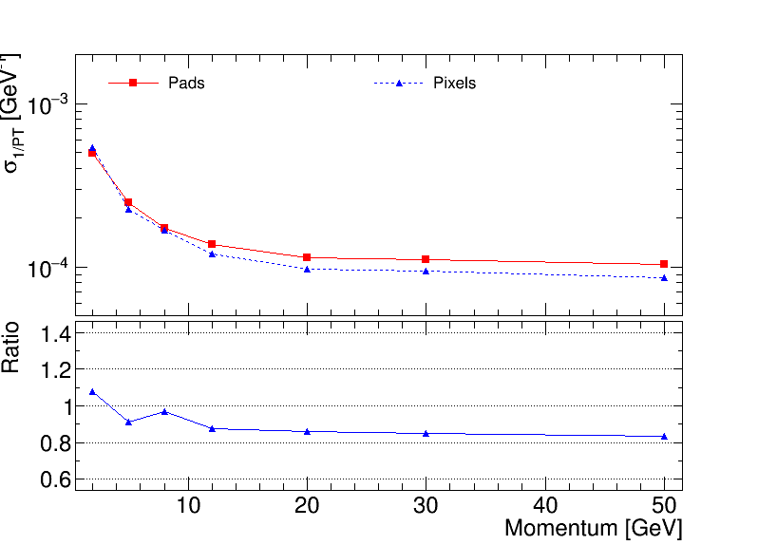
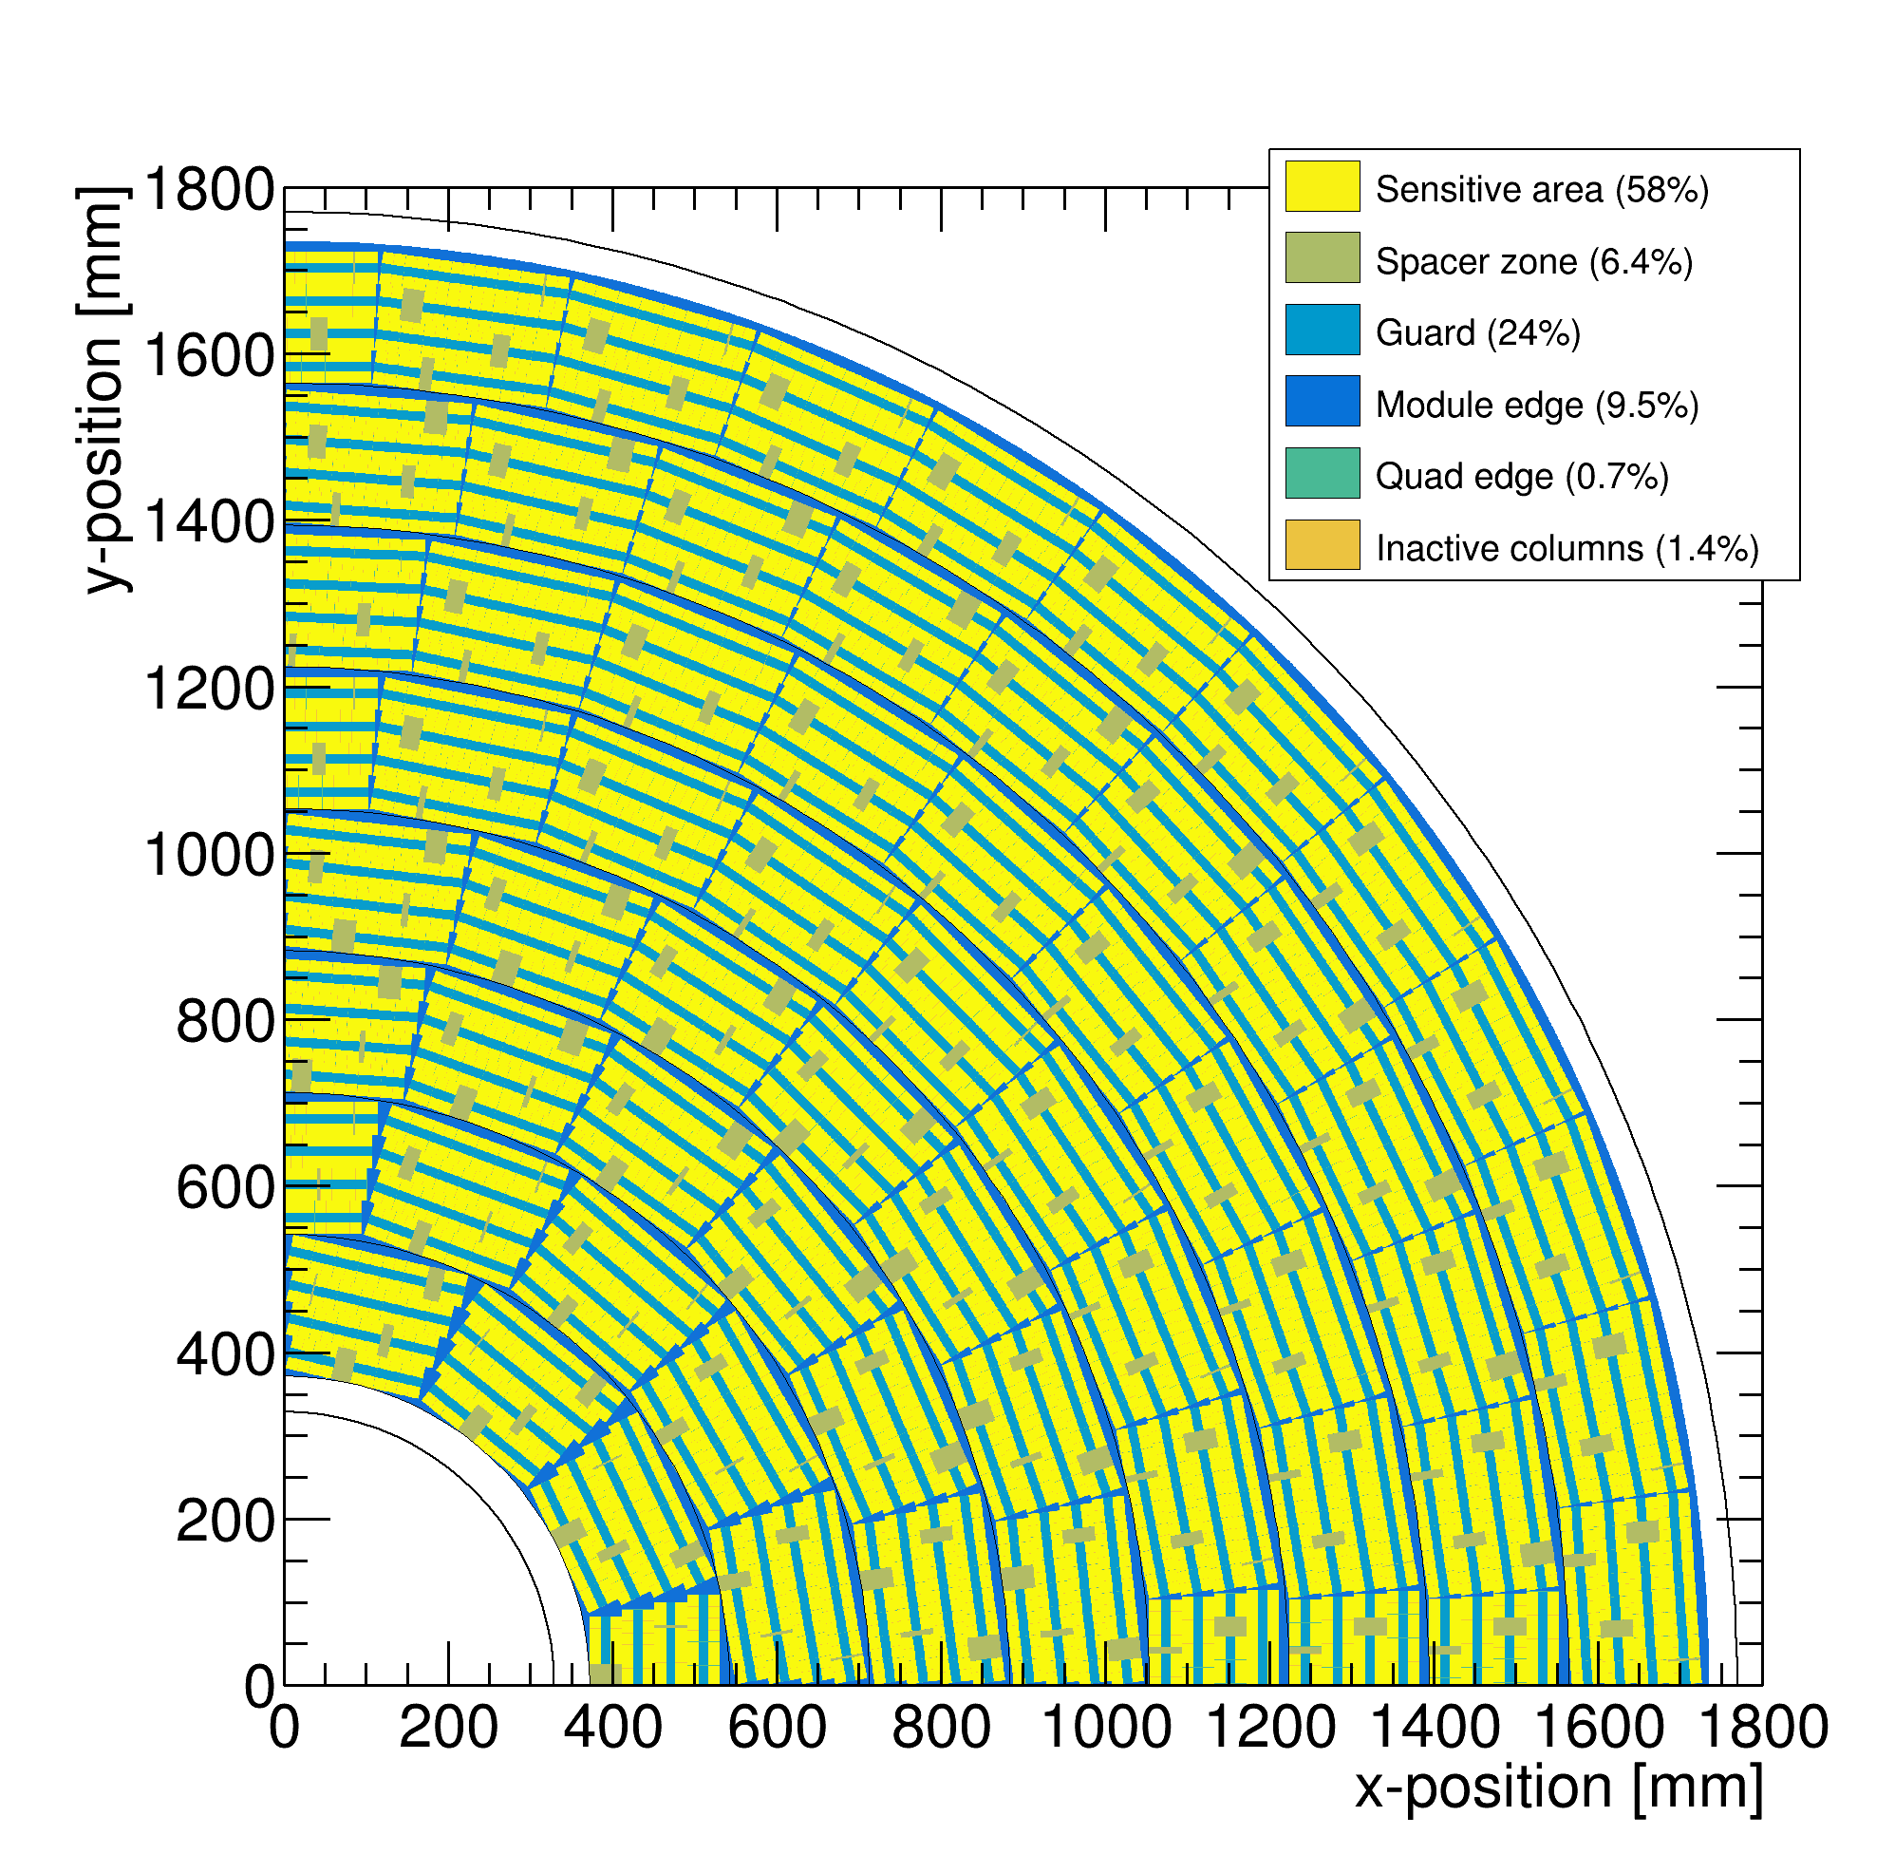
Performance of a GridPix TPC at ILC
From full simulation the momentum resolution can be determined
Momentum resolution is about 15% better for the pixels with realistic coverage (with the quads arranged in modules coverage 59%) and deltas.

Slide 33
GridPix TPC: Track fitting at the edge
In case of the a realistic geometry with detector edges, Kees Ligtenberg observed a worsened momentum resolution and momentum biases. This was traced down to be caused by biases in the residuals at the edge of the detector
The conclusion was that the track fit should be updated to take into account the biases in the residuals at the detector edge(s)
Recently, a master student (computational physics) at the UvA, Peter Voerman, has written a track fit that corrects the biases in one pass: “Track fitting at the edge”.
The technique can also be applied to fit hits from other gaseous or non-gaseous detectors:
  a centre of gravity technique is used (with measured charges over multiple strips near the edge)
  in case of silicon detector hits near the boundaries of the sensitive volume

Slide 34
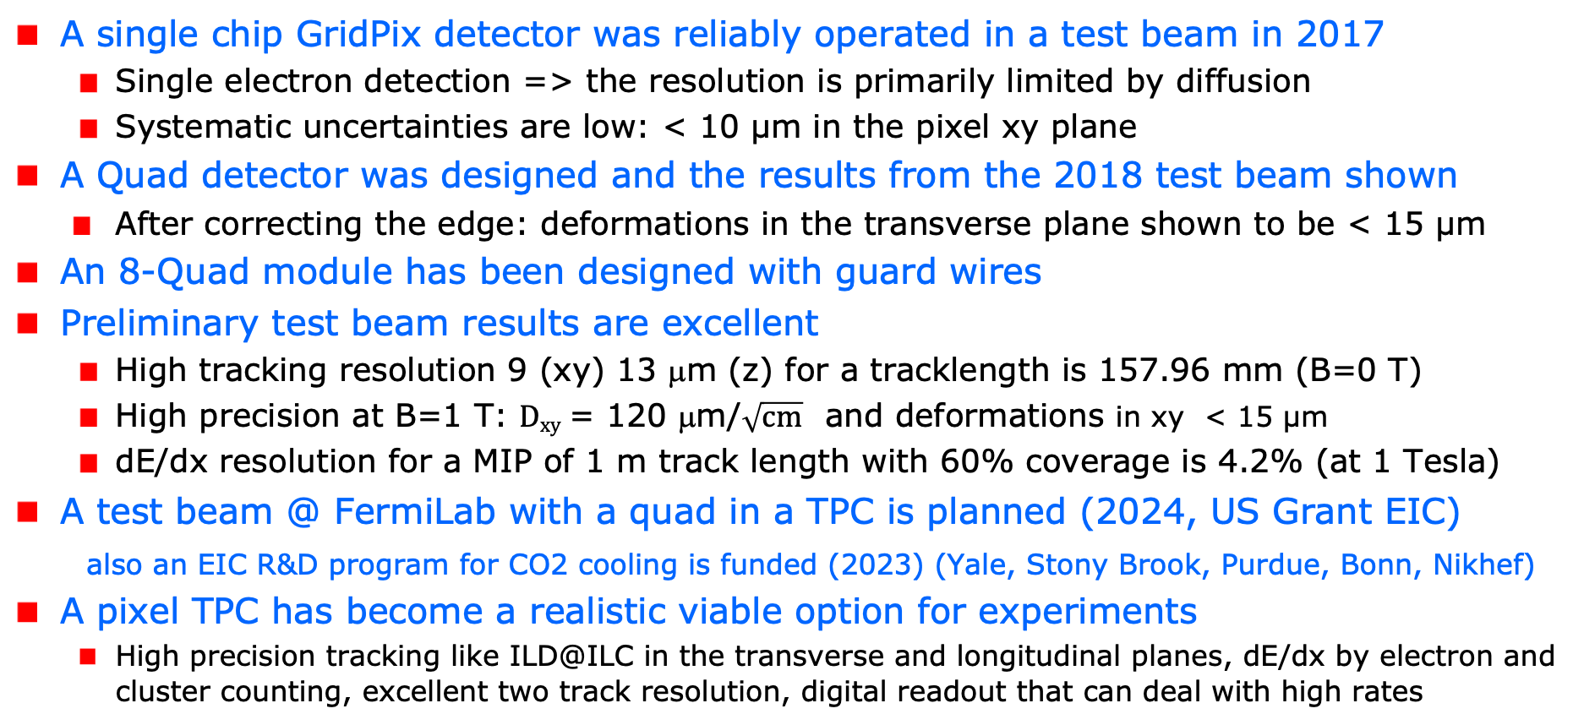
Summary of the Pixel TPC performance
A single chip GridPix detector was reliably operated in a test beam in 2017
  Single electron detection => the resolution is primarily limited by diffusion
  Systematic uncertainties are low: < 10 µm in the pixel xy plane
  A Quad detector was designed and the results from the 2018 test beam shown
    After correcting the edge: deformations in the transverse plane shown to be < 15 µm
An 8-Quad module has been designed with guard wires
Preliminary test beam results are excellent
  High tracking resolution 9 (xy) 13 μm (z) for a tracklength is 157.96 mm (B=0 T)
  High precision at B=1 T: $Dxy$ = 120 μm/$\sqrt{cm}$ and deformations in xy < 15 µm
  dE/dx resolution for a MIP of 1 m track length with 60% coverage is 4.2% (at 1 Tesla)
A test beam @ FermiLab with a quad in a TPC is planned (2024, US Grant EIC)
also an EIC R&D program for CO2 cooling is funded (2023) (Yale, Stony Brook, Purdue, Bonn, Nikhef)
A pixel TPC has become a realistic viable option for experiments
  High precision tracking like ILD@ILC in the transverse and longitudinal planes, dE/dx by electron and cluster counting, excellent two track resolution, digital readout that can deal with high rates

Slide 35



A Pixel TPC at CEPC or FCC-ee
The most difficult situation for a TPC is running at the Z.
At the Z pole with L = 200 10³⁴ cm⁻² s⁻¹ Z bosons will be produced at $\sim$60 kHz
Can a pixel TPC reconstruct the events?
  The TPC total drift time is about 30 μs
  This means that there is on average 2 event / TPC readout cycle
  YES: The excellent time resolution: time stamping of tracks < 1.2 ns allows to resolve and reconstruct the events
Can the current readout deal with the rate?
  Link speed of Timepix3 (in Quad) is 80 Mbps: 2.6 MHits/s per 1.41 × 1.41 cm²
  YES: This is largely sufficient to deal with high luminosity Z running
  NB: Data size is not a show stopper as e.g. LHCb experiment shows using the VeloPix chip
Picture IHEP

Slide 36

A Pixel TPC at CEPC or FCC-ee
What is the current power consumption?
  No power pulsing possible at these colliders (at ILC power pulsing was possible)
  Current power consumption TPX3 chip $\sim$2W/chip per 1.41 × 1.41 cm²
  So: good cooling is important but in my opinion no show stopper
  For Silicon detectors lower consumption for the chips and cooling is an important point that needs R&D (e.g. microchannel cooling).
  To save power the TPX3/4 chips can be run in LowPowerMode: reduction factor 10.
Can one limit the track distortions?
  There are two important sources of track distortions:
    the distortions of the TPC drift field due to the primary ions
    the distortions of the TPC drift field due to the ion back flow (IBF)
  At the ILC gating is possible; for CEPC or FCC-ee this is more involved, for a Pixel TPC a double grid is the best solution (see next slide)

Slide 37
A Pixel TPC at CEPC or FCC-ee
Is it possible to reduce the IBF for a pixel TPC?
  IDEA: by making chip with a double grid structure (see next slide)
  This idea was already realized as a TWINGRID NIMA 610 (2009) 644-648
  For GEMs for the ALICE TPC this was also the way – several GEMs on top of each other to reduce IBF
  For the Pixel the IBF can be easily modelled and with a hole size of 25 μm an IBF of 3 10⁻⁴ can be achieved and the value for IBF*Gain (2000) would be 0.6.
  YES: the IBF can be reduced to 0.6 but this needs R&D
  In the new detector lab in Bonn it is possible to make and study this device
What would be the size of the TPC distortions?
  Tera-Z studies by Daniel Jeans and Keisuke Fuji show that for FCC-ee or CEPC this means: distortions from Z decays up to < O(100) μm
  Beam strahlung gives (now) a factor 200 more background. Detector optimization and shielding is important for TPC and Silicon detectors to reduce pair background.
  It was argued that in an ILD like detector the distortions can be mapped out using the VTX-SIT/SET detectors.

Slide 38
Reducing the Ion back flow in a Pixel TPC
The Ion back flow can be reduced by adding a second grid to the device.
It is important that the holes of the grids are aligned. The Ion back flow is a function of the geometry and electric fields. Detailed simulations – validated by data - have been presented in LCTPC WP #326.
With a hole size of 25 μm an IBF of 3 10⁻⁴ can be achieved and the value for IBF*Gain (2000) would be 0.6.
Ion backflow | Hole 30 μm | Hole 25 μm | Hole 20 μm
Top grid | 2.2% | 1.2% | 0.7%
GridPix | 5.5% | 2.8% | 1.7%
Total | 12 10⁻⁴ | 3 10⁻⁴ | 1 10⁻⁴
transparancy | 100% | 99.4% | 91.7%

Slide 39
Conclusions: Pixel TPC at a circular collider
YES: a pixel TPC can reconstruct the Z events in one readout cycle
YES: the current readout of the Timepix3 chip can deal with the rate
The current power consumption is 1W/cm². By running the TPX chips in low power mode this can be reduced by a factor of 10. Still good cooling is important no show stopper; but needs extensive R&D.
Track distortions in the TPC drift volume are a concern at high lumi Z running:
  Track distortions from Z decays in TPC are O(100) μm
  It is possible to reduce the IBF for a pixel TPC by making a device with a double grid
  A double grid needs dedicated R&D that can be performed in the new lab in Bonn
The Z physics program at FCC-ee or CEPC with an ILD-like detector with a Pixel TPC (with double grid structures) sliced between two silicon trackers (VTX-SIT and SET) can be fully exploited. The reduction of beamstrahlung needs more study.
A pixel TPC can perfectly run at WW, ZH or tt energies where track distortions are several orders of magnitude smaller

Slide 40


Forschungs- und Technologiezentrum Detektorphysik
Backup
First stone laying ceremony 2.11.2016
Inauguration ceremony 8.11.2021
Office space:
• 880 m²
• 4 Floors
Lab space
• 2010 m²
• 4 Levels + Underground Laboratory
• 360 m² clean rooms (ISO 5, 6, 7)

Slide 41




Cleanroom
Backup
ISO 7
Maskless Aligner
ISO 6
ISO 5
PECVD
Wet bench:
Inorganic
processes
Wet bench:
organic
processes
sputterer
RIE

Slide 42



Pictures of repair work in Bonn
Backup
The short in chip 11 was succesully repaired by Fred Hartjes

Slide 43
DESY testbeam Module Analysis
Runs 6909, 6916-17, 6934-35 B=0 T p =6,5 GeV
Mean residuals (module) row (module) column
Regrouping the module plane to increase stats
Granularity 8x8 pixels
acceptance cut
entries > 1500
xy
xy
Backup
Preliminary
column 256 pixels
z
column 4x256 pixels
row 4x256 pixels
For the column plot the 4 chip rows are kept separately (that is why there are white bands)
For the row plot the data is projected keeping 4 bins in local y (one follows the track)
z
row 256 pixel

