Slide 1
Report Spark test preparations from Fred Hartjes 7 November 2016
For the Spark test 8 GridPix chips have been installed in the two gas envelopes, using the chips I received recently from Yevgen. The chips are not electrically read out, only the grid and ground pads are connected. Each chip has its own remote controlled HV supply (miniHV) with a current readout with 0.1 nA resolution. The currents are recorded at 3 Hz rate.
At occurrence of a spark, the waveform 5 min before until 5 min after is registered. There are no grid preamps installed. At a spark we see a current peak until 400 nA high.
Installed were:
4 TPX3 chips with very low electrical grade, all equipped with 4 um SiN and an InGrid
2 "dummy" chips: bare silicon with a metal layer, a 4 um SiN layer and an InGrid
1 TPX1 chip with 8 um SiN and an InGrid
1 TPX1 chip with 4 um SiN and an InGrid
The grids have been connected to HV by a 50 um copper wire, connection made by TraDuct silver glue, reinforced by Globtop. When doing this I realized that in future we need some kind of micro dosimeter system for this that is not commercially available, I have some ideas.

Slide 2
Report from Fred Hartjes 6 November
The ground connection was made on the GND bonding pads by a few W-Au wires and TraDuct * all chips have been tested last Thursday and Friday in T2K gas for HV tolerance and gas gain, indicated by the increase of grid current when irradiated by a 90Sr source. They all work properly. When placing the source, the induced current shows a rapid peak falling within some 10 - 20 s down to about half the value. When removing the source and replacing it shortly afterwards, the new peak is much less high. This can easily be understood from the almost infinite resistivity of the protection layer for voltages of 10 - 15 V. Some characteristic differences are:
the 4 TPX3 chips show an almost identical behaviour, grid current ~3 nA @ 400 V. One chip I tried to ramp further, but it started sparking above 420 V
the 2 dummies showed a very high current (6.7 nA) already at 350 V, but became unstable above this value. One should realize that at the grounded TPX3 the pads cover only 5% of the chip surface while the rest is passivated. For the dummies 100% of the surface is grounded.

Slide 3
Report from Fred Hartjes 6 November
TPX1 chips show 3.7 and 2.2 nA resp. at 350 V, above this voltage they became unstable. These chips have a considerable larger pad size that the TPX3.
So comparing TPX3 with TPX1 we may roughly conclude that for TPX3 we can geta comparable gain in spite of the lower pad size when increasing the gridvoltage by 50 V.

Slide 4
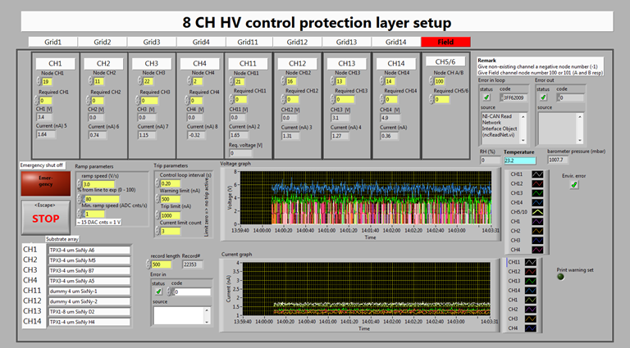

Slide 5
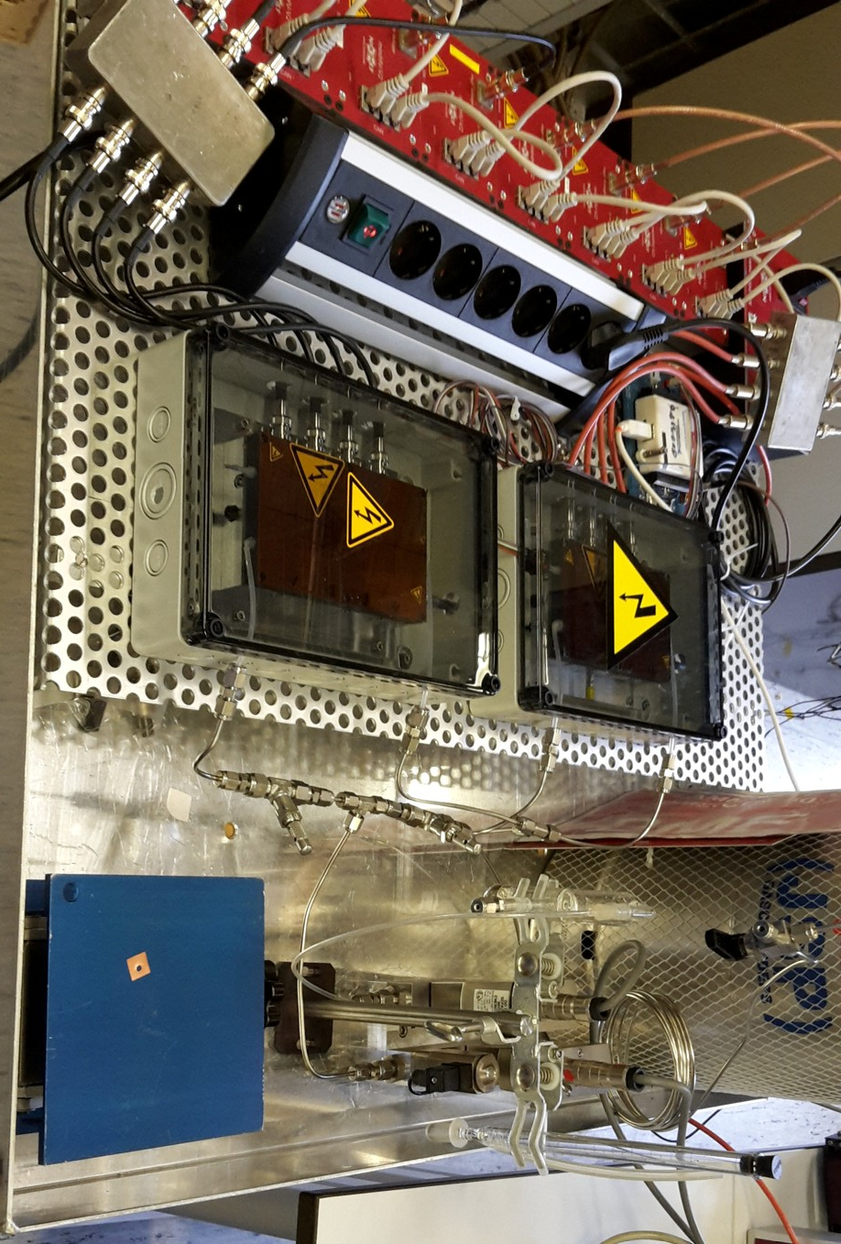

Slide 6
