Slide 1

Medium-enhanced production of charm quark pairs in jets
Jasmine Brewer
In collaboration with Maximilian Attems, Gian Michele Innocenti, Aleksas Mazeliauskas, Sohyun Park, Wilke van der Schee, and Urs Wiedemann
[2203.11241], [2209.13600], and ongoing work

Slide 2
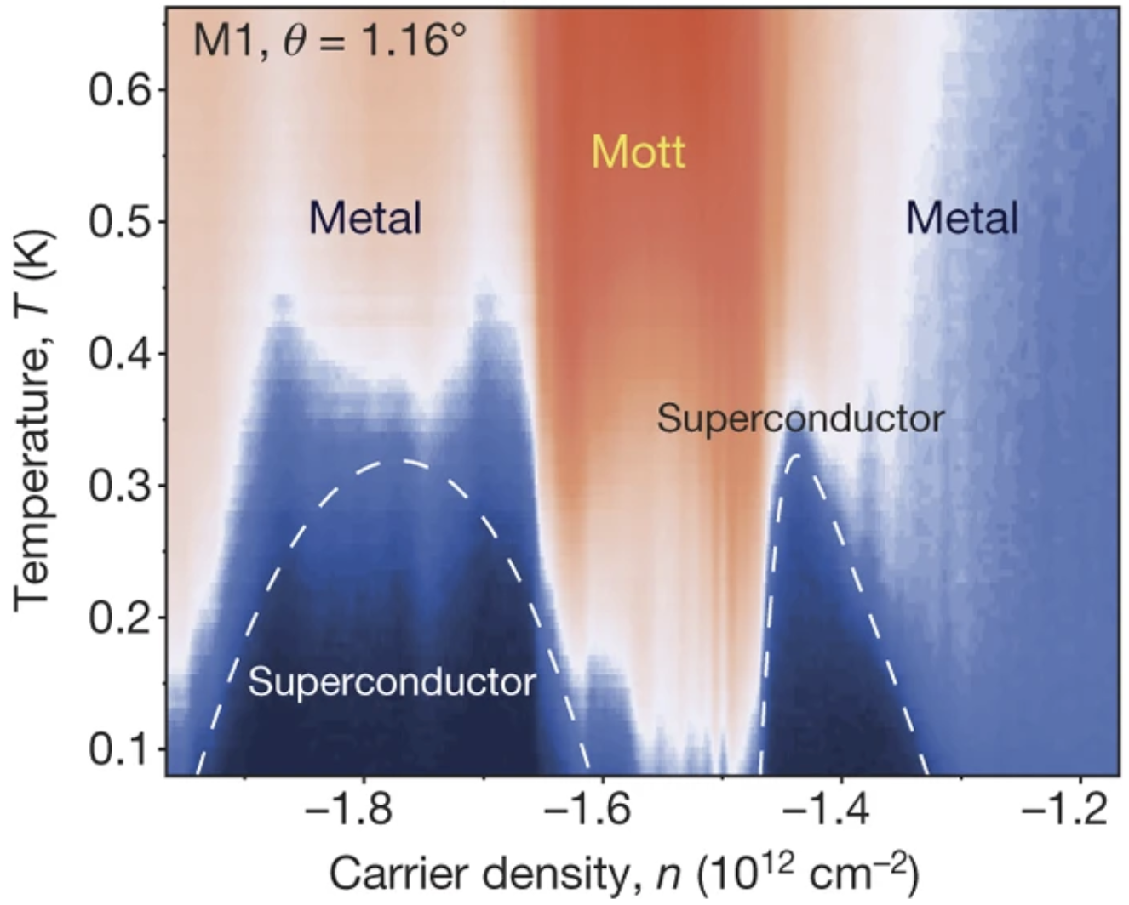
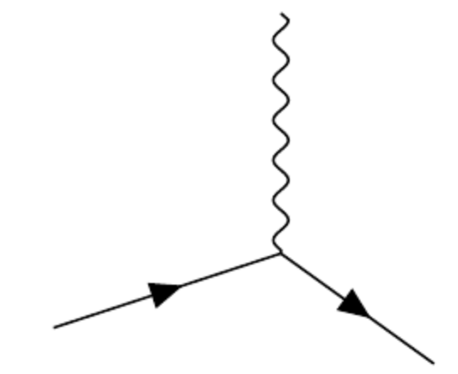
  Magic angle graphene
  Cao et. al. Nature 556, 43–50 (2018)
  QED
Notes:
Unfortunately, the interpretation of jet modification observables often depends crucially on which proton-proton jets are taken to be a comparable baseline for a given heavy-ion measurement. In di-jet and inclusive jet studies, the standard answer is to compare heavy-ion jets to a proton-proton baseline with the same reconstructed pT. For example, comparing the jet production spectra for p-p and HI at the same reconstructed pT (as illustrated by the blue arrows) gives rise to the famous jet RAA.

Slide 3
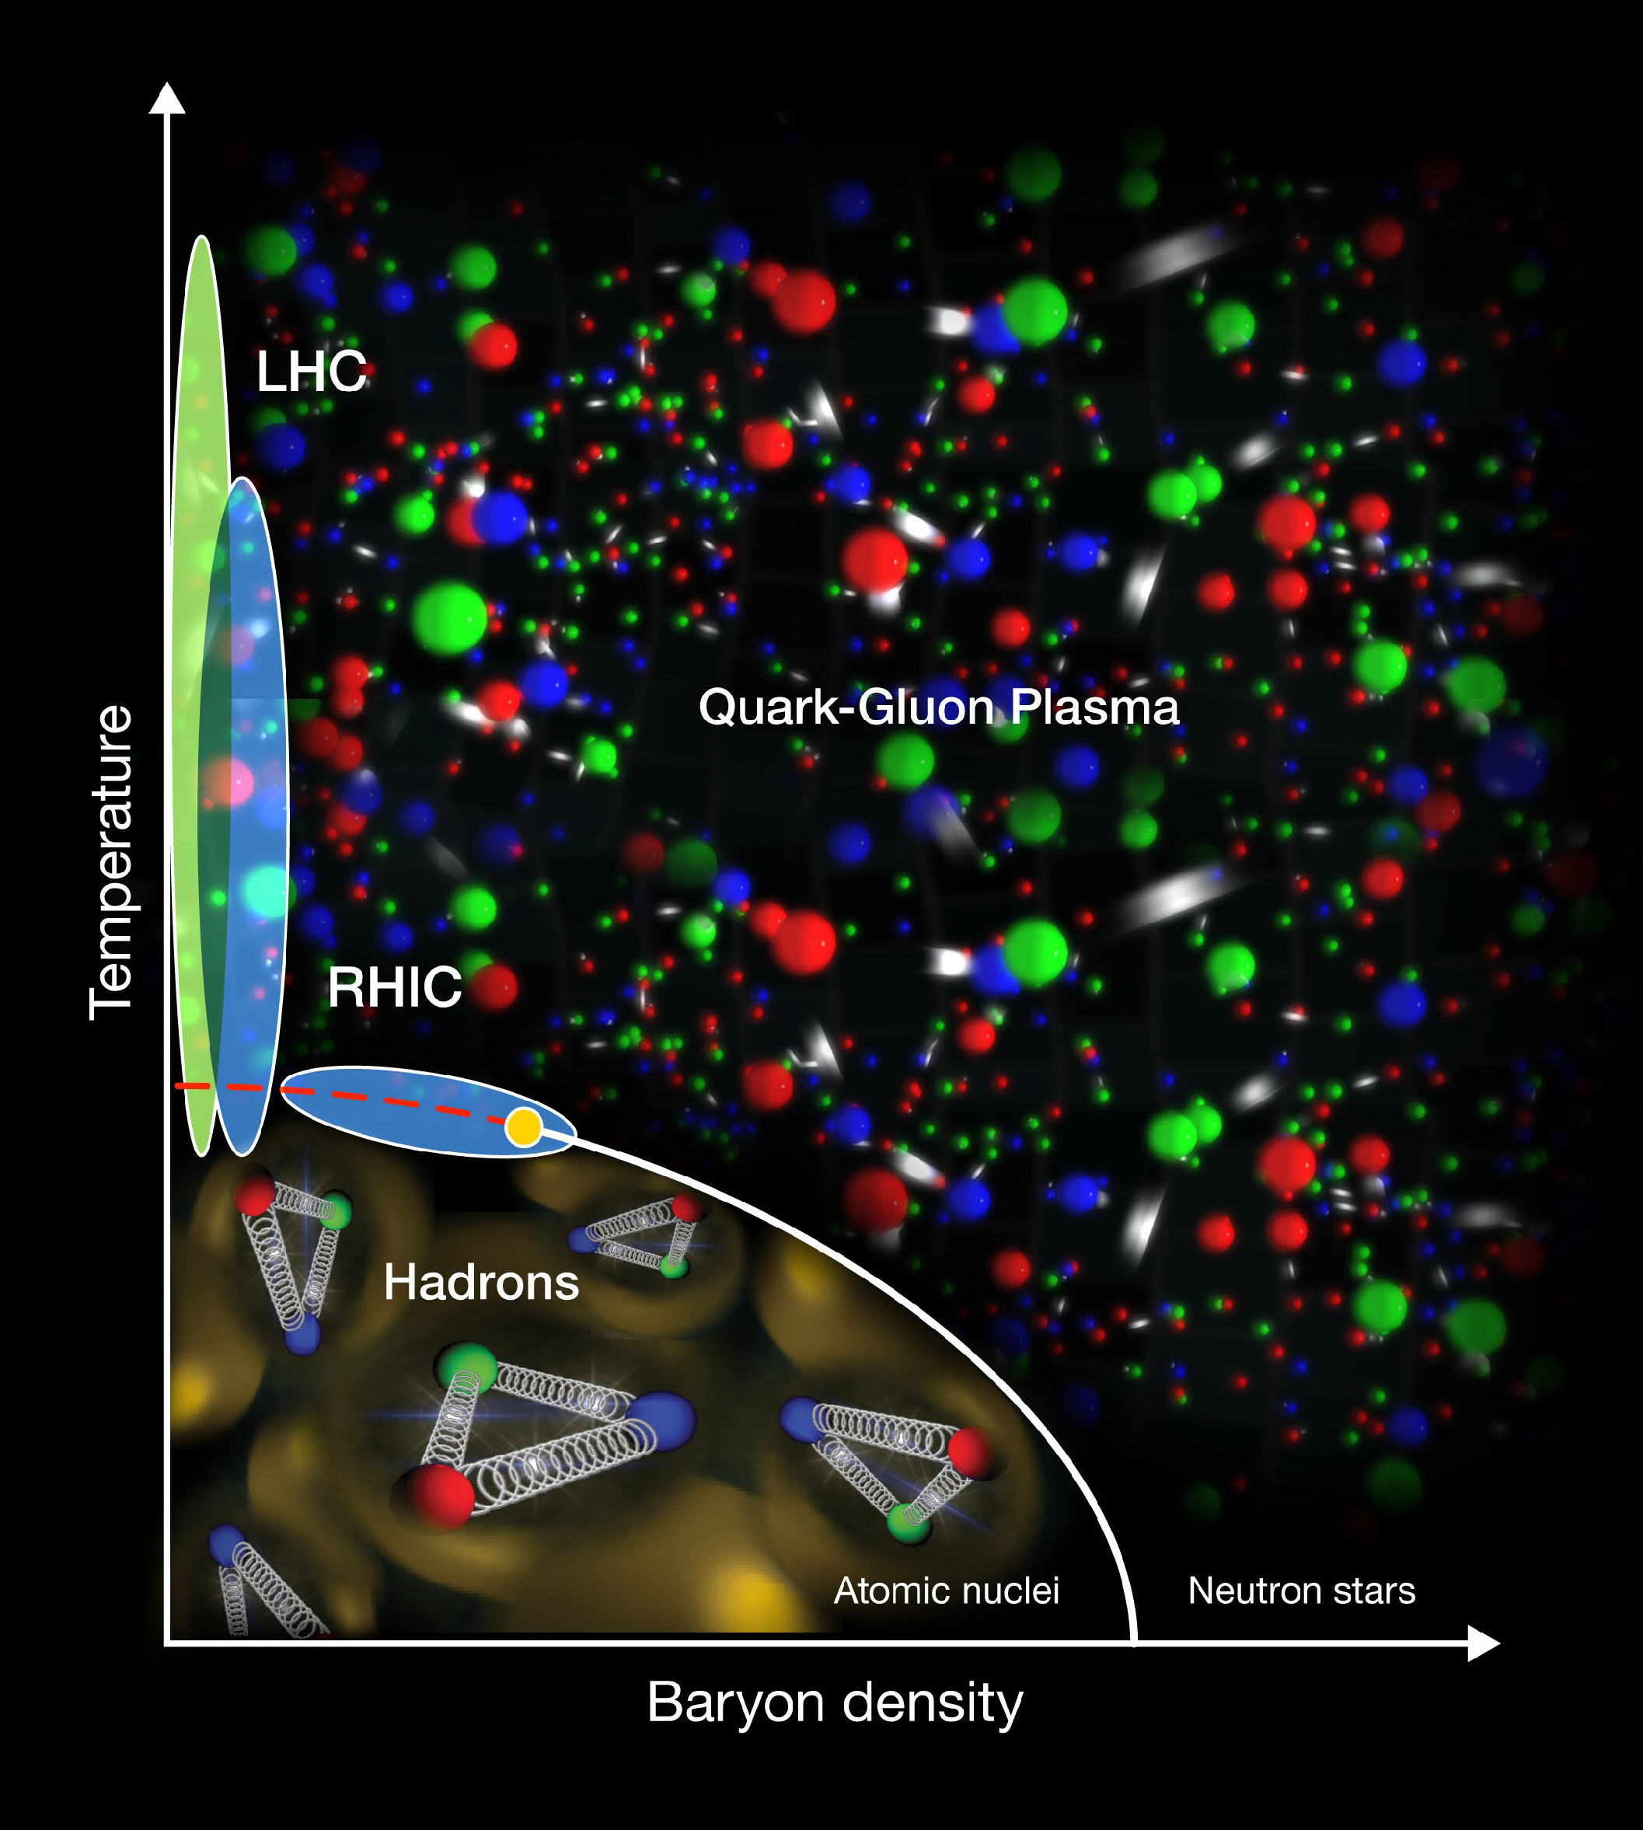
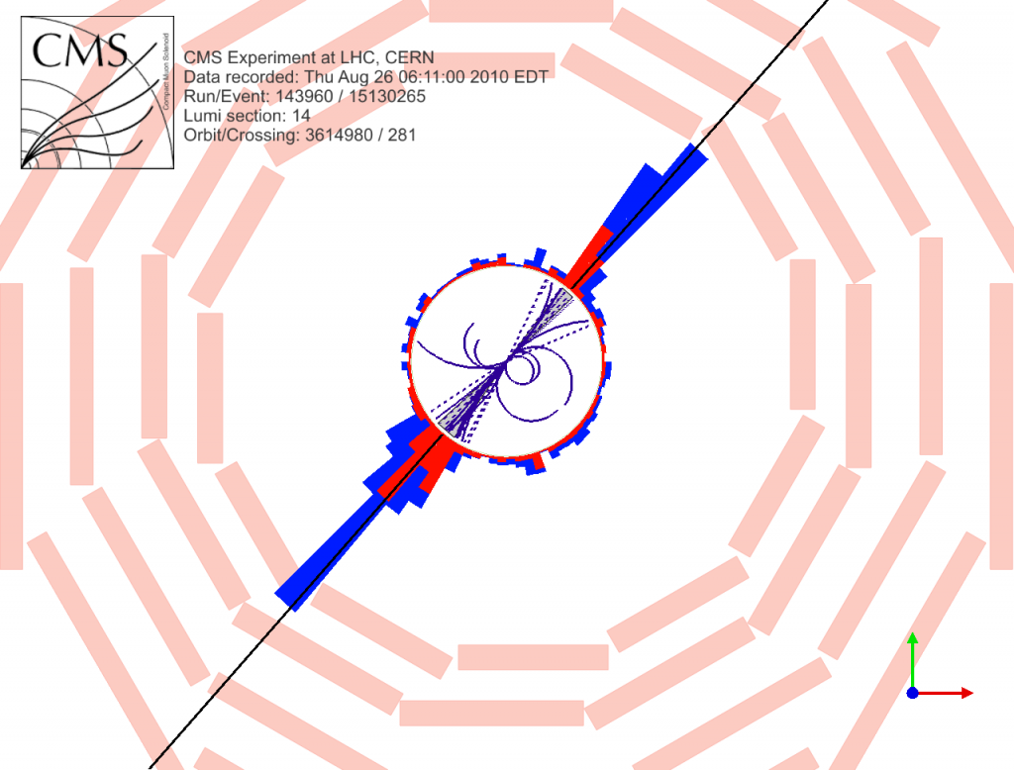
  Magic angle graphene
  Cao et. al. Nature 556, 43–50 (2018)
  QED
  QCD
  Understanding the fundamental interactions is just the beginning!
Notes:
Unfortunately, the interpretation of jet modification observables often depends crucially on which proton-proton jets are taken to be a comparable baseline for a given heavy-ion measurement. In di-jet and inclusive jet studies, the standard answer is to compare heavy-ion jets to a proton-proton baseline with the same reconstructed pT. For example, comparing the jet production spectra for p-p and HI at the same reconstructed pT (as illustrated by the blue arrows) gives rise to the famous jet RAA.

Slide 4
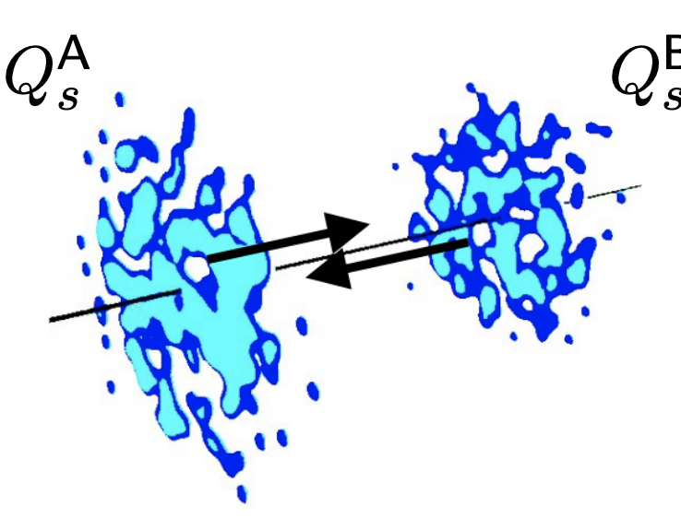

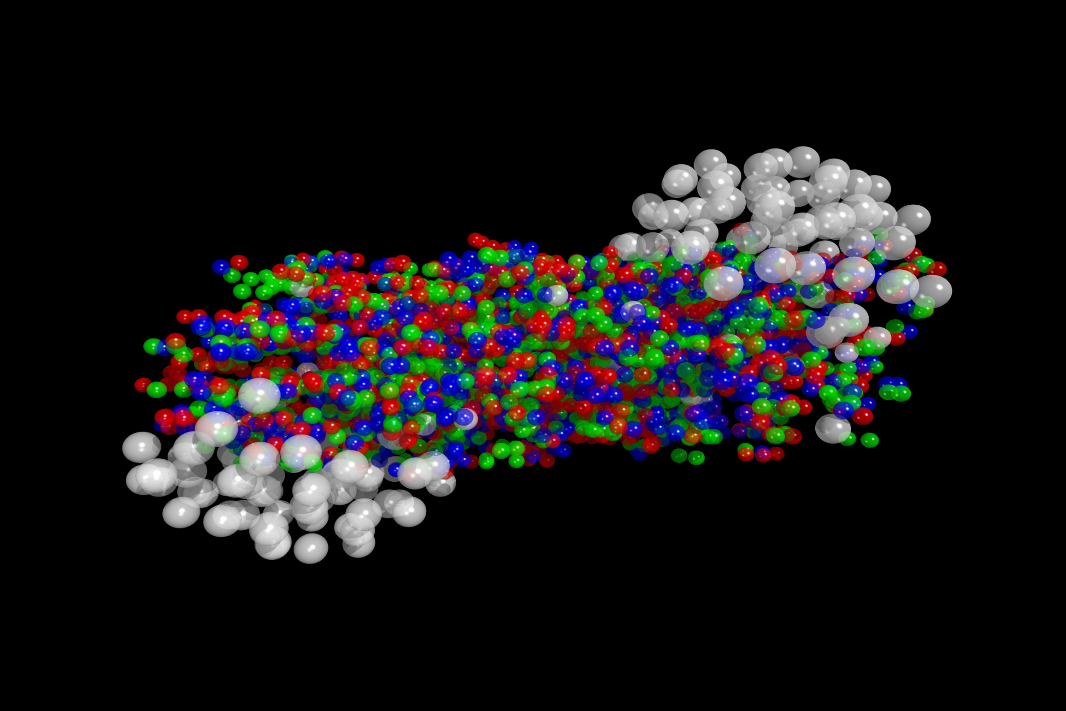
  Heavy-ion collisions and quark-gluon plasma
  Temperature
Notes:
Unfortunately, the interpretation of jet modification observables often depends crucially on which proton-proton jets are taken to be a comparable baseline for a given heavy-ion measurement. In di-jet and inclusive jet studies, the standard answer is to compare heavy-ion jets to a proton-proton baseline with the same reconstructed pT. For example, comparing the jet production spectra for p-p and HI at the same reconstructed pT (as illustrated by the blue arrows) gives rise to the famous jet RAA.

Slide 5
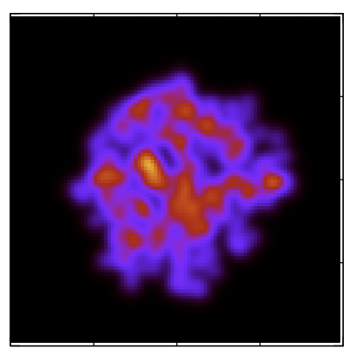
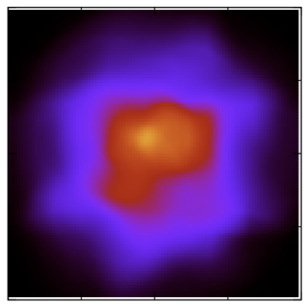
  energy
  Heavy-ion collisions
  far from equilibrium initial state
  hydrodynamics
  hadron gas
  time
Notes:
Unfortunately, the interpretation of jet modification observables often depends crucially on which proton-proton jets are taken to be a comparable baseline for a given heavy-ion measurement. In di-jet and inclusive jet studies, the standard answer is to compare heavy-ion jets to a proton-proton baseline with the same reconstructed pT. For example, comparing the jet production spectra for p-p and HI at the same reconstructed pT (as illustrated by the blue arrows) gives rise to the famous jet RAA.

Slide 6
  energy
  Heavy-ion collisions
  high energy scatterings
  energy loss
  far from equilibrium initial state
  hydrodynamics
  hadron gas
  time
Notes:
Unfortunately, the interpretation of jet modification observables often depends crucially on which proton-proton jets are taken to be a comparable baseline for a given heavy-ion measurement. In di-jet and inclusive jet studies, the standard answer is to compare heavy-ion jets to a proton-proton baseline with the same reconstructed pT. For example, comparing the jet production spectra for p-p and HI at the same reconstructed pT (as illustrated by the blue arrows) gives rise to the famous jet RAA.

Slide 7
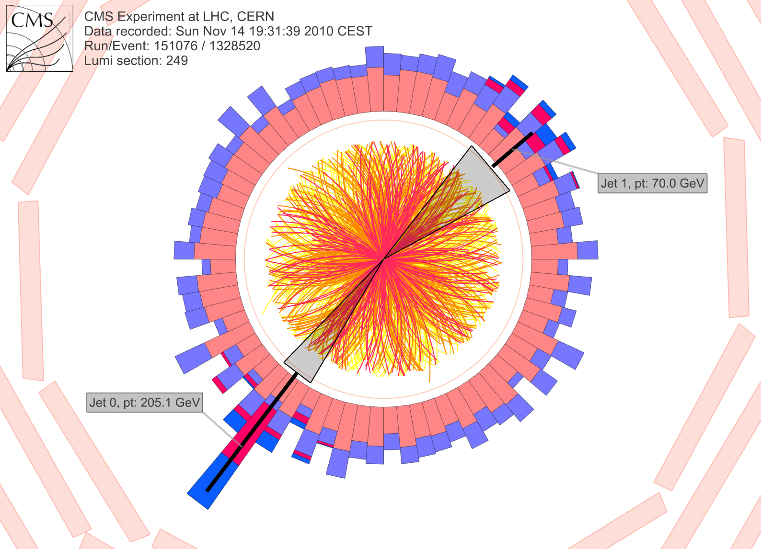
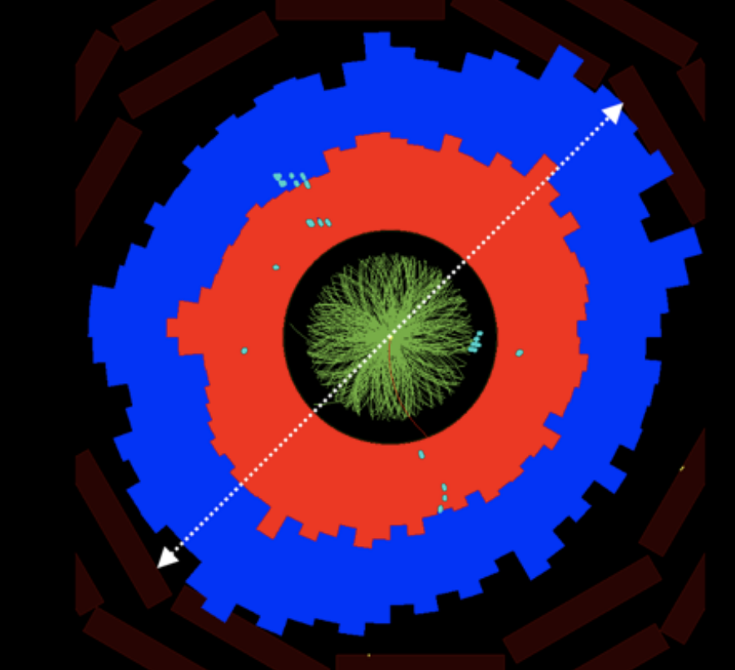
  Studying the dense QCD medium
  Modification of high-energy probes
  (hadrons, jets, heavy flavor, ..)
  high $p_{T}$
  Collective behavior of low-$p_{T}$ particles
  low $p_{T}$
Notes:
Unfortunately, the interpretation of jet modification observables often depends crucially on which proton-proton jets are taken to be a comparable baseline for a given heavy-ion measurement. In di-jet and inclusive jet studies, the standard answer is to compare heavy-ion jets to a proton-proton baseline with the same reconstructed pT. For example, comparing the jet production spectra for p-p and HI at the same reconstructed pT (as illustrated by the blue arrows) gives rise to the famous jet RAA.

Slide 8
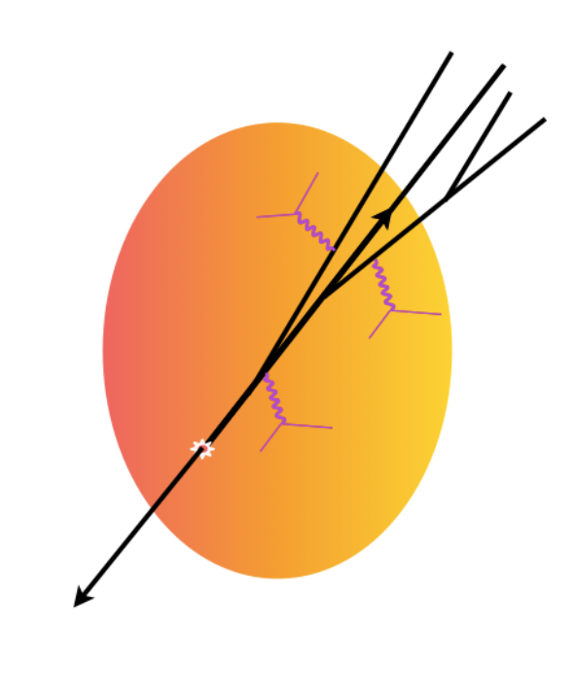
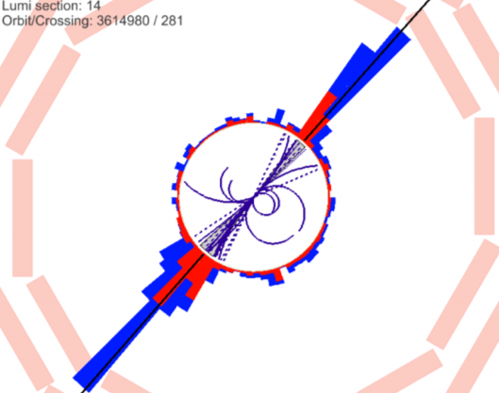
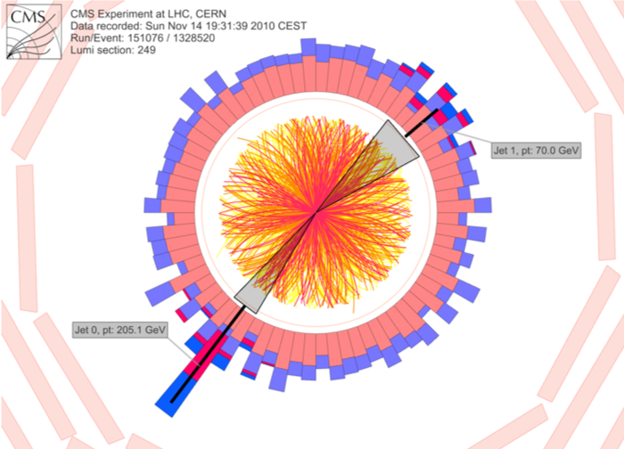
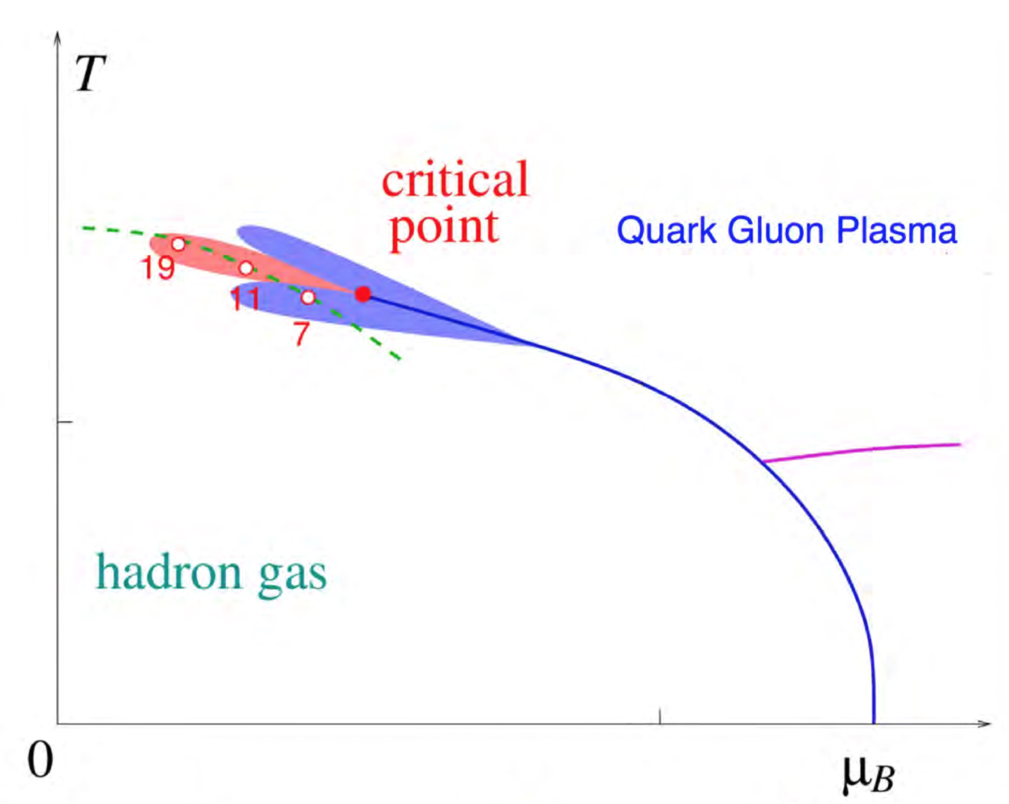
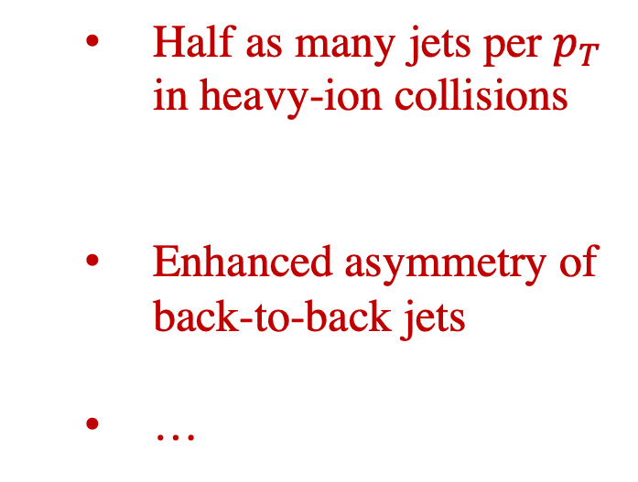
  Modification of jets as a probe of quark-gluon plasma
  proton–proton
  heavy-ion
  Large effect:
  Half as many jets per $p_{T}$ in heavy-ion collisions
  Enhanced asymmetry of back-to-back jets
  …
  “baseline” jet properties
Notes:
There have been a multitude of nice measurements quantifying the differences between the properties of p-p and A-A jets through jet modification observables, for example the dijet asymmetry and jet shape modifications. The aim in this program is to use jet modification observables to make direct inferences about how the quark-gluon plasma interacts with partons traversing through it.

Slide 9



  Parton splittings in vacuum
  hadrons
$$θ_{1}$$
$$θ_{2}$$
$$θ_{3}$$
  Splitting functions
  Iteratively apply splitting functions, descending in angle, virtuality
  Parton showers connect perturbative QCD to hadronic world
  Next-to-leading log calculations
  Going to higher accuracy
  Parton showers
Notes:
Unfortunately, the interpretation of jet modification observables often depends crucially on which proton-proton jets are taken to be a comparable baseline for a given heavy-ion measurement. In di-jet and inclusive jet studies, the standard answer is to compare heavy-ion jets to a proton-proton baseline with the same reconstructed pT. For example, comparing the jet production spectra for p-p and HI at the same reconstructed pT (as illustrated by the blue arrows) gives rise to the famous jet RAA.

Slide 10
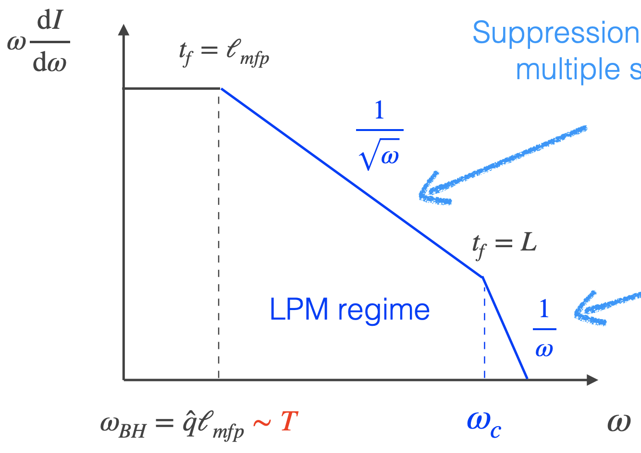
  A single high-energy parton in finite-temperature QCD
  Parton undergoes transverse momentum diffusion
  L
  Kicks occasionally induce gluon radiation
  Radiation can’t be resolved instantaneously
  Baier, Dokshitzer, Mueller, Peigne, Schiff (1996), Zakharov (1996)
  Arnold, Moore, Yaffe (2003)
  Fig: adapted from Yacine Mehtar-Tani QM’19
Notes:
Unfortunately, the interpretation of jet modification observables often depends crucially on which proton-proton jets are taken to be a comparable baseline for a given heavy-ion measurement. In di-jet and inclusive jet studies, the standard answer is to compare heavy-ion jets to a proton-proton baseline with the same reconstructed pT. For example, comparing the jet production spectra for p-p and HI at the same reconstructed pT (as illustrated by the blue arrows) gives rise to the famous jet RAA.

Slide 11
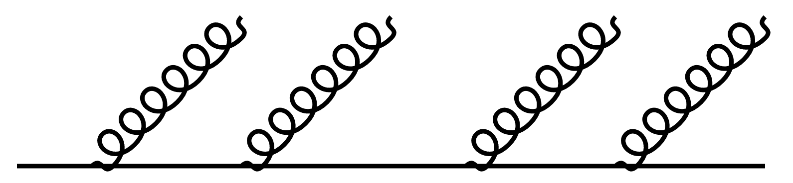
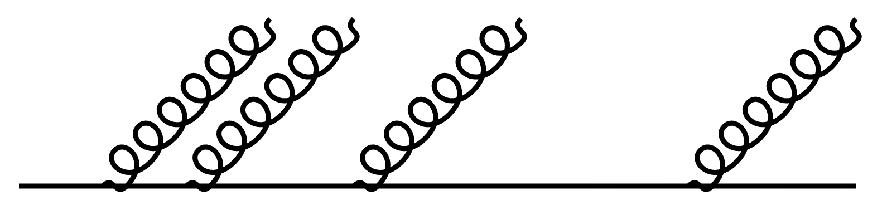
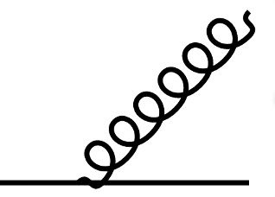







  A high-energy parton fragments even in vacuum
  Detailed interplay of vacuum physics and medium modification
  Improved theory
  vacuum shower
$$θ_{1}$$
$$θ_{2}$$
$$θ_{3}$$
$$θ_{4}$$
  Improved parton radiation spectrum
Mehtar-Tani, Tywoniuk, Andres, Dominguez, Salgado, …
  Parton showers in medium
  vacuum shower
  in medium
Caucal, Iancu, Mueller, Soyez, Wiedemann, Zapp, …
$$t_{1}$$
$$t_{2}$$
$$t_{3}$$
$$t_{4}$$
  No current theories capture full complexity
  Improved phenomenology
  medium shower
  Deconstructing a jet to access individual splittings
Notes:
Unfortunately, the interpretation of jet modification observables often depends crucially on which proton-proton jets are taken to be a comparable baseline for a given heavy-ion measurement. In di-jet and inclusive jet studies, the standard answer is to compare heavy-ion jets to a proton-proton baseline with the same reconstructed pT. For example, comparing the jet production spectra for p-p and HI at the same reconstructed pT (as illustrated by the blue arrows) gives rise to the famous jet RAA.

Slide 12
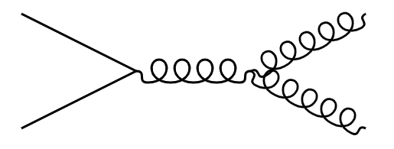
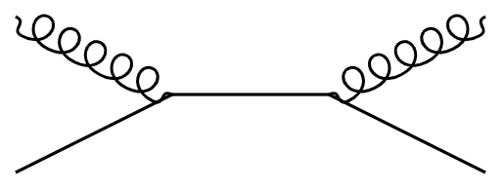
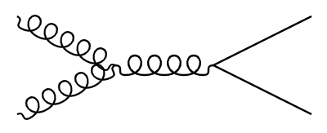
  Building up a picture of a medium-modified jet from phenomenology
  hadrons
  Hadrons to splittings
  Flavor-dependence of splittings
  hadrons
Notes:
Unfortunately, the interpretation of jet modification observables often depends crucially on which proton-proton jets are taken to be a comparable baseline for a given heavy-ion measurement. In di-jet and inclusive jet studies, the standard answer is to compare heavy-ion jets to a proton-proton baseline with the same reconstructed pT. For example, comparing the jet production spectra for p-p and HI at the same reconstructed pT (as illustrated by the blue arrows) gives rise to the famous jet RAA.

Slide 13
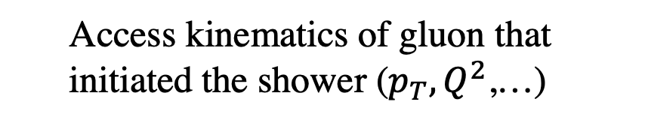
  Accessing splitting functions from jet substructure
  Access kinematics of gluon that initiated the shower ($p_{T},Q^{2}$,…)
  jet
Notes:
Unfortunately, the interpretation of jet modification observables often depends crucially on which proton-proton jets are taken to be a comparable baseline for a given heavy-ion measurement. In di-jet and inclusive jet studies, the standard answer is to compare heavy-ion jets to a proton-proton baseline with the same reconstructed pT. For example, comparing the jet production spectra for p-p and HI at the same reconstructed pT (as illustrated by the blue arrows) gives rise to the famous jet RAA.

Slide 14
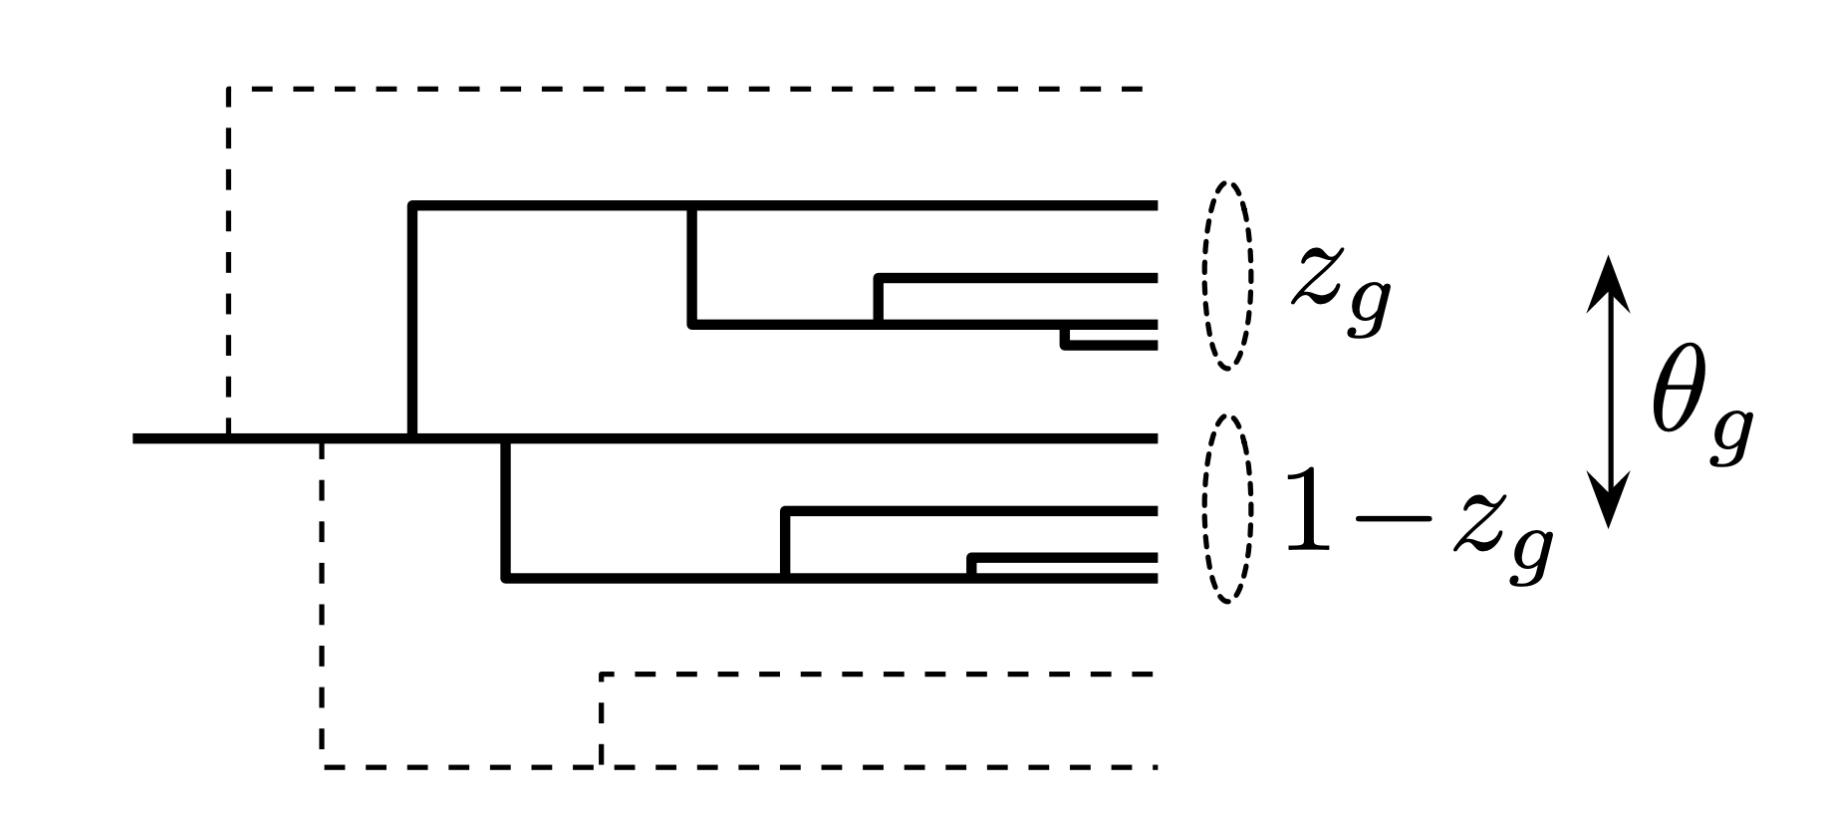
  Accessing splitting functions from jet substructure
  Access kinematics of gluon that initiated the shower ($p_{T},Q^{2}$,…)
  jet
  Use angular ordering of QCD to reconstruct emission history of shower from hadron level
Larkoski, Marzani, Soyez, Thaler [1402.2657]
Notes:
Unfortunately, the interpretation of jet modification observables often depends crucially on which proton-proton jets are taken to be a comparable baseline for a given heavy-ion measurement. In di-jet and inclusive jet studies, the standard answer is to compare heavy-ion jets to a proton-proton baseline with the same reconstructed pT. For example, comparing the jet production spectra for p-p and HI at the same reconstructed pT (as illustrated by the blue arrows) gives rise to the famous jet RAA.

Slide 15
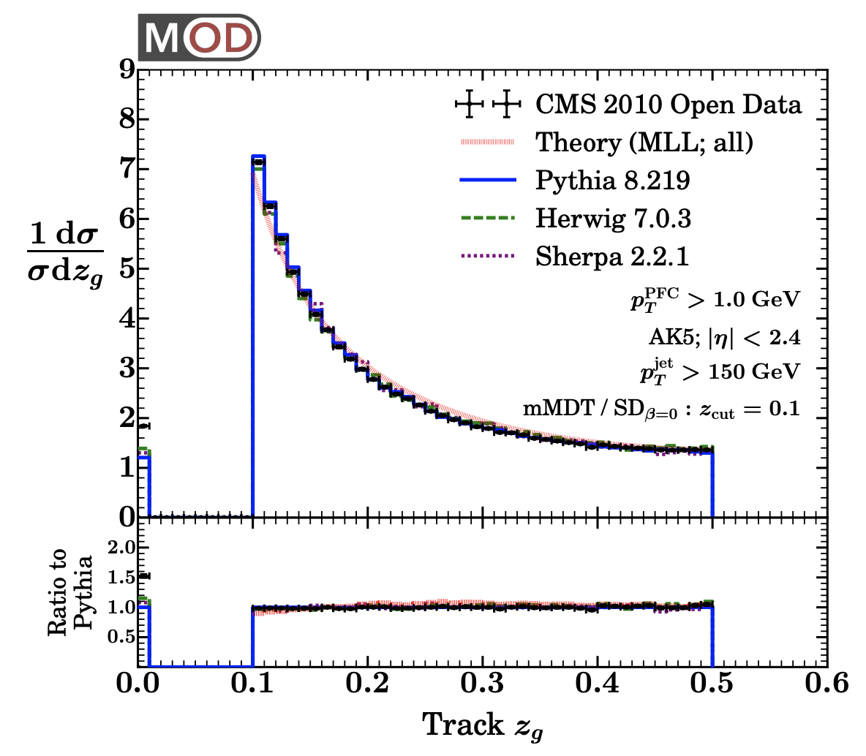

  Accessing splitting functions from jet substructure
  QCD splitting function from jets
  hadrons
  Adapted for heavy ions: splittings with shortest formation time, highest $k_{t}$, …
Mehtar-Tani, Soto-Ontoso, Tywoniuk [1911.00375]; Caucal, Soto-Ontoso, Takacs [2111.14768]
(see also Apolinario, Cordeiro, Zapp [2012.02199])
Larkoski, Marzani, Thaler [1502.01719]
Larkoski, Marzani, Thaler, Tripathee, Xue [1704.05066]
Notes:
There have been a multitude of nice measurements quantifying the differences between the properties of p-p and A-A jets through jet modification observables, for example the dijet asymmetry and jet shape modifications. The aim in this program is to use jet modification observables to make direct inferences about how the quark-gluon plasma interacts with partons traversing through it.

Slide 16
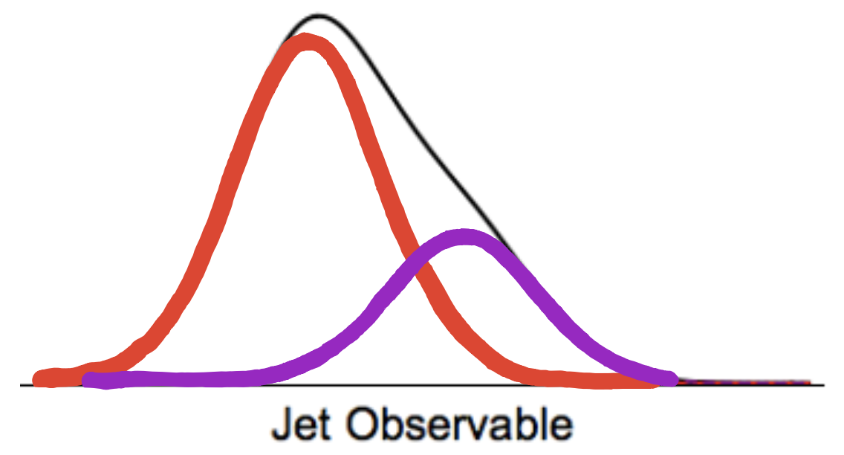

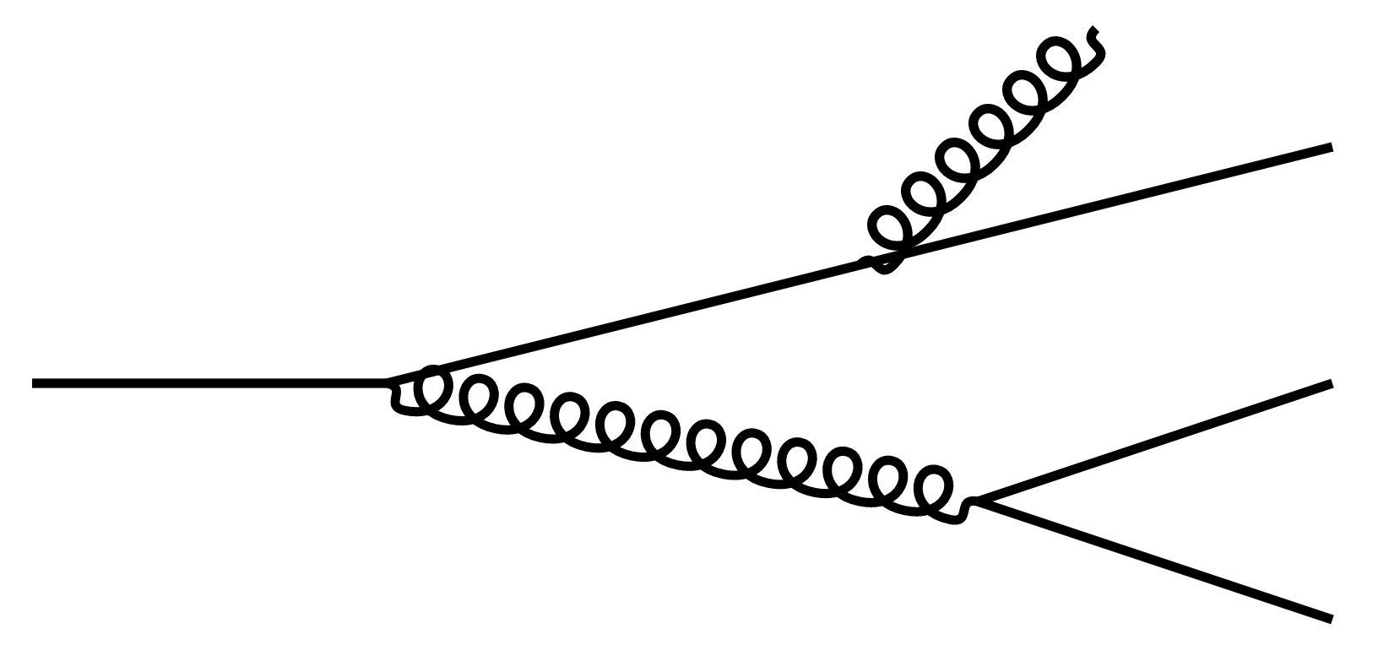
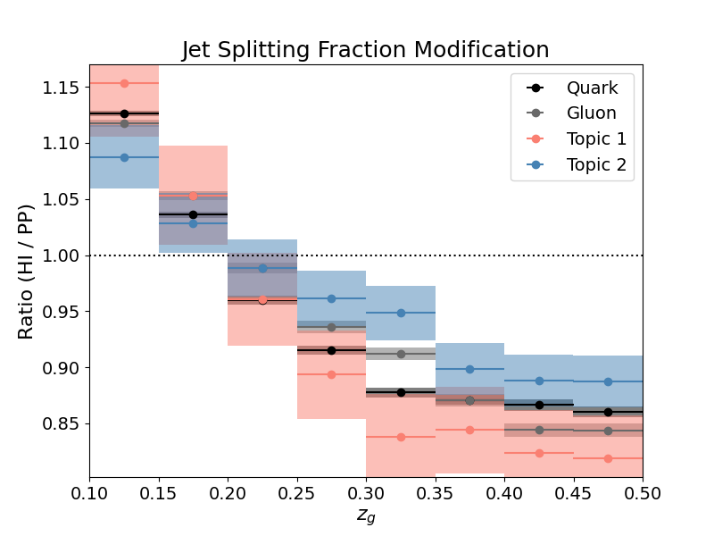
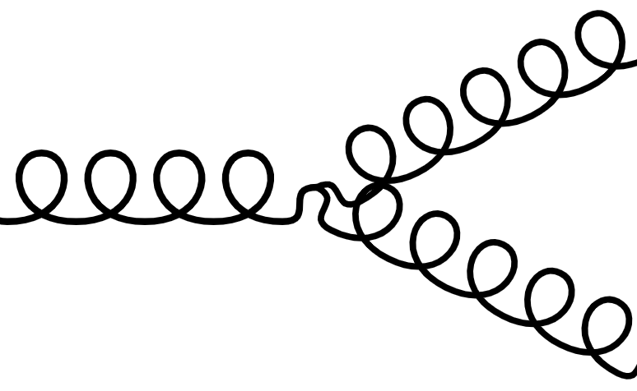
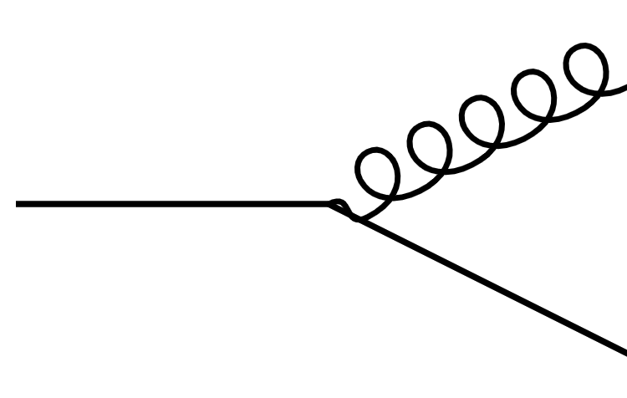

  Accessing light flavor splitting functions
  Challenging to define beyond leading order
  In vacuum
Banfi, Salam, Zanderighi [0601139]; Czakon, Mitov, Poncelet [2205.11879];
Caola, Grabarczyk, Hutt, Salam, Scyboz, Thaler [2306.07314]
  “gluon jet”
  Observable-based, machine learning approaches
Thaler, Metodiev, Komiske, Schwartz, Dreyer, Soyez, Takacs, Larkoski, …
  “quark jet”
  Modified q,g splitting functions
  Data-driven quark, gluon
  In medium
  Flavor-dependent modification
  Monte Carlo quark, gluon
JB, Jesse Thaler, Andrew Patrick Turner [2008.08596]; Ying, JB, Chen, Lee [2204.00641]
Notes:
Unfortunately, the interpretation of jet modification observables often depends crucially on which proton-proton jets are taken to be a comparable baseline for a given heavy-ion measurement. In di-jet and inclusive jet studies, the standard answer is to compare heavy-ion jets to a proton-proton baseline with the same reconstructed pT. For example, comparing the jet production spectra for p-p and HI at the same reconstructed pT (as illustrated by the blue arrows) gives rise to the famous jet RAA.

Slide 17
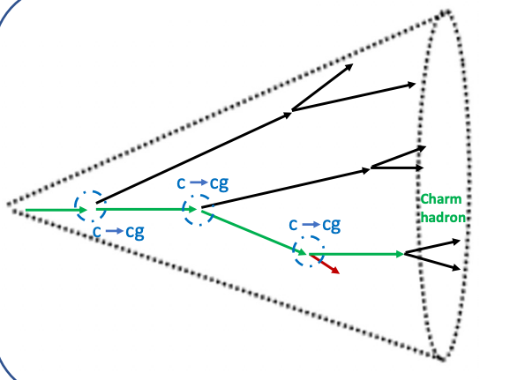



  Accessing heavy flavor splitting functions
$$\overline{c},\overline{b}$$
  Heavy flavor splittings:
$$c,b$$
$$c,b$$
  Advantages:
  Heavy flavor is preserved in the shower and not produced at hadronization
Used in ALICE [2106.05713]
  Access later (more modified) splittings in the shower
  At high energies, access light flavor splittings
  Focus of this talk: phenomenology of $g→c\overline{c}$
Notes:
Unfortunately, the interpretation of jet modification observables often depends crucially on which proton-proton jets are taken to be a comparable baseline for a given heavy-ion measurement. In di-jet and inclusive jet studies, the standard answer is to compare heavy-ion jets to a proton-proton baseline with the same reconstructed pT. For example, comparing the jet production spectra for p-p and HI at the same reconstructed pT (as illustrated by the blue arrows) gives rise to the famous jet RAA.

Slide 18
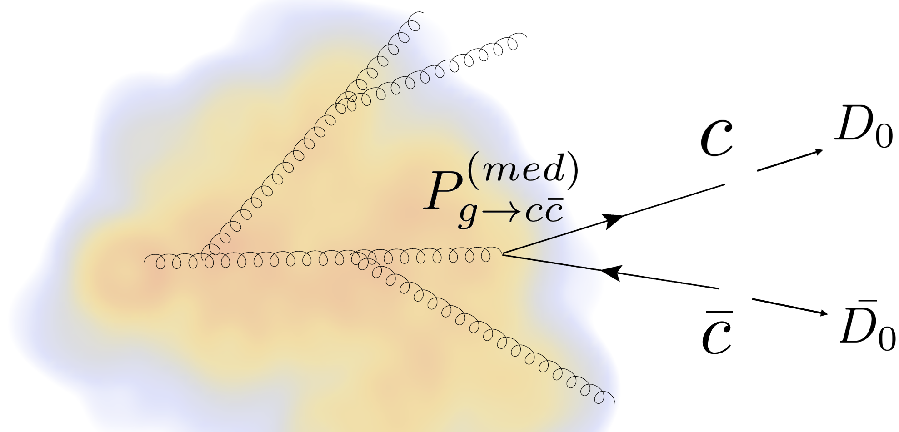
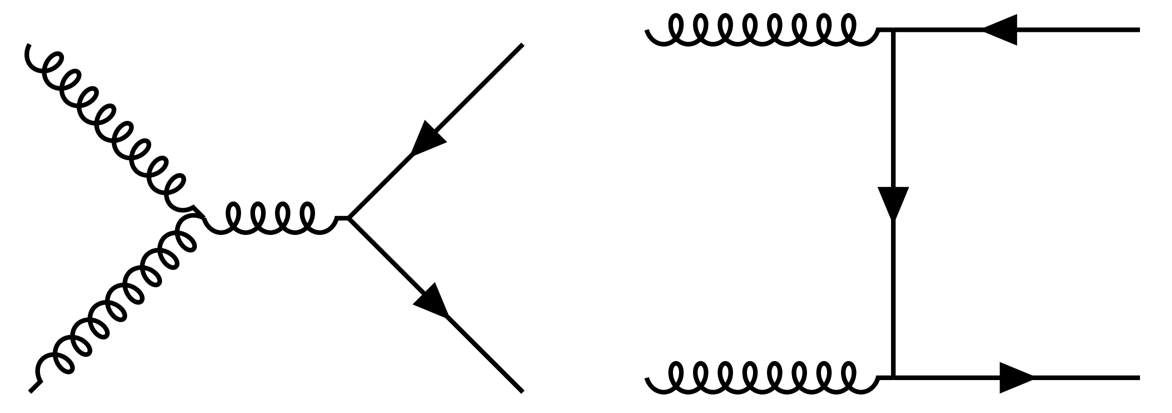
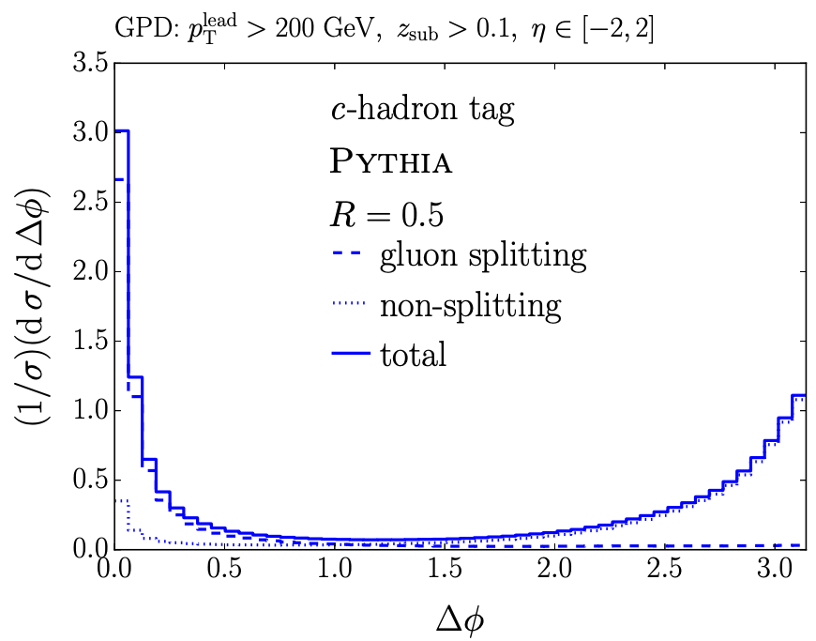
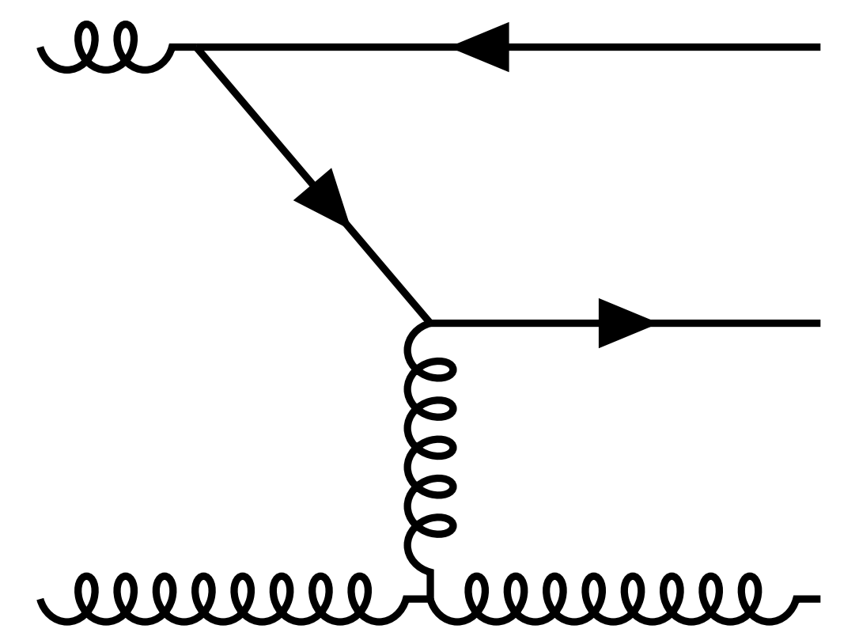
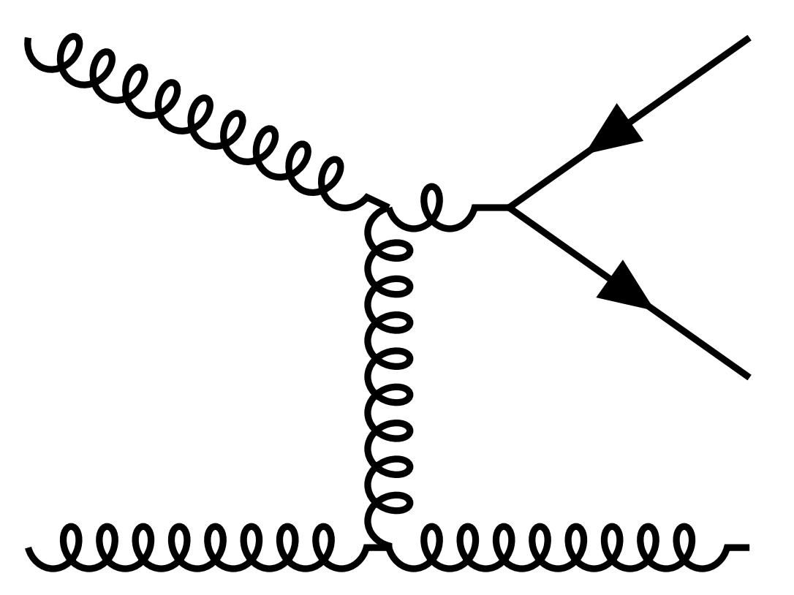
  Phenomenologically accessing the $g→c\overline{c}$ splitting in jets
  Leading processes for heavy quark production
  (approximately) collinear
Flavor creation
Flavor excitation
Gluon splitting
  Gluon splitting
  Non-gluon-splitting
Ilten, Rodd, Thaler, Williams [1702.02947]
Notes:
Unfortunately, the interpretation of jet modification observables often depends crucially on which proton-proton jets are taken to be a comparable baseline for a given heavy-ion measurement. In di-jet and inclusive jet studies, the standard answer is to compare heavy-ion jets to a proton-proton baseline with the same reconstructed pT. For example, comparing the jet production spectra for p-p and HI at the same reconstructed pT (as illustrated by the blue arrows) gives rise to the famous jet RAA.

Slide 19
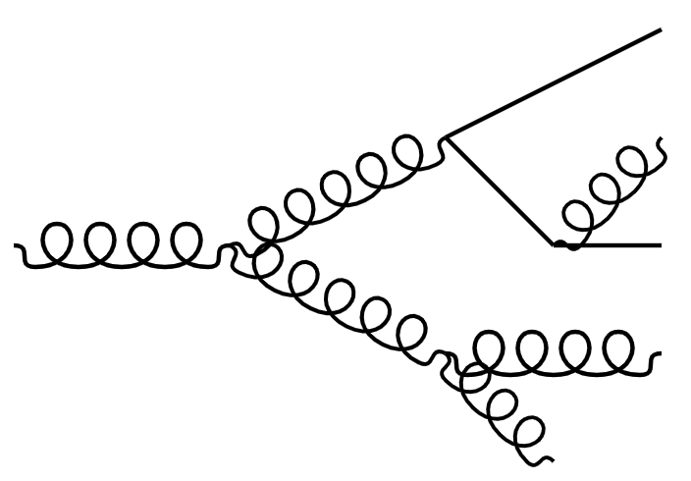
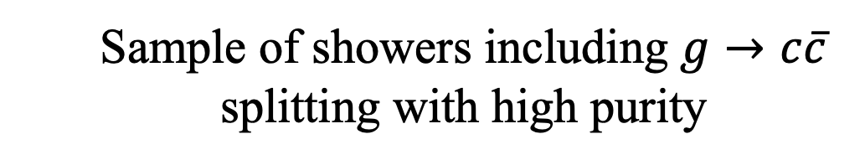


  Phenomenologically accessing the $g→c\overline{c}$ splitting in jets
$${\overline{D}}^{0}$$
$$D^{0}$$
  Sample of showers including $g→c\overline{c}$ splitting with high purity
  Expected experimental sensitivity already in Run 3/4
Notes:
Unfortunately, the interpretation of jet modification observables often depends crucially on which proton-proton jets are taken to be a comparable baseline for a given heavy-ion measurement. In di-jet and inclusive jet studies, the standard answer is to compare heavy-ion jets to a proton-proton baseline with the same reconstructed pT. For example, comparing the jet production spectra for p-p and HI at the same reconstructed pT (as illustrated by the blue arrows) gives rise to the famous jet RAA.

Slide 20
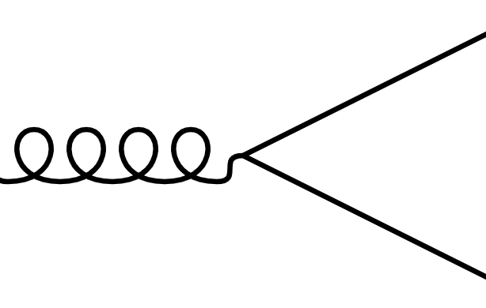
  Modification of the $g→c\overline{c}$splitting function
  Resum arbitrarily-many soft gluon interactions with a medium of length L
Attems, JB, Innocenti, Mazeliauskas, Park, van der Schee, Wiedemann [2203.11241]
Notes:
Unfortunately, the interpretation of jet modification observables often depends crucially on which proton-proton jets are taken to be a comparable baseline for a given heavy-ion measurement. In di-jet and inclusive jet studies, the standard answer is to compare heavy-ion jets to a proton-proton baseline with the same reconstructed pT. For example, comparing the jet production spectra for p-p and HI at the same reconstructed pT (as illustrated by the blue arrows) gives rise to the famous jet RAA.

Slide 21

  Modification of the $g→c\overline{c}$splitting function
  Resum arbitrarily-many soft gluon interactions with a medium of length L
  Results of the calculation:
  Depletion at small $k_{c}^{2}$
  broadening
Attems, JB, Innocenti, Mazeliauskas, Park, van der Schee, Wiedemann [2203.11241]
Notes:
Unfortunately, the interpretation of jet modification observables often depends crucially on which proton-proton jets are taken to be a comparable baseline for a given heavy-ion measurement. In di-jet and inclusive jet studies, the standard answer is to compare heavy-ion jets to a proton-proton baseline with the same reconstructed pT. For example, comparing the jet production spectra for p-p and HI at the same reconstructed pT (as illustrated by the blue arrows) gives rise to the famous jet RAA.

Slide 22
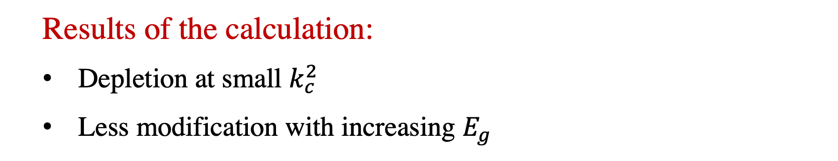
  Modification of the $g→c\overline{c}$splitting function
  Resum arbitrarily-many soft gluon interactions with a medium of length L
  Results of the calculation:
  Depletion at small $k_{c}^{2}$
  Less modification with increasing $E_{g}$
  broadening
  formation-time dependence
Attems, JB, Innocenti, Mazeliauskas, Park, van der Schee, Wiedemann [2203.11241]
Notes:
Unfortunately, the interpretation of jet modification observables often depends crucially on which proton-proton jets are taken to be a comparable baseline for a given heavy-ion measurement. In di-jet and inclusive jet studies, the standard answer is to compare heavy-ion jets to a proton-proton baseline with the same reconstructed pT. For example, comparing the jet production spectra for p-p and HI at the same reconstructed pT (as illustrated by the blue arrows) gives rise to the famous jet RAA.

Slide 23
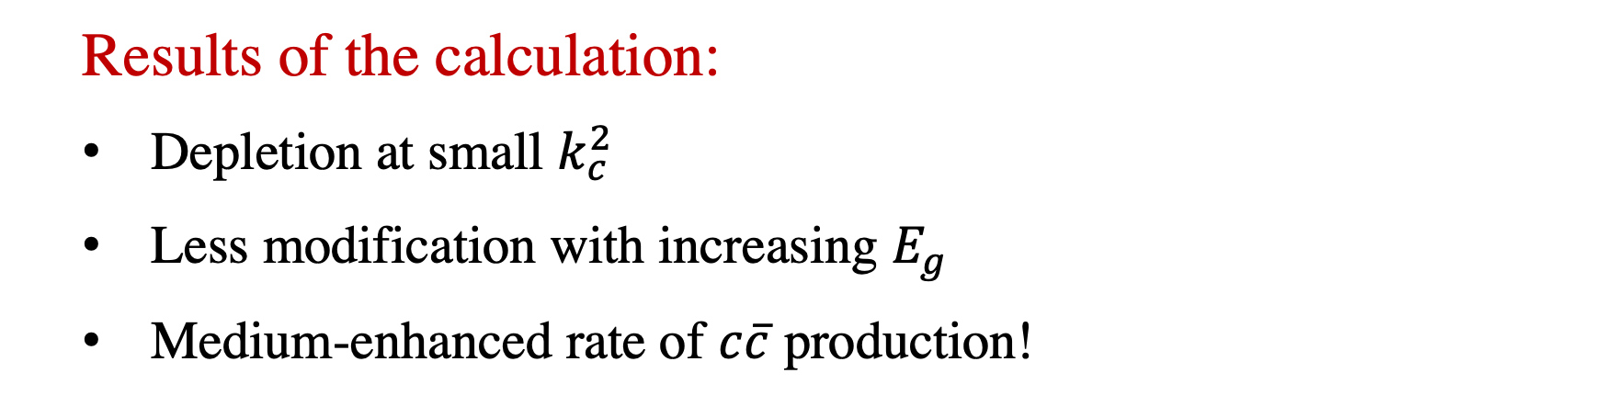
  Modification of the $g→c\overline{c}$splitting function
  Resum arbitrarily-many soft gluon interactions with a medium of length L
  Results of the calculation:
  Depletion at small $k_{c}^{2}$
  Less modification with increasing $E_{g}$
  Medium-enhanced rate of $c\overline{c}$ production!
  broadening
  formation-time dependence
  gluons promoted above threshold
Attems, JB, Innocenti, Mazeliauskas, Park, van der Schee, Wiedemann [2203.11241]
Notes:
Unfortunately, the interpretation of jet modification observables often depends crucially on which proton-proton jets are taken to be a comparable baseline for a given heavy-ion measurement. In di-jet and inclusive jet studies, the standard answer is to compare heavy-ion jets to a proton-proton baseline with the same reconstructed pT. For example, comparing the jet production spectra for p-p and HI at the same reconstructed pT (as illustrated by the blue arrows) gives rise to the famous jet RAA.

Slide 24
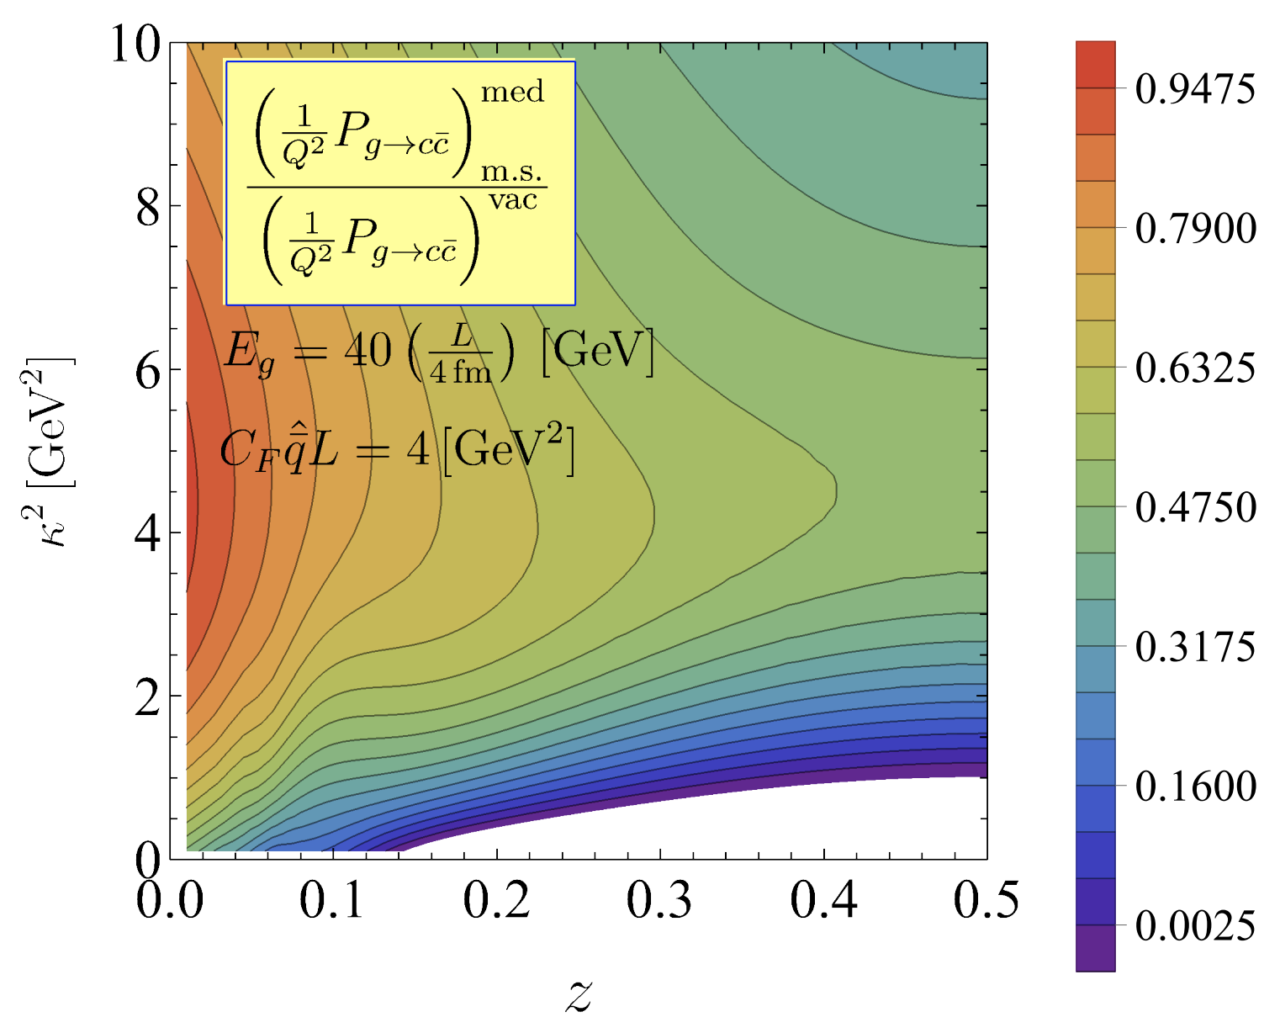
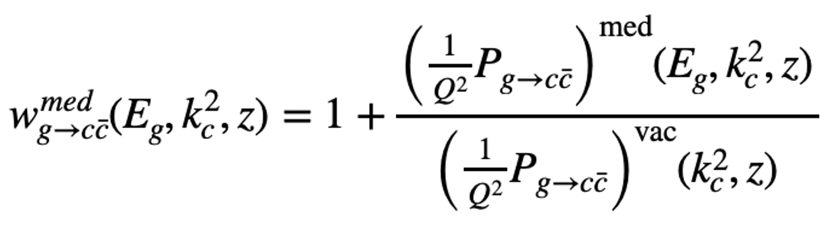



  Observing $g→c\overline{c}$ enhancement in jets
$${\overline{D}}^{0}$$
$$D^{0}$$
  Get kinematics of $g→c\overline{c}$
  Reweight each splitting by
Attems, JB, Innocenti, Mazeliauskas, Park, van der Schee, Wiedemann [2209.13600]
Notes:
Unfortunately, the interpretation of jet modification observables often depends crucially on which proton-proton jets are taken to be a comparable baseline for a given heavy-ion measurement. In di-jet and inclusive jet studies, the standard answer is to compare heavy-ion jets to a proton-proton baseline with the same reconstructed pT. For example, comparing the jet production spectra for p-p and HI at the same reconstructed pT (as illustrated by the blue arrows) gives rise to the famous jet RAA.

Slide 25
  Observing $g→c\overline{c}$ enhancement in jets
$${\overline{D}}^{0}$$
$$D^{0}$$
  Get kinematics of $g→c\overline{c}$
  Reweight each splitting by
Attems, JB, Innocenti, Mazeliauskas, Park, van der Schee, Wiedemann [2209.13600]
Notes:
Unfortunately, the interpretation of jet modification observables often depends crucially on which proton-proton jets are taken to be a comparable baseline for a given heavy-ion measurement. In di-jet and inclusive jet studies, the standard answer is to compare heavy-ion jets to a proton-proton baseline with the same reconstructed pT. For example, comparing the jet production spectra for p-p and HI at the same reconstructed pT (as illustrated by the blue arrows) gives rise to the famous jet RAA.

Slide 26


  $g→c\overline{c}$ enhancement in state-of-the-art Monte Carlo simulations
$${\overline{D}}^{0}$$
$$D^{0}$$
$$\overline{c}$$
$$c$$
  (parton level)
  w/ Gregory Soyez
  Jet quenching in JetMed: factorization of vacuum-like and medium-induced emissions
Caucal, Iancu, Soyez [1907.04866]
Attems, JB, Innocenti, Mazeliauskas, Park, van der Schee, Wiedemann [2209.13600]
Notes:
Unfortunately, the interpretation of jet modification observables often depends crucially on which proton-proton jets are taken to be a comparable baseline for a given heavy-ion measurement. In di-jet and inclusive jet studies, the standard answer is to compare heavy-ion jets to a proton-proton baseline with the same reconstructed pT. For example, comparing the jet production spectra for p-p and HI at the same reconstructed pT (as illustrated by the blue arrows) gives rise to the famous jet RAA.

Slide 27
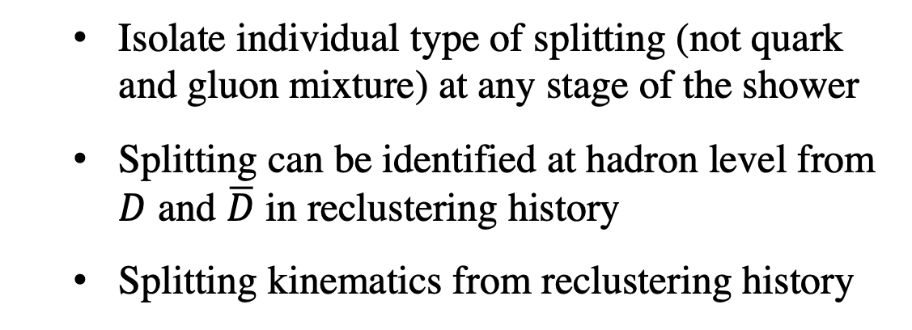
  Beyond enhancement: unique phenomenology of $g→c\overline{c}$ splittings
  A uniquely clean phenomenological signature of medium modification
$${\overline{D}}^{0}$$
  Isolate individual type of splitting (not quark and gluon mixture) at any stage of the shower
  Splitting can be identified at hadron level from $D$ and $\overline{D}$ in reclustering history
  Splitting kinematics from reclustering history
$$D^{0}$$
Notes:
Unfortunately, the interpretation of jet modification observables often depends crucially on which proton-proton jets are taken to be a comparable baseline for a given heavy-ion measurement. In di-jet and inclusive jet studies, the standard answer is to compare heavy-ion jets to a proton-proton baseline with the same reconstructed pT. For example, comparing the jet production spectra for p-p and HI at the same reconstructed pT (as illustrated by the blue arrows) gives rise to the famous jet RAA.

Slide 28
  Beyond enhancement: unique phenomenology of $g→c\overline{c}$ splittings
  momentum broadening of $c\overline{c}$ pair
  Broadening:
  Can use jet substructure to access broadening at hadron-level
Notes:
Unfortunately, the interpretation of jet modification observables often depends crucially on which proton-proton jets are taken to be a comparable baseline for a given heavy-ion measurement. In di-jet and inclusive jet studies, the standard answer is to compare heavy-ion jets to a proton-proton baseline with the same reconstructed pT. For example, comparing the jet production spectra for p-p and HI at the same reconstructed pT (as illustrated by the blue arrows) gives rise to the famous jet RAA.

Slide 29
  Beyond enhancement: unique phenomenology of $g→c\overline{c}$ splittings
  Formation time dependence of broadening
  Gluons have a “lifetime” depending on their energy
  time
Another time-delayed probe: Apolinario, Milhano, Salam, Salgado [1711.03105]
Notes:
Unfortunately, the interpretation of jet modification observables often depends crucially on which proton-proton jets are taken to be a comparable baseline for a given heavy-ion measurement. In di-jet and inclusive jet studies, the standard answer is to compare heavy-ion jets to a proton-proton baseline with the same reconstructed pT. For example, comparing the jet production spectra for p-p and HI at the same reconstructed pT (as illustrated by the blue arrows) gives rise to the famous jet RAA.

Slide 30

  Beyond enhancement: unique phenomenology of $g→c\overline{c}$ splittings
  Formation time dependence of broadening
  Gluons have a “lifetime” depending on their energy
  Access modification of $c\overline{c}$ pair at later times in the QGP
  $∼$ $1−6 fm$ delay for $20−100 GeV$ gluons
  time
  time
  time
  Increasing gluon energy
Another time-delayed probe: Apolinario, Milhano, Salam, Salgado [1711.03105]
Notes:
Unfortunately, the interpretation of jet modification observables often depends crucially on which proton-proton jets are taken to be a comparable baseline for a given heavy-ion measurement. In di-jet and inclusive jet studies, the standard answer is to compare heavy-ion jets to a proton-proton baseline with the same reconstructed pT. For example, comparing the jet production spectra for p-p and HI at the same reconstructed pT (as illustrated by the blue arrows) gives rise to the famous jet RAA.

Slide 31
  Beyond enhancement: unique phenomenology of $g→c\overline{c}$ splittings
  Formation time dependence of broadening
  Near mass threshold $Q^{2}∼m_{c}^{2}$, formation time grows with energy
  Level
  0
  1
  …
  2
Notes:
Unfortunately, the interpretation of jet modification observables often depends crucially on which proton-proton jets are taken to be a comparable baseline for a given heavy-ion measurement. In di-jet and inclusive jet studies, the standard answer is to compare heavy-ion jets to a proton-proton baseline with the same reconstructed pT. For example, comparing the jet production spectra for p-p and HI at the same reconstructed pT (as illustrated by the blue arrows) gives rise to the famous jet RAA.

Slide 32

  A process with many exciting future avenues!
  So far..
  Medium-enhanced rate of $c\overline{c}$ production
  Outlook
  Broadening of $c\overline{c}$ pair from hadron level
  Formation time dependence of modification
  Clean process with a lot of exciting physics opportunities!
Notes:
Unfortunately, the interpretation of jet modification observables often depends crucially on which proton-proton jets are taken to be a comparable baseline for a given heavy-ion measurement. In di-jet and inclusive jet studies, the standard answer is to compare heavy-ion jets to a proton-proton baseline with the same reconstructed pT. For example, comparing the jet production spectra for p-p and HI at the same reconstructed pT (as illustrated by the blue arrows) gives rise to the famous jet RAA.

Slide 33
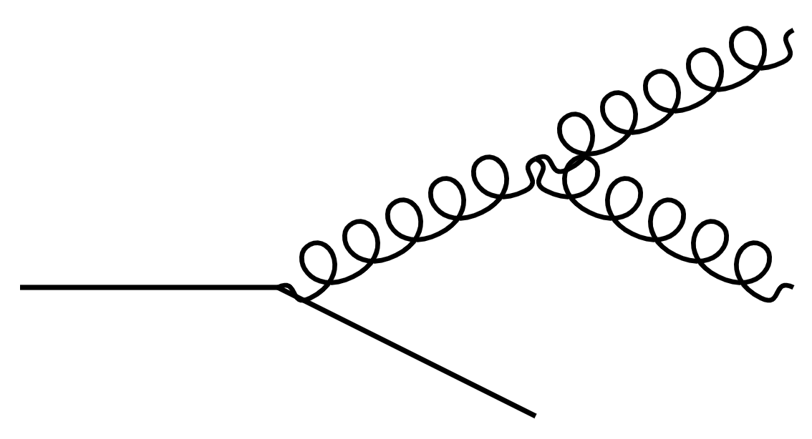




  Outlook
  Phenomenology of heavy-flavor tagged jets
$$\overline{c}$$
$$c$$
$$c$$
$$c$$
  This work
  Future
  Constructing a picture of modified jets from phenomenology
  hadrons
Notes:
Unfortunately, the interpretation of jet modification observables often depends crucially on which proton-proton jets are taken to be a comparable baseline for a given heavy-ion measurement. In di-jet and inclusive jet studies, the standard answer is to compare heavy-ion jets to a proton-proton baseline with the same reconstructed pT. For example, comparing the jet production spectra for p-p and HI at the same reconstructed pT (as illustrated by the blue arrows) gives rise to the famous jet RAA.

