Slide 1


Future Colliders
There is consensus that a next future collider should be an e⁺e⁻ collider, with a rich physics program: energy range from Z W⁺W⁻ ZH ttbar ZHH and higher energies
Most relevant machine options are e.g.
linear: ILC CLIC C3 circular: CEPC and FCee
Detector concepts are developed and the ILD detector- Nikhef member - plays a central role for all of them (slide 4)

Slide 2
Future Colliders
The machine choice is usually discussed with the physics
program. However more important are three questions the time line, the realism (how advanced technically) and the cost and energy use (CO2 footprint) of the project.
Priority number one should be given to take the decision and steps to build as fast as possible a future collider near CERN. So the time line.
The CEPC TDR is ready and says: “Construction is anticipated to begin around 2027-2028, pending government approval, with an estimated duration of 8 years. The commencement of experiments could potentially initiate in the mid-2030s.” CEPC=100 km circular e⁺e⁻ collider in China.

Slide 3
Future Colliders
The FCCee timeline is thus that operation FCCee starts in 2048 (see slide 5). Apart from that, the machine and digging of the tunnel is extremely costly (typically a factor 2 as expensive as the CLIC and ILC proposals).
This is too far in the future. In my opinion this is damaging for particle physics at CERN.
We can realize at CERN an ILC or a CLIC collider and have physics in 12 years from ‘now’. The technology is there and CLIC was the CERN future collider for many years. This we knew already in Granada and 10 years ago (see e.g. slide 6)
New developments at the CCC are promising US plans P5.

Slide 4
Future Collider Detectors
Tracker ILD (Pixel) TPC
Nikhef is member of ILD

Slide 5
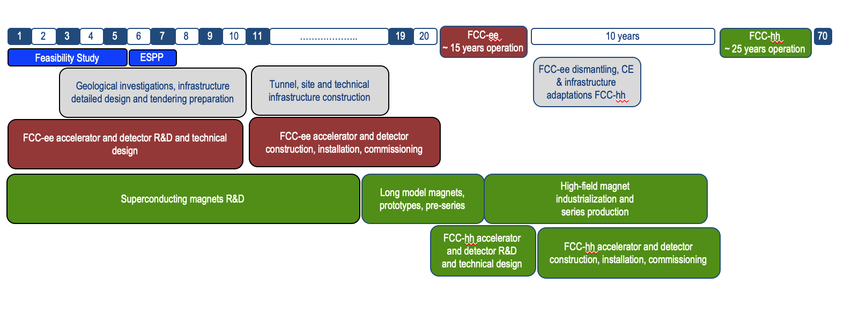
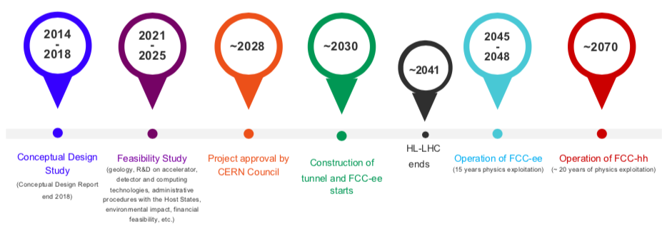
FCCee timeline(2023)
Fabiola Gianotti
Technical schedule:
FCC-ee could start
physics operation in 2040 or earlier
“Realistic” schedule takes into account:
past experience in building colliders at CERN
approval timeline: ESPP, Council decision
that HL-LHC will run until ~ 2041
ANY future collider at CERN cannot
start physics operation before ~ 2045
(but construction will proceed in parallel to
HL-LHC operation)
1st stage collider, FCC-ee: electron-positron collisions 90-360 GeV
Construction: 2033-2045 → Physics operation: 2048-2063
2nd stage collider, FCC-hh: proton-proton collisions at ≥ 100 TeV
Construction: 2058-2070 → Physics operation: ~ 2070-2095
Care should be taken when comparing to other
proposed facilities, for which in some cases only
the (optimistic) technical schedule is shown

Slide 6
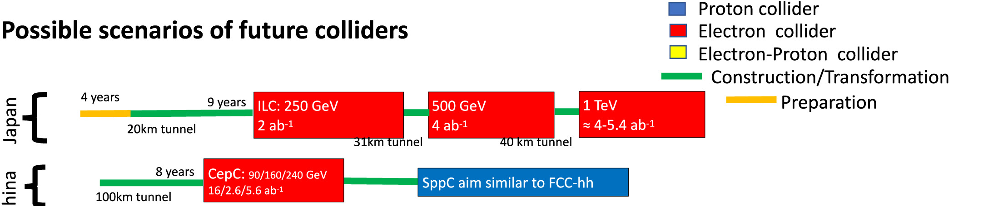
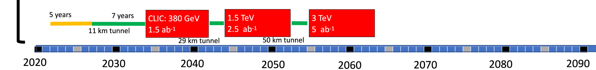
From: Future colliders for the high-energy frontier
Cern China Japan

