Slide 1
Soapbox of Random Stuff
UK e-Science CA
Sept. 2016

Slide 2
Overview
Adventures in RCauth land
Probably relevant since we covered RCauth at previous PMAs
By extension, extensions
SHA2 migration
Renewals and video

Slide 3
RCauth

Slide 4
Example of using RCauth
EUDAT is investigating whether it can use RCauth instead of its own in-house CA
The remainder of this section is with EUDAT-as-a-RP-hat
Need to satisfy both RCauth policy and IOTA/DOGWOOD
E.g. RCauth does not require traceability, but IOTA does

Slide 5
EUDAT use of RCauth
RCauth policy
Is the lifetime 400 days or 11 days (6.3.2)
IOTA requirement
“documented and verifiable relationship”
B2ACCESS is only a proxy (cf. AARC MJRA1.4)
External IdM
External IdP
B2ACCESS proxy
RCauth
No DaVR here except eduGAIN at best
The DaVR is between B2ACCESS and RCauth as IdP and SP, resp.

Slide 6
EUDAT use of RCauth
Need to check quite a few things (SIRTFI, R&S)
EUDAT claims to be SIRTFI compliant but best to check whether it is actually happening ☺
All portals must be PKPG compliant
Of course a central MyProxy service might help here but this is not in the EUDAT AARChitecture
Revocations
EUDAT has a doc’d account deprovisioning process but otherwise no way of detecting “loss of traceability”

Slide 7
EUDAT use of RCauth
Namespace:
Can RPs disambiguate B2ACCESS-issued credentials from other-IdP-issued credentials?
Accepting other credentials useful in some cases (B2STAGE), less so in others (GOCDB)
Namespace
Where’s the stuff required by DOGWOOD?
Must be {O,CN}, but …?

Slide 8
EUDAT use of IOTA/DOGWOOD
“Traceability of the credential is provided only in a cooperative way […]”
So is traceability a requirement on the proxy?
Proxy can (only) say “go ask over there”
Authority must be told the originator IdP?
Authority must have information to trace id with originator IdP (DW3.1, DW3.2)?
“the identity management system via which the identity of this person was vetted” so must be originator IdP, not the proxy (DW3.2)
“name [..] must contain sufficient information s.t. utilizing only this data, an enquiry via the issuer [RCauth] to the IdM”

Slide 9
EUDAT use of Rcauth – Constructing the CSR?
Inconsistent use of O in EUDAT (user filled field… ☹), or does it come from FIMS?
(i.e. O=B2ACCESS)
Cf. Dogwood requirement (previous slide)
Single CN (EUDAT has two, unique id and name/principal(?))
Risk of using non-ASCII UTF8?
Originating IdP and identifier with originating IdP
And the authorisation extensions, of course ☺

Slide 10
Interfacing and Performance
EUDAT uses its own CA
(née Contrail CA but much code has been replaced ☺)
API is OAuth controlled
Authorised portals have OAuth client ids
DN is issued by token, DN in CSR is ignored ☺
CA queries authorisation attrs.
Proposed use of RCauth
Heavily relying on MyProxy caches?!
Needs GSI delegation also to add extns.
Currently EUDAT (=Shiraz) is trying to set up a test Rcauth

Slide 11
Interfacing and Performance
Options (Shiraz & Mischa)
B2ACCESS as an IdP
Preferred option as less work is required ☺
However, RCauth performance not good enough ☹
B2ACCESS as a master portal
Shiraz says it requires changes in B2ACCESS ☹
B2ACCESS as a VO

Slide 12
Extensions
EUDAT needs extensions in short-lived EE certs
Authorisation attributes
Unfortunately a non-standard 1.3.6.1.4.1.3536(Globus).1.1.1.12
(But then so was VOMS, initially)

Slide 13
Extensions

Slide 14
Useful PKCS#10 extensions
subjectAltName
Accept requests for xple SANs
User email addresses
Hosts - increasingly required with Globus compliance with RFC2818
Would allow useful ext’ns in user SLCs
Shorter proxy chains, too

Slide 15
Using OpenSSL
… for requests
(e.g.) –reqexts req_section
And the section contains (e.g.)
1.3.6…1.1.12=ASN1:UTF8String:${ENV::SAML}
subjectAltName=DNS:xxx,DNS:yyy
… for signing
copy_extensions = copyall (in CA config section)
Obviously all extensions should be filtered (allowed) and verified (by RA)
NB! With copyall request extensions overrule configured extensions!

Slide 16
SHA2 migration

Slide 17
Document sent to IGTF Friday (and again Monday)
Unsigned:
https://cert.ca.ngs.ac.uk/sha2migration/sha2migration-1.6.pdf
With signature:
https://cert.ca.ngs.ac.uk/sha2migration/sha2migration-1.6.tar
https://cert.ca.ngs.ac.uk/sha2migration/sha2migration-1.6.zip

Slide 18
SHA2 migration for subordinate CAs
Several approaches are effective
Resigning the CA certificate with SHA2 is not one of them
Bad options:
Resign the CA certificate with SHA2
Rekey (rollover) the CA certificate with SHA2
So-so options:
Withdraw support for SHA1 signatures in mw.
Better options:
Rekey the root, and re-sign the subordinate

Slide 19
SHA2 signatures
Suggestions
Drop 2A (online) – no certificates on it any more
Rekey root, and re-sign 2B with SHA2 under new root – best way to deal with issue (see doc)
A compromise to mitigate against a compromise

Slide 20
Renewals and Video verification

Slide 21
Video verification of Id (JK+JJ)
Can we have a demonstrator?!!
Ideally before we approve the process ☺
Both a genuine id and if possible a fake id
(and independently, not by someone who does it for a living)
Is the process recorded?
Use of passport
Too much information on passport (GDPR) processed
Non-passport ids wouldn’t have verifiable features
Giving away enough information for passport to be faked?
Can people be trained in examining passports from all countries? Can the training be kept up to date? Are there so few that they have to process requests from several countries (= Chinese applying for UK cert and verified by authority in China)?
… or just make it a lower LoA ☺

Slide 22
Video verifications (JK)
Suggest it is OK for the following:
User who has previously held certificate, but all the user’s certificates are expired or revoked
User applies for same DN
User still holds the same id that was in the original record
RA still holds the original records and can compare
(Obviously the id was originally checked in-person by RA or notary public as req’d by CEDAR)

Slide 23
Host Rekey (JK)
Approval of host certificate rekey is normally routine
In UK eSc CA, host certs rekey themselves
“Need” for certificate usu. a given
Similar risks to the 3 yr lifetime for hosts, only with slightly less risk
Risks are not so much at issuance (processes deal OK with issuance), more down the road
Proposal to auto-approve and notify RA instead of waiting for approval

Slide 24
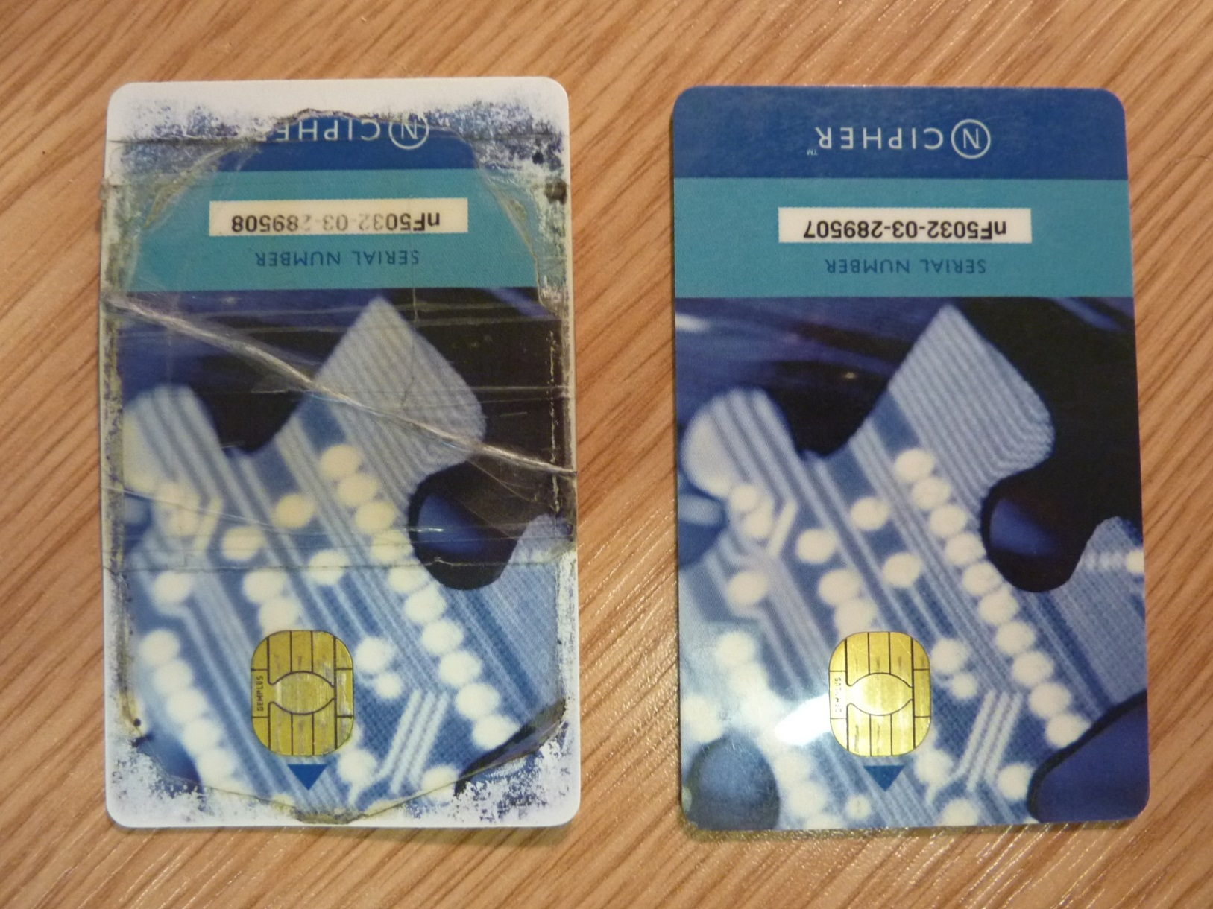
View from a hard working CA ☺
One CA operator’s card (used frequently)
CA manager’s card (used less frq.)

