Slide 1
Incident Response for Federated Identities
Authentication and Authorisation for Research and Collaboration
Hannah Short
AARC
Computer Security, CERN
EUGridPMA
19 September 2016

Slide 2
Agenda
Security Incident Response in Distributed Infrastructures
The challenge of Federated Identity Management
What can we do?

Slide 3
Agenda
Security Incident Response in Distributed Infrastructures
The challenge of Federated Identity Management
What can we do?

Slide 4
Security Incident Response in Distributed Infrastructures
Shared Policies
Trust
Operational Support

Slide 5
Shared Policies
Written rules, and obligations
Clear basis for exclusion from infrastructure if not followed
Reasonable likelihood that sites follow best practices in security

Slide 6
Operational Support
Incident preparation and prevention - cascade advisories, IOCs, patches etc
Coordinate incident response across multiple Sites
Power to block problematic Sites & users

Slide 7
Trust
Fundamentally, incident response is more successful when the individuals know and trust each other
Online trust
Consistent, trustworthy behaviour
Voluntary collaboration
Offline trust
Key exchange
Verification that you are a real person ☺

Slide 8
Agenda
Security Incident Response in Distributed Infrastructures
The challenge of Federated Identity Management
What can we do?

Slide 9
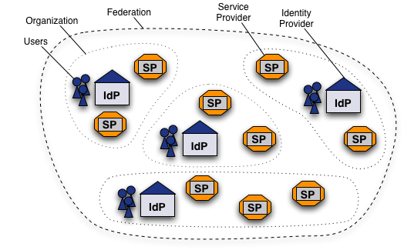
Federated Identity Management Worldwide What is a Federation?
Federated Identity Mangement (FIM) is the concept of groups of Service Providers (SPs) and Identity Providers (IdPs) agreeing to interoperate under a set of policies.
Federations are typically established nationally and use the SAML2 protocol for information exchange
Each entity within the federation is described by metadata
https://www.switch.ch/aai/about/federation/

Slide 10
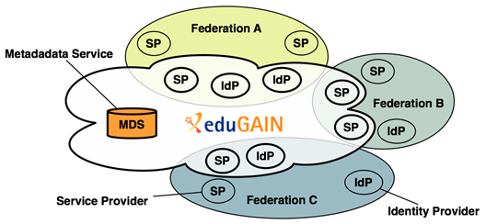
Federated Identity Management Worldwide eduGAIN
eduGAIN is a form of interfederation
Participating federations share information (metadata) about entities from their own federation with eduGAIN
eduGAIN bundles this metadata and publishes it in a central location.
Credit to Alessandra Scicchitano – GEANT for this slide
Notes:
eduGAIN aggregates metadata from participating federations (metadata service). This aggregate is consumed by all participating federations, such that Identity Providers and Service Providers can find each other.
Technically, this aggregate works as follows: 'export metadata aggregate’, eduGAIN aggregate,
Each participating federation produces a so called 'export metadata aggregate'; a file that contains the metadata of local Identity Providers and Service Providers that participate in eduGAIN. Note that this is often a subset of all Identity Providers and Service Providers from that federation.
eduGAIN combines all export metadata aggregates and generates an "eduGAIN aggregate"; a file that combines all metadata from all participating federations.
This eduGAIN aggregate is signed by eduGAIN and published on the internet, thereby making it available to all participating federations.
Each participating federation must consume this eduGAIN aggregate and supply it to their local Identity Providers and Service Providers.

Slide 11
Federated Identity Management Worldwide eduGAIN adoption
eduGAIN Stats
Federations: 38
All entities: 3157
IdPs: 2007
SPs: 1151
Credit to eduGAIN, data taken March 2016

Slide 12
Security Incident Response in Distributed Infrastructures
Shared Policies
Trust
Operational Support

Slide 13
The challenge of Federated Identity Management
EduGAIN membership includes 4 policies… Security Incident Response is not one
We have no insight into security practices of each participant
Collaboration between IdPs and SPs is essential to build full incident timeline – they have no obligation to collaborate
Shared Policies
Trust
Operational Support

Slide 14
The challenge of Federated Identity Management
EduGAIN has no central help desk
Few national federations offer central security support
No way to block an identity, IdP, or federation everywhere and immediately
Shared Policies
Trust
Operational Support

Slide 15
The challenge of Federated Identity Management
Security is often not priority (or even in skillset) of engaged FIM participants
Simply too big…
Shared Policies
Trust
Operational Support

Slide 16
2037 IdPs
Potential sources of compromised identities
1197 SPs
Potential targets

Slide 17
Agenda
Security Incident Response in Distributed Infrastructures
The challenge of Federated Identity Management
What can we do?

Slide 18
What can we do?
Federation 2
SP
Federation 1
SP
IdP
IdP
SP
SP
SP
SP
SP
All I need is one identity…
IdP
Federation 3
SP
IdP
SP

SP
IdP
Clearly an inviting vector of attack… luckily, this was noticed several years ago!

Slide 19
Beginnings
Issues of IdM raised by IT leaders from EIROforum labs (Jan 2011)
CERN, EFDA-JET, EMBL, ESA, ESO, ESRF, European XFEL and ILL
These laboratories, as well as national and regional research organizations, face similar challenges
Prepared a paper that documents common requirements https://cdsweb.cern.ch/record/1442597
“Security procedures and incident response would need to be reviewed. Today, each resource provider is for example responsible for terminating access by known compromised identities. With identity federation, this responsibility will be shifted to the IdP though resource providers will insist on the ability to revoke access.”
“Such an identity federation in the High Energy Physics (HEP) community would rely on:
• A well-defined framework to ensure sufficient trust and security among the different IdPs and relying parties.“
Credit to David Kelsey (STFC) for this content

Slide 20
Evolution
Several years later, 2016
Security Incident Response Trust Framework for Federated Identity
Approved by the REFEDS (Research & Education FEDerations) Community
Registered Internet Assigned Numbers Authority (IANA) Assurance Profilehttps://www.iana.org/assignments/loa-profiles/loa-profiles.xhtml

Slide 21
Sirtfi
Operational Security
Require that a security incident response capability exists with sufficient authority to mitigate, contain the spread of, and remediate the effects of an incident.
Incident Response
Assure confidentiality of information exchanged
Identify trusted contacts
Guarantee a response during collaboration
Traceability
Improve the usefulness of logs
Ensure logs are kept in accordance with policy
Participant Responsibilities
Confirm that end users are aware of an appropriate AUP

Slide 22
Current adoption
4
102
1
1

Slide 23
Find out more
https://refeds.org/sirtfi

Slide 24
How does Sirtfi help?

Slide 25
How does Sirtfi help?
Shared Policies
Trust
Operational Support
Shared framework fulfills purpose of basic policy
Obliged to collaborate
Basic operational security best practices
Allows us to identify security conscious bodies

Slide 26
How does Sirtfi not help?
Shared Policies
Trust
Operational Support
Some Federation Operators unwilling to act as gatekeepers
No large-scale blocking mechanism
Trust tied to organisation/entity, not individual
Difficult to build offline trust

Slide 27
What’s missing?
Requirement | How could we get this?
Indication of who really trusts who | Independent trust portal, votes based web of trust
Capability to remove participants from Sirtfi | Shared Operational Support
Periodic tests of contact responsiveness
Channel for smaller participants to access security support and trust groups
Log of “bad behaviour”
Ability to block identities across eduGAIN | Distributed mechanism for blocking users (e.g. confyrm, perun…)

Slide 28
Operational Support is needed, but where?
GEANT
GEANT – possible but not ideal
eduGAIN – no central support
Federations – not all are willing
Research Communities – very possible!
eduGAIN
Fed 1
Fed 2
Fed 3
Research Communities

Slide 29
Conclusion
Federated Identity Management is a likely evolution from the end-user certificate model
There is a need to establish an effective Security Incident Response capability within eduGAIN
Sirtfi goes some way to providing the missing capabilities
There are still gaps, particularly for sustainable operational support
Shared Policies
Trust
Operational Support

Slide 30
hannah.short@cern.ch

