Slide 1
LepCol QUAD-Pix Design Concepts II
A. Korporaal – Nikhef Amsterdam

Slide 2
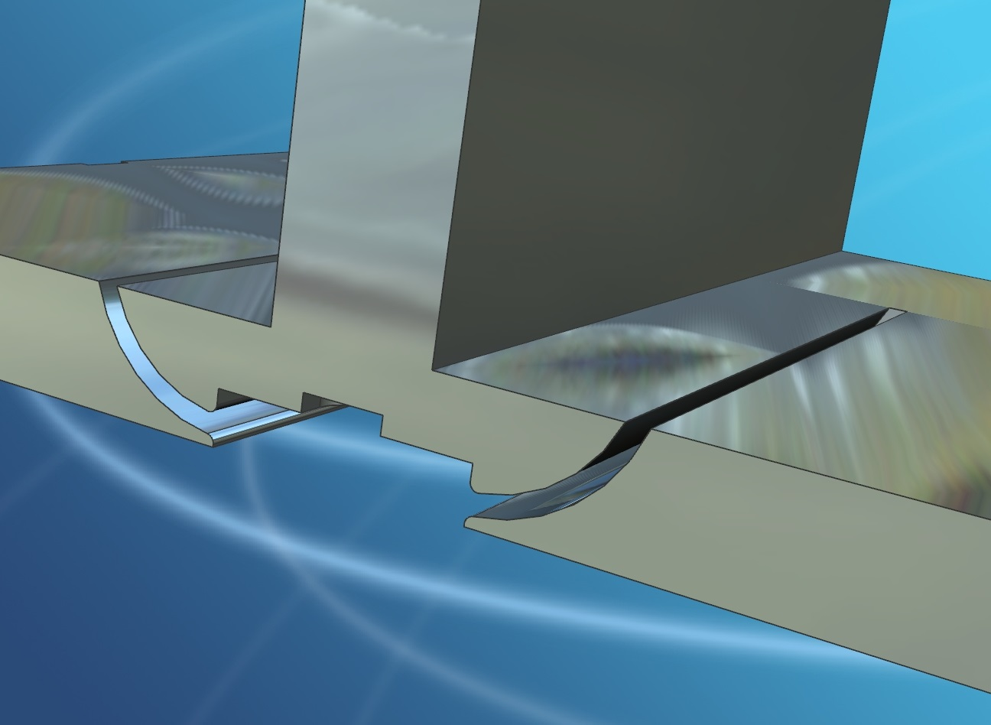
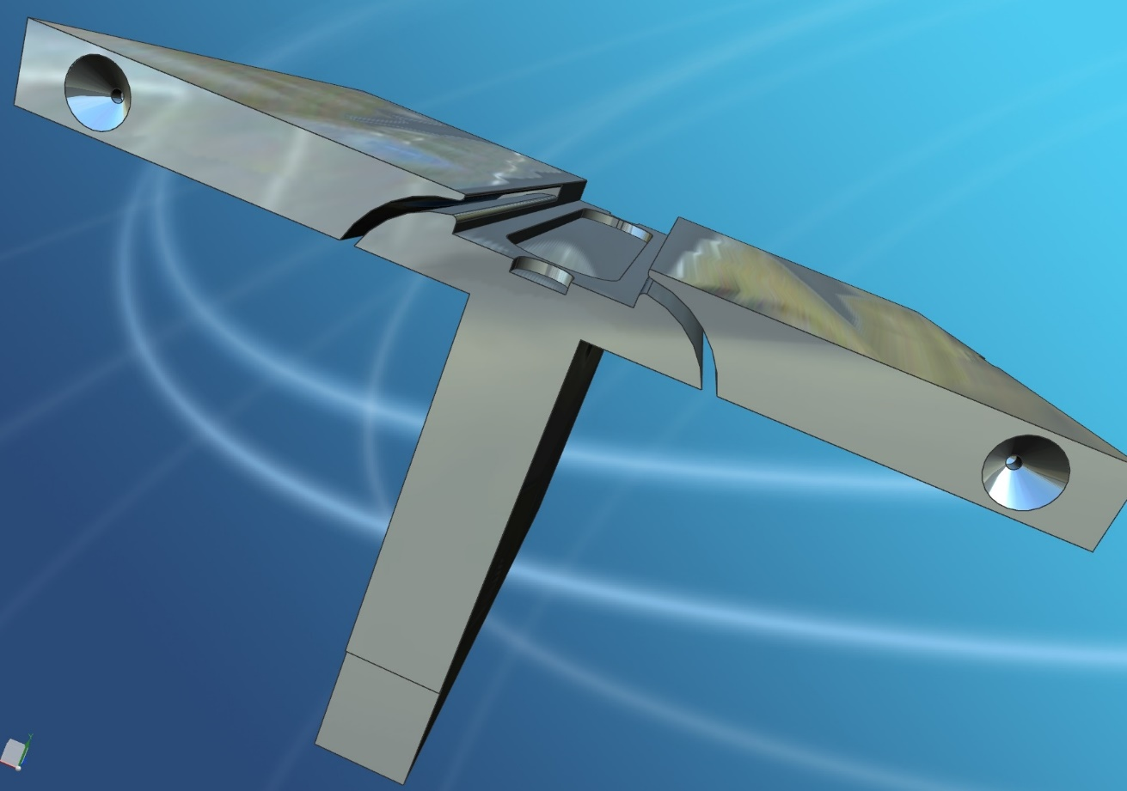
Quad TPX-3 Type E Main Ass’y (006087_A1)
Slot Concept

Slide 3
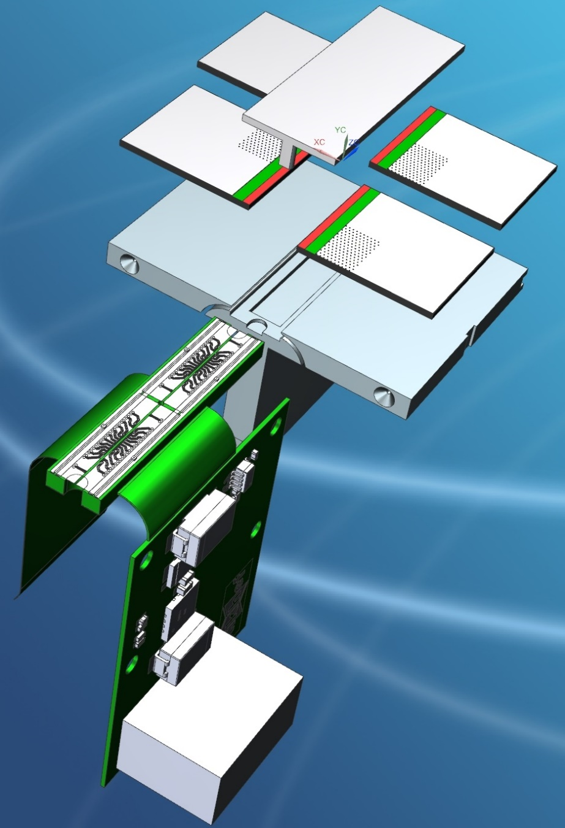
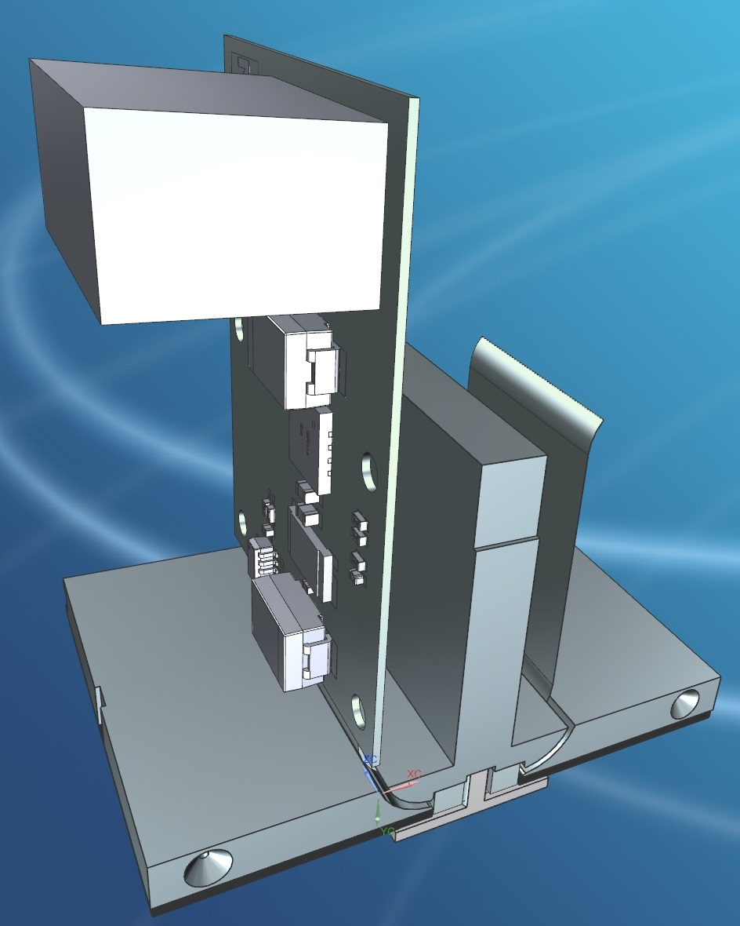
Quad TPX-3 Type E Main Ass’y (006087_A1)
Slot Concept

Slide 4
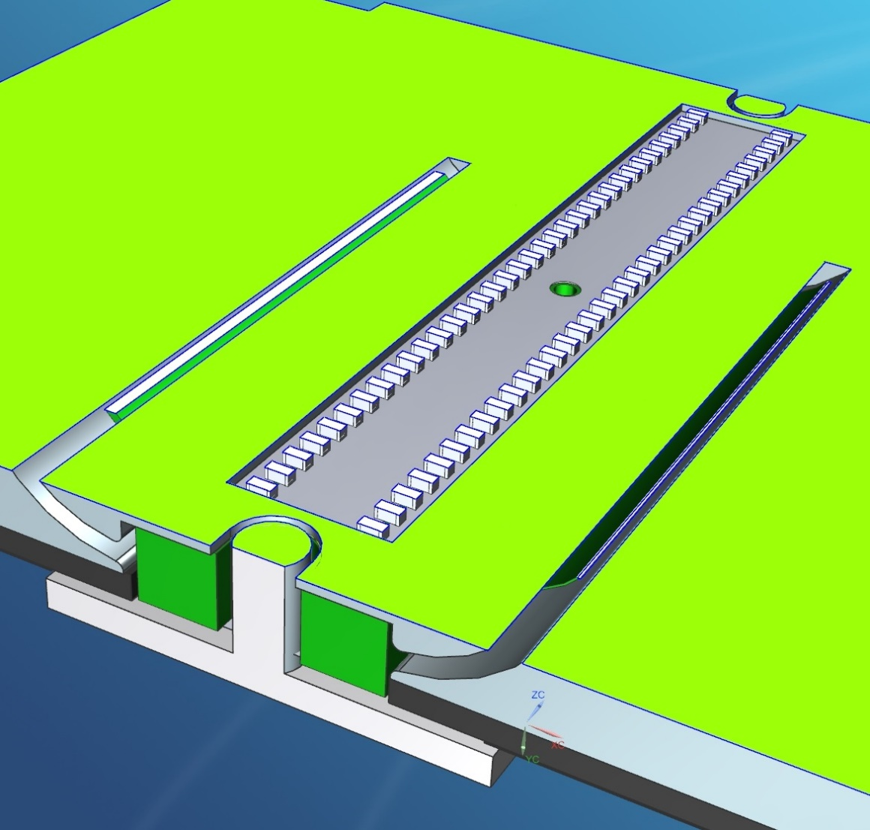
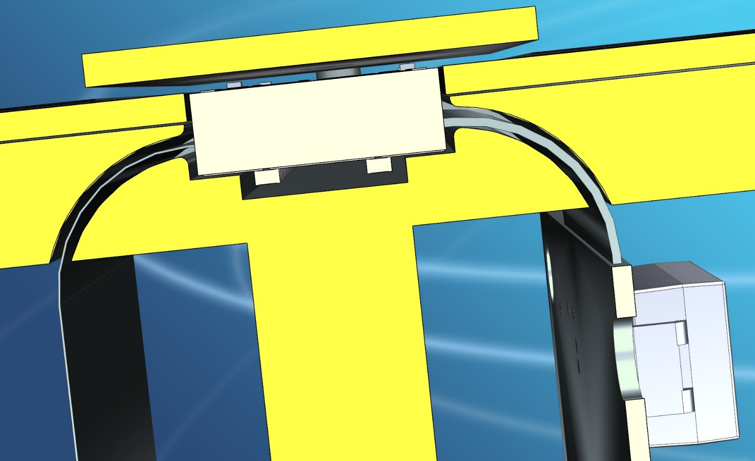
Quad TPX-3 Type E Main Ass’y (006087_A1)
Slot Concept

Slide 5
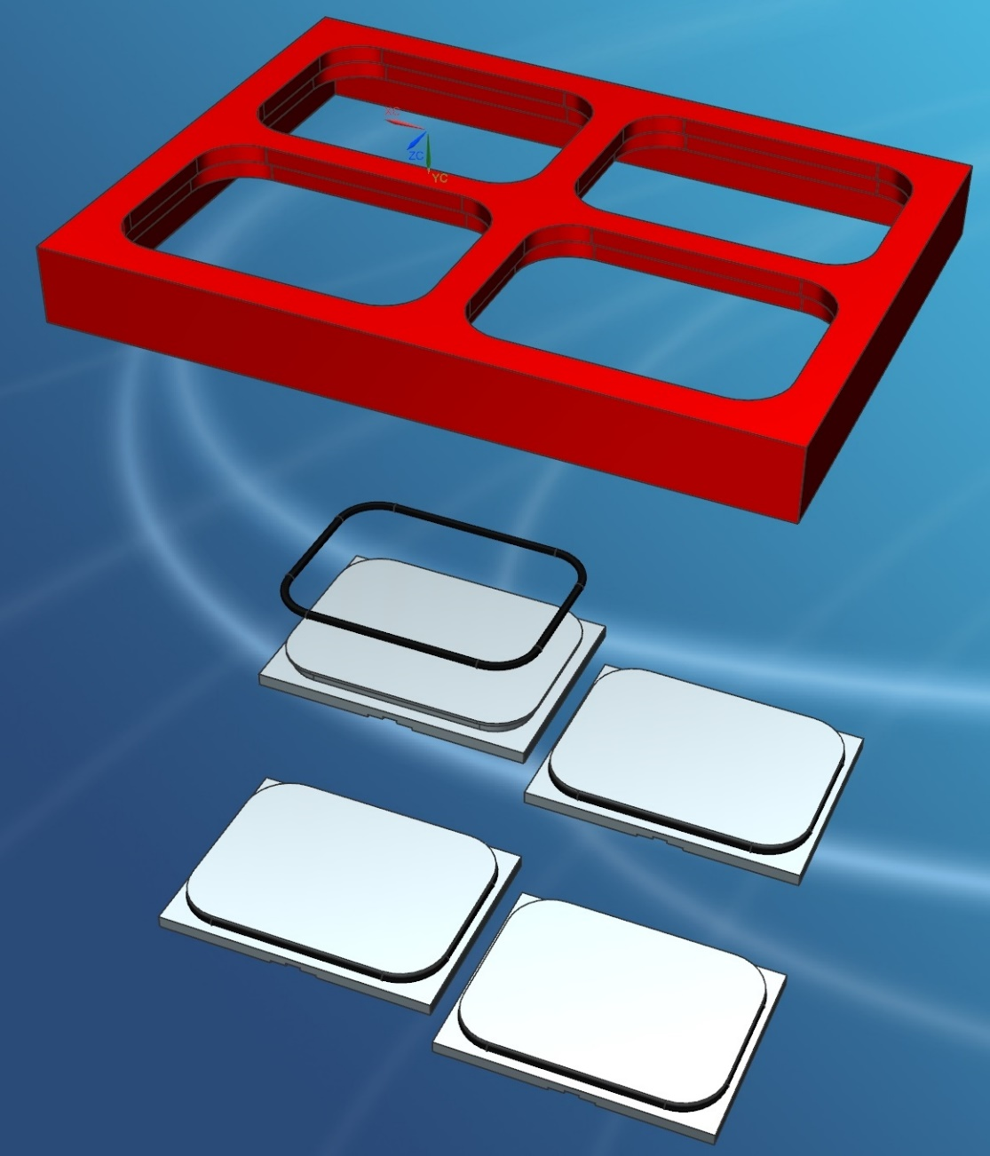
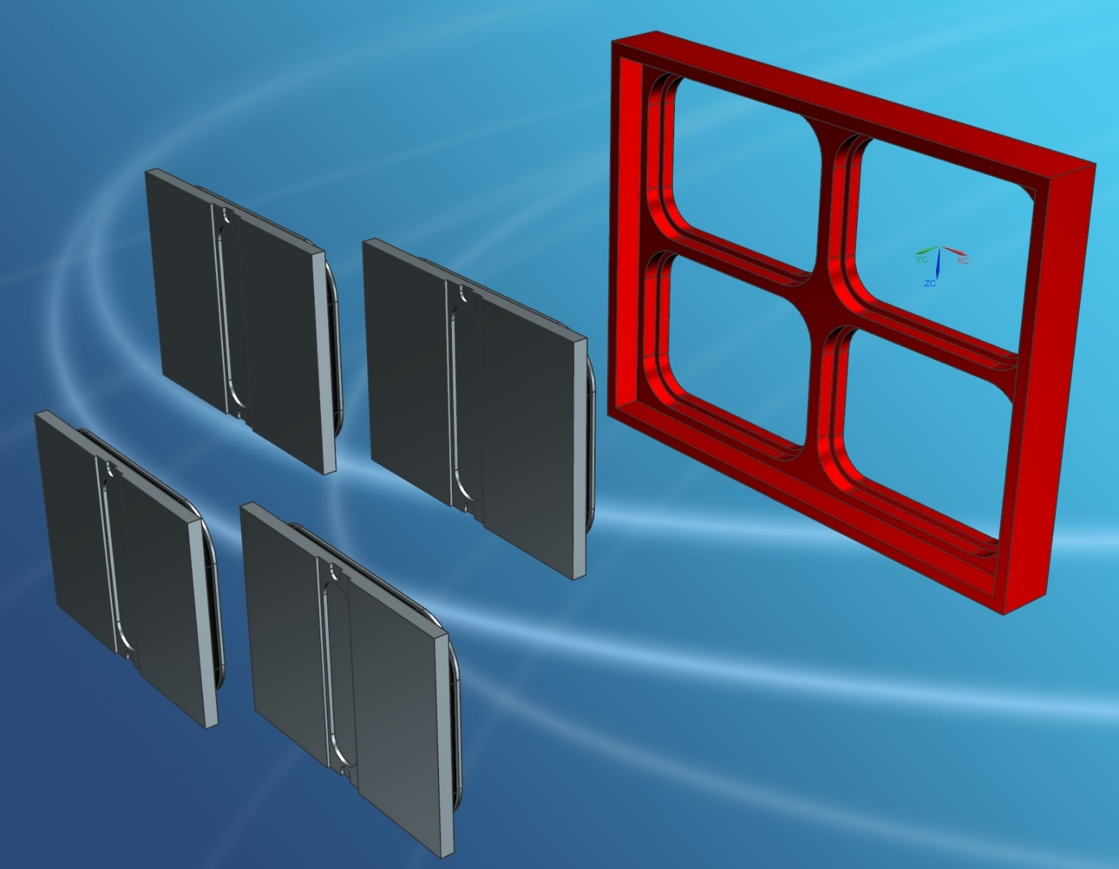
Quad TPX-3 Type F Main Ass’y (007832_A1)
Tray Concept

Slide 6
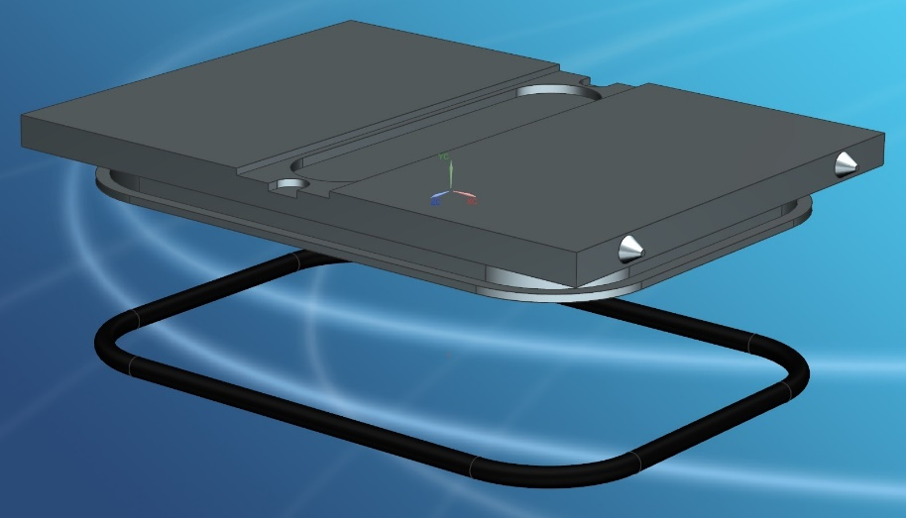
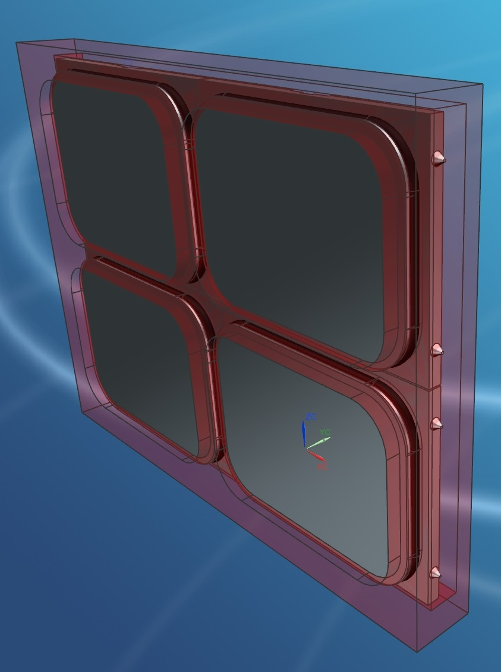
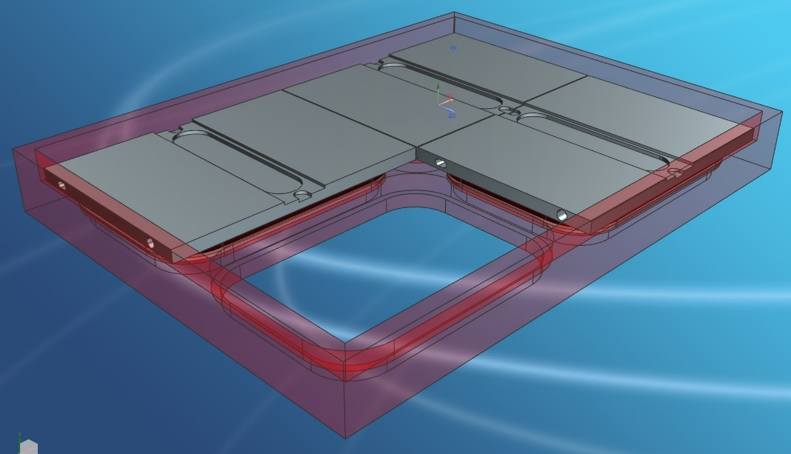
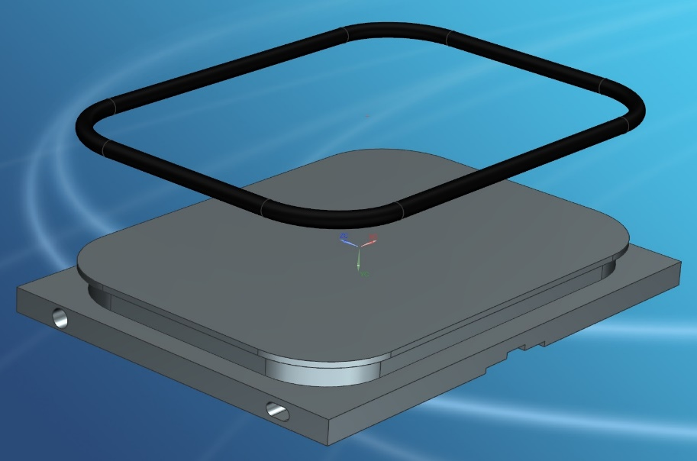
Quad TPX-3 Type F Main Ass’y (007832_A1)
Tray Concept

Slide 7
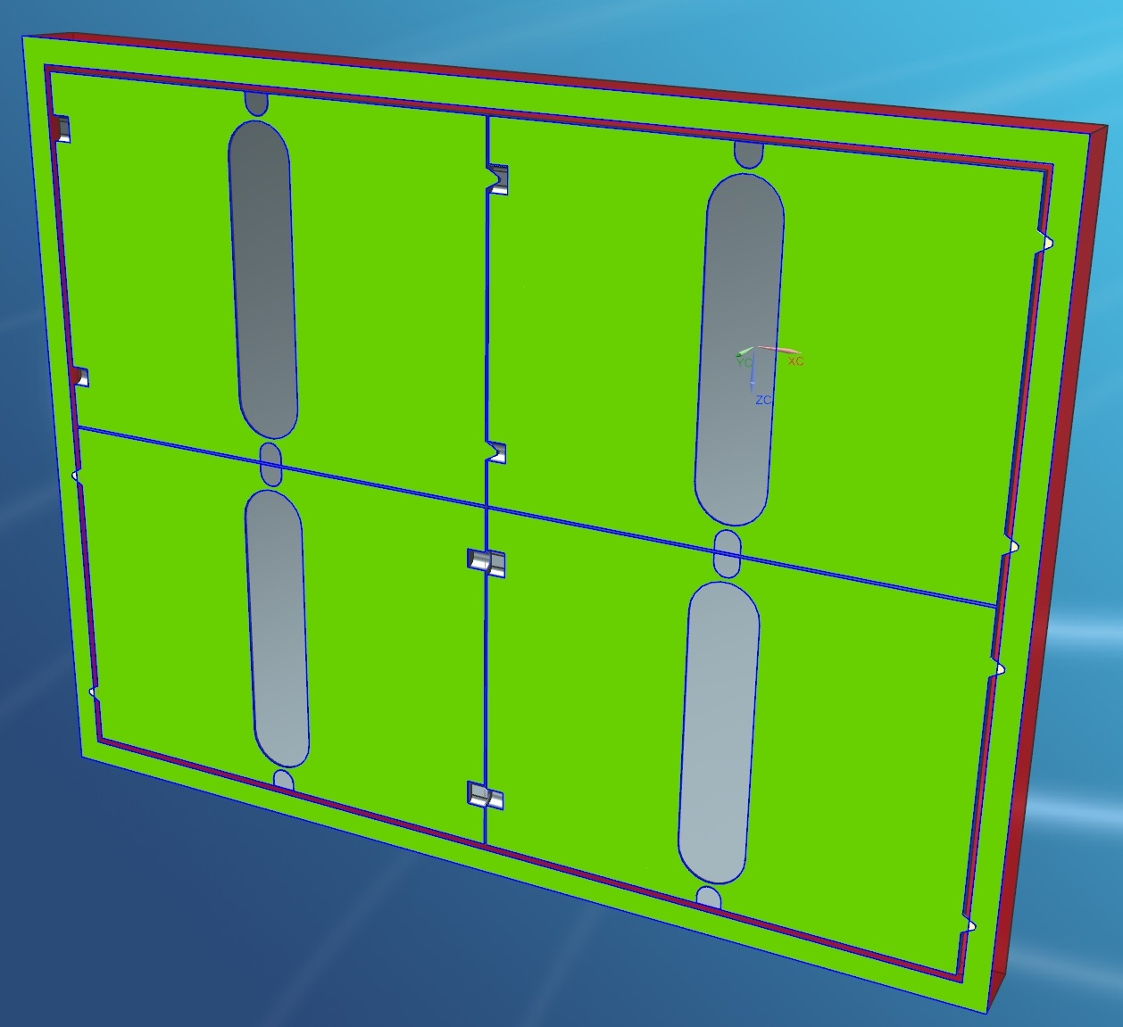
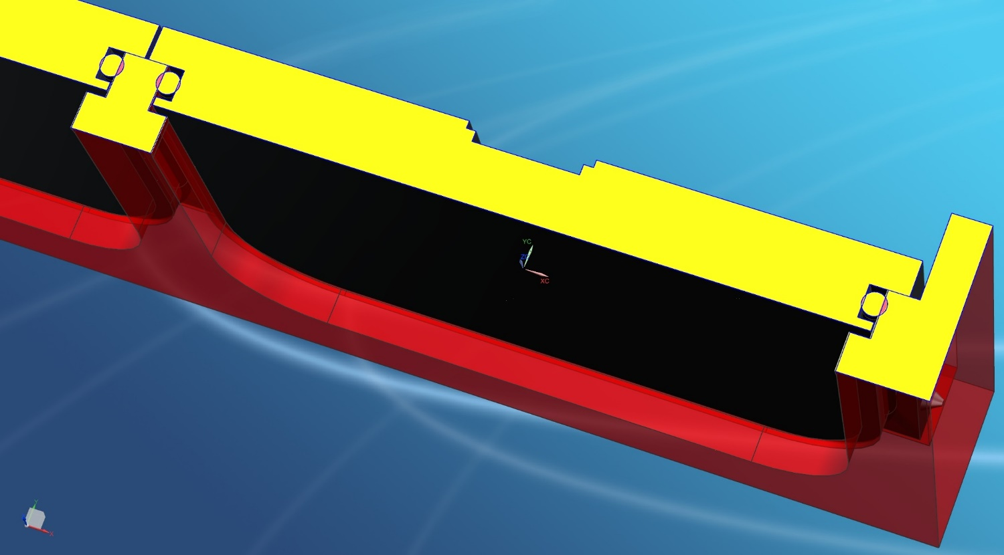
Quad TPX-3 Type F Main Ass’y (007832_A1)
Tray Concept

Slide 8
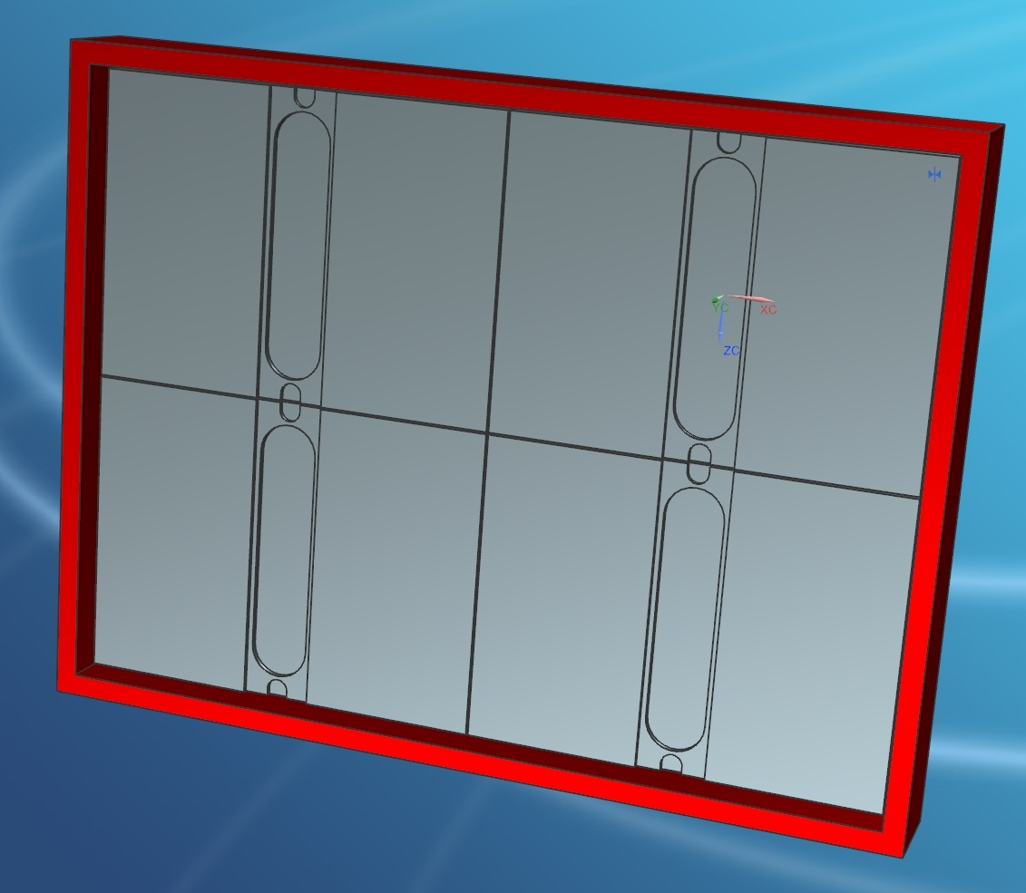
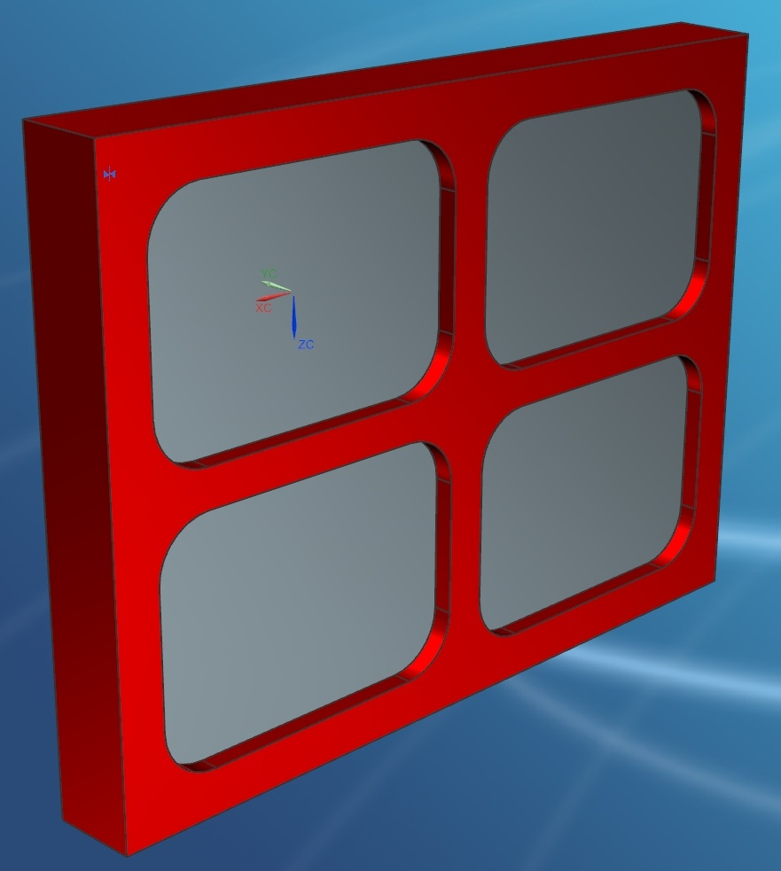
Quad TPX-3 Type F Main Ass’y (007832_A1)
Tray Concept

Slide 9
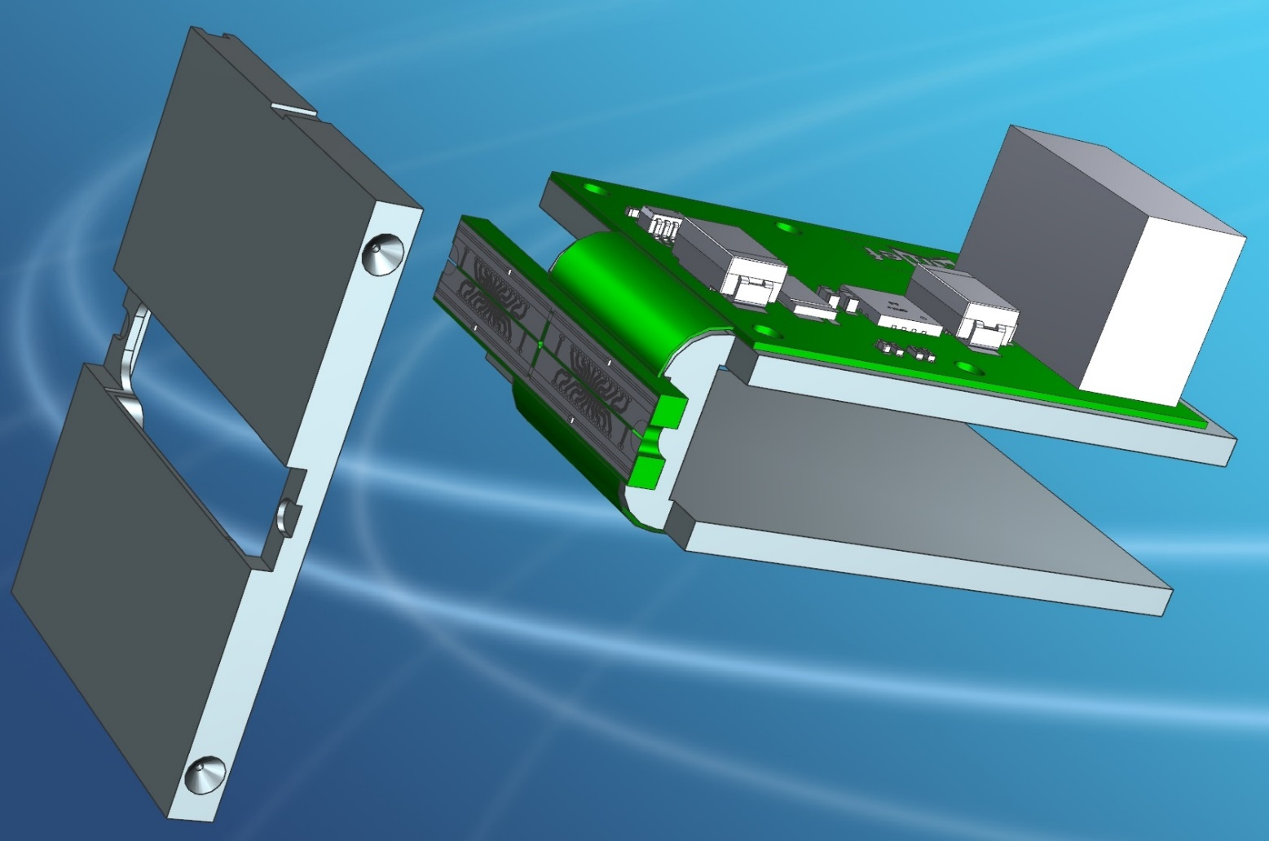
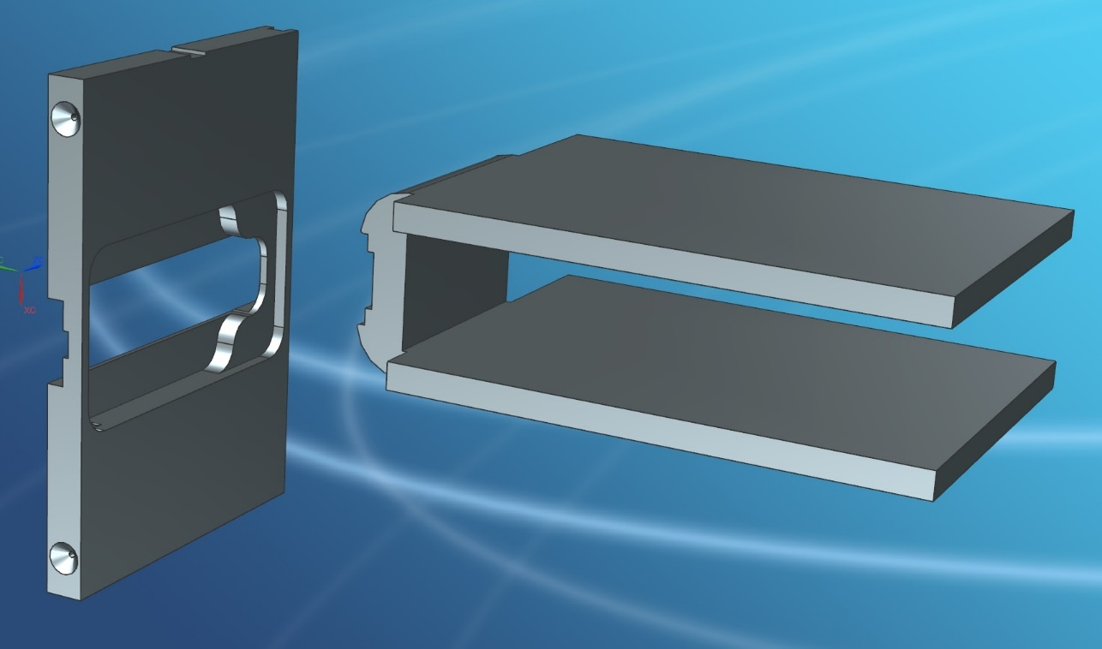
Quad TPX-3 Type H Main Ass’y (006092_A1)
Hook Concept
Hook Concept

Slide 10
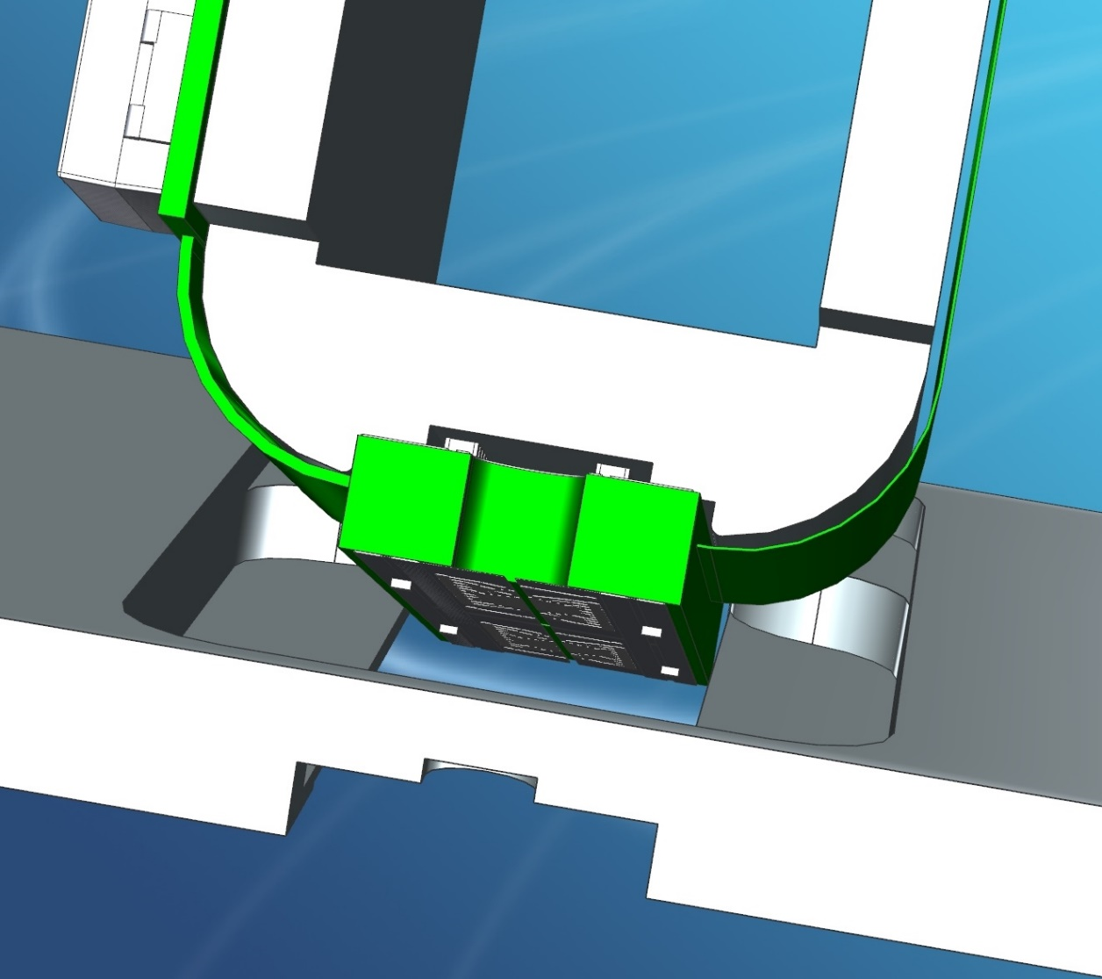
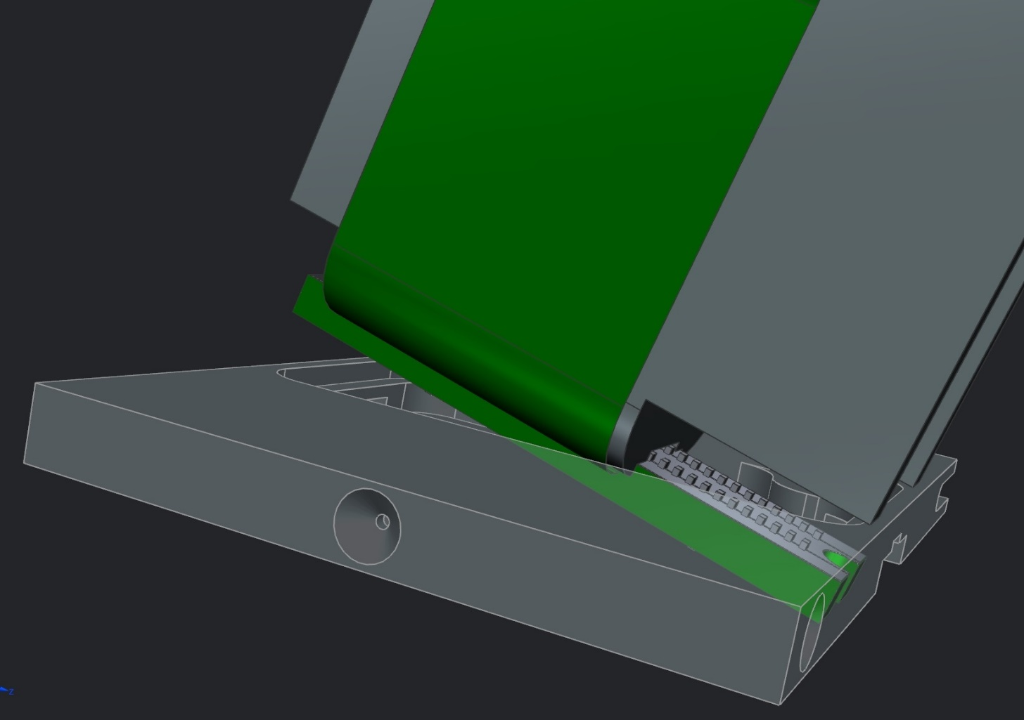
Quad TPX-3 Type H Main Ass’y (006092_A1)
Hook Concept

Slide 11
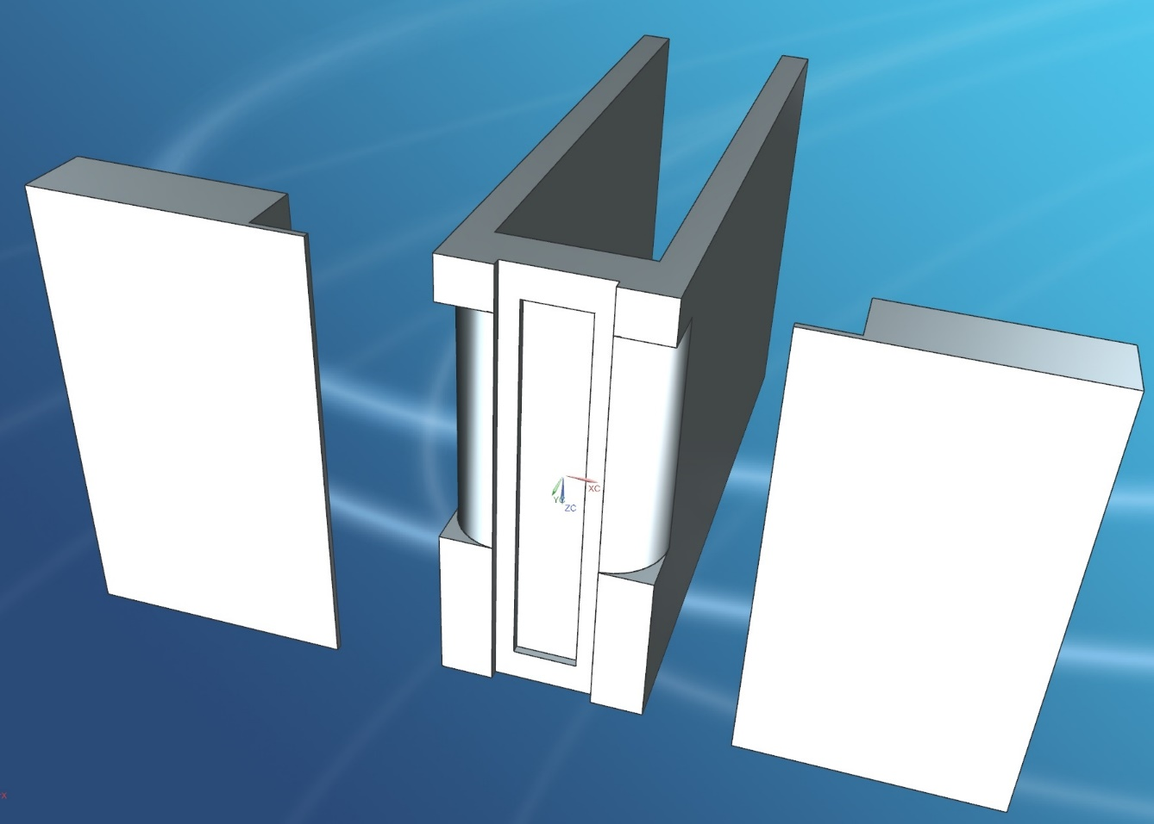
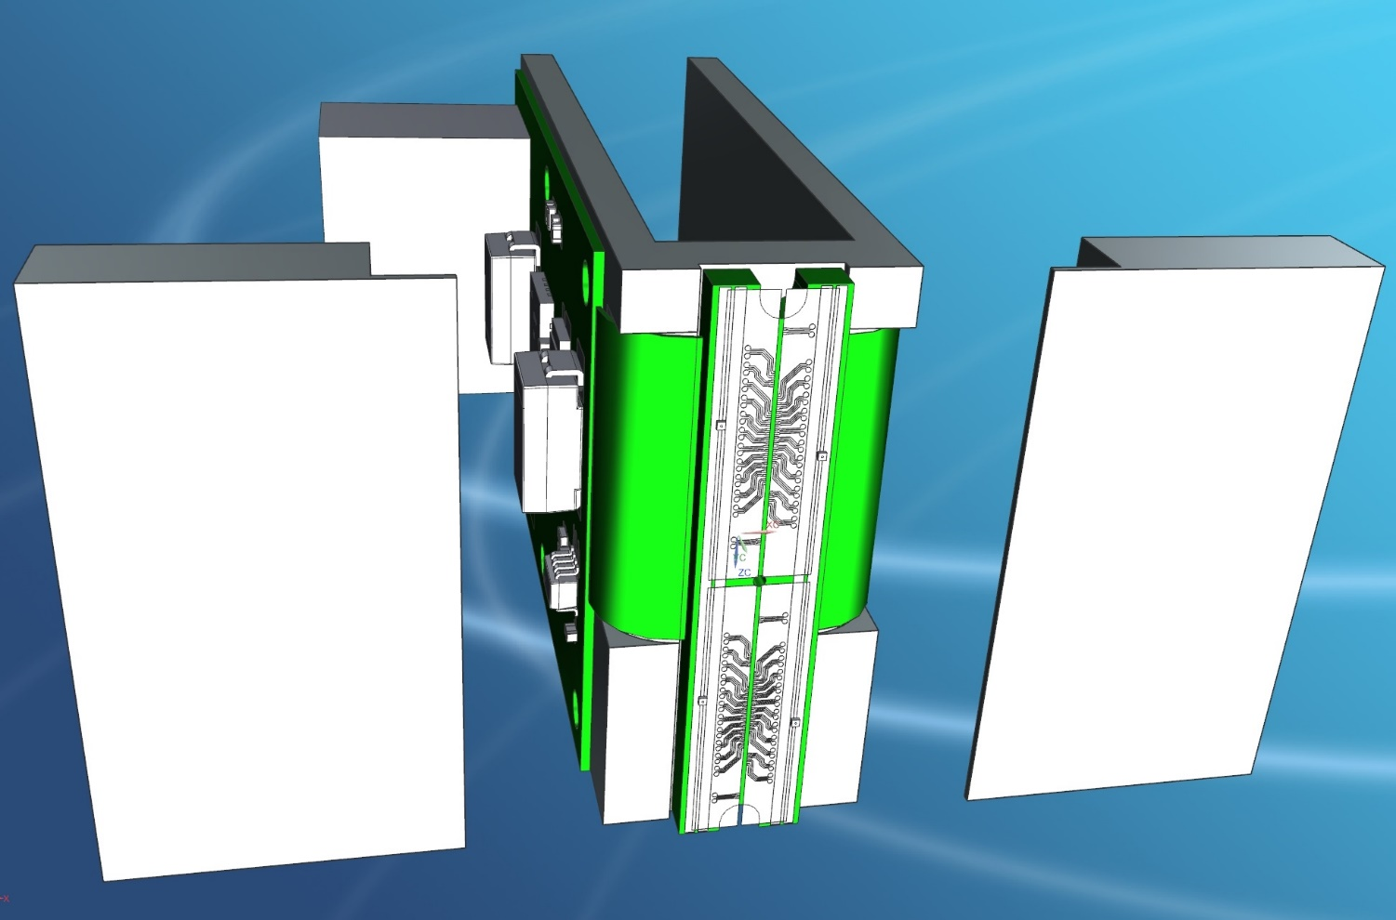
Quad TPX-3 Type J Main Ass’y (006096_A1)
Split Concept

Slide 12
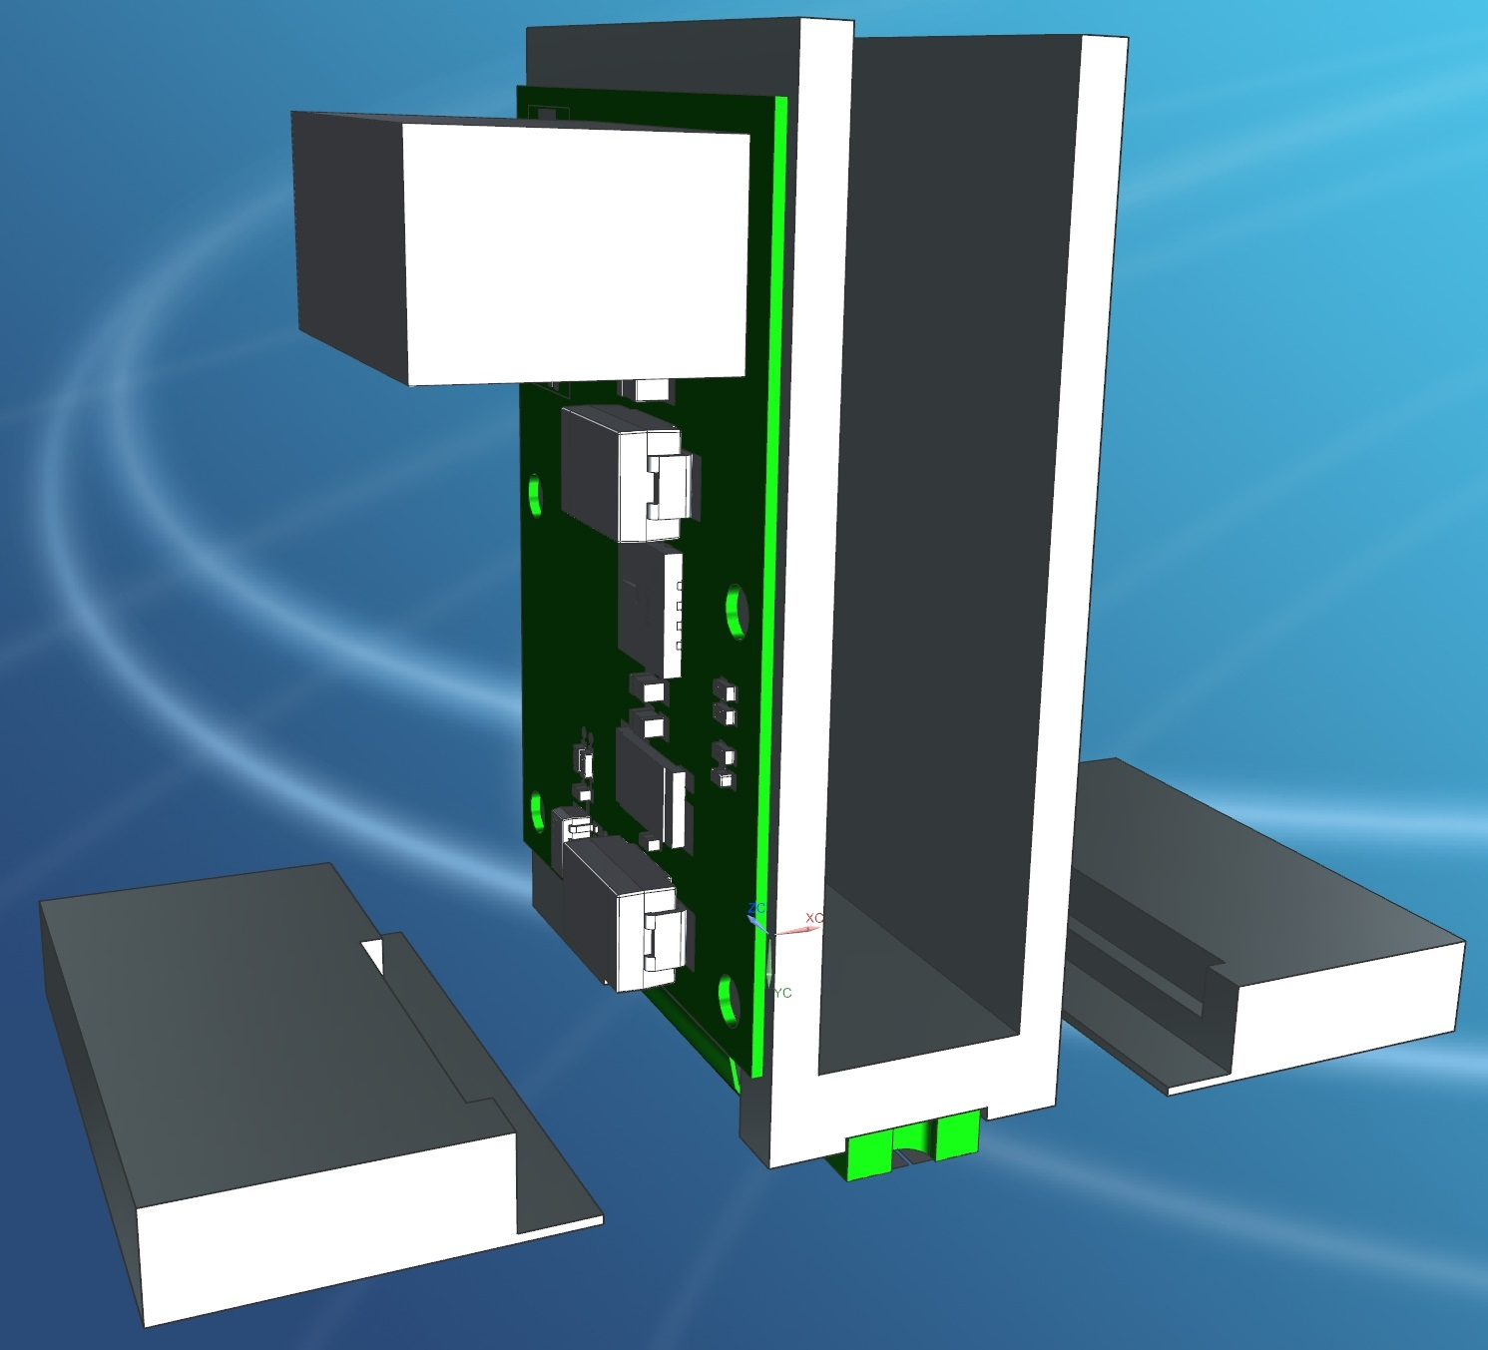
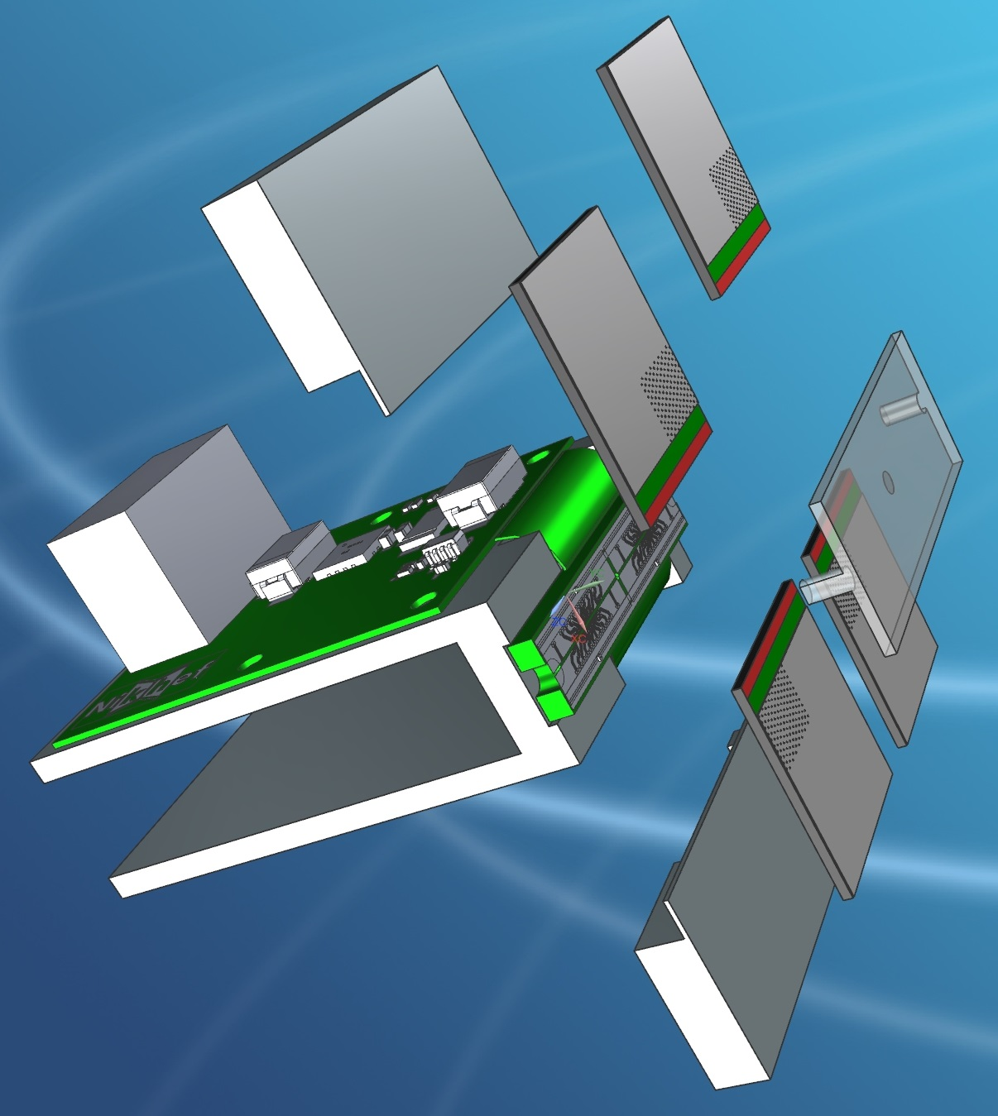
Quad TPX-3 Type J Main Ass’y (006096_A1)
Split Concept

Slide 13
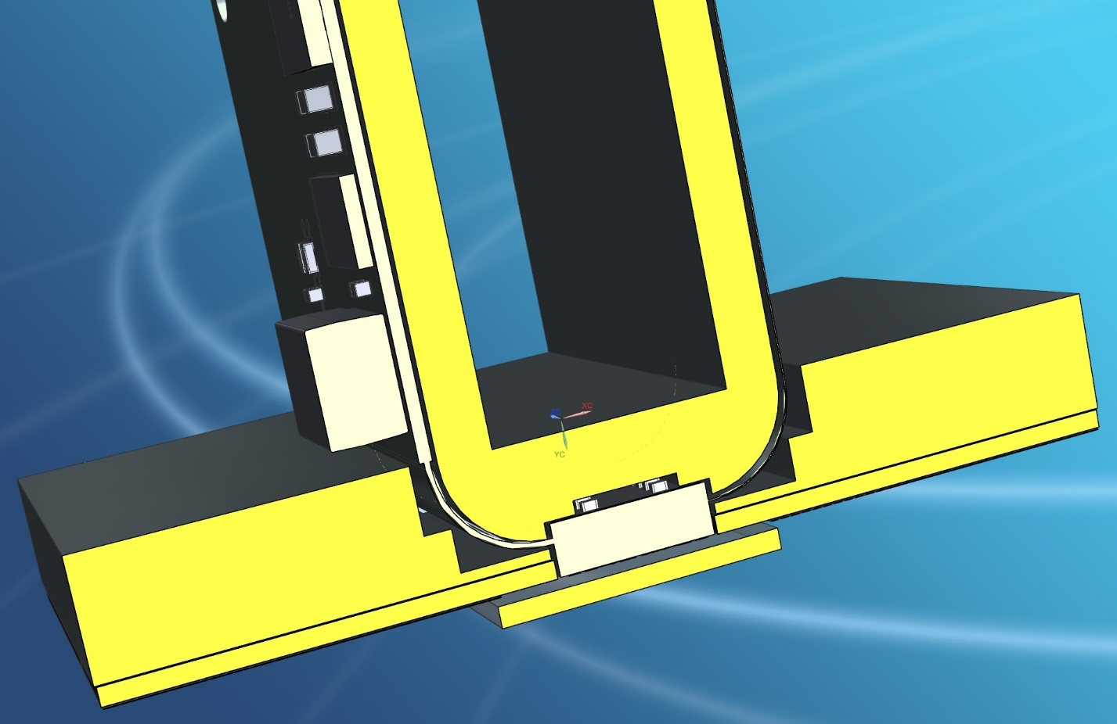
Quad TPX-3 Type J Main Ass’y (006096_A1)
Split Concept

Slide 14
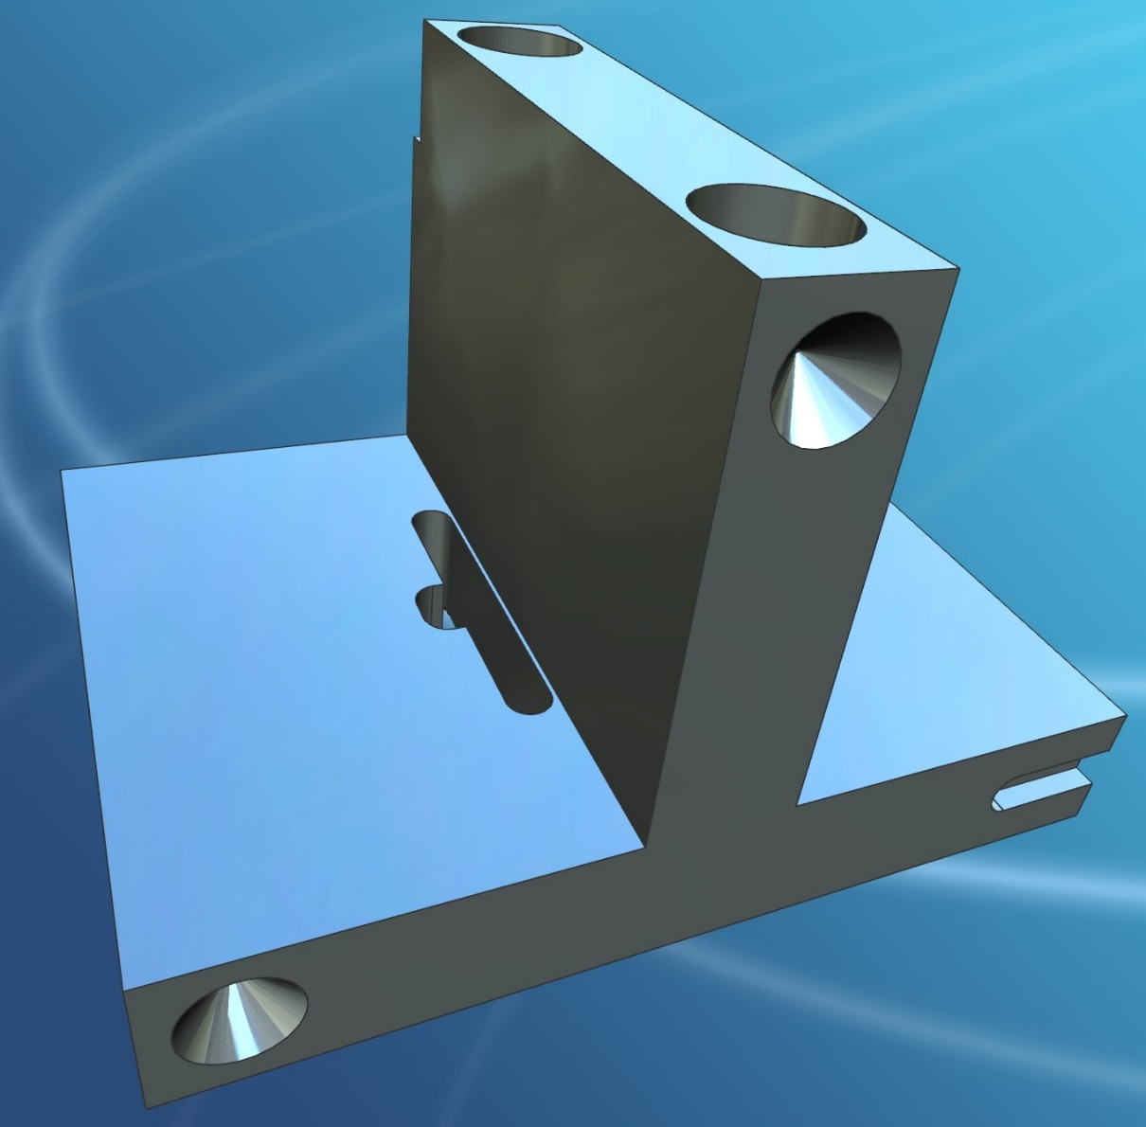
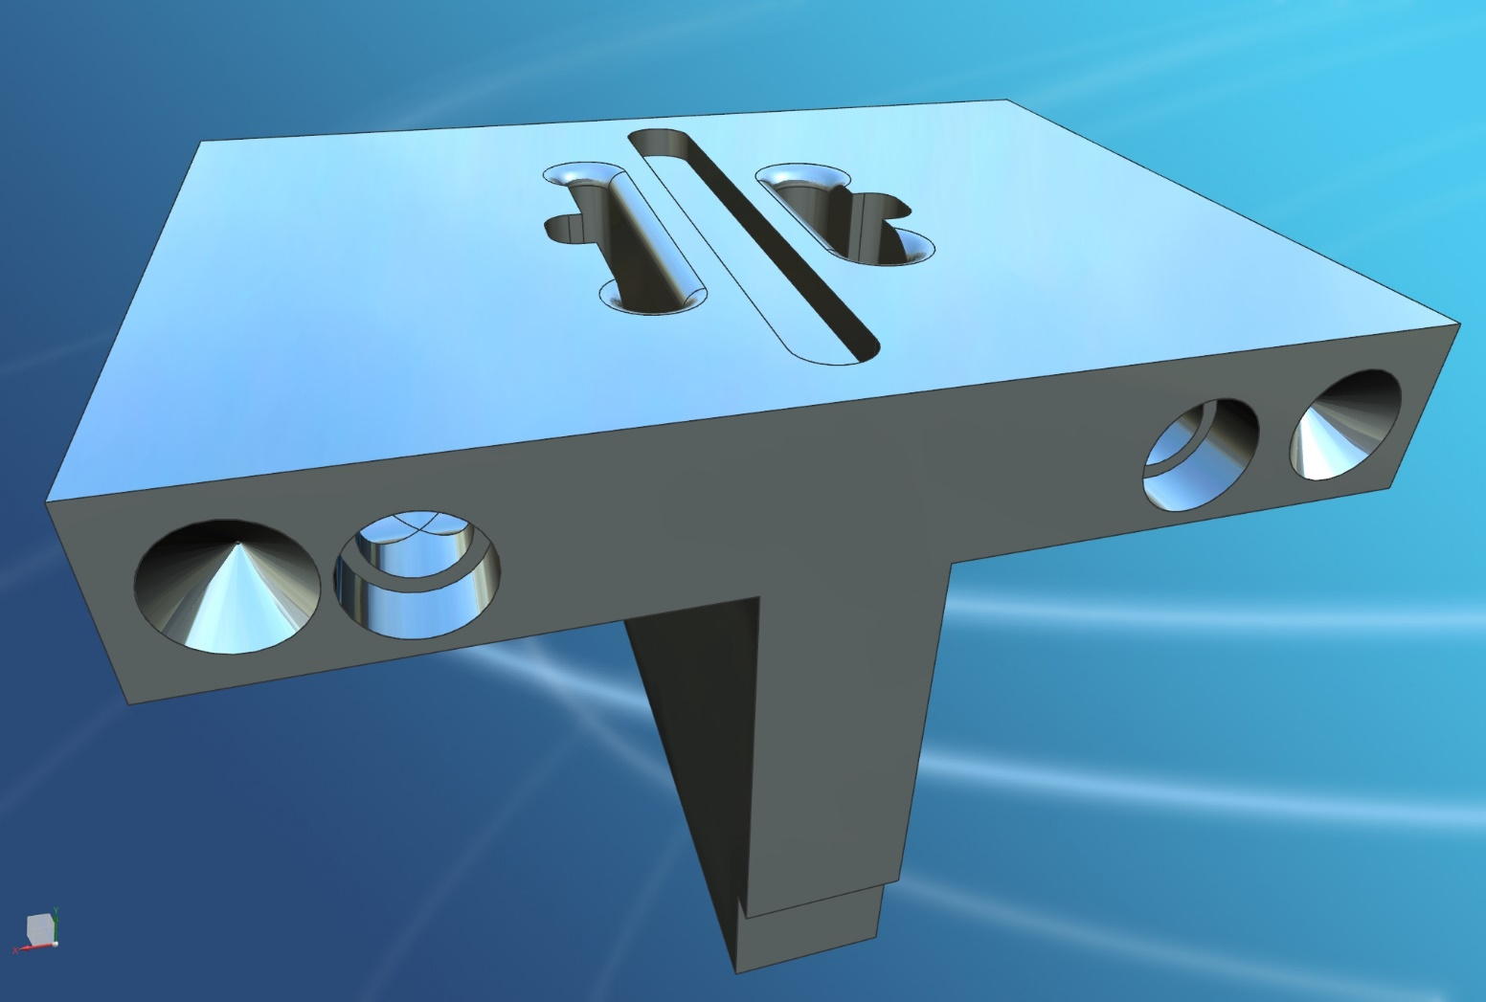
Quad TPX-3 Type B Main Ass’y (006075_A1)

Slide 15
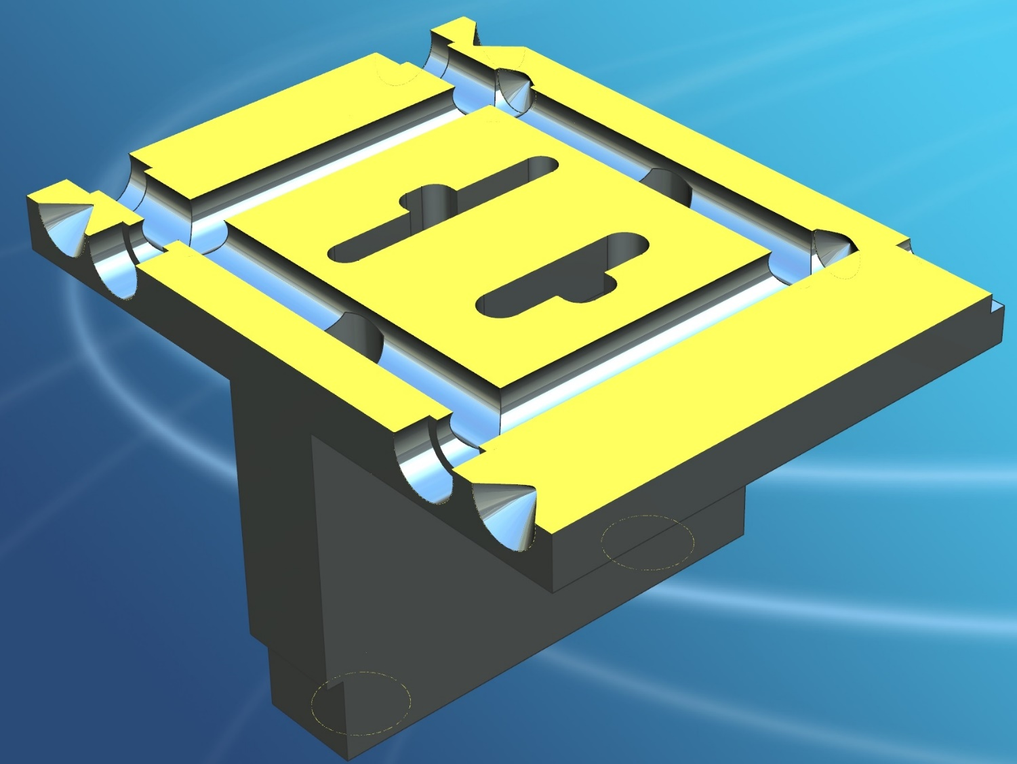
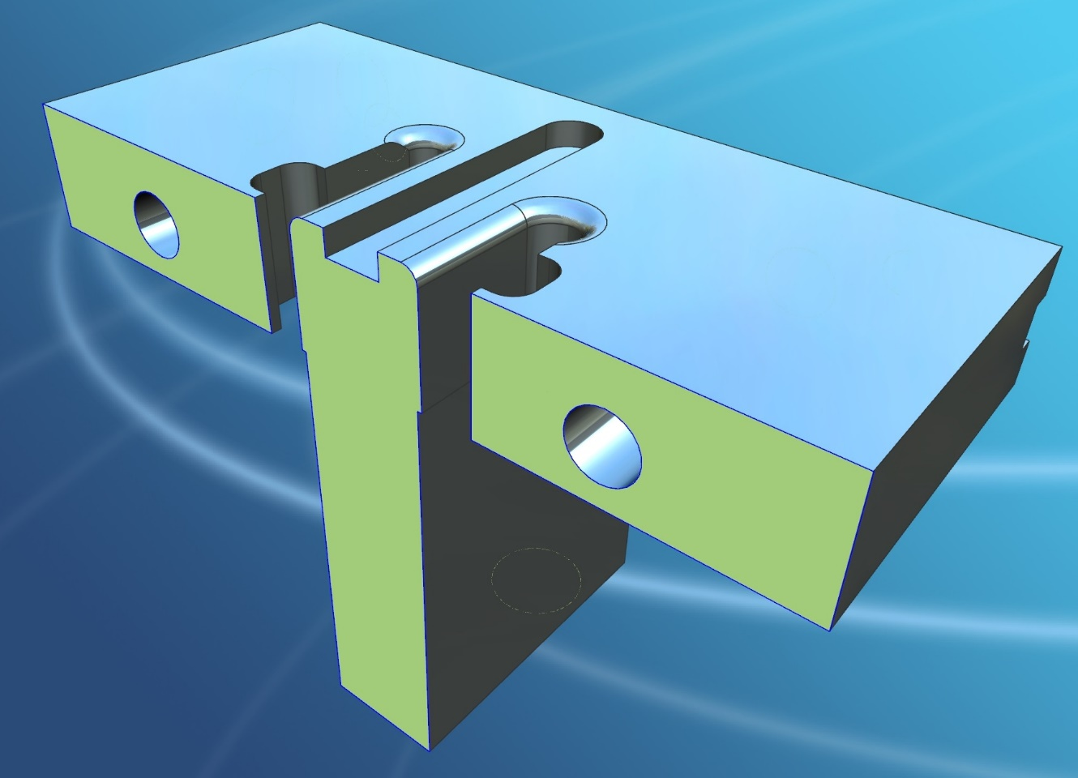
Quad TPX-3 Type B Main Ass’y (006075_A1)

Slide 16
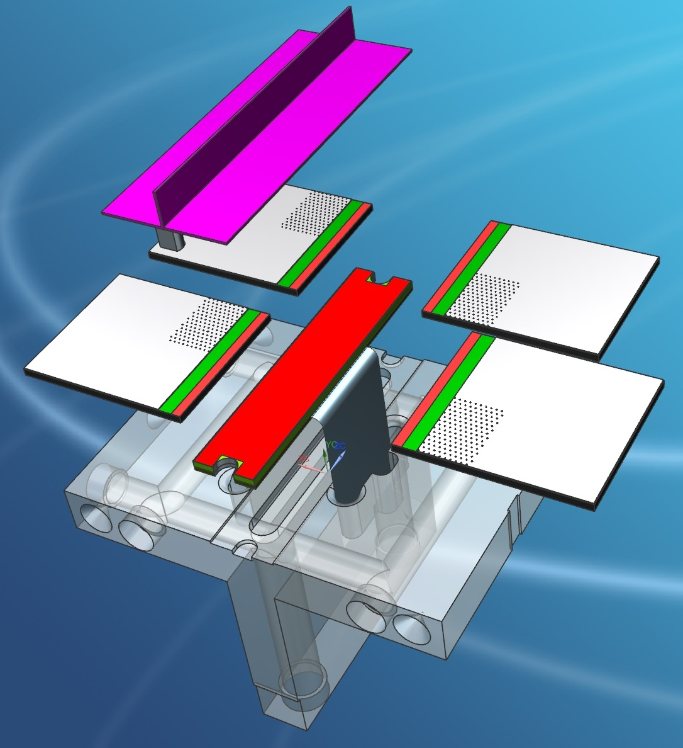
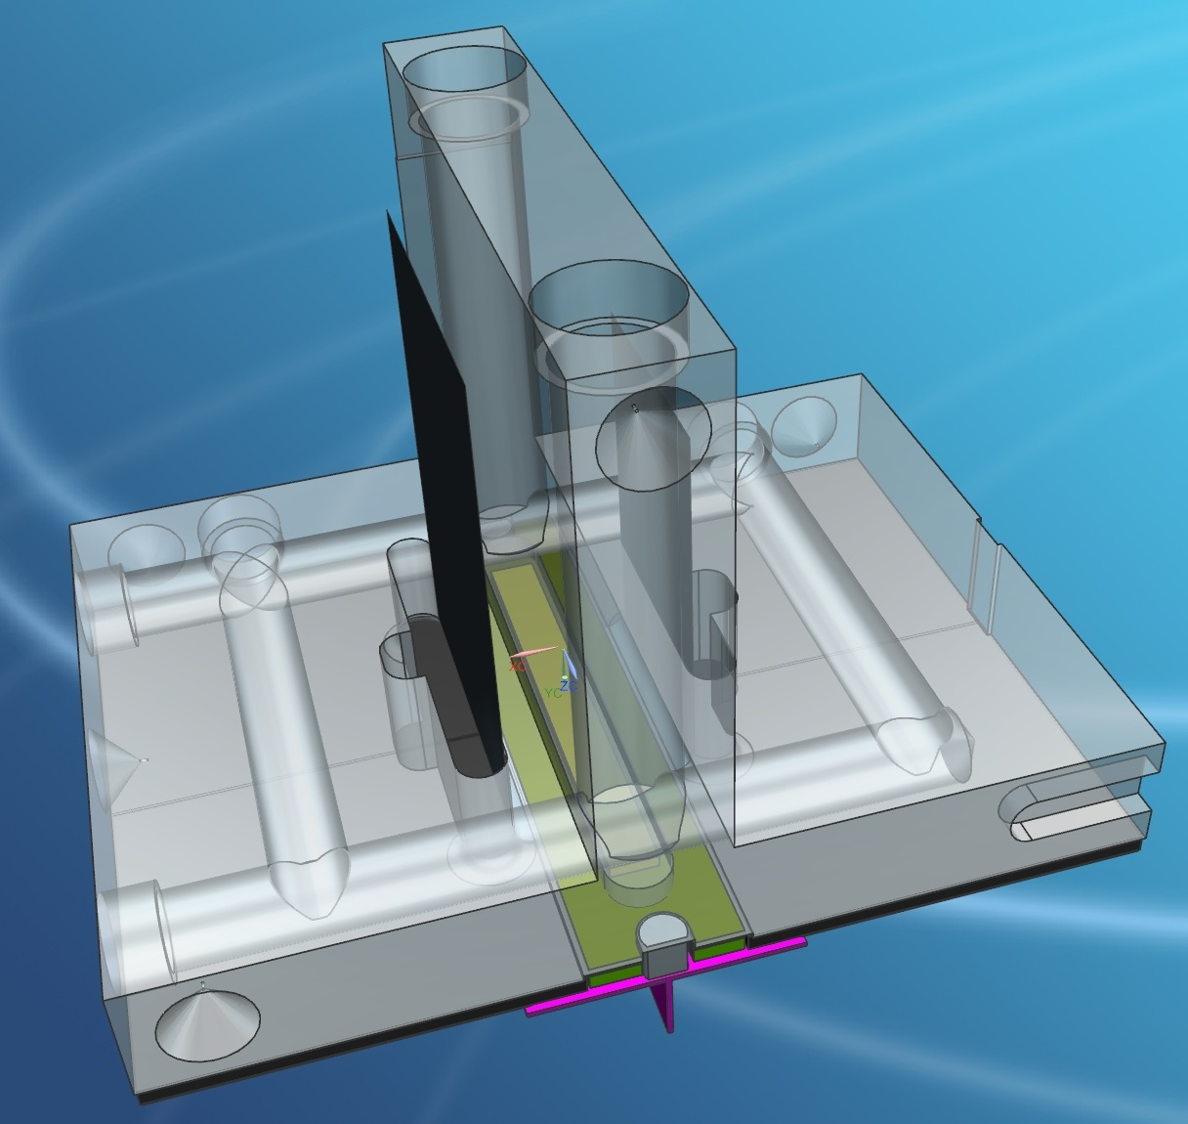
Quad TPX-3 Type B Main Ass’y (006075_A1)

