Slide 1
Sphalerons & search for mini black holes
- ATLAS experiment -
Marcel’s Nikhef sphaleron afternoon, 12 October 2016
Ivo van Vulpen

Slide 2
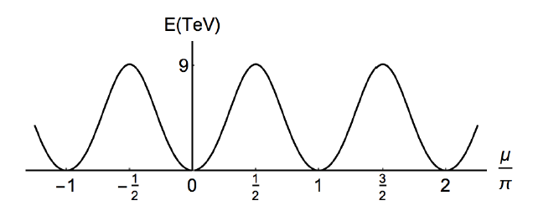
Sphaleron signatures at the LHC:
“Non-perturbative effects in EW sector of the SM violate B+L, but conserve B-L. Sphalerons: process, transition to different vacuum (Chern-Simons number), E_{sp} ~ 9 TeV”
https://arxiv.org/abs/1601.03654
Δn=-1
Δn=+1
https://arxiv.org/abs/1505.03690
p is an unknown normalization constant
Δn=-1:
Δn=+1:
Experimental signature: - Large number of high-P_{T} objects - High values of H_{T} = Σ_{jets} P_{T}^{jet} w.r.t SM - peculiar set of lepton combinations (e⁺,μ⁺,τ⁺)

Slide 3
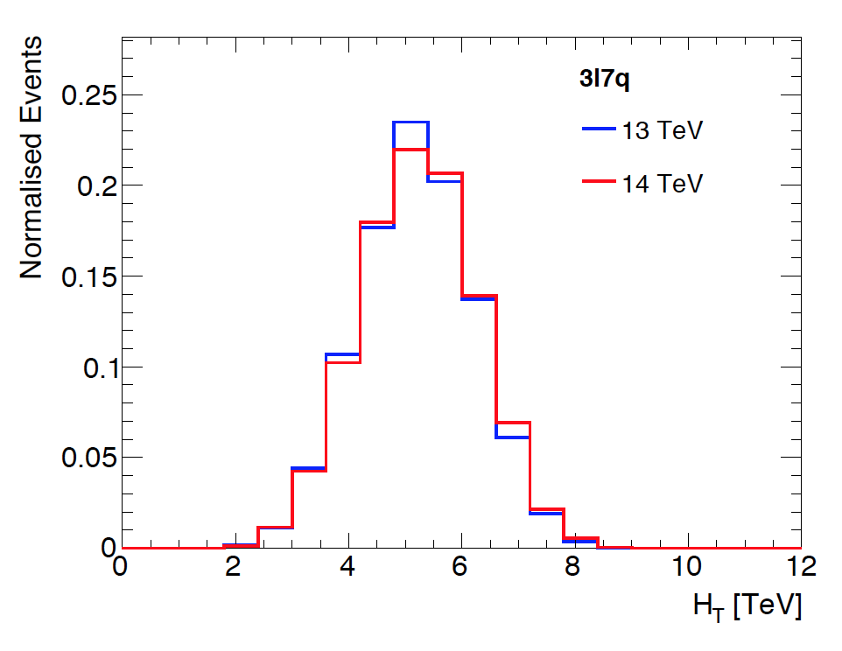
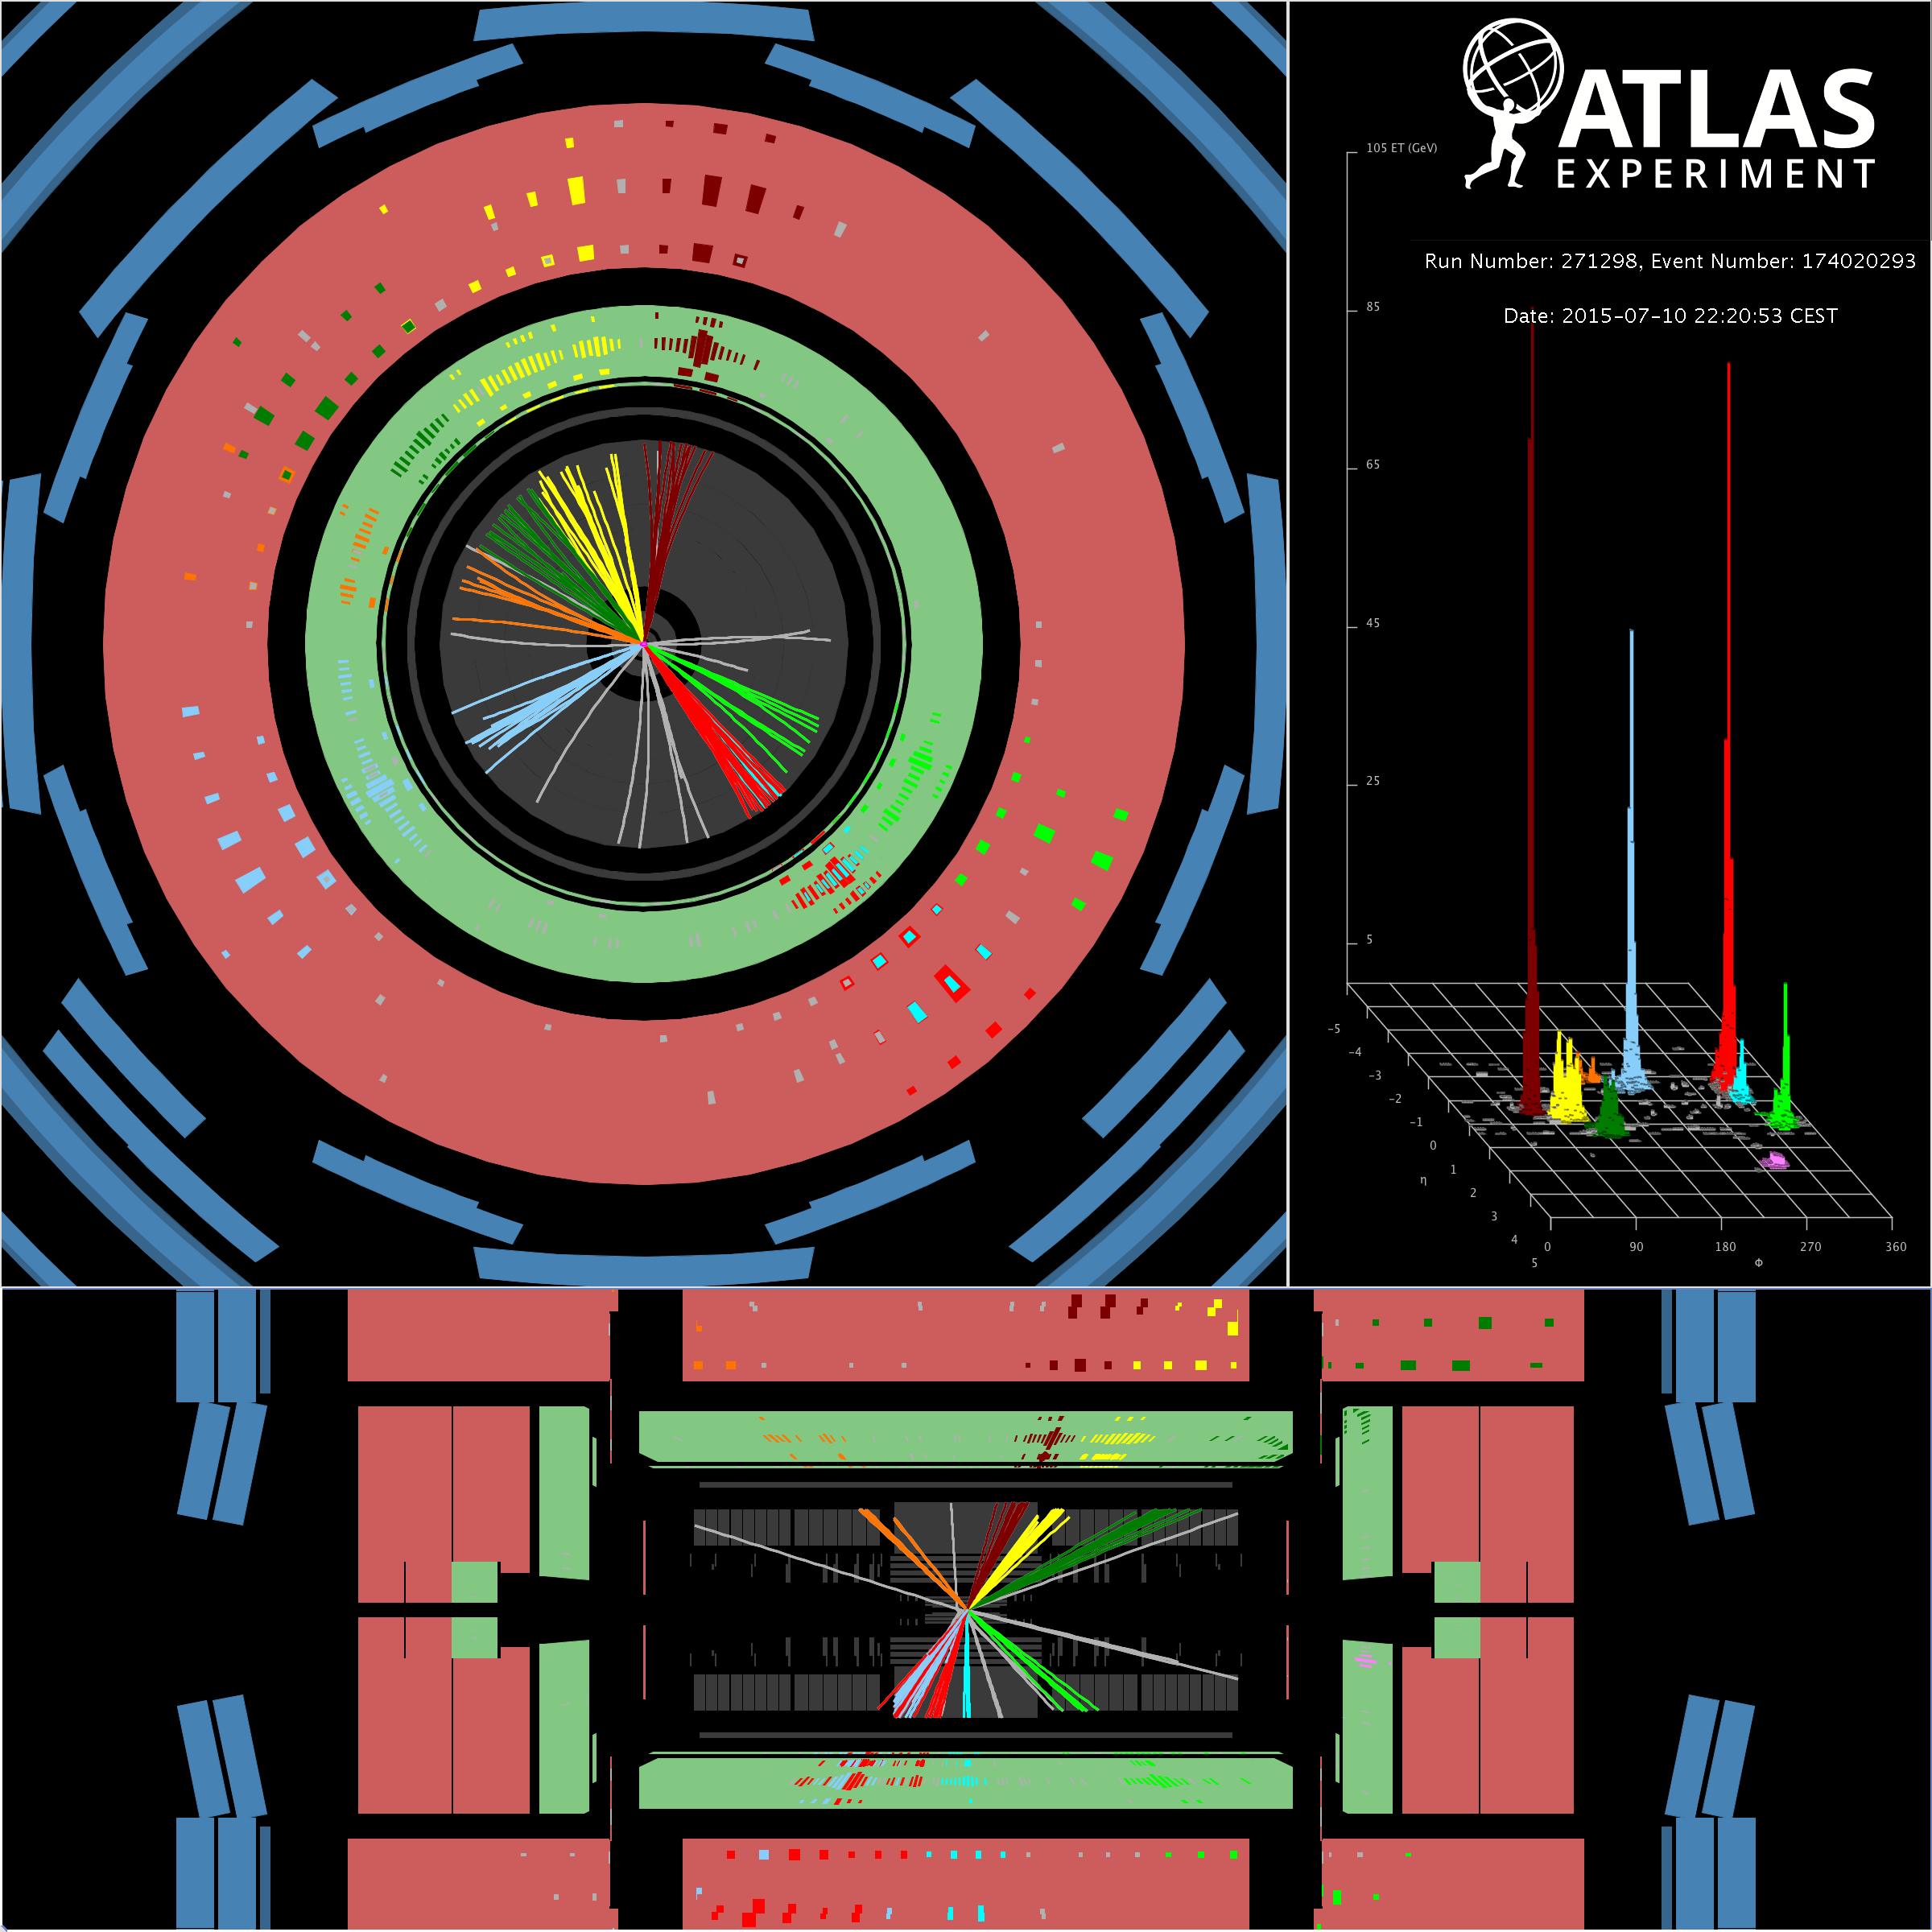
Multi-jet events with high-H_{T} at the LHC
Δn=-1
Event: 9 jets (P_{T} > 50 GeV), H_{T} = 2.93 TeV

Slide 4
Extra dimensions & micro black holes
https://arxiv.org/abs/1512.02586
https://arxiv.org/abs/1606.02265
Multi-jet final state Quoted in paper Ellis/Sakurai
Jets + leptons

Slide 5
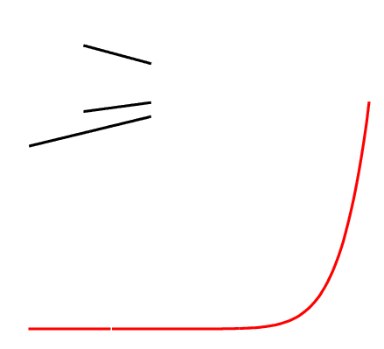
The 3+1 forces of nature
STRENGHT
strong force
quantum gravity
weak force
Effects quantum gravity: - gravitons (Kaluza Klein) - mini black holes
electromagnetism
~10⁴⁰
gravity
ENERGY
LHC
100 GeV (10⁻¹⁸ m)
10¹⁹ GeV (10⁻³⁵ m)

Slide 6
Looking for micro black holes at the LHC
Theory prediction (as seen by an experimentalist)
No QG and semi-classical approach works if m_{BH} > m_{D} and m_{BH}> T_{Hawking}
Hawking radiation (black body): - Energy emitted particles: 50-100 GeV (T, stochastic)
- Type emitted particles: democratically (all particles equal)
Experimental signature: - multi-jet final state with high-P_{T} jets (+ leptons) - high
2) Experimental analysis (as seen by theorists)
- Select events with: ≥ 1 jet with P_{T} > 200 GeV ≥ 3 jets with P_{T} > 50 GeV
- Look at excess w.r.t. SM prediction in distribution of H_{T}

Slide 7
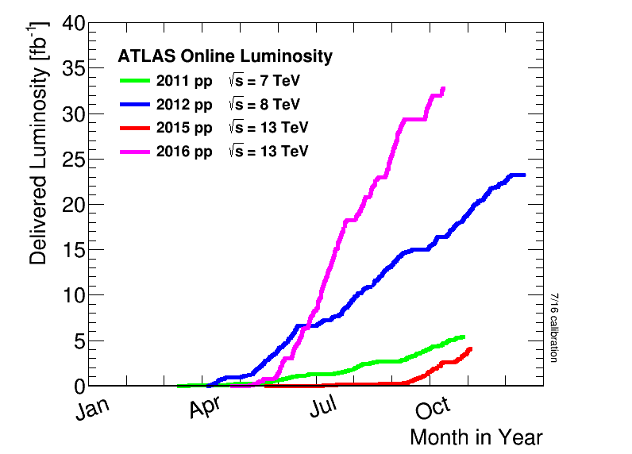
LHC operation and data-set
Strong gravity regime: passed energy threshold → large cross section
Micro black hole analysis uses only 3.2 fb⁻¹ of √s=13 TeV data
Note for theorists: on average 25 overlapping events per bunchcrossing

Slide 8
Results from micro black hole search: H_{T} distribution
Note: for different classes of jet multiplicities

Slide 9
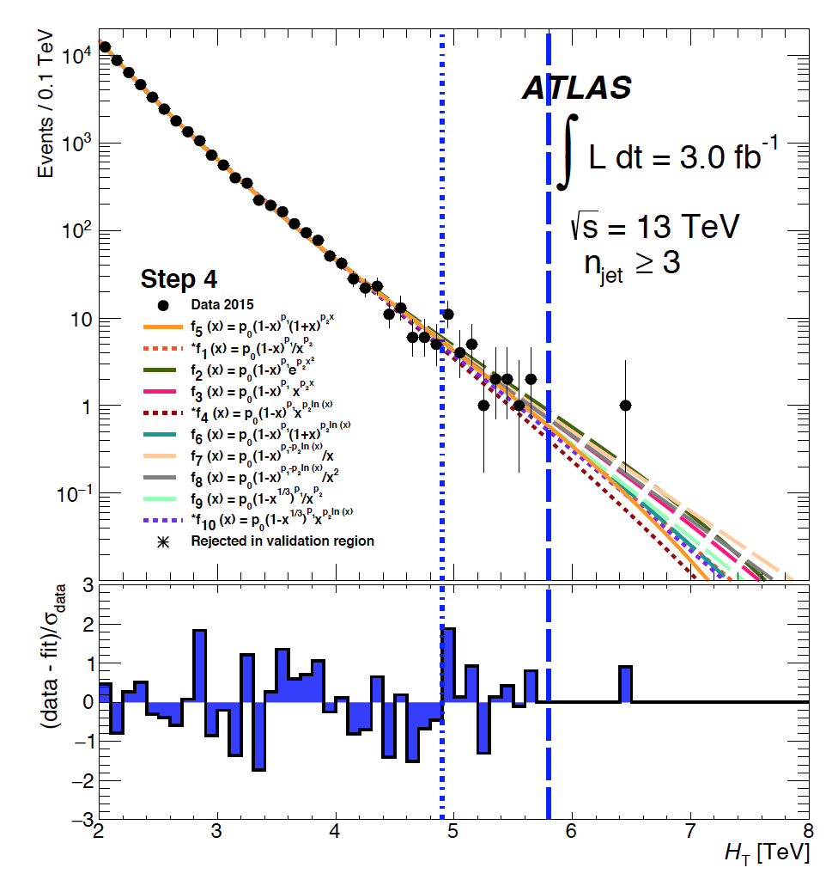
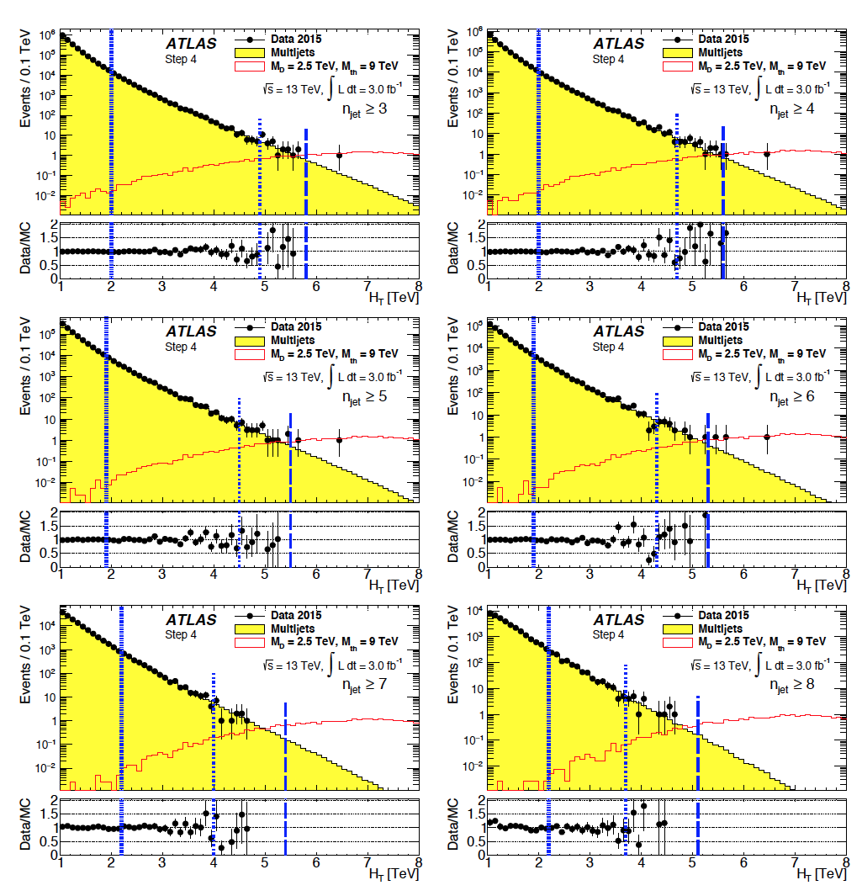
ATLAS analysis:
Strong gravity model: m_{D} = 2.5 Tev, m_{th} = 9 TeV
Main background: multi-jets
H_{T} distribution
H_{T} distribution (n_{jets}≥ 3, …, n_{jets}≥ 8)
normalisation
validation
signal
n_{jet}≥ 3
n_{jet}≥ 4
n_{jet}≥ 5
n_{jet}≥ 6
n_{jet}≥ 3
n_{jet}≥ 7
n_{jet}≥ 8

Slide 10
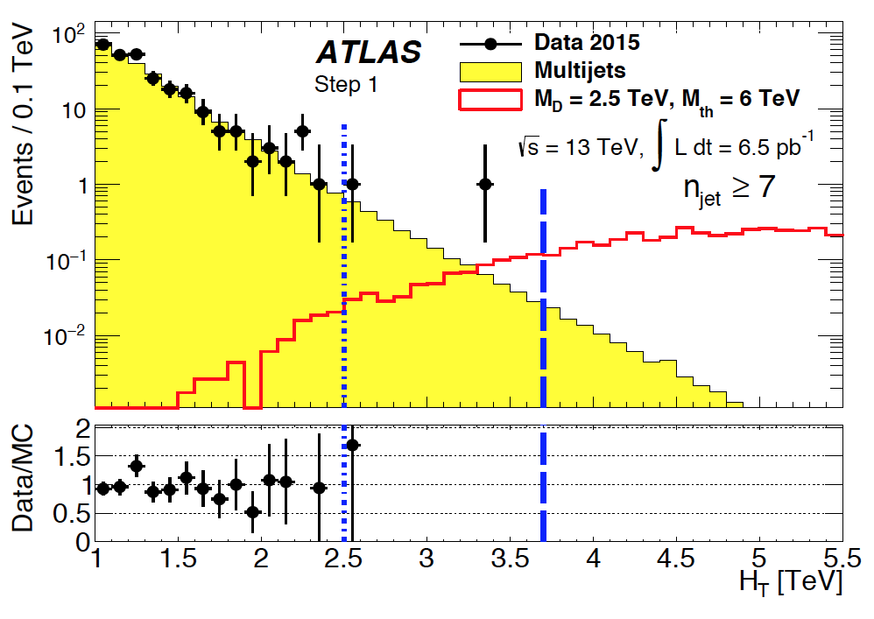
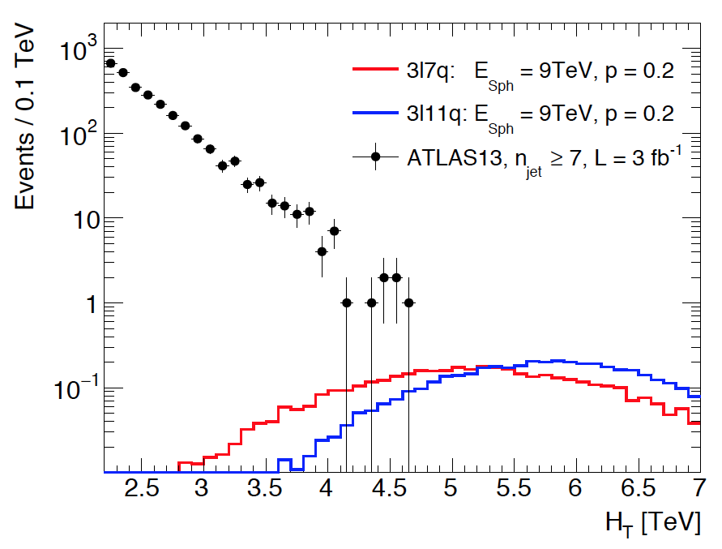
ATLAS
Interpretation ATLAS analysis in Sphaleron transitio (Ellis/Sakurai)
n_{jet}≥ 7
micro black hole
- p is an unknown normalization constant
- suppression factor for theorist-debate
H_{T} distribution (n_{jets}≥7)
Ellis/Sakurai
not excluded
Δn=+1
Δn=-1

Slide 11
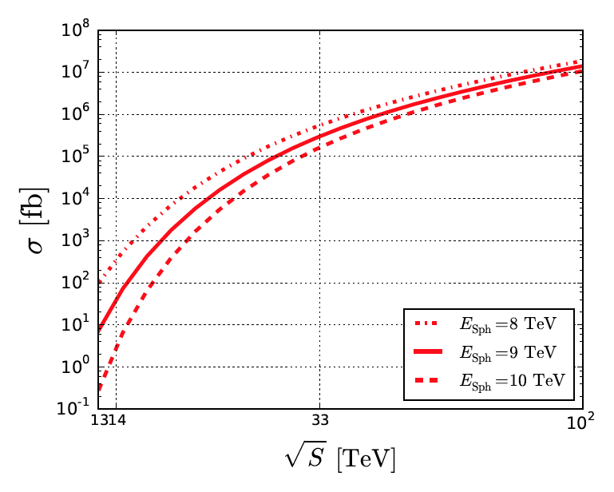
Higgs
Sphaleron vs Higgs
sphaleron

Slide 12
Sensitivity for smaller rates (smaller p)
cross section versus √s
Improving sensitivity
LHC: √s=14 TeV/3000 fb⁻¹: 6x/30x better
→ reach: p = 10⁻⁴
New 100 TeV collider, 2x20,000 fb⁻¹: → reach: p = 10⁻¹¹
Conclusions:
Yes, ATLAS and CMS are sensitive to sphaleron transitions
LHC still has small window, but better hopes for a future collider

