Slide 1
“Sphalerons”
4-th Nikhef Mini Workshop
“Theory Meets Experiment”
Oct 12, 2016

Slide 2
Agenda
Introduction
  Context of this mini-workshop, M.M. – 10’
Part I: Theory
  “What are Sphalerons?”
  Bert Schellekens – 25’
  “Sphalerons in the Early Universe”
  Marieke Postma – 25’
  “Sphaleron signatures in QCD”
  Chris Korthalsaltes – 15’
  “Sphaleron signatures for B+L Violation”
  Jan Smit – 15’
Break
Part II: Experiment
  Search for Sphalerons in (high energy) LHC
  Ivo van Vulpen – 20’
  Sphalerons in Alice: “Chiral magnetic effect”
  Jacopo Margutti – 20’
  Search for Sphalerons in cosmic ray showers
  Charles Timmermans – 20’
Borrel

Slide 3
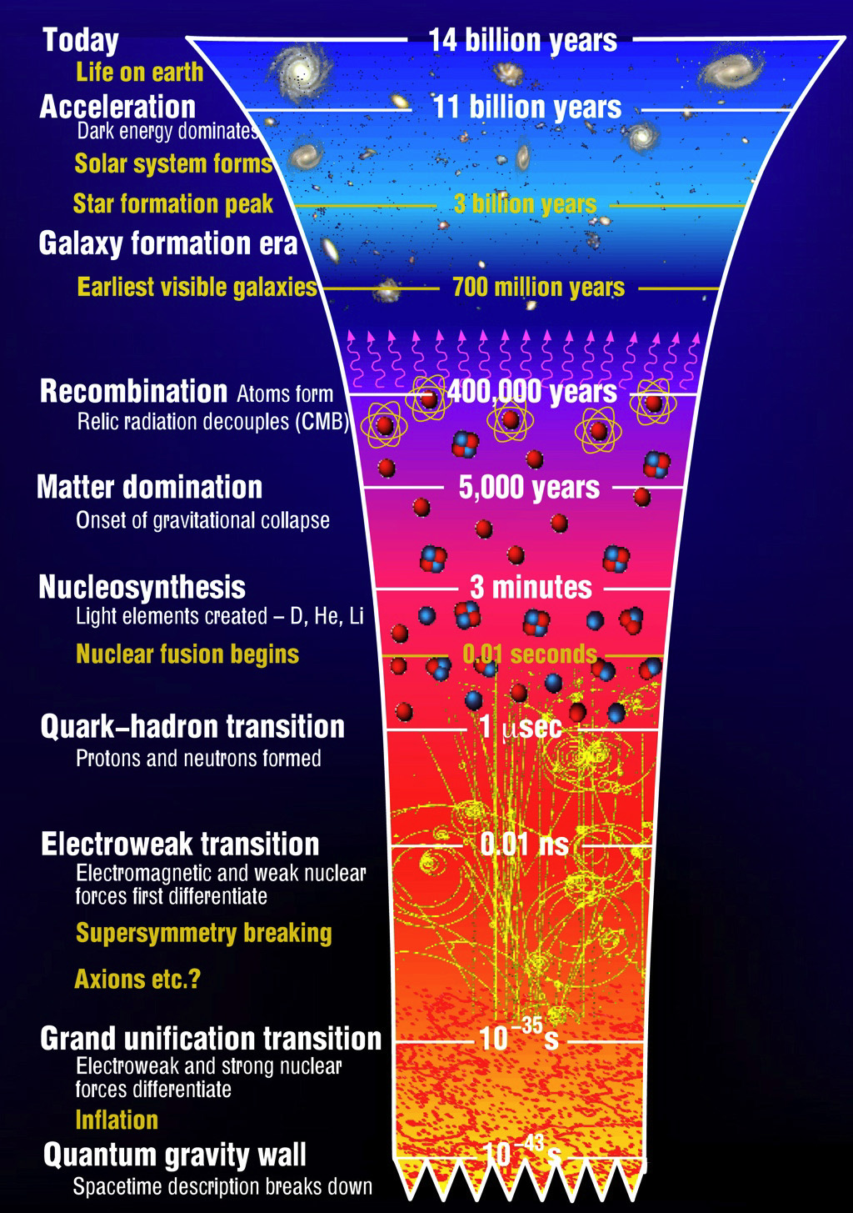


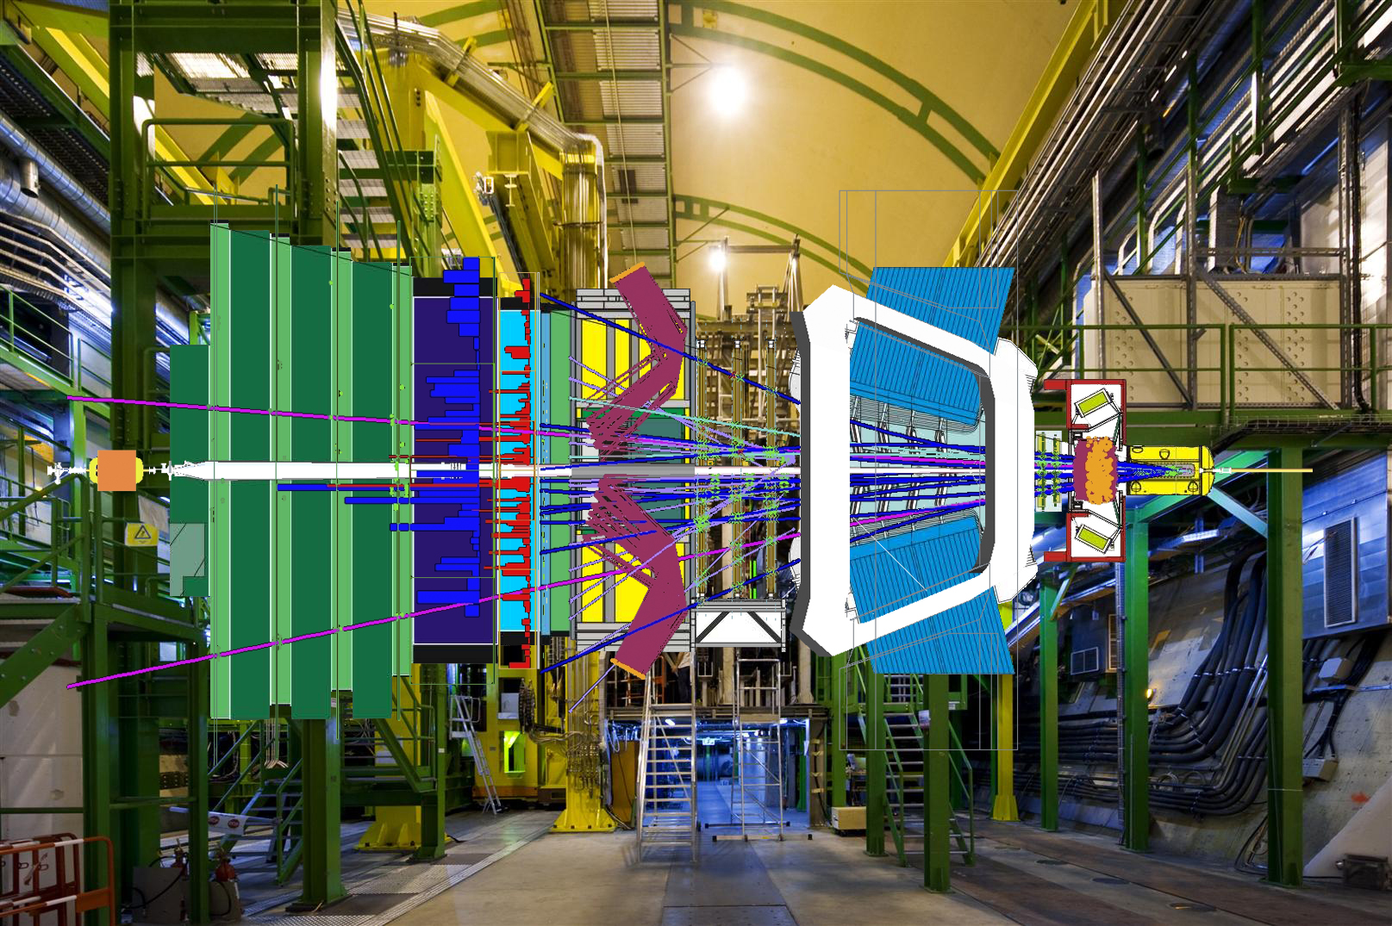

Physics of the Early Universe
Chiral Symmetry Breaking (mass)
EW Symmetry Breaking (mass)
Notes:
Can we learn from SU3 and SU2 – different languages. Potential picture in SU3?
What role do Sphalerons play?

Slide 4
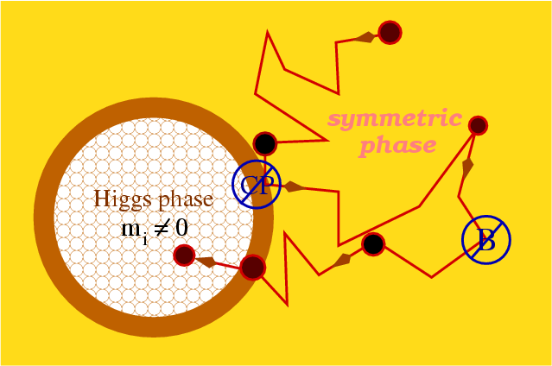
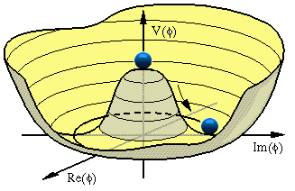
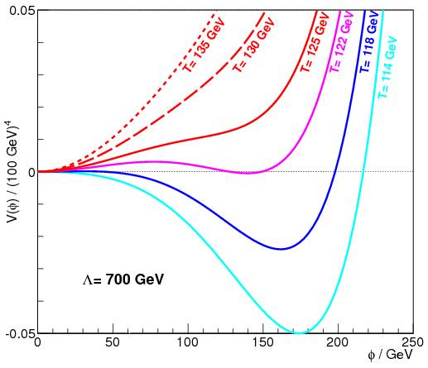
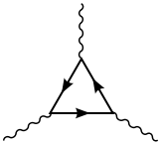
Electroweak Baryogenesis in the Standard Model?
symmetric phase
broken phase
expanding bubble (Higgs condensates)
Three Sacharov Conditions:
✔ Baryon Number Violation
✔ C and CP Violation
✔ Thermal non-equilibrium
Adler-Bell-
Jackiw
1st order
‘t Hooft, PRL
37 (1976) 8
V
Axial Anomaly:
f
f
tunnel
f
Quantum anomaly
φ
Weak Interaction
Higgs Phase Transition
Notes:
Bubbles met Higgs Vev. Do we currently see different Bubbles in the sky? (Adler-Bell-Jackiw)
Axial anomaly at quantum level: B+L violating, B-L conserving

Slide 5
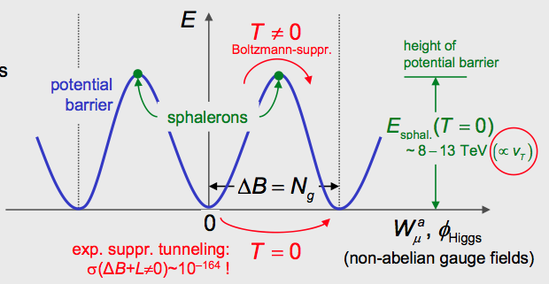
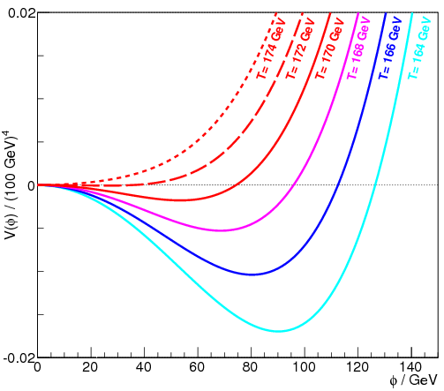
Electroweak Baryogenesis in the Standard Model?
➔ Search for new particles or fields!
CPV from CKM:
− A_{CP} = J_{inv} * (m_{t}²-m_{c}²) (m_{c}²-m_{u}²) (m_{u}²-m_{t}²)
  * (m_{b}²-m_{s}²) (m_{s}²-m_{d}²) (m_{d}²-m_{b}²)
  − BAU: Δn_{B}/n_{γ} ≈ 10⁻¹⁰
  • From CKM: A_{CP} / T_{c}¹² ≈ 10⁻²⁰
  • Used: T_{c} ~ 100 GeV !
• SM: M_{H} < ~70 GeV
• THDM: M_{H} ~ 125 OK
✔ Baryon Number Violation
✔ C and CP Violation
✔ Thermal non-equilibrium
✖
✖
1st order
Adler-Bell-
Jackiw
‘t Hooft, PRL
37 (1976) 8
2nd order
SM
V
V
Axial Anomaly:
f
f
tunnel
f
Quantum anomaly
φ
Weak Interaction
Higgs Phase Transition
Notes:
‘t Hooft shows that for internal fermion loop.
Jarlskog invariant: 3 x 10^-5

Slide 6
Recipes for Baryogenesis - skip
Expanding bubbles of broken phase
In a medium of symmetric phase
Baryon production in front of bubble wall
Note: new physics must be abundant in the thermal plasma at the time of EWSB.
Therefore the particles must be roughly at the TeV scale.

Slide 7
Sphaleron Discussions Today
Anomaly:
Quantum anomaly
What are sphalerons?
How do we go from the quantum anomaly to the nonperturbative picture?
What are differences/similarities between SU2 and SU3
Which quantum number play the role of “winding number” SU2:B+L, SU3:Q₅?
What determines the height of the sphaleron potential?
How do sphalerons affect physics in the early universe: Baryogenesis/Leptogenesis
Are B+L violating interactions possible: qq →3 l + 7 q +nW, n’Z, n’’H (also Khoze talk 2014)
What would be the experimental signatures:
  B+L violating interactions in the LHC (sphaleron potential is ~ 9 TeV)
  Chiral magnetic effects in Alice
  B+L violating interactions in Auger: shower depth and more?
  Km3Net?
Notes:
About 9 TeV potential

Slide 8
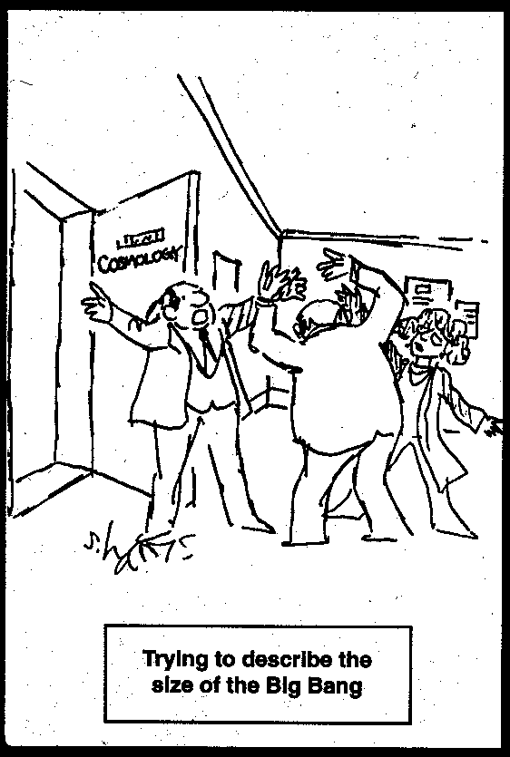
Enjoy the workshop…
https://indico.nikhef.nl/categoryDisplay.py?categId=19

Slide 9
Agenda
Introduction
  Context of this mini-workshop, M.M. – 10’
Part I: Theory
  “What are Sphalerons?”
  Bert Schellekens – 25’
  “Sphalerons in the Early Universe”
  Marieke Postma – 25’
  “Sphaleron signatures in QCD”
  Chris Korthalsaltes – 15’
  “Sphaleron signatures for B+L Violation”
  Jan Smit – 15’
Break
Part II: Experiment
  Search for Sphalerons in (high energy) LHC
  Ivo van Vulpen – 20’
  Sphalerons in Alice: “Chiral magnetic effect”
  Jacopo Margutti – 20’
  Search for Sphalerons in cosmic ray showers
  Charles Timmermans – 20’
Borrel

