Slide 1
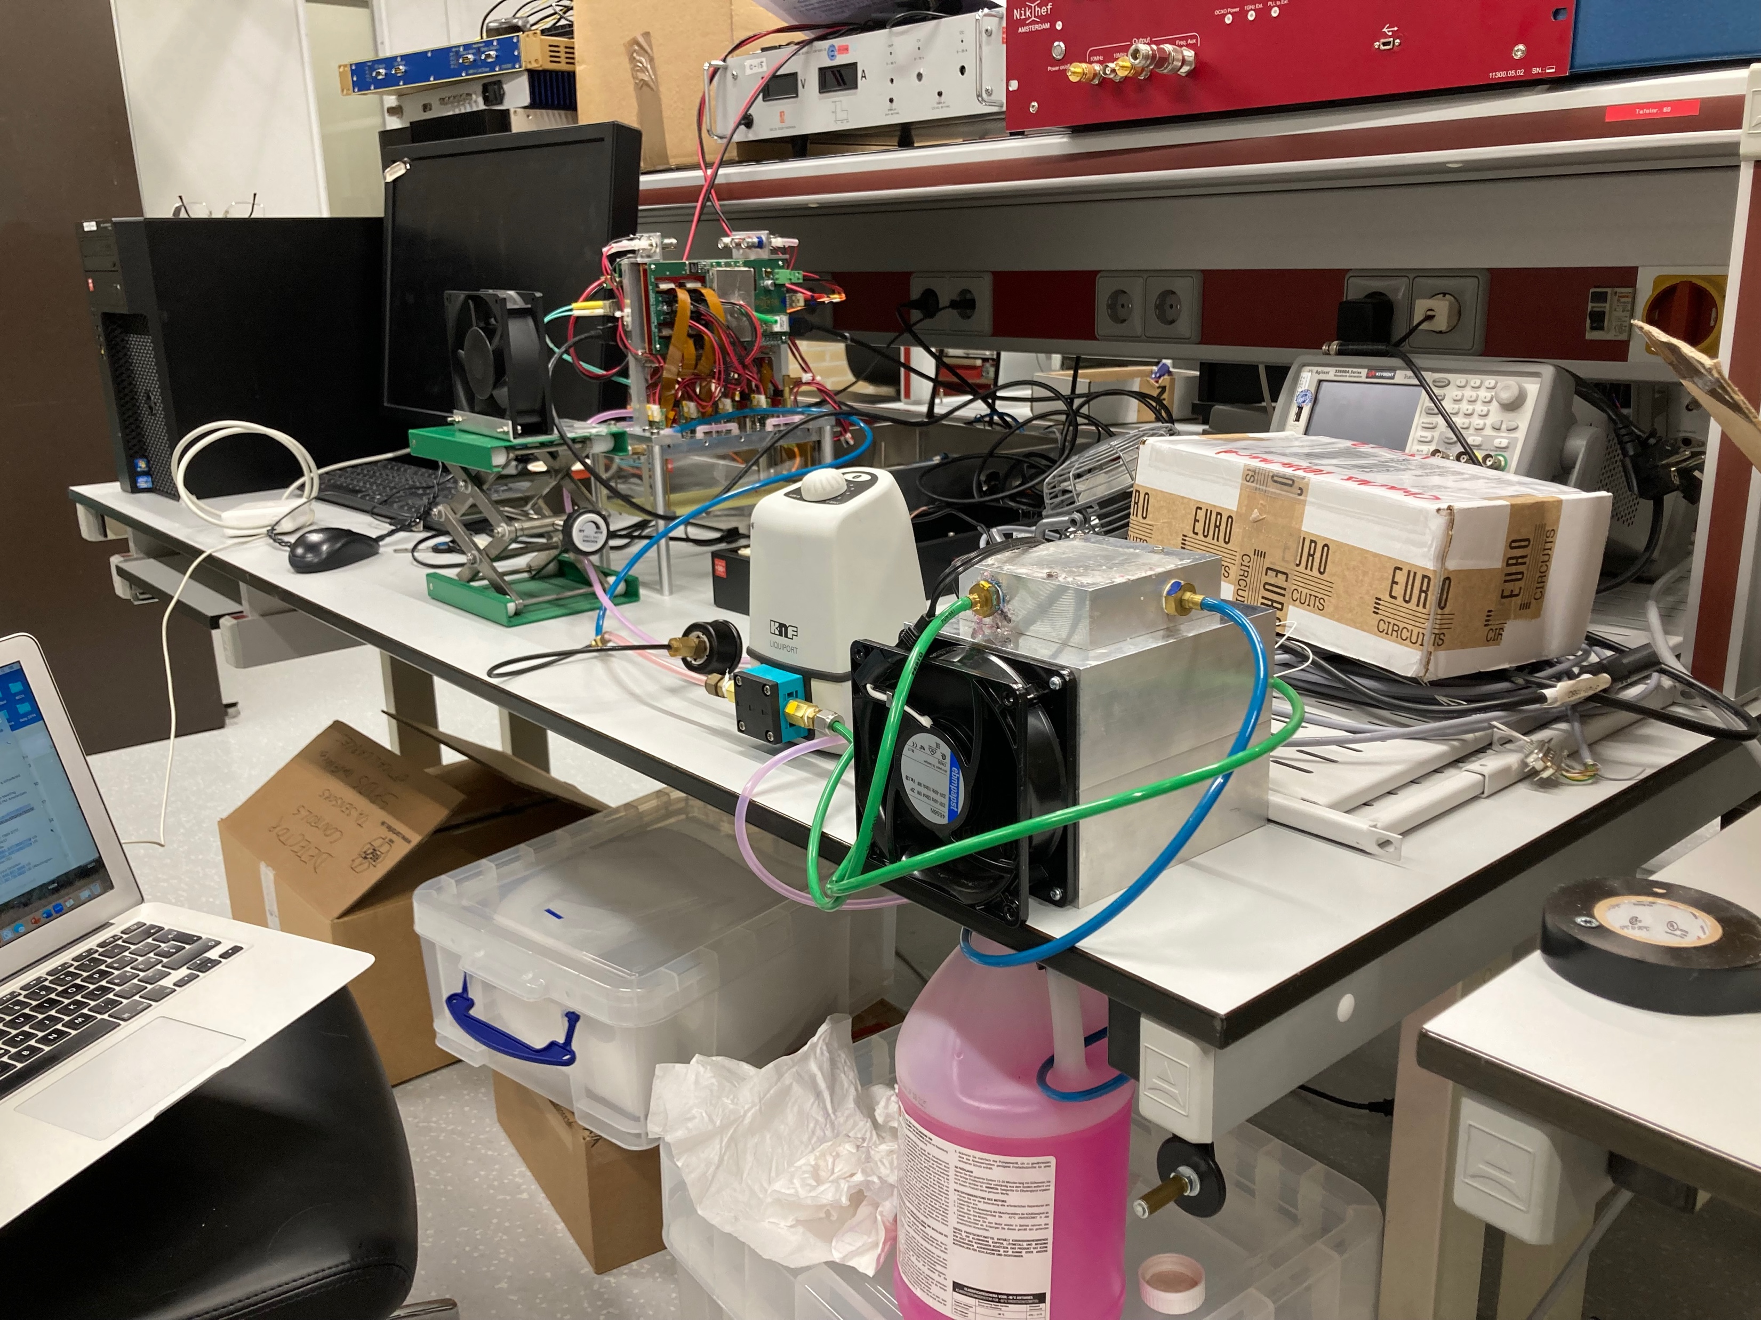
Repaired Module has arrived at Nikhef
The main goal is:
Test the DAQ with the computers and SPDRs including the cooling.
  Install the cooling
  Run the DAQ with noise runs
  Check the thresholds in particular for chips 28, 29,30, 31
setup in N133 electronics lab

Slide 2
Cooling part block scheme
module pressure meter pump cooling block
ventilator
220V
>
>
>
adaptor
bottle
<
pink anti-frost liquid is used for cooling; flow direction indicated with arrow. color coding corresponds to tube color (pink=transparent)

Slide 3
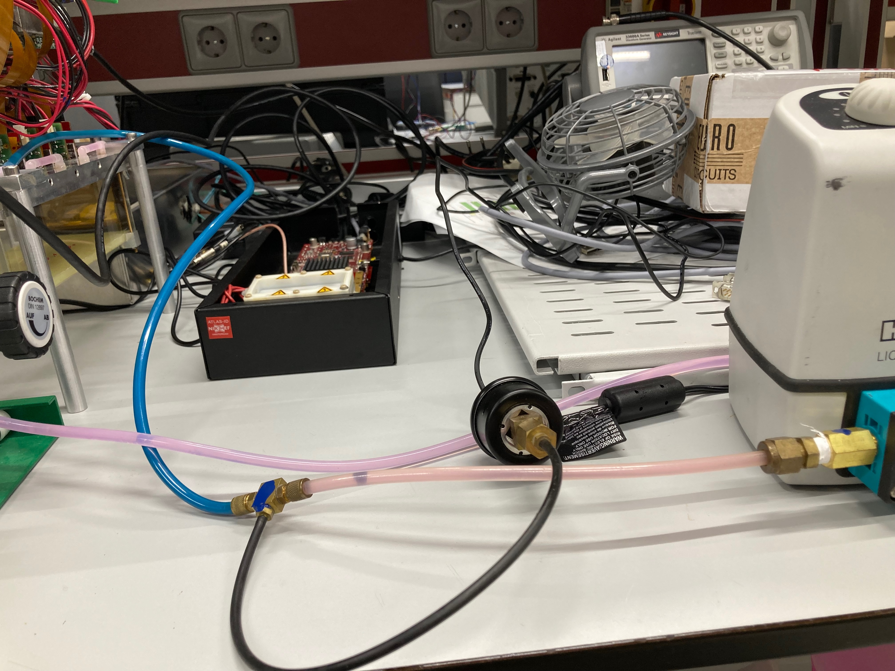
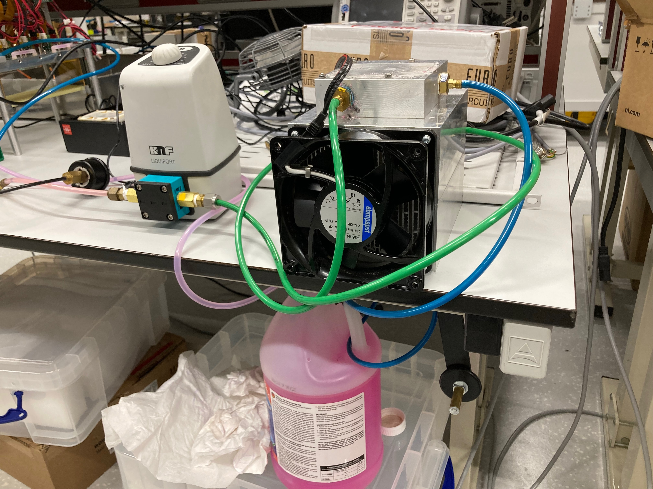
Cooling part of setup
Pressure meter and pump pump cooling block and bottle

Slide 4
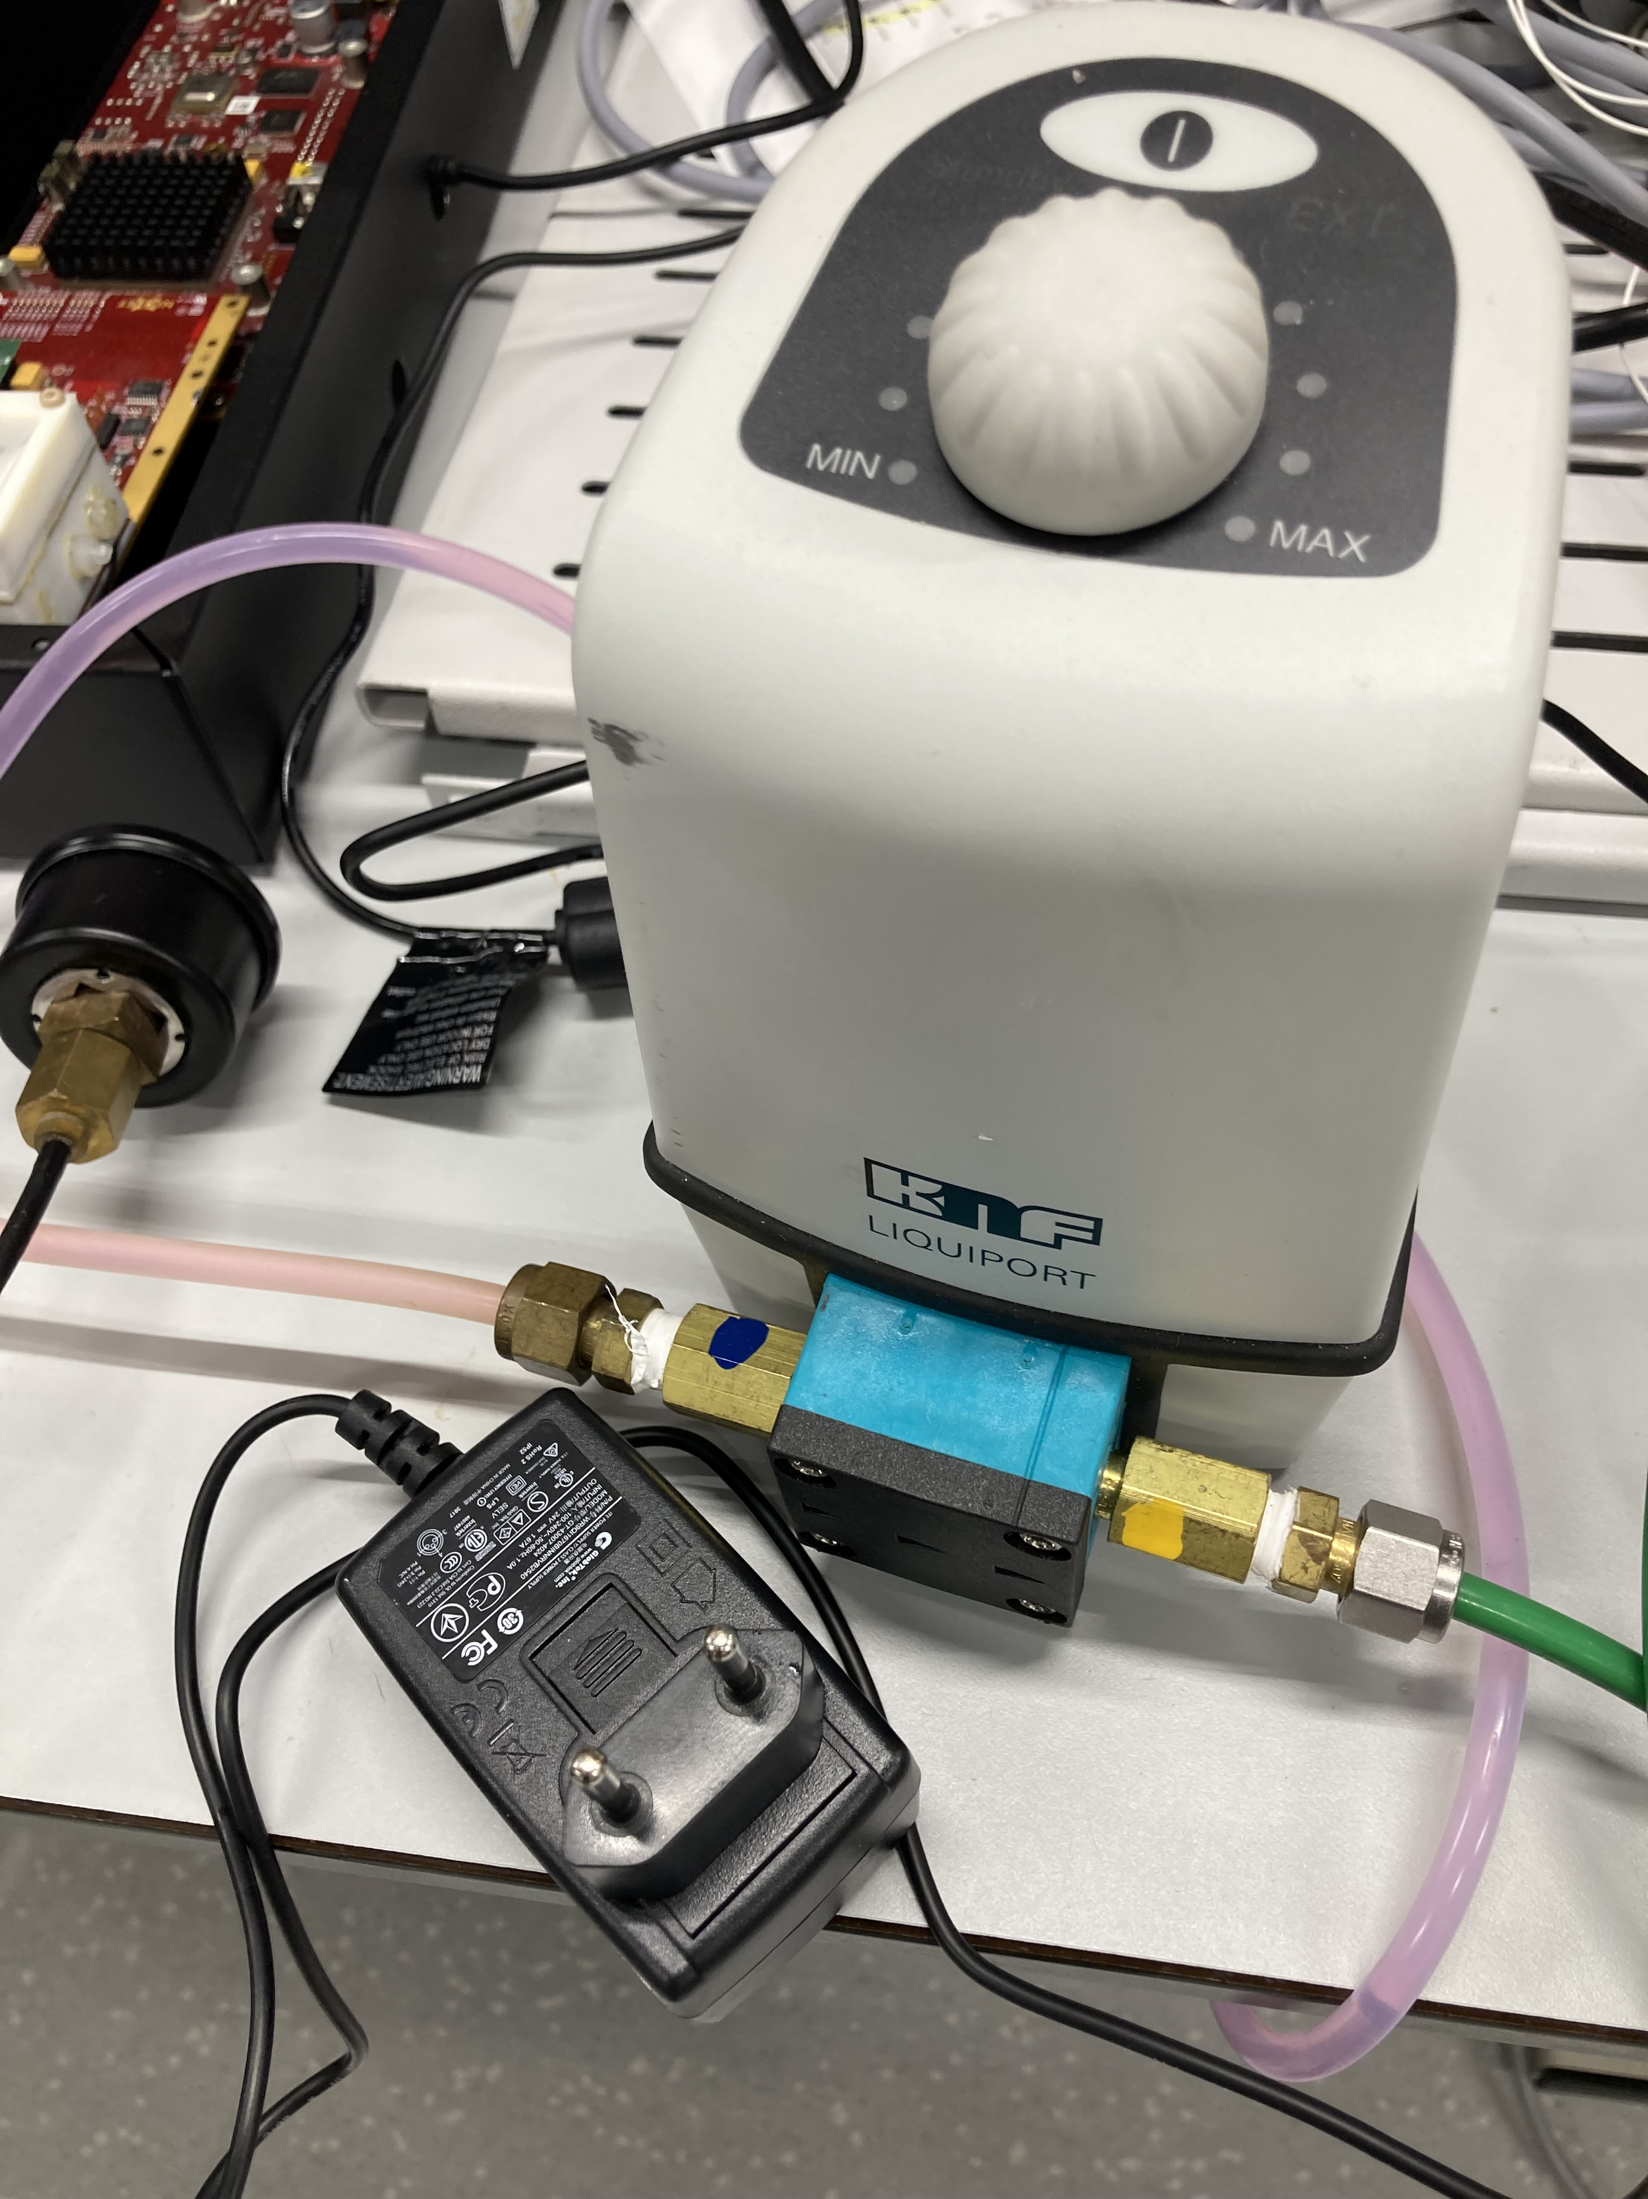
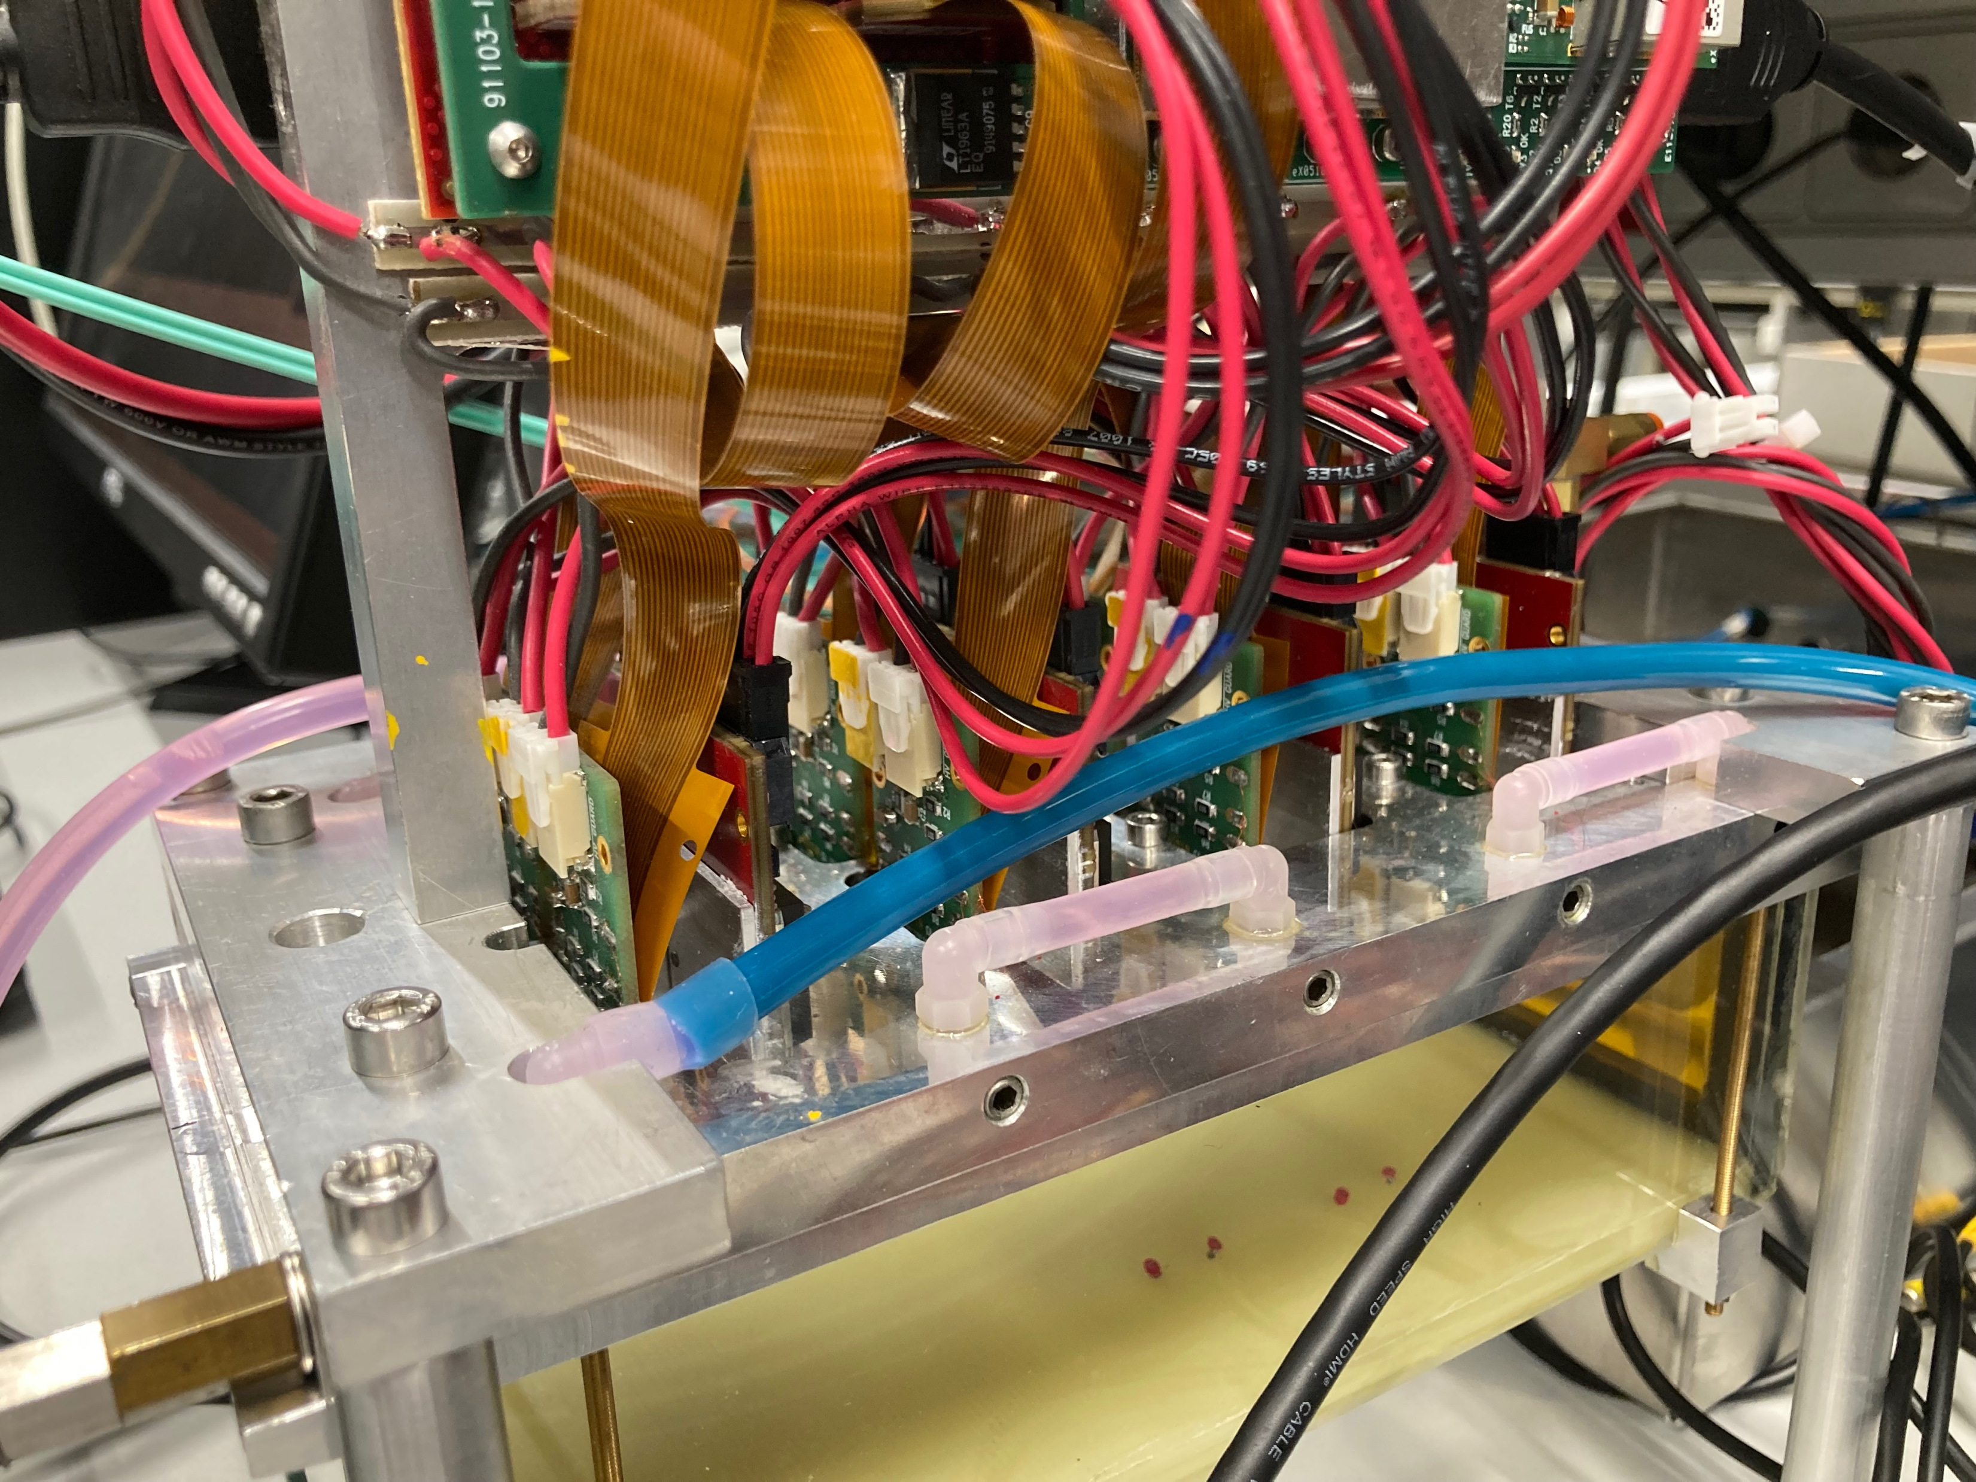
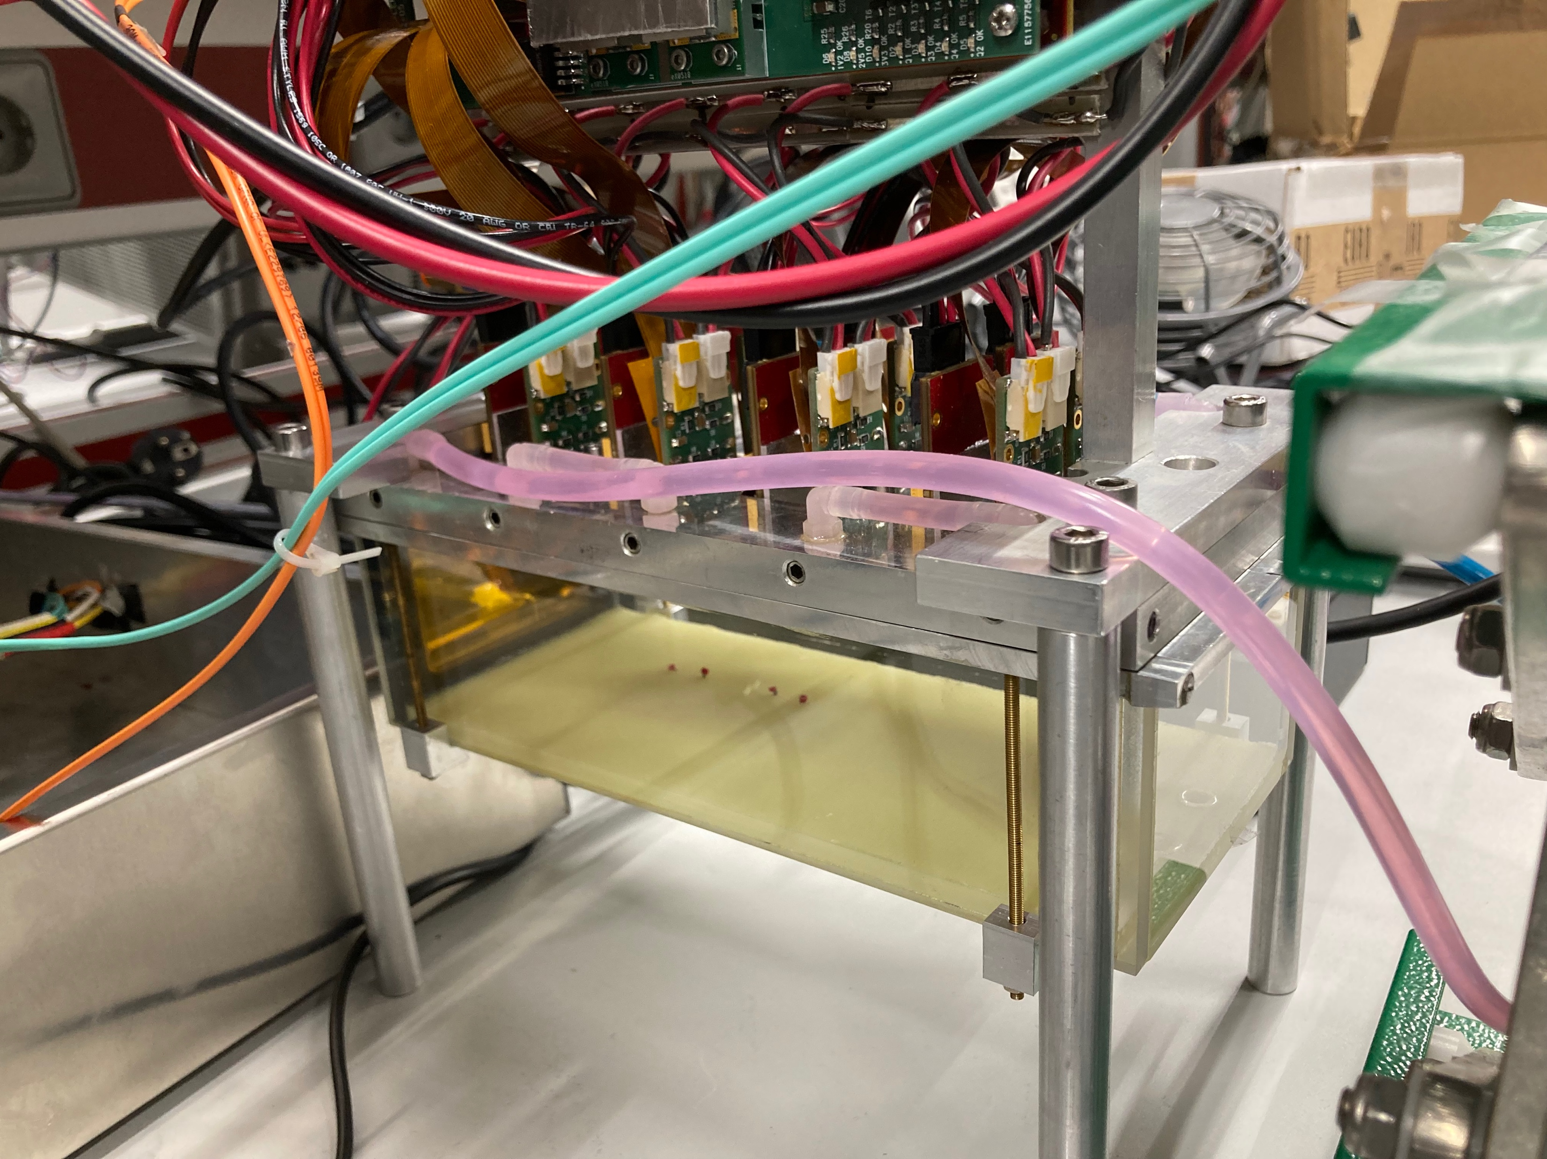
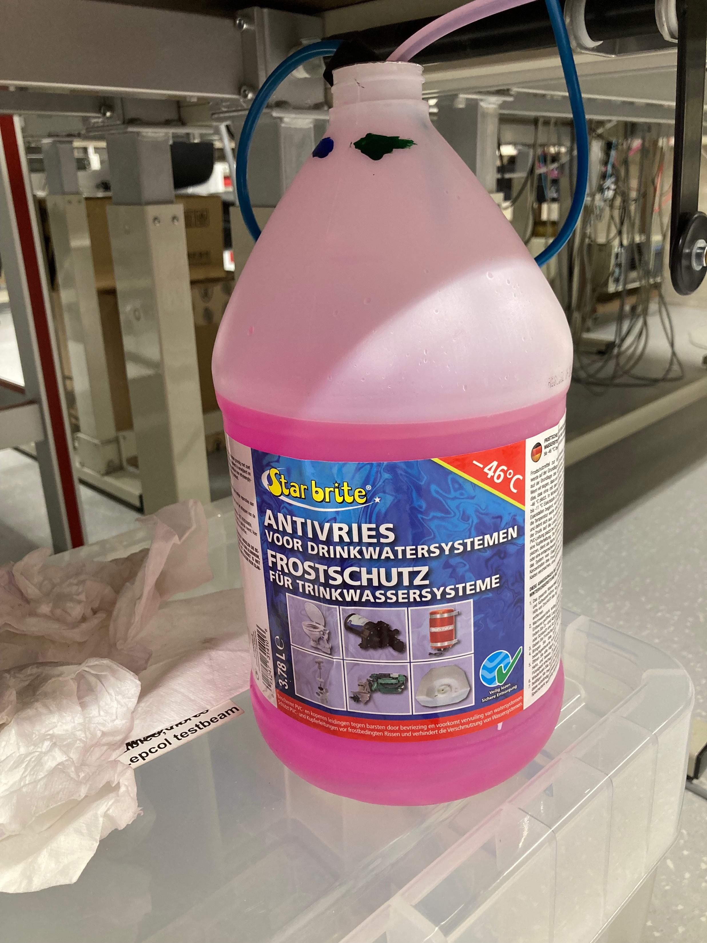
Cooling part of setup
standby/on
speed
adapter for pump
Module with transparant (in) blue (out) tubes
pink cooling liquid bottle

Slide 6
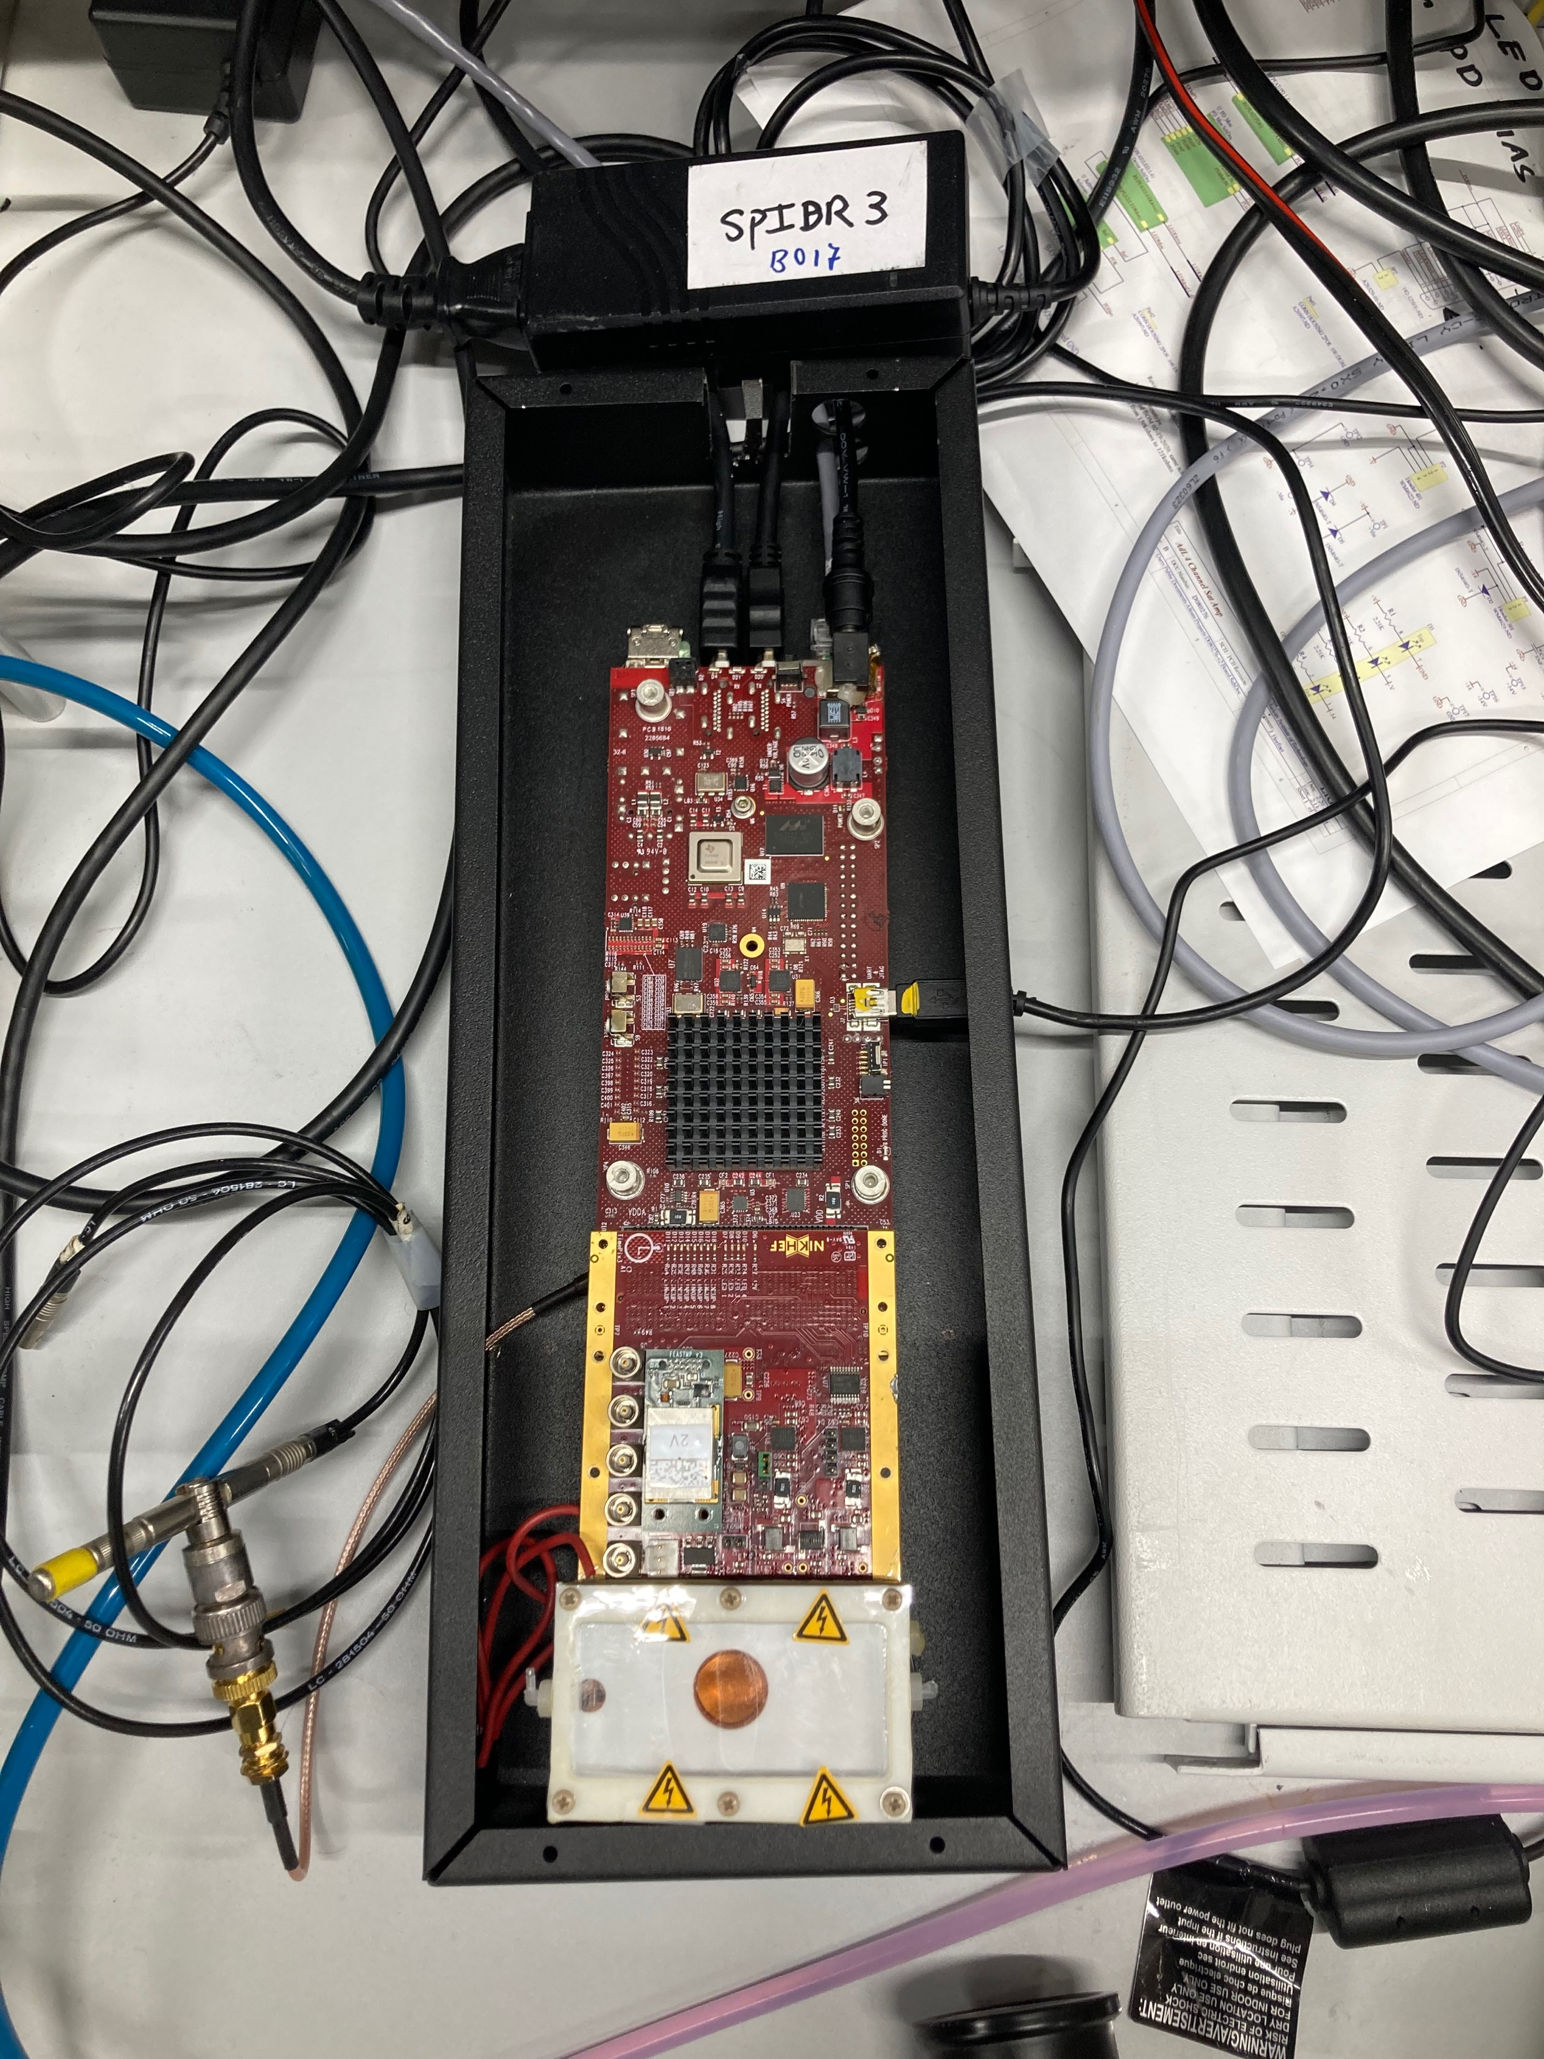
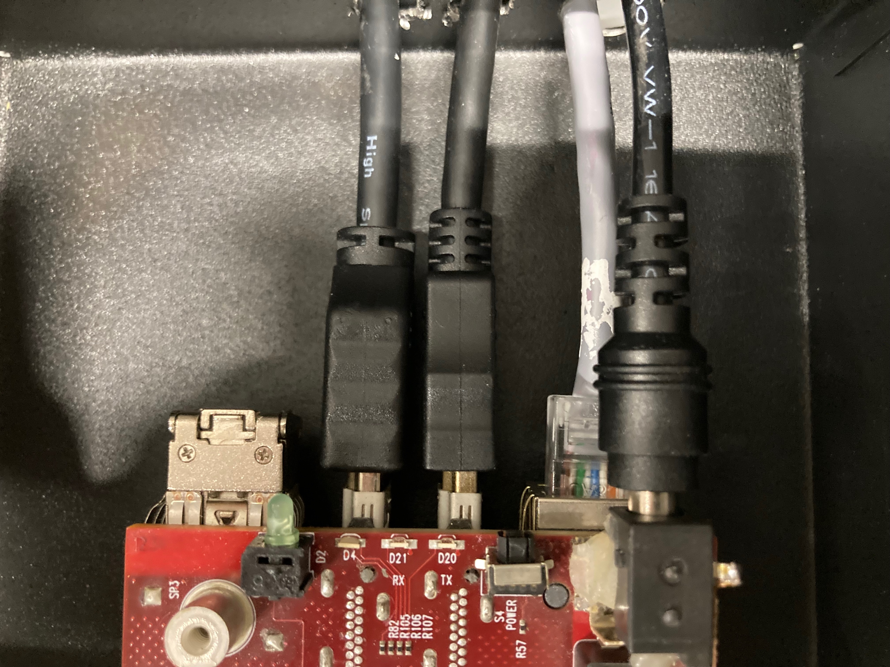
Trigger SPDR and connections
The Trigger SPDR does the synchronization of the concentrators and puts a trigger time stamp in the time stamp stream
Adaptor SPIDR 3
Grey UTP cable goes to arawana (white dot)
2HDMI for synchronization goes to module
Yellow USB connected to arawana for minicom spying on stream
Trigger input signal
Near the HDMI cable is a
mini power switch

Slide 7
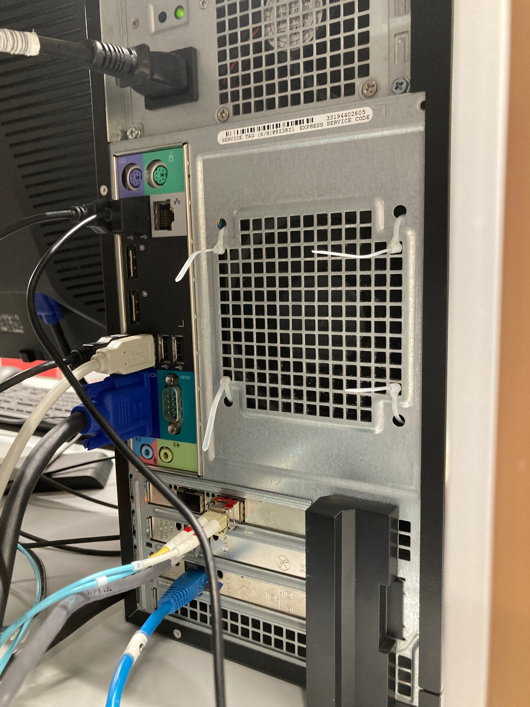
Arawana main daq computer
Apart 220V power, USB mouse, keyboard and monitor connectors
2 USB connected to arawana for minicom spying on streams (Trigger SPIDR and main module SPIDR)
2 Optical fibers coming from main SPIDR
Grey UTP cable (white dot) to Timestamp SPIDR
Blue UTP cable goes to main SPIDR

Slide 8
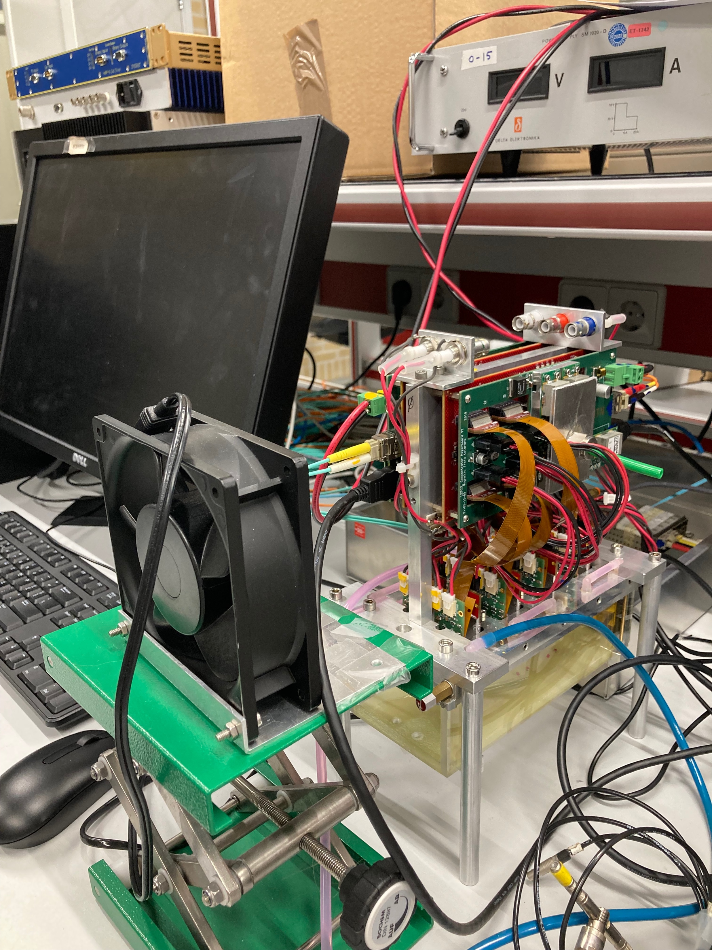
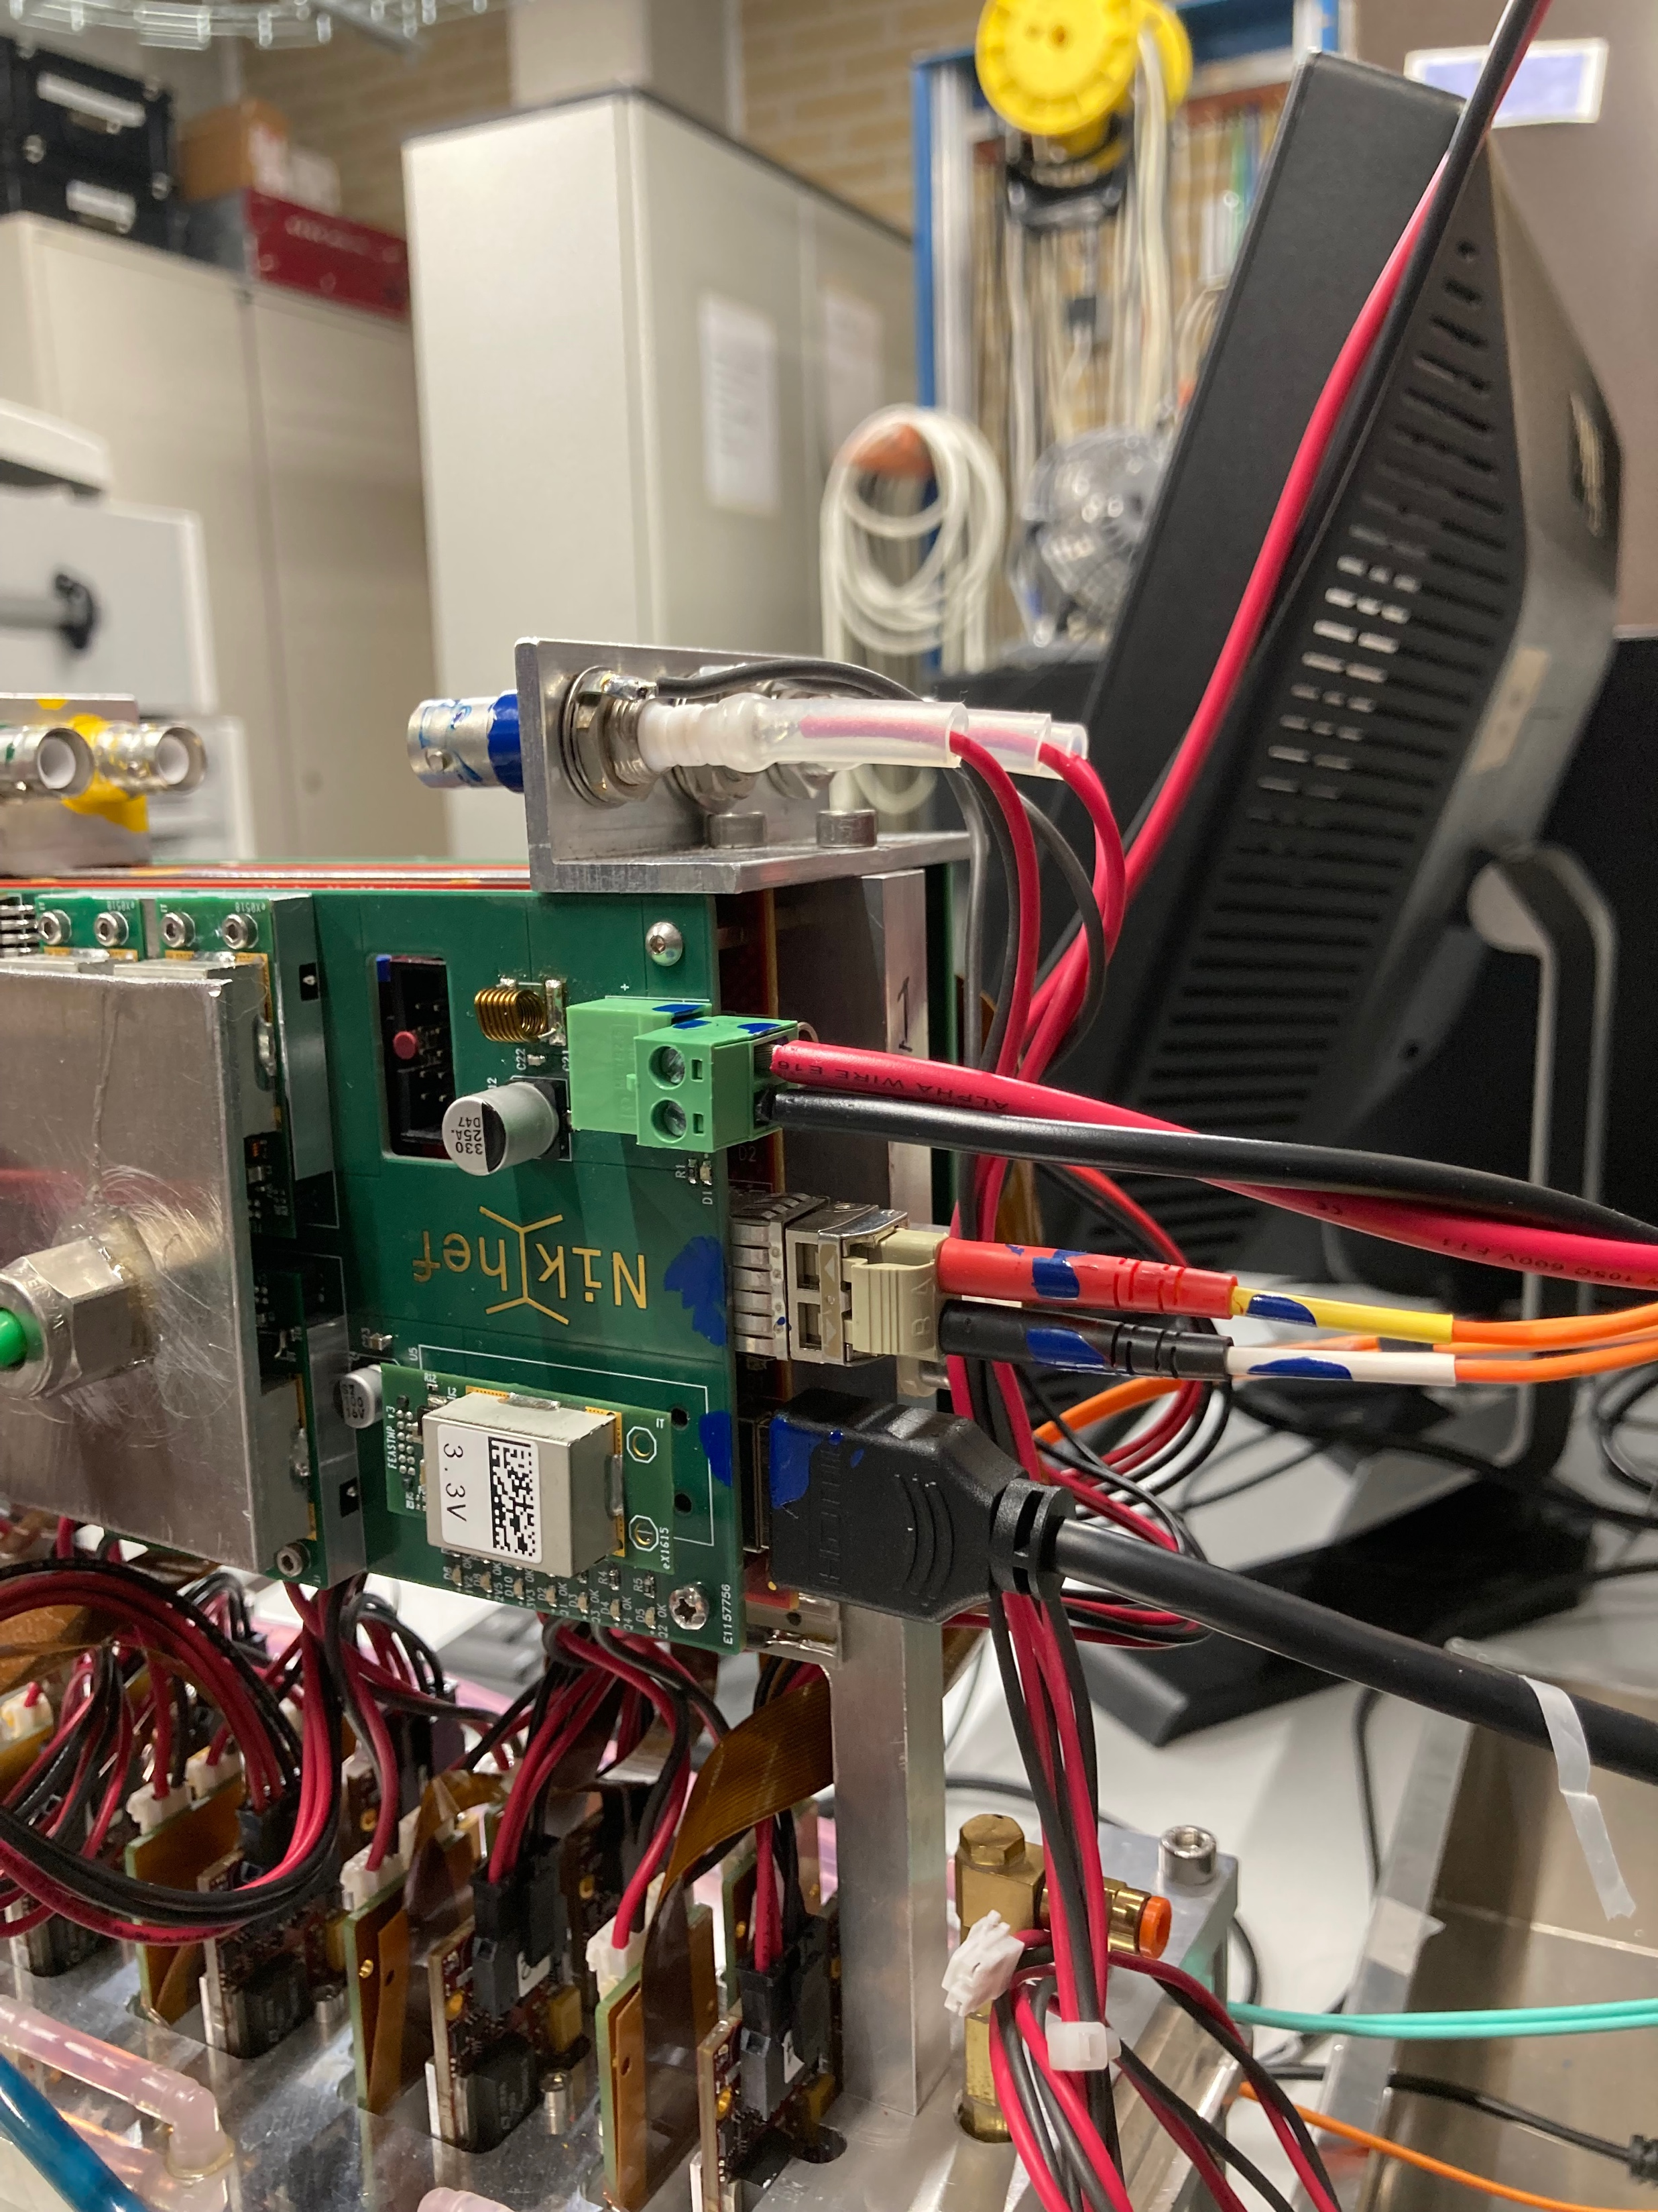
Connecting the module
Power = 12 V max 20 A l
Each concentrator has
LV power connector
Optical fibers (orange, light blue) going to main SPIDR (color marked blue and yellow for conc0 and conc1) Don’t interchange.
Black HDMI cable goes to Trigger SPIDR
A ventilator is essential to cool the multiplexer

Slide 9
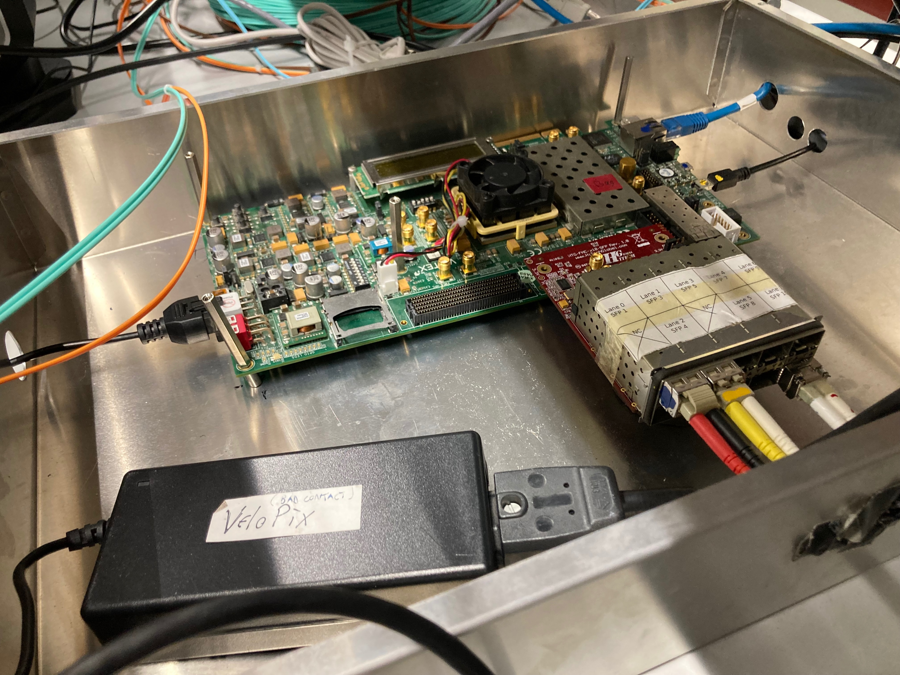
Main SPIDR and connections
The main SPIDR controls and reads the multiplexer produces data streams for concentrator 0 and 1
Blue UTP cable goes to arawana (white dot)
Yellow USB connected to arawana for minicom spying on SPIDR
1 (x2) optical fibre goes to arawana
2 (x2) optical fibres go to module (multiplexer), blue and yellow marks
Adaptor ‘VeloPix’ with power connector

Slide 10
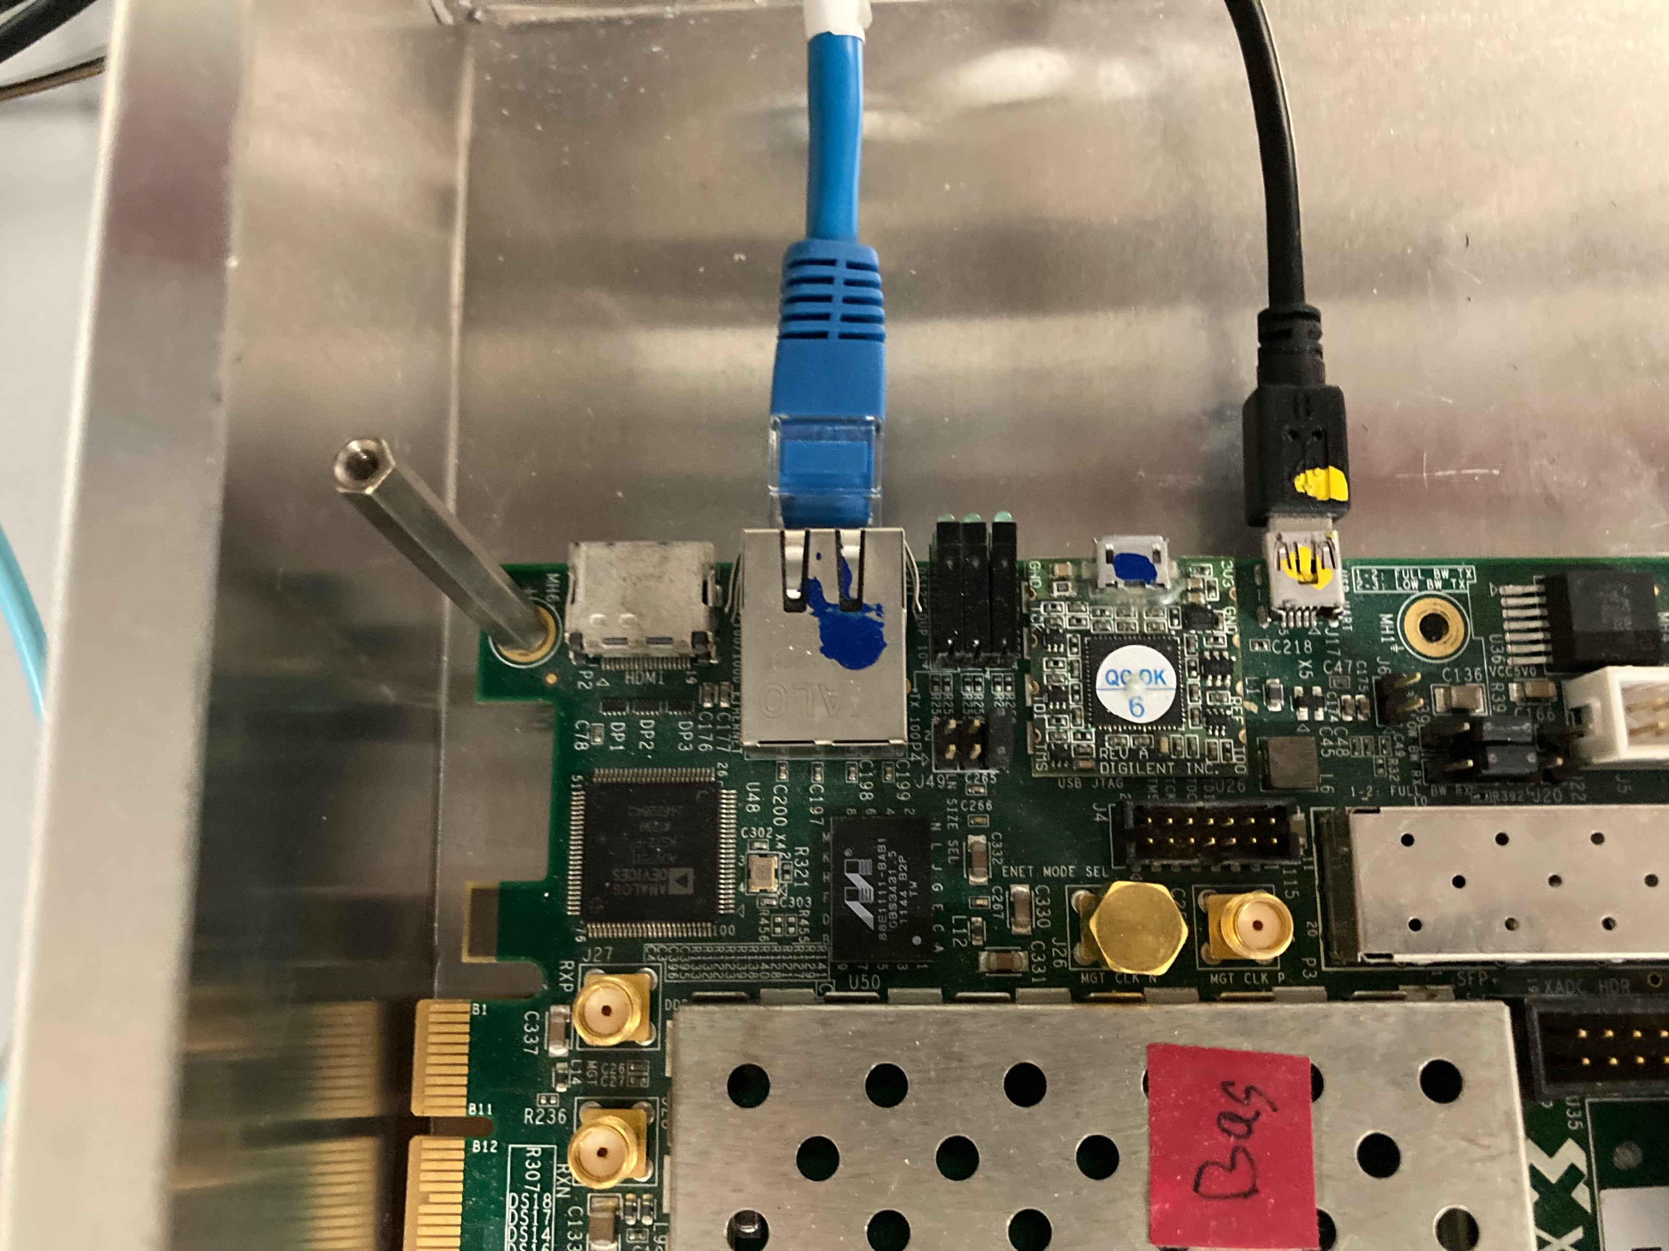
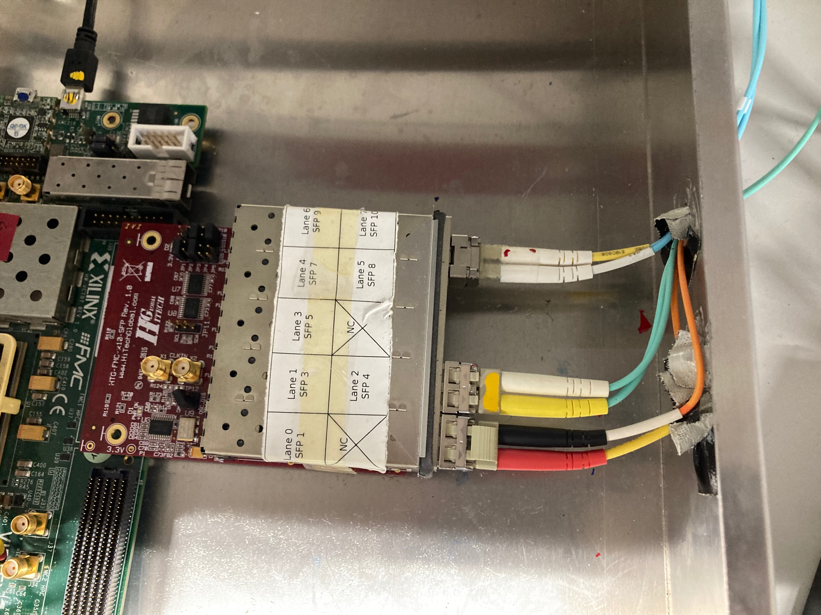
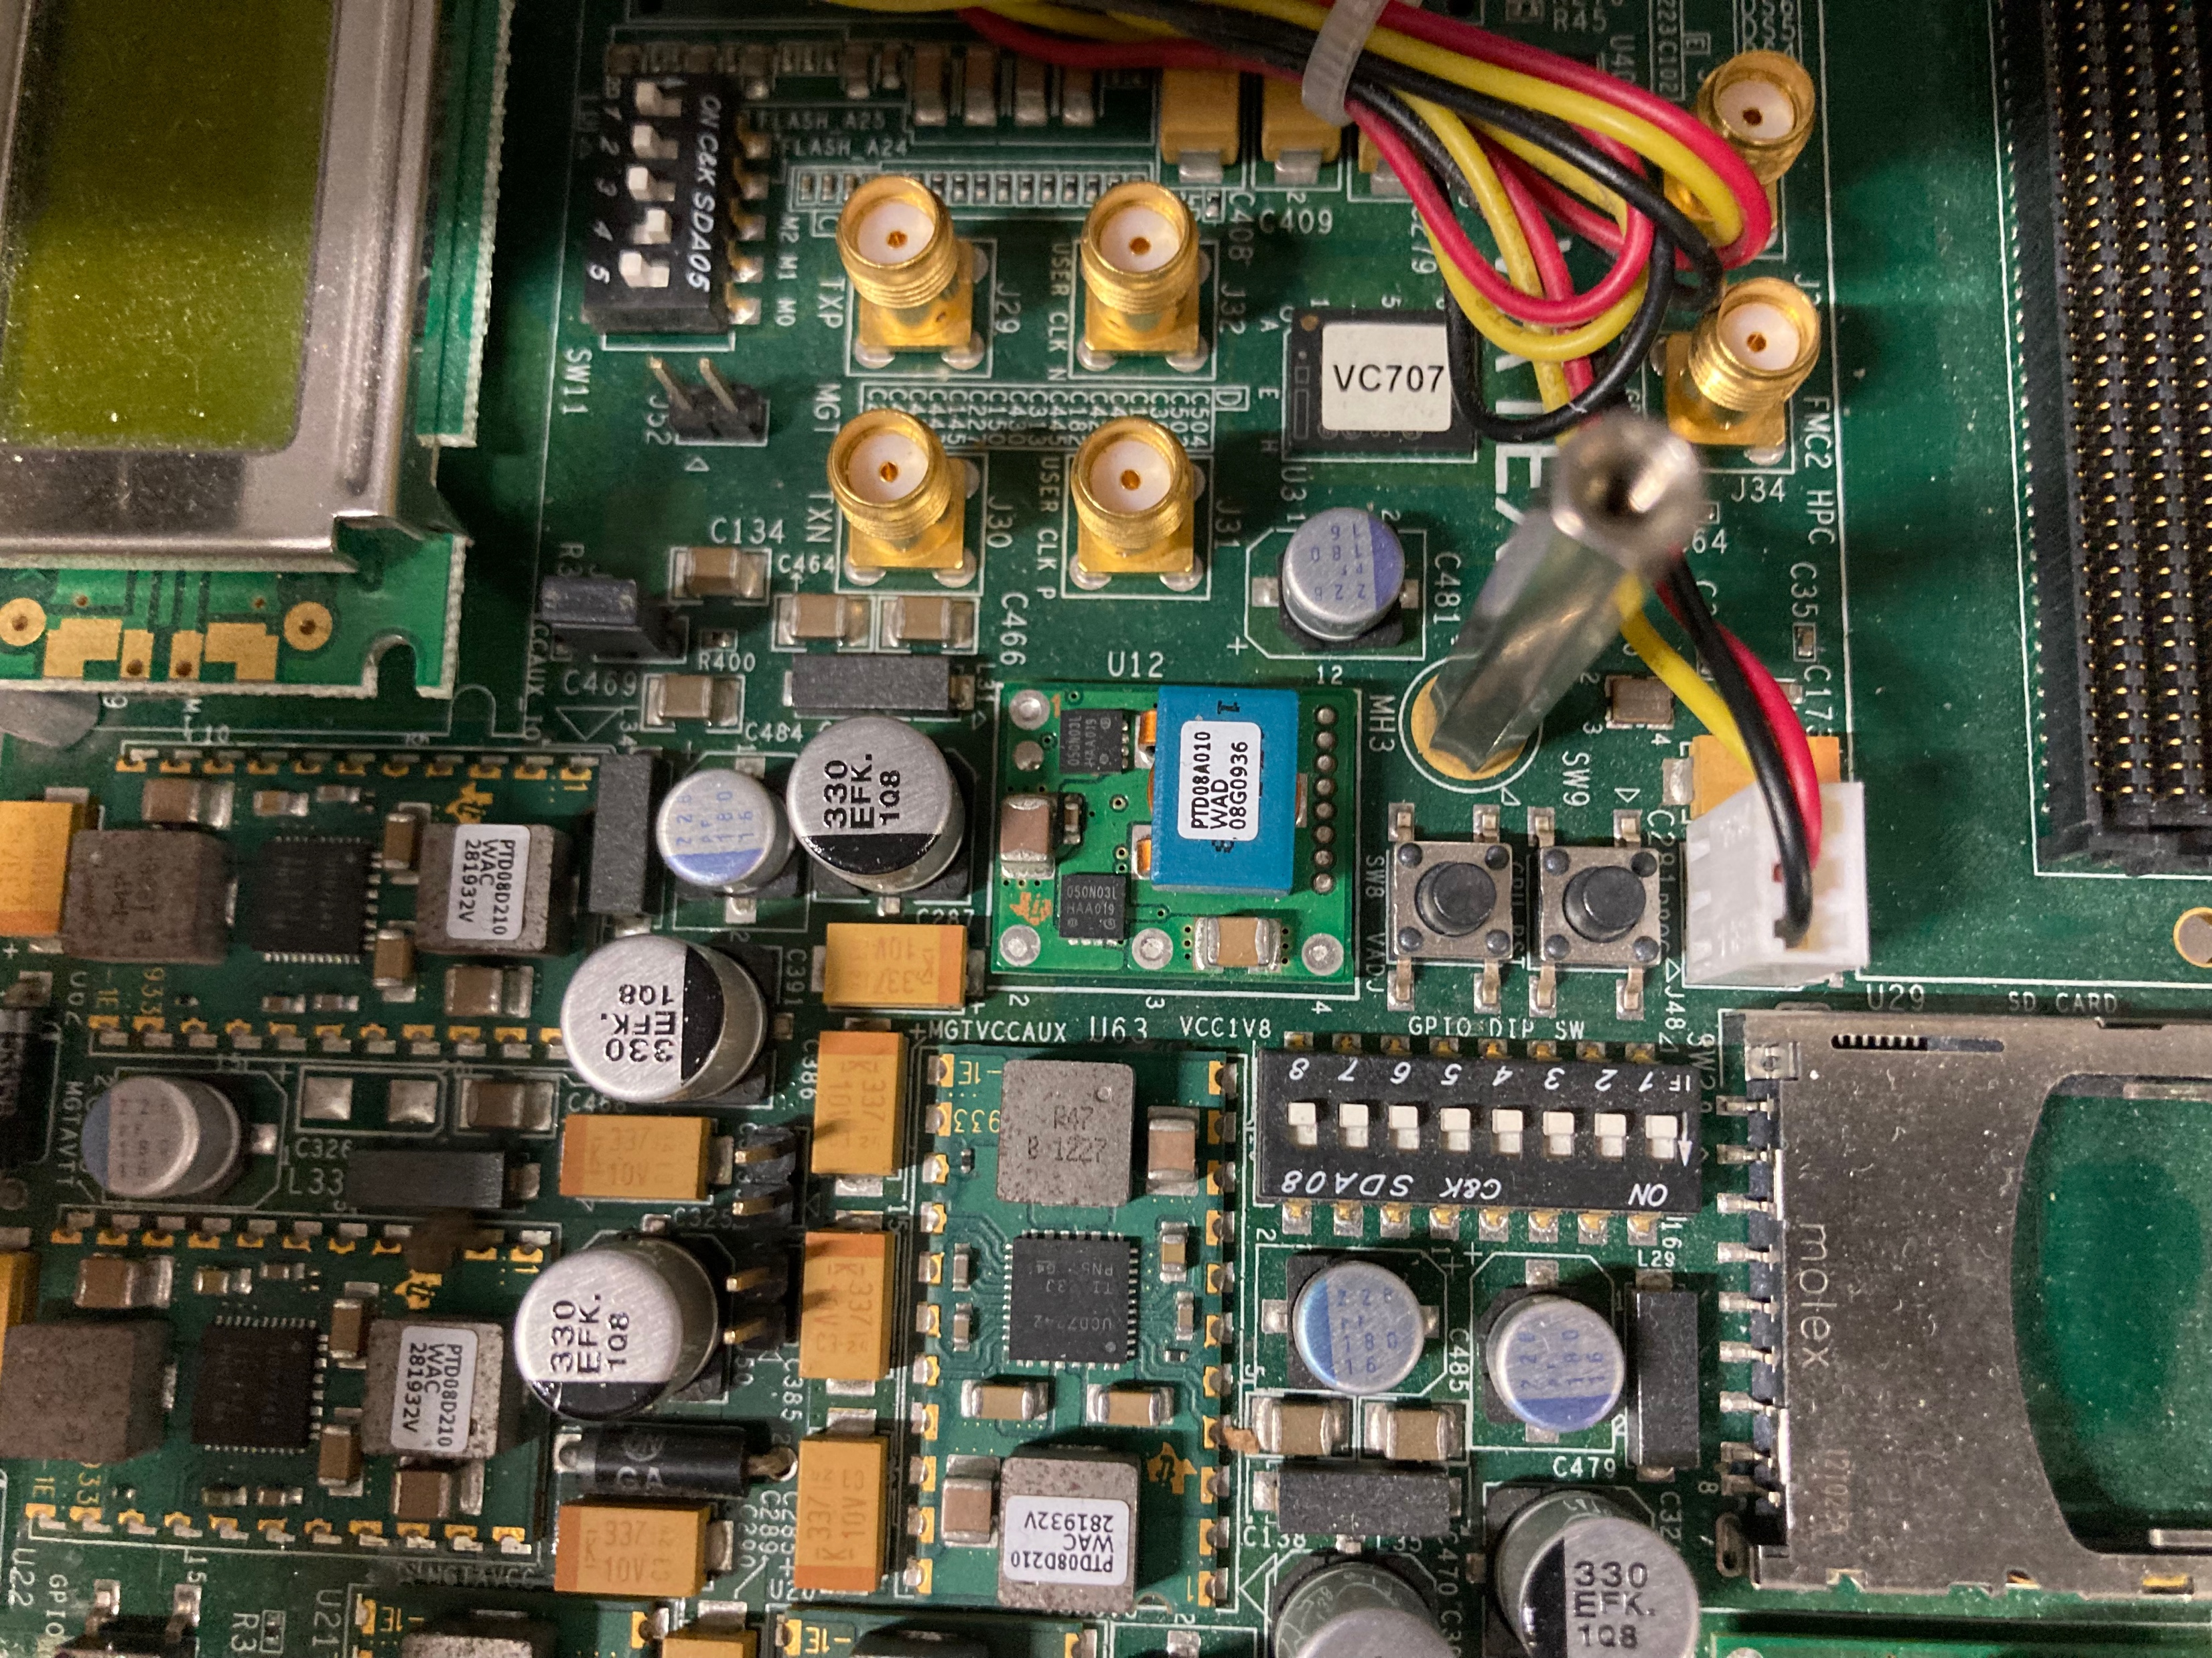
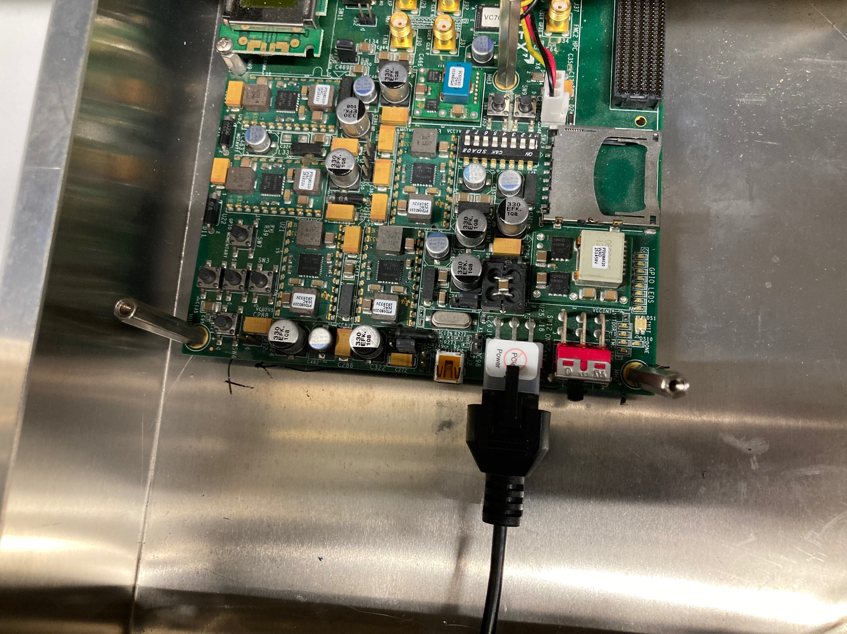
Main SPIDR zoomed connections
Blue UTP cable goes to arawana (white dot)
Yellow USB connected to arawana for minicom spying on SPIDR
1 (x2) optical fibre goes to arawana (output)
2 (x2) optical fibres go to module (multiplexer), blue and yellow marks (input)
Power connector
Microswitches
Main power switch

Slide 11
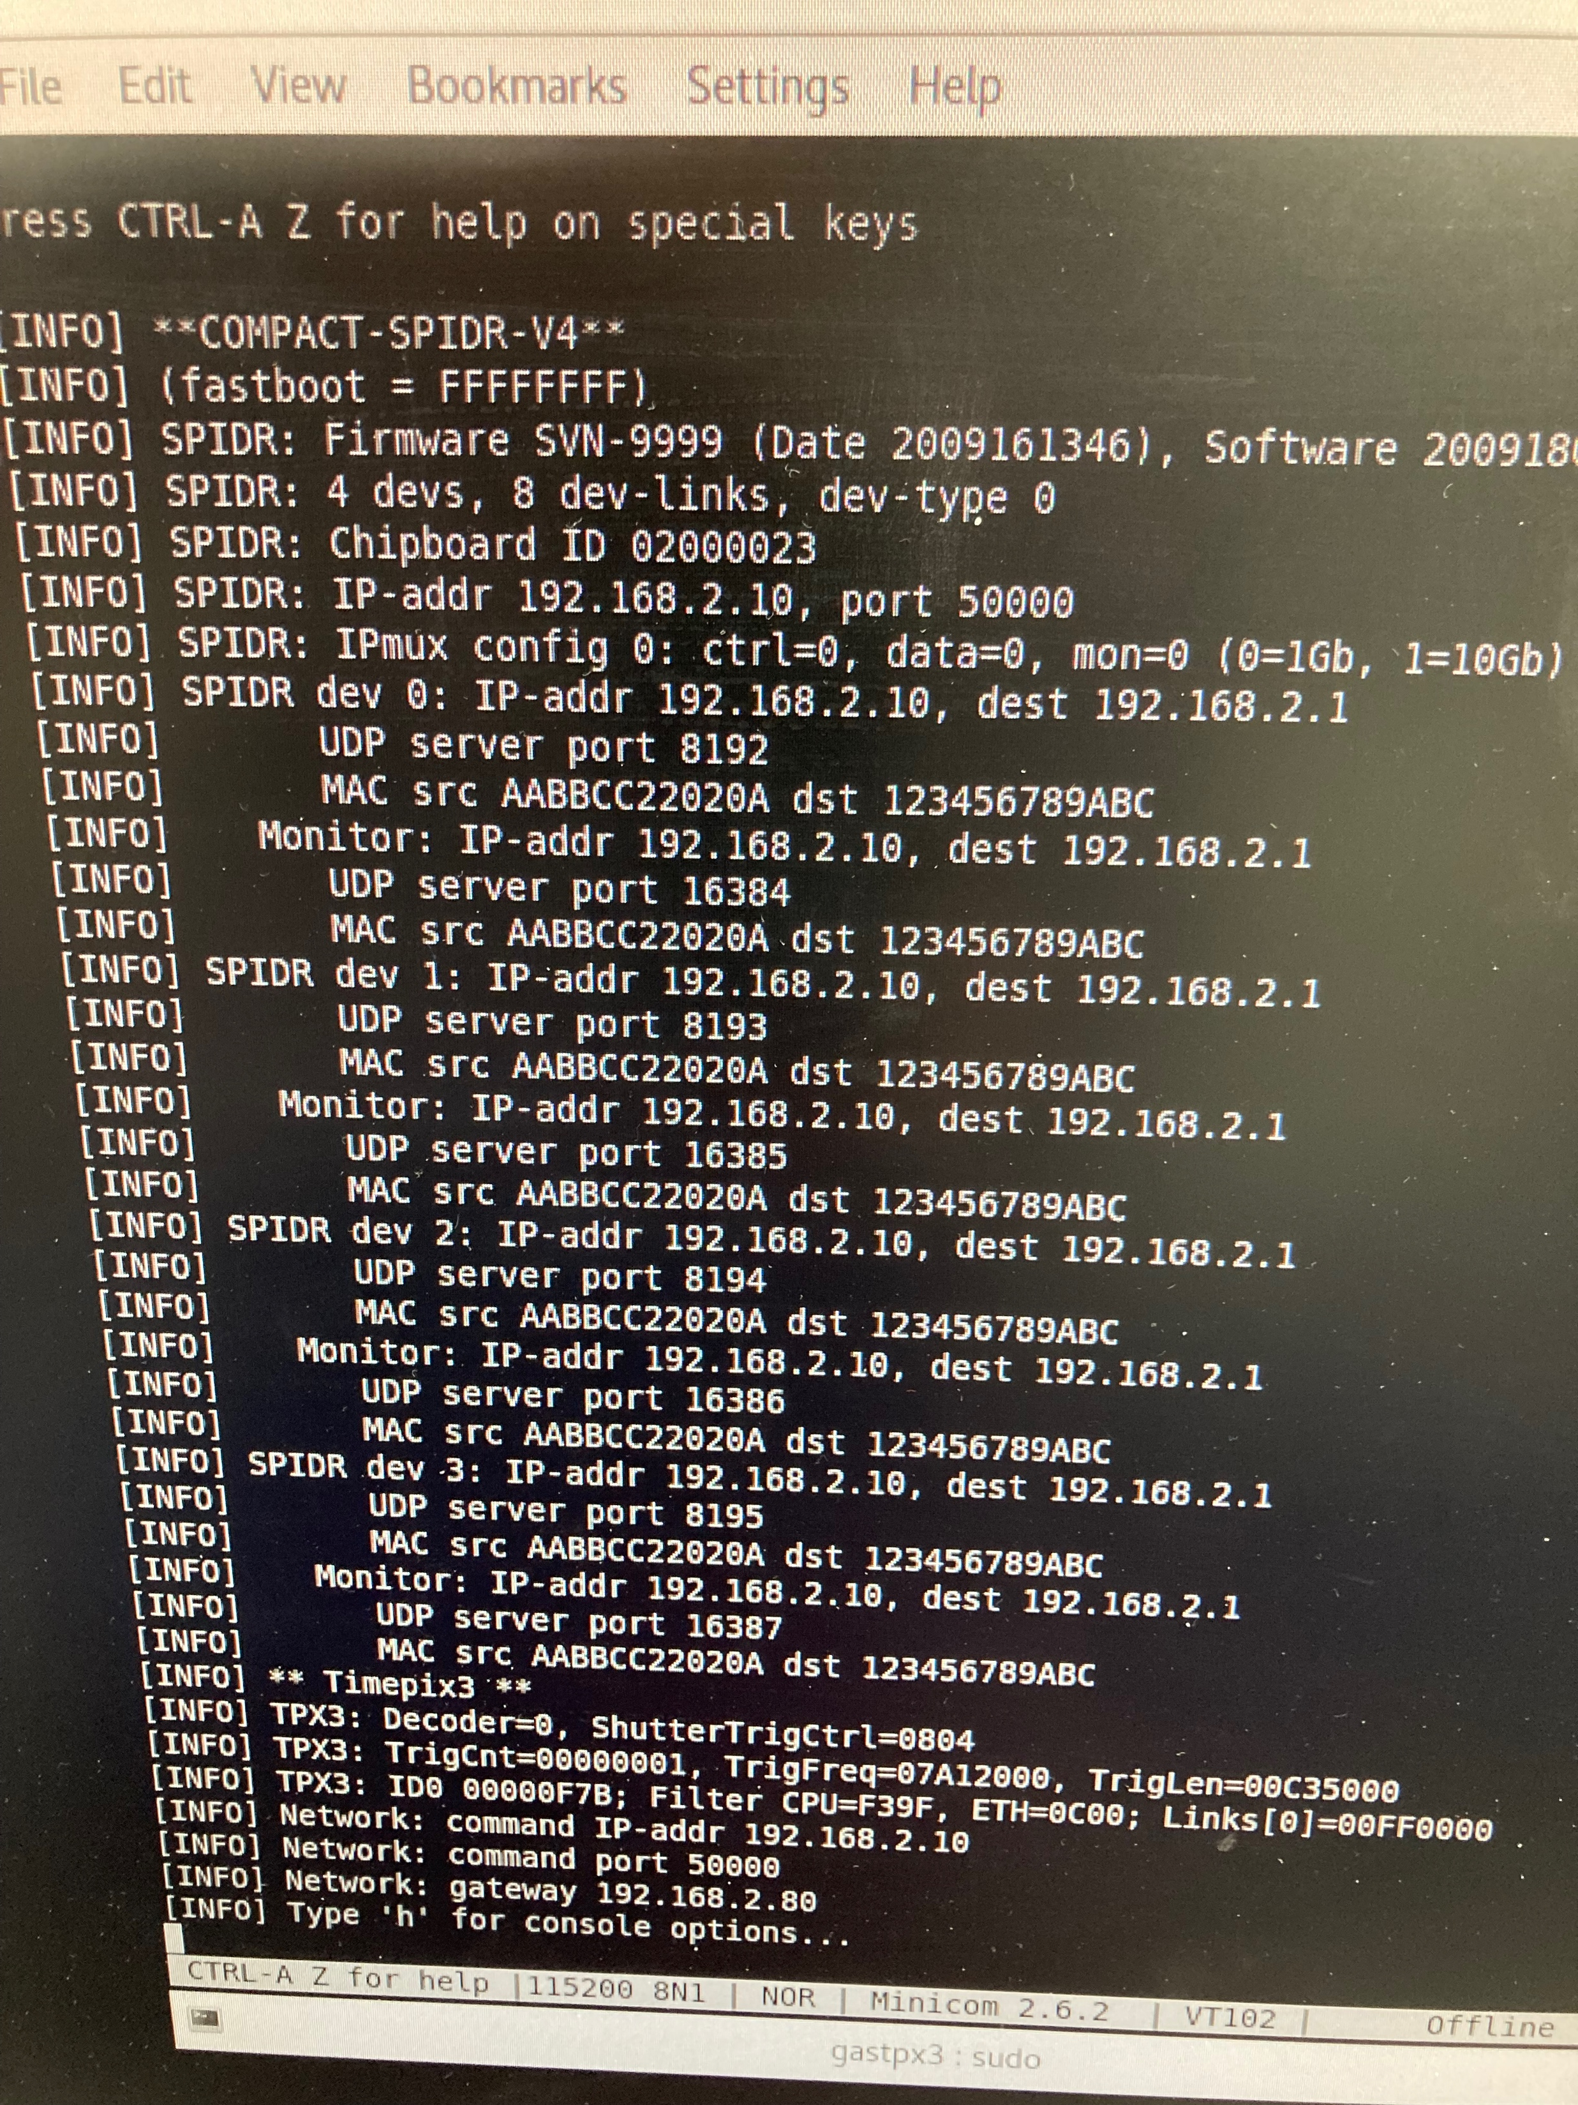
Start up procedure part I
1 Start the pump and liquid cooling (powering them)
2 Start ventilators of the concentrators (power them) and Trigger SPIDRs
3 Connect the adapter of Trigger SPIDR to 220 V
Press the microswitch: the SPIDR should start up and work
4 Switch on arawana login gastpx3
5 Create minicom to USB0 or 1 sudo minicom -D /dev/ttyUSB0
press D (h=help)
one should get this output on arawana

Slide 12
Start up procedure part 2
6 Switch on the Low Voltage (12 V max 20 A)
Concentrators are now powered green control lights on
7 Connect the adapter of main SPIDR to 220 V
Switch on main power switch: the SPIDR should start up and work
8 Create minicom to USB2(?) sudo minicom -D /dev/ttyUSB2
press D (h=help)
one should get this output on arawana
9 from arawana /localstore/TPX3/spidr3-software/Release/spidrchipids 192.168.1.10
one should get a list with all 32 chips identifiers
10 Unfortunately often one or more chips in concentrator 1 are not in the
list. There is a trial and error procedure to get them all in the read out

Slide 13
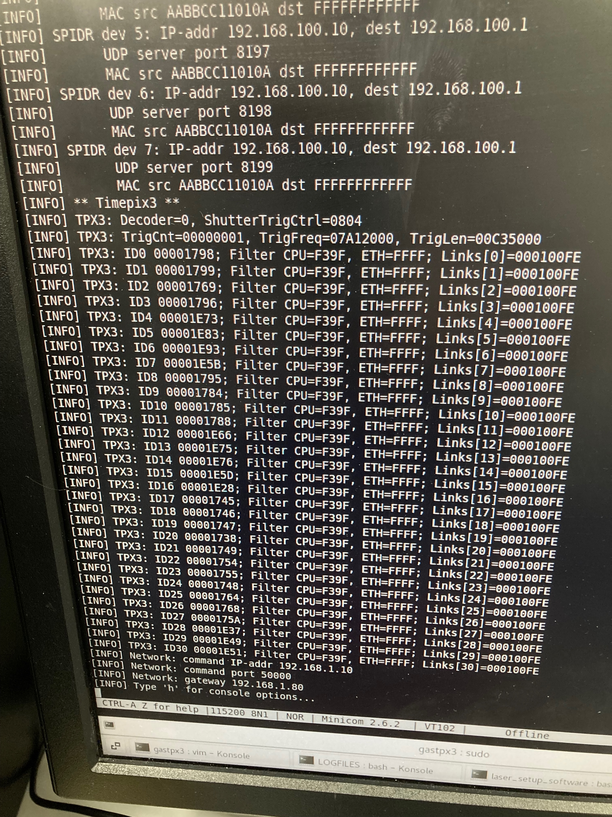
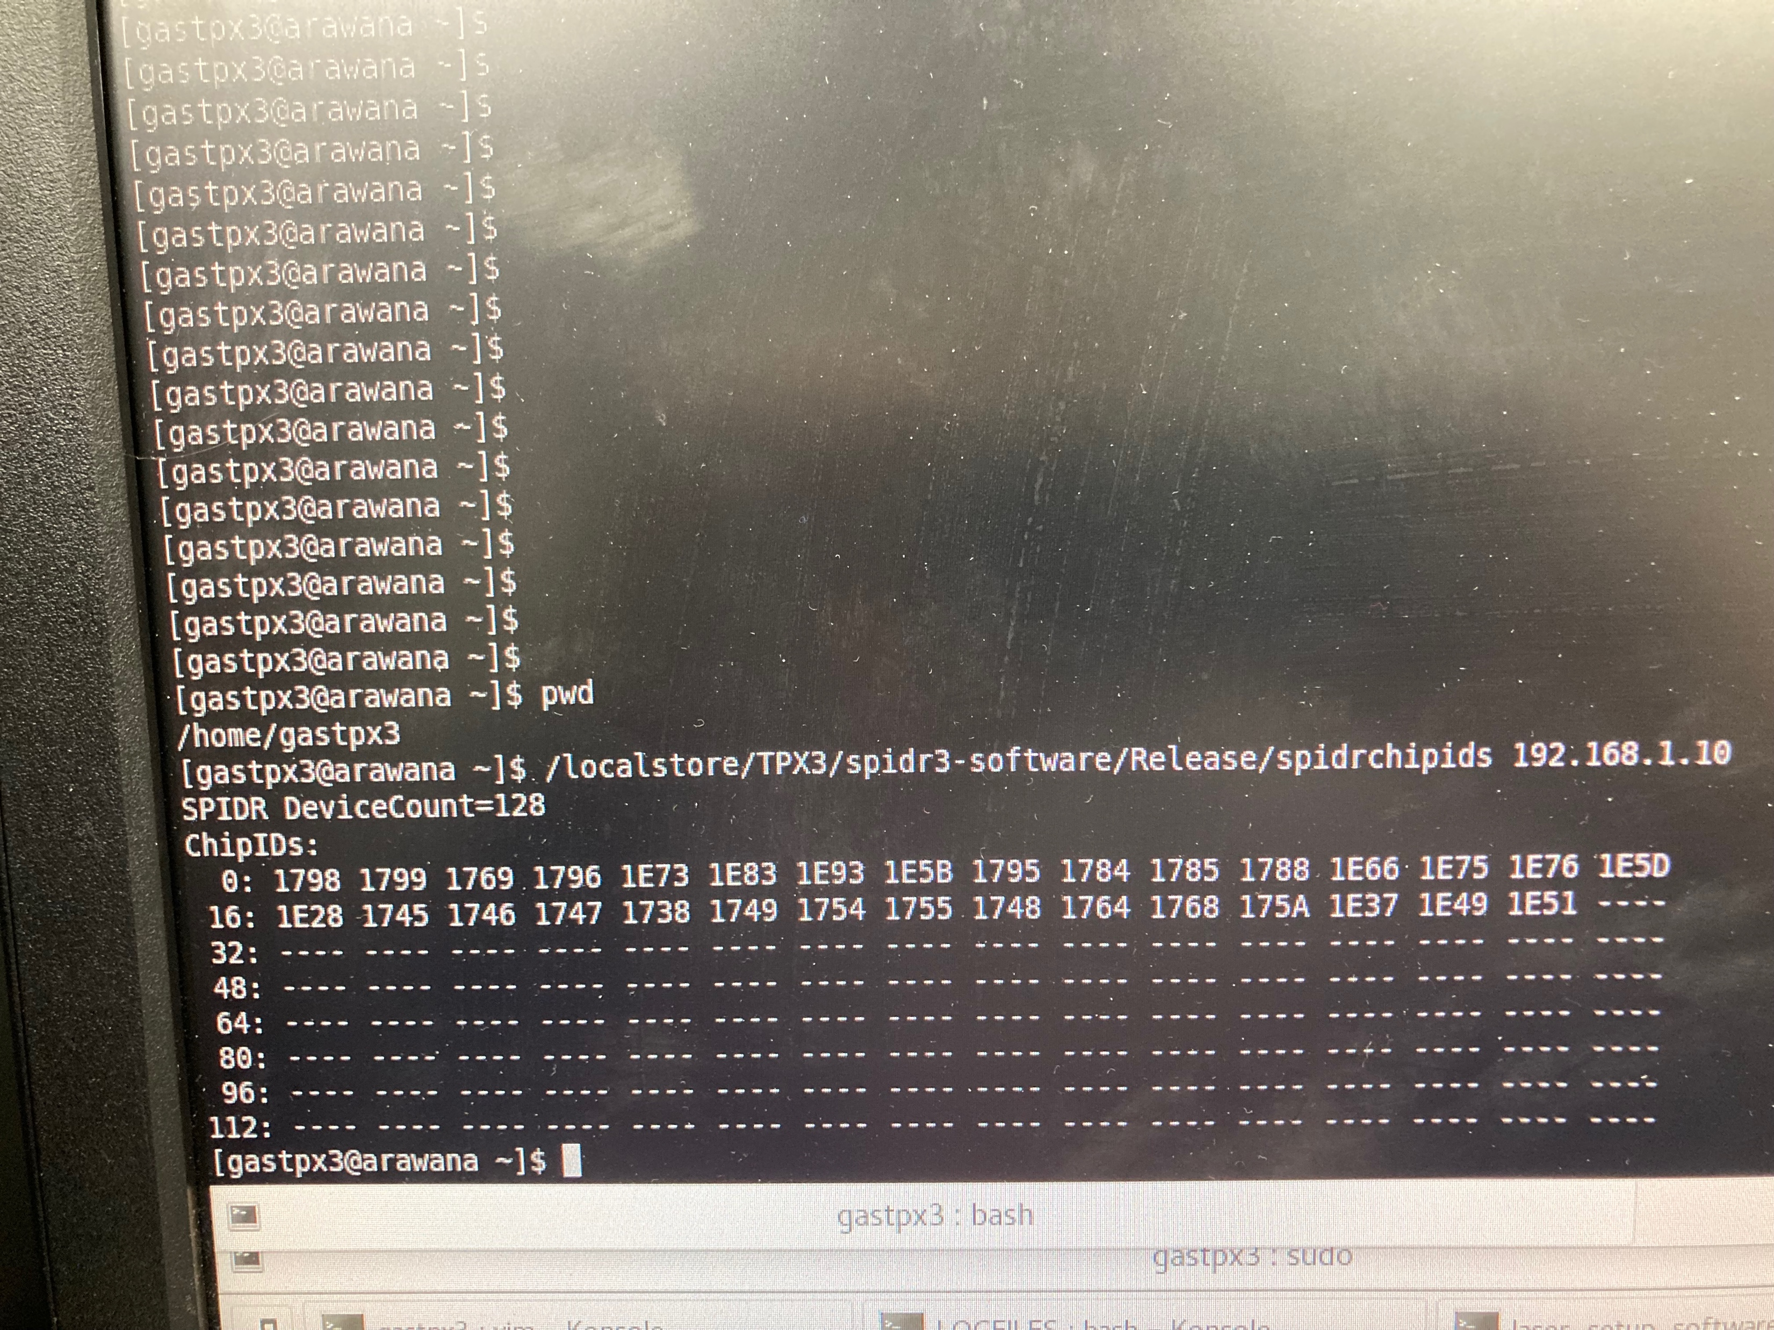
Start up procedure part 2
Left the minicom output indicating less than 32 chips.
With the command chipids (see step 9) we get a list of 31 chips (16+15). We need step 10 to get all chips

