Slide 1




Pixel TPC testbeam results
Yevgen Bilevych, Klaus Desch, Harry van der Graaf, Fred Hartjes, Jochen Kaminski, Peter Kluit, Naomi van der Kolk,
Cornelis Ligtenberg,
Gerhard Raven, and
Jan Timmermans
8 Quad Module
Lepton Collider 30 October 2023

Slide 2
DESY testbeam Module Analysis
Hits per chip (dEdx)
B=0 T
B=1 T
Preliminary
B=0 T has a large Landau tail
B=1 T tiny Landau tail and a more gaussian distribution

Slide 3
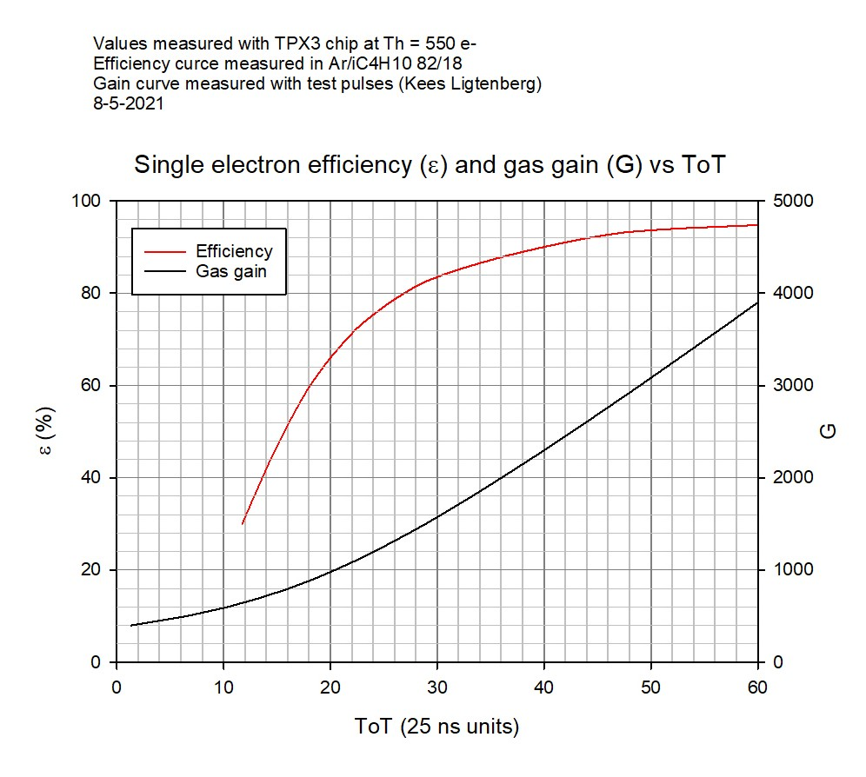
DESY testbeam Module Analysis
Hits per chip scan vs grid voltage
Thesis Kees Ligtenberg
B=0 T

Slide 4
DESY testbeam Module Analysis
Hits per chip
B=0 T has a large Landau tail is related to the extra hits that are created in the T2K gas. The ”linear” rise and the absence of a real plateau in the grid voltage scan (slide 3).
A follow up question is: a) is the rise due to the production of secondary electrons that are created in the T2K gas (now detected due to the higher gain) or b) to the production of extra hits by UV photons in the avalanche in the high field region below the grid.
It is likely that the extra hits will affect the resolution and have an impact on the measured diffusion coefficient. From the data we observe that the longitudinal diffusion (so the time) is probably affected.

