Slide 1



Ameliorating transient noise bursts in gravitational-wave searches for intermediate-mass black holes
Melissa Lopez, on behalf of the authors
EuCAIFCon 2024

Slide 2
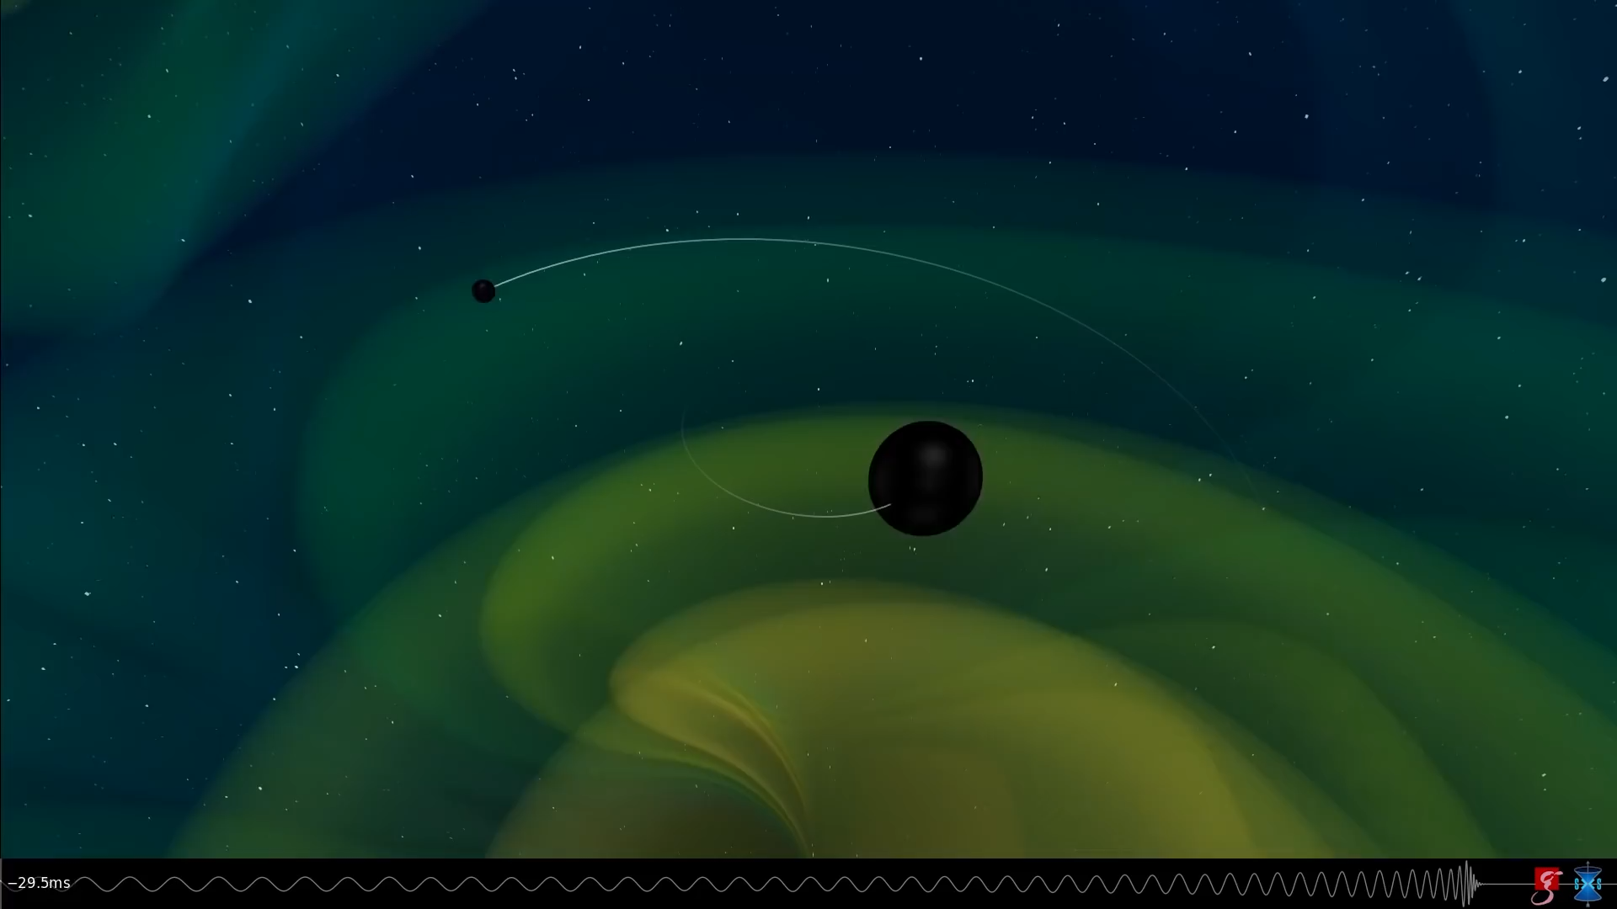
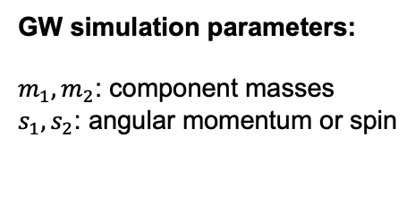
What is a compact binary coalescence (CBC)?
Credits: Max Planck Institute
Binary systems consisting on compact objects in a compact orbit around each other.
GW simulation parameters:
$m_{1}, m_{2}$: component masses
$s_{1}, s_{2}$: angular momentum or spin
Inspiral
Merger
Ring-down
Melissa Lopez
EuCAIFCon 2024

Slide 3
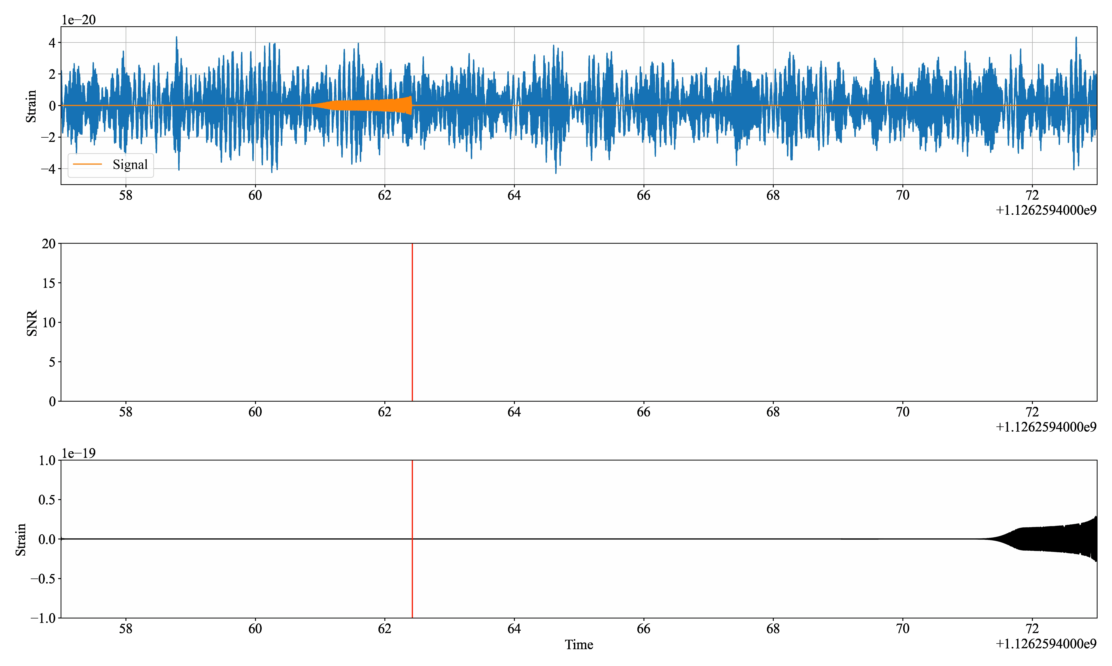


Modelled searches: matched filtering (MF) for CBC
What is matched filtering?
Template
Bank
(simulated GW)
Unknown signal
$$∗$$
$$→$$
Triggers
SNR
Idea: unknown signals generate multiple triggers. Can we find patterns with Machine Learning?
SNR amplitude
Melissa Lopez
EPS-BBH– November 2023
EuCAIFCon 2024

Slide 4
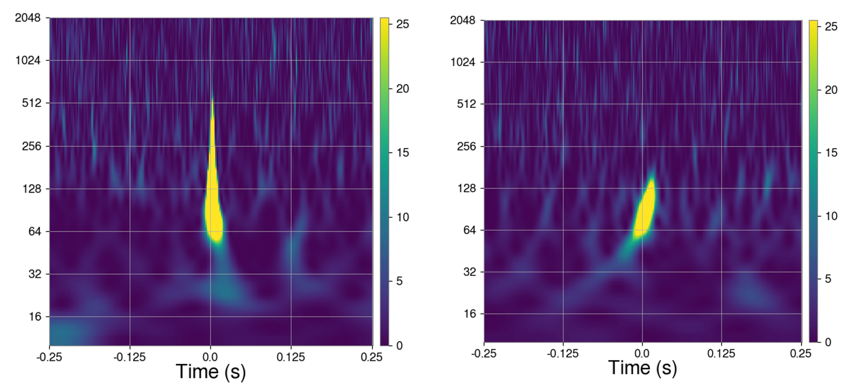
Transient noise burst (glitches)
Caused by instruments or environment
(known or unknown)
Diminish scientific data available
Hinder GW detection (mask and/or mimic)
Example of a blip glitch (left) and a intermediate-mass black hole (right)
Melissa Lopez
EPS-BBH– November 2023
EuCAIFCon 2024
Example of a blip glitch (left) and a intermediate-mass BBH (right)
Examples of glitches.
S. Bahaadini. Inf. Sci. 2018

Slide 5
Motivation
Context: intermediate-mass black holes (IMBH) are the missing link between stellar black holes and supermassive black holes, but they are hard to detect!
Idea: use triggers from matched filtering (free information) from detection algorithms to learn the background (glitches) and foreground (GW signals) with ML
MF searches use strict conditions for detection.
Can we relax the search with the interpolation ability of ML?
Similar ideas with cWB:
Gayathri et al. 2020 (XGBoost)
Lopez et al. 2021 (GMM)
Example of a blip glitch (left) and a IMBH (right)
Melissa Lopez
EPS-BBH– November 2023
EuCAIFCon 2024

Slide 6
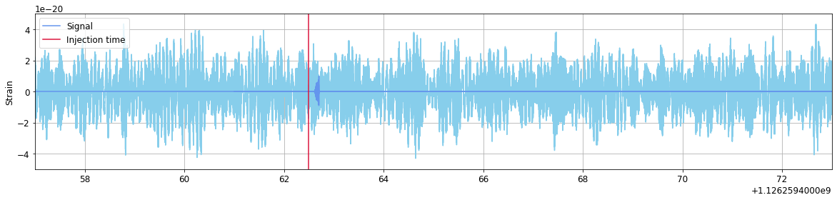
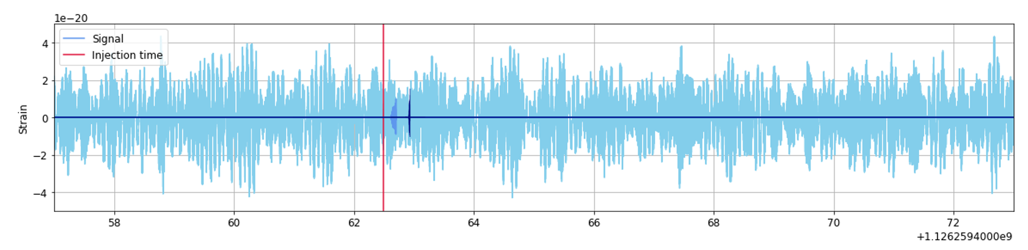

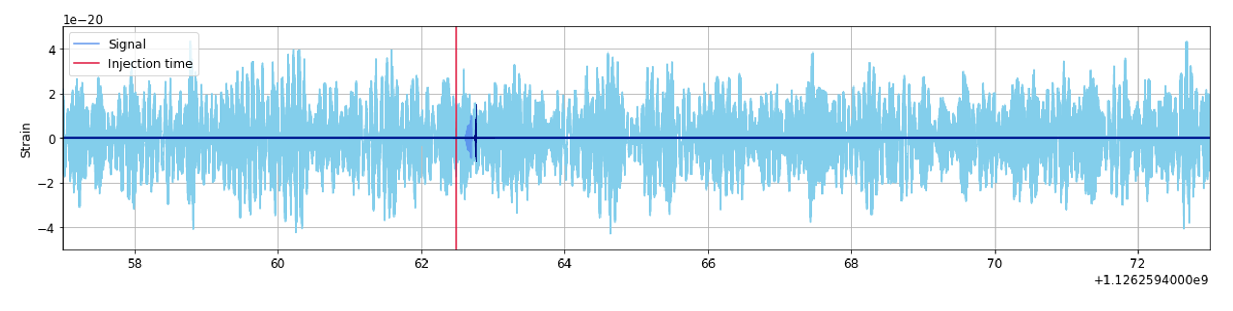
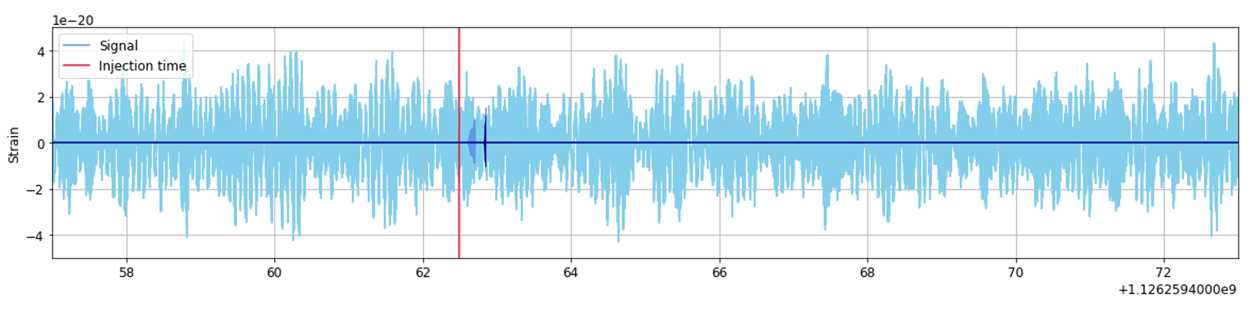
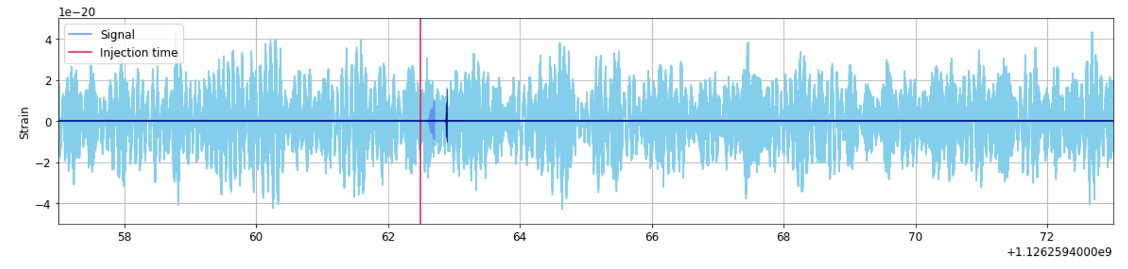
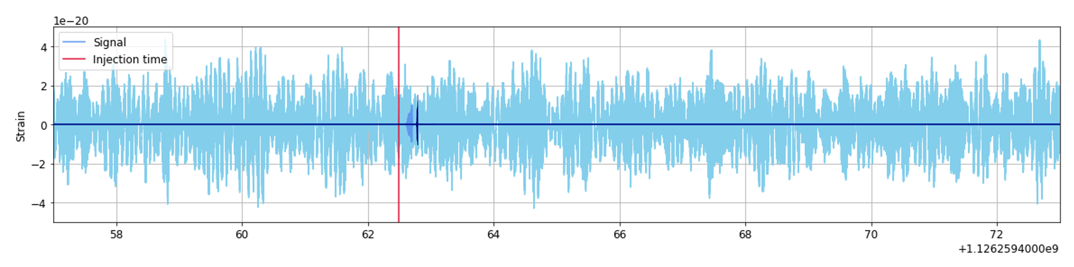
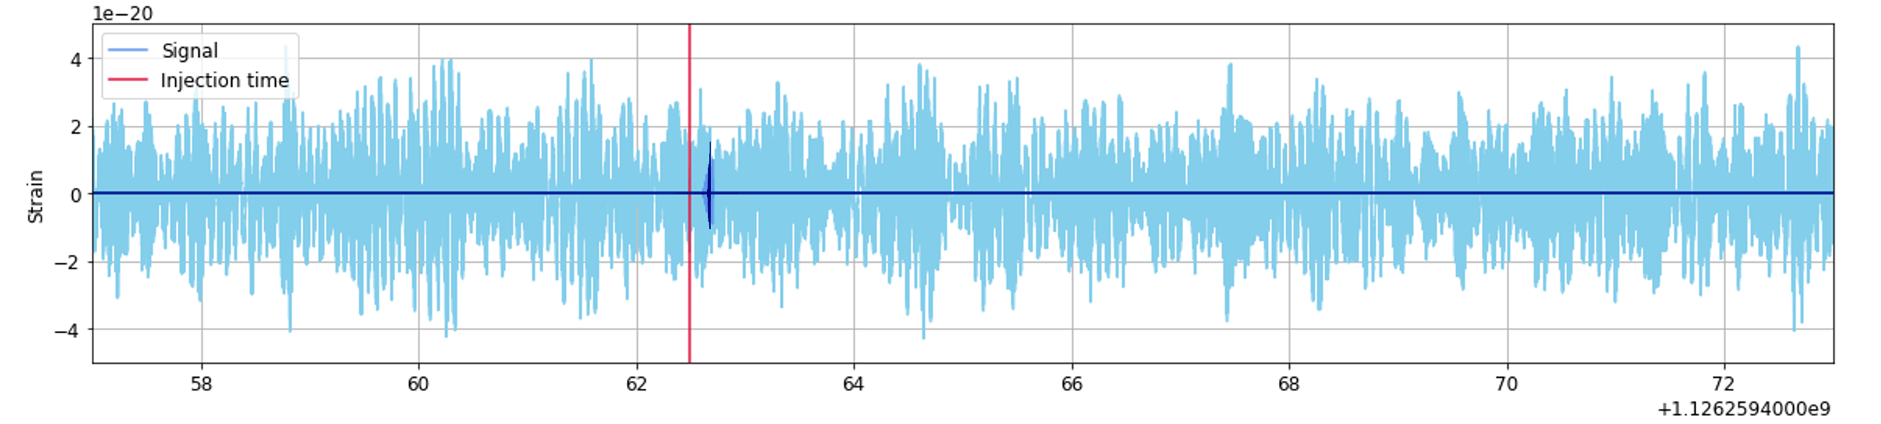

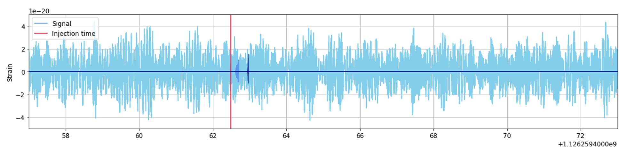
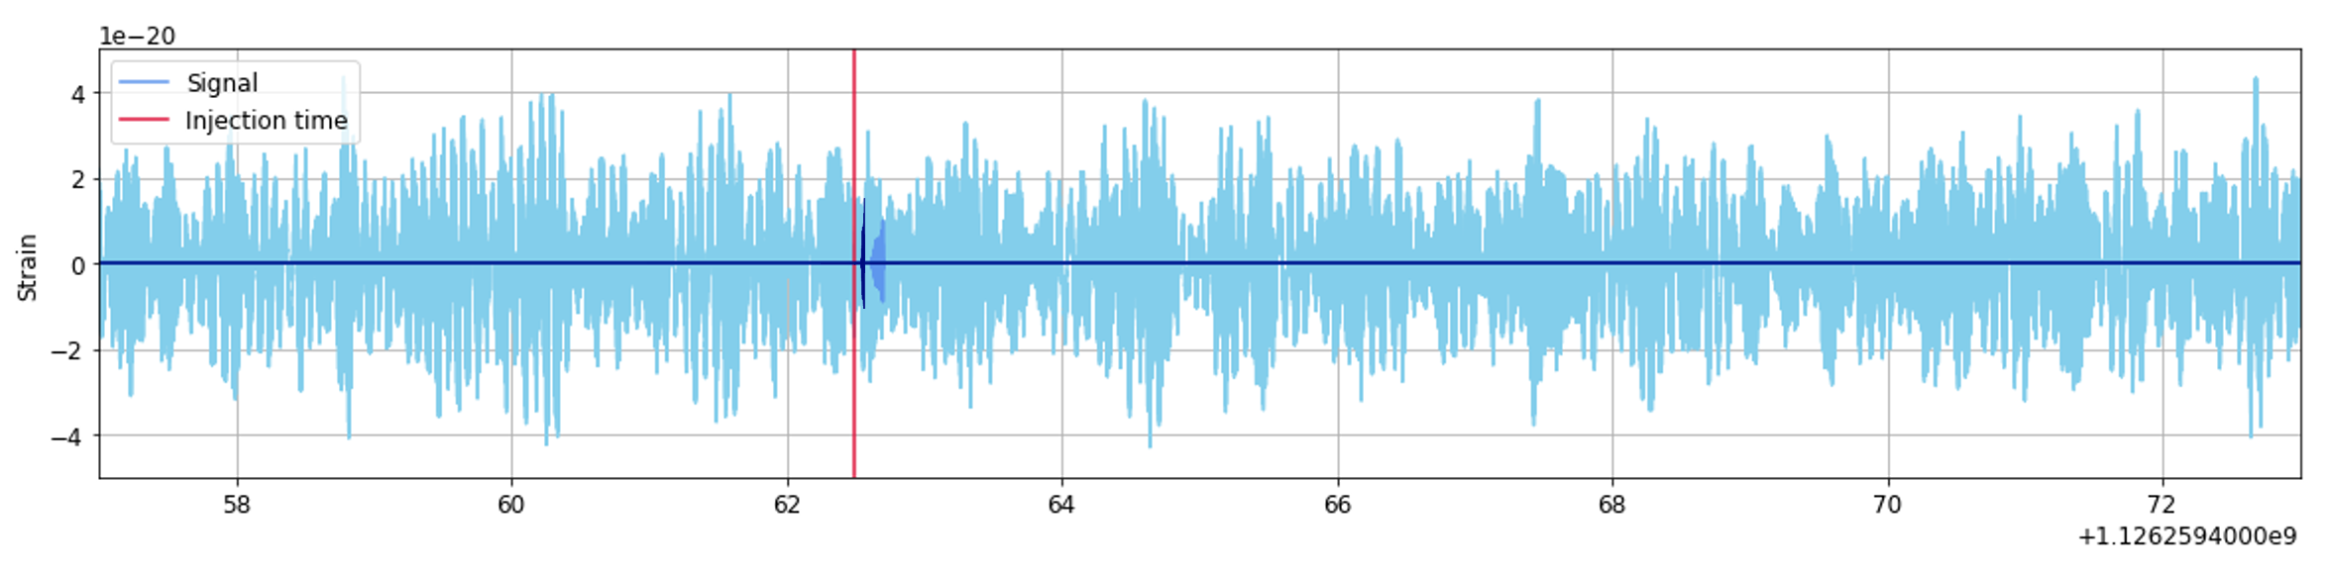
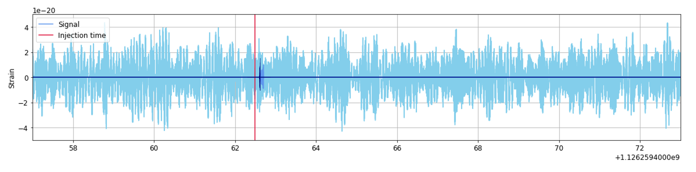
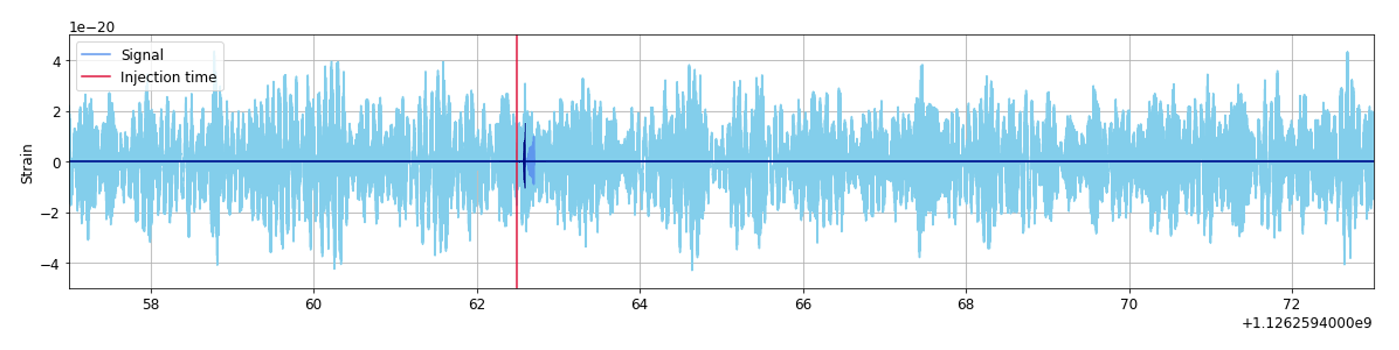
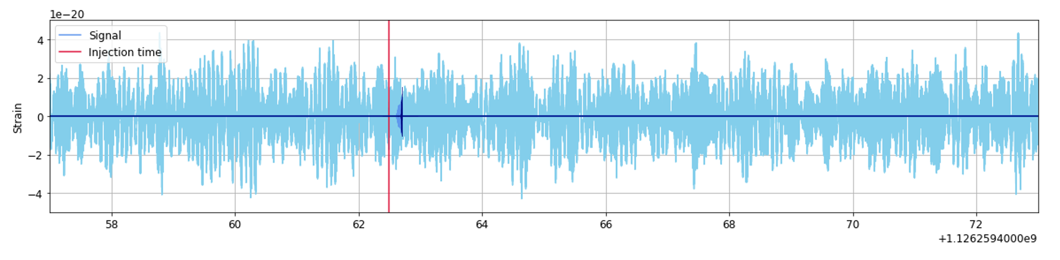


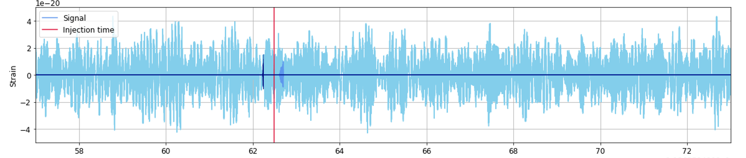
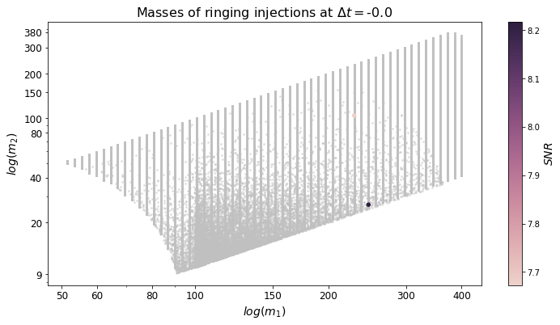


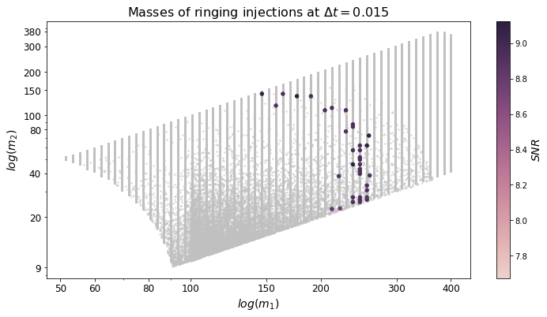
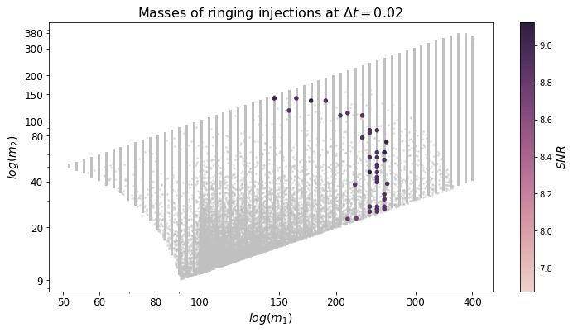




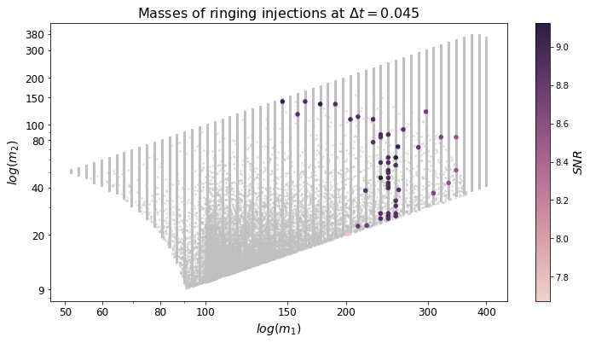





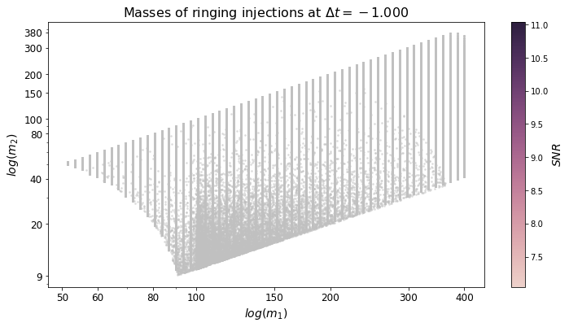
A simulated GW through a detection pipeline
$∆t$: time when trigger happened – time when GW signal was added to the noise
Melissa Lopez
EuCAIFCon 2024

Slide 7



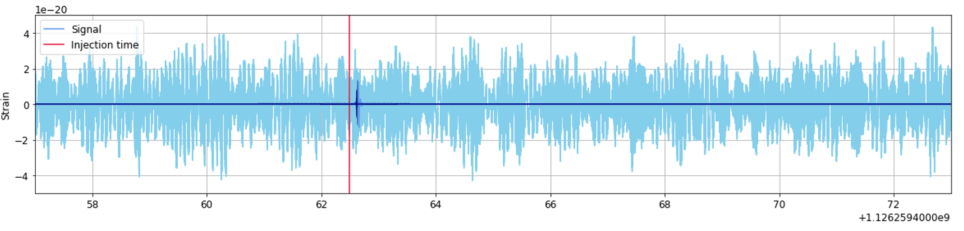



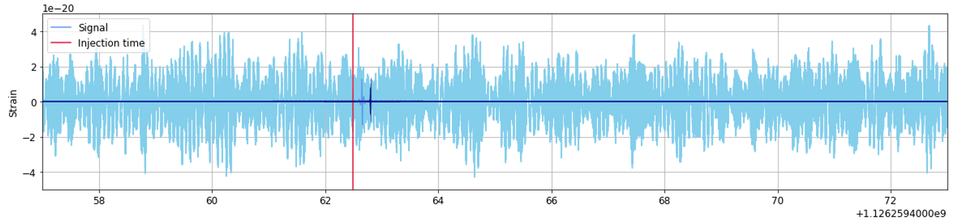
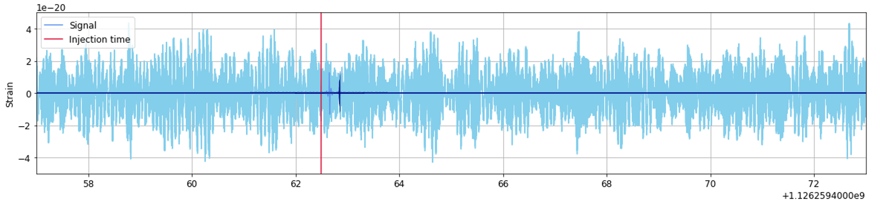

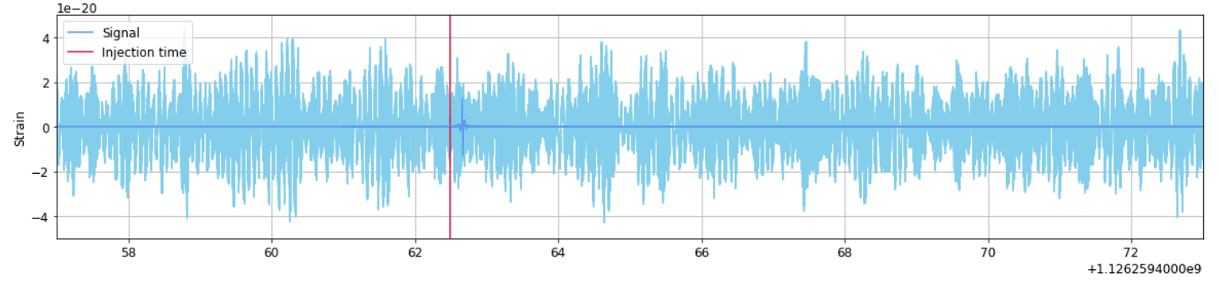
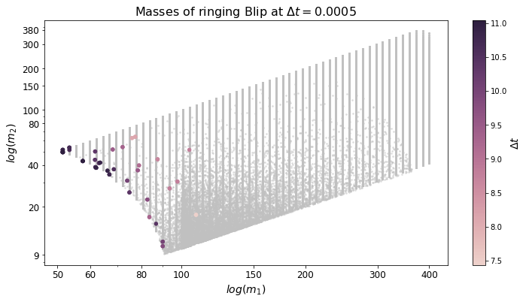
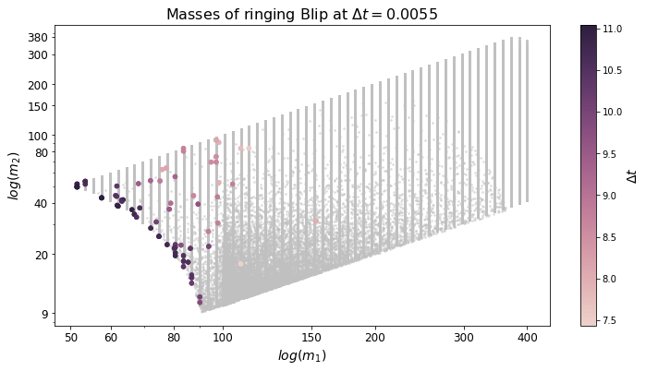
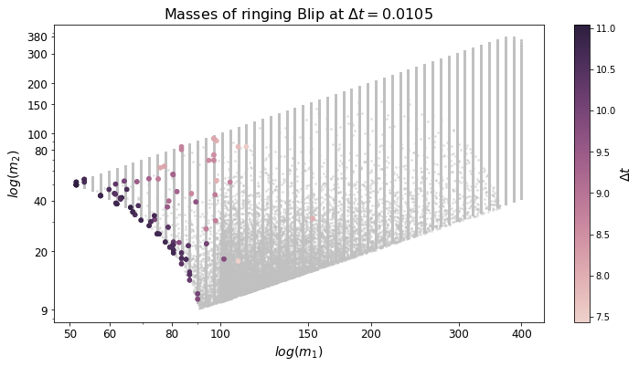
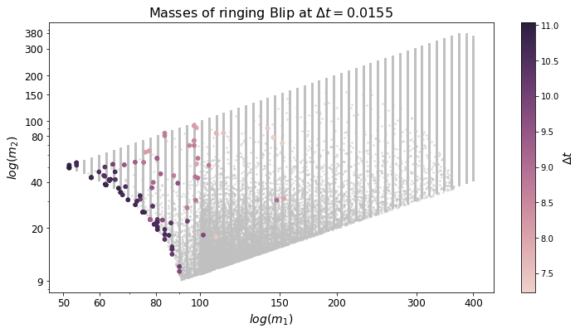
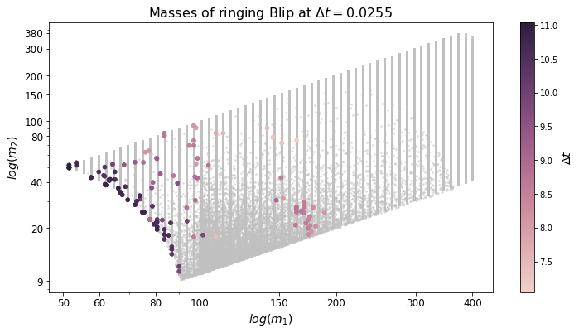




A glitch through a detection pipeline
$∆t$: time when trigger happened – time when glitch happened
$$SNR$$
Melissa Lopez
EuCAIFCon 2024

Slide 8
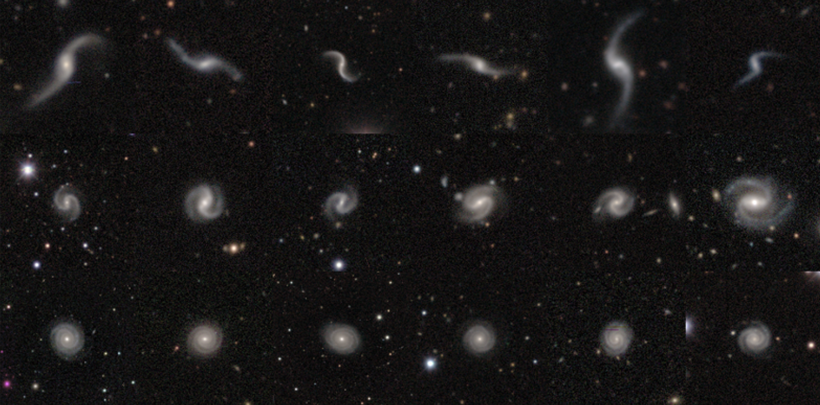
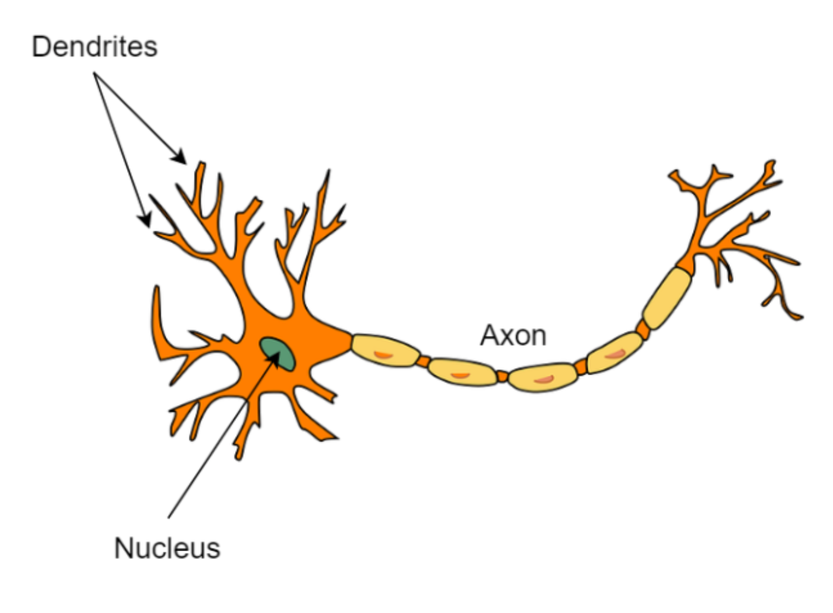
Brief introduction to Machine Learning (ML)
Supervised learning
Student
Lectures
Mock exam
Final exam
You did it!
Task
Algorithm
Training set
Validation set
Test set
Task
It did it!
Input
We will use multi-layer percetron a.k.a. fully connected neural networks
Galaxy Zoo
Output
Melissa Lopez
EuCAIFCon 2024

Slide 9
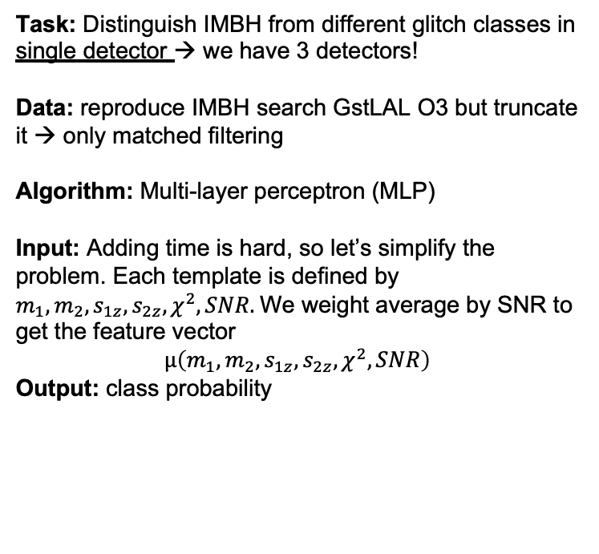
Methodology
Task: Distinguish IMBH from different glitch classes in single detector → we have 3 detectors!
Data: reproduce IMBH search GstLAL O3 but truncate it → only matched filtering
Algorithm: Multi-layer perceptron (MLP)
Input: Adding time is hard, so let’s simplify the problem. Each template is defined by $m_{1}, m_{2}, s_{1z}, s_{2z}, χ^{2}, SNR.$We weight average by SNR to get the feature vector
$$μ\left(m_{1}, m_{2}, s_{1z}, s_{2z}, χ^{2}, SNR\right)$$
Output: class probability
Idea: MLP differentiates 6 classes: 5 different types of background (glitches) and single foreground (GW signals). It uses only 6 parameters in single detector
Melissa Lopez
EuCAIFCon 2024

Slide 10
Methodology
1. Accounting for imbalanced data (boostrapping with replacement)
Injections
(GR GW)
Blips
Whistles
Shuffled data
…
Whistles
N=100
Blips
Whistles
Whistles
2. Improving model prediction (k-fold cross-validation): train & validate
K=1
K=2
…
K=9
We avoid unbalanced data and overfitting
Melissa Lopez
EuCAIFCon 2024

Slide 11
Results: diving into the known (controlled data set)
O3a
O3b
3rd observing run (O3)
(data collection)
Time
Learning
(training/validation/test)
Generalization power
(only test)
Detector | Accuracy O3a (%) | Accuracy O3b (%)
LIGO Hanford (H1) | 98.75 | 73.01
LIGO Livingston (L1) | 95.81 | 67.45
Virgo | 99.27 | 75.91
Accuracy drops due to loud and confussing background.
Idea: time coincidence among detectors since most glitches do not overlap
Melissa Lopez
EuCAIFCon 2024
Notes:
(7, 7) 98.75 (7, 7) 95.81 (6, 6) 99.27 (7, 7) 73.01 (7, 7) 67.45 (6, 6) 75.91

Slide 12
Results: diving into the known (time coincidence)
Known foreground
(simulated IMBH signals)
Known background
(all glitches)
GW simulation = Injection
Melissa Lopez
EuCAIFCon 2024

Slide 13

Results: diving into the (un)known – GWOSC catalogue
GW190521
$P_{inj}=0.999$
It has learnt to identify GW simulations. Can we see real GW signals?
WARNING: this is not a detection, i.e. no background estimation
Melissa Lopez
EuCAIFCon 2024

Slide 14
Results: diving into the (un)known – Other catalogues
WARNING: this is not a detection, i.e. no background estimation
4-OGC, Nitz et al. 2023 ApJ 946 59
Olsen et al. 2023, Phys. Rev. D 106, 043009
Melissa Lopez
EuCAIFCon 2024

Slide 15
Conclusions & future work
We can differentiate signals from glitches with MF triggers & neural networks
We learned O3a and explored generalization power in O3b
Identified GW190521 and other GW signals
Paper out soon. Stay tuned!
Background estimation
Include time component: ordering might be relevant
Extend to other template banks and/or pipelines
Thank you for listening! Questions?
Melissa Lopez
EPS-BBH– November 2023
Melissa Lopez
EuCAIFCon 2024

Slide 16
Extra slides

Slide 17
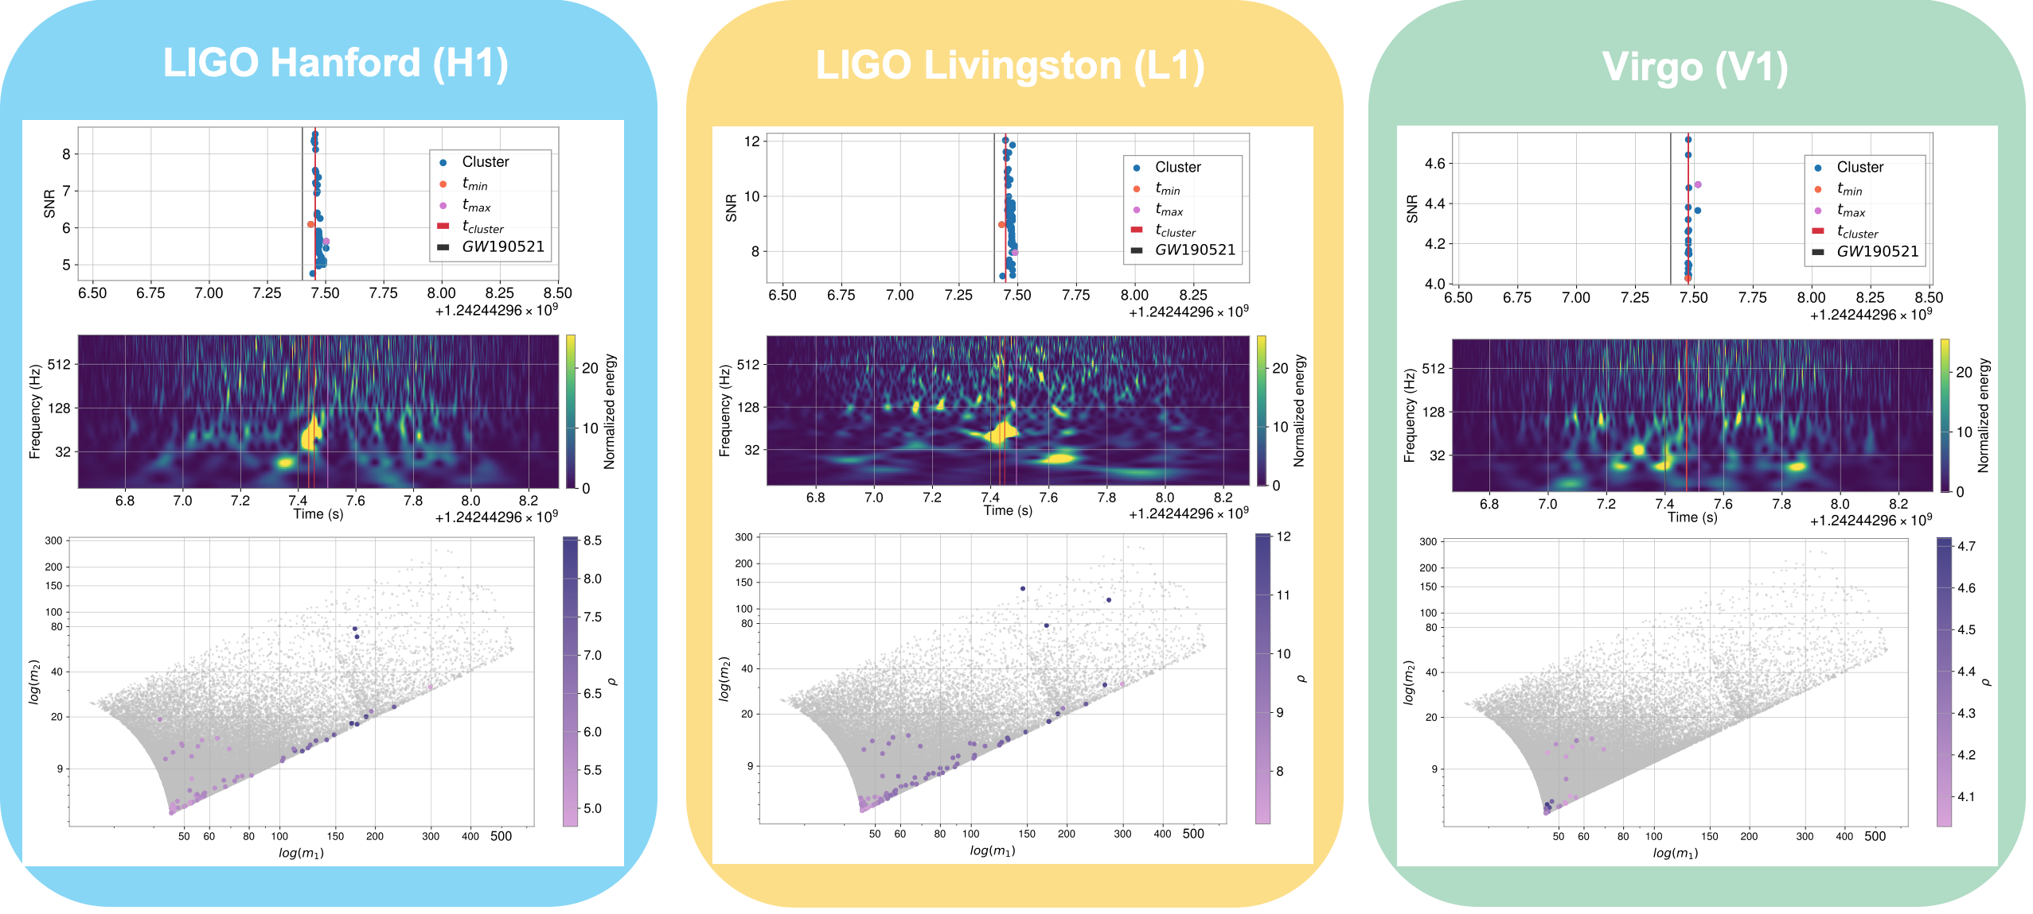
Results: diving into the (un)known - GW190521
SNR
SNR
SNR
Melissa Lopez
EuCAIFCon 2024

Slide 18
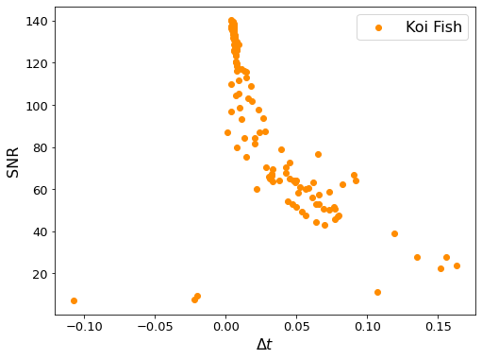
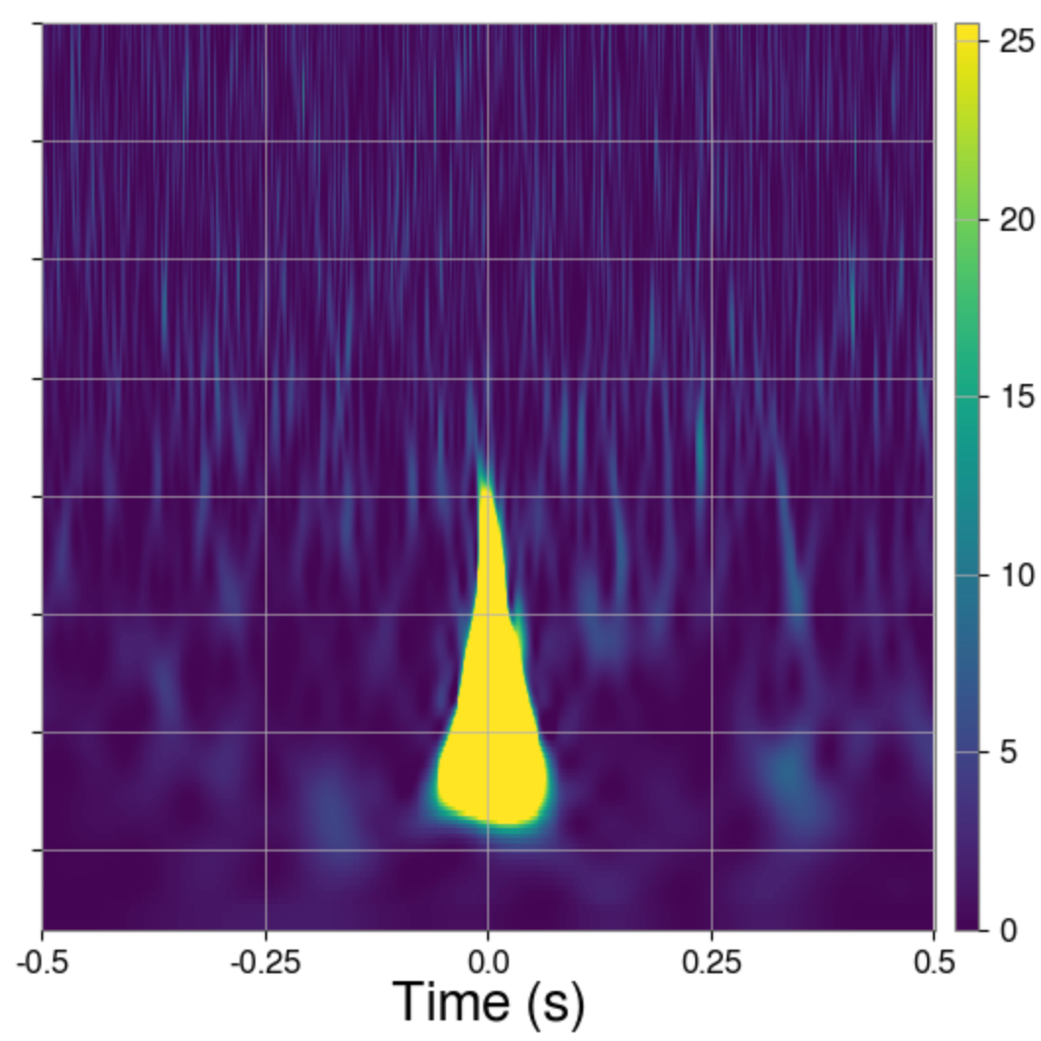
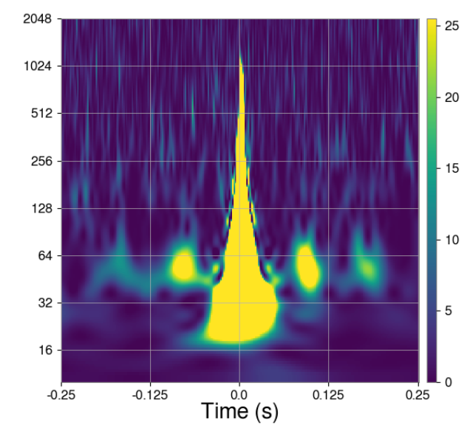
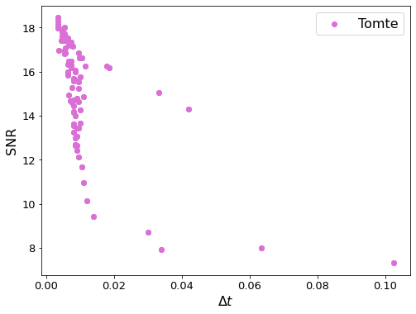
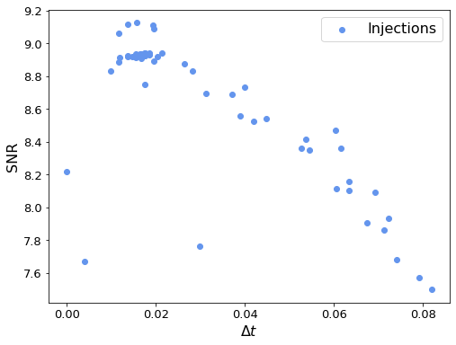
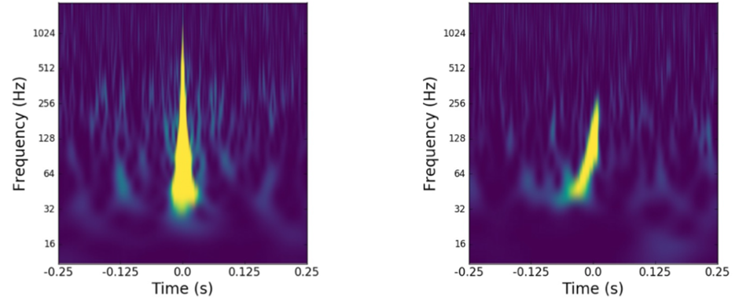
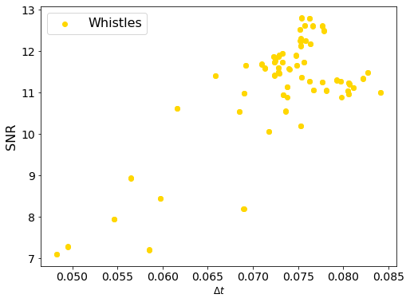
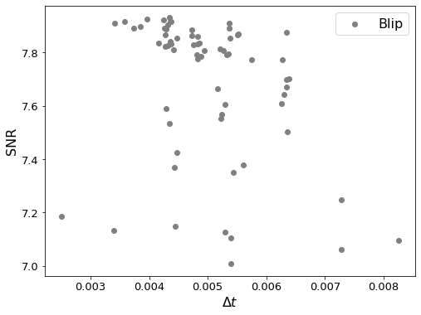
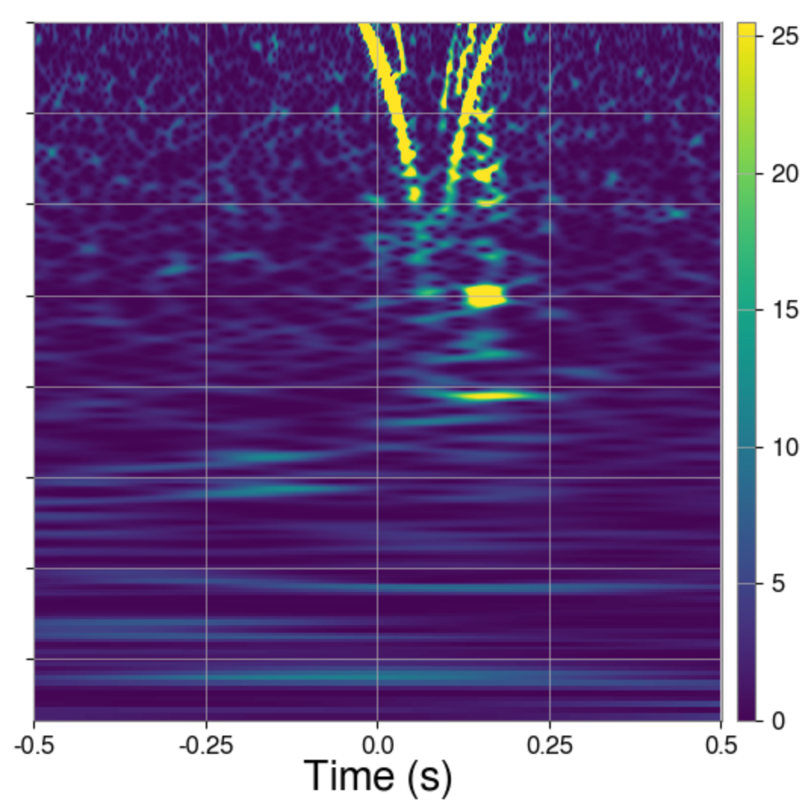
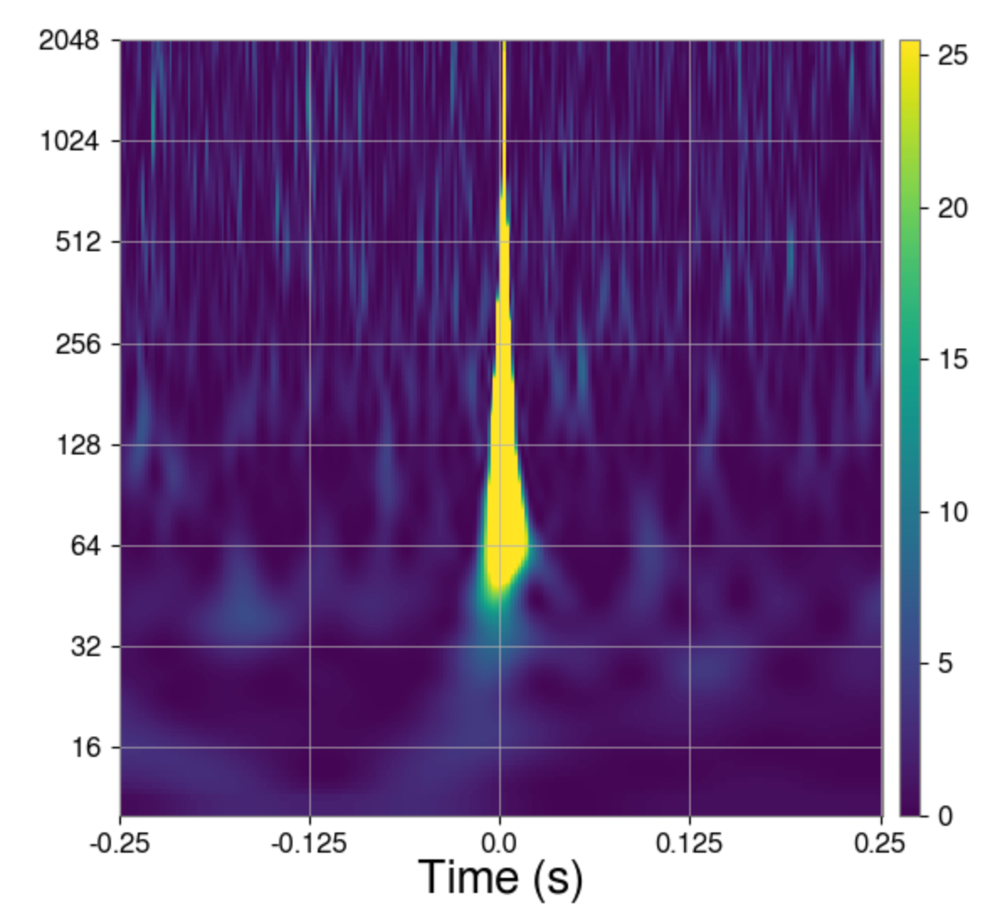
What does the dynamic SNR pattern look like?
Taking time interval: -1s < event time < 1s
Not all glitches produce many injections/triggers
Melissa Lopez
EuCAIFCon 2024

