Slide 1

EINSTEIN TELESCOPE
Preliminary workflow outline for Civil Engineering approach
ENGINEERING SERVICES BY AMBERG ENGINEERING AG

Slide 2
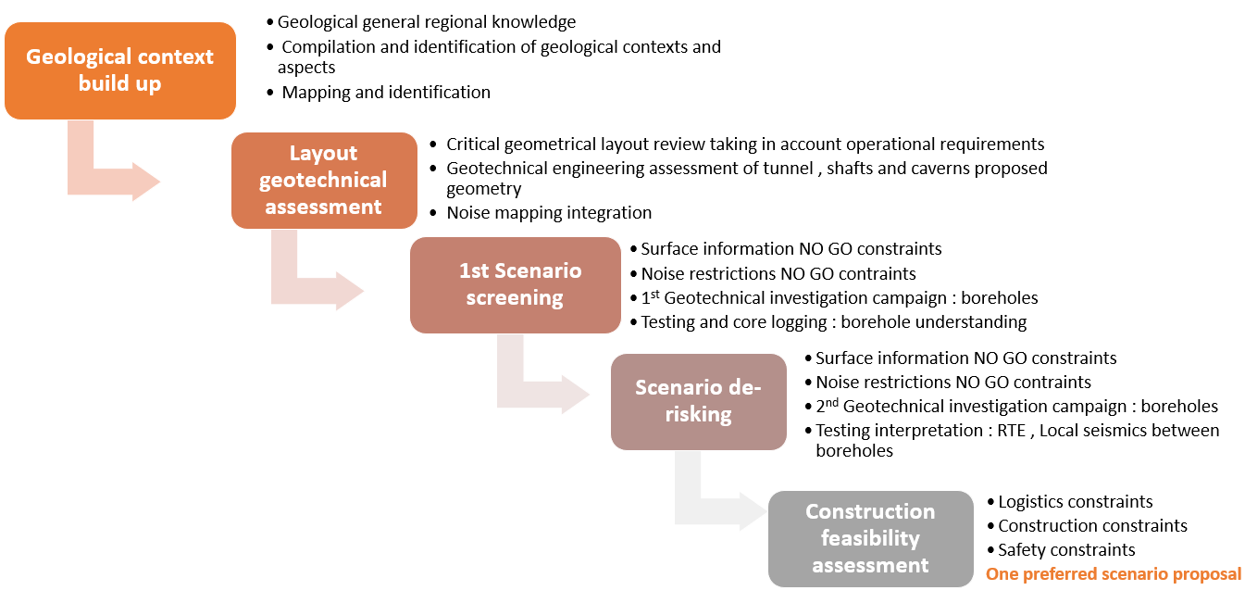
Synoptic stepwise approach

Slide 3
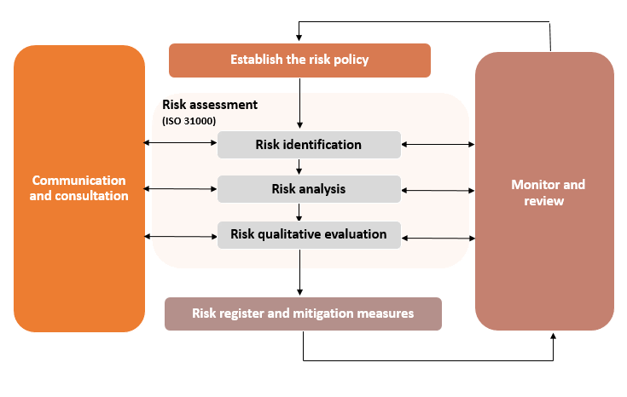
Quality approach
Criteria for qualitative risk assessment
Planning compliance
Resources availability
Countermeasures for foreseen perturbations
Unforeseen circumstances mitigation

Slide 4
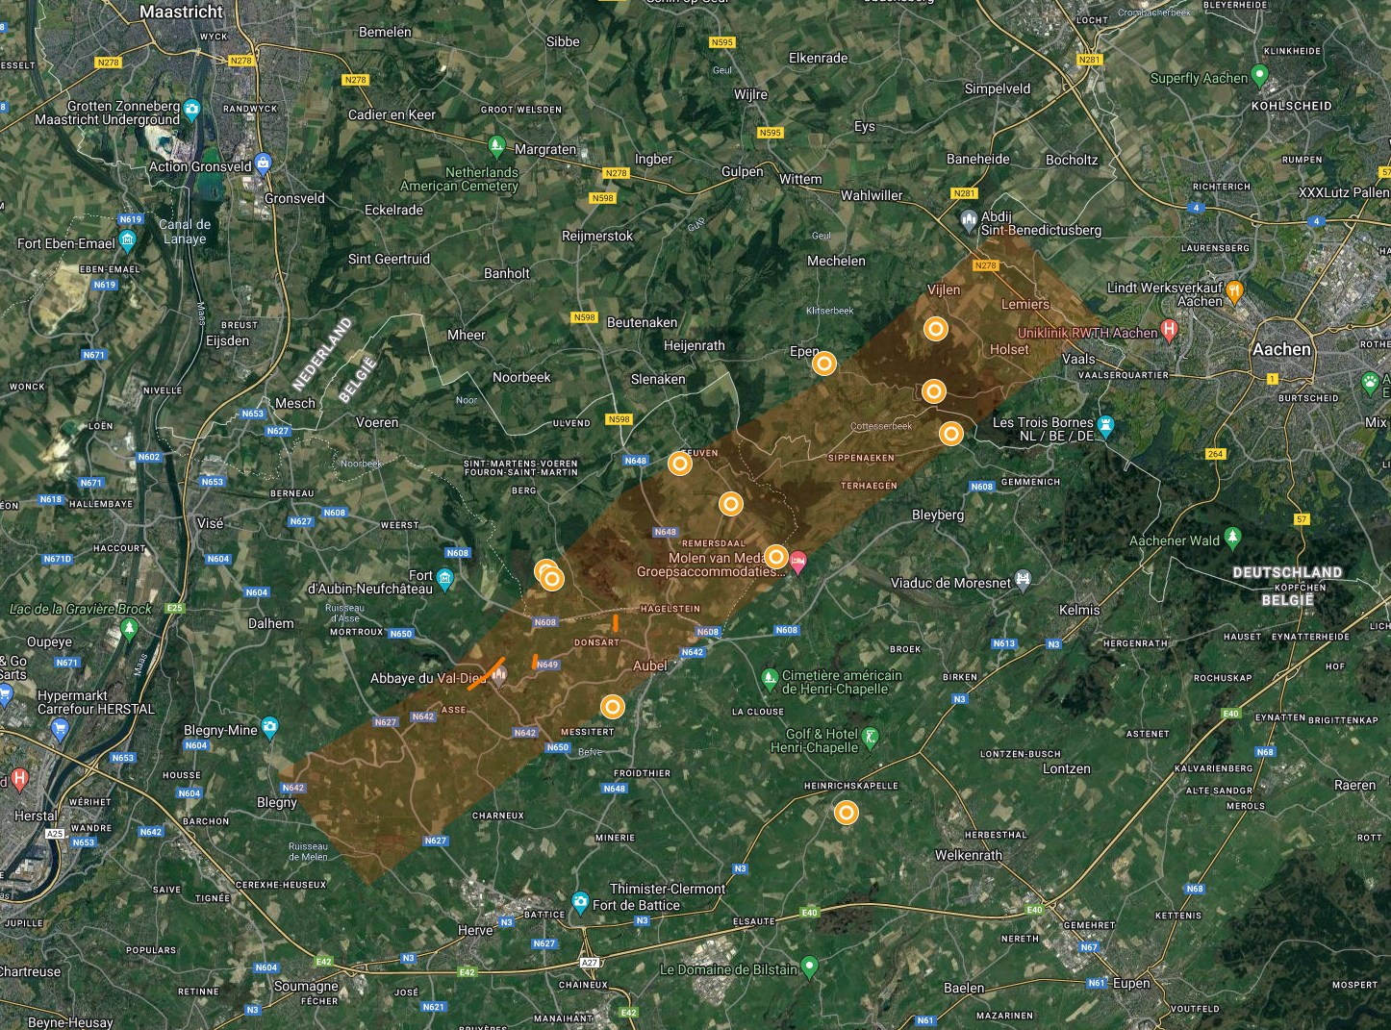
EMR Geological Region
It has been outpointed that rock formations originate from the Devonian, Famennian age have a better quality than the overlaying Namurian (Upper-Carboniferous rock).
An uplift or upthrusted area has been identified in the Netherlands – Belgium border region, where the Famennian formation can be observed at + 50m NN/TAW.
A first borehole campaign including 10 boreholes has been defined and tendered for a better identification and assessment of this rock mass
Planned boreholes in Phase 1

Slide 5
Stepwise approach
Phase 1 : Subsurface characterization
Aims at laying out the geological foundation of the region, from a structural, stratigraphic, geohydrological and geotechnical perspective.
The exploration deals with regional geological derisking on three main aspects:
A regional tectonostratigraphic model. This model, essentially consisting of 3-5 parallel cross SE-NW directed sections elucidate how rock layers are distributed in space and depth throughout the ET-search area. This model will also illustrate the position, and as far as possible the features of the main faults and thrust planes.
An evaluation of rock properties, particularly focussing on geotechnical aspects. This will result in a catalogue of encountered and expected rock types in the area.
Hydrology : Construction of a baseline monitoring network and a general description of the hydrological interactions between the Paleozoic and the overburden.
HOW?

Slide 6
Stepwise approach
Phase 1 : Subsurface geological and geomechanical characterization
1st borehole campaign
Evaluation of the log and test data, cores and samples (geomechanics, biostratigraphy, etc.) taken from the cores
Regional geologic cross sections down to 500 m
Defining a structural element map which connects the main (thrust) faults between the cross sections
Site and laboratory specific data
  rock strength (point load, uniaxial, triaxial, tensile), rock mass strength, in-situ stress,
  mineralogical composition (fault gouge material and argillaceous rock to check for the presence of swelling clay minerals), quartz content
  chemical properties of rock and groundwater
  drillability of rock: quartz content, drilling index, Cherchar abrasivity, rate of drill bit penetration into the rock or TBM penetration into the rock
  …
Hydrogeological parameters from a tunnel engineering perspective
Outcome : Regional ranking of locations where, caverns/corner points can be emplaced.

Slide 7
Stepwise approach
Phase 2 : Site derisking
Input data
Input from 1st and 2nd borehole campaigns
Input from phase 1 : Set of possible configurations at regional scale and a hydrogeological assessment of the groundwater regime and the hydrological sensitivity and suitability of the area for tunnel engineering
Operational requirements appointed by ETO
NO-GO criteria linked to surface and noise requirements and demands.
Challenges
Validating preliminary layout and the geometric definition of the caverns and shafts, especially the configuration of adjoining caverns
Ensuring escape routes during construction and limiting the length of dead-end galleries if any
Ensuring geometrical layout to meet ventilation and fire safety requirements
Ensuring the feasibility from a logistic point of view
Ensuring an adequate lifetime for the constructions
Considering the construction design codes in effect
Following the advice of trustable recommendations as underground works are not fully described in the construction design codes

Slide 8
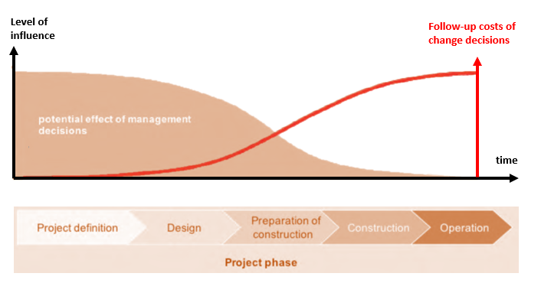
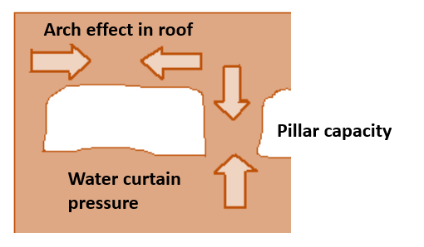
Stepwise approach
Phase 2 : Site derisking
Boundary conditions or design requirements for engineering feasibility stage
Design specifications conform the scope of a further feasibility mission : Design alternatives for the Einstein Telescope project
Cavers design criteria
Regarding general geometric aspects of the caverns and its probable interaction with the geological and geotechnical context:
Cavern orientation
Shape
Column stability
Lining
Drainage
Aim : Challenging current Einstein Telescope layout

Slide 9
Stepwise approach
Phase 2 : Site derisking
Analysis of caverns design
The caverns are the most challenging part of the project and their study and design compliance will determine the go-no go for Einstein Telescope emplacement for the eligible foreseen case scenarios.
Main aspects which determine the caverns design are :
  Initial stress state to be determined by insitu testing in boreholes
  Rock mass behavior
  Geomechanical parameters
  Water presence
  Discontinuities, disturbed areas …
Cavers design criteria
Regarding general geometric aspects of the caverns and its probable interaction with the geological and geotechnical context:
Cavern orientation
Shape
Column stability
Lining
Drainage
Aim : Challenging current Einstein Telescope layout

Slide 10
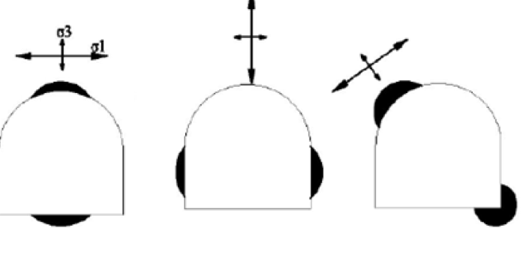
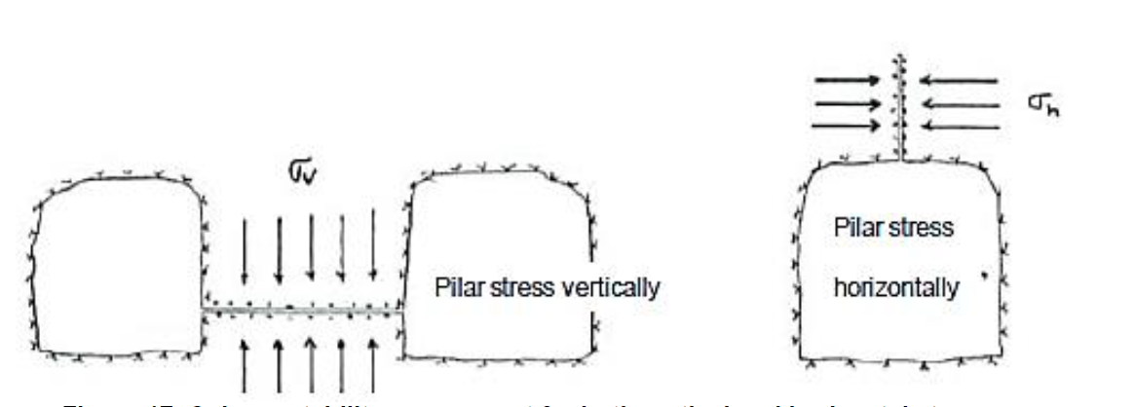
Stepwise approach
Phase 2 : Site derisking
Expected outcome
Delimited and reduced number of potential scenarios satisfying feasibility criteria from a geological, geotechnical and engineering point of view.
Selection of these scenarios will have into account NO-GO criteria linked to surface , noise requirements and operation (among others).
These scenarios may suggest different layout alternatives which might vary in either geographical locationally, geometric definition or in depth and cross-checked with main stakeholders .
Understanding of the groundwater regime and the connectivity between subsurface hydrological system and the surface hydrology

Slide 11
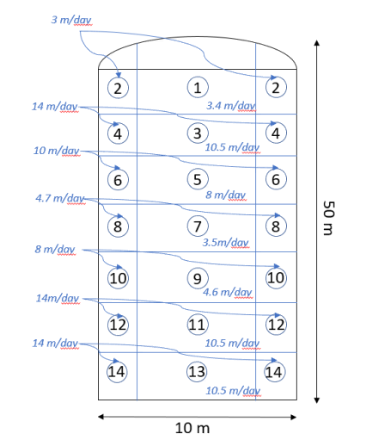
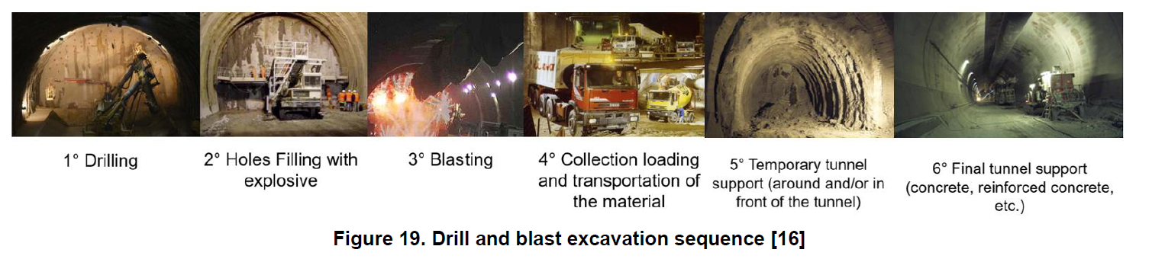
Stepwise approach
Phase 3 – Scenario screening
Approach
Multicriteria analysis of the potential scenarios selected on Phase 2 will be conducted aiming to conclude on one and only best preferred scenario.
Elaborated input from all surface involved disciplines (environmental, permitting, public acceptance etc) regarding the limited number of scenarios from Phase 2
Identification of logistic centers
Construction constraints

Slide 12
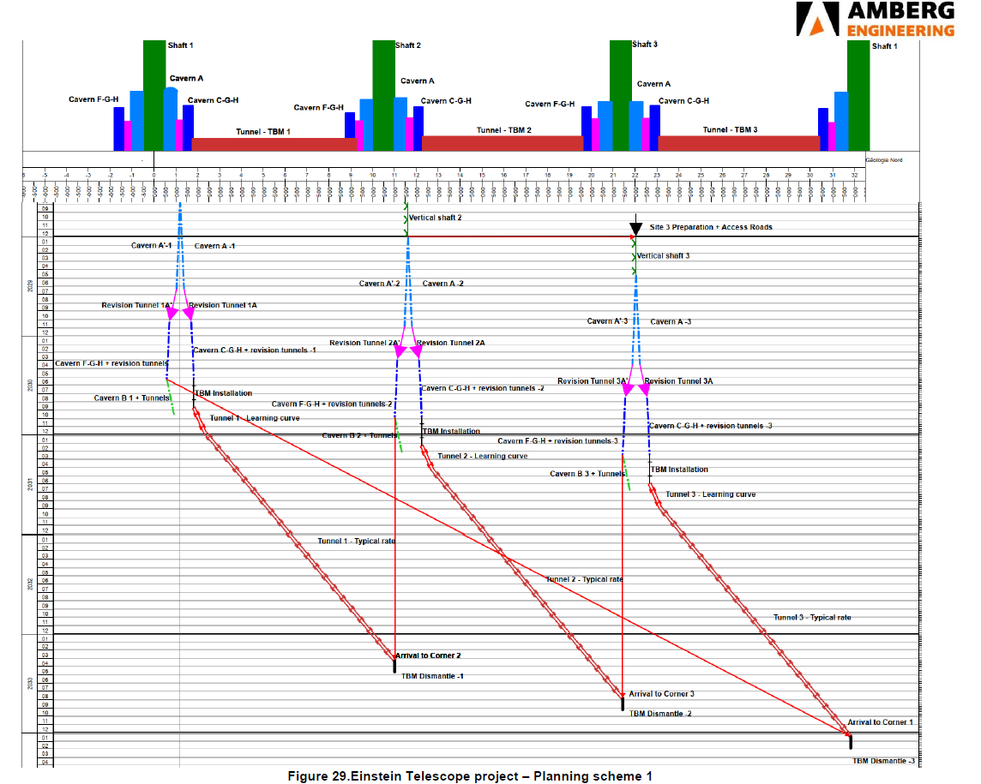
Stepwise approach
Phase 3 - Scenario screening
Evaluation criteria after technical validation
Planning estimation
  Critical path identification
  Industry technology review
  Construction stages plan and schedule scenarios
Cost estimation
  Based on the planning scenarios
  Risk and constraints contingency margin
Outcome : The preferred layout.
Validation of the Einstein Telescope construction acceptable impact both for surface and subsurface hydrological system.

Slide 13
Stepwise approach
Phase 3- Scenario screening
Outcome : The preferred layout.
Validation of the Einstein Telescope construction acceptable impact both for surface and subsurface hydrological system.
Sufficient input to write the Geoscience- and Geo-Engineering part of the Bid Book.
A report compiling the trajectory towards the selection of the preferred layout and the reasoning behind the final site selection will be delivered by the end of the feasibility mission.
Specific criteria basis for site evaluation, budget estimation, permitting validation, environmental compliance and every topic covered and treated by the feasibility study that might compromise feasibility will be properly addressed and justified.

Slide 14
Questions round
Thank you for your attention

