Slide 1
E-TEST – Uncertainty in Geological Modeling
Nils Chudalla ^{[1]}, Marius Waldvogel ^{[2]}, Florian Wellmann ^{[1, 4]}, Pooya Hamdi ^{[3]},
Florian Amann^{[3]}
^{[1]} RWTH Aachen University - Computational Geoscience, Geothermics Reservoirgeophysics
^{[2]} RWTH Aachen University – Geological Institute
^{[3]} RWTH Aachen University – Chair of Engineering Geology and Hydrogeology
^{[4]} RWTH Fraunhofer Research Institution for Energy Infrastructures and Geothermal Systems IEG

Slide 2
What is a structural geological model
Representation/Simplification of (subsurface) geological structures/interfaces
Often layers grouped by geological age (Stratigraphy)
Can be subdivided by rock type
Based on different observations on different scales
Result of application of mathematical algorithms, computational simulations and geological knowledge

Slide 3
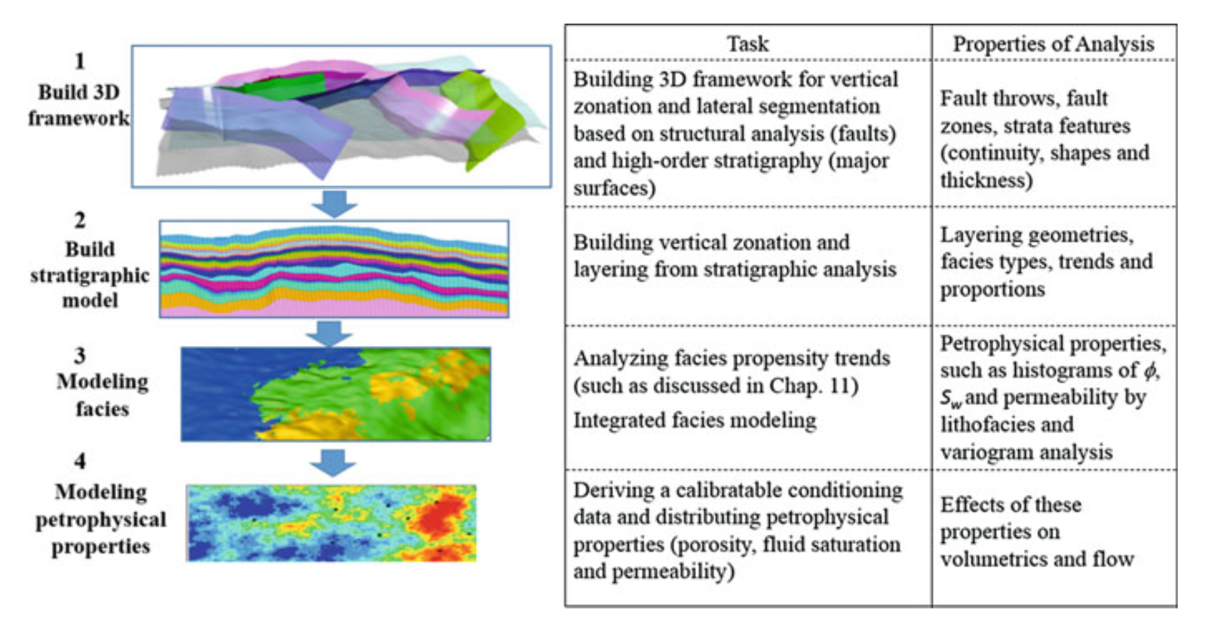
Geological Modeling
(Trend Modeling)
(Multiple Point) Geostatistics
Object
(Two-point) Geostatistics
(Quantitative Geosciences: Data Analytics, Geostatistics, Reservoir Characterization and Modeling, Ma, 2019)

Slide 4
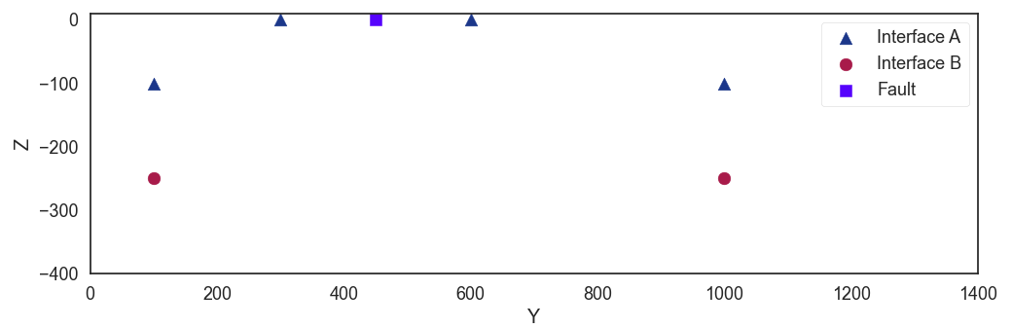
Life of a hypothesis
Outcrop Measurement
Boreholes/Bore Logs

Slide 5

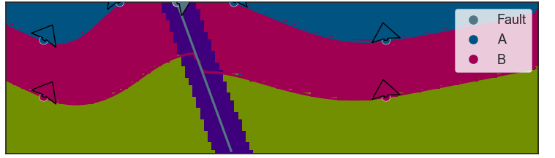
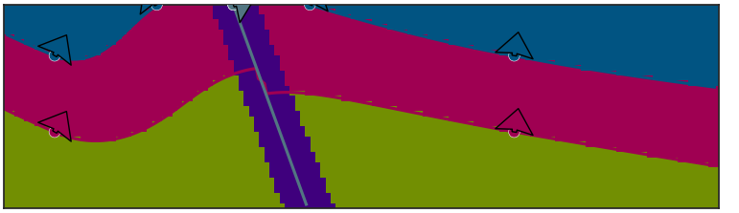
Life of a hypothesis
https://www.gempy.org
All shown models were computed with gempy (not limited to 2D)
Scenario 1 or 2?

Slide 6
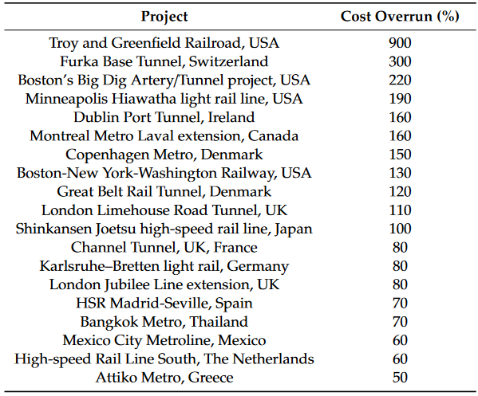
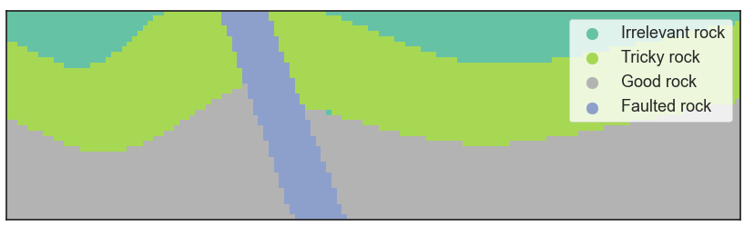
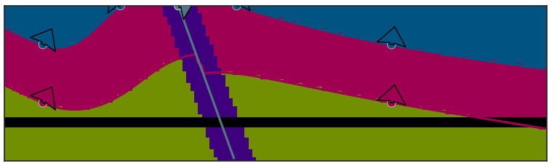

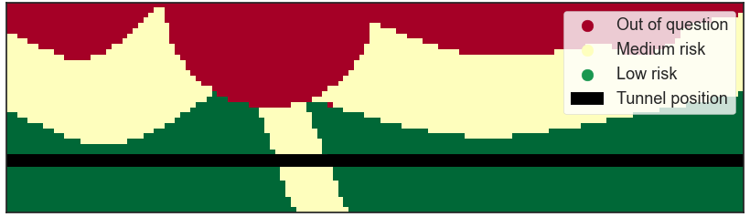
Life of a hypothesis
Additional measures required
Construction extended
Cost overrun (Client liability)

Slide 7
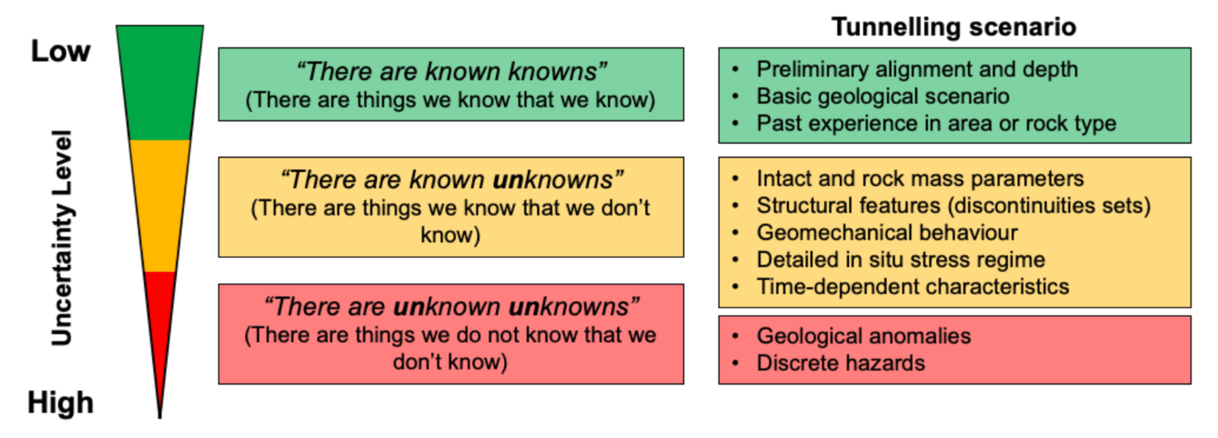
Uncertainty in tunnelling
Paraskevopoulou & Boutsis 2020

Slide 8
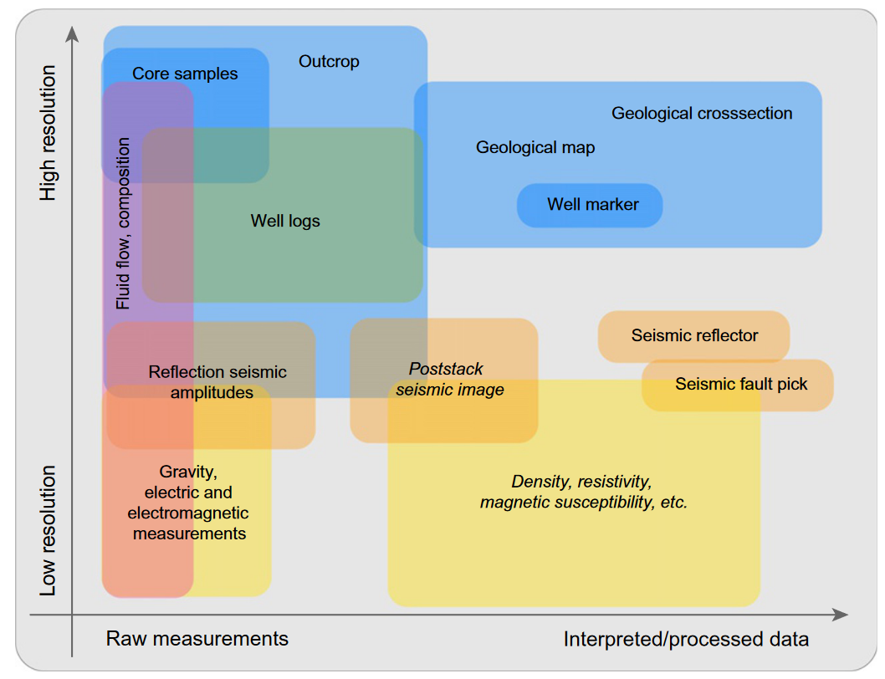
Uncertainty in geological/geophysical data
(Wellmann & Caumon, 2018)
Notes:
Geophysical methods have systematic error. These can be addressed by modeling statistical uncertainty

Slide 9
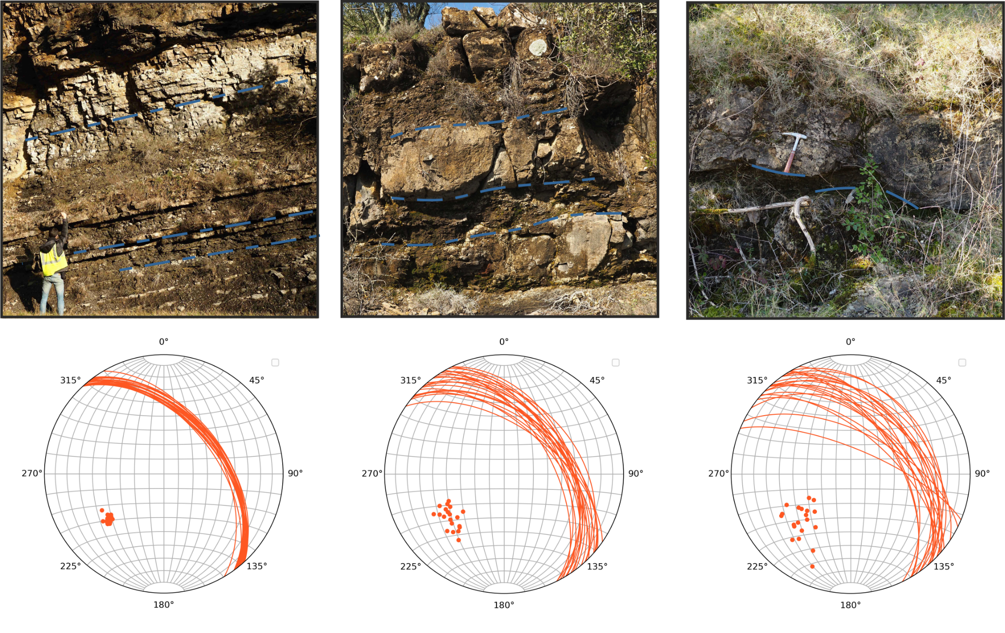

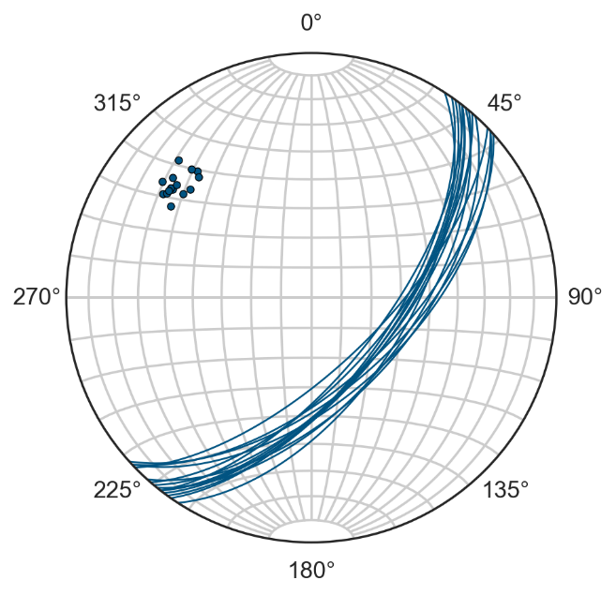
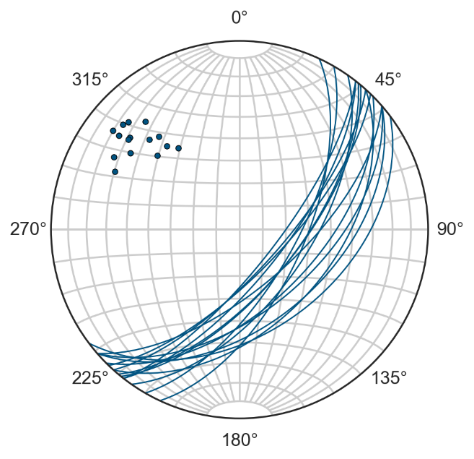
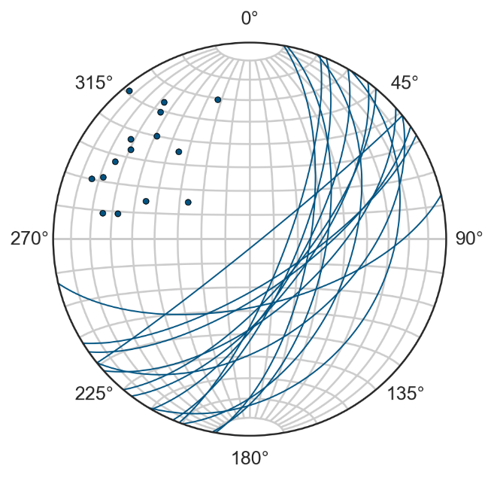
Examples – Uncertainty in Geology/Geophysics
(Elisa Heim et al.)

Slide 10

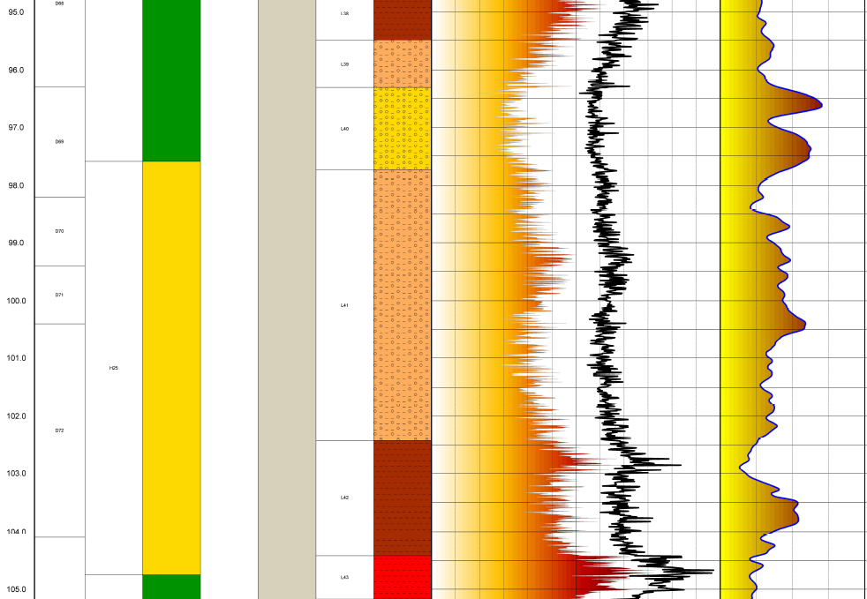
Examples – Uncertainty in Geology/Geophysics

Slide 11
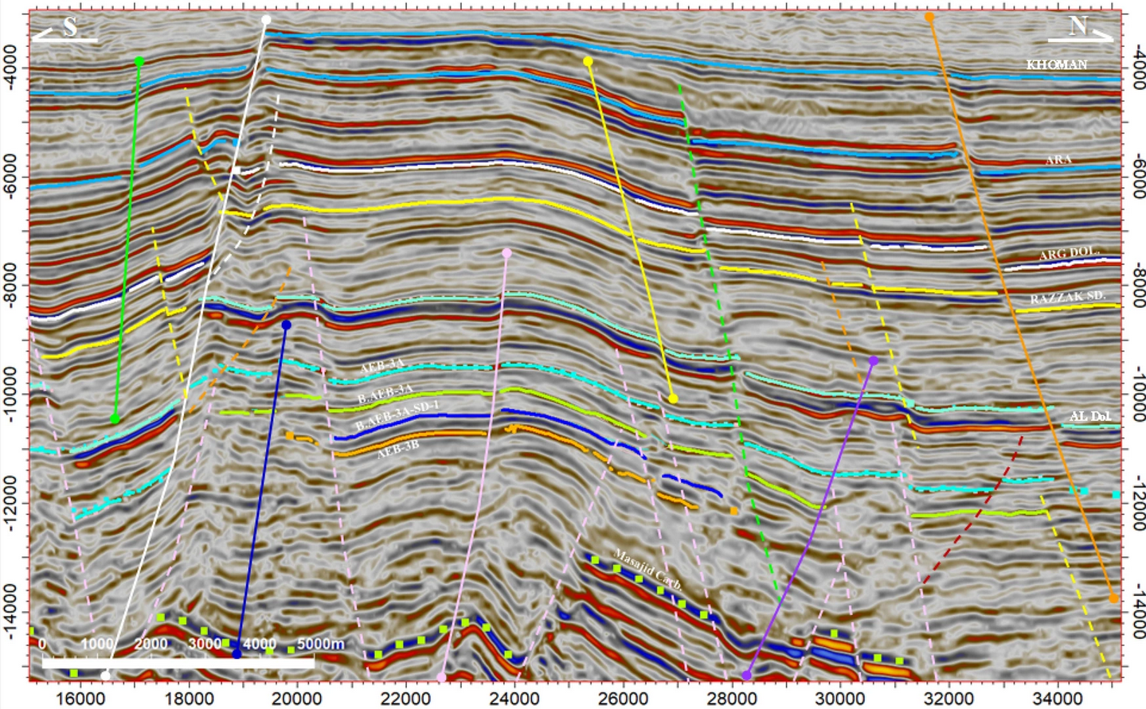
How can we deal with uncertainty?
Structural uncertainty:
Expert evaluation of model input
Consider as many geological scenarios as possible (Monte Carlo Simulation)
Additional information (ERT, Gravimetry, Magnetic surveys) to validate models
Geophysical inversion
(El-Nikhely et al. 2022)

Slide 12
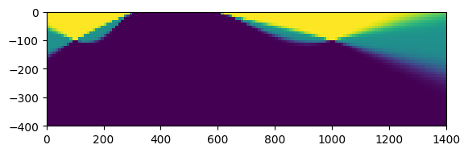
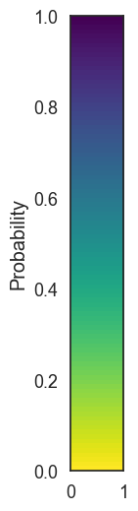
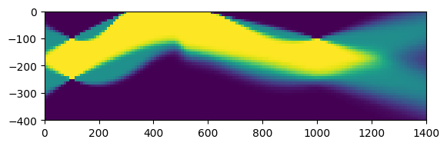
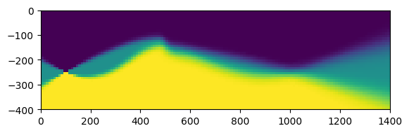
How can we deal with uncertainty?
Layer A
Structural uncertainty:
Expert evaluation of model input
Consider as many geological scenarios as possible (Monte Carlo Simulation)
Additional information (ERT, Gravimetry, Magnetic surveys) to validate models (Geophysical inversion)
Layer B
Layer C

Slide 13
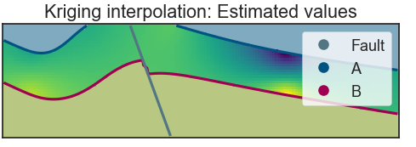
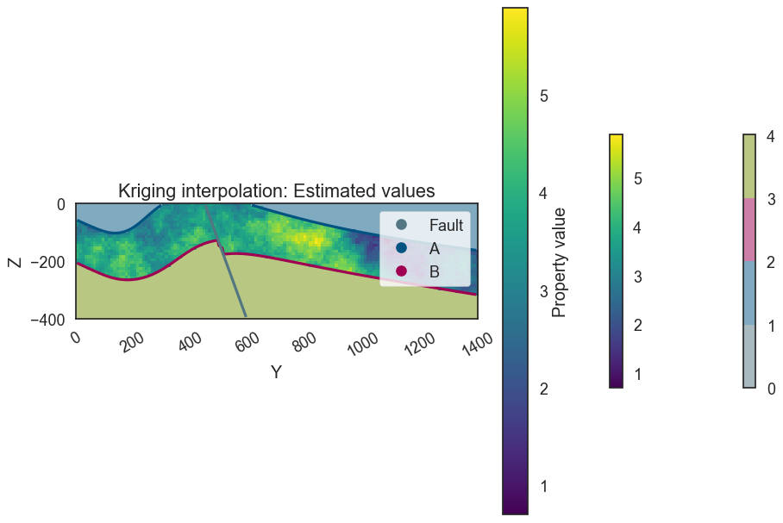
How can we deal with uncertainty?
Simple Kriging: Estimated values
Parameter uncertainty
Spatial statistics (Kriging, SGSIM, Novel Approaches)
End Member Modelling (Best case-worst case)
Sequential Gaussian Simulation: Estimated values

Slide 14
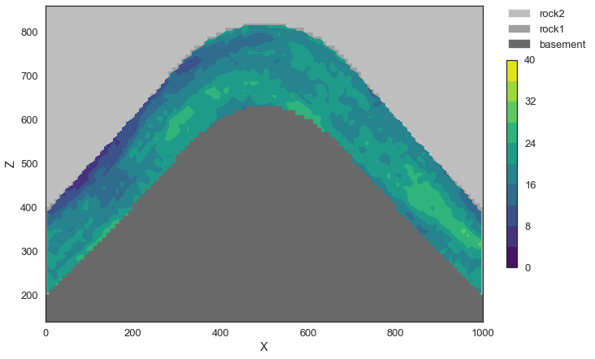
How can we deal with uncertainty?
Parameter uncertainty
Spatial statistics* (Kriging, SGSIM, Novel Approaches)
End Member Modelling (Best case-worst case)
*Presented functionalities are not limited to Gempy
Domain kriging with adjusted distance fields (von Harten, Wellmann, et al. in prep.)

Slide 15
A guide to interpreting (derived) models
Expression of geologist’s interpretation of data
  Prob. Model: Realizations of models given the input uncertainty
Result on a predefined scale
Limited by knowledge, available data, and data quality
No failure free prediction but approximation
Very relevant information like joint sets is difficult/impossible to predict without drilling

Slide 16
Invitation
Need for “high quality geological models” and reproducible, open-source methods in the context of noise modelling (Luca Naticchioni, 6.12.)
CG3 Aachen is open for talks about:
  Follow-up research project
  Workshop to train geologists using Gempy
  Workshop to train geologists using geostatistical methods

Slide 17
Conclusions
Use models to optimize data acquisition
Importance to communicate confidence of models
Display different interpretations and their likelihood
Optimize estimation of “best case” and “worst case” scenario for tunnel planning
Building an uncertainty model is never a simple “one button” solution but a complex process involving specialists

Slide 18
Thank you for your attention!

Slide 19















E-TEST is co-funded by the Regions:
E-TEST is also co-funded by the own-fundings of all Partners:

Slide 20







E-TEST partners

Slide 21
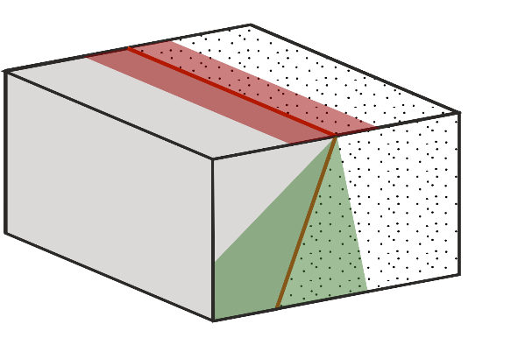



Which geological structure is hidden here?
Geologist 1
Geologist 2
Geologist 1 & 2
impossible to access
Aleatory uncertainty
claystone
sandstone
Epistemic uncertainty
Geologist 3
Coarsening-
upward
→ Different geologists create different models
(Elisa Heim et al., in prep.)

Slide 22
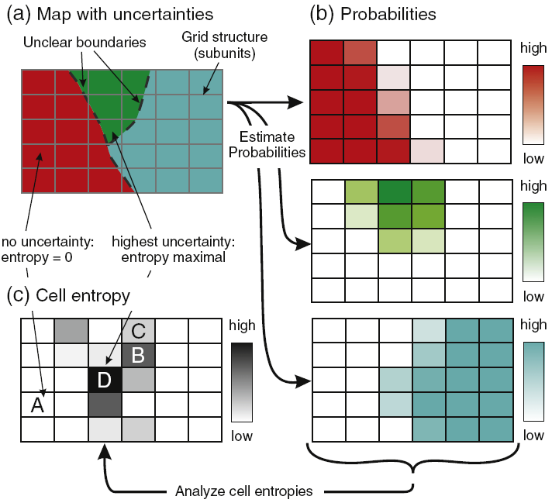
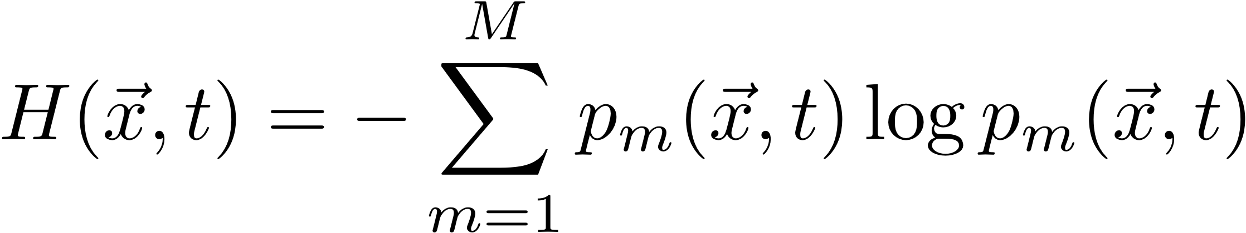
Uncertainty and Shannon cell Entropy
(Wellmann and Regenauer-Lieb, 2012)
Notes:
We have acquired multiple solutions with varying input from our blockmodels. We use these solutions to describe the probability of each lithological layer for each cell. (*click*) This is a great information already, as we see the probability decreasing towards the boundaries. However, we must consider 3 sets of probabilities in this example, and even more in more complex ones. This is why we introduce the Shannon cell Entropy (*click*). To get some things directly out of the way: this parameter is not physically linked to energy and entropy… I like to imagine the Shannon cell Entropy as a “measure of surprise”: If an outcome is highly probable or unlikely, I will not be surprised by the outcome. The entropy for these examples is very low. If however, all outcomes are equally probable, I will be very surprised by the outcome. The Entropy will be high. (*click*) Probability and Shannon cell Entropy stand in a relation described by this formula

Slide 23
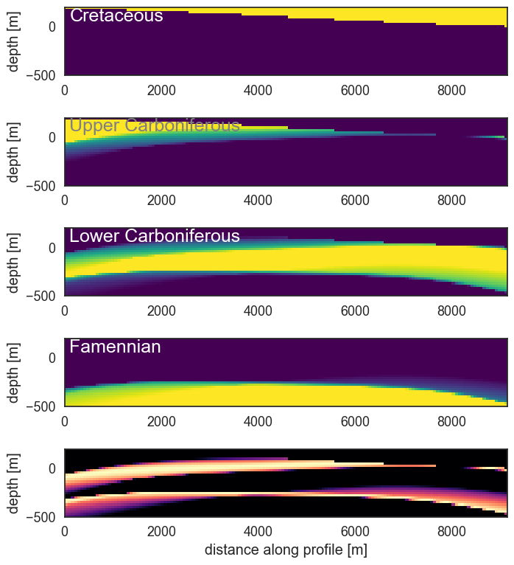
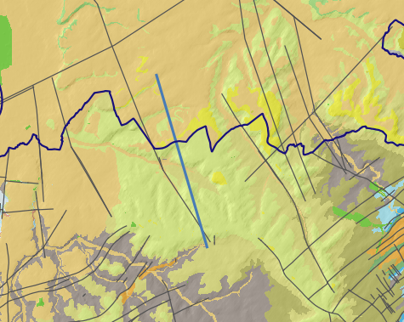
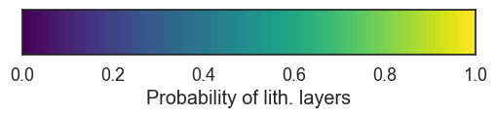
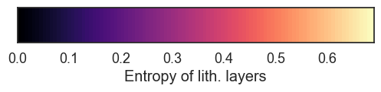
Uncertainty Model: Paleozoic layers 2 (Border region)

Slide 24
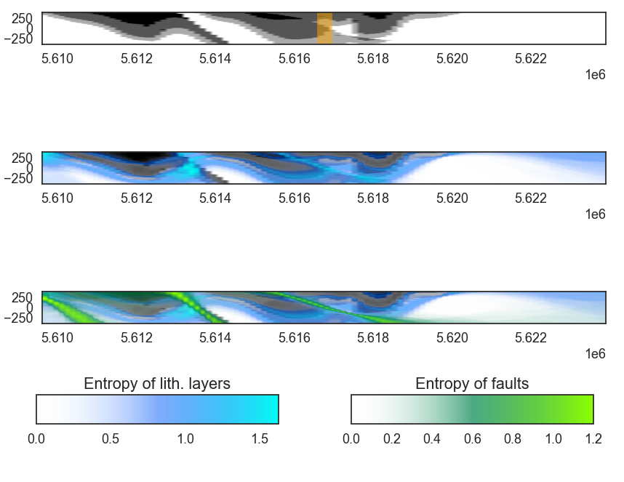
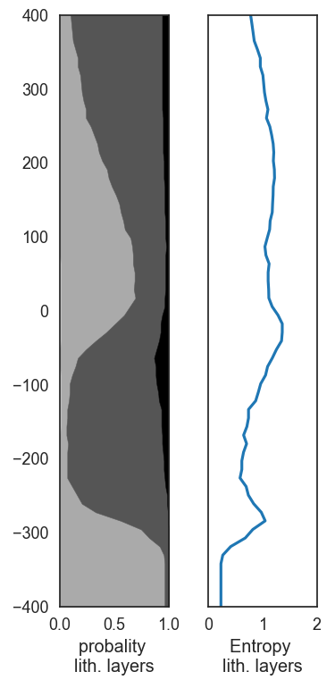
3D Cross-Border Open Geological Model: Uncertainty

Slide 25
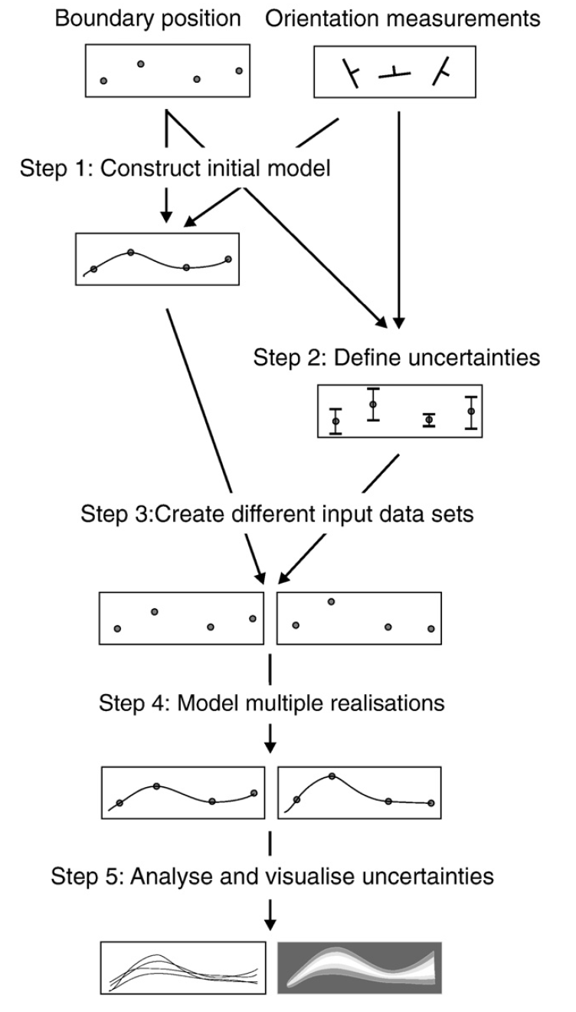
Uncertainty modeling
(Wellmann & Caumon, 2018)

