Slide 1
Regional groundwater modeling for estimating the drained fluxes by the ET works and their impact
Guillemoto Quentin, Orban Philippe, Dassargues Alain, Nguyen Frédéric
Liège University
06/12/2023
Einstein Telescope – Site Preparation Board Workshop 3

Slide 2
Summary
Regional hydrogeological model
Objectives of the regional groundwater model
Conceptual model
Numerical model
Calibration
Estimation of tunnels groundwater inflow and impacts to regional groundwater
Conclusions & perspectives of the model

Slide 3
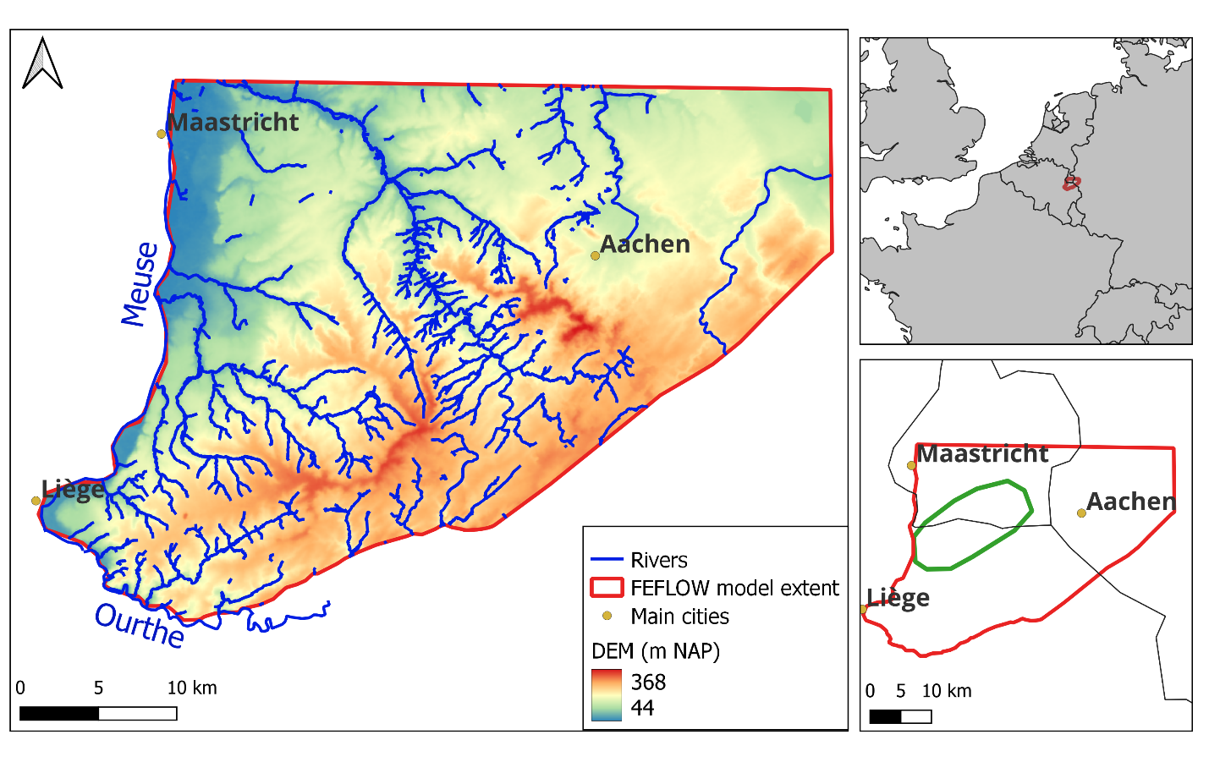
Objectives of the model
Regional hydrogeological model extent
Open cross-border groundwater model for ecosystem services
quantify quantitative impacts of ET tunnels implantations on groundwater
estimate groundwater inflows in tunnels

Slide 4
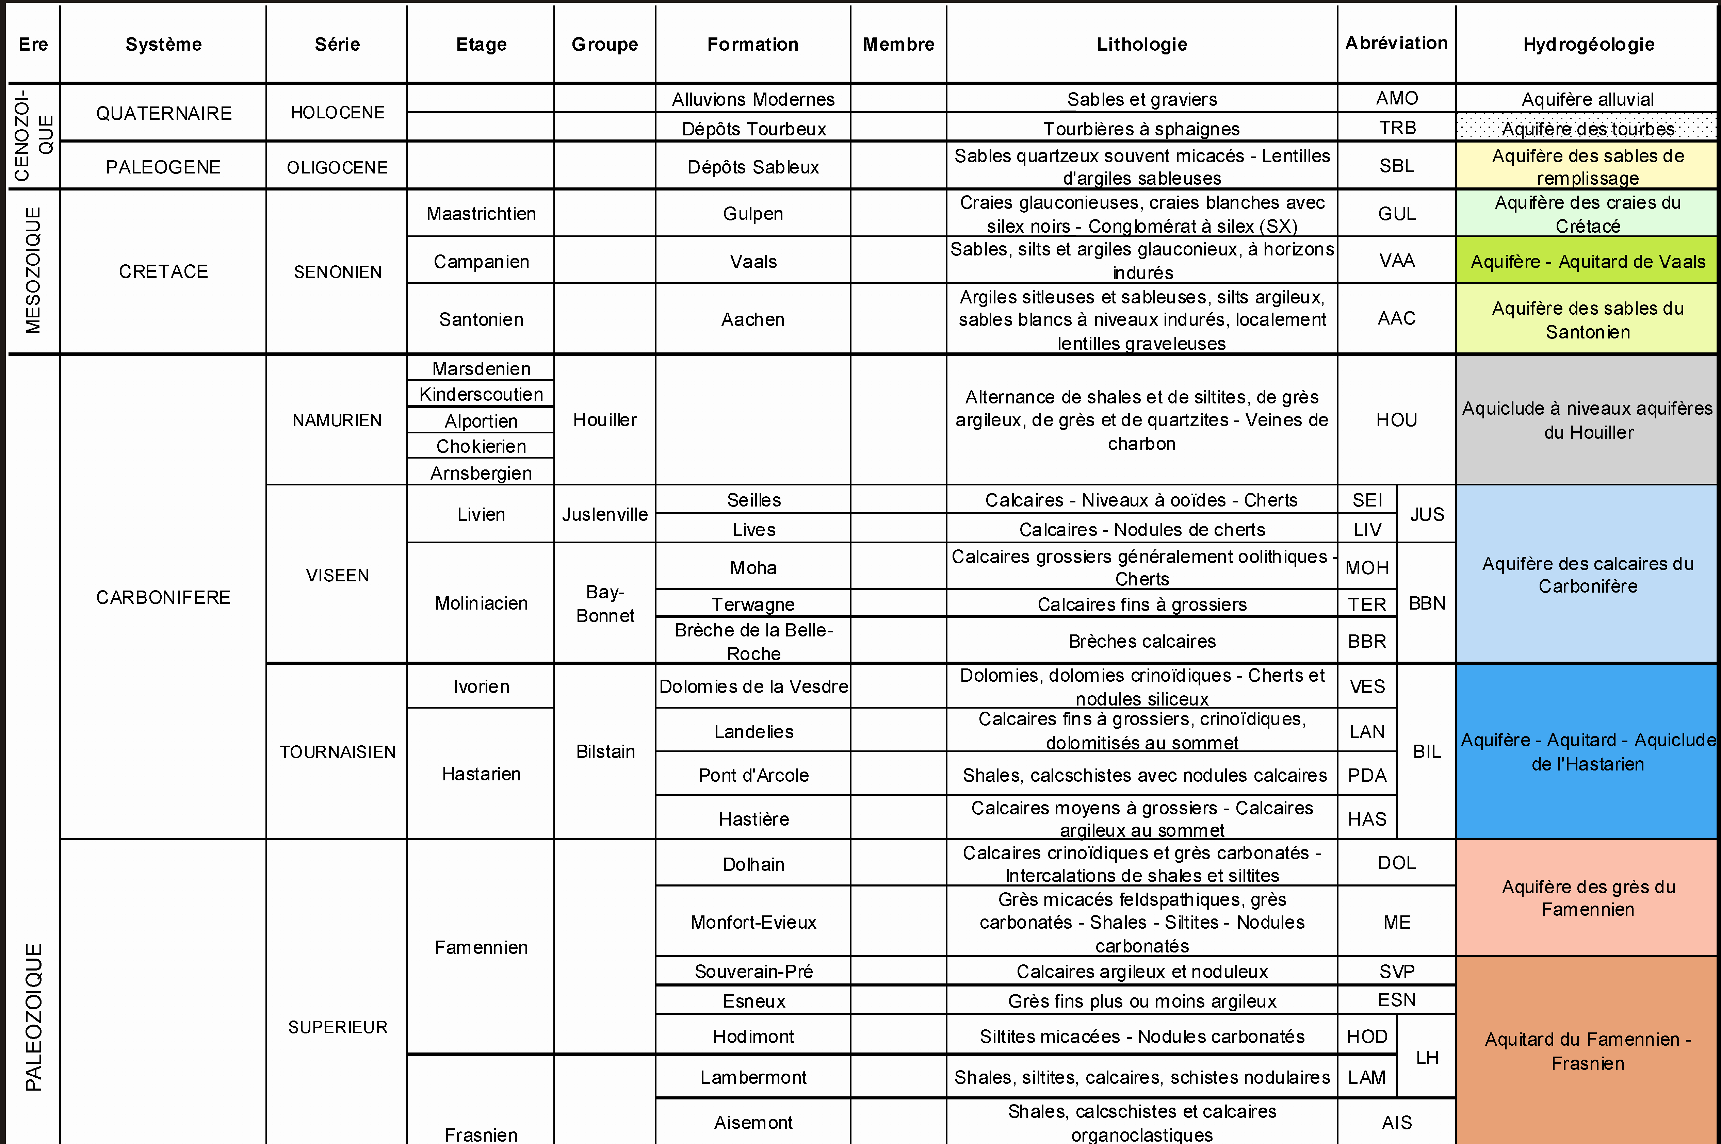
Aquifers
all the aquifers are simulated until lower Famennian
aquifers considered as connected
with different hydrogeological properties
Cretaceous aquifers (sands, chalk)
Houiller (Namurian)
(shales, siltstones, sandstones)
Visean and Tournaisian (limestones)
Famennian (limestones-sandstones)
Lower Famennian aquitard (siltstones)
Table of hydrogeological units
Hydrogeological map. RUTHY and DASSARGUES, 2009.
Notes:
Aquiclude Rock formation that contains water but has very low hydraulic conductivity.
Aquitard geological formation that is not sufficiently permeable to extract water

Slide 5
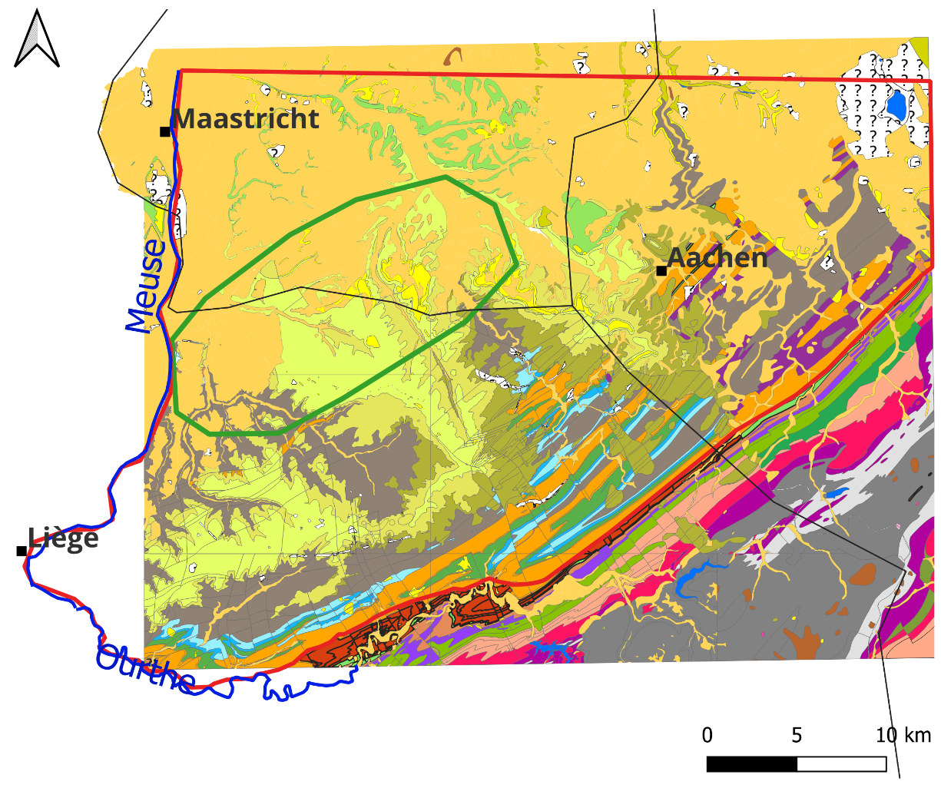
Geology
Wallonia geological map
Cretaceous in the North
Older formations to the South
Numerous faults
Cretaceous
Houiller (Namurian)
Visean, Tournaisian
Famennian
Notes:
Geological section

Slide 6
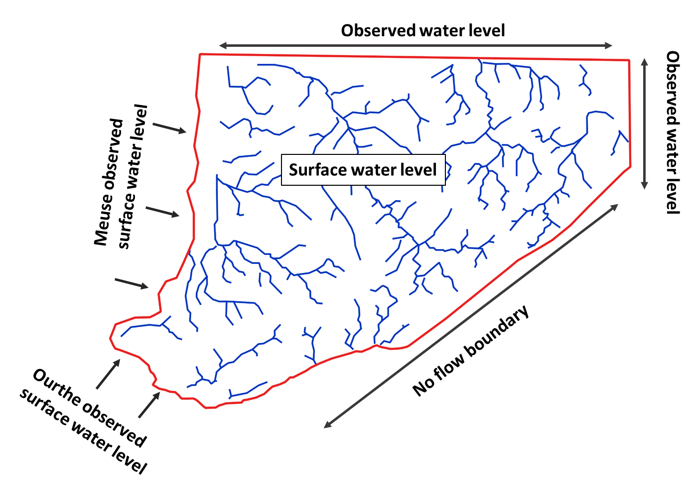
Conceptual model
natural boundaries of the model:
based on geology
rivers
North and East : no natural boundary
groundwater measurements set as prescribed heads BCs
Notes:
Affleurements : emergences. Famenian émergence south east.

Slide 7
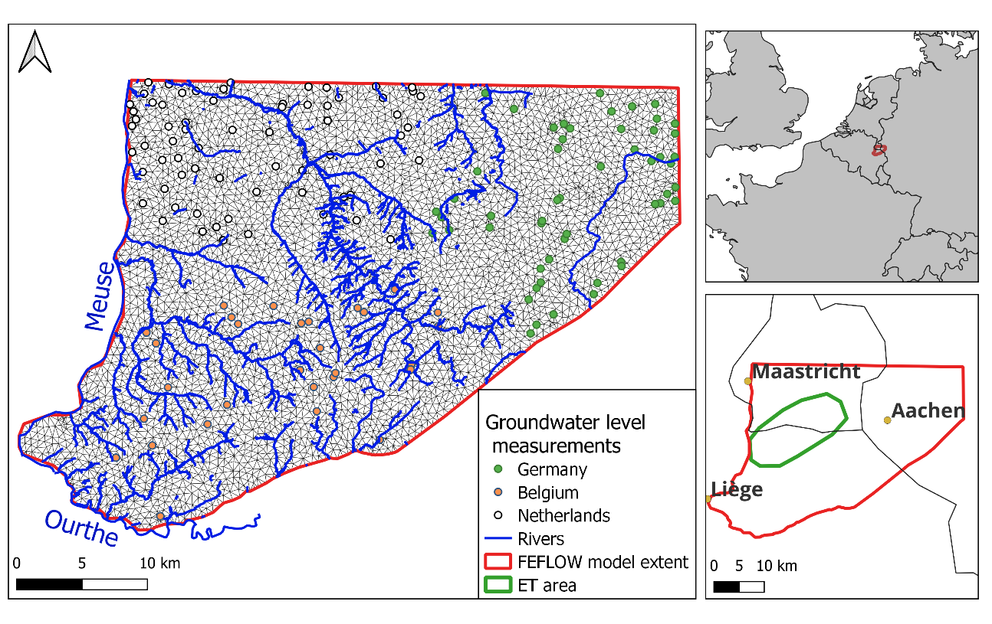
Numerical model
Feflow® hydrogeological flow model construction:
finite element mesh
steady flow model
based on 2018 data
Regional database used in the model:
groundwater water level observations, groundwater abstractions (Wallonia, Germany, The Netherlands)
hydraulic conductivities
topography
geology
River network, groundwater level measurements and mesh of the finite elements model
Mesh sizes about 500 meters length
Hydrogeological model according to regional geological model

Slide 8
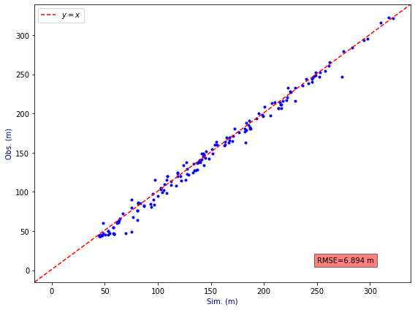
Numerical model calibration
Groundwater levels calibration
Hydraulic conductivity ranges taken from previous studies in the region
 | K m/s |  | K m/d
Geology | min | max | min | max
Cretaceous | 1.00E-07 | 1.00E-03 | 0.00864 | 86.4
Houiller | 1.00E-08 | 1.00E-05 | 0.000864 | 0.864
Visean and Tournaisian | 1.00E-07 | 5.00E-03 | 0.00864 | 432
Famennian | 1.00E-07 | 1.00E-05 | 0.000864 | 0.864
Calibration with Pest software
50 pilot points/geological layers, considering prior hydraulic conductivities.
Plot of groundwater level observations and groundwater level simulations.

Slide 9
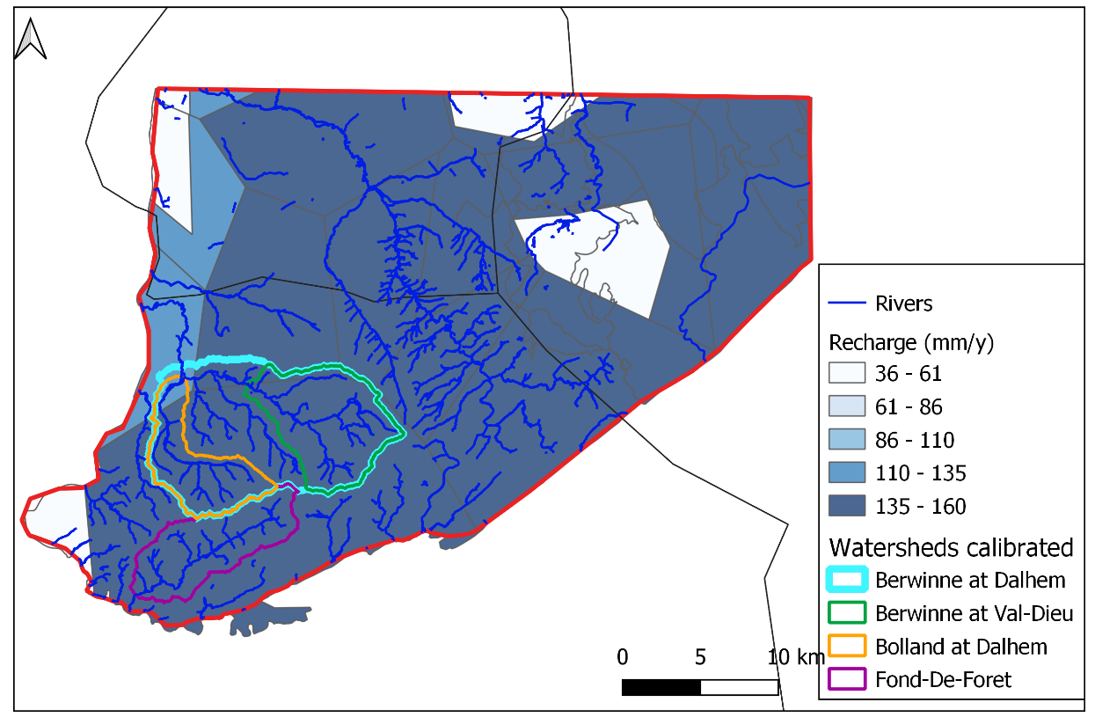
Numerical model calibration
Calibration of river base flows
 | Area (km²) | Rainfall (mm) | Recharge (mm/y) | Observed base flow m³/s | Simulated base flow (m³/s)
Fond de Forêt | 39 | 885 | 123 | 0.17 | 0.19
Berwinne Dalhem | 119 | 885 | 123 | 0.43 | 0.50
Berwinne Valdieu | 49 | 885 | 140 | 0.20 | 0.24
Dalhem Bolland | 31 | 885 | 96 | 0.14 | 0.12
Veul Cottessen | 123 | 929 | 166 | 0.4* | 0.65
Measured base-flow are estimated with a classical statistical method applied to river hydrograms
4 watershed with data for now
Map of natural groundwater recharge calibrated from groundwater contribution to river flow, according to subsurface geology, urbanization and rainfall observations

Slide 10
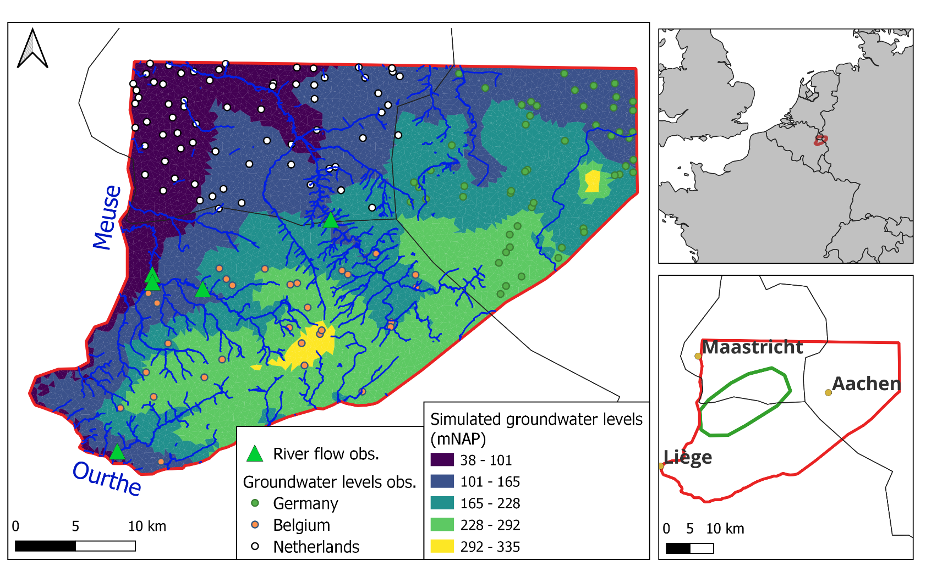
Simulated groundwater levels

Slide 11
Estimation of tunnels water inflow and impacts to regional groundwater
Topo: 115 – 280 mNAP
Hydraulic head:
109 – 230 mNAP
Method:
estimate analytically the inflow in the tunnels
simulate the impacts with the groundwater numerical model
h_{a}=100m
H
K_{aq}
Reference: 0 mNAP
Tunnel surrounded by an impermeable lining
Kolymbas and Wagner (2007)
uniform drainage layer decreasing the water pressure at the tunnel to 10 bars = hydraulic head h_{a} = 100 m

Slide 12
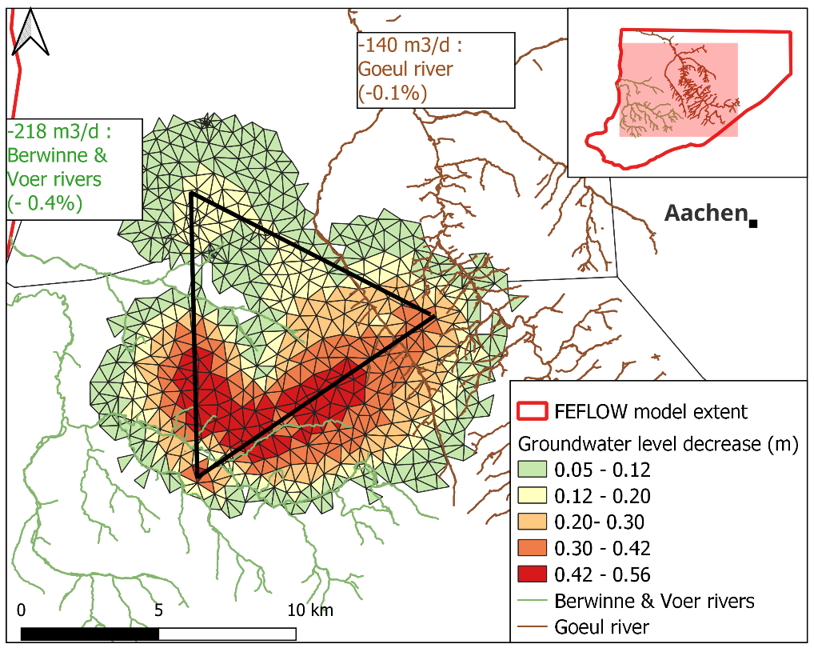
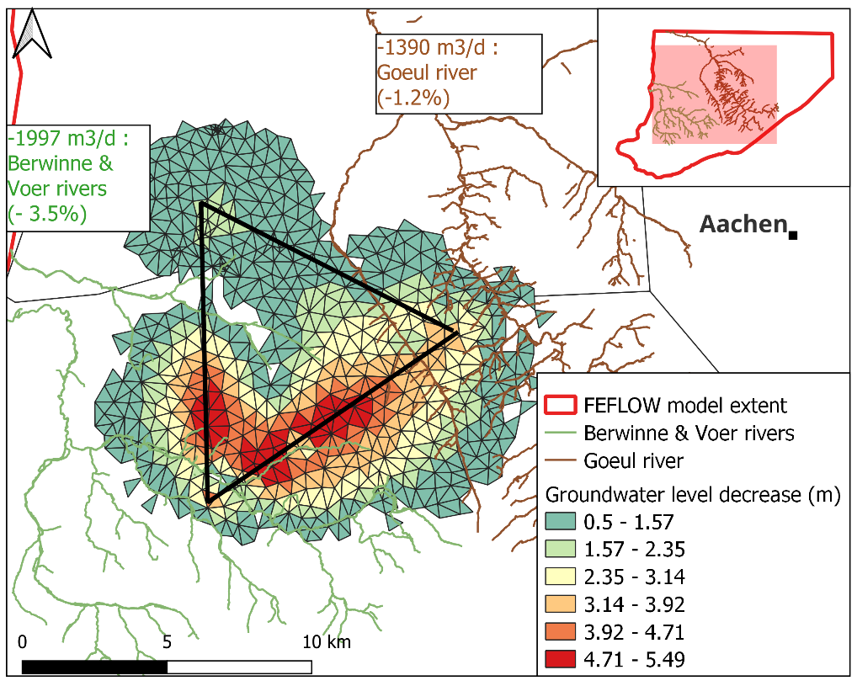
Inflow and impacts of groundwater drained by the tunnel on regional groundwater resources
In the case of K_{aq}=10⁻⁸ m/s conductivity, calculations with analytical solution: 380 m³/d -> 4850 m³/d (depending on H)
estimated impact
Considering 3780 m³/d tunnel water inflow transfer rate Φ = 0.03 s⁻¹
for a 380 m³/d tunnel water inflow
for a 4850 m³/d tunnel water inflow
Notes:
Depending on the local groundwater level

Slide 13
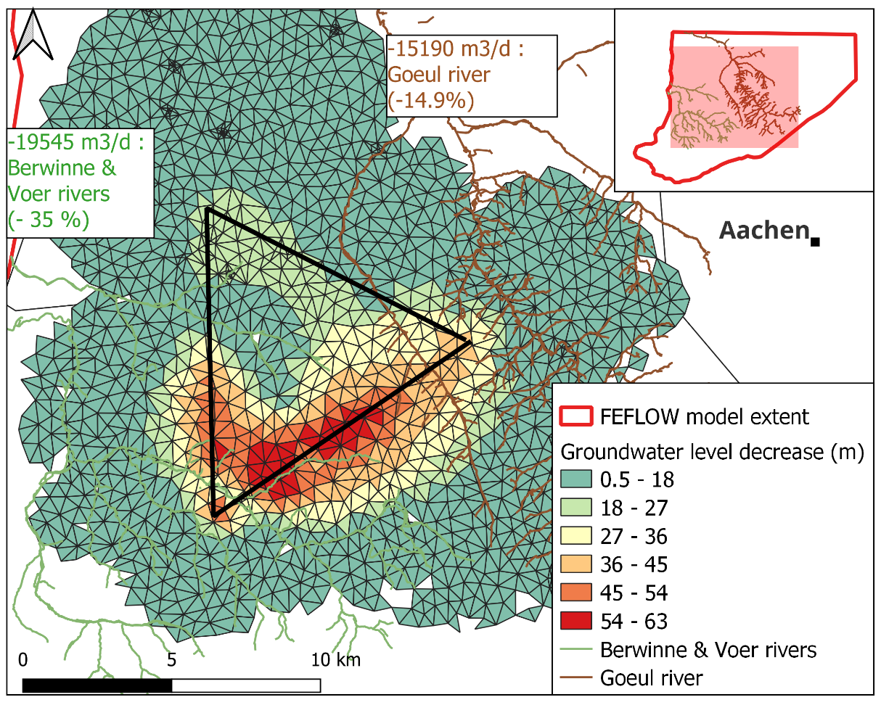
Inflow and impacts of groundwater drained by the tunnel on regional groundwater ressources
In the case of K_{aq} = 10⁻⁷ m/s conductivity, calculations with analytical solution: 3800 m³/d -> 48500 m³/d (depending on H)
=> If K_{aq} >10⁻⁷ m/s, large amount of groundwater inflow and huge impact on regional groundwater
for a 4850 m³/d tunnel water inflow
for a 48500 m³/d tunnel water inflow

Slide 14
Conclusions
Regional numerical model adapted to predict impacts of tunnels on regional groundwater resource
Analytically calculated inflows and first estimation of the effects on the water table and base river flows
estimation of hydraulic conductivities near tunnels are needed.
if natural conductivities around tunnel K>10⁻⁸ m/s, grouting is needed to reduce inflow rates
Feflow regional 3D groundwater model

Slide 15
Perspectives
Numerical model improvements
new geological model data
additional hydro measurements for the robustness of the model
sensitivity of model results to hydraulic conductivity values (inflows, regional impacts)
Further sub-models (local models) to be developed using regional model for BCs
fine discretization of tunnels, complex caverns, local heterogeneities
transient simulations of the tunnel drainage impacts, during excavations works
The current numerical model can be used, as an ideal tool, for future design simulations of the tunnel

Slide 16
Thank you for your attention !
q.guillemoto@uliege.be

