Slide 1
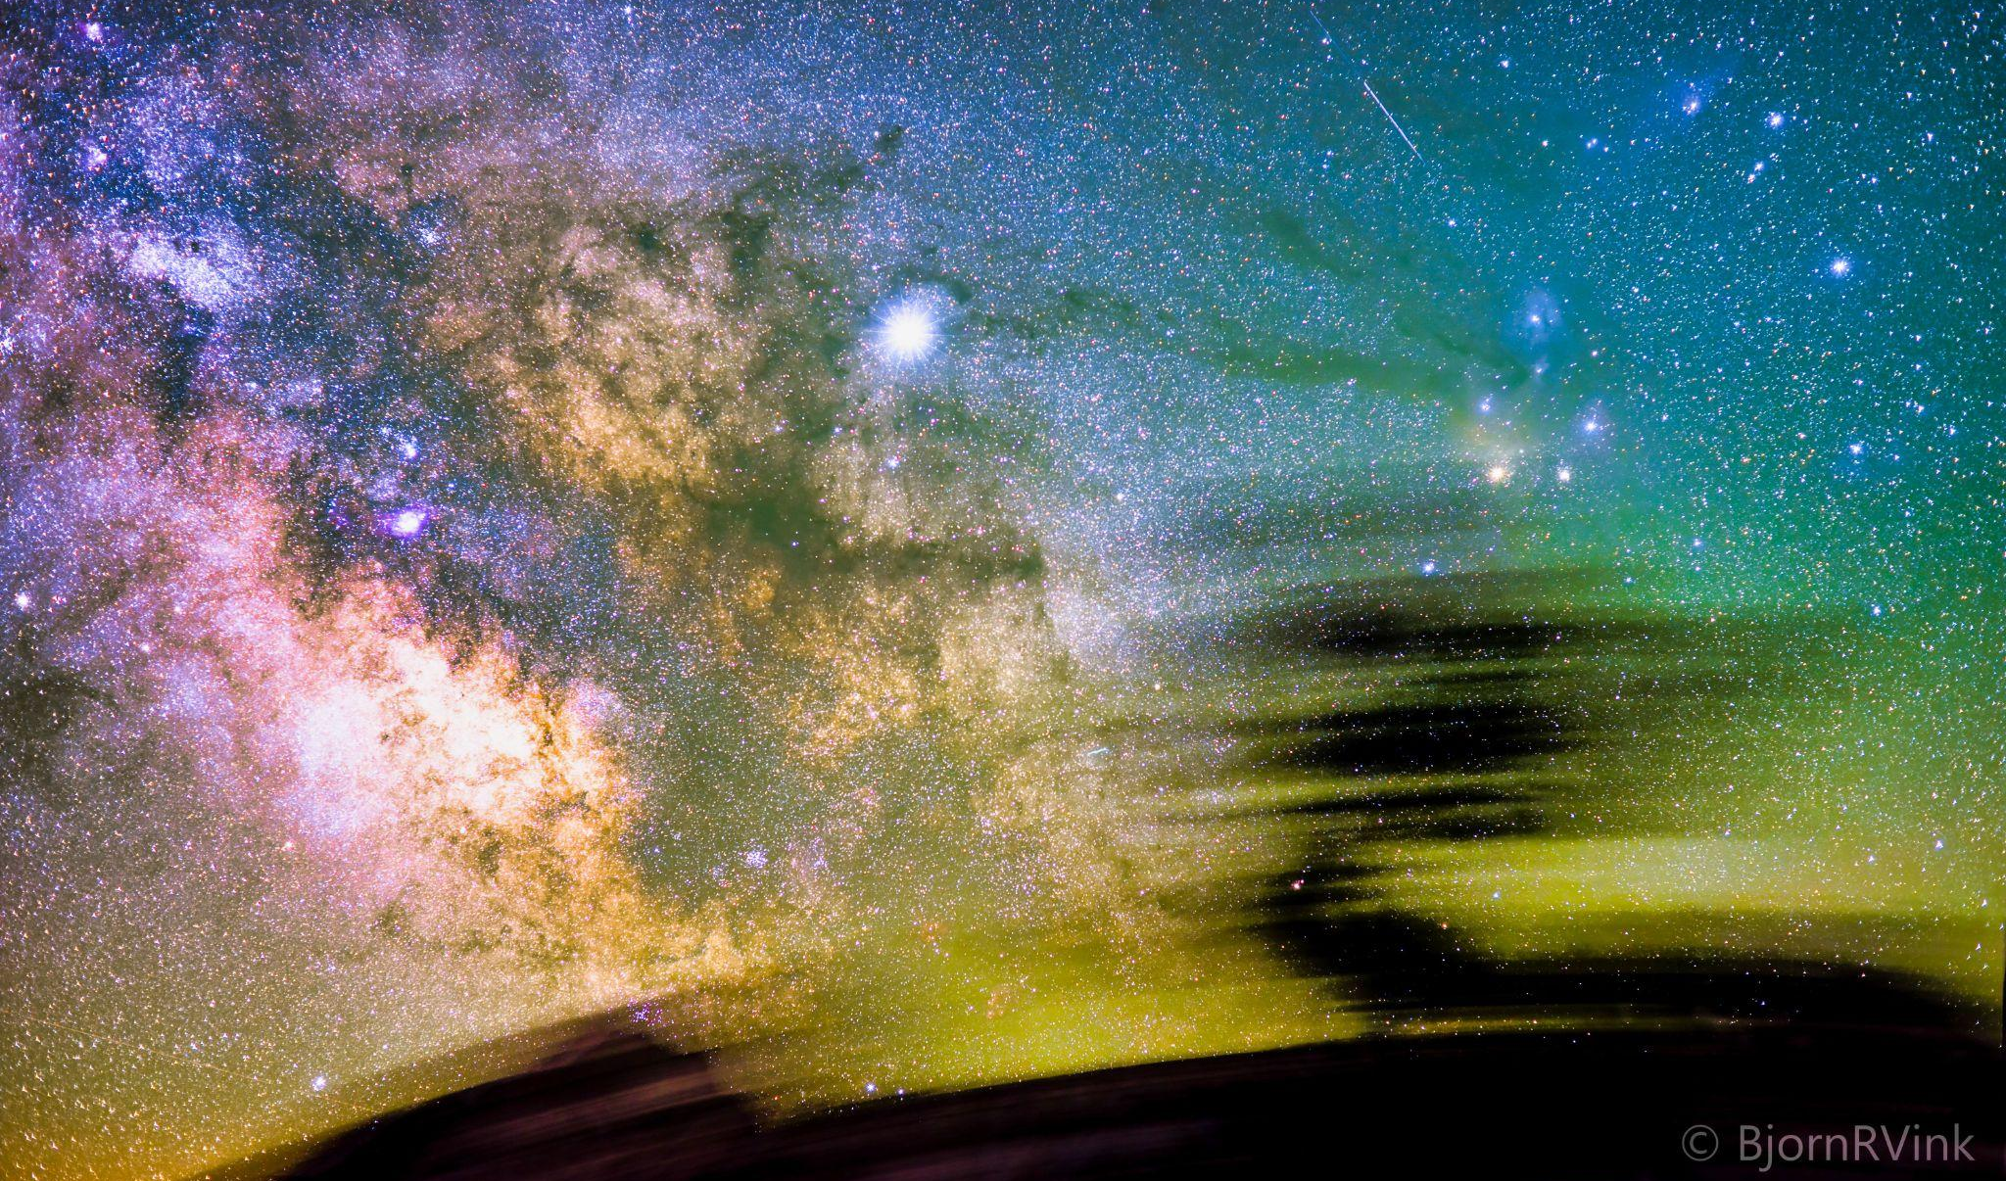
Einstein
Telescope
Bjorn Vink
Nikhef

Slide 2
Completed, Ongoing & Upcoming Geo-studies EMR
what has been done
ongoing surveys nov 2023 E-test briefly (ULiège,Uni Bonn)
upcoming borehole campaign and logging
“Core Store Aubel “

Slide 3
What has been done far past boreholes, for mining et cetera
Booze Val Dieu
mining
area
Liège
former zinc/lead mining area
multiple deep boreholes
deep quarries
boreholes
outcrops
Liège Soumagne
outcrops
outcrops

Slide 4
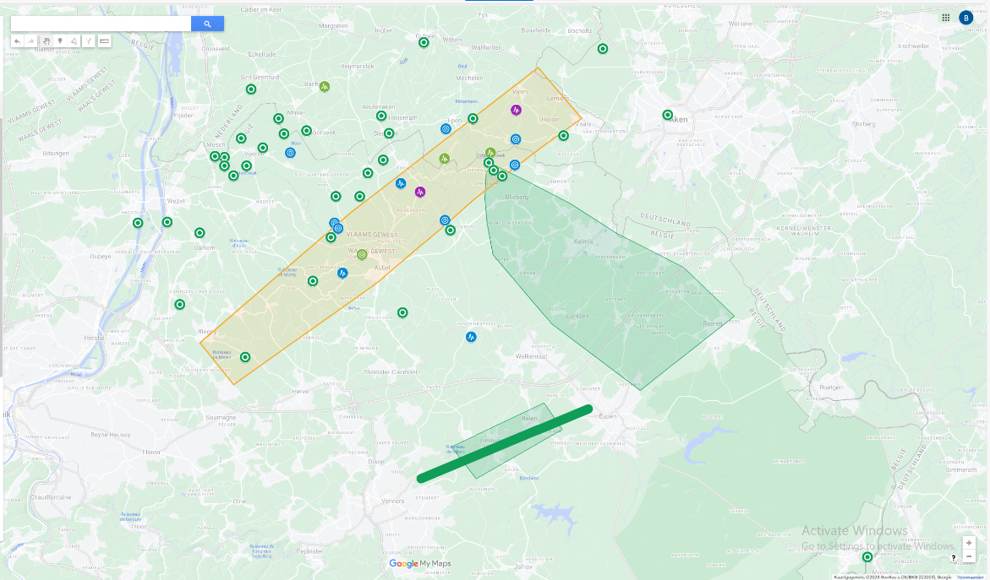
Planned boreholes first phase
E-test/pré-E-test
15 km
1st phase borehole
to schedule seismic
profile (Belgium)

Slide 5
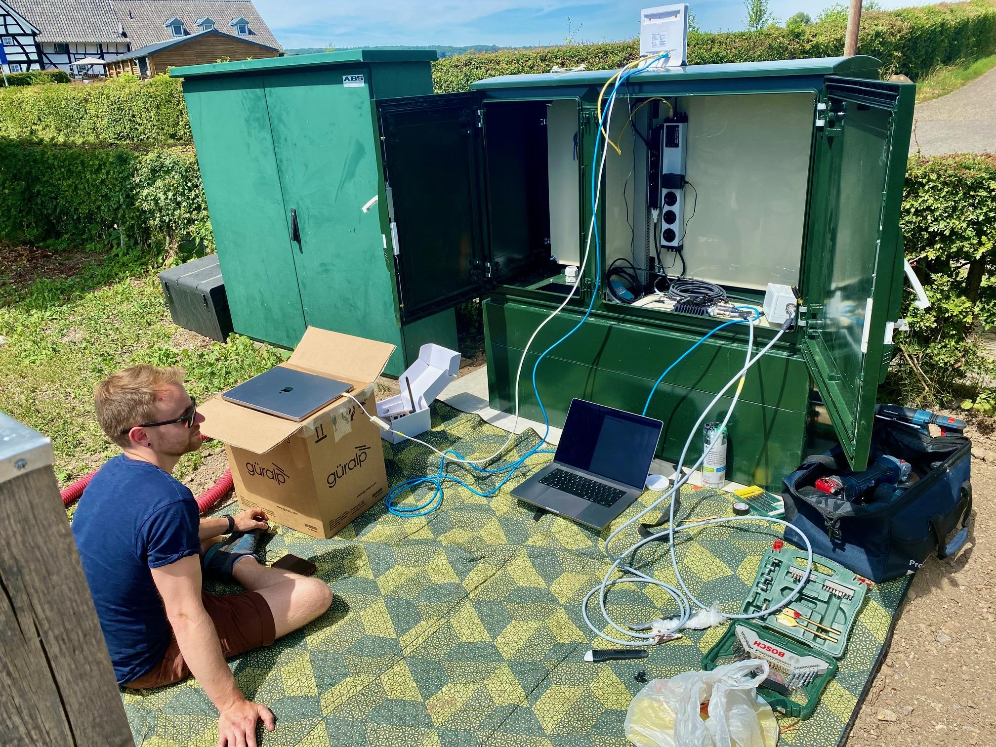
2024-2025 list upcoming surveys
2 phases of 10 cored drillings, total ~6000 m length
5 to add deep seismometers [noise at ET-level], total = 8 *
15 deep piëzometers [hydraulic head at ET-level], total ~20.
Core storage at Aubel (core workshops)
Geophysical surveys (deep ERT, active & passive seismic)
Microgravitation study area
Geohydrological testing (borehole & monitoring wells)
In borehole testing
lab testing geomechanical properties
Seismic noise studies, railways, windmills, ET-cetera*

Slide 6
Drilling
core drilling also sampling for overburden for lab testing ;
standard core sampling SQ: Փ = 146/102mm PQ: Փ = 95/122,6 mm ;
in situ testing and borehole surveys feasible
Holes finalized as deep seismic noise monitoringstation
reaming in case needed
will be dry cemented boreholes
include glass fibre / DAS system depending evaluation Cottessen borehole
Other boreholes deep piezometer, level filter below 150m depending findings drilling.

Slide 7
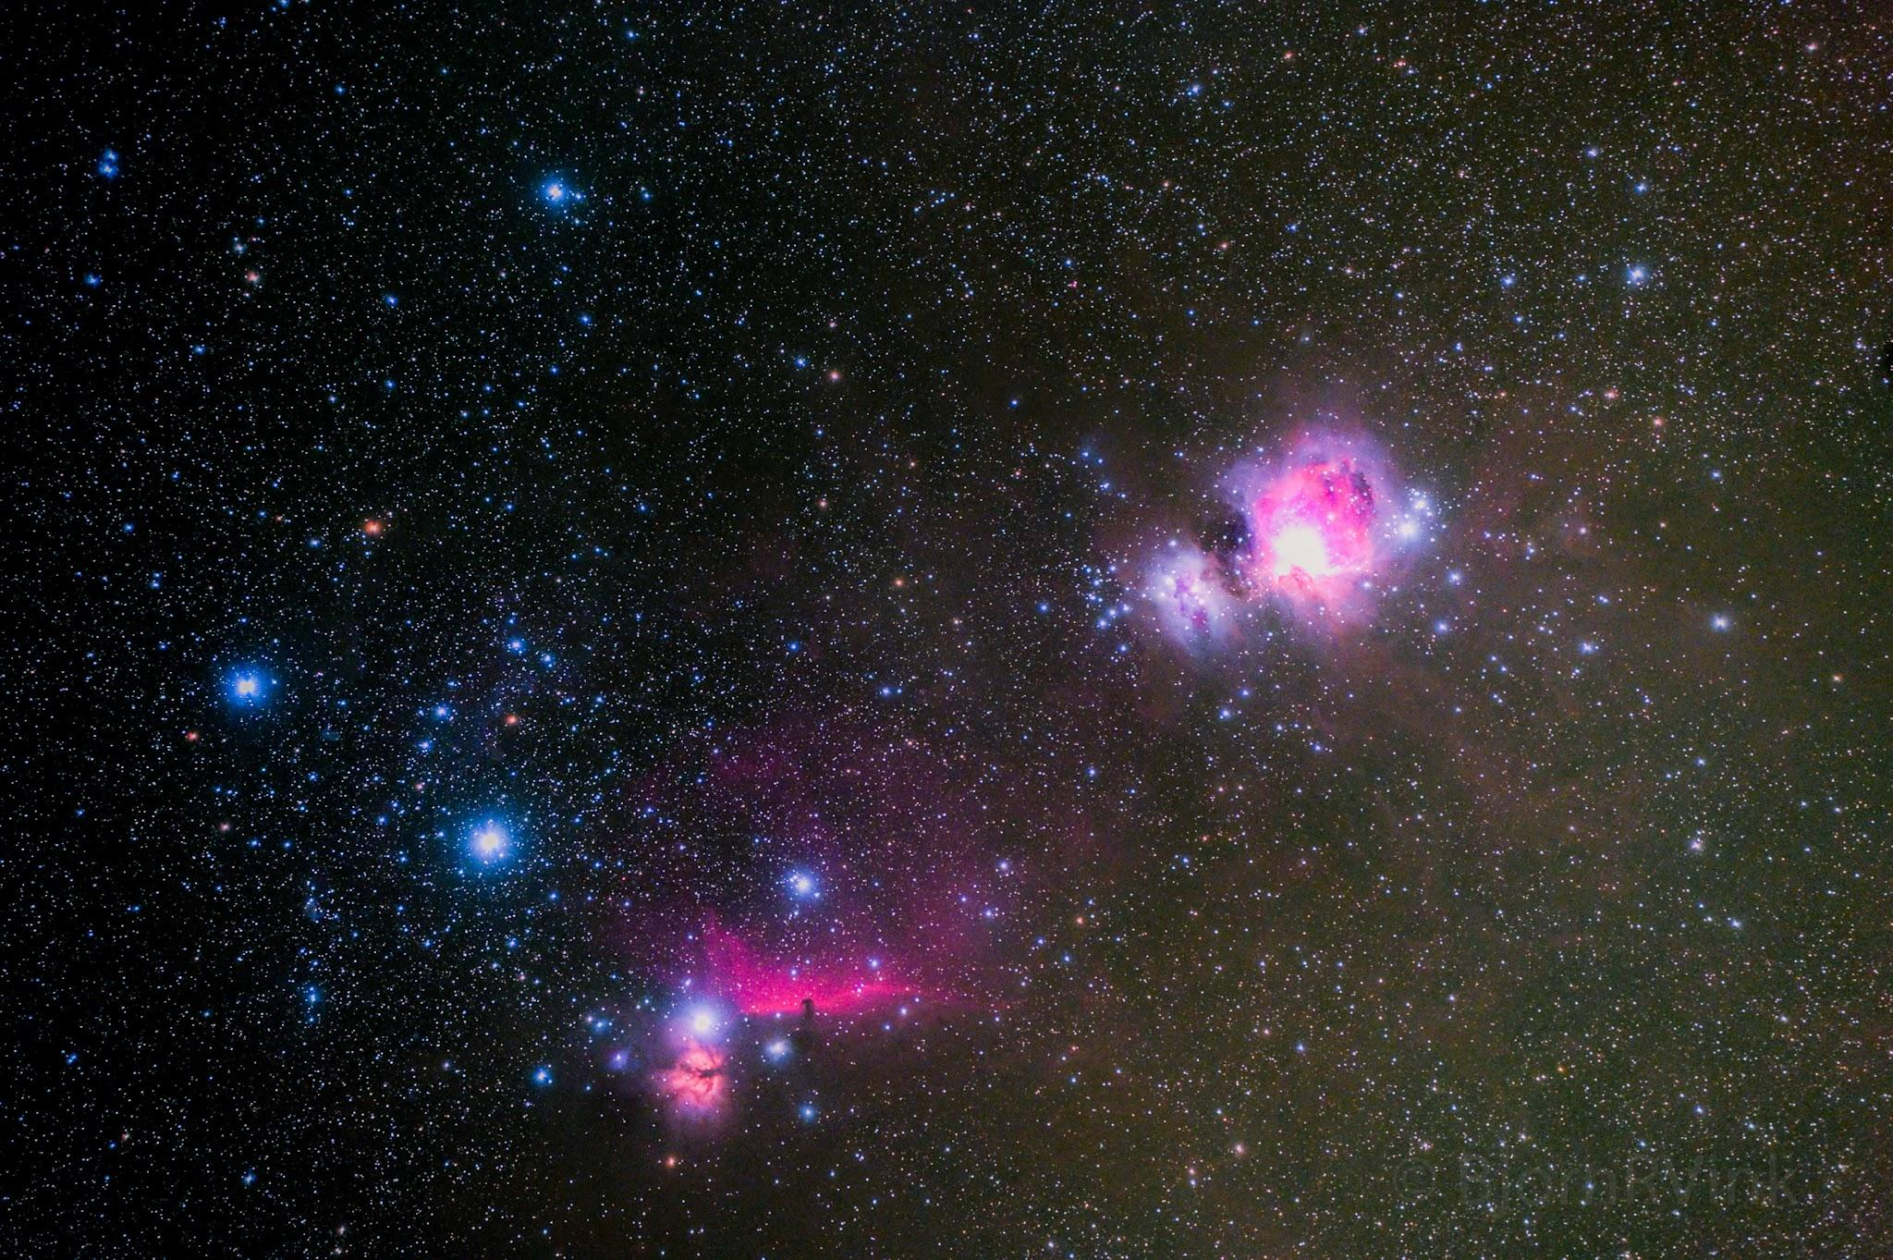
Thanx 4 your attention
Any Questions?

