Slide 1
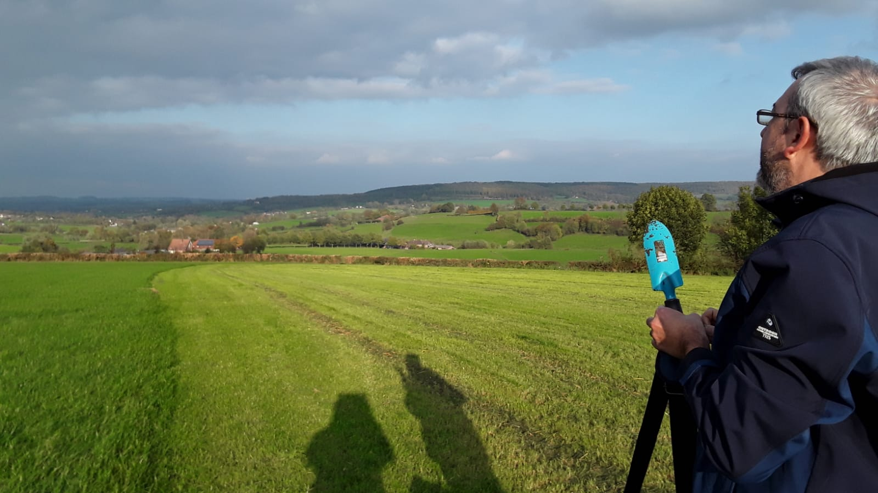
Prospects of passive seismic for shallow subsurface characterization at EMR - a candidate site for ET
S. Koley, X. Campman, S. Kadmiel, M. Kiehn, W. Walk, F. Linde, B. Vink et al.
Additional credits: Fugro, Sisprobe

Slide 2
Scope of the talk
Where we start?
Existing passive array
Existing group/phase velocity maps
Existing Vs-depth maps
Example Eigenfunction estimation
Fundamental and overtones
Determination of frequency band of interest
Spatial distribution of Rayleigh-wave depth of penetration
Minimum sensor separation
Avoid non-uniqueness/Local control of phase velocity estimates
Azimuthal averaging of cross-correlations
Future array design

Slide 3
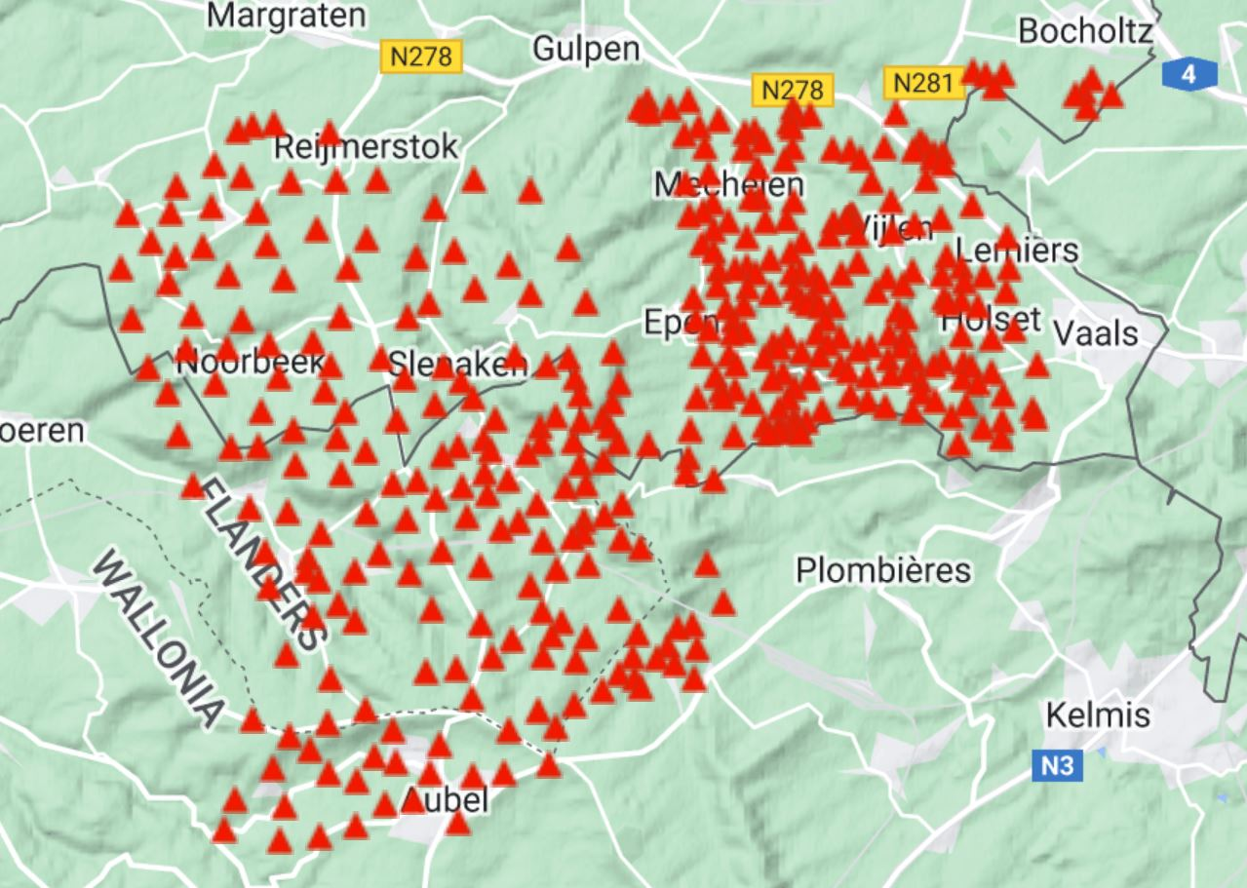
How ambient seismic noise interferometry works?
Acquire seismic noise with an array
Iterate – new campaign
Learn and improve array
3-D subsurface model
N
Temporal normalization
Surface-wave tomography
Pre-processing before cross-correlations
Spectral whitening
4 km
Array analysis
Surface waves – Rayleigh/Love
Surface-wave dispersion
Noise cross-correlation between station-pairs
Stacked cross-correlation between station-pairs
Linear, Robust, $N^{th}$ root, phase-weighted etc.
Body waves/leaky modes
Body-wave tomography

Slide 4
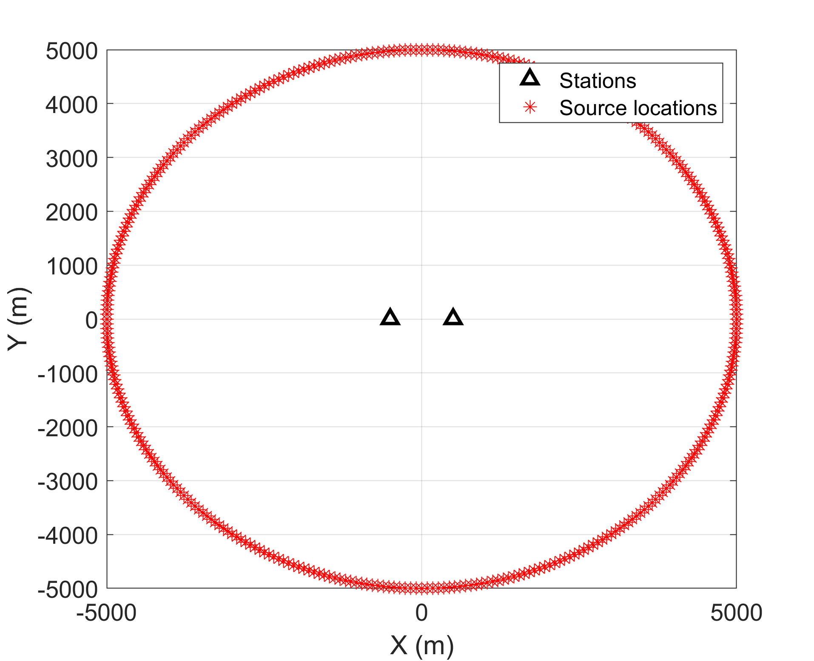
Why and when ambient seismic noise interferometry works?
Ensemble average of seismic noise correlations ($C_{AB}$) over a sufficiently long measurement period approximates to the Green’s function of the propagation medium (EGF)
$EGF=−\frac{d}{2dt}(C_{AB}\left(t\right)+C_{AB}(−t))$ Wapenaar 2004, Weaver and Lobkis 2006
azimuthal sum
Observed signals
Phases cancel for:
$180−θ_{FZ}>φ>0+θ_{FZ}$, and
$360−θ_{FZ} >φ>180+θ_{FZ}$
$θ_{FZ}$ is the Fresnel angle where constructive interference occurs
Isotropic distribution of noise sources
Sufficiently long measurement time might mimic isotropic distribution
Related Literature: Yao and van der Hilst 2009, Yao, van der Hilst, de Hoop, 2006

Slide 5
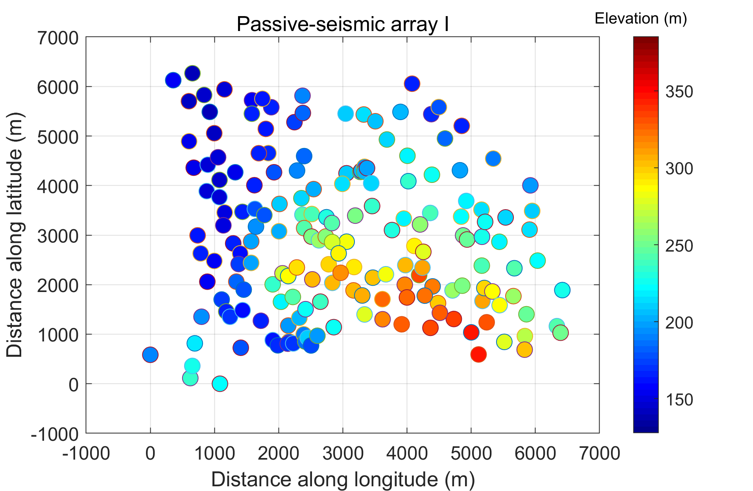
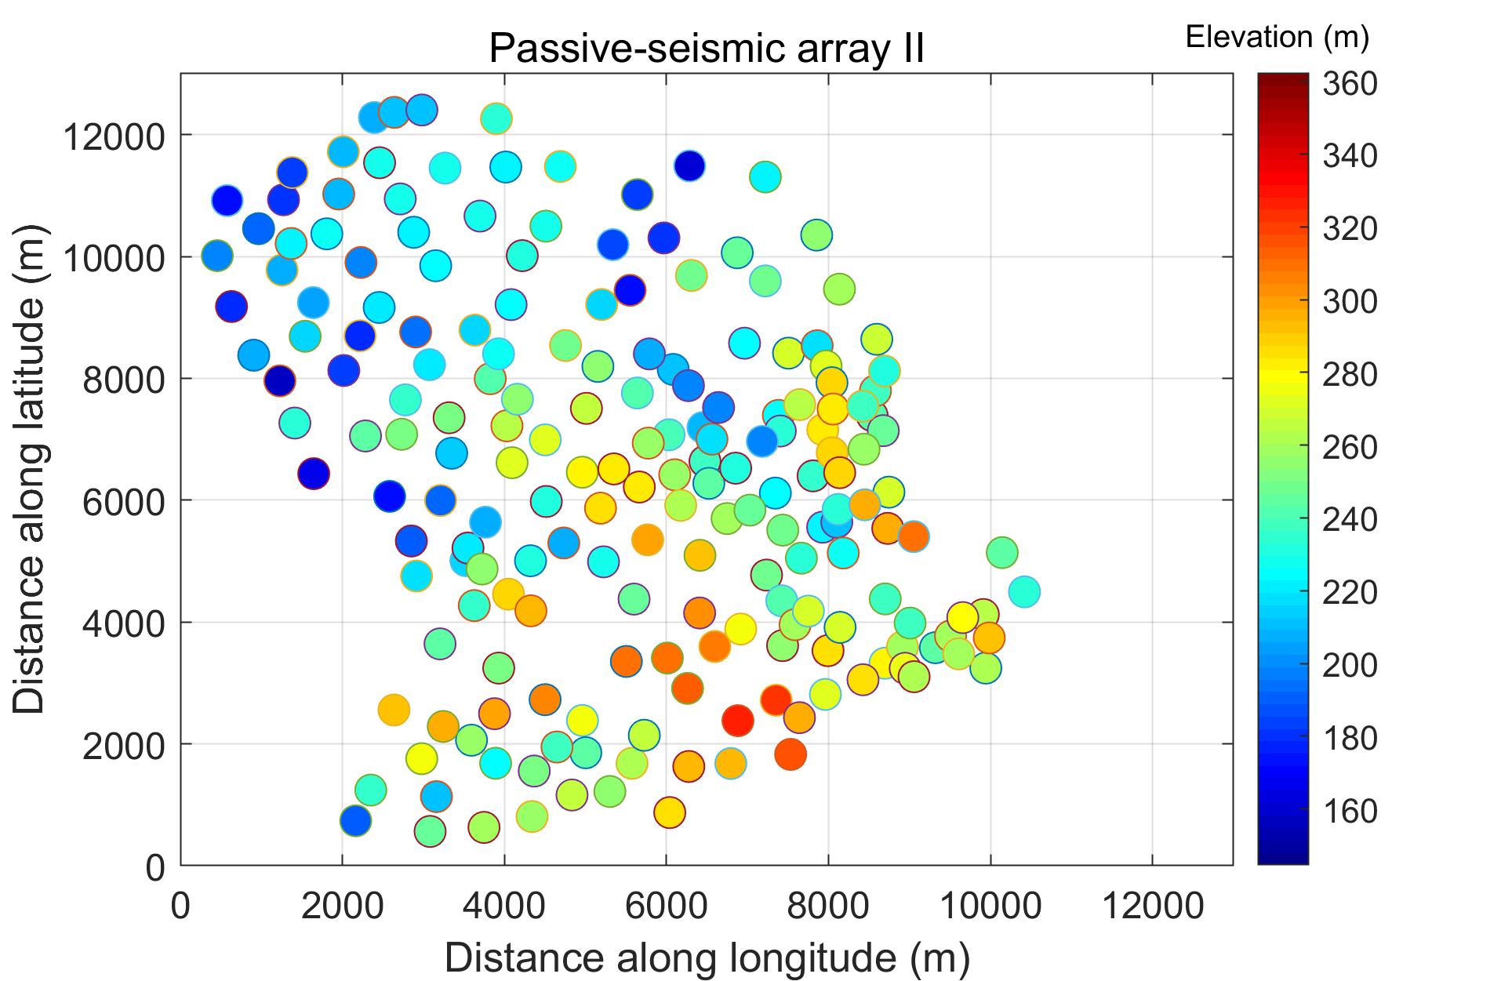
Where we stand at the EMR site – Two passive seismic arrays so far
Two reconnaissance passive-seismic arrays of 5 Hz vertical component geophones were deployed between 2020-2021- understand noise wavefield and subsurface characteristics for targeted arrays
Note that an elevation difference of 200 m might not matter for low-frequency (< 3 Hz) analysis
wavelengths >> elevation difference

Slide 6
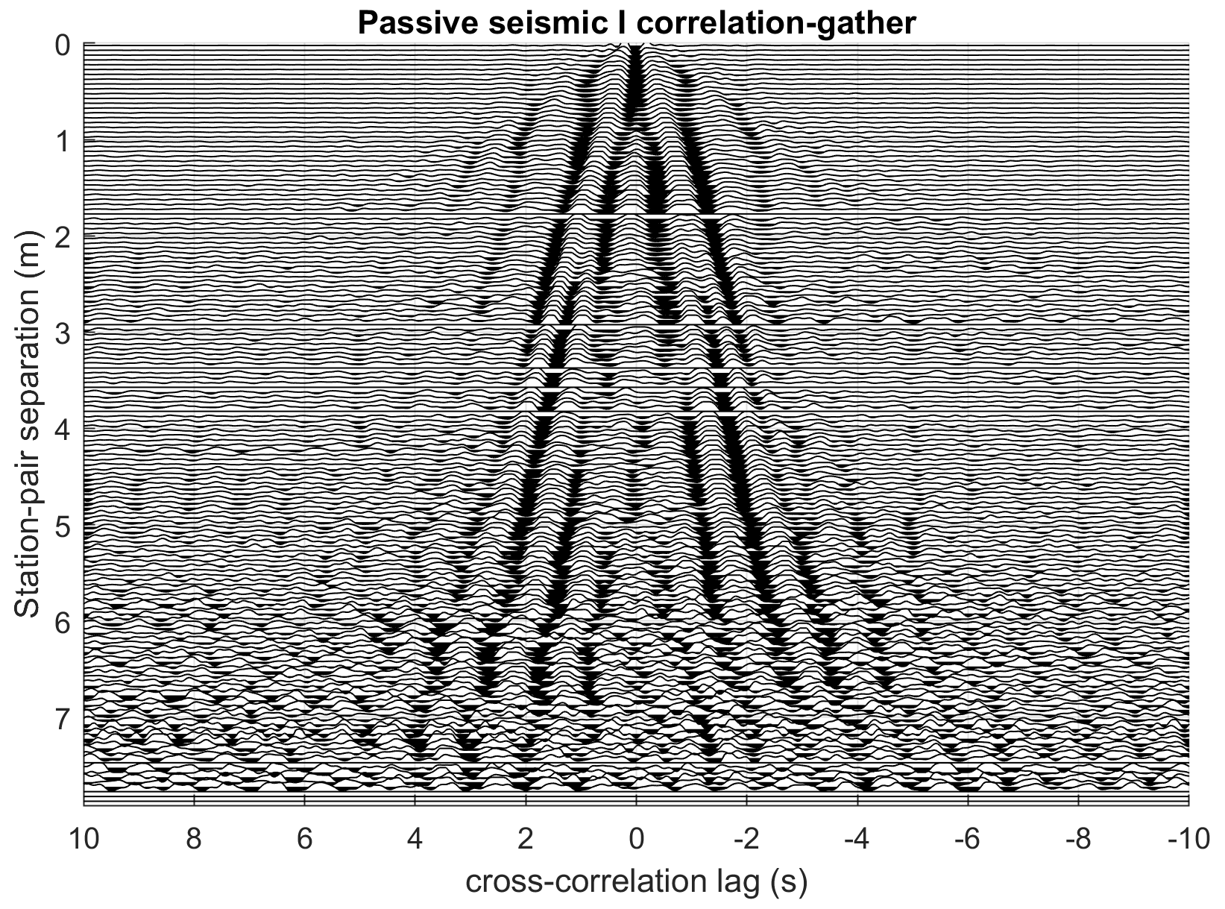
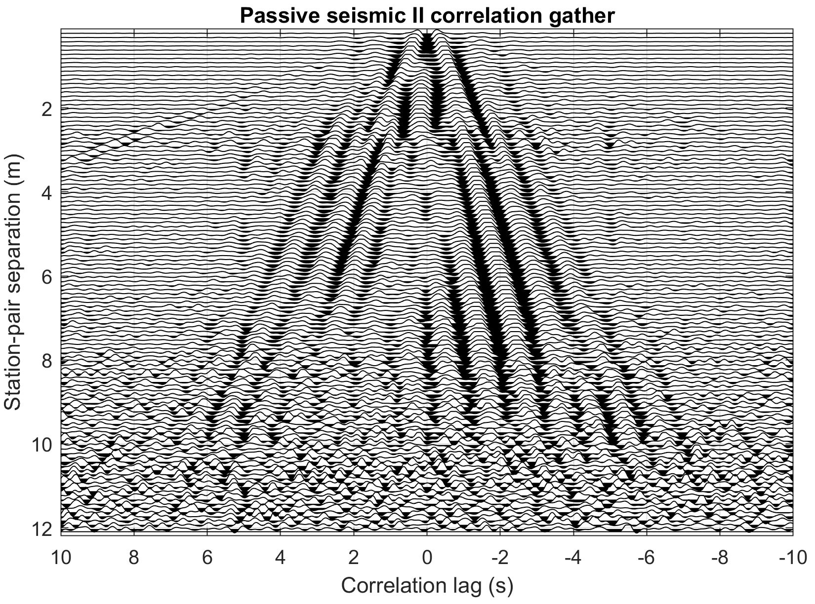
Data quality for the two arrays – correlation gathers
Both passive correlation gathers show dominant ballistic surface waves in the frequency band 0.5 – 3 Hz
Propagating approximately between1.5 – 3.5 km/s – dispersion
Azimuthal averaging makes the correlations time-symmetric – not symmetric for one pair
Summed azimuthally in 50 m distance bins
Note a strange acoustic like arrival propagating approximately at 330 m/s – To be understood (low-velocity zone)
Related Literature: Mordret et al 2013, Chmiel et al 2019, Roux et al 2016

Slide 7
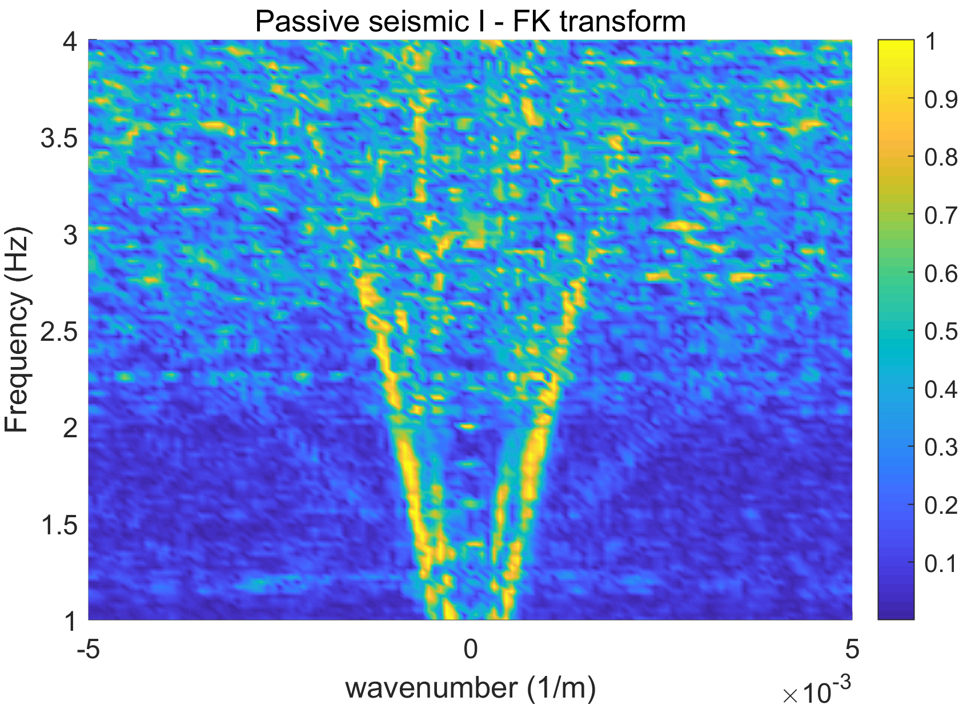
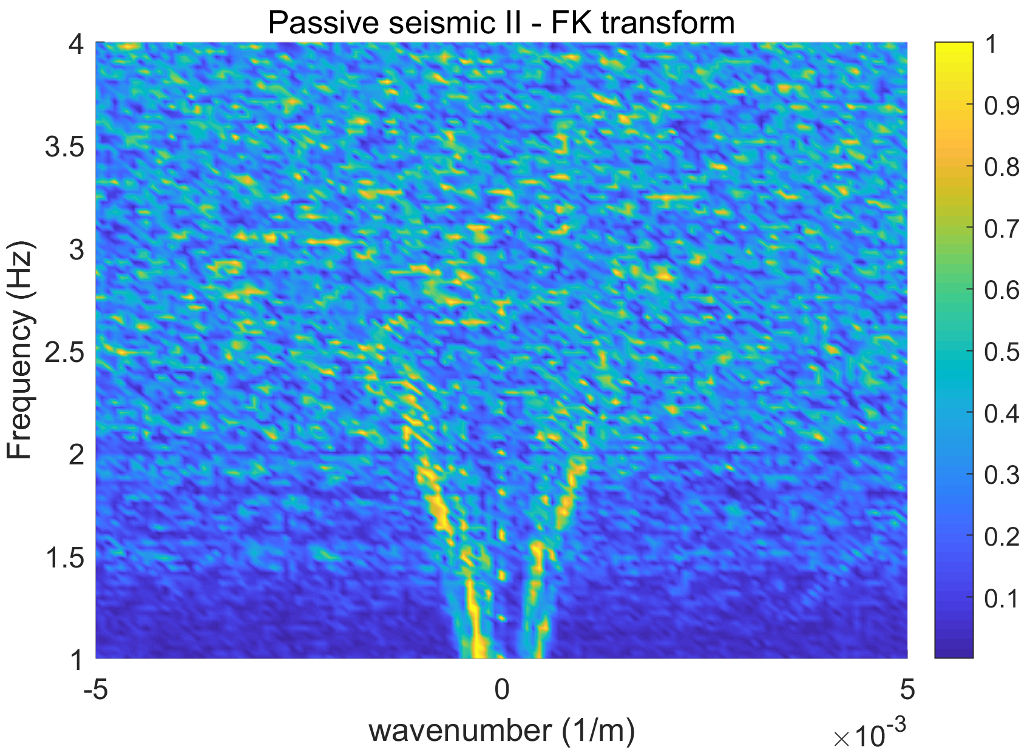
Data quality for the two arrays – frequency-wavenumber characteristics
Phase dispersion ($ω/k$) can be understood from frequency-wavenumber transform
Both arrays show similar dispersion
Passive I which has maximum station-separation of 7 kms show much stronger coherence (up to 3 Hz) than Passive II (~2.5 Hz) which is about 12 kms in aperture

Slide 8
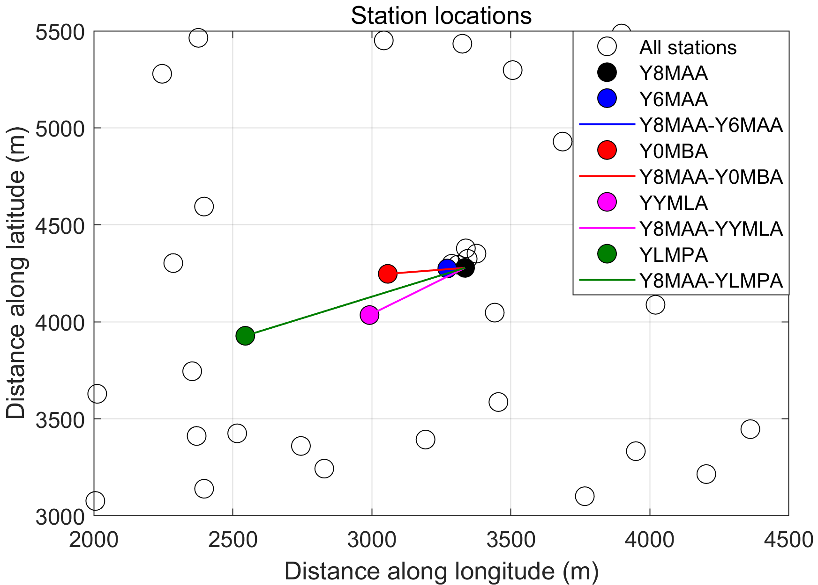
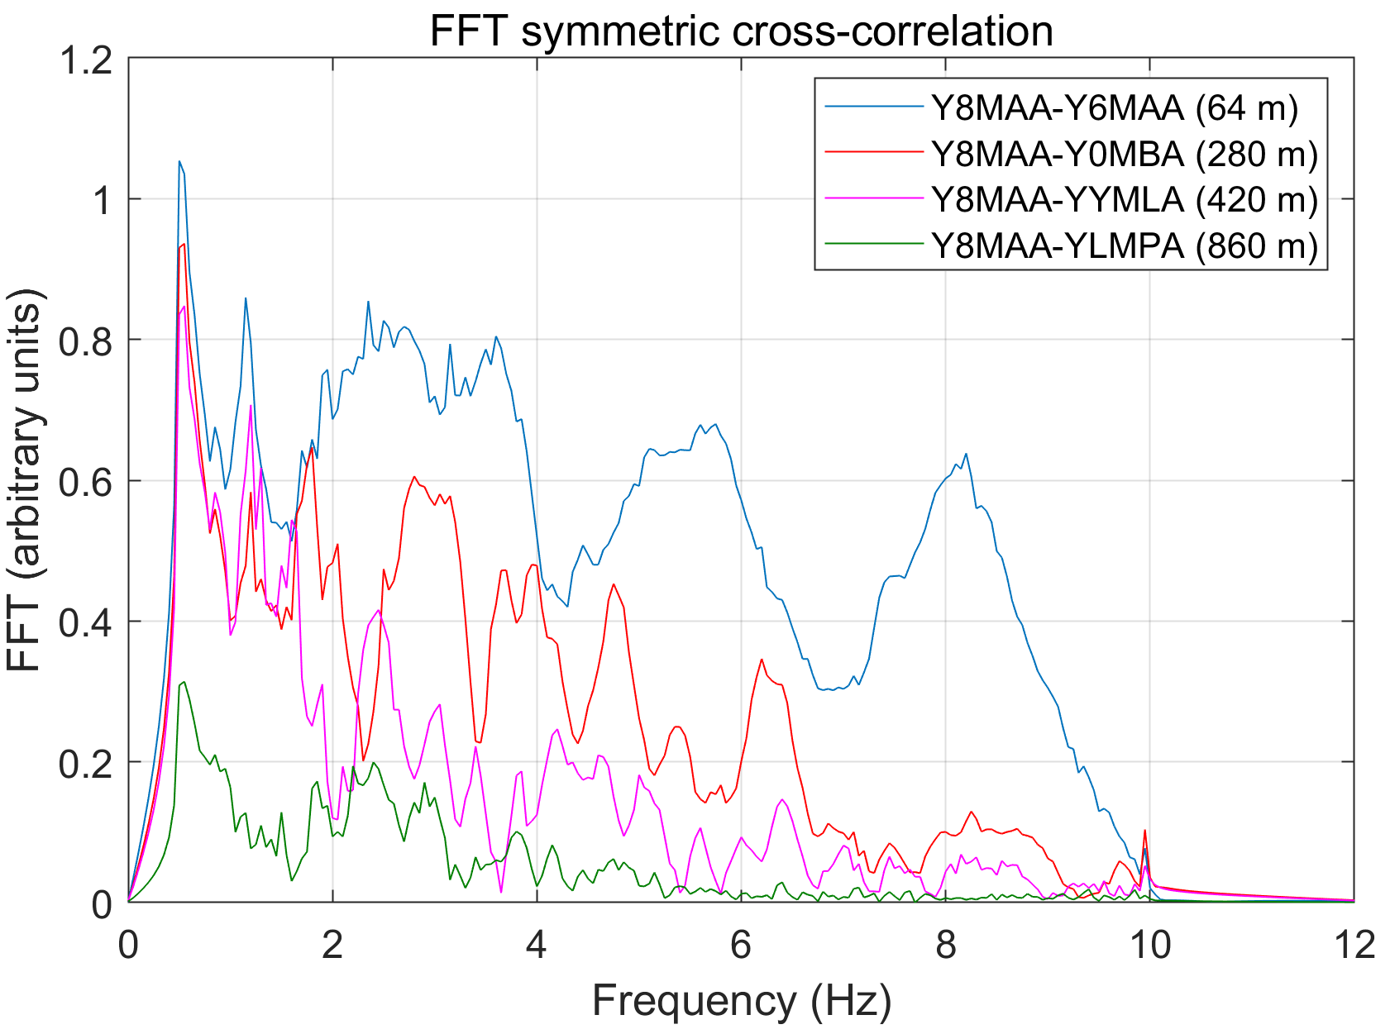
Learning I – correlation vs distance attenuation
Current analysis uses noise up to 3 Hz due to lack of significant correlation between distant stations at greater frequencies: however, we need to move to higher frequencies (why?)
A station spacing of about 150 m would ensure good correlation between stations (Passive 1 – nominal separation 250 m, passive II – nominal separation 450 m)
A denser station spacing will also enable double beamforming or traditional beamforming – a fall back in case tomography fails

Slide 9
Learning II – Distribution of noise sources is anisotropic
We use a Bartlett Beamformer to determine velocity and direction of propagation of the coherent part of noise
Dominant propagation is North-Eastern, existence of modes
Decrease of coherent noise at frequencies > 2 Hz
Accurate EGF construction still possible: If noise direction along the Fresnel zone of the line joining station pairs: 𝜋/4 phase error (Yao & van der Hilst, 2009)
Related Literature: Koley et al 2022

Slide 10
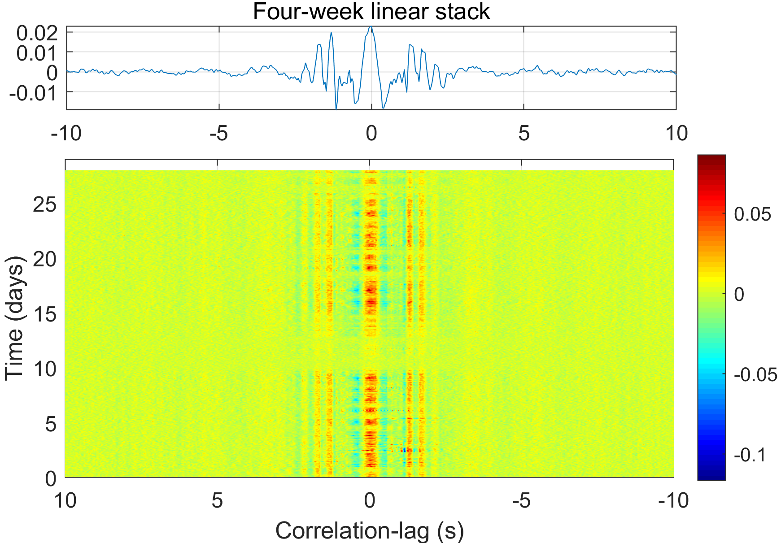
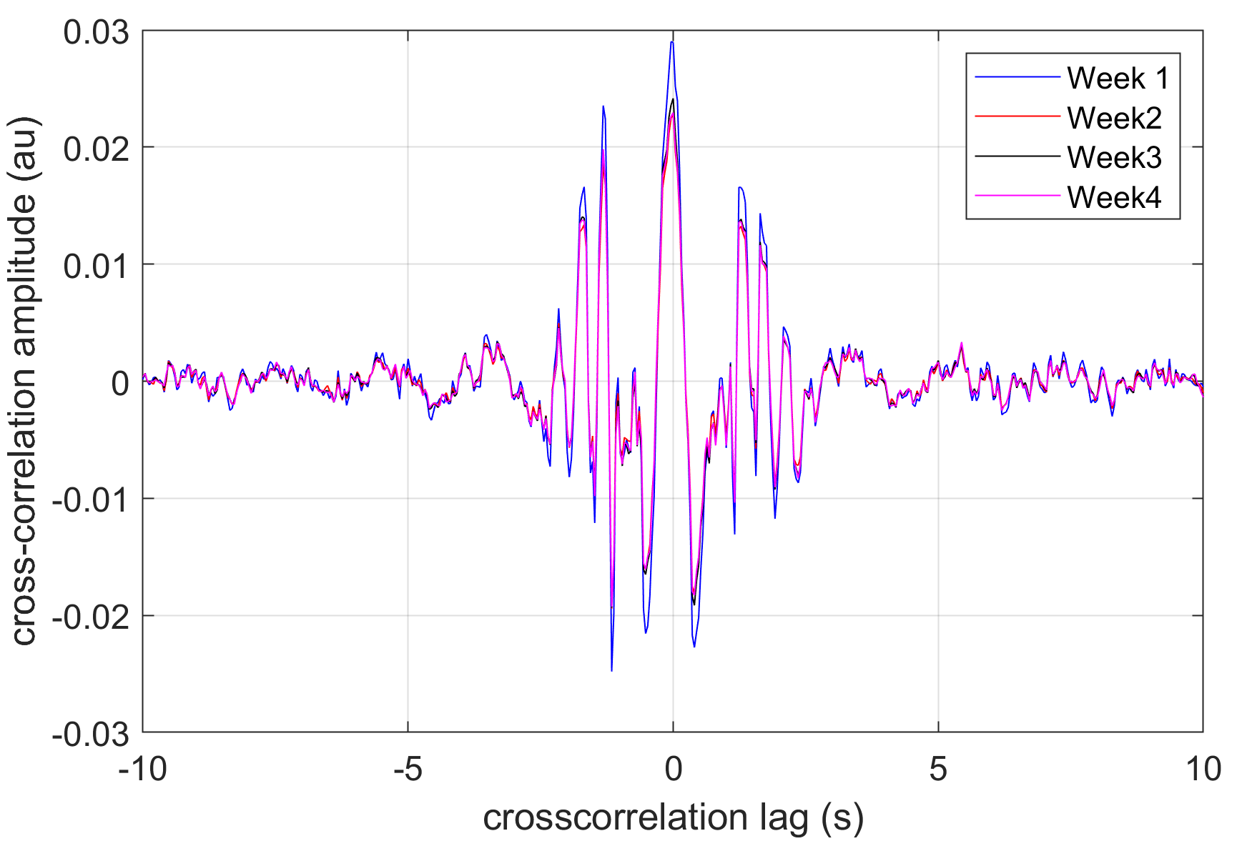
Learning III – How long we need to measure?
We propose a measurement time of at least 3 weeks – hourly or bihourly correlation evaluation
Unlike theoretical works where noise sources move-around with time – reality is that the cross-correlations are stationary (hourly)
Implies that the noise is already mixed or diffused
There can be time windows in which noise amplitudes are low, example for Passive II campaign (Feb 26 – March 31, 2021)
Tomography with weekly stacks improves the error estimates (similar approach for low frequencies in Goutorbe et al., 2015)
Station separation ~ 500 m
Related Literature: Seats 2012

Slide 11
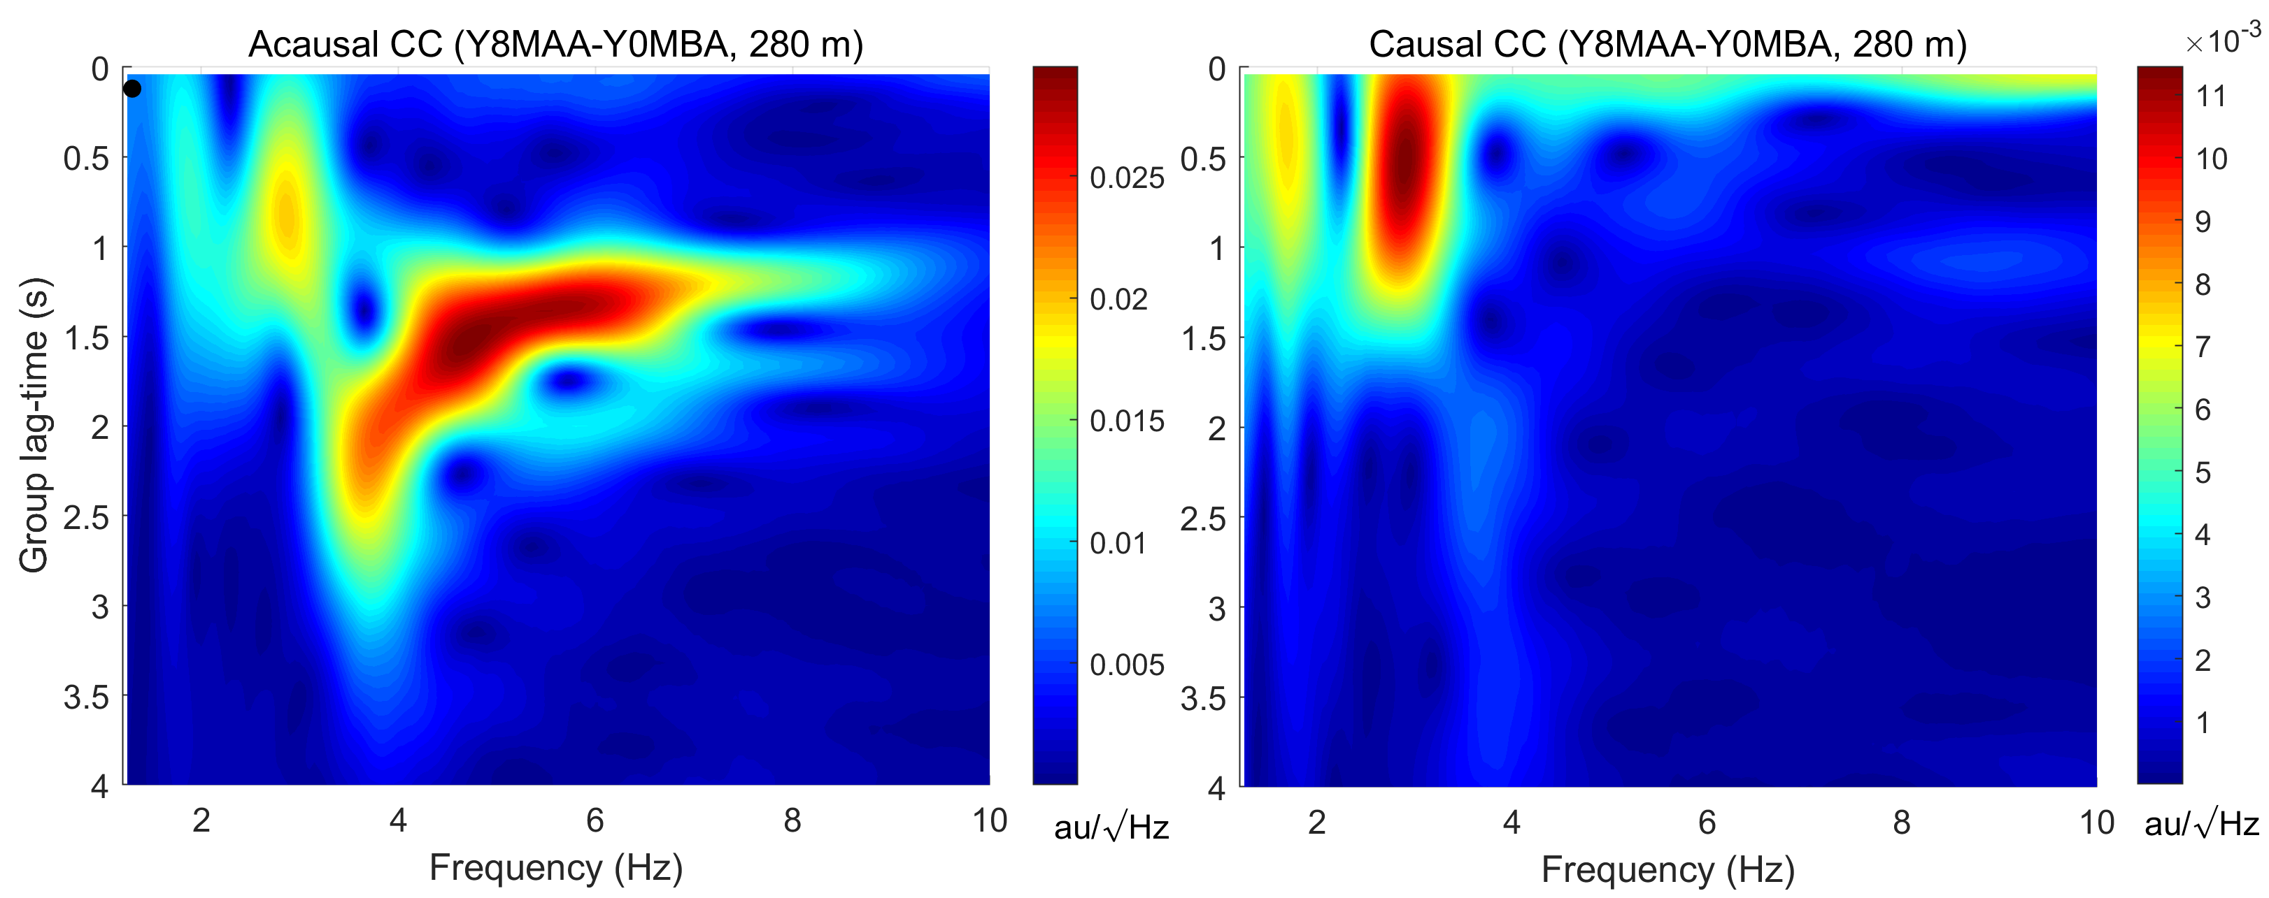
Learning IV – Noise correlations are seldom symmetric!
Traditional straight ray tomography approaches rely on accurate selection of frequency dependent travel-times between station pairs – problematic for anisotropic noise distribution
Two example Frequency-Time Analysis (Bensen et al 2007) for a station pair from Passive I Array are shown
Group travel-time for the causal and the acausal times are not the same
At a station-pair separation of more than 400 m, mode mixing and poor convergence of cross-correlation to the Empirical Green’s function is highly probable
Reduce station-spacing
As proposed earlier ~ 150 m
Clear observation of body-waves at higher frequencies for the causal part of cross-correlation (almost zero travel-time)
Outcome – wrong travel-time selection
Related Literature: Dziewonski et al, 1969,
Levshin & Ritzwoller, 2001

Slide 12
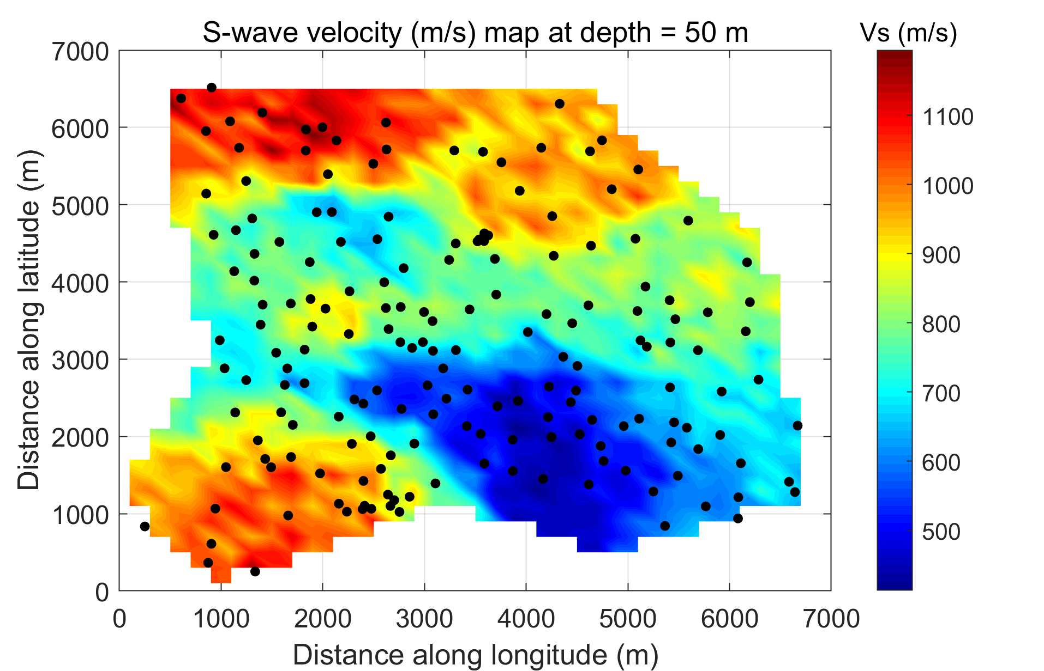
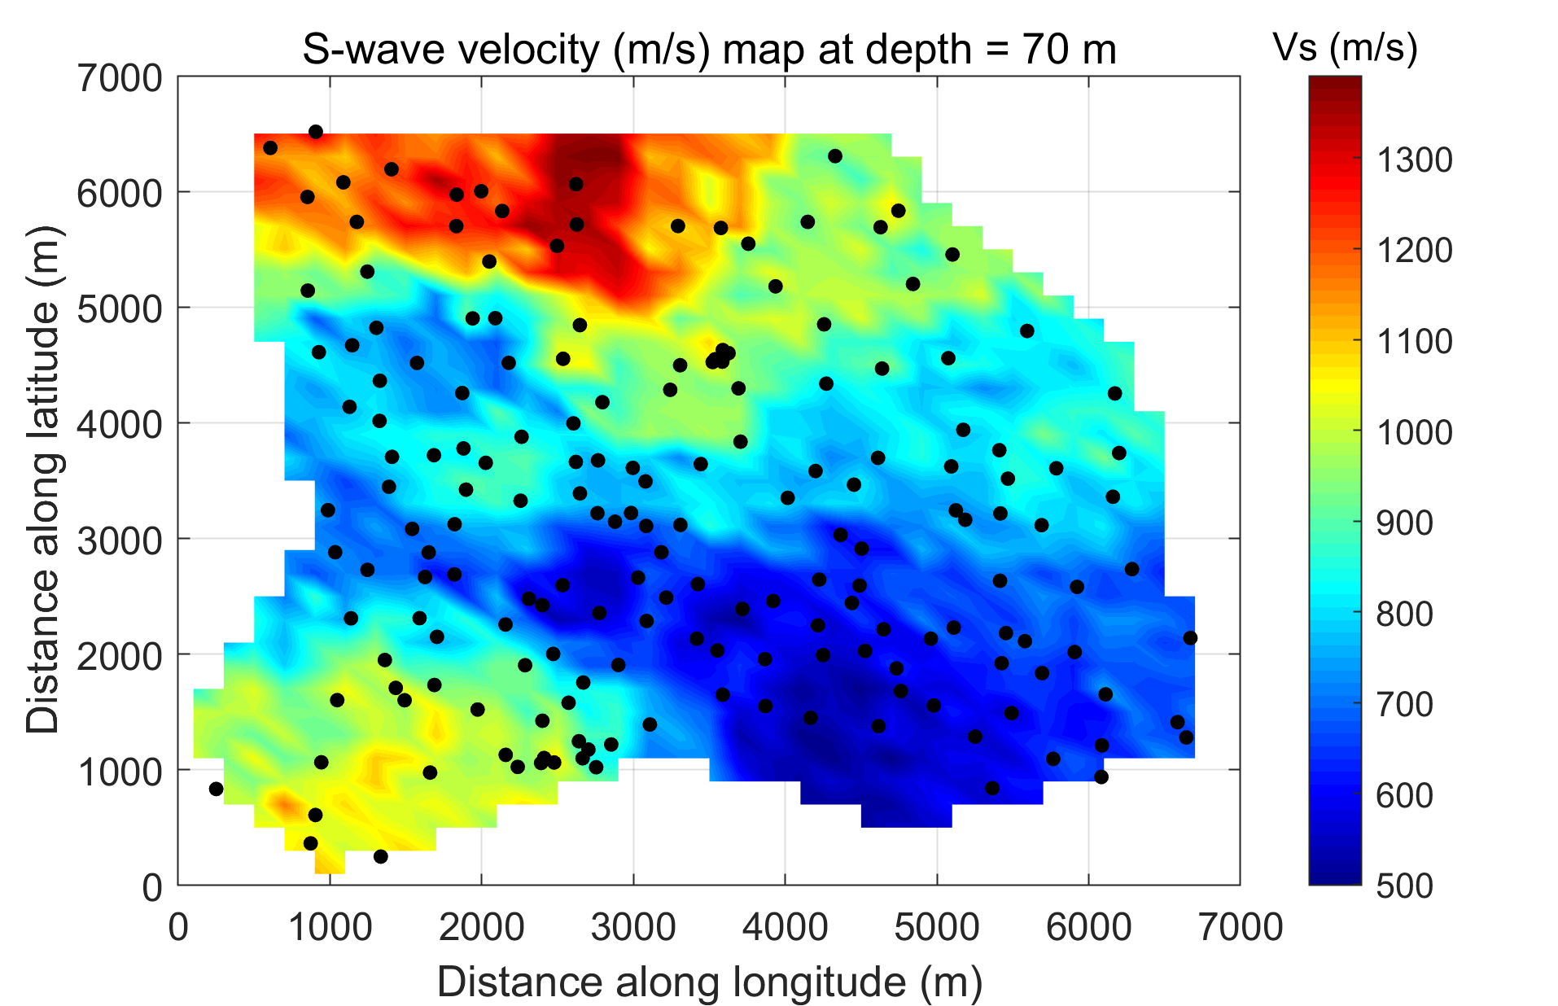
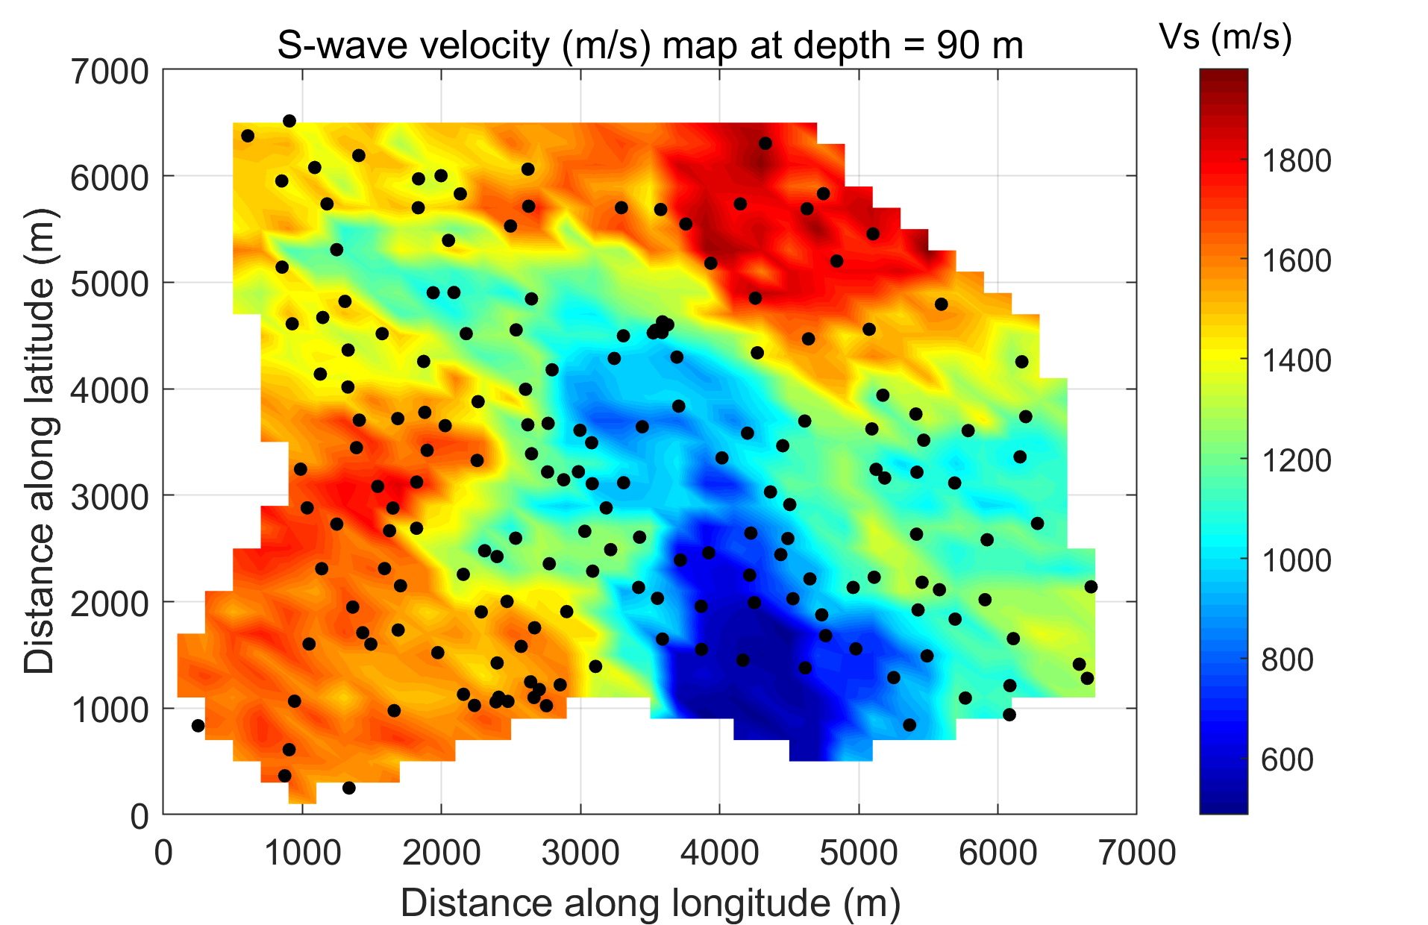
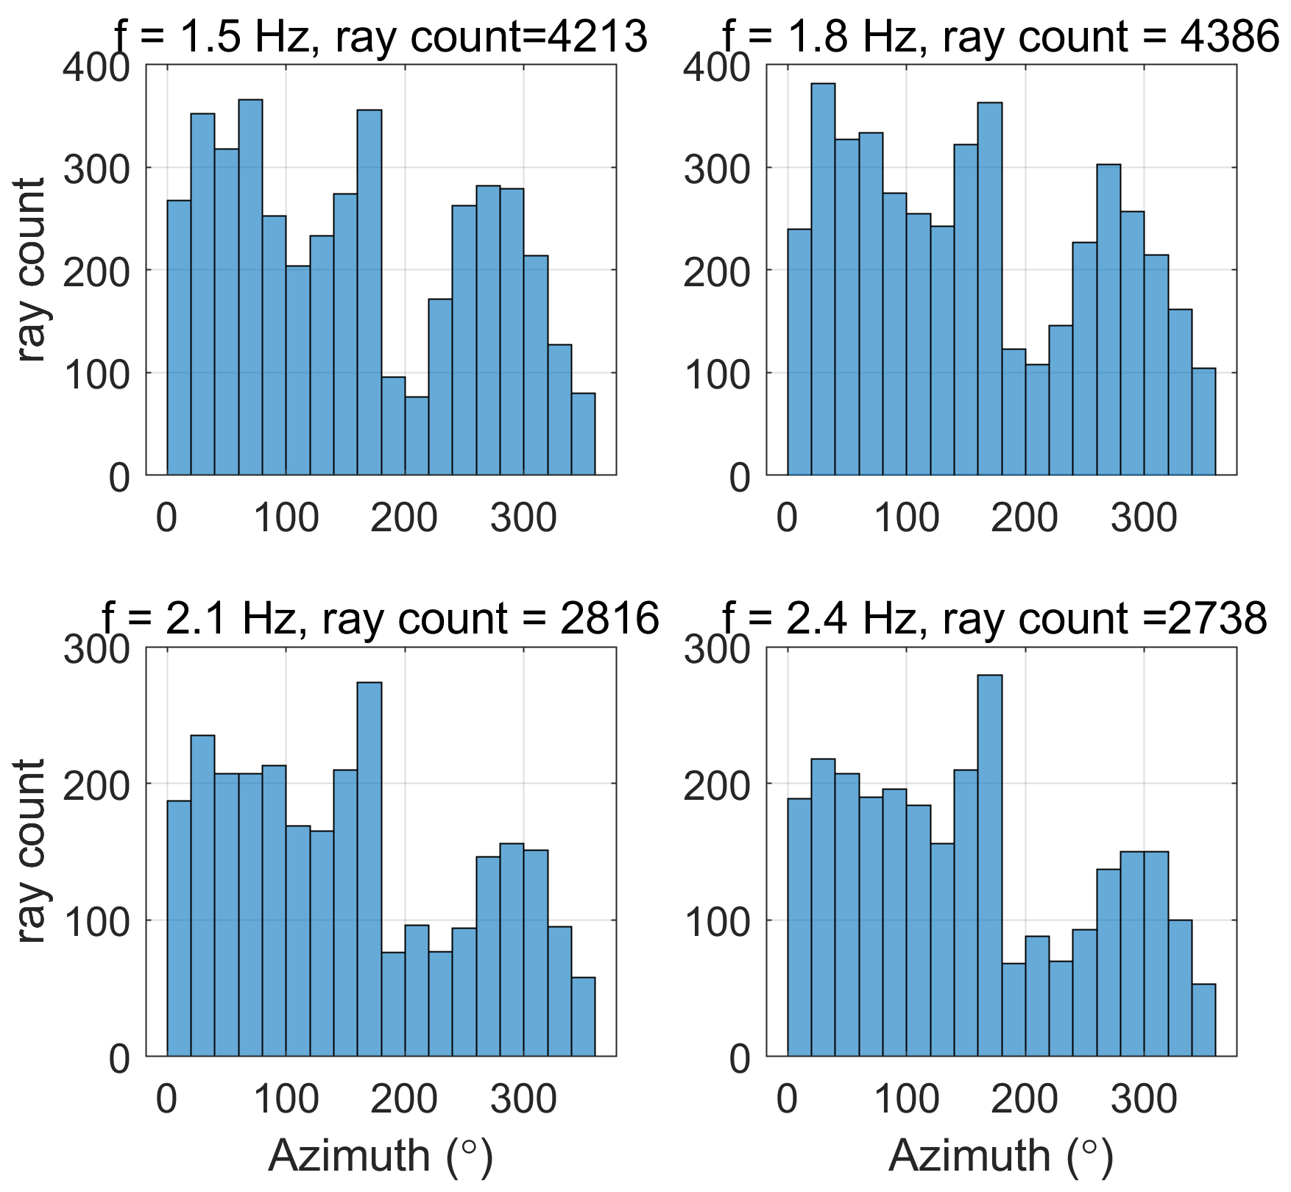
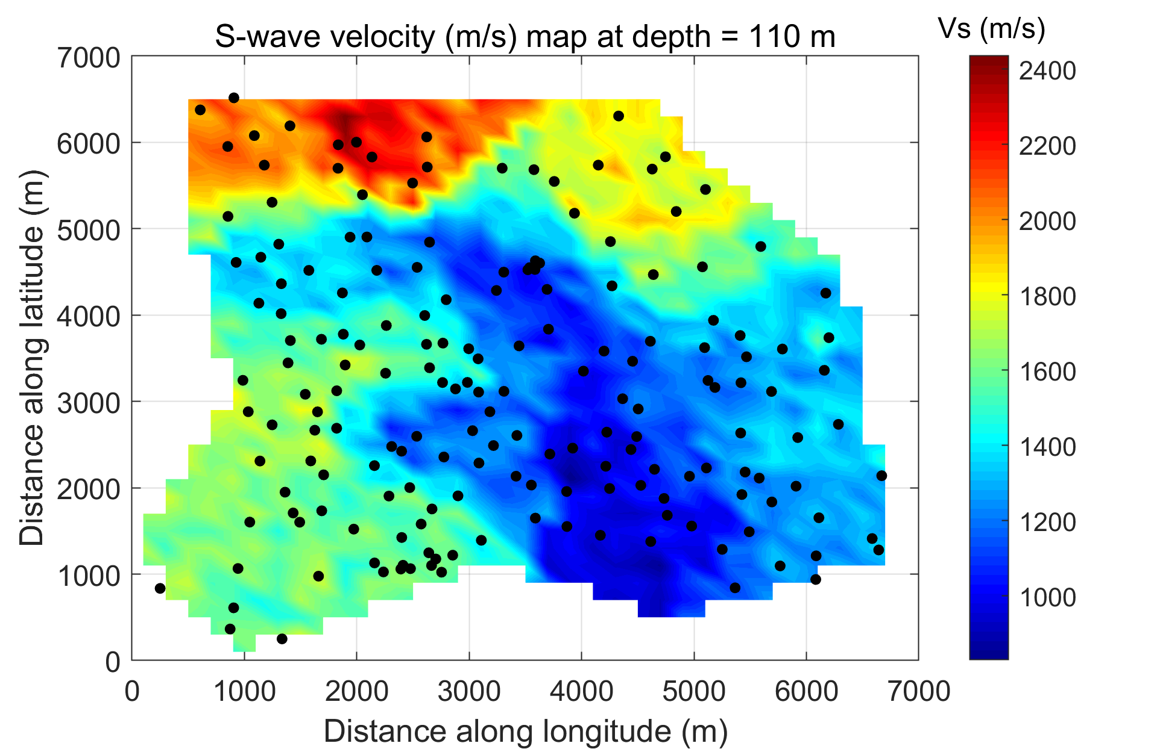
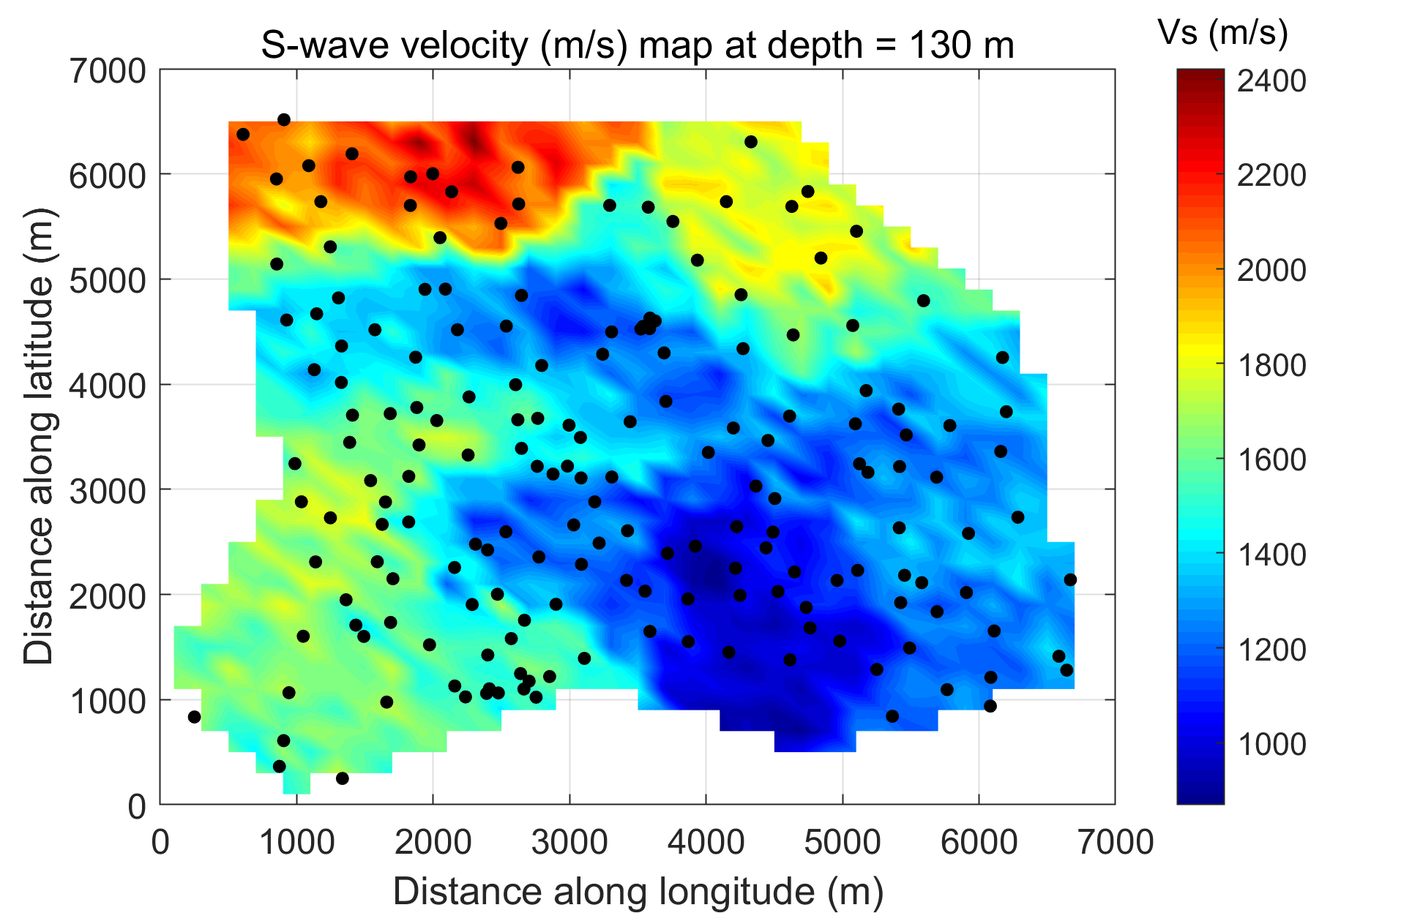
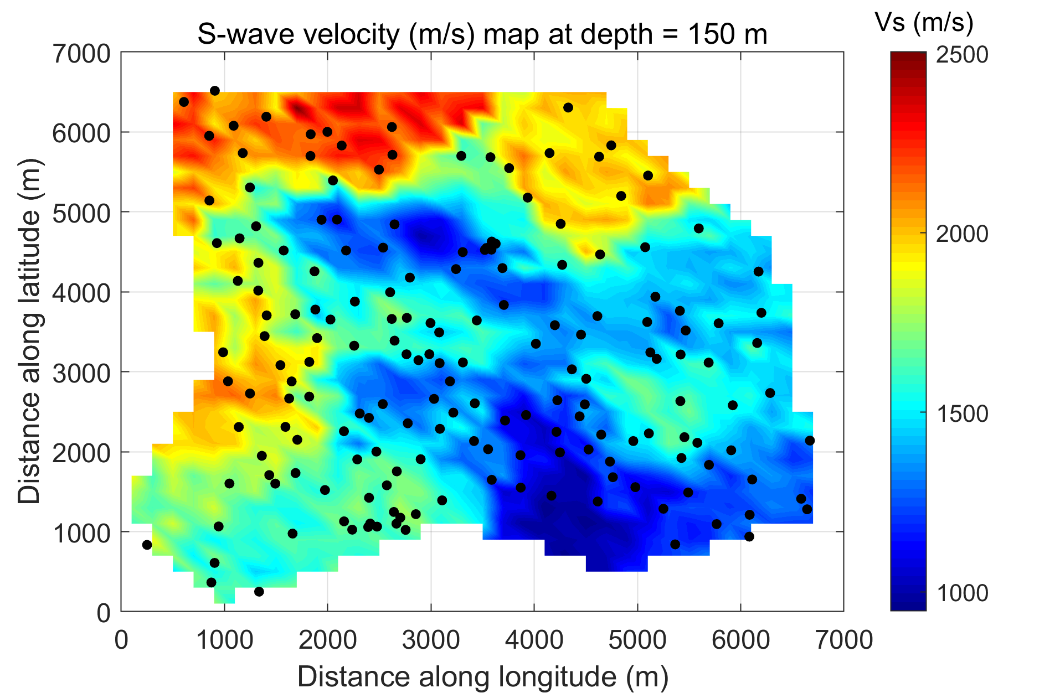
Straight-ray tomography results from Passive Array I
Straight ray tomography was performed using Rayleigh wave dispersion in the frequency band 1.0 – 2.5 Hz
Two faults were identified and each on dominant at different depths
Some limitations of the study
A spatial resolution of between 200 – 300 m
Low Ray Count (<20 %)
Shallow vertical resolution of 50 m
Need to probe higher frequencies
Geul valley fault
Another West-East trending fault
Related Literature: Chmiel et al 2018
Mordret et al 2013

Slide 13
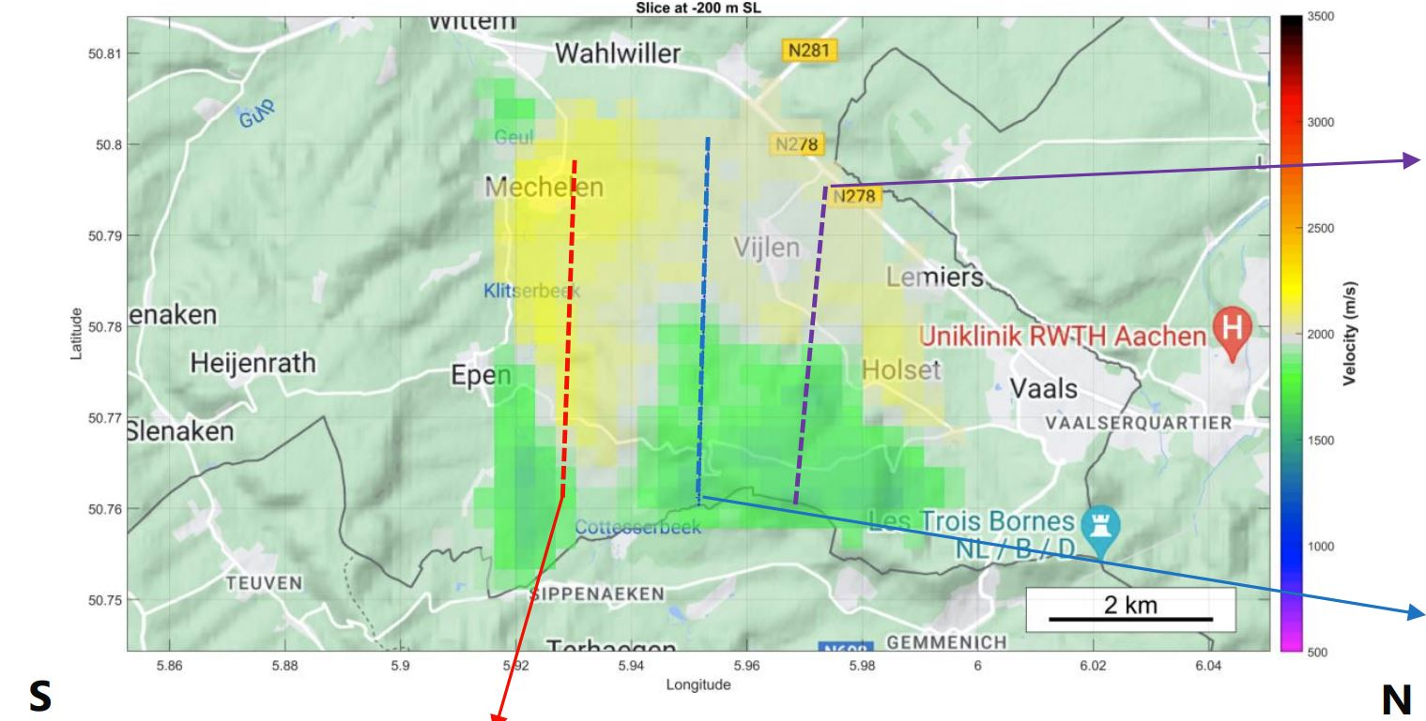
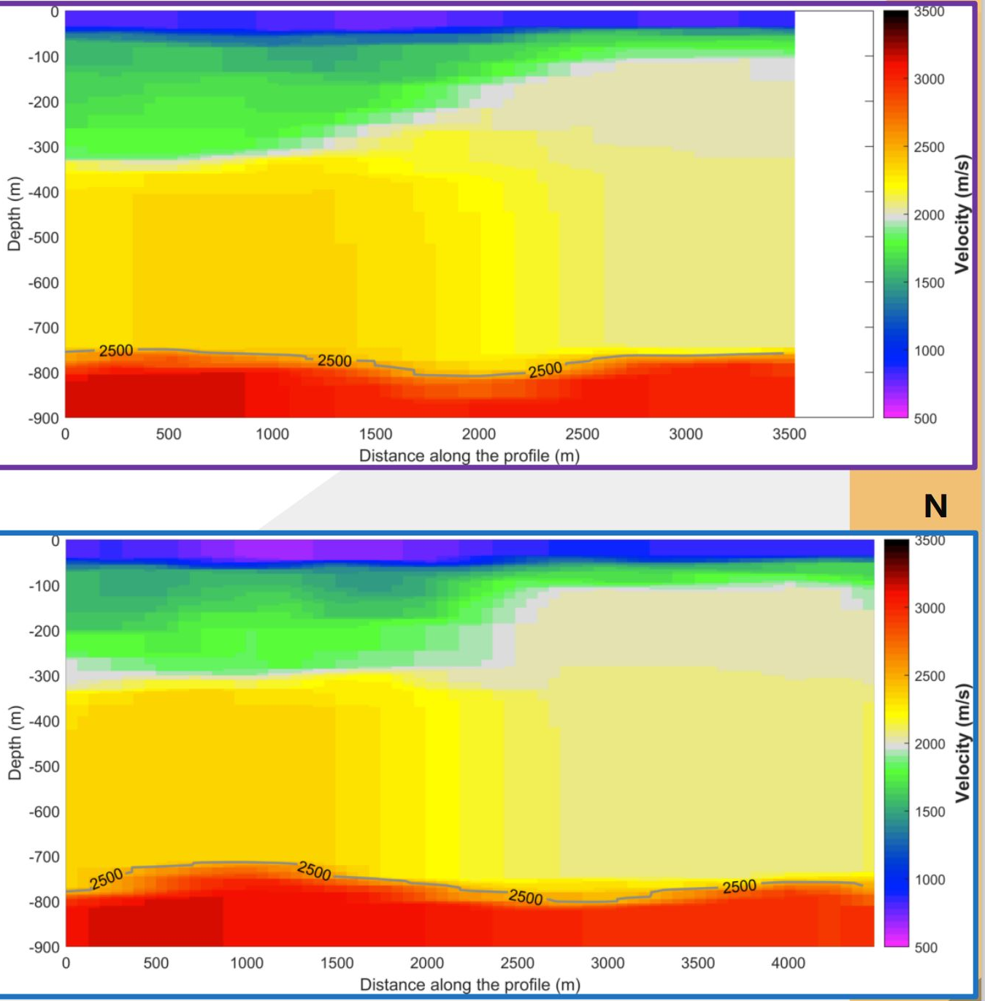
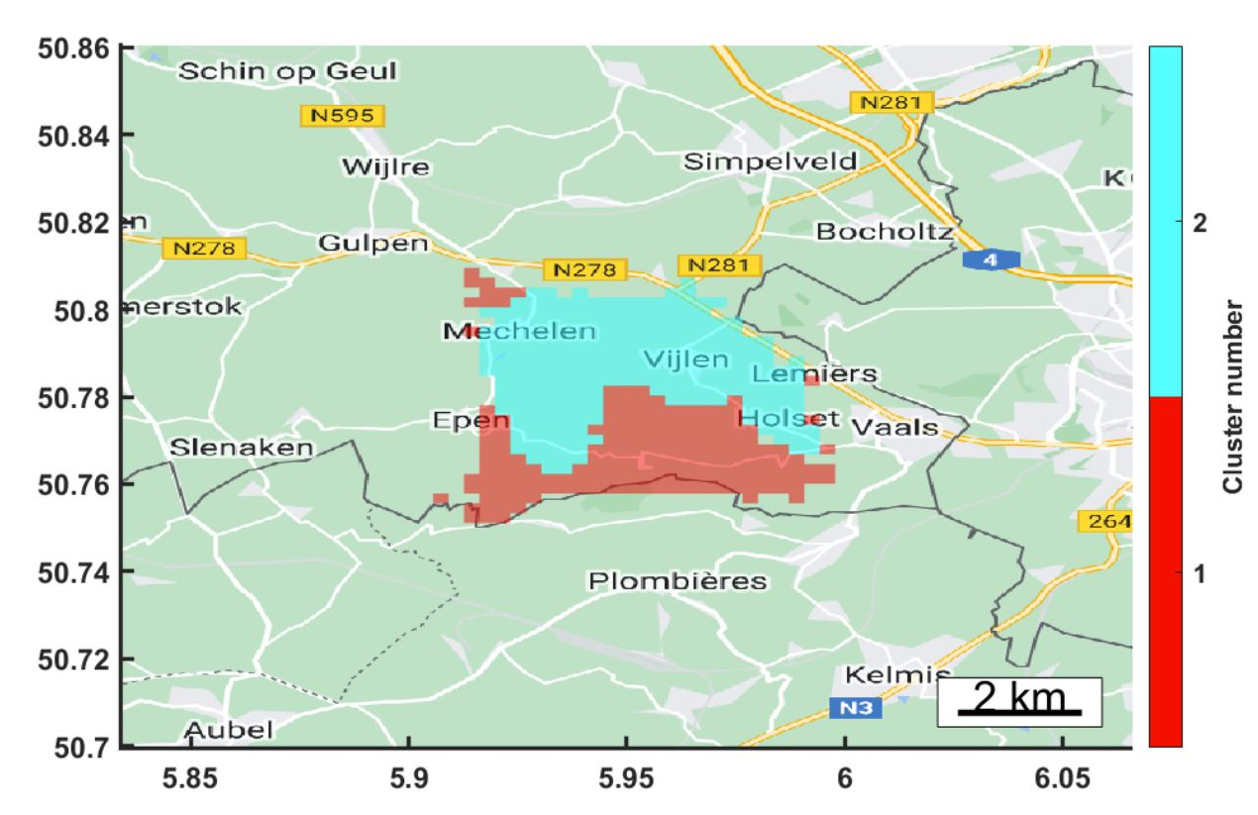
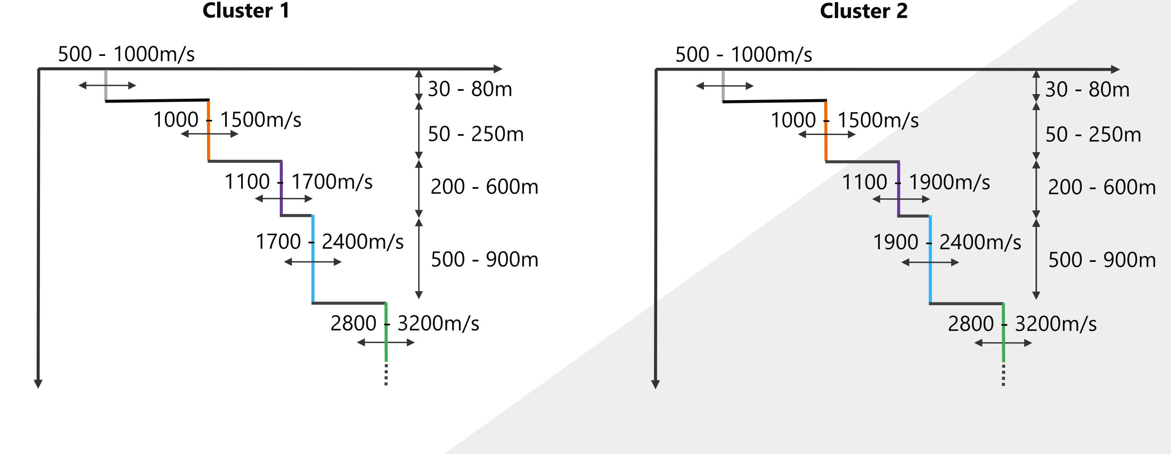
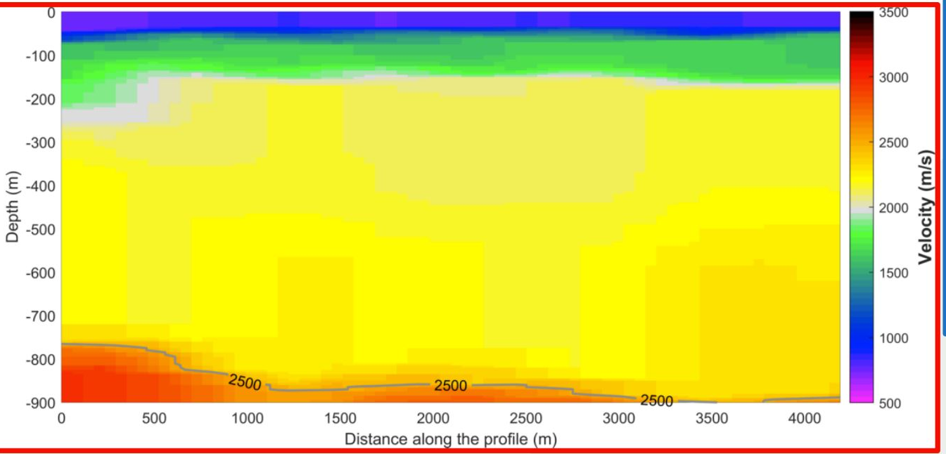
Straight-ray tomography results from Passive Array I (Sisprobe)
Frequency domain group-velocity to velocity-depth conversion using stochastic search approach
Inversion performed using local group velocity at the cell and the global phase velocity
A 5-layer model used as the starting point shown in the figure below
Sisprobe uses a stochastic search algorithm (e.g, NA)
Related Literature: Sambridge, 1999

Slide 14
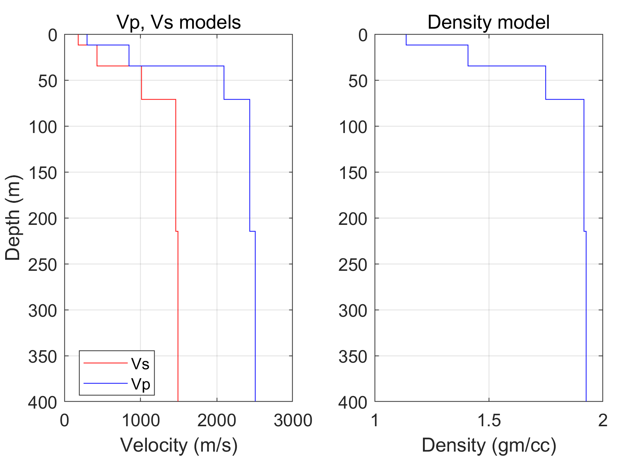
Learning V – Rayleigh wave Eigenfunction and frequency band of interest
Based on Vs depth models from Passive I array, we calculate the Rayleigh wave Eigenfunctions at different frequencies – shows the sensitivity of Rayleigh waves to different depth of penetration
Frequencies below 2.5 Hz are mostly sensitive to depths greater than 50 m
Need to probe at least to 4 Hz or 5 Hz to have a strong constraint on shallower structure
Note that frequencies below 2.5 Hz depend on shallower structures but to a lesser extent
Eigenfunction calculation
Related Literature: Cercato, 2007, CPS 330

Slide 15
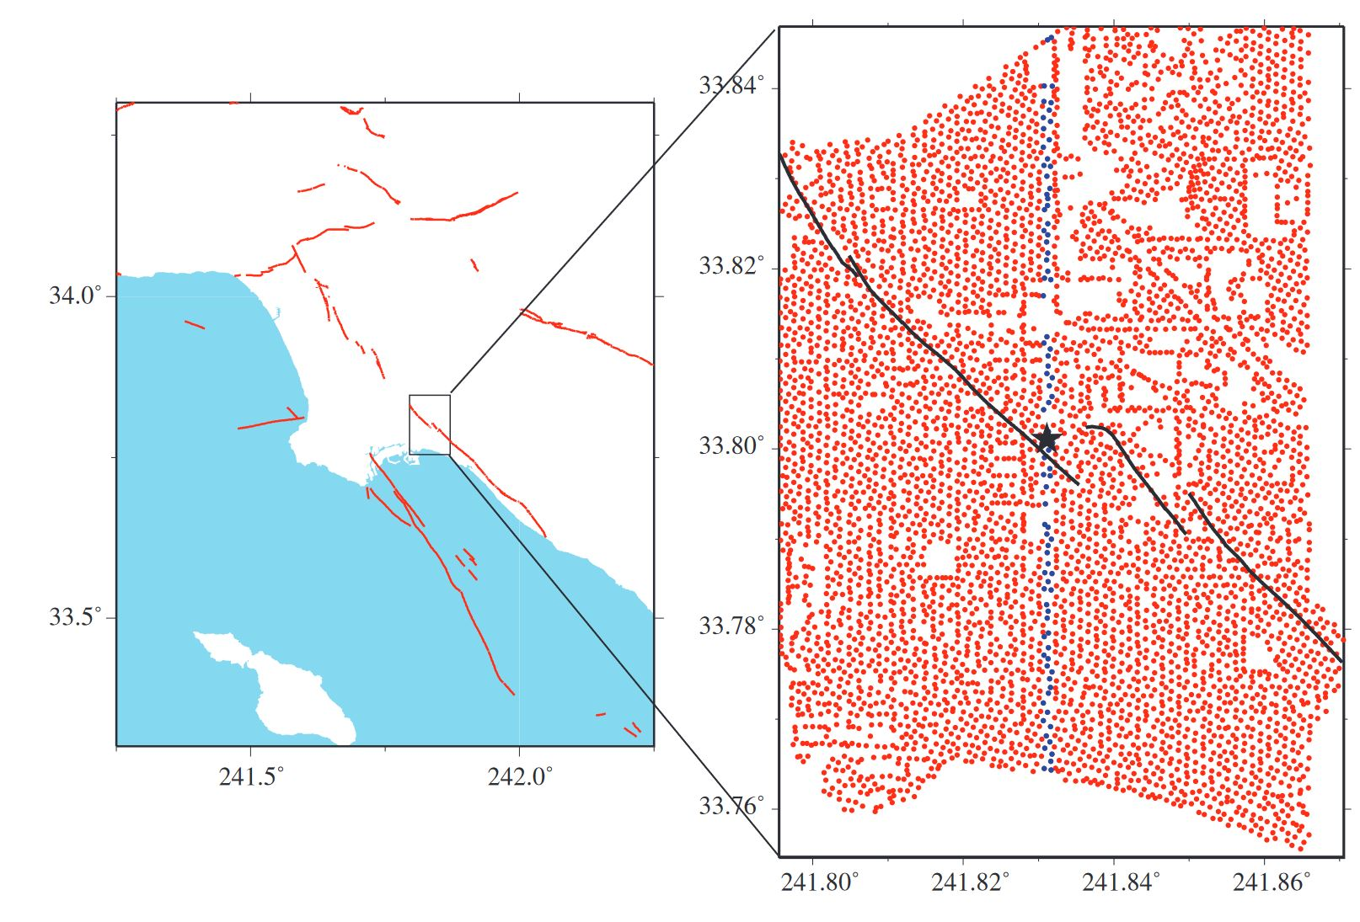
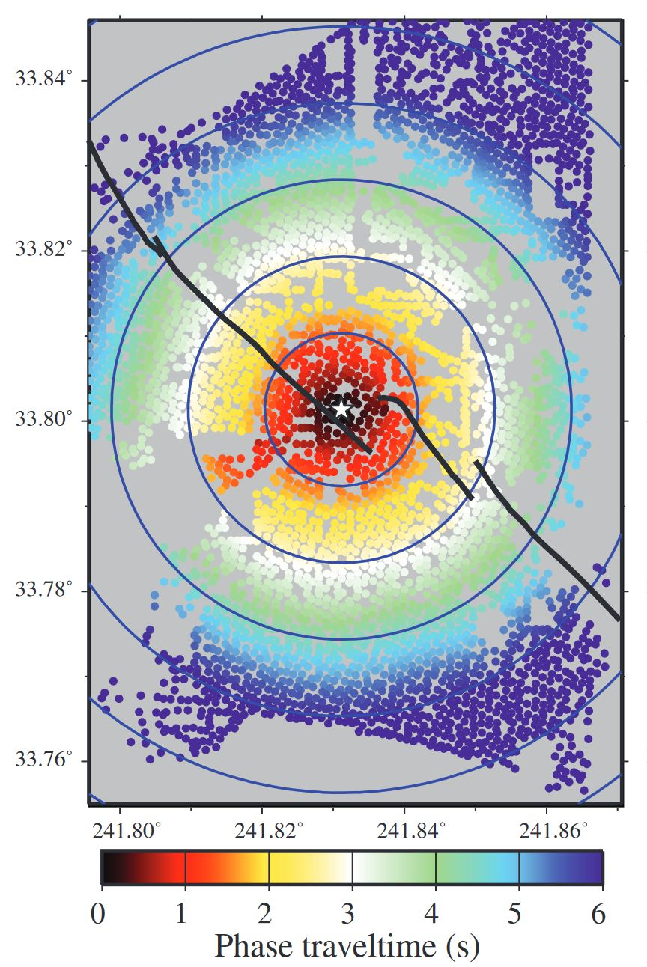
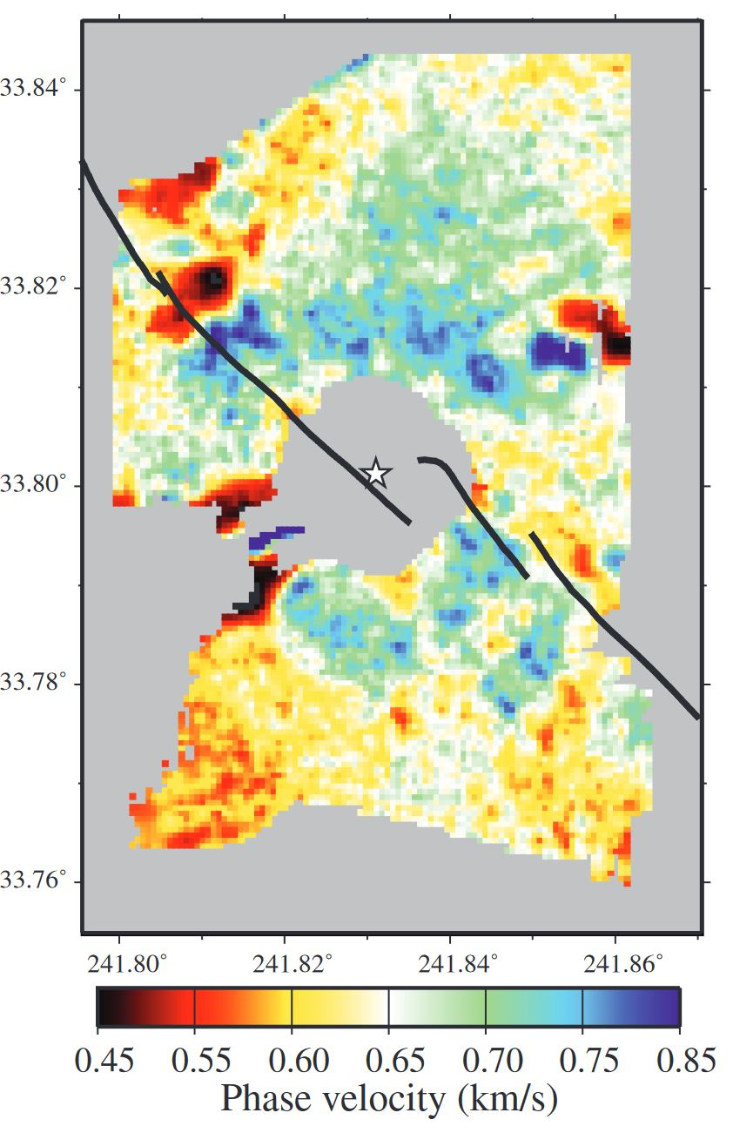
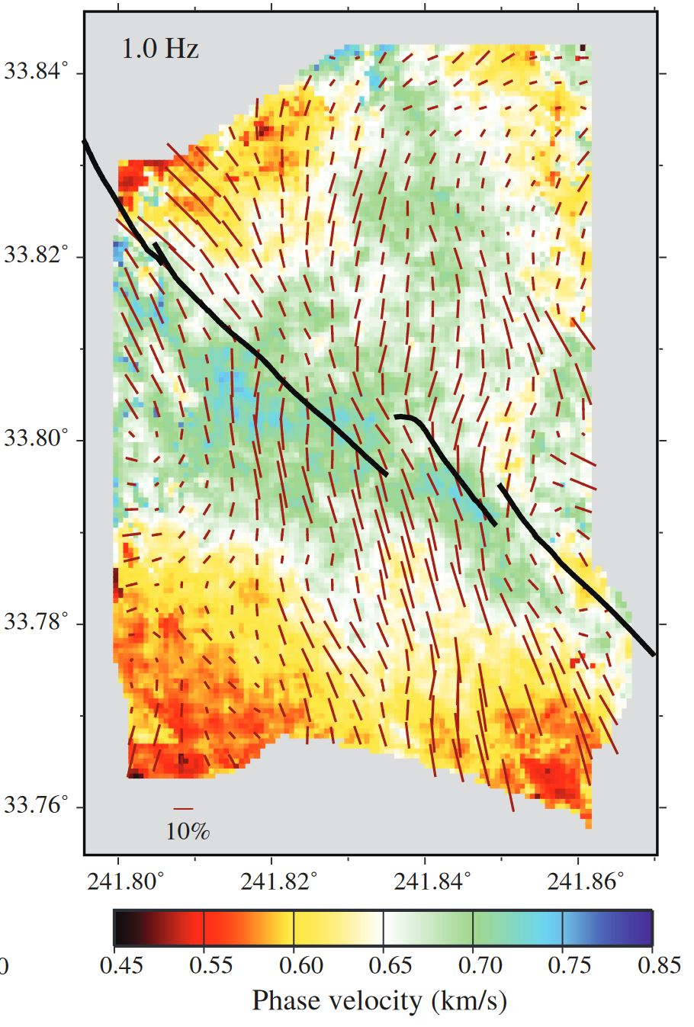
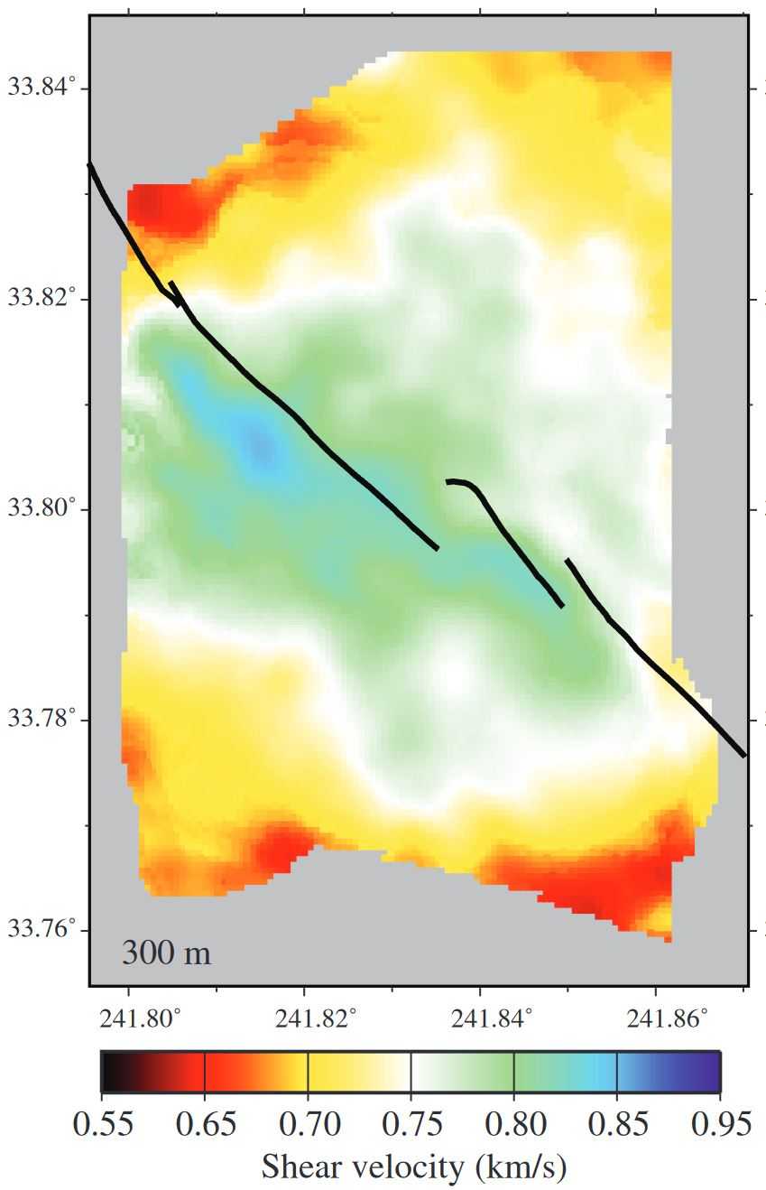
Improvements: Moving towards Eikonal phase-traveltime tomography
Eikonal tomography works on virtual source-receiver gather and evaluates the traveltime gradient at each grid-point: gives local estimate of velocity and direction of propagation of the wavefront (Lin et al., 2013)
Can handle anisotropic noise illumination
Gives an estimate of local anisotropy
An array of 5204 vertical component stations covering an area of $7×10$ sq. km
Recording time – 3 months
Pick travel times from virtual gather
Ignore bad picks
Phase travel time – phase velocity
Repeat for many virtual gathers
Phase velocity – Vs depth inversion
Related Literature: Lin et al 2009, Fu et al, 2022

Slide 16
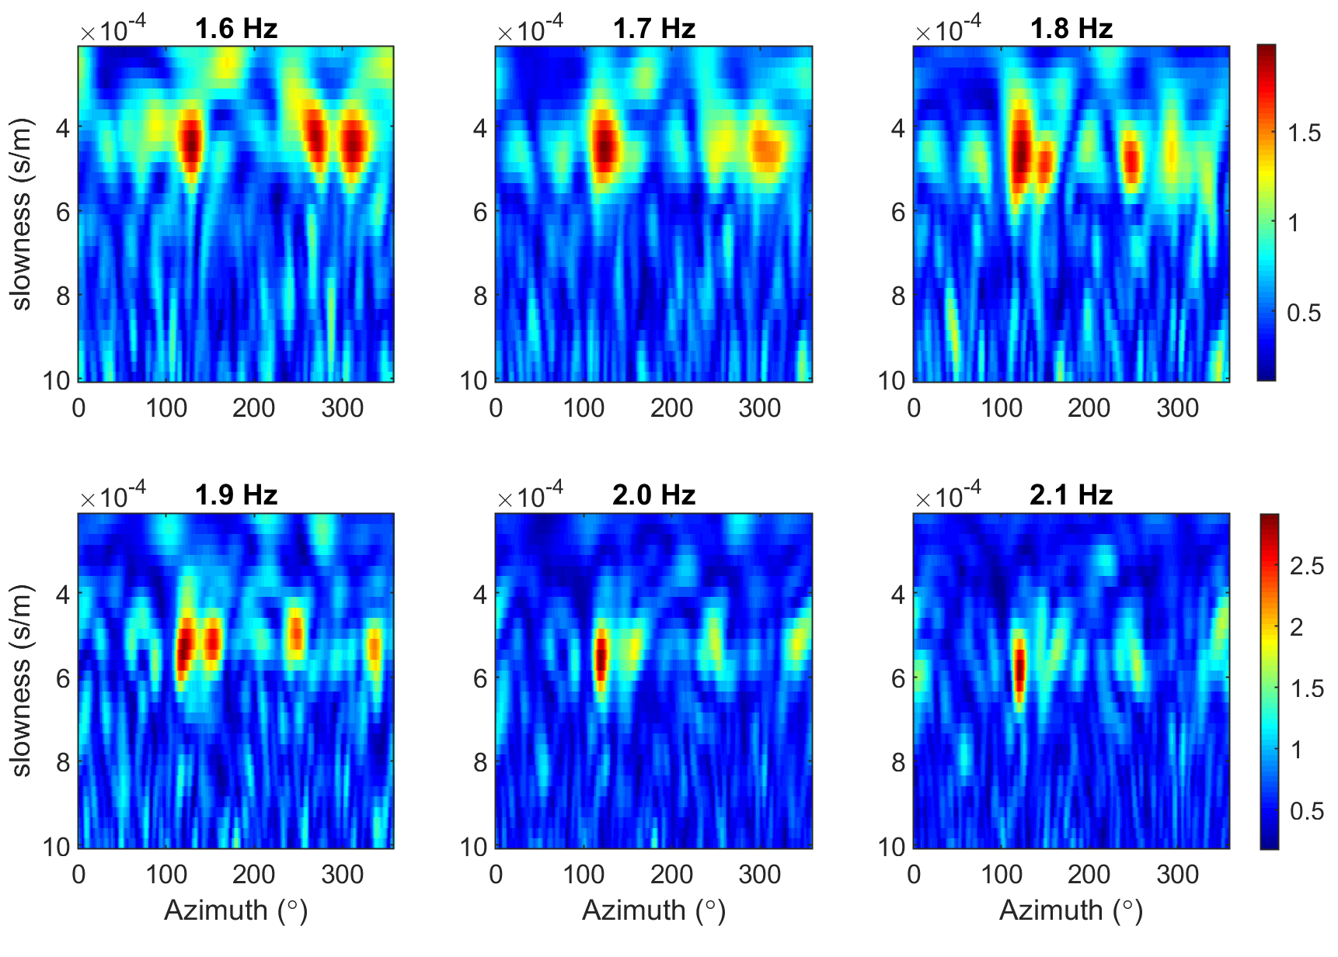
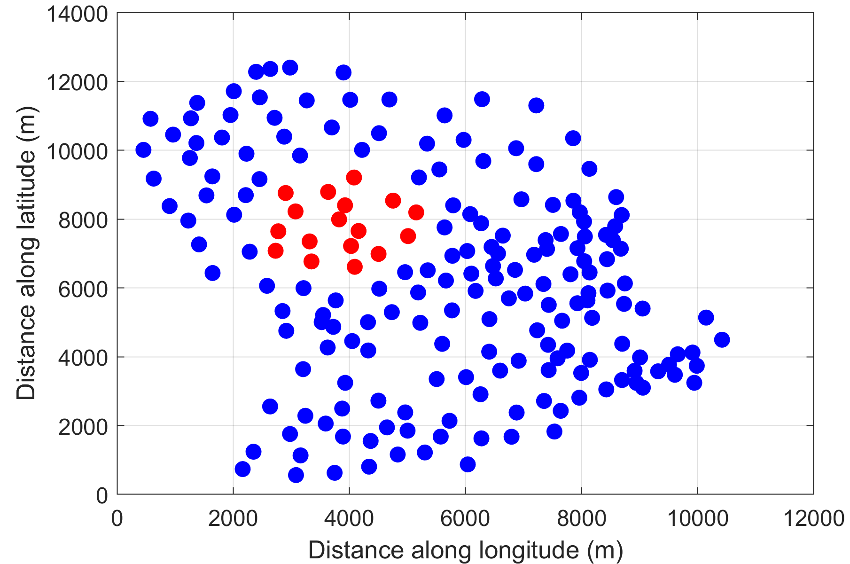
Improvements: A double-beamforming based subarray approach
The subarray based approach gives a local control on the phase velocity estimate, alleviating problems with cycle skipping, source phase ambiguity, local understanding of wave propagation before tomography
A strong dispersion is observed for the source along azimuth 90 – 130 degrees
Passive Seismic II Array
Related Literature: Fu et al., 2022, Ruigrok et al., 2017,
Boue et al., 2013

Slide 17
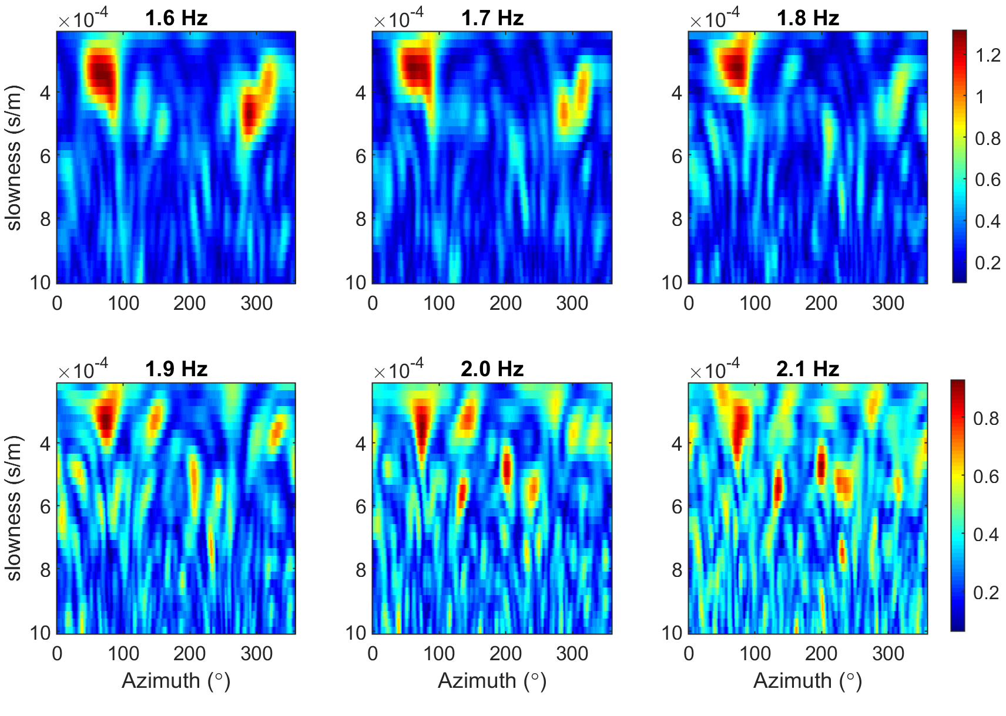
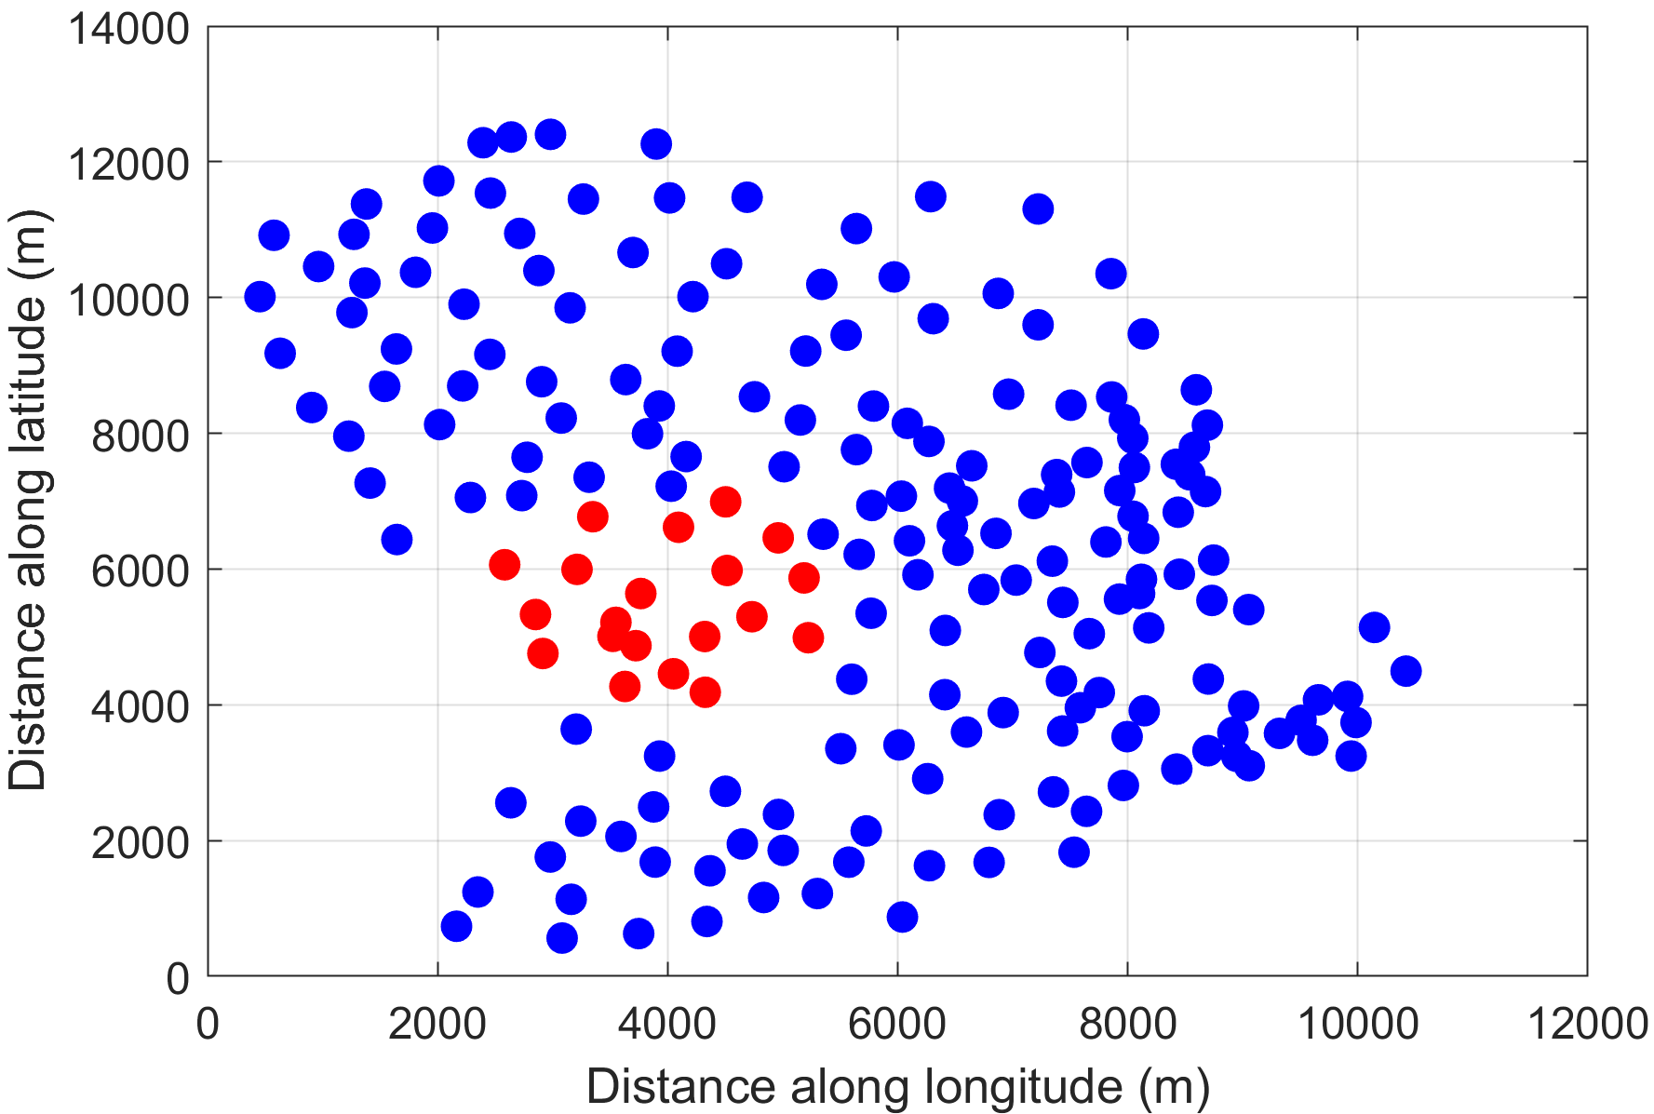
Improvements: subarray approach and body-wave tomography
The subarray based approach gives a local control on the phase velocity estimate, alleviating problems with cycle skipping, source phase ambiguity, local understanding of wave propagation before tomography
The same noise source is non-dispersive in an adjacent subarray
Too thin covering of soft-soil – depth to hard rock too less
Passive Seismic II Array
Related Literature: Nakata et al, 2015, Ruigrok et al 2017

Slide 18
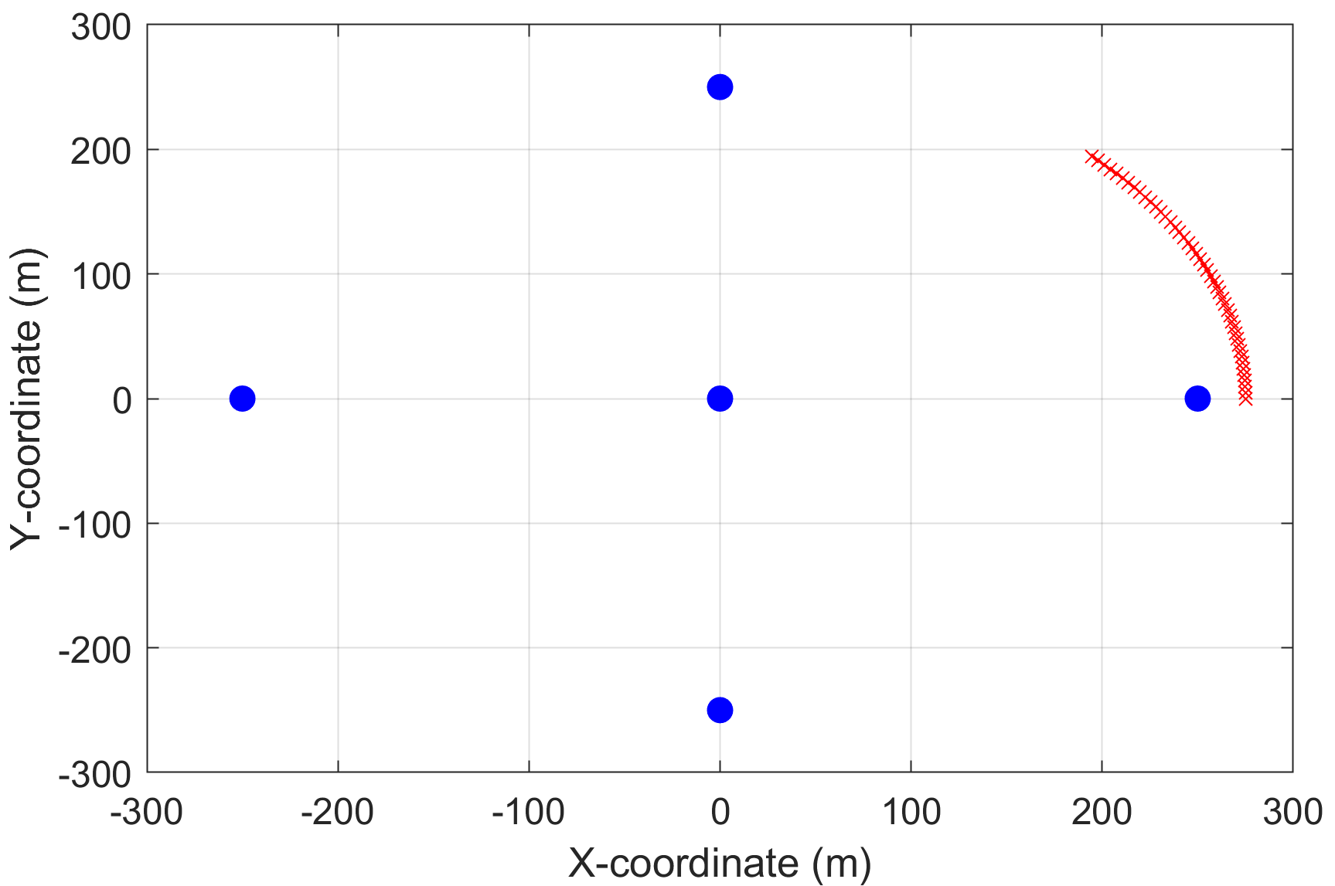
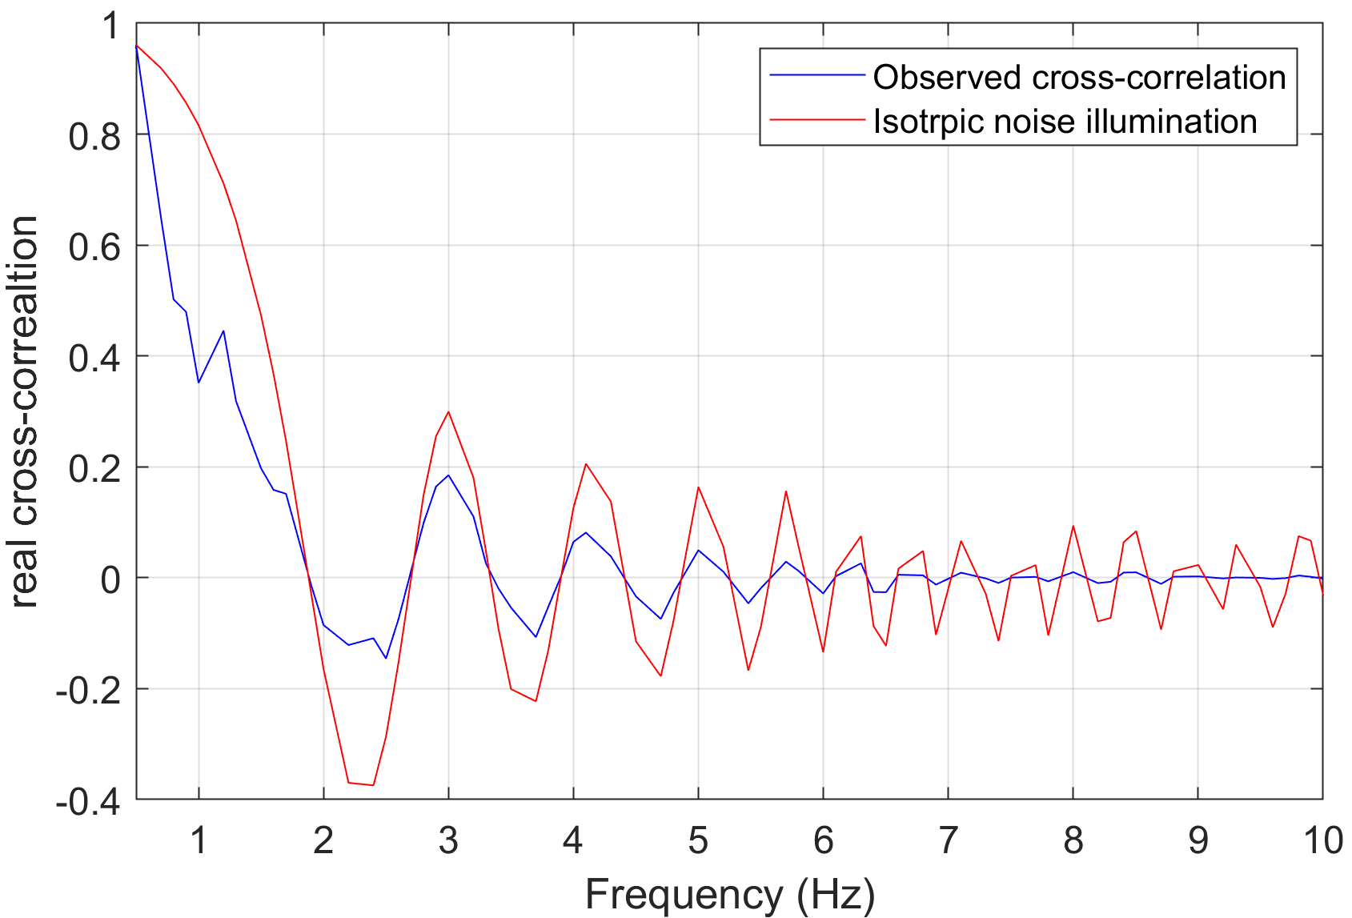
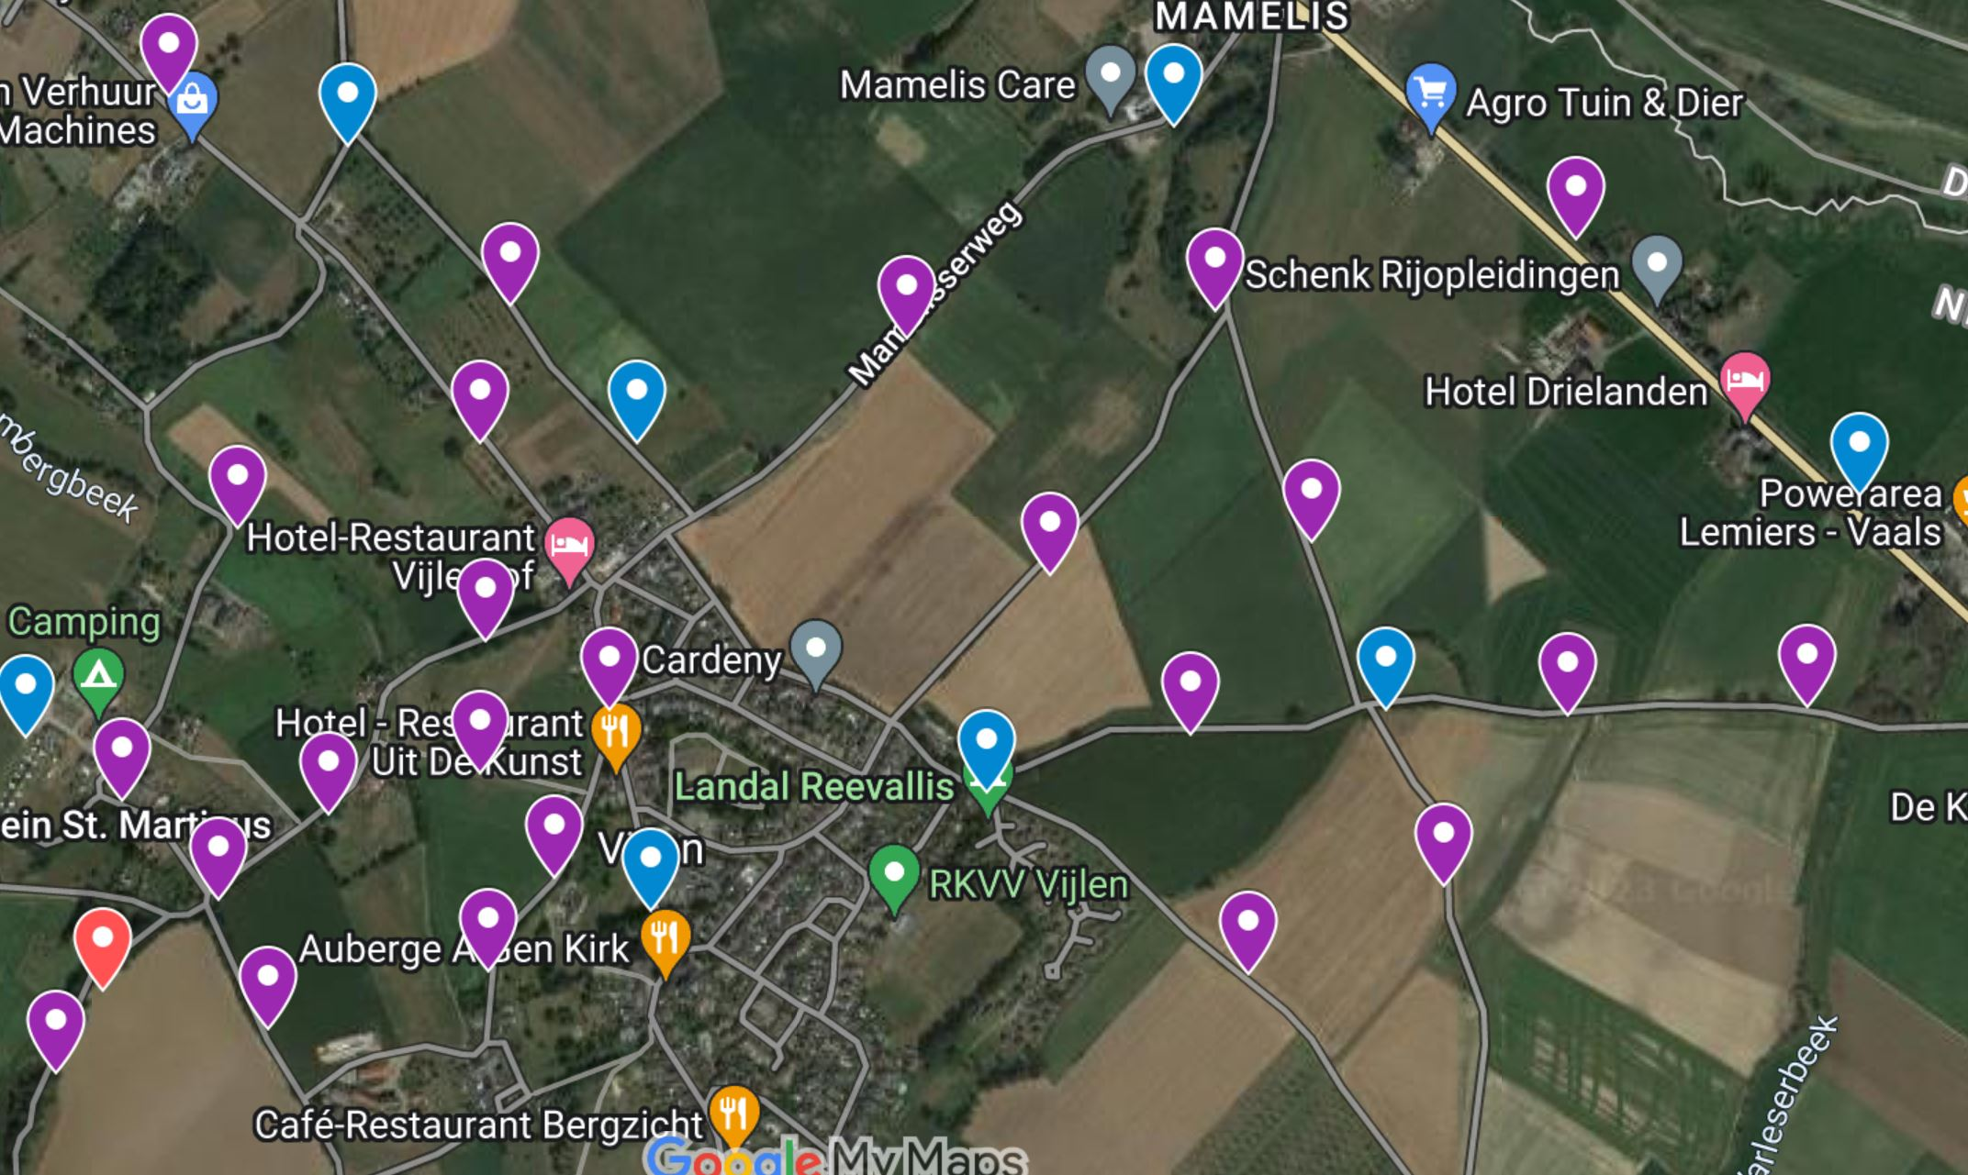
What’s Next?
Future arrays with 400 3-component stations and nominal separation of 150 m – tomographic resolution below 50 m, depth resolution – 10 m
Try to have a variable node separation in areas like forests to ensure that beamforming can be done up to high frequencies (Fail-safe)
Rings of increasing radii
Increasing squares
Use frequencies in the band 1.5 – 6 Hz, even if we can go to 5 Hz, we will have the shallowest layer at depths between 20-30 m
Use several overlapping arrays for ET
Deploy 3-component stations strategically and use the Rayleigh-ellipticity, Love wave and Rayleigh wave tomography
Try to have a symmetrical azimuthal coverage of stations at fixed distances around a central station
Will enhance local velocity control while doing tomography
Eikonal tomography while computing the local traveltime gradient
Aki’s
principle
Related Literature: Aki 1957, Ohori et al., 2001

Slide 19
Thank you ! Questions?

