Slide 2
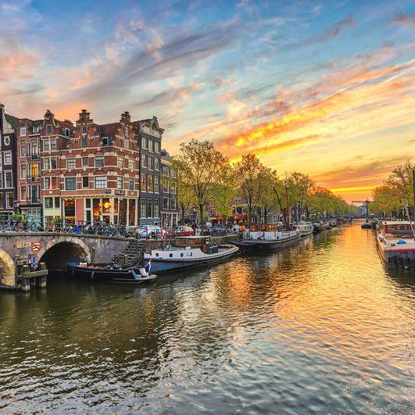
3rd Einstein Telescope Site Preparation Board Workshop at NIKHEF, Amsterdam
6-7 December, 2023
Objectives:
Follow up on previous two workshops in Nuoro (Nov21) and Maastricht (Jan23).
Update on site-specific characteristics that impact ET sensitivity and performance
Moving towards common methodologies and standardized measurements to compare sites properly
  Noise (Focus, Main Topic)
  (Hydro)geologic measurements (Start)
  Geomechanics / impact Civil Engineering (Start)
  ….
Outlook discussion
Meet and network opportunity
Have fun

Slide 3
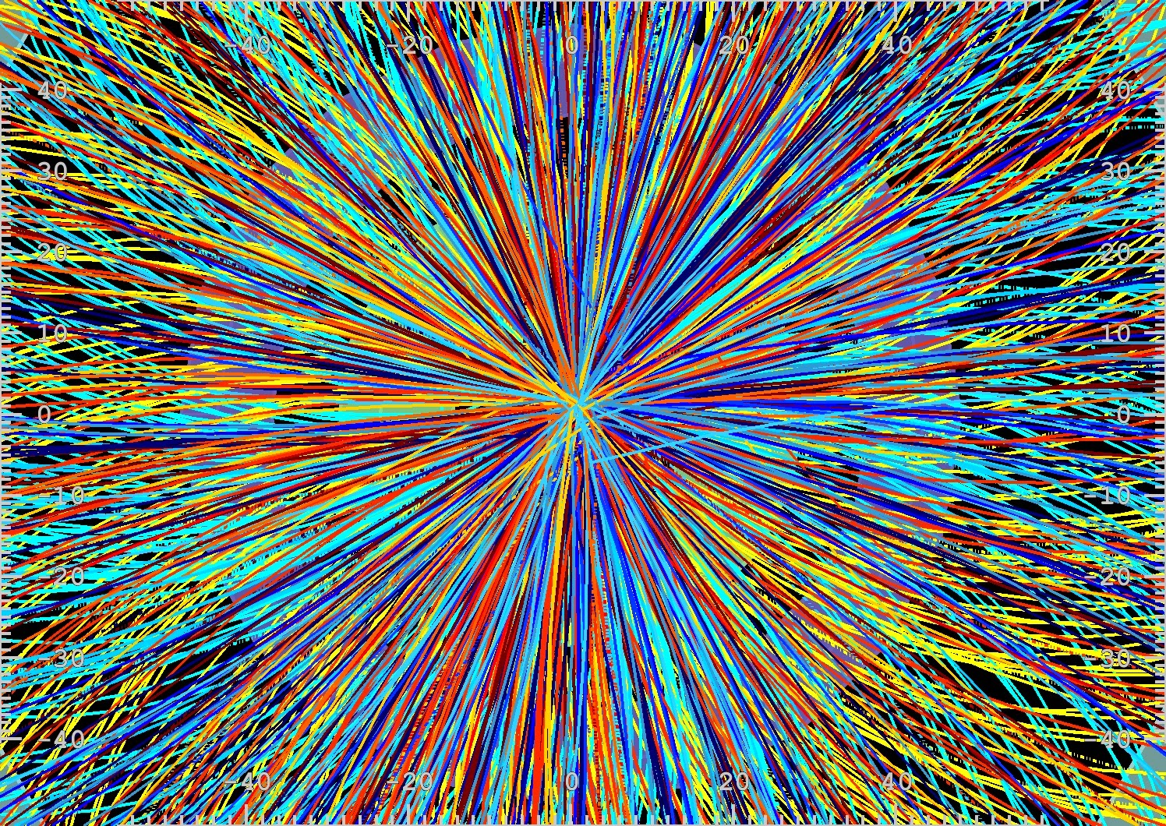
A few things to note:
Colloquium room / Positron meeting room / Library meeting room
We have 51 participatng in person and 36 remotely
A/V temporary solution – bear with us…
Coffee etc.
Lunch
Dinner
Other admin things like validating your parking card, getting an invoice etc, please check with Joan Berger.
Emergency telephone: +31 20 592 5008

Slide 4
3rd Einstein Telescope Site Preparation Board Workshop at NIKHEF, Amsterdam
6-7 December, 2023
Objectives:
Follow up on previous two workshops in Nuoro (Nov21) and Maastricht (Jan23).
Update on site-specific characteristics that impact ET sensitivity and performance
Moving towards common methodologies and standardized measurements to compare sites properly
  Noise (Focus, Main Topic)
  (Hydro)geologic measurements (Start)
  Geomechanics / impact Civil Engineering (Start)
  ….
Outlook discussion
Meet and network opportunity
Have fun

Slide 5
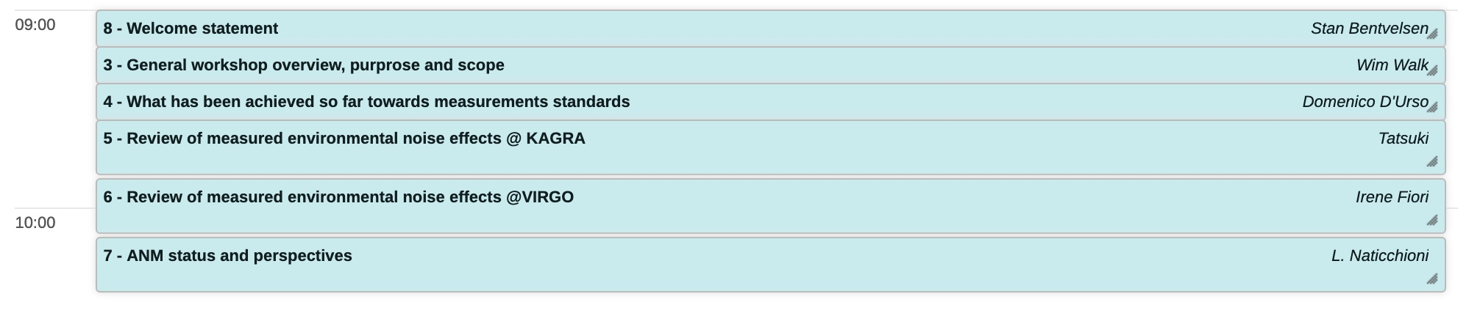
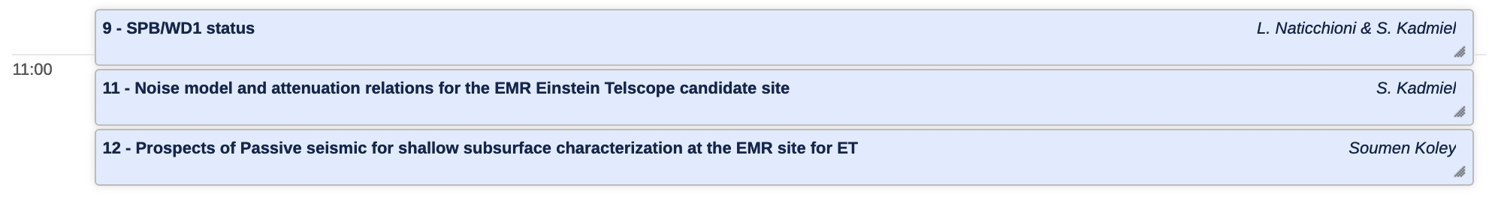
This morning’s program:
8:00-9:00 Registration
10.30-10.45 Coffee/Tea
10.45-12:00
12:00-13:00 Lunch

