Slide 1
Soapbox
59th EUGridPMA Abingdon
4-5 October 2023
J Jensen, UKRI

Slide 2
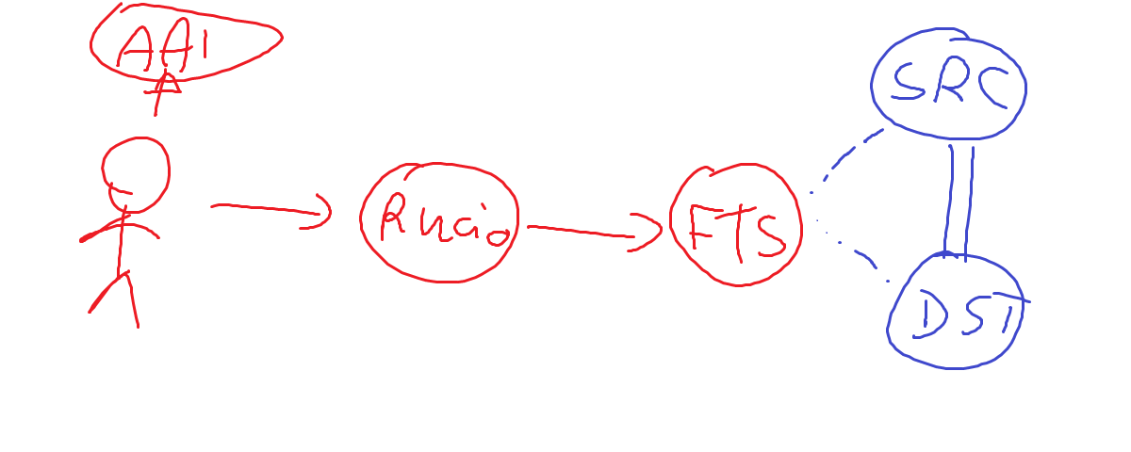
Delegated Fine Grained Access Control?

Slide 3
Old School? certificates
GSI proxy (RFC 3820) doing the whole thing
User is not present
VOMS ACs carrying authorisation statements
Renewed by authorised renewers through MyProxy
Subsequent proxy delegations can restrict attributes
GridFTP can ask the destination to fetch data from the source

Slide 4
New School? tokens
Non-clients use bearer token (6750)
User is not present
Token exchange (8693)
How can we require token exchange instead of bearer tokens?
Do these look familiar?
max_path_length, naming_constraints
Trust anchor, intermediate, leaf…

Slide 5
Old old school –
Kerberos tickets
User forwards ticket to FTS
FTS needs an identity that the user can forward to
FTS forwards a user proxy ticket to the destination
Destination needs an identity to forward to
Destination uses ticket to fetch data from the source

Slide 6
New old new school? - Macaroons
Macaroons are not just dCache (or Google), apparently
Can be constrained upon delegation

Slide 7
Old new old school – SAML/XACML
Assertions can be revoked
Even after the job has started, it can be stopped/suspended

Slide 8
Old old old school - delegation
Delegated authorisation
FTS (in our example) retains its identity but gets the right to act on behalf of the user
K5 is an example (sort of), or the original single-AS OAuth2 (6749)
Authorisation is not done to the

Slide 9
Assurance levels – lifetime of credentials
GSI proxies – no revocation
(Normal) tokens – revocation is possible (RFC 7009)

Slide 10
The Questions to Ask
Limiting what the credential can do
Authorisation associated with cred
Credential lifetime is long enough – or extensible – to cover duration
How fine grained is the auz?
Most of our customers are not too fussed
Compare REMS
Audit trail – what has the cred done
Who created the token, and when
And who has used it to do what to whom, and when
Where does the audit trail go?

Slide 11
Expressing Policy and Practical Constraints
Two people must authorise access?
Or m-of-n authorisation?
Time constraints (e.g. working hours), phase of the moon
Token lifetime
How can the resource express its requirements
Without using XACML… ☺
Or OIDC-Fed policy language (which could be extended?)
At the time of access?
Before the user interaction starts (cf 7521)

Slide 12
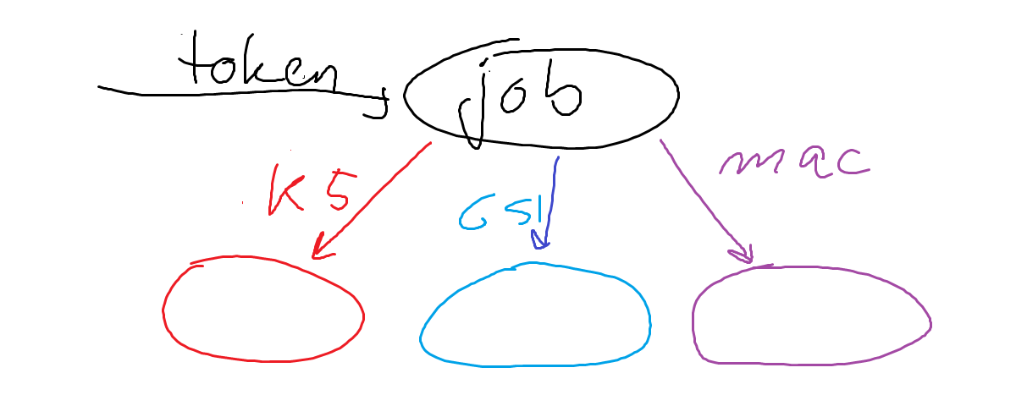
The proxy problem

Slide 13
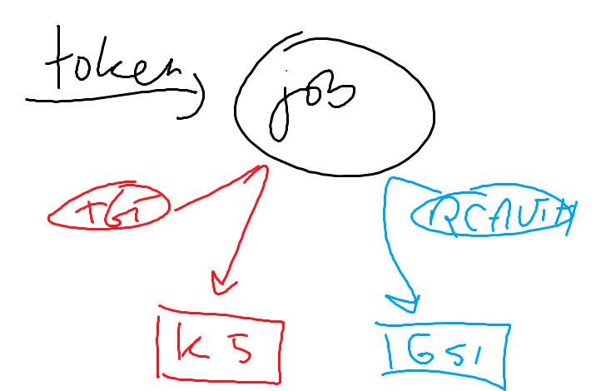
Solving the problem?
Credential translation
Transparently turning
to token translation

Slide 14
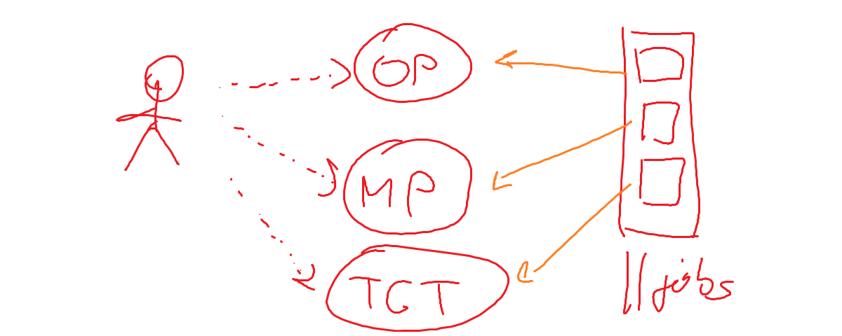
The time view of proxy problem
or AS
STS(es)

Slide 15
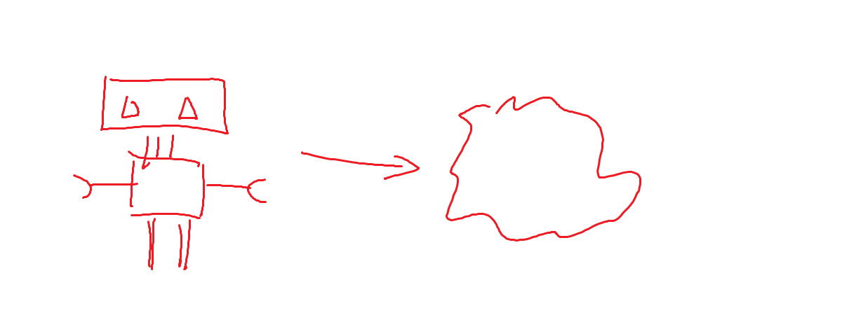
The time view of the time problem
Robots….

